Slide 1
Launch of the Third and Fourth Degree Perineal Tears Clinical Care Standard 21 APRIL 2021

Slide 2
The clinicians identified that I had severe tearing.
They were trying to explain they would take me down to theatre and stitch me under the correct lighting.
My head was not in that space.

Slide 3
If someone had that conversation with me around tears,
I would have felt a lot more empowered
I would have felt a lot more supported, and more confident about my birth.

Slide 4
Perineal tears
TYPE | WHERE IT OCCURS | TREATMENT
First degree | Skin of the perineum | May need stitches
Second degree | Muscles of the perineum | Usually needs stitches
Third degree | Muscles controlling the anus | Surgical repair
Fourth degree | Lining of the anus | Surgical repair

Slide 5
Third and fourth degree tears
TYPE | WHERE IT OCCURS | TREATMENT
First degree | Skin of the perineum | May need stitches
Second degree | Muscles of the perineum | Usually needs stitches
Third degree | Muscles controlling the anus | Surgical repair
Fourth degree | Lining of the anus | Surgical repair
Long-term impacts on physical, psychological & sexual wellbeing

Slide 6
3
in every 100 women who give birth vaginally will experience a third or fourth degree perineal tear

Slide 7
5
in every 100 women who give birth vaginally for the first time

Slide 8
1 in 20 first-time mothers who have a vaginal birth

Slide 9
Second Atlas of Healthcare Variation 2017

Slide 10
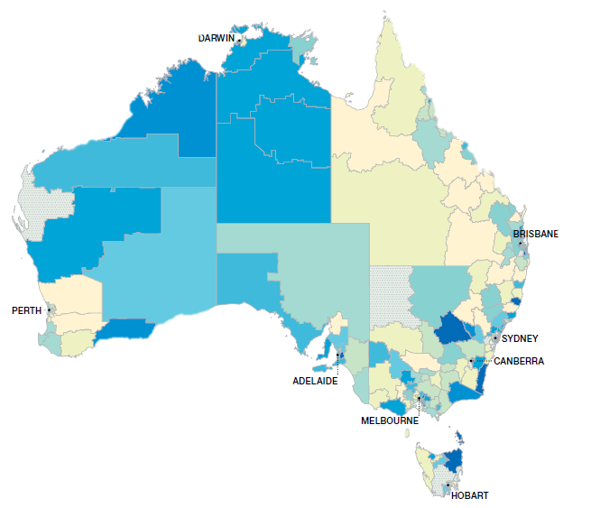
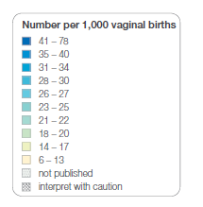
Second Atlas of Healthcare Variation (2017)

Slide 11
71
in every 1,000 women
12-fold variation nationally
6
in every 1,000 women
Second Atlas of Healthcare Variation (2017)

Slide 12
Third and Fourth Degree Perineal Tears Clinical Care Standard

Slide 13
Clinical Care Standards
Support the delivery of evidence-based care
Focus on high-priority areas of quality improvement
Address areas of unwarranted variation
They do not replace Clinical Practice Guidelines

Slide 14
Hospital-acquired Complications
16 agreed high-priority complications
National Safety and Quality Health Service Standards
protect the public from harm and improve the quality of health service

Slide 15
Quality Statements
DECISION-MAKING & INFORMED CONSENT
RISK DURING PREGNANCY, LABOUR & BIRTH
INSTRUMENTAL BIRTH
IDENTIFYING THIRD & FOURTH TEARS
REPAIRING THIRD & FOURTH TEARS
POST-OPERATIVE CARE
FOLLOW-UP CARE
Providing information | Reducing risk during pregnancy and birth | Improving identification and repair | High quality care for affected women

Slide 16
Indicators
REDUCING RISK DURING PREGNANCY & LABOUR
INSTRUMENTAL VAGINAL BIRTH
IDENTIFYING THIRD & FOURTH DEGREE PERINEAL TEARS
INDICATOR 2 Proportion of women who had a vaginal birth who received warm compresses in the second stage of labour.

Slide 17
Clinical Care Standard Toolkit
CLINICAL CARE STANDARD
VIDEOS
FACTSHEETS

Slide 18
Panel Discussion
Notes:
[possibly add names of panel]

Slide 19
safetyandquality.gov.au/perineal-tears

