Slide 1
The Fourth Australian Atlas of Healthcare Variation

Slide 2
About the Atlas

Slide 3
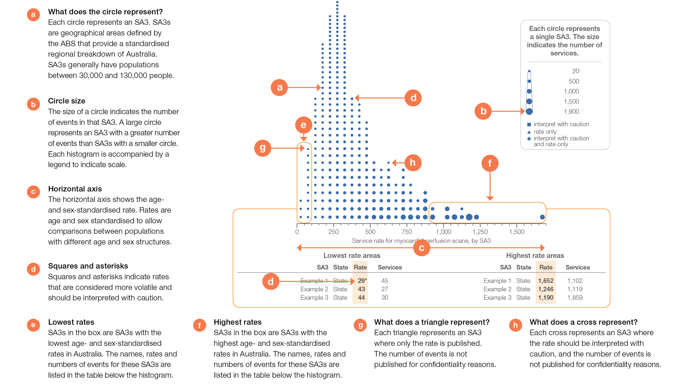
How to interpret our data visualisations
Histogram

Slide 4
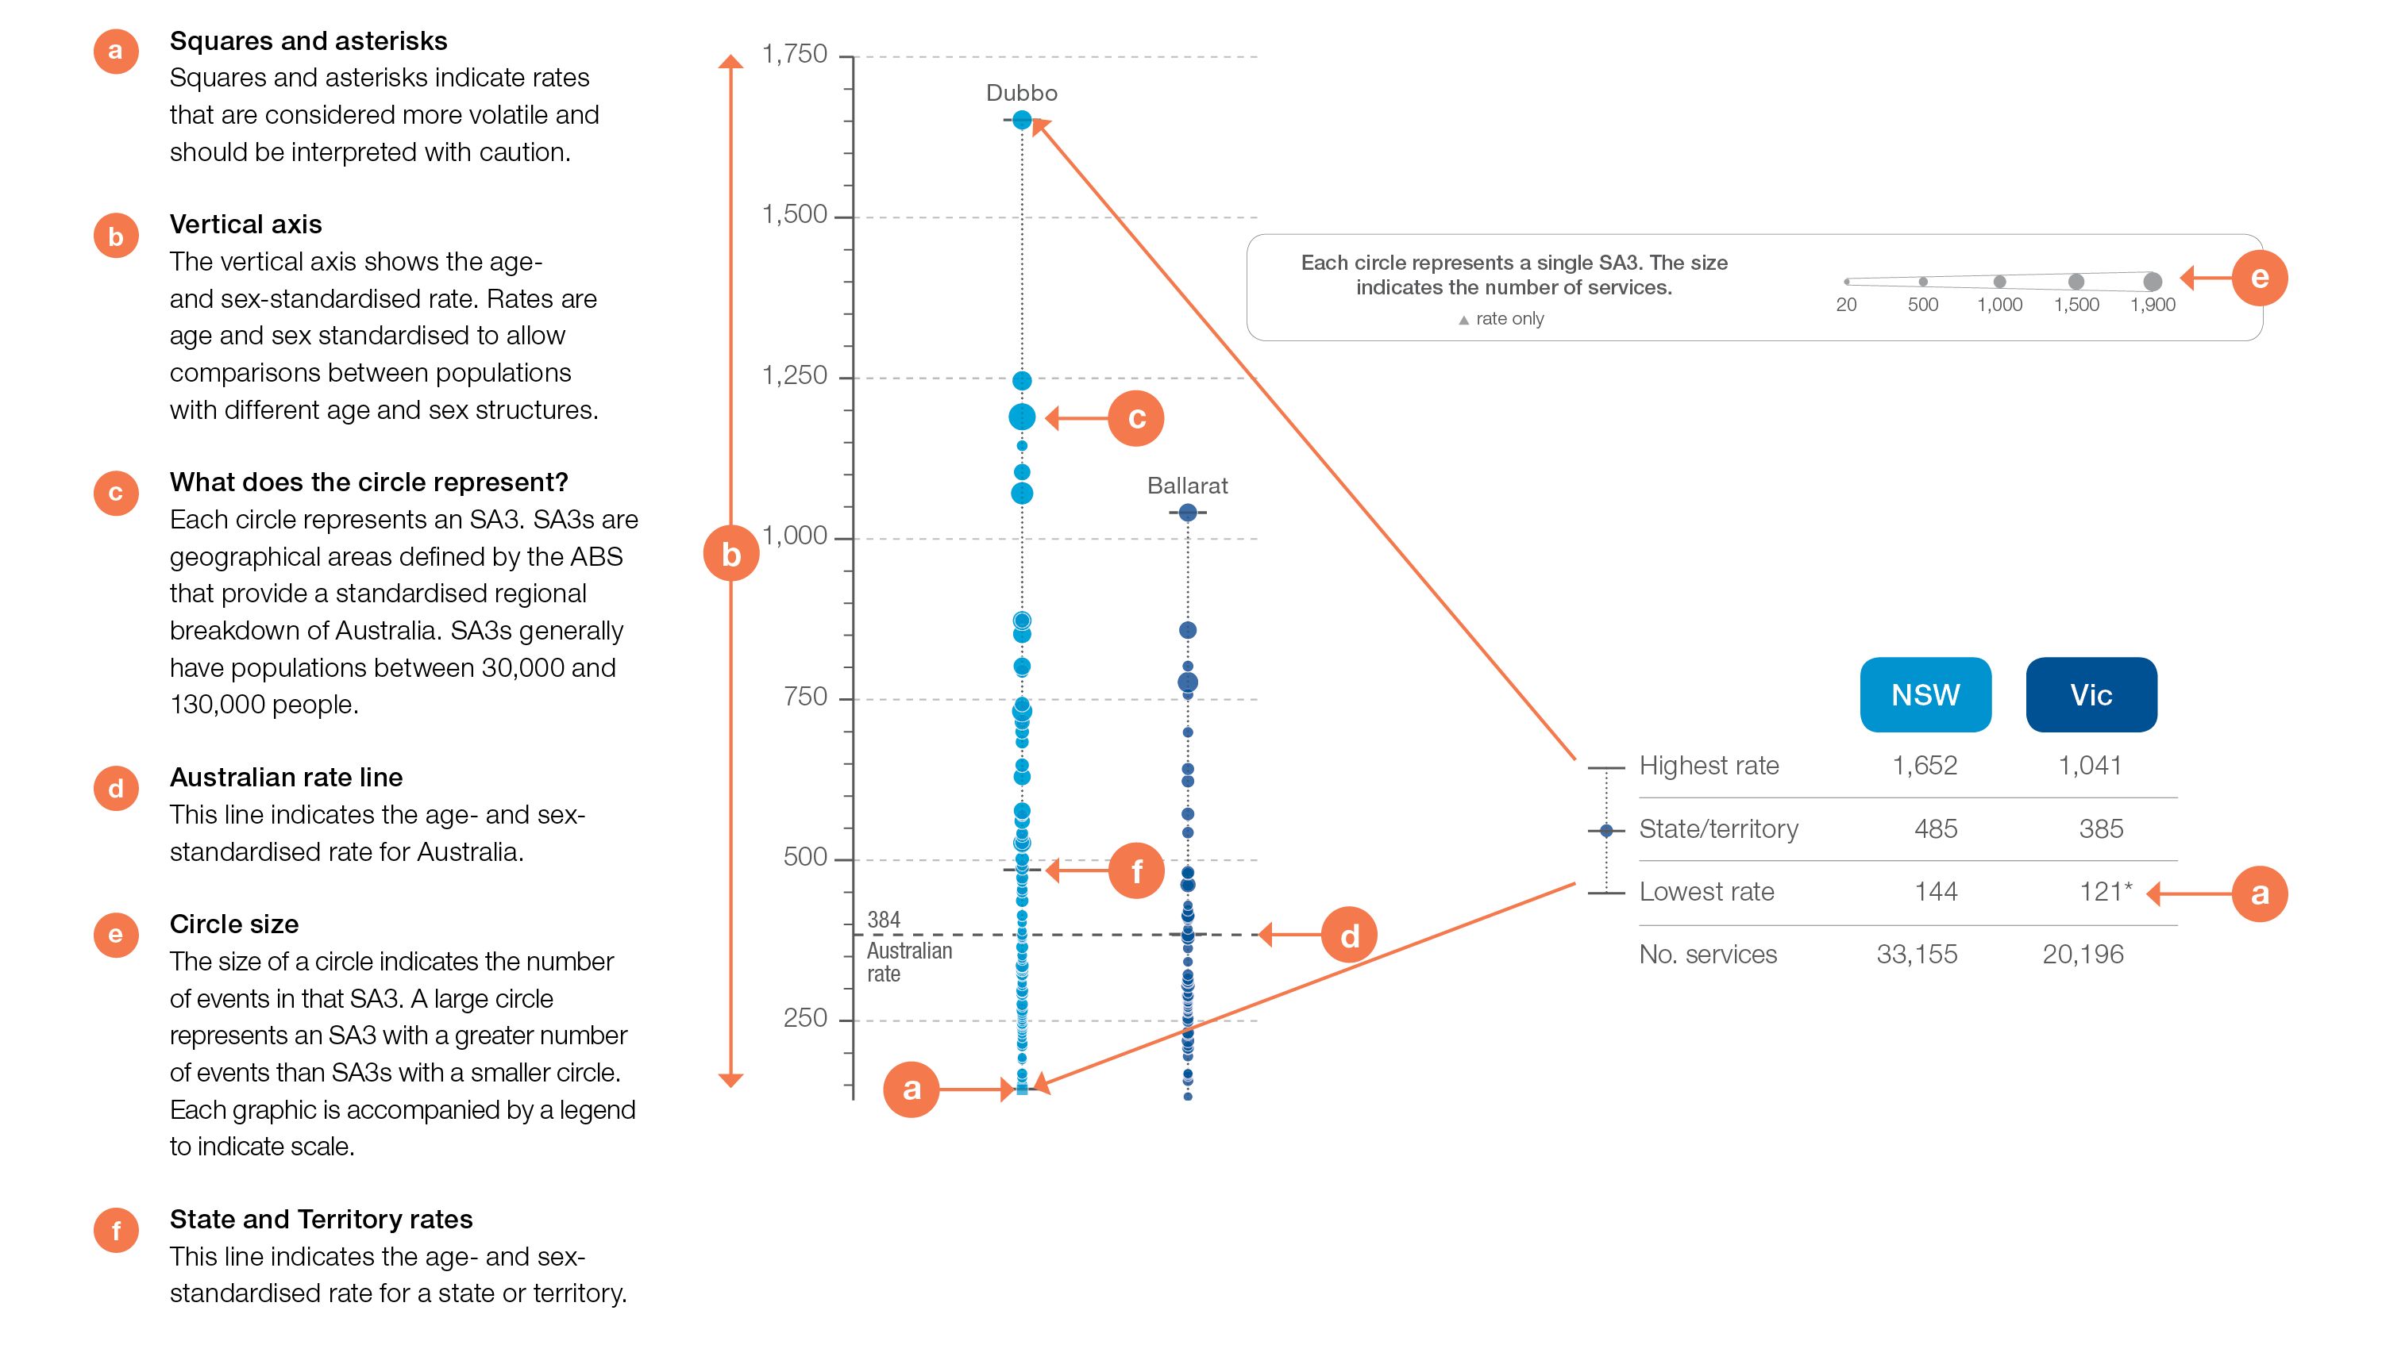
How to interpret our data visualisations
State and territory graphic

Slide 5
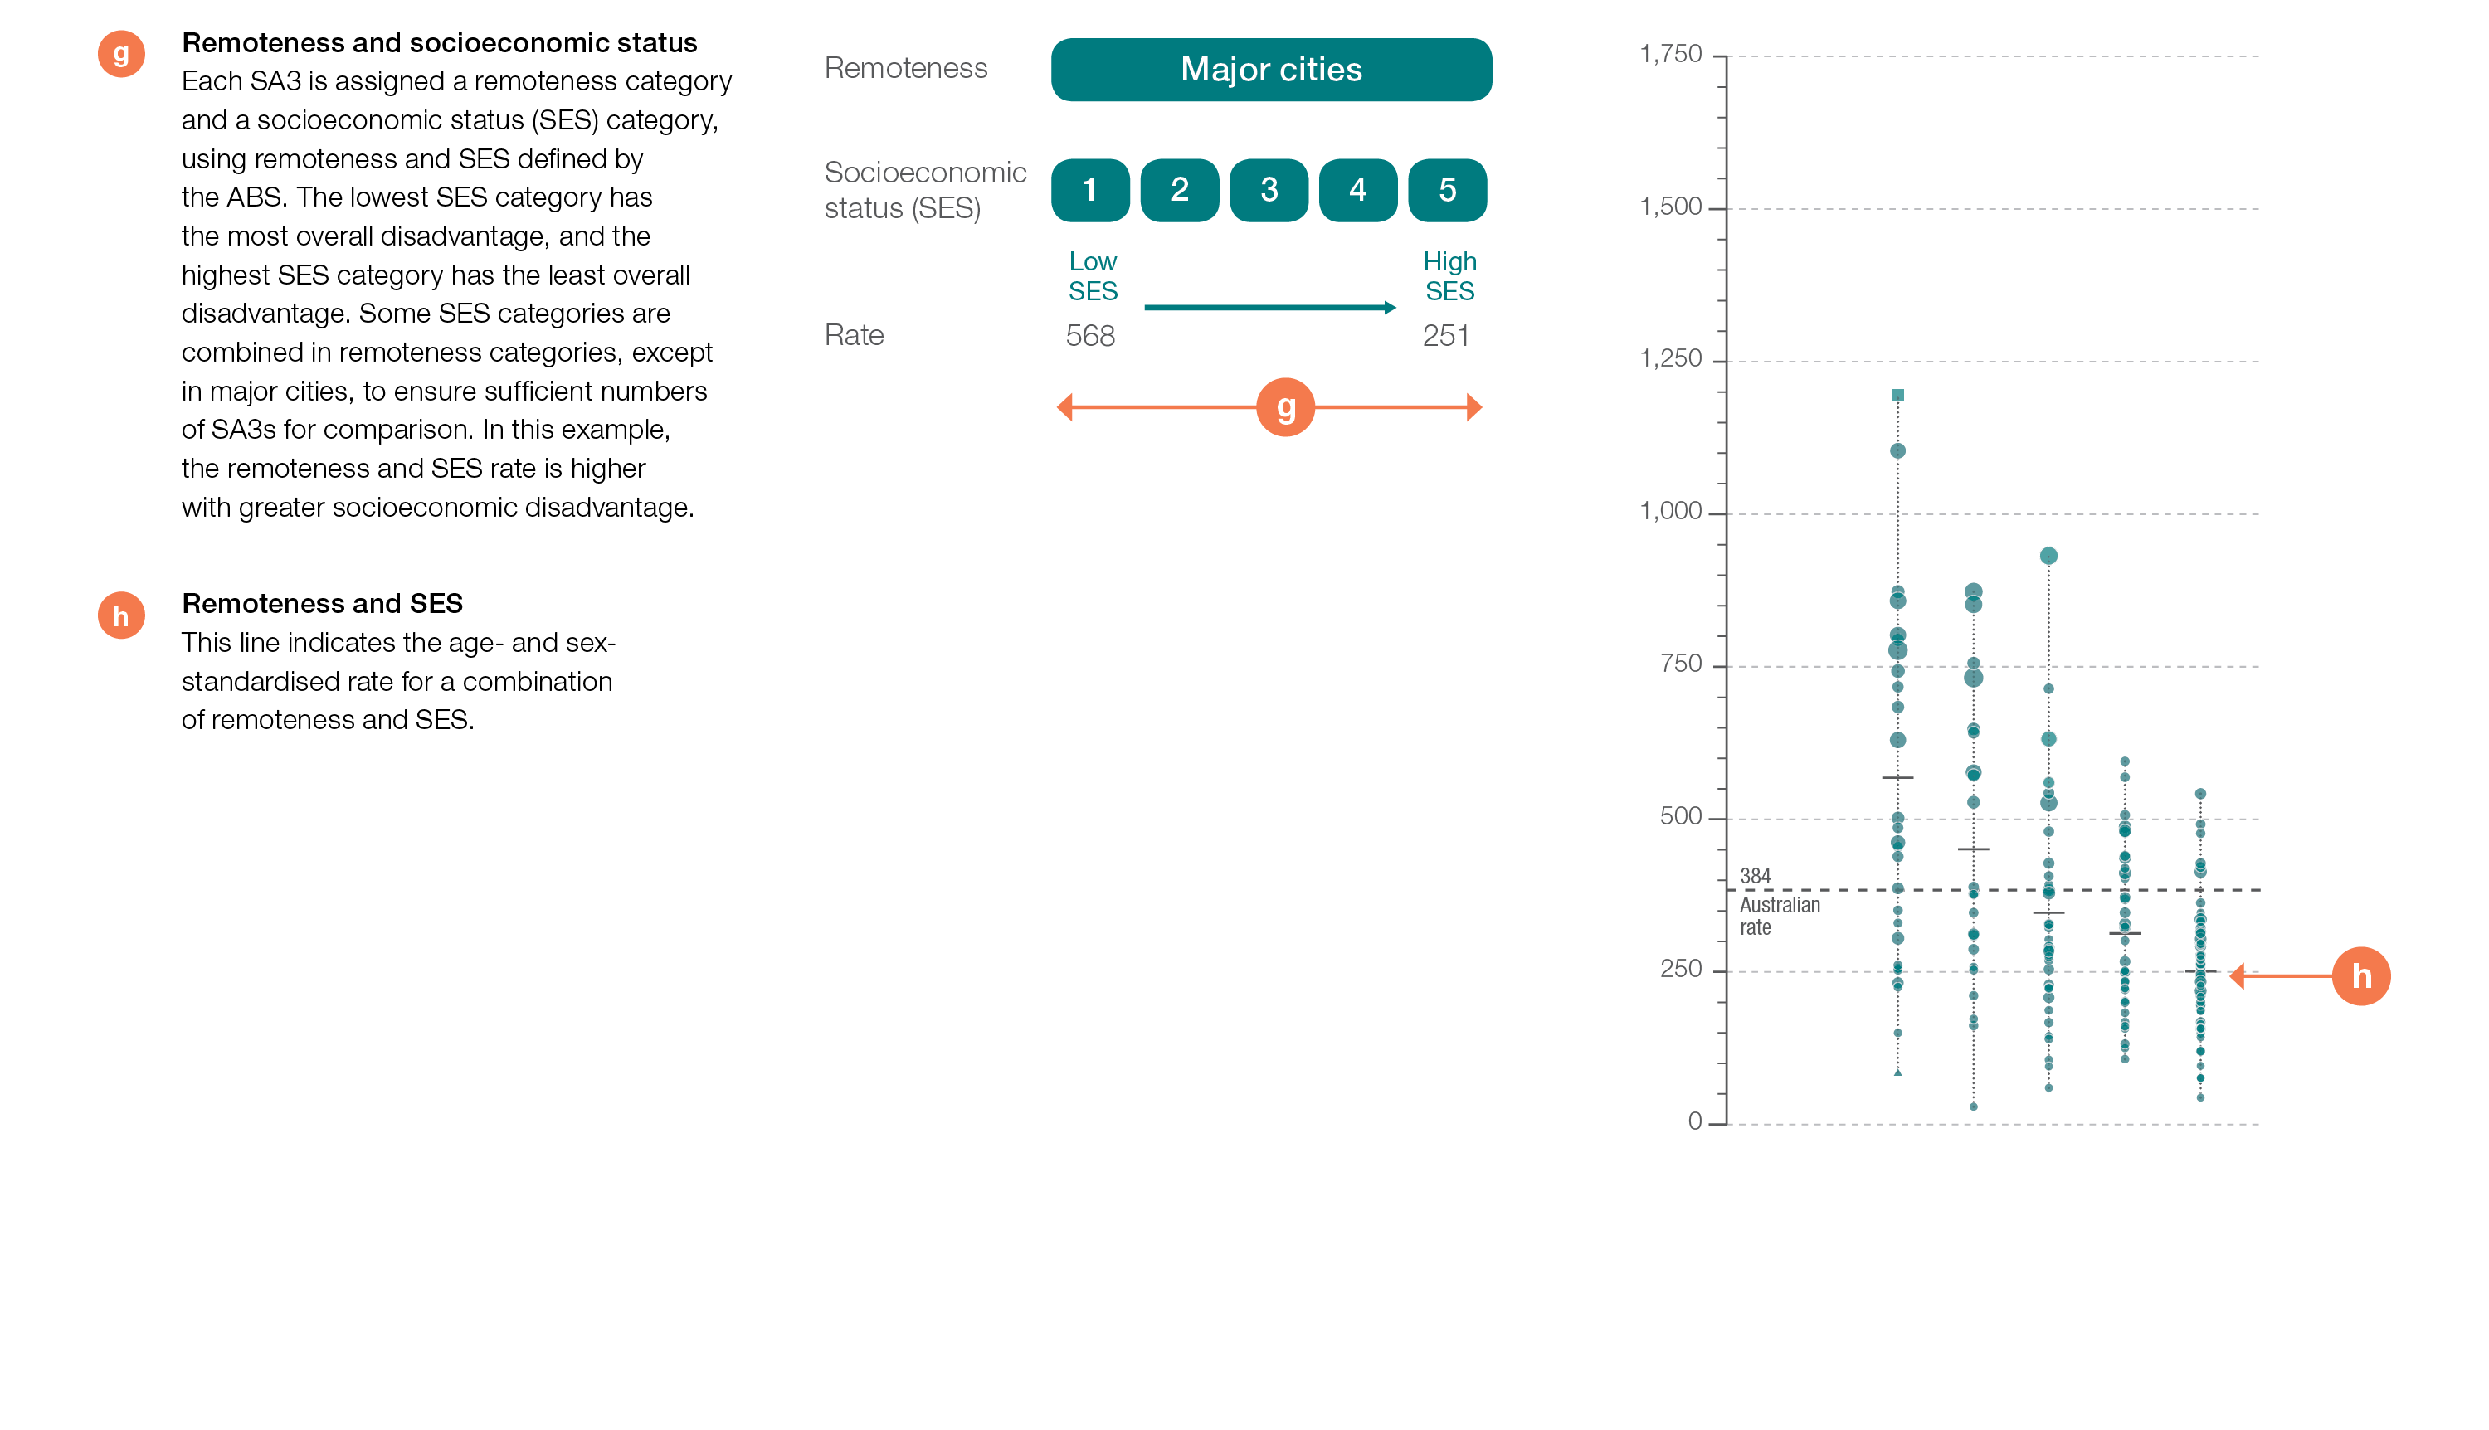
How to interpret our data visualisations
Remoteness and socioeconomic status graphic

Slide 6
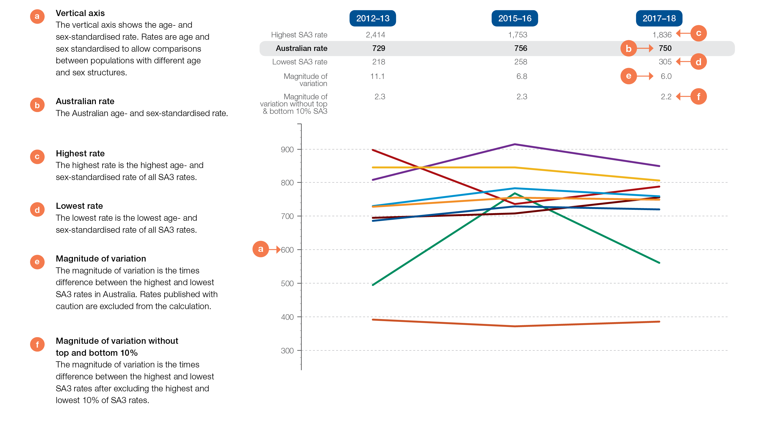
How to interpret our data visualisations
Rates across years line graph

Slide 7
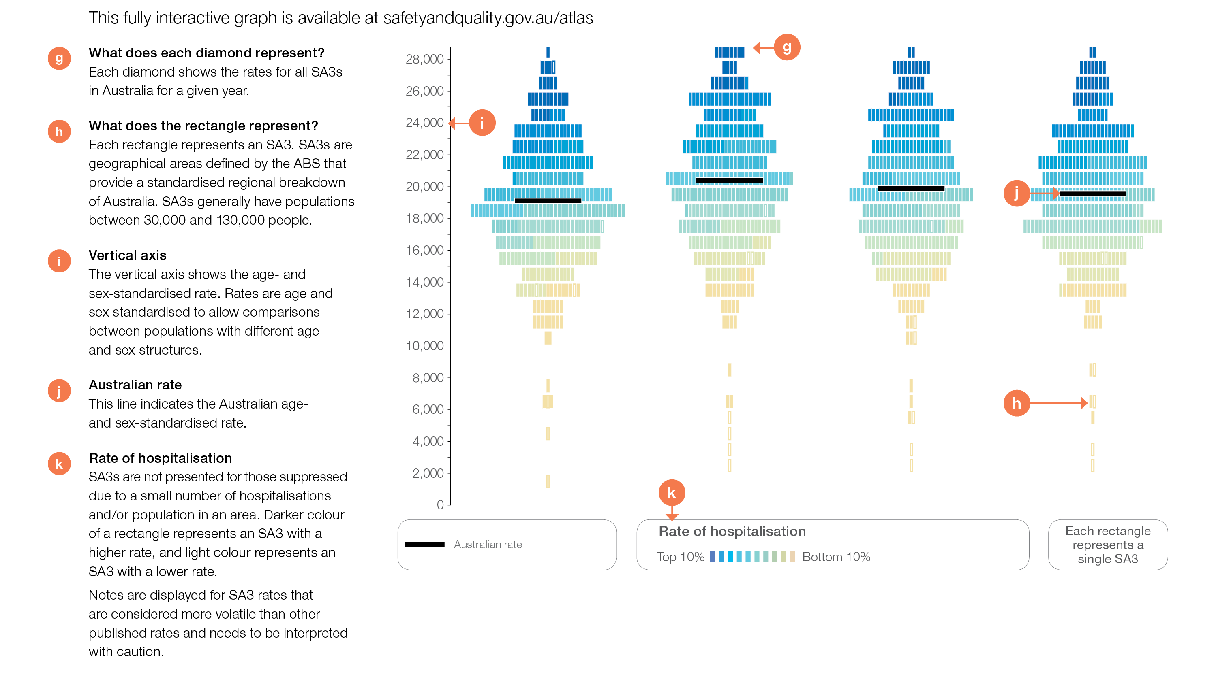
How to interpret our data visualisations
Rates across years graphic (interactive Atlas only)

