Slide 1
Early planned births
Early planned births

Slide 2
Early planned births without medical or obstetric indication
Key findings
Gestational age | Range of state and territory rates* for caesarean sections without a medical or obstetric indication, as a percentage of all caesarean sections at these gestational ages, 2017
<37 weeks | 13.3–19.3%
<38 weeks | 24.8–32.7%
<39 weeks | 42.8–56.1%
* Excludes Northern Territory
Gestational age | Range of state and territory rates* for induction of labour without a medical or obstetric indication, as a percentage of all inductions at this gestational age
<39 weeks | 0.2–6.0%
* Excludes New South Wales and the Northern Territory
Early planned births

Slide 3
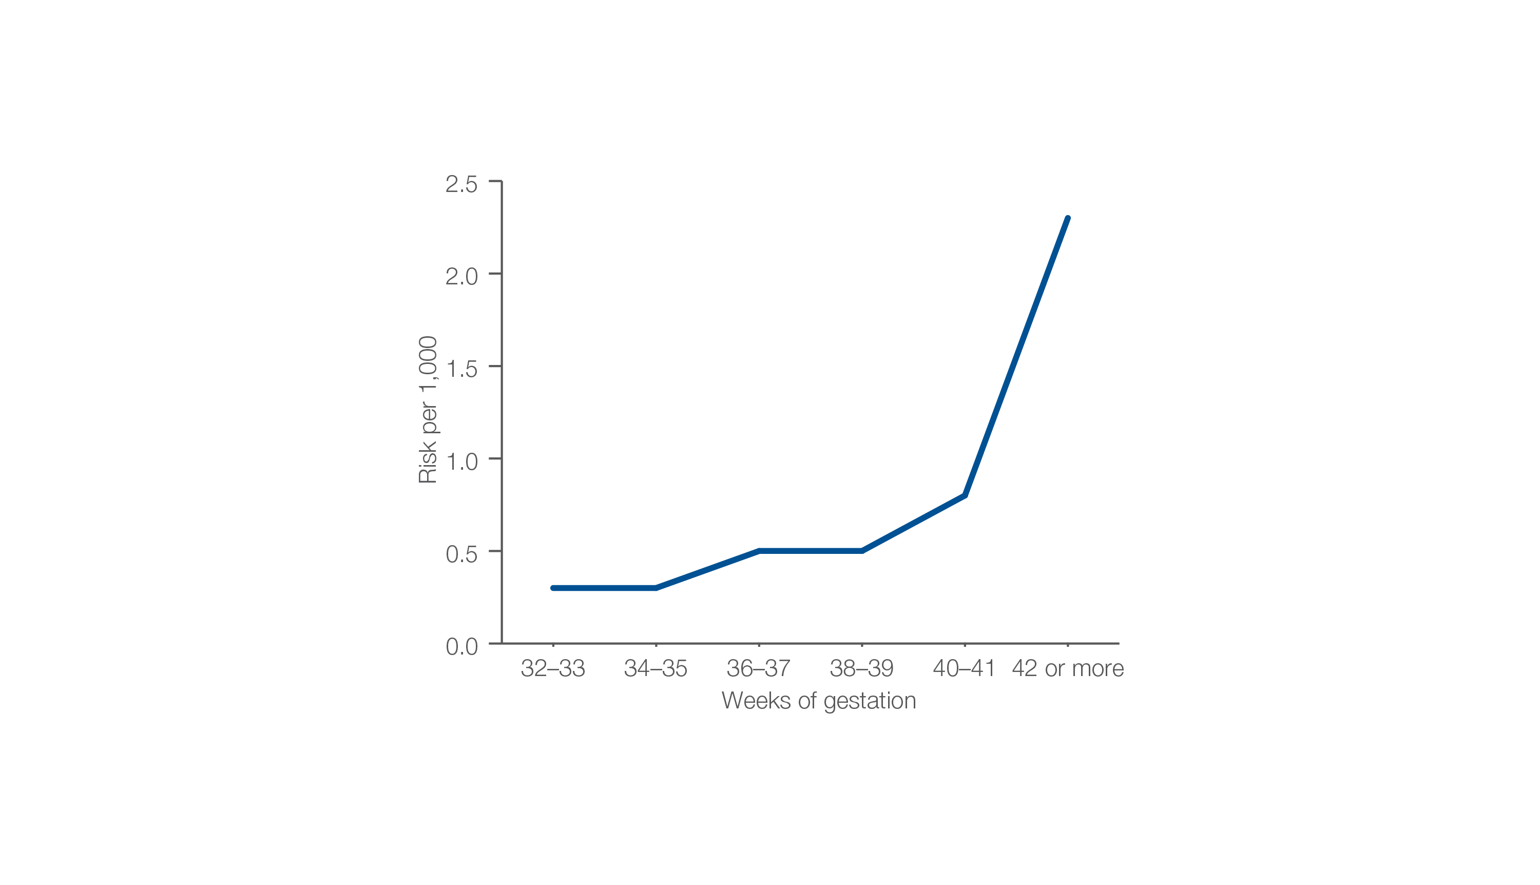
Risk of stillbirth per 1,000 fetuses remaining in utero
Gestational age in weeks, 2015 and 2016
Source: Stillbirths and Neonatal Deaths in Australia 2015 and 2016: In brief.
Early planned births

Slide 4
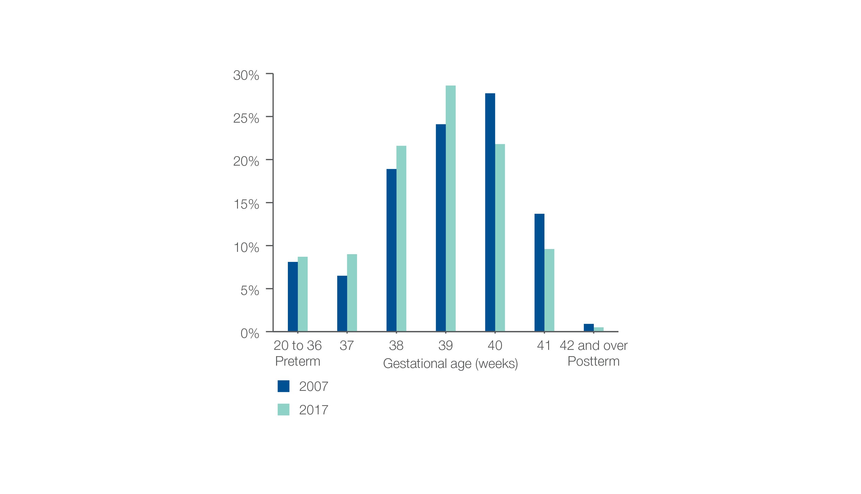
Percentage of babies
Gestational age in weeks, 2007 and 2017
Source: Australia’s Mothers and Babies 2017: In brief.
Early planned births

Slide 5
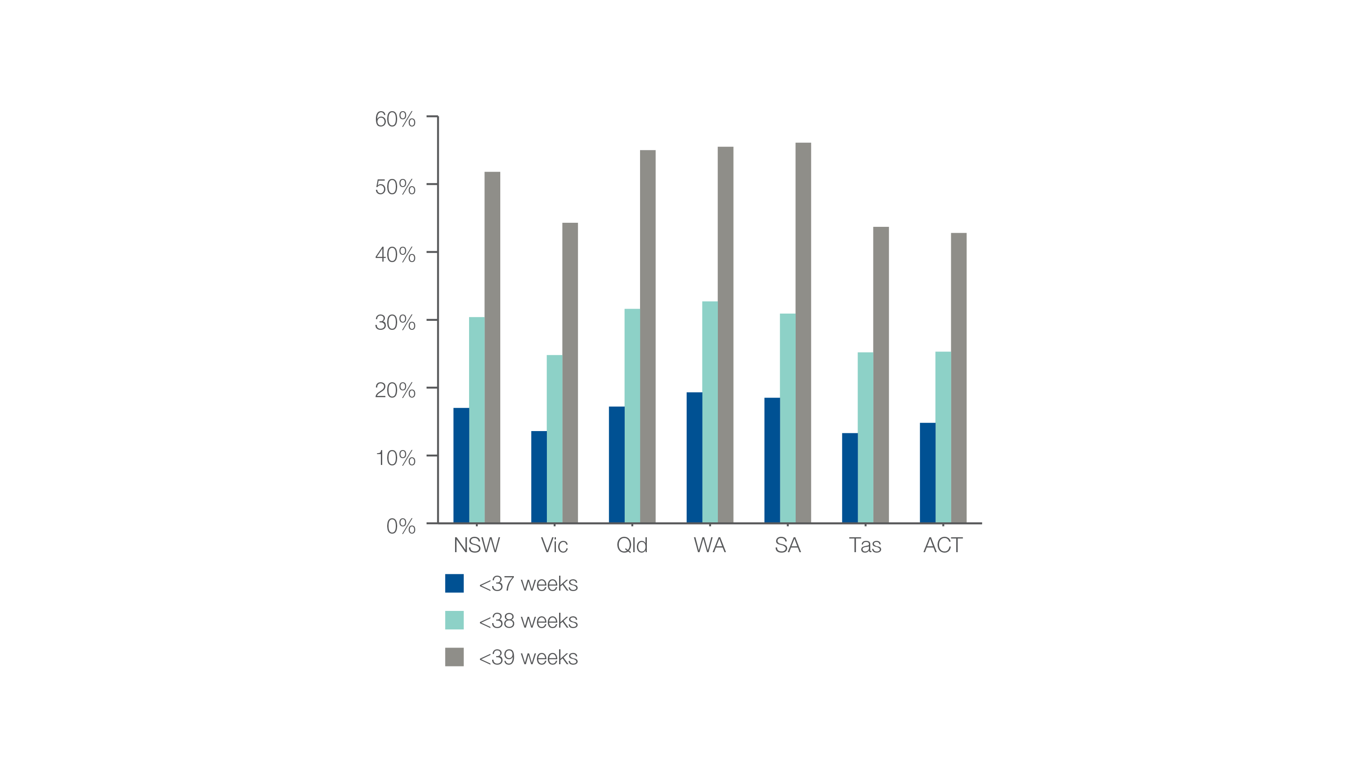
Caesarean sections at <37, <38 or <39 weeks without a medical or obstetric indication
As a percentage of all caesarean sections at these gestational ages, 2017
Source: AIHW analysis of National Perinatal Data Collection.
Early planned births

Slide 6
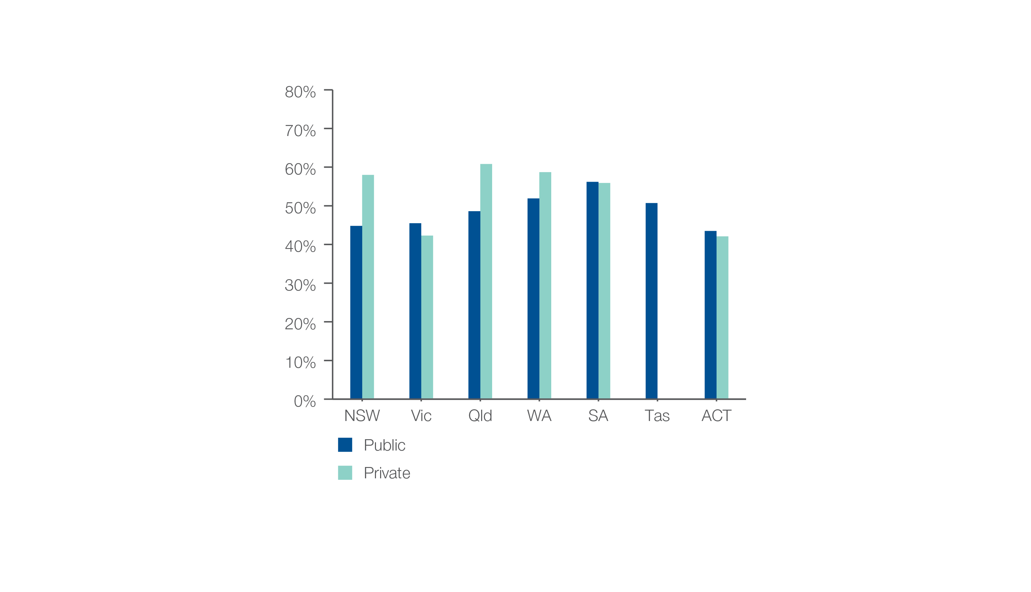
Caesarean sections at <39 weeks gestation without medical or obstetric indication
Patient funding status, 2017
Source: AIHW analysis of National Perinatal Data Collection.
Early planned births

Slide 7
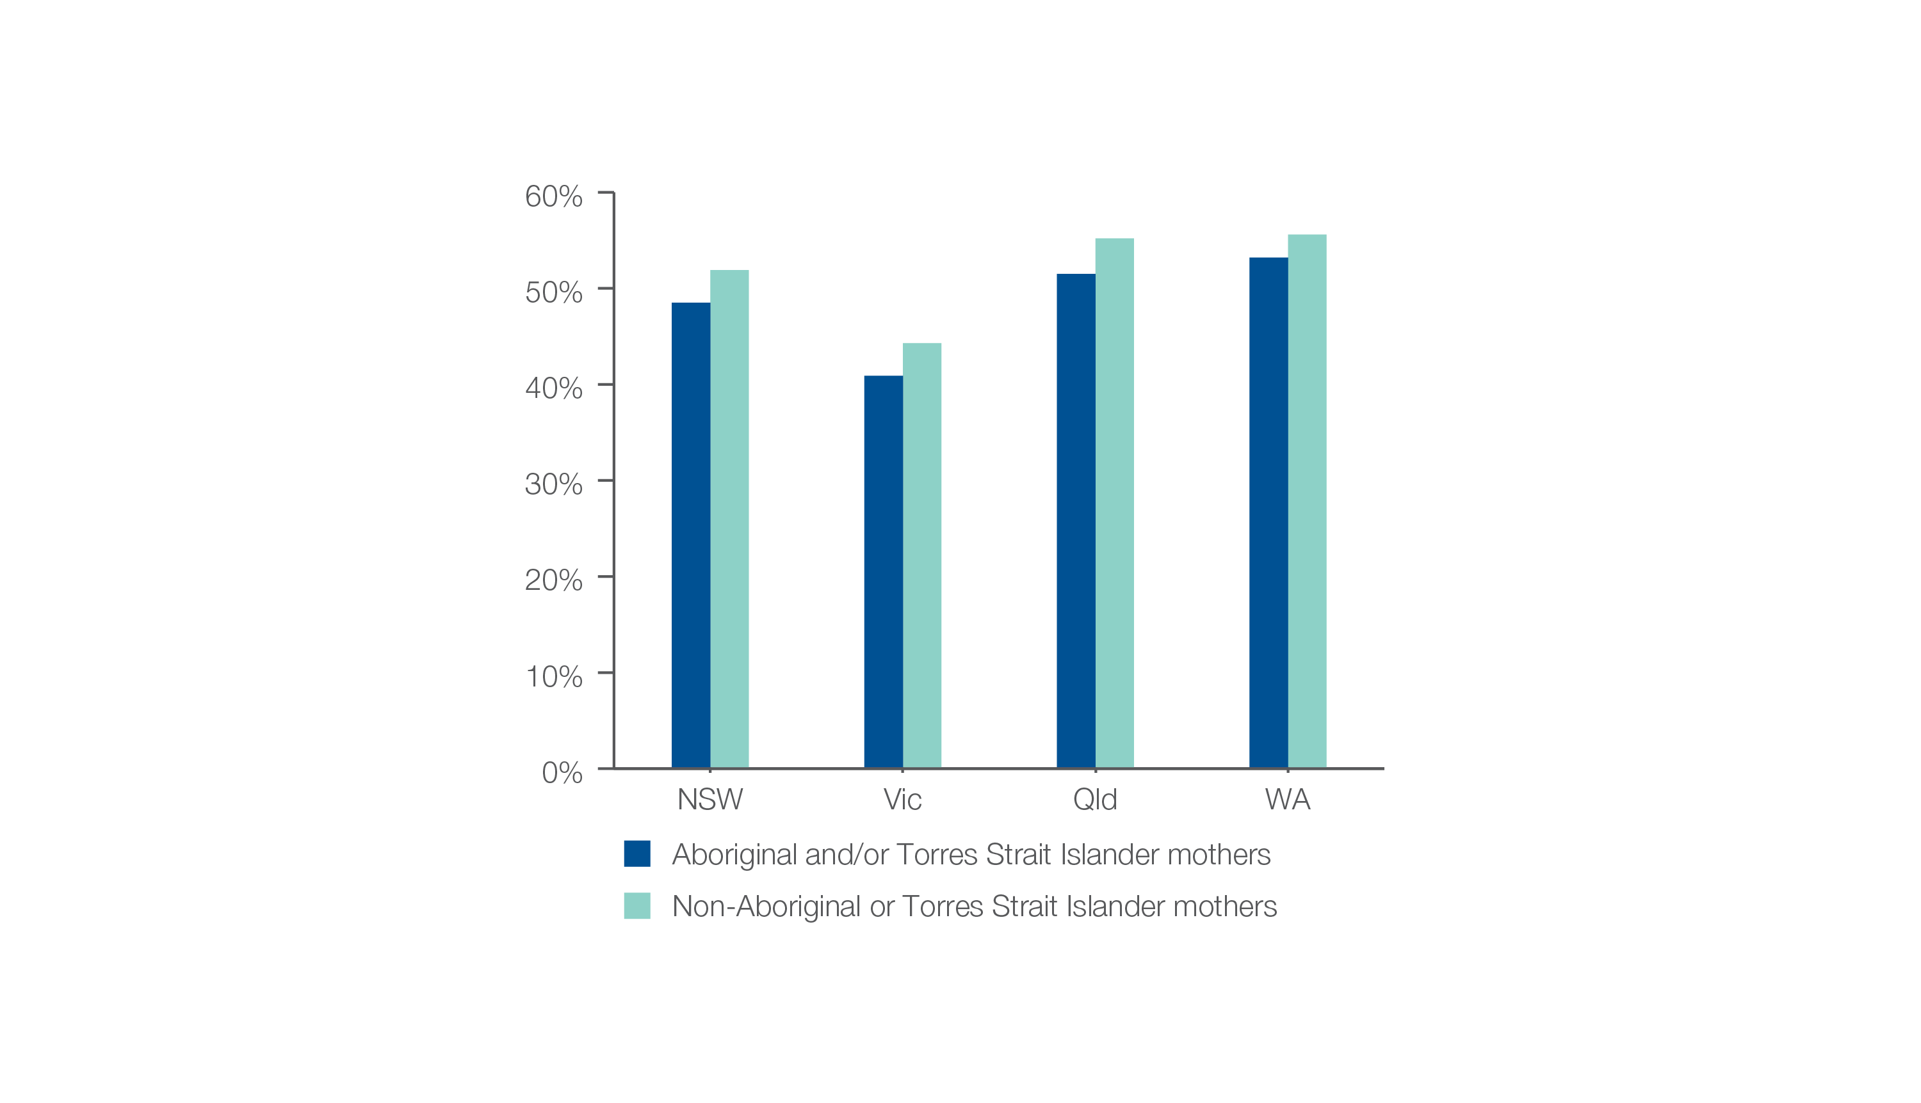
Caesarean sections at <39 weeks gestation without medical or obstetric indication
Aboriginal and Torres Strait Islander status, 2017
Source: AIHW analysis of National Perinatal Data Collection.
Early planned births

Slide 8
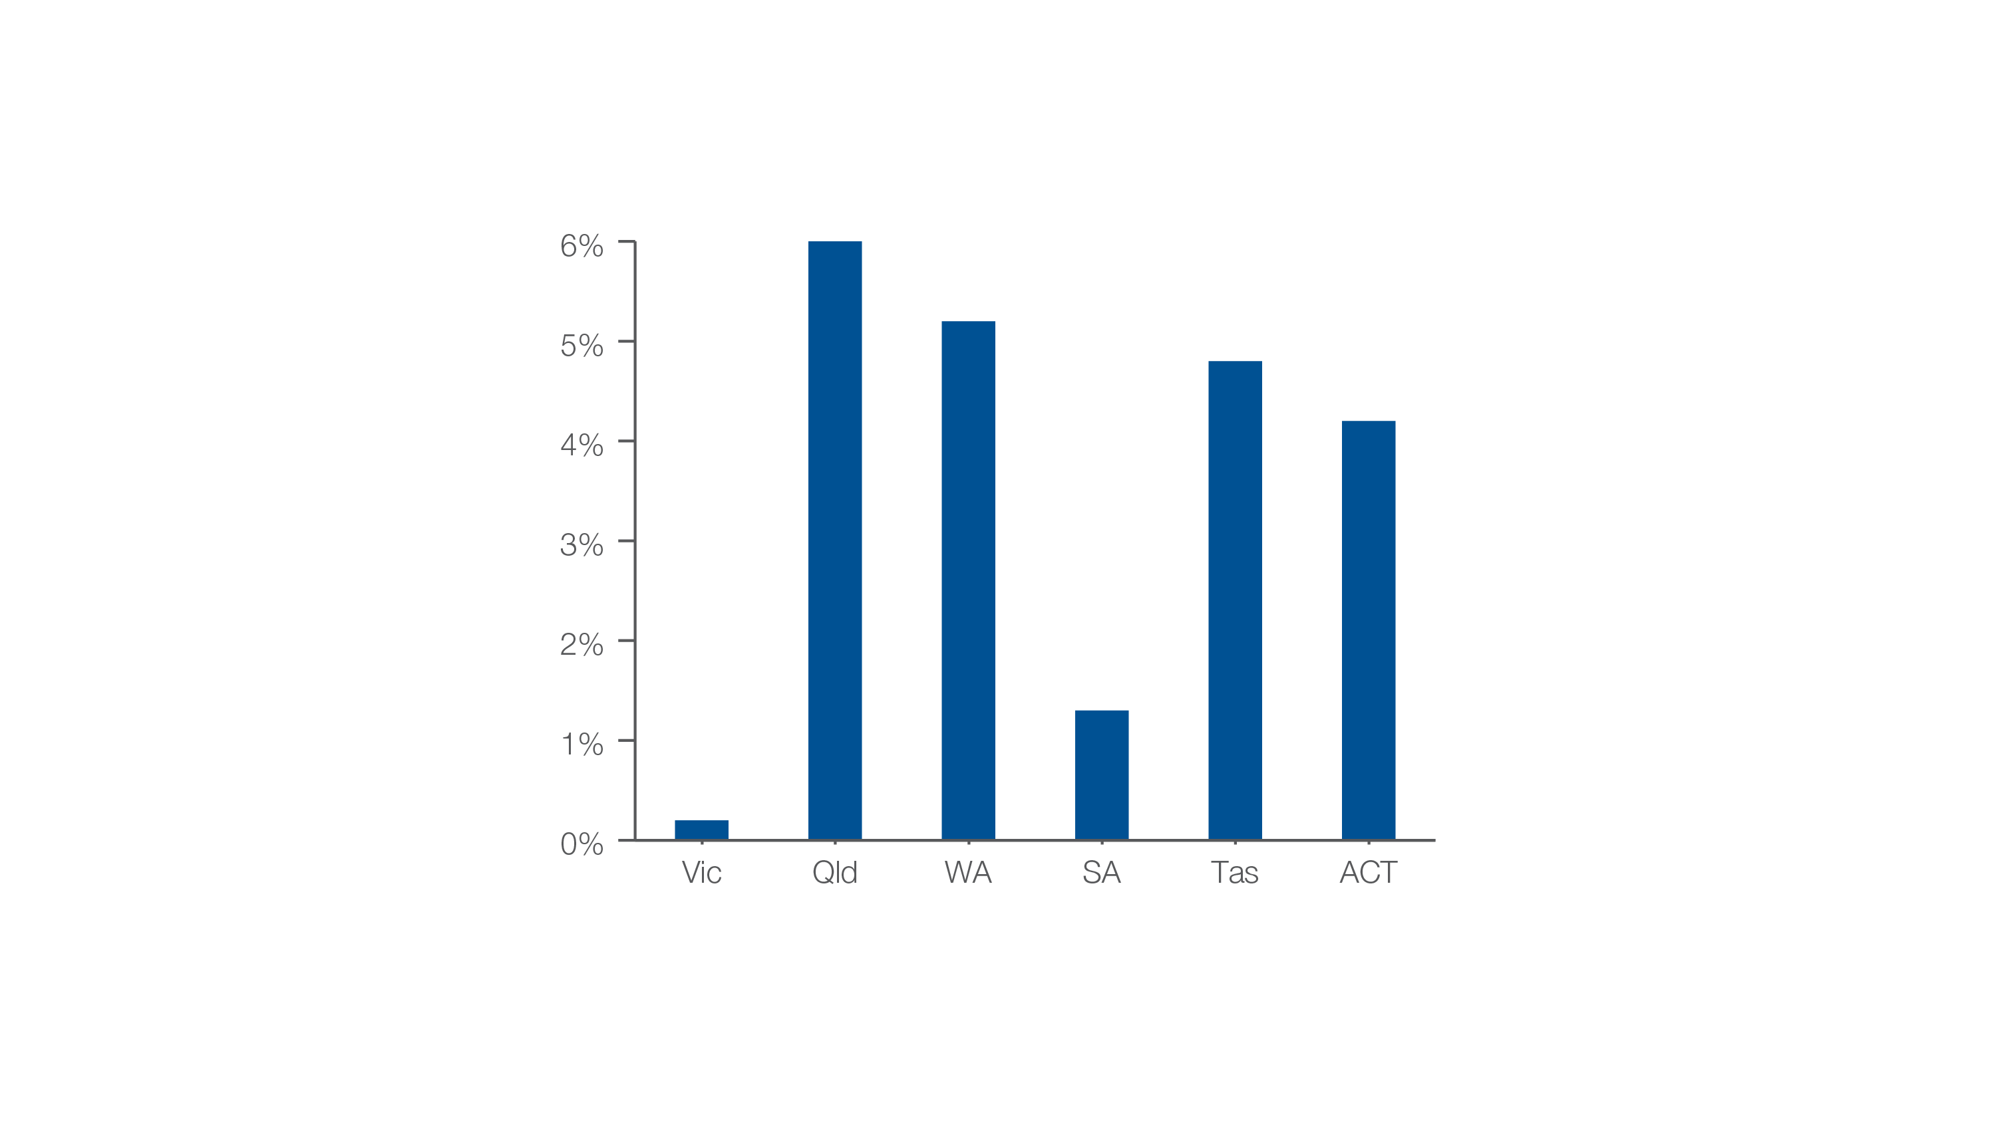
Inductions at <39 weeks gestation without a medical or obstetric indication
As a percentage of all inductions at <39 weeks, 2017
Source: AIHW analysis of National Perinatal Data Collection.
Early planned births

