Slide 1
Chronic disease and infection: potentially preventable hospitalisations
Chronic disease and infection: potentially preventable hospitalisations

Slide 2
Chronic disease and infection: potentially preventable hospitalisations
Key findings, 2017-18
Data item | Range across local areas* per 100,000 | Times difference | Times difference excluding top and bottom 10% | Number during 2017–18
Chronic obstructive pulmonary disease (COPD) | 56 – 1,013 | 18.1 | 3.3 | 77,754
Heart failure | 91 – 531 | 5.8 | 2.0 | 62,554
Diabetes complications | 64 – 782 | 12.2 | 2.9 | 50,273
Kidney infections and urinary tract infections | 141 – 893 | 6.3 | 2.3 | 76,854
Cellulitis | 90 – 1,393 | 15.5 | 2.9 | 68,663
* Statistical Area Level 3
Chronic disease and infection: potentially preventable hospitalisations

Slide 3
Chronic disease and infection: potentially preventable hospitalisations
Key findings, 2014-15 to 2017-18
Data item | 2014-15* | 2015-16* | 2016-17* | 2017-18* | Per cent change
Chronic obstructive pulmonary disease (COPD) | 241 | 255 | 268 | 260 | 8%
Heart Failure | 194 | 207 | 208 | 201 | 4%
Diabetes complications | 172 | 181 | 177 | 184 | 7%
Kidney infections and urinary tract infections | 283 | 286 | 278 | 281 | - 1%
Cellulitis | 235 | 250 | 265 | 256 | 9%
* Australian age and sex standardised rate given as hospitalisations per 100,000 people
Chronic disease and infection: potentially preventable hospitalisations

Slide 4
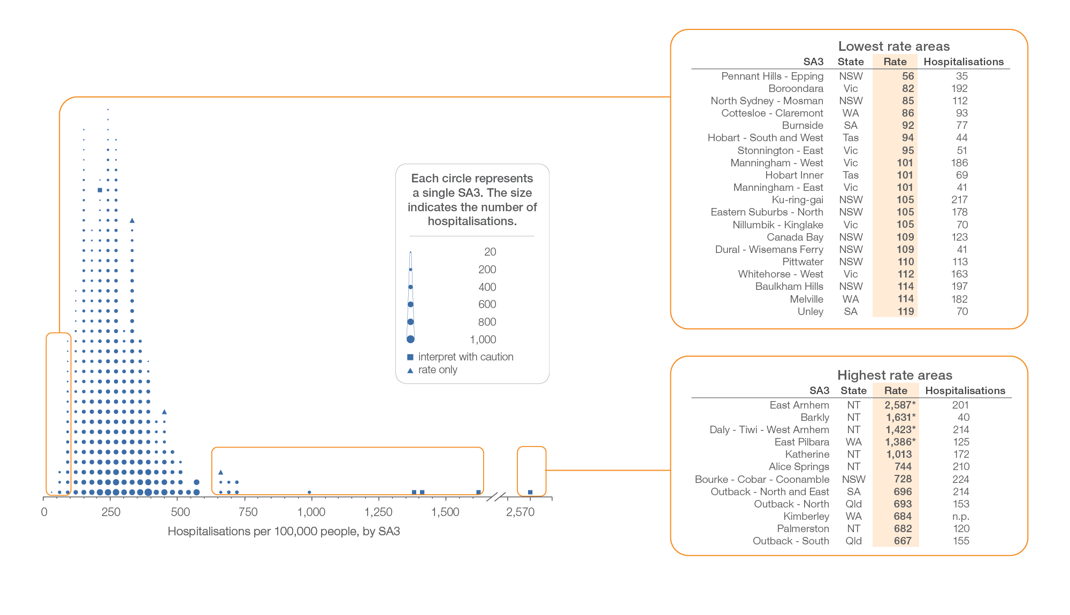
Chronic obstructive pulmonary disease (COPD)
Local area, SA3 of patient residence, 2017-18
Sources: AIHW analysis of National Hospital Morbidity Database and ABS Estimated Resident Populations 30 June of 2017 and 2018.
Chronic disease and infection: potentially preventable hospitalisations

Slide 5
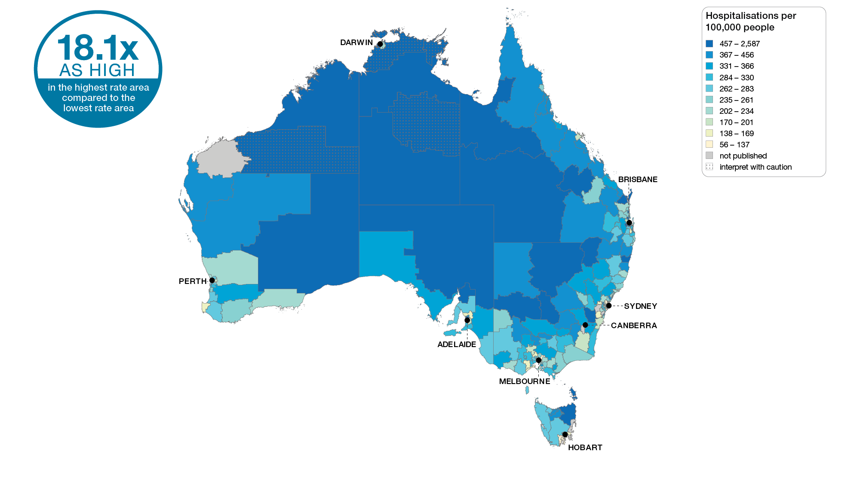
Chronic obstructive pulmonary disease (COPD)
Australia, SA3 of patient residence, 2017-18
Sources: AIHW analysis of National Hospital Morbidity Database and ABS Estimated Resident Populations 30 June of 2017 and 2018.
Chronic disease and infection: potentially preventable hospitalisations

Slide 6
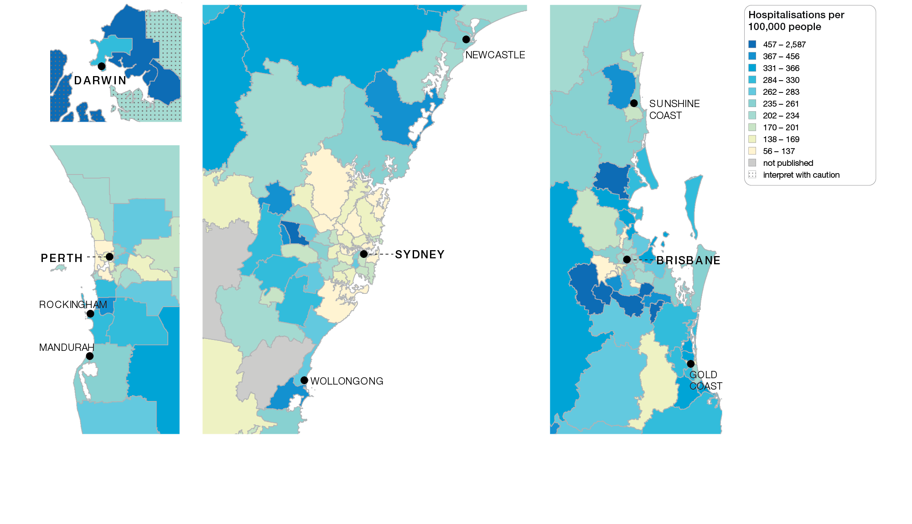
Chronic obstructive pulmonary disease (COPD)
Capital cities, SA3 of patient residence, 2017-18
Sources: AIHW analysis of National Hospital Morbidity Database and ABS Estimated Resident Populations 30 June of 2017 and 2018.
Chronic disease and infection: potentially preventable hospitalisations

Slide 7
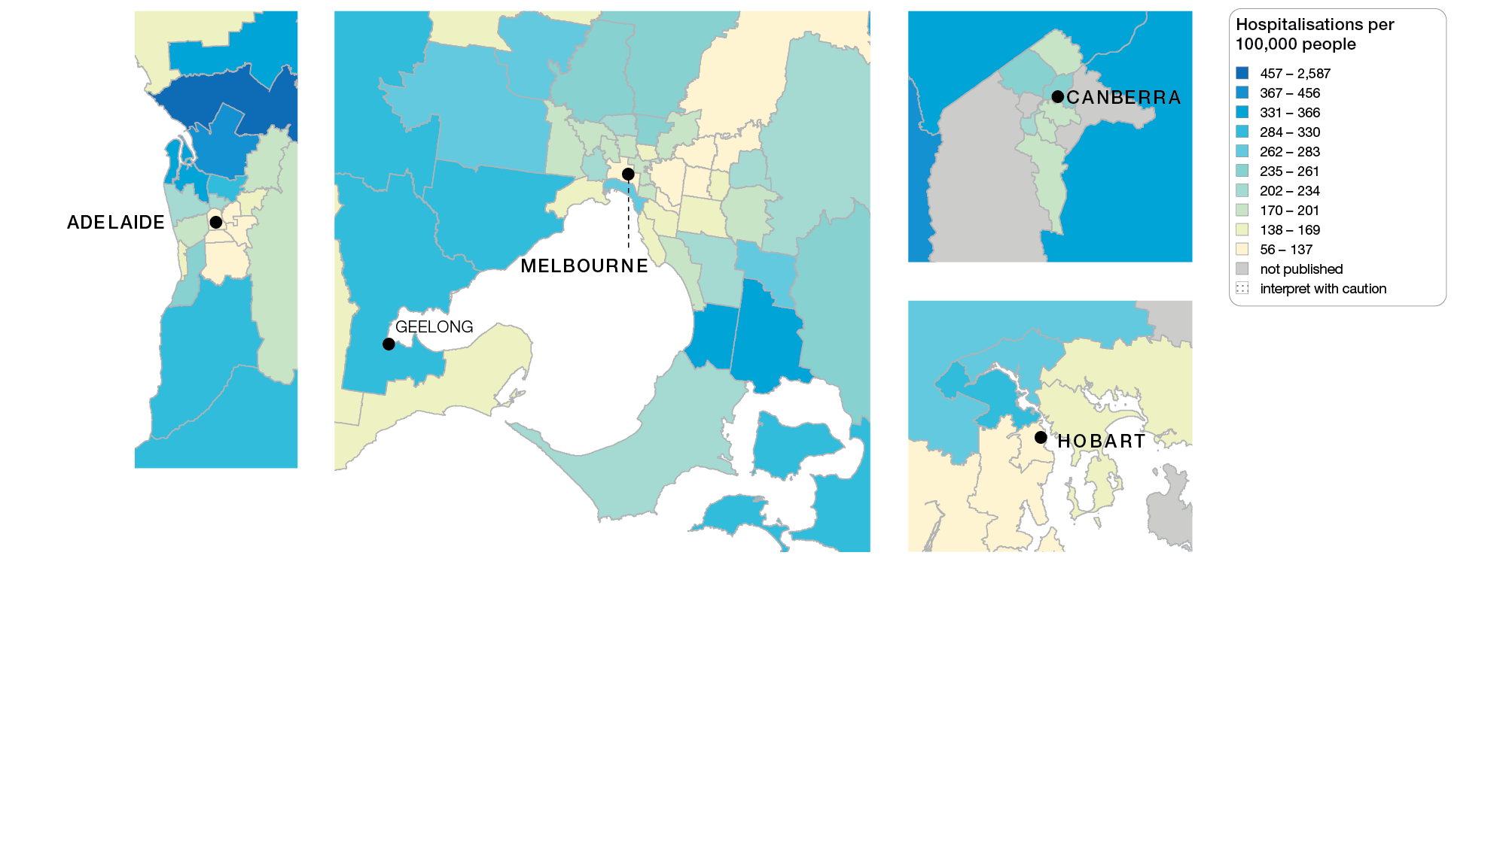
Chronic obstructive pulmonary disease (COPD)
Capital cities, SA3 of patient residence, 2017-18
Sources: AIHW analysis of National Hospital Morbidity Database and ABS Estimated Resident Populations 30 June of 2017 and 2018.
Chronic disease and infection: potentially preventable hospitalisations

Slide 8
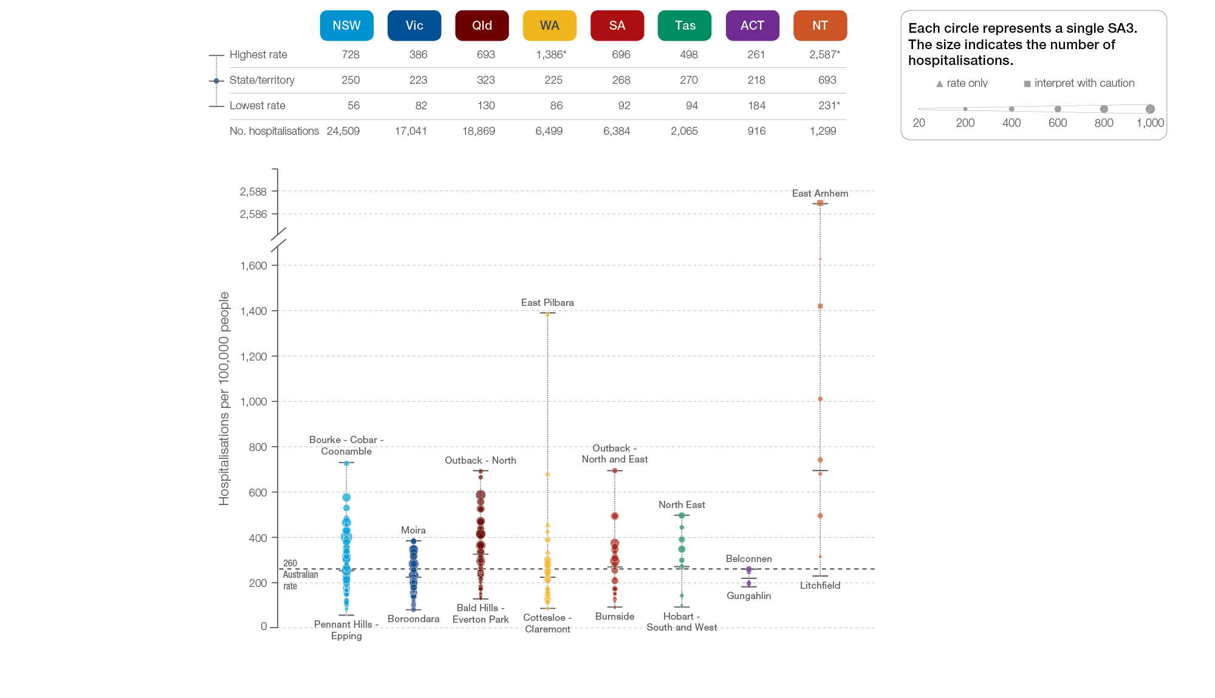
Chronic obstructive pulmonary disease (COPD)
State and territory, SA3 of patient residence, 2017-18
Sources: AIHW analysis of National Hospital Morbidity Database and ABS Estimated Resident Populations 30 June of 2017 and 2018.
Chronic disease and infection: potentially preventable hospitalisations

Slide 9
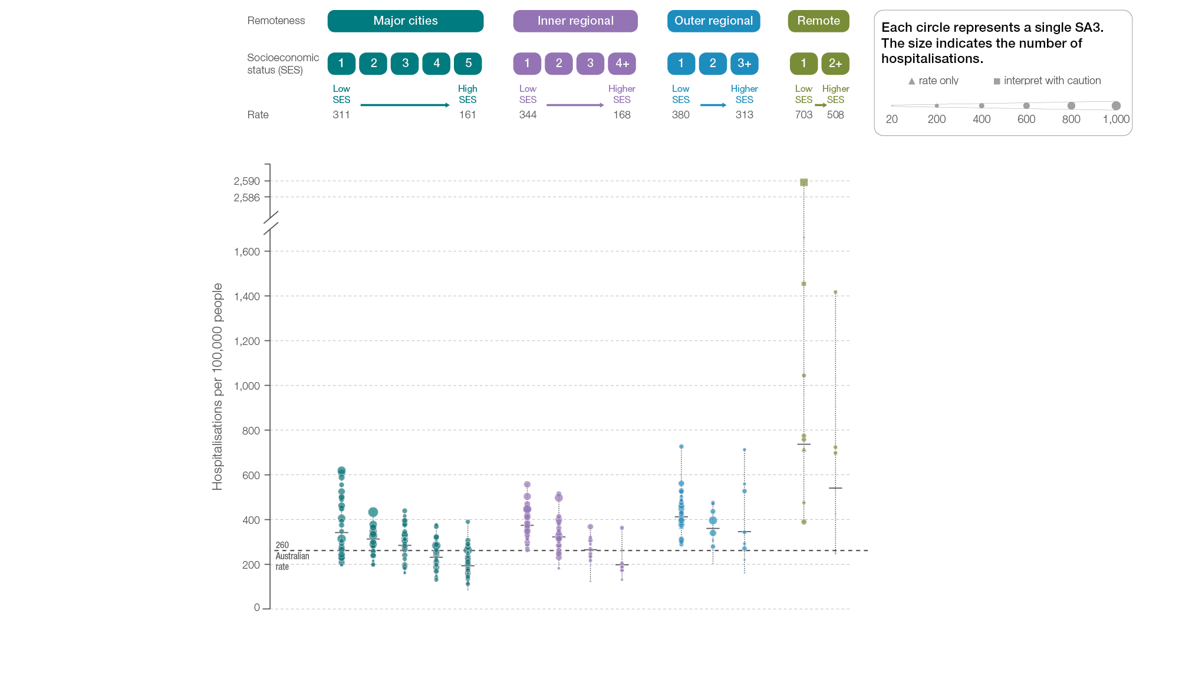
Chronic obstructive pulmonary disease (COPD)
Remoteness and socioeconomic status, SA3 of patient residence, 2017-18
Sources: AIHW analysis of National Hospital Morbidity Database and ABS Estimated Resident Populations 30 June of 2017 and 2018.
Chronic disease and infection: potentially preventable hospitalisations

Slide 10
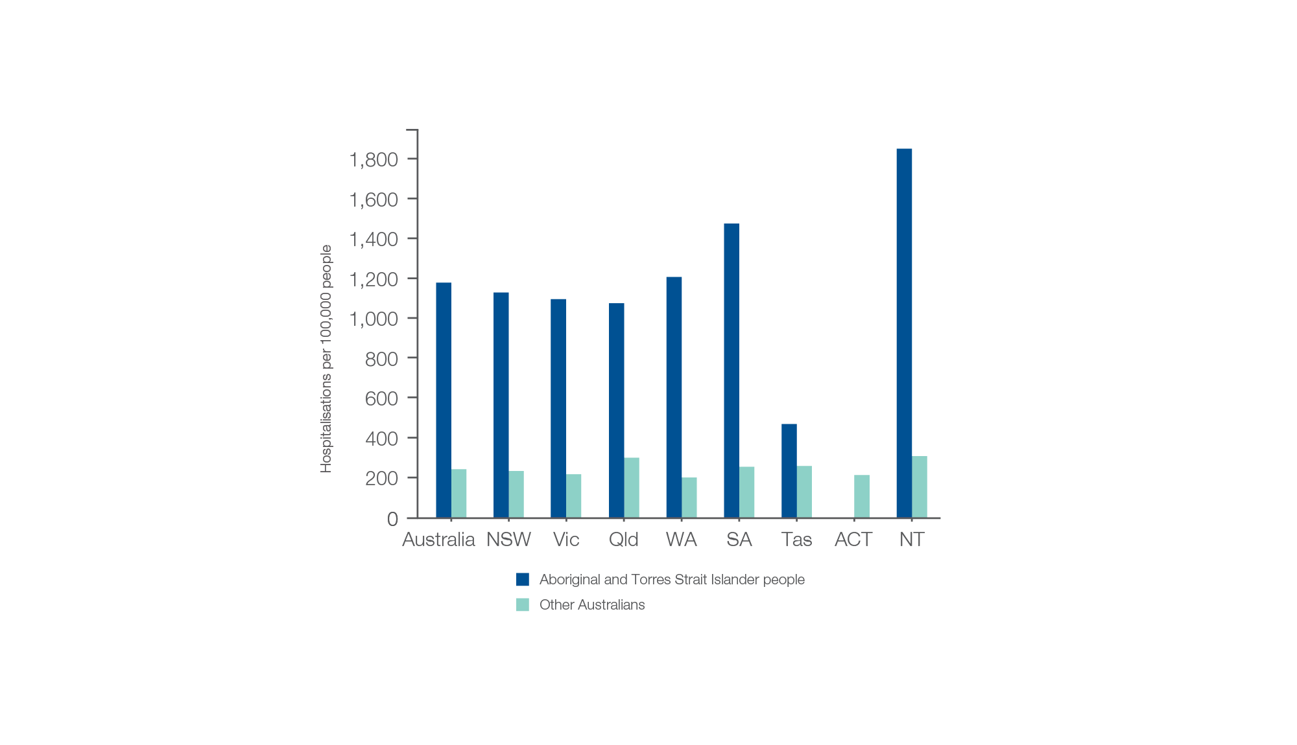
Chronic obstructive pulmonary disease (COPD)
Aboriginal and Torres Strait Islander status, 2017-18
Sources: AIHW analysis of National Hospital Morbidity Database and ABS Estimated Resident Populations 30 June of 2017 and 2018.
Chronic disease and infection: potentially preventable hospitalisations

Slide 11
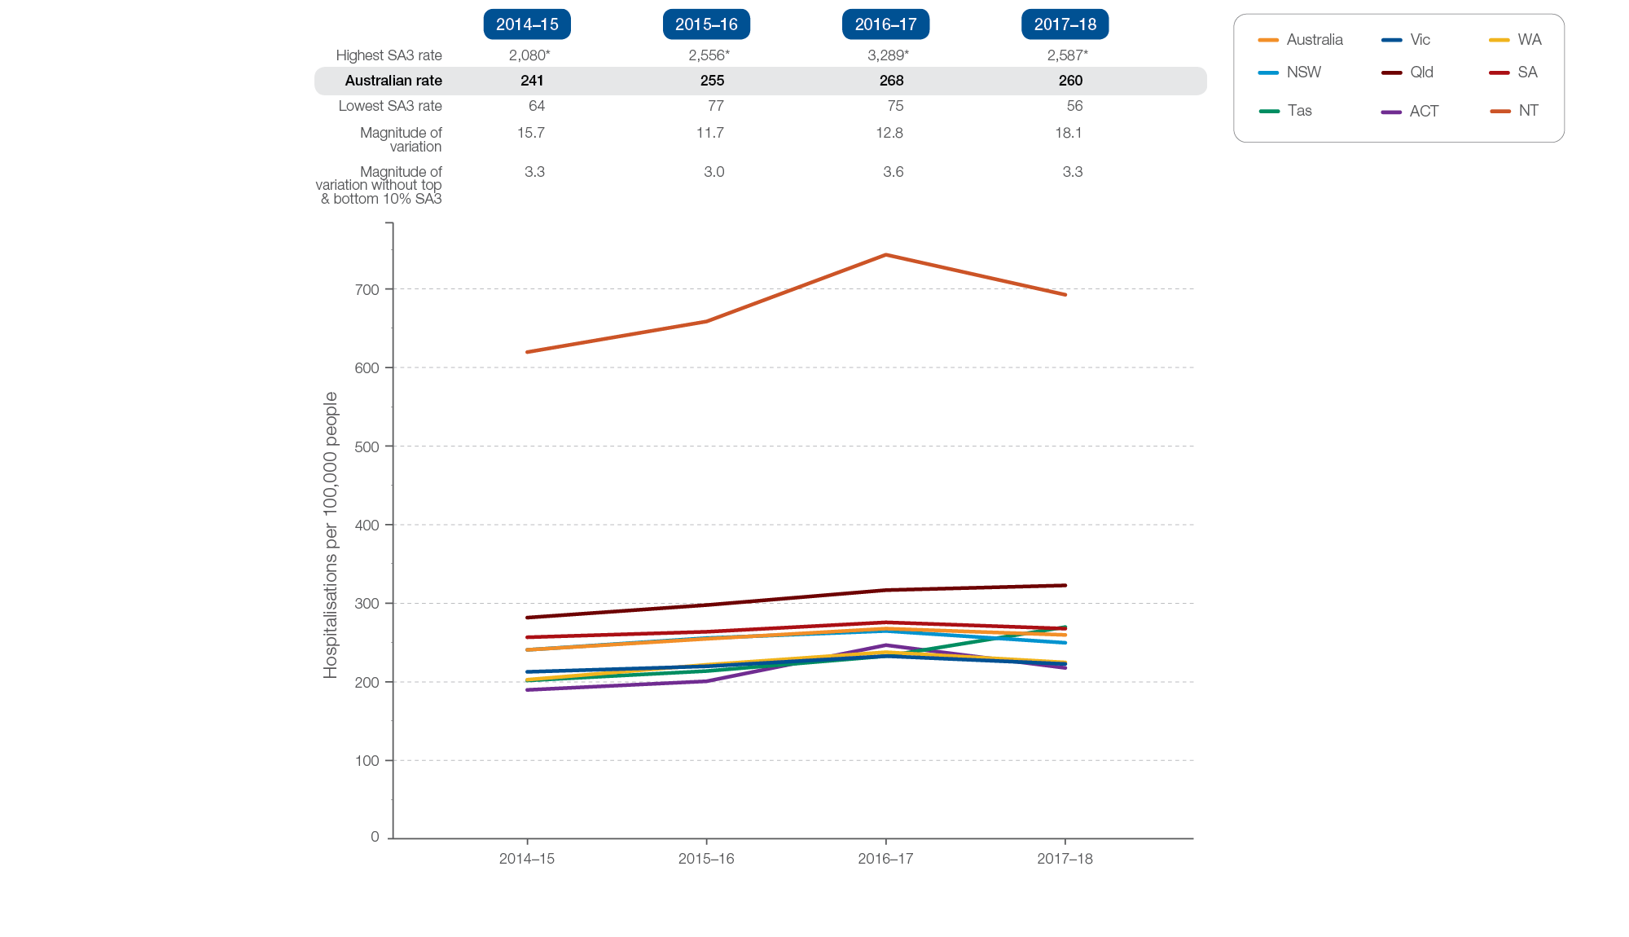
Chronic obstructive pulmonary disease (COPD)
Rates across years, 2014-15 to 2017-18
Sources: AIHW analysis of National Hospital Morbidity Database and ABS Estimated Resident Populations 30 June of 2014 to 2018.
Chronic disease and infection: potentially preventable hospitalisations

Slide 12
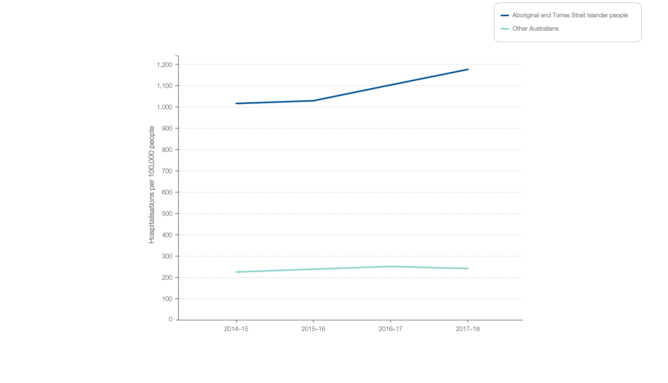
Chronic obstructive pulmonary disease (COPD)
Aboriginal and Torres Strait Islander status, 2014-15 to 2017-18
Sources: AIHW analysis of National Hospital Morbidity Database and ABS Estimated Resident Populations 30 June of 2014 to 2018.
Chronic disease and infection: potentially preventable hospitalisations

Slide 13
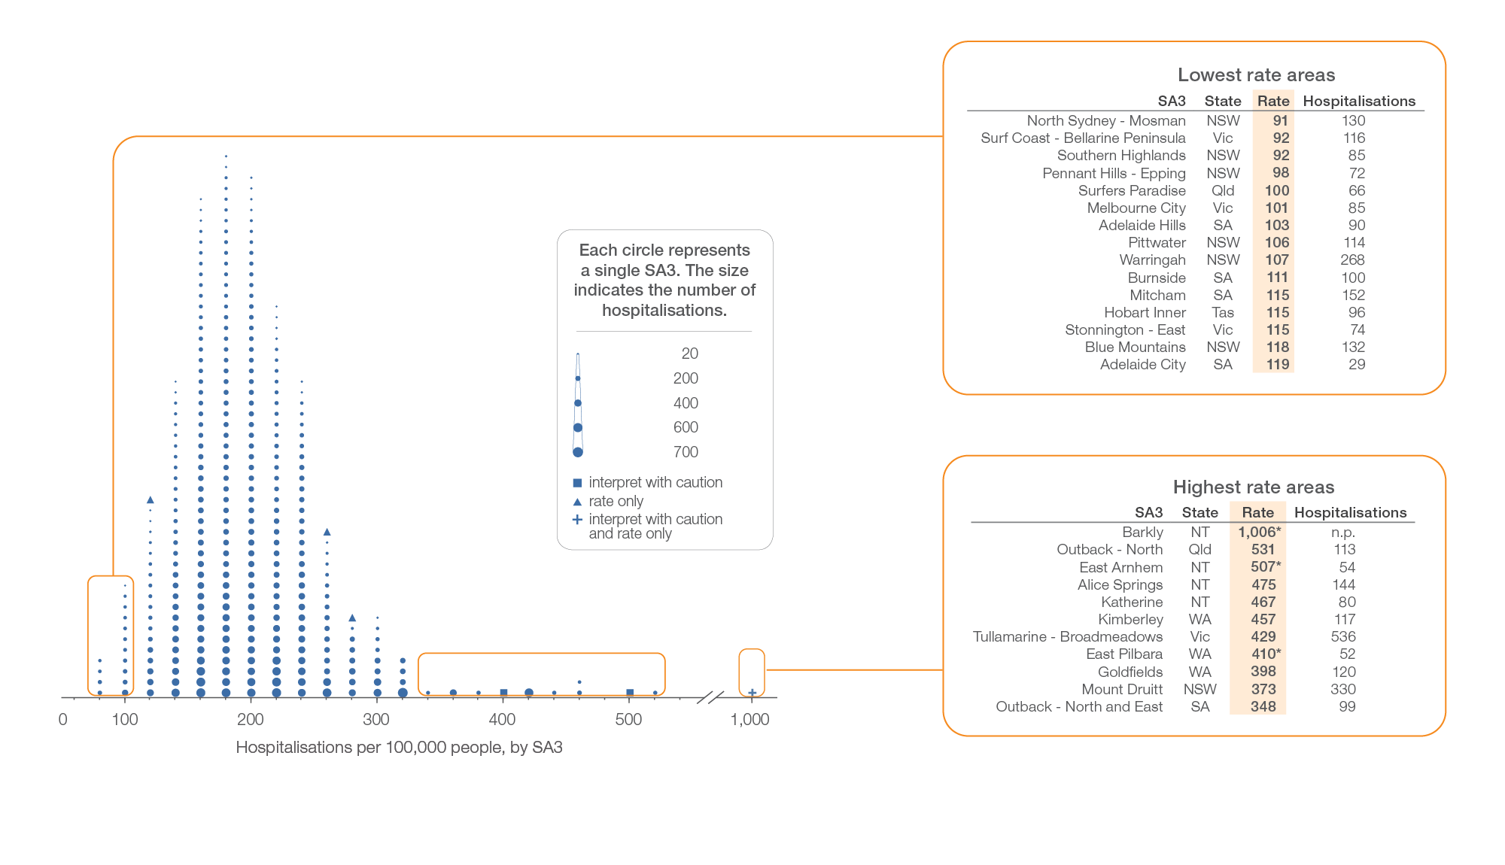
Heart failure
Local area, SA3 of patient residence, 2017-18
Sources: AIHW analysis of National Hospital Morbidity Database and ABS Estimated Resident Populations 30 June of 2017 and 2018.
Chronic disease and infection: potentially preventable hospitalisations

Slide 14
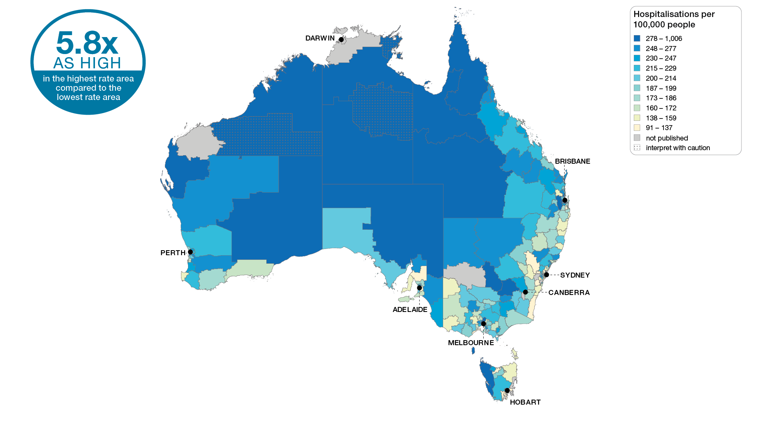
Heart failure
Australia, SA3 of patient residence, 2017-18
Sources: AIHW analysis of National Hospital Morbidity Database and ABS Estimated Resident Populations 30 June of 2017 and 2018.
Chronic disease and infection: potentially preventable hospitalisations

Slide 15
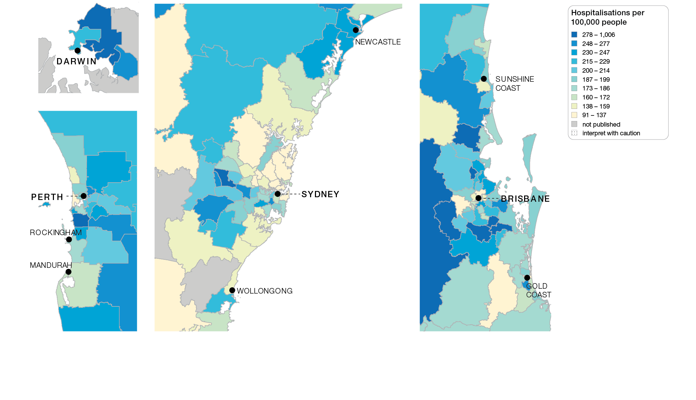
Heart failure
Capital cities, SA3 of patient residence, 2017-18
Sources: AIHW analysis of National Hospital Morbidity Database and ABS Estimated Resident Populations 30 June of 2017 and 2018.
Chronic disease and infection: potentially preventable hospitalisations

Slide 16
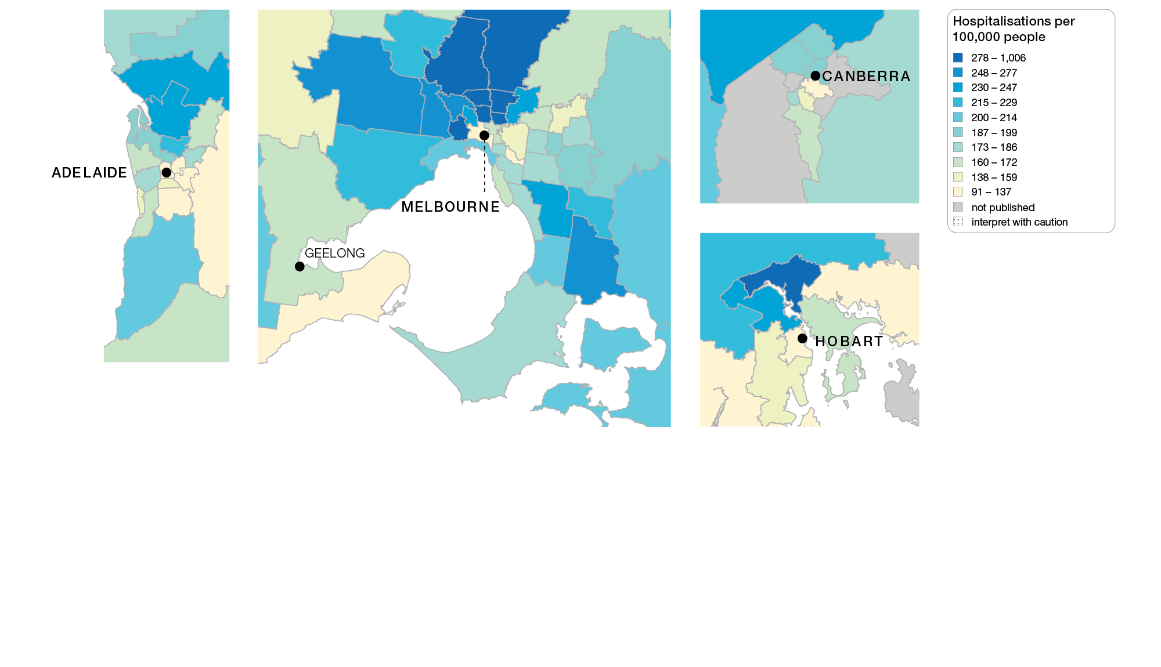
Heart failure
Capital cities, SA3 of patient residence, 2017-18
Sources: AIHW analysis of National Hospital Morbidity Database and ABS Estimated Resident Populations 30 June of 2017 and 2018.
Chronic disease and infection: potentially preventable hospitalisations

Slide 17
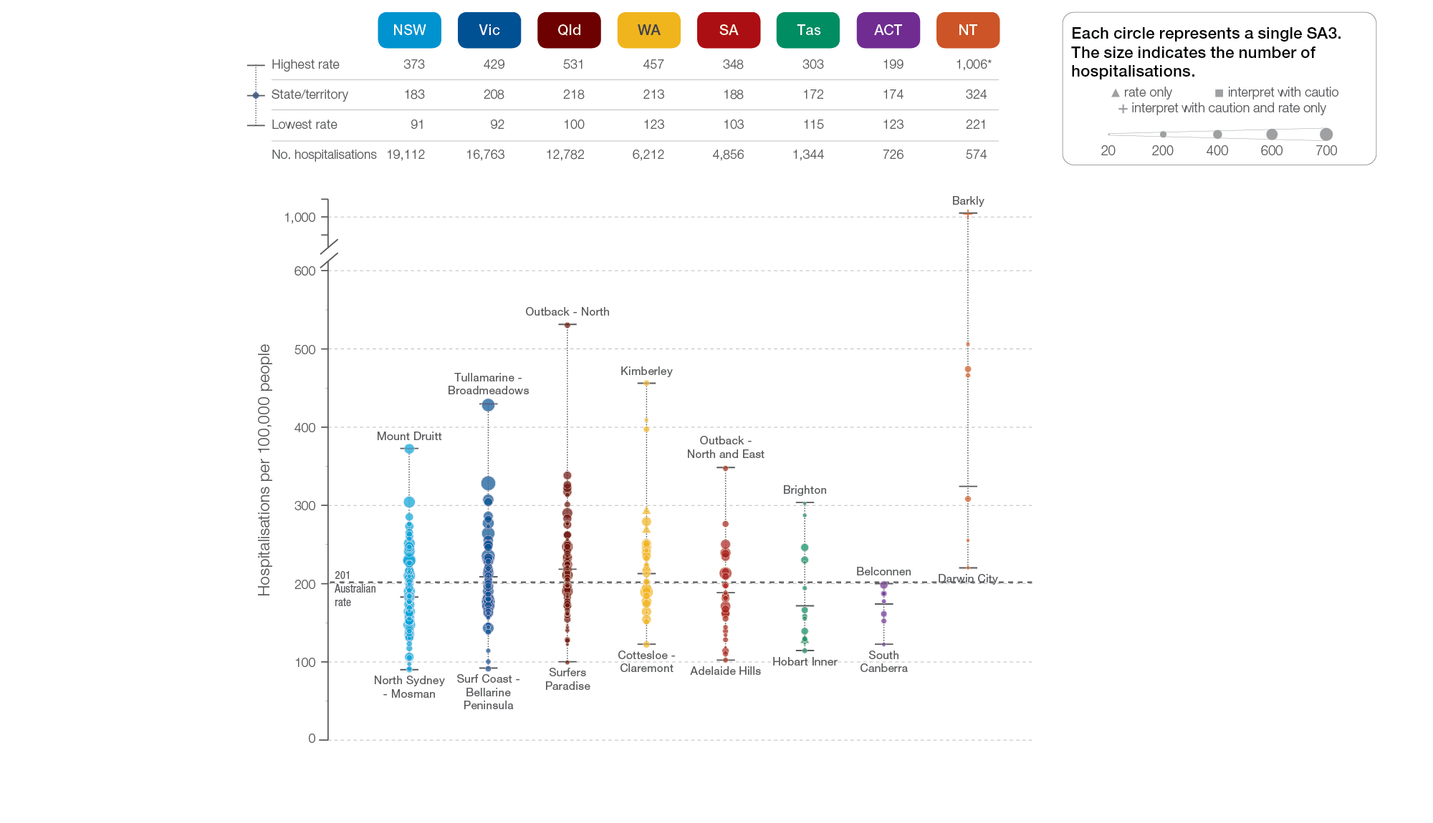
Heart failure
State and territory, SA3 of patient residence, 2017-18
Sources: AIHW analysis of National Hospital Morbidity Database and ABS Estimated Resident Populations 30 June of 2017 and 2018.
Chronic disease and infection: potentially preventable hospitalisations

Slide 18
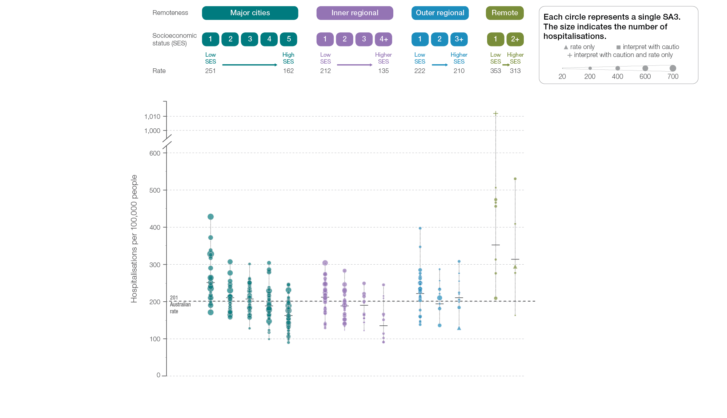
Heart failure
Remoteness and socioeconomic status, SA3 of patient residence, 2017-18
Sources: AIHW analysis of National Hospital Morbidity Database and ABS Estimated Resident Populations 30 June of 2017 and 2018.
Chronic disease and infection: potentially preventable hospitalisations

Slide 19
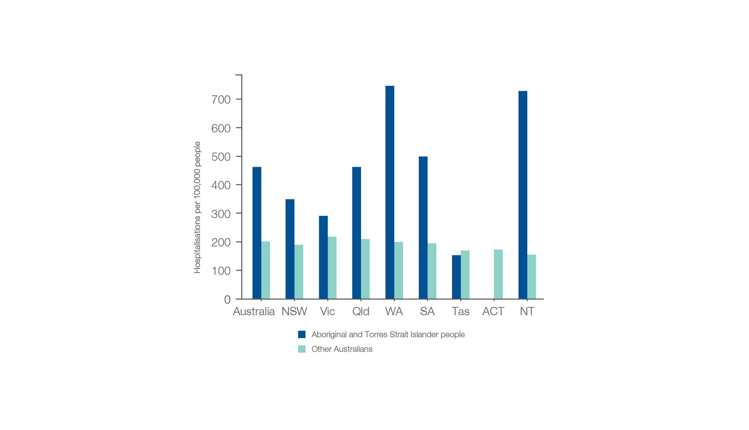
Heart failure
Aboriginal and Torres Strait Islander status, 2017-18
Sources:. AIHW analysis of National Hospital Morbidity Database and ABS Estimated Resident Populations 30 June of 2014 to 2018
Chronic disease and infection: potentially preventable hospitalisations

Slide 20
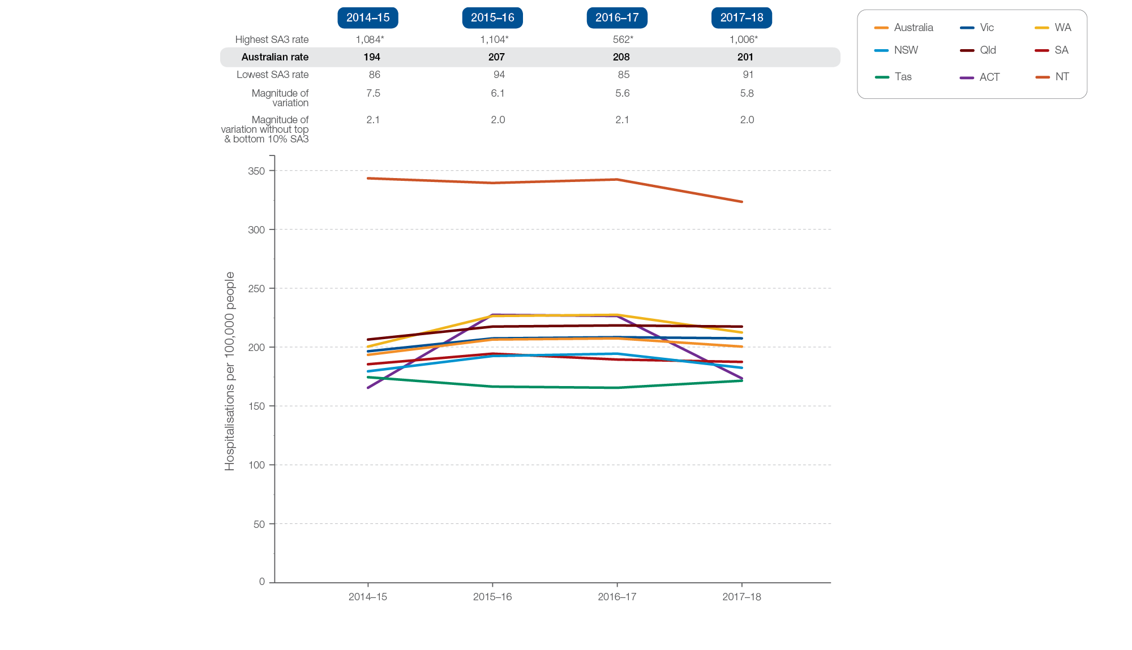
Heart failure
Rates across years, 2014-15 to 2017-18
Sources: AIHW analysis of National Hospital Morbidity Database and ABS Estimated Resident Populations 30 June of 2014 to 2018.
Chronic disease and infection: potentially preventable hospitalisations

Slide 21
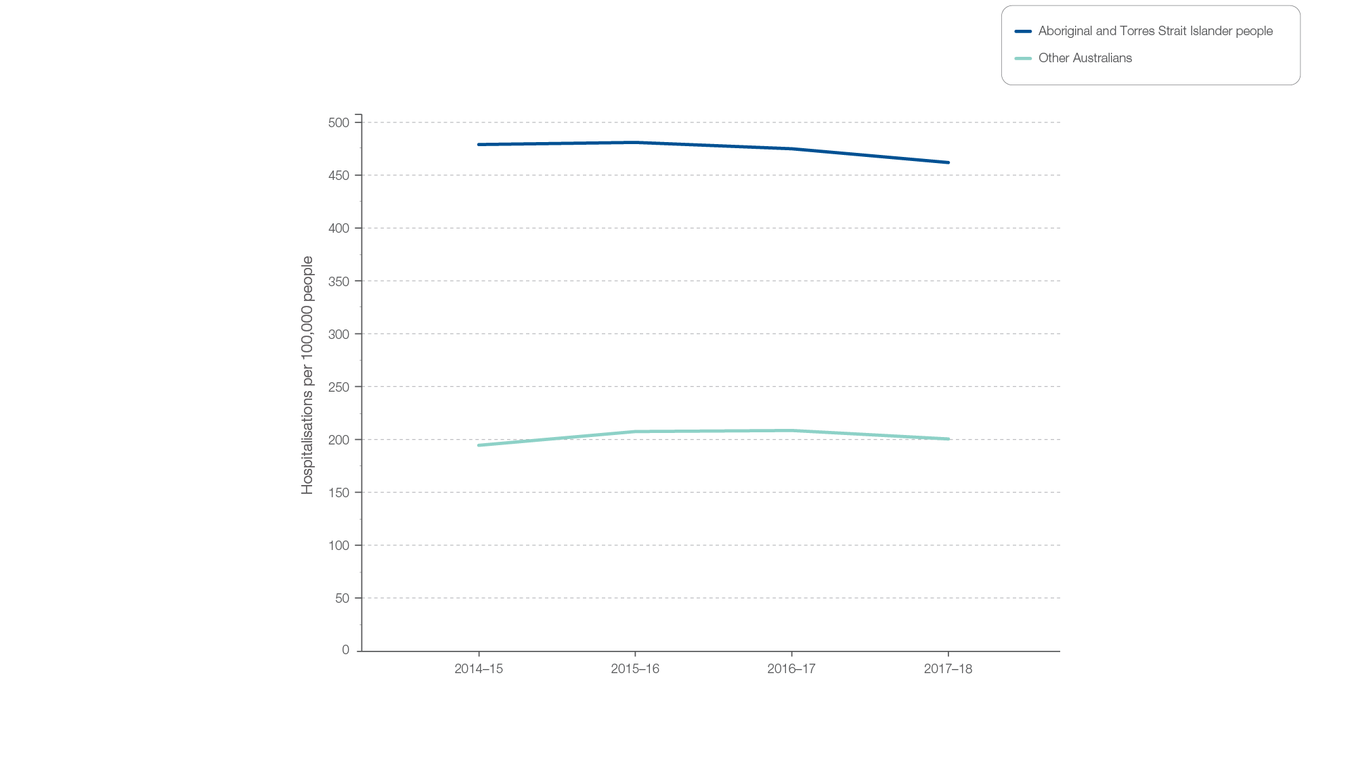
Heart failure
Aboriginal and Torres Strait Islander status, 2014-15 to 2017-18
Sources: AIHW analysis of National Hospital Morbidity Database and ABS Estimated Resident Populations 30 June of 2014 to 2018.
Chronic disease and infection: potentially preventable hospitalisations

Slide 22
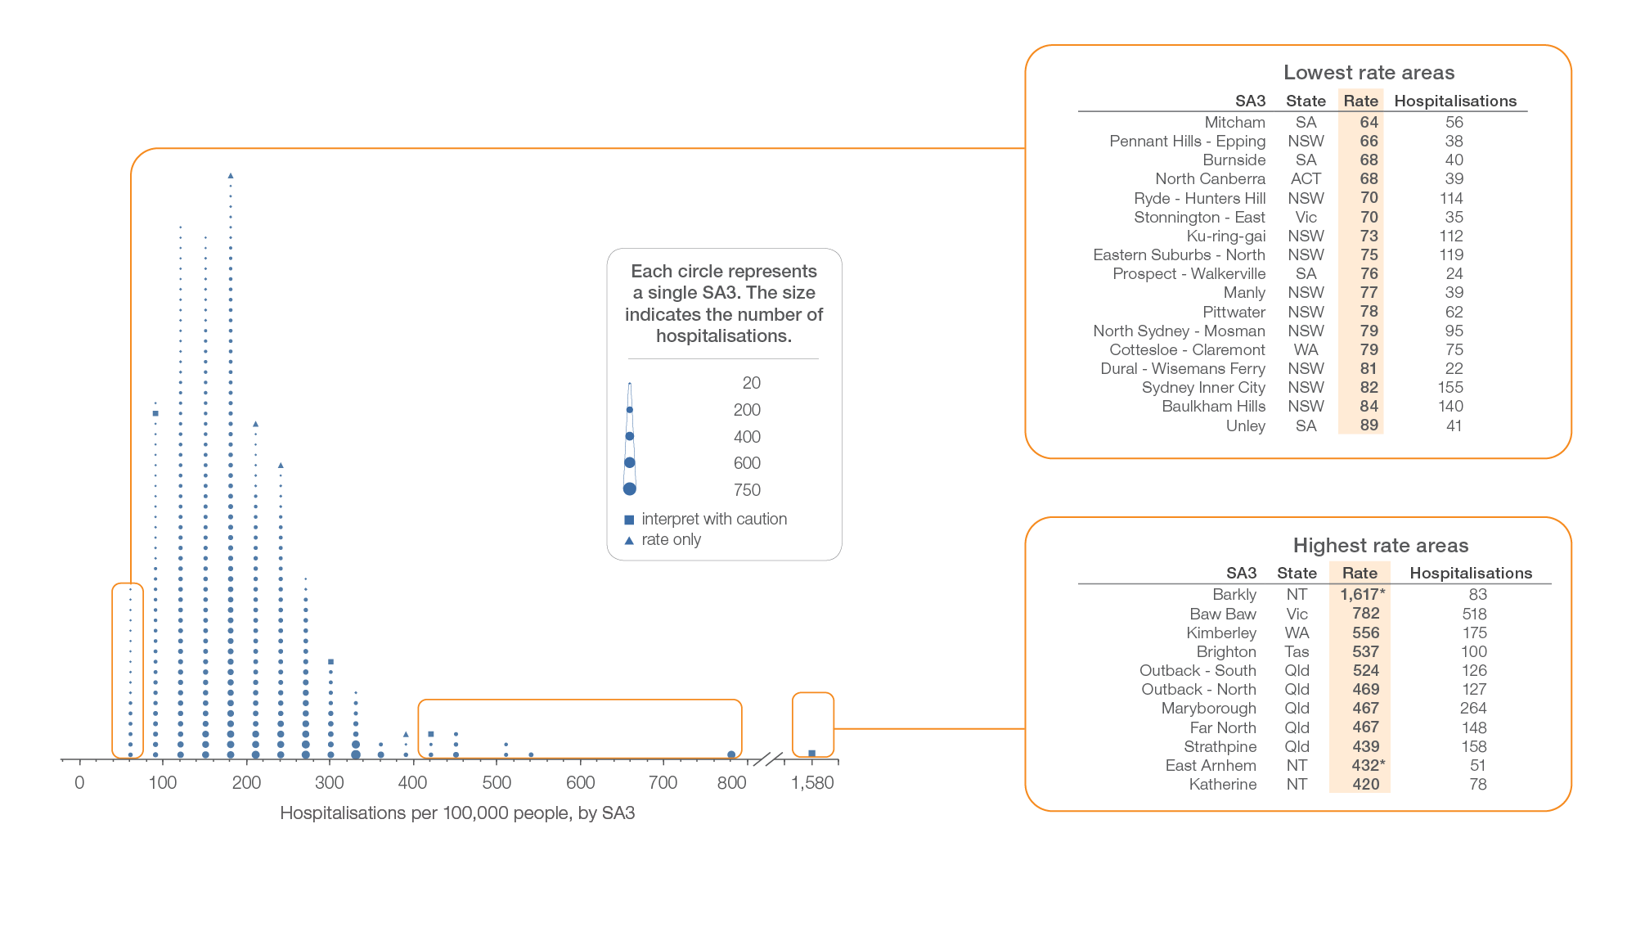
Diabetes complications
Local area, SA3 of patient residence, 2017-18
Sources: AIHW analysis of National Hospital Morbidity Database and ABS Estimated Resident Populations 30 June of 2017 and 2018.
Chronic disease and infection: potentially preventable hospitalisations

Slide 23
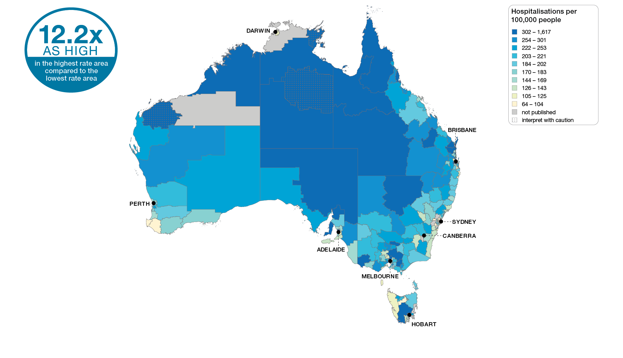
Diabetes complications
Australia, SA3 of patient residence, 2017-18
Sources: AIHW analysis of National Hospital Morbidity Database and ABS Estimated Resident Populations 30 June of 2017 and 2018.
Chronic disease and infection: potentially preventable hospitalisations

Slide 24
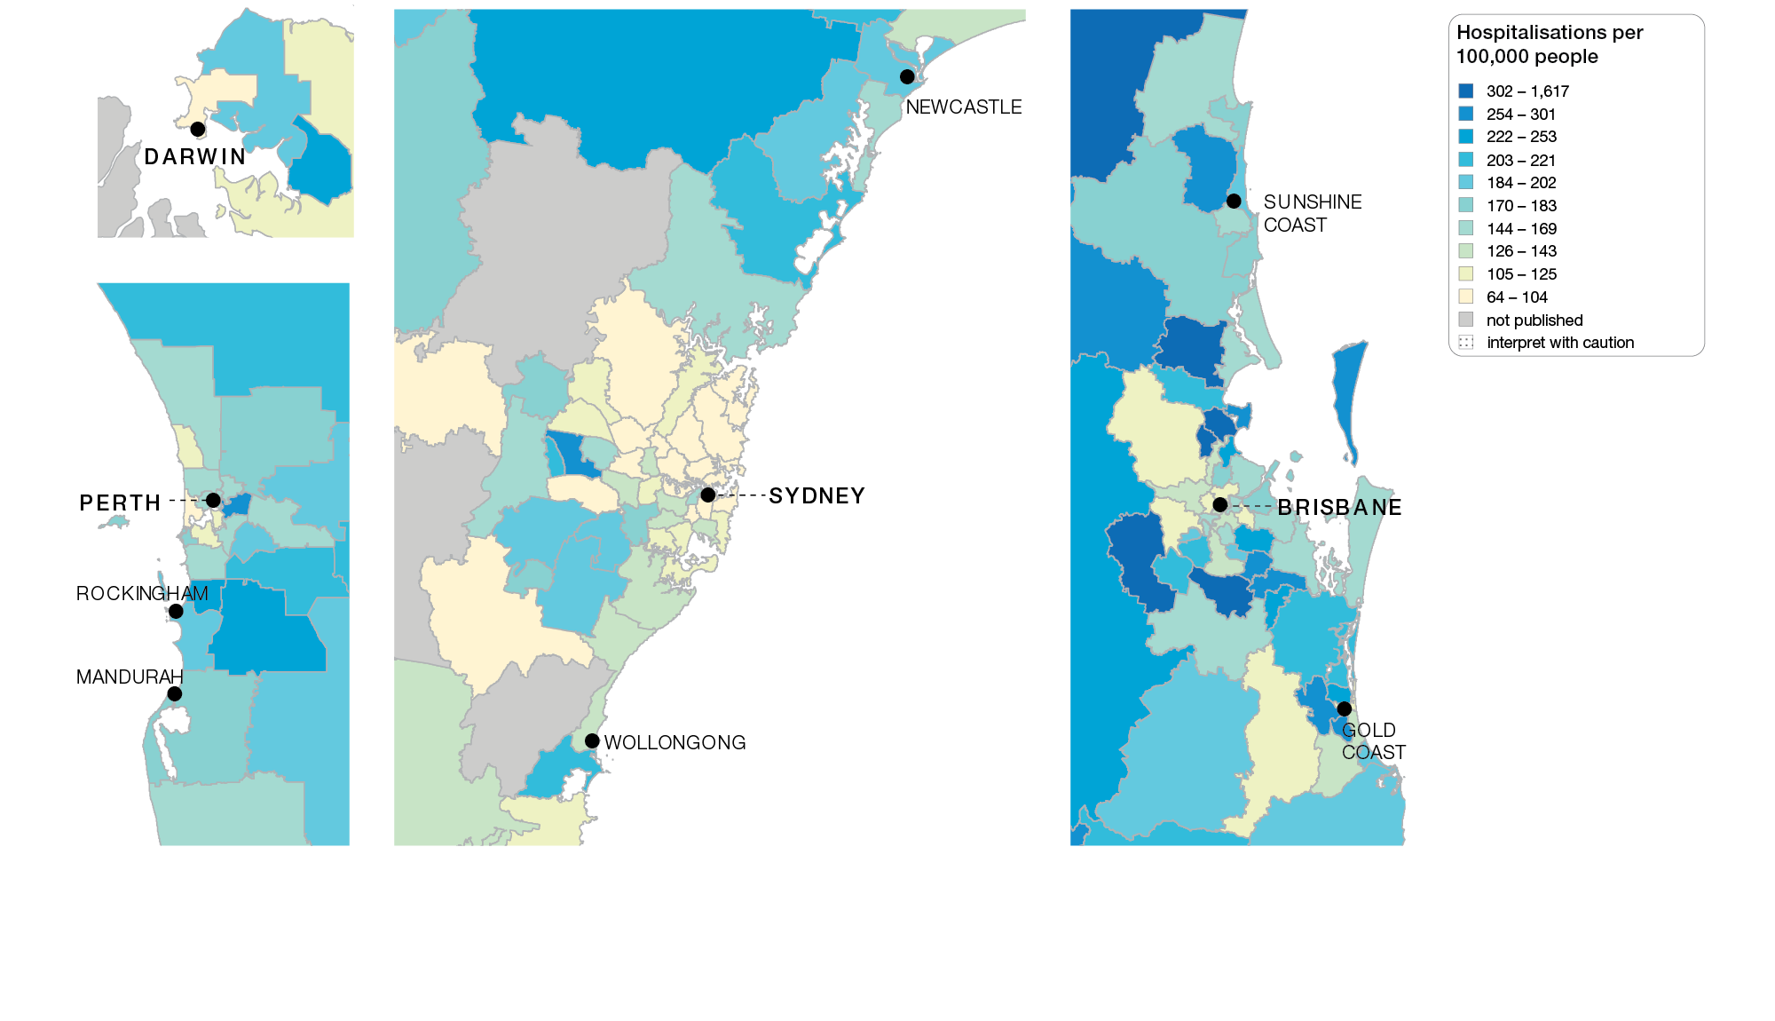
Diabetes complications
Capital cities, SA3 of patient residence, 2017-18
Sources: AIHW analysis of National Hospital Morbidity Database and ABS Estimated Resident Populations 30 June of 2017 and 2018.
Chronic disease and infection: potentially preventable hospitalisations

Slide 25
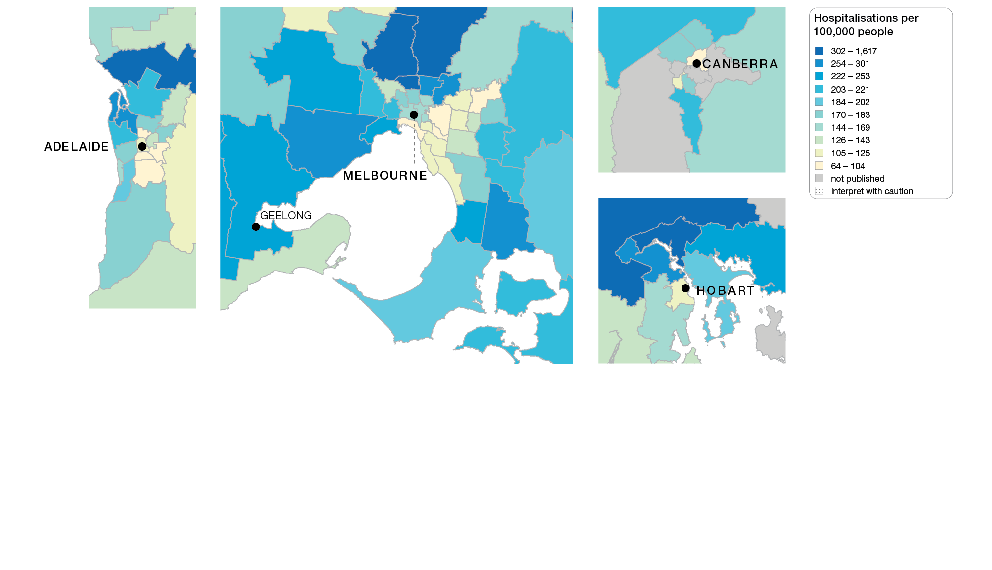
Diabetes complications
Capital cities, SA3 of patient residence, 2017-18
Sources: AIHW analysis of National Hospital Morbidity Database and ABS Estimated Resident Populations 30 June of 2017 and 2018.
Chronic disease and infection: potentially preventable hospitalisations

Slide 26
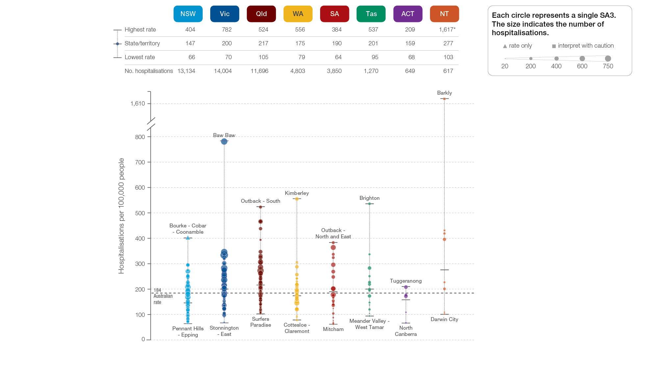
Diabetes complications
State and territory, SA3 of patient residence, 2017-18
Sources: AIHW analysis of National Hospital Morbidity Database and ABS Estimated Resident Populations 30 June of 2017 and 2018.
Chronic disease and infection: potentially preventable hospitalisations

Slide 27
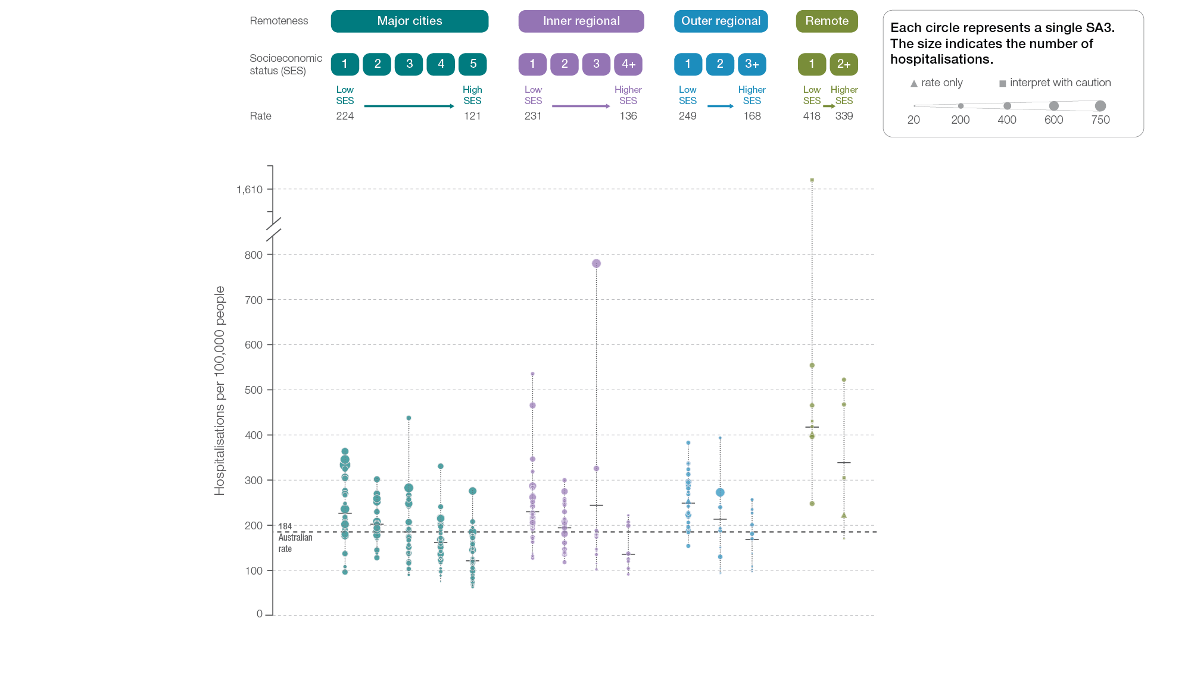
Diabetes complications
Remoteness and socioeconomic status, SA3 of patient residence, 2017-18
Sources: AIHW analysis of National Hospital Morbidity Database and ABS Estimated Resident Populations 30 June of 2017 and 2018.
Chronic disease and infection: potentially preventable hospitalisations

Slide 28
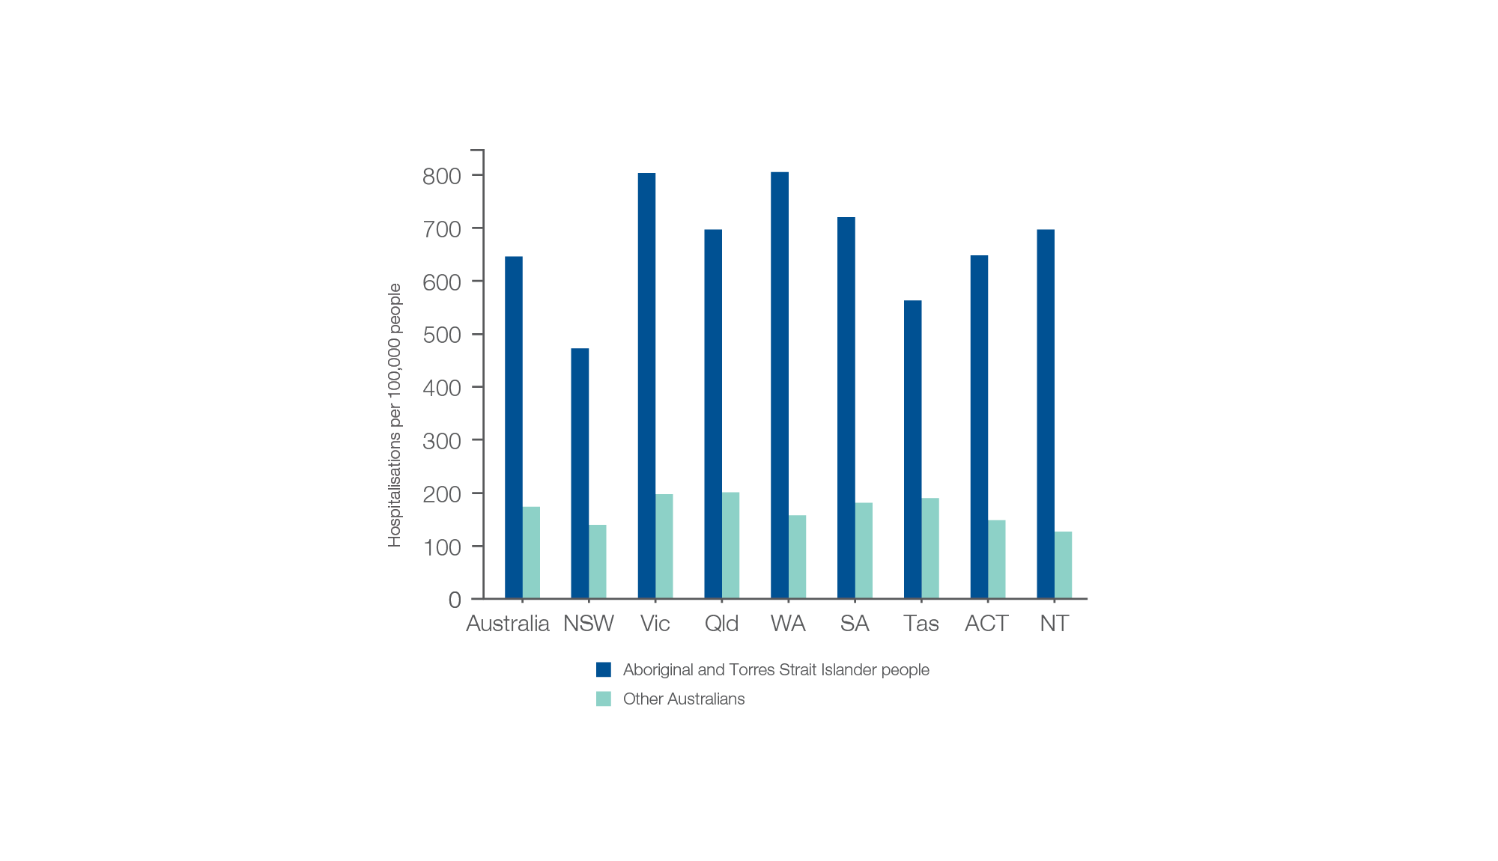
Diabetes complications
Aboriginal and Torres Strait Islander status, 2017-18
Sources: AIHW analysis of National Hospital Morbidity Database and ABS Estimated Resident Populations 30 June of 2017 and 2018.
Chronic disease and infection: potentially preventable hospitalisations

Slide 29
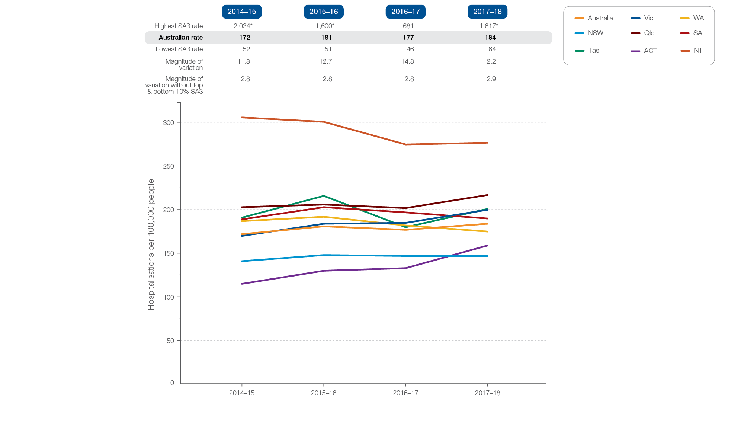
Diabetes complications
Rates across years, 2014-15 to 2017-18
Sources: AIHW analysis of National Hospital Morbidity Database and ABS Estimated Resident Populations 30 June of 2014 to 2018.
Chronic disease and infection: potentially preventable hospitalisations

Slide 30
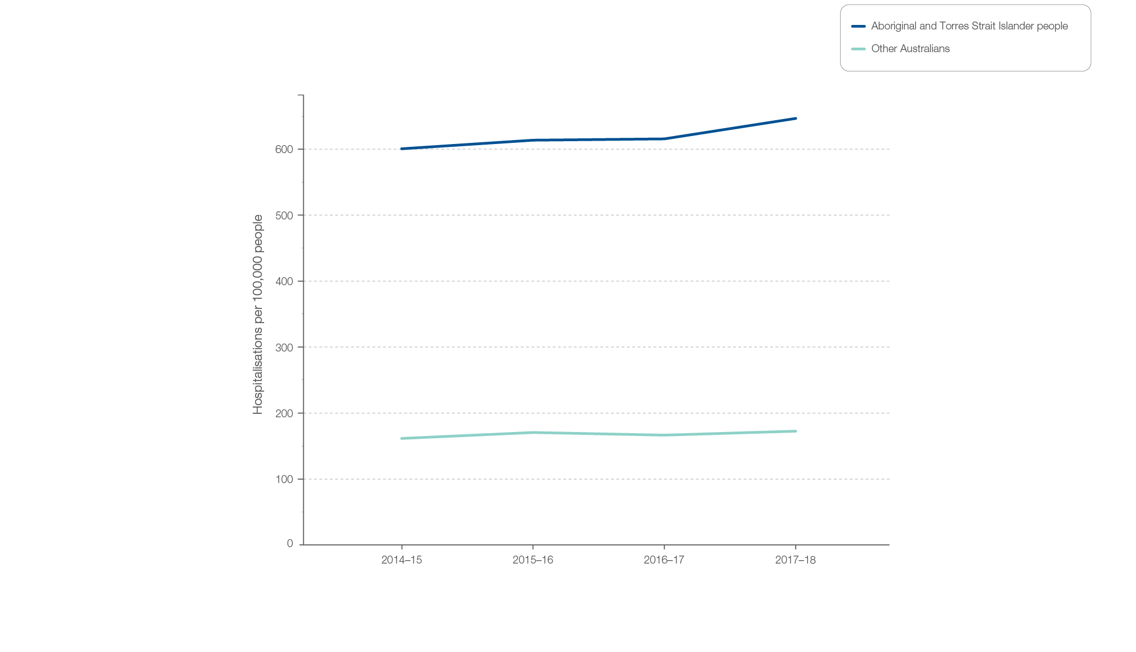
Diabetes complications
Aboriginal and Torres Strait Islander status, 2014-15 to 2017-18
Sources: AIHW analysis of National Hospital Morbidity Database and ABS Estimated Resident Populations 30 June of 2014 to 2018.
Chronic disease and infection: potentially preventable hospitalisations

Slide 31
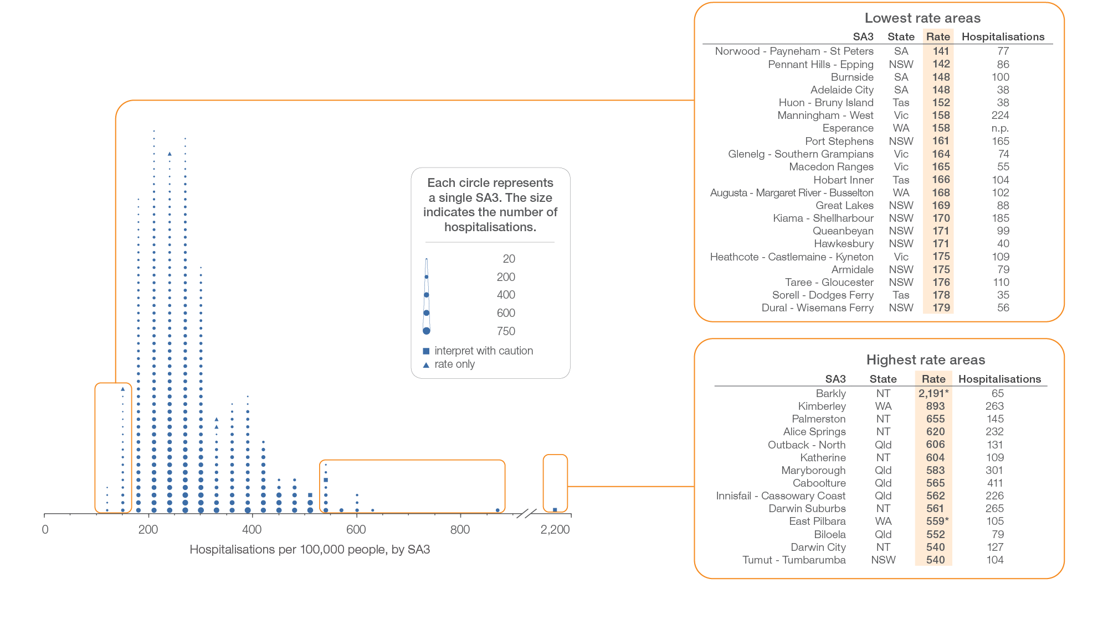
Kidney infections and urinary tract infections
Local area, SA3 of patient residence, 2017-18
Sources: AIHW analysis of National Hospital Morbidity Database and ABS Estimated Resident Populations 30 June of 2017 and 2018.
Chronic disease and infection: potentially preventable hospitalisations

Slide 32
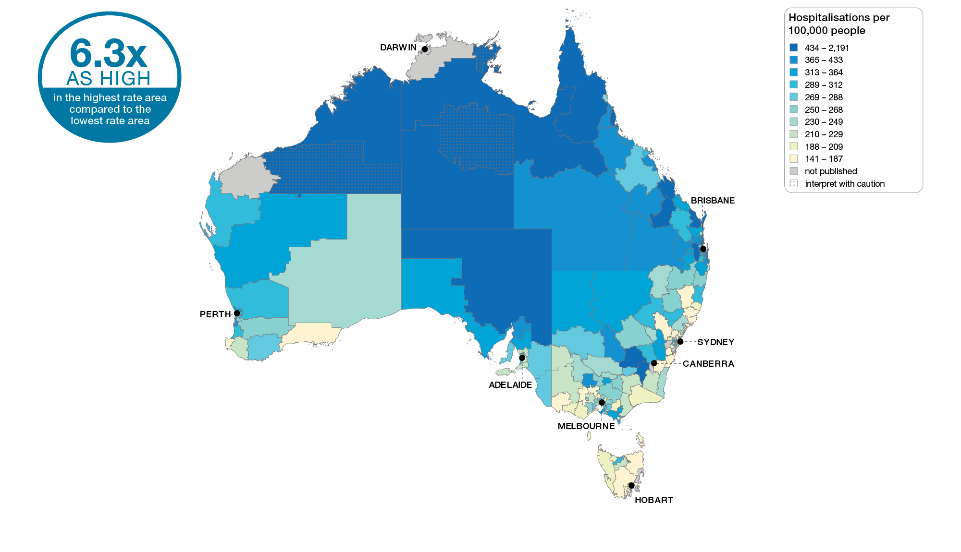
Kidney infections and urinary tract infections
Australia, SA3 of patient residence, 2017-18
Sources: AIHW analysis of National Hospital Morbidity Database and ABS Estimated Resident Populations 30 June of 2017 and 2018.
Chronic disease and infection: potentially preventable hospitalisations

Slide 33
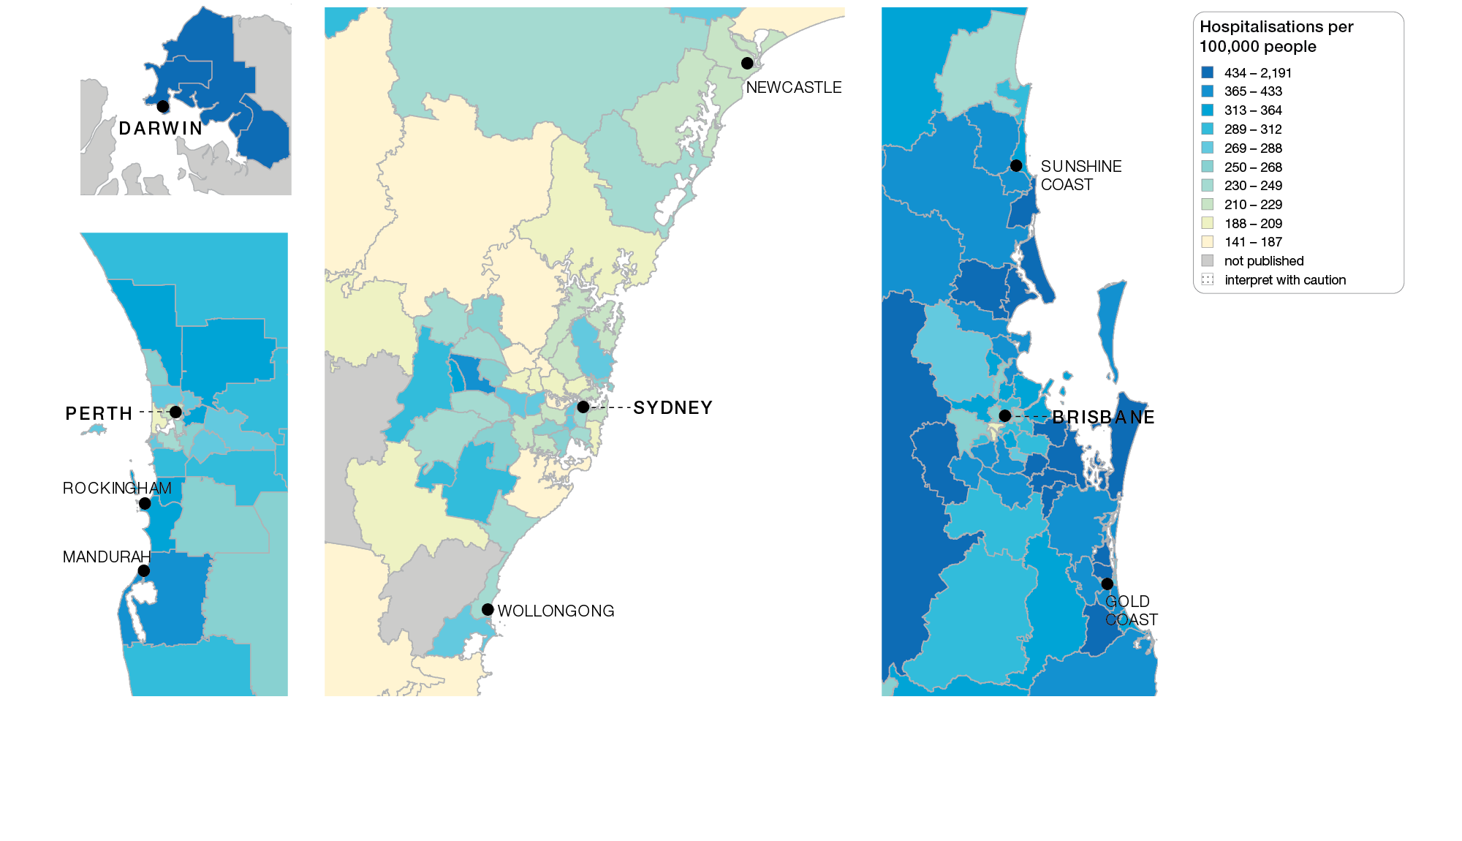
Kidney infections and urinary tract infections
Capital cities, SA3 of patient residence, 2017-18
Sources: AIHW analysis of National Hospital Morbidity Database and ABS Estimated Resident Populations 30 June of 2017 and 2018.
Chronic disease and infection: potentially preventable hospitalisations

Slide 34
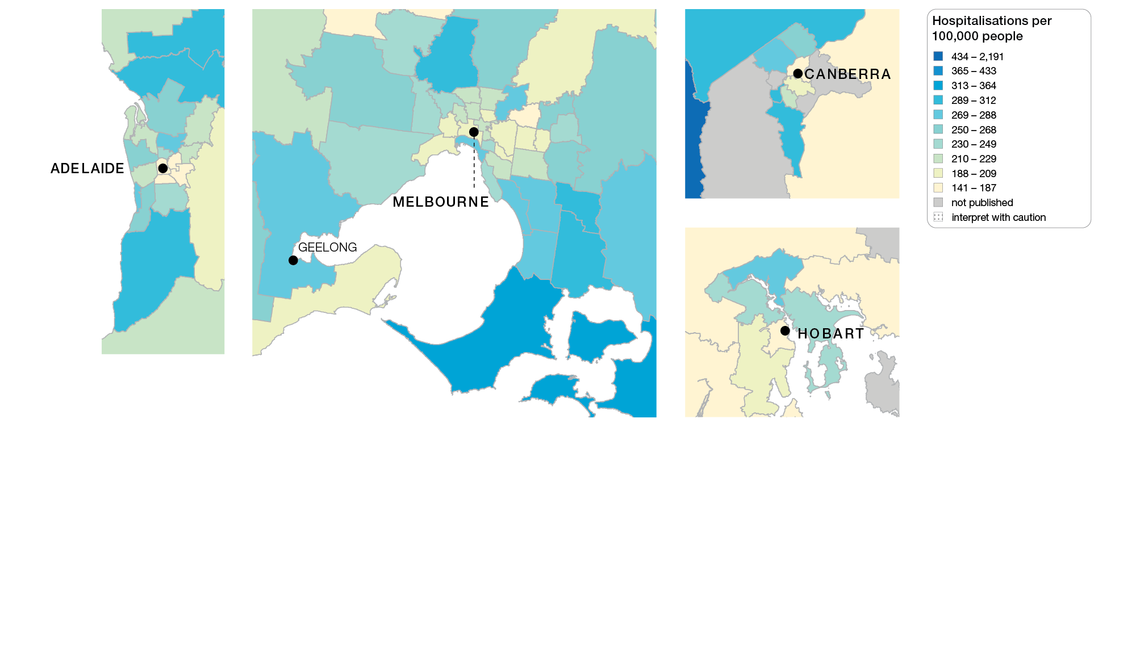
Kidney infections and urinary tract infections
Capital cities, SA3 of patient residence, 2017-18
Sources: AIHW analysis of National Hospital Morbidity Database and ABS Estimated Resident Populations 30 June of 2017 and 2018.
Chronic disease and infection: potentially preventable hospitalisations

Slide 35
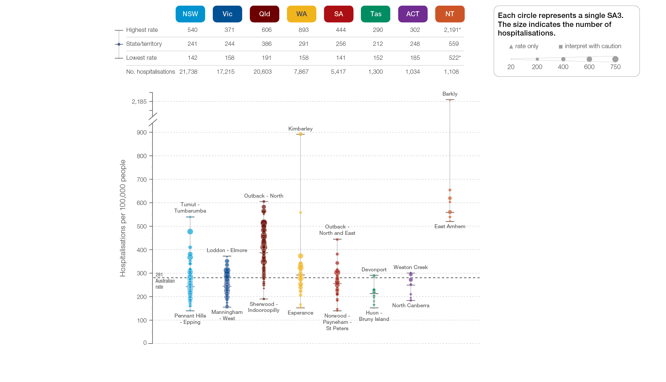
Kidney infections and urinary tract infections
State and territory, SA3 of patient residence, 2017-18
Sources: AIHW analysis of National Hospital Morbidity Database and ABS Estimated Resident Populations 30 June of 2017 and 2018.
Chronic disease and infection: potentially preventable hospitalisations

Slide 36
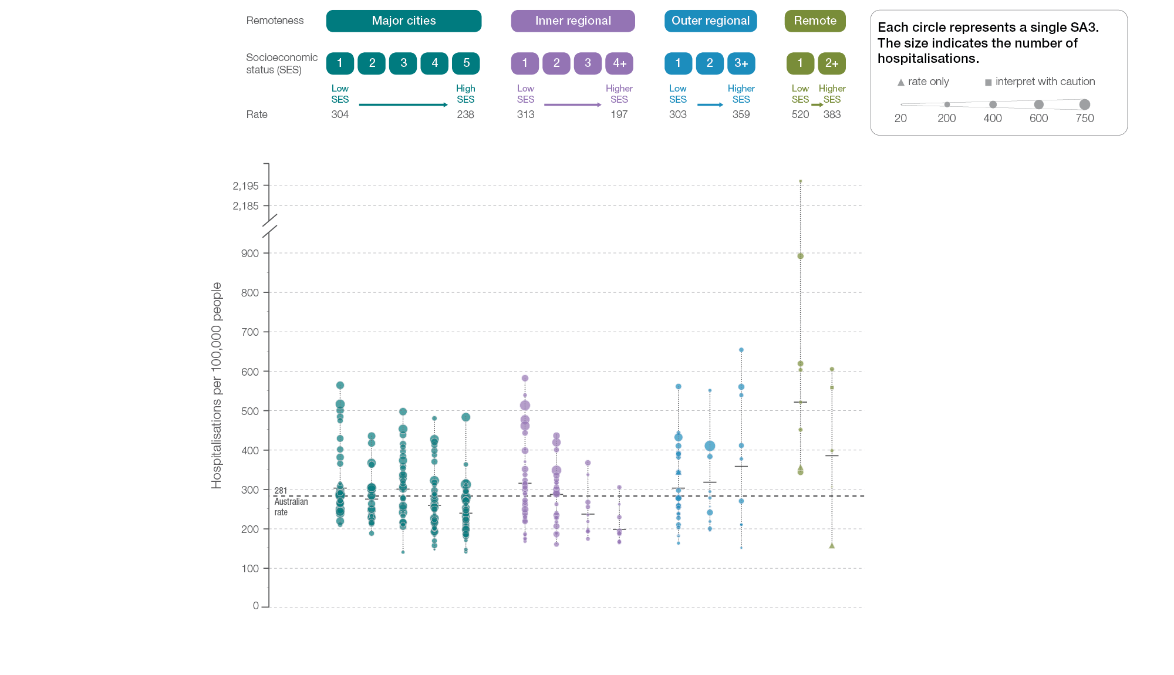
Kidney infections and urinary tract infections
Remoteness and socioeconomic status, SA3 of patient residence, 2017-18
Sources: AIHW analysis of National Hospital Morbidity Database and ABS Estimated Resident Populations 30 June of 2017 and 2018.
Chronic disease and infection: potentially preventable hospitalisations

Slide 37
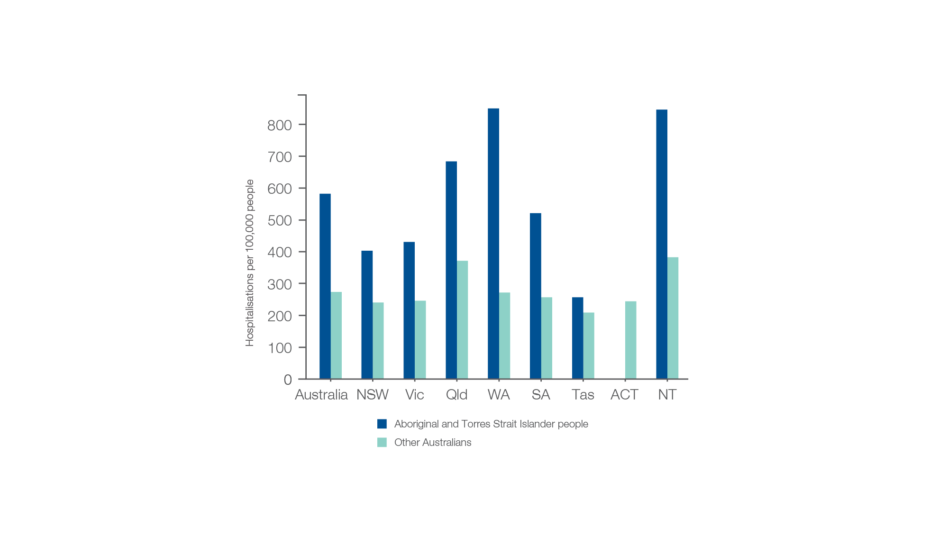
Kidney infections and urinary tract infections
Aboriginal and Torres Strait Islander status, 2017-18
Sources: AIHW analysis of National Hospital Morbidity Database and ABS Estimated Resident Populations 30 June of 2017 and 2018.
Chronic disease and infection: potentially preventable hospitalisations

Slide 38
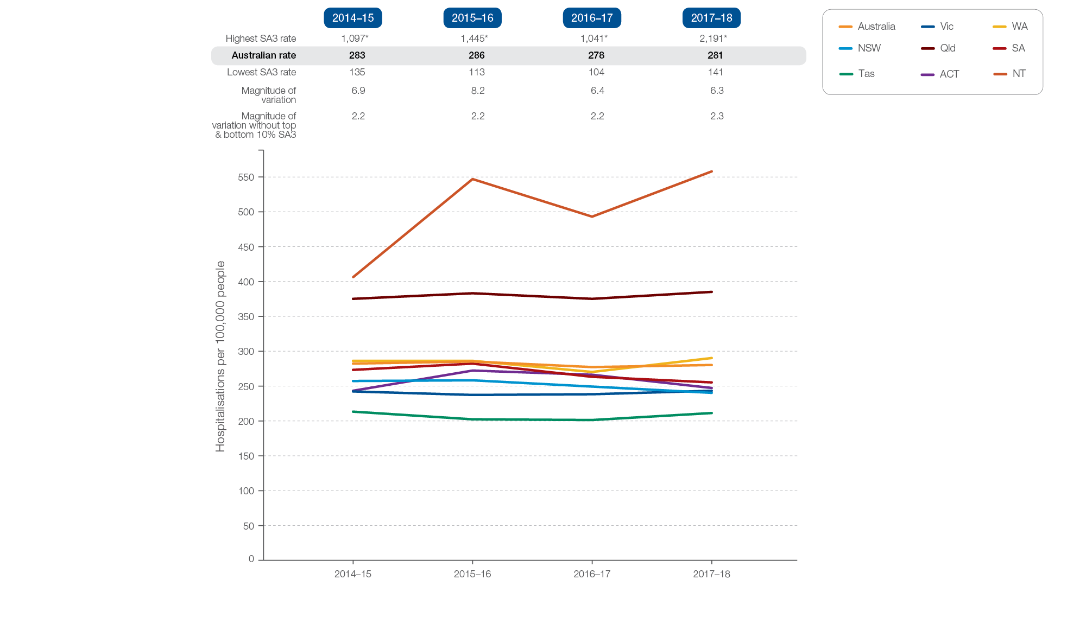
Kidney infections and urinary tract infections
Rates across years, 2014-15 to 2017-18
Sources: AIHW analysis of National Hospital Morbidity Database and ABS Estimated Resident Populations 30 June of 2014 to 2018.
Chronic disease and infection: potentially preventable hospitalisations

Slide 39
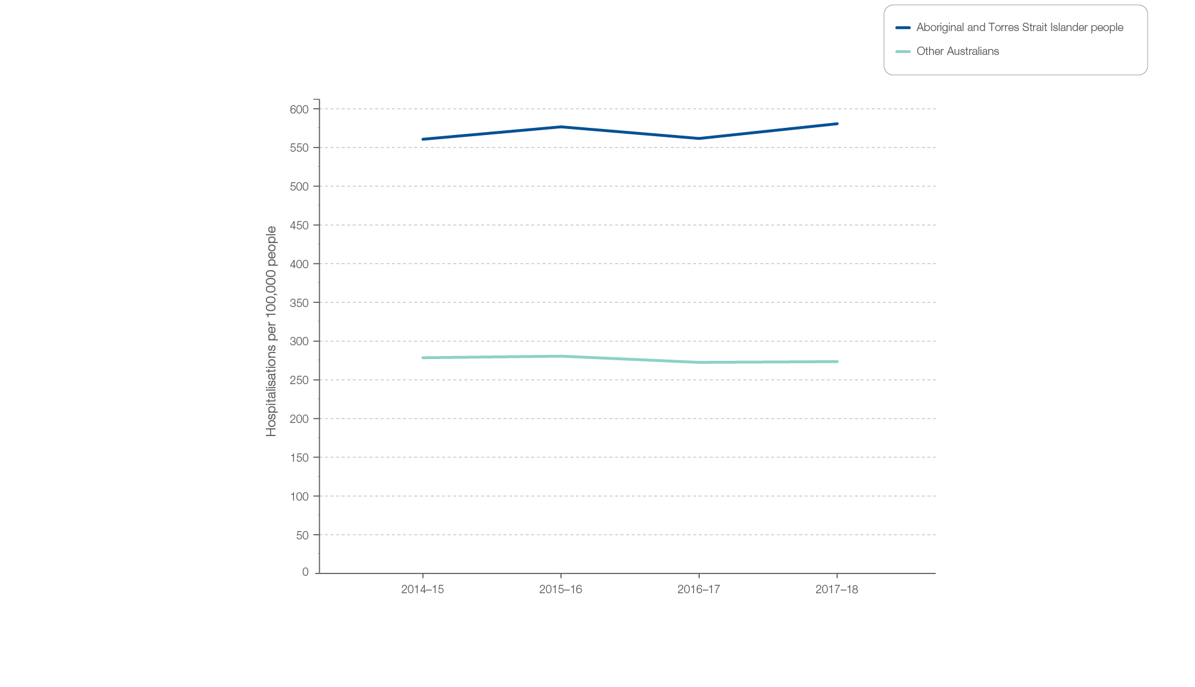
Kidney infections and urinary tract infections
Aboriginal and Torres Strait Islander status, 2014-15 to 2017-18
Sources: AIHW analysis of National Hospital Morbidity Database and ABS Estimated Resident Populations 30 June of 2014 to 2018.
Chronic disease and infection: potentially preventable hospitalisations

Slide 40
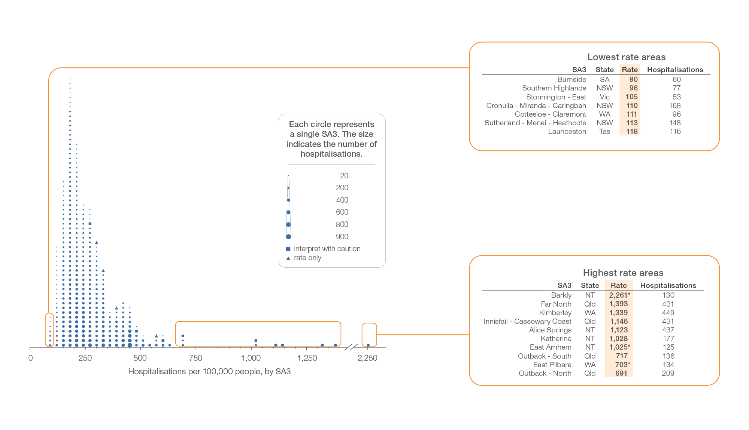
Cellulitis
Local area, SA3 of patient residence, 2017-18
Sources: AIHW analysis of National Hospital Morbidity Database and ABS Estimated Resident Populations 30 June of 2017 and 2018.
Chronic disease and infection: potentially preventable hospitalisations

Slide 41
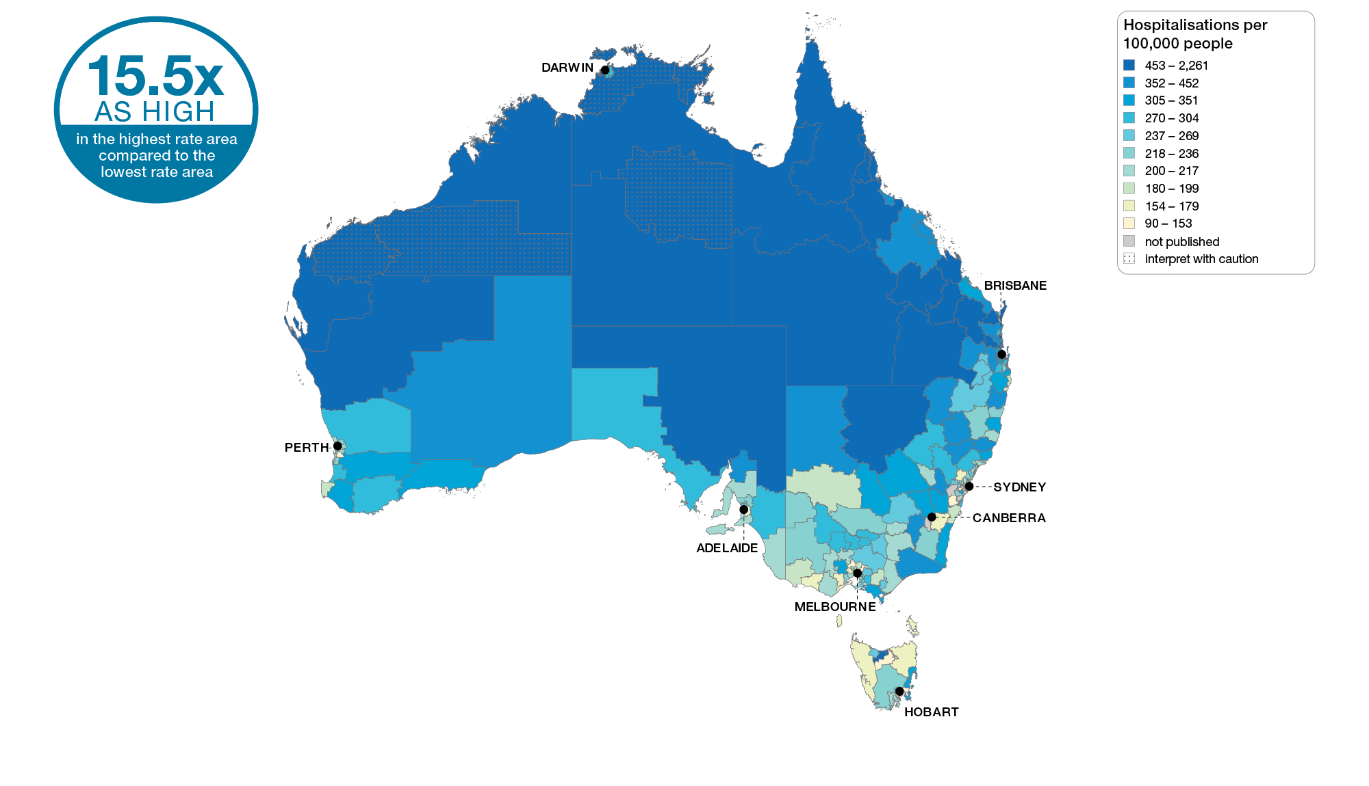
Cellulitis
Australia, SA3 of patient residence, 2017-18
Sources: AIHW analysis of National Hospital Morbidity Database and ABS Estimated Resident Populations 30 June of 2017 and 2018.
Chronic disease and infection: potentially preventable hospitalisations

Slide 42
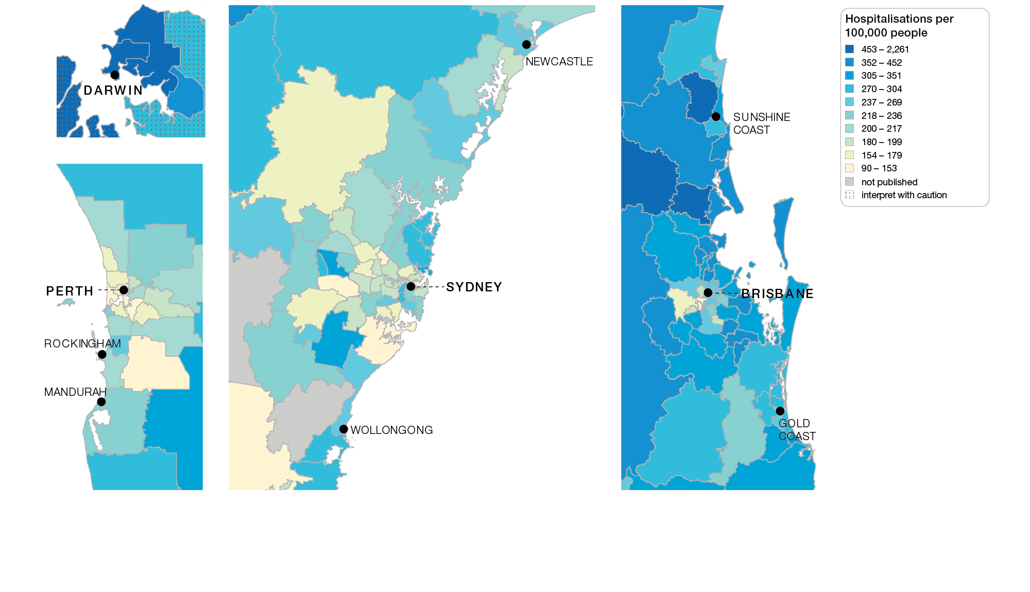
Cellulitis
Capital cities, SA3 of patient residence, 2017-18
Sources: AIHW analysis of National Hospital Morbidity Database and ABS Estimated Resident Populations 30 June of 2017 and 2018.
Chronic disease and infection: potentially preventable hospitalisations

Slide 43
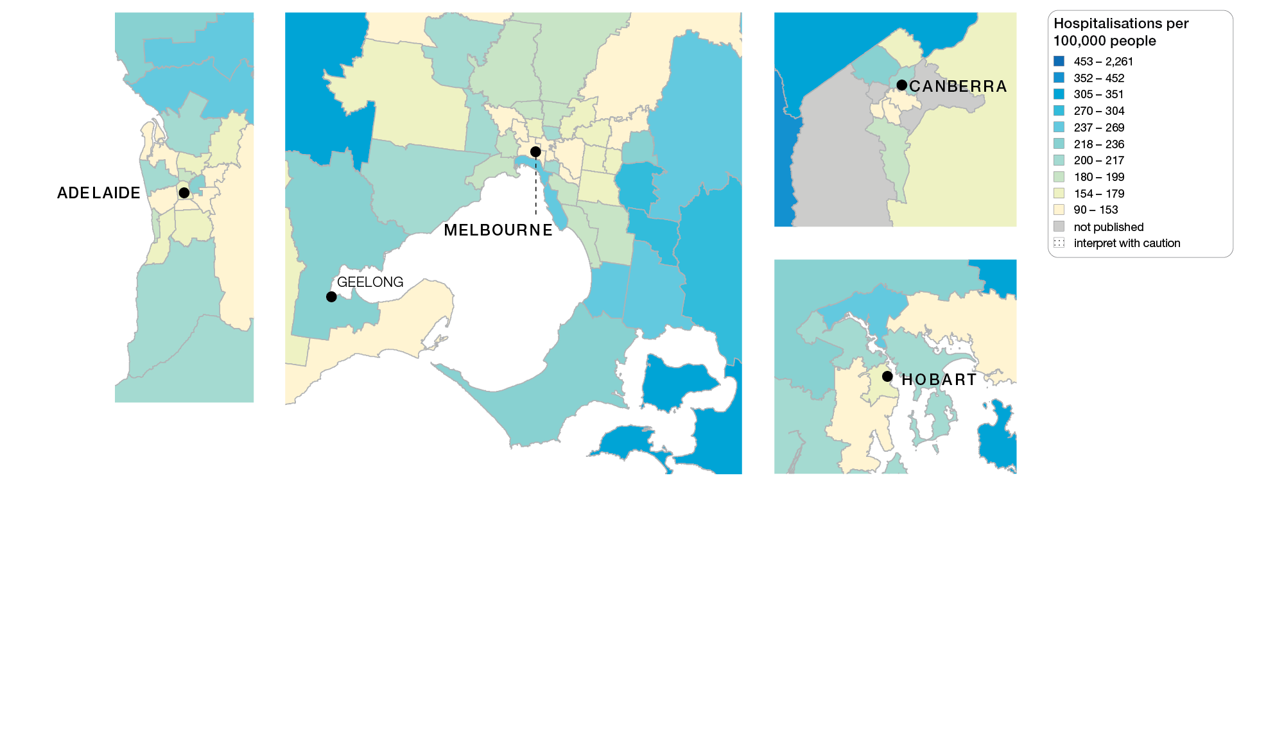
Cellulitis
Capital cities, SA3 of patient residence, 2017-18
Sources: AIHW analysis of National Hospital Morbidity Database and ABS Estimated Resident Populations 30 June of 2017 and 2018.
Chronic disease and infection: potentially preventable hospitalisations

Slide 44
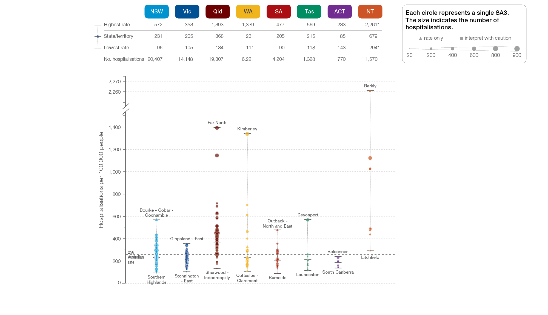
Cellulitis
State and territory, SA3 of patient residence, 2017-18
Sources: AIHW analysis of National Hospital Morbidity Database and ABS Estimated Resident Populations 30 June of 2017 and 2018.
Chronic disease and infection: potentially preventable hospitalisations

Slide 45
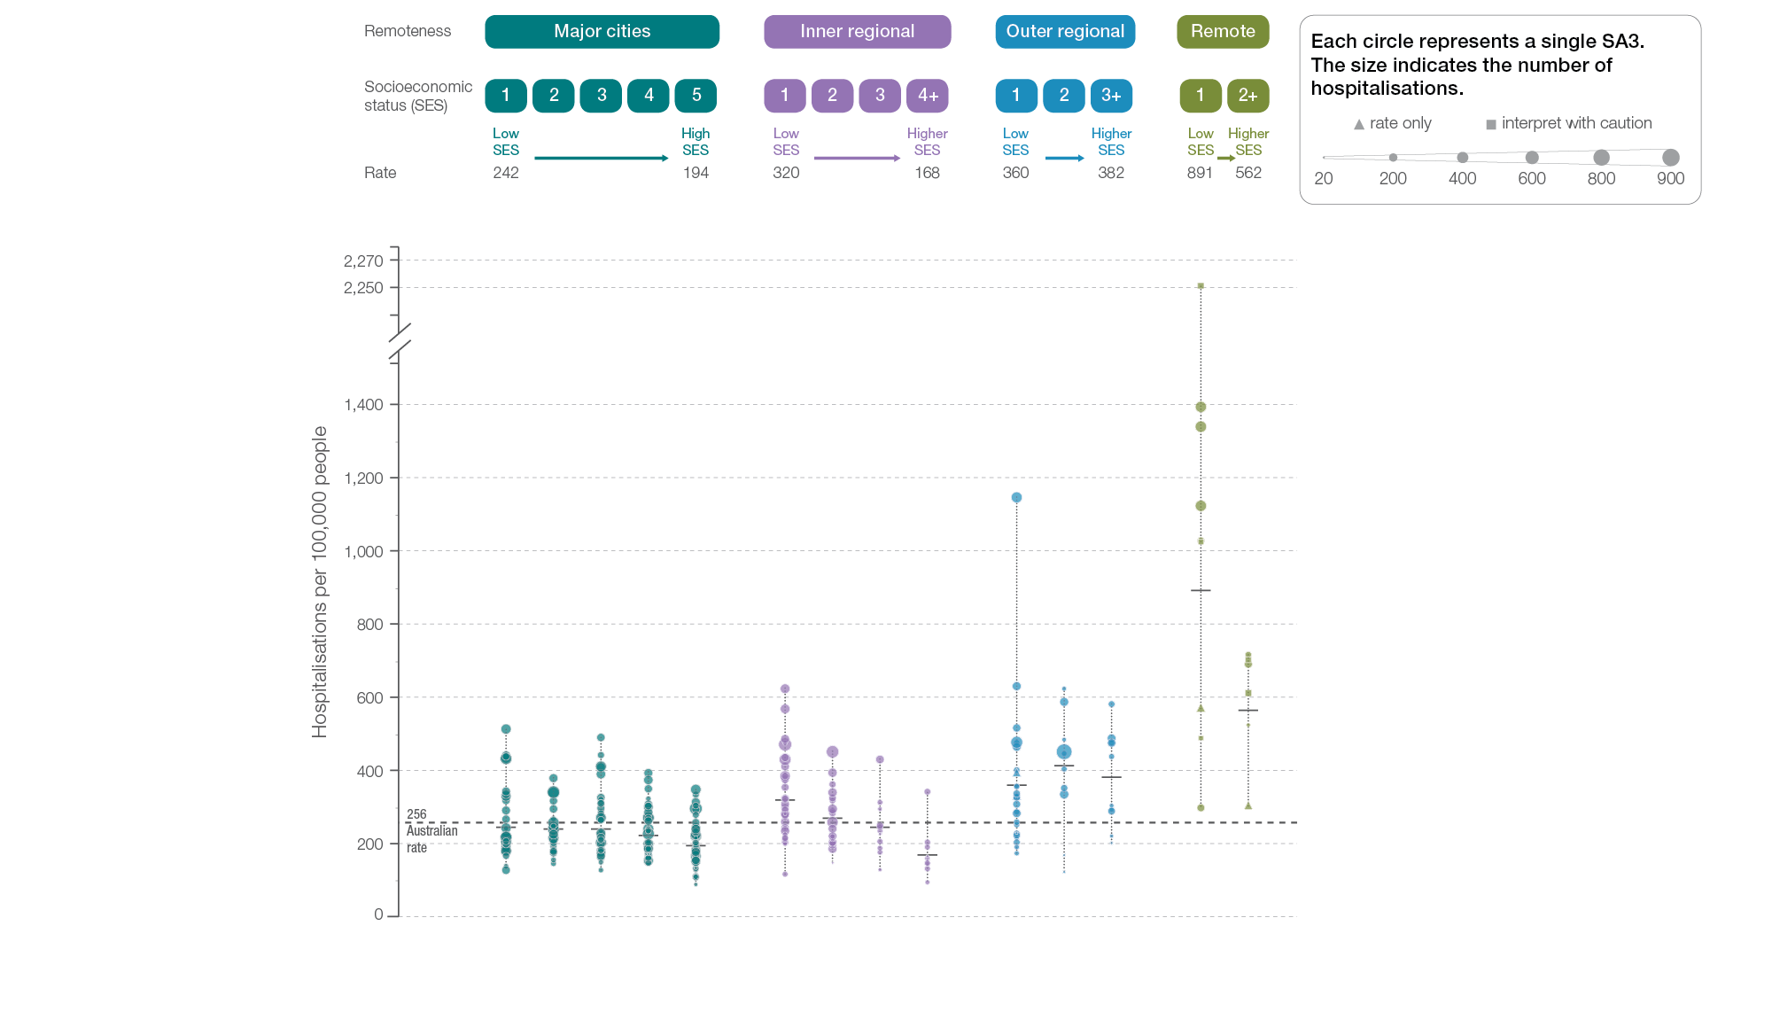
Cellulitis
Remoteness and socioeconomic status, SA3 of patient residence, 2017-18
Sources: AIHW analysis of National Hospital Morbidity Database and ABS Estimated Resident Populations 30 June of 2017 and 2018.
Chronic disease and infection: potentially preventable hospitalisations

Slide 46
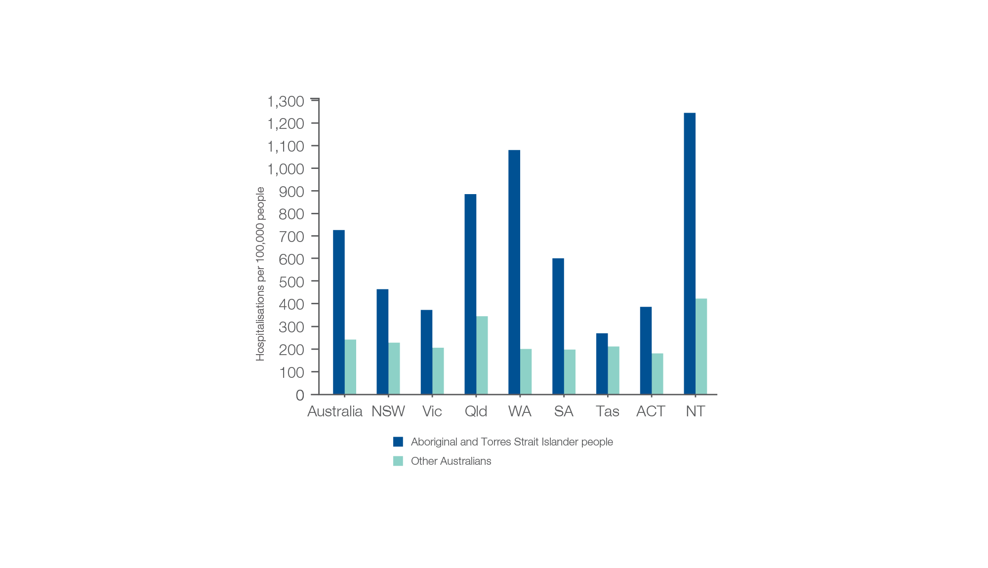
Cellulitis
Aboriginal and Torres Strait Islander status, 2017-18
Sources: AIHW analysis of National Hospital Morbidity Database and ABS Estimated Resident Populations 30 June of 2017 and 2018.
Chronic disease and infection: potentially preventable hospitalisations

Slide 47
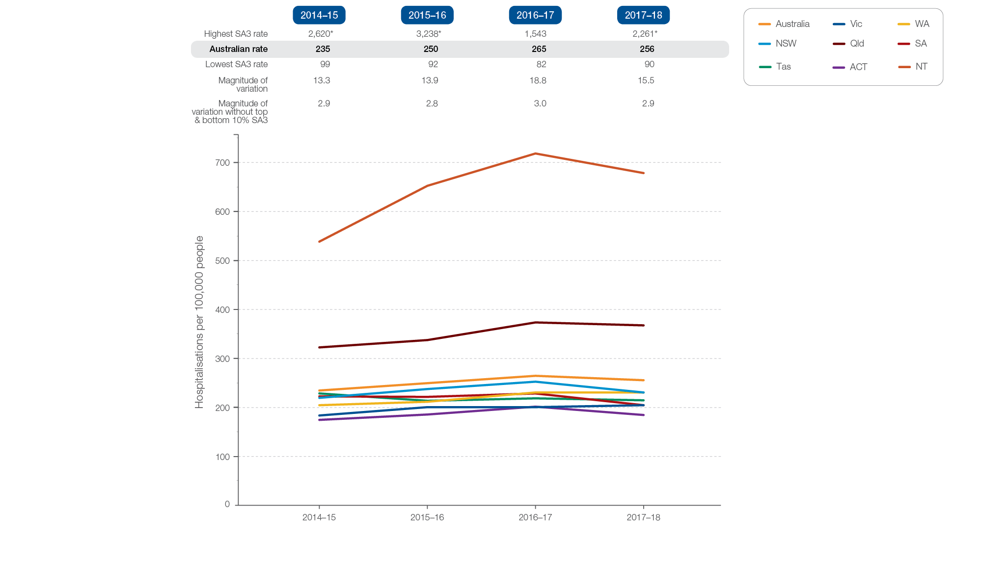
Cellulitis
Rates across years, 2014-15 to 2017-18
Sources: AIHW analysis of National Hospital Morbidity Database and ABS Estimated Resident Populations 30 June of 2014 to 2018.
Chronic disease and infection: potentially preventable hospitalisations

Slide 48
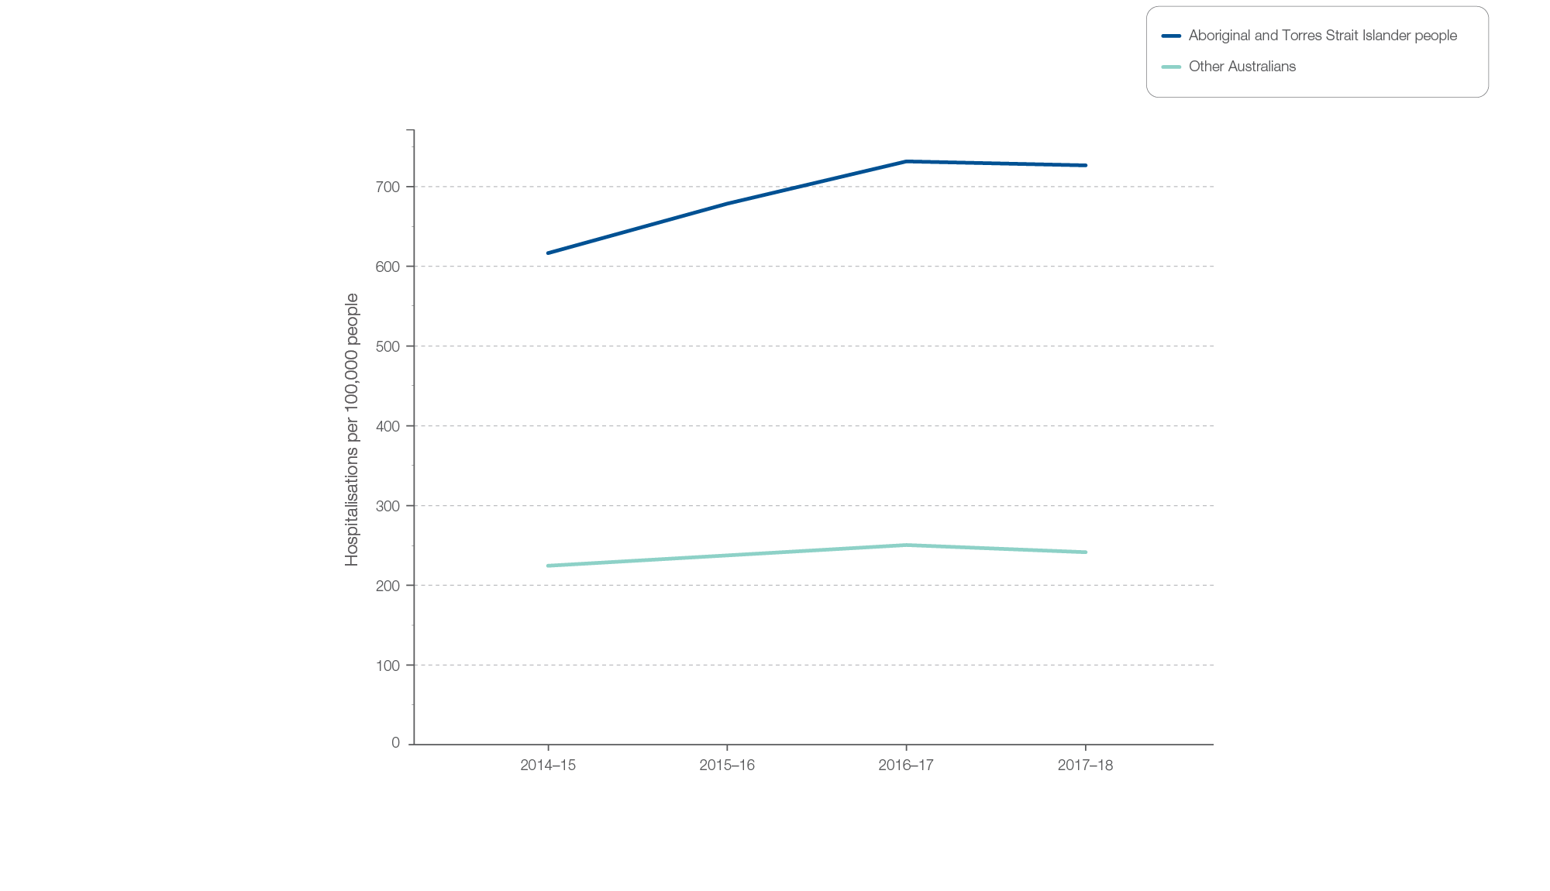
Cellulitis
Aboriginal and Torres Strait Islander status, 2014-15 to 2017-18
Sources: AIHW analysis of National Hospital Morbidity Database and ABS Estimated Resident Populations 30 June of 2014 to 2018.
Chronic disease and infection: potentially preventable hospitalisations

