Slide 1
Lumbar spinal surgery
Lumbar spinal surgery

Slide 2
Lumbar spinal surgery
Key findings, 2015-18
Data item | Range across local areas* per 100,000 | Times difference | Times difference excluding top and bottom 10% | Number during 2015–18
Lumbar spinal fusion, 18 years and over | 7 – 87 | 12.4 | 2.7 | 14,608
Lumbar spinal decompression excluding fusion, 18 years and over | 27 – 209 | 7.7 | 2.1 | 43,185
* Statistical Area Level 3
Sources: AIHW analysis of National Hospital Morbidity Database and ABS Estimated Resident Populations 30 June of 2015 to 2018
Lumbar spinal surgery

Slide 3
Lumbar spinal surgery
Key findings, 2012-15 to 2015-18
Data item | 2012-15* | 2015-18* | Per cent change
Lumbar spinal fusion, 18 years and over | 25 | 24 | - 4%
Lumbar spinal decompression excluding fusion, 18 years and over | 79 | 74 | - 6%
* Australian age and sex standardised rate given as hospitalisations per 100,000 people
Sources: AIHW analysis of National Hospital Morbidity Database and ABS Estimated Resident Populations 30 June of 2015 to 2018
Lumbar spinal surgery

Slide 4
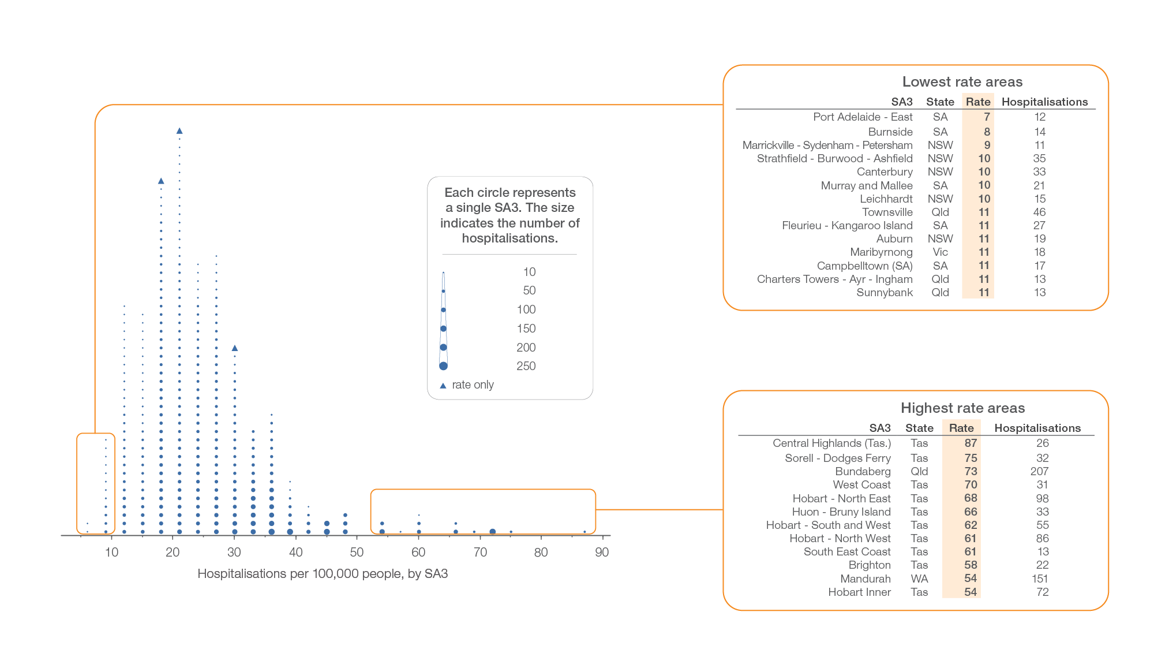
Lumbar spinal fusion, 18 years and over
Local area, SA3 of patient residence, 2015-16 to 2017-18
Sources: AIHW analysis of National Hospital Morbidity Database and ABS Estimated Resident Populations 30 June of 2015 to 2018.
Lumbar spinal surgery

Slide 5
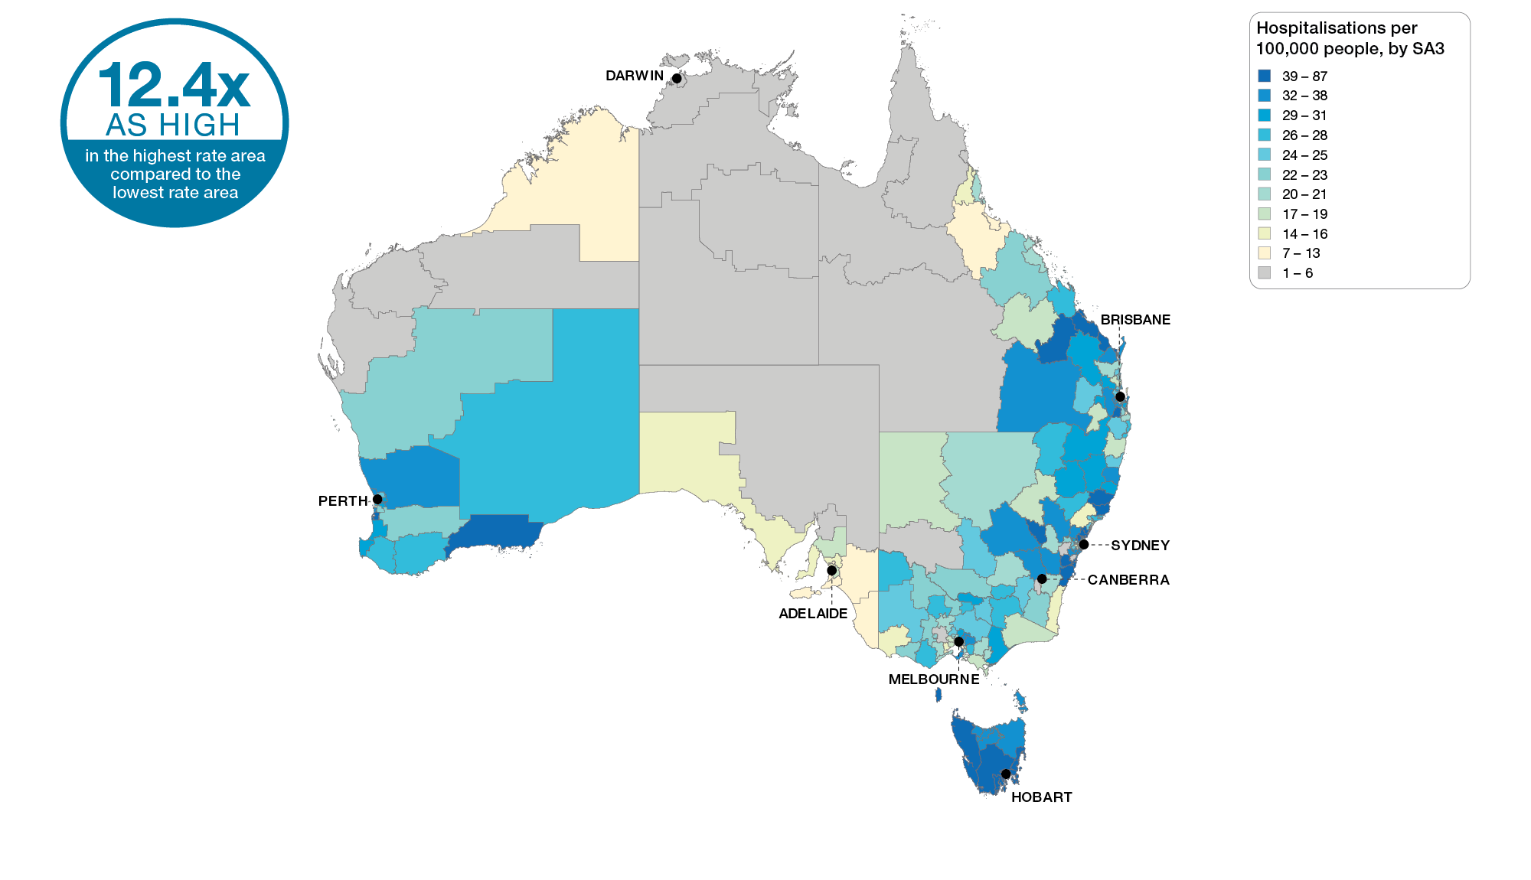
Lumbar spinal fusion, 18 years and over
Australia, SA3 of patient residence, 2015-16 to 2017-18
Sources: AIHW analysis of National Hospital Morbidity Database and ABS Estimated Resident Populations 30 June of 2015 to 2018
Lumbar spinal surgery

Slide 6
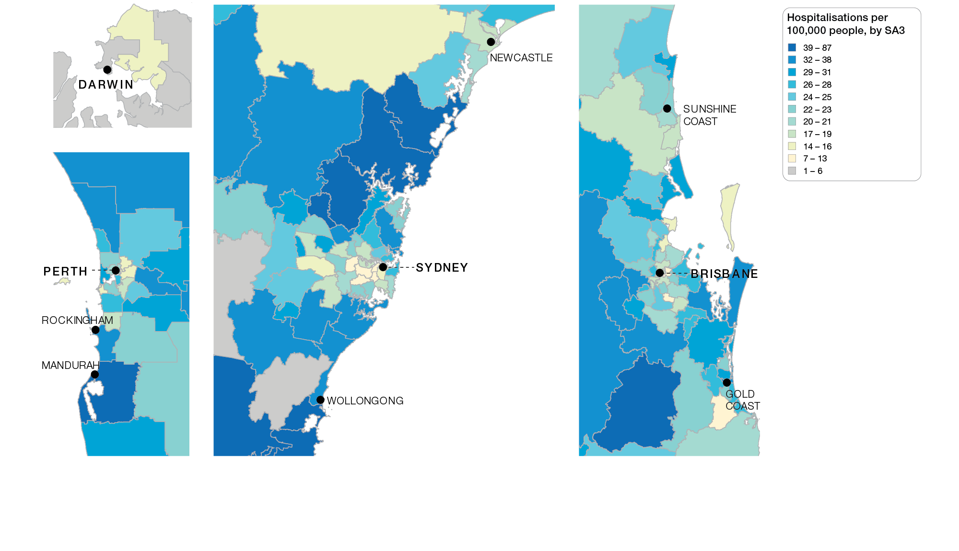
Lumbar spinal fusion, 18 years and over
Capital cities, SA3 of patient residence, 2015-16 to 2017-18
Sources: AIHW analysis of National Hospital Morbidity Database and ABS Estimated Resident Populations 30 June of 2015 to 2018
Lumbar spinal surgery

Slide 7
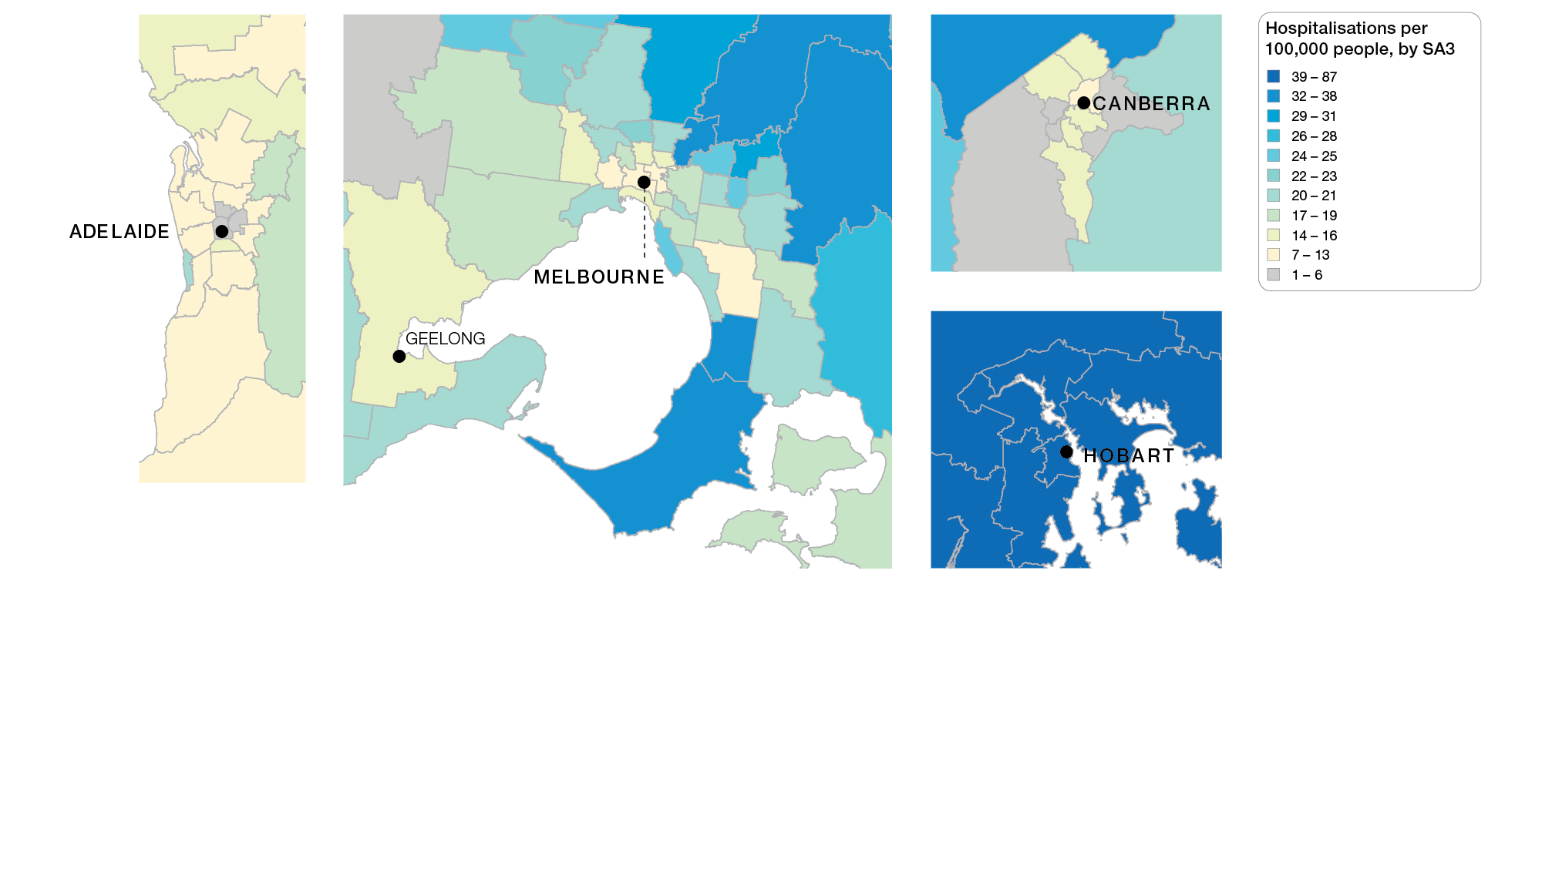
Lumbar spinal fusion, 18 years and over
Capital cities, SA3 of patient residence, 2015-16 to 2017-18
Sources: AIHW analysis of National Hospital Morbidity Database and ABS Estimated Resident Populations 30 June of 2015 to 2018
Lumbar spinal surgery

Slide 8
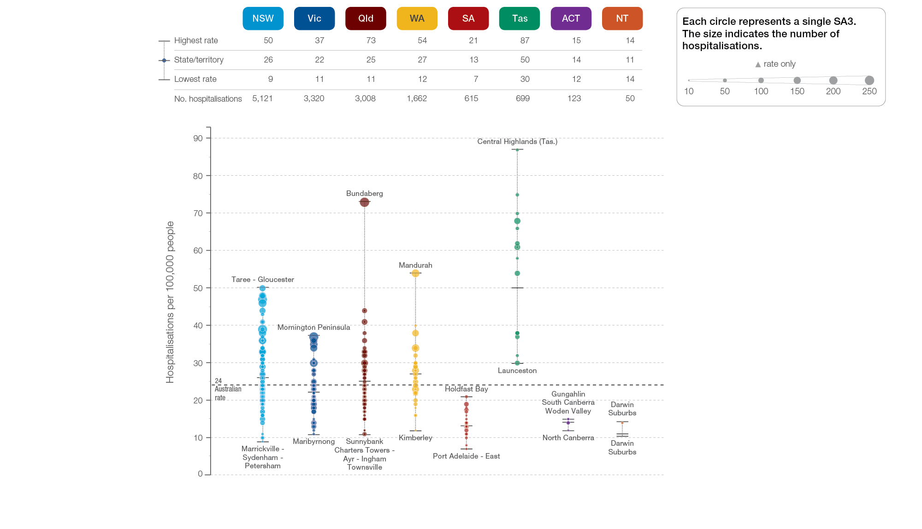
Lumbar spinal fusion, 18 years and over
State and territory, SA3 of patient residence, 2015-16 to 2017-18
Sources: AIHW analysis of National Hospital Morbidity Database and ABS Estimated Resident Populations 30 June of 2015 to 2018
Lumbar spinal surgery

Slide 9
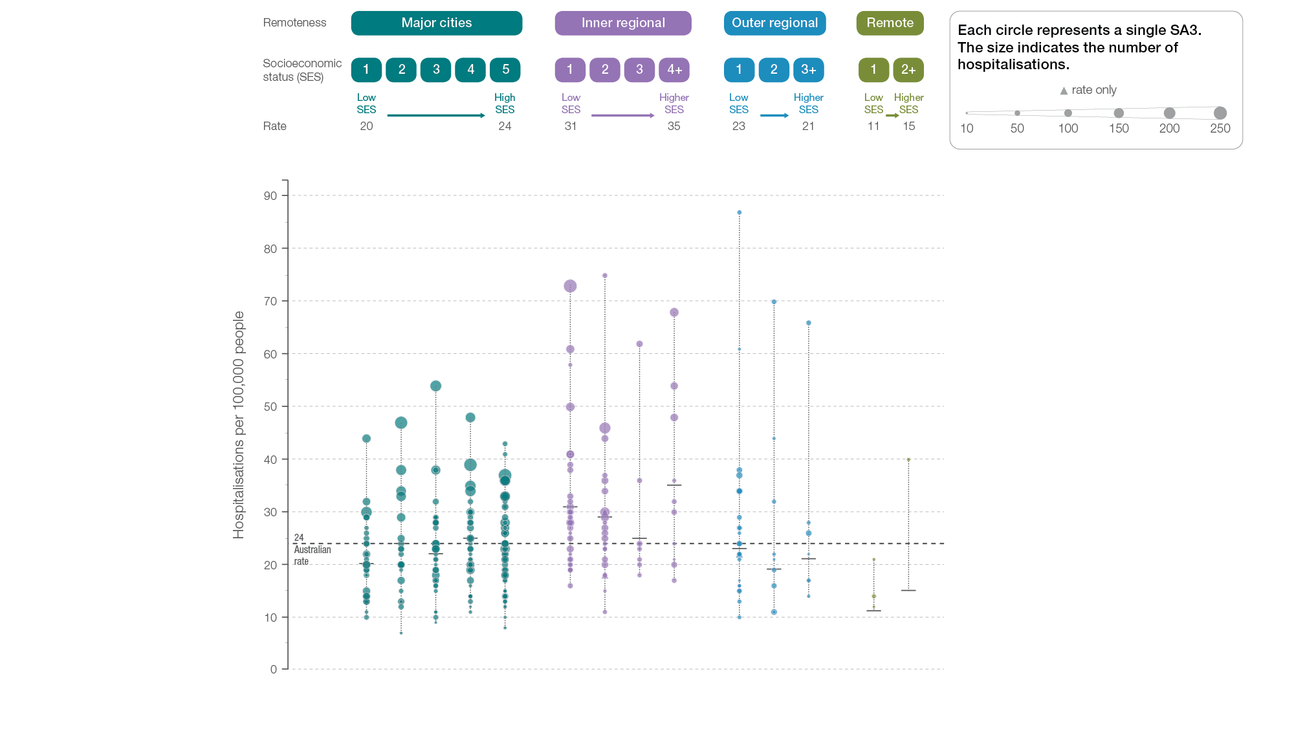
Lumbar spinal fusion, 18 years and over
Remoteness and socioeconomic status, SA3 of patient residence, 2015-16 to 2017-18
Sources: AIHW analysis of National Hospital Morbidity Database and ABS Estimated Resident Populations 30 June of 2015 to 2018.
Lumbar spinal surgery

Slide 10
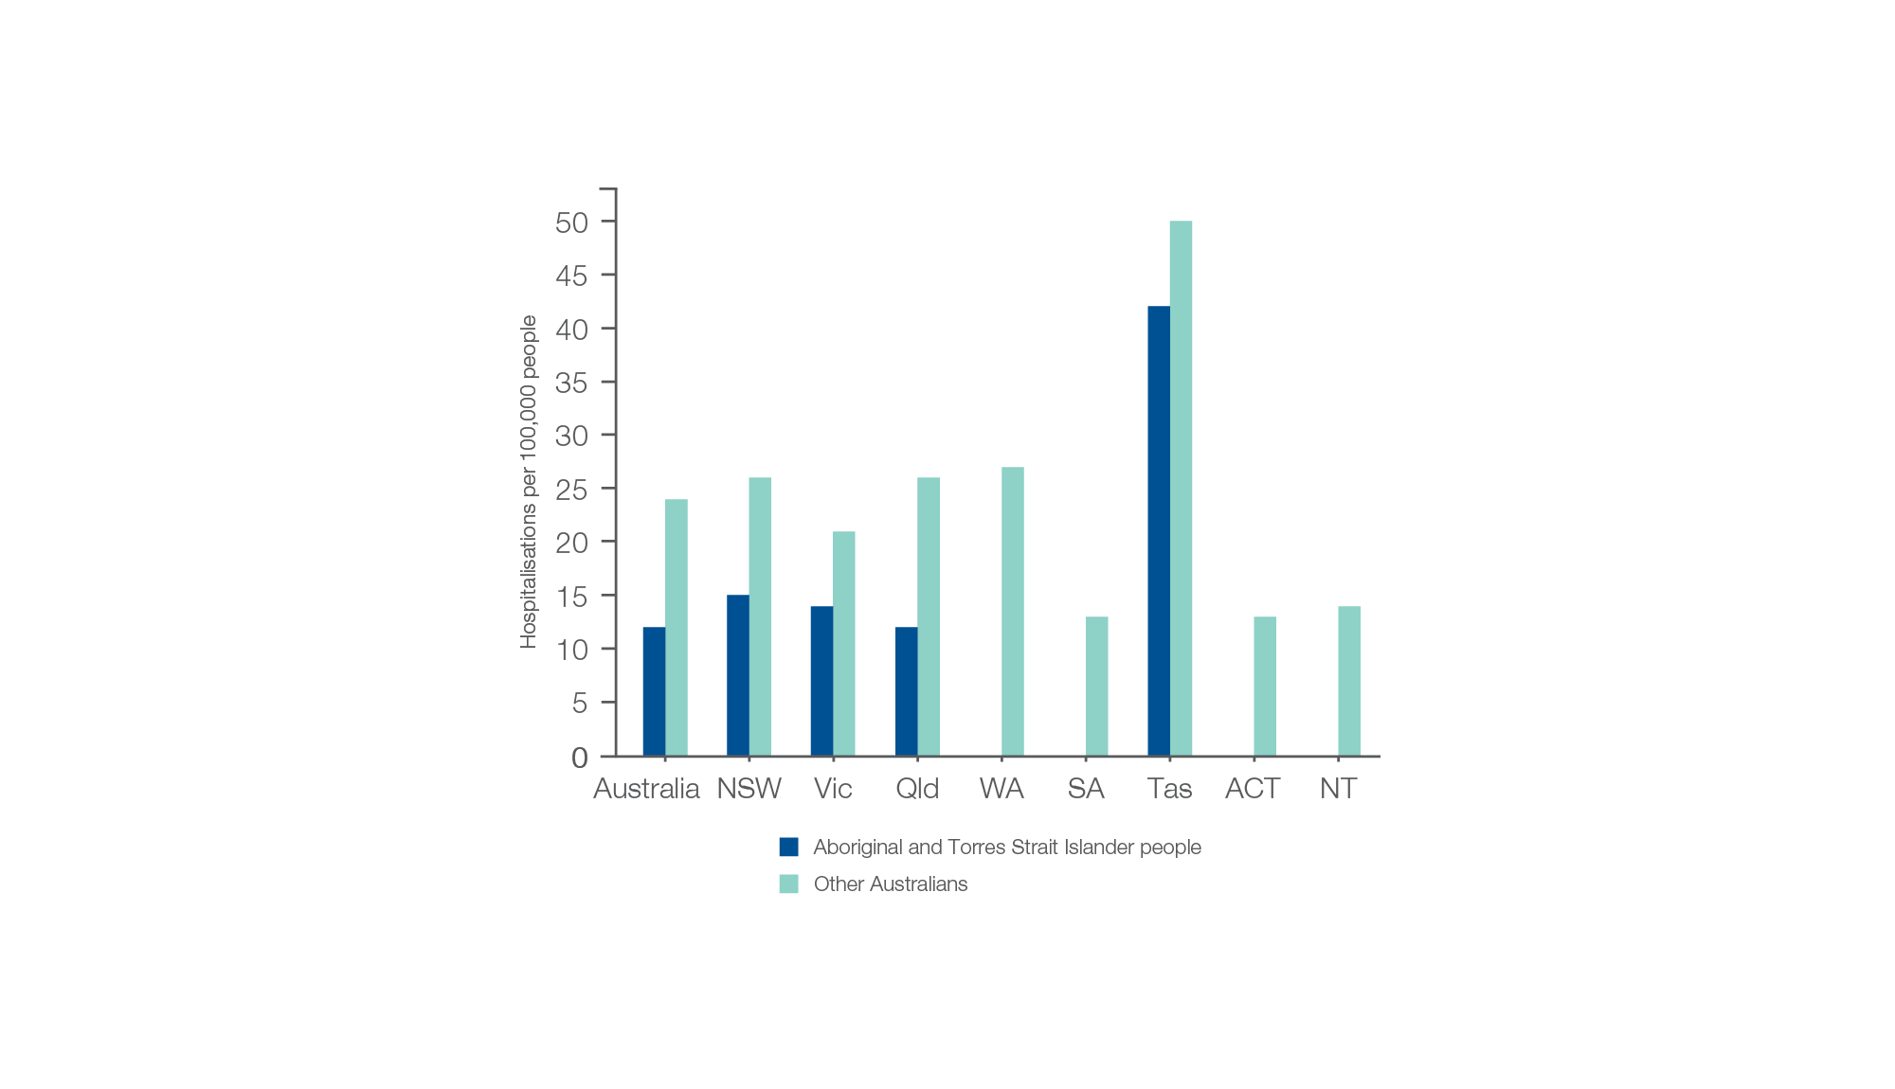
Lumbar spinal fusion, 18 years and over
Aboriginal and Torres Strait Island status, 2015-16 to 2017-18
Sources: AIHW analysis of National Hospital Morbidity Database and ABS Estimated Resident Populations 30 June of 2015 to 2018
Lumbar spinal surgery

Slide 11
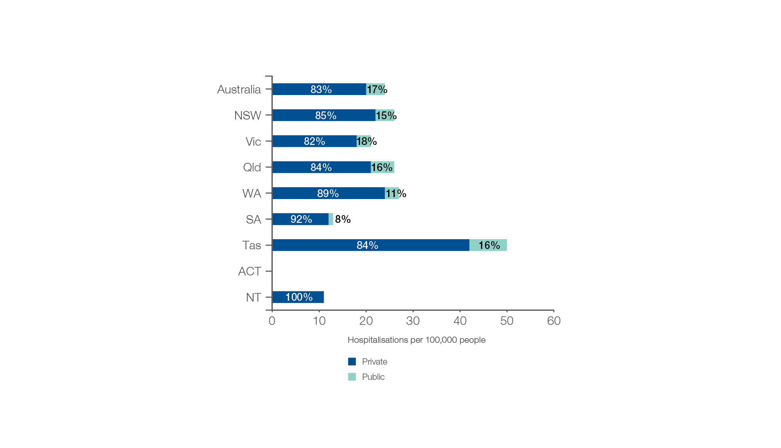
Lumbar spinal fusion, 18 years and over
Patient funding status, 2015-16 to 2017-18
Sources: AIHW analysis of National Hospital Morbidity Database and ABS Estimated Resident Populations 30 June of 2015 to 2018
Lumbar spinal surgery

Slide 12
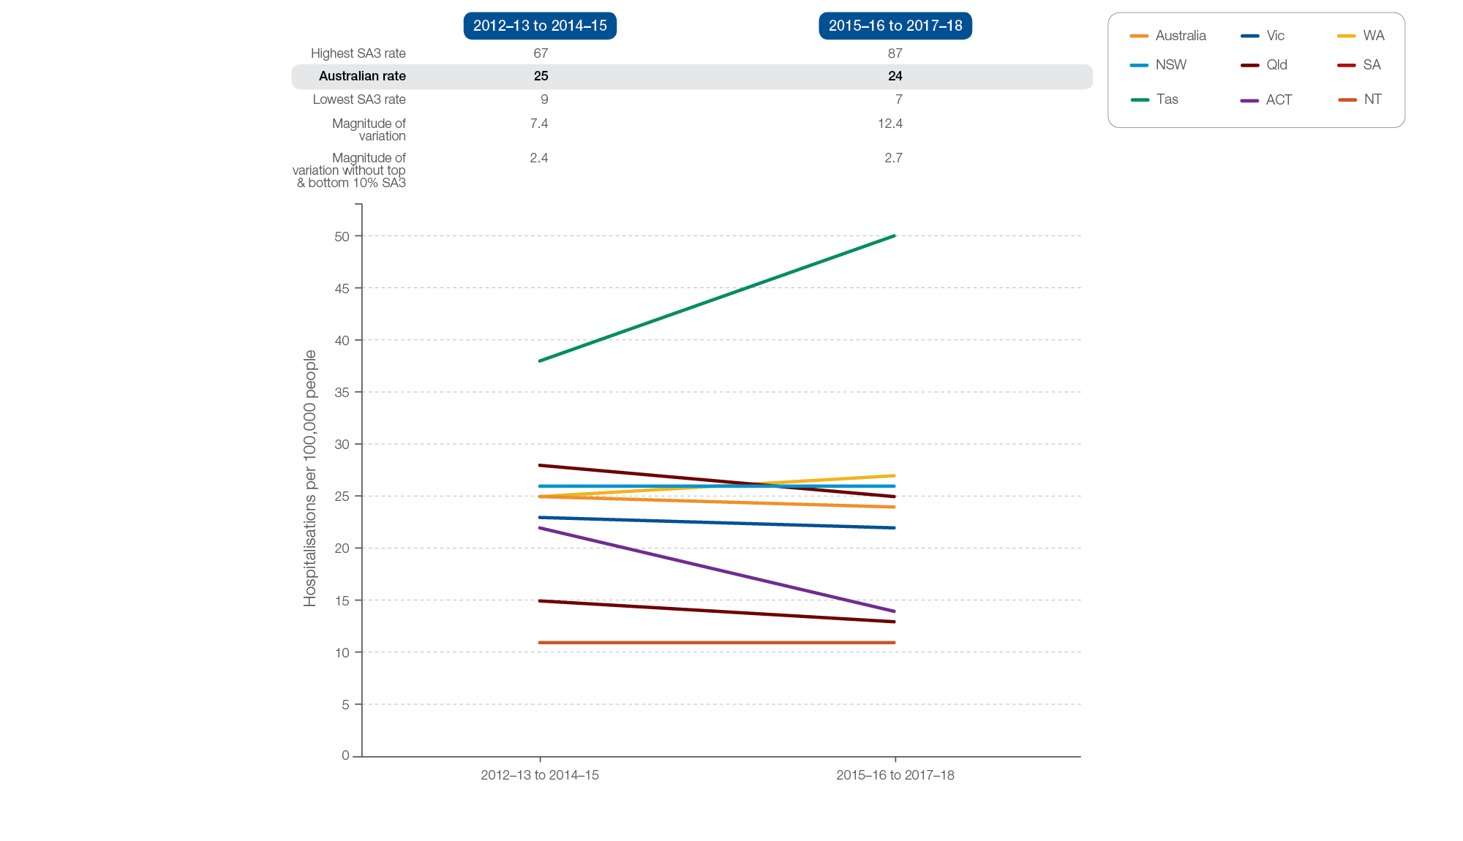
Lumbar spinal fusion, 18 years and over
Rates across years, 2012–13 to 2014–15 and 2015–16 to 2017–18
Sources: AIHW analysis of National Hospital Morbidity Database and ABS Estimated Resident Populations 30 June of 2012 to 2015 and 2015 to 2018.
Lumbar spinal surgery

Slide 13
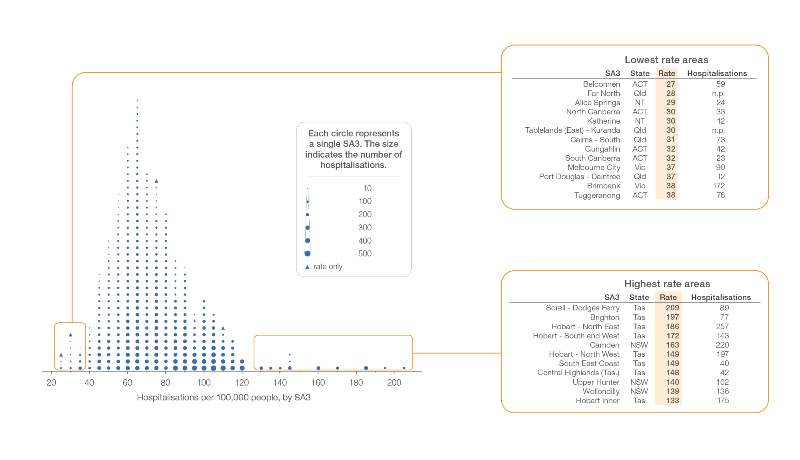
Lumbar spinal decompression excluding fusion, 18 years and over
Local area, SA3 of patient residence, 2015-16 to 2017-18
Sources: AIHW analysis of National Hospital Morbidity Database and ABS Estimated Resident Populations 30 June of 2015 to 2018
Lumbar spinal surgery

Slide 14
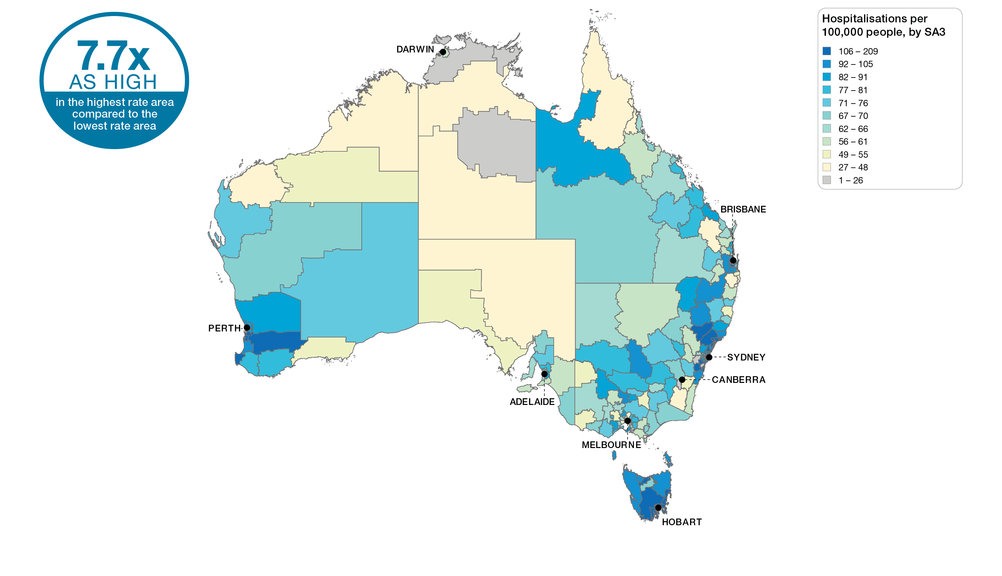
Lumbar spinal decompression excluding fusion, 18 years and over
Australia, SA3 of patient residence, 2015-16 to 2017-18
Sources: AIHW analysis of National Hospital Morbidity Database and ABS Estimated Resident Populations 30 June of 2015 to 2018
Lumbar spinal surgery

Slide 15
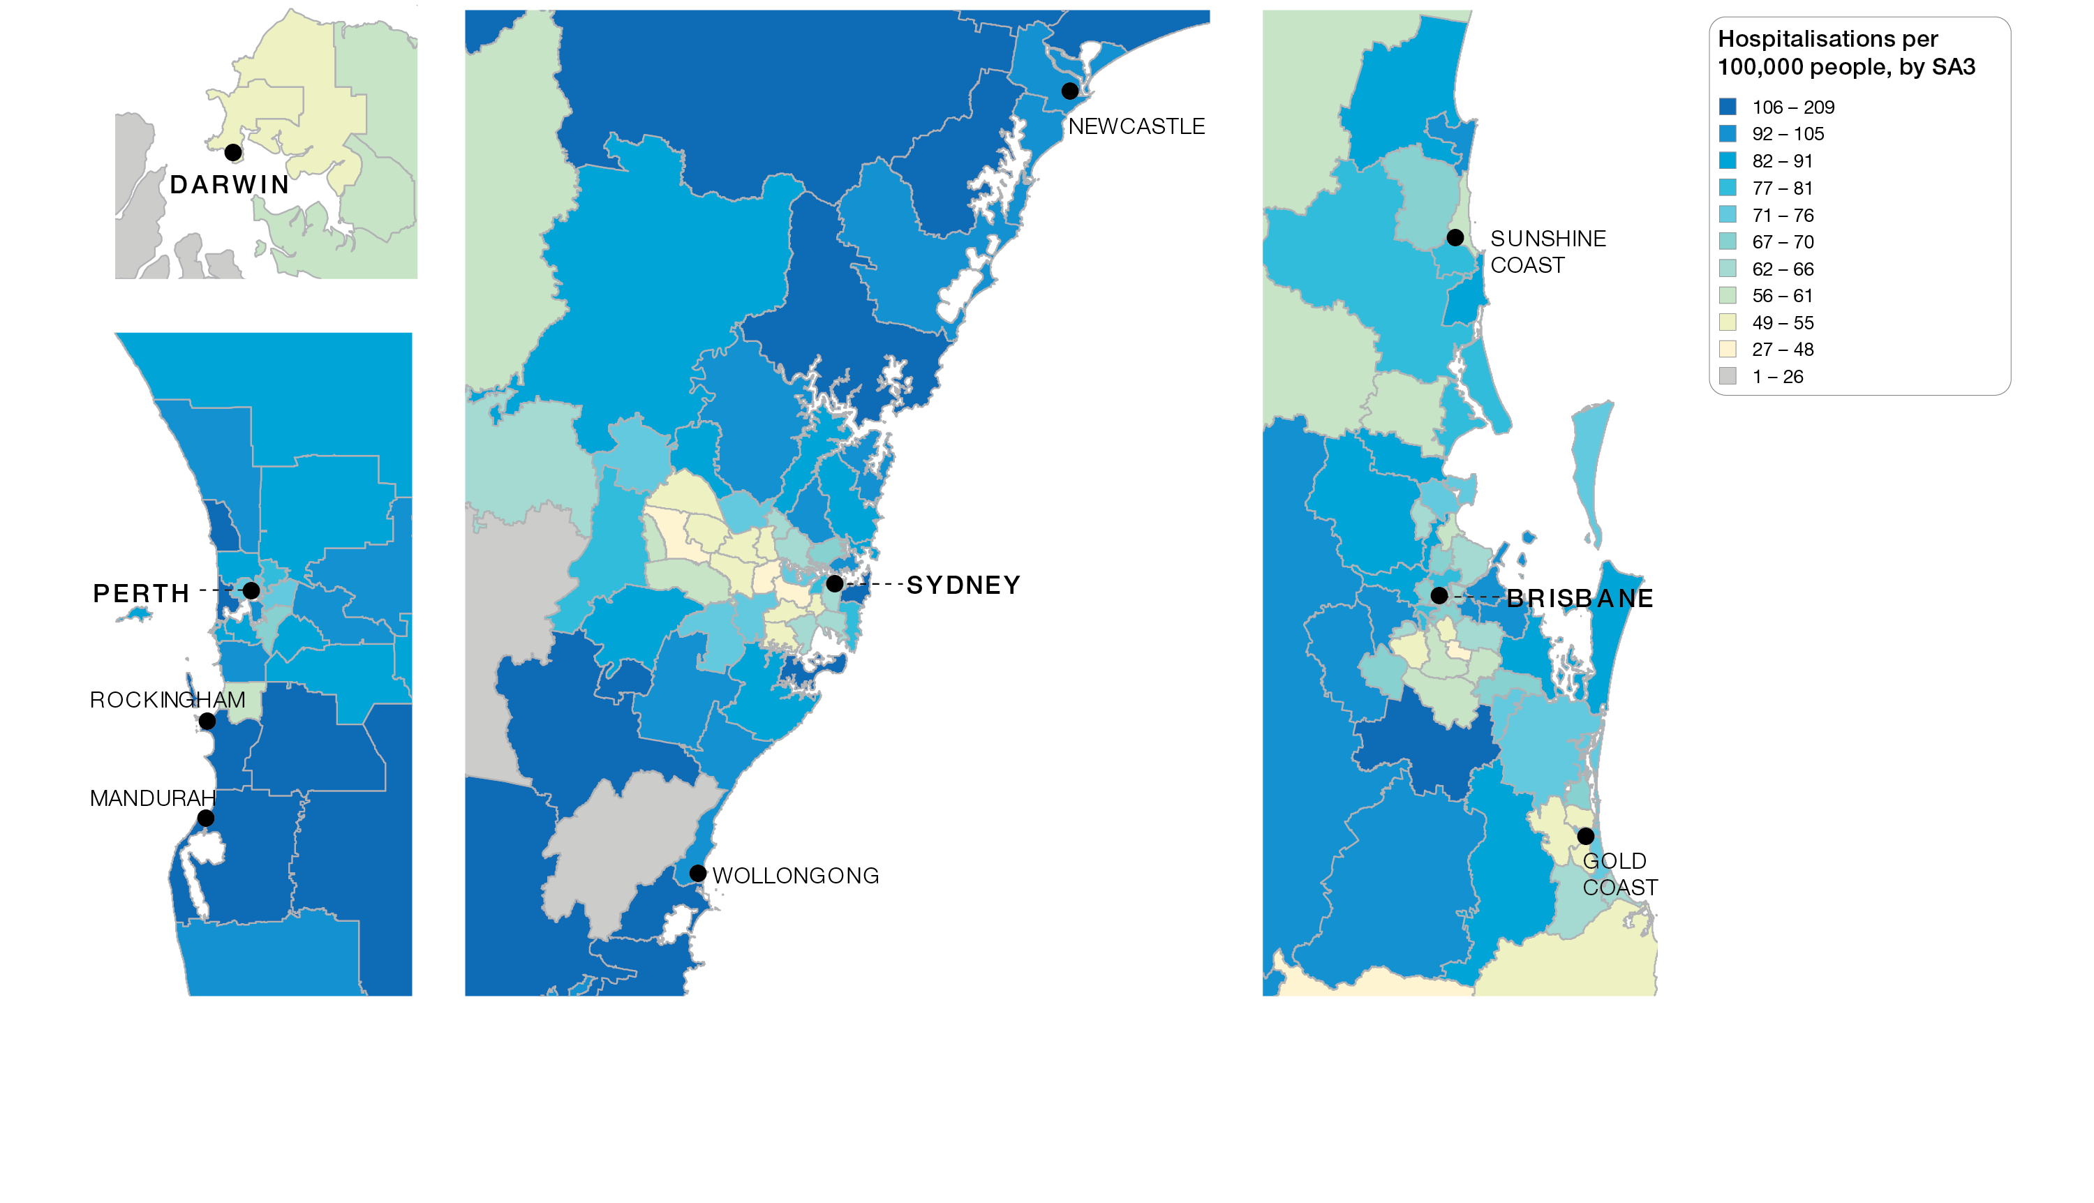
Lumbar spinal decompression excluding fusion, 18 years and over
Capital cities, SA3 of patient residence, 2015-16 to 2017-18
Sources: AIHW analysis of National Hospital Morbidity Database and ABS Estimated Resident Populations 30 June of 2015 to 2018
Lumbar spinal surgery

Slide 16
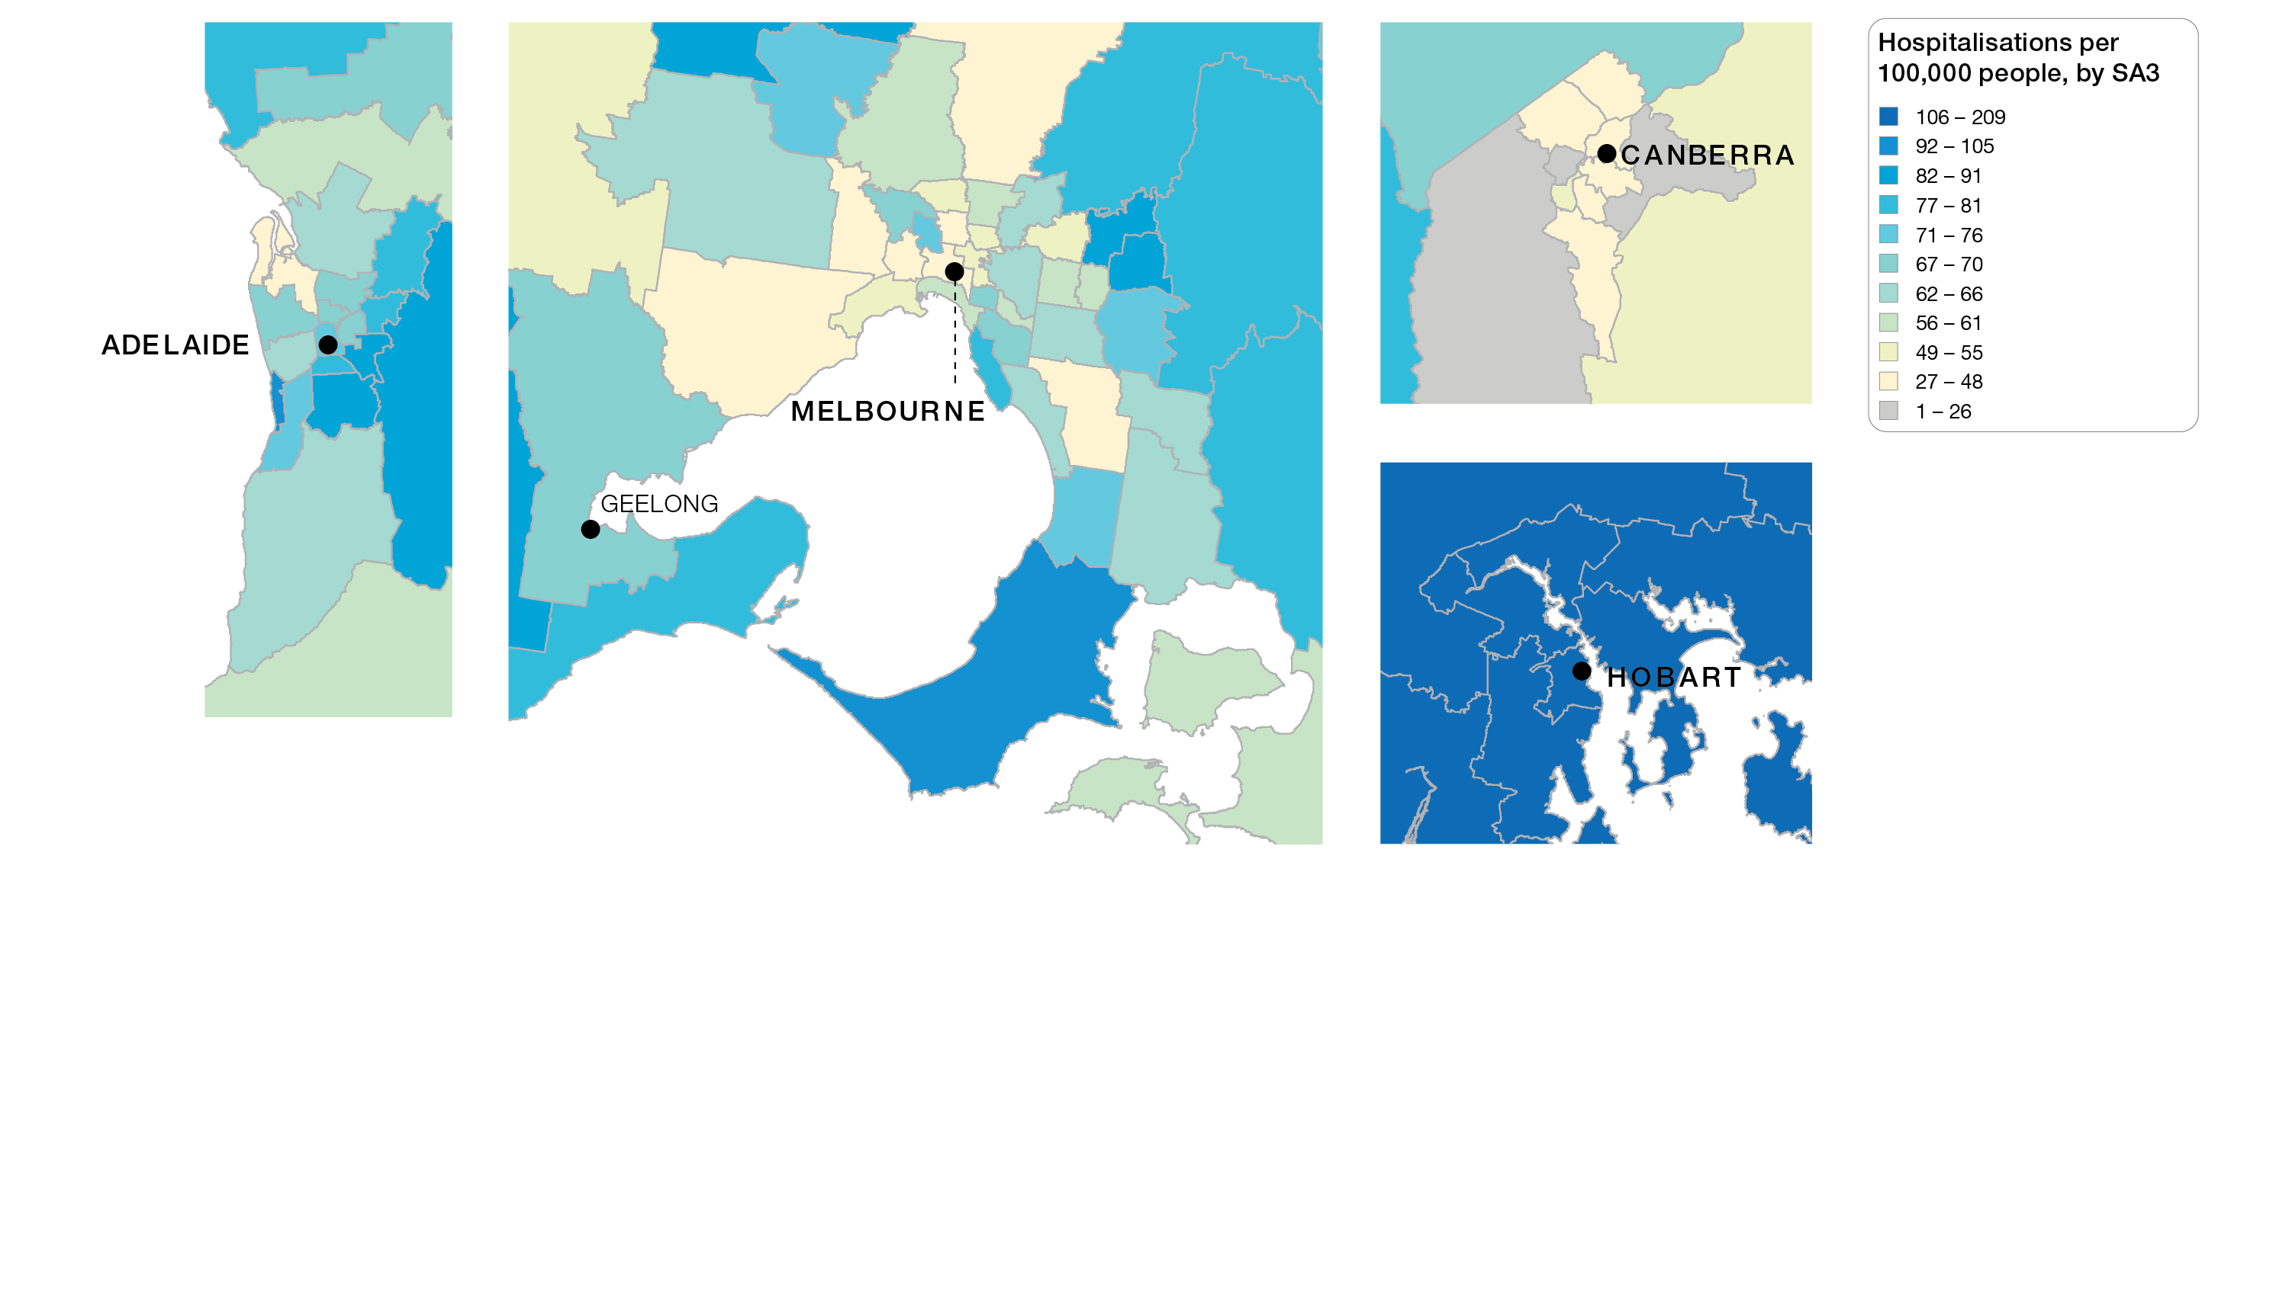
Lumbar spinal decompression excluding fusion, 18 years and over
Capital cities, SA3 of patient residence, 2015-16 to 2017-18
Sources: AIHW analysis of National Hospital Morbidity Database and ABS Estimated Resident Populations 30 June of 2015 to 2018
Lumbar spinal surgery

Slide 17
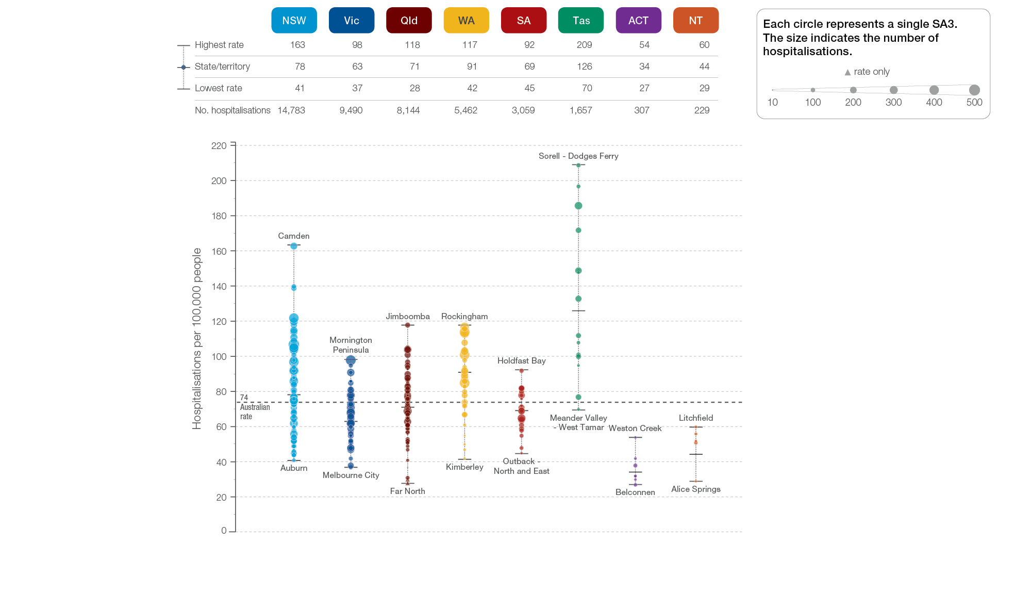
Lumbar spinal decompression excluding fusion, 18 years and over
State and territory, SA3 of patient residence, 2015-16 to 2017-18
Sources: AIHW analysis of National Hospital Morbidity Database and ABS Estimated Resident Populations 30 June of 2015 to 2018
Lumbar spinal surgery

Slide 18
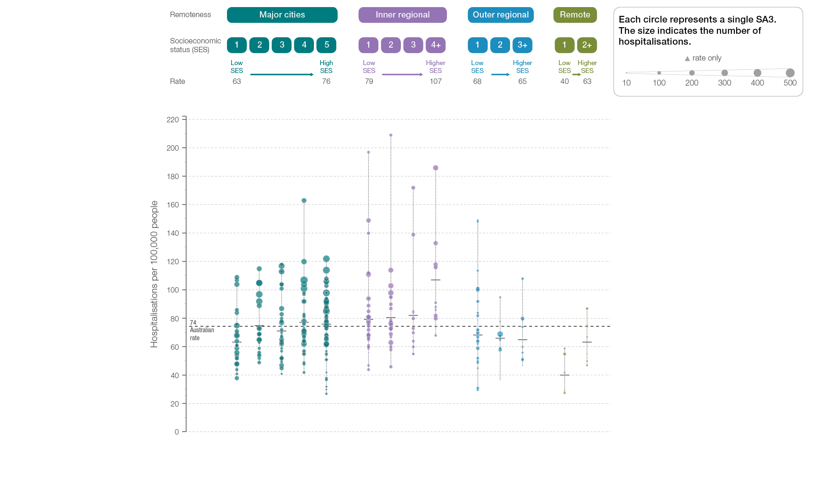
Lumbar spinal decompression excluding fusion, 18 years and over
Remoteness and socioeconomic status, SA3 of patient residence, 2015-16 to 2017-18
Sources: AIHW analysis of National Hospital Morbidity Database and ABS Estimated Resident Populations 30 June of 2015 to 2018
Lumbar spinal surgery

Slide 19
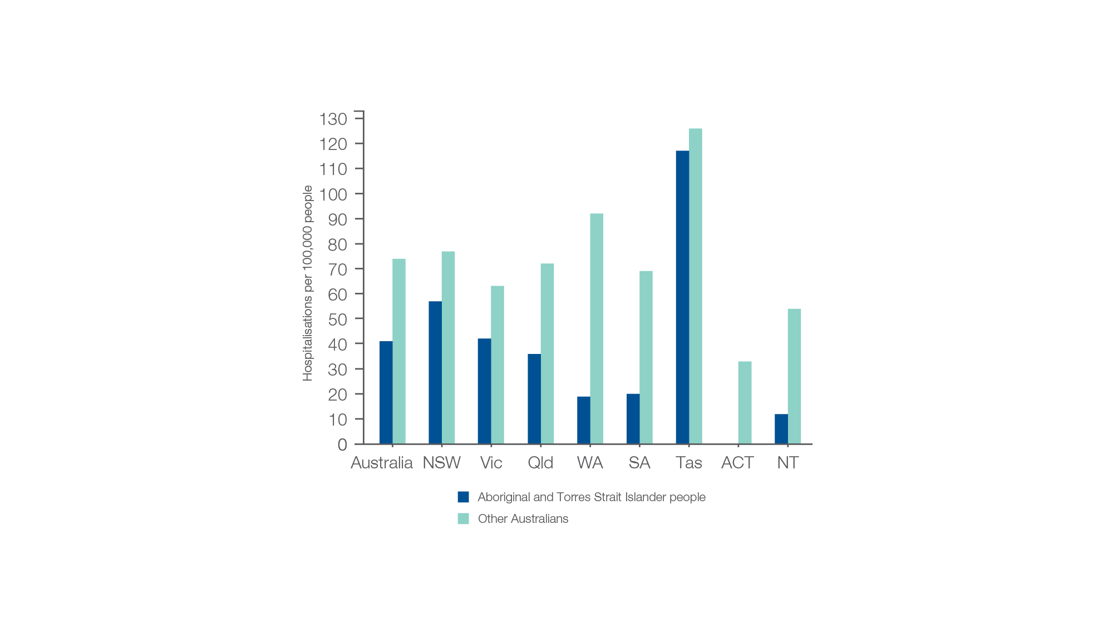
Lumbar spinal decompression excluding fusion, 18 years and over
Aboriginal and Torres Strait Island status, 2015-16 to 2017-18
Sources: AIHW analysis of National Hospital Morbidity Database and ABS Estimated Resident Populations 30 June of 2015 to 2018.
Lumbar spinal surgery

Slide 20
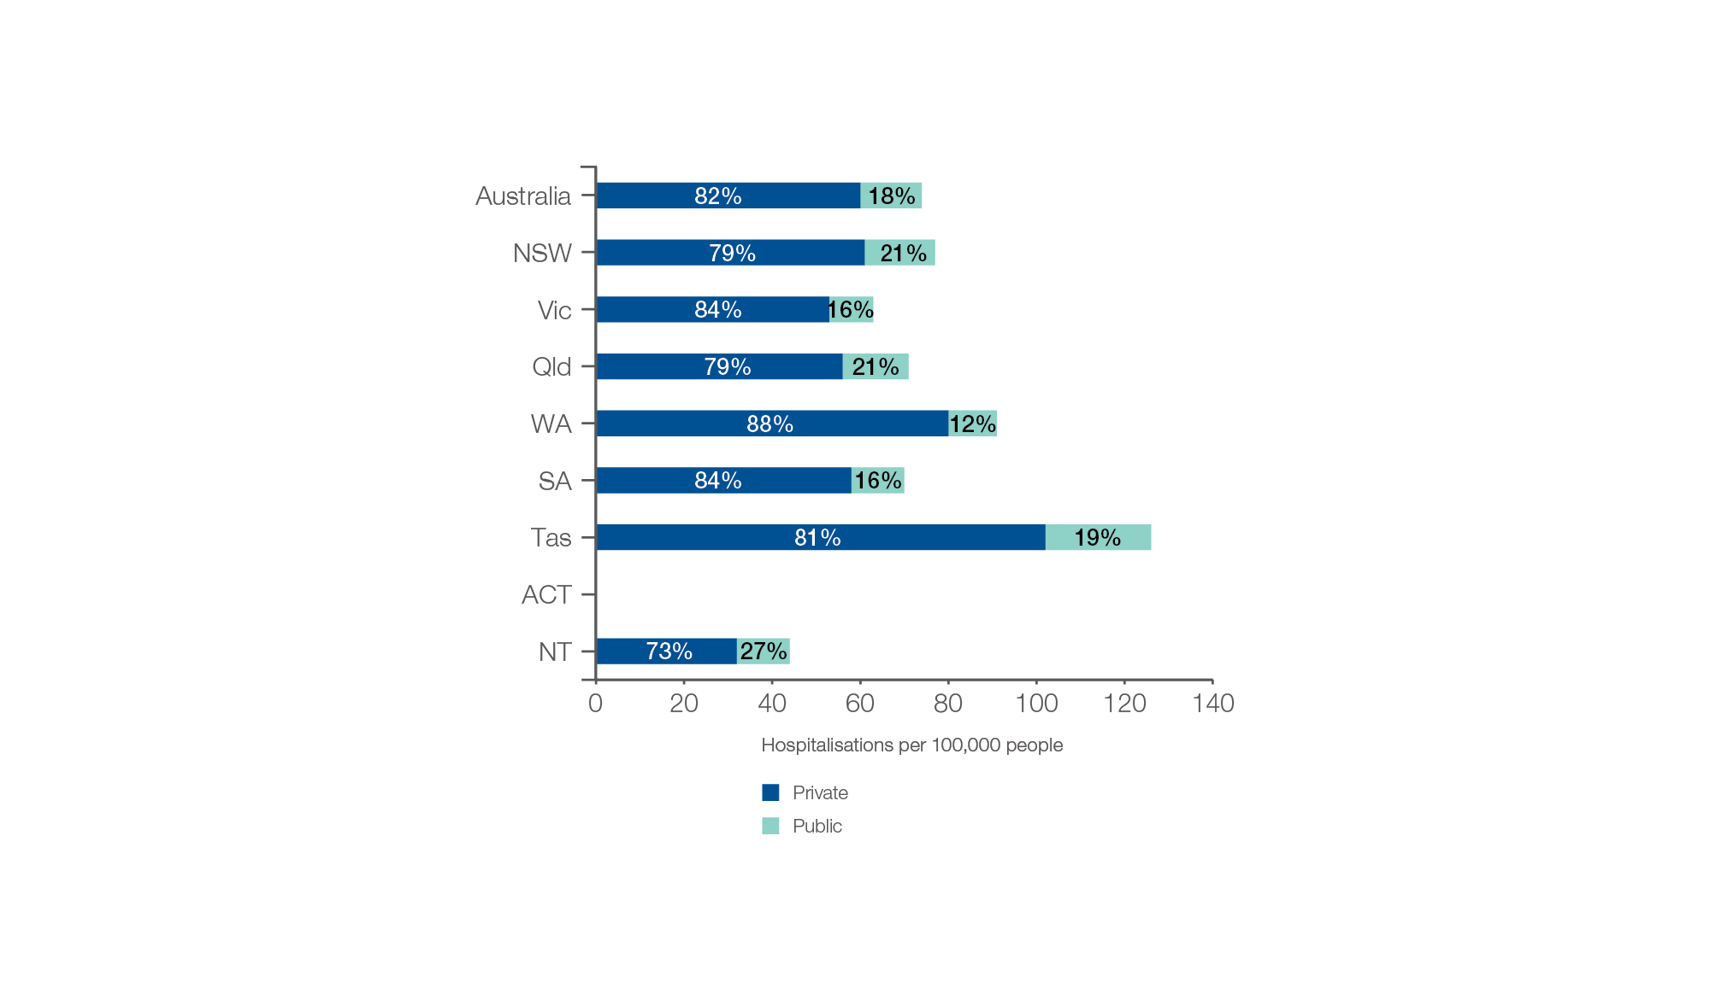
Lumbar spinal decompression excluding fusion, 18 years and over
Patient funding status, 2015-16 to 2017-18
Sources: AIHW analysis of National Hospital Morbidity Database and ABS Estimated Resident Populations 30 June of 2015 to 2018.
Lumbar spinal surgery

Slide 21
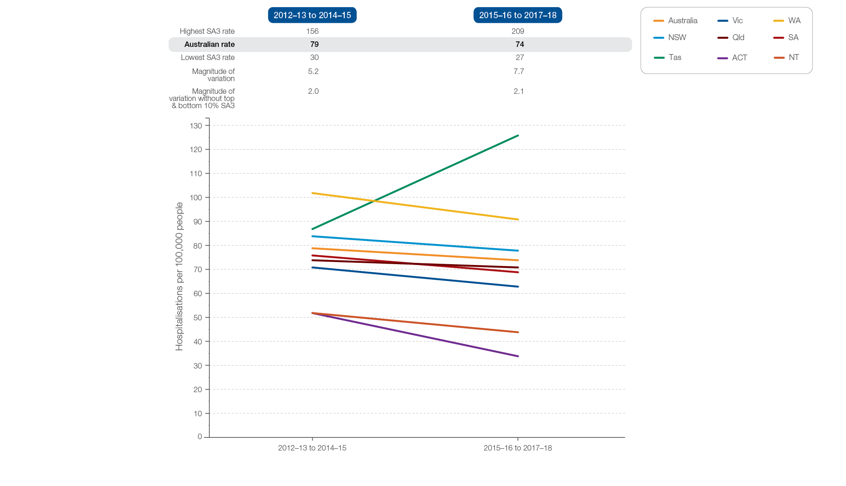
Lumbar spinal decompression excluding fusion, 18 years and over
Rates across years, 2012–13 to 2014–15 and 2015–16 to 2017–18
Sources: AIHW analysis of National Hospital Morbidity Database and ABS Estimated Resident Populations 30 June of 2012 to 2015 and 2015 to 2018.
Lumbar spinal surgery

