Slide 1

Gastrointestinal investigations
Gastrointestinal investigations

Slide 2
Gastrointestinal investigations
Key findings
Data item | Range across local areas* per 100,000 | Times difference | Times difference excluding top and bottom 10% | Number during 2018–19
Gastroscopy MBS services, 18–54 years | 218 – 2,348 | 10.8 | 2.9 | 154,338
Repeat colonoscopy MBS services, all ages | 62 – 1,236 | 19.9 | 2.7 | 147,875
Repeat gastroscopy MBS services, all ages | 61 – 908 | 14.9 | 3.1 | 87,933
* Statistical Area Level 3
Sources: AIHW analysis of Medicare Benefits Schedule data and ABS Estimated Resident Population 30 June 2018.
Gastrointestinal investigations

Slide 3
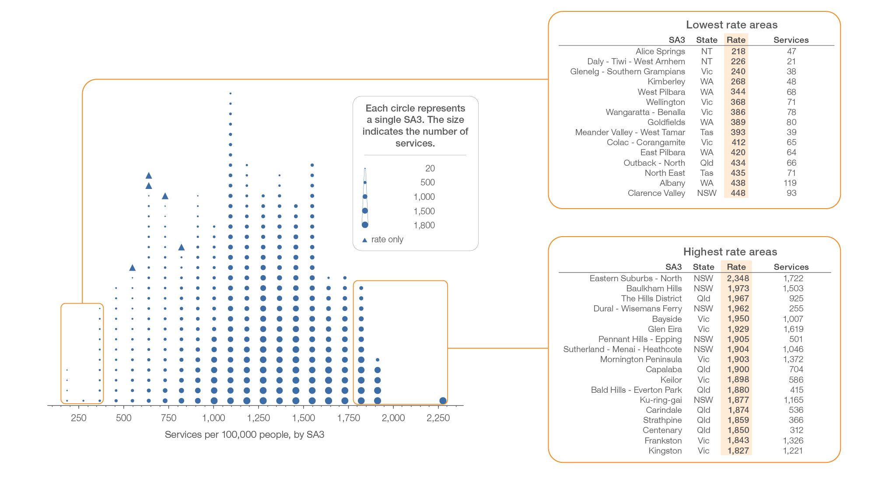
Gastroscopy MBS services, 18–54 years
Local area, SA3 of patient residence, 2018-19
Sources: AIHW analysis of Medicare Benefits Schedule data and ABS Estimated Resident Population 30 June 2018.
Gastrointestinal investigations

Slide 4
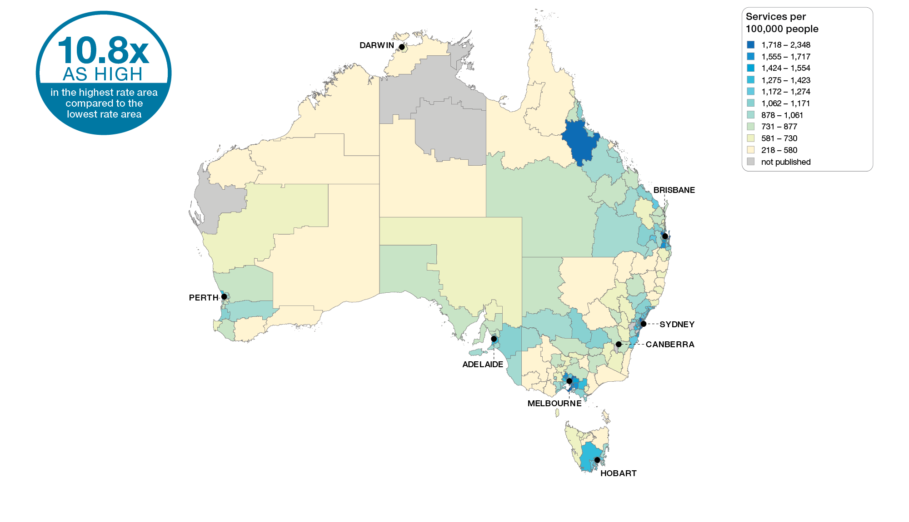
Gastroscopy MBS services, 18–54 years
Australia, SA3 of patient residence, 2018-19
Sources: AIHW analysis of Medicare Benefits Schedule data and ABS Estimated Resident Population 30 June 2018.
Gastrointestinal investigations

Slide 5
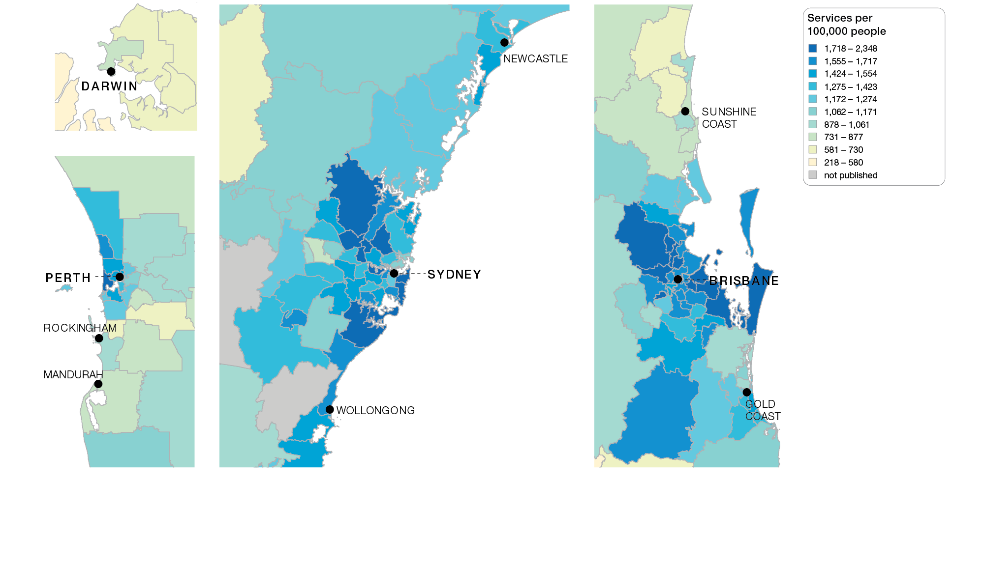
Gastroscopy MBS services, 18–54 years
Capital cities, SA3 of patient residence, 2018-19
Sources: AIHW analysis of Medicare Benefits Schedule data and ABS Estimated Resident Population 30 June 2018.
Gastrointestinal investigations

Slide 6
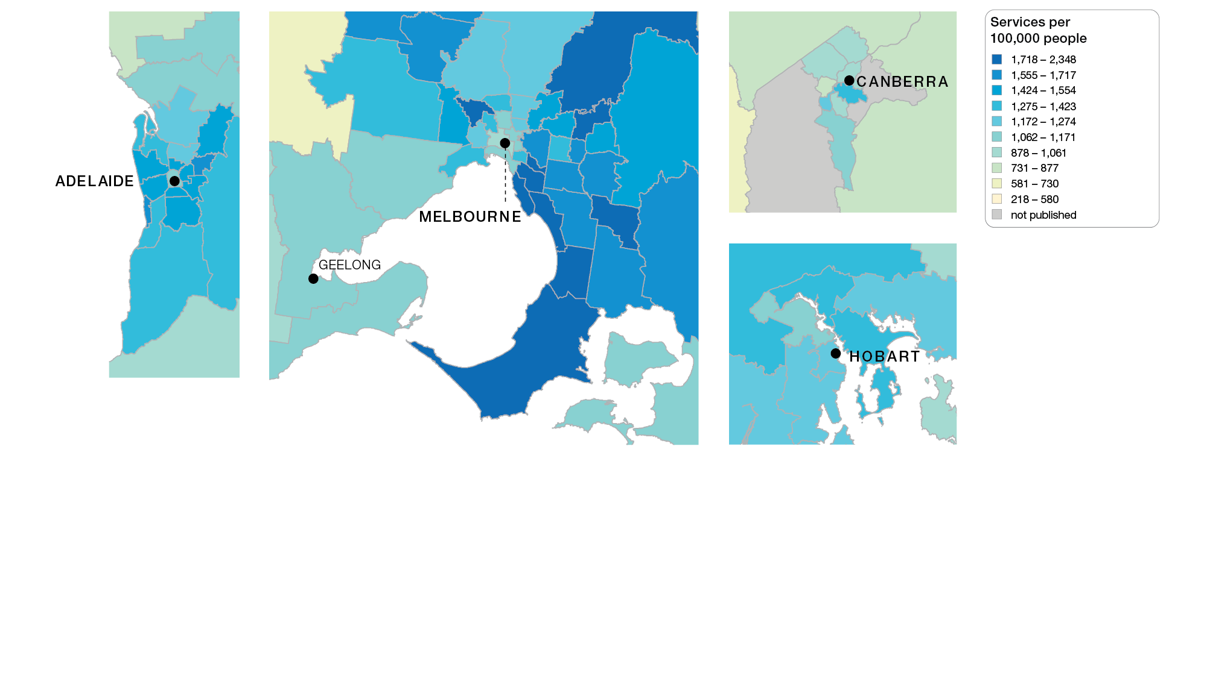
Gastroscopy MBS services, 18–54 years
Capital cities, SA3 of patient residence, 2018-19
Sources: AIHW analysis of Medicare Benefits Schedule data and ABS Estimated Resident Population 30 June 2018.
Gastrointestinal investigations

Slide 7
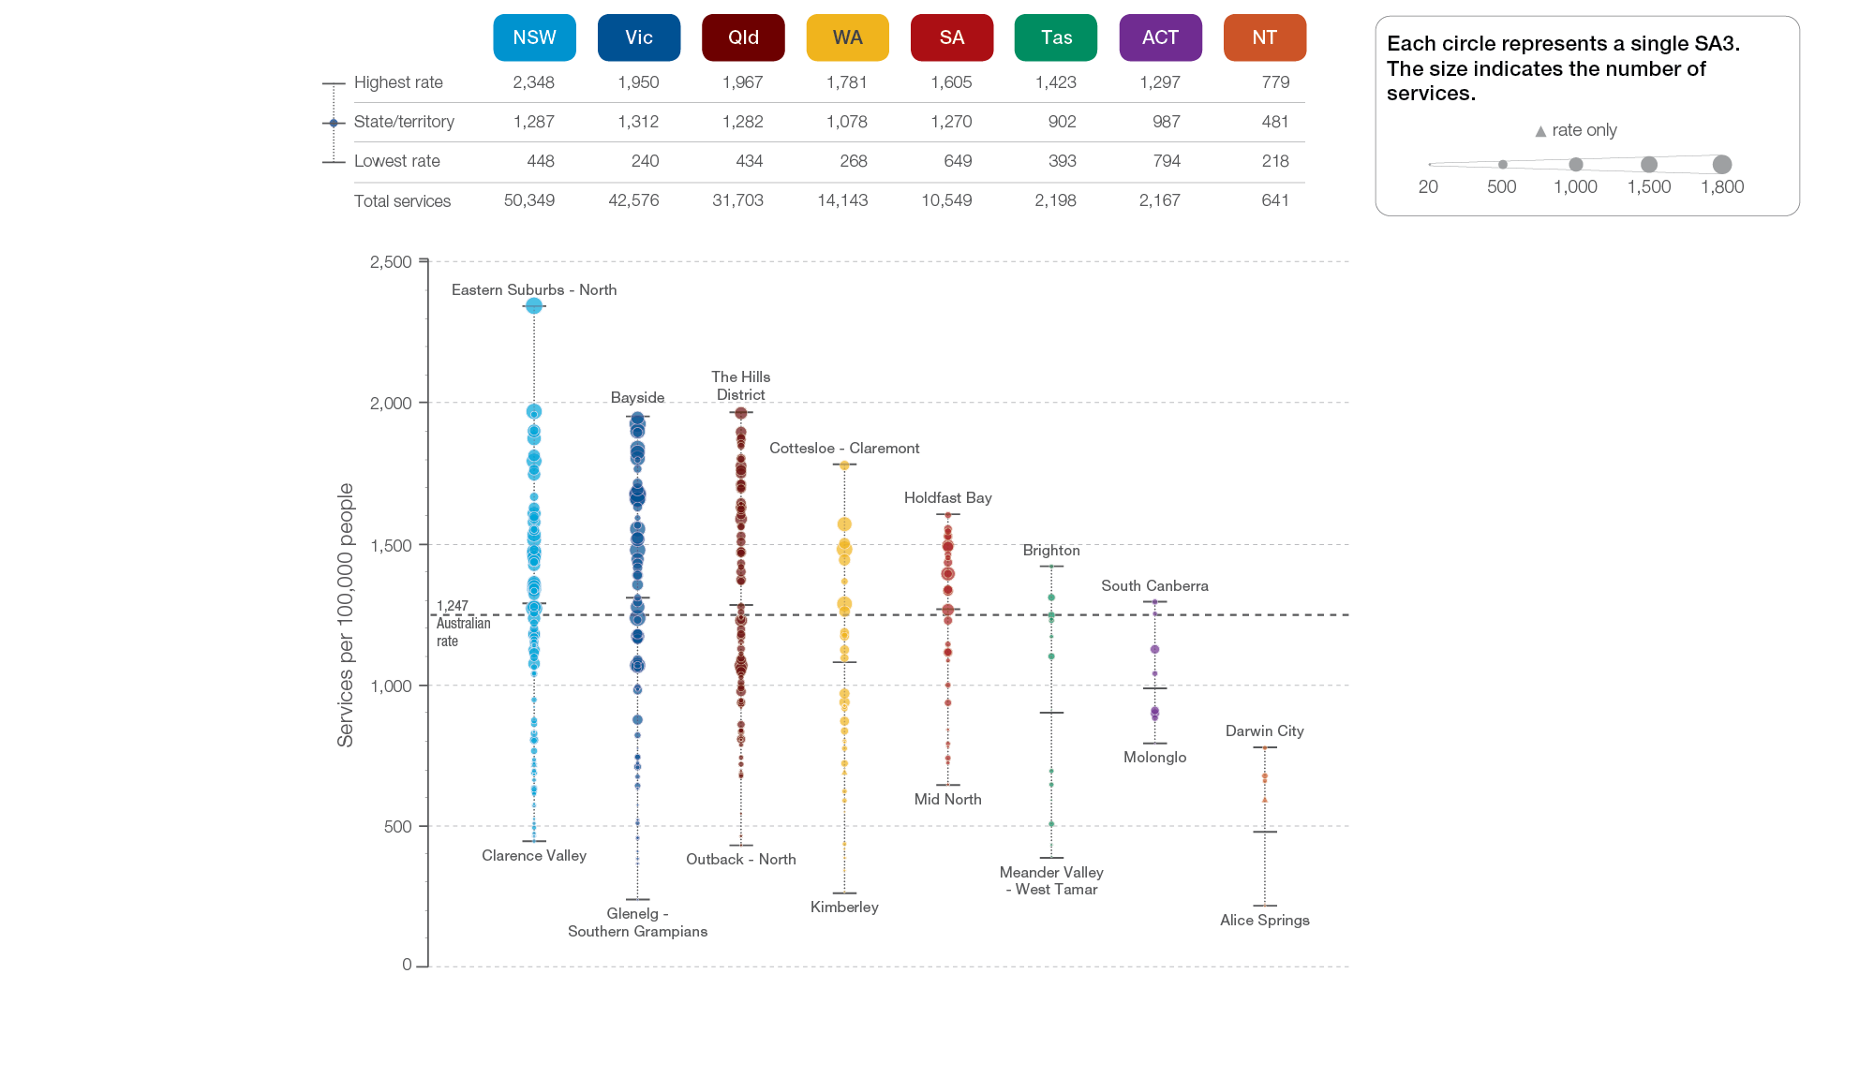
Gastroscopy MBS services, 18–54 years
State and territory, SA3 of patient residence, 2018-19
Sources: AIHW analysis of Medicare Benefits Schedule data and ABS Estimated Resident Population 30 June 2018.
Gastrointestinal investigations

Slide 8
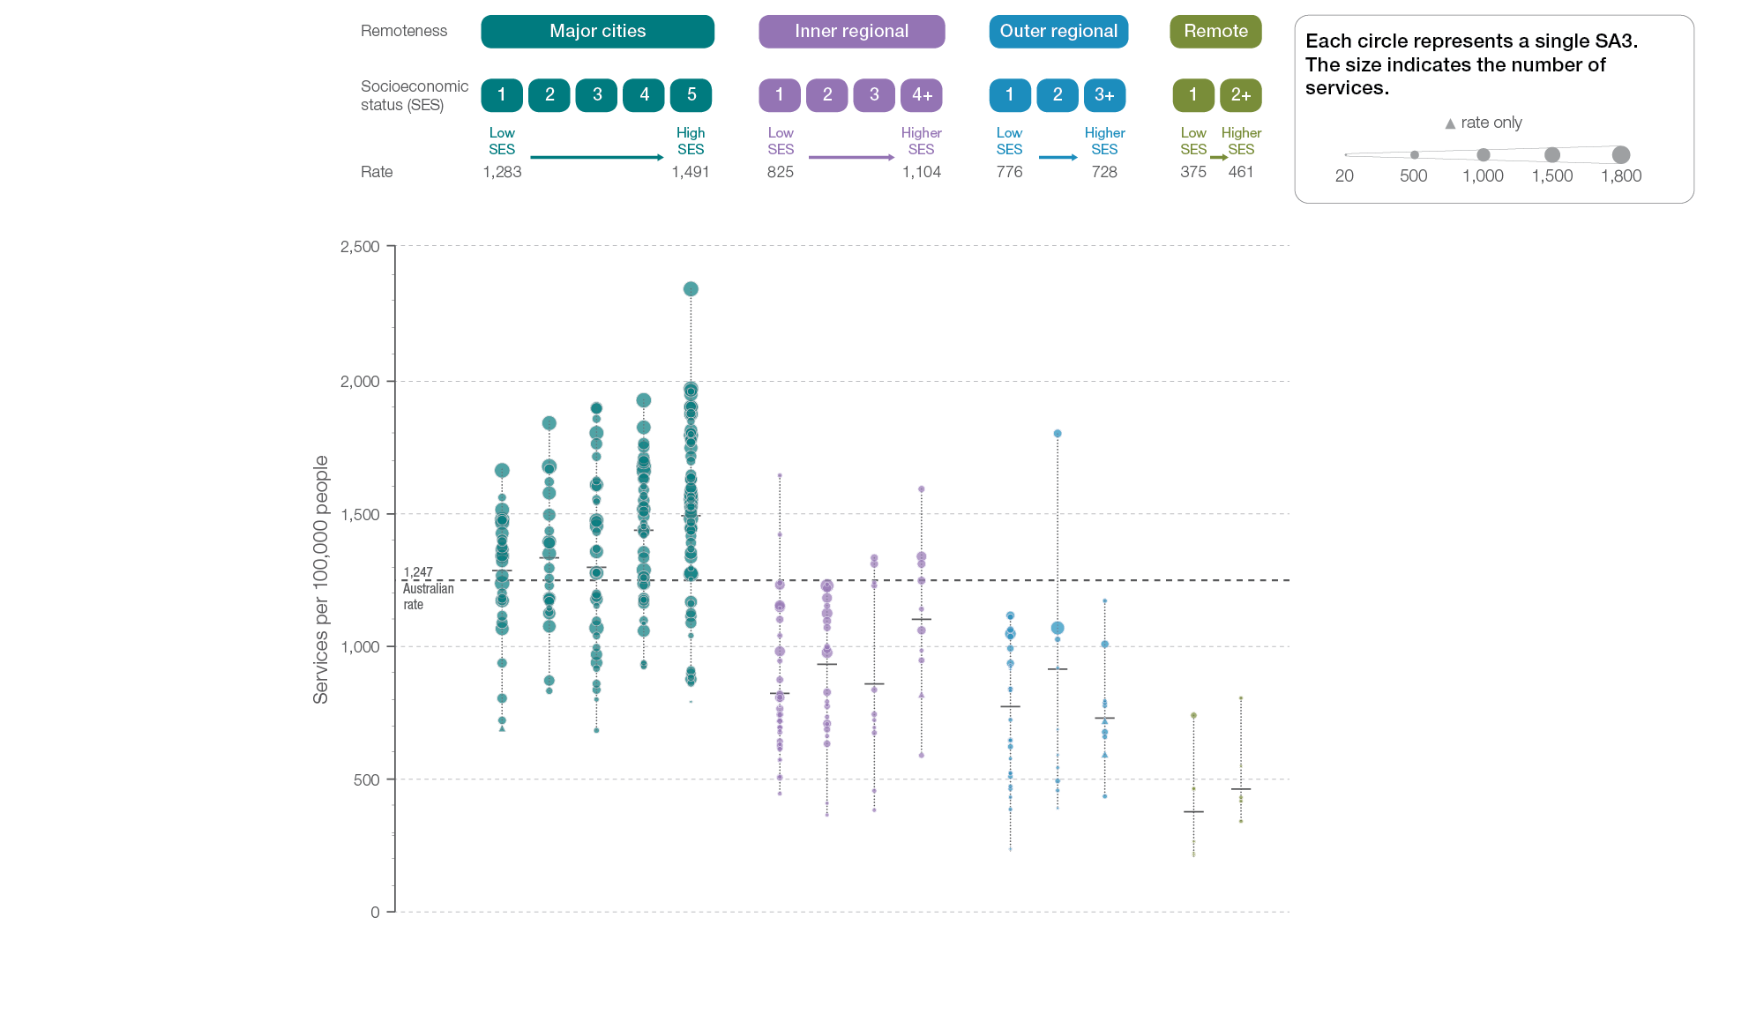
Gastroscopy MBS services, 18–54 years
Remoteness and socioeconomic status, SA3 of patient residence, 2018-19
Sources: AIHW analysis of Medicare Benefits Schedule data and ABS Estimated Resident Population 30 June 2018.
Gastrointestinal investigations

Slide 9
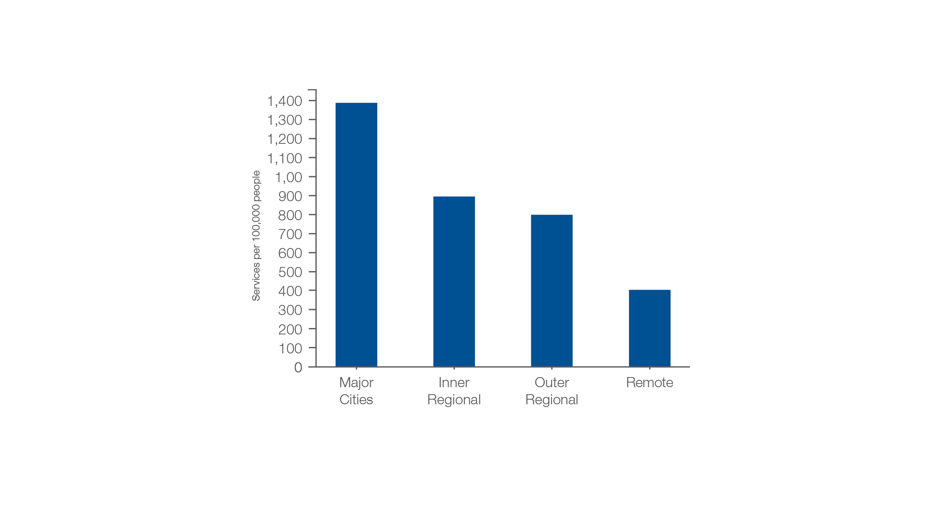
Gastroscopy MBS services, 18–54 years
Remoteness of patient residence, 2018-19
Sources: AIHW analysis of Medicare Benefits Schedule data and ABS Estimated Resident Population 30 June 2018.
Gastrointestinal investigations

Slide 10
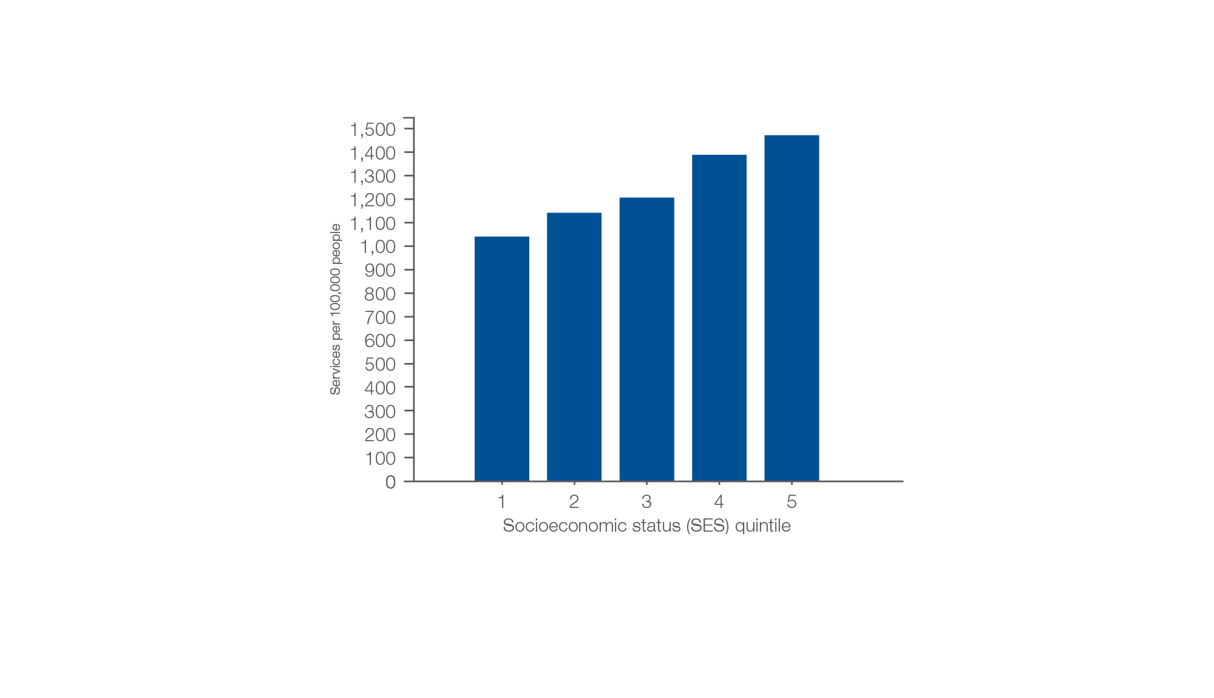
Gastroscopy MBS services, 18–54 years
Socioeconomic area of patient residence, 2018-19
Sources: AIHW analysis of Medicare Benefits Schedule data and ABS Estimated Resident Population 30 June 2018.
Gastrointestinal investigations

Slide 11
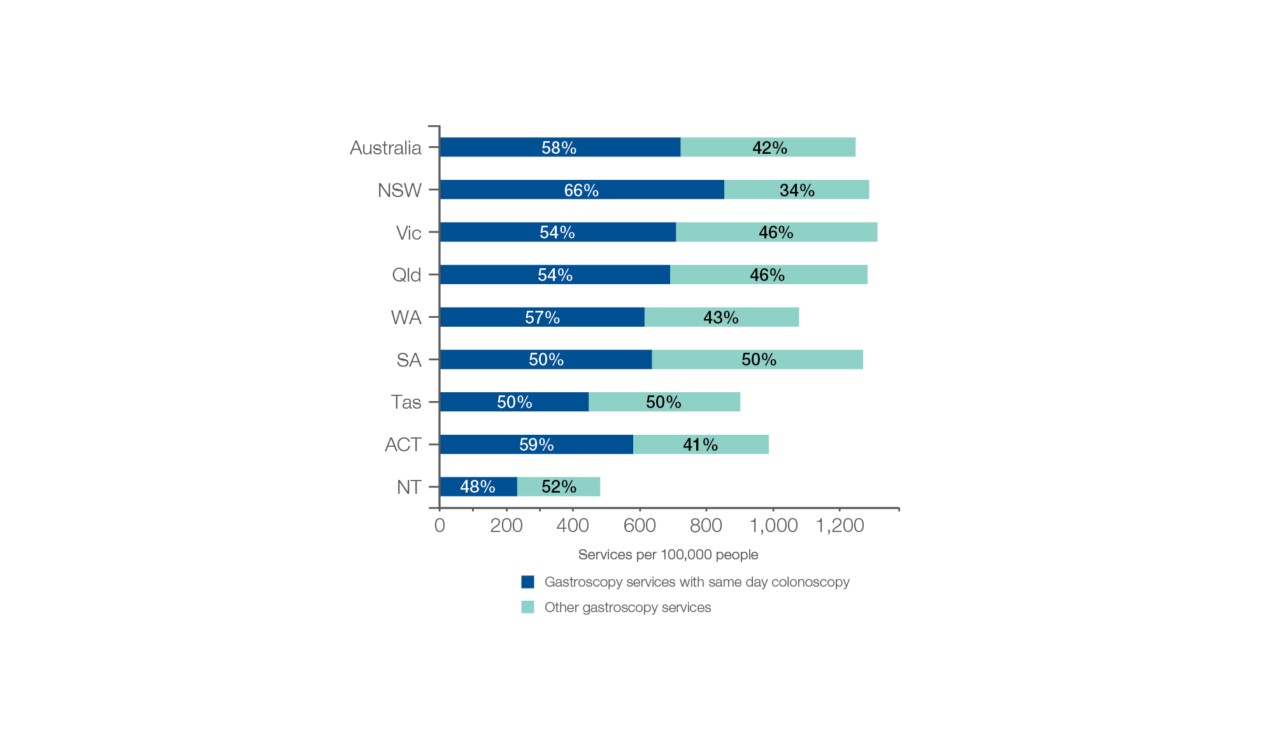
Gastroscopy MBS services, 18–54 years
Gastroscopy services with same day colonoscopy for the same patient
Sources: AIHW analysis of Medicare Benefits Schedule data and ABS Estimated Resident Population 30 June 2018.
Gastrointestinal investigations

Slide 12
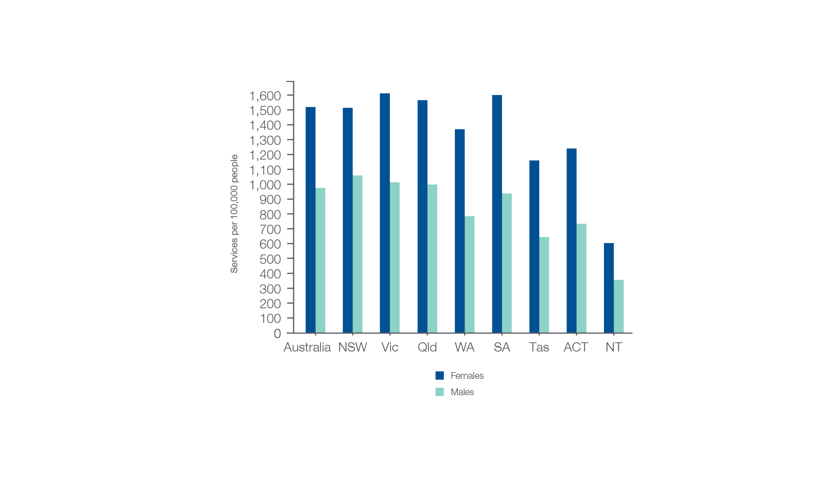
Gastroscopy MBS services, 18–54 years
Sex, 2018-19
Sources: AIHW analysis of Medicare Benefits Schedule data and ABS Estimated Resident Population 30 June 2018.
Gastrointestinal investigations

Slide 13
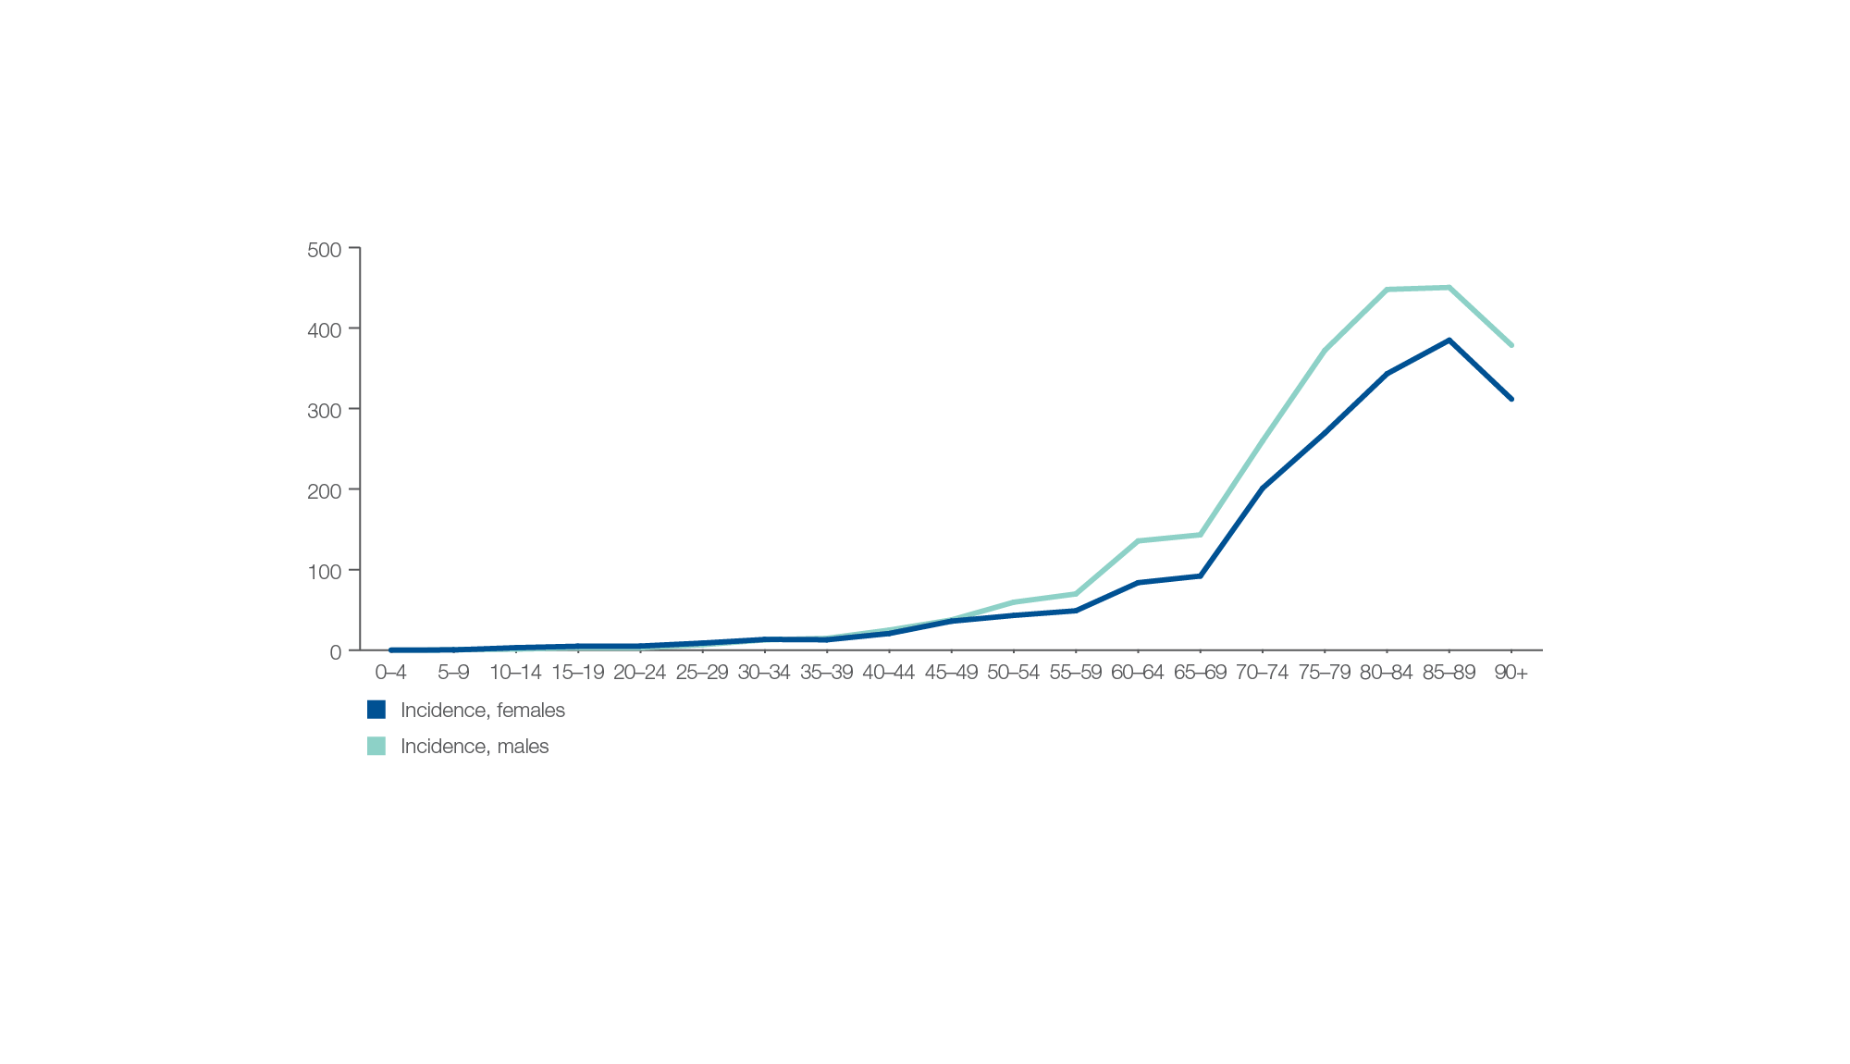
Colorectal cancer rates (per 100,000 people)
Sex and age group, 2020
Sources: Australian Institute of Health and Welfare.
Gastrointestinal investigations

Slide 14
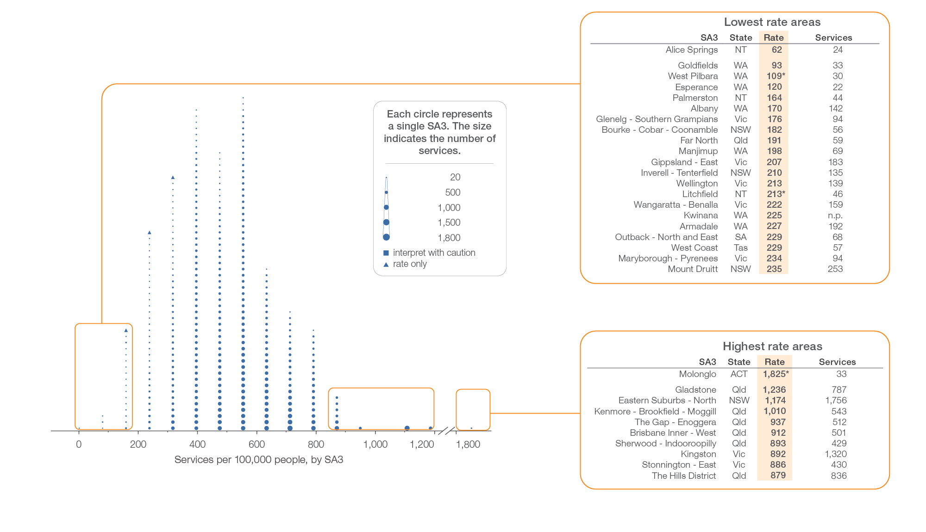
Repeat colonoscopy MBS services, all ages
Local area, SA3 of patient residence, 2018-19
Sources: AIHW analysis of Medicare Benefits Schedule data and ABS Estimated Resident Population 30 June 2018.
Gastrointestinal investigations

Slide 15
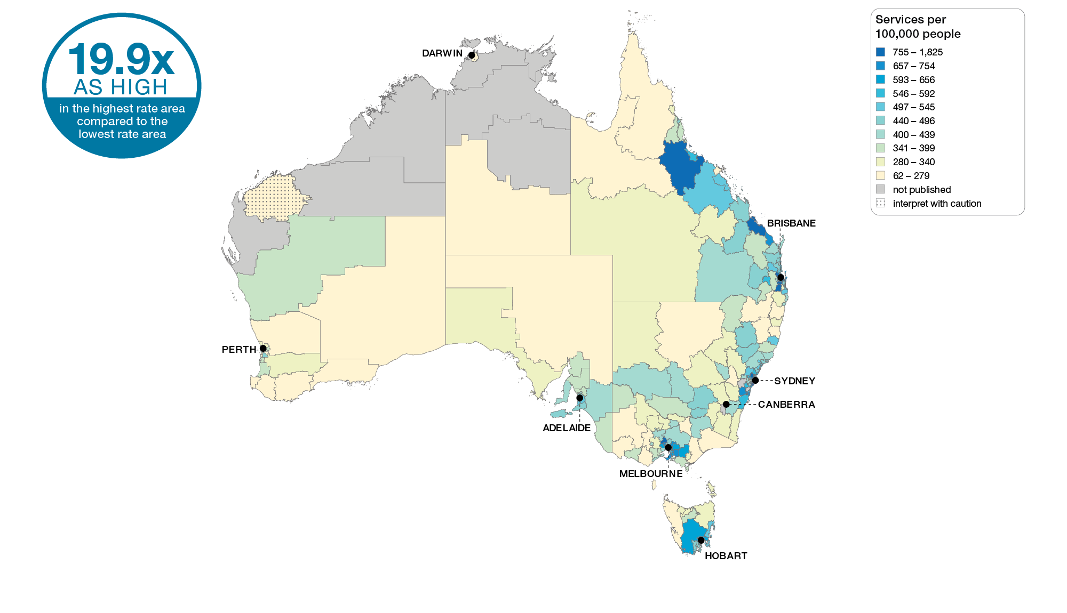
Repeat colonoscopy MBS services, all ages
Australia, SA3 of patient residence, 2018-19
Sources: AIHW analysis of Medicare Benefits Schedule data and ABS Estimated Resident Population 30 June 2018.
Gastrointestinal investigations

Slide 16
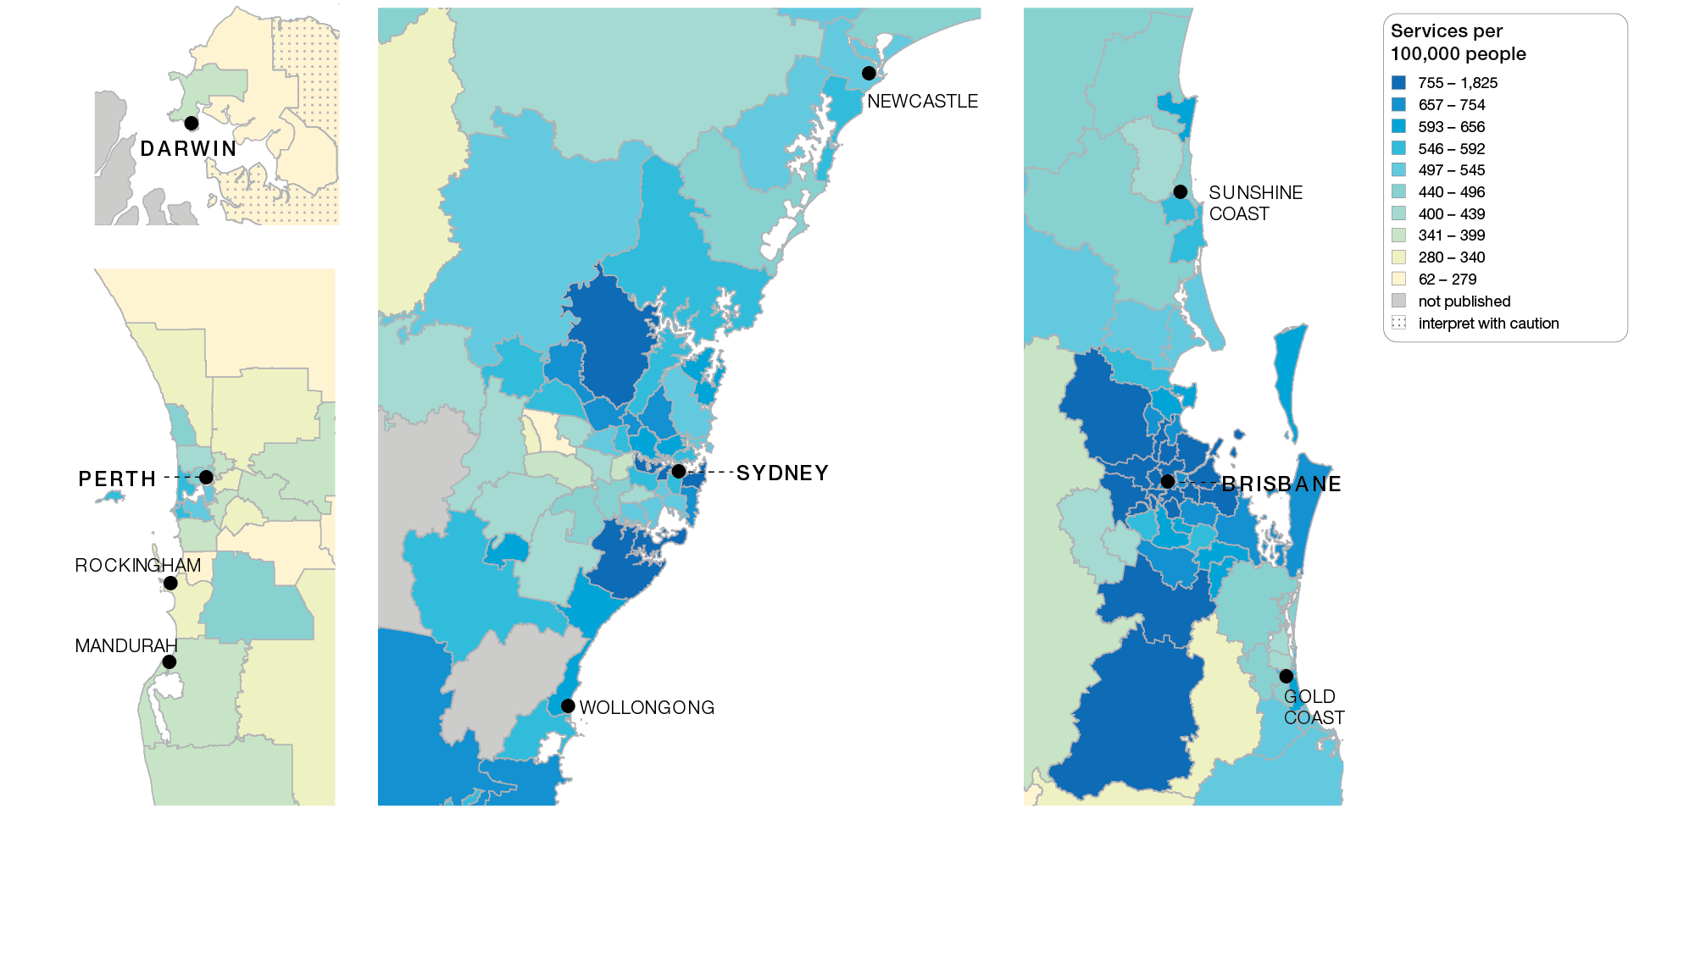
Repeat colonoscopy MBS services, all ages
Capital cities, SA3 of patient residence, 2018-19
Sources: AIHW analysis of Medicare Benefits Schedule data and ABS Estimated Resident Population 30 June 2018.
Gastrointestinal investigations

Slide 17
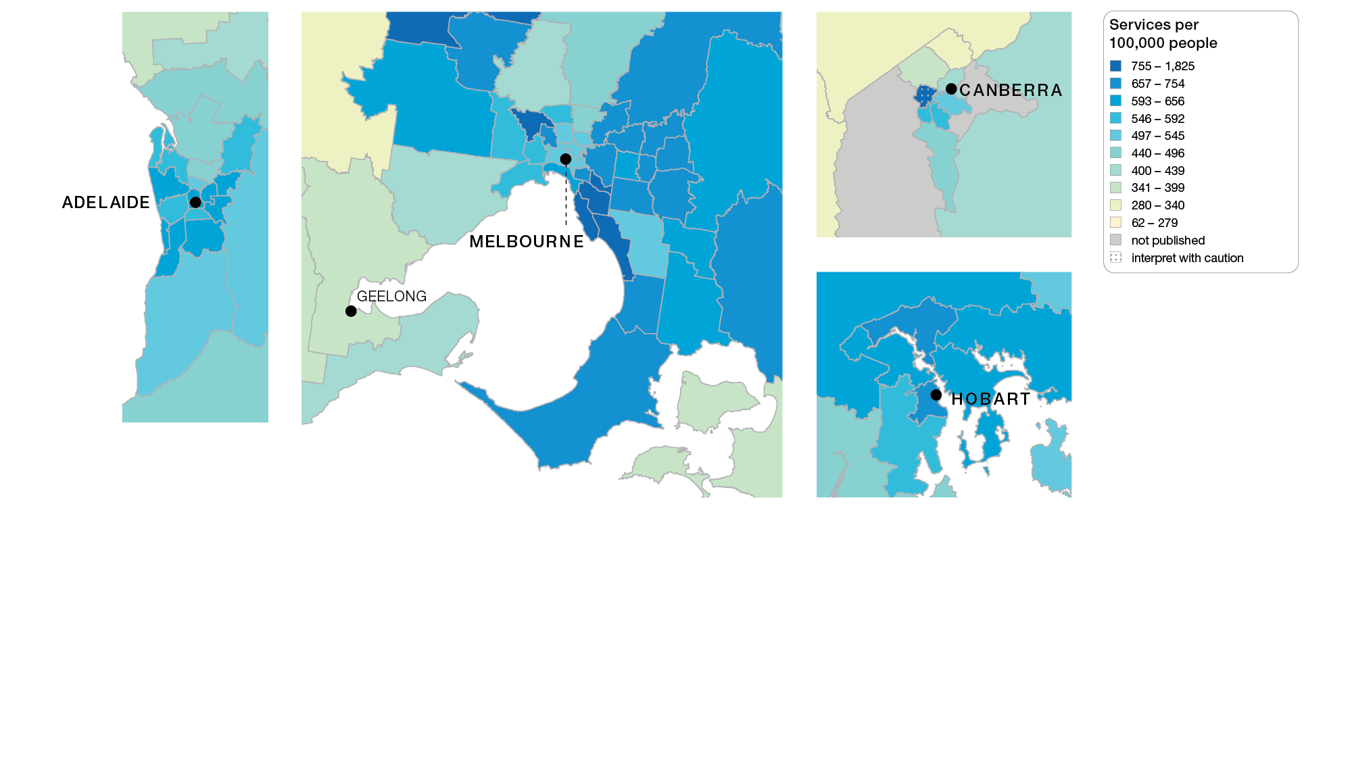
Repeat colonoscopy MBS services, all ages
Capital cities, SA3 of patient residence, 2018-19
Sources: AIHW analysis of Medicare Benefits Schedule data and ABS Estimated Resident Population 30 June 2018.
Gastrointestinal investigations

Slide 18
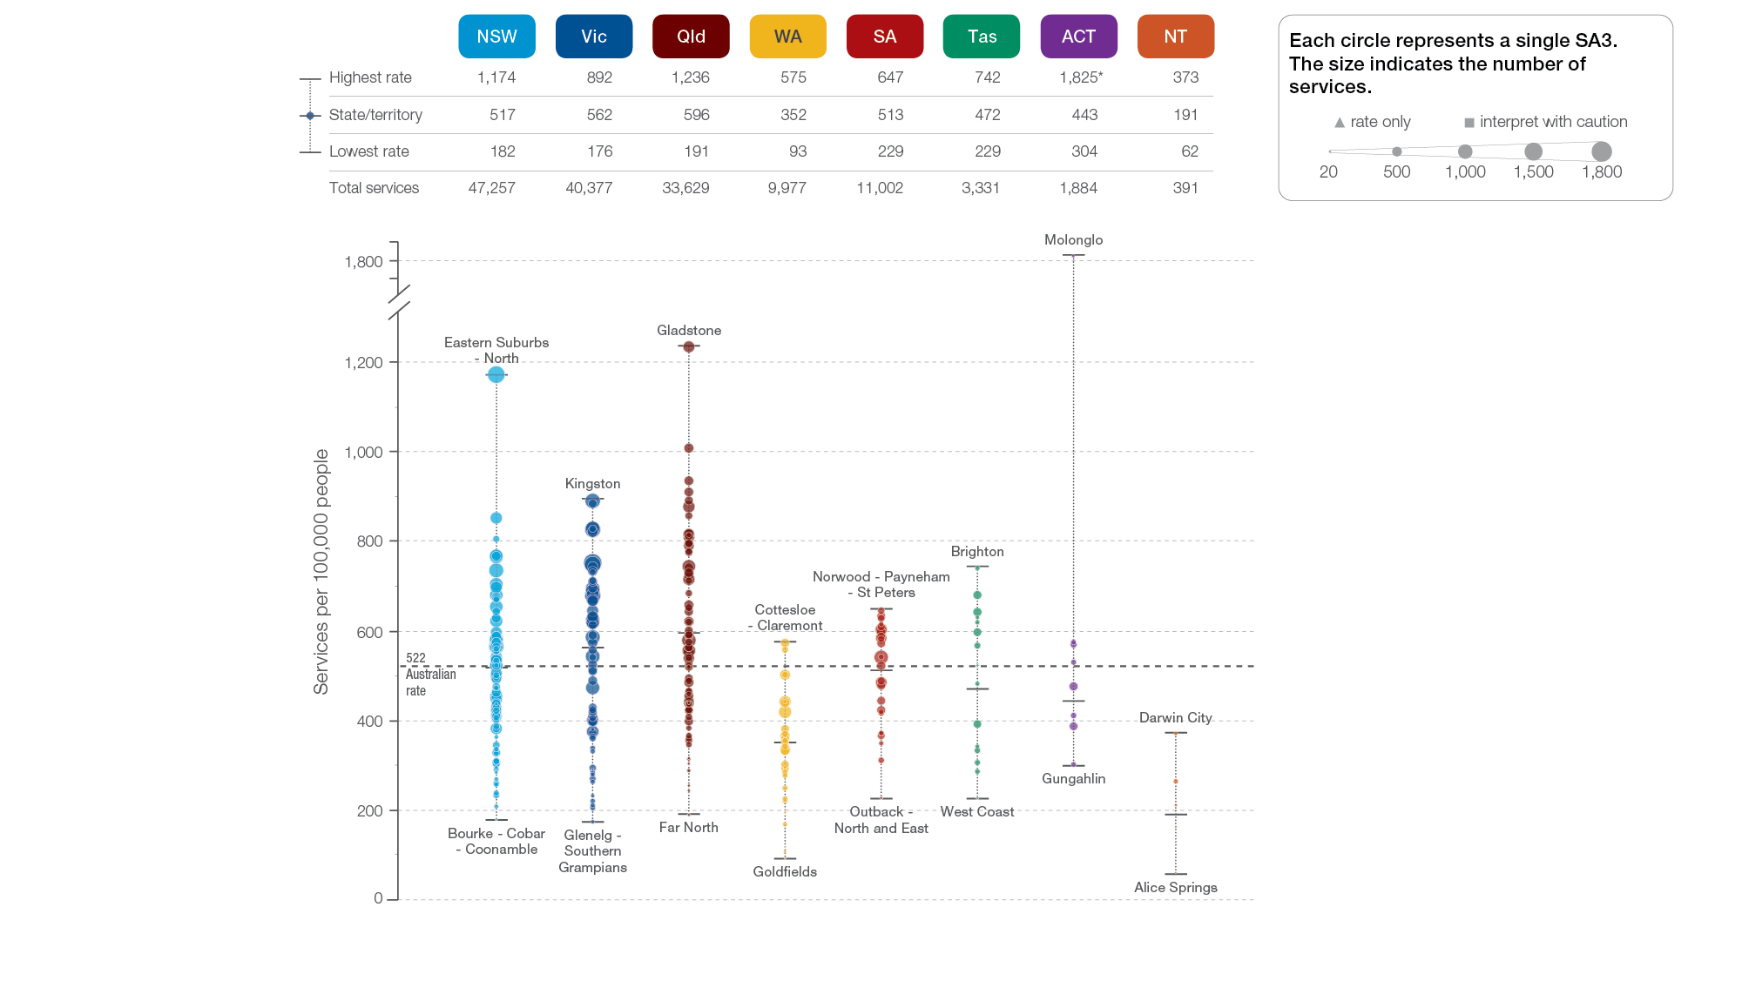
Repeat colonoscopy MBS services, all ages
State and territory, SA3 of patient residence, 2018-19
Sources: AIHW analysis of Medicare Benefits Schedule data and ABS Estimated Resident Population 30 June 2018.
Gastrointestinal investigations

Slide 19
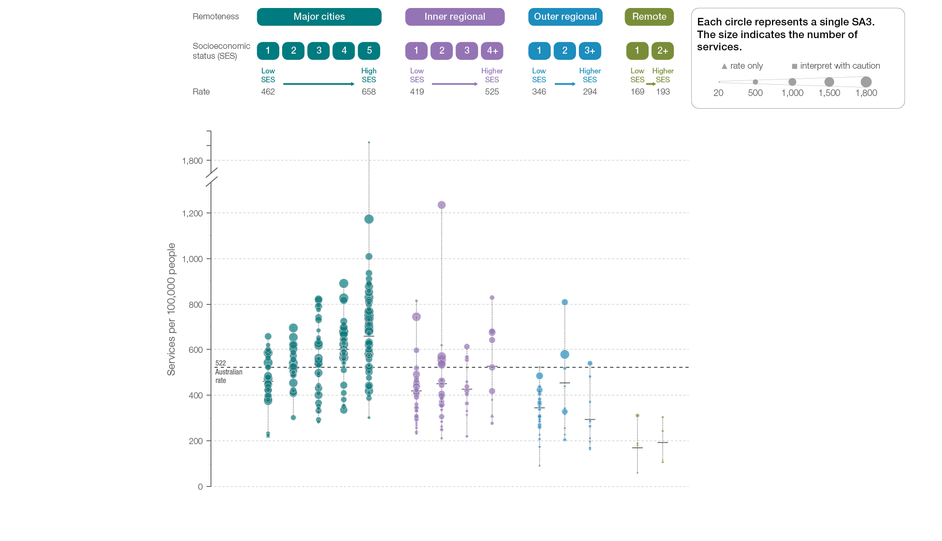
Repeat colonoscopy MBS services, all ages
Remoteness and socioeconomic status, SA3 of patient residence, 2018-19
Sources: AIHW analysis of Medicare Benefits Schedule data and ABS Estimated Resident Population 30 June 2018.
Gastrointestinal investigations

Slide 20
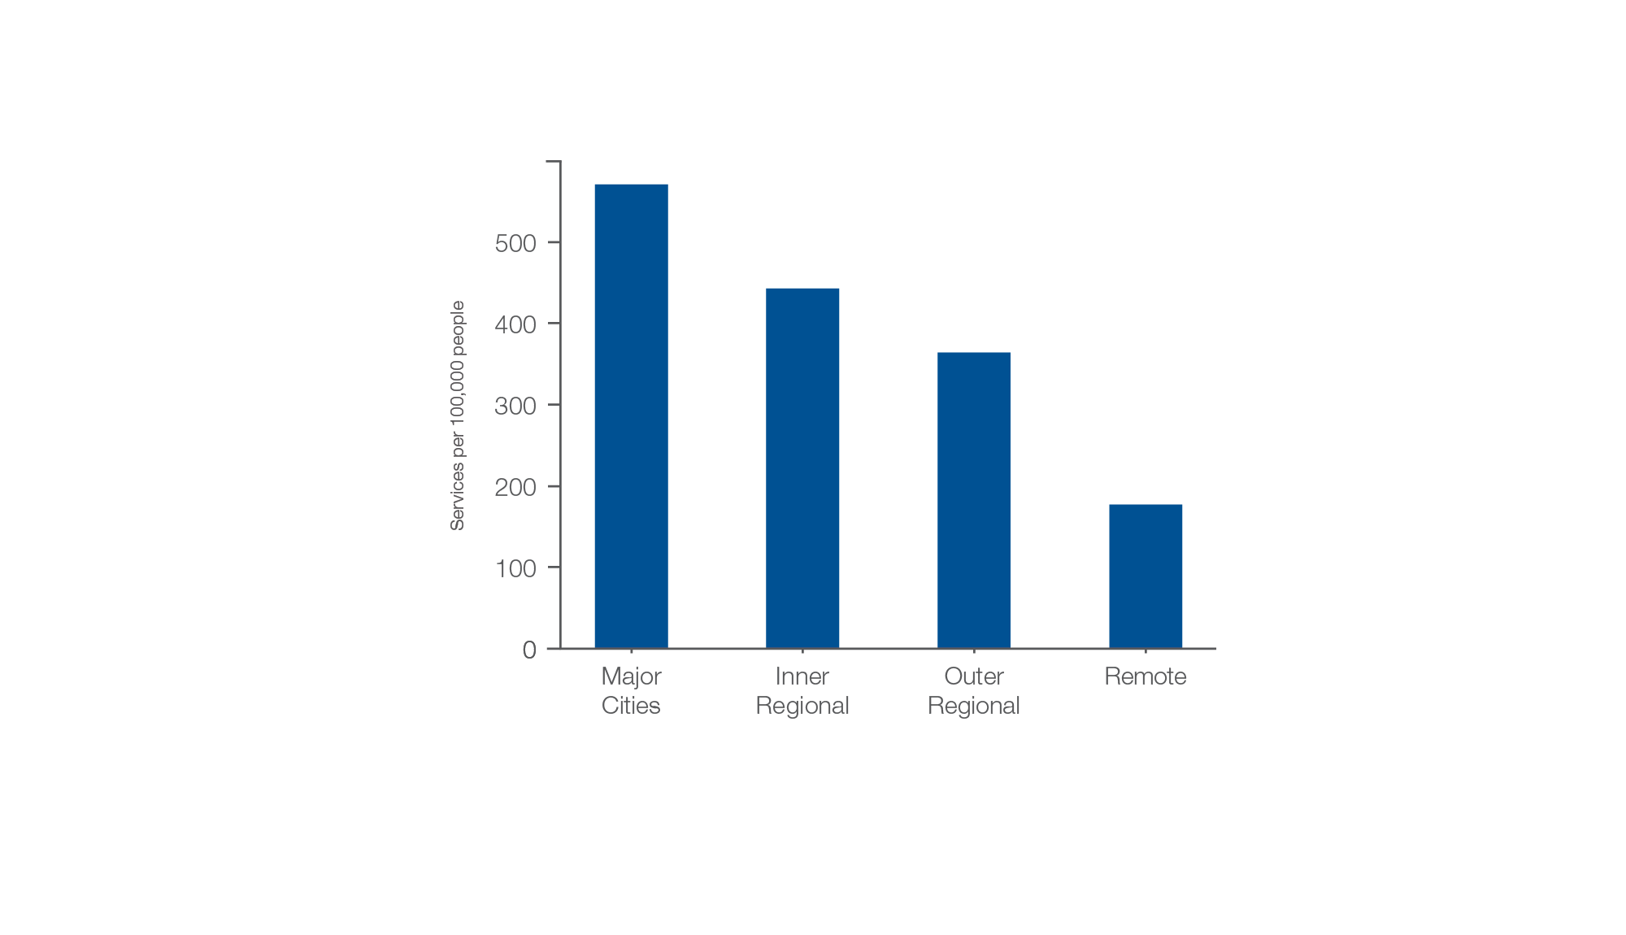
Repeat colonoscopy MBS services, all ages
Remoteness of patient residence, 2018-19
Sources: AIHW analysis of Medicare Benefits Schedule data and ABS Estimated Resident Population 30 June 2018.
Gastrointestinal investigations

Slide 21
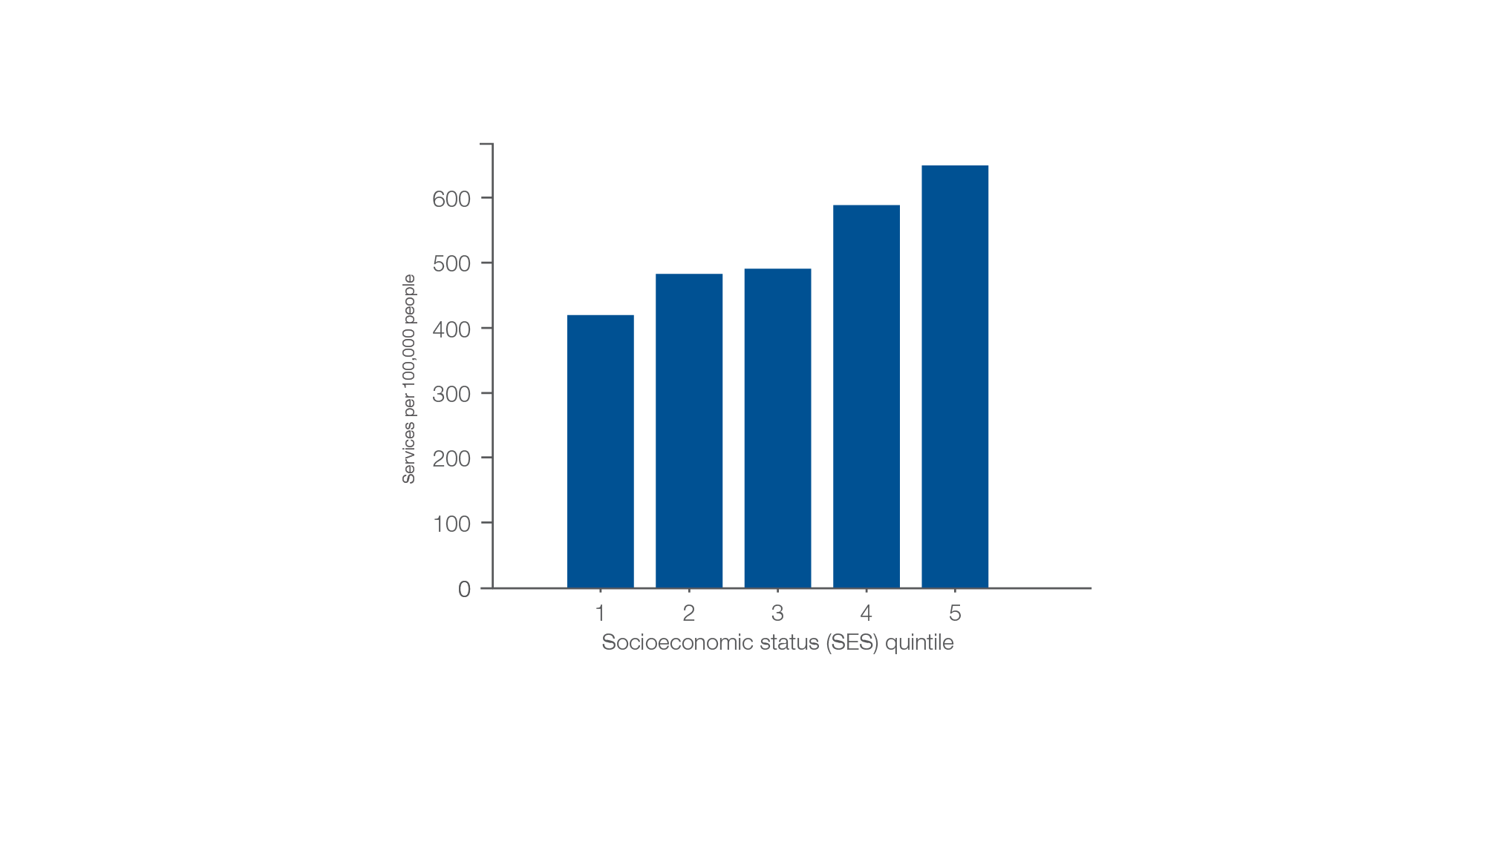
Repeat colonoscopy MBS services, all ages
Socioeconomic area of patient residence, 2018-19
Sources: AIHW analysis of Medicare Benefits Schedule data and ABS Estimated Resident Population 30 June 2018.
Gastrointestinal investigations

Slide 22
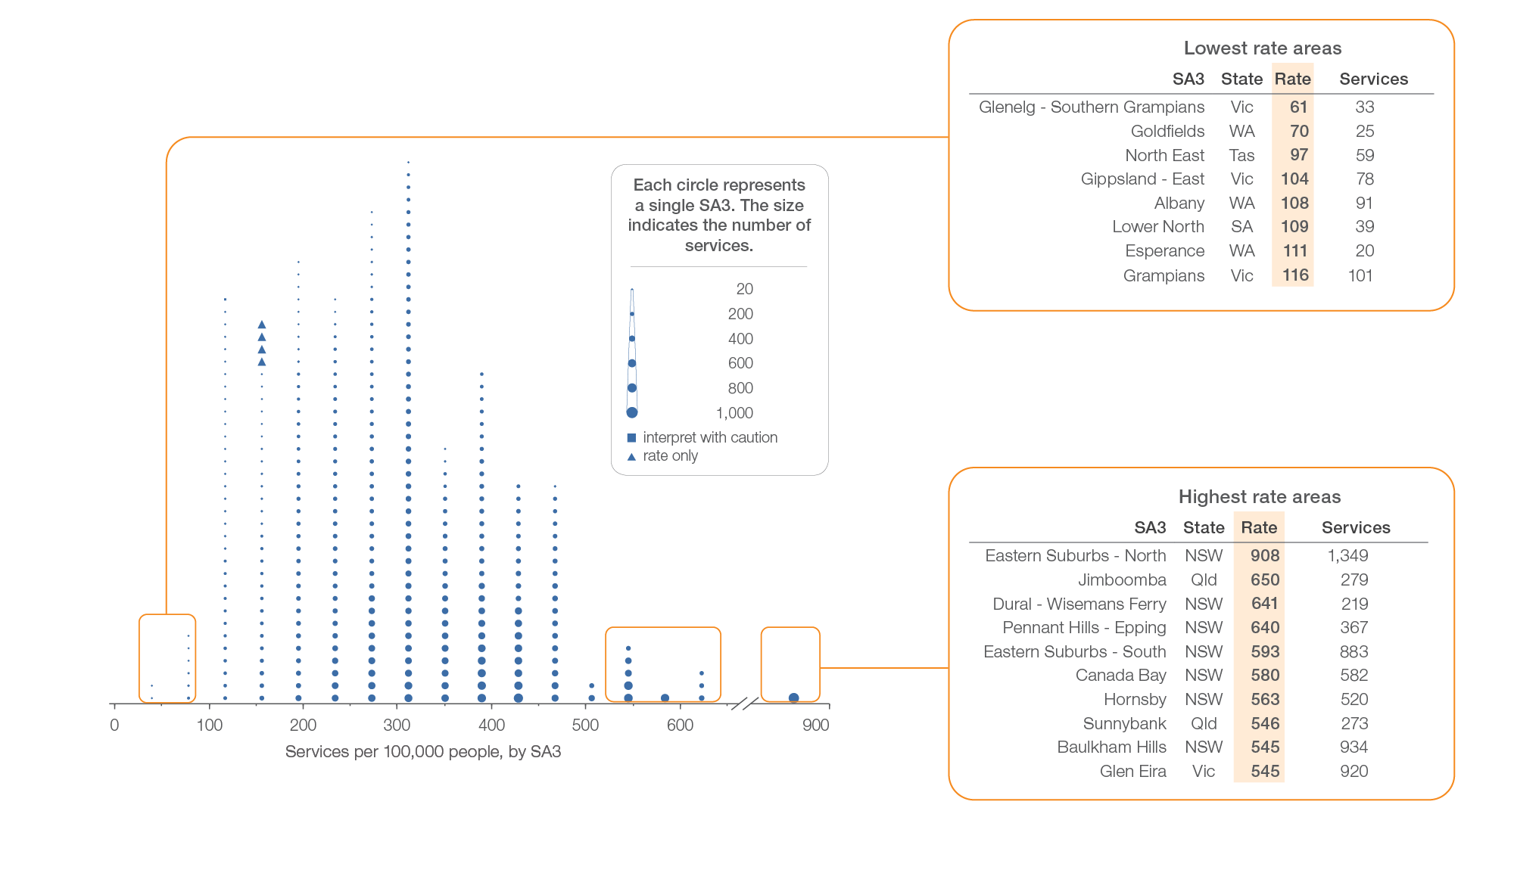
Repeat gastroscopy MBS services, all ages
Local area, SA3 of patient residence, 2018-19
Sources: AIHW analysis of Medicare Benefits Schedule data and ABS Estimated Resident Population 30 June 2018.
Gastrointestinal investigations

Slide 23
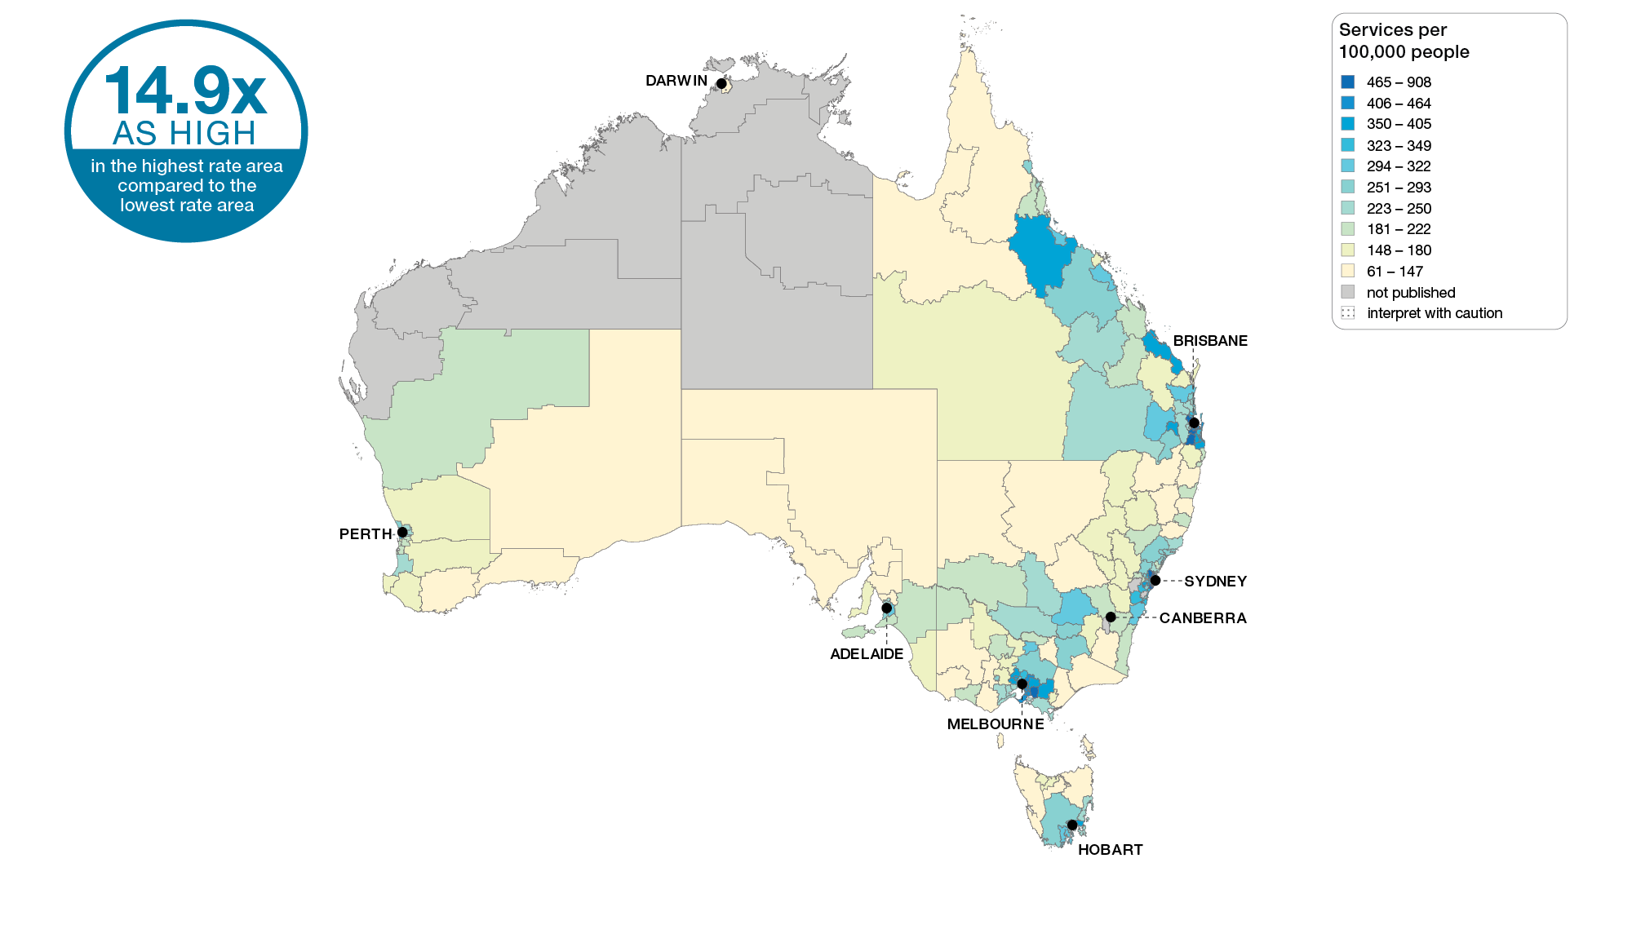
Repeat gastroscopy MBS services, all ages
Australia, SA3 of patient residence, 2018-19
Sources: AIHW analysis of Medicare Benefits Schedule data and ABS Estimated Resident Population 30 June 2018.
Gastrointestinal investigations

Slide 24
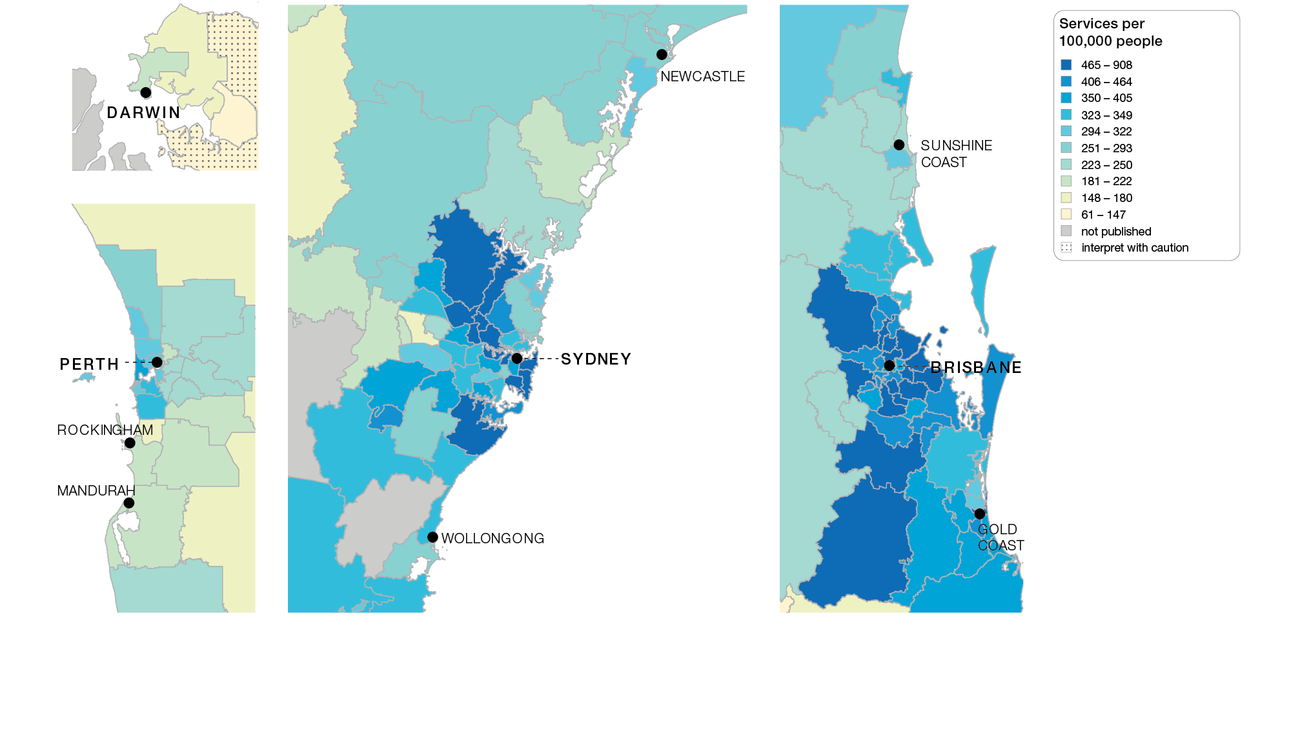
Repeat gastroscopy MBS services, all ages
Capital cities, SA3 of patient residence, 2018-19
Sources: AIHW analysis of Medicare Benefits Schedule data and ABS Estimated Resident Population 30 June 2018.
Gastrointestinal investigations

Slide 25
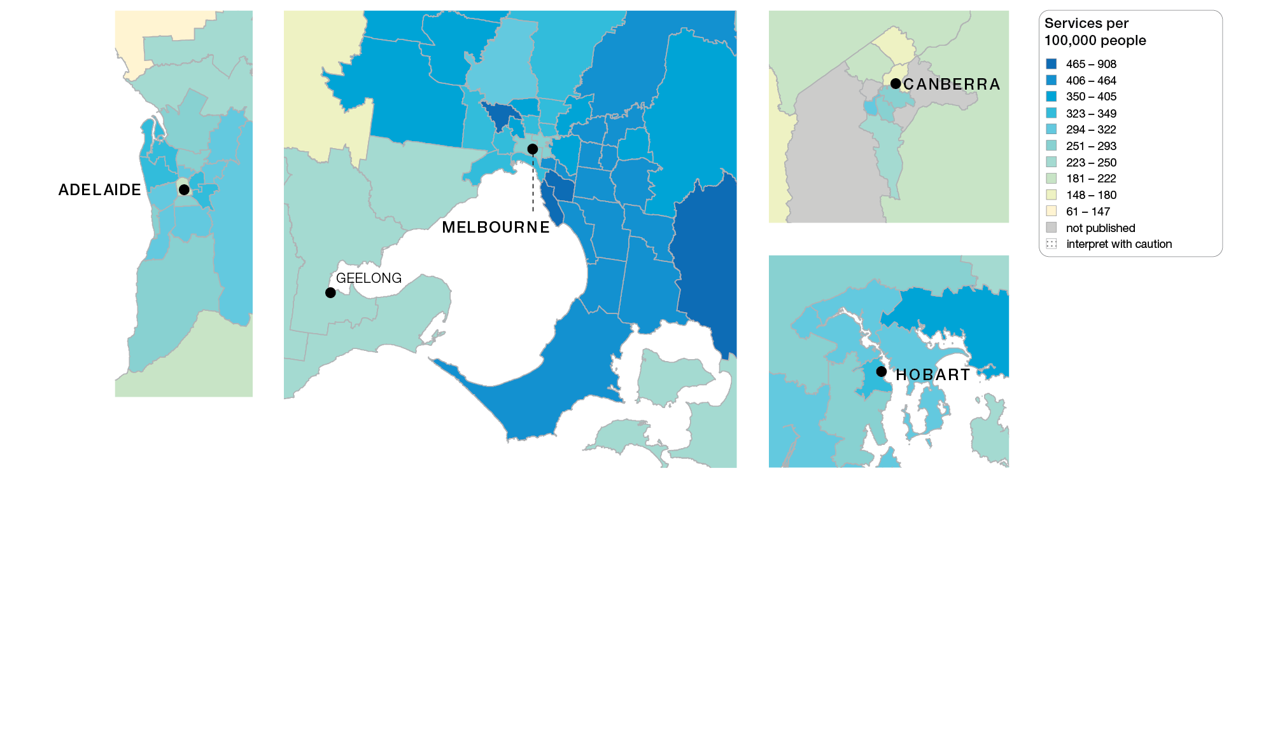
Repeat gastroscopy MBS services, all ages
Capital cities, SA3 of patient residence, 2018-19
Sources: AIHW analysis of Medicare Benefits Schedule data and ABS Estimated Resident Population 30 June 2018.
Gastrointestinal investigations

Slide 26
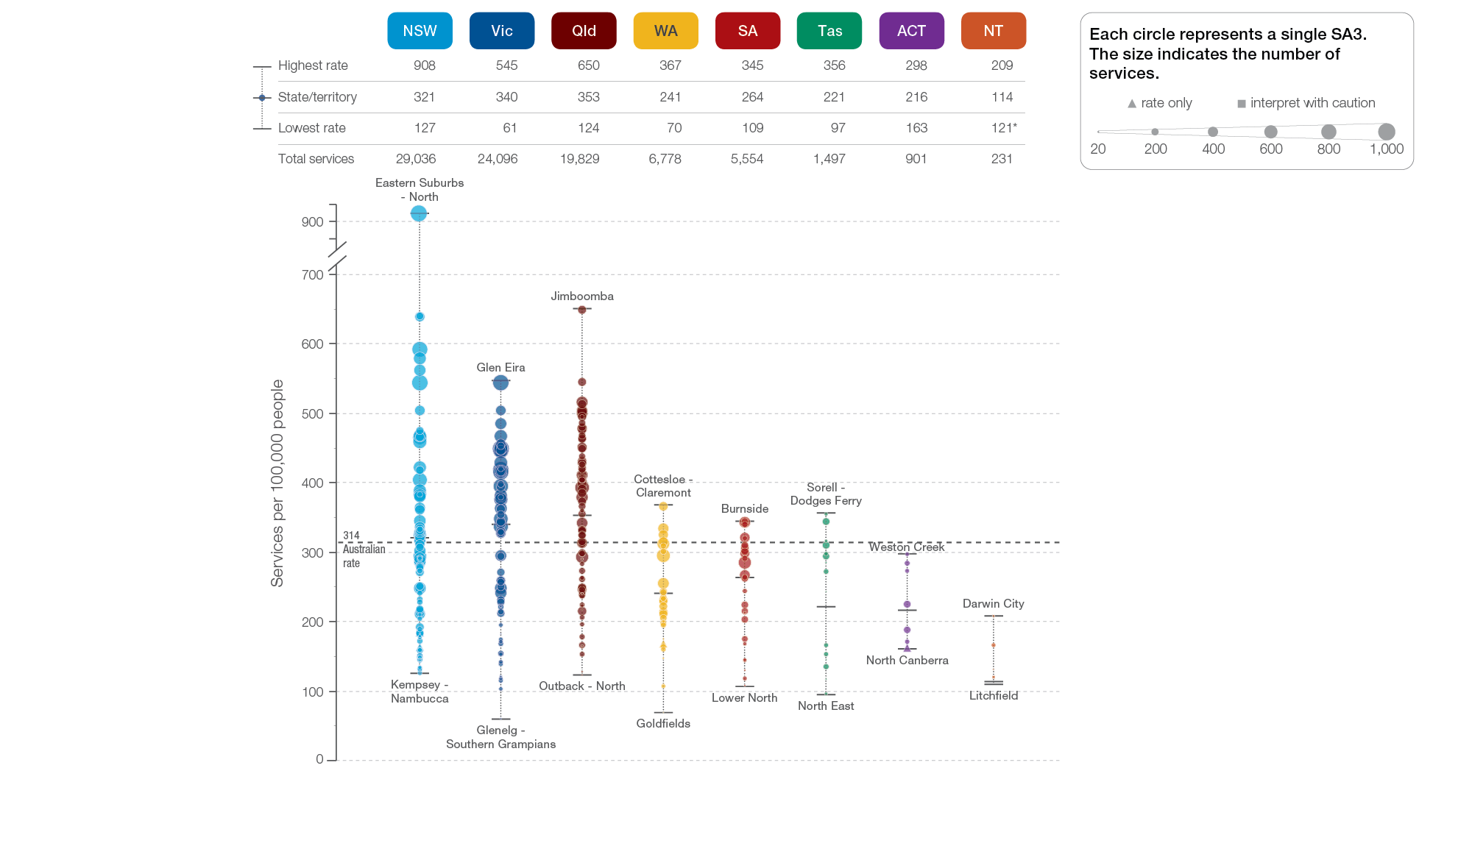
Repeat gastroscopy MBS services, all ages
State and territory, SA3 of patient residence, 2018-19
Sources: AIHW analysis of Medicare Benefits Schedule data and ABS Estimated Resident Population 30 June 2018.
Gastrointestinal investigations

Slide 27
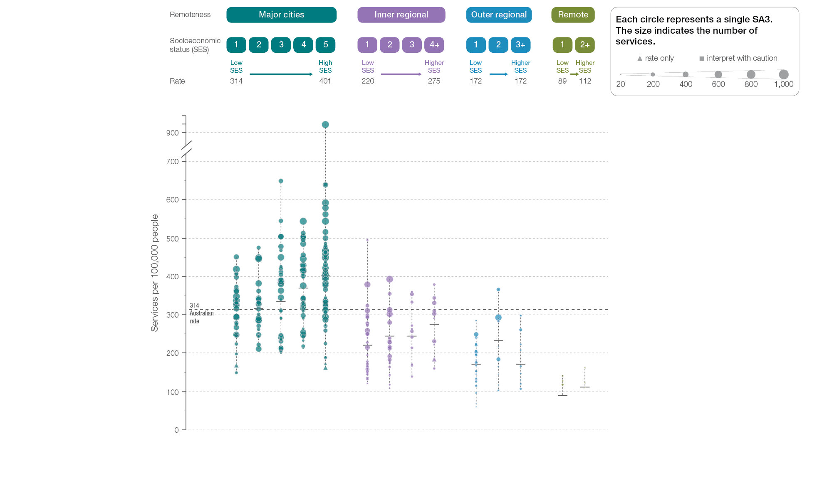
Repeat gastroscopy MBS services, all ages
Remoteness and socioeconomic status, SA3 of patient residence, 2018-19
Sources: AIHW analysis of Medicare Benefits Schedule data and ABS Estimated Resident Population 30 June 2018.
Gastrointestinal investigations

Slide 28
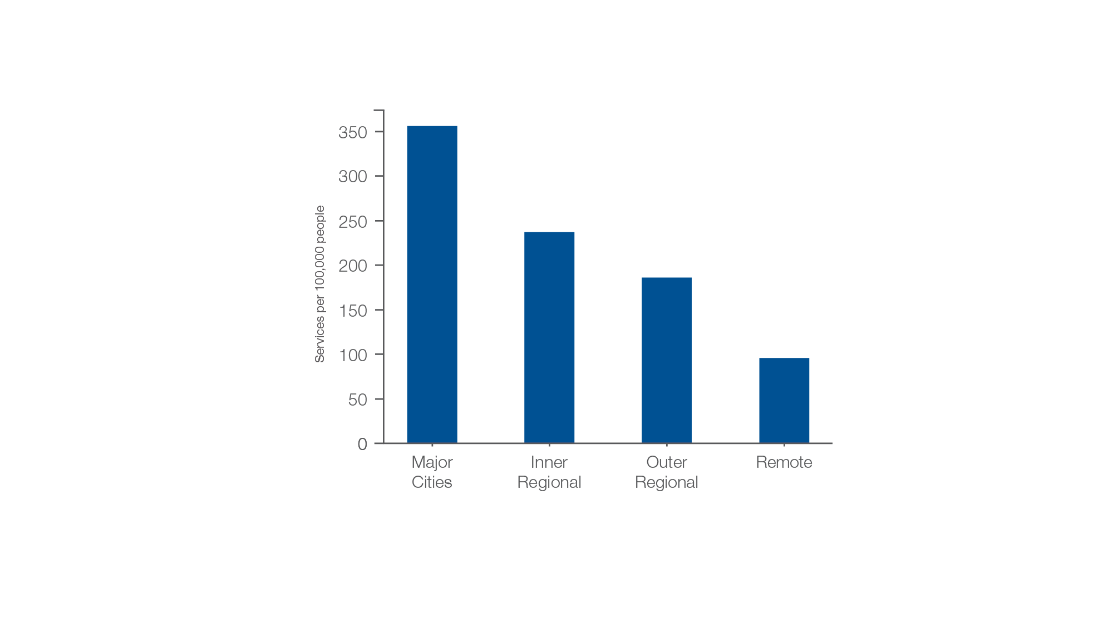
Repeat gastroscopy MBS services, all ages
Remoteness of patient residence, 2018-19
Sources: AIHW analysis of Medicare Benefits Schedule data and ABS Estimated Resident Population 30 June 2018.
Gastrointestinal investigations

Slide 29
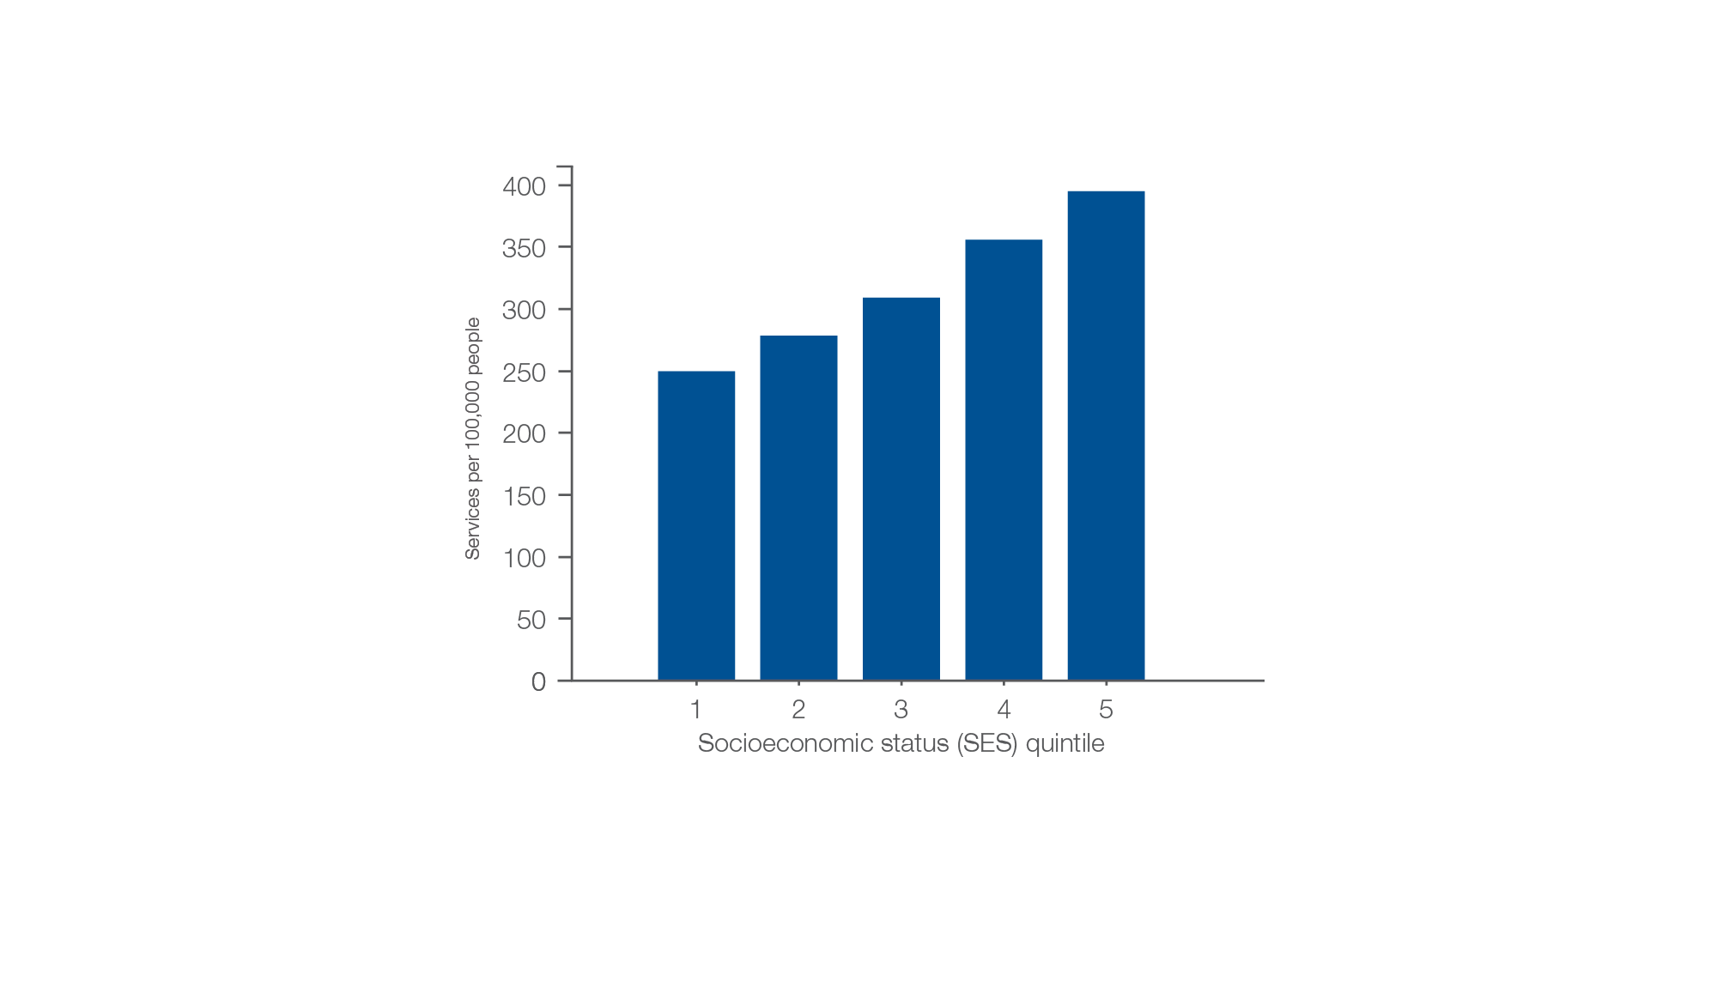
Repeat gastroscopy MBS services, all ages
Socioeconomic area of patient residence, 2018-19
Sources: AIHW analysis of Medicare Benefits Schedule data and ABS Estimated Resident Population 30 June 2018.
Gastrointestinal investigations

