Slide 1
The Fourth Australian Atlas of Healthcare Variation

Slide 2
About the Atlas

Slide 3
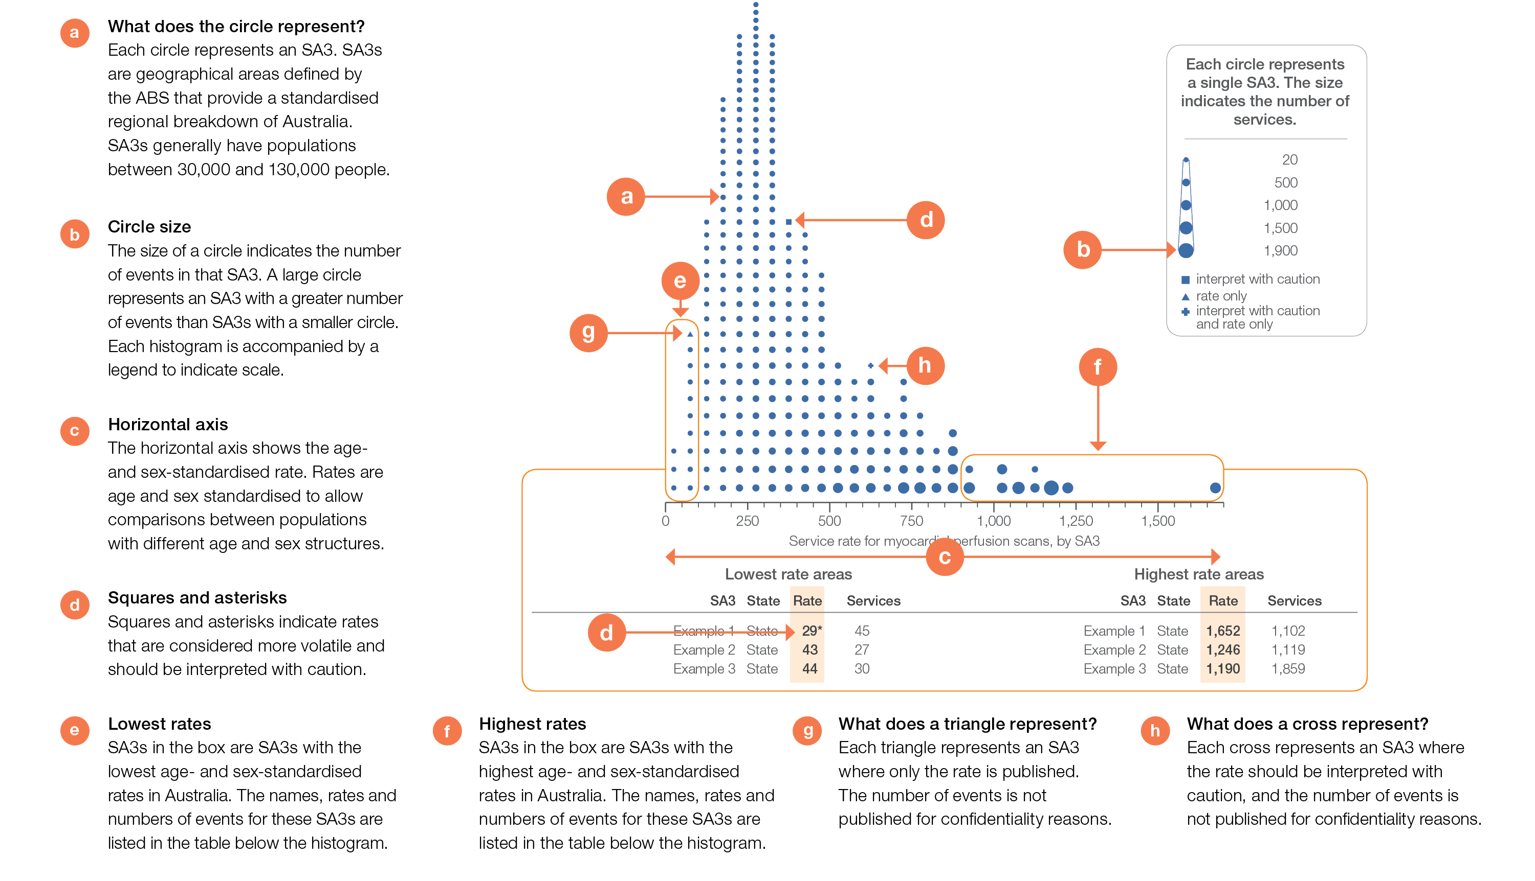
How to interpret our data visualisations
Histogram

Slide 4
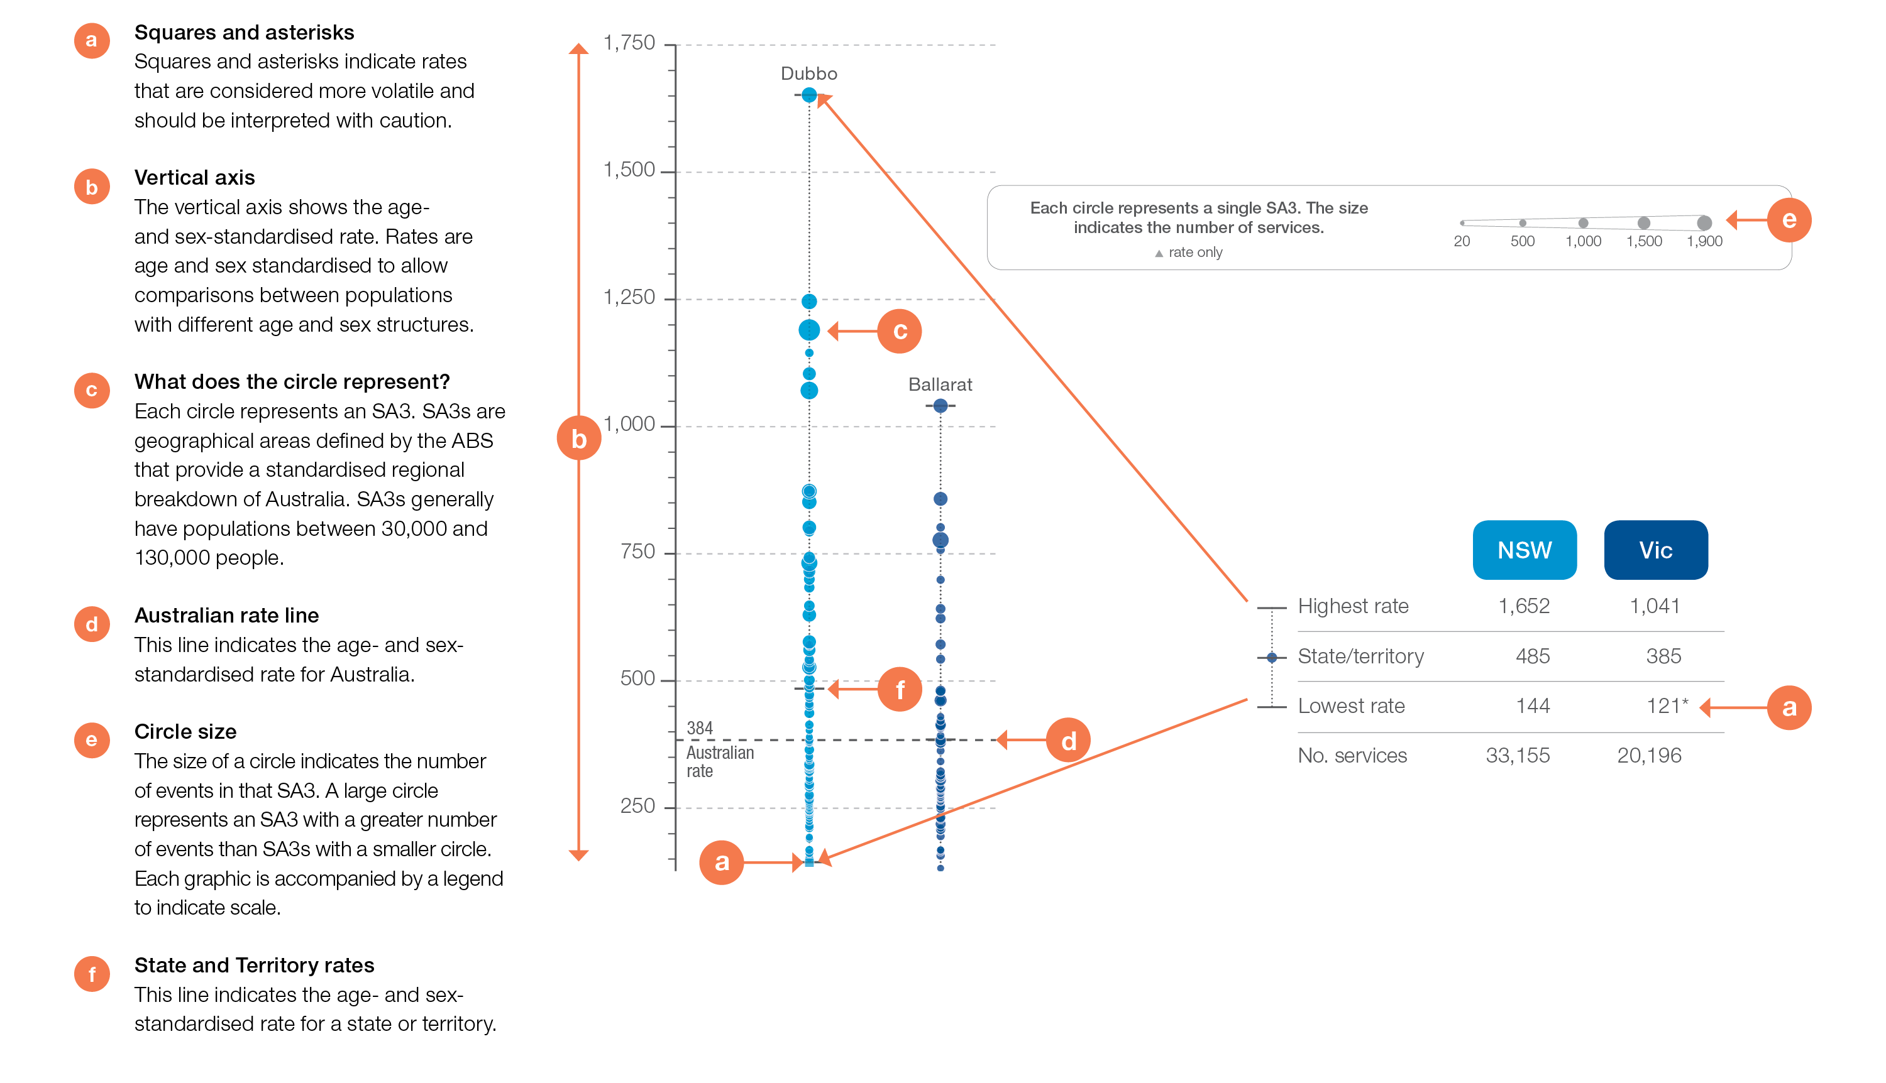
How to interpret our data visualisations
State and territory graphic

Slide 5
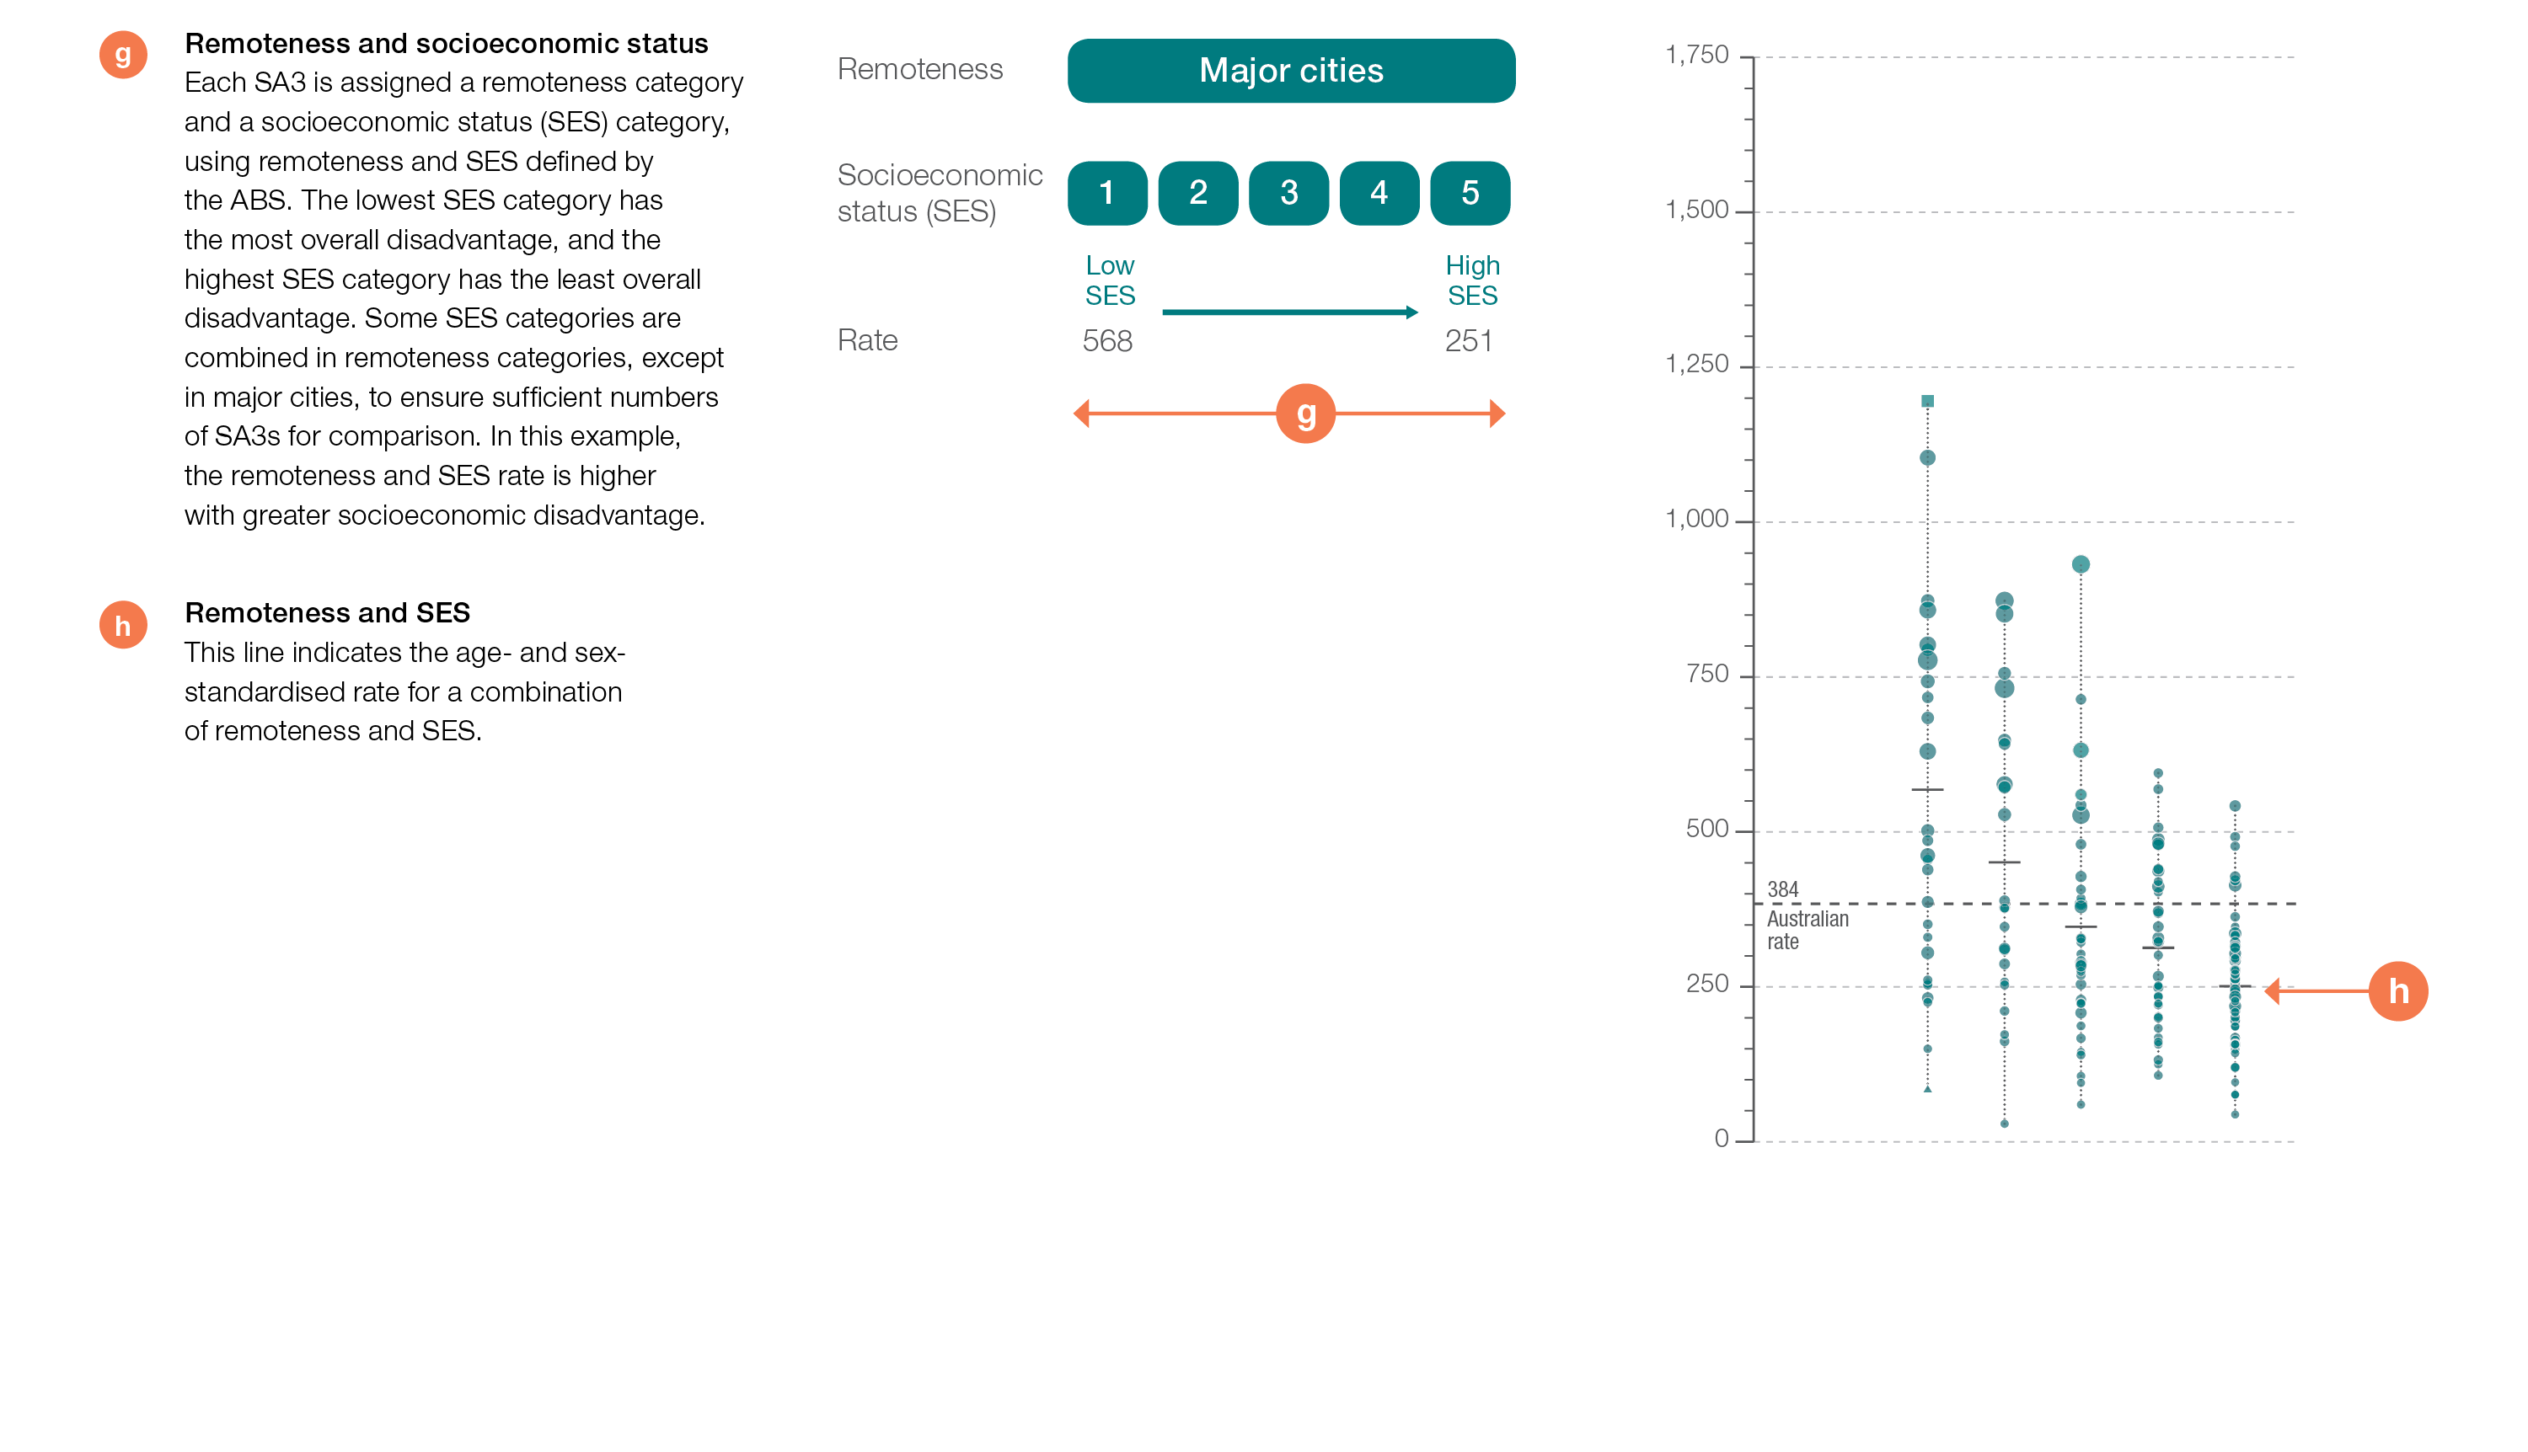
How to interpret our data visualisations
Remoteness and socioeconomic status graphic

Slide 6
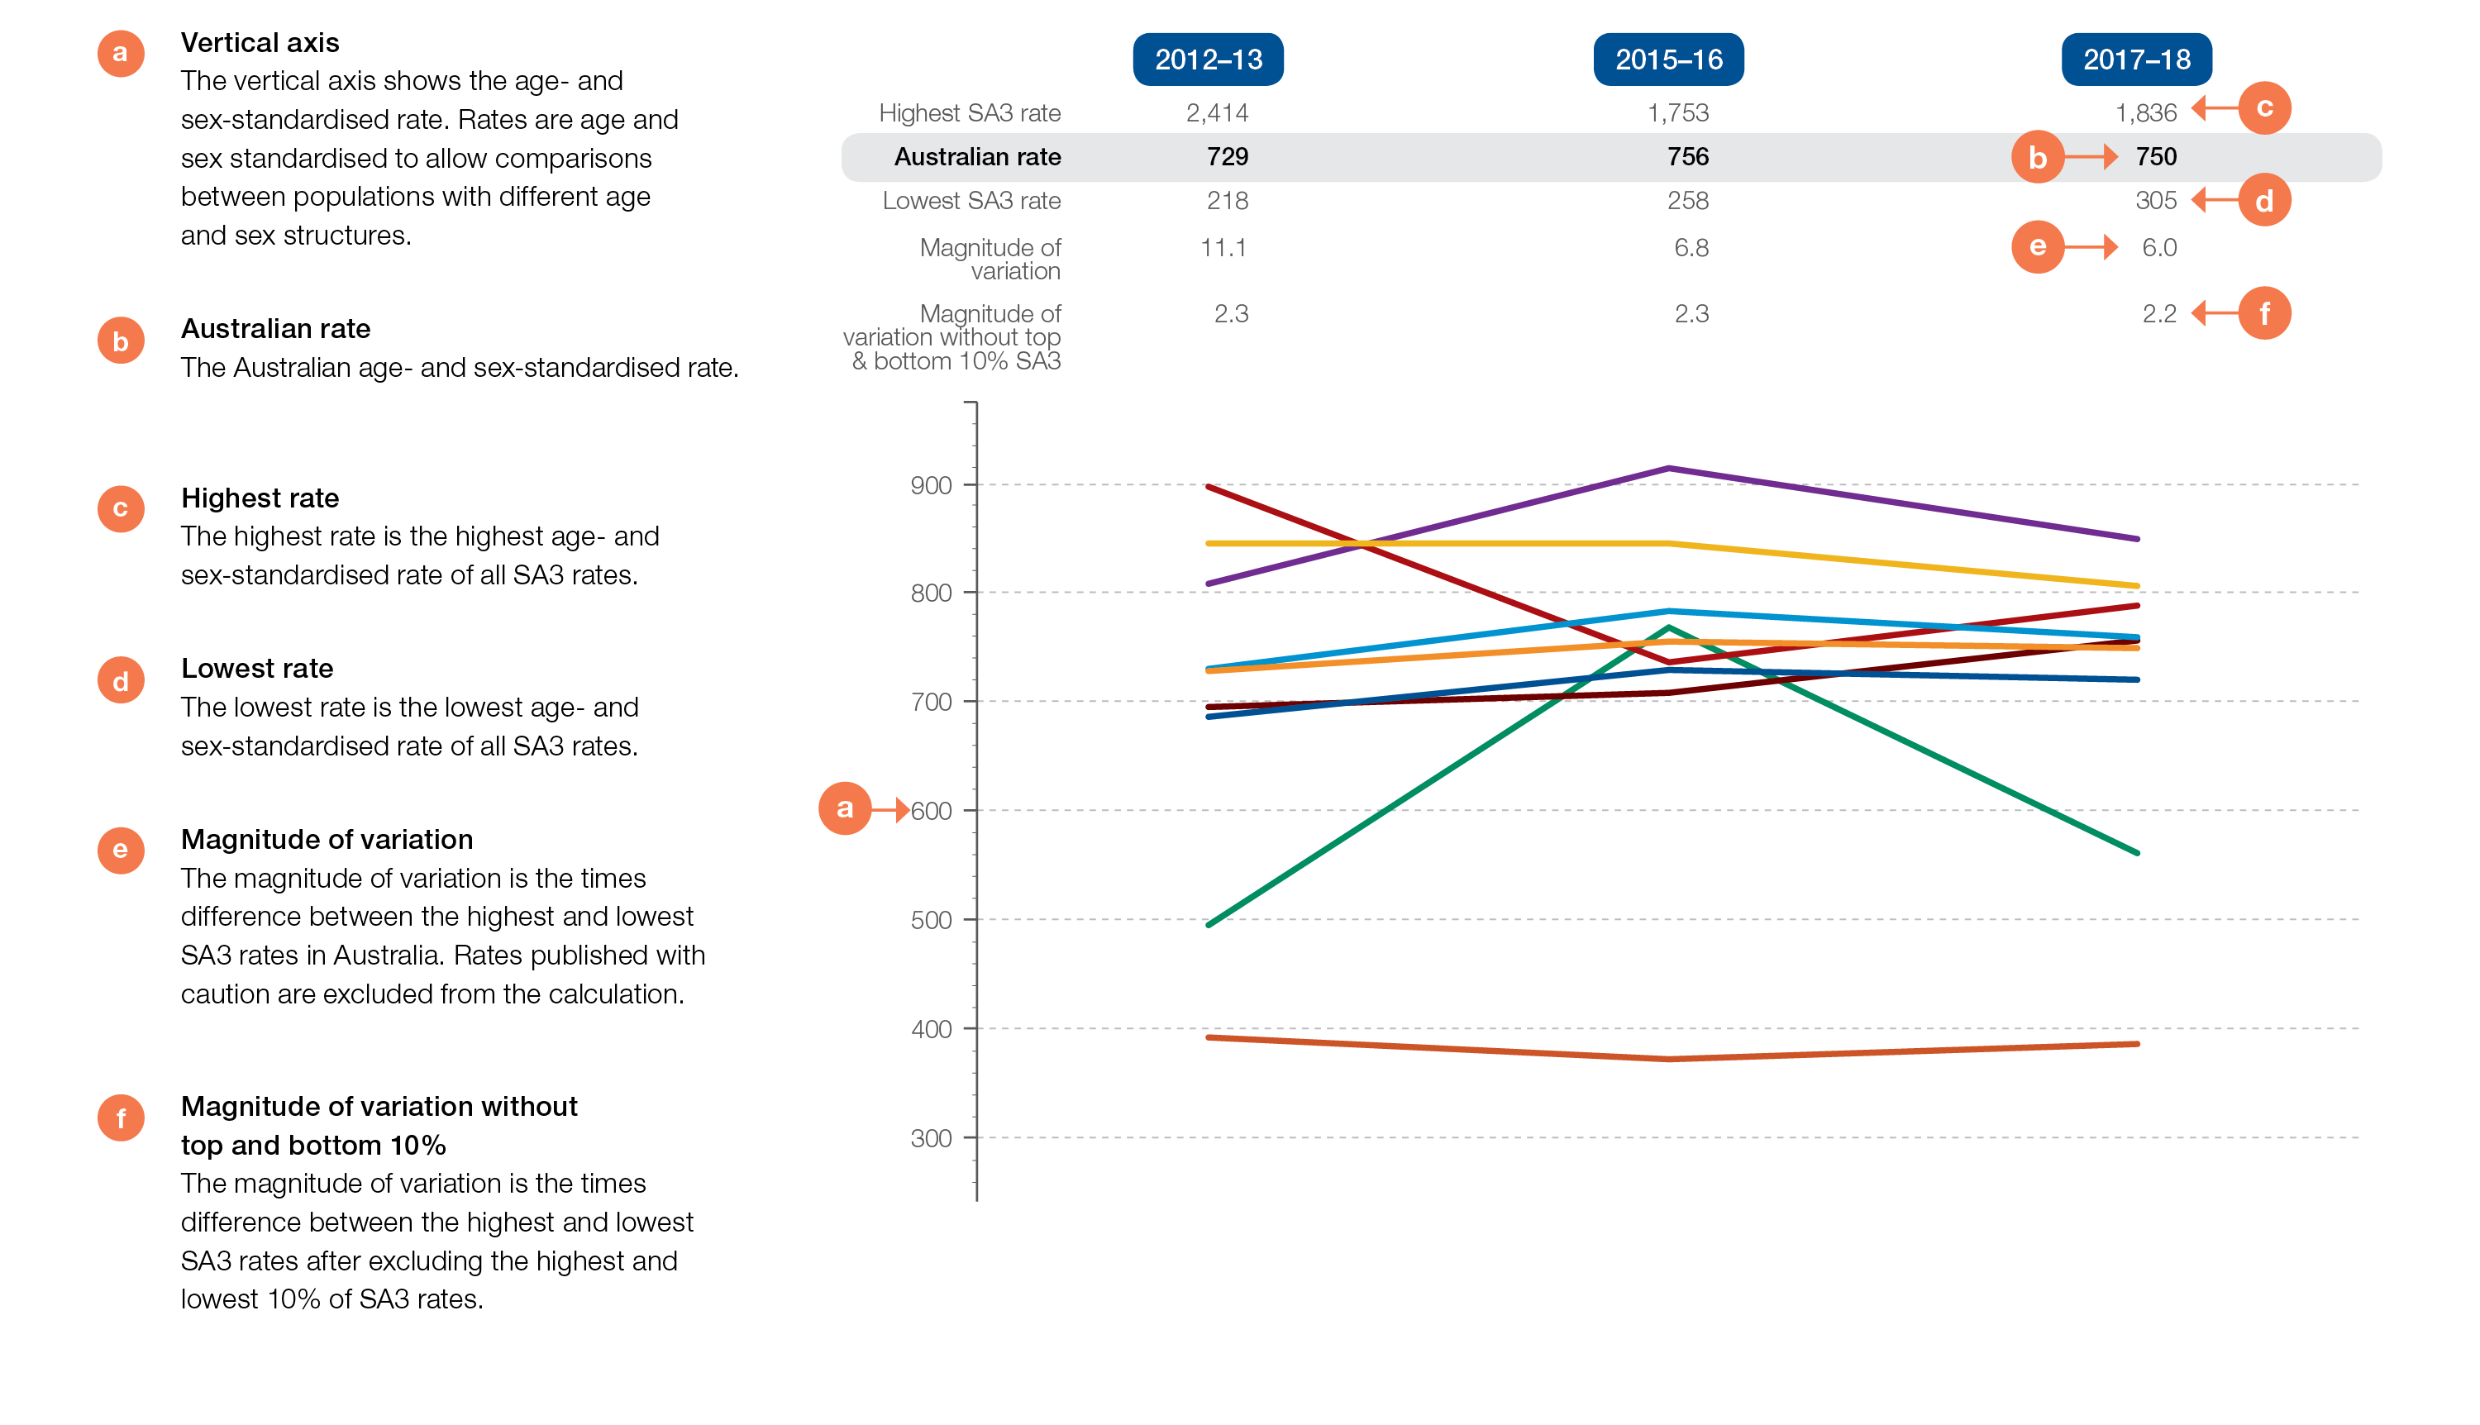
How to interpret our data visualisations
Rates across years line graph

Slide 7
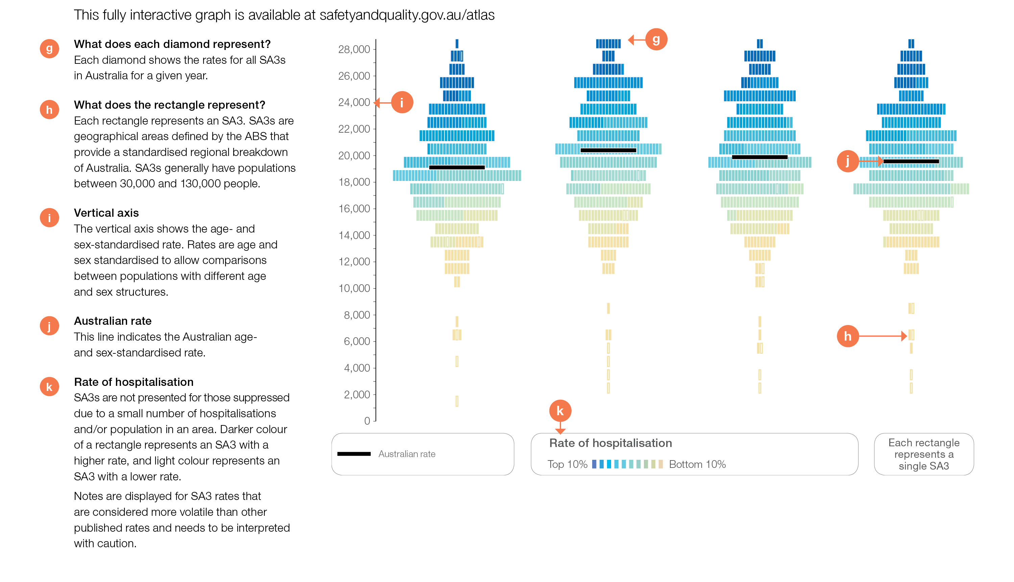
How to interpret our data visualisations
Rates across years graphic (interactive Atlas only)

Slide 8
Early planned births
Early planned births

Slide 9
Early planned births without medical or obstetric indication
Key findings
Gestational age | Range of state and territory rates* for caesarean sections without a medical or obstetric indication, as a percentage of all caesarean sections at these gestational ages, 2017
<37 weeks | 13.3–19.3%
<38 weeks | 24.8–32.7%
<39 weeks | 42.8–56.1%
* Excludes Northern Territory
Gestational age | Range of state and territory rates* for induction of labour without a medical or obstetric indication, as a percentage of all inductions at this gestational age
<39 weeks | 0.2–6.0%
* Excludes New South Wales and the Northern Territory
Early planned births

Slide 10
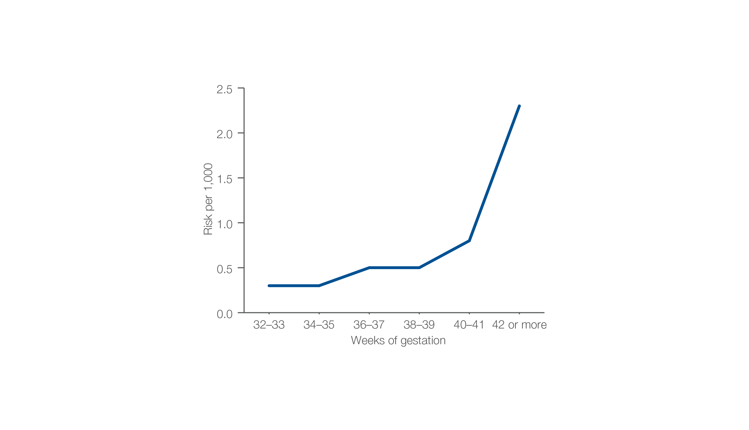
Risk of stillbirth per 1,000 fetuses remaining in utero
Gestational age in weeks, 2015 and 2016
Source: Stillbirths and Neonatal Deaths in Australia 2015 and 2016: In brief.
Early planned births

Slide 11
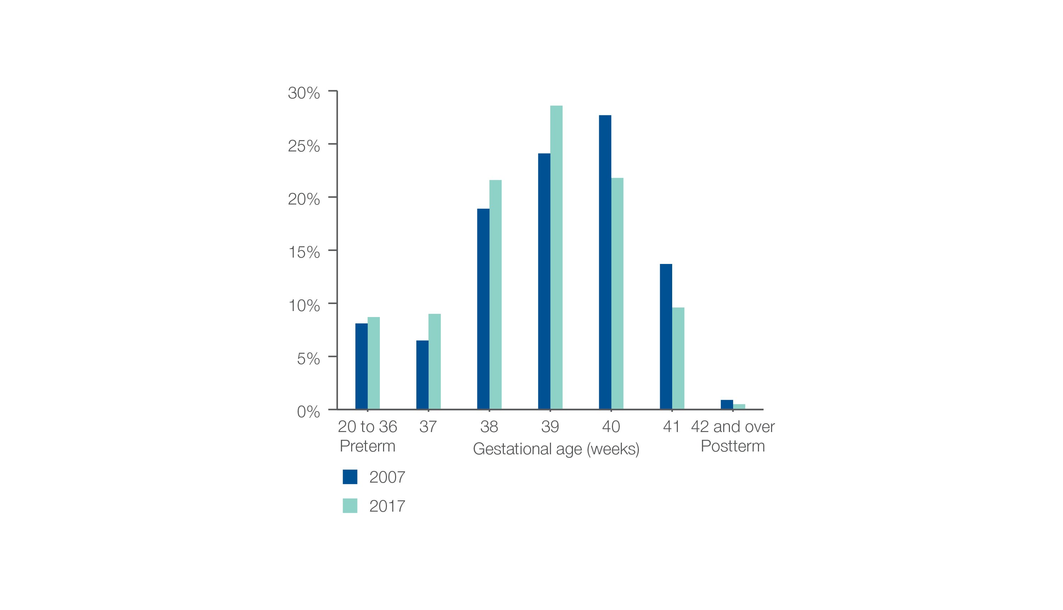
Percentage of babies
Gestational age in weeks, 2007 and 2017
Source: Australia’s Mothers and Babies 2017: In brief.
Early planned births

Slide 12
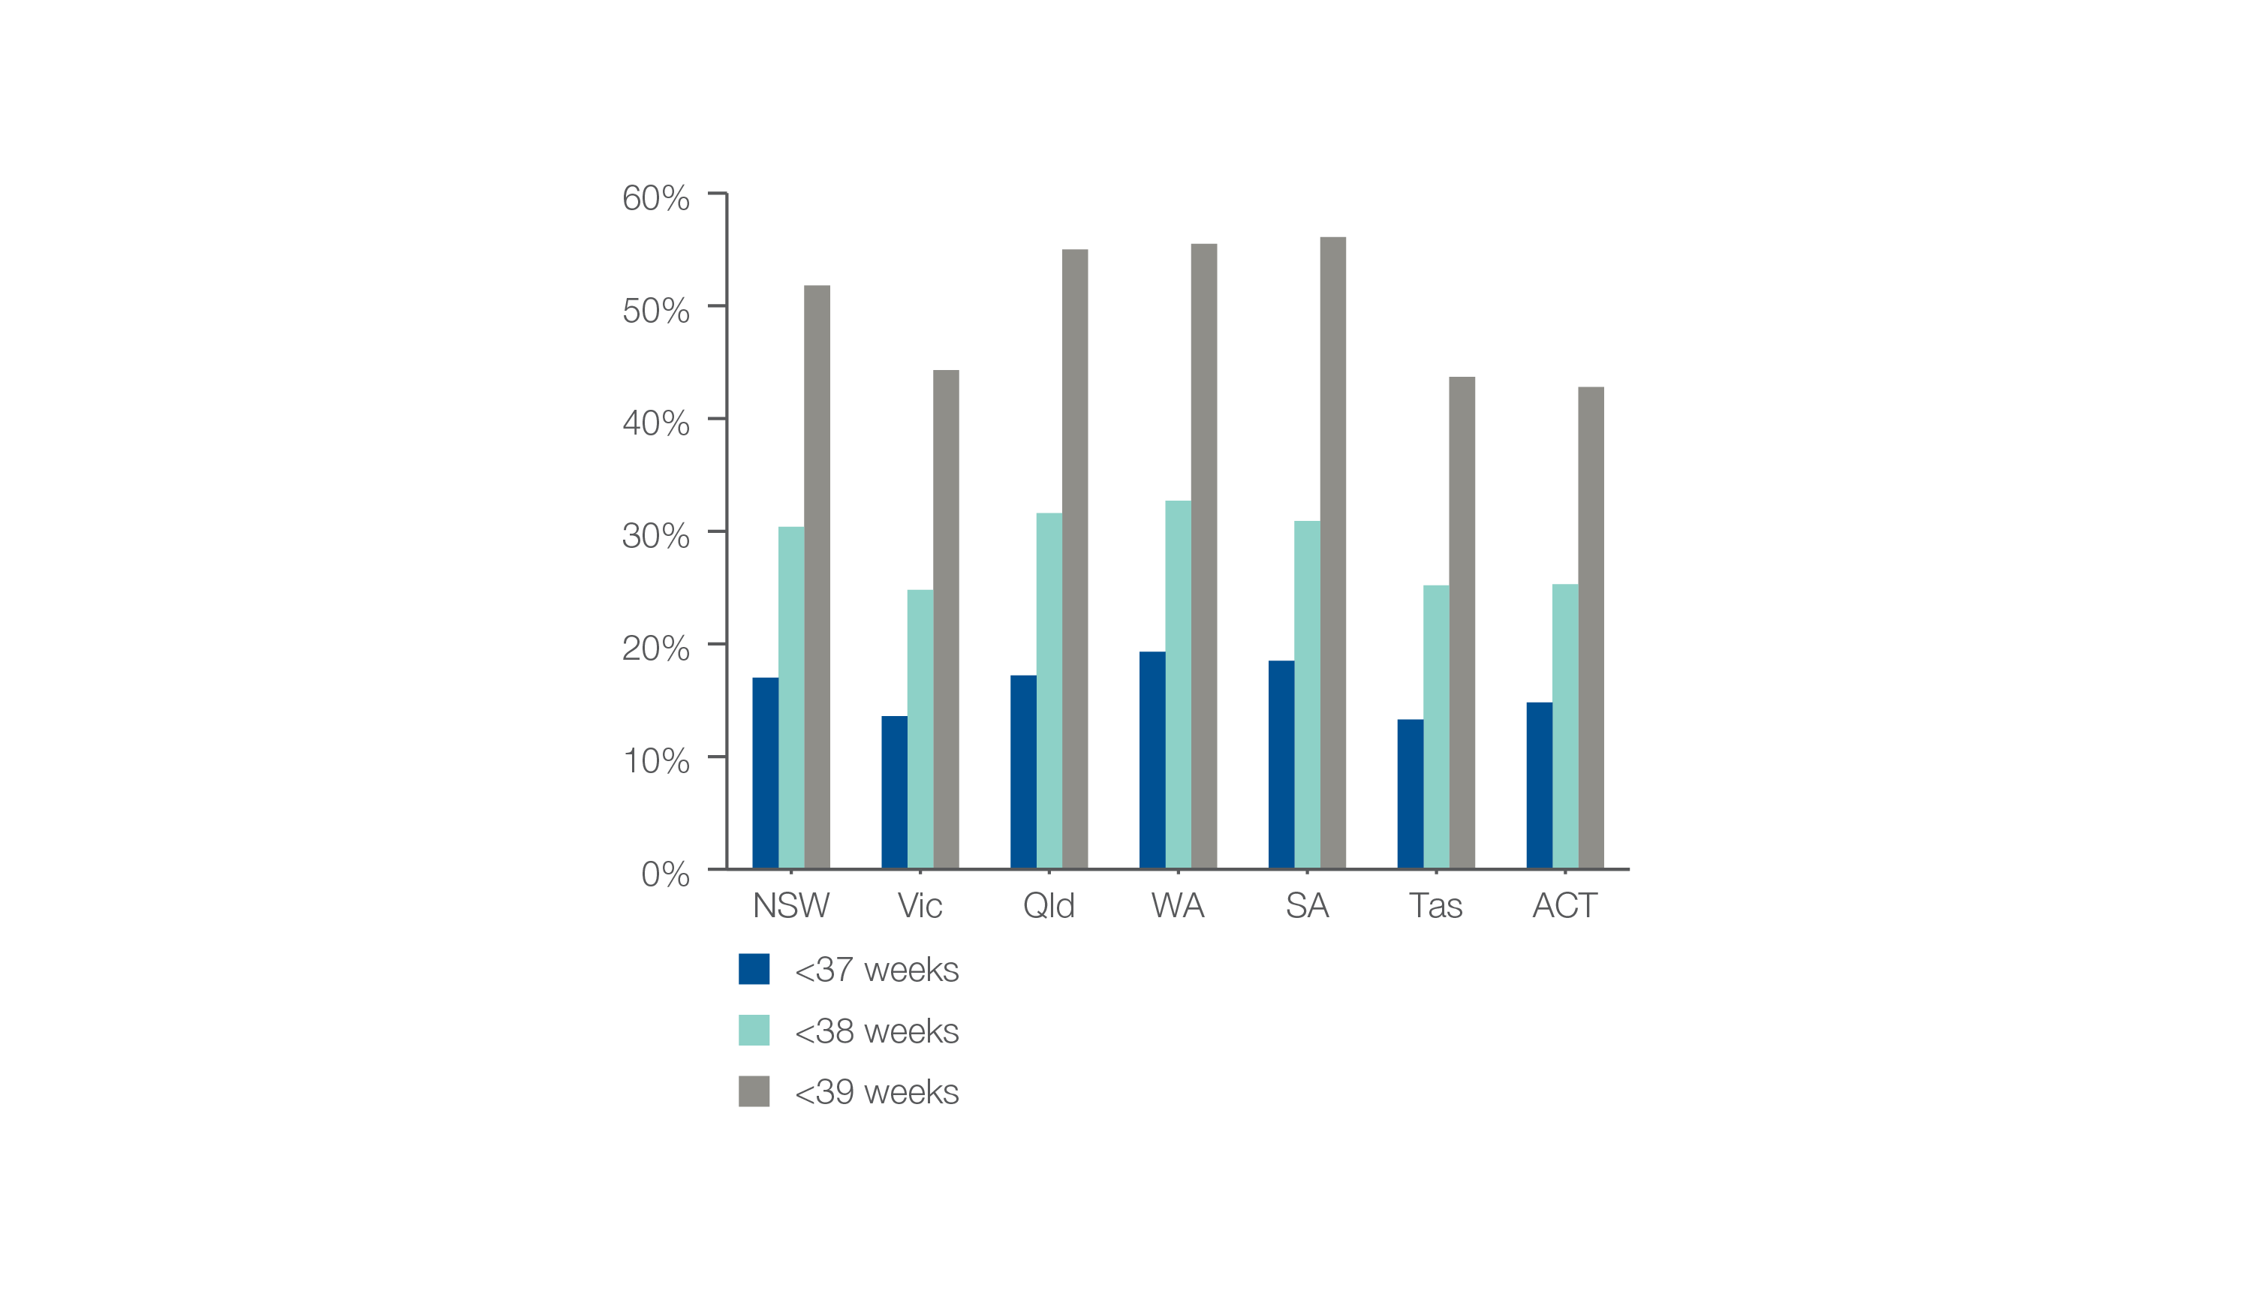
Caesarean sections at <37, <38 or <39 weeks without a medical or obstetric indication
As a percentage of all caesarean sections at these gestational ages, 2017
Source: AIHW analysis of National Perinatal Data Collection.
Early planned births

Slide 13
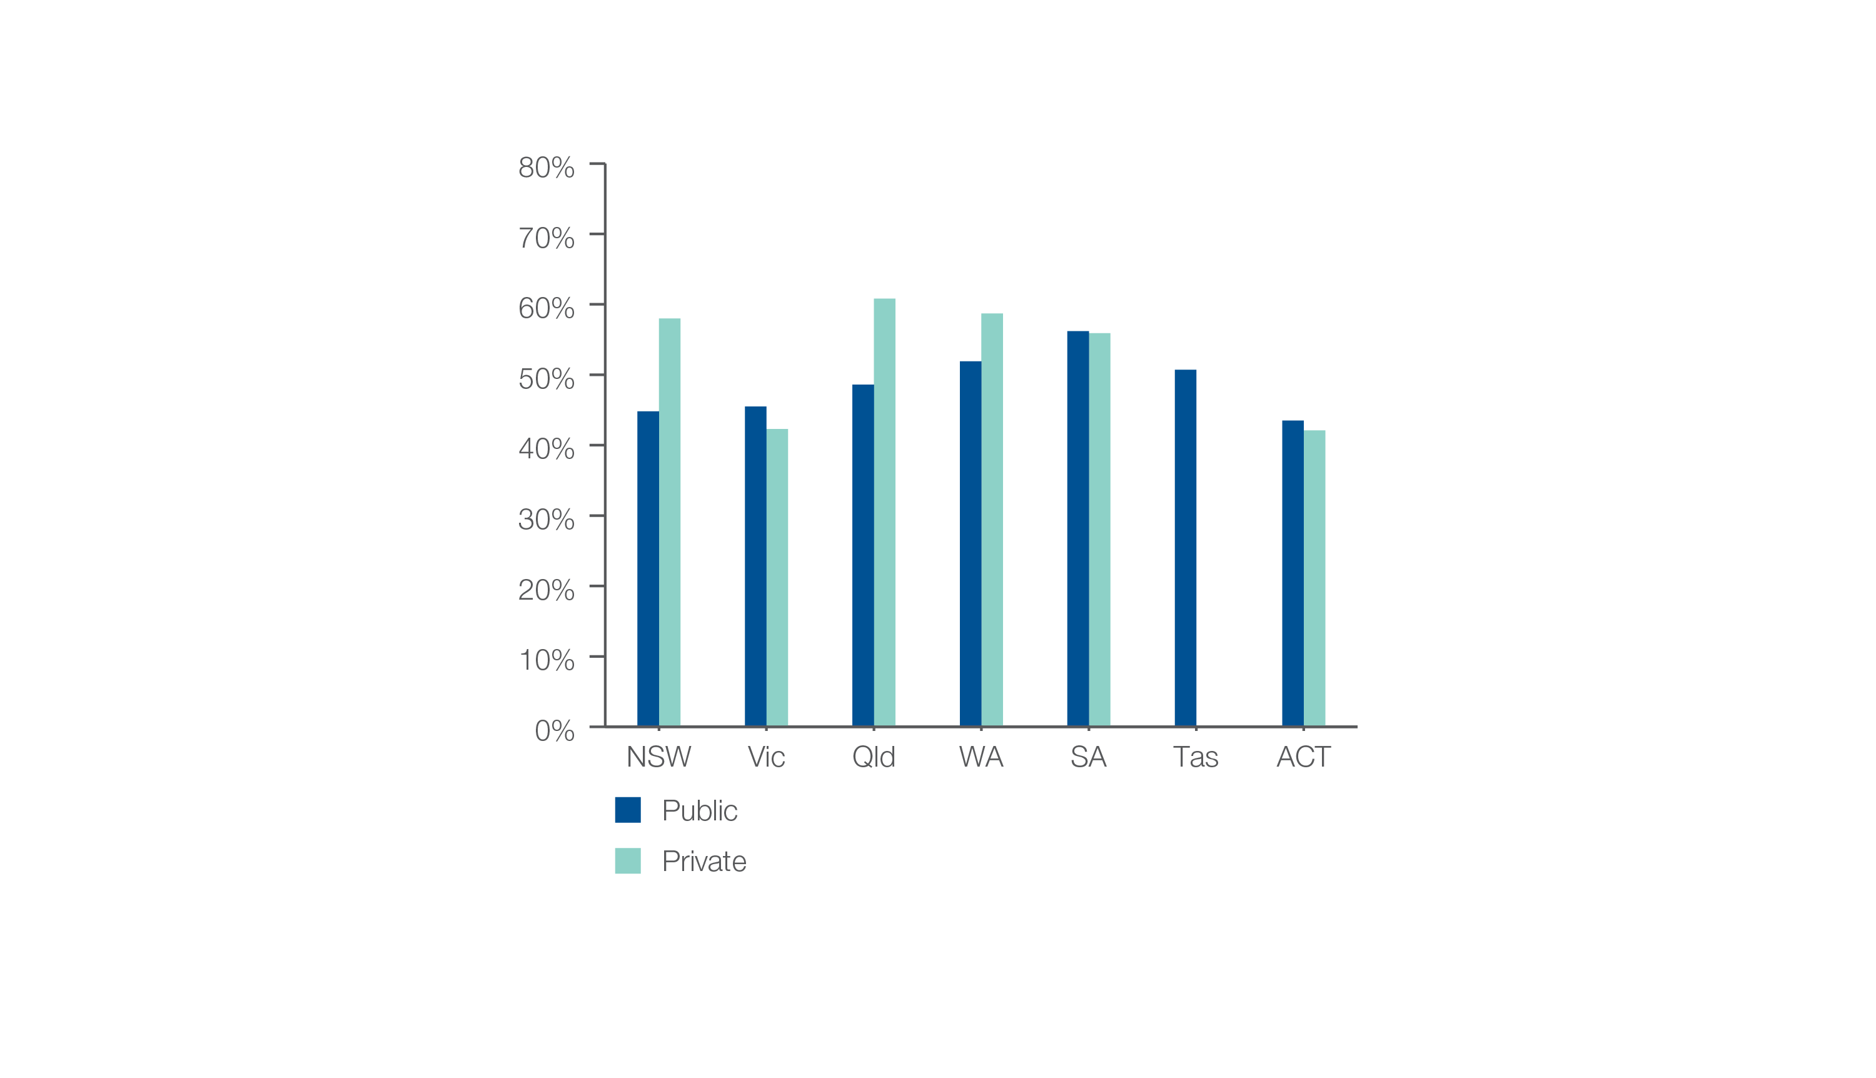
Caesarean sections at <39 weeks gestation without medical or obstetric indication
Patient funding status, 2017
Source: AIHW analysis of National Perinatal Data Collection.
Early planned births

Slide 14
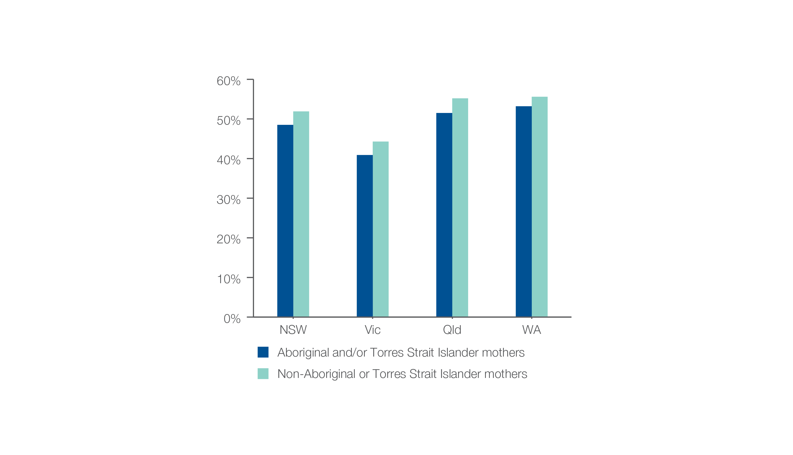
Caesarean sections at <39 weeks gestation without medical or obstetric indication
Aboriginal and Torres Strait Islander status, 2017
Source: AIHW analysis of National Perinatal Data Collection.
Early planned births

Slide 15
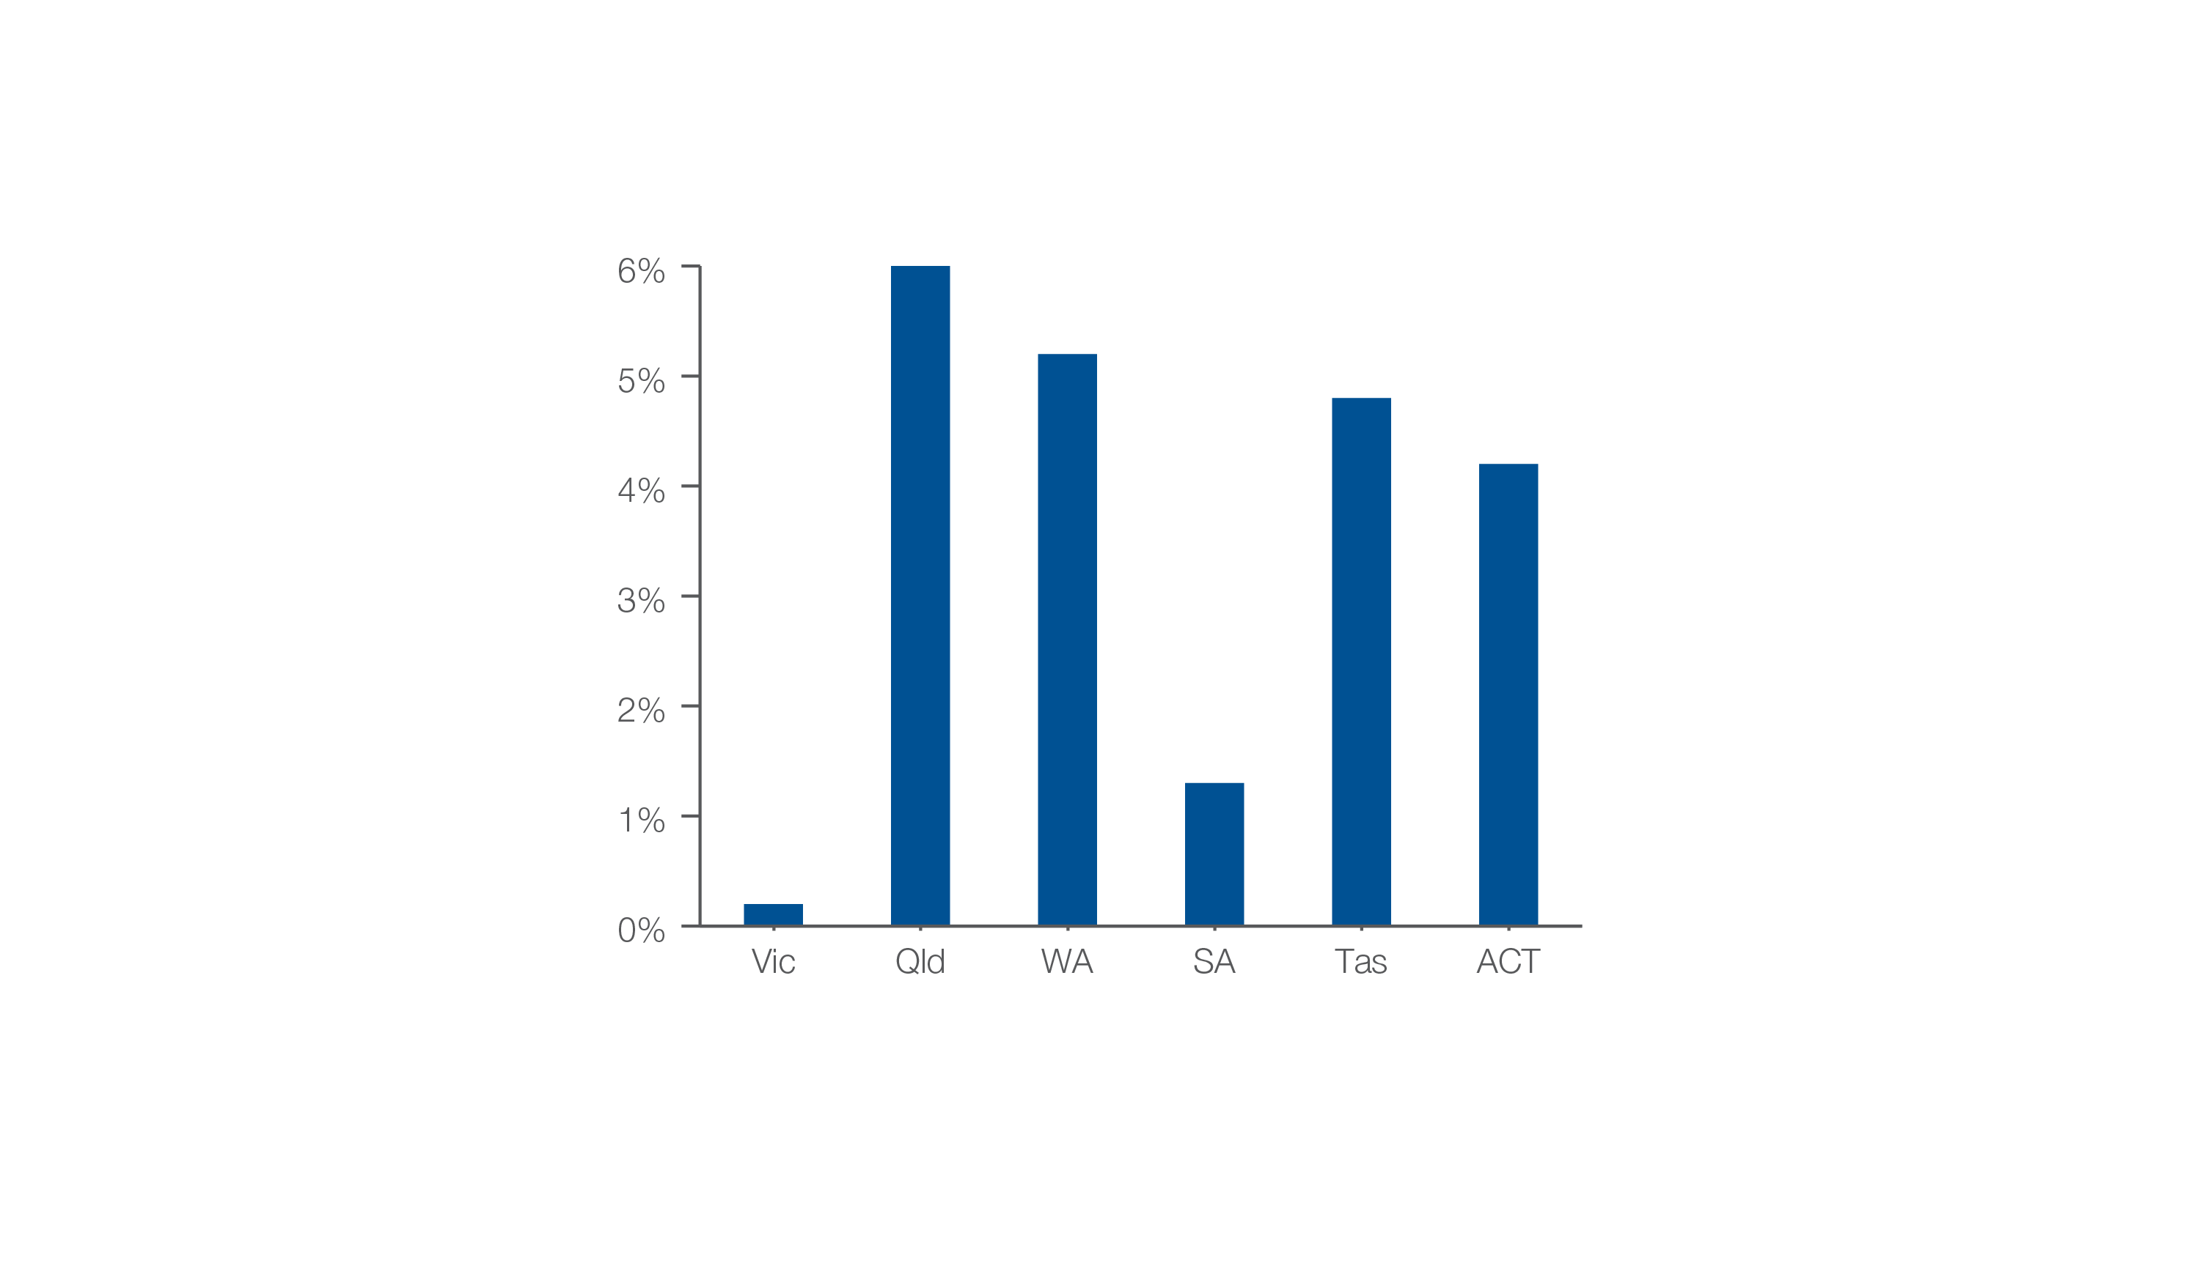
Inductions at <39 weeks gestation without a medical or obstetric indication
As a percentage of all inductions at <39 weeks, 2017
Source: AIHW analysis of National Perinatal Data Collection.
Early planned births

Slide 16
Chronic disease and infection: potentially preventable hospitalisations
Chronic disease and infection: potentially preventable hospitalisations

Slide 17
Chronic disease and infection: potentially preventable hospitalisations
Key findings, 2017-18
Data item | Range across local areas* per 100,000 | Times difference | Times difference excluding top and bottom 10% | Number during 2017–18
Chronic obstructive pulmonary disease (COPD) | 56 – 1,013 | 18.1 | 3.3 | 77,754
Heart failure | 91 – 531 | 5.8 | 2.0 | 62,554
Diabetes complications | 64 – 782 | 12.2 | 2.9 | 50,273
Kidney infections and urinary tract infections | 141 – 893 | 6.3 | 2.3 | 76,854
Cellulitis | 90 – 1,393 | 15.5 | 2.9 | 68,663
* Statistical Area Level 3
Chronic disease and infection: potentially preventable hospitalisations

Slide 18
Chronic disease and infection: potentially preventable hospitalisations
Key findings, 2014-15 to 2017-18
Data item | 2014-15* | 2015-16* | 2016-17* | 2017-18* | Per cent change
Chronic obstructive pulmonary disease (COPD) | 241 | 255 | 268 | 260 | 8%
Heart Failure | 194 | 207 | 208 | 201 | 4%
Diabetes complications | 172 | 181 | 177 | 184 | 7%
Kidney infections and urinary tract infections | 283 | 286 | 278 | 281 | - 1%
Cellulitis | 235 | 250 | 265 | 256 | 9%
* Australian age and sex standardised rate given as hospitalisations per 100,000 people
Chronic disease and infection: potentially preventable hospitalisations

Slide 19
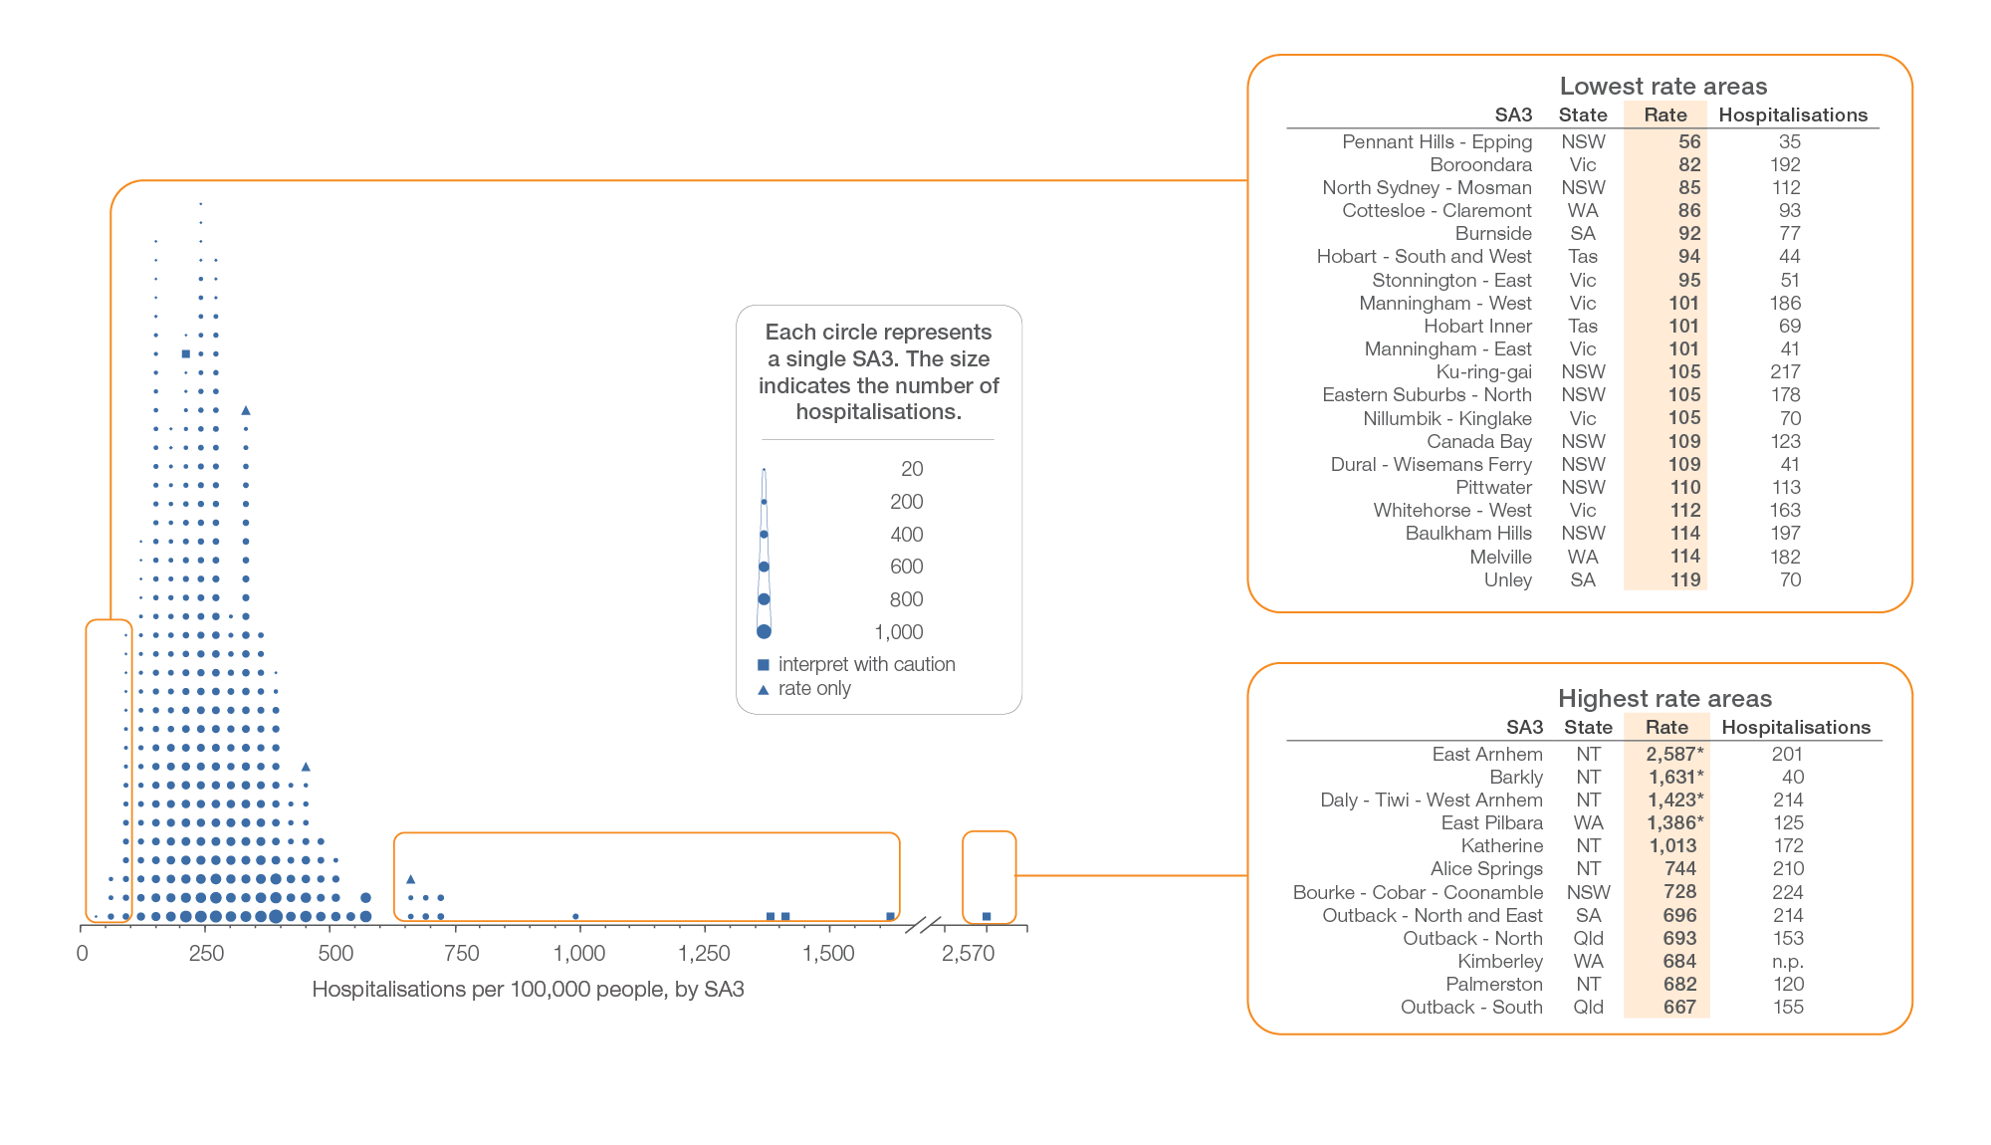
Chronic obstructive pulmonary disease (COPD)
Local area, SA3 of patient residence, 2017-18
Sources: AIHW analysis of National Hospital Morbidity Database and ABS Estimated Resident Populations 30 June of 2017 and 2018.
Chronic disease and infection: potentially preventable hospitalisations

Slide 20
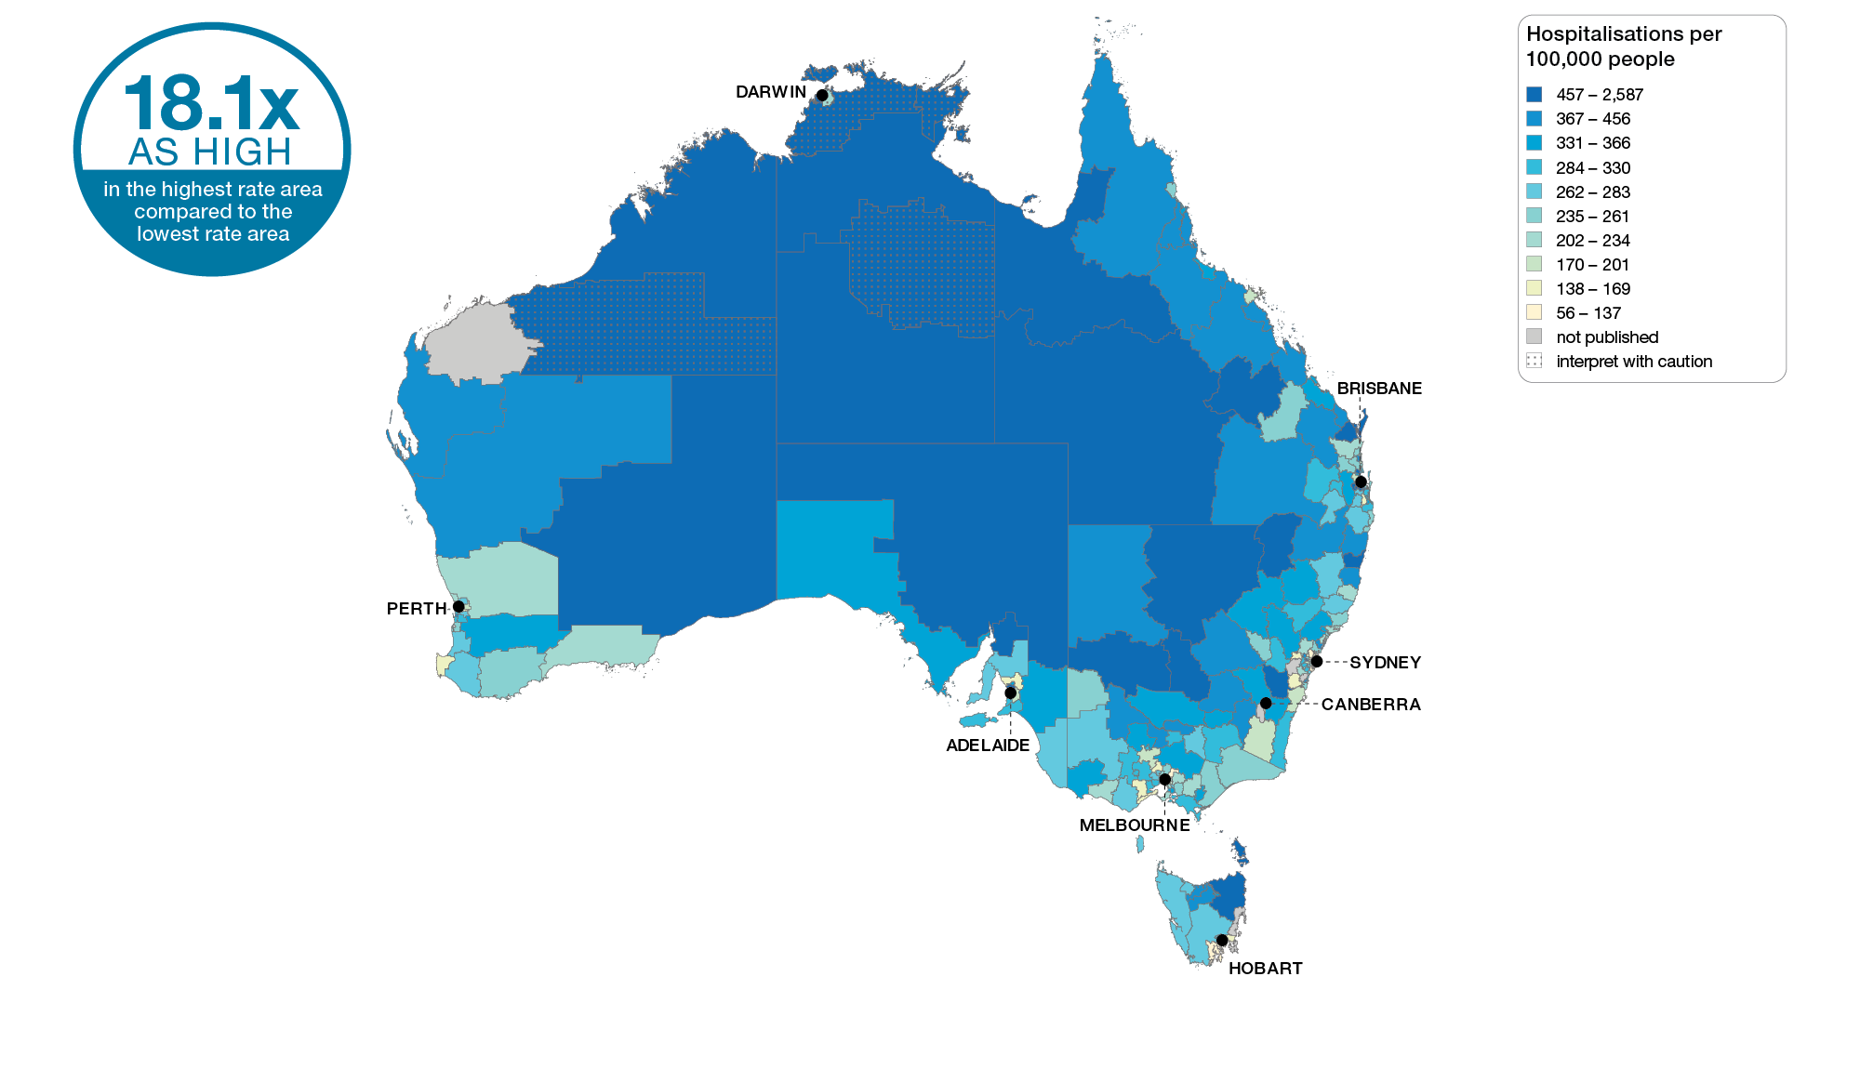
Chronic obstructive pulmonary disease (COPD)
Australia, SA3 of patient residence, 2017-18
Sources: AIHW analysis of National Hospital Morbidity Database and ABS Estimated Resident Populations 30 June of 2017 and 2018.
Chronic disease and infection: potentially preventable hospitalisations

Slide 21
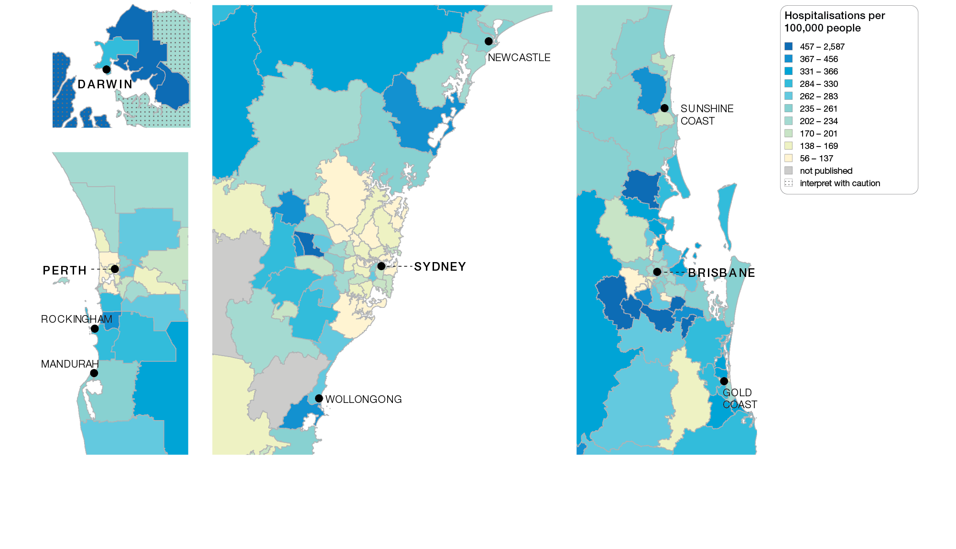
Chronic obstructive pulmonary disease (COPD)
Capital cities, SA3 of patient residence, 2017-18
Sources: AIHW analysis of National Hospital Morbidity Database and ABS Estimated Resident Populations 30 June of 2017 and 2018.
Chronic disease and infection: potentially preventable hospitalisations

Slide 22
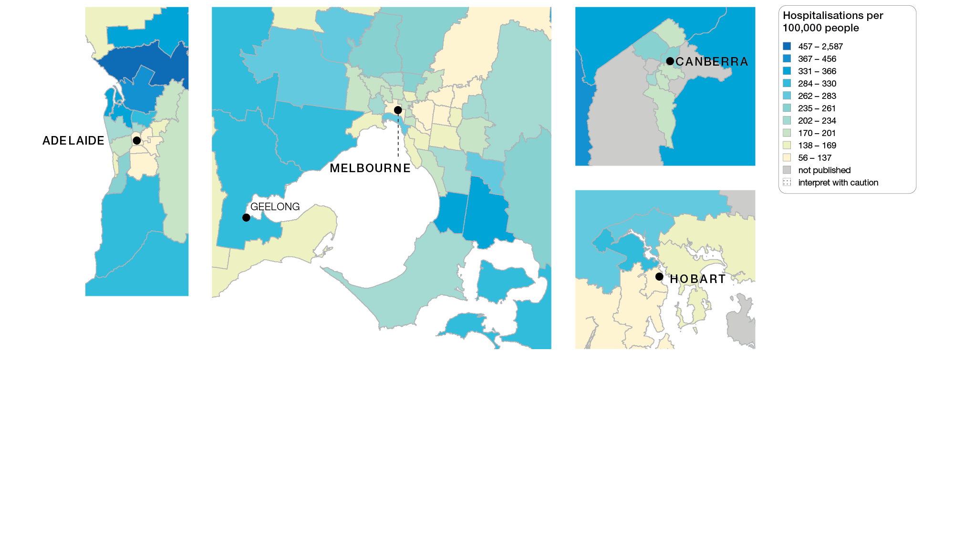
Chronic obstructive pulmonary disease (COPD)
Capital cities, SA3 of patient residence, 2017-18
Sources: AIHW analysis of National Hospital Morbidity Database and ABS Estimated Resident Populations 30 June of 2017 and 2018.
Chronic disease and infection: potentially preventable hospitalisations

Slide 23
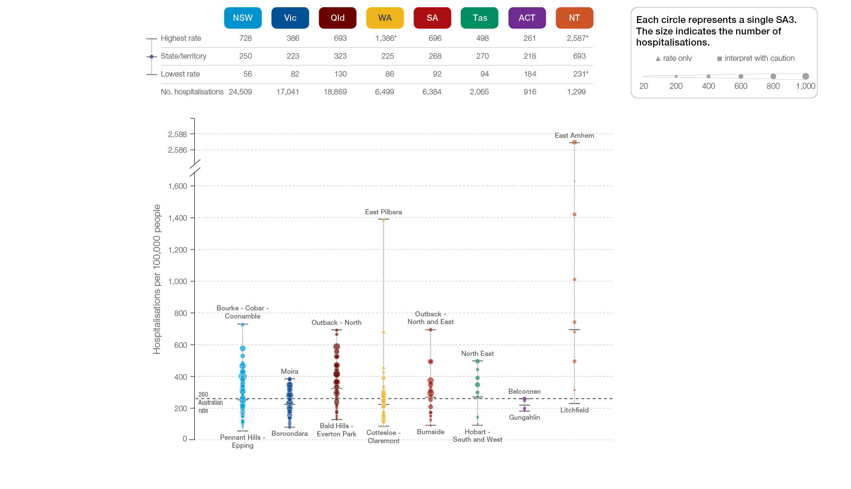
Chronic obstructive pulmonary disease (COPD)
State and territory, SA3 of patient residence, 2017-18
Sources: AIHW analysis of National Hospital Morbidity Database and ABS Estimated Resident Populations 30 June of 2017 and 2018.
Chronic disease and infection: potentially preventable hospitalisations

Slide 24
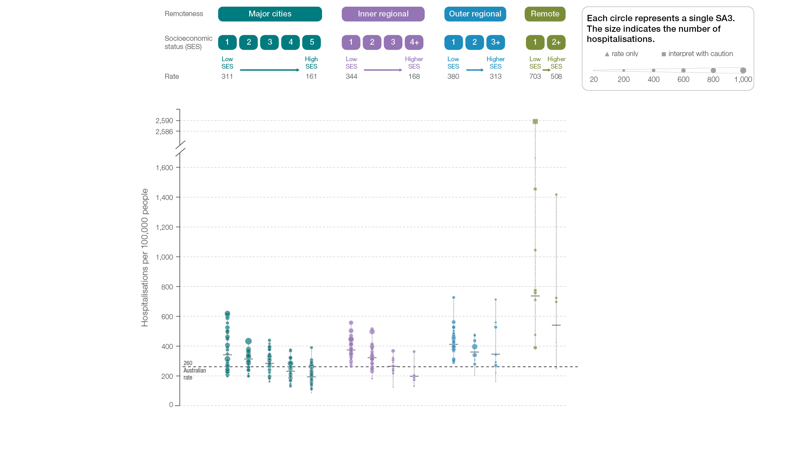
Chronic obstructive pulmonary disease (COPD)
Remoteness and socioeconomic status, SA3 of patient residence, 2017-18
Sources: AIHW analysis of National Hospital Morbidity Database and ABS Estimated Resident Populations 30 June of 2017 and 2018.
Chronic disease and infection: potentially preventable hospitalisations

Slide 25
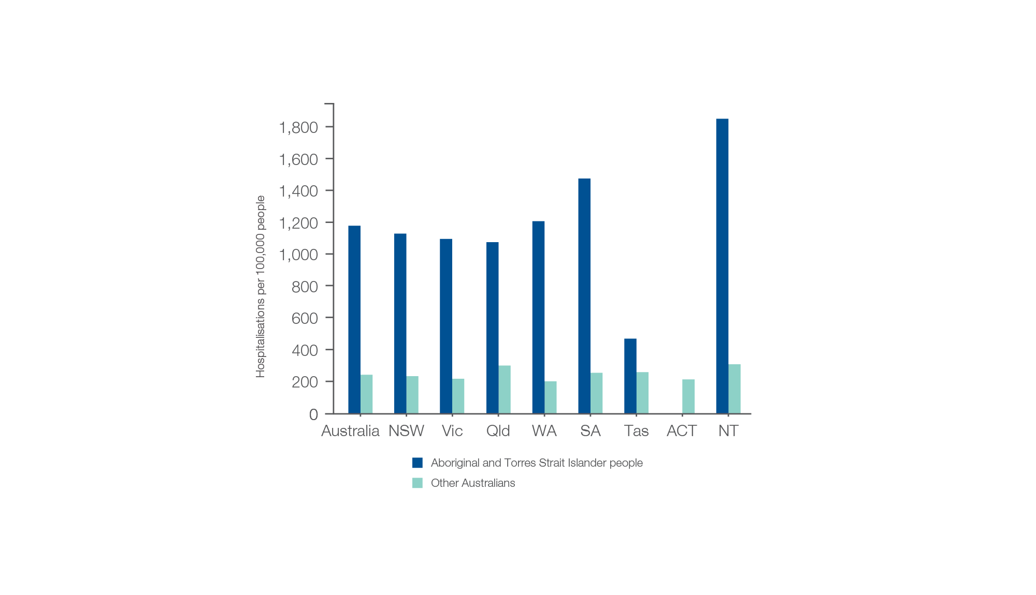
Chronic obstructive pulmonary disease (COPD)
Aboriginal and Torres Strait Islander status, 2017-18
Sources: AIHW analysis of National Hospital Morbidity Database and ABS Estimated Resident Populations 30 June of 2017 and 2018.
Chronic disease and infection: potentially preventable hospitalisations

Slide 26
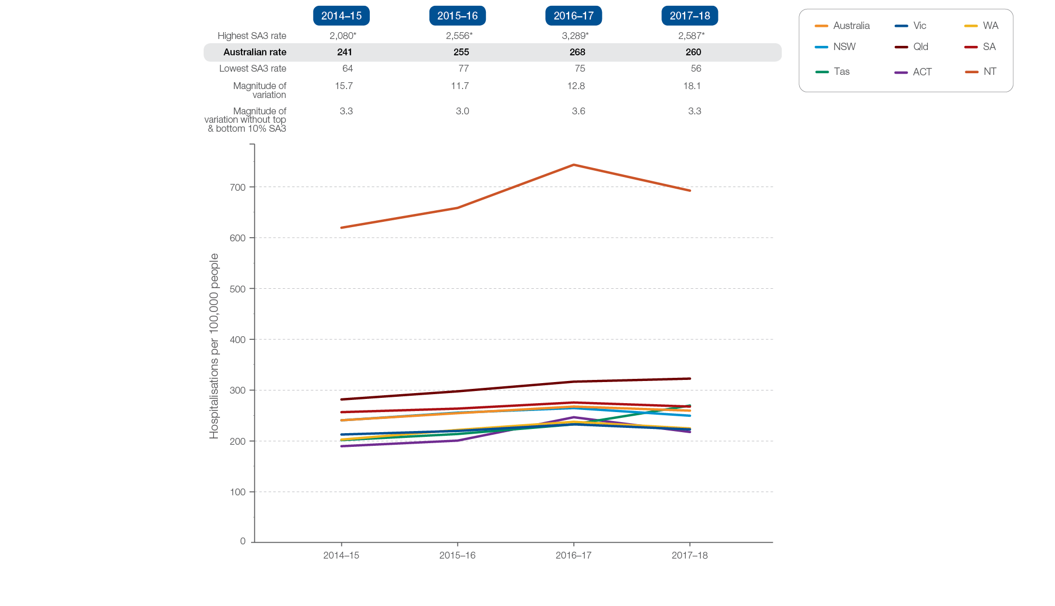
Chronic obstructive pulmonary disease (COPD)
Rates across years, 2014-15 to 2017-18
Sources: AIHW analysis of National Hospital Morbidity Database and ABS Estimated Resident Populations 30 June of 2014 to 2018.
Chronic disease and infection: potentially preventable hospitalisations

Slide 27
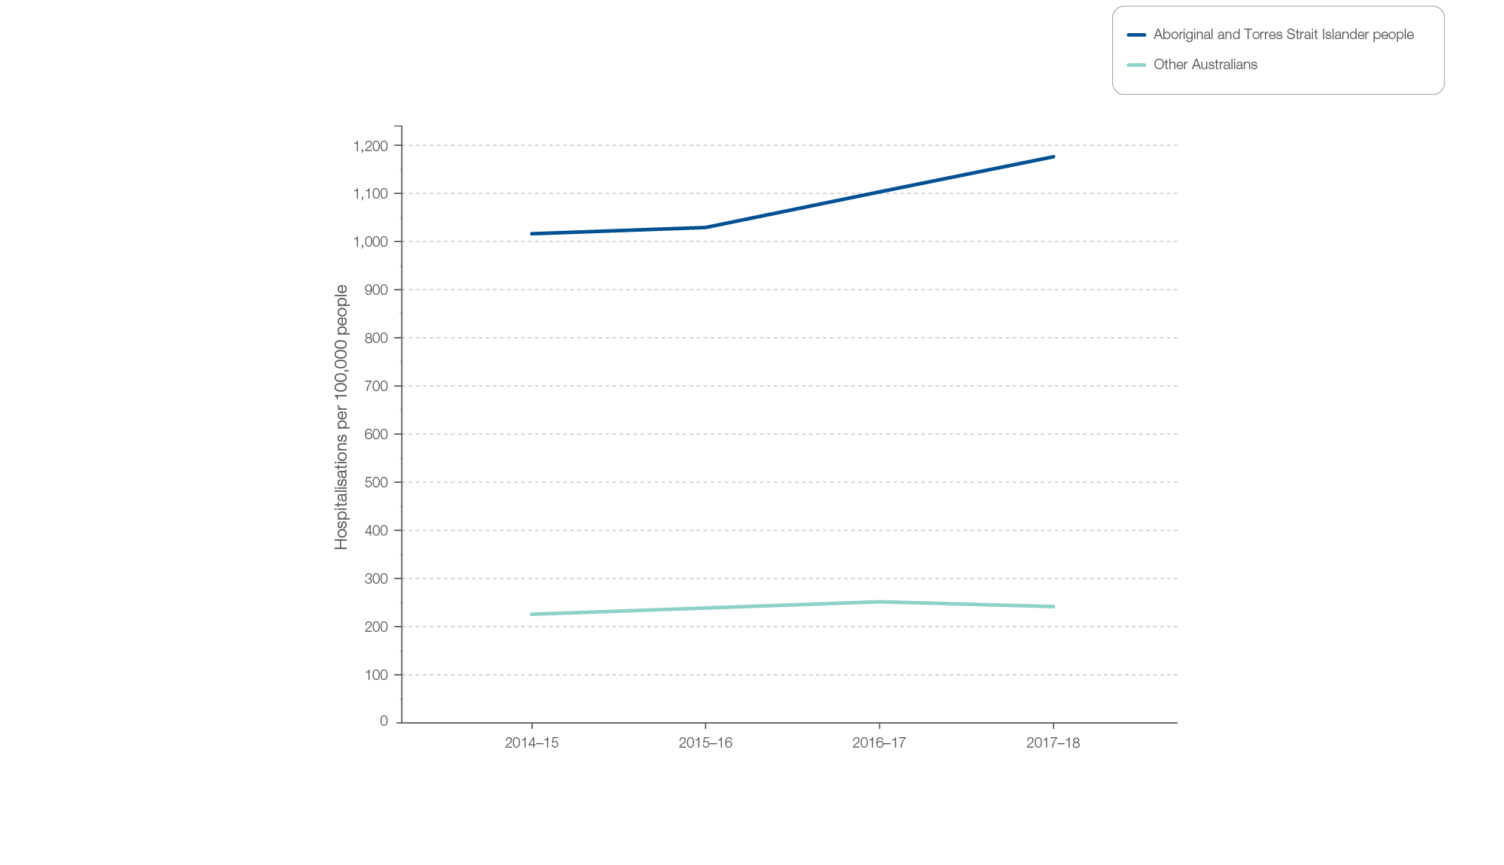
Chronic obstructive pulmonary disease (COPD)
Aboriginal and Torres Strait Islander status, 2014-15 to 2017-18
Sources: AIHW analysis of National Hospital Morbidity Database and ABS Estimated Resident Populations 30 June of 2014 to 2018.
Chronic disease and infection: potentially preventable hospitalisations

Slide 28
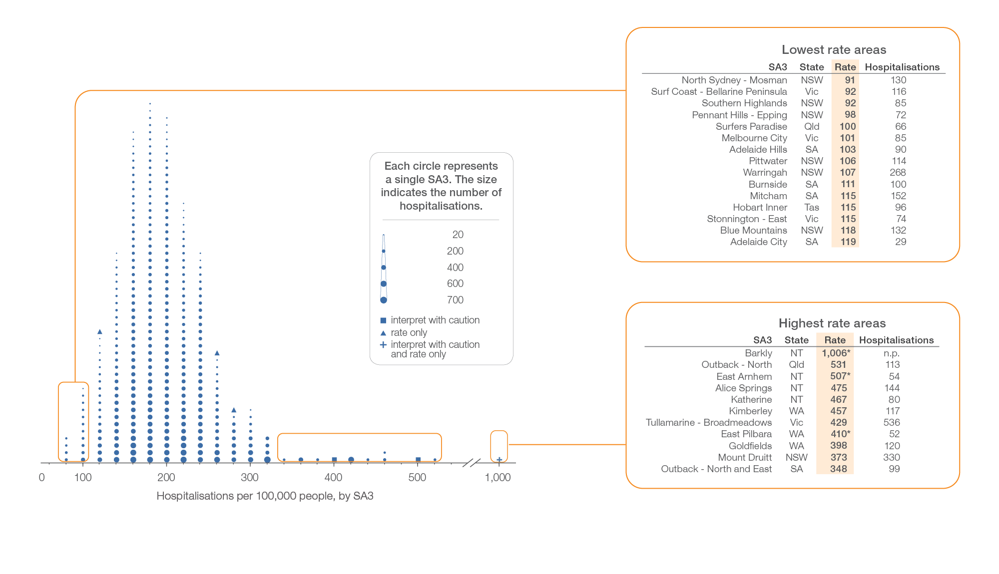
Heart failure
Local area, SA3 of patient residence, 2017-18
Sources: AIHW analysis of National Hospital Morbidity Database and ABS Estimated Resident Populations 30 June of 2017 and 2018.
Chronic disease and infection: potentially preventable hospitalisations

Slide 29
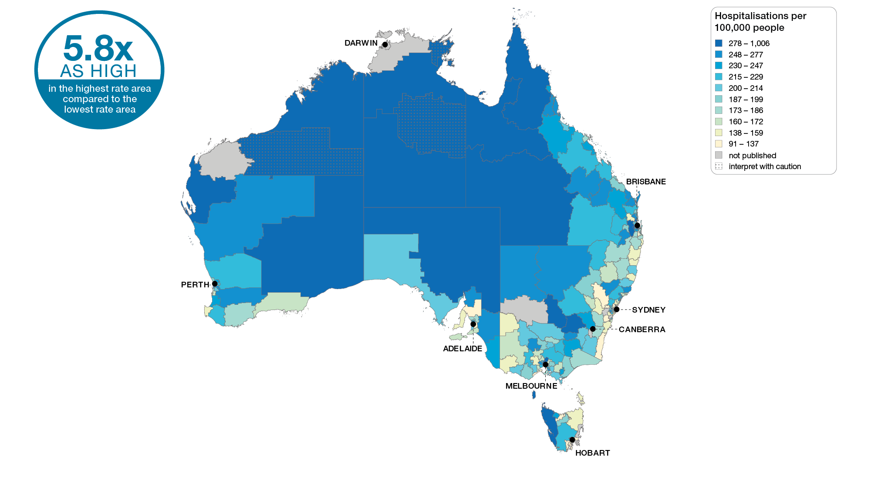
Heart failure
Australia, SA3 of patient residence, 2017-18
Sources: AIHW analysis of National Hospital Morbidity Database and ABS Estimated Resident Populations 30 June of 2017 and 2018.
Chronic disease and infection: potentially preventable hospitalisations

Slide 30
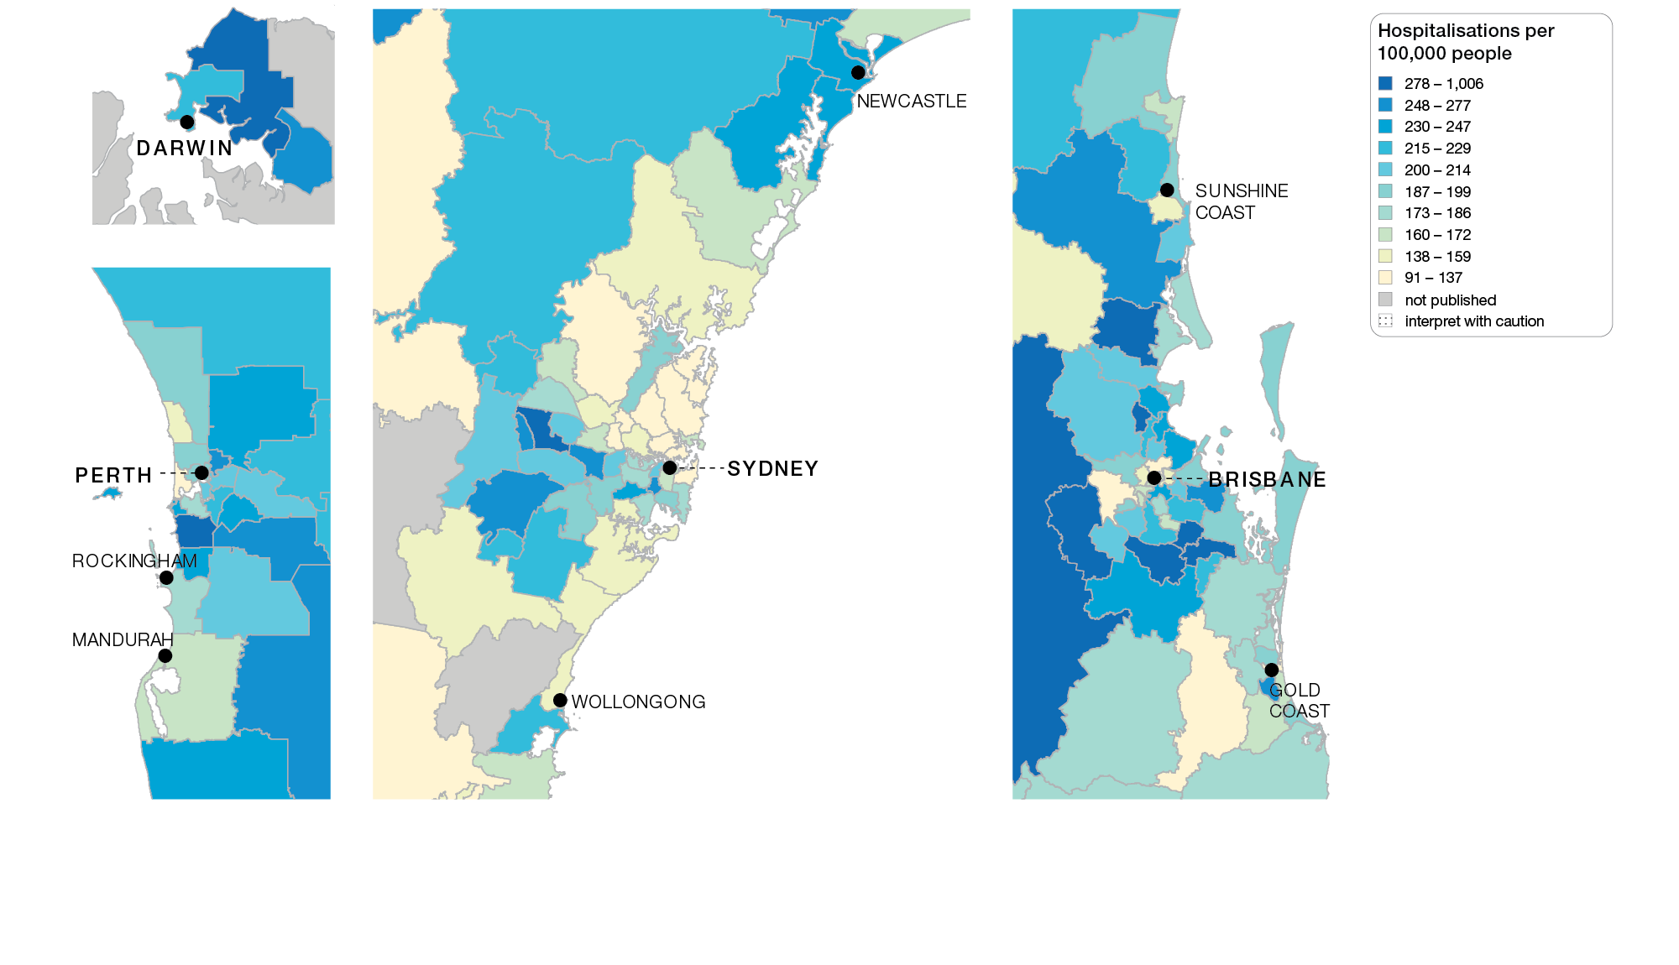
Heart failure
Capital cities, SA3 of patient residence, 2017-18
Sources: AIHW analysis of National Hospital Morbidity Database and ABS Estimated Resident Populations 30 June of 2017 and 2018.
Chronic disease and infection: potentially preventable hospitalisations

Slide 31
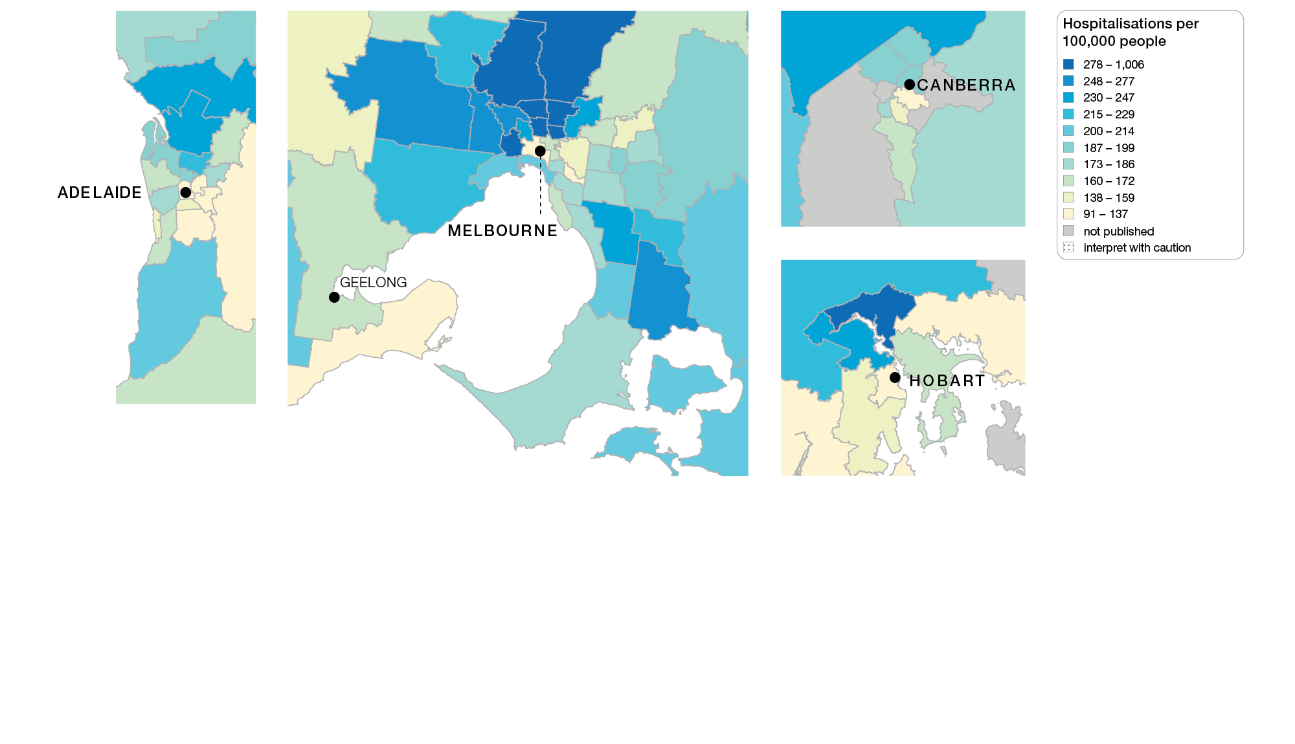
Heart failure
Capital cities, SA3 of patient residence, 2017-18
Sources: AIHW analysis of National Hospital Morbidity Database and ABS Estimated Resident Populations 30 June of 2017 and 2018.
Chronic disease and infection: potentially preventable hospitalisations

Slide 32
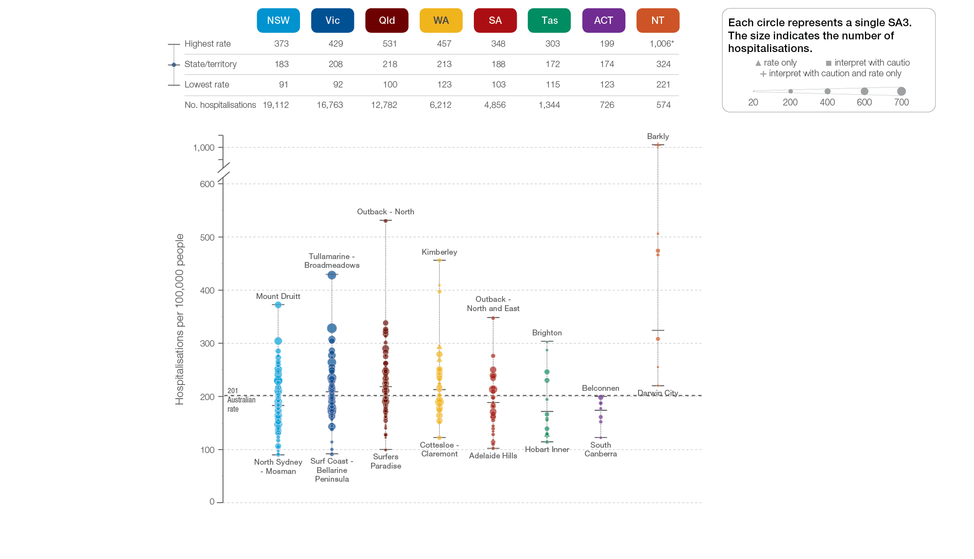
Heart failure
State and territory, SA3 of patient residence, 2017-18
Sources: AIHW analysis of National Hospital Morbidity Database and ABS Estimated Resident Populations 30 June of 2017 and 2018.
Chronic disease and infection: potentially preventable hospitalisations

Slide 33
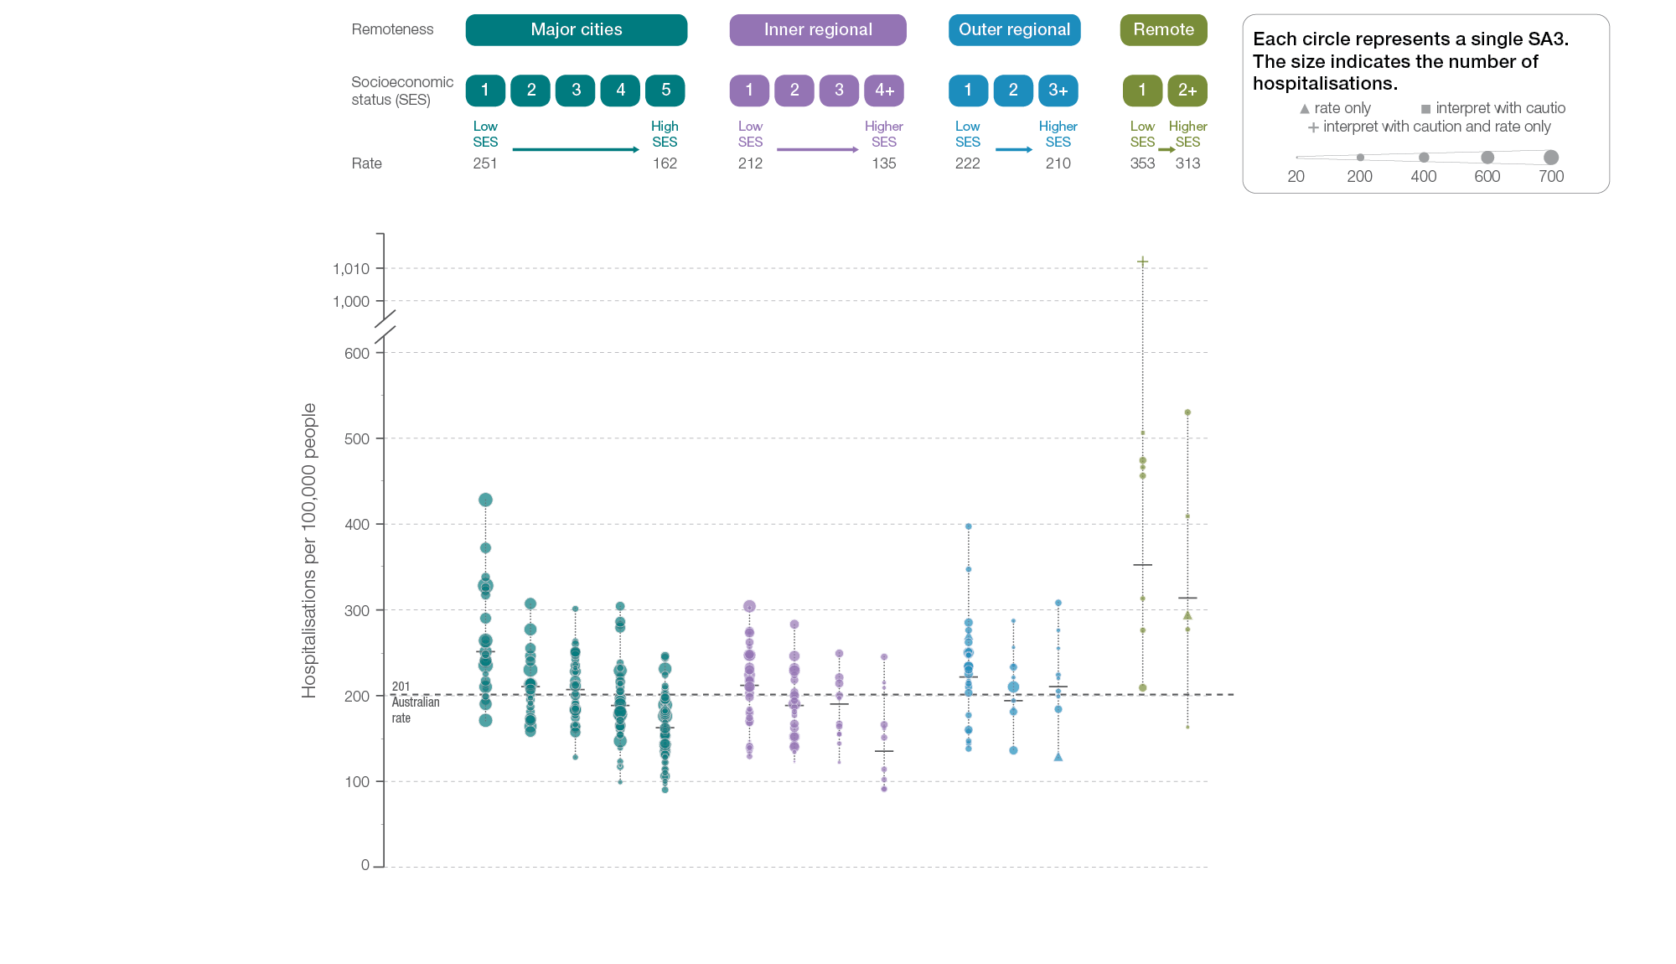
Heart failure
Remoteness and socioeconomic status, SA3 of patient residence, 2017-18
Sources: AIHW analysis of National Hospital Morbidity Database and ABS Estimated Resident Populations 30 June of 2017 and 2018.
Chronic disease and infection: potentially preventable hospitalisations

Slide 34
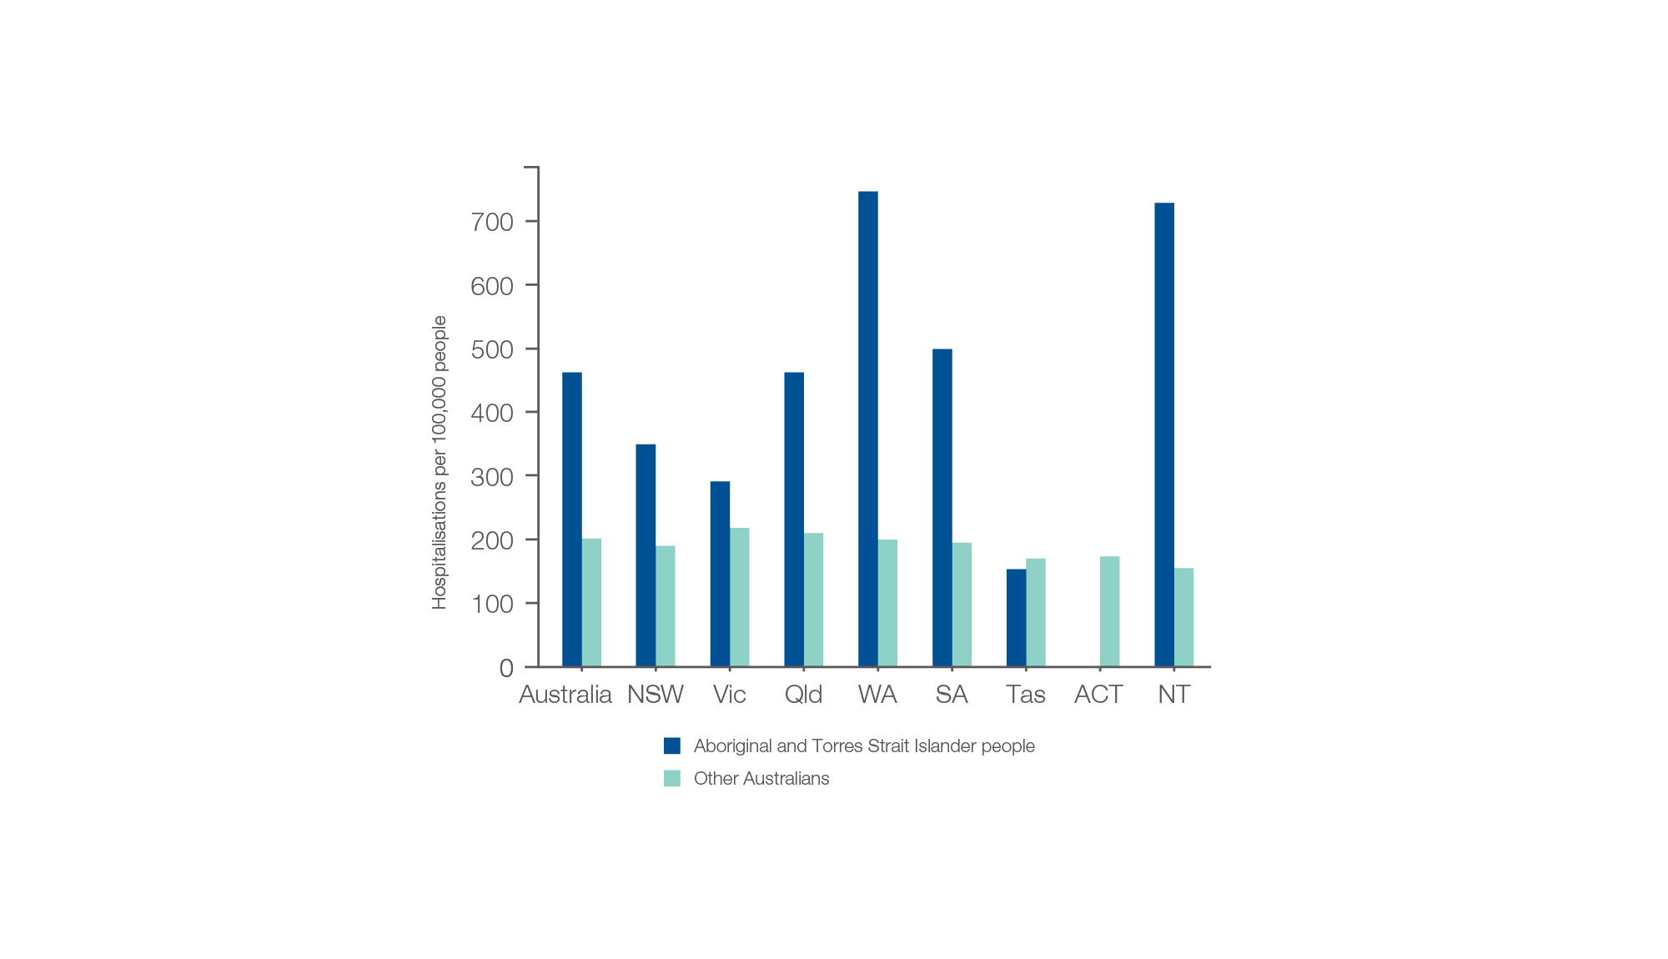
Heart failure
Aboriginal and Torres Strait Islander status, 2017-18
Sources:. AIHW analysis of National Hospital Morbidity Database and ABS Estimated Resident Populations 30 June of 2014 to 2018
Chronic disease and infection: potentially preventable hospitalisations

Slide 35
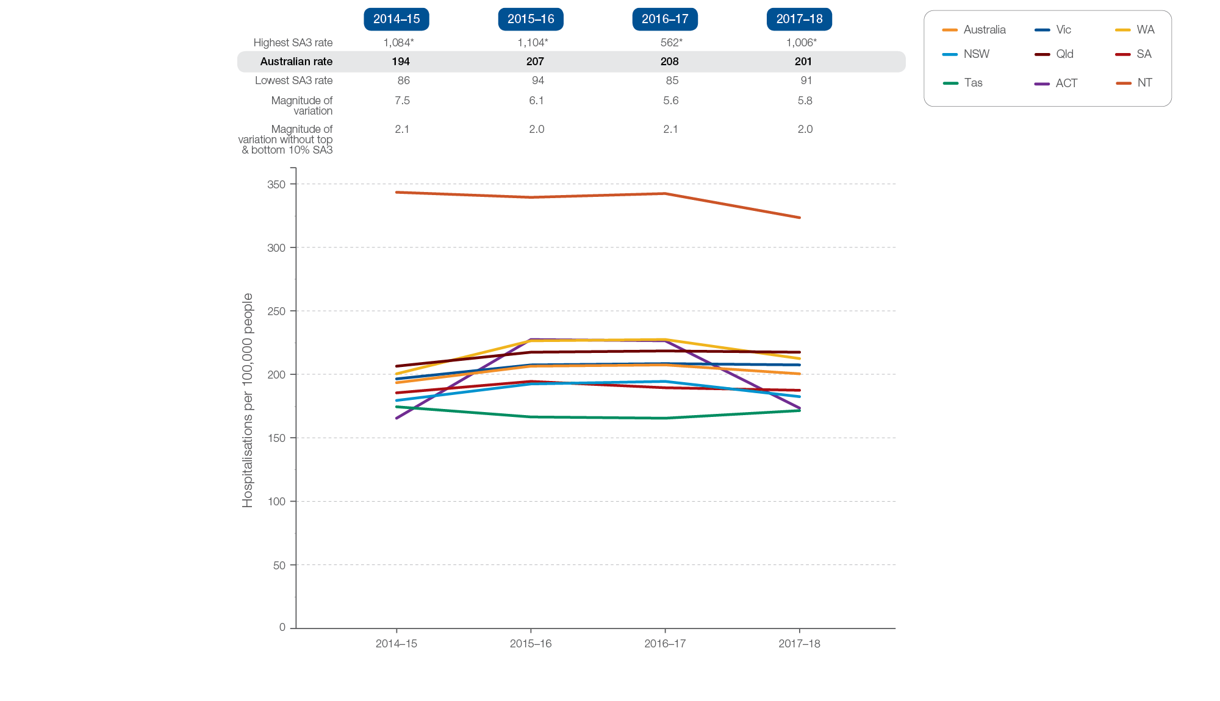
Heart failure
Rates across years, 2014-15 to 2017-18
Sources: AIHW analysis of National Hospital Morbidity Database and ABS Estimated Resident Populations 30 June of 2014 to 2018.
Chronic disease and infection: potentially preventable hospitalisations

Slide 36
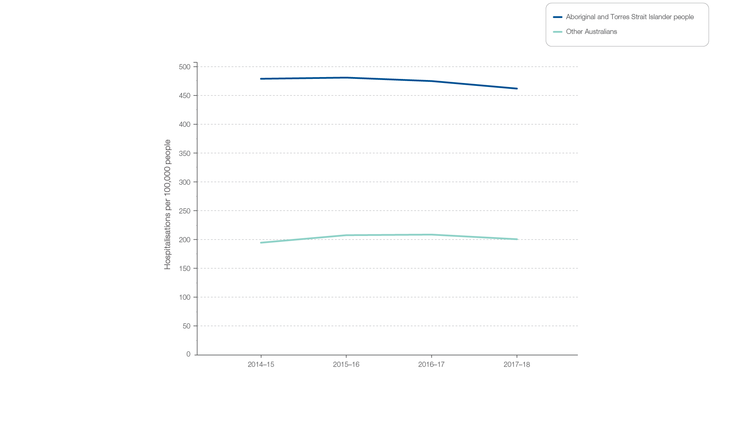
Heart failure
Aboriginal and Torres Strait Islander status, 2014-15 to 2017-18
Sources: AIHW analysis of National Hospital Morbidity Database and ABS Estimated Resident Populations 30 June of 2014 to 2018.
Chronic disease and infection: potentially preventable hospitalisations

Slide 37
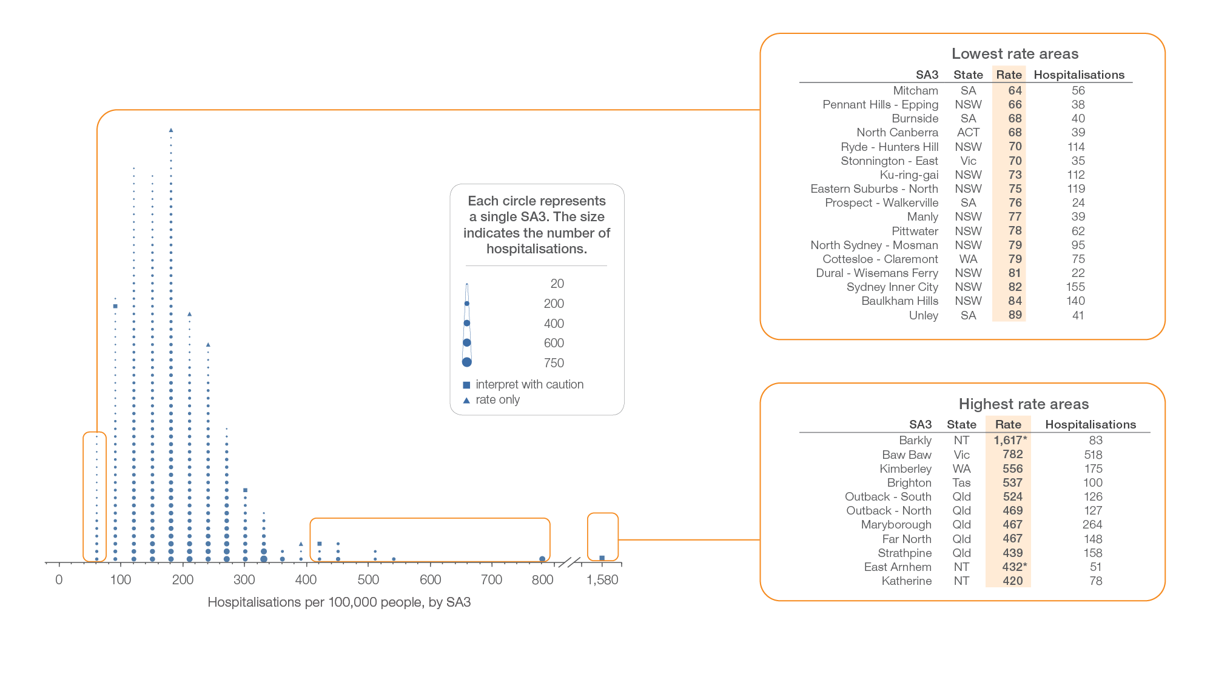
Diabetes complications
Local area, SA3 of patient residence, 2017-18
Sources: AIHW analysis of National Hospital Morbidity Database and ABS Estimated Resident Populations 30 June of 2017 and 2018.
Chronic disease and infection: potentially preventable hospitalisations

Slide 38
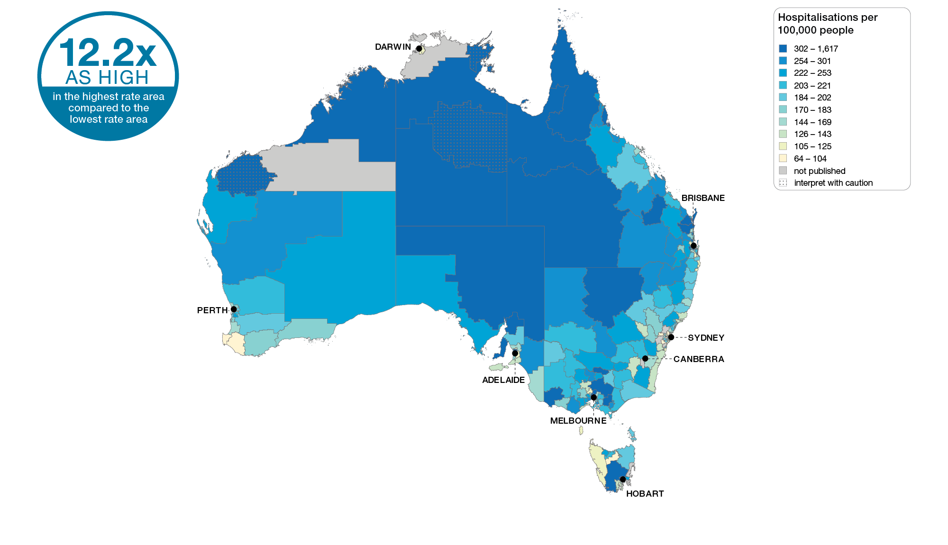
Diabetes complications
Australia, SA3 of patient residence, 2017-18
Sources: AIHW analysis of National Hospital Morbidity Database and ABS Estimated Resident Populations 30 June of 2017 and 2018.
Chronic disease and infection: potentially preventable hospitalisations

Slide 39
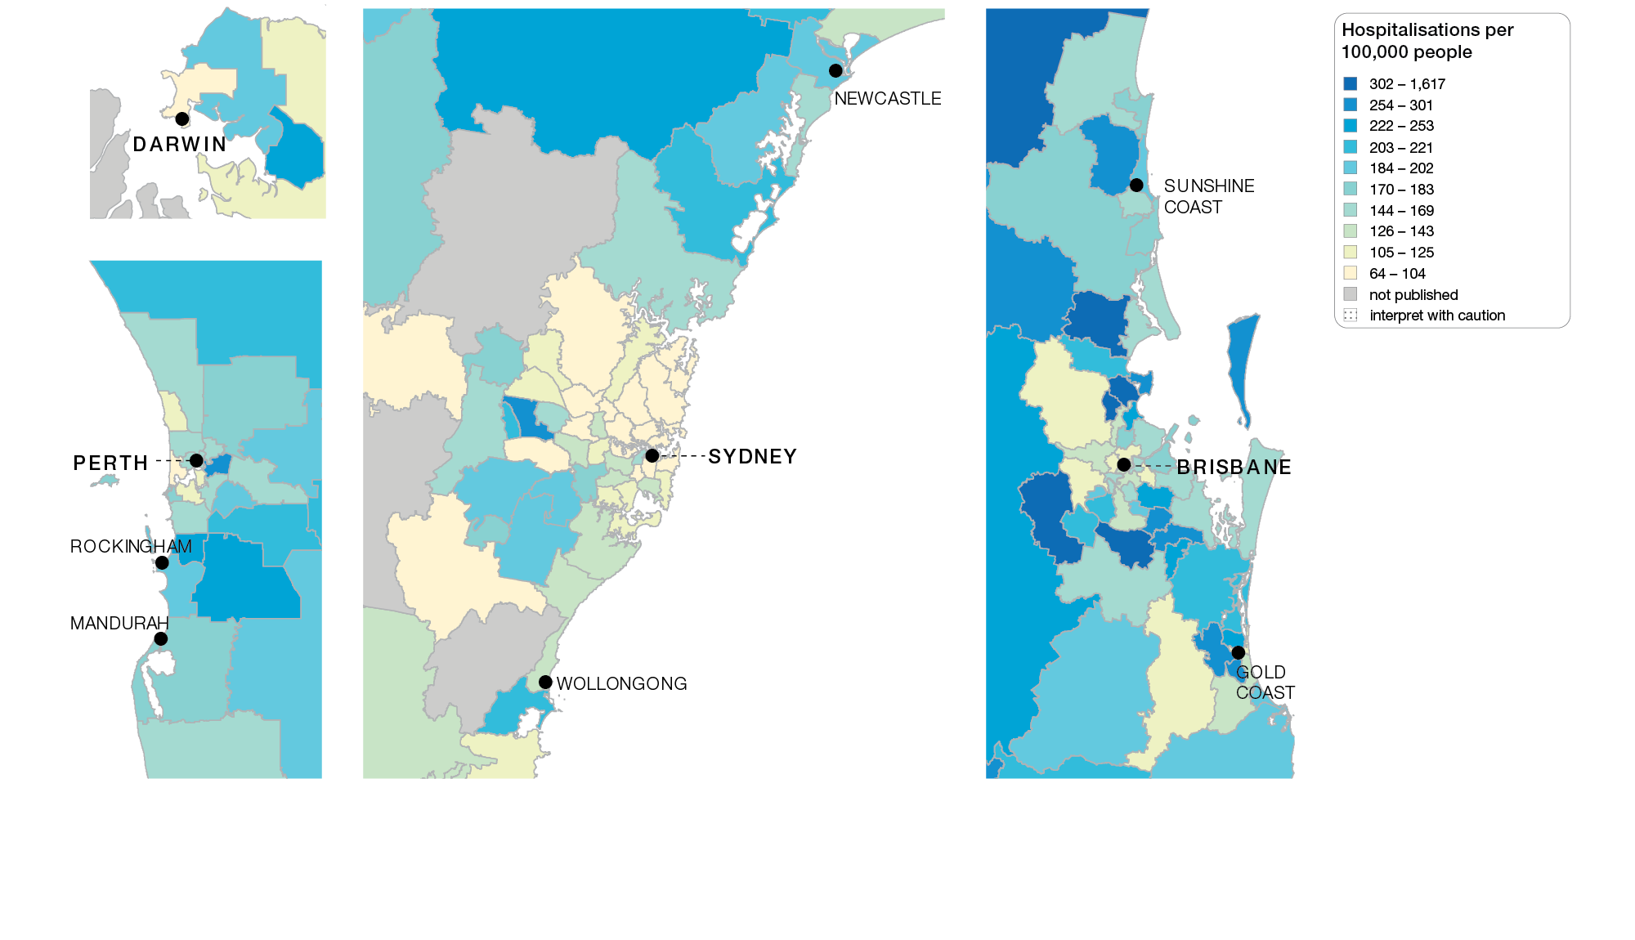
Diabetes complications
Capital cities, SA3 of patient residence, 2017-18
Sources: AIHW analysis of National Hospital Morbidity Database and ABS Estimated Resident Populations 30 June of 2017 and 2018.
Chronic disease and infection: potentially preventable hospitalisations

Slide 40
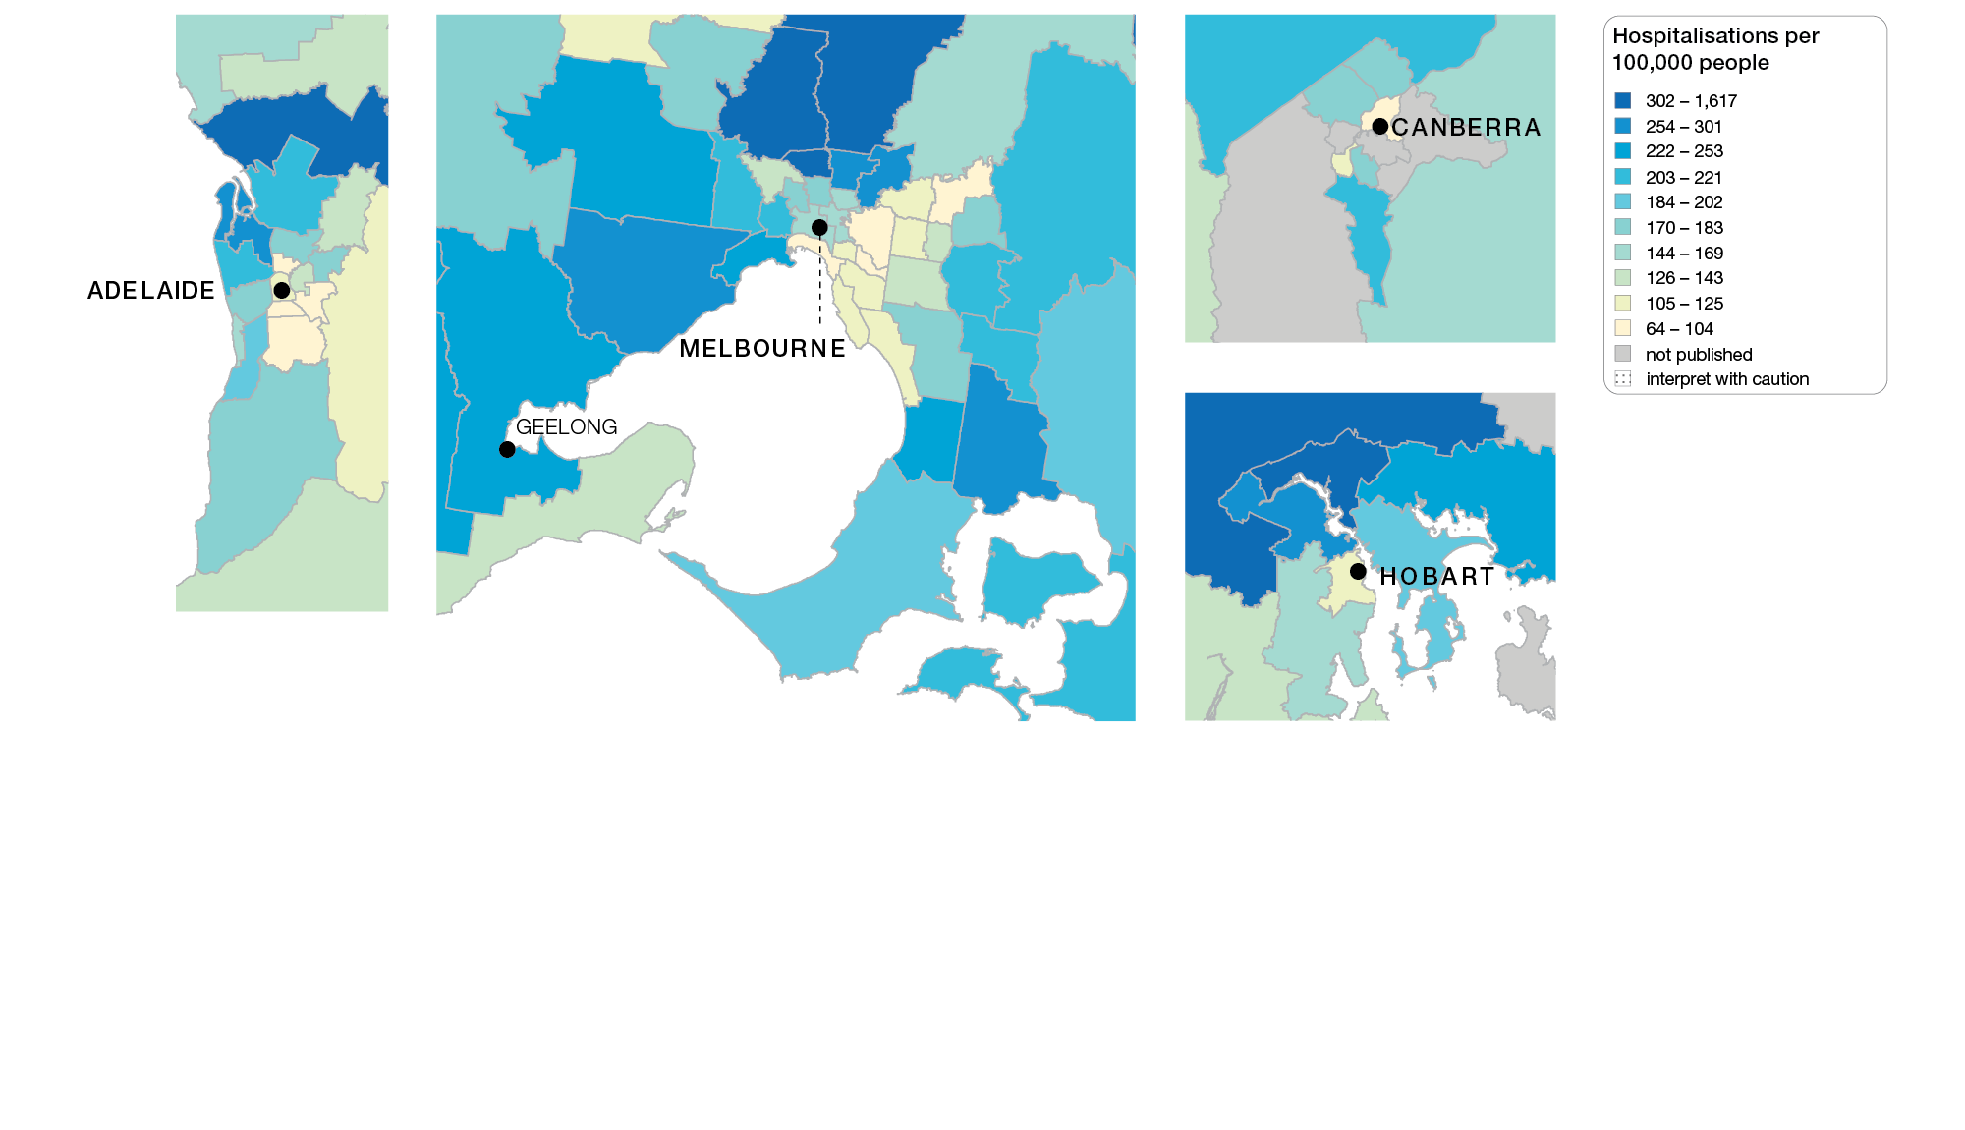
Diabetes complications
Capital cities, SA3 of patient residence, 2017-18
Sources: AIHW analysis of National Hospital Morbidity Database and ABS Estimated Resident Populations 30 June of 2017 and 2018.
Chronic disease and infection: potentially preventable hospitalisations

Slide 41
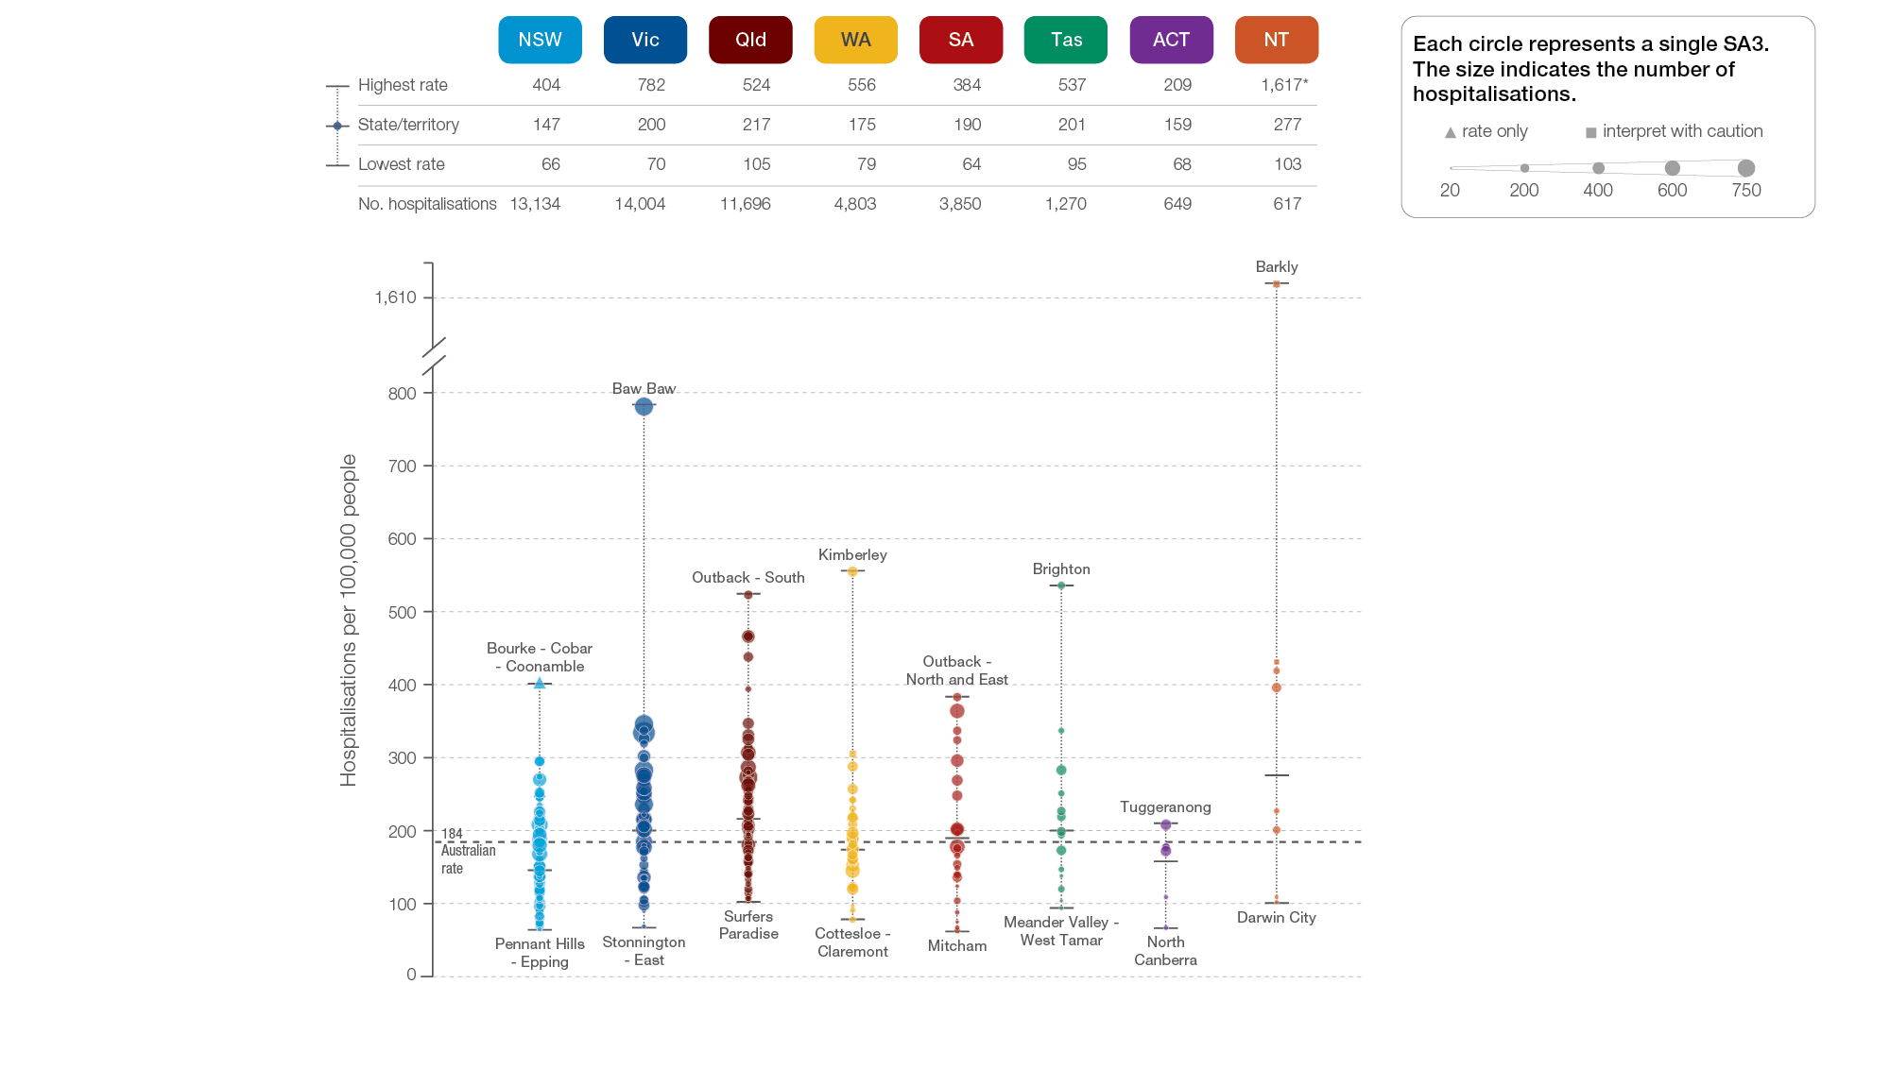
Diabetes complications
State and territory, SA3 of patient residence, 2017-18
Sources: AIHW analysis of National Hospital Morbidity Database and ABS Estimated Resident Populations 30 June of 2017 and 2018.
Chronic disease and infection: potentially preventable hospitalisations

Slide 42
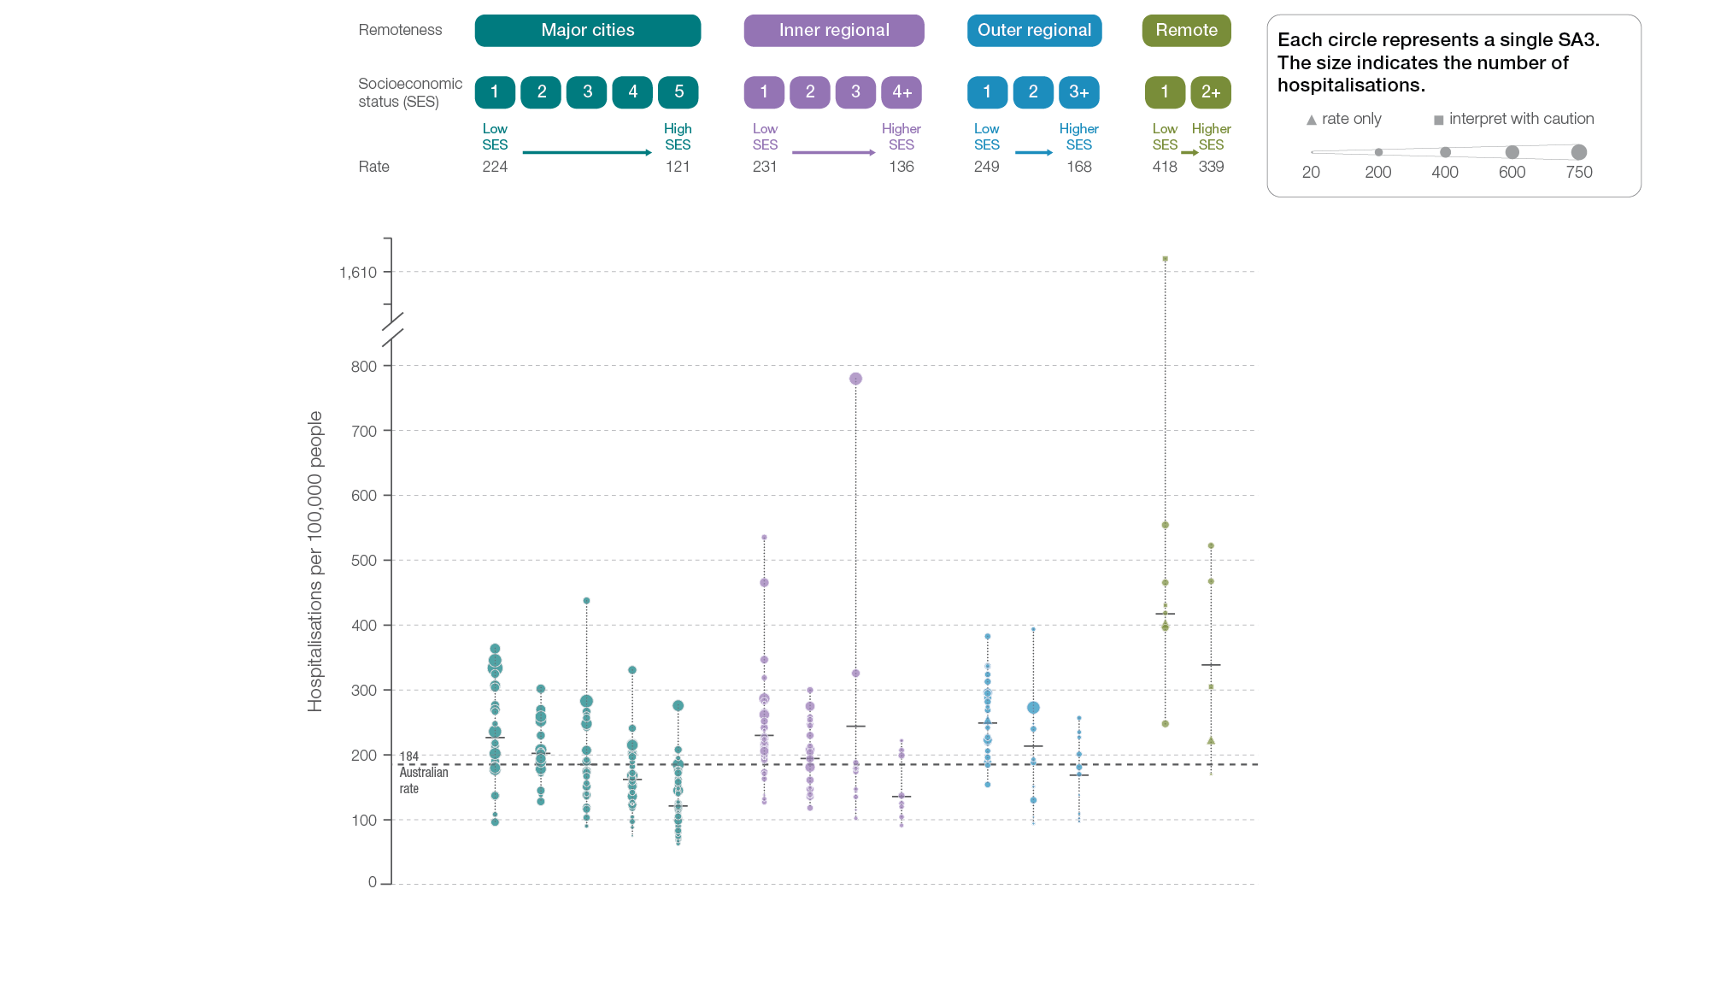
Diabetes complications
Remoteness and socioeconomic status, SA3 of patient residence, 2017-18
Sources: AIHW analysis of National Hospital Morbidity Database and ABS Estimated Resident Populations 30 June of 2017 and 2018.
Chronic disease and infection: potentially preventable hospitalisations

Slide 43
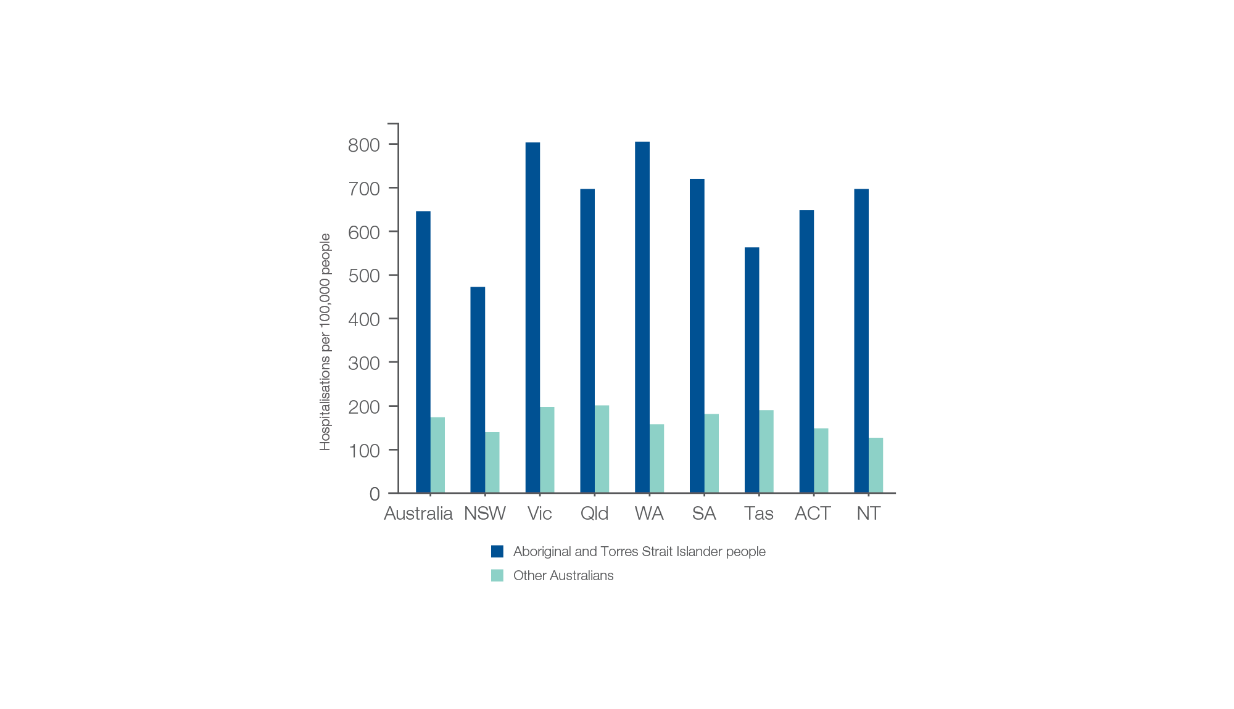
Diabetes complications
Aboriginal and Torres Strait Islander status, 2017-18
Sources: AIHW analysis of National Hospital Morbidity Database and ABS Estimated Resident Populations 30 June of 2017 and 2018.
Chronic disease and infection: potentially preventable hospitalisations

Slide 44
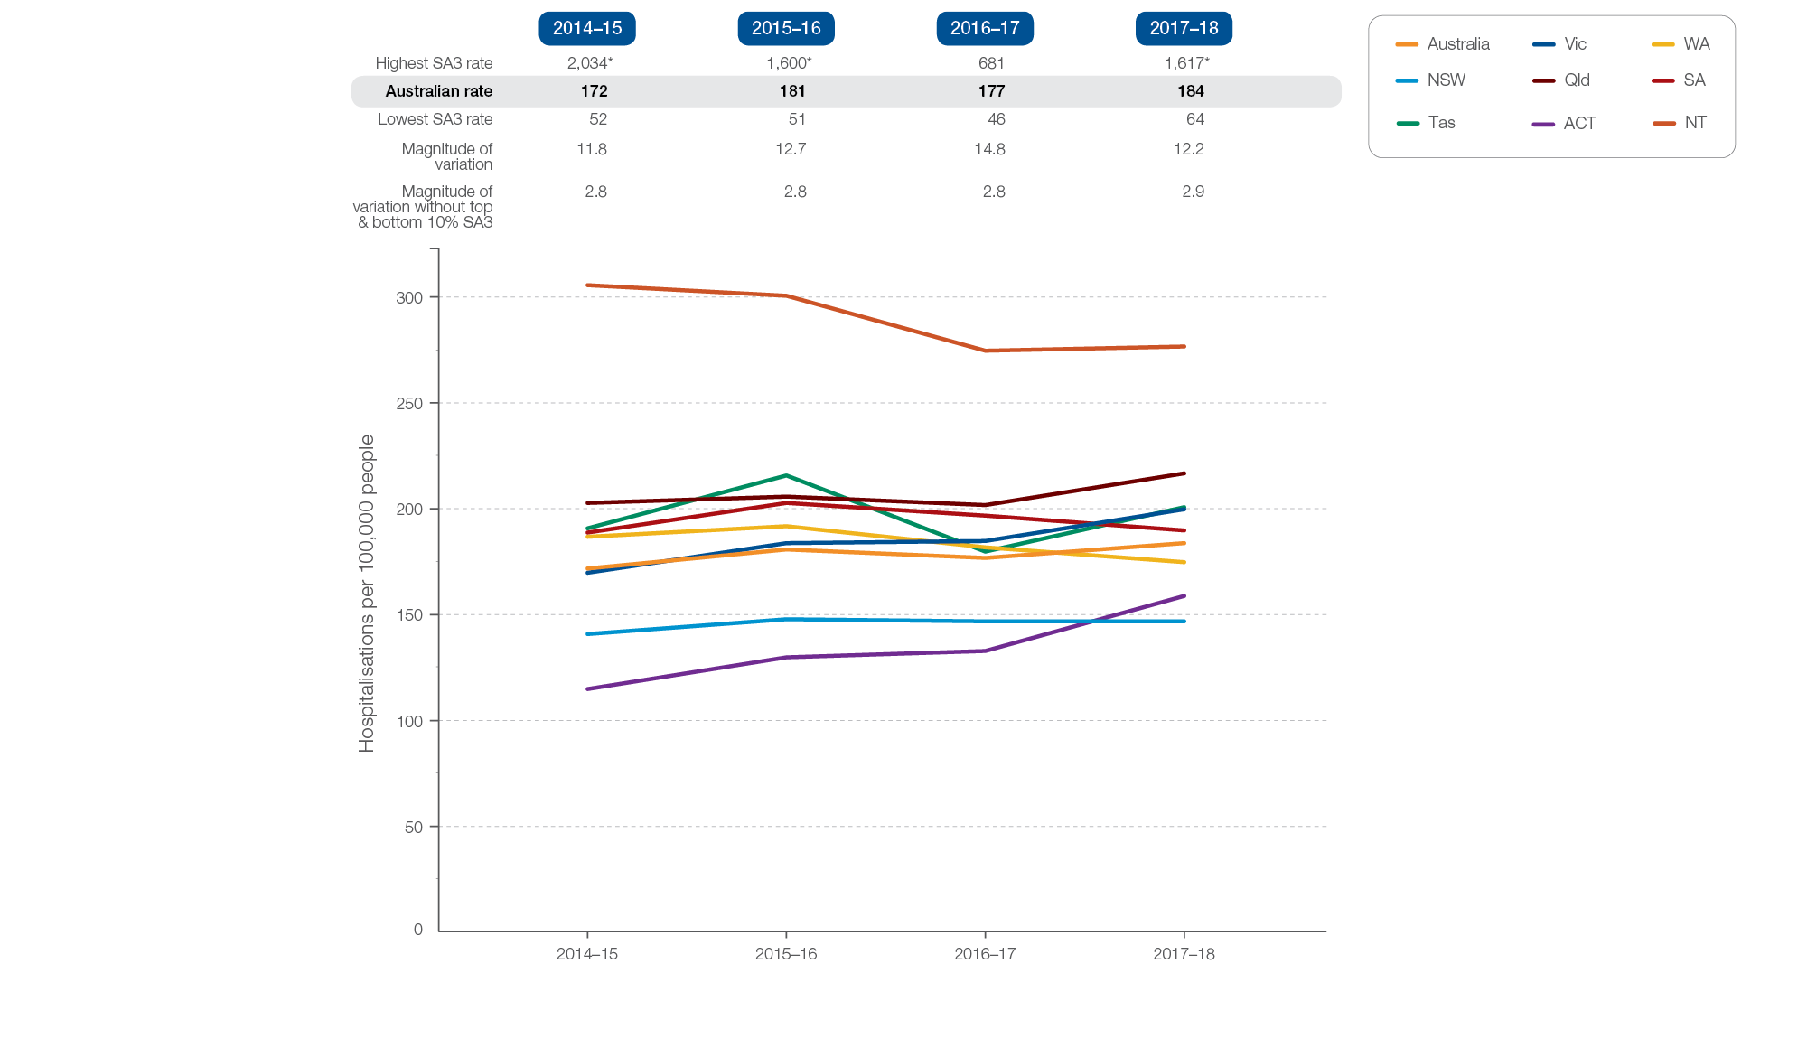
Diabetes complications
Rates across years, 2014-15 to 2017-18
Sources: AIHW analysis of National Hospital Morbidity Database and ABS Estimated Resident Populations 30 June of 2014 to 2018.
Chronic disease and infection: potentially preventable hospitalisations

Slide 45
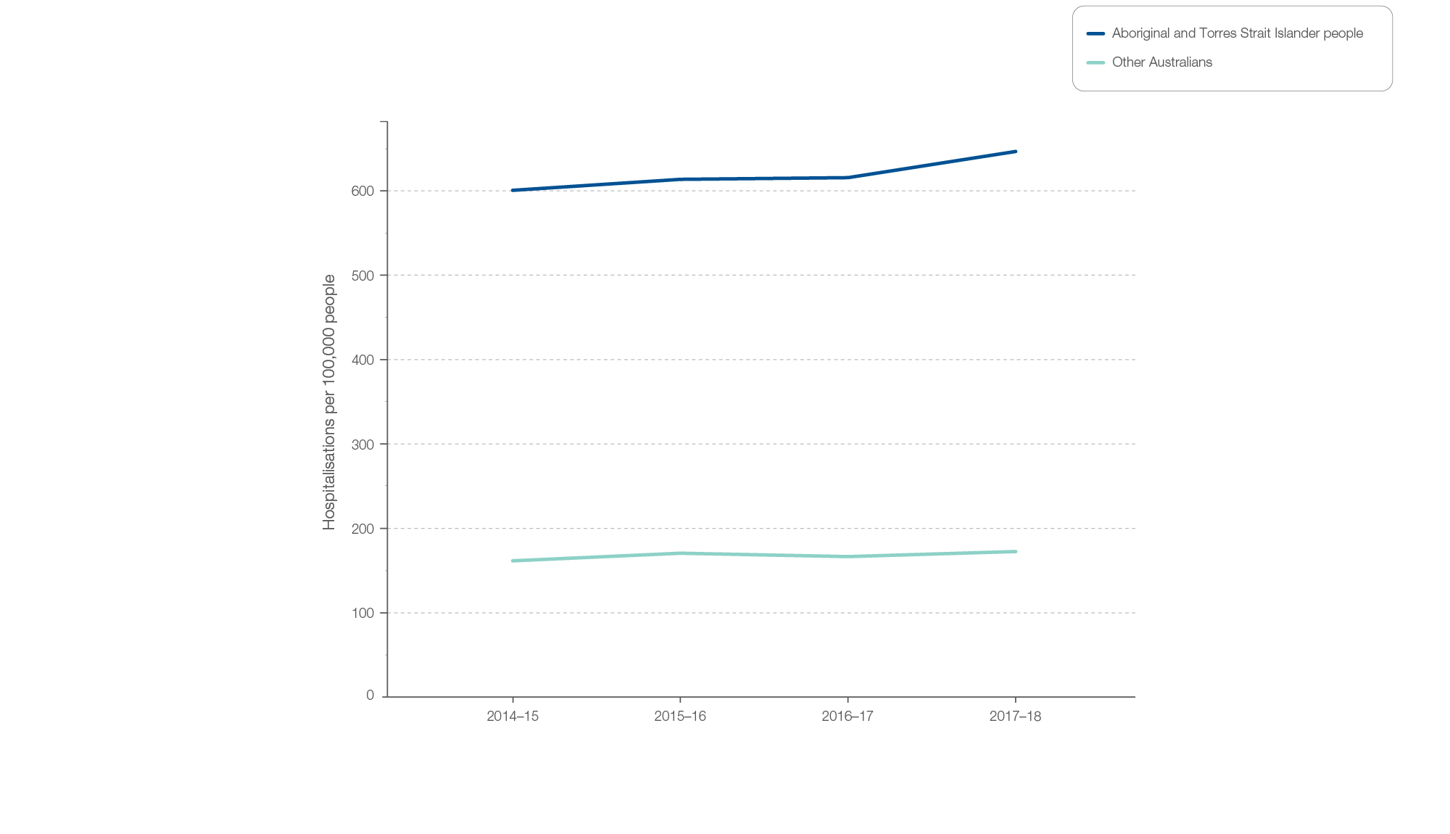
Diabetes complications
Aboriginal and Torres Strait Islander status, 2014-15 to 2017-18
Sources: AIHW analysis of National Hospital Morbidity Database and ABS Estimated Resident Populations 30 June of 2014 to 2018.
Chronic disease and infection: potentially preventable hospitalisations

Slide 46
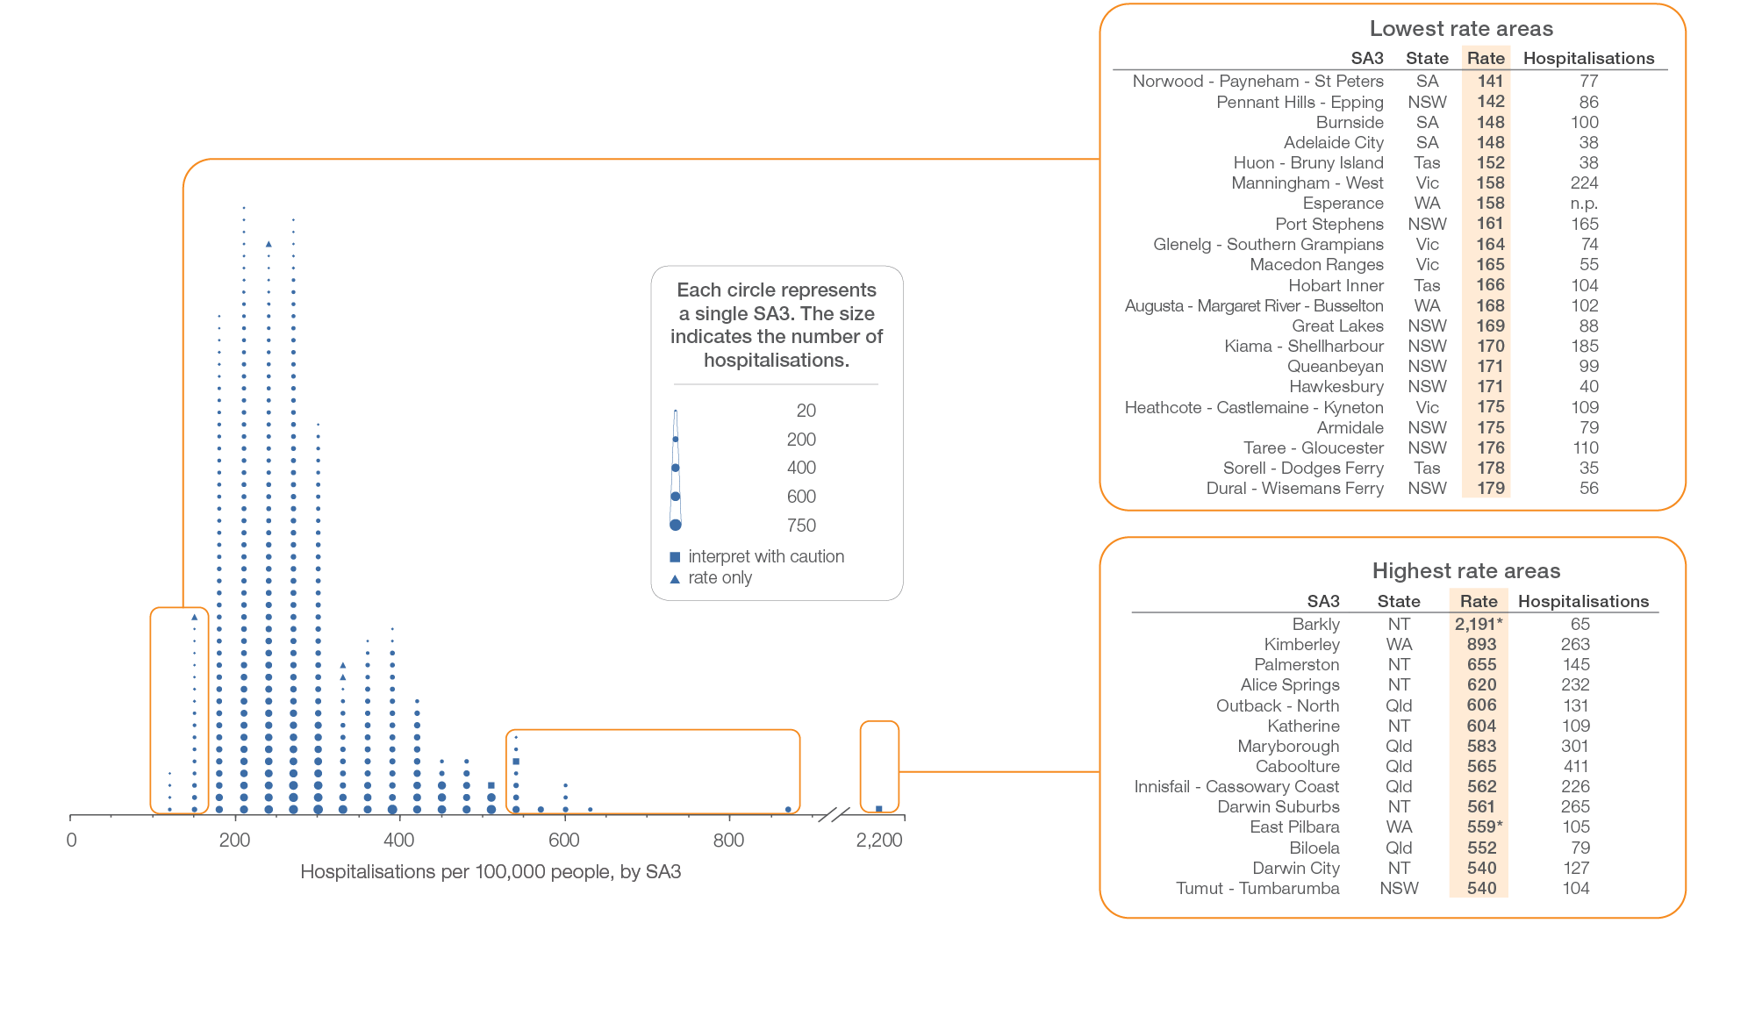
Kidney infections and urinary tract infections
Local area, SA3 of patient residence, 2017-18
Sources: AIHW analysis of National Hospital Morbidity Database and ABS Estimated Resident Populations 30 June of 2017 and 2018.
Chronic disease and infection: potentially preventable hospitalisations

Slide 47
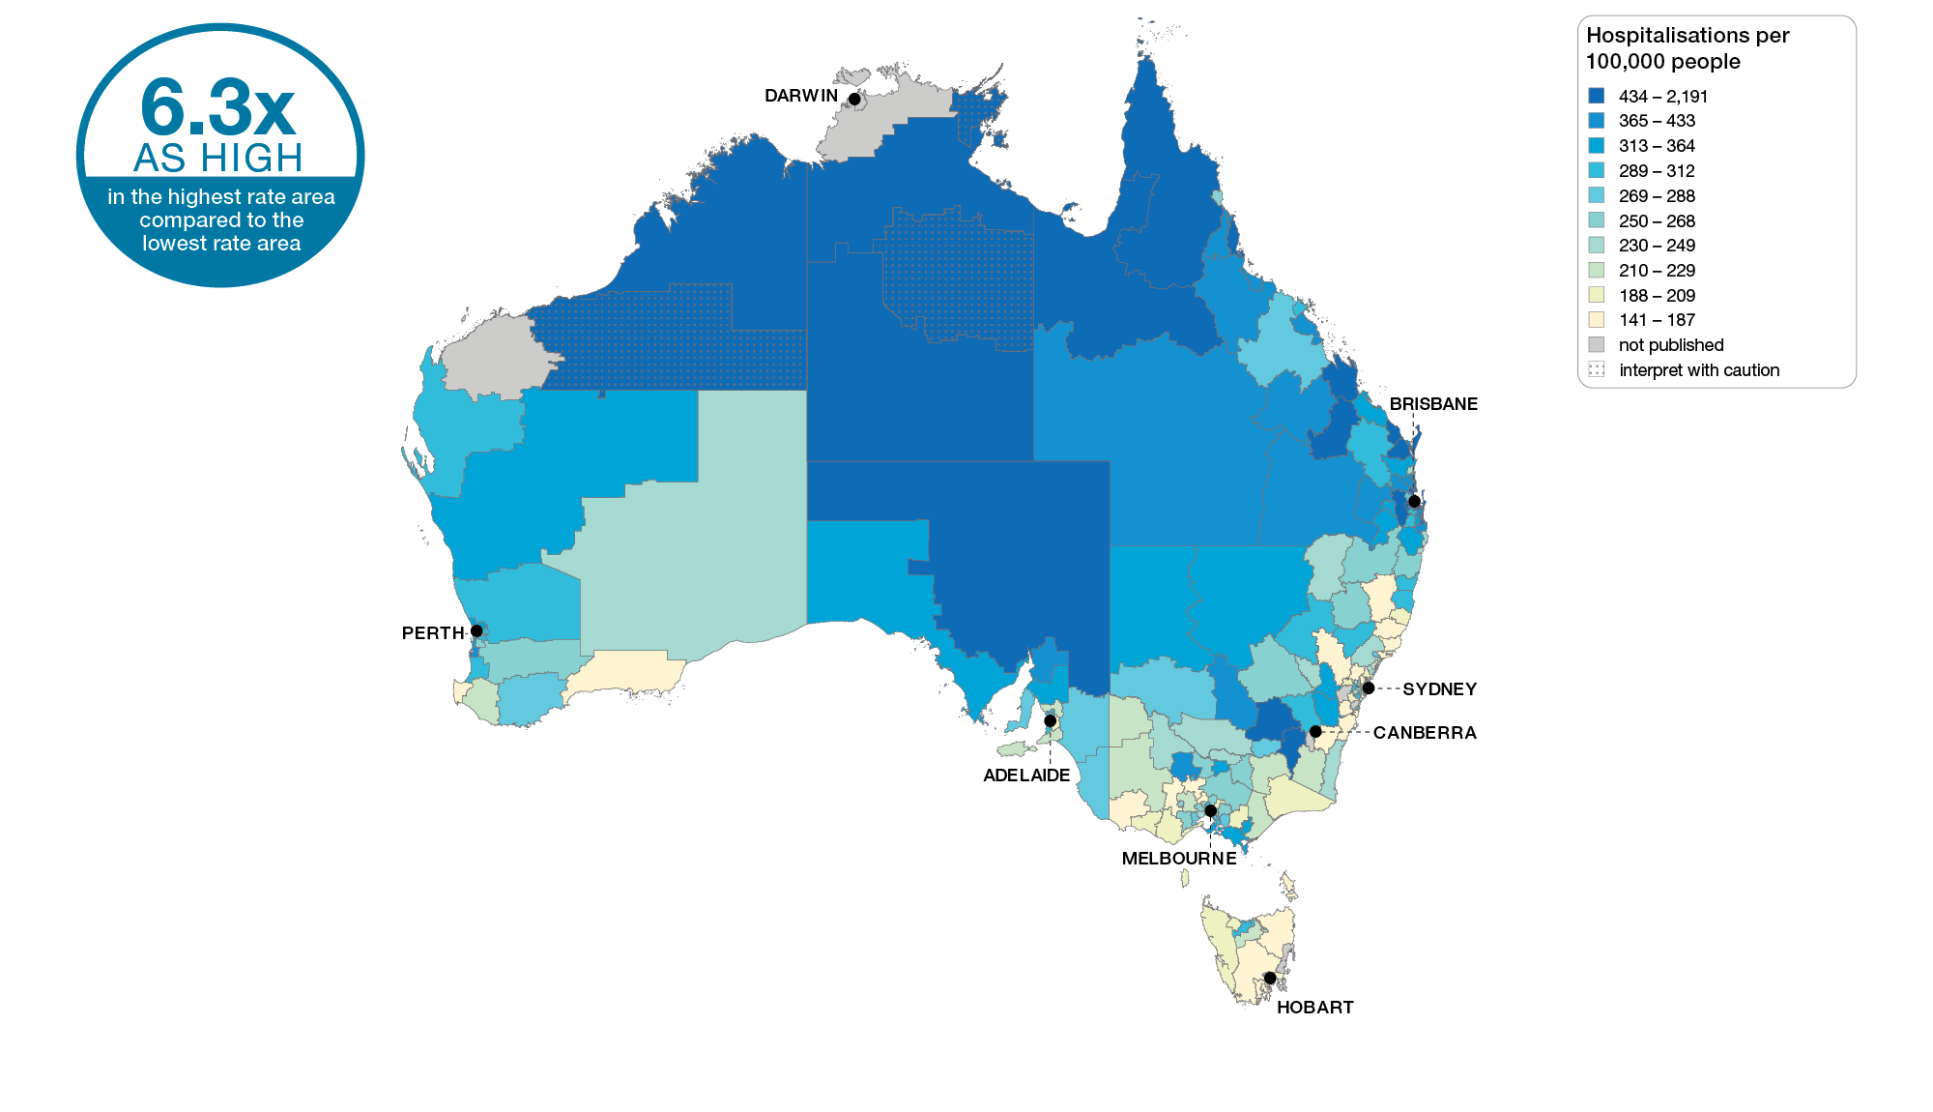
Kidney infections and urinary tract infections
Australia, SA3 of patient residence, 2017-18
Sources: AIHW analysis of National Hospital Morbidity Database and ABS Estimated Resident Populations 30 June of 2017 and 2018.
Chronic disease and infection: potentially preventable hospitalisations

Slide 48
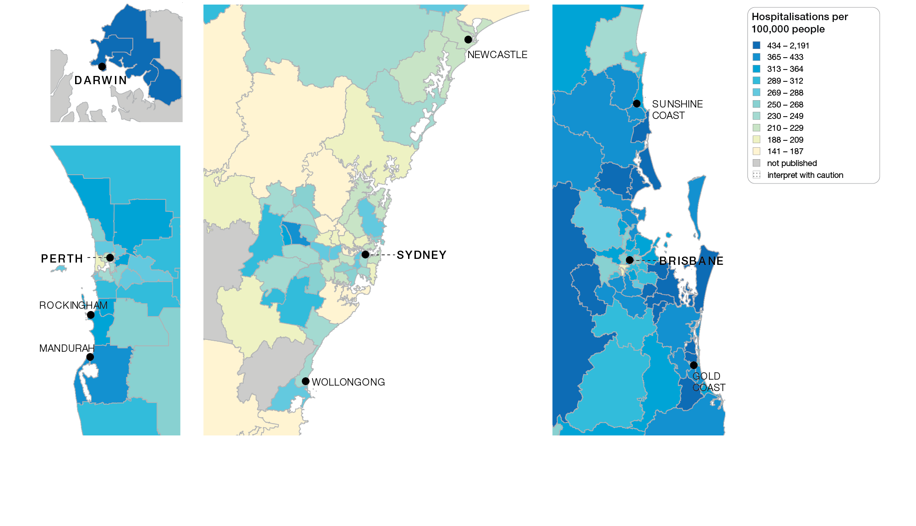
Kidney infections and urinary tract infections
Capital cities, SA3 of patient residence, 2017-18
Sources: AIHW analysis of National Hospital Morbidity Database and ABS Estimated Resident Populations 30 June of 2017 and 2018.
Chronic disease and infection: potentially preventable hospitalisations

Slide 49
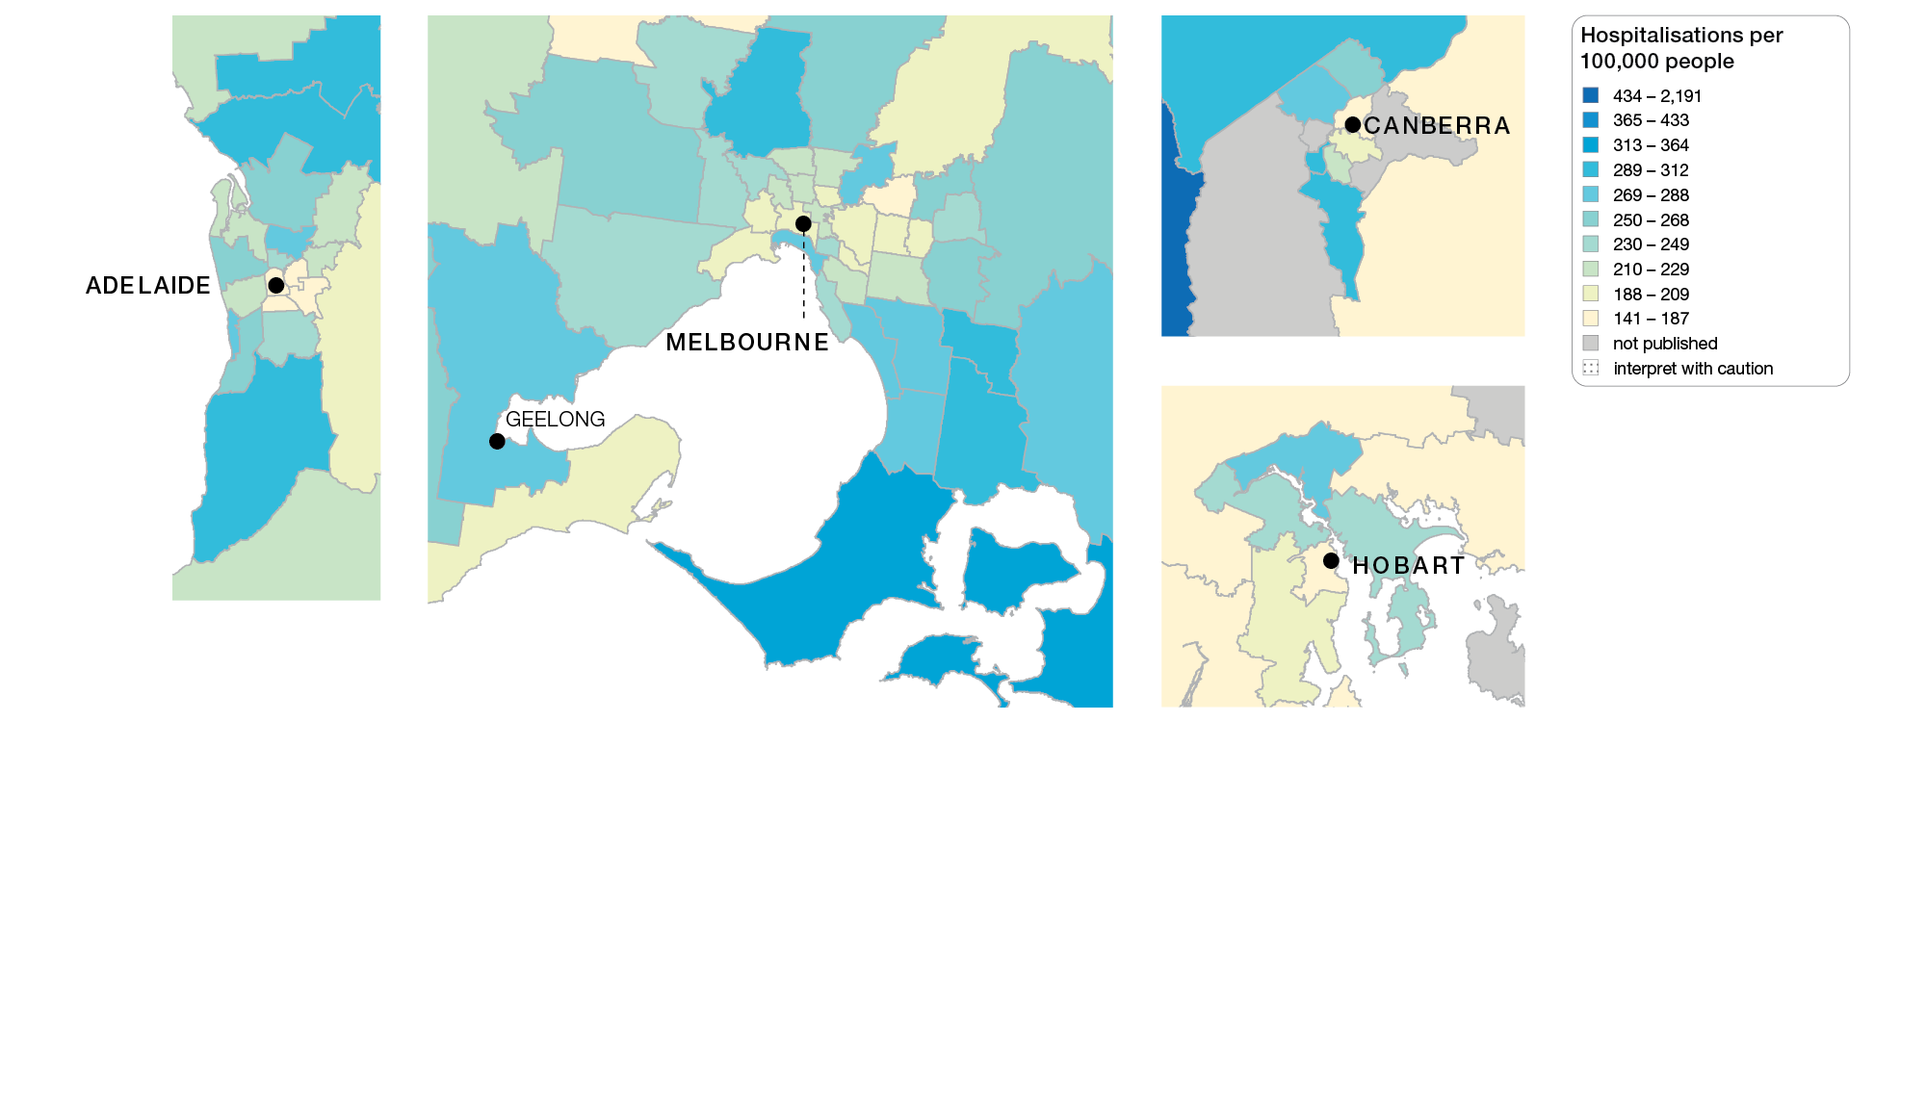
Kidney infections and urinary tract infections
Capital cities, SA3 of patient residence, 2017-18
Sources: AIHW analysis of National Hospital Morbidity Database and ABS Estimated Resident Populations 30 June of 2017 and 2018.
Chronic disease and infection: potentially preventable hospitalisations

Slide 50
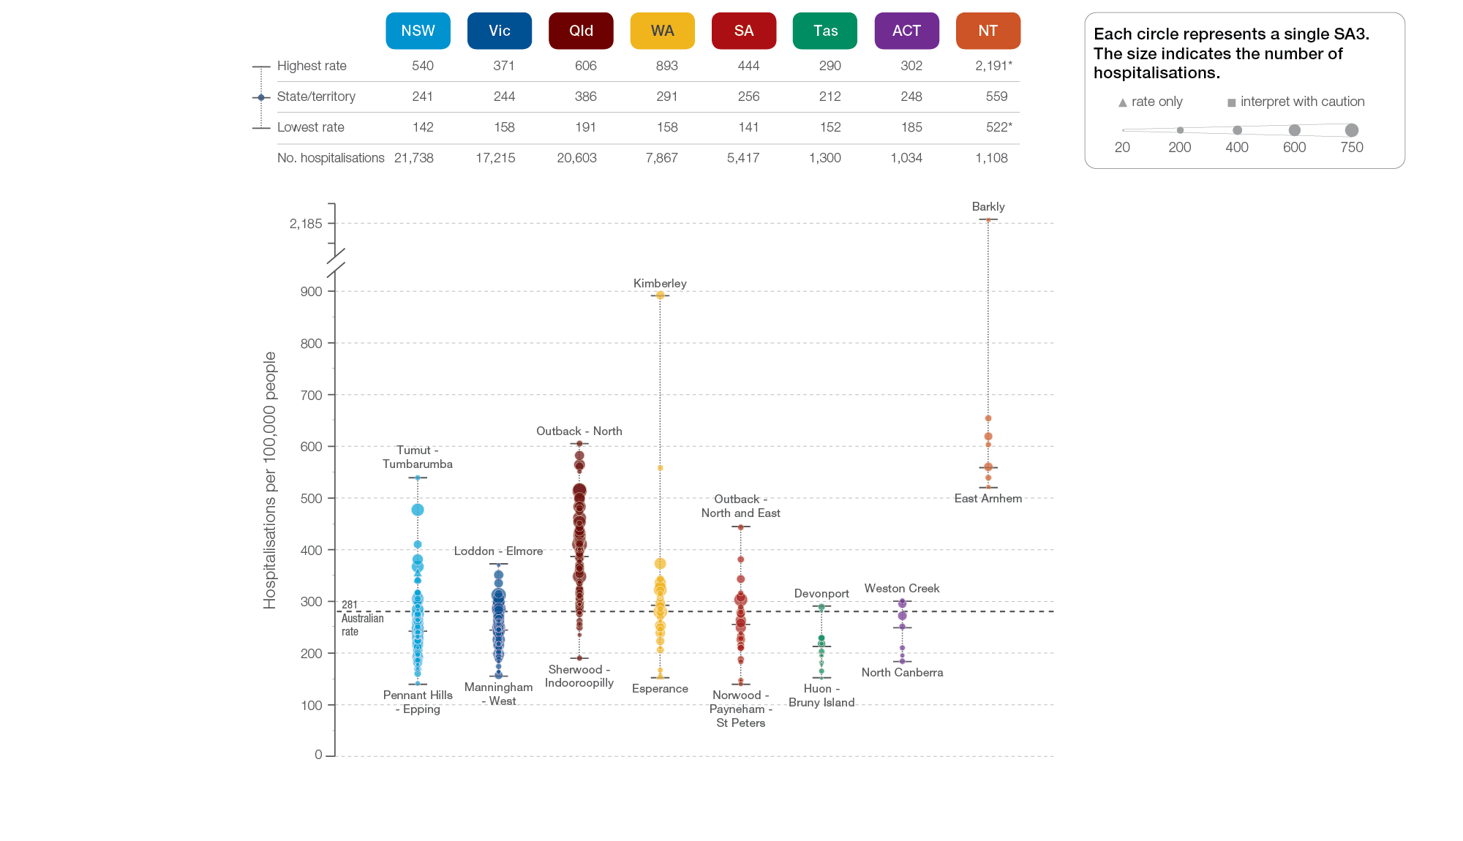
Kidney infections and urinary tract infections
State and territory, SA3 of patient residence, 2017-18
Sources: AIHW analysis of National Hospital Morbidity Database and ABS Estimated Resident Populations 30 June of 2017 and 2018.
Chronic disease and infection: potentially preventable hospitalisations

Slide 51
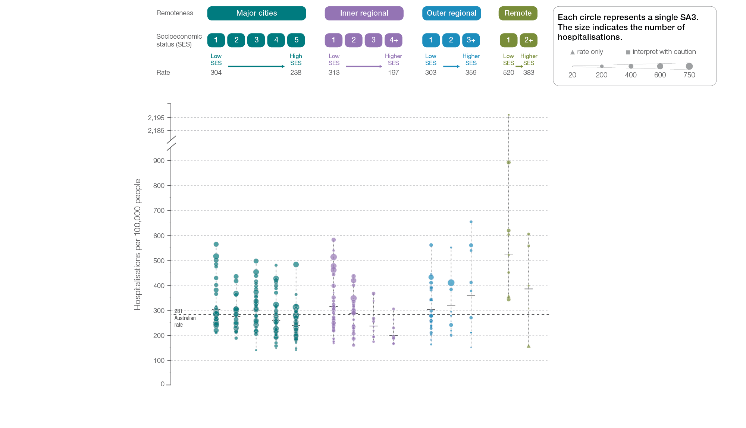
Kidney infections and urinary tract infections
Remoteness and socioeconomic status, SA3 of patient residence, 2017-18
Sources: AIHW analysis of National Hospital Morbidity Database and ABS Estimated Resident Populations 30 June of 2017 and 2018.
Chronic disease and infection: potentially preventable hospitalisations

Slide 52
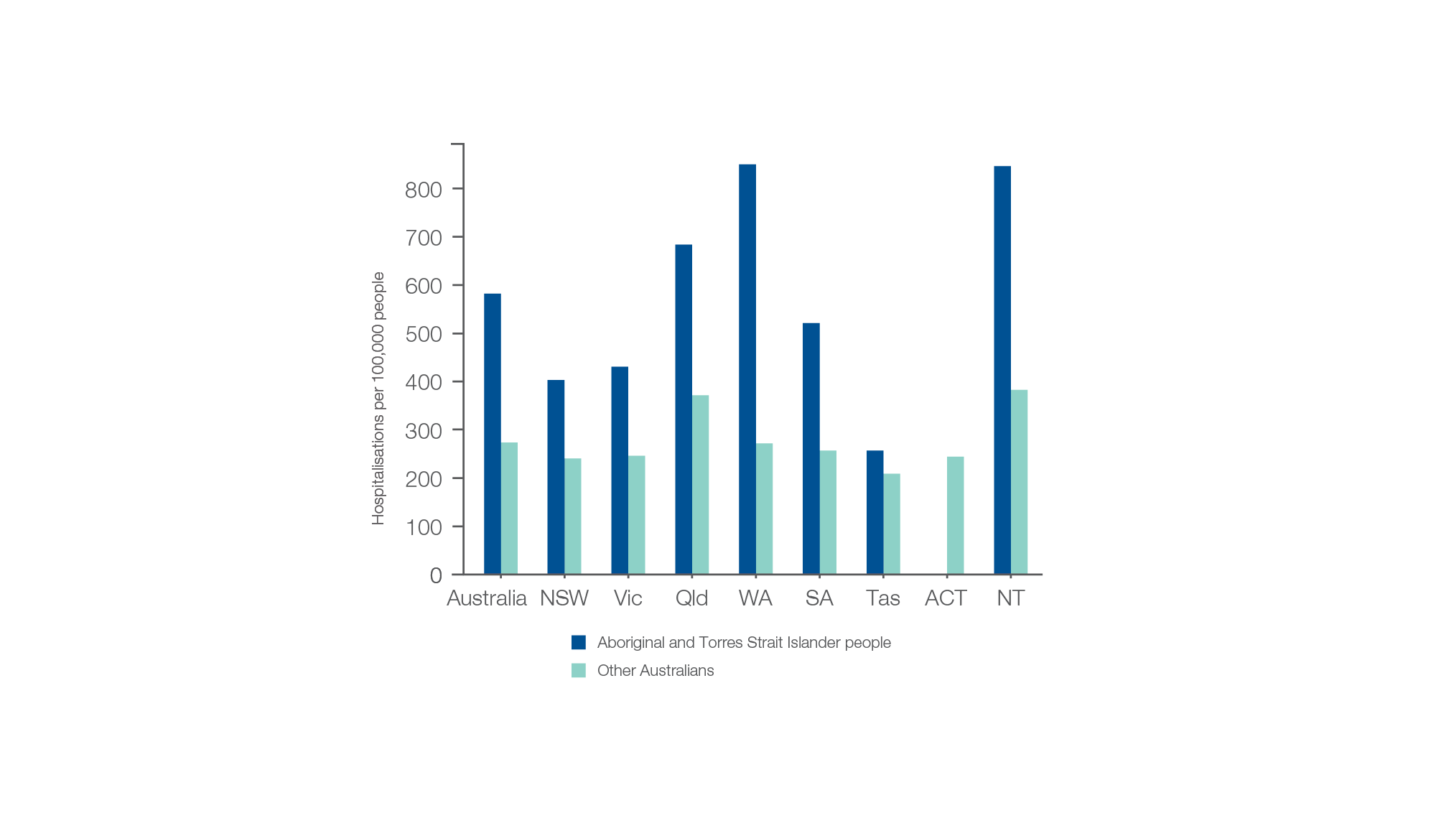
Kidney infections and urinary tract infections
Aboriginal and Torres Strait Islander status, 2017-18
Sources: AIHW analysis of National Hospital Morbidity Database and ABS Estimated Resident Populations 30 June of 2017 and 2018.
Chronic disease and infection: potentially preventable hospitalisations

Slide 53
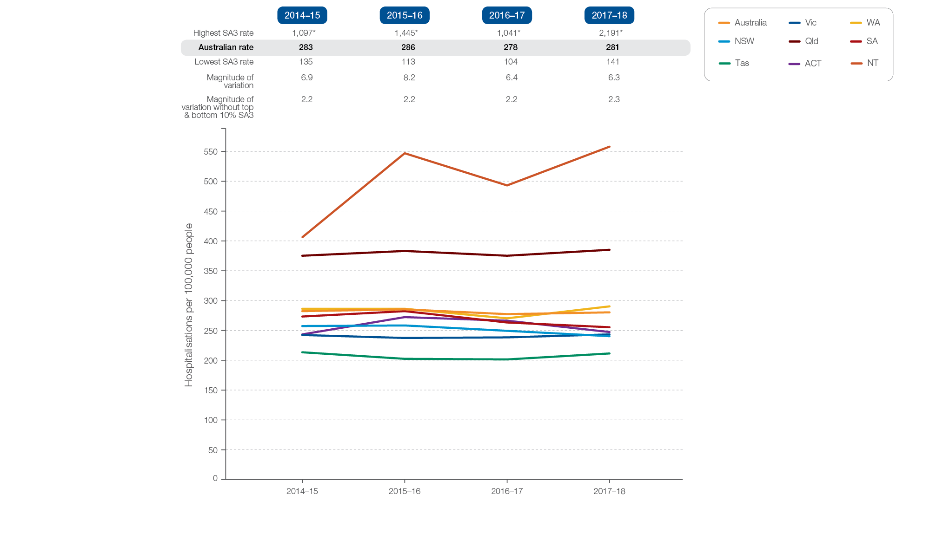
Kidney infections and urinary tract infections
Rates across years, 2014-15 to 2017-18
Sources: AIHW analysis of National Hospital Morbidity Database and ABS Estimated Resident Populations 30 June of 2014 to 2018.
Chronic disease and infection: potentially preventable hospitalisations

Slide 54
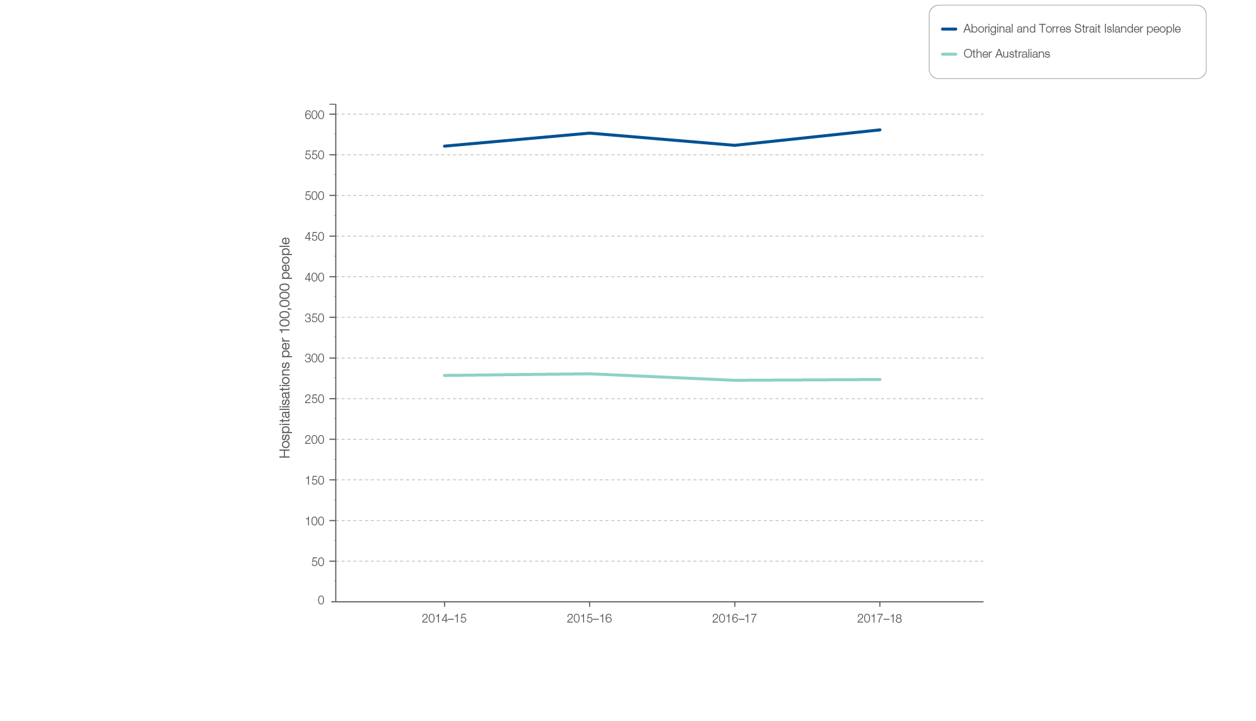
Kidney infections and urinary tract infections
Aboriginal and Torres Strait Islander status, 2014-15 to 2017-18
Sources: AIHW analysis of National Hospital Morbidity Database and ABS Estimated Resident Populations 30 June of 2014 to 2018.
Chronic disease and infection: potentially preventable hospitalisations

Slide 55
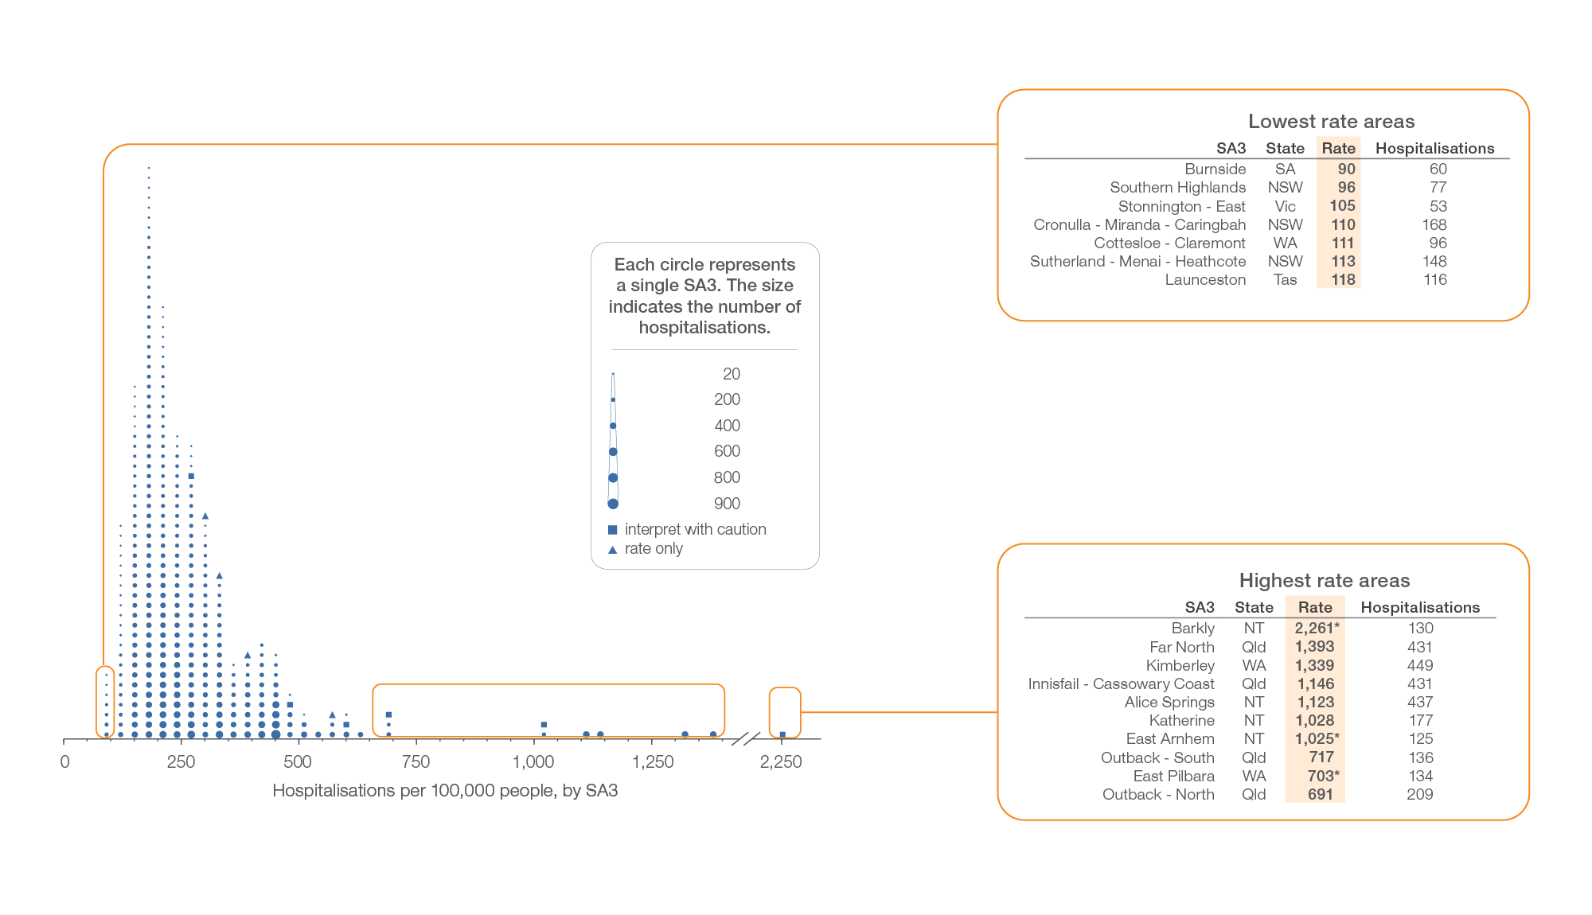
Cellulitis
Local area, SA3 of patient residence, 2017-18
Sources: AIHW analysis of National Hospital Morbidity Database and ABS Estimated Resident Populations 30 June of 2017 and 2018.
Chronic disease and infection: potentially preventable hospitalisations

Slide 56
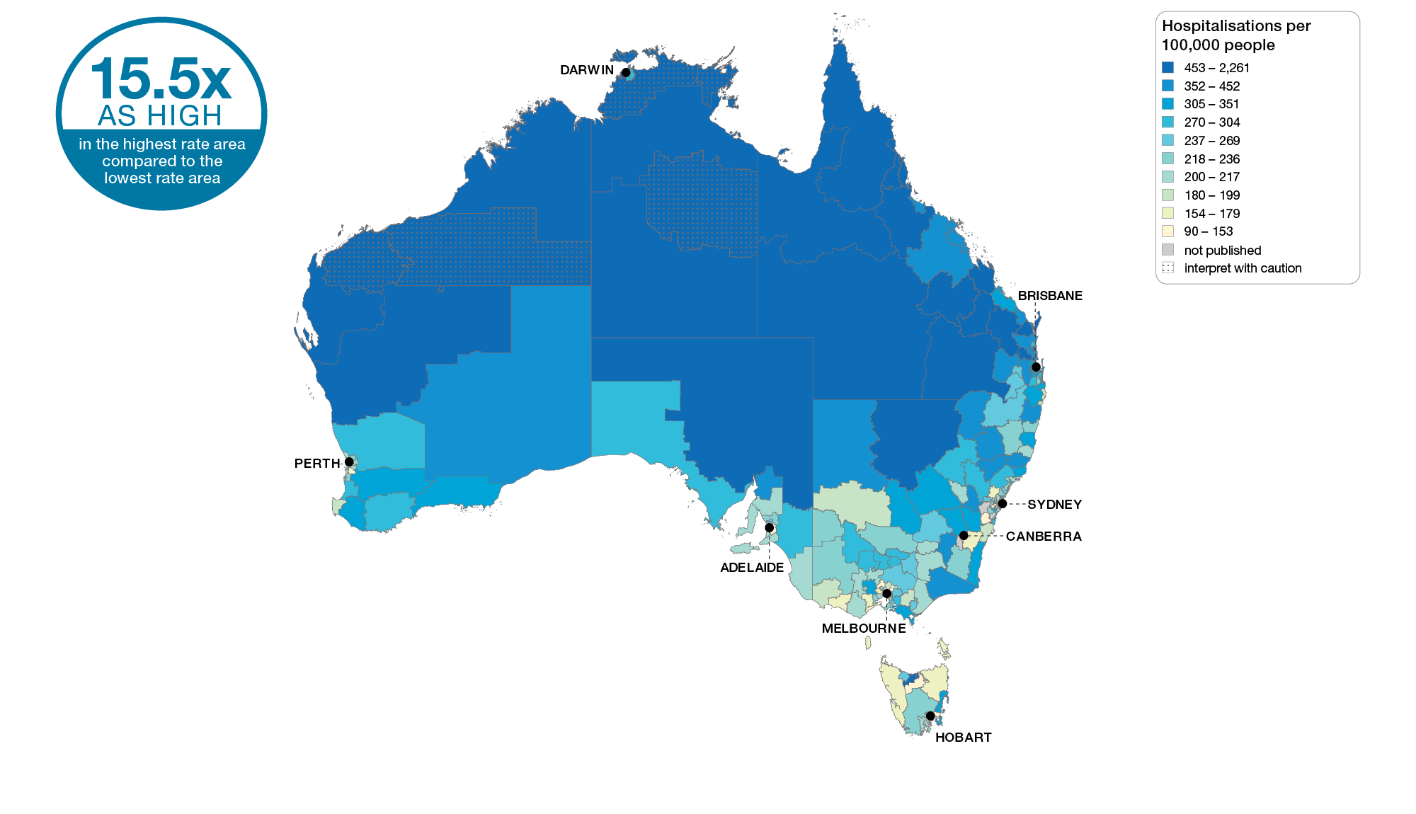
Cellulitis
Australia, SA3 of patient residence, 2017-18
Sources: AIHW analysis of National Hospital Morbidity Database and ABS Estimated Resident Populations 30 June of 2017 and 2018.
Chronic disease and infection: potentially preventable hospitalisations

Slide 57
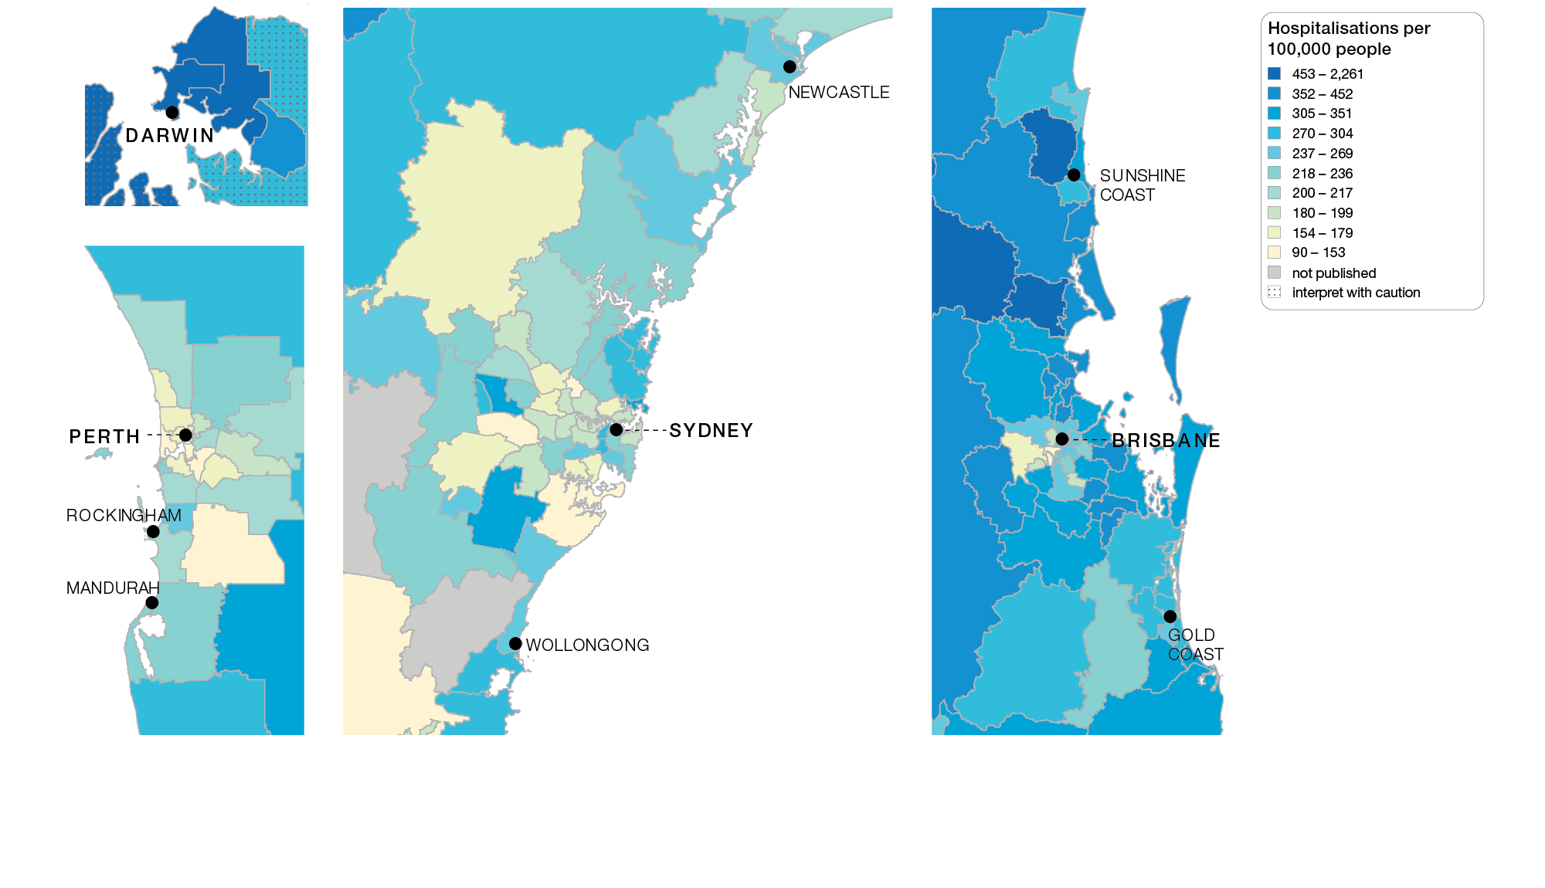
Cellulitis
Capital cities, SA3 of patient residence, 2017-18
Sources: AIHW analysis of National Hospital Morbidity Database and ABS Estimated Resident Populations 30 June of 2017 and 2018.
Chronic disease and infection: potentially preventable hospitalisations

Slide 58
Cellulitis
Capital cities, SA3 of patient residence, 2017-18
Sources: AIHW analysis of National Hospital Morbidity Database and ABS Estimated Resident Populations 30 June of 2017 and 2018.
Chronic disease and infection: potentially preventable hospitalisations

Slide 59
Cellulitis
State and territory, SA3 of patient residence, 2017-18
Sources: AIHW analysis of National Hospital Morbidity Database and ABS Estimated Resident Populations 30 June of 2017 and 2018.
Chronic disease and infection: potentially preventable hospitalisations

Slide 60
Cellulitis
Remoteness and socioeconomic status, SA3 of patient residence, 2017-18
Sources: AIHW analysis of National Hospital Morbidity Database and ABS Estimated Resident Populations 30 June of 2017 and 2018.
Chronic disease and infection: potentially preventable hospitalisations

Slide 61
Cellulitis
Aboriginal and Torres Strait Islander status, 2017-18
Sources: AIHW analysis of National Hospital Morbidity Database and ABS Estimated Resident Populations 30 June of 2017 and 2018.
Chronic disease and infection: potentially preventable hospitalisations

Slide 62
Cellulitis
Rates across years, 2014-15 to 2017-18
Sources: AIHW analysis of National Hospital Morbidity Database and ABS Estimated Resident Populations 30 June of 2014 to 2018.
Chronic disease and infection: potentially preventable hospitalisations

Slide 63
Cellulitis
Aboriginal and Torres Strait Islander status, 2014-15 to 2017-18
Sources: AIHW analysis of National Hospital Morbidity Database and ABS Estimated Resident Populations 30 June of 2014 to 2018.
Chronic disease and infection: potentially preventable hospitalisations

Slide 64
Ear, nose and throat surgery for children and young people
Ear, nose and throat surgery for children and young people

Slide 65
Ear, nose and throat surgery for children and young people
Key findings, 2017-18
Data item | Range across local areas* per 100,000 | Times difference | Times difference excluding top and bottom 10% | Number during 2017–18
Tonsillectomy hospitalisations, 17 years and under | 305 – 1,836 | 6.0 | 2.2 | 42,509
Myringotomy hospitalisations, 17 years and under | 198 – 1,607 | 8.1 | 2.3 | 34,755
* Statistical Area Level 3
Sources: AIHW analysis of National Hospital Morbidity Database and ABS Estimated Resident Populations 30 June of 2017 and 2018.
Ear, nose and throat surgery for children and young people

Slide 66
Ear, nose and throat surgery for children and young people
Key findings, 2012-13 to 2017-18
Data item | 2012-13* | 2015-16* | 2017-18* | Per cent change
Tonsillectomy hospitalisations, 17 years and under | 729 | 756 | 750 | 3%
Myringotomy hospitalisations, 17 years and under | 625 | 628 | 600 | - 4%
* Australian age and sex standardised rate given as hospitalisations per 100,000 people
Sources: AIHW analysis of National Hospital Morbidity Database and ABS Estimated Resident Populations 30 June of 2017 and 2018.
Ear, nose and throat surgery for children and young people

Slide 67
Tonsillectomy, 17 years and under
Local area, SA3 of patient residence, 2017-18
Sources: AIHW analysis of National Hospital Morbidity Database and ABS Estimated Resident Populations 30 June of 2017 and 2018.
Ear, nose and throat surgery for children and young people

Slide 68
Tonsillectomy, 17 years and under
Australia, SA3 of patient residence, 2017-18
Sources: AIHW analysis of National Hospital Morbidity Database and ABS Estimated Resident Populations 30 June of 2017 and 2018.
Ear, nose and throat surgery for children and young people

Slide 69
Tonsillectomy, 17 years and under
Capital cities, SA3 of patient residence, 2017-18
Sources: AIHW analysis of National Hospital Morbidity Database and ABS Estimated Resident Populations 30 June of 2017 and 2018.
Ear, nose and throat surgery for children and young people

Slide 70
Tonsillectomy, 17 years and under
Capital cities, SA3 of patient residence, 2017-18
Sources: AIHW analysis of National Hospital Morbidity Database and ABS Estimated Resident Populations 30 June of 2017 and 2018.
Ear, nose and throat surgery for children and young people

Slide 71
Tonsillectomy, 17 years and under
State and territory, SA3 of patient residence, 2017-18
Sources: AIHW analysis of National Hospital Morbidity Database and ABS Estimated Resident Populations 30 June of 2017 and 2018.
Ear, nose and throat surgery for children and young people

Slide 72
Tonsillectomy, 17 years and under
Remoteness and socioeconomic status, SA3 of patient residence, 2017-18
Sources: AIHW analysis of National Hospital Morbidity Database and ABS Estimated Resident Populations 30 June of 2017 and 2018.
Ear, nose and throat surgery for children and young people

Slide 73
Tonsillectomy, 17 years and under
Aboriginal and Torres Strait Islander status, 2017-18
Sources: AIHW analysis of National Hospital Morbidity Database and ABS Estimated Resident Populations 30 June of 2017 and 2018.
Ear, nose and throat surgery for children and young people

Slide 74
Tonsillectomy, 17 years and under
Patient funding status, 2017-18
Sources: AIHW analysis of National Hospital Morbidity Database and ABS Estimated Resident Populations 30 June of 2017 and 2018.
Ear, nose and throat surgery for children and young people

Slide 75
Tonsillectomy, 17 years and under
Rates across years, 2012–13, 2015–16 and 2017–18
Sources: AIHW analysis of National Hospital Morbidity Database and ABS Estimated Resident Populations 30 June of 2012, 2013 and 2015 to 2018.
Ear, nose and throat surgery for children and young people

Slide 76
Tonsillectomy, 17 years and under
Aboriginal and Torres Strait Islander status, 2012–13, 2015–16 and 2017–18
Sources: AIHW analysis of National Hospital Morbidity Database and ABS Estimated Resident Populations 30 June of 2012, 2013 and 2015 to 2018.
Ear, nose and throat surgery for children and young people

Slide 77
Myringotomy, 17 years and under
Local area, SA3 of patient residence, 2017-18
Sources: AIHW analysis of National Hospital Morbidity Database and ABS Estimated Resident Populations 30 June of 2017 and 2018.
Ear, nose and throat surgery for children and young people

Slide 78
Myringotomy, 17 years and under
Australia, SA3 of patient residence, 2017-18
Sources: AIHW analysis of National Hospital Morbidity Database and ABS Estimated Resident Populations 30 June of 2017 and 2018.
Ear, nose and throat surgery for children and young people

Slide 79
Myringotomy, 17 years and under
Capital cities, SA3 of patient residence, 2017-18
Sources: AIHW analysis of National Hospital Morbidity Database and ABS Estimated Resident Populations 30 June of 2017 and 2018.
Ear, nose and throat surgery for children and young people

Slide 80
Myringotomy, 17 years and under
Capital cities, SA3 of patient residence, 2017-18
Sources: AIHW analysis of National Hospital Morbidity Database and ABS Estimated Resident Populations 30 June of 2017 and 2018.
Ear, nose and throat surgery for children and young people

Slide 81
Myringotomy, 17 years and under
State and territory, SA3 of patient residence, 2017-18
Sources: AIHW analysis of National Hospital Morbidity Database and ABS Estimated Resident Populations 30 June of 2017 and 2018.
Ear, nose and throat surgery for children and young people

Slide 82
Myringotomy, 17 years and under
Remoteness and socioeconomic status, SA3 of patient residence, 2017-18
Sources: AIHW analysis of National Hospital Morbidity Database and ABS Estimated Resident Populations 30 June of 2017 and 2018.
Ear, nose and throat surgery for children and young people

Slide 83
Myringotomy, 17 years and under
Aboriginal and Torres Strait Islander status, 2017-18
Sources: AIHW analysis of National Hospital Morbidity Database and ABSEstimated Resident Populations 30 June of 2017 and 2018.
Ear, nose and throat surgery for children and young people

Slide 84
Myringotomy, 17 years and under
Patient funding status, 2017-18
Sources: AIHW analysis of National Hospital Morbidity Database and ABSEstimated Resident Populations 30 June of 2017 and 2018.
Ear, nose and throat surgery for children and young people

Slide 85
Myringotomy, 17 years and under
Rates across years, 2012–13, 2015–16 and 2017–18
Sources: AIHW analysis of National Hospital Morbidity Database and ABS Estimated Resident Populations 30 June of 2012, 2013 and 2015 to 2018.
Ear, nose and throat surgery for children and young people

Slide 86
Myringotomy, 17 years and under
Aboriginal and Torres Strait Islander status, 2012–13, 2015–16 and 2017–18
Sources: AIHW analysis of National Hospital Morbidity Database and ABS Estimated Resident Populations 30 June of 2012, 2013 and 2015 to 2018.
Ear, nose and throat surgery for children and young people

Slide 87
Lumbar spinal surgery
Lumbar spinal surgery

Slide 88
Lumbar spinal surgery
Key findings, 2015-18
Data item | Range across local areas* per 100,000 | Times difference | Times difference excluding top and bottom 10% | Number during 2015–18
Lumbar spinal fusion, 18 years and over | 7 – 87 | 12.4 | 2.7 | 14,608
Lumbar spinal decompression excluding fusion, 18 years and over | 27 – 209 | 7.7 | 2.1 | 43,185
* Statistical Area Level 3
Sources: AIHW analysis of National Hospital Morbidity Database and ABS Estimated Resident Populations 30 June of 2015 to 2018
Lumbar spinal surgery

Slide 89
Lumbar spinal surgery
Key findings, 2012-15 to 2015-18
Data item | 2012-15* | 2015-18* | Per cent change
Lumbar spinal fusion, 18 years and over | 25 | 24 | - 4%
Lumbar spinal decompression excluding fusion, 18 years and over | 79 | 74 | - 6%
* Australian age and sex standardised rate given as hospitalisations per 100,000 people
Sources: AIHW analysis of National Hospital Morbidity Database and ABS Estimated Resident Populations 30 June of 2015 to 2018
Lumbar spinal surgery

Slide 90
Lumbar spinal fusion, 18 years and over
Local area, SA3 of patient residence, 2015-16 to 2017-18
Sources: AIHW analysis of National Hospital Morbidity Database and ABS Estimated Resident Populations 30 June of 2015 to 2018.
Lumbar spinal surgery

Slide 91
Lumbar spinal fusion, 18 years and over
Australia, SA3 of patient residence, 2015-16 to 2017-18
Sources: AIHW analysis of National Hospital Morbidity Database and ABS Estimated Resident Populations 30 June of 2015 to 2018
Lumbar spinal surgery

Slide 92
Lumbar spinal fusion, 18 years and over
Capital cities, SA3 of patient residence, 2015-16 to 2017-18
Sources: AIHW analysis of National Hospital Morbidity Database and ABS Estimated Resident Populations 30 June of 2015 to 2018
Lumbar spinal surgery

Slide 93
Lumbar spinal fusion, 18 years and over
Capital cities, SA3 of patient residence, 2015-16 to 2017-18
Sources: AIHW analysis of National Hospital Morbidity Database and ABS Estimated Resident Populations 30 June of 2015 to 2018
Lumbar spinal surgery

Slide 94
Lumbar spinal fusion, 18 years and over
State and territory, SA3 of patient residence, 2015-16 to 2017-18
Sources: AIHW analysis of National Hospital Morbidity Database and ABS Estimated Resident Populations 30 June of 2015 to 2018
Lumbar spinal surgery

Slide 95
Lumbar spinal fusion, 18 years and over
Remoteness and socioeconomic status, SA3 of patient residence, 2015-16 to 2017-18
Sources: AIHW analysis of National Hospital Morbidity Database and ABS Estimated Resident Populations 30 June of 2015 to 2018.
Lumbar spinal surgery

Slide 96
Lumbar spinal fusion, 18 years and over
Aboriginal and Torres Strait Island status, 2015-16 to 2017-18
Sources: AIHW analysis of National Hospital Morbidity Database and ABS Estimated Resident Populations 30 June of 2015 to 2018
Lumbar spinal surgery

Slide 97
Lumbar spinal fusion, 18 years and over
Patient funding status, 2015-16 to 2017-18
Sources: AIHW analysis of National Hospital Morbidity Database and ABS Estimated Resident Populations 30 June of 2015 to 2018
Lumbar spinal surgery

Slide 98
Lumbar spinal fusion, 18 years and over
Rates across years, 2012–13 to 2014–15 and 2015–16 to 2017–18
Sources: AIHW analysis of National Hospital Morbidity Database and ABS Estimated Resident Populations 30 June of 2012 to 2015 and 2015 to 2018.
Lumbar spinal surgery

Slide 99
Lumbar spinal decompression excluding fusion, 18 years and over
Local area, SA3 of patient residence, 2015-16 to 2017-18
Sources: AIHW analysis of National Hospital Morbidity Database and ABS Estimated Resident Populations 30 June of 2015 to 2018
Lumbar spinal surgery

Slide 100
Lumbar spinal decompression excluding fusion, 18 years and over
Australia, SA3 of patient residence, 2015-16 to 2017-18
Sources: AIHW analysis of National Hospital Morbidity Database and ABS Estimated Resident Populations 30 June of 2015 to 2018
Lumbar spinal surgery

Slide 101
Lumbar spinal decompression excluding fusion, 18 years and over
Capital cities, SA3 of patient residence, 2015-16 to 2017-18
Sources: AIHW analysis of National Hospital Morbidity Database and ABS Estimated Resident Populations 30 June of 2015 to 2018
Lumbar spinal surgery

Slide 102
Lumbar spinal decompression excluding fusion, 18 years and over
Capital cities, SA3 of patient residence, 2015-16 to 2017-18
Sources: AIHW analysis of National Hospital Morbidity Database and ABS Estimated Resident Populations 30 June of 2015 to 2018
Lumbar spinal surgery

Slide 103
Lumbar spinal decompression excluding fusion, 18 years and over
State and territory, SA3 of patient residence, 2015-16 to 2017-18
Sources: AIHW analysis of National Hospital Morbidity Database and ABS Estimated Resident Populations 30 June of 2015 to 2018
Lumbar spinal surgery

Slide 104
Lumbar spinal decompression excluding fusion, 18 years and over
Remoteness and socioeconomic status, SA3 of patient residence, 2015-16 to 2017-18
Sources: AIHW analysis of National Hospital Morbidity Database and ABS Estimated Resident Populations 30 June of 2015 to 2018
Lumbar spinal surgery

Slide 105
Lumbar spinal decompression excluding fusion, 18 years and over
Aboriginal and Torres Strait Island status, 2015-16 to 2017-18
Sources: AIHW analysis of National Hospital Morbidity Database and ABS Estimated Resident Populations 30 June of 2015 to 2018.
Lumbar spinal surgery

Slide 106
Lumbar spinal decompression excluding fusion, 18 years and over
Patient funding status, 2015-16 to 2017-18
Sources: AIHW analysis of National Hospital Morbidity Database and ABS Estimated Resident Populations 30 June of 2015 to 2018.
Lumbar spinal surgery

Slide 107
Lumbar spinal decompression excluding fusion, 18 years and over
Rates across years, 2012–13 to 2014–15 and 2015–16 to 2017–18
Sources: AIHW analysis of National Hospital Morbidity Database and ABS Estimated Resident Populations 30 June of 2012 to 2015 and 2015 to 2018.
Lumbar spinal surgery

Slide 108
Gastrointestinal investigations
Gastrointestinal investigations

Slide 109
Gastrointestinal investigations
Key findings
Data item | Range across local areas* per 100,000 | Times difference | Times difference excluding top and bottom 10% | Number during 2018–19
Gastroscopy MBS services, 18–54 years | 218 – 2,348 | 10.8 | 2.9 | 154,338
Repeat colonoscopy MBS services, all ages | 62 – 1,236 | 19.9 | 2.7 | 147,875
Repeat gastroscopy MBS services, all ages | 61 – 908 | 14.9 | 3.1 | 87,933
* Statistical Area Level 3
Sources: AIHW analysis of Medicare Benefits Schedule data and ABS Estimated Resident Population 30 June 2018.
Gastrointestinal investigations

Slide 110
Gastroscopy MBS services, 18–54 years
Local area, SA3 of patient residence, 2018-19
Sources: AIHW analysis of Medicare Benefits Schedule data and ABS Estimated Resident Population 30 June 2018.
Gastrointestinal investigations

Slide 111
Gastroscopy MBS services, 18–54 years
Australia, SA3 of patient residence, 2018-19
Sources: AIHW analysis of Medicare Benefits Schedule data and ABS Estimated Resident Population 30 June 2018.
Gastrointestinal investigations

Slide 112
Gastroscopy MBS services, 18–54 years
Capital cities, SA3 of patient residence, 2018-19
Sources: AIHW analysis of Medicare Benefits Schedule data and ABS Estimated Resident Population 30 June 2018.
Gastrointestinal investigations

Slide 113
Gastroscopy MBS services, 18–54 years
Capital cities, SA3 of patient residence, 2018-19
Sources: AIHW analysis of Medicare Benefits Schedule data and ABS Estimated Resident Population 30 June 2018.
Gastrointestinal investigations

Slide 114
Gastroscopy MBS services, 18–54 years
State and territory, SA3 of patient residence, 2018-19
Sources: AIHW analysis of Medicare Benefits Schedule data and ABS Estimated Resident Population 30 June 2018.
Gastrointestinal investigations

Slide 115
Gastroscopy MBS services, 18–54 years
Remoteness and socioeconomic status, SA3 of patient residence, 2018-19
Sources: AIHW analysis of Medicare Benefits Schedule data and ABS Estimated Resident Population 30 June 2018.
Gastrointestinal investigations

Slide 116
Gastroscopy MBS services, 18–54 years
Remoteness of patient residence, 2018-19
Sources: AIHW analysis of Medicare Benefits Schedule data and ABS Estimated Resident Population 30 June 2018.
Gastrointestinal investigations

Slide 117
Gastroscopy MBS services, 18–54 years
Socioeconomic area of patient residence, 2018-19
Sources: AIHW analysis of Medicare Benefits Schedule data and ABS Estimated Resident Population 30 June 2018.
Gastrointestinal investigations

Slide 118
Gastroscopy MBS services, 18–54 years
Gastroscopy services with same day colonoscopy for the same patient
Sources: AIHW analysis of Medicare Benefits Schedule data and ABS Estimated Resident Population 30 June 2018.
Gastrointestinal investigations

Slide 119
Gastroscopy MBS services, 18–54 years
Sex, 2018-19
Sources: AIHW analysis of Medicare Benefits Schedule data and ABS Estimated Resident Population 30 June 2018.
Gastrointestinal investigations

Slide 120
Colorectal cancer rates (per 100,000 people)
Sex and age group, 2020
Sources: Australian Institute of Health and Welfare.
Gastrointestinal investigations

Slide 121
Repeat colonoscopy MBS services, all ages
Local area, SA3 of patient residence, 2018-19
Sources: AIHW analysis of Medicare Benefits Schedule data and ABS Estimated Resident Population 30 June 2018.
Gastrointestinal investigations

Slide 122
Repeat colonoscopy MBS services, all ages
Australia, SA3 of patient residence, 2018-19
Sources: AIHW analysis of Medicare Benefits Schedule data and ABS Estimated Resident Population 30 June 2018.
Gastrointestinal investigations

Slide 123
Repeat colonoscopy MBS services, all ages
Capital cities, SA3 of patient residence, 2018-19
Sources: AIHW analysis of Medicare Benefits Schedule data and ABS Estimated Resident Population 30 June 2018.
Gastrointestinal investigations

Slide 124
Repeat colonoscopy MBS services, all ages
Capital cities, SA3 of patient residence, 2018-19
Sources: AIHW analysis of Medicare Benefits Schedule data and ABS Estimated Resident Population 30 June 2018.
Gastrointestinal investigations

Slide 125
Repeat colonoscopy MBS services, all ages
State and territory, SA3 of patient residence, 2018-19
Sources: AIHW analysis of Medicare Benefits Schedule data and ABS Estimated Resident Population 30 June 2018.
Gastrointestinal investigations

Slide 126
Repeat colonoscopy MBS services, all ages
Remoteness and socioeconomic status, SA3 of patient residence, 2018-19
Sources: AIHW analysis of Medicare Benefits Schedule data and ABS Estimated Resident Population 30 June 2018.
Gastrointestinal investigations

Slide 127
Repeat colonoscopy MBS services, all ages
Remoteness of patient residence, 2018-19
Sources: AIHW analysis of Medicare Benefits Schedule data and ABS Estimated Resident Population 30 June 2018.
Gastrointestinal investigations

Slide 128
Repeat colonoscopy MBS services, all ages
Socioeconomic area of patient residence, 2018-19
Sources: AIHW analysis of Medicare Benefits Schedule data and ABS Estimated Resident Population 30 June 2018.
Gastrointestinal investigations

Slide 129
Repeat gastroscopy MBS services, all ages
Local area, SA3 of patient residence, 2018-19
Sources: AIHW analysis of Medicare Benefits Schedule data and ABS Estimated Resident Population 30 June 2018.
Gastrointestinal investigations

Slide 130
Repeat gastroscopy MBS services, all ages
Australia, SA3 of patient residence, 2018-19
Sources: AIHW analysis of Medicare Benefits Schedule data and ABS Estimated Resident Population 30 June 2018.
Gastrointestinal investigations

Slide 131
Repeat gastroscopy MBS services, all ages
Capital cities, SA3 of patient residence, 2018-19
Sources: AIHW analysis of Medicare Benefits Schedule data and ABS Estimated Resident Population 30 June 2018.
Gastrointestinal investigations

Slide 132
Repeat gastroscopy MBS services, all ages
Capital cities, SA3 of patient residence, 2018-19
Sources: AIHW analysis of Medicare Benefits Schedule data and ABS Estimated Resident Population 30 June 2018.
Gastrointestinal investigations

Slide 133
Repeat gastroscopy MBS services, all ages
State and territory, SA3 of patient residence, 2018-19
Sources: AIHW analysis of Medicare Benefits Schedule data and ABS Estimated Resident Population 30 June 2018.
Gastrointestinal investigations

Slide 134
Repeat gastroscopy MBS services, all ages
Remoteness and socioeconomic status, SA3 of patient residence, 2018-19
Sources: AIHW analysis of Medicare Benefits Schedule data and ABS Estimated Resident Population 30 June 2018.
Gastrointestinal investigations

Slide 135
Repeat gastroscopy MBS services, all ages
Remoteness of patient residence, 2018-19
Sources: AIHW analysis of Medicare Benefits Schedule data and ABS Estimated Resident Population 30 June 2018.
Gastrointestinal investigations

Slide 136
Repeat gastroscopy MBS services, all ages
Socioeconomic area of patient residence, 2018-19
Sources: AIHW analysis of Medicare Benefits Schedule data and ABS Estimated Resident Population 30 June 2018.
Gastrointestinal investigations

Slide 137
Medicines use in older people
Medicines use in older people

Slide 138
Medicines use in older people
Key findings, 2018-19
Data item | Range across local areas* per 100,000 | Times difference | Times difference excluding top and bottom 10% | Number during 2018–19
Polypharmacy, 75 years and over | 11,206 – 72,059 | 6.4 | 1.4 | 690,516
Medication management reviews, 75 years and over | 1,618 – 19,006 | 11.7 | 2.0 | 96,533
Proton pump inhibitor medicines dispensing, 75 years and over | 131,393 – 777,098 | 5.9 | 1.4 | 7,114,281
* Statistical Area Level 3
Sources: AIHW analysis of Pharmaceutical Benefits Scheme data and ABS Estimated Resident Population 30 June 2018.
Medicines use in older people

Slide 139
Polypharmacy, 75 years and over
Local area, SA3 of patient residence, 2018-19
Sources: AIHW analysis of Pharmaceutical Benefits Scheme data and ABS Estimated Resident Population 30 June 2018.
Medicines use in older people

Slide 140
Polypharmacy, 75 years and over
Australia, SA3 of patient residence, 2018-19
Sources: AIHW analysis of Pharmaceutical Benefits Scheme data and ABS Estimated Resident Population 30 June 2018.
Medicines use in older people

Slide 141
Polypharmacy, 75 years and over
Capital cities, SA3 of patient residence, 2018-19
Sources: AIHW analysis of Pharmaceutical Benefits Scheme data and ABS Estimated Resident Population 30 June 2018.
Medicines use in older people

Slide 142
Polypharmacy, 75 years and over
Capital cities, SA3 of patient residence, 2018-19
Sources: AIHW analysis of Pharmaceutical Benefits Scheme data and ABS Estimated Resident Population 30 June 2018.
Medicines use in older people

Slide 143
Polypharmacy, 75 years and over
State and territory, SA3 of patient residence, 2018-19
Sources: AIHW analysis of Pharmaceutical Benefits Scheme data and ABS Estimated Resident Population 30 June 2018.
Medicines use in older people

Slide 144
Polypharmacy, 75 years and over
Remoteness and socioeconomic status, SA3 of patient residence, 2018-19
Sources: AIHW analysis of Pharmaceutical Benefits Scheme data and ABS Estimated Resident Population 30 June 2018.
Medicines use in older people

Slide 145
Polypharmacy, 75 years and over
Percentage of people with polypharmacy by the number of medicines dispensed, 2018-19
Sources: AIHW analysis of Pharmaceutical Benefits Scheme data and ABS Estimated Resident Population 30 June 2018.
Medicines use in older people

Slide 146
Medication management reviews, 75 years and over
Local area, SA3 of patient residence, 2018-19
Sources: AIHW analysis of Medicare Benefits Schedule data and ABS Estimated Resident Population 30 June 2018.
Medicines use in older people

Slide 147
Medication management reviews, 75 years and over
Australia, SA3 of patient residence, 2018-19
Sources: AIHW analysis of Medicare Benefits Schedule data and ABS Estimated Resident Population 30 June 2018.
Medicines use in older people

Slide 148
Medication management reviews, 75 years and over
Capital cities, SA3 of patient residence, 2018-19
Sources: AIHW analysis of Medicare Benefits Schedule data and ABS Estimated Resident Population 30 June 2018.
Medicines use in older people

Slide 149
Medication management reviews, 75 years and over
Capital cities, SA3 of patient residence, 2018-19
Sources: AIHW analysis of Medicare Benefits Schedule data and ABS Estimated Resident Population 30 June 2018.
Medicines use in older people

Slide 150
Medication management reviews, 75 years and over
State and territory, SA3 of patient residence, 2018-19
Sources: AIHW analysis of Medicare Benefits Schedule data and ABS Estimated Resident Population 30 June 2018.
Medicines use in older people

Slide 151
Medication management reviews, 75 years and over
Remoteness and socioeconomic status, SA3 of patient residence, 2018-19
Sources: AIHW analysis of Medicare Benefits Schedule data and ABS Estimated Resident Population 30 June 2018.
Medicines use in older people

Slide 152
Proton pump inhibitor medicines dispensing, 75 years and over
Local area, SA3 of patient residence, 2018-19
Sources: AIHW analysis of Pharmaceutical Benefits Scheme data and ABS Estimated Resident Population 30 June 2018.
Medicines use in older people

Slide 153
Proton pump inhibitor medicines dispensing, 75 years and over
Australia, SA3 of patient residence, 2018-19
Sources: AIHW analysis of Pharmaceutical Benefits Scheme data and ABS Estimated Resident Population 30 June 2018.
Medicines use in older people

Slide 154
Proton pump inhibitor medicines dispensing, 75 years and over
Capital cities, SA3 of patient residence, 2018-19
Sources: AIHW analysis of Pharmaceutical Benefits Scheme data and ABS Estimated Resident Population 30 June 2018.
Medicines use in older people

Slide 155
Proton pump inhibitor medicines dispensing, 75 years and over
Capital cities, SA3 of patient residence, 2018-19
Sources: AIHW analysis of Pharmaceutical Benefits Scheme data and ABS Estimated Resident Population 30 June 2018.
Medicines use in older people

Slide 156
Proton pump inhibitor medicines dispensing, 75 years and over
State and territory, SA3 of patient residence, 2018-19
Sources: AIHW analysis of Pharmaceutical Benefits Scheme data and ABS Estimated Resident Population 30 June 2018.
Medicines use in older people

Slide 157
Proton pump inhibitor medicines dispensing, 75 years and over
Remoteness and socioeconomic status, SA3 of patient residence, 2018-19
Sources: AIHW analysis of Pharmaceutical Benefits Scheme data and ABS Estimated Resident Population 30 June 2018.
Medicines use in older people

Slide 158
Proton pump inhibitor medicines dispensing, 75 years and over
PHN and dose category, 2018-19
Sources: AIHW analysis of Pharmaceutical Benefits Scheme data and ABS Estimated Resident Population 30 June 2018.
Medicines use in older people

Slide 159
Dose category
High dose comprises esomeprazole 40 mg.
Standard dose comprises esomeprazole 20 mg, lansoprazole 30 mg, omeprazole 20 mg, panatoprazole 40 mg and rabeprazole 20 mg.
Low dose comprises lansoprazole 15 mg, omeprazole 10 mg, pantoprazole 20 mg and rabeprazole 10 mg.
For further detail about the methods used, please refer to the Technical Supplement.

