Slide 1
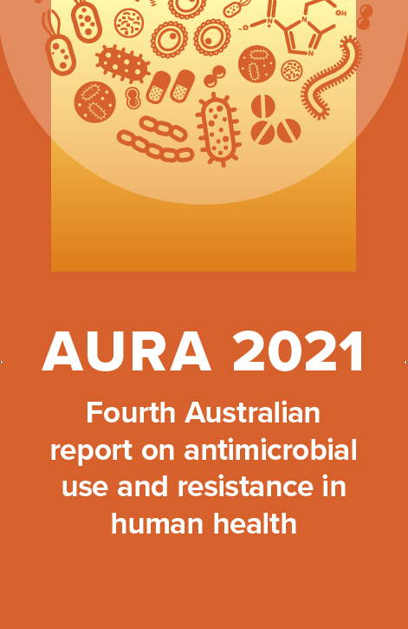
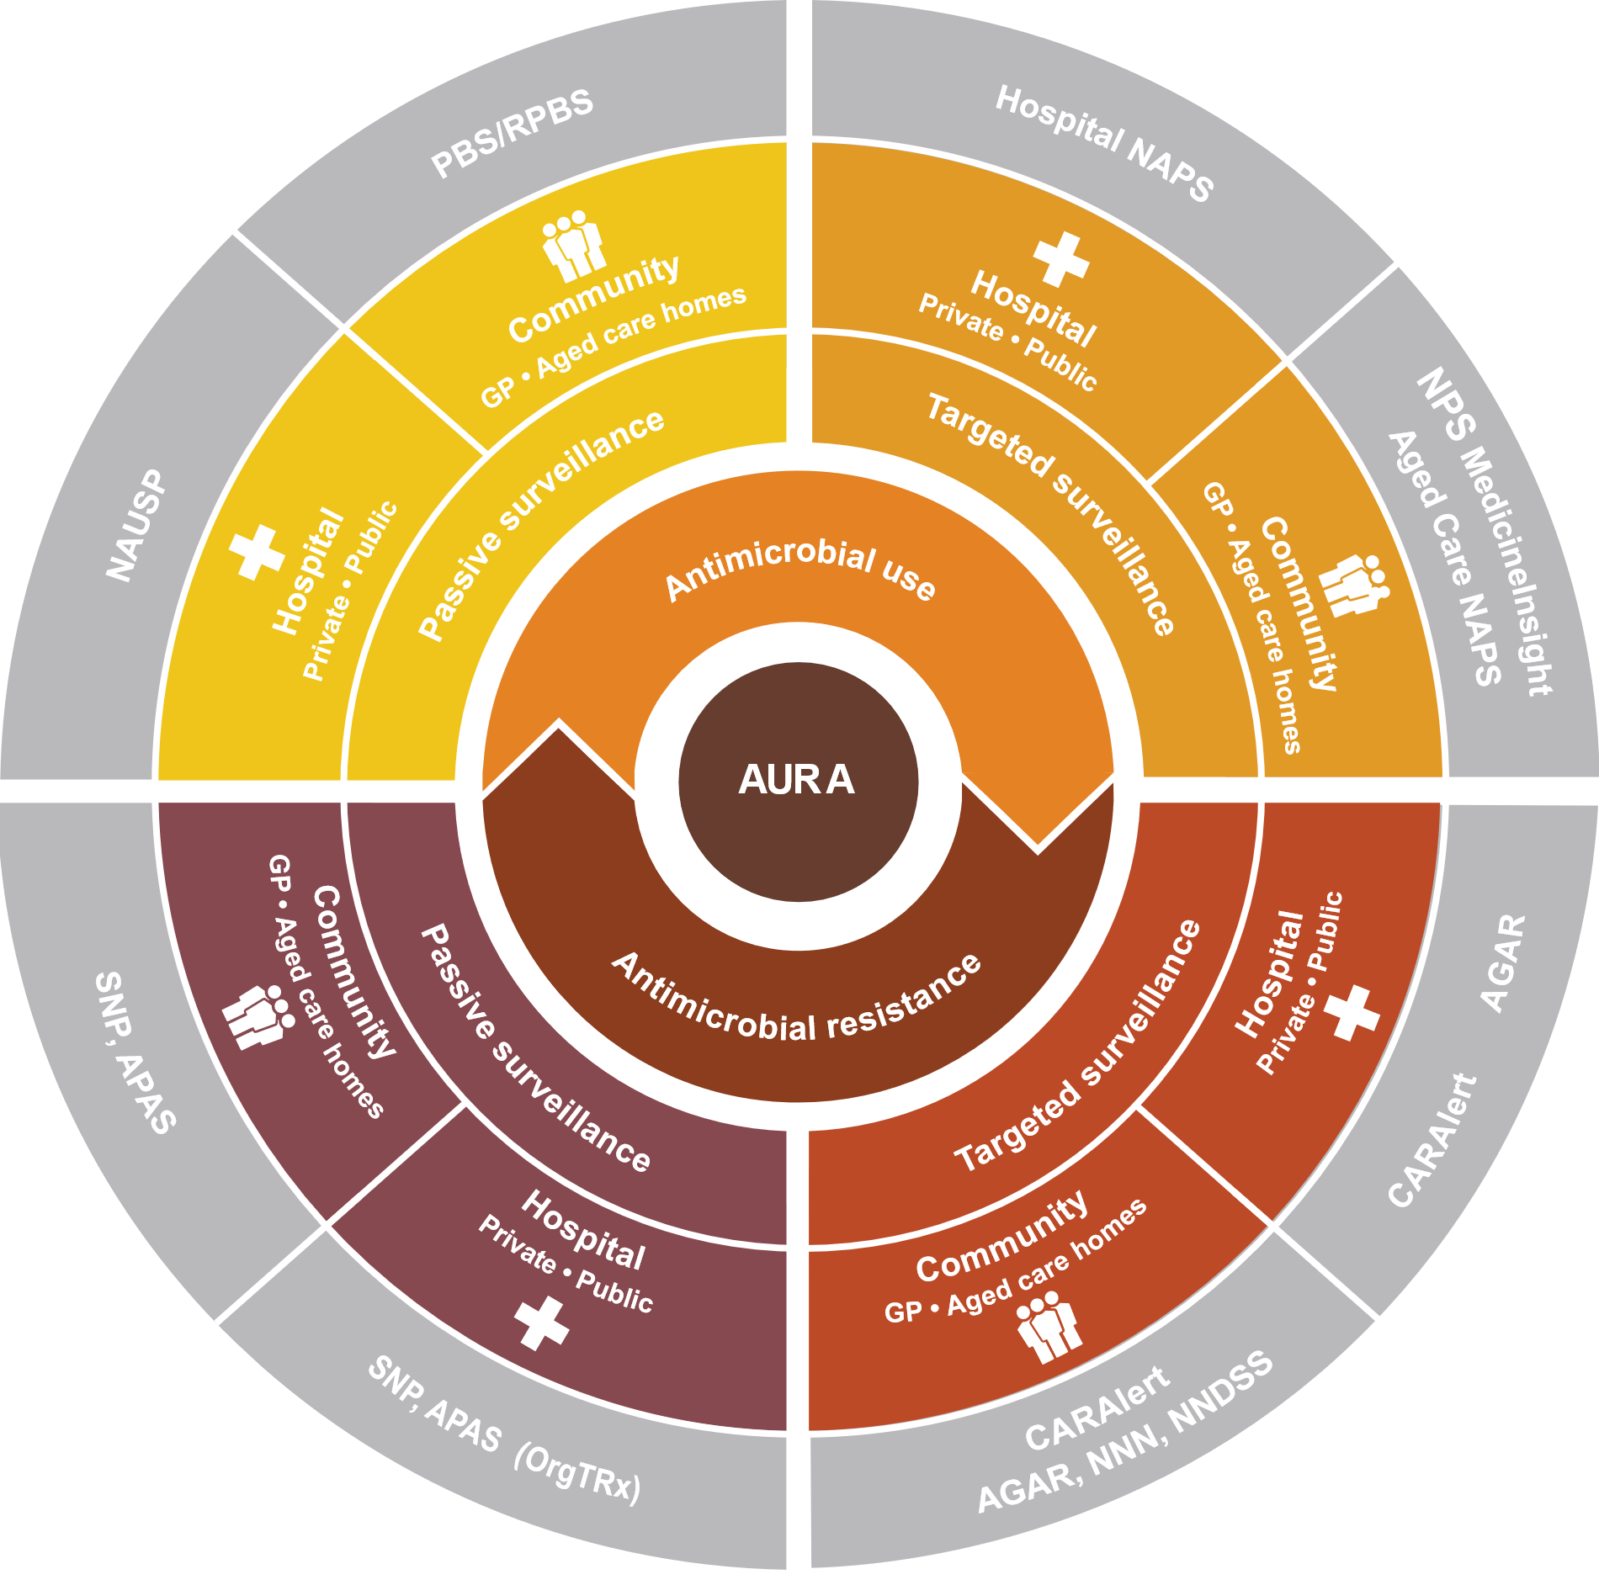

Slide 2
Chapter 6 Focus areas
Figures and Tables
AURA 2021 is the fourth in a series of national reports on antimicrobial use and resistance in human health in Australia
These slides include figures and tables from the report, for use in presentations or other documents
Please attribute any of the material included in these slides using the following citation:
Australian Commission on Safety and Quality in Health Care. AURA 2021: fourth Australian report on antimicrobial use and resistance in human health. Sydney: ACSQHC; 2021
Further information about the AURA Surveillance System is provided at www.safetyandquality.gov.au/aura

Slide 3
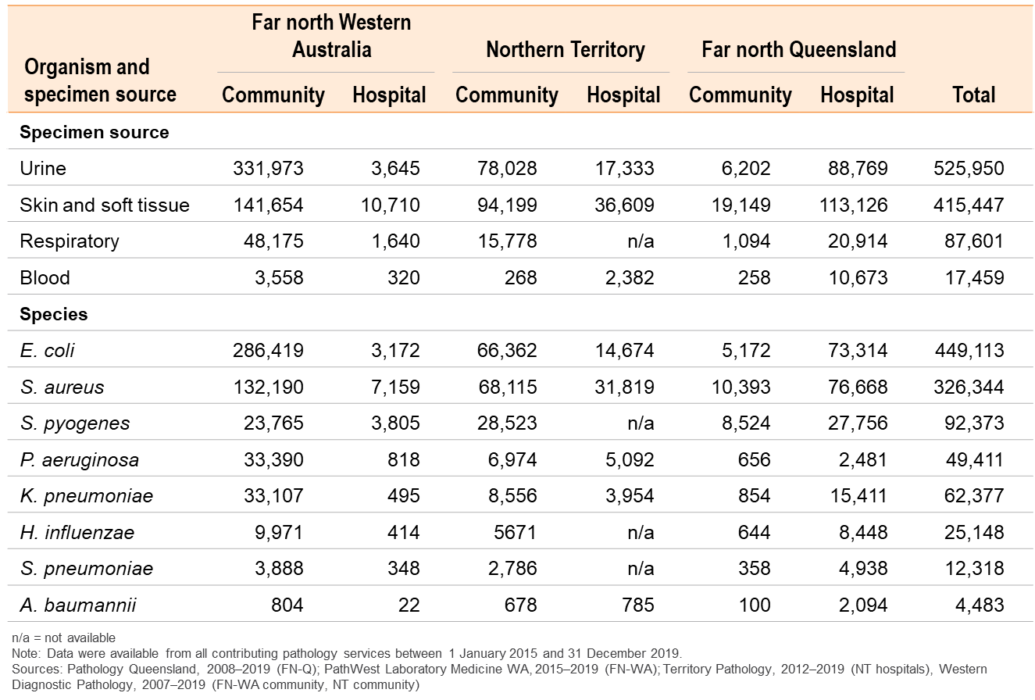
Table 6.1: Top eight organisms, specimen source, by region and setting, 2007–2019

Slide 4
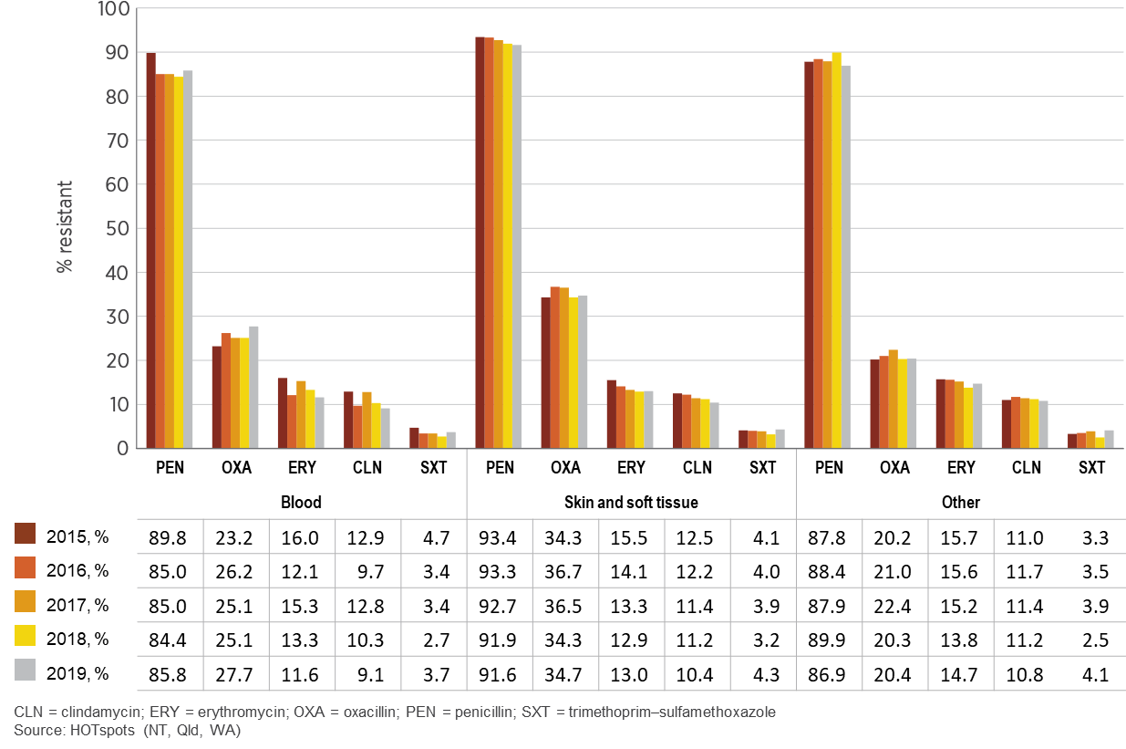
Figure 6.1: Staphylococcus aureus resistance in northern Australia, by specimen source, 2015–2019

Slide 5
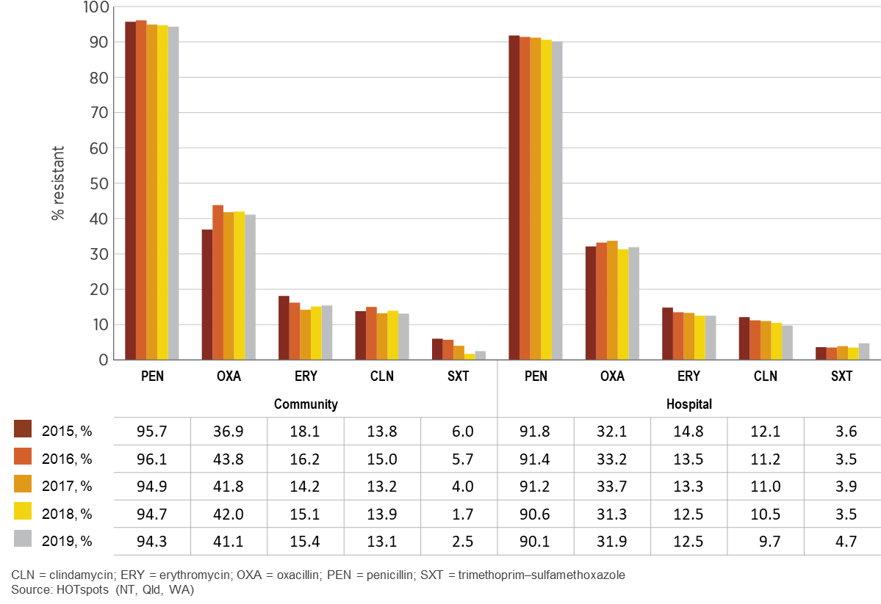
Figure 6.2: Staphylococcus aureus resistance in northern Australia, by setting, 2015–2019

Slide 6
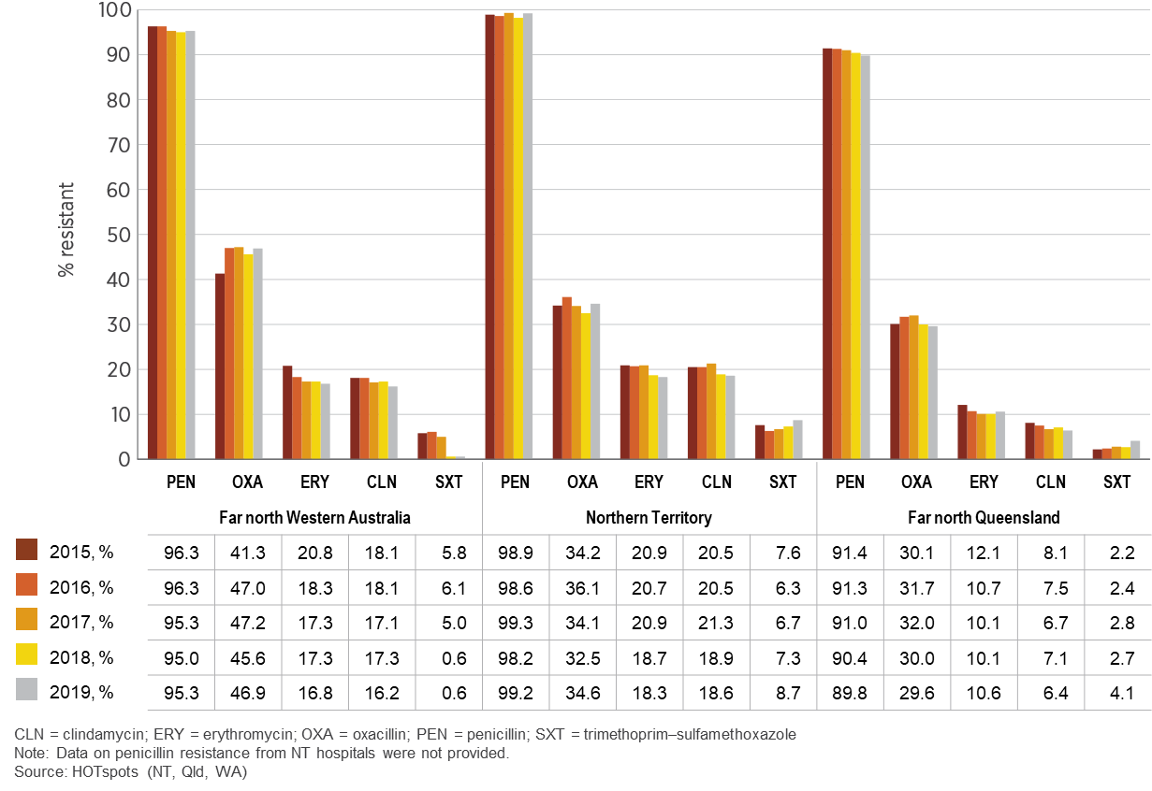
Figure 6.3: Staphylococcus aureus resistance in northern Australia, by state and territory, 2015–2019

Slide 7
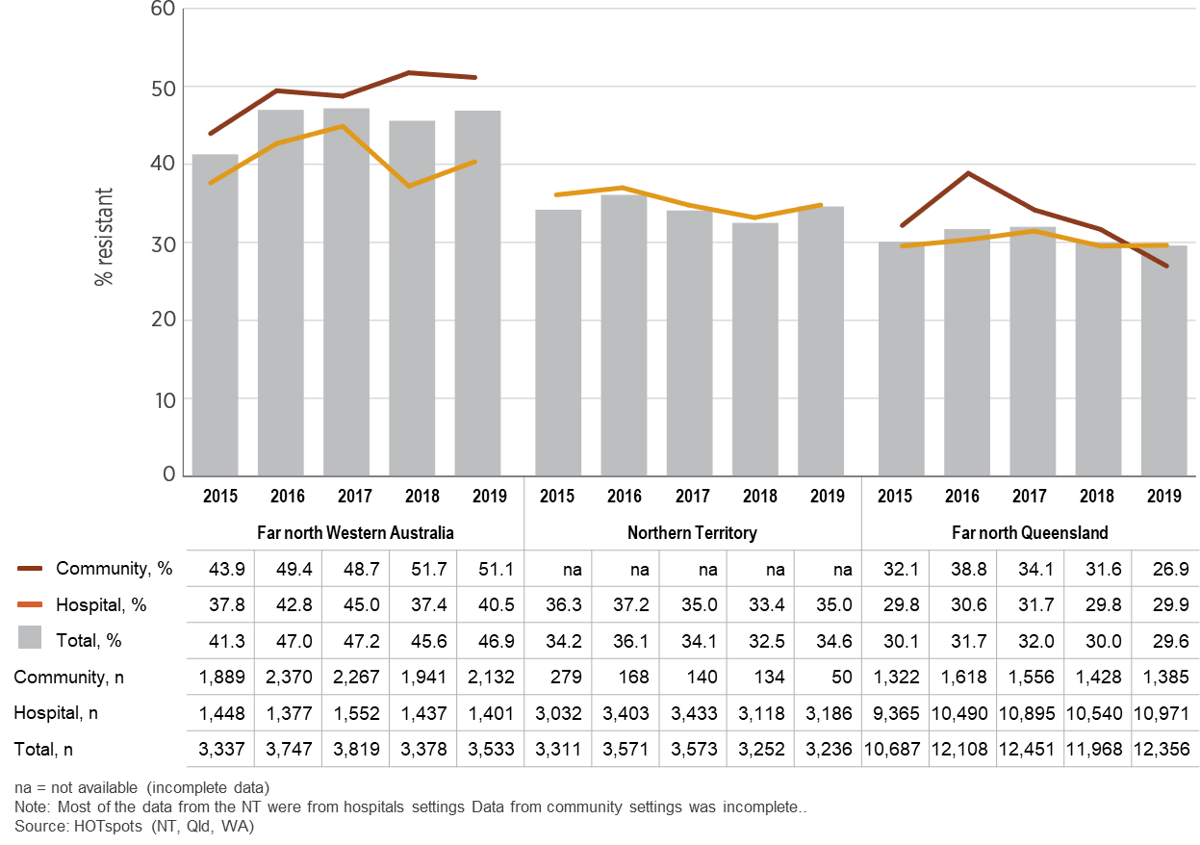
Figure 6.4: Methicillin-resistant Staphylococcus aureus, by region and setting, 2015–2019

Slide 8
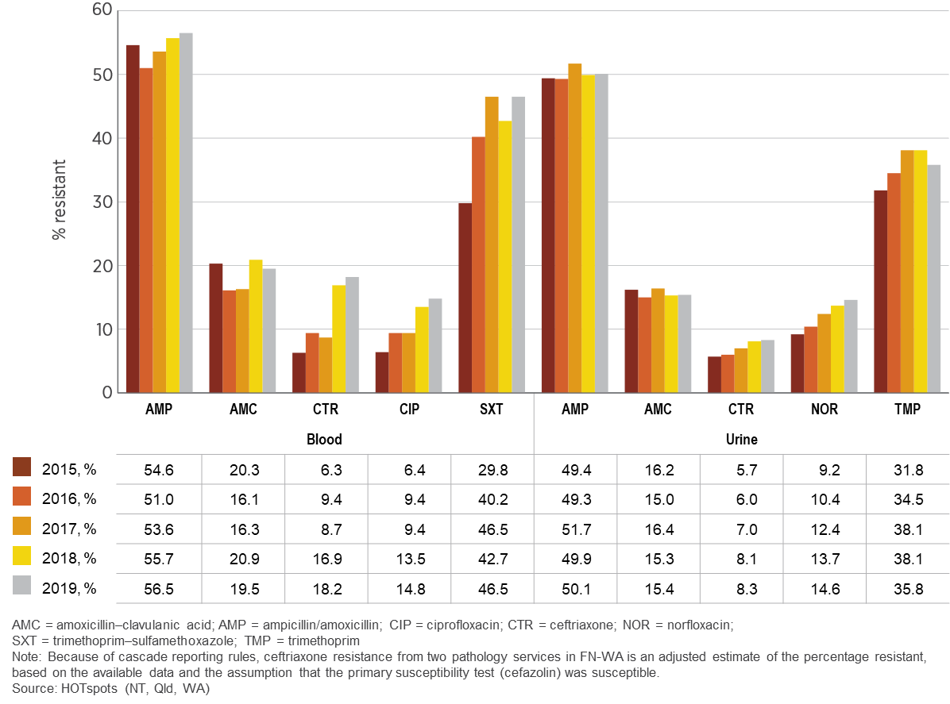
Figure 6.5: Escherichia coli resistance in northern Australia, by specimen source, 2015–2019

Slide 9
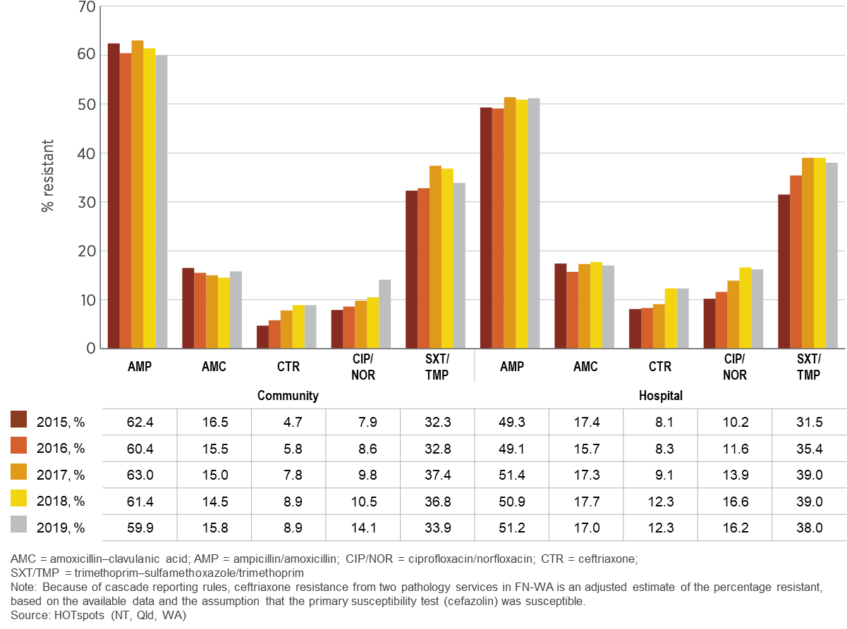
Figure 6.6: Escherichia coli resistance in northern Australia, by setting, 2015–2019

Slide 10
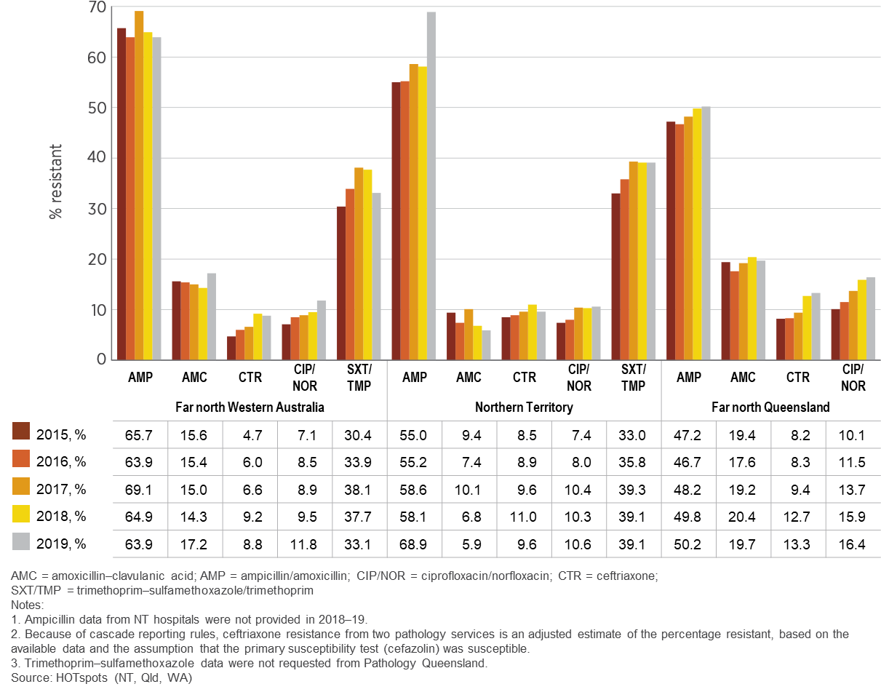
Figure 6.7: Escherichia coli resistance in northern Australia, by region, 2015–2019

Slide 11
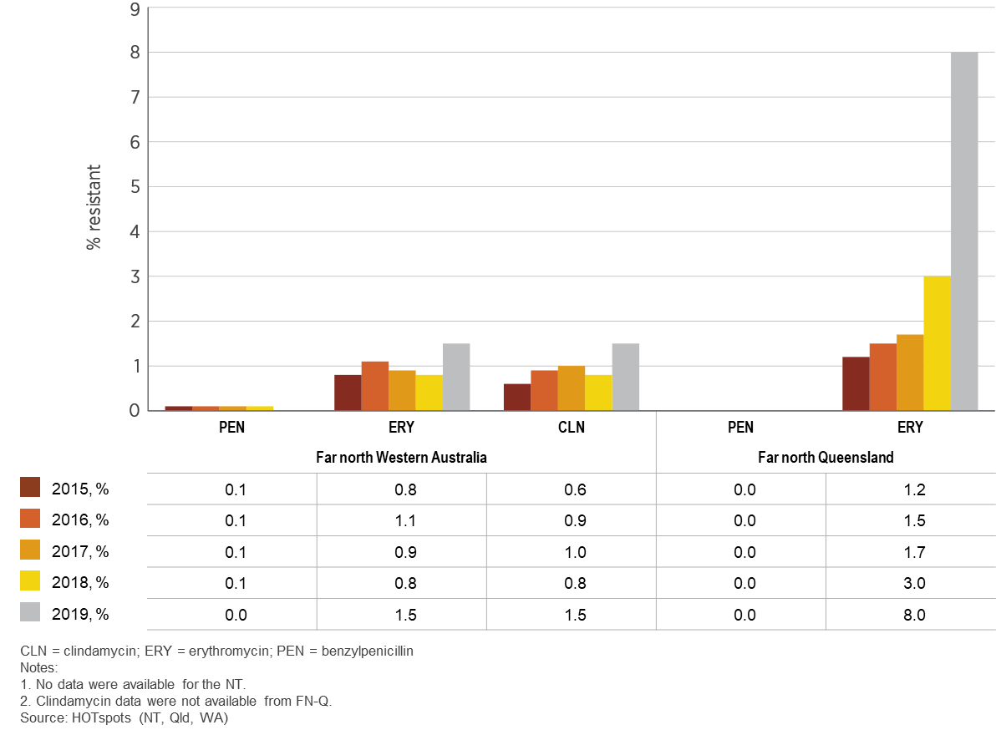
Figure 6.8: Streptococcus pyogenes resistance in northern Australia, by region, 2015–2019

Slide 12
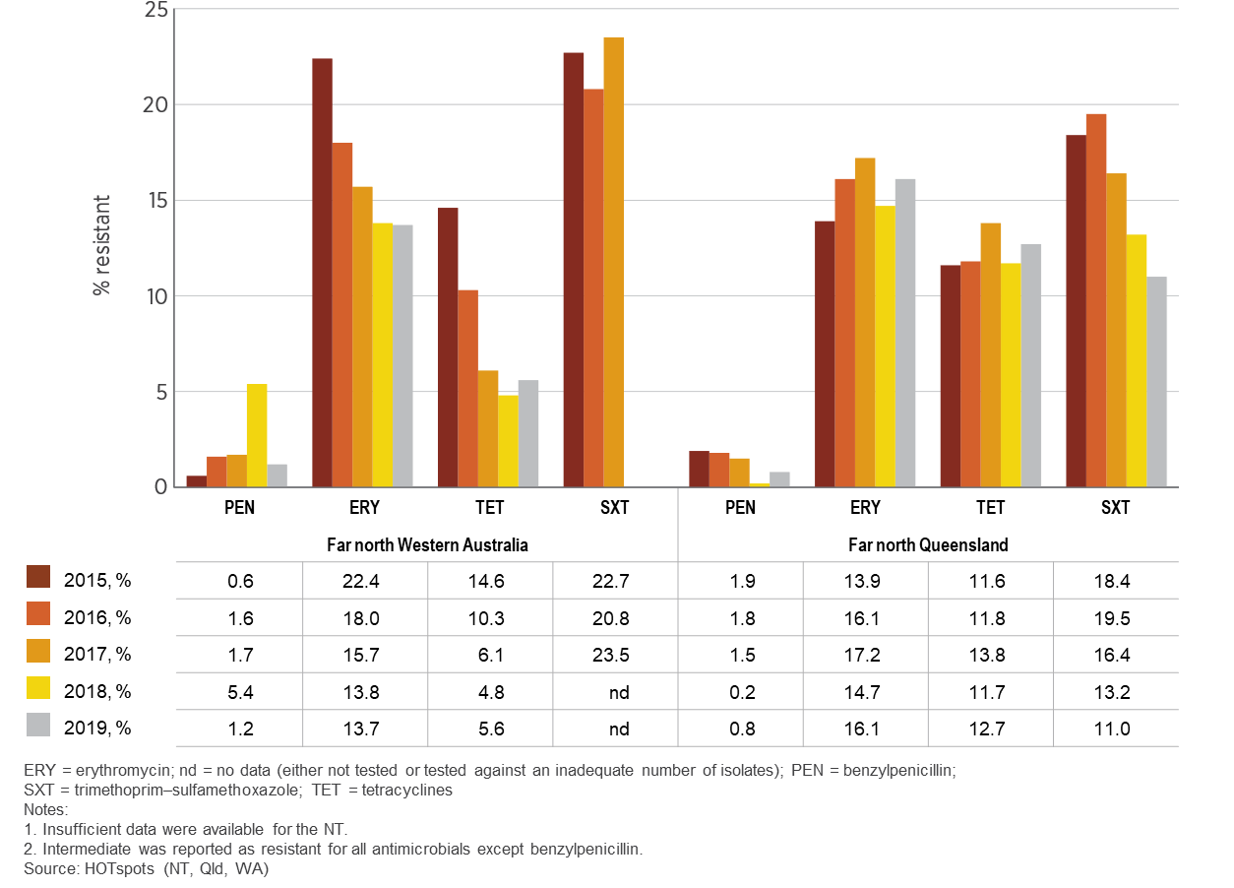
Figure 6.9: Streptococcus pneumoniae resistance in northern Australia, by region, 2015–2019

Slide 13
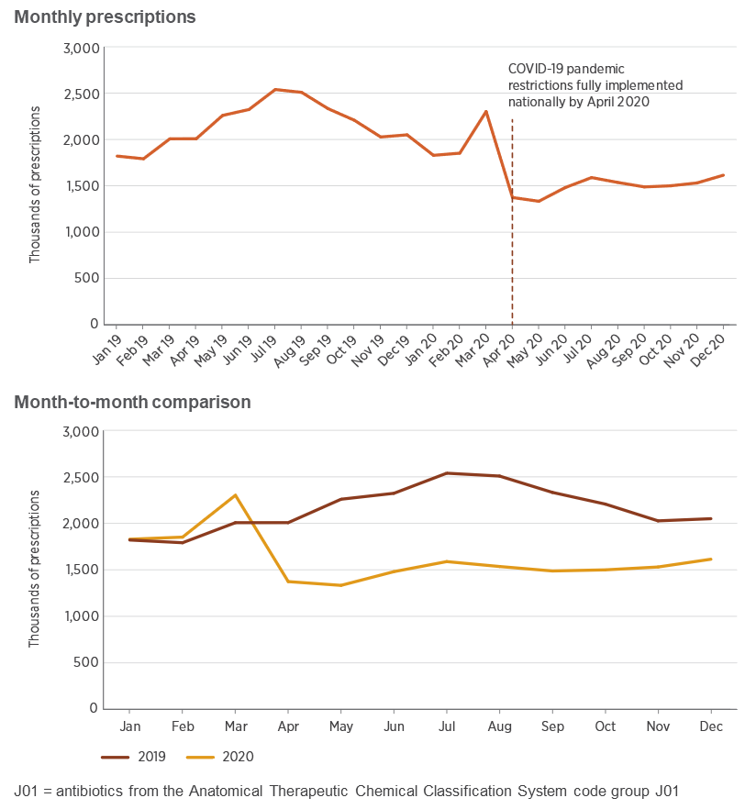
Figure 6.10: Number of prescriptions for systemic antibiotics (J01) supplied in 2019 and 2020

Slide 14
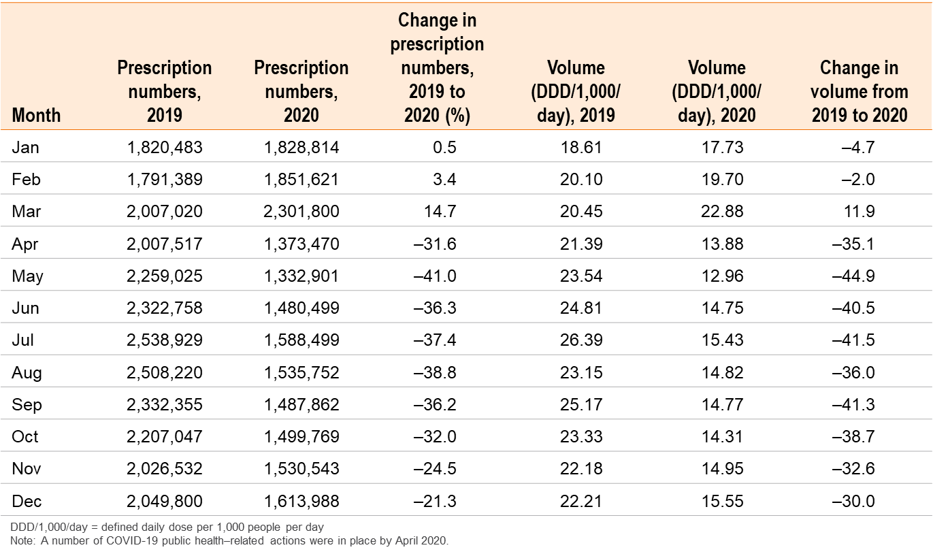
Table 6.2: Difference in number of prescriptions and antibiotic volume between 2020 and 2019

Slide 15
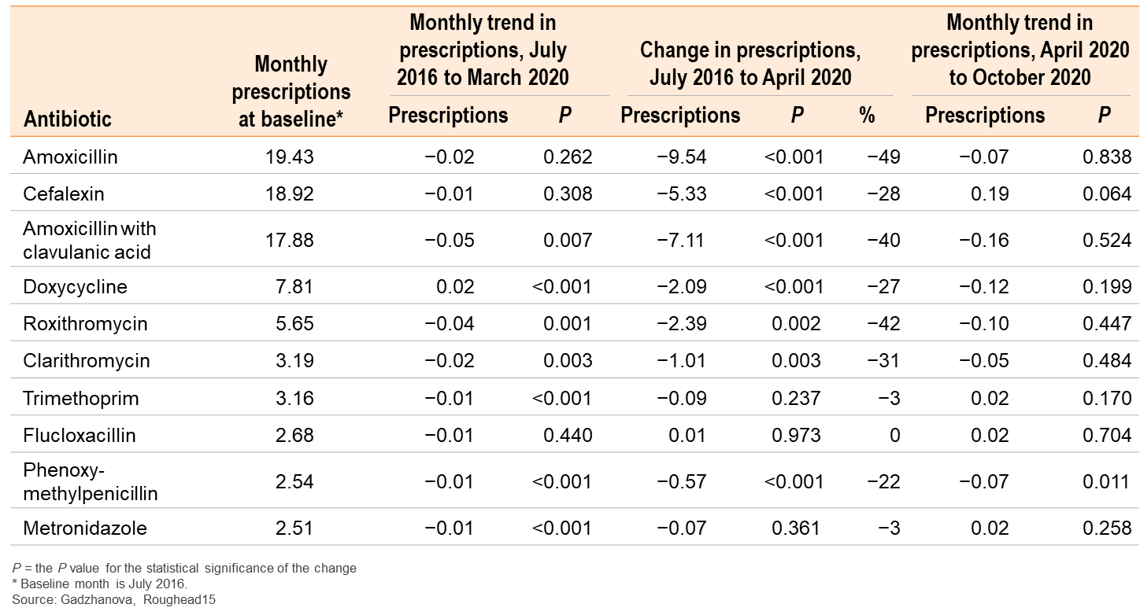
Table 6.3: Estimated number of antibiotic dispensings per 1,000 people in Australia, July 2016 to October 2020, by selected agent

Slide 16
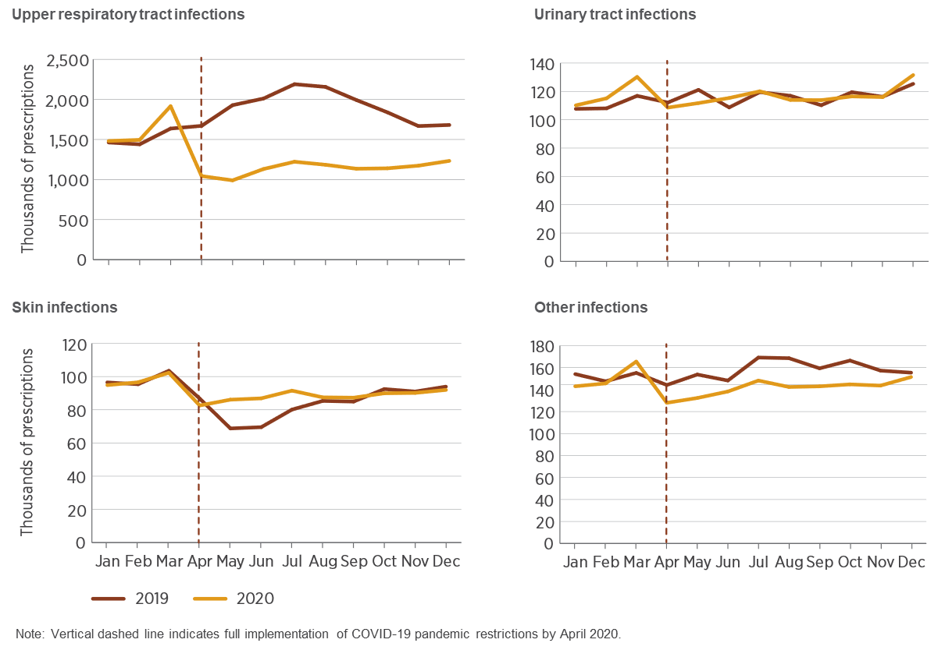
Figure 6.11: Number of prescriptions for oral systemic antibiotics typically used for upper respiratory tract infections, urinary tract infections, skin infections and other infections, 2019 and 2020

Slide 17
Figure 6.12: Number of prescriptions for antibiotics frequently used for upper respiratory tract infections, by type of antibiotic, 2019 and 2020

Slide 18
Figure 6.13: Number of prescriptions per 1,000 people for antibiotics for upper respiratory tract infections, by state and territory, 2019 and 2020

Slide 19
Figure 6.14: Number of prescriptions per 1,000 people for antibiotics for upper respiratory tract infections, by age group, 2019 and 2020

Slide 20
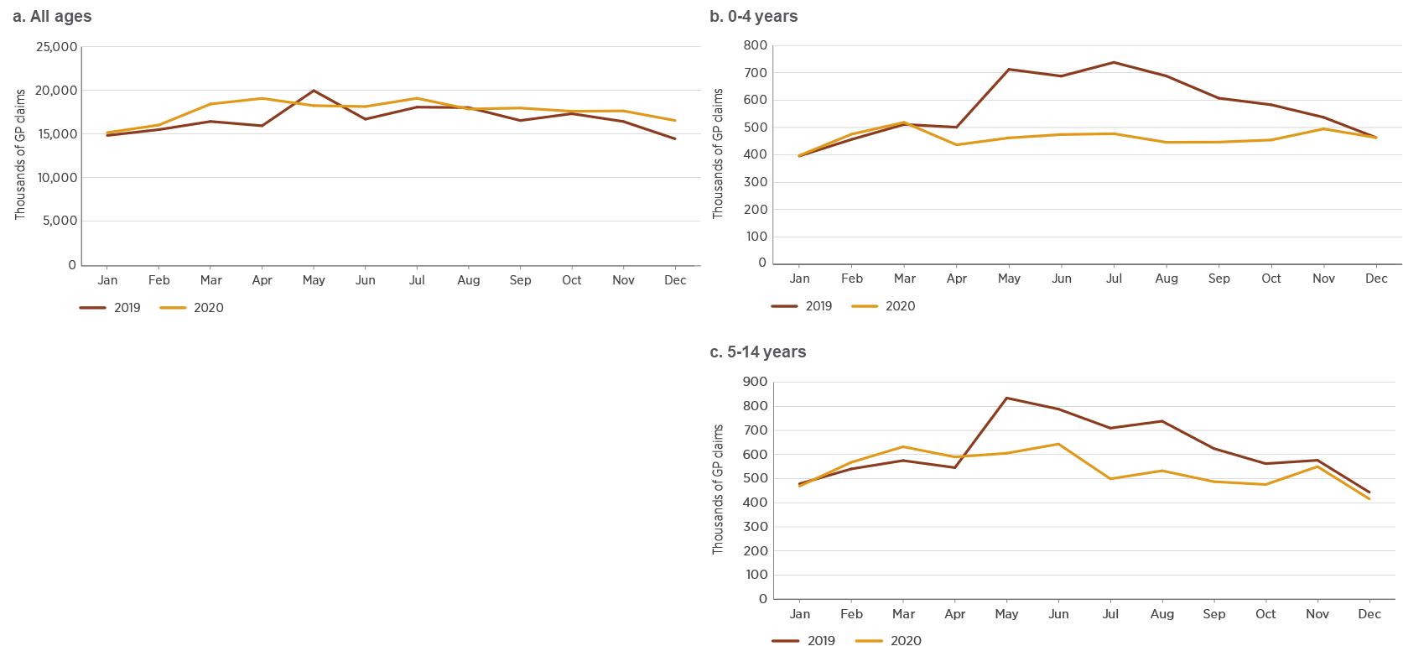
Figure 6.15: Number of GP standard consultations (standard and COVID telehealth items), 2019 and 2020

Slide 21
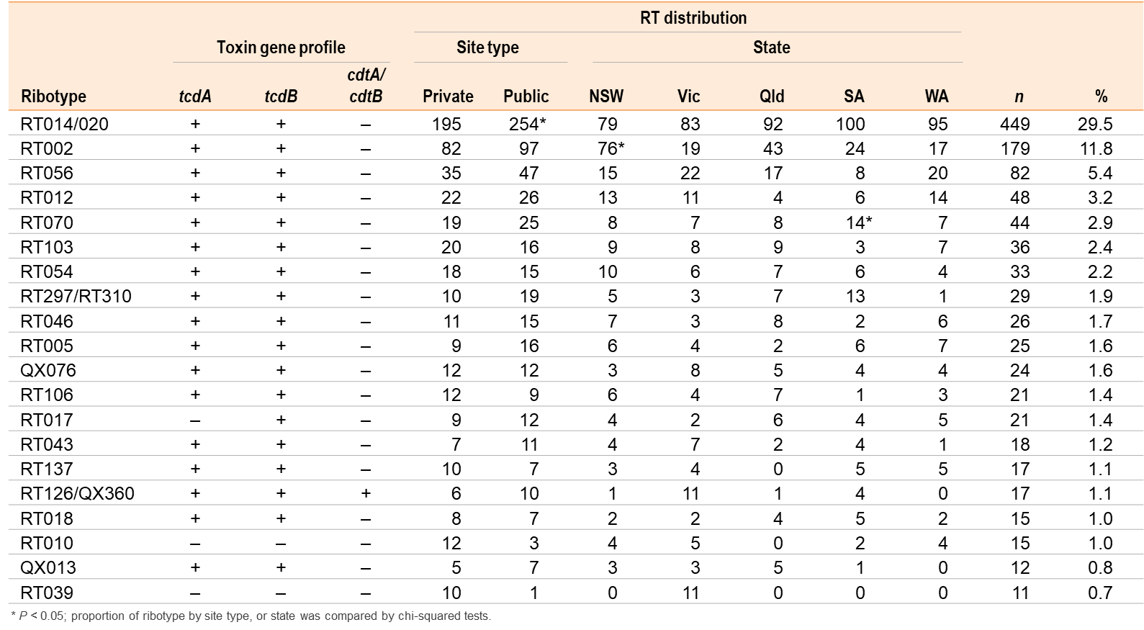
Table 6.4: Summary of the 20 most prevalent Clostridioides difficile ribotypes, and their toxin gene profiles and distribution

Slide 22
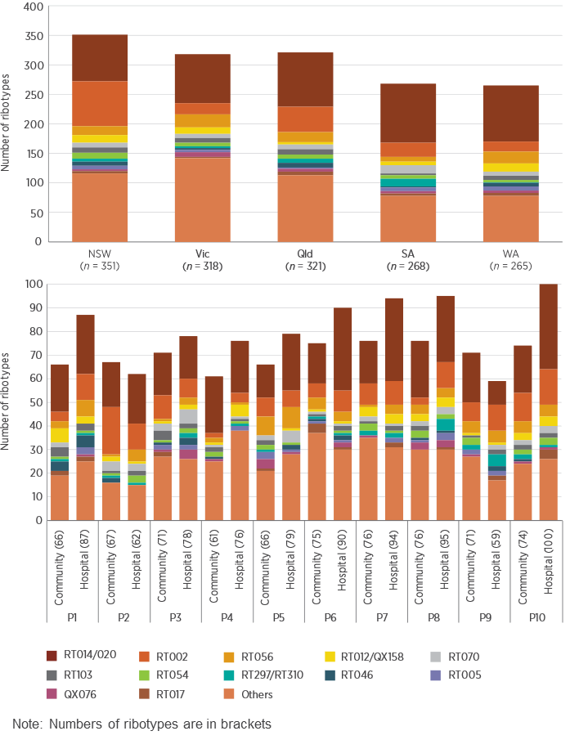
Figure 6.16: Distribution of Clostridioides difficile ribotypes, by (a) state and (b) private or public collection site, over 10 collection phases, 2013–2018

Slide 23
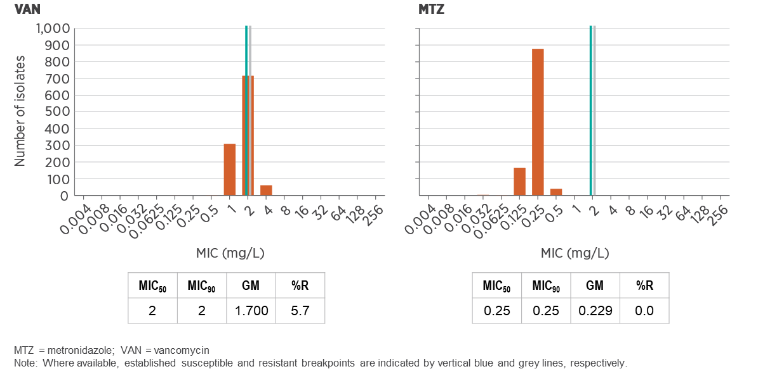
Figure 6.17a: Minimum inhibitory concentration distributions for nine antimicrobials against 1,091 Clostridioides difficile isolates

Slide 24
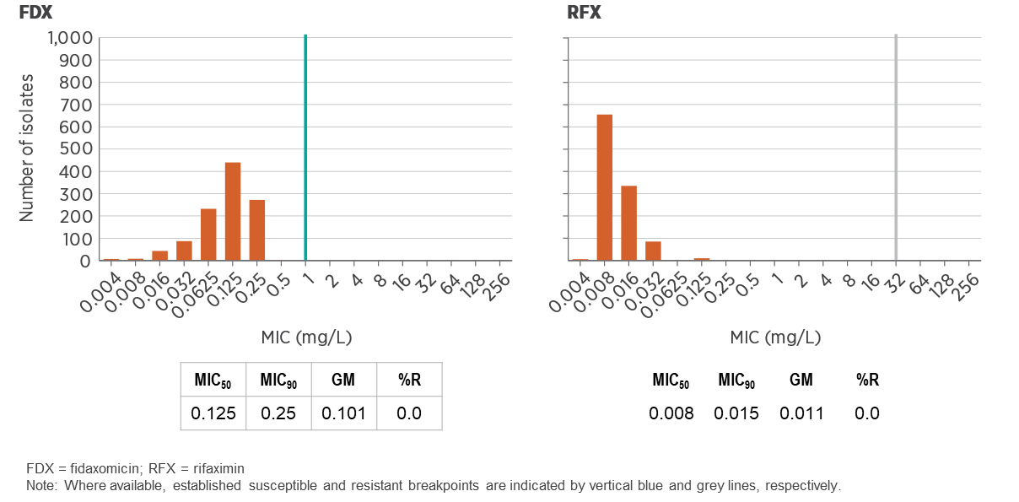
Figure 6.17b: Minimum inhibitory concentration distributions for nine antimicrobials against 1,091 Clostridioides difficile isolates

Slide 25
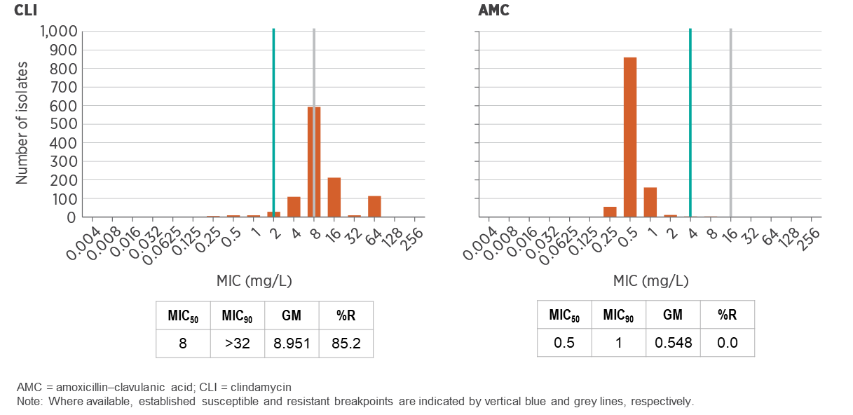
Figure 6.17c: Minimum inhibitory concentration distributions for nine antimicrobials against 1,091 Clostridioides difficile isolates

Slide 26
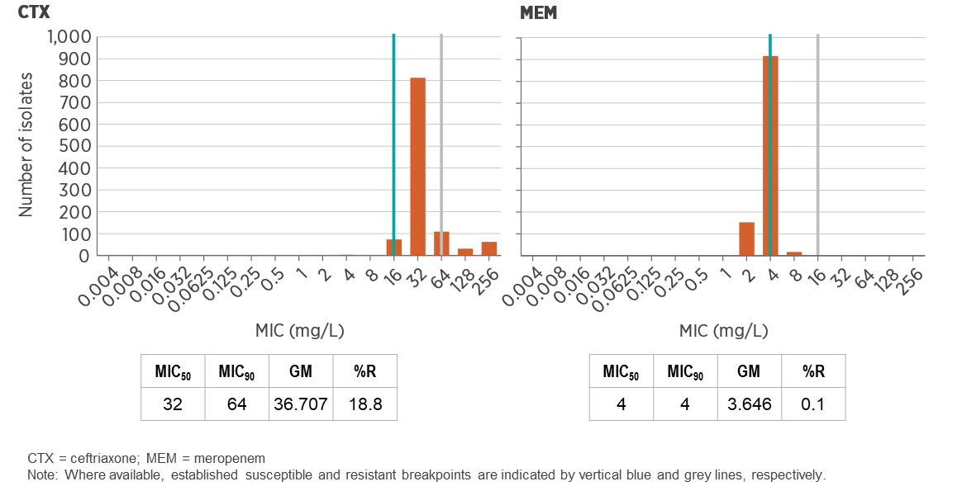
Figure 6.17d: Minimum inhibitory concentration distributions for nine antimicrobials against 1,091 Clostridioides difficile isolates

Slide 27
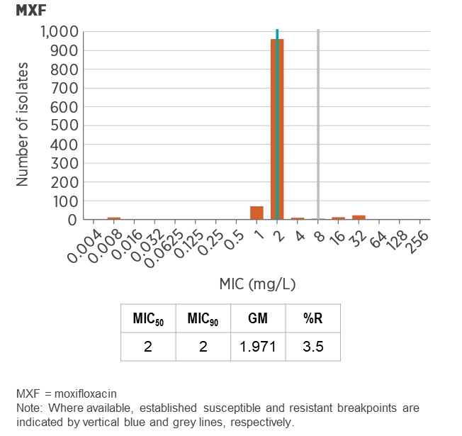
Figure 6.17e: Minimum inhibitory concentration distributions for nine antimicrobials against 1,091 Clostridioides difficile isolates

Slide 28
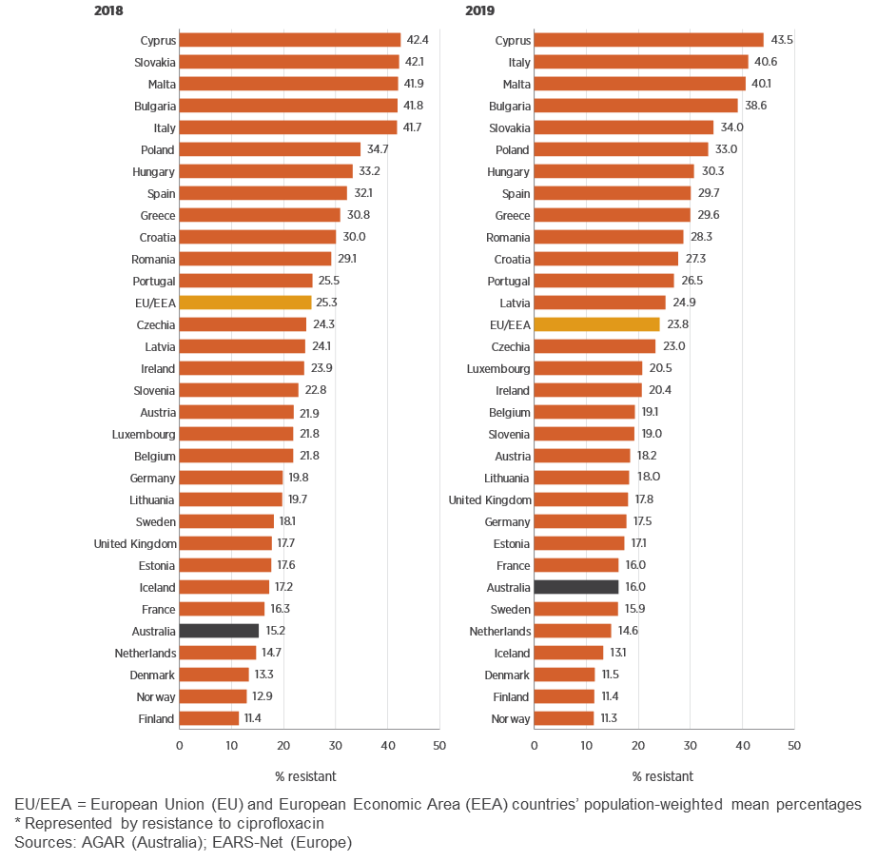
Figure 6.18: Escherichia coli rates of resistance to fluoroquinolones* in Australia and European countries, 2018 and 2019

Slide 29
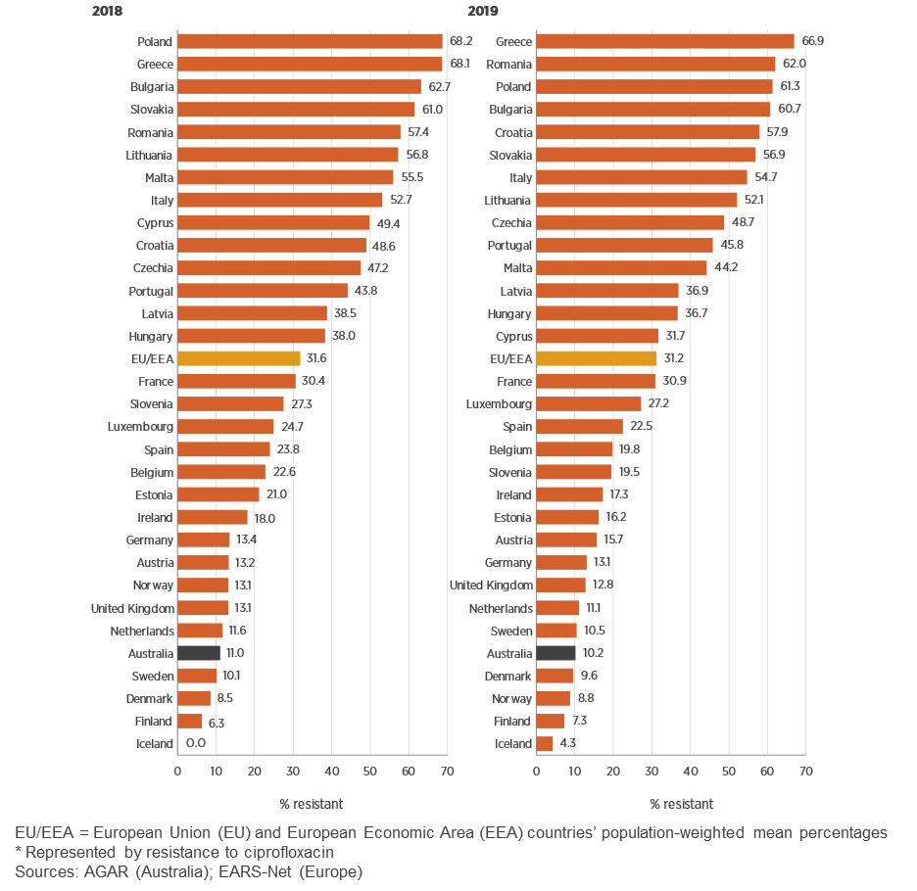
Figure 6.19: Klebsiella pneumoniae rates of resistance to fluoroquinolones* in Australia and European countries, 2018 and 2019

Slide 30
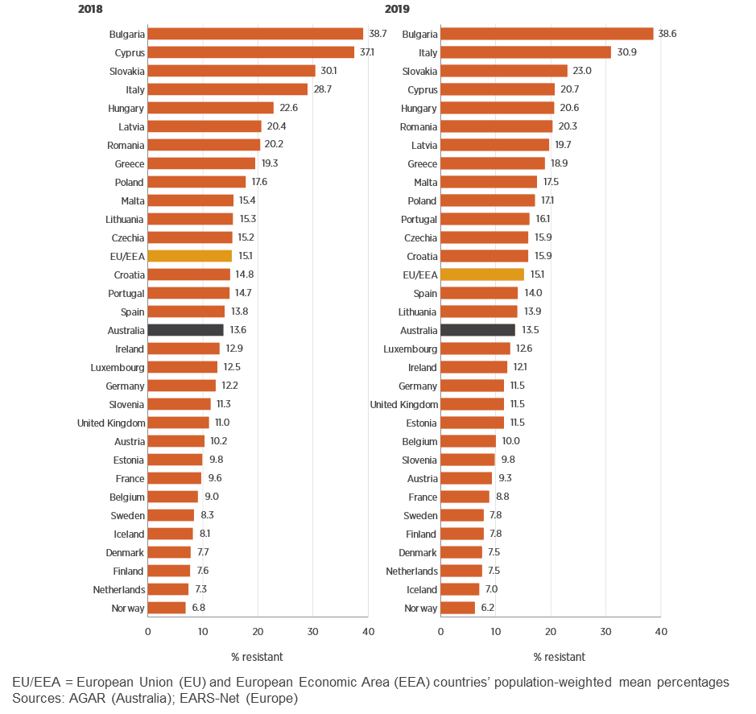
Figure 6.20: Escherichia coli rates of resistance to third-generation cephalosporins in Australia and European countries, 2018 and 2019

Slide 31
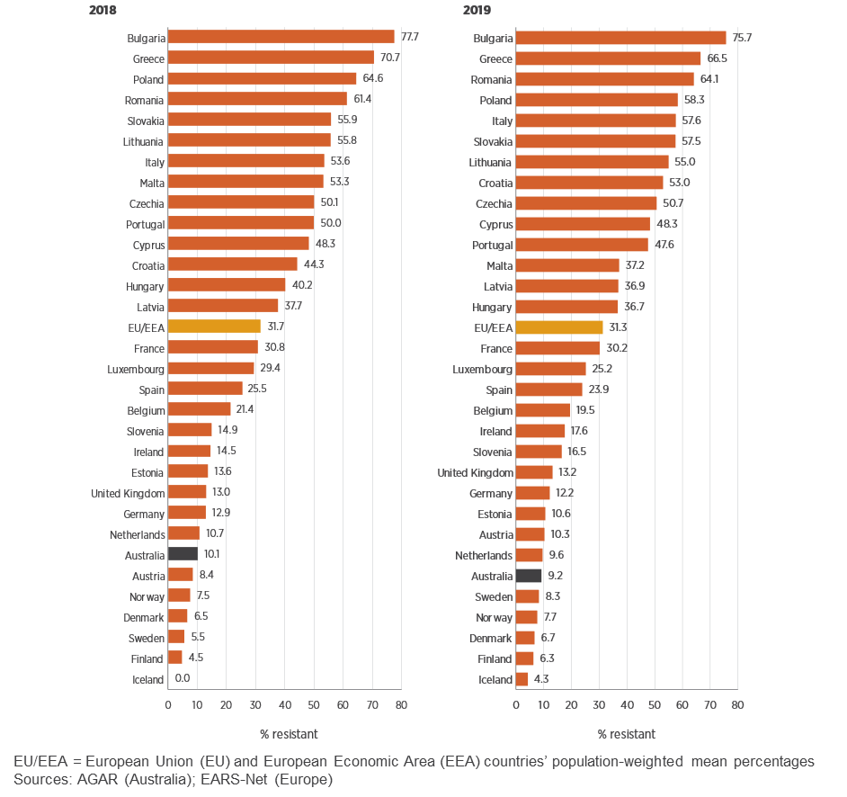
Figure 6.21: Klebsiella pneumoniae rates of resistance to third-generation cephalosporins in Australia and European countries, 2018 and 2019

Slide 32
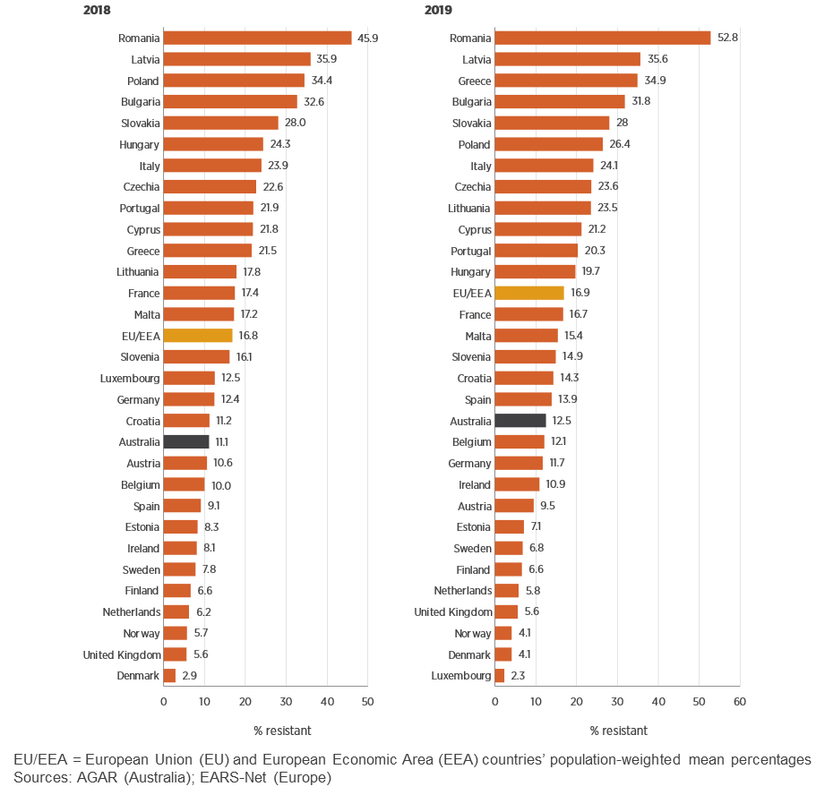
Figure 6.22: Pseudomonas aeruginosa rates of resistance to piperacillin–tazobactam in Australia and European countries, 2018 and 2019

Slide 33
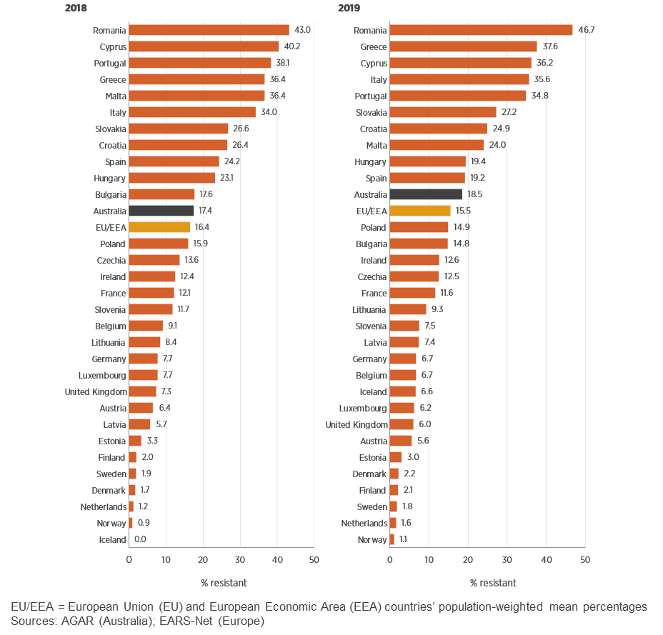
Figure 6.23: Staphylococcus aureus rates of resistance to methicillin in Australia and European countries, 2018 and 2019

Slide 34
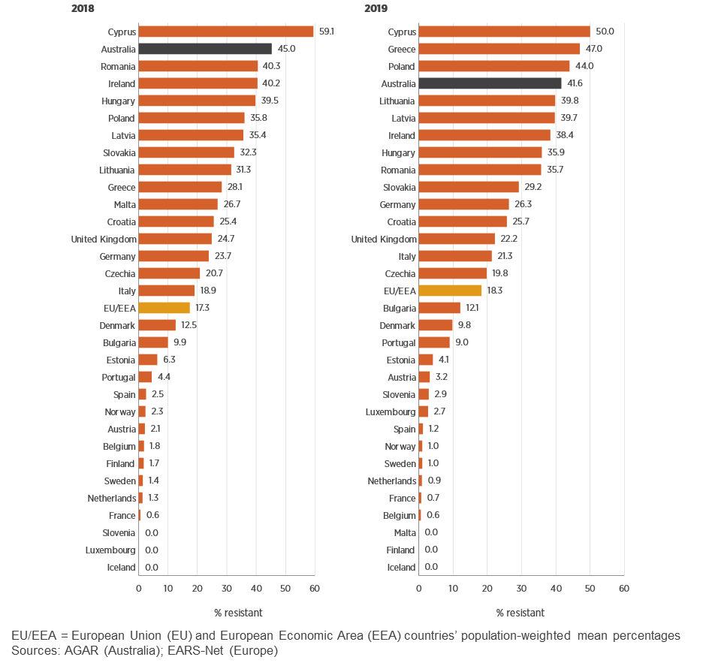
Figure 6.24: Enterococcus faecium rates of resistance to vancomycin in Australia and European countries, 2018 and 2019

Slide 35
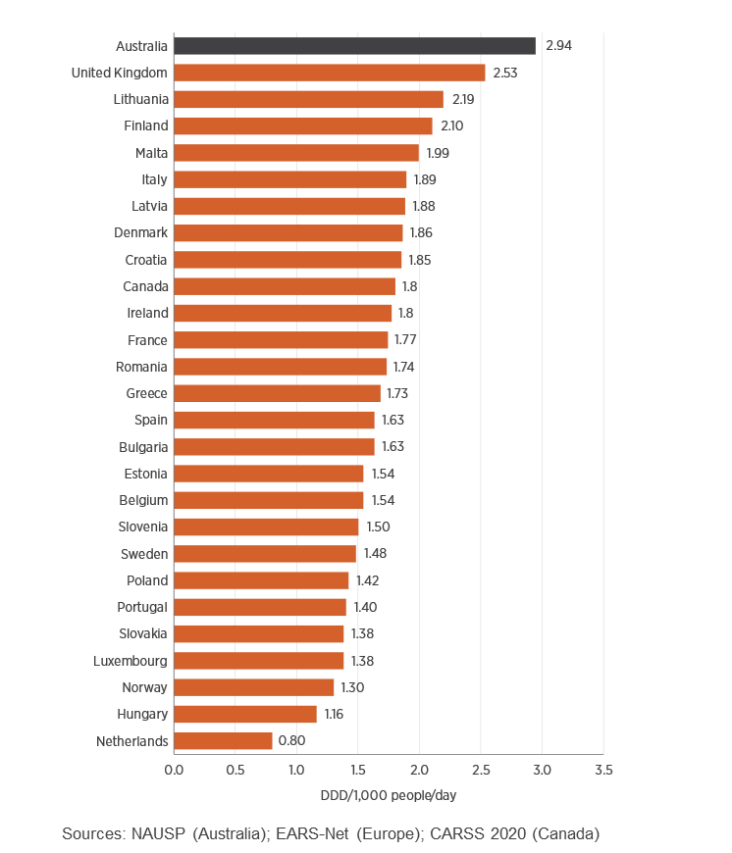
Figure 6.25: Hospital antimicrobial use in Australia, European countries and Canada, 2019

Slide 36
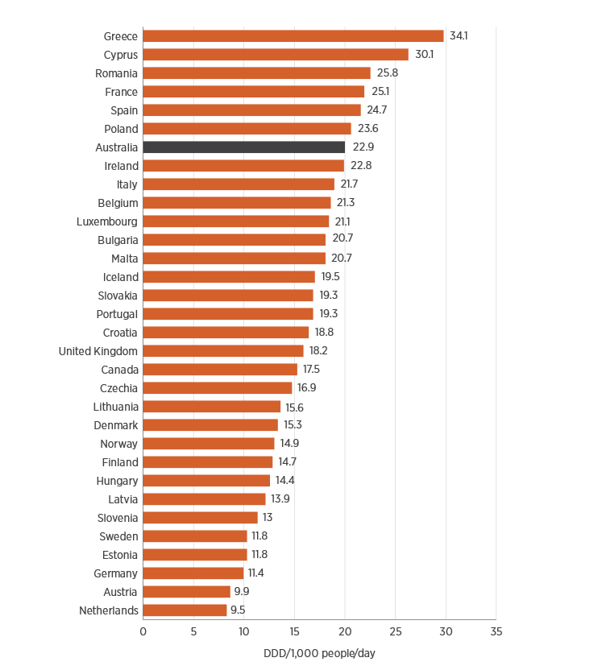
Figure 6.26: Community antimicrobial use in Australia, European countries (2019) and Canada (2018)

