Slide 1
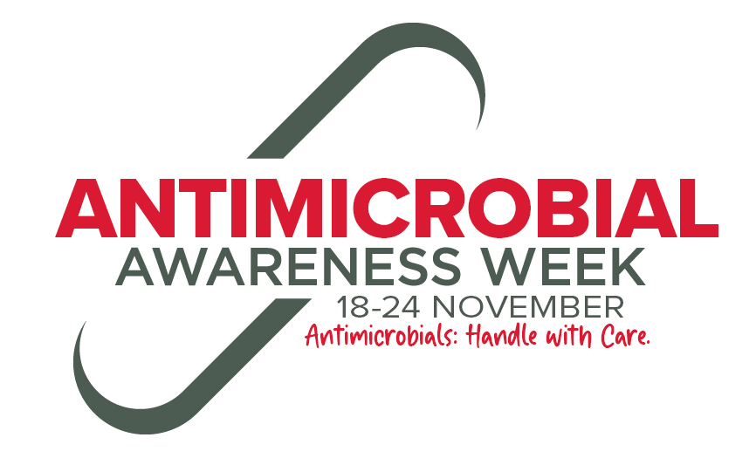
Antimicrobial Stewardship and Antimicrobial Resistance in human health
A resource for consumers 2021

Slide 2
Learning Objectives
Describe antimicrobial resistance (AMR)
Explain why antimicrobial resistance is a problem
Summarise how antimicrobial resistance develops
Identify the difference between broad and narrow spectrum antibiotics
Identify strategies to address antimicrobial resistance

Slide 3
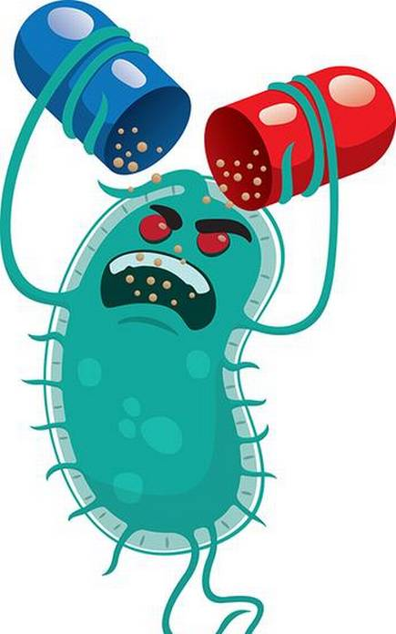
What
Antimicrobial resistance (AMR)
Why
Role and impact of overuse and misuse of antimicrobials
Who
All people
Where
Wherever antimicrobials are used
When
Now
Notes:
What is the problem?
Why is the use of antimicrobials important in AMR?
Who does it affect?
Where is AMR an issue?
When do we need action on AMR?

Slide 4
A consumer story
Notes:
Play this video - https://www.youtube.com/watch?v=BFYuguuImW8&feature=youtu.be
Other consumer stories can be found here:
https://www.idsociety.org/public-health/patient-stories/patient-
https://antibioticguardian.com/stories/stories/

Slide 5
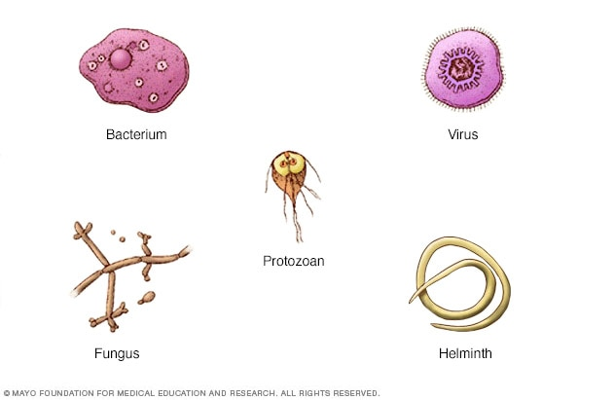
Microbes
Also known as microorganisms
Organisms so small a microscope is needed to see them
Are found everywhere
Can be both helpful and harmful to human health
Most are helpful
Types
Bacteria
Viruses
Fungi
Parasites (protozoa, helminths, and ectoparasites)

Slide 6
Different types of antimicrobials and the microorganisms they are active against
Notes:
Antibiotics are a type of antimicrobial
Used when bacterial microbes are harmful to human health
Treat bacterial infections by targeting bacteria
They don’t cause harm to human cells or work on viruses
Can cause side effects, drug interactions, allergies and damage the good bacteria that we carry and need (microbiome)
Very important to understand the four different group as it helps with the understand of why we can’t use antibiotics for viruses etc

Slide 7
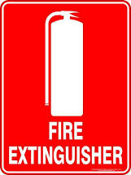
“Antibiotics are like fire extinguishers.
We don’t want to use them all the time but we are happy we have them on the wall.”
John Rex

Slide 8
Antibiotics
Your doctor should:
Not waste them
Only use them when necessary
Always choose the most appropriate for
what bacteria is being fought
Notes:
We will focus on antibiotics for this presentation

Slide 9
Antibiotic Spectrum
Bacteria A | Bacteria B | Bacteria C | Bacteria D | Bacteria E | Bacteria F | Bacteria G
 | Antibiotic 1
 | Antibiotic 2
 | Antibiotic 3
Antibiotic 4
Antibiotic 5
 | Antibiotic 6
Antibiotic 7
 | Antibiotic 8
Antibiotic 9
Antibiotic 10
There are many different kinds of bacteria
We need different tools for different jobs
Notes:
We need many different kinds of antibiotics to treat the infections they cause

Slide 10
Broad Spectrum Antibiotics
Sledgehammer
Antibiotics can be broad spectrum e.g., Antibiotic 6 to 10
Affect many different species of bacteria
BUT - Broad spectrum antibiotics contribute more to resistance

Slide 11
Narrow Spectrum Antibiotics
Scalpel
More targeted
Antibiotics can be narrow spectrum – e.g., Antibiotic 1 to 5
Effect one or two kinds of bacteria
Narrow spectrum antibiotics contribute less to resistance

Slide 12
Antibiotics
Previously untreatable illnesses now curable
Minimise the infection risk of modern medicine
Preventing infection
During some types of surgery
When cancer treatments weaken immune system
Antibiotics have an impact not just for the person taking them, but also the broader community

Slide 13
Where do we use antibiotics?
Humans
Community
Hospital
Animals
Pets
Livestock
Agriculture
Crops
Aquaculture
Notes:
This data is from England. Australia does not have this data available but it is a good comparison to Australia’s situation.
England uses less antibiotics than Australia but has a similar proportion of where they are used

Slide 14
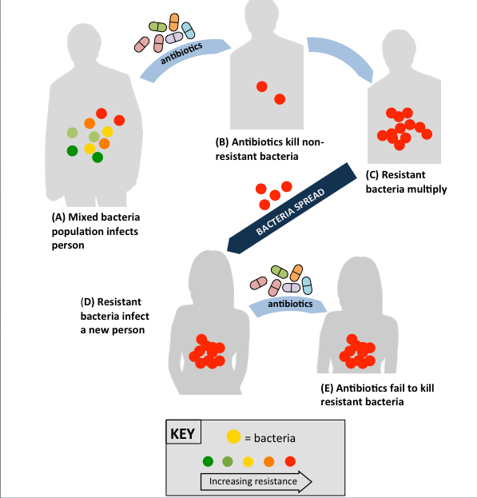
Antimicrobial Resistance
Bacteria evolve over time in response to the environment
Bacteria are constantly adapting to resist antibiotics
This is called antibiotic resistance
Overuse and misuse of antibiotics accelerates this even more
Notes:
Whilst bacteria naturally evolve over time, overuse/misuse of antibiotics accelerates this. This acceleration costs us precious time whilst we wait for new therapies to be developed.

Slide 15
Commission video on antimicrobial resistance
Notes:
Video Link: https://www.youtube.com/watch?v=4bckD5YAYrQ

Slide 16
Bacteria, not humans, become antibiotic resistant
Resistant bacteria can spread like other microbes
e.g. by shaking hands
Resistant bacteria can be carried by anyone – healthy or ill
The use of antibiotics in animals and agriculture contributes to the problem but to a lesser extent
The more often or the longer a person takes antibiotics, the more likely they are to carry antibiotic resistant bacteria in their body
Notes:
All exposure to antibiotics can lead to resistant microbes which can be carried by anyone and passed on in simple ways to anyone who may then become ill.
A person can be either ‘colonised’ or ‘infected’ with resistant bacteria.
‘Colonised’ means that a person has the bacteria present on the skin, in body openings or in the gut, but has no signs of infection.
'Infected’ means that a person has signs of an infection, such as fever or pus from a wound.
So a “healthy” person may be colonised with resistant bacteria and pass this on to anyone who could develop an infection. Also, if that “healthy” person were to develop an infection themselves which would be more serious as they are have resistant bacteria.

Slide 17
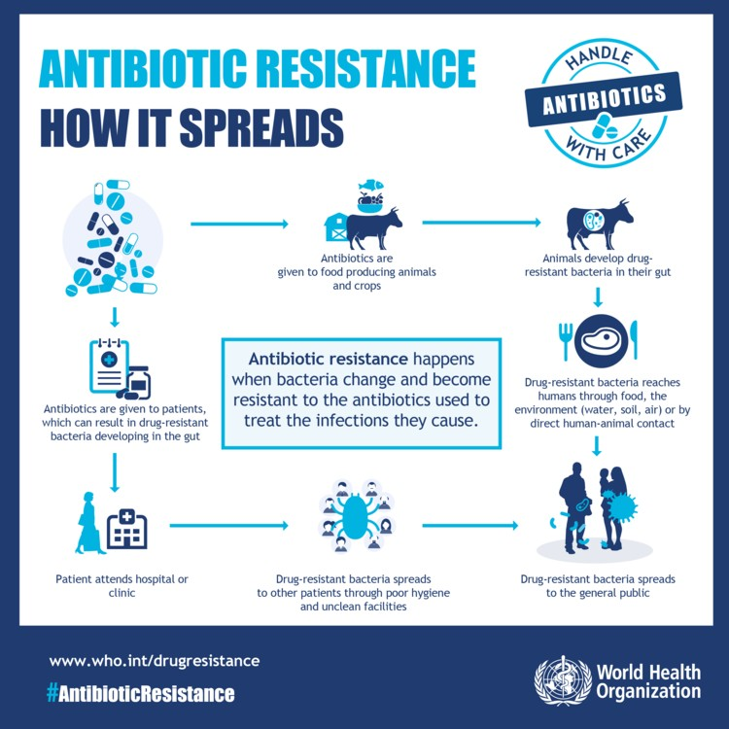
Notes:
Explains the concept of “One Health”

Slide 18
Why is resistance a problem?
Rates of antibiotic resistance are rising
Australia uses more antibiotics than many other comparable countries
Significant proportion of that use is inappropriate
e.g. using antibiotics for a cold
Few new antibiotics becoming available
Notes:
There are rising rates of resistance in Australia to various bacteria, in some cases resistance is becoming so significant that very few antibiotics are left.
It is difficult to know why Australia uses more antibiotics than other countries. Australia does use less antibiotics than other countries where antibiotics are available over the counter without a prescription (and the rates of resistance are worse in those countries).
The Commission compares healthcare variation for many different things including antimicrobial use.
Few new antibiotics becoming available for many reasons
Research and development is difficult and expensive
Antimicrobials don’t make pharmaceutical companies as much money as medicines for chronic illness
Chronic illness medications are taken ongoing, antimicrobials are only for short durations
Chronic illness medication don’t develop resistance
Chronic illness medications are usually indicated for a larger population

Slide 19
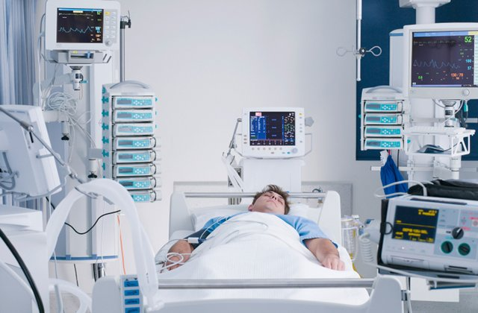
Resistant infections
More difficult to treat
Other antibiotics need to be used which may not work as well or be more toxic
Usually require longer hospital stays
Can become resistant to all antibiotics → untreatable
Notes:
More difficult to treat
Hospital rather than community
Broader spectrum antibiotics, worsening resistance
Antibiotics with more side effects

Slide 20
What can health professionals do?
Follow Australian guidelines when prescribing antibiotics
This ensures
Antibiotics have the best chance of working effectively and safely
Chance of resistance minimised

Slide 21
What can health professionals do?
Embrace “antimicrobial stewardship”
Antimicrobial Stewardship isn’t about “not using antimicrobials” but rather
“identify that small group of patients who really need antibiotic treatment and then explain,
reassure and educate the large group of patients who don’t.”

Slide 22
AMS CLINICAL CARE STANDARD
Notes:
Latest version of the Clinical Care Standard has excellent resources for consumers
https://www.safetyandquality.gov.au/our-work/clinical-care-standards/antimicrobial-stewardship-clinical-care-standard

Slide 23
What can the community do?
Prevent infections
Hand washing
Vaccinations
Preventative medicine e.g., anti-parasitic medication for malaria when in high-risk areas
Don’t request antibiotics for coughs, cold and flu
These are caused by viruses, antibiotics will not work
Antibiotics are not without personal risk
Take antibiotics exactly as prescribed
Do not share antibiotics
Do not take previously prescribed antibiotics for a different illness
Notes:
Sometimes prescribers will give a prescription for antibiotics with a repeat as the prescribing software often defaults with this option. Consumers may then use this unfilled repeat many months later without seeing the Doctor again even though this is probably inappropriate.
What do we mean by “personal risk”? Antimicrobials can have adverse effects. Some mild ie nausea and diarrhoea. Others have more significant adverse effects.

Slide 24
Great places to learn more…
NPS MedicineWise Factsheet -https://www.nps.org.au/consumers/antibiotic-resistance-the-facts
ABC Ask the Dr Antibiotics - https://iview.abc.net.au/show/ask-the-doctor/series/2/video/DO1708V006S00
Better Health Victoria Information - https://www.betterhealth.vic.gov.au/health/conditionsandtreatments/antibiotic-resistant-bacteria

Slide 25
References
Slide Number | Website
3 | Image - https://www.thehindubusinessline.com/opinion/invisible-threat-of-antimicrobial-resistance/article9964030.ece
4 | Video - https://www.youtube.com/watch?v=BFYuguuImW8&feature=youtu.be
5 | Image - https://www.mayoclinic.org/diseases-conditions/infectious-diseases/in-depth/germs/art-20045289
6 | https://www.reactgroup.org/toolbox/understand/antibiotics/
7 | Image - https://www.australiansafetysigns.net.au/products/fire-fire-extinguisher
10 | Image - https://ajp.com.au/columns/opinion/wielding-the-sledgehammer/
11 | Image - https://www.patentearth.com/blog/history-of-the-scalpel-the-original-surgical-instrument.html
13 | Image - https://assets.publishing.service.gov.uk/government/uploads/system/uploads/attachment_data/file/843129/English_Surveillance_Programme_for_Antimicrobial_Utilisation_and_Resistance_2019.pdf
14 | Image - http://sitn.hms.harvard.edu/flash/special-edition-on-infectious-disease/2014/the-arms-race-between-germs-and-medicine-how-superbugs-have-taken-the-lead-and-how-humans-can-take-it-back/
15 | Video - https://www.youtube.com/watch?v=4bckD5YAYrQ

Slide 26
References
Slide Number | Website
16 | https://www.gosh.nhs.uk/conditions-and-treatments/general-medical-conditions/resistant-bugs-antibiotic-resistance-and-multidrug-resistant-organisms https://www.cedars-sinai.org/health-library/diseases-and-conditions/a/antibiotic-resistance.html Images: https://lovepik.com/image-400225679/bacteria.html ; http://clipart-library.com/free/shaking-hands-clipart-black-and-white.html ; https://www.creativefabrica.com/product/icon-set-time-5-oclock/ ; http://learnonlinedevelopments.blogspot.com/2013/04/free-people-graphic-image.html
17 | https://www.who.int/health-topics/antimicrobial-resistance
18 | safetyandquality.gov.au/antimicrobials-report-2020
19 | Image - https://health.usnews.com/wellness/articles/2016-11-30/what-to-expect-when-your-loved-one-is-in-the-icu
20 | https://www.tg.org.au/
21 | https://www.ncbi.nlm.nih.gov/pmc/articles/PMC2751913/
22 | https://www.safetyandquality.gov.au/sites/default/files/2019-06/AURA-2019-Consumer-resource-Trifold-Brochure-Do-I-really-need-Content-from-Literally-Inspired.pdf https://www.mayoclinic.org/diseases-conditions/infectious-diseases/in-depth/germs/art-20045289#dialogId65139475

