Slide 1

Patient-Reported Indicator Health Survey
(PaRIS)
DRAFT: Mock-up dashboard for Practice Level Reporting
Please note – this is mock-up is an example only. It is intended to demonstrate the type of results that can be included and explored in the practice-level dashboard – it is not the final dashboard. Dummy data is used.

Slide 2










Filters and comparisons
Compare individual practice results to other practices in the same/ similar categories, including based on:
Location | Primary Health Network | Local Government Area | Practice Size | Billing approach
Filter individual practice results to explore specific patient characteristics, for example:
Age | Gender | Culturally and Linguistically Diverse | First Nations | Chronic health conditions
* Note: if there are insufficient responses to a question after filters are applied, results will be suppressed to protect patient privacy

Slide 3





Demographics
Experiences
Outcomes
Other measures
Home
Step 1: Update your contact details Step 2: Share the survey with your patients Step 3: Complete the practice survey
Monitor your patient survey response rate View practice level report
Log off
Your patient demographics
Compare with
Filter by
GENDER
OTHER DEMOGRAPHICS
45%
Male
49%
Female
24% Culturally and linguistically diverse
3% First Nations
6% non-binary/gender diverse/prefer not to say
AGE
HOUSEHOLD INCOME
18-24 years
25-34 years
35-44 years
45-54 years
55-74 years
75+ years

Slide 4
Demographics
Experiences
Outcomes
Other measures
Home
Step 1: Update your contact details Step 2: Share the survey with your patients Step 3: Complete the practice survey
Monitor your patient survey response rate View practice level report
Log off
Your patient demographics – comparison
Compare with
Filter by
Prevalence of chronic health conditions
High blood pressure | Your practice
 | Comparison practices
Cardiovascular or heart condition | Your practice
 | Comparison practices
Diabetes (type 1 or 2) | Your practice
 | Comparison practices
Arthritis or ongoing problem with back or joints | Your practice
 | Comparison practices
Breathing condition (e.g., asthma or COPD) | Your practice
 | Comparison practices
Alzheimer’s disease or other cause of dementia | Your practice
 | Comparison practices
Depression, anxiety or other mental health condition (e.g., bipolar disorder or schizophrenia) (ongoing) | Your practice
 | Comparison practices

Slide 5
Demographics
Experiences
Outcomes
Other measures
Home
Step 1: Update your contact details Step 2: Share the survey with your patients Step 3: Complete the practice survey
Monitor your patient survey response rate View practice level report
Log off
Patient experiences – your practice
Compare with
Filter by
Overall reported experience of medical care received in the past 12 months
Did the healthcare professional spend enough time with you?

Slide 6
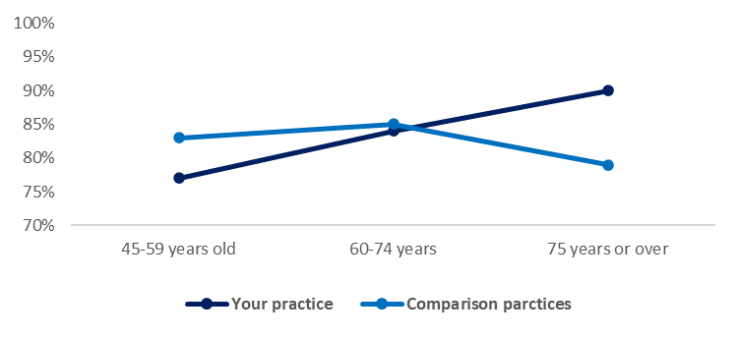
Demographics
Experiences
Outcomes
Other measures
Home
Step 1: Update your contact details Step 2: Share the survey with your patients Step 3: Complete the practice survey
Monitor your patient survey response rate View practice level report
Log off
Patient experiences – comparison
Compare with
Filter by
Reported quality of most recent consultation (by age)
(% excellent or very good)

Slide 7
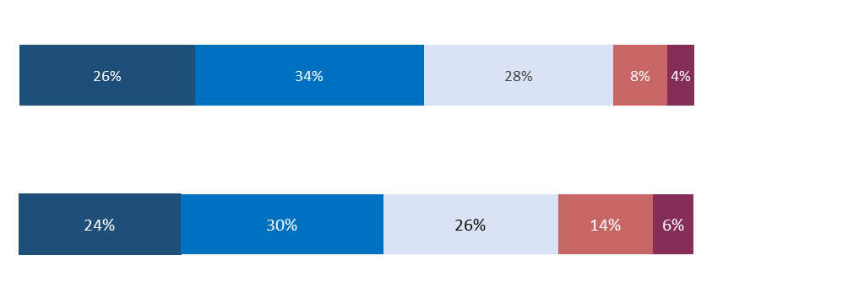
Demographics
Experiences
Outcomes
Other measures
Home
Step 1: Update your contact details Step 2: Share the survey with your patients Step 3: Complete the practice survey
Monitor your patient survey response rate View practice level report
Log off
Patient experiences – your practice
Compare with
Filter by
See underlying calculations
Experiences of person-centred care (PC3EQ*)
Your practice
Comparison practices
* Patients completed the P3CEQ, an 11-item measure designed to assess aspects of patient related care, including communication and shared-decision making. Higher scores represent better experiences of person-centred care.

Slide 8


Demographics
Experiences
Outcomes
Other measures
Home
Step 1: Update your contact details Step 2: Share the survey with your patients Step 3: Complete the practice survey
Monitor your patient survey response rate View practice level report
Log off
Patient outcomes – your practice
Compare with
Filter by
See underlying calculations
Overall patient health rating for PROMIS Physical Health and Mental Health Scales*
85% of patients recorded positive PROMIS Mental health scores**
56% of patients recorded positive PROMIS Physical health scores**
* Patients completed the Patient-Reported Outcomes Measurement Information System (PROMIS) questionnaire, which measures physical, mental and social well-being from the patient perspective. Positive scores are close to the average for the US general population or higher.

Slide 9
Demographics
Experiences
Outcomes
Other measures
Home
Step 1: Update your contact details Step 2: Share the survey with your patients Step 3: Complete the practice survey
Monitor your patient survey response rate View practice level report
Log off
Patient outcomes – your practice
Compare with
Filter by
See underlying calculations
Patient health rating for PROMIS Mental Health Scale* by patient characteristics
 |  | Poor | Fair | Good | Very Good | Excellent
Overall |  | 1% | 13% | 46% | 24% | 15%
Age | 45-64 years | 4% | 15% | 39% | 30% | 12%
 | 65-74 years | 1% | 15% | 30% | 31% | 23%
 | 75+ years | 0% | 5% | 50% | 28% | 17%
Gender | Male | 3% | 23% | 38% | 21% | 16%
 | Female | 2% | 9% | 37% | 35% | 17%
*Patients completed the Patient-Reported Outcomes Measurement Information System (PROMIS) questionnaire, which measures physical, mental and social well-being from the patient perspective. Positive scores are close to the average for the US general population or higher.

Slide 10
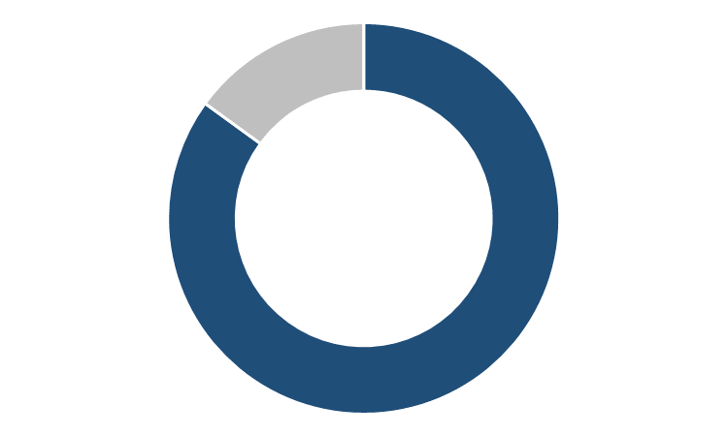
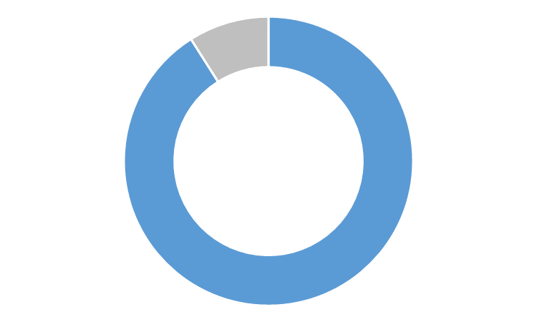

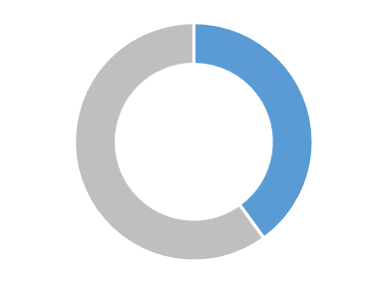
Demographics
Experiences
Outcomes
Other measures
Home
Step 1: Update your contact details Step 2: Share the survey with your patients Step 3: Complete the practice survey
Monitor your patient survey response rate View practice level report
Log off
Patient outcomes – comparison
Compare with
Filter by
See underlying calculations
PROMIS Mental health scores (% positive scores)
85%
91%
Your practice
Comparison practices
PROMIS Physical health scores (% positive scores)
56%
40%
Your practice
Comparison practices
* Patients completed the Patient-Reported Outcomes Measurement Information System (PROMIS) questionnaire, which measures physical, mental and social well-being from the patient perspective. Positive scores are close to the average for the US general population or higher.

Slide 11
Demographics
Experiences
Outcomes
Other measures
Home
Step 1: Update your contact details Step 2: Share the survey with your patients Step 3: Complete the practice survey
Monitor your patient survey response rate View practice level report
Log off
Patient outcomes – your practice
Compare with
Filter by
See underlying calculations
WHO-5 wellbeing scale* – assessing subjective psychological well-being
* Patients completed the World Health Organisation – Five Well-Being Index (WHO-5) a self-reported measure of subjective wellbeing.

Slide 12
Demographics
Experiences
Outcomes
Other measures
Home
Step 1: Update your contact details Step 2: Share the survey with your patients Step 3: Complete the practice survey
Monitor your patient survey response rate View practice level report
Log off
Patient outcomes – your practice
Compare with
Filter by
See underlying calculations
Patient health rating for WHO-5 Wellbeing Scale by patient characteristics
 |  | Poor | Fair | Good | Excellent
Overall |  | 12% | 24% | 39% | 25%
Age | 45-64 years | 11% | 29% | 49% | 11%
 | 65-74 years | 14% | 20% | 35% | 31%
 | 75+ years | 0% | 17% | 43% | 17%
Gender | Male | 17% | 23% | 37% | 23%
 | Female | 8% | 22% | 48% | 22%
* Patients completed the World Health Organisation – Five Well-Being Index (WHO-5) a self-reported measure of subjective wellbeing.

Slide 13

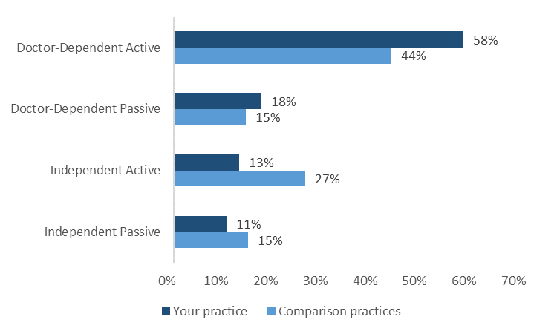





Demographics
Experiences
Outcomes
Other measures
Home
Step 1: Update your contact details Step 2: Share the survey with your patients Step 3: Complete the practice survey
Monitor your patient survey response rate View practice level report
Log off
Patient information seeking – your practice
Compare with
Filter by
See underlying calculations
Information seeking about health issues/ concerns*
Actively partners with their GP in addressing personal health issues and concerns
Less likely to seek health information from any source
Seeks out information and potential connections to facilitate new information regarding a specific issue
Reliant on chance encounters with information in their environment
*Based on the Porter-Novelli 10-item scale for defining the Health Information-Seeking Cluster Groups.

