Slide 1
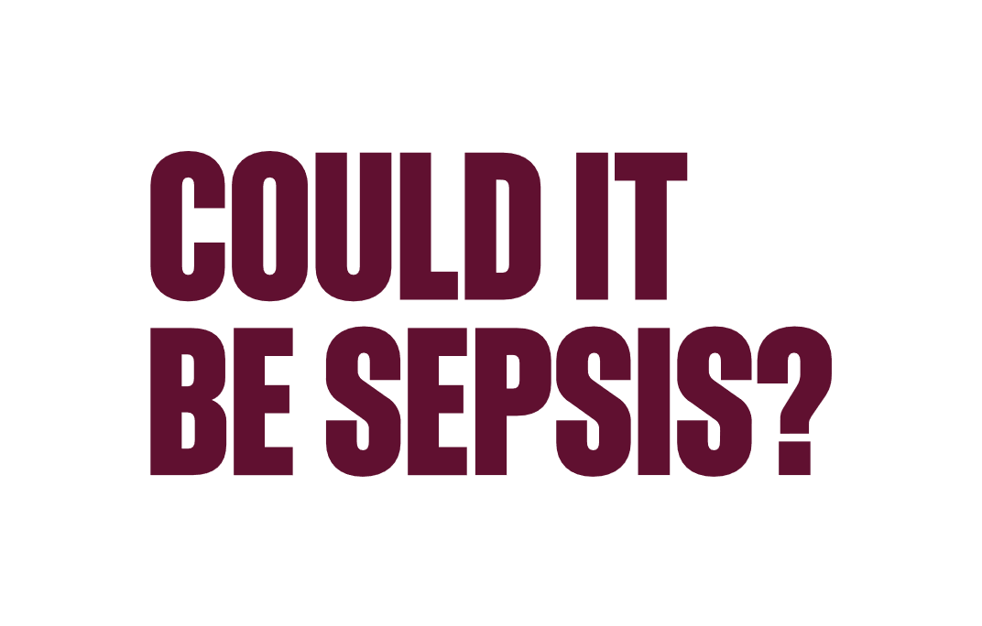
By simply asking the question, we can create the necessary urgency to commence treatment to help save the lives of Australians.
Matthew Ames, Sepsis Survivor

Slide 2
It’s important to use the word sepsis, not septicaemia or blood infection. Using the term sepsis can help create the necessary urgency to trigger life-saving treatment.

Slide 3
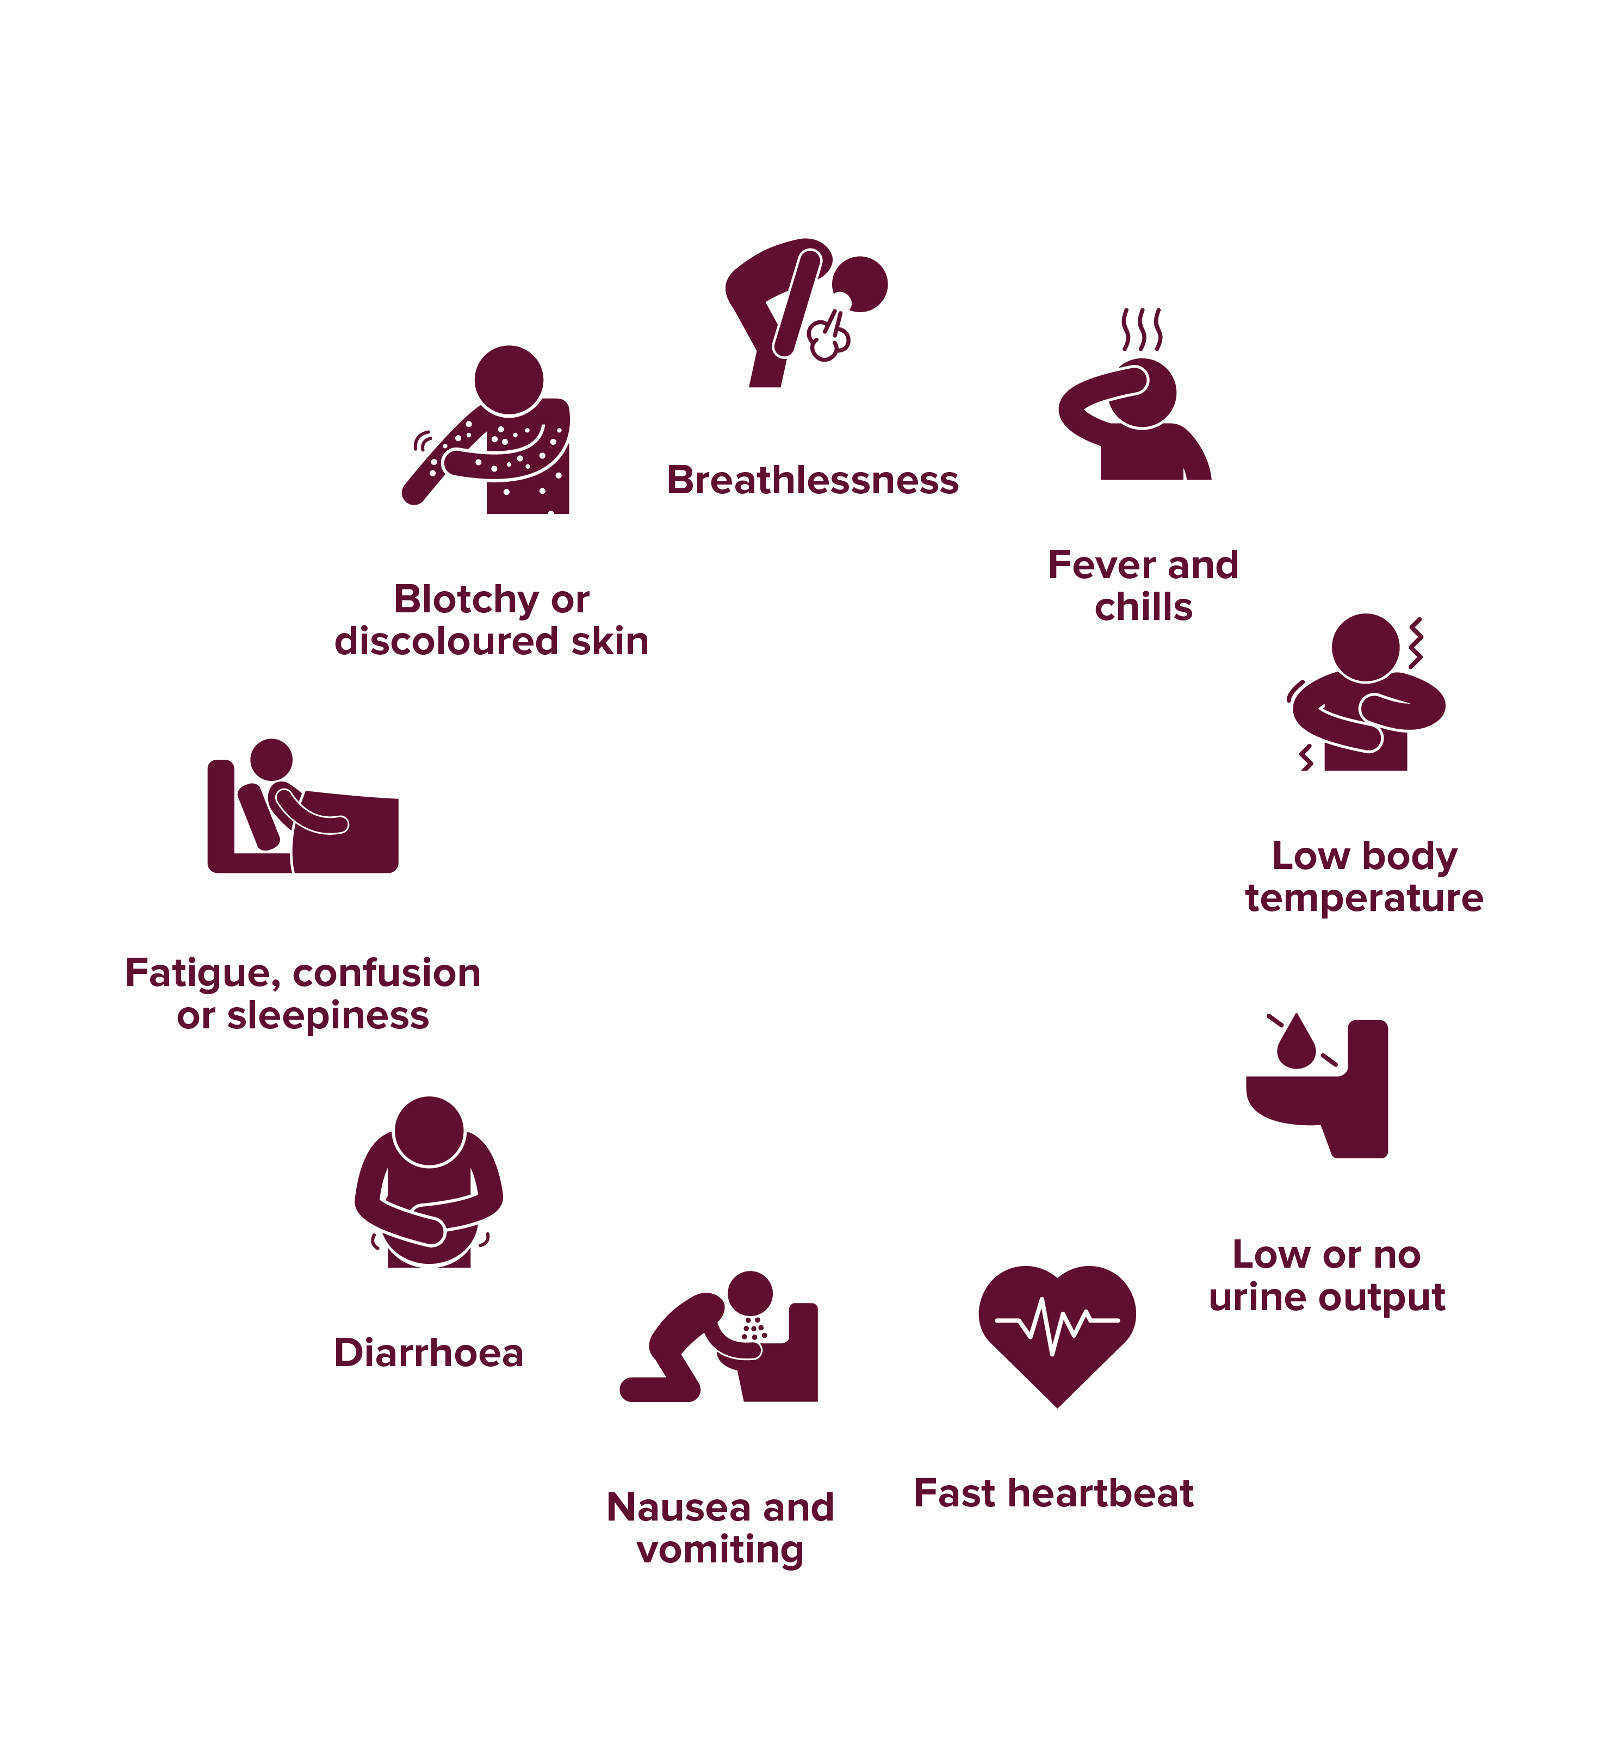
OVER 80% OF SEPSIS CASES START IN THE COMMUNITY.
KNOW THE SIGNS

Slide 4
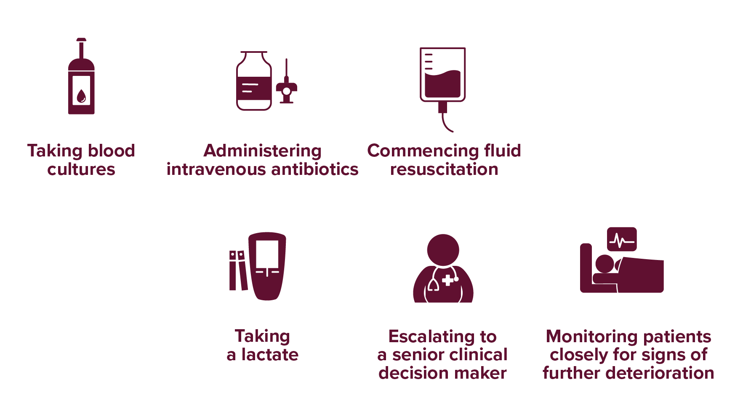
SEPSIS ONSET CAN BE RAPID. IT’S CRUCIAL TO ACT QUICKLY.
LIFE-SAVING INTERVENTIONS INCLUDE:

Slide 5
SPEAK UP ABOUT SEPSIS!
If you are concerned about a family member or friend and feel they either might have sepsis or are at higher risk, it is important to speak up.
Ask your GP or other healthcare worker: “Could it be sepsis?”
Fiona Gray, Sepsis Survivor

Slide 6
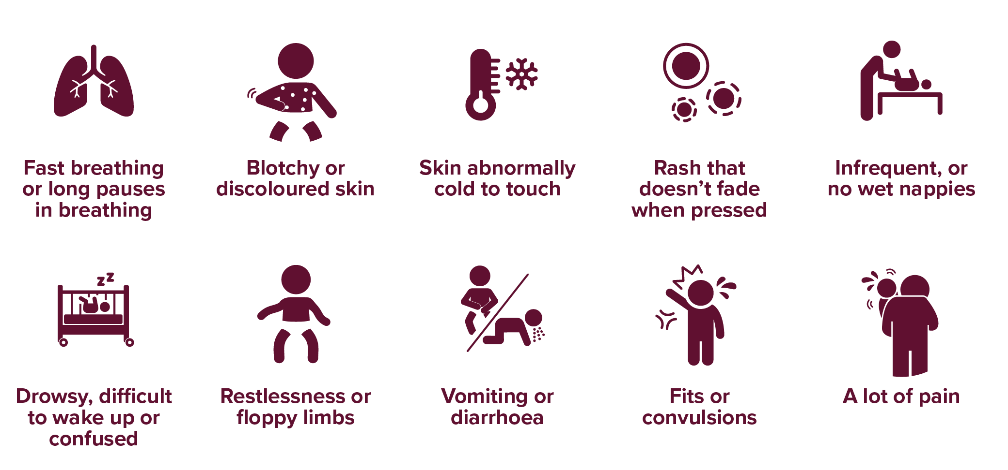
KNOW THE SIGNS OF SEPSIS IN BABIES AND CHILDREN:
The signs of sepsis can be mild in some cases. Remember that not all need to be present and some may be milder than others.

