Slide 1


Osteoarthritis of the Knee
Clinical Care Standard
August 2024
<Insert PHN name>

Slide 2

Osteoarthritis of the Knee Clinical Care Standard (2024)
Clinical care standards
Focus on key areas of clinical practice for a specific condition where there is evidence of unwarranted variation from best practice
Address quality improvement priorities
Notes:
Clinical care standards are a set of up to 10 quality statements that address quality improvement priorities and describe the expected care for a health condition or procedure.

Slide 3
Osteoarthritis of the Knee Clinical Care Standard (2024)
Clinical care standards
Support evidence-based clinical care
Reduce unwarranted variation
Promote shared decision-making
Describe key areas of care that all people receive, unlike clinical guidelines which describe all aspects of care
Notes:
The purpose of clinical care standards is to support evidence-based care and reduce variation in care, while promoting shared decision-making between health professionals and consumers.
It is important to note that clinical care standards are not clinical guidelines.
Clinical care guidelines detail components of care, eg. the RACGP Guideline for the management of knee and hip osteoarthritis
Indicators are provided in the standards to assist in measuring how well they are being implemented by individual healthcare services.

Slide 4
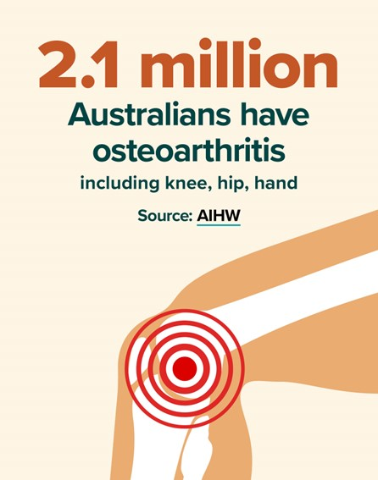
Osteoarthritis of the Knee Clinical Care Standard (2024)
Why do we need it?
Osteoarthritis of the knee is the most common type of osteoarthritis
High burden of disease
Over-reliance on imaging in diagnosis
Knee arthroscopy still used
Limited use of non-surgical management other than medicines
Notes:
The Osteoarthritis of the Knee Clinical Care Standard was first released in 2017 in response to findings from the 2015 Australian Atlas of Healthcare Variation.
The Atlas identified considerable variation in rates of knee arthroscopy in Australia, despite the limited value of this intervention for degenerative disease due to knee osteoarthritis.
The Atlas also noted the importance of appropriate assessment, investigation, and management of knee osteoarthritis and recommended the development of a clinical care standard to support improved care.
The Standard was intended to improve the quality and consistency of care in the assessment and management of knee osteoarthritis and reduce the need for inappropriate interventions.
The NSW Osteoarthritis Chronic Care Program reported that nearly 70% of participants on waiting list for knee replacement surgery had not received any non-surgical management other than medication.

Slide 5
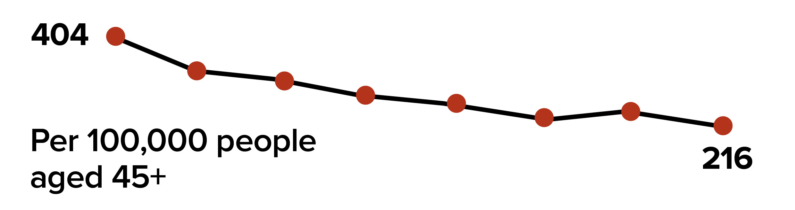
Osteoarthritis of the Knee Clinical Care Standard (2024)
Knee arthroscopy services 2015 - 2022
2015
2022
Notes:
Rates of knee arthroscopy have declined since the first Atlas and since the publication of the 2017 Standard, with broad recognition that knee arthroscopy has a very limited role in knee arthritis and subsequent changes in MBS funding.
While the number of arthroscopy services has been falling steadily since 2012, there is still room for improvement.

Slide 6
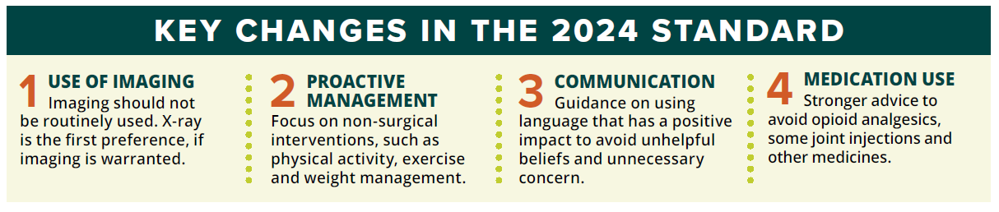
Osteoarthritis of the Knee Clinical Care Standard (2024)
Key updates
Notes:
The 2024 Standard aligns with current best practice for person-centred non-surgical management and addresses the potential overuse of imaging for diagnosis of osteoarthritis of the knee.
The revised Standard highlights the importance of individual self-management, including physical activity and weight management.
It contains additional guidance for clinicians on having positive conversations about knee osteoarthritis and addressing unhelpful beliefs about pain and the benefits of exercise and physical activity especially.
A detailed table of recommendations for the use of medicines is included in the Standard with current, evidence- based information on the efficacy and safety of a range of medicines and advice that opioids should be avoided since the significant risk of harm outweighs the benefits for knee osteoarthritis.

Slide 7


Osteoarthritis of the Knee Clinical Care Standard (2024)
Aboriginal and Torres Strait Islander peoples
1.5 times more likely to have osteoarthritis
50% less likely to access primary care management of knee osteoarthritis
20-50% less likely to knee replacement
Artist: Lani Balzan
Notes:
Aboriginal and Torres Strait Islander people are 1.5 times more likely to have osteoarthritis than non-Indigenous Australians and less likely to access treatment.

Slide 8
Osteoarthritis of the Knee Clinical Care Standard (2024)
Cultural safety and equity
Involve where appropriate:
Carers and community, family and friends
Aboriginal and Torres Strait islander Health Workers or Practitioners
Interpreter services and cultural translators
Notes:
Cultural safety and equity issues for Aboriginal and Torres Strait islander patient are addressed in the Standard which include the importance of providing flexible care and considering:
Engagement of interpreter services and cultural translators
Collaboration with Aboriginal and Torres Strait Islander Health Workers and Aboriginal and Torres Strait Islander Health Practitioners when this will assist the patient
Inclusion of a carer, family member or friend in all aspects of care, including decision-making and management planning.
The Osteoarthritis of the Knee Clinical Care Standard provides more detailed considerations with respect to cultural safety and equity.

Slide 9

Osteoarthritis of the Knee Clinical Care Standard (2024)
Quality statements
Comprehensive assessment and diagnosis
Appropriate use of imaging
Education and self-management
Physical activity and exercise
Weight management and nutrition
Medicines used to manage pain and mobility
Patient review
Surgery
Notes:
The standard is comprised of these eight quality statements.
Indicators for local monitoring are included for some statements to allow healthcare services to measure how well they are implementing the quality statements.
Tip: follow the links for the indicators to the detailed specifications (in METEOR) to see which are applicable in primary care settings meteor.aihw.gov.au/content/790044

Slide 10

Osteoarthritis of the Knee Clinical Care Standard (2024)
1 Assessment and diagnosis
Assessment is comprehensive and patient-centred
Diagnosis is based on clinical assessment
History and physical examination considers atypical features
Notes:
Quality statement 1: A patient with suspected knee osteoarthritis receives a comprehensive, person-centred assessment which includes a detailed history of the presenting symptoms, comorbidities, a physical examination, and a psychosocial evaluation of factors affecting quality of life and participation in activities. A diagnosis of knee osteoarthritis can be confidently made based on this assessment.
Purpose: To ensure that all patients are treated as individuals and that care is evidence-based and provided in a way that respects and responds to their situation, priorities, needs and values. The patient’s diagnosis is informed by an initial assessment of history, physical examination, and factors that might affect their self-management of their condition.
Notes:
Emphasis on the fact that knee osteoarthritis can be confidently diagnosed based on a comprehensive person-centred clinical assessment that considers the person’s individual circumstances rather than a joint-centric medical assessment alone.
Confident diagnosis can be made based on good history and examination - no imaging is needed.
Revisit red flags and discuss mechanical locking.
Tell the patient that they have osteoarthritis.
Atypical features – past trauma, malignancy, prolonged morning joint stiffness, rapid worsening or hot swollen joint, possible referral from hip or spinal pathology.

Slide 11

Osteoarthritis of the Knee Clinical Care Standard (2024)
1 Assessment and diagnosis cont.
Comprehensive assessment includes:
  Psychosocial impacts
  Health literacy and beliefs about knee osteoarthritis
  Readiness to self-manage
Notes:
Notes:
A comprehensive assessment is made in the context of the patient’s individual situation, preferences, and priorities and should include consideration of their psychological and emotional health as well as their degree of social support, financial situation, cultural context, and location in relation to services and support.
Identification of atypical features
The Standard includes a comprehensive list of relevant disease-specific, functional, pain, depression and anxiety, work limitations, and quality of life assessment tools that may be used.

Slide 12
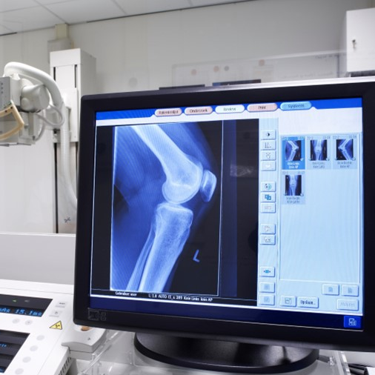
Osteoarthritis of the Knee Clinical Care Standard (2024)
2 Appropriate use of imaging
Imaging is not used routinely for diagnosis with no atypical features
X-ray is the first-line imaging if an alternative diagnosis is suspected
MRI, CT, and ultrasound are not used for diagnosis of knee osteoarthritis
Notes:
Quality statement 2: Imaging is not routinely used to diagnose knee osteoarthritis and is not offered to a patient with suspected knee osteoarthritis. When clinically warranted, X-ray is the first-line imaging. Magnetic resonance imaging (MRI), computerised tomography (CT) and ultrasound are not appropriate investigations to diagnose knee osteoarthritis. The limited value of imaging is discussed with the patient, including that imaging results are not required for effective non-surgical management.
Purpose: Reduce the potential harm to patients from unnecessary tests, investigations, and exposure to radiation.
Notes:
Imaging is not usually necessary for diagnosis of knee osteoarthritis
When imaging is clinically warranted, X-ray is first line.
MRI and CT scans are rarely needed for people with typical knee osteoarthritis symptoms and may lead to unnecessary concern and interventions.
Where imaging is appropriate, good communication between radiologists and referring clinicians can avoid unnecessary concern. If knee osteoarthritis is the most likely cause of symptoms, this should be communicated in the referral request and the radiology report.
If imaging is requested, provide pre-test counselling about the reasons; discuss patient expectations of imaging
Meniscal changes such as small tears are common and do not usually need treatment, even though they are often seen with MRI.

Slide 13

Osteoarthritis of the Knee Clinical Care Standard (2024)
3 Education and self-management
Positive communication is used to influence a patient’s beliefs and attitudes
Self-management plans are tailored to individual patient’s priorities
Referrals are made to other suitable clinicians, services and resources
Notes:
Quality statement 3: Information about knee osteoarthritis and treatment options is discussed with the patient. The patient participates in developing an individualised self-management plan that addresses their physical, functional, and psychosocial health needs.
Purpose: To educate and equip people with the information, skills, and support they require to self-manage their condition, knee osteoarthritis, and comorbidities, and to participate in life activities that are important to them.
Notes:
Use of joint-centric language focusing on structural damage e.g. ‘bone on bone’ can reduce engagement with effective care
Patients should be provided with information in a way that is accessible to them and that will enable them to:
Collaborate with health professionals to make informed decisions about their treatment
Develop a tailored plan for self-management.
GP Management Plans can include referrals to other suitable clinicians such as:
Physiotherapists
Exercise physiologists
Sport and exercise physicians
Dietitians
Health educators.

Slide 14
Osteoarthritis of the Knee Clinical Care Standard (2024)
Effective communication with patients
Unhelpful beliefs |  | Helpful beliefs
Being physically active with knee osteoarthritis will cause damage to the joint. |  | Physical activity is safe and beneficial for all people with knee osteoarthritis.
Medication and surgery are the only solutions for knee osteoarthritis. |  | Lifestyle solutions are key for managing knee osteoarthritis including exercise, maintaining a healthy weight, and a nutritious diet.
Notes:
A person-centred approach supports self-management and improved wellbeing for people with knee osteoarthritis. Careful use of language can empower people proactively self-manage in collaboration with health professionals and address any unhelpful beliefs and misconceptions.
Tailor communication about knee osteoarthritis to the person’s unique needs, preferences, and priorities. This means considering self-management in the context of their:
Physical health and function
Psychological and emotional wellbeing
Social and economic situation
Cultural identity and practices
Health literacy
Beliefs and concerns about their knee osteoarthritis
Preferred activities
Readiness to adopt self-management behaviours.

Slide 15
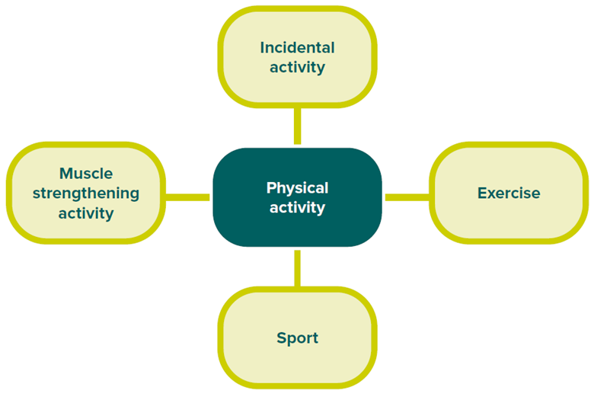
Osteoarthritis of the Knee Clinical Care Standard (2024)
4 Physical activity and exercise
Patients are advised that exercise and activity is safe and beneficial
Goals are tailored to the individual patient’s priorities
Referrals are made to other suitable clinicians, services and resources
Notes:
Quality statement 4: A patient with knee osteoarthritis is advised that being active can help manage knee pain and improve function. The patient is offered advice on physical activity and exercise that is tailored to their priorities and preferences. The patient is encouraged to set exercise and physical activity goals and is recommended services or programs to help them achieve their goals.
Purpose: Improve function and participation in life activities, manage pain, improve general health, improve psychosocial wellbeing, and reduce the need for medicines and surgery to manage knee osteoarthritis.
Notes:
Promote strategies to reach physical activity goals and reassure them that exercise will not cause damage
Collaborate with the patient to create a plan that is tailored to the individual patients needs and help them to manage knee pain and improve function.
Refer the patient to other clinicians or recommended services, supports, and resources – if appropriate and available – that may help them to achieve their goals. This may include:
Local community programs, groups, and activities
Links to reliable online resources
Clinicians such as physiotherapists, exercise physiologists, and sport and exercise physicians, and multidisciplinary services as appropriate.

Slide 16

Osteoarthritis of the Knee Clinical Care Standard (2024)
5 Weight management and nutrition
Encouragement and support is offered to support optimum nutrition and weight management goals
Goals are tailored to the individual patient’s priorities
Referrals are made to other suitable clinicians, services and resources
Notes:
Quality statement 5: A patient with knee osteoarthritis is advised of the impact of body weight on symptoms. The patient is offered support to manage their weight and optimise nutrition that is tailored to their priorities and preferences. The patient is encouraged to set weight management goals and is referred for any services required to help them achieve these goals.
Purpose: Minimise knee osteoarthritis symptoms, improve physical function and mobility, improve overall health and management of comorbidities, and limit the need for medicines or surgery by optimising a patient’s nutrition and weight.
Notes:
A 5–10% or greater weight loss over a 20‑week period is associated with reduced pain and improved quality of life.
Non-stigmatising language and communication is crucial.
Support from other health professionals such as dietitians and health educators should be considered.
Bariatric surgery may be an option for some

Slide 17

Osteoarthritis of the Knee Clinical Care Standard (2024)
6 Medicines used to manage pain and mobility
Appropriate medicines are offered
Opioid analgesics are avoided as there is a significant risk of harm
Joint injections are not offered
Use of corticosteroid injections is limited
Notes:
Quality statement 6: A patient with knee osteoarthritis is offered medicines to manage their pain and mobility in accordance with the current version of Therapeutic Guidelines or locally endorsed, evidence-based guidelines. A patient is not offered opioid analgesics for knee osteoarthritis because the risk of harm outweighs the benefits.
Purpose: To ensure medicines are used effectively for patients with knee osteoarthritis and that the risk of side effects is minimised.
Notes:
Medicines have a limited role for knee osteoarthritis.
Medicines do not replace physical activity, exercise, nutrition, and weight management as effective interventions.
NSAIDs are the first-line treatment after an assessment of risks. Preferred to paracetamol due to greater efficacy.
Duloxetine may be considered as an adjunct treatment to oral NSAIDs where recommended treatment strategies are ineffective. Use for knee osteoarthritis is off-label and supported by limited evidence
Recommendations for the role of a range of medicines are listed in the Standard, including advice against using platelet-rich plasma (PRP), hyaluronan, adipocyte cell suspensions or mesenchymal stem cell injections.
- Intra-articular corticosteroid injections should be used judiciously - as an adjunctive, short-term treatment for pain relief. Long-term use is not supported by current evidence and repeat injections may cause cartilage damage, further joint deterioration and reduce beneficial effects.

Slide 18

Osteoarthritis of the Knee Clinical Care Standard (2024)
7 Patient review
Symptoms, responses to treatment, and side effects are monitored
Referrals are made to other medical specialists for assessment where necessary
Notes:
Quality statement 7: A patient with knee osteoarthritis receives planned clinical review at agreed intervals, and management is adjusted for any changing needs. A patient who has worsening symptoms and severe functional impairment that persists despite optimal non-surgical management is referred for assessment to a non-general practitioner (GP) specialist or multidisciplinary service.
Purpose: To monitor a patient’s symptoms, function, and psychosocial wellbeing so that management can be optimised to support the patient achieving their goals and referral arranged when appropriate.
Notes:
Regular review with repeat history, physical examination, and psychosocial assessment that includes:
Monitoring symptoms and response to treatment
Reviewing all medicines
Evaluating any side effects from treatment
Monitoring and evaluating healthcare goals included in the patient’s self-management plans
Offering further education, coaching or behaviour change support
Discussing other treatment options as necessary or requested.
Refer a patient with worsening symptoms and severe persistent functional impairment despite optimal non-surgical management for:
Weight-bearing X-ray imaging of the knee
Non-GP specialist assessment, such as a rheumatologist, orthopaedic surgeon, or sports and exercise physician. If referring to an orthopaedic surgeon for assessment, follow recommendations for referral in the RACGP Guideline for the management of knee and hip osteoarthritis.

Slide 19
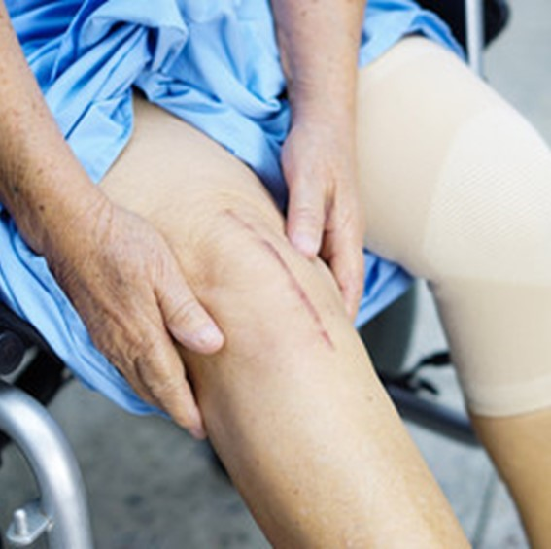
Osteoarthritis of the Knee Clinical Care Standard (2024)
8 Surgery
Severe functional impairment despite optimal non-surgical management – offered surgery
Adequate information for informed decision making and consent
Arthroscopic procedures are not offered for uncomplicated knee osteoarthritis
Notes:
Quality statement 8: A patient with knee osteoarthritis who has severe functional impairment despite optimal non-surgical management is considered for timely joint replacement surgery or joint-conserving surgery. The patient receives comprehensive information about the procedure and potential outcomes to inform their decision. Arthroscopic procedures are not offered to treat uncomplicated knee osteoarthritis.
Purpose: To ensure that patients with knee osteoarthritis who are not responding to non-surgical management and have severe impairment are offered appropriate surgical options and adequate information to help them make an informed decision about surgery.
Notes:
Most people with knee osteoarthritis can manage their condition successfully without surgery.
Before recommending surgery for knee osteoarthritis, ensure that non-surgical interventions tailored to the person have been trialled – including education, self-management, physical activity and weight management.
Arthroscopic procedures, including debridement and partial meniscectomy, should not be offered for uncomplicated knee osteoarthritis. They provide little or no clinically significant benefit in pain or function and are not indicated as a primary treatment.
Performed at the right time for the right people, surgery can have a dramatic benefit. However, a significant number of patients remain dissatisfied after joint replacement due to unmet expectations.[i]
Most people can avoid TKR if offered non-surgical treatment.
Up to 25% of people have bad outcome from TKR. Try to identify likely non-responders before offering surgery. They are more likely to be a patient with depression, BMI > 40, low pain score, and/or imaging appears more normal.
[i] Hafkamp, F. J., Gosens, T., de Vries, J., & den Oudsten, B. L. (2020). Do dissatisfied patients have unrealistic expectations? A systematic review and best-evidence synthesis in knee and hip arthroplasty patients. EFORT open reviews, 5(4), 226–240. https://doi.org/10.1302/2058-5241.5.190015

Slide 20
Osteoarthritis of the Knee Clinical Care Standard (2024)
Case study
Use the case study in following slides 21-26 or invite a local patient with knee osteoarthritis or a local clinician who may be willing to attend and share their experience

Slide 21

Osteoarthritis of the Knee Clinical Care Standard (2024)
Case study - Henry
History
65 yo man, married and retired
Lives in regional area
Right knee osteoarthritis – 10y
BMI 25 kg/m²
Daily dog walk (45 min)
Father had OA and TKR
Notes:
Henry is a 65 yo man first diagnosed with knee OA 10 years ago
No x-ray or other imaging on records
Last seen 6 months ago
His father had painful knee OA and TKR
Enjoys daily dog walk for physical and mental health

Slide 22

Osteoarthritis of the Knee Clinical Care Standard (2024)
Case study
Today
Persistent, worsening knee pain
Morning stiffness
Limited relief from paracetamol
Dog walk now only weekly (20 min)
Diet high in fat and sugar
Low mood and social isolation
Notes:
Has travelled from home in regional area to attend metro practice with his husband
Henry presents with chronic right knee pain, impacting his daily activities and emotional wellbeing.
He reports:
Worsening pain and stiffness
Frustration and decreased motivation due to limited mobility and loss of daily walk with dogs
Experiencing isolation from friends and family.
His husband reports that he seems depressed and his participation in social activities is decreased.

Slide 23

Osteoarthritis of the Knee Clinical Care Standard (2024)
Case study - Henry
Physical exam
Crepitus
Mild effusion, no heat
Mild varus deformity on standing
Mild muscle strength reduction
Moderate R-side weight-bearing reduction
Increased BMI 27 kg/m²
Notes:
Physical examination finds:
Crepitus
Mild effusion, no heat
Mild varus deformity on standing
Mild muscle strength reduction
Moderate R-side weight-bearing reduction
Increased weight to BMI 27.

Slide 24

Osteoarthritis of the Knee Clinical Care Standard (2024)
Case study - Henry
Unhelpful beliefs and misconceptions
‘My knee is definitely on the way out – I’ll need to start thinking about surgery.’
‘I know it’s just going to get worse as I get older.’
‘Surely he needs an MRI to find out how bad his knee is getting.’
Notes:
Henry and his husband have some unhelpful beliefs and misconceptions about his knee osteoarthritis based on the way his father’s condition was managed some years ago.
Henry is pessimistic about the way it will progress and has misconceptions about the need for imaging and surgery.

Slide 25

Osteoarthritis of the Knee Clinical Care Standard (2024)
Case study - Henry
Positive communication
‘There’s every chance you can avoid surgery - we didn’t know what we know now when your dad was being treated.’
‘Osteoarthritis pain doesn’t always get worse - some people even find that their pain is resolved when they’re active and manage their weight.’
Insert image
Notes:
Reassure Henry and his husband and address their misconceptions with statements like:
‘There’s every chance you can avoid surgery - we didn’t know what we know now when your dad was being treated.’
‘Osteoarthritis pain doesn’t always get worse - some people even find that their pain is resolved when they stay maintain their muscle strength and bone health by exercising and being active.’
‘Some people with no pain have joint changes that show up on scans and others with significant symptoms don’t have any. they don’t predict the way a person’s osteoarthritis will respond to treatment.’

Slide 26

Osteoarthritis of the Knee Clinical Care Standard (2024)
Case study - Henry
Management and review
Education and helpful beliefs
Counselling and support groups
Exercise, activity, and pacing
Dietary advice
Behavioural strategies for weight loss
NSAIDs
Notes:
1. Education and Support:
Address concerns and unhelpful beliefs based on father’s experience of TKR
Provide information about knee osteoarthritis, its progression, and the importance of self-management.
Direct to Commission website for practical evidence-based patient resources – specialised information, education, support, exercise and diet programs.
Recommend counselling and osteoarthritis support groups for emotional wellbeing.
2. Exercise Program:
Encourage strength training and low-impact activities such as swimming and cycling to improve cardiovascular health.
Advise that some pain with physical activity is not harmful but necessary for maintaining joint health.
Explain the importance of pacing exercise and activity for ‘good’ and ‘bad’ days
Offer referral to physiotherapist or exercise physiologist if appropriate.
3. Weight Management:
Promote benefits of excess weight loss, emphasising a balanced diet rich in fruits, vegetables, and lean proteins
Use goal-setting and self-monitoring techniques to support weight loss efforts.
Offer referral to dietitian
4. Medicines
Prescribe NSAIDs for pain relief as needed
5. Review
Discuss schedule for regular review of symptoms and progress
Consider access to transport and options for future consultations, eg. telehealth

Slide 27

Osteoarthritis of the Knee Clinical Care Standard (2024)
QUM Learning
Log into QUM Learning
Complete the case study Practical tools for osteoarthritis management
It is recommended that 1-hour CPD be recorded for the purposes of self-directed CPD
Notes:
A more detailed clinical case study for Henry with 10 review questions is available on the QUM Learning site (https://learn.nps.org.au/).
It’s listed under Practical tools for osteoarthritis management and can be recorded as 1-hour CPD on completion.

Slide 28
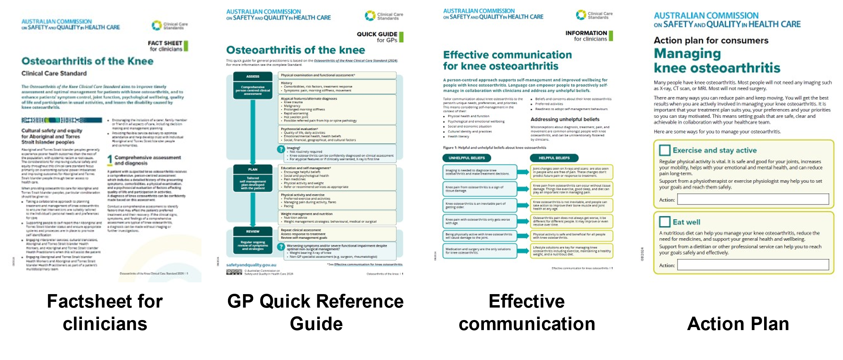
Osteoarthritis of the Knee Clinical Care Standard (2024)
Resources for clinicians
Notes:
Resources available for clinicians include:
Factsheet for clinicians: summary of what each of the quality statements mean for clinicians.
Quick reference guide for general practitioners: graphical one-page summary of the process of assessment, diagnosis, management, and review for knee osteoarthritis as described in the quality statements for GPs and other primary health clinicians.
Effective communication guide: providing recommendations and tips on ways to communicate with patients in ways that promote positive beliefs, reduce stigma, and encourage active self-management.
Knee osteoarthritis management - Action plan: a one-page checklist for guiding discussion of effective self-management strategies with patients.
Notes:
Tailored resources are also available for consumers and for healthcare services, including a consumer guide and healthcare service factsheet that includes descriptions of the quality statements as well as indicators that can be used to measure how well local services are implementing the quality statements.
A comprehensive list of other resources, tools, and information available is available for clinicians and consumers on the Osteoarthritis of the Knee Clinical Care Standard pages on the Commission’s website.

Slide 29

Osteoarthritis of the Knee Clinical Care Standard (2024)
Key messages
Effective communication can avoid development of unhelpful beliefs
Imaging should not be routinely used
Non-surgical interventions should be offered – most patients will not require surgery
Medicines have a limited role and opioid analgesics should not be offered
Arthroscopy should not be used for uncomplicated knee osteoarthritis
Notes:
Notes:
The most important recommendations for clinicians to take from the Standard are that:
How clinicians talk to their patients about knee osteoarthritis can significantly influence their attitudes to physical activity and other treatment choices.
Knee osteoarthritis can be confidently diagnosed based on clinical assessment alone.
Imaging is not necessary for diagnosis of knee osteoarthritis because there is a poor correlation between severity of symptoms and radiological findings.
When imaging is clinically warranted, X-ray is first line. MRI and CT scans are rarely needed for people with typical knee osteoarthritis symptoms and may lead to unnecessary concern and interventions.
Medicines have a limited role for knee osteoarthritis and opioid analgesics are not recommended because the risk of harm outweighs the benefits.
Arthroscopic procedures should not be offered to treat uncomplicated knee osteoarthritis.
Before recommending surgery for knee osteoarthritis, ensure that non-surgical interventions tailored to the person have been trialled – including education, self-management, physical activity and weight management.

Slide 30

Osteoarthritis of the Knee Clinical Care Standard (2024)
safetyandquality.gov.au/OAK-CCS

