Slide 1

World AMR Awareness Week
#WorldAMRAwarenessWeek
Presentation for health service organisations
Insert your organisation’s name here
Notes:
This presentation has been prepared by the Australian Commission on Safety and Quality in Health Care for use during World AMR Awareness Week.
The content within this presentation can be modified, expanded on, points or slides deleted to tailor it to clinical audiences within health service organisations where antimicrobials are prescribed and used. This presentation can also be modified for use in aged care, primary care or any other health care setting where antimicrobials are also prescribed and used.
Disclaimer
safetyandquality.gov.au
© Australian Commission on
Safety and­­ ­Quality in Health Care 2024

Slide 2
Overview
Antimicrobials and the development of antimicrobial resistance (AMR)
Significance of antimicrobial resistance
Addressing antimicrobial resistance in Australia
Antimicrobial stewardship (AMS)
Local data
World AMR Awareness Week (WAAW)
Notes:
Content covered in this presentation includes:
The link between antimicrobial use and the development of antimicrobial resistance and its significance
The importance of appropriate antibiotic use as one strategy to contain and control antimicrobial resistance
The action being undertaken globally and in Australia to prevent, monitor and reduce antimicrobial resistance
The role antimicrobial stewardship (AMS) programs play in supporting the appropriate use of antibiotics.
Local data on usage and appropriateness of antimicrobial prescribing
World AMR Awareness Week activities happening at your local health service organisation

Slide 3
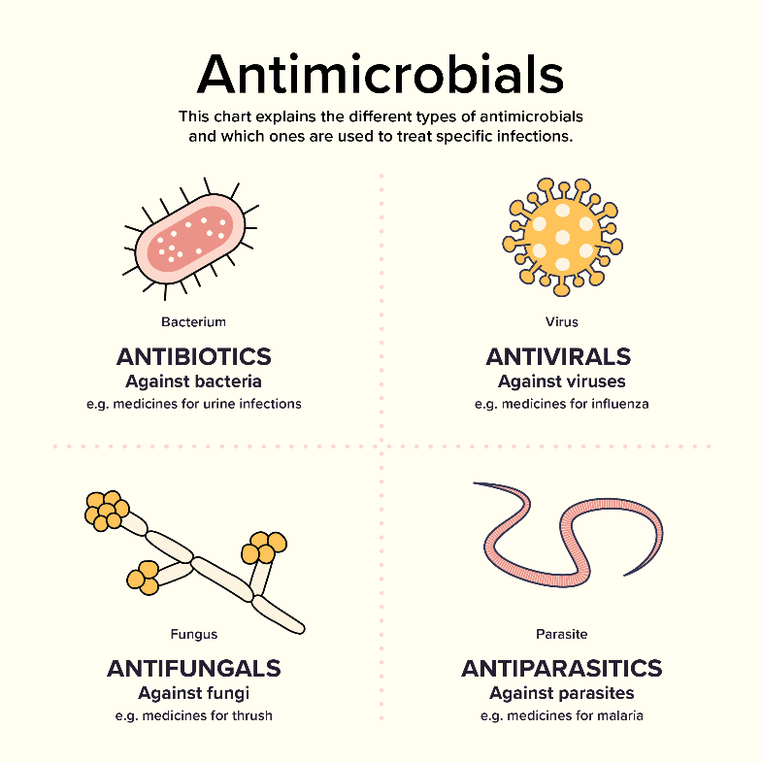
What are antimicrobials?
Antimicrobials are medicines which treat infections
Includes antibiotics, antivirals, antifungals, antiparasitics
Different types of antimicrobials are active against different types of microorganism
Life-saving medicines
Notes:
The term ‘antimicrobial’ refers to a substance that inhibits or destroys bacteria, parasites, viruses or fungi. The term antimicrobial also refers to medicines used to treat or prevent infections caused by bacteria, parasites, viruses or fungi. Antimicrobials fall into four categories:
Antibacterials (antibiotics)
Antifungals
Antivirals
Antiparasitics.
Antibiotics are one type of antimicrobial agent. Antibiotics are medicines used to treat infections caused by bacteria. Mostly importantly, antibiotics will have no impact on treating infections caused by viruses.
Antibiotic: A compound that inhibits the growth or kills bacteria. In recent years, ‘antibiotic’ has become synonymous with ‘antibacterial’.
Antibacterial: A drug, chemical or other substance that kills bacteria (bactericidal) or stops their growth (bacteriostatic).
Antimicrobial: A drug, chemical or other substance that kills, inactivates or slows the growth of microbes, including bacteria, viruses, fungi and parasites.
References:
https://www.safetyandquality.gov.au/publications-and-resources/resource-library/what-are-antimicrobials-graphic

Slide 4
What is antimicrobial resistance?
Antimicrobial resistance occurs when bacteria, parasites, viruses or fungi change to protect themselves from the effects of antimicrobial drugs designed to destroy them.
This means previously effective antimicrobial medicines (e.g. antibiotics) used to treat or prevent infections may no longer work.
The World Health Organization (WHO) has identified AMR as ‘one of the biggest threats to global health’.
Notes:
Antimicrobial resistance is one of the most significant challenges for the provision of safe, high-quality health services across the world. The term ‘antimicrobial resistance’ refers to the failure of an antimicrobial (which includes antibiotics) to inhibit or destroy bacteria, parasites, viruses or fungi for which it has been designed using standard dosing regimens
Antimicrobial resistance has a direct effect on patient care and creates a set of critical ongoing challenges to health service delivery. It can increase a patient’s length of hospital stay and severity of patient illness. Severe infections caused by bacteria that do not respond to available ‘last-line’ antimicrobials (including antibiotics) can result in septicaemia and death.
Antimicrobial resistance also increases the complexity of treatment, and places a significant burden on patients, health service organisations and the health system.
Amina J. Mohammed (Deputy Secretary-General of the UN) was quoted as saying that “Antimicrobial resistance is one of the most pressing issues globally, not only for human health but it is a multi-sectoral problem involving animal health, agriculture, the environment, trade and many other sectors”.
Dr Tedros Adhanom Ghebreyesus, Director-General of WHO was quoted as saying “A lack of effective antibiotics is as serious a security threat as a sudden and deadly disease outbreak. Strong, sustained action across all sectors is vital if we are to turn back the tide of antimicrobial resistance and keep the world safe."
Prof Dame Sally Davies, England’s chief medical officer was quoted as saying “We will be given the choice of, well you can have an expensive treatment that’s likely to cure you, but you’ll get an infection that is likely to be resistant and you’ll probably die of it,” she told MPs. “Meanwhile all transplants will be out of the window because they are all prone to infections. There will be a lot of suffering and modern medicine will be lost.”

Slide 5
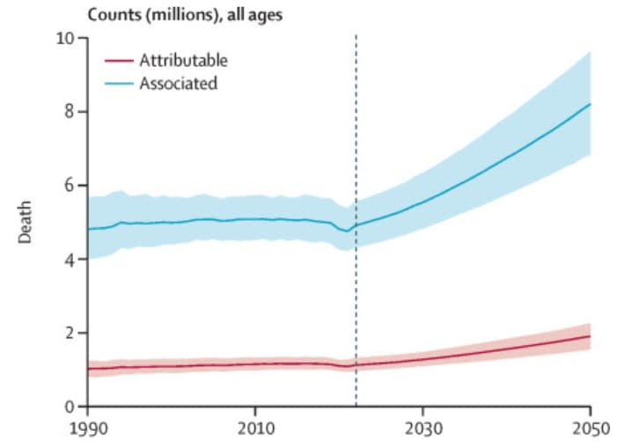
Significance of AMR
Global impact of AMR in 2021:
  1.14 million deaths attributed to bacterial AMR infections
  4.71 million deaths associated with bacterial AMR infections
Global forecast for 2050:
  1.91 million deaths attributable to AMR
  8.22 million deaths associated with AMR
Notes:
The Lancet recently published, ‘Global burden of bacterial antimicrobial resistance 1990-2021: a systematic analysis with forecasts to 2050,’ which provides the first comprehensive assessment of the global burden of AMR from 1990 to 2021, with results forecasted until 2050. The study estimated, that in 2021, there were 1.14 million deaths attributable to bacterial AM and 4.71 million associated with bacterial AMR. For both deaths associated with AMR, methicillin-resistant Staphylococcus aureus increased the most globally (from 261000 associated deaths and 57200 attributable deaths in 1990 , to 550000 associated deaths and 130000 attributable deaths in 2021).
It is predicted that in 2050, there will be 1.91 million deaths attributable to AMR and 8.22 million deaths associated with AMR could occur globally in 2050. Regions with the highest all-age AMR mortality forecasted in 2050 are south Asia and Latin America and the Caribbean.
The implications of AMR include:
Productivity losses, increased health care costs, rise in poverty
Puts gains of modern medicine at risk, especially surgery and cancer treatments which are dependent on effective antibiotics
References:
https://www.thelancet.com/journals/lancet/article/PIIS0140-6736(24)01867-1/fulltext

Slide 6
Antimicrobial-resistant infections
Treatment failures
Recurring infections
Longer hospital stays
Longer recovery times
Higher risk of mortality or long-term complications
Higher cost to the health care system
Notes:
Antimicrobial resistant infections make infections more difficult to treat. Resulting in:
Treatment failures
Recurring infections
Longer hospital stays
Longer recovery times
Higher risk of mortality or long-term complications
Higher cost to the health care system

Slide 7
How has AMR developed?
AMR is a natural phenomenon accelerated by overuse, misuse and inappropriate use of antibiotics
Through the delivery of increasingly complex health care, often accompanied by extended durations of antibiotics
The potential impact of surgery undertaken overseas where AMR may be more prevalent
Resistant pathogens are spreading
  during hospitalisation, impacted by infection, prevention, and control practices and antimicrobial use
  with increased overseas travel
Notes:
Antimicrobial resistance occurs when bacteria develop resistance to an antimicrobial that was previously an effective treatment. Bacteria develop natural defences against antibiotics. When this occurs, potentially due to prolonged exposure to or overuse of a particular antibiotic, the antibiotic’s effectiveness to treat the infection decreases, and may reach a point where the antibiotic has no benefit.
The overuse of antibiotics in health (human and animal) and agriculture has increased the amount of exposure bacteria have to them, giving bacteria more opportunity to develop resistance. The process of natural selection (‘survival of the fittest’ – favouring bacteria that develop the strongest natural defences) fuels the increasing prevalence of antimicrobial resistance.
New challenges in infection control resulting from more complex health care (for example, outpatient chemotherapy) and increasing domestic and international travel have increased the spread of resistant bacteria both between individuals and between countries.
When patients have longer hospital stays, this may increase the chance of patients acquiring resistant organisms from other patients.

Slide 8
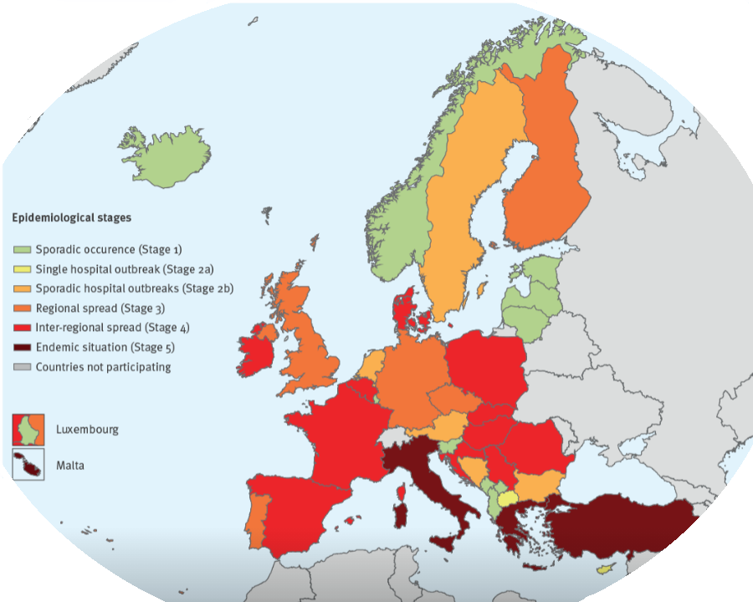
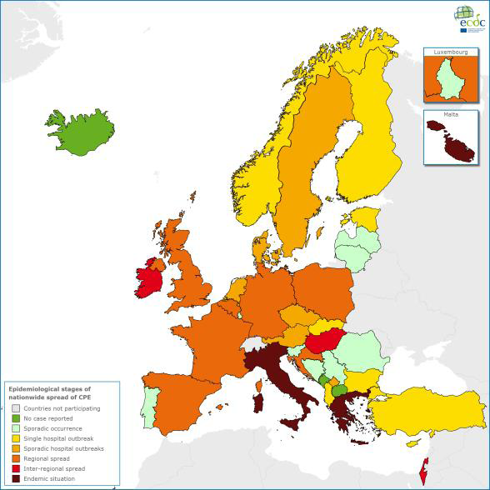
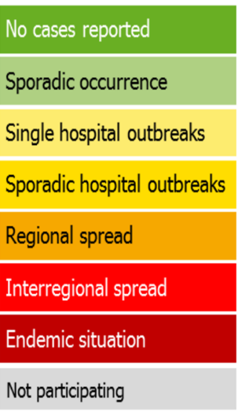

Some resistance is getting worse
Carbapenem-resistant Enterobacteriaceae
Carbapenem-resistant Enterobacteriaceae
2013
2018
Notes:
This diagram shows Carbapenemase producing Enterobacteriaceae (CPE) becoming more prevalent in Europe over a short period of time. Enterobacteriaceae has been renamed Enterobacterales.
References:
https://ecdc.europa.eu/sites/portal/files/media/en/publications/Publications/carbapenem-resistant-enterobacteriaceae-risk-assessment-april-2016.pdf
https://www.ecdc.europa.eu/sites/default/files/documents/carbapenem-resistant-enterobacteriaceae-risk-assessment-rev-2.pdf

Slide 9
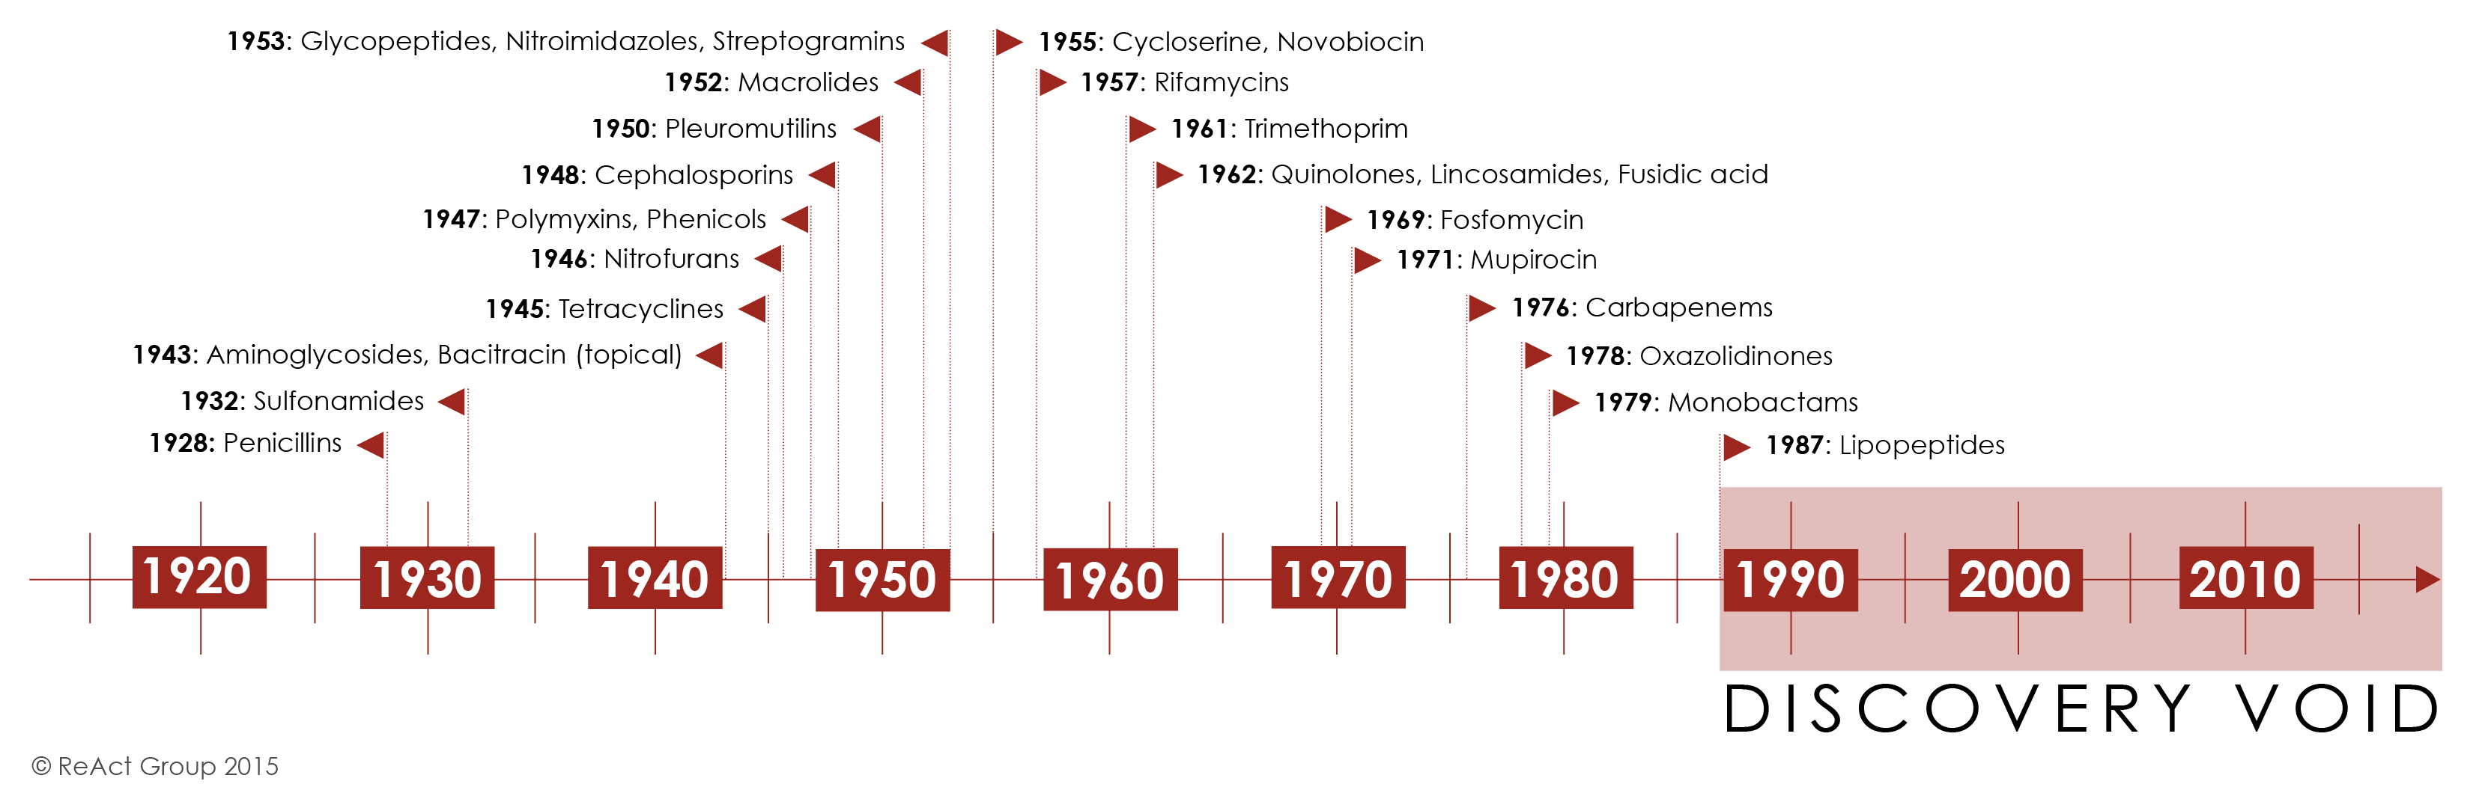
The antibiotic pipeline is drying up
Notes:
So why can’t new antibiotics be developed to tackle resistance? Well, they can but there are reasons why this is a very slow and complex process.
Many pharmaceutical companies have stopped developing antibiotics over the last 20 years, resulting in very few new antibiotics being developed and released onto the market. The reason for this decline is that antibiotics, in particular, are extremely expensive and resource-intensive to develop.
The World Health Organisation reviewed the publicly available information on the current clinical development pipeline of antimicrobial agents. Their review showed the current clinical pipeline is still insufficient to mitigate the threat of antimicrobial resistance (particularly Gram-negative bacteria and TB). And most agents in the pipeline are modifications of existing antibiotic classes – therefore they are only short-term solutions as they usually cannot overcome multiple existing resistance mechanisms.
In 2011, there were only 27 new antibiotics in clinical development against priority pathogens, down from 31 products in 2017. Although the number of antibacterial agents in the clinical pipeline increased from 80 in 2021 to 97 in 2023, there is a pressing need for new, innovative agents for serious infections and to replace those becoming ineffective due to widespread use
References:
https://www.who.int/news/item/22-06-2022-22-06-2022-lack-of-innovation-set-to-undermine-antibiotic-performance-and-health-gains#:~:text=According%20to%20WHO%20annual%20analyses,over%20the%20last%203%20years.
https://www.reactgroup.org/toolbox/understand/how-did-we-end-up-here/few-antibiotics-under-development/
https://www.who.int/news/item/14-06-2024-who-releases-report-on-state-of-development-of-antibacterials#:~:text=Although%20the%20number%20of%20antibacterial,ineffective%20due%20to%20widespread%20use.

Slide 10
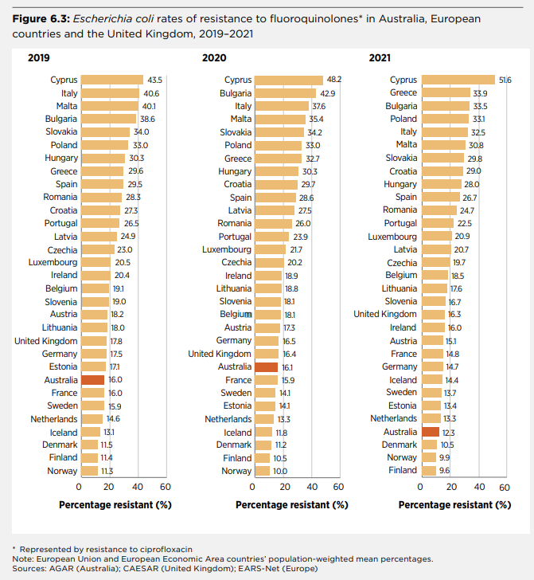
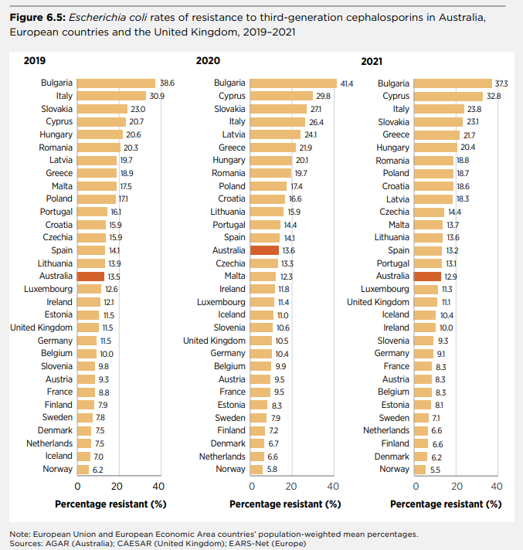
AMR in Australia
Notes:
In these graphs here, we have a comparison of E. coli resistance rates (blood cultures) from Australia to European Antimicrobial Resistance Surveillance Network (EARS-Net) program, and the WHO Central Asian and European Surveillance of Antimicrobial Resistance (CAESAR) network. Rates of resistance to fluroquinolones in E. coli remain low in Australia compared with most European countries. From 2015 to 2019, fluoroquinolone resistance in Australia increased substantially to 16.0% for E. coli. In 2021, these rates declined for the first time to 12.3%.
In Australia, there was an increasing trend in third-generation cephalosporin resistance from 2015 to 2019. Australia now ranks around the middle of European rates of resistance to third-generation cephalosporins in E. coli. It slowly rose in rank over the previous decade to 2019.
Footnotes
Represented by resistance to ciprofloxacin Note: European Union and European Economic Area countries’ population-weighted mean percentages. Sources: AGAR (Australia); CAESAR (United Kingdom); EARS-Net (Europe)
References:
https://www.safetyandquality.gov.au/our-work/antimicrobial-resistance/antimicrobial-use-and-resistance-australia-aura/aura-2023-fifth-australian-report-antimicrobial-use-and-resistance-human-health (page 226)

Slide 11
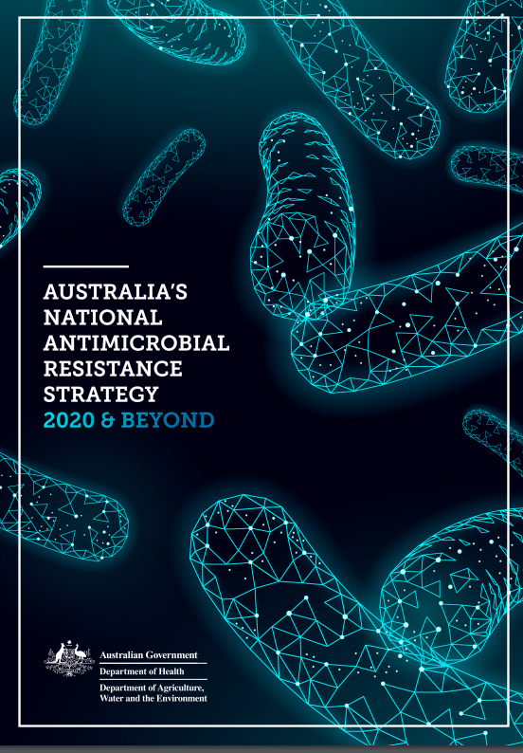
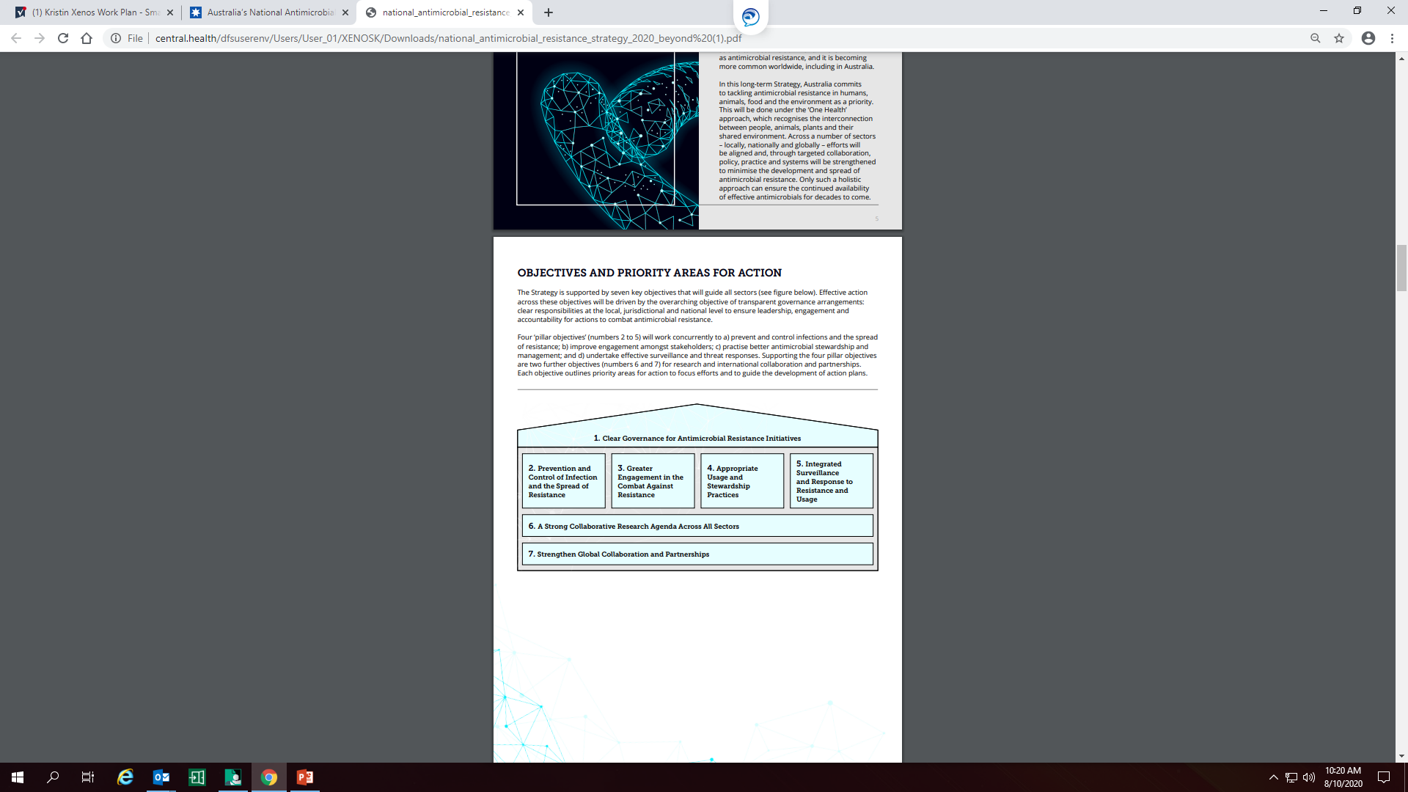
Australia’s response to AMR
In March 2020, the Australian Government released the second AMR strategy Australia’s National Antimicrobial Resistance Strategy - 2020 and Beyond to guide the response to the threat of antimicrobial misuse and resistance.
Objectives:
Notes:
The Australian Government has released Australia’s next national antimicrobial resistance strategy, following endorsement by the Council of Australian Governments.
Australia’s National Antimicrobial Resistance Strategy - 2020 and Beyond sets a 20-year vision to protect the health of humans, animals and the environment through minimising the development and spread of AMR while continuing to have effective antimicrobials available.
References:
https://www.amr.gov.au/resources/australias-national-antimicrobial-resistance-strategy-2020-and-beyond

Slide 12
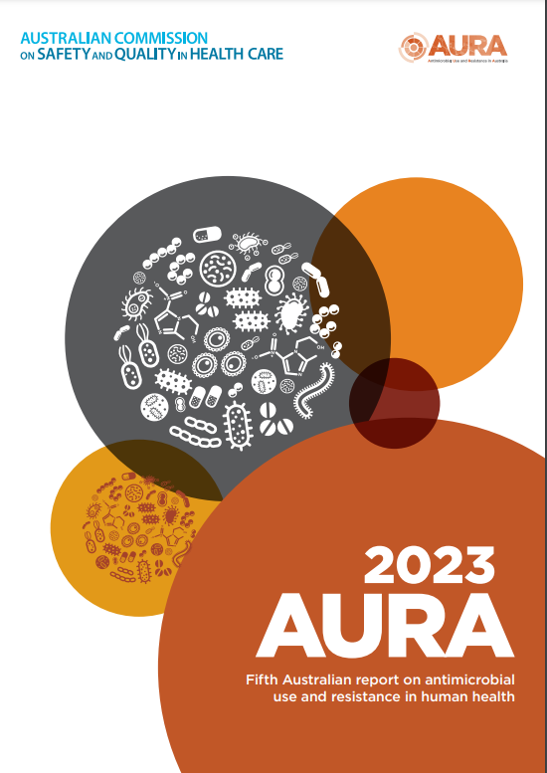
Surveillance: Antimicrobial Use and Resistance in Australia (AURA)
The AURA Surveillance Program:
Coordinated by the Australian Government Department of Health and Aged Care
Integrates data from a range of sources on antimicrobial use and resistance
Supports Australia’s efforts to prevent and contain AMR in human health
Notes:
The Antimicrobial Use and Resistance in Australia (AURA) Surveillance System was developed by the Commission with funding from the Australian Government Department of Health in partnership with states, territories and the private health and laboratory sectors, experts in AMS and AMR, and other organisations to draw together multiple different surveillance programs in order to create a comprehensive national picture of the different aspects of antimicrobial use and resistance.
AURA 2023 includes:
Data about organisms that have been determined to be a priority for Australia
The volume of antimicrobial use
The appropriateness of antimicrobial prescribing
Key emerging issues for antimicrobial resistance
A comparison of Australia’s situation with other countries.
You may wish to play this clip about AURA - https://www.youtube.com/watch?time_continue=4&v=4bckD5YAYrQ
References:
https://www.safetyandquality.gov.au/publications-and-resources/resource-library/aura-2023-fifth-australian-report-antimicrobial-use-and-resistance-human-health-report

Slide 13

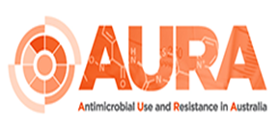






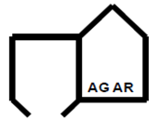
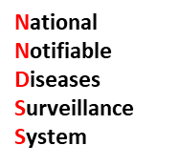









Notes:
The Commission’s AURA team collates data for national AURA reports and coordinates 2 AMR surveillance programs (CARAlert and APAS).
Funding for AURA is provided by the Australian Government, and state and territory health departments.
Multiple partners contribute data.
Participation in the AURA Surveillance System by all Australian states and territories, and both public and private healthcare providers has grown since the system was established by the Australian Commission on Safety and Quality in Health Care in 2013. The increase in the volume and currency of data has greatly contributed to the capacity to use the AURA Surveillance System to identify emerging issues and monitor trends unique to Australia.
The AURA Surveillance System sources data on antimicrobial use and its appropriateness from the:
National Antimicrobial Prescribing Survey
National Antimicrobial Utilisation Surveillance Program
NPS MedicineWise MedicineInsight program
Pharmaceutical Benefits Scheme/Repatriation Pharmaceutical Benefits Scheme.
The AURA Surveillance System sources data on antimicrobial resistance from the:
Australian Group on Antimicrobial Resistance
National Passive AMR Surveillance System (based on the Queensland Health OrgTRx system)
National Neisseria Network
National Notifiable Diseases Surveillance System
Sullivan Nicolaides Pathology
National Alert System for Critical Antimicrobial Resistances (CARAlert).
The Commission established the National Alert System for Critical Antimicrobial Resistances (CARAlert) in 2016 to capture data from confirming laboratories for AURA on critical antimicrobial resistances. CARAlert supports early detection of CARs and, over time, will provide information on the effectiveness of measures and strategies promoting appropriate antimicrobial use to contain antimicrobial resistance.
‘Passive surveillance’ is the use of data that are already collected for other purposes, to identify patterns and trends in antimicrobial resistance and antimicrobial use. Whereas ‘targeted surveillance’ is where the primary purpose of collecting data is to identify trends and patterns in antimicrobial resistance and antimicrobial use.

Slide 14
AURA 2023 key findings
Acute care
There are opportunities to address the high and continued inappropriate use of surgical prophylaxis in public and private hospitals.
High rates of inappropriate antimicrobial prescribing for chronic obstructive pulmonary disease (COPD) continue.
Rates of critical antimicrobial resistances (CARs) in hospitals have increased, particularly carbapenemase-producing Enterobacterales (CPE).
There is increasing antifungal use in hospitals, which may drive AMR in the future.
Notes:
Reference:
https://www.safetyandquality.gov.au/publications-and-resources/resource-library/aura-2023-fifth-australian-report-antimicrobial-use-and-resistance-human-health-report

Slide 15
AURA 2023 key findings
Community
The encouraging overall decrease in AU in the community continues.
Rates of Escherichia coli resistance to fluoroquinolones decreased nationally from 2020 to 2021, which may have been associated with reduced community AU and restricted international travel during the COVID-19 response.
Rates of azithromycin non-susceptibility in Neisseria gonorrhoeae have declined since 2017.
There is an increasing proportion of private prescriptions for antimicrobials and there are limited reporting and monitoring mechanisms, which continues to be a gap in AU surveillance in Australia.
Notes:
Reference:
https://www.safetyandquality.gov.au/publications-and-resources/resource-library/aura-2023-fifth-australian-report-antimicrobial-use-and-resistance-human-health-report

Slide 16
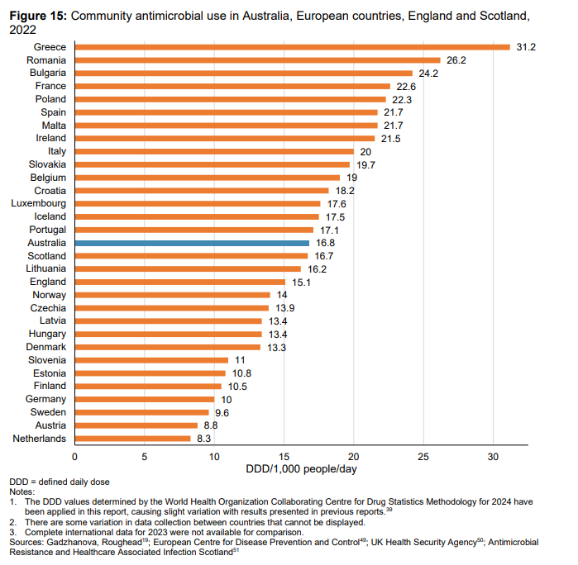
Antimicrobial use in Australia
Community - 2023
Overall downtrend in antimicrobial use in the community from 2015 to 2023 (down 24.4%)
Consistently high antimicrobial prescribing rates compared to other OECD countries.
11% increase from 2022 to 2023 in antimicrobials dispensed for aged care home residents; higher rates of prescribing for older Australians
Notes:
OECD= Organisation for Economic Co-operation and Development. Antimicrobial use is more than double of Netherlands
The latest antimicrobial use in the community report has been published in August 2024.
Overall usage in 2023 was 24.4% lower than in 2015. Within the overall decrease, from 2022 to 2023, there was an 11% increase in antimicrobials dispensed for aged care home residents and there were high rates of prescribing for older Australians.
References:
https://www.safetyandquality.gov.au/publications-and-resources/resource-library/antimicrobial-use-community-2023

Slide 17

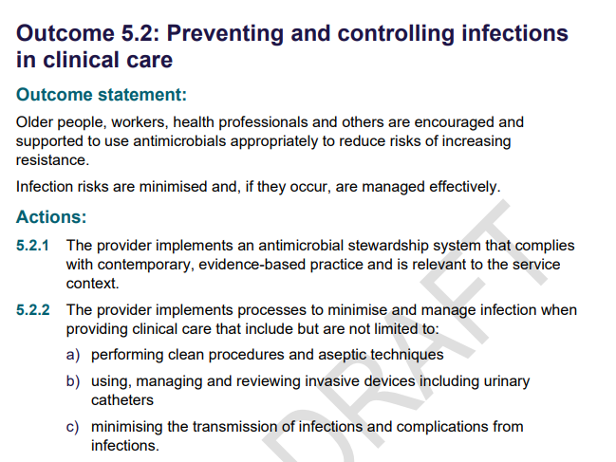
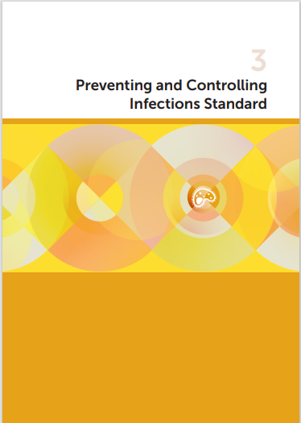
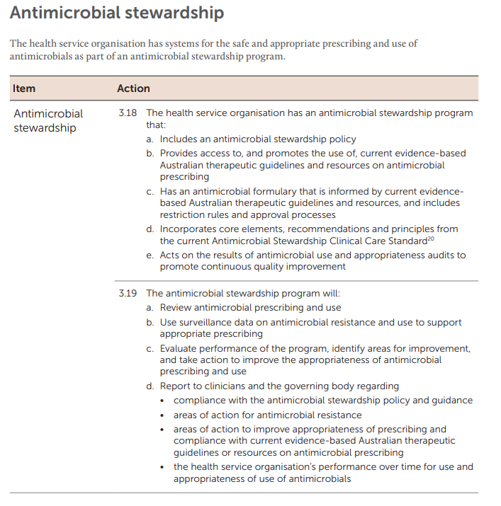
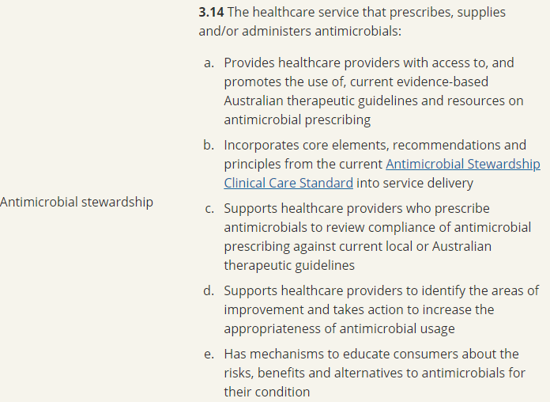


Standards
Notes:
Standards ensure that the health system is informed, supported and organised to deliver safe and high- quality care.
Antimicrobial stewardship in included in:
National Safety and Quality health Service Standards
National Safety and Quality Primary and Community Healthcare Standards
Strengthened Aged Care Quality Standards
The second edition of the NSQHS Standards for Antimicrobial Stewardship is available here: https://www.safetyandquality.gov.au/publications-and-resources/resource-library/national-safety-and-quality-health-service-standards-second-edition
The Preventing and Controlling Infections Standard was released in 2021 following revision. The review was primarily focussed on infection prevention and control issues, but also provided an opportunity to strengthen actions relating to AMS, particularly in relation to reporting to governance groups and clinicians on antimicrobial use and appropriateness surveillance data, and using those data to inform action to improve antimicrobial use and patient safety.
References:
https://www.safetyandquality.gov.au/standards/nsqhs-standards/preventing-and-controlling-infections-standard/antimicrobial-stewardship

Slide 18
Antimicrobial resistance locally – What is happening in our health service?
Which infections are we seeing? [Insert surveillance data, i.e. what is the most common cause of bacteraemia in your facility]
What are our susceptibility and resistance patterns?
  [Insert hospital data]
  [Numbers of cases]
  [Examples of cases]
Are there local antimicrobial resistance issues?
What are local rates of MRSA, Clostridioides difficile (C diff)?
Do you have access to a local antibiogram?
Notes:
Locally, surveillance data enables understanding of local resistance patterns and helps contribute to policies and procedures for appropriate antibiotic prescribing and use.
Note to presenters:
Users should insert local hospital data into this slide. If a hospital antibiogram is available, it would be useful to include it here for explanation and discussion. If not, give examples of infections from resistant bacteria that have occurred in your healthcare facility.
Examples might include:
Central-line-associated bacteraemia
Catheter-associated urinary tract infections
Surgical site infections.
Consider the audience and the information that will be most relevant.
Consider also including information about the negative outcomes for patients from resistant infections, such as increased length of stay and personal impact.
Consider asking the audience before revealing the answers:
What are the common infections seen in our hospital?
What are our local susceptibility and resistance patterns?

Slide 19
Local data
Insert health organisation name here
Insert local audit data on appropriateness, usage etc.
Does your healthcare facility audit appropriateness of prescribing?
What tools are used (e.g.. National Antimicrobial Prescribing Survey [NAPS], National Antimicrobial Utilisation Surveillance Program [NAUSP], jurisdictional audit tools)
If your facility uses NAPS or NAUSP, consider
  Comparison to national results
  Time series data
  How local results have contributed to your AMS program
Notes:
Include data on antimicrobial use and appropriateness at your facility

Slide 20
Patient story
This is a placeholder for a local example of a patient who experienced a resistant bacterial infection at your healthcare facility
Insert a case study (optional)
You may want to detail the:
  diagnosis and the method of diagnosis
  bacterium that was resistant to the preferred antibiotic
  medications used to treat the bacterial infection
  time, resources and people involved to treat the infection
  impact on the patient, the patient’s life and patient’s family
  immediate, medium or long-term health implications (if any).
Notes:
If you have a patient who is willing to share their experience of having a resistant bacterial infection, consider including it here.
Locally-relevant and personal stories are an effective way of improving engagement with AMS programs.

Slide 21
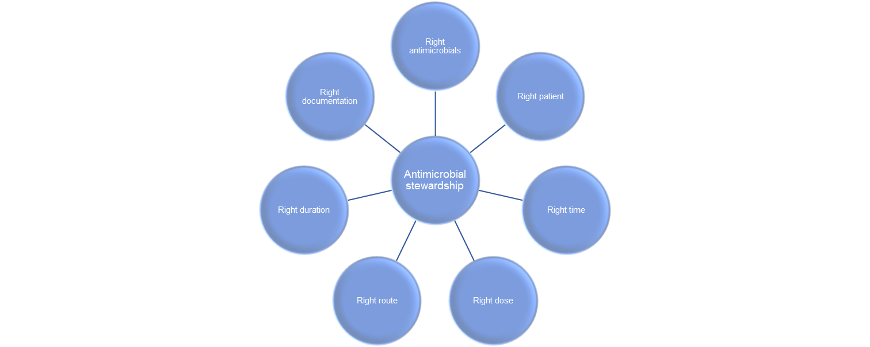
Antimicrobial stewardship
Goals of AMS are to:
    improve patient outcomes / patient safety
    reduce antimicrobial resistance
    reduce costs
    improve environmental sustainability
AMS works hand-in-hand with infection prevention and control, and environmental cleaning strategies
Notes:
Antimicrobial Stewardship isn’t about “not using antimicrobials” but rather “identify that small group of patients who really need antibiotic treatment and then explain, reassure and educate the large group of patients who don’t”
Stewardship means to protect something
AMS is a systematic approach to optimising the use of antimicrobials
Reference: https://www.safetyandquality.gov.au/publications-and-resources/resource-library/world-amr-awareness-week-consumer-powerpoint-presentation

Slide 22
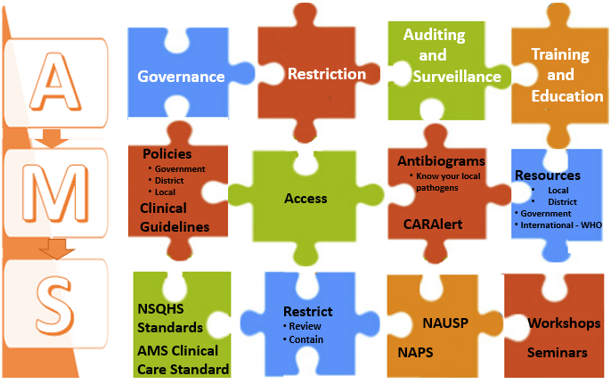
AMS – putting the pieces together
Auditing
and
Surveillance
Training
and
Education
Governance
Restriction
Notes:
AMS is a set of co-ordinated initiatives or activities that together prevent poor prescribing and emergence of resistance. The four pillars of AMS are good governance, restricting antimicrobials to appropriate indications and first line therapies. Auditing, surveillance and using these to undertake quality improvement initiatives. Training and educating the workforce using international, government or in-house educational resources, and providing regular workshops and seminars on using antimicrobials wisely

Slide 23
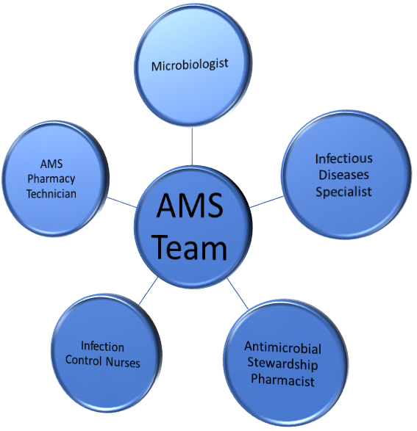
Antimicrobial Stewardship in our healthcare facility
Insert information on your AMS service:
  Structure, governance – who is responsible?
  Who leads AMS activities?
  Who is on your local AMS team?
  What AMS activities are undertaken?
  What AMS activities are you / your department involved in?
Notes:
Antimicrobial Stewardship requires teamwork at all levels. It is ‘everybody's business’ and requires good partnership with the executive and clinical leadership, the clinical team (doctors, nurses, pharmacists, allied health) and consumers.

Slide 24
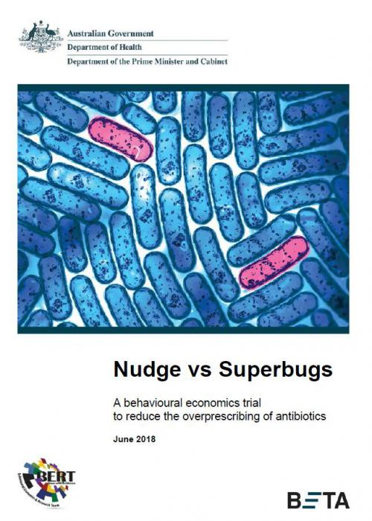
Antimicrobial stewardship – not just for hospitals
Home:
Not taking antibiotics that haven’t been prescribed for you
Discarding old antibiotic medicines appropriately
Industry:
Investing in research and development for antimicrobials
Appropriate waste management of antimicrobials
Community:
  National Safety and Quality Primary and Community Healthcare Standards
  General Practice
    Not prescribing antibiotics for colds and flu
    Delayed prescribing
    Shared decision making
    Public declarations in the practice about conserving antibiotics
  Pharmacies
    Offering symptomatic support for cold and flu
Notes:
Delayed prescribing – if a patient is insistent on receiving antibiotics, offering a script but suggesting that it should not be dispensed unless symptoms worsen or fail to improve after a specified time
Shared decision making – providing information to patients about each management option and arriving at a shared decision that incorporates the patient values and preferences
Public declarations in the practice about conserving antibiotics – for example, having signs in the waiting room
https://behaviouraleconomics.pmc.gov.au/projects/nudge-vs-superbugs-behavioural-economics-trial-reduce-overprescribing-antibiotics
Great initiatives in the UK
https://www.patients-association.org.uk/Handlers/Download.ashx?IDMF=a560fc34-925a-447c-ae1f-cd8e9a2639b0&utm_source=The%20King%27s%20Fund%20newsletters%20%28main%20account%29&utm_medium=email&utm_campaign=11717376_NEWSL_HMP%202020-08-04&dm_i=21A8,6Z56O,2H0RHD,S3EY2,1
References:
https://www.health.gov.au/resources/publications/nudge-vs-superbugs?utm_source=health.gov.au&utm_medium=callout-auto-custom&utm_campaign=digital_transformation

Slide 25
Sustainability + Environment
Limited antimicrobial pipeline to conserve
Patients with AMR often consume more health resources → larger carbon footprint
Waste management of antimicrobials
  Waterways, landfill, industrial
Procurement decisions
  Consider the environmental impact of the product and the company practices
One Health
Climate change
Following guidance for when diagnostic tests such as throat swabs are appropriate
Notes:
The health system has a responsibility to play in minimising its contributions to carbon emissions and play its part in achieving Australia’s Long-Term Emissions Reduction Plan. Antimicrobial Stewardship promotes the responsible use of antibiotics to preserve their effectiveness while supporting sustainability by reducing the environmental impact of antimicrobial resistance.
Climate change
Endemic infectious diseases and novel disease outbreaks may worsen as shifts in climate create favourable conditions for disease vectors or pathogens to proliferate
Procurement
“As part of the Norwegian Hospital Procurement Agency’s 2019 sustainable procurement pilot, three companies in scope of this report were awarded with tenders, partly for achieving the highest score on environmental criteria that specifically addressed whether companies have environmentally friendly production in place and reduce the risk of AMR.”
References:
https://www.who.int/news-room/fact-sheets/detail/climate-change-and-health
What steps are companies taking to help curb AMR by manufacturing responsibly? - AMR Insights (amr-insights.eu)
https://www.health.state.mn.us/diseases/antibioticresistance/environment/environmentfs.pdf
https://accesstomedicinefoundation.org/resource/what-are-pharmaceutical-companies-doing-to-limit-amr-risk-in-the-production-of-antibiotics
https://www.dcceew.gov.au/climate-change/publications/australias-long-term-emissions-reduction-plan

Slide 26

World AMR Awareness Week
18 – 24 November “Educate. Advocate. Act now.”
World Health Organization (WHO) global campaign celebrated annually
Improve awareness and understanding of AMR
Encourages best practices among the public, One Health stakeholders and policy makers
Notes:
World AMR Awareness Week aims to encourage appropriate prescribing and responsible use of antibiotics in all healthcare settings. It has been a major recurring global event since 2015 but has been in existence for some time before then.
It was previously named Antimicrobial Awareness Week (AAW)
WAAW focuses on building awareness of:
What is antimicrobial resistance
How antimicrobial resistance occurs
The health impacts resulting from resistant bacterial infections
Actions that can be taken to reduce antimicrobial resistance
The resources available for clinicians and consumers.

Slide 27
World AMR Awareness Week
List activities occurring at your health facility here + include pictures + contact people

Slide 28
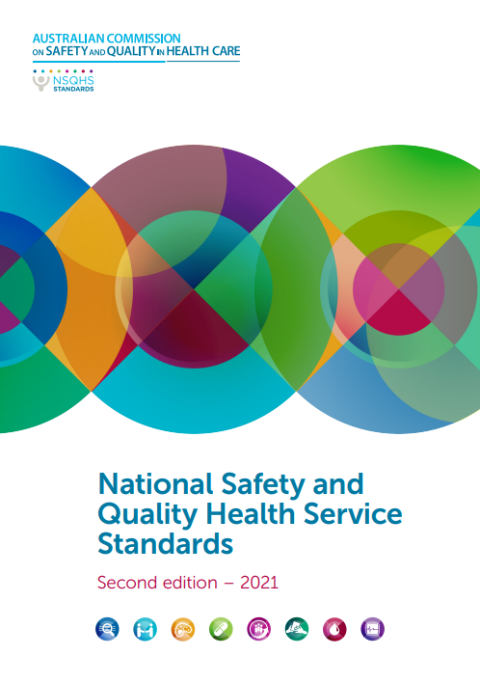
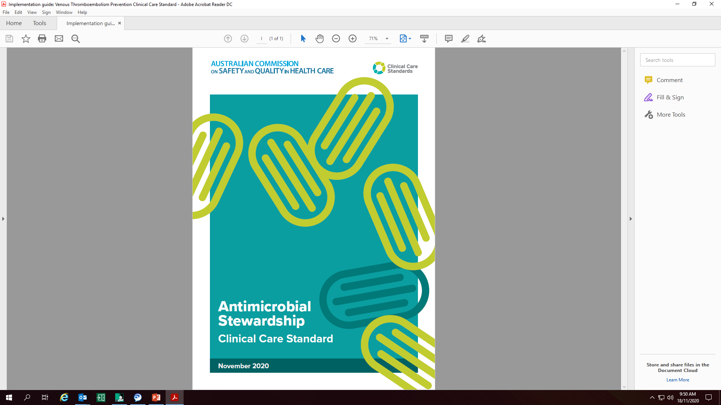
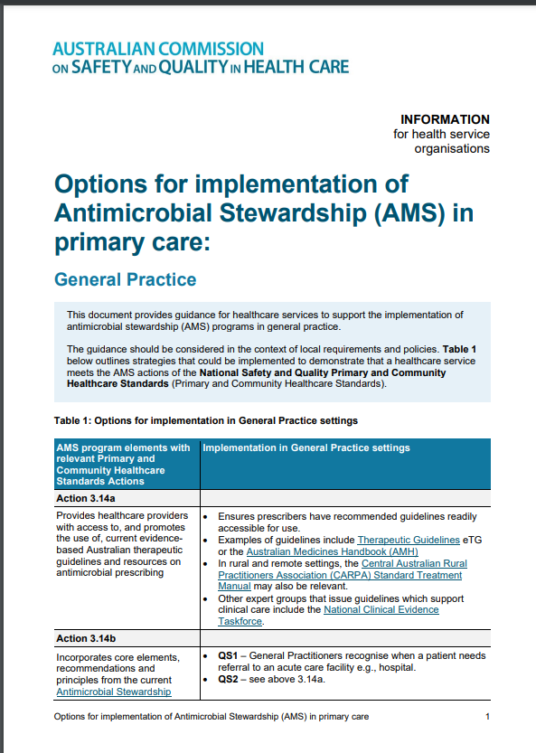
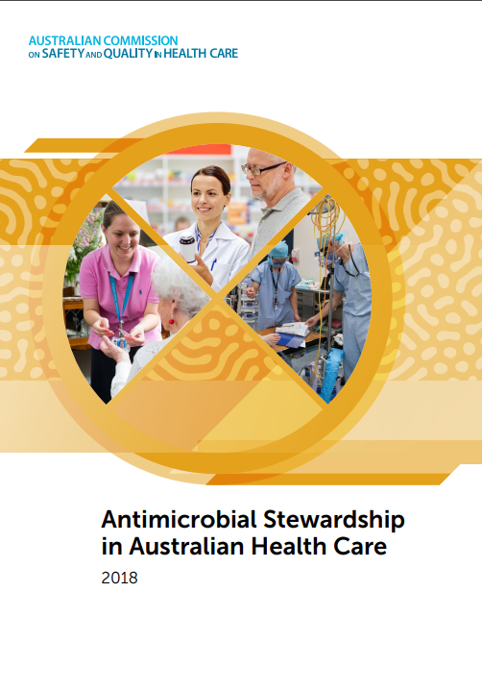
Commission resources for AMS
Notes:
Resources include:
National Safety and Quality Health Service Standards (second edition)- The Standards provide a quality assurance mechanism that tests whether relevant systems are in place to ensure that expected standards of safety and quality are met
Antimicrobial Stewardship in Australian Health Care (the AMS Book) – Initially published in 2018, continues to be updated and enhanced with additional evidence, information and topic areas to inform AMS strategies, interventions and implementation across a range of healthcare settings
Antimicrobial Stewardship Clinical Care Standard- The Antimicrobial Stewardship Clinical Care Standard supports quality improvement by health services and clinicians to help reduce AMR
Options for implementation of Antimicrobial Stewardship (AMS) in primary care: General Practice – Fact sheet that provides guidance for healthcare services to support the implementation of AMS.
Current and future resources for AMS will be available here https://www.safetyandquality.gov.au/our-work/healthcare-associated-infection/antimicrobial-stewardship/

Slide 29
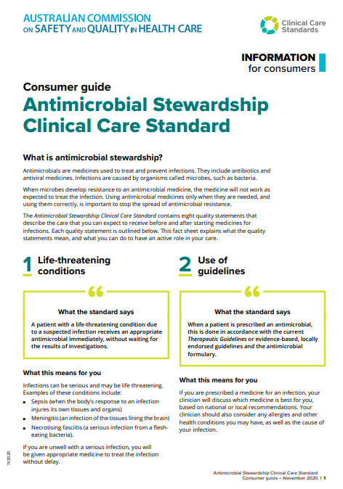
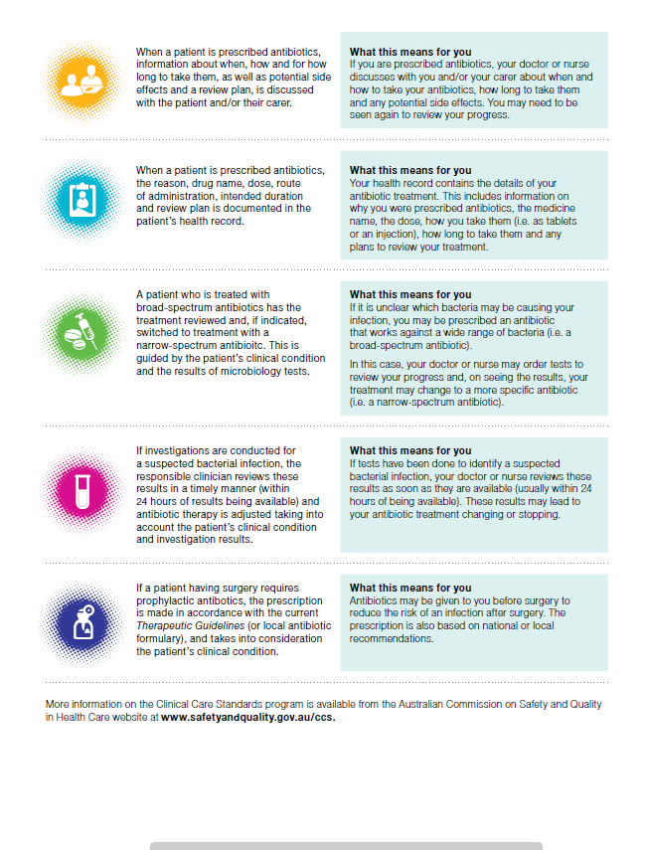
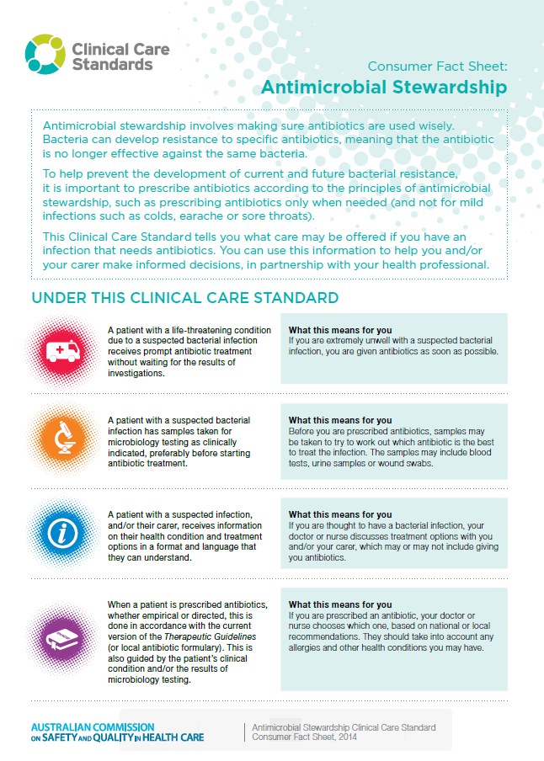
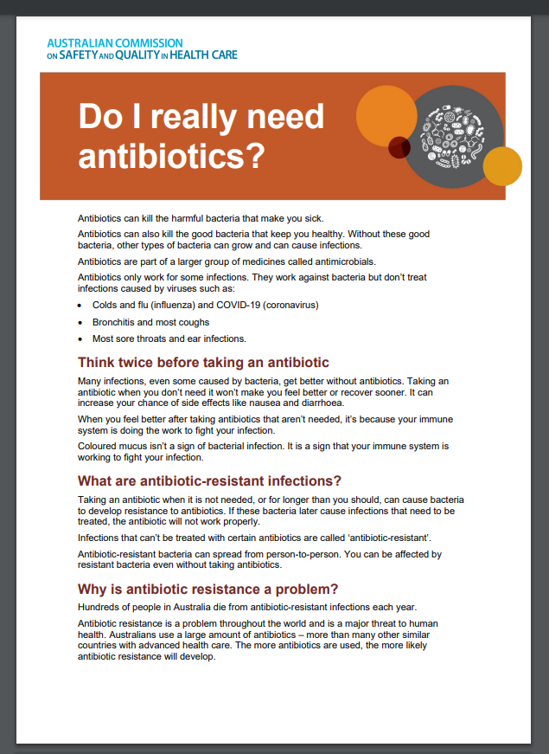
Partnering with consumers
Link
Notes:
Providing information to patients / consumers is a critical part of health care.
The Commission has prepared patient information brochures relating antimicrobial resistance and Antimicrobial Stewardship
https://www.safetyandquality.gov.au/our-work/clinical-care-standards/antimicrobial-stewardship-clinical-care-standard/info-consumers and https://www.safetyandquality.gov.au/antimicrobial-use-and-resistance-in-australia/aura-consumers/
Do I really need antibiotics?
https://www.safetyandquality.gov.au/publications-and-resources/resource-library/do-i-really-need-antibiotics
Decision aids about use of antibiotics for sore throat, middle ear infection, sinusitis, bronchitis, exacerbations of COPD – https://www.safetyandquality.gov.au/our-work/partnering-consumers/shared-decision-making/decision-support-tools-specific-conditions

Slide 30
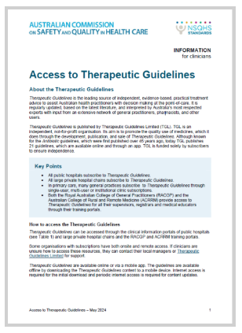
Therapeutic Guidelines
Always use the most current version
Check your hospital’s intranet page
A ‘go to’ reference especially when there are limited local guidelines
Learn more: www.tg.org.au

Slide 31
Key messages
Antimicrobial resistance:
  occurs when an organism evolves and develops resistance to an antimicrobial that should inhibit or destroy it
  is reducing the effectiveness of antimicrobials to treat infections
  is happening now
Few new antimicrobials are being developed
All antimicrobial use can contribute to resistance, but the overuse and inappropriate use of antimicrobials can drive further antimicrobial resistance
Antimicrobial stewardship works hand in hand with prevention and control strategies to help address antimicrobial resistance.
Notes:
Key messages of this presentation:
Antimicrobial resistance is a worldwide problem that affects human and animal health
The misuse, overuse, and inappropriate use of antimicrobials has contributed, and continues to contribute, to antimicrobial resistance.

Slide 32
safetyandquality.gov.au
X.com/ACSQHC
Youtube.com/ACSQHC

