Slide 1

The Basics of Hand Hygiene
Staff name
Position/role
Date
Notes:
Suggest add presenter name/ organisation details here

Slide 2

Acknowledgement of Country
I would like to acknowledge the Traditional Owners and Custodians of the lands on which we meet today and pay my respects to Elders past, present and emerging.
I would like to extend that acknowledgement and respect to any Aboriginal and Torres Strait Islander peoples here today.
The artwork was designed for the Commission’s Reconciliation Action Plan by Kylie Hill, a proud Kalkadoon and Waanyi woman from Mount Isa in far North Queensland.

Slide 3
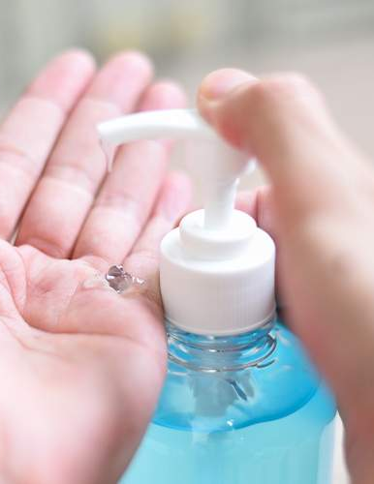

Learning objectives
Know what hand hygiene
is and why it is important
Know when and how to
perform good hand hygiene
Know how to look after your hands
Know why hand hygiene compliance is monitored

Slide 4
The National Hand Hygiene Initiative
The Australian Commission on Safety and Quality in Health Care (the Commission) established the National Hand Hygiene Initiative (NHHI) to prevent and reduce healthcare-associated infections in Australian healthcare settings.
Key elements of the NHHI are:
Promoting the use of alcohol-based hand rub at the point of care
Ensuring standardised hand hygiene and infection prevention and control education
Monitoring hand hygiene compliance and providing feedback,
as part of a quality improvement approach
Identifying targeted opportunities for improving hand hygiene
compliance.
Notes:
How are the elements of the NHHI implemented in your own organisation?

Slide 5
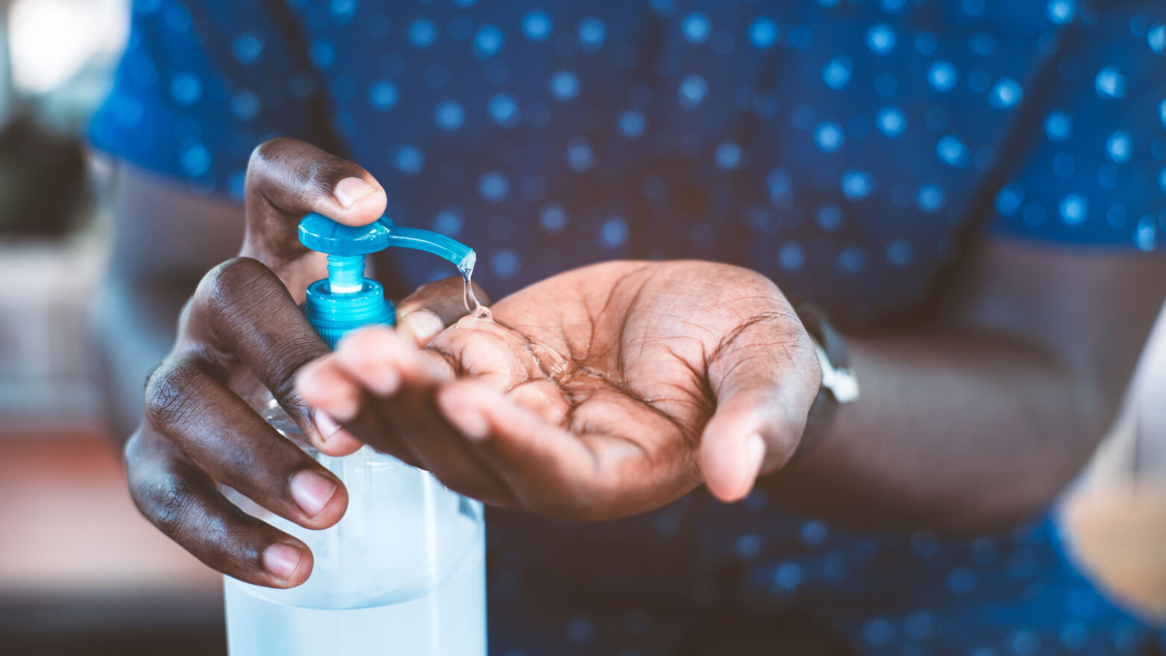
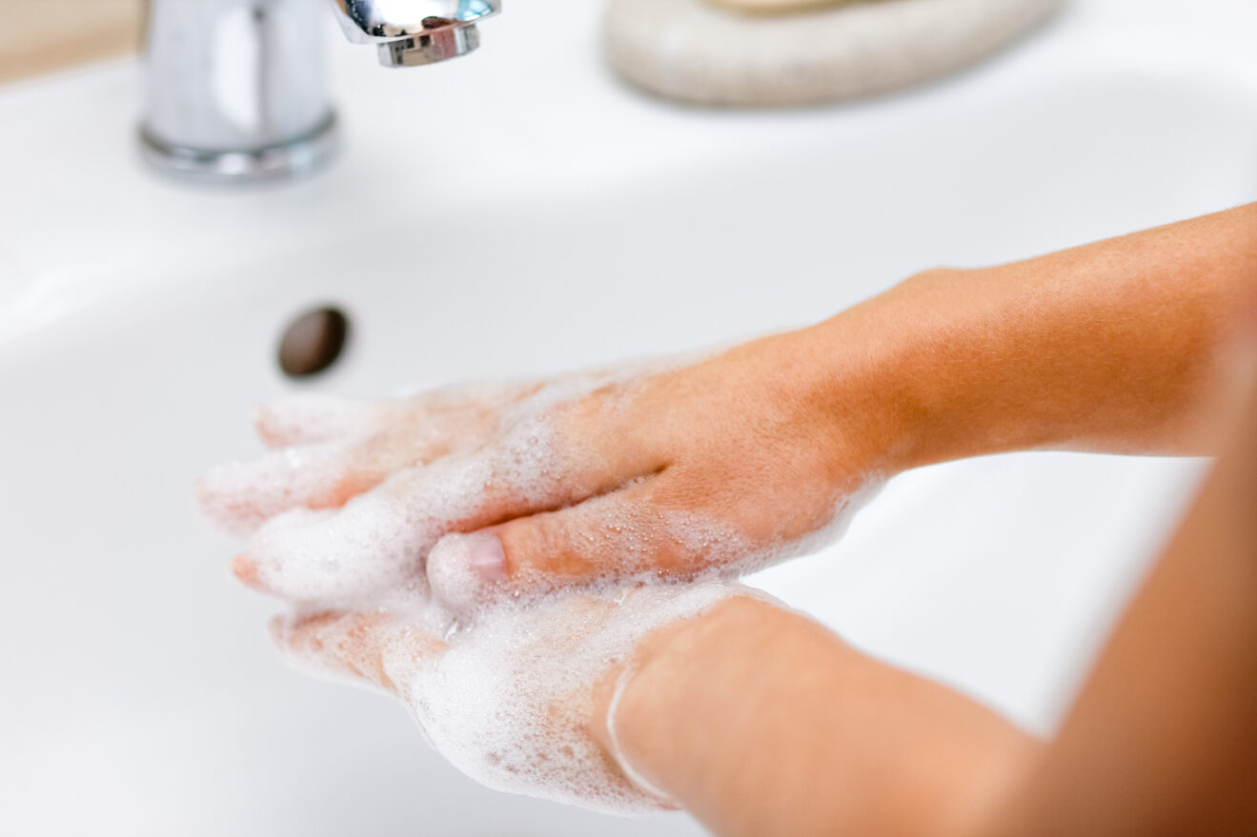
What is hand hygiene and why is it important?
Hand Hygiene is the single most effective action to prevent or reduce the spread of infectious agents/germs to patients and healthcare workers, and limits contamination of the healthcare environment.
Hand hygiene refers to actions taken to clean your hands by:
Applying an AHBR to the surface of your hands (including liquids, gels and foams)
Washing your hands with soap or a soap solution (non-antimicrobial or antimicrobial) and water.
Notes:
You may wish to edit the terminology used in this presentation to suit your audience, for example- will your audience be more familiar with the word germ or term infectious agent?

Slide 6
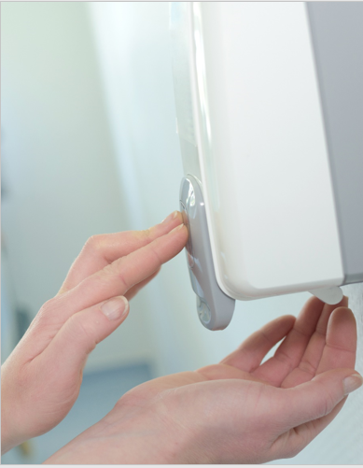
ABHR
ABHR (or hand sanitiser) is appropriate for all situations where hands are not visibly dirty and has the following advantages:
It takes only 15 to 20 seconds to decontaminate hands
It is less irritating and drying for skin than soap and water
It does not require running water or paper towels to dry hands, which reduces waste and helps achieve sustainability objectives.
Notes:
You may want to add examples of when it is appropriate to use ABHR, e.g., before touching a patient, after handling patient care equipment etc.

Slide 7

Soap and water
Washing hands with soap and water is preferable when:
Hands are visibly dirty or contaminated
Caring for someone who has diarrhoea or is vomiting.
Notes:
Other examples:
care of a patient with Clostridioides difficile when gloves have not been worn
caring for someone with bacterial spores, non-enveloped viruses or other specific organisms

Slide 8
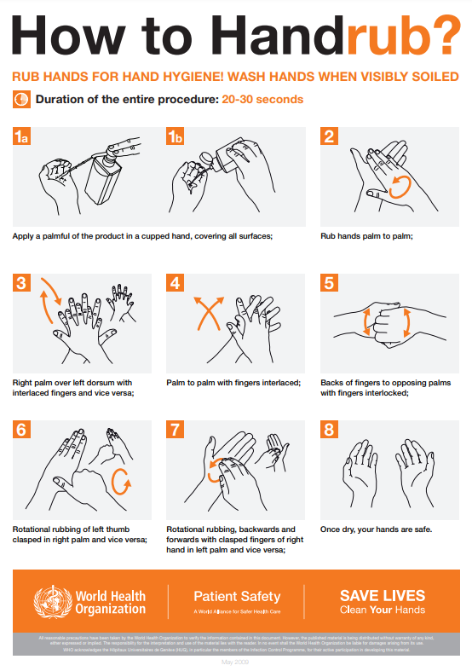
Using an ABHR (or hand sanitiser)
Apply an adequate amount of ABHR in the palm of your hands
Rub the ABHR over all surfaces of your hands including your fingers, fingertips, webs, thumbs and wrists
Allow your hands to dry.
Source: WHO How to handrub? Last update 4 May 2009
Notes:
You can include:
demonstration and practising hand hygiene using an ABHR
using fluorescent powder/gel and UV light for hand hygiene demonstrations and activities

Slide 9
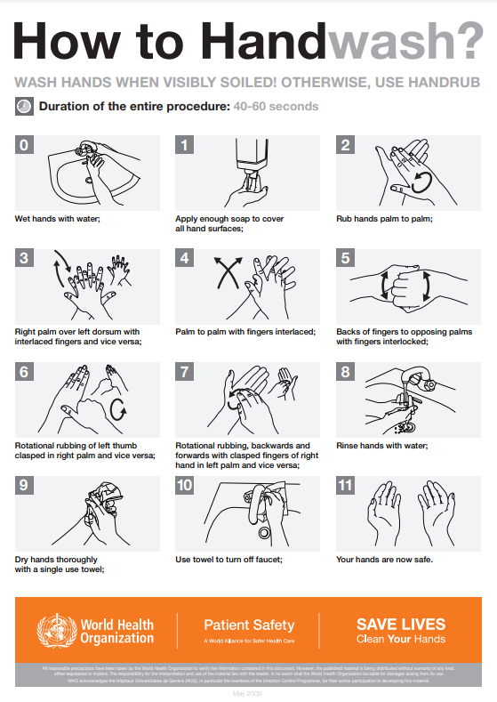
Using soap and water
Wet hands with clean, running water
Apply an adequate amount of soap to hands
Lather soap over all surfaces of your hands including your fingers, webs, thumbs and wrists
Scrub your hands for at least 20 seconds
Rinse your hands well under clean, running water
Dry your hands using a clean single-use paper towel.
Source: WHO How to handwash? Last update 4 May 2009

Slide 10
Who should perform hand hygiene
Everyone should perform hand hygiene, whether at home, in hospital, or in the community to protect themselves and those around them.
Hand hygiene is important for you, as a healthcare worker because you are exposed to:
Patients who may be colonised or infected with infectious agents/germs
Patient care equipment that may be contaminated with infectious agents/germs.

Slide 11
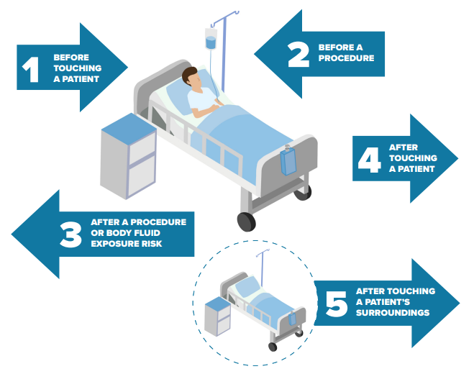
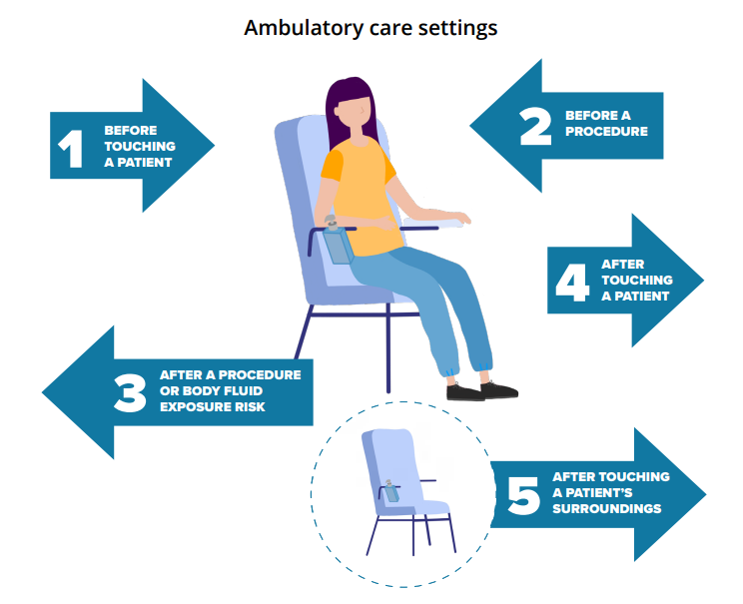
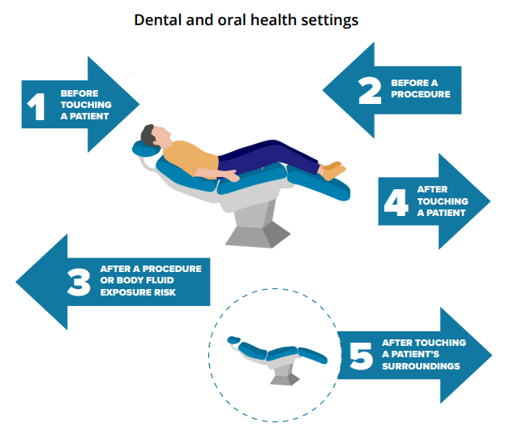
The 5 Moments for Hand Hygiene
There are five critical times during patient care when hand hygiene can prevent the spread of infectious agents/germs and the onset of severe illness.
These are known as the “5 Moments for Hand Hygiene”
It’s a theoretical model based on the World Health Organization’s ‘Your 5 Moments for Hand Hygiene’ approach.
Notes:
Direct observational auditing of hand hygiene practices is one commonly used method to monitor healthcare workers hand hygiene practices. Data is collected by observing HCWs when they are in a patient care area and recording which moment of hand hygiene should occur and if they did hand hygiene. Other methods of monitor hand hygiene practices can include, monitoring product usage, patient feedback … (add other that may be used in your own organisation).
You may want to update the image of this slide with an image of the 5 Moments that relates to your specific workplace/ clinical setting- refer to https://www.safetyandquality.gov.au/our-work/infection-prevention-and-control/national-hand-hygiene-initiative/materials-support-improved-hand-hygiene-australia-nhhi

Slide 12
Where and when is hand hygiene needed?
Hand hygiene should be performed in both the patient zone (the space dedicated to an individual patient for the duration of their stay) and the healthcare zone (all areas outside the patient zone, such as doors or shared patient areas).
To minimise the risk of spreading infectious agents/germs from the patient to yourself, other people and the healthcare environment, hand hygiene should be performed:
BEFORE entering and AFTER exiting the healthcare environment
BEFORE entering and AFTER exiting the patient zone
BEFORE and AFTER touching doors or other surfaces when moving between different patient/ healthcare zones.
BEFORE entering and AFTER exiting the healthcare zone
Notes:
The healthcare environment refers to all clinical and non-clinical spaces within an organisation.
Examples of clinical and non-clinical spaces in the healthcare environment include patient rooms and ward areas, consultation rooms, stock storage areas, waiting areas cafeteria areas ) or provide examples relevant to your own organisation.
The healthcare environment includes two zones- the health care zone and the patient zone.

Slide 13
Other moments hand hygiene is needed
Hand hygiene should be done BEFORE:
Starting and leaving work
Eating or handling food or drinks
Using shared computers or mobile devices
Using gloves and other items of personal protective equipment.
Hand hygiene should be done AFTER:
Going to the toilet
Blowing, wiping or touching your nose or mouth
Removing gloves and other items of personal protective equipment
Contact with body fluid or items potentially contaminated with body fluid
Handling used linen, equipment or waste
Notes:
Can you think of any other examples? Consider examples specific to your organisation/ clinical areas/ or specific HCW roles
Before and after using and cleaning share patient care equipment
After smoking/ vaping
After being in a healthcare environment where there is an outbreak of an infectious disease

Slide 14
Enhancing hand hygiene
Clothing, jewellery, and nail treatments can harbour infectious agents/germs that can be transferred to others, the healthcare environment and equipment.
The following are practical actions you can take to improve hand hygiene practice and help to prevent the spread of infectious agents/germs in your workplace:
Keeping nails natural, short and clean
Being bare below the elbows (i.e. hands and forearms are free of jewellery and clothing).
Notes:
Refer to local policies that help to support these recommendations.

Slide 15
Skin care
Intact skin is one of the body’s natural defences against infection. Dry, irritated and damaged hands carry more germs/infectious agents and are a risk to yourself and your patients.
So, it is important to take care of your hands by:
Avoid irritants on the skin, such as chemicals, heat, dirt and sweating/moisture
Dry your hands thoroughly after washing with soap and water
Moisturise your hands regularly
Protect irritated or damaged skin on your hands with a waterproof film or dressing
Report skin problems on your hands to management/ staff health service
Seek professional advice if you have irritated or damaged skin.
Notes:
Refer to local actions/ services to support staff with skin issues.

Slide 16
Hand hygiene compliance
Hand hygiene compliance can be monitored through direct observation, education, training and assessments, audits or patient experience surveys.
Audit tools can be accessible through the Commission’s website.
The data collected from these activities should be used to develop improvement strategies and resources that aim to improve workforce compliance to hand hygiene practices.
This may include increasing access to hand hygiene products, providing targeted education sessions or developing and reviewing hand hygiene education materials

Slide 17
How can you get involved?
Be a role model by promoting hand hygiene to patients, their carers and your colleagues
Get involved with hand hygiene and infection prevention and control activities in your organisation
Become a Hand Hygiene Auditor or Hand Hygiene Auditor Educator
Help promote local hand hygiene and infection prevention and control initiatives
Ensure your team meetings include agenda items for hand hygiene and infection prevention and control.
Notes:
Do you have any local activities or program to add to this list?

Slide 18
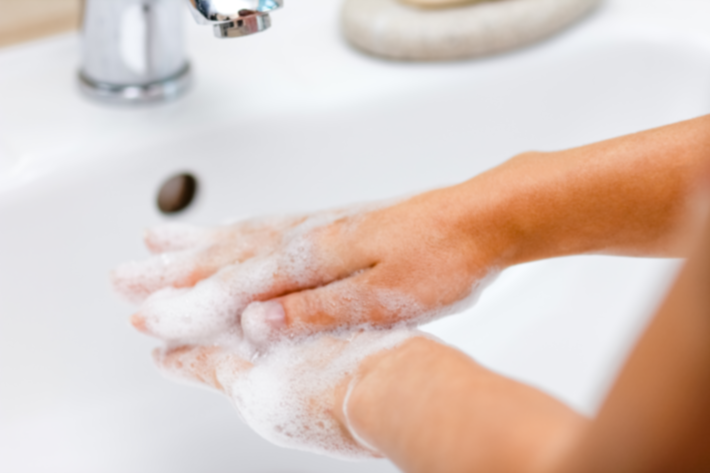
All healthcare workers have a role to play in ensuring patient and healthcare worker safety and a clean and safe healthcare environment
A fundamental part of this role is performing hand hygiene correctly, at the right time.

Slide 19

Questions?

Slide 20


Safetyandquality.gov.au
X.com/ACSQHC
Youtube.com/user/ACSQHC
National Hand Hygiene Initiative
Staff name
staffname@safetyandquality.gov.au
www.safetyandquality.gov.au

