Slide 1
The basics of hand hygiene
safetyandquality.gov.au
Staff name
Position/role
Date

Slide 2

Acknowledgement of Country
The Australian Commission on Safety and Quality in Health Care pay respect to the Gadigal people as the Traditional Custodians of Country where the Commission's office is located. We extend that respect to all Aboriginal and Torres Strait Islander peoples, and their deep time connections to land, water and sky.
We recognise that knowledge about healthy Country, community and culture has been developed by Aboriginal and Torres Strait Islander peoples over tens of thousands of years and has been shared for generations. We are committed to partnering with and learning from Aboriginal and Torres Strait Islander peoples through the work that we do.

Slide 3
Learning objectives
Know what hand hygiene is and why it is important
Know when and how to perform good hand hygiene
Know how to look after your hands
Know why hand hygiene compliance is monitored

Slide 4
The National Hand Hygiene Initiative
The Australian Commission on Safety and Quality in Health Care (the Commission) established the National Hand Hygiene Initiative (NHHI) to prevent and reduce healthcare-associated infections in Australian healthcare settings.
Key elements of the NHHI are:
promoting the use of alcohol-based hand rub at the point of care
ensuring standardised hand hygiene and infection prevention and control education
monitoring hand hygiene compliance and providing feedback,
as part of a quality improvement approach
identifying targeted opportunities for improving hand hygiene
compliance.
Notes:
How are the elements of the NHHI implemented in your own organisation?

Slide 5
What is hand hygiene and why is it important?
Hand hygiene is the single most effective action to prevent or reduce the spread of infectious agents/germs to patients and healthcare workers, and limits contamination of the healthcare environment.
Hand hygiene refers to actions taken to clean your hands by:
applying an alcohol-based hand rub (ABHR) to the surface of your hands (including liquids, gels and foams)
washing your hands with soap or a soap solution (non-antimicrobial or antimicrobial) and water.
Notes:
You may wish to edit the terminology used in this presentation to suit your audience, for example- will your audience be more familiar with the word germ or term infectious agent?

Slide 6

ABHR (or hand sanitiser)
Is appropriate for all situations where hands are not visibly dirty and has the following advantages:
it takes only 15 to 20 seconds to decontaminate hands
it is less irritating and drying for skin than soap and water
it does not require running water or paper towels to dry hands, which reduces waste and helps achieve sustainability objectives.
The basics of hand hygiene
Notes:
You may want to add examples of when it is appropriate to use ABHR, e.g., before touching a patient, after handling patient care equipment etc.

Slide 7

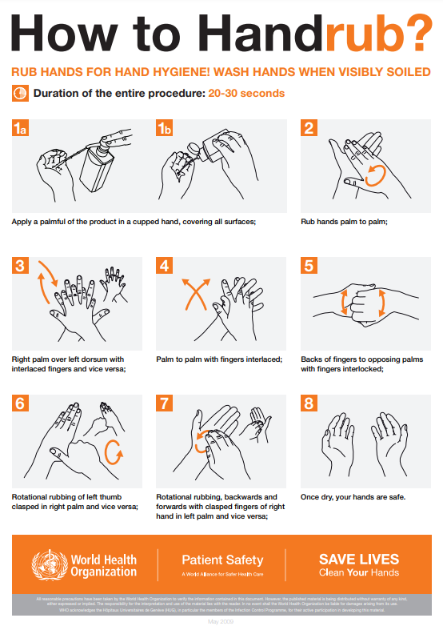
Using an ABHR
(or hand sanitiser)
Apply: Pour a palmful of ABHR into a cupped hand, covering all surfaces.
Palm to Palm: Rub hands together.
Backs of Hands: Rub the right palm over the left dorsum with interlaced fingers, then vice versa.
Interlaced: Rub palm to palm with fingers interlaced.
Back of Fingers: Rub the back of fingers to opposing palms with fingers interlocked.
Thumbs: Rotational rubbing of the left thumb clasped in the right palm, then vice versa.
Fingertips: Rub backwards and forwards with clasped right fingers in left palm, then vice versa.
Dry: Once dry, your hands are safe
Source: WHO How to handrub? Last update 4 May 2009
The basics of hand hygiene
Notes:
You can include:
demonstration and practising hand hygiene using an ABHR
using fluorescent powder/gel and UV light for hand hygiene demonstrations and activities

Slide 8
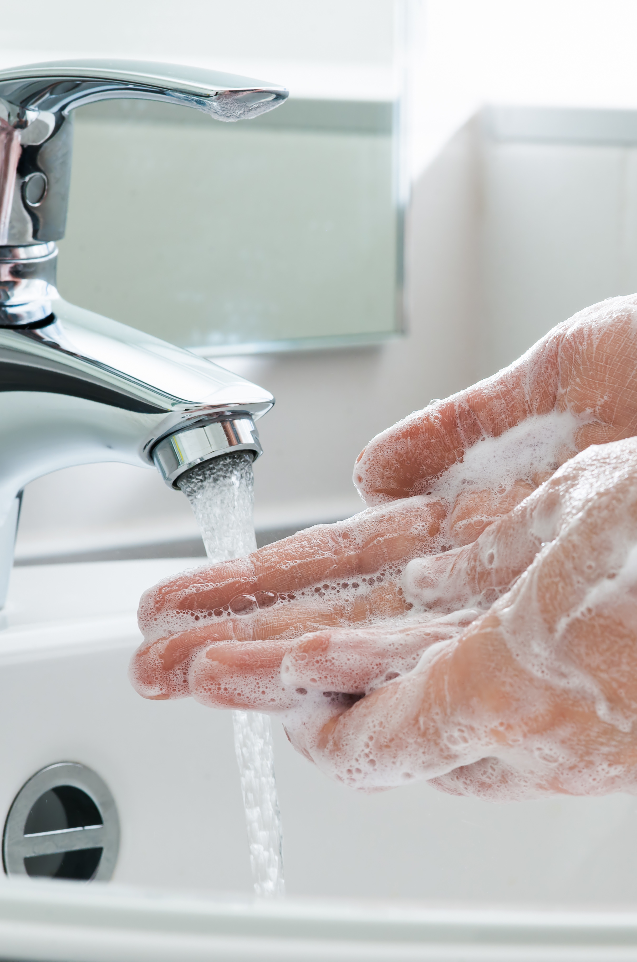
Soap and water
Washing hands with soap and water is preferable when:
hands are visibly dirty or contaminated
caring for someone who has diarrhoea or is vomiting.
The basics of hand hygiene
Notes:
Other examples:
care of a patient with Clostridioides difficile when gloves have not been worn
caring for someone with bacterial spores, non-enveloped viruses or other specific organisms

Slide 9
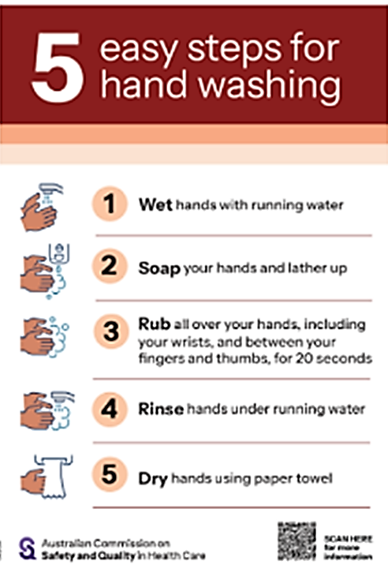
Using soap and water
Wet hands with running water
Apply soap and lather hands
Rub hands thoroughly, including wrists, between fingers, and thumbs, for 20 seconds
Rinse hands under running water
Dry hands using a paper towel
Source: Australian Commission on Safety and Quality in Healthcare 5 easy steps for hand washing - poster
Notes:
You can include:
demonstration and practising hand hygiene using an ABHR
using fluorescent powder/gel and UV light for hand hygiene demonstrations and activities

Slide 10
Who should perform hand hygiene?
Everyone should perform hand hygiene, whether at home, in hospital, or in the community to protect themselves and those around them.
Hand hygiene is important for you, as a healthcare worker because you are exposed to:
patients who may be colonised or infected with infectious agents/germs
patient care equipment that may be contaminated with infectious agents/germs.
Notes:
You may wish to edit the terminology used in this presentation to suit your audience, for example- will your audience be more familiar with the word germ or term infectious agent?

Slide 11
Where and when is hand hygiene needed?
Perform hand hygiene in both:
  Patient zone (individual patient’s space)
  Healthcare zone (areas outside the patient zone)
To reduce the spread of germs, perform hand hygiene:
  Before entering and after exiting the healthcare environment
  Before entering and after exiting the patient zone
  Before and after touching doors or shared surfaces when moving between zones

Slide 12
Other moments hand hygiene is needed
Hand hygiene should be done before:
starting and leaving work
eating or handling food or drinks
using shared computers or mobile devices
using gloves and other items of personal protective equipment.
Hand hygiene should be done after:
going to the toilet
blowing, wiping or touching your nose or mouth
removing gloves and other items of personal protective equipment
contact with body fluid or items potentially contaminated with body fluid
handling used linen, equipment or waste.
Notes:
Can you think of any other examples? Consider examples specific to your organisation/ clinical areas/ or specific HCW roles
Before and after using and cleaning share patient care equipment
After smoking/ vaping
After being in a healthcare environment where there is an outbreak of an infectious disease

Slide 13
Enhancing hand hygiene
Clothing, jewellery, and nail treatments can harbour infectious agents/germs that can be transferred to others, the healthcare environment and equipment.
The following are practical actions you can take to improve hand hygiene practice and help to prevent the spread of infectious agents/germs in your workplace:
keeping nails natural, short and clean
being bare below the elbows (i.e. hands and forearms are free of jewellery and clothing).
Notes:
Refer to local policies that help to support these recommendations.

Slide 14
Skin care
avoiding irritants on the skin, such as chemicals, heat, dirt and sweating/moisture
drying your hands thoroughly after washing with soap and water
moisturising your hands regularly
protecting irritated or damaged skin on your hands with a waterproof film or dressing
reporting skin problems on your hands to management/staff health service
seeking professional advice if you have irritated or damaged skin.
Intact skin is one of the body’s natural defences against infection. Dry, irritated and damaged hands carry more germs/infectious agents and are a risk to yourself and your patients.
So, it is important to take care of your hands by:
Notes:
Refer to local actions/ services to support staff with skin issues.

Slide 15
Hand hygiene compliance
Audit tools can be accessed through the Commission’s website.
Hand hygiene compliance can be monitored through direct observational audits or patient experience surveys.
Our organisation uses data collected from these activities to develop improvement strategies and resources that aim to improve workforce hand hygiene compliance, such as:
>organisation to insert local strategies here<

Slide 16
How can you get involved?
Be a role model by promoting hand hygiene to patients, their carers and your colleagues
Get involved with hand hygiene and infection prevention and control activities in your organisation
Become a Hand Hygiene Auditor or Hand Hygiene Auditor Educator
Help promote local hand hygiene and infection prevention and control initiatives
Ensure your team meetings include agenda items for hand hygiene and infection prevention and control.
Notes:
Do you have any local activities or program to add to this list?

Slide 17
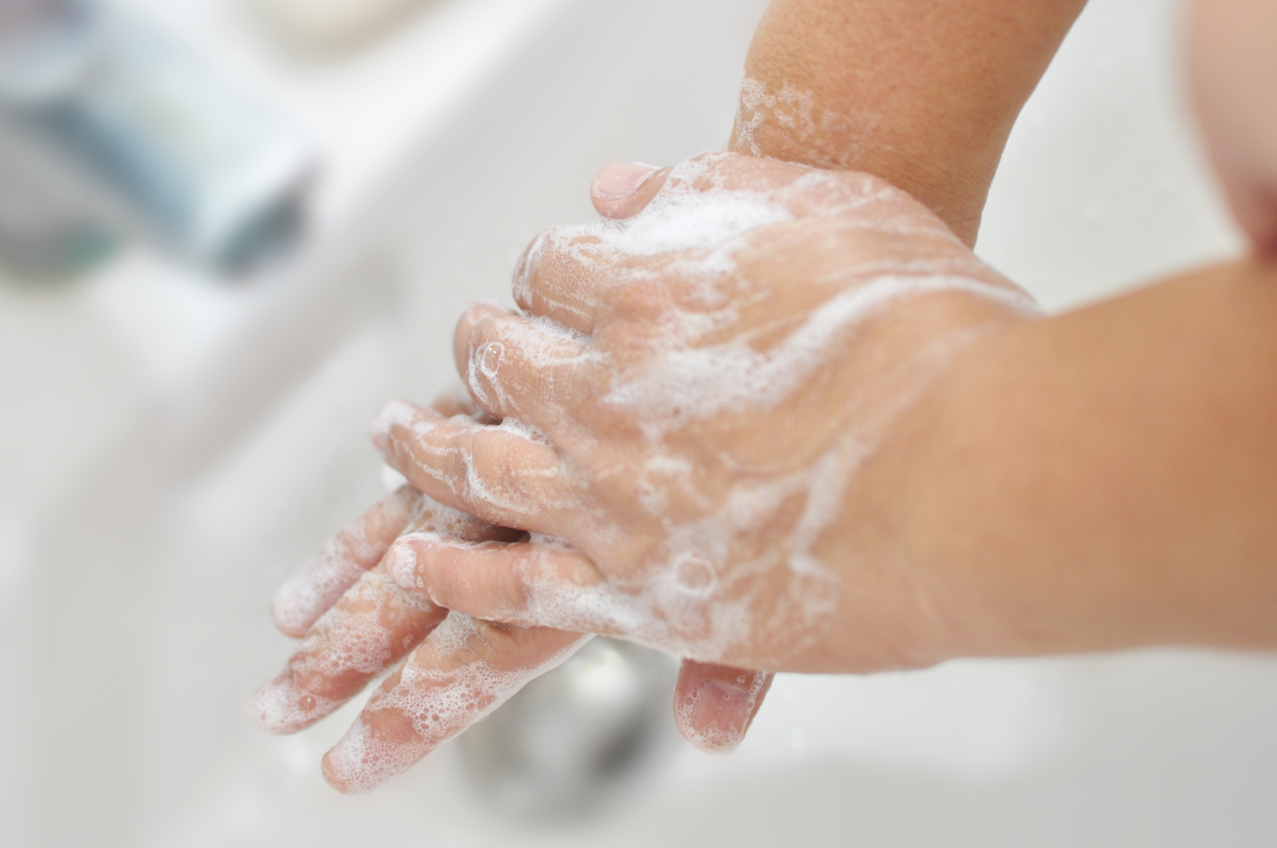
All healthcare workers have a role to play in ensuring patient and healthcare worker safety and a clean and safe healthcare environment.
A fundamental part of this role is performing hand hygiene correctly, at the right time.

Slide 18
Questions?

Slide 19
T. +61 2 9126 3600
Level 5, 255 Elizabeth St
Sydney NSW 2000 Australia
safetyandquality.gov.au
© Australian Commission on Safety and Quality in Health Care 2026

