Slide 1

Hand Hygiene
Notes:
Suggest add presenter name here

Slide 2

Acknowledgement of Country
I would like to acknowledge the Traditional Owners and Custodians of the lands on which we meet today and pay my respects to Elders past, present and emerging.
I would like to extend that acknowledgement and respect to any Aboriginal and Torres Strait Islander peoples here today.
The artwork was designed for the Commission ‘s Reconciliation Action Plan by Kylie Hill, a proud Kalkadoon and Waanyi woman from Mount Isa in far North Queensland.

Slide 3
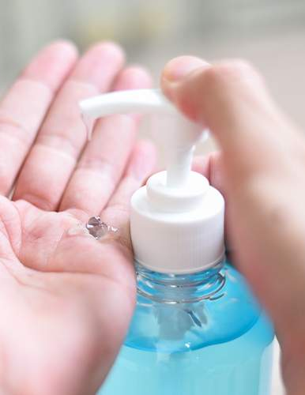

Learning objectives
Know what hand hygiene is and why it is important
Know when and how to perform good hand hygiene
Know how to look after your hands
Know why hand hygiene compliance is monitored

Slide 4
The National Hand Hygiene Initiative
The Australian Commission on Safety and Quality in Health Care (the Commission) established the National Hand Hygiene Initiative (NHHI) to prevent and reduce healthcare-associated infections in Australian healthcare settings.
Key elements of the NHHI are:
Promoting the use of alcohol-based hand rub at the point of care
Ensuring standardised hand hygiene and infection prevention and control education
Monitoring hand hygiene compliance and providing feedback,
as part of a quality improvement approach
Identifying targeted opportunities for improving hand hygiene
compliance.

Slide 5
Monitoring hand hygiene compliance
The National Safety and Quality Health Service (NSQHS) Standards and the National Safety and Quality Primary and Community Healthcare Standards require health services to have processes that ensure hand hygiene is incorporated in their overarching infection prevention and control program as part of standard precautions.
Health services accredited to these Standards may be required to collect hand hygiene compliance data for national audits.
Hand hygiene audit data, and data on healthcare-associated infections are used to support infection prevention and control quality improvement strategies.

Slide 6
Healthcare-associated infections
Healthcare-associated infections (HAIs):
Are infections acquired in the healthcare environment or because of the delivery of health care
May develops during a patient’s stay in hospital or some time after the patient has been discharged
Can prolong recovery, add to complications, increase care requirements, and can even lead to death.
People working in or visiting a healthcare environment are also at risk of acquiring a HAI.

Slide 7
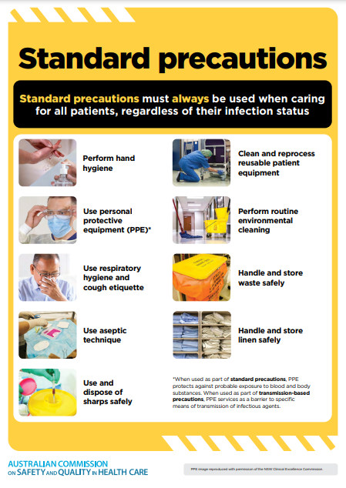
Standard precautions
Standard precautions are:
Minimum infection prevention and control practices that must always be used for all patients, in all situations
Used to reduce or prevent the transmission of infectious agents/germs and to render and maintain objects and healthcare settings as free as possible from infectious agents.
Hand hygiene is one element of standard precautions.
Notes:
Standard precautions involve:
hand hygiene, as consistent with the 5 moments for hand hygiene
the use of appropriate personal protective equipment
the safe use and disposal of sharps
routine environmental cleaning
reprocessing of reusable medical equipment and instruments
respiratory hygiene and cough etiquette
aseptic technique
waste management
appropriate handling of linen.

Slide 8
What is hand hygiene?
Hand hygiene is the single most effective action to reduce the spread of infectious agents/germs in health care.
Hand hygiene refers to actions taken to clean your hands by:
Applying an alcohol-based hand rub (AHBR) to the surface of your hands (including liquids, gels and foams)
Washing your hands with soap or a soap solution (non-antimicrobial or antimicrobial) and water.

Slide 9
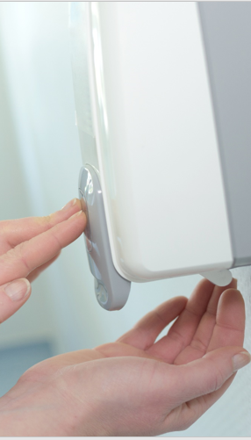
When to use ABHR
ABHR (or hand sanitiser) is appropriate for all situations where hands are not visibly dirty and has the following advantages:
It takes only 15 to 20 seconds to decontaminate hands
It is less irritating and drying for skin than soap and water
It does not require running water or paper towels to dry hands, which reduces waste and helps achieve sustainability objectives.

Slide 10
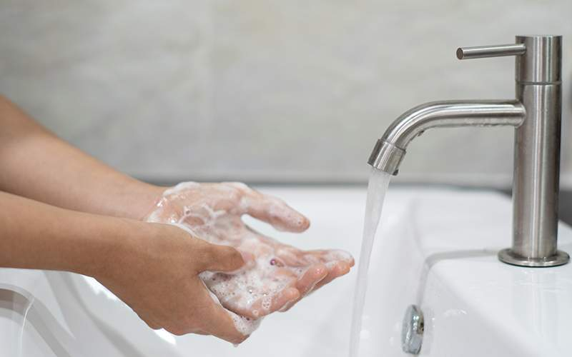
When to use soap and water
Washing hands with soap and water is preferable when:
Hands are visibly dirty or contaminated
Caring for someone who has diarrhoea or is vomiting.
Notes:
Other examples:
care of a patient with Clostridioides difficile when gloves have not been worn
care for someone with bacterial spores, non-enveloped viruses or other specific organisms

Slide 11
Why is hand hygiene important?
Hand Hygiene:
Is the single most effective action to prevent or reduce the spread of infectious agents/germs to patients and healthcare workers, and limits contamination of the healthcare environment
Protects patients and yourself from healthcare-associated infections.

Slide 12
Who should perform hand hygiene
Everyone should perform hand hygiene, whether at home, in hospital, or in the community to protect themselves and those around them.
Hand hygiene is important for you because you are exposed to:
Patients who may be colonised or infected with infectious agents/germs
Patient care equipment that may be contaminated with infectious agents/germs.

Slide 13
Where is hand hygiene needed?
Appropriate hand hygiene is required throughout the healthcare environment.
The healthcare environment refers to all clinical and non-clinical spaces within an organisation. For example:
Patient rooms and ward areas
Consultation rooms
Stock storage areas
Waiting areas
Cafeteria areas.

Slide 14
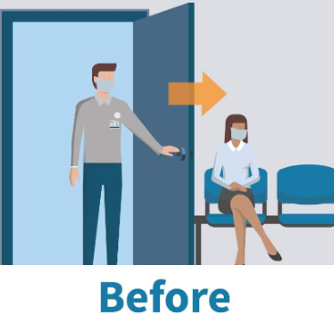
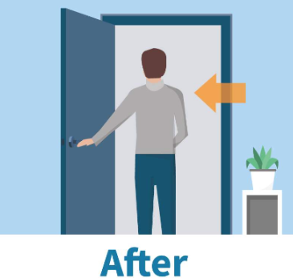
Hand hygiene in healthcare environment
Hand hygiene should be performed BEFORE entering the healthcare environment to minimise the risk of spreading infectious agents/germs to patients
Hand hygiene should be performed AFTER exiting the healthcare environment to minimise the risk of spreading infectious agents/germs from the patient to yourself, other people and the healthcare environment.

Slide 15
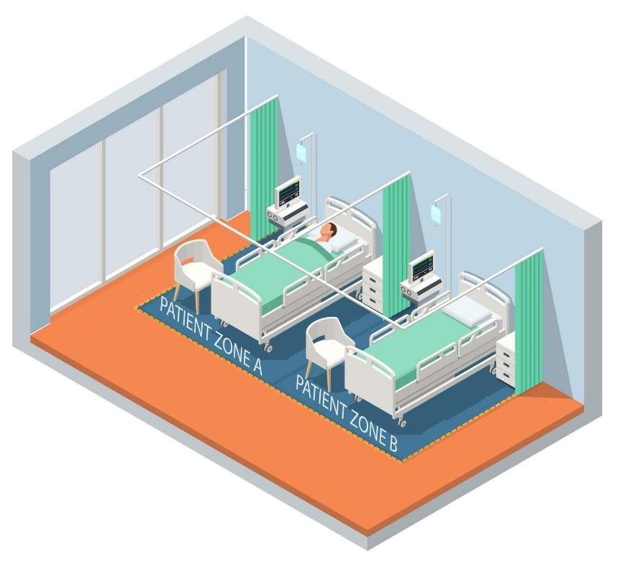
The healthcare environment
Within the healthcare environment, there are two zones where hand hygiene is critical:
The patient zone
The healthcare zone.
HEALTHCARE ZONE

Slide 16
The patient zone
The patient zone is a space dedicated to an individual patient for the duration of the patient’s stay, including:
The patient
Any equipment attached to the patient
The patient's immediate surroundings.

Slide 17
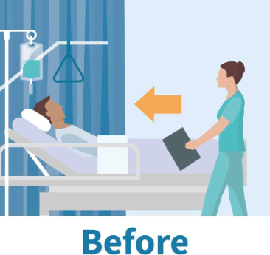
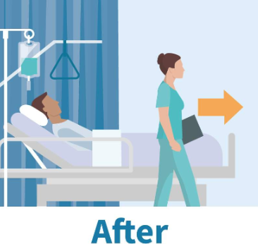
Hand hygiene in patient zone
Hand hygiene should be performed BEFORE entering the patient zone to minimise the risk of spreading infectious agents/germs to patients
Hand hygiene should be performed AFTER exiting the patient zone to minimise the risk of spreading infectious agents/germs from the patient to yourself, other people and the healthcare environment.

Slide 18
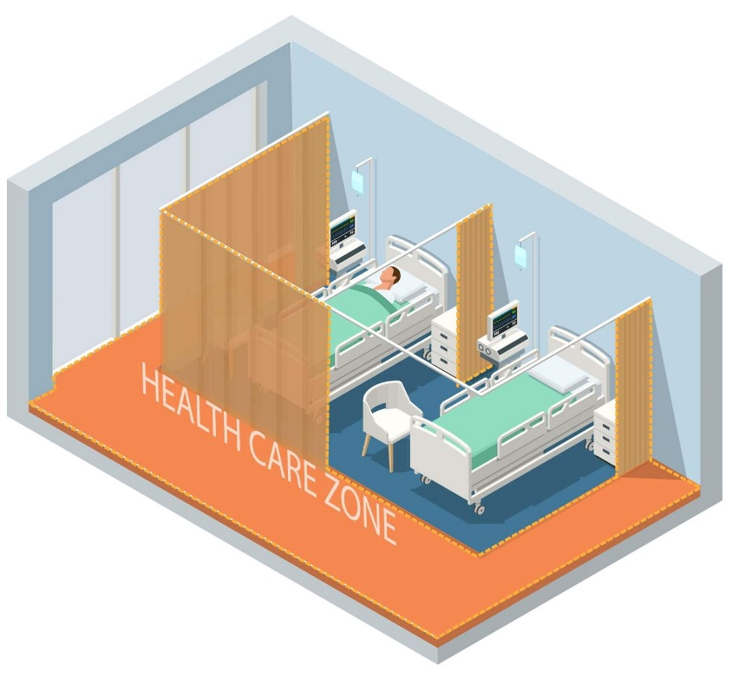
The healthcare zone
The healthcare zone refers to all areas outside the patient zone, such as curtains, partitions, doors and any shared patient area.
The healthcare zone is shared by patients, healthcare workers and visitors and may be contaminated by infectious agents/germs from these individuals.

Slide 19
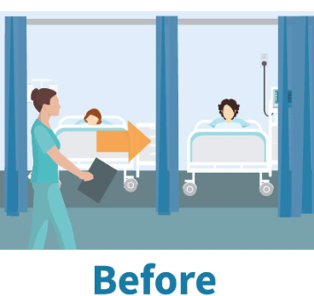
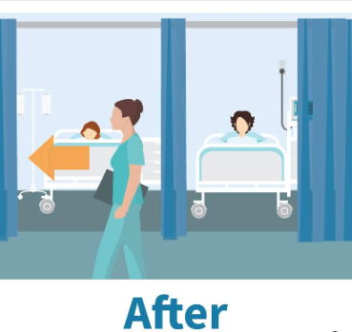
Hand hygiene in healthcare zone
Hand hygiene should be performed BEFORE entering the healthcare zone to minimise the risk of spreading infectious agents/germs to patients
Hand hygiene should be performed AFTER exiting the healthcare zone to minimise the risk of spreading infectious agents/germs from the patient to yourself, other people and the healthcare environment.

Slide 20
Curtains, partitions and doors
Curtains, partitions and doors are the boundary between the patient zone and healthcare zone.
They are not always cleaned between patients and so are potentially contaminated with infectious agents/germs.
Hand hygiene should be performed:
AFTER touching the curtains, partitions or doors and BEFORE touching the patient
AFTER touching the patient or their surroundings and BEFORE touching the curtains, partitions or doors.
Notes:
Hand hygiene should be performed:
AFTER touching the curtains, partitions or doors and BEFORE touching the patient, so that you do not transfer infectious agents/germs from the environment to the patient or yourself
AFTER touching the patient or their surroundings and BEFORE touching the curtains, partitions or doors so that you do not transfer infectious agents/germs from the patient to yourself or the broader healthcare environment.

Slide 21
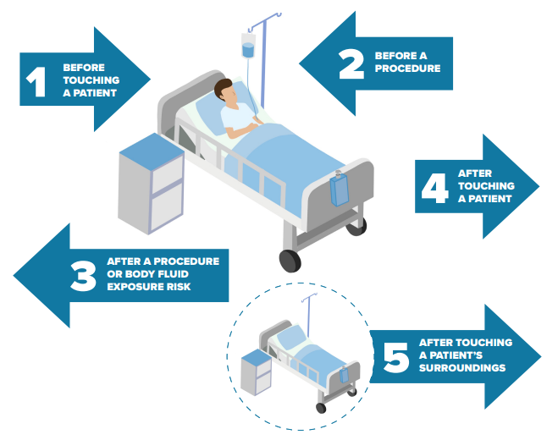
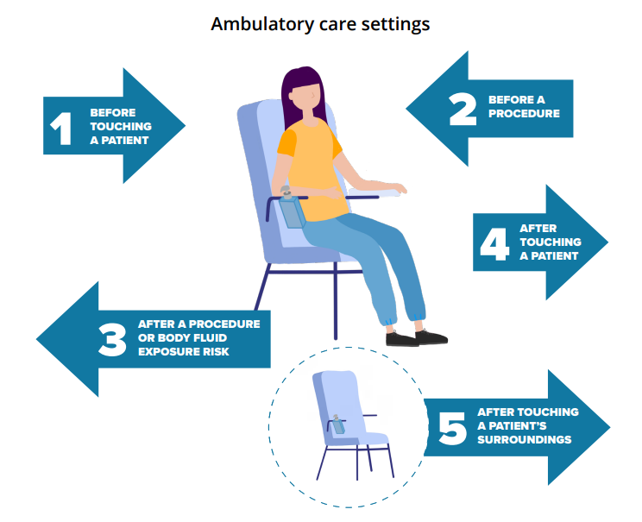
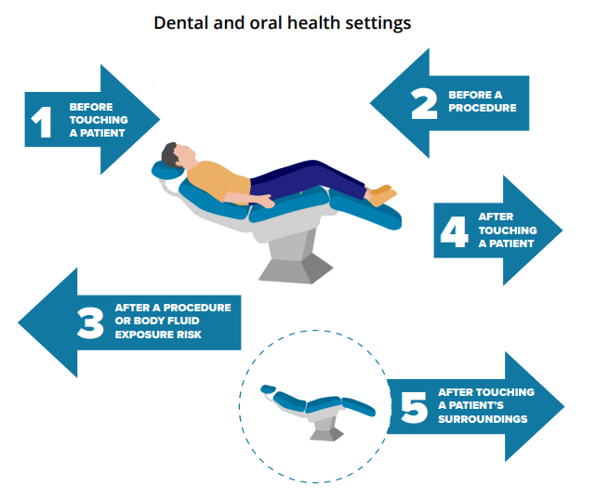
The 5 Moments for Hand Hygiene
There are five critical times during patient care when hand hygiene can prevent the spread of infectious agents/germs and the onset of severe illness.
These are known as the “5 Moments for Hand Hygiene”
It’s a theoretical model based on the World Health Organization’s ‘Your 5 Moments for Hand Hygiene’ approach.

Slide 22
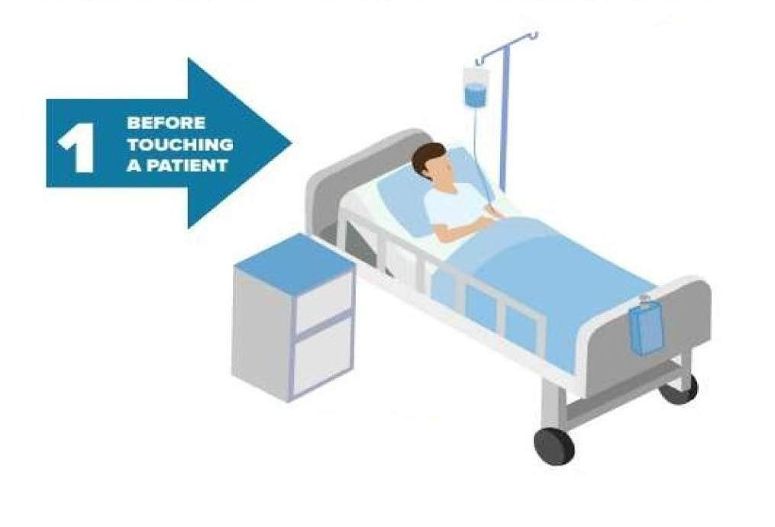
Before touching a patient (known as a Moment 1)
When:
Perform hand hygiene before touching a patient.
Why:
To protect the patient against acquiring infectious agents/germs from the hands of the healthcare worker.
Notes:
Definition of a patient
The patient refers to any part of the patient/client including:
the clothes they are wearing
any medical device (such as an indwelling urinary catheter, infusion pumps, infusion line, or enteral feeding equipment) connected to the patient/client.
For example:
Riley is social worker. Riley needs to clean his hands BEFORE he shakes hands with the patient.

Slide 23
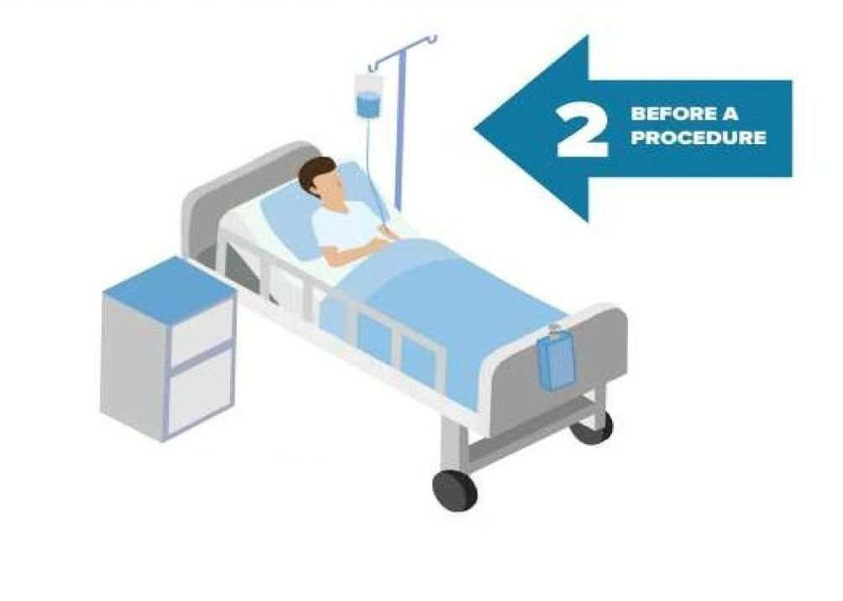
Before a procedure (known as a Moment 2)
When:
Perform hand hygiene immediately before a procedure.
Why:
To protect the patient against infectious agents/germs (including the patient’s own) entering the patient’s body during a procedure.
Notes:
Once hand hygiene has been performed, nothing else in the patient’s environment should be touched prior to starting the procedure.
Definition of procedure
Within the framework of the 5 Moments for Hand Hygiene, a procedure is defined as any invasive observation, treatment, or intervention where there is the potential for infectious agents to enter the patient’s body through broken skin, wound sites, blood, or mucous membranes.
Examples include wound dressings, surgical operations, injections, administering eye drops or taking a patient’s blood.
For example:
Maryanne is a nurse. She is about to change a wound dressing. She needs to clean her hands immediately BEFORE she puts on her gloves and begins cleaning the wound (the procedure).

Slide 24
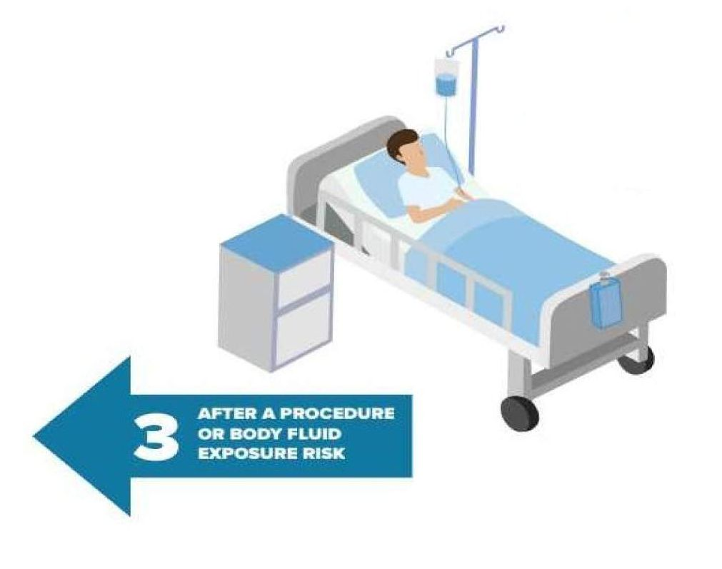
After a procedure or body fluid exposure risk (known as a Moment 3)
When:
Perform hand hygiene immediately after a procedure or body fluid exposure risk.
Why:
To protect healthcare worker and surroundings from becoming contaminated with infectious agents/germs.
Notes:
Definition of body fluid:
Body fluids include blood, saliva, mucous, semen, tears, ear wax, breast milk, colostrum, urine, faeces, vomitus, pleural fluid, cerebrospinal fluid, ascites fluid, organic body samples (such as biopsy samples, cell samples, lochia, meconium, pus, bone marrow, bile).
For example:
Ivy is a dentist working in private practice. She has just completed a dental examination of her patient. AFTER removing her gloves, she needs to wash her hands immediately AFTER this procedure.

Slide 25
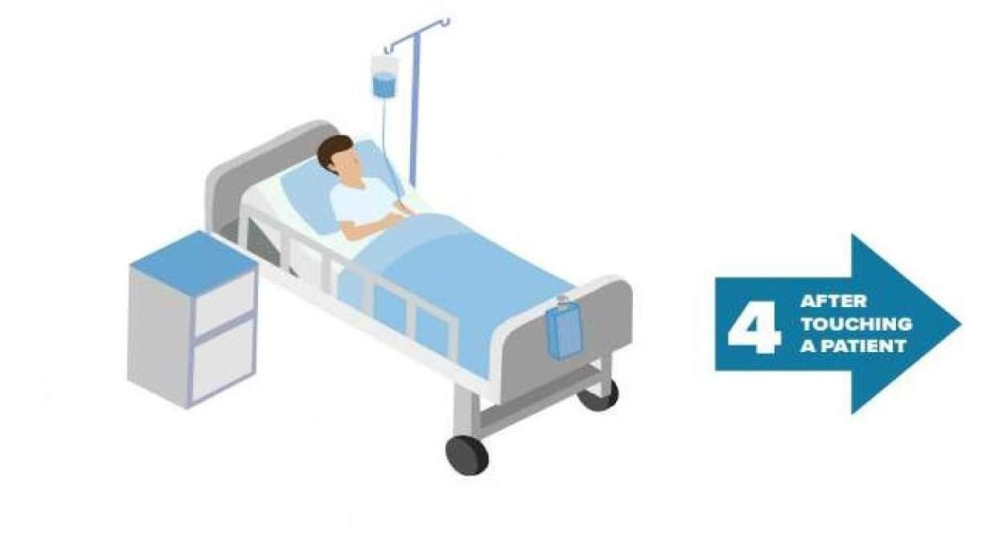
After touching a patient (known as a Moment 4)
When:
Perform hand hygiene after touching a patient.
Why:
To protect the healthcare worker and surroundings from becoming contaminated with infectious agents/germs.
Notes:
For example:
Julie is a General Practitioner. She has just finished a patient consultation. She needs to clean her hands AFTER the patient leaves her consulting room and before she sees her next patient.

Slide 26
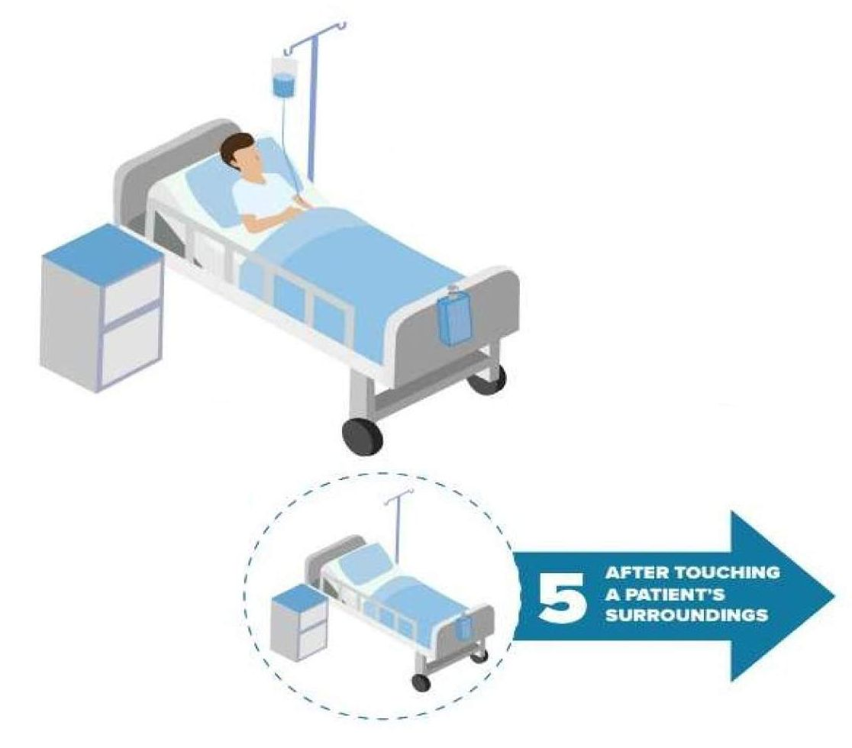
After touching a patient’s surroundings (known as a Moment 5)
  When:
Perform hand hygiene after leaving the patient zone if you have touched anything in the patient zone but not the patient.
  Why:
To protect the healthcare worker and the healthcare environment from becoming contaminated with infectious agents/germs.
Notes:
For example:
Eugenie is a dietitian at a hospital. While consulting the patient, she moves the over bed table closer to the patient so the patient can reach their food, without touching the patient. She needs to clean her hands AFTER exiting the patient zone.

Slide 27
Scenario 1
Lisa is a doctor. She is seeing several patients today. As she moves between each patient in a four-bedded room, she may touch curtains in the room.
When should Lisa perform hand hygiene?
After touching curtain
Before touching a patient
After touching a patient.

Slide 28
Scenario 2
Mike is a student nurse. He is assisting a patient with diarrhoea and vomiting to toilet.
When should Mike perform hand hygiene?
Before putting on gloves to assist the patient
After removing gloves.
How should Mike perform hand hygiene after removing gloves?
Wash his hands with soap and water.

Slide 29
Shared clinical equipment
Shared clinical equipment is equipment that:
Can be used on multiple patients
May be moved between patient zones and healthcare zones during patient care
Is exposed to multiple patients and can be a source of infection transmission.
Notes:
Examples are: observation machines, workstation on wheels, patient slides, commodes, and intravenous pumps

Slide 30
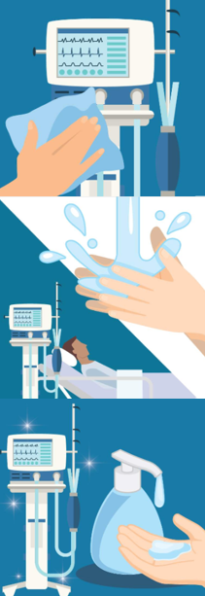
Cleaning of shared clinical equipment
To prevent contamination of shared clinical equipment, you should:
Clean the equipment between each patient and before storage
Perform hand hygiene before and after using the equipment on patient
Perform hand hygiene after cleaning the equipment.

Slide 31
When else is hand hygiene needed?
Hand hygiene should be done BEFORE :
Starting and leaving work
Eating or handling food or drinks
Using shared computers or mobile devices
Using gloves and other items of personal protective equipment.

Slide 32
When else is hand hygiene needed?
Hand hygiene should be done AFTER :
Going to the toilet
Blowing, wiping or touching your nose or mouth
Smoking
Removing gloves and other items of personal protective equipment
Contact with body fluid or items potentially contaminated with body fluid
Handling used linen, equipment or waste
Being in a healthcare environment where there is an outbreak of an infectious disease.

Slide 33
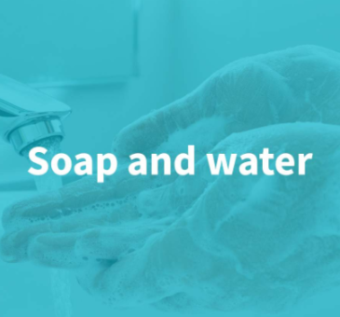
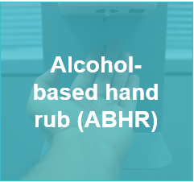
How to perform hand hygiene?
There are important steps to follow when performing hand hygiene using:

Slide 34
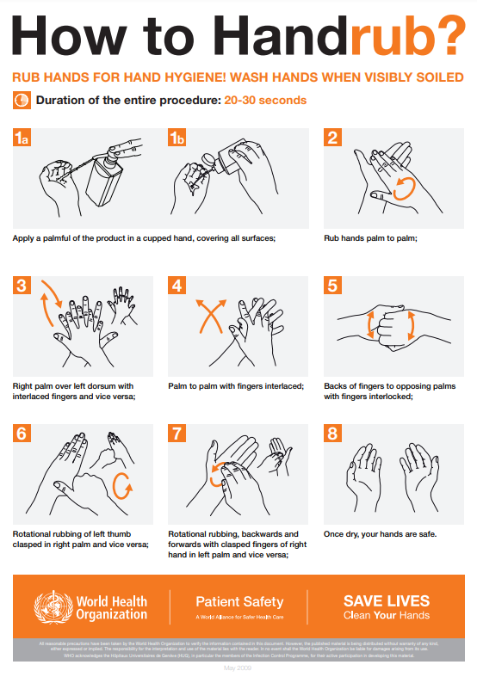
Using an ABHR (or hand sanitiser)
Apply an adequate amount of ABHR in the palm of your hands
Rub the ABHR over all surfaces of your hands including your fingers, finger tips, webs, thumbs and wrists
Allow your hands to dry.
Source: WHO How to handrub? Last update 4 May 2009
Notes:
You can include:
demonstration and practising hand hygiene using an ABHR
using fluorescent powder/gel and UV light for hand hygiene demonstrations and activities

Slide 35
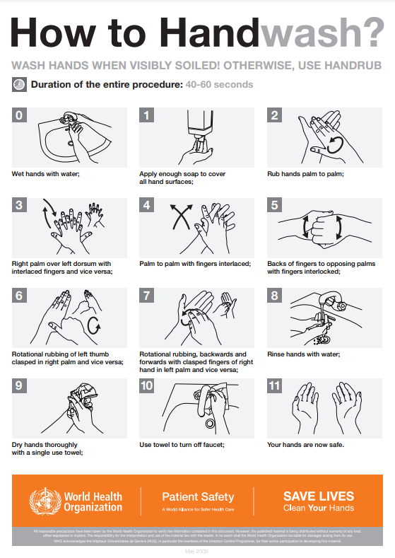
Using soap and water
Wet hands with clean, running water
Apply an adequate soap to hands
Lather soap over all surfaces of your hands including your fingers, webs, thumbs and wrists
Scrub your hands for at least 20 seconds
Rinse your hands well under clean, running water
Dry your hands using a clean single-use paper towel.
Source: WHO How to handwash? Last update 4 May 2009

Slide 36
Enhancing hand hygiene
Clothing, jewellery, and nail treatments can harbour infectious agents/germs that can be transferred to others, the healthcare environment and equipment.
The following practical actions you can take to improve hand hygiene practice and help to prevent the spread of infectious agents/germs in your workplace:
Keeping nails natural, short and clean
Being bare below the elbows (i.e. hands and forearms are free of jewellery and clothing).
Notes:
.

Slide 37
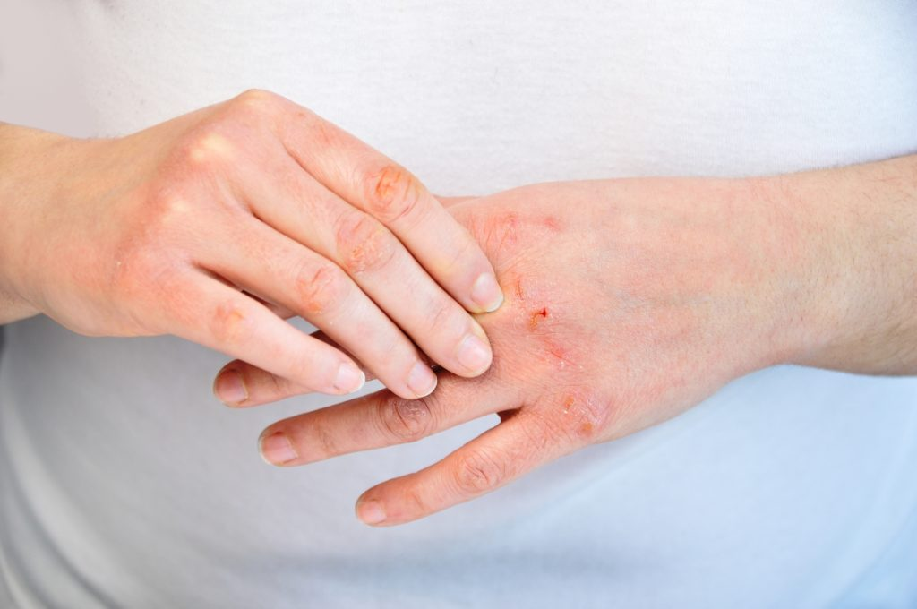
Skin on your hands
Intact skin is a natural defence against infection.
Dermatitis, cuts and abrasions are possible entry sites for infectious agents.
Dry, irritated and damaged hands carry more infectious agents and are a risk to yourself and your patients.

Slide 38
Look after your hands
Tips:
Avoid irritants on the skin, such as chemicals, heat, dirt and sweating/moisture
Dry your hands thoroughly after washing with soap and water
Moisturise your hands regularly
Protect irritated or damaged skin on your hands with a waterproof film or dressing
Report skin problems on your hands to management
Seek professional advise if you have irritated or damaged skin.

Slide 39
Monitoring hand hygiene in the healthcare environment
Monitoring hand hygiene helps to identify opportunities to:
Improve hand hygiene practice
Provide healthcare workers with positive feedback when correct hand hygiene is observed
Assist with monitoring the effects of hand hygiene practice on infection rates
Inform and reassure patients and the community of your organisation's safety culture.

Slide 40
How is hand hygiene monitored
Hand hygiene can be monitored through:
Direct observation of healthcare worker hand hygiene compliance (auditing) based on the 5 Moments for Hand Hygiene
Uptake of workforce hand hygiene education and training
Assessment of workforce hand hygiene technique and/or knowledge
Audits of product availability, placement and usage
Client or patient experience surveys.
Audit tools can be accessible through the Commission’s website.

Slide 41
How can hand hygiene compliance be improved?
Hand hygiene compliance audit and other hand hygiene program compliance data can be used to develop strategies and resources that meet the workforce’s specific needs.
This may include:
Increasing hand hygiene products accessibility
Providing targeted education sessions
Developing and reviewing hand hygiene education materials.
Notes:
Increasing hand hygiene products accessibility by providing hand hygiene products at the end of patient beds, on mobile equipment and in easy to reach locations to improve accessibility for healthcare workers and patients
Providing targeted education sessions for specific healthcare workers groups or departments
Developing new hand hygiene education materials and ongoing review existing hand hygiene education materials to ensure they reflect current workflows and practices.

Slide 42
How can you get involved?
You can:
Be a role model by promoting hand hygiene to patients, their carers and your colleagues
Get involved with hand hygiene and infection prevention and control activities in your organisation
Become a Hand Hygiene Auditor or Hand Hygiene Auditor Educator
Help promote local hand hygiene and infection prevention and control initiatives
Ensure your team meetings include agenda items for hand hygiene and infection prevention and control.
Notes:
.

Slide 43
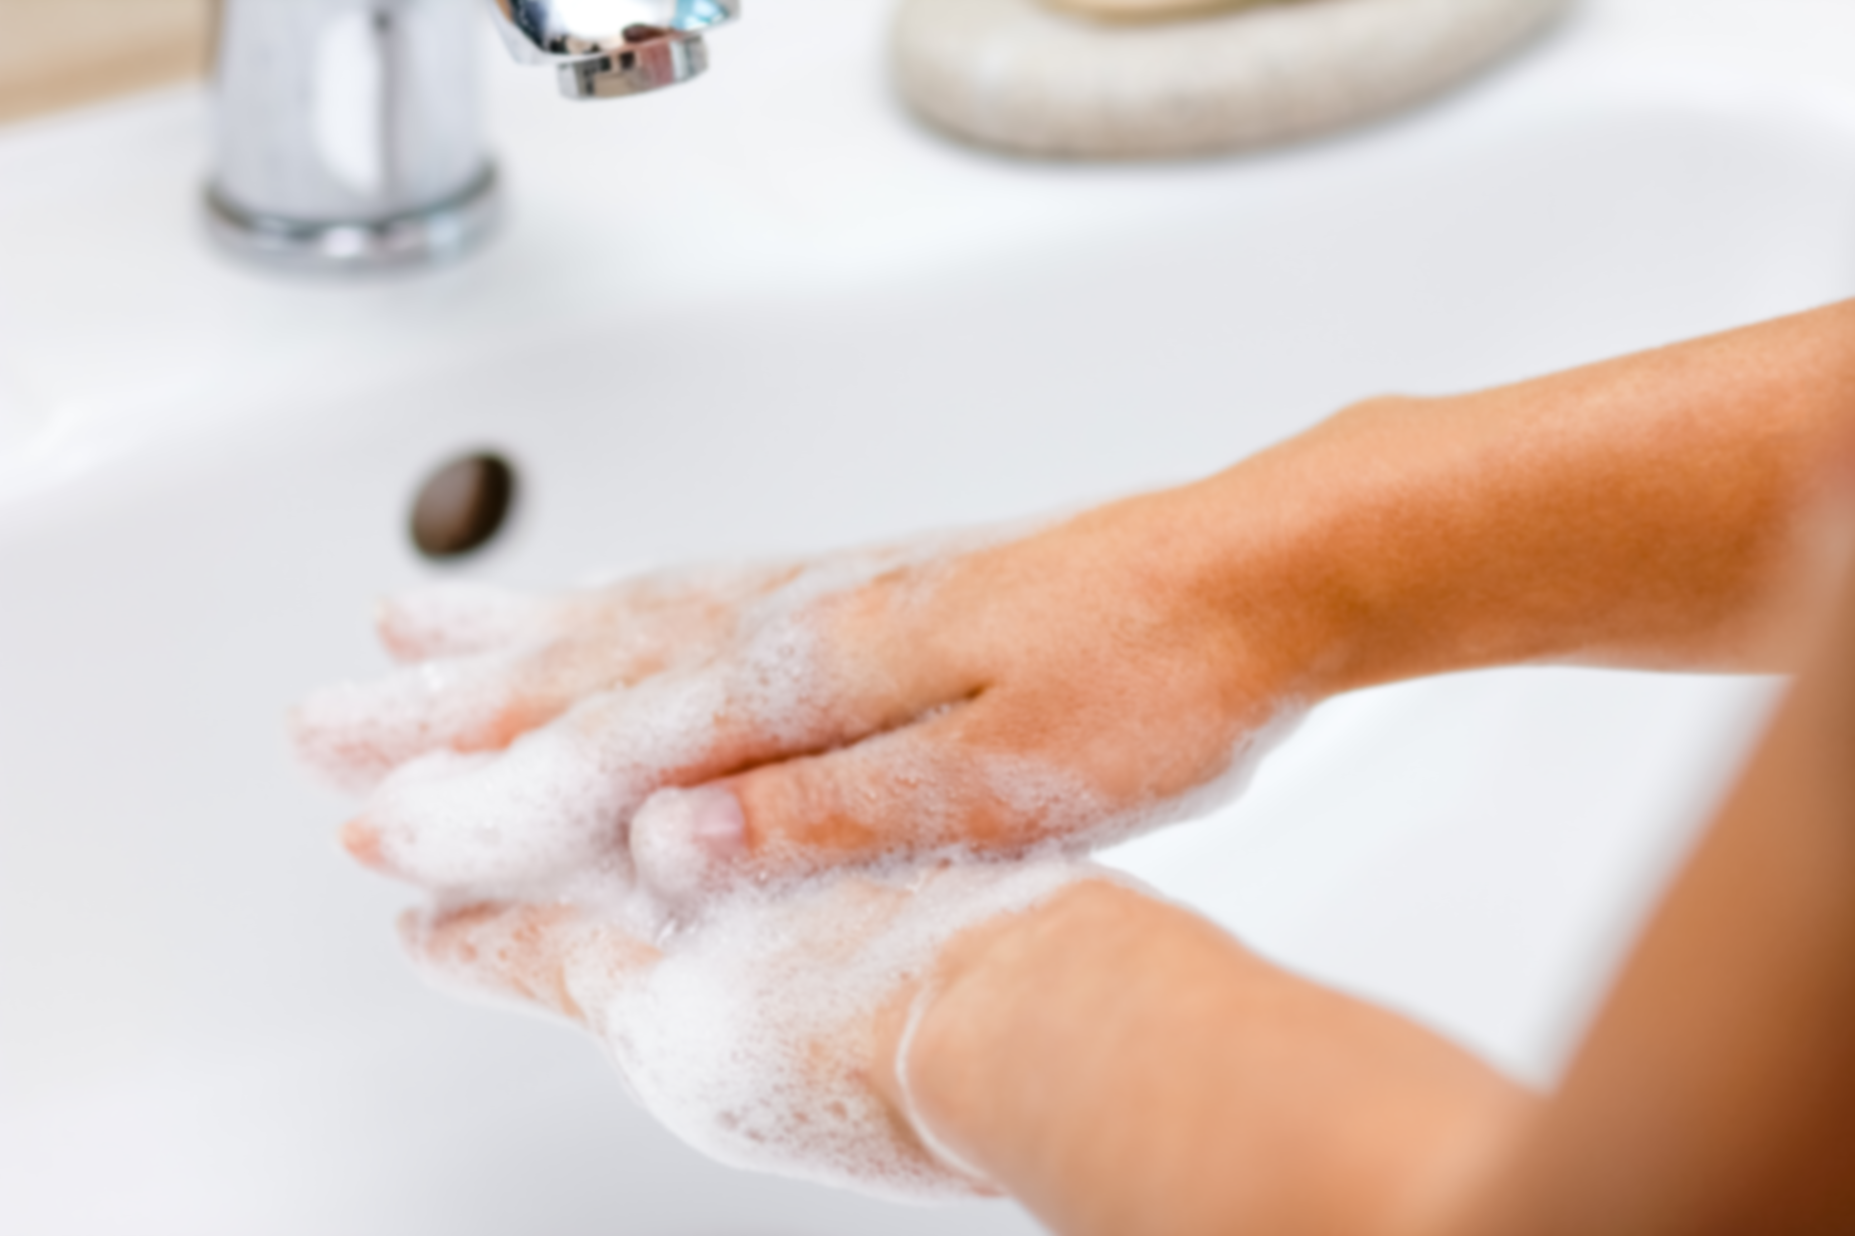
All healthcare workers have a role to play in ensuring patient and healthcare worker safety and a clean and safe healthcare environment
A fundamental part of this role is performing hand hygiene correctly, at the right time.

Slide 44

Questions?

Slide 45

National Hand Hygiene Initiative

