Slide 1
About this template
This template should be used for preparing local ‘Sip Til Send’ educational and promotional presentations for clinicians.
The template contains core information about the ‘Sip Til Send’ initiative and should be used in conjunction with the ‘Sip Til Send’ implementation guide.
As part of your local implementation process, the content should be validated and/or updated in line with local governance arrangements
The purple boxes contain additional instructions and should be deleted before presenting
Slides may also be rearranged and updated depending on the audience

Slide 2
‘Sip Til Send’ Implementation
safetyandquality.gov.au
What you need to know

Slide 3
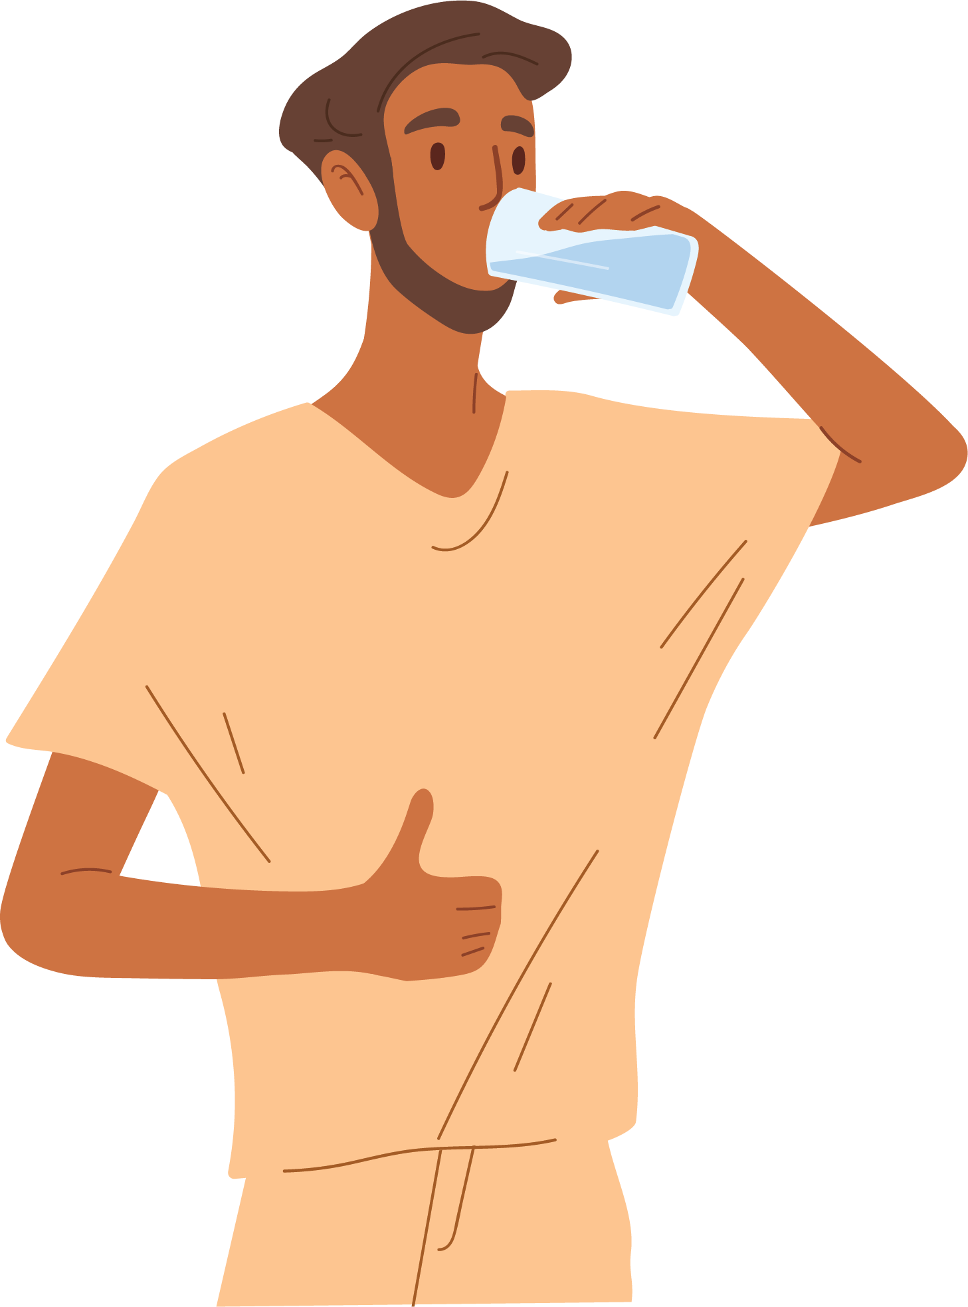
Improving pre-procedural fluid management
‘Sip Til Send’ is a global initiative, allowing patients, if thirsty, to consume small volumes of water (or similar clear liquids) while awaiting surgery, up until they are called to the operating theatre.
Allowing patients to sip clear liquids until transfer to the operating theatre can significantly reduce fluid fasting times and help:
maintain hydration
decrease light-headedness and anxiety
decrease the feelings of thirst – improving patient well-being
reduce the incidence of nausea and vomiting
reduce the subsequent need for intravenous (IV) fluids.
Notes:
‘Sip Til Send’ is simple, safe and kind - large observational studies have shown no increased risk of aspiration.

Slide 4
Purpose and rationale
Current guidelines: A pre-sedation or anaesthesia fluid fasting period of 2 hours for adults and 1 hour for children.
In practice:
  clinicians are uncertain when intake of clear fluids should stop due to the unpredictable nature of theatre schedules
  patients often continue to fluid fast for a median duration of up to 12 hours before anaesthesia.
‘Sip Til Send’ initiative: Decreases the ‘no oral liquid’ period, reducing the negative consequences of prolonged fasting and the need for IV fluid administration, where appropriate.

Slide 5
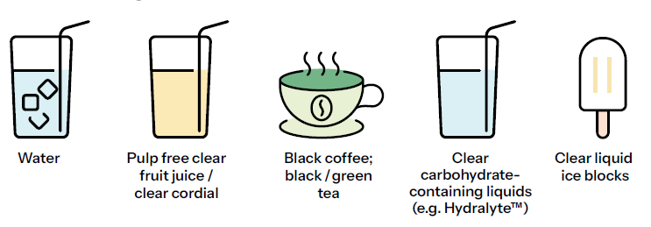
Acceptable clear liquids
Avoid fluids containing milk, particulate matter, soluble fibre or jelly.
For local Sip Til Send Implementation Leads - Action the below implementation consideration and update this slide if required. Delete this box before presenting.
Local Anaesthetic Department confirmation of acceptable clear liquids / liquids to be avoided is required, given variance in preferences and local availability.

Slide 6

Clear liquid volumes
If thirsty, patients can sip clear liquids until called to the operating theatre / procedure room
Children ≤ 16 years AND ≤ 65 kg: Up to 3 mL per kg per hour
Adults: Up to 200 mL per hour
Note: Some patients may have difficulty with self‑managing intake (for example, children). Consideration should be given to how clear liquid intake will be supervised and measured.
For local Sip Til Send Implementation leads - Action the below implementation consideration and update this slide if required. Delete this box before presenting.
There is variability in hourly volume recommendations across existing ‘Sip Til Send’ guidelines.
Confirmation of maximum hourly volumes is required by your Anaesthetic Department before implementation.

Slide 7

Exceptions and special considerations
‘Sip Til Send’ is not suitable or not recommended for patients that are:
Nil by mouth for medical or surgical reasons
Taking modified textured fluids
Using glucagon-like peptide-1 (GLP-1) receptor agonists which slow absorption of gastric contents.
Scenarios that require special consideration or variation include where patients:
Are on a fluid restriction for a reason other than fasting for anaesthesia or sedation
Require a modified liquid fasting plan (for example, undergoing sedation for a PET scan who may consume water)
Have been identified as at risk of aspiration.
Where the anaesthetist has communicated that a patient is not suitable for ‘Sip Til Send’,
the patient-specific fluid fasting plan is to be followed.
Notes:
Aspiration risk
Aspiration risk should be assessed on an individual basis. An increased risk of aspiration can exist in patients that:
Experience delayed gastric emptying which may be caused by pain, analgesic medicines, anxiety and emergency surgery, noting an increased susceptibility in children
Have impaired airway reflexes or are at risk of regurgitation
Require emergency surgery that renders them at increased risk of aspiration due to bowel obstruction, paralytic ileus or delayed gastric emptying due to their pathology, underlying medical conditions or medicines.

Slide 8
Frequently asked questions
What about solid food?
Patients may consume solid food until 6 hours before anaesthesia.
What about breast milk, formula, and non‑human milk?
Breast milk: Permitted until 3 hours before anaesthesia.
Infant formula or non‑human milk:
  Infants <12 months: Up to 4 hours before anaesthesia
  Children ≥12 months: Up to 6 hours before anaesthesia
What about medicines?
Regular medicines (for example, tablets, capsules and liquid medicines) may be taken during the fasting period.
Each medicine should be reviewed prior to procedural sedation or anaesthesia for appropriateness to continue/hold, depending on the nature of the procedure and patient-specific factors.

Slide 9
‘Sip Til Send’ at ___________________
For local Sip Til Send implementation leads
You can use this slide to add any local considerations or practice points for your health service organisation. Delete this box before presenting.

Slide 10
Questions

