Slide 1
Past, Present, Prepared for the future
safetyandquality.gov.au
Embedding best practice infection prevention and control into everyday practice

Slide 2

Acknowledgement of Country
The Australian Commission on Safety and Quality in Health Care pay respect to the Gadigal people as the Traditional Custodians of Country where the Commission's office is located. We extend that respect to all Aboriginal and Torres Strait Islander peoples, and their deep time connections to land, water and sky.
We recognise that knowledge about healthy Country, community and culture has been developed by Aboriginal and Torres Strait Islander peoples over tens of thousands of years and has been shared for generations. We are committed to partnering with and learning from Aboriginal and Torres Strait Islander peoples through the work that we do.

Slide 3
Instructions for use
This presentation is a framework for building a local infection prevention and control (IPC) presentation on the key elements and ongoing importance of IPC. You can adapt the information in this presentation to make it relevant to your staff and health service organisation.
This presentation includes information on key topic areas aligned with this year’s IPC Week theme: Past, Present, Prepared for the future.

Slide 4
Learning objectives
Understand the progression of infection prevention and control (IPC) practices over time
Know how to embed infection prevention and control best practice into your day
Understand standard precautions
Know how to include risk assessment into your practice
Understand why surveillance of infections is important
Awareness of the system wide approaches that support best practice IPC

Slide 5
Brief History of IPC
Early to mid 1800s
Understanding that hand hygiene, ventilation, and the environment can prevent infections
Mid to late 1800s
Link between specific microorganisms and specific diseases
Rubber gloves for infection prevention introduced
Early to mid 1900s
Barrier nursing, isolation practices and use of masks in hospitals
Penicillin is discovered
Mid to late 1900s
Formal infection control programs in hospitals
Introduction of universal precautions then
Standard precautions
2000s
Introduction of alcohol-based hand rub
National Hand Hygiene Initiative established in Australia (2008)
First edition of the Australian Guidelines for Prevention and Control in Healthcare (2010)
IPC Week 2026 – Past, Present, Prepared for the future

Slide 6
Everyone is responsible
Patients and visitors | Healthcare workers | Health service organisation
Stay up to date with vaccinations Monitoring and early presentation of symptoms Perform hand hygiene Follow instructions about isolation and transmission-based infection precautions Practice respiratory etiquette Avoid visiting when unwell unless seeking treatment | Perform hand hygiene Follow standard and transmission-based precautions Ensure the environment and equipment is safe and clean Maintain aseptic technique during procedures Stay up to date with vaccinations Keep up to date with training Educate patients, families and colleagues on infection prevention practices | Have policies, protocols and procedures which support the application of standard and transmission-based precautions and workforce safety Strong leadership and governance frameworks which support infection control best practice Provide education for healthcare workers, patients and visitors on infection prevention practices Encourage and support healthcare workers to stay up-to-date with mandatory and seasonal vaccinations
Notes:
Patients, visitors, healthcare workers and healthcare organisations all play an important role in reducing the spread of infections and keeping healthcare environments safe.

Slide 7
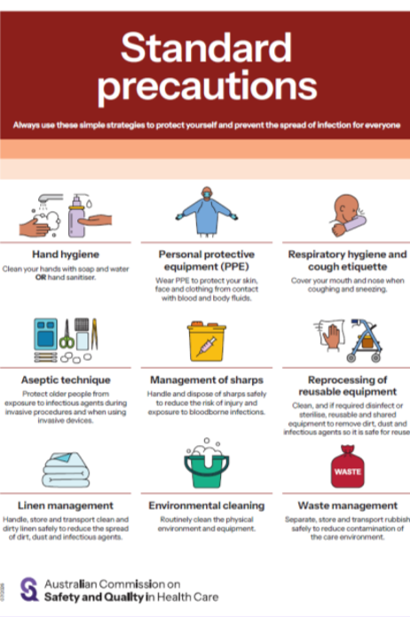
Standard precautions for every patient
Standard precautions are the primary strategy for reducing the spread of infections in health care settings
Standard precautions include:
hand hygiene
the use of appropriate personal protective equipment
respiratory hygiene and cough etiquette
aseptic technique
the safe use and disposal of sharps
reprocessing of reusable medical equipment and instruments
appropriate handling of linen
routine environmental cleaning
waste management

Slide 8
Risk assess every time
Risk assessment is an ongoing process. Infection prevention and control risk assessment considers the source of infection, route of transmission and other factors that influence the likelihood and impact of exposure.
IPC risk assessment includes:
Risk identification
Assessment
Application of the hierarchies of controls
Documentation and communication
Ongoing monitoring and assessment of the risk
Escalation as required

Slide 9
Surveillance and monitoring into the future
Monitoring infections that patients can get while receiving healthcare (known as healthcare-associated infections or HAIs) is an important way to improve patient safety.
HAI surveillance in Australia includes:
National monitoring | State/Territory determined
Staphylococcus aureus bloodstream infections (SABSI) | Central line-associated bloodstream infection (CLABSI) Clostridioides difficile infection Multi-drug resistant organisms Peripheral intravenous catheter (PIVC) infection

Slide 10
System wide approach
A system wide approach addresses the complex interactions and interdependencies of various IPC elements in the healthcare system. These approaches help to identify and mitigate risks, improve quality and efficiency and enhance patient outcomes.
Examples of system wide approaches:
National Safety and Quality Health Service Standards
The Aged Care Infection Prevention and Control Guide
Public health – notifiable disease surveillance and prevention of health threats
National Model for Clinical Governance
Australian Guidelines for the Prevention and Control of Infection in Healthcare

Slide 11
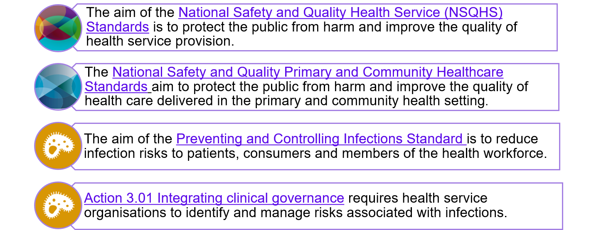
National Safety and Quality Health Standards
Notes:
The National Safety and Quality Health Service Standards and the National Safety and Quality Primary and Community Care Standards apply to acute and primary care health settings, there are also other standards for specific setting such as Cosmetic Surgery Standards, Pathology Standards and Mental Health Standards for Community Managed Organisations.

Slide 12
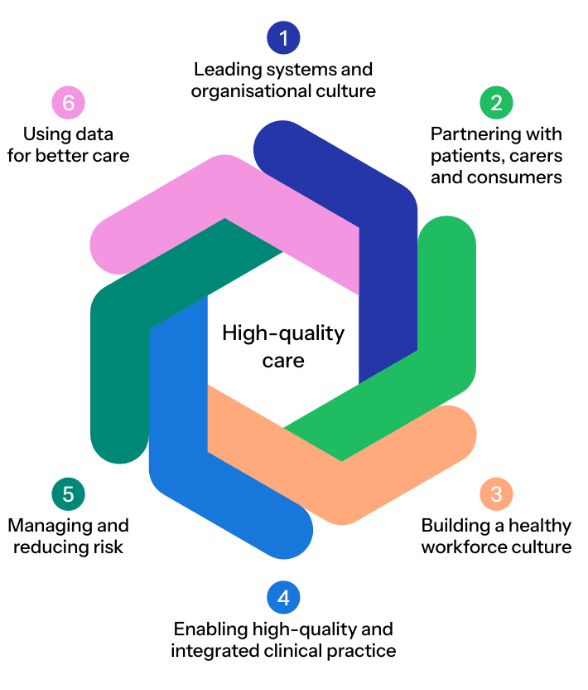
National Model for Clinical Governance
Effective clinical governance unites everyone in a health service organisation to deliver high-quality care every day. Clinical governance supports infection prevention and control best practice through:
Responsible and action focused leaders
Engaging with patients, carers and consumers to implement infection control activities
Building and maintaining a workforce who embeds IPC into everyday practice
Effective evidence-based systems
Managing and reducing IPC risks
Using infection surveillance data to inform quality improvement initiatives and improve patient care

Slide 13
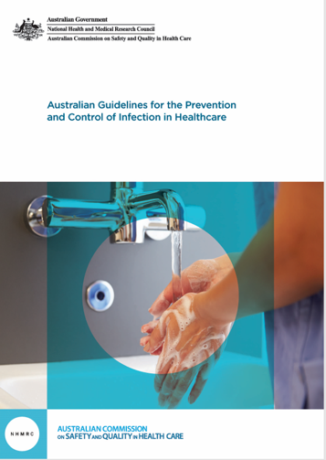
Australian Guidelines for the Prevention and Control of Healthcare
The Australian Guidelines for the Prevention and Control of Infection in Healthcare provide evidence-based recommendations to prevent and manage infections across all healthcare settings, supporting safe patient care and workplace safety.
Health service organisations use the guidelines to develop tailored local protocols based on risk assessment and specific circumstances.

Slide 14
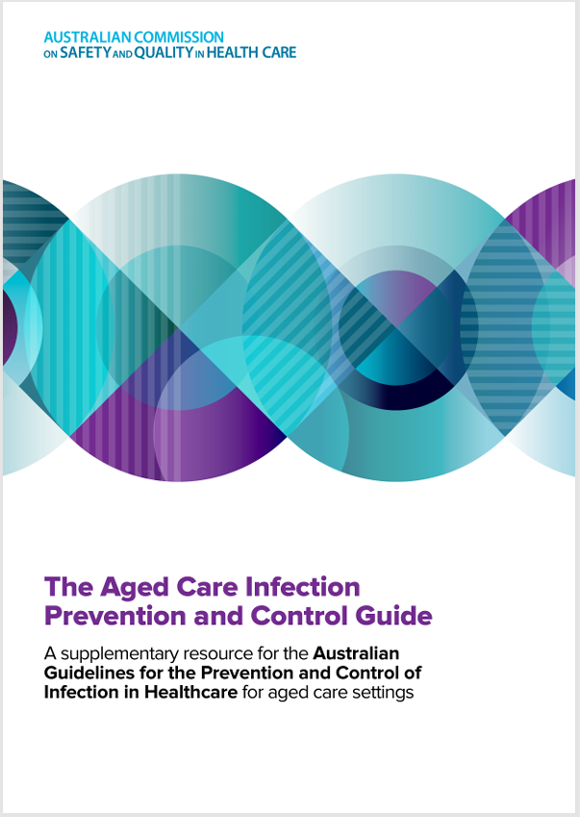
The Aged Care Infection Prevention and Control Guide
The Aged Care Infection Prevention and Control Guide supports implementation of the strengthened Aged Care Quality Standards and supplements the Australian Guidelines for the Prevention and Control of Infection in Healthcare for the aged care workforce and those providing care for older people. The Guide outlines the basic principles of infection prevention and control and explains how to apply these principles using a risk-based approach.

Slide 15
Public health – surveillance and prevention
Provision of surveillance and national guidance on the management of notifiable diseases
Preparedness and response to health emergencies, disease outbreaks and pandemics
Work across government to make the Australian health system resilient and responsive to climate change
Manage environmental health including water quality, toxins and contaminants, occupational exposures
Public health systems work alongside and support infection prevention and control through:

Slide 16
Standard Precautions – local implementation
Use this slide to identify how standard precautions are embedded into everyday healthcare in your hospital e.g. signage, personal protective equipment, policies and protocols, hand hygiene

Slide 17
Risk assessment – local implementation
Use this slide to identify how risk management is embedded into infection prevention and control practice in your health service organisation e.g. risk management frameworks, equipment risk assessments, environmental cleaning risk management protocols

Slide 18
Infection surveillance – local implementation
Use this slide to identify the local surveillance and monitoring of healthcare-associated infections that occur in your health service organisation and how these are reported and communicated to leadership, patients and consumers to improve patient safety.

Slide 19
Key IPC resources
Australian Guidelines for the Prevention and Control of Infection in Healthcare
Aged Care Infection Prevention and Control Guide
National Safety and Quality Health Service NSQHS Standards
National Safety and Quality Primary and Community Healthcare Standards
Preventing and Controlling Infections Standard
Antimicrobial stewardship (AMS)
Infection prevention and control
National Hand Hygiene Initiative (NHHI)
Management of peripheral intravenous catheters clinical care standard
Hierarchy of controls
National Antimicrobial Resistance Surveillance: APAS and CARAlert
Antimicrobial Use and Resistance in Australia (AURA)
Australasian Health Facility Guidelines: Part D
Notes:
IDEAS TO ADAPT FOR LOCAL USE:
Add other local resources that are important to your local organisation

Slide 20
Questions

Slide 21
T. +61 2 9126 3600
Level 5, 255 Elizabeth St
Sydney NSW 2000 Australia
safetyandquality.gov.au
© Australian Commission on Safety and Quality in Health Care 2026

