Slide 1
Acute Stroke Clinical Care Standard
An introduction for clinicians and health services

Slide 2
Outline
What Clinical Care Standards are
Why we need the Acute Stroke Clinical Care Standard
What the Acute Stroke Clinical Care Standard is about
Your role in implementing the Clinical Care Standard

Slide 3
What is a Clinical Care Standard?
Clinical Care Standards
identify and define the care that people should expect to be offered or receive, regardless of where they are treated in Australia
play an important role in delivering appropriate care and reducing unwarranted variation
are developed using up-to-date clinical guidelines and standards, information about gaps between evidence and practice, the professional expertise of clinicians and researchers, and consideration of issues important to consumers.

Slide 4
Clinical Care Standards
Clinical care standards include
a small number (six to nine) of concise recommendations - the quality statements.
a set of suggested indicators to facilitate monitoring.
The Commission established the Clinical Care Standards program to support the development of clinical care standards by clinical experts and consumers for clinical conditions that would benefit from a coordinated approach.

Slide 5
Why do we need an Acute Stroke Clinical Care Standard?
There is variation in
systems pivotal for access to intravenous thrombolysis
60% of hospitals report organised pre-hospital services¹
hospitalisation rates, which are
1.4 times higher in remote areas compared to major cities
1.3 times higher for the lowest socioeconomic group compared to the highest
twice as high for Aboriginal and Torres Strait Islander peoples compared to non-indigenous.
National Stroke Foundation. National Stroke Audit - Acute Services Report 2015. Melbourne: NSF, 2015
Australian Institute of Health and Welfare. Stroke and its management in Australia: an update. Canberra: AIHW, 2013
Notes:
Presenter’s notes
Despite well-developed guidelines for managing stroke not all people receive appropriate treatment.
In 2010¹,
Aboriginal and Torres Strait Islander people had twice the rate of hospitalisations, and were 1.6 times more likely to die from stroke than non-Indigenous Australians
People in remote and very remote areas had 1.4 times the hospitalisation rates compared to major cities
People from the lowest socioeconomic group had 1.3 times the rate of stroke hospitalisation of people from the highest socioeconomic group.
References
Australian Institute of Health and Welfare. Stroke and its management in Australia: an update. Cardiovascular Disease Series no 37,Cat no CVD 61. Canberra: AIHW, 2013.

Slide 6
Why do we need an Acute Stroke Clinical Care Standard?
2011
2015
2011
2015
2011
2015
2011
2015
National Stroke Foundation. National Stroke Audit - Acute Services Report 2015.
Notes:
Presenter’s Notes
Outcomes for stroke have improved in recent years but variation exists.
Of patients with stroke in the 2015 National Stroke clinical audit:¹
67% were admitted to a stroke unit
8% of those with ischaemic stroke received intravenous thrombolysis (N.B 7% without incorporating exclusions – this figure is shown as it allows comparison with previous audits)
of those who received thrombolysis, 78% had it within 4.5 hours of stroke onset
68% were assessed for rehabilitation needs by a physiotherapist with 24 to 48 hours of hospital admission
56% received a written care plan before leaving hospital.
Other findings
59% of patients with stroke whose carers received a formal needs assessment
48% of patients with stroke who required assistance with activities of daily living, whose carers received training before the patient was discharged.
66% were transported to a hospital able to provide thrombolysis.

Slide 7
What is the Acute Stroke Clinical Care Standard trying to achieve?
Aim
To ensure that a patient with stroke receives optimal treatment during the acute phase of management.
Scope
Covers recognition of stroke, rapid assessment, early management and early initiation of an individualised rehabilitation plan.
Goal
To improve the early assessment and management of patients with stroke in order to increase their chance of surviving the stroke, to maximise their recovery and to reduce their risk of another stroke.

Slide 8
Improving outcomes in the acute care of stroke
Mortality
Morbidity & disability
Risk of another stroke
Early assessment
Time-critical therapy
Stroke unit care
Early rehabilitation
Minimising the risk of another stroke
Carer training and support
Transition from hospital care
Notes:
Presenter’s notes
Hospitalisation and mortality rates for stroke have declined over the past two to three decades, due in part to better risk factor control and improvements in stroke care.(1) However, there are further gains to be had in the acute care of stroke – from early recognition of stroke signs through to transition from hospital care to ongoing care in the community.
Achieving more consistent care in the areas defined in the 7 quality statements has the potential to:
reduce mortality and disability (2-5)
reduce the risk of another stroke (6-10).
This care includes early recognition and immediate assessment of patients with suspected stroke, timely administration of intravenous thrombolysis in ischaemic stroke - where clinically appropriate, and stroke unit care. It also covers early assessment for, and commencement of, rehabilitation, as soon as a patient’s condition allows; treatment and education to reduce risk of future strokes, training and support for carers, and an individualised care plan to support the ongoing care of patients after they leave hospital.
The Clinical Care Standard recognises that people who have had a stroke are at high risk of a recurrence. There is still considerable opportunity to reduce the likelihood of another stroke. While much of the preventive work will happen in the community, it is important that while a patient is in hospital, treatment and education is commenced and appropriate referral is made. This will help to maximise patient rehabilitation, lifestyle modification and adherence to the guideline recommended treatments – all of which will help prevent further morbidity and early mortality.(6-10)
References
Australian Institute of Health and Welfare. Stroke and its management in Australia: an update. Cardiovascular Disease Series no 37,Cat no CVD 61. Canberra: AIHW, 2013.
Emberson J, Lees KR, Lyden P, et al. Effect of treatment delay, age, and stroke severity on the effects of intravenous thrombolysis with alteplase for acute ischaemic stroke: a meta-analysis of individual patient data from randomised trials. Lancet. 2014.
Expert Working Group of the Commission on Human Medicines: Medicines and Healthcare Products Regulatory Agency (UK). Alteplase for treatment of acute ischaemic stroke: independent review. 2015.
Wardlaw JM, Murray V, Berge E, et al. Recombinant tissue plasminogen activator for acute ischaemic stroke: an updated systematic review and meta-analysis. Lancet. 2012; 379: 2364-72.
Stroke Unit Trialists’ Collaboration. Organised inpatient (stroke unit) care for stroke (Review). Cochrane Database of Systematic Reviews, 2013: Issue 9.
Lakhan SE and Sapko MT. Blood pressure lowering treatment for preventing stroke recurrence: a systematic review and meta-analysis. Int Arch Med. 2009; 2: 30.
Manktelow BN and Potter JF. Interventions in the Management of Serum Lipids for Preventing Stroke Recurrence. Stroke. 2009; 40: e622-3.
Algra A and van Gijn J. Cumulative meta-analysis of aspirin efficacy after cerebral ischaemia of arterial origin. Journal of Neurology, Neurosurgery & Psychiatry. 1999; 66: 255.
Secondary prevention in non-rheumatic atrial fibrillation after transient ischaemic attack or minor stroke. EAFT (European Atrial Fibrillation Trial) Study Group. Lancet. 1993; 342: 1255-62.
Ntaios G, Papavasileiou V, Diener H-C, Makaritsis K and Michel P. Nonvitamin-K-Antagonist Oral Anticoagulants in Patients With Atrial Fibrillation and Previous Stroke or Transient Ischemic Attack: A Systematic Review and Meta-Analysis of Randomized Controlled Trials. Stroke. 2012; 43: 3298-304.

Slide 9
What can be achieved?
PAST protocol, Hunter Region, NSW¹
four-fold increase in thrombolysis rate for ischaemic stroke: 21% post-intervention versus ~5% pre-intervention p<0.001
standardised assessment tool, hospital bypass protocol and pre-notification system.
Alteplase ≤ 3 hours for ischaemic stroke²
75% greater odds of disability-free survival (odds ratio [OR] 1.75, 95% confidence interval [CI] 1.35-2.27)
10% more patients disability-free with rt-PA compared with no rt-PA.
13% reduced odds of death or dependency (OR 0.87, 95% CI 0.69 to 0.94)
22% reduced odds of death or institutionalised care (OR 0.78, 95% CI 0.68 to 0.89)
Stroke unit care³
Quain DA et al Med J Aust 2008;189:429-433
Emberson J et al. Lancet. 2014. Epub 2014/08/12.
Stroke Unit Trialists’ Collaboration. Organised inpatient (stroke unit) care for stroke. Cochrane review, 2013
Notes:
Presenter’s notes
PAST protocol, Hunter Region, NSW ^{1,}
John Hunter Hospital, principal tertiary referral hospital for Hunter region, with stroke unit.
Evaluation period:
September 2005-March 2006 (pre-intervention), 205 patients presented to ED with initial diagnosis of stroke
September 2006-March 2007 (post-intervention), 232 patients presented to ED with initial diagnosis of stroke
Key features:
Pre-hospital assessment tool for ambulance officers. GAS-T tool: G = glucose in the normal range (4-17 mmol/L); A = arm drift, grip strength; S= speech disturbance; and T=time since symptom onset.
Pre-notification system, using SMS messaging used to notify on-call neurologist when a patient met the GAS-T criteria
Ambulance hospital bypass protocol for thrombolysis-eligible patients outside primary catchment of the tertiary hospital
On-call neurologist approval for bypass of regional hospitals
Rapid deployment of acute stroke team to the Emergency Department to meet the ambulance.
After-hours training for ambulance officers by members of acute stroke team.
Incorporation of stroke and GAS-T tool into in-service sessions led by ambulance educators
Pocket cards outlining GAS-T tool distributed to all ambulance officers
Reperfusion Treatment: rt-PA²
Key points:
Intravenous rt-PA (alteplase) within 3 hours of stroke onset improves the odds of disability-free survival by 75% (odds ratio [OR] 1.75, 95% confidence interval [CI] 1.35-2.27). ²
There is also a benefit from rt-PA within 3 to 4.5 hours: rt-PA within 3 to 4.5 hours following stroke onset improves the odds of disability-free survival by 26% (OR 1.26, 95% CI 1.05-1.51) .²
Intravenous rt-PA increases the odds of fatal intracranial haemorrhage during the first 7 days of treatment (OR = 7.14, 95% CI 3.98 to 12.79) , but after the first 7 days, mortality rates are similar for thrombolysis-treated patients versus non-treated patients:²
In absolute terms, for every 100 people treated with rt-PA within 3 hours, there are:
2 more deaths in the first 7 days
10 more survivors disability-free after 3 to 6 months
no difference in deaths at 3 to 6 months.
Stroke unit care³
Key points:
Compared with care on an alternative acute management ward, stroke unit care results in:
13% reduced odds of death or dependency [OR 0.87, 95% CI 0.69 to 0.94]
22% reduced odds of death or institutionalised care [OR 0.78, 95% CI 0.68 to 0.89]
21% reduced odds of death or dependency [OR 0.79, 95% CI 0.68 to 0.90]
References
Quain DA et al. Improving access to acute stroke therapies: a controlled trial of organised pre-hospital and emergency care. Med J Australia. 2008;189(8):429-33.
Emberson J et al. Effect of treatment delay, age, and stroke severity on the effects of intravenous thrombolysis with alteplase for acute ischaemic stroke: a meta-analysis of individual patient data from randomised trials. Lancet. 2014. Epub 2014/08/12.
Stroke Unit Trialists’ Collaboration. Organised inpatient (stroke unit) care for stroke (Review). Cochrane Database of Systematic Reviews; 2013: Issue 9 [cited August 2014]

Slide 10
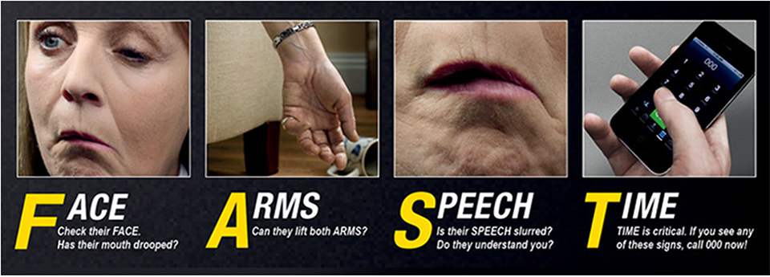
Quality Statement 1 Early assessment
What should we do?
A person with suspected stroke is immediately assessed at first contact using a validated stroke screening tool, such as the F.A.S.T. (Face, Arm, Speech and Time) test.
Notes:
Presenter’s notes
Presently, there is no single recommended screening tool for stroke, but a simple screening tool, such as the F.A.S.T. test may be the most useful. This is because the F.A.S.T. test is validated for use by ambulance services and is also used in community awareness campaigns. ¹
1. Harbison J, Hossain O, Jenkinson D, Davis J, Louw SJ and Ford GA. Diagnostic Accuracy of Stroke Referrals From Primary Care, Emergency Room Physicians, and Ambulance Staff Using the Face Arm Speech Test. Stroke. 2003; 34: 71-6.

Slide 11
Quality Statement 1 Early assessment
Why does it matter?
‘Time is brain’ – delays in diagnosis and treatment matter
Care provided in the first 24 to 48 hours after stroke onset is crucial for improving patient outcomes.¹
Immediate assessment and efficient transfer to a suitable hospital facilitates time-critical therapies.²
e.g. intravenous thrombolysis for ischaemic stroke can only be given within 4.5 hours of stroke onset.
Australian Stroke Coalition.48 hours: Improving stroke management in the critical window. NSF, 2014
National Stroke Foundation. Clinical Guidelines for Stroke Management. Melbourne: NSF; 2010
Notes:
Presenter’s notes
A large proportion of patients cannot be considered for thrombolysis because they do not present to a thrombolysis-capable hospital in time. Educating first contact providers and consumers about the importance of rapid assessment could increase the number of people eligible for thrombolysis and other time-critical therapies.

Slide 12
What can be achieved?
East Melbourne ¹
Melbourne Ambulance Stroke Screen (MASS)
Newcastle, NSW ²
Stroke screening tool and protocol
Training and education of ambulance officers
Training for ambulance services
Pre-notification system and bypass protocol
Increased diagnostic accuracy from 78% to 94%
Reduced median time from symptom onset to ED arrival by 60 minutes
Increased rates of thrombolysis 4.7% to 21.4%
Bray JE, et al, Prehospital Emergency Care. 2005; 9: 297-302
Quain DA, et al, Med J Australia. 2008; 189: 429-33
Notes:
Presenter’s notes
Training of ambulance officers in the use of stroke screening tools can improve diagnostic accuracy.¹ Also, training in screening tools combined with pre-notification systems from ambulance services to emergency departments may improve the proportion of patients who receive thrombolysis. ²
In a study in east Melbourne, education and training in the use of a stroke screening tool (the Melbourne Ambulance Stroke Screen) improved the diagnostic accuracy of stroke by ambulance officers from 78% (pre-intervention) to 94% (post-intervention). In a control group, diagnostic accuracy remained similar (per 78%; post 80%). ¹
In a study in Newcastle, training in the use of a stroke screening tool and implementation of a pre-notification system resulted in reduced time from symptom onset to hospital admission.
Symptom onset to ED arrival decreased from 150 to 90.5 minutes and
ED arrival to stroke unit admission decreased from 361 to 232.5 minutes
increase in the thrombolysis rate of patients with ischaemic stroke; from 4.7% (pre-intervention) to 21.4% (post-intervention). ²
References
Bray JE, Martin J, Cooper G, Barger B, Bernard S and Bladin C. An Interventional Study to Improve Paramedic Diagnosis of Stroke. Prehospital Emergency Care. 2005; 9: 297-302
Quain DA, Parsons MW, Loudfoot AR, et al. Improving access to acute stroke therapies: a controlled trial of organised pre-hospital and emergency care. Med J Australia. 2008; 189: 429-33

Slide 13
Quality Statement 1 Early assessment
What the quality statement means for
Clinicians: assess all people with suspected stroke using a validated screening tool to guide diagnosis of stroke.*
Health managers: ensure that a validated screening tool is available in pre-hospital and hospital settings to guide the diagnosis of people with stroke, and that it is used by clinicians.
* Validated stroke screening tools for consideration:
i. Face, Arm, Speech and Time (F.A.S.T.) test
ii. the Recognition of Stroke in the Emergency Room (ROSIER) Scale
iii. the Melbourne Ambulance Stroke Screen (MASS).

Slide 14
Quality Statement 2 Time-critical therapy
What should we do?
A patient with ischaemic stroke for whom reperfusion treatment is clinically appropriate, and after brain imaging excludes haemorrhage, is offered a reperfusion treatment in accordance with the settings and time frames recommended in the Clinical guidelines for stroke management.¹
National Stroke Foundation. Clinical Guidelines for Stroke Management. Melbourne: NSF; 2010

Slide 15
Quality Statement 2 Time-critical therapy
Why does it matter?
80% of strokes are ischaemic
Treatment is time-critical
Intravenous rt-PA
within 3 hours of stroke onset increases odds of disability-free survival by 75% (OR 1.75, 95% CI 1.35-2.27)
within 3 to 4.5 hours of stroke onset increases odds of disability-free survival by 26% (OR 1.26, 95% CI 1.05-1.51)
Emberson J. Lancet. 2014. Epub 2014/08/12.
Notes:
Presenter’s notes
80% of strokes are ischaemic
8% of patients with ischaemic stroke receive intravenous thrombolysis (rt-PA).¹
The efficacy of thrombolysis with intravenous rt-PA (alteplase) is time-critical
Thrombolysis with intravenous rt-PA (alteplase):
within 3 hours of stroke onset improves the odds of disability-free survival by 75% (odds ratio [OR] 1.75, 95% confidence interval [CI] 1.35-2.27). ²
within 3 to 4.5 hours following stroke onset improves the odds of disability-free survival by 26% (OR 1.26, 95% CI 1.05-1.51) .²
However there is an increased risk of intracranial haemorrhage so consideration of the risk-benefit profile is important (see later slide).
References
National Stroke Foundation. National Stroke Audit - Acute Services Report 2015. Melbourne: NSF, 2015
Emberson J et al. Effect of treatment delay, age, and stroke severity on the effects of intravenous thrombolysis with alteplase for acute ischaemic stroke: a meta-analysis of individual patient data from randomised trials. Lancet. 2014. Epub 2014/08/12.

Slide 16
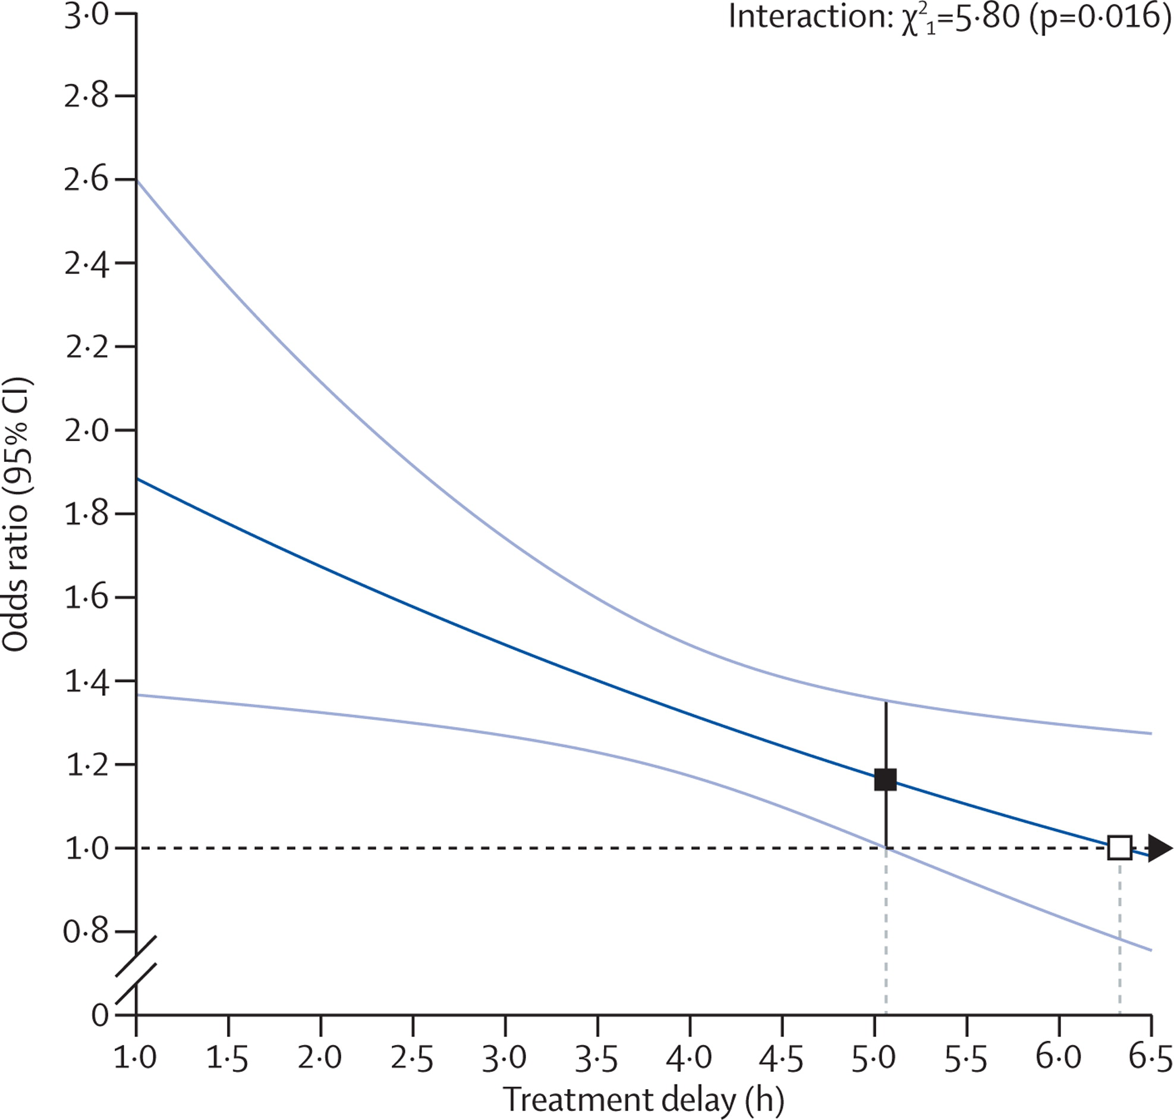
Figure 1
Effect of timing of alteplase (rt-PA) treatment on good stroke outcome (mRS 0–1)
Stroke outcome mRS 0–1 at 3-6 months
Delay in rt-PA treatment
The Lancet 2014 384, 1929-1935DOI: (10.1016/S0140-6736(14)60584-5)
Copyright © 2014 Emberson et al. Open Access article distributed under the terms of CC BY Terms and Conditions
Notes:
Effect of timing of alteplase treatment on good stroke outcome (mRS 0–1)
The solid line is the best linear fit between the log odds ratio for a good stroke outcome for patients given alteplase compared with those given control (vertical axis) and treatment delay (horizontal axis; pinteraction=0·016). Estimates are derived from a regression model in which alteplase, time to treatment, age, and stroke severity (handled in a quadratic manner) are included as main effects but the only treatment interaction included is with time to treatment. Only 198 patients (159 from IST–3) had a time from stroke onset to treatment of more than 6 h. The white box shows the point at which the estimated treatment effect crosses 1. The black box shows the point at which the lower 95% CI for the estimated treatment effect first crosses 1·0. mRS=modified Rankin Scale.
NB – This is the line of best fit and shows the declining benefit with delay in treatment. When analysed in terms of subgroups the odds ratios were as follows:
<=3 hours, OR = 1.75 (95% CI 1.35-2.27)
3 hours up to 4.5 hrs, OR = 1.26 (1.06-1.51)
>4.5 hrs 1.15 (0.95-1.40)
mRS = modified Rankin Score of 0-1 = symptom-free or residual symptoms with no loss of activity
From : The Lancet 2014 384, 1929-1935DOI: (10.1016/S0140-6736(14)60584-5

Slide 17
Quality Statement 2 Time-critical therapy
Risk-benefit profile
For every 100 people treated with rt-PA ≤ 3 hours, compared with people who are not treated, there are: ¹
10 more people disability-free after 3 to 6 months
2 more deaths in the first 7 days
no difference in deaths between treated and untreated at 3 to 6 months
Emberson J. Lancet. 2014. Epub 2014/08/12.
Notes:
Presenter’s notes
For every 100 people treated with rt-PA within 3 hours, compared with people who are not treated, there are:¹
10 more people disability-free after 3 to 6 months
2 more deaths in the first 7 days
no difference in deaths between treated and untreated people at 3 to 6 months.
For every 100 people treated with rt-PA within 3 to 4.5 hours, compared with people who are not treated, there are:¹
5 more people disability-free after 3 to 6 months
2 more deaths in the first 7 days
no difference in deaths between treated and untreated people at 3 to 6 months.
Thrombolysis with intravenous rt-PA (alteplase):
within 3 hours of stroke onset improves the odds of disability-free survival by 75% (odds ratio [OR] 1.75, 95% confidence interval [CI] 1.35-2.27). ¹
within 3 to 4.5 hours following stroke onset improves the odds of disability-free survival by 26% (OR 1.26, 95% CI 1.05-1.51) .¹
increases the odds of fatal intracranial haemorrhage during the first 7 days of treatment (OR = 7.14, 95% CI 3.98 to 12.79) , but after the first 7 days, mortality rates are similar for thrombolysis-treated patients versus non-treated patients.¹
References
Emberson J et al. Effect of treatment delay, age, and stroke severity on the effects of intravenous thrombolysis with alteplase for acute ischaemic stroke: a meta-analysis of individual patient data from randomised trials. Lancet. 2014. Epub 2014/08/12.

Slide 18
Quality Statement 2 Time-critical therapy
What the quality statement means for
Clinicians: Urgently assess and arrange imaging for all patients with suspected stroke. Using clinical judgement and taking into consideration patient comorbidities, patient circumstances and patient preferences, discuss the risks and benefits of treatment options with each patient.
Following discussion with the patient, if it is clinically indicated and the patient’s preferred option, offer reperfusion treatment (e.g. intravenous thrombolysis) within the time frames recommended in the Clinical guidelines for stroke management. ¹
If a patient has a haemorrhagic stroke, consider time-critical therapies, such as blood pressure control.
National Stroke Foundation. Clinical Guidelines for Stroke Management. Melbourne: NSF, 2010

Slide 19
Quality Statement 2 Time-critical therapy
What the quality statement means for
Health managers: ensure systems and processes are in place and services adequately resourced for clinicians to offer a reperfusion treatment to patients for whom it is clinically indicated at a hospital with staff trained in the delivery and monitoring of such treatments and within the time frames recommended in the Clinical guidelines for stroke management.¹
National Stroke Foundation. Clinical Guidelines for Stroke Management. Melbourne: NSF, 2010
Notes:
Presenter’s notes
Streamlining the acute treatment of stroke, with standardisation of screening tools for ambulance officers, hospital pre-notification systems and ambulance bypass protocols, has been shown to:
Increase thrombolysis rates two-to three fold: Hunter region (NSW) from 4.7% to 21%¹ ;Central Coast (NSW) from 7% to 19% ²;
Reduce onset to door time.¹
Reduce door to needle time.²
Reduce time to admission to stroke unit. ^{1,2}
At Royal Melbourne Hospital, the combination of hospital pre-notification by ambulances, transfer of patients from triage on ambulance stretcher to CT table, and delivery of rt-PA in CT immediately after imaging ,was shown to: reduce door to needle time (DNT) from 61 minutes (43-75 minutes) to 46 minutes (24-79 minutes); p=0.040.³ The effect was due to change in business hours DNT; there was no change in after hours DNT.
References
Quain DA, Parsons MW, Loudfoot AR, et al. Improving access to acute stroke therapies: a controlled trial of organised pre-hospital and emergency care. Med J Australia. 2008; 189: 429-33
O'Brien W, Crimmins D, Donaldson W, Risti R, Clarke TA, Whyte S, et al. FASTER (Face, Arm, Speech, Time, Emergency Response): experience of Central Coast Stroke Services implementation of a pre-hospital notification system for expedient management of acute stroke. Journal of clinical neuroscience : official journal of the Neurosurgical Society of Australasia. 2012;19(2):241-5. Epub 2011/11/29
Meretoja A, Weir L, Ugalde M, Yassi N, Yan B, Hand P, et al. Helsinki model cut stroke thrombolysis delays to 25 minutes in Melbourne in only 4 months. Neurology. 2013;81(12):1071-6. Epub 2013/08/16.

Slide 20
Quality Statement 3 Stroke unit care
What should we do?
A patient with stroke is offered treatment in a stroke unit as defined in the Acute stroke services framework.¹
Stroke unit refers to a dedicated area within a hospital that ensures specialist, multidisciplinary management of people with stroke.
1. National Stroke Foundation. Acute Stroke Services Framework NSF; 2015
Notes:
Stroke units
Co-located beds within a geographically defined unit that is staffed by a dedicated, multidisciplinary team who specialise in stroke management, meet once a week to discuss a patient’s care, and receive regular programs of staff education and training related to stroke.
The Acute stroke services framework 2015 ¹
- outlines recommended structures, networks, settings and criteria for monitoring of stroke services
- outlines 3 categories of service:
General hospital service
hospitals admitting less than 75 stroke patients a year.
should have formal networks and recommended agreements in place to transfer stroke patients to a comprehensive or primary stroke service or support where there is a decision not to transfer a patient.
Primary stroke service
- hospitals admitting 75 or more stroke patients a year.
- dedicated stroke unit with clinicians who have stroke expertise
- written stroke protocols for emergency services, acute care and rehabilitation, CT angiography capability
- ability to offer thrombolytic therapy at least during normal business hours and preferably 24/7,
- protocols to transfer patients to a comprehensive service as needed
- timely neurovascular imaging and timely access to expert interpretation
- telemedicine services and coordinated processes for patient transition to ongoing rehabilitation and secondary prevention services.
Comprehensive stroke services
- located in large, tertiary referral services which see high volumes of stroke patients (usually over 350 annual admissions).
- highly specialised resources and personnel available (24/7, 365 days a year)
- dedicated stroke unit, established well-organised systems to link emergency services, hyperactute care
- coordinated processes for ongoing inpatient rehabilitation, secondary prevention, and early supported discharge.
timely neurovascular imaging and expert interpretation
ability to offer thrombolytic therapy, endovascular therapy and neurosurgery (24/7), along with links to other specialist services (e.g. cardiology, palliative care)
Reference
1. National Stroke Foundation. Acute Stroke Services Framework 2015. NSF; 2015;

Slide 21
Quality Statement 3 Stroke unit care
Why does it matter?
Stroke unit care* reduces the odds of
death or institutionalised care by 22%
death or dependency by 21%¹
In Australia, 2015
67% of patients with acute stroke are treated in a stroke unit
39% spent most of their stay in the stroke unit
32% of stroke patients in hospitals with stroke unit beds, were not in the stroke unit (on the day of audit). ²
*Compared with an alternative acute ward
Stroke Unit Trialists’ Collaboration. Organised inpatient (stroke unit) care for stroke (Review). Cochrane Database of Systematic Reviews, 2013
National Stroke Foundation. National Stroke Audit: - Acute Services Report 2015. Melbourne: NSF, 2015
Notes:
Presenter’s notes
Why does it matter
Compared with an alternative acute management ward, care provided in a stroke unit provides a:¹
22% reduced odds of death or institutionalised care (OR 0.78, 95% CI 0.68 to 0.89)
21% reduced odds of death or dependency. (OR 0.79, 95% CI 0.68 to 0.90)
13% reduced odds of death (OR=0.87, 95% CI 0.69 to 0.94).
Where health systems have been redesigned to increase access to stroke units in Australia, similar benefits have been reported to those found from controlled clinical trials. (see next slide)
Currently
According to the 2015 National Stroke Audit ²
67% of patients with stroke are treated in a stroke unit
39% of acute stroke patients spent most of their admission (90% of their acute hospital care) in the unit
Some patients with stroke are admitted to other wards in hospitals with a stroke unit, despite availability of stroke unit beds. On the day of the national stroke audit organisational survey, 32% of stroke patients in stroke unit hospitals were not in a stroke unit.
References
Stroke Unit Trialists’ Collaboration. Organised inpatient (stroke unit) care for stroke (Cochrane review), 2013
National Stroke Foundation. National Stroke Audit - Acute Services Report 2015. Melbourne:NSF, 2015

Slide 22
Quality Statement 3 Stroke unit care
What can be achieved?
Sydney Greater Metropolitan region ¹
Redesign created nine stroke area networks with 19 stroke units (previously 7)
After redesign, patients with stroke were:
more often admitted directly to a stroke unit (71% versus 13%)
less likely to have a disabling outcome at discharge (OR 0.73, 95% CI 0.57 to 0.94)
Increasing stroke unit access through system redesigns have achieved similar benefits to trials.
Similar benefits found with redesign in rural locations. ²
Cadilhac DA et al. Qual Saf Health Care 2008;17(5):329-33.
Cadilhac DA et al. Stroke 2013;44(10):2848-53.
Notes:
Presenter’s notes
Where health systems have been redesigned to increase access to stroke units in Australia, similar benefits have been reported to those found from controlled clinical trials. Compared with a time period before a system redesign of the system in metropolitan New South Wales, patients who had a stroke after the redesign were more often admitted directly to a stroke unit (71% versus 13%) and more often received care in stroke units (81% versus 16%).¹ Patients after the system redesign had a 27% reduced odds (OR 0.73; 95% 0.57 to 0.94 ) of having experiencing a disabling outcome at discharge from hospital, compared with a time period before the new stroke units were established.
The redesign also resulted in more patients receiving evidence-based clinical care such as medicines to prevent recurrent strokes, diagnostic imaging, and rehabilitation and assessments from allied health professionals. ¹ Similar benefits have been found in rural locations, with a contributing factor being the employment of dedicated clinical stroke care coordinators to establish clinical pathways and the stroke unit infrastructure.²
References
1. Cadilhac DA, Pearce DC, Levi CR and Donnan GA. Improvements in the quality of care and health outcomes with new stroke care units following implementation of a clinician-led, health system redesign programme in New South Wales, Australia. Qual Saf Health Care. 2008; 17: 329-33.
2. Cadilhac DA, Purvis T, Kilkenny MF, et al. Evaluation of rural stroke services: does implementation of coordinators and pathways improve care in rural hospitals? Stroke; a journal of cerebral circulation. 2013; 44: 2848-53

Slide 23
Quality Statement 3 Stroke unit care
What the quality statement means for
Clinicians: ensure that patients with stroke are offered multidisciplinary care in a stroke unit as defined in the Acute stroke services framework.¹
Health managers: ensure that the systems, infrastructure and resources are in place for patients with stroke to be treated in a stroke unit, as recommended in the Acute stroke services framework.¹ For rural and remote services, this may mean provision of rapid transport to a stroke unit, where safe to do so, or care at a locally-agreed alternative, bearing in mind the wishes of the patient.
1. National Stroke Foundation. Acute Stroke Services Framework Melbourne: NSF, 2015.

Slide 24
Quality Statement 4 Early rehabilitation
What should we do?
A patient’s rehabilitation needs and goals are assessed by staff trained in rehabilitation within 24–48 hours of admission to the stroke unit. Rehabilitation is started as soon as possible, depending on the patient’s clinical condition and their preferences.

Slide 25
Quality Statement 4 Early rehabilitation
Why does it matter?
Many patients after stroke have impairments in mobility, vision, swallowing and communication.
Stroke rehabilitation therapies¹:
improve functional recovery
support patients to return to doing usual activities
Early assessment and initiation of activities within a few days after stroke helps reduce risk of complications. ²
1. Langhorne P et al. Lancet. 2011;377(9778):1693-702.
2. National Stroke Foundation. Clinical Guidelines for Stroke Management. NSF; 2010
Notes:
Presenter’s notes
Early assessment and initiation of mobilisation activities within a few days following stroke is important to help minimise the risk of complications. ¹
The optimal frequency and intensity of mobilisation activities is yet to be established. ^{2,3}
AVERT trial ³
- Group treated with ‘very early and intensive mobilisation’ had worse outcomes at three months after stroke than ‘usual care’ group, which consisted of early but less intensive mobilisation. But both groups mobilised within a few days, with 98% and 93% of patients in the ‘very early’ and ‘usual care’ groups, respectively, starting out-of-bed activities within 48 hours.
- rates of serious complications related to immobility were low for both ‘very early’ and ‘usual care’ groups (less than 6% in each group).
- findings support mobilisation within a few days of stroke, but more research is required to determine optimal ‘dosing’ (type of activity, frequency and intensity) for out-of-bed activity.
In Australia, models of stroke unit care vary and there is some evidence that stroke units with a rehabilitation focus provide more physiotherapy and occupational therapy per day than acute stroke units without a focus on rehabilitation (60 minutes versus five minutes, p<0.001) and have more patients returning directly home. ⁴
References
Langhorne P, Bernhardt J, Kwakkel G. Stroke rehabilitation. Lancet. 2011;377(9778):1693-702.
National Stroke Foundation. Clinical Guidelines for Stroke Management. Melbourne: NSF; 2010
3. Avert Trial Collaboration group, Bernhardt J, Langhorne P, Lindley RI, Thrift AG, Ellery F, et al. Efficacy and safety of very early mobilisation within 24 h of stroke onset (AVERT): a randomised controlled trial. Lancet. 2015;386(9988):46-55.
4. West T, Churilov L, Bernhardt J. Early physical activity and discharge destination after stroke: a comparison of acute and comprehensive stroke unit care. Rehabil Res Pract. 2013;2013:498014

Slide 26
Quality Statement 4 Early rehabilitation
Why does it matter?
Recent audit data for patients with stroke found:
68% assessed by physiotherapist ≤ 48 hours¹
65% assessed by speech pathologist ≤ 48 hours²
56% have swallow function checked ≤ 24 hours²
National Stroke Foundation. National Stroke Audit - Acute Services Report 2015. Melbourne: NSF, 2015
National Stroke Foundation. National Stroke Audit - Acute Services Clinical Audit Report 2013. Melbourne: NSF, 2013
Notes:
Presenter’s notes
In the 2015 national stroke audit of acute services:
- 68% of patients with stroke had an assessment by a physiotherapist within 48 hours of admssion
- 82% began rehabilitation therapy within 48 hours of the initial assessment.
In the 2013 national stroke audit of acute services:
- 65% of patients with stroke were assessed by a speech pathologist within 48 hours of admission
- 56% have their swallow function checked within 24 hours of admission.
References
National Stroke Foundation. National Stroke Audit - Acute Services Report 2015. Melbourne: NSF, 2015
National Stroke Foundation. National Stroke Audit - Acute Services Clinical Audit Report 2013. Melbourne: NSF, 2013

Slide 27
Quality Statement 4 Early rehabilitation
What the quality statement means for
Clinicians: assess the rehabilitation needs and goals of patients with stroke within 24–48 hours of admission to the hospital, using a validated tool*, and start rehabilitation during the acute phase of care. Complete the sections of the assessment relevant to your practice (e.g. medical, nursing, physiotherapy, speech therapy) or complete the assessment together in a multidisciplinary team meeting or ward round.
* Australian Stroke Coalition Rehabilitation Working Group. Assessment for rehabilitation: pathway and decision-making tool, 2012.

Slide 28
Quality Statement 4 Early rehabilitation
What the quality statement means for
Health managers: ensure processes and resources are in place so that the rehabilitation needs of patients with stroke are assessed within 24–48 hours and for rehabilitation to start as soon as possible in hospital. Processes should also include liaison with other rehabilitation providers responsible for continuing care as guided by the Rehabilitation stroke services framework.¹
1. National Stroke Foundation. Rehabilitation Stroke Services Framework. Melbourne: NSF, 2013.

Slide 29
Quality Statement 5 Minimising risk of another stroke
What should we do?
A patient with stroke, while in hospital, starts treatment and education to reduce their risk of another stroke.
Why does it matter?
Risk of stroke recurrence increases after a stroke − 11% at one year, 26% at five years, 40% at ten years post-stroke¹
Preventive medicines and lifestyle modifications reduce the risk.
Mohan KM et al. Stroke. 2011;42(5):1489-94.

Slide 30
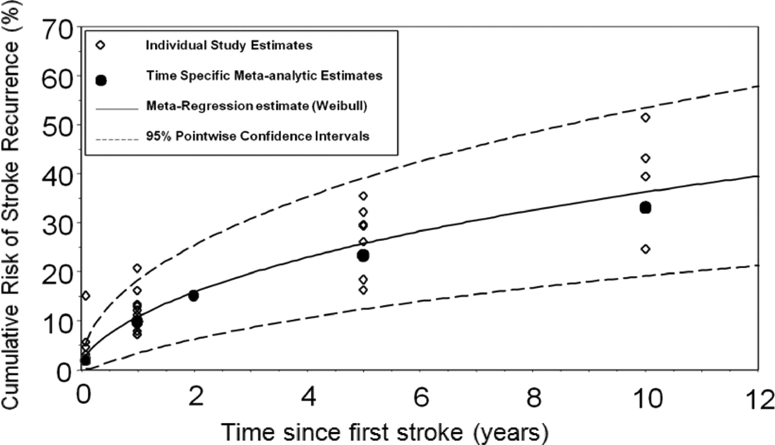
Risk of stroke recurrence after first-ever stroke
Mohan KM et al. Stroke. 2011;42:1489-1494
Copyright © American Heart Association, Inc. All rights reserved.
Notes:
Presenter’s notes
In a meta-analysis of 13 studies of recurrence after any first-ever stroke.
The pooled cumulative risk of stroke recurrence was: 3.1% (95% CI, 1.7– 4.4) at 30 days; 11.1% (95% CI, 9.0 –13.3) at 1 year; 26.4% (95% CI, 20.1–32.8) at 5 years; and 39.2% (95% CI, 27.2–51.2) at 10 years after initial stroke.
The figure shows the model (Weibull model) fitted to the risk of stroke recurrence of individual studies and pooled estimates of cumulative risk were calculated with 95% CI (Figure). At each time point analysed, the pooled estimates closely follow the Weibull model shown.
Mohan KM, Wolfe CD, Rudd AG, et al. Stroke. 2011;42(5):1489-94.

Slide 31
Quality Statement 5 Minimising risk of another stroke
Why does it matter?
Antihypertensive meds¹
Cholesterol -lowering²
Aspirin³
Warfarin⁴
Reduced risk
31%
22%
13%
62%
* Stroke patients with non-valvular atrial fibrillation CV = cardiovascular, CVA = cerebrovascular
Lakhan SE et al. Int Arch Med. 2009;2(1):30
Manktelow BN et al. Stroke. 2009;40(11):e622-3.
Algra A et al. . J Neurol Neurosurg Psychiatry. 1999;66(2):255.
EAFT Study Group. Lancet. 1993;342(8882):1255-62
Notes:
Presenter’s Notes
All shown relate to patients after a stroke except warfarin which is for patients with non-valvular AF and stroke. (see below for odds ratios and other risk ratios)
Efficacy of medicines
Ongoing treatment with medicines can substantially reduce the chance of another stroke or other cardiovascular event.
Antihypertensive medicines reduce the odds of another stroke by 29% (OR 0.71, 95% CI 0.59 to 0.86) and cardiovascular events by approximately 31% (OR 0.69, 95% CI 0.57 to 0.85) compared with placebo . ¹
In patients with ischaemic stroke, compared with placebo, cholesterol-lowering medicines reduce the odds of another cerebrovascular event by 22% (OR 0.78, 95% CI 0.67 to 0.92) ², and antiplatelet medicines reduce the relative risk of vascular events by about 13% (95% CI 6% to 19%). ³
In patients with non-valvular atrial fibrillation and stroke, compared with placebo, warfarin reduces the relative risk of a major disabling or fatal stroke by 62% (HR 0.38, 95% CI 0.18-0.81). ⁴
The cumulative risk reductions from using a combination of these medicines may be substantial. There is limited direct evidence of benefits of combination therapy in patients with stroke, but it has been estimated that for patients with cardiovascular disease, a 75% relative-risk reduction in stroke, heart attack and death could be achieved with lifestyle modification and a combination of secondary prevention medicines.
References
1. Lakhan SE, Sapko MT. Blood pressure lowering treatment for preventing stroke recurrence: a systematic review and meta-analysis. Int Arch Med. 2009;2(1):30. Epub 2009/10/22.
2. Manktelow BN, Potter JF. Interventions in the Management of Serum Lipids for Preventing Stroke Recurrence. Stroke. 2009;40(11):e622-3.
3. Algra A, van Gijn J. Cumulative meta-analysis of aspirin efficacy after cerebral ischaemia of arterial origin. Journal of Neurology, Neurosurgery & Psychiatry. 1999;66(2):255. Epub 1999/03/10.
4. EAFT (European Atrial Fibrillation Trial) Study Group. Secondary prevention in non-rheumatic atrial fibrillation after transient ischaemic attack or minor stroke. Lancet. 1993;342(8882):1255-62. Epub 1993/11/20.

Slide 32
Quality Statement 5 Minimising risk of another stroke
Why does it matter?
Starting treatment and education in hospital helps to:
improve risk factor management after discharge¹
promote long-term adherence to medicines²
improve long-term outcomes.³
In 2015 of stroke patients audited:⁴
56% received advice on modifying risk factors during admission
66% with haemorrhagic stroke were prescribed antihypertensive medicines on discharge
64% with ischaemic stroke were prescribed combination of cholesterol-lowering agent, antithrombotic and antihypertensive on discharge.
1.Touzé E et al. Stroke. 2008;39(6):1834-43 2. Thrift AG et al. Stroke. 2014;45(2):539-44 3. Cadilhac DA et al. Qual Saf Health Care. 2008;17(5):329-33 4. National Stroke Foundation. National Stroke Audit - Acute Services Report 2015. Melbourne NSF, 2015
Notes:
Presenter’s notes
Starting treatment and education for stroke prevention in hospital is important because it has been shown to:
improve risk factor management ¹
promote long-term adherence to medicines ² and may result in better long-term outcomes.³
Medicines
The medicines recommended for the prevention of recurrent stroke depend on the type of stroke and whether the patient has atrial fibrillation.⁴
Medicines recommended for patients after an ischaemic stroke include combination therapy with:⁴
Antihypertensives
Antithrombotics (antiplatelet agent or anticoagulant agent depending on whether there is atrial fibrillation)
Cholesterol-lowering medicines
Generally, patients with haemorrhagic stroke are recommended blood-pressure lowering medicines only. ⁴
Life-style changes
All patients after stroke should be supported to make lifestyle changes that reduce the risk of recurrent stroke:
Smoking cessation
Reducing alcohol consumption
Increasing physical activity levels
Reducing weight if they are overweight
Improving diet.
References
1. Touzé E, Coste J, Voicu M, Kansao J, Masmoudi R, Doumenc B, et al. Importance of In-Hospital Initiation of Therapies and Therapeutic Inertia in Secondary Stroke Prevention. Stroke. 2008;39(6):1834-43.
2. Thrift AG, Kim J, Douzmanian V, Gall SL, Arabshahi S, Loh M, et al. Discharge is a critical time to influence 10-year use of secondary prevention therapies for stroke. Stroke. 2014;45(2):539-44. Epub 2013/12/18.
3. Cadilhac DA, Pearce DC, Levi CR, Donnan GA. Improvements in the quality of care and health outcomes with new stroke care units following implementation of a clinician-led, health system redesign programme in New South Wales, Australia. Qual Saf Health Care. 2008;17(5):329-33.
4. National Stroke Foundation. Clinical Guidelines for Stroke Management 2010. Melbourne: National Stroke Foundation; 2010

Slide 33
Quality Statement 5 Minimising risk of another stroke
What the quality statement means for
Clinicians: assess, treat and educate patients with stroke about their risk of another stroke. This includes discussing risk factors, providing written information and prescribing medicines. It may also include important interventions that are time limited (e.g. carotid endarterectomy).
Health managers: ensure processes and resources are in place for clinicians to assess, treat and educate patients about reducing their risk of another stroke and improve adherence to stroke management recommendations.

Slide 34
Quality Statement 6 Carer training and support
What should we do?
A carer of a patient with stroke is given practical training and support to enable them to provide care, support and assistance to a patient with stroke.

Slide 35
Quality Statement 6 Carer training and support
Why does it matter?
Being the carer of a stroke survivor has an associated burden¹
74% of stroke survivors at 3 months require assistance with activities of daily living from a family member or friend.²
Carers in Australian hospitals³
59%
have support needs assessed
48%
receive training
1. Rigby H, et al. Int J Stroke. 2009; 4: 285-92.
2. Dewey HM, et al. Stroke. 2002; 33: 1028-33.
3. National Stroke Foundation. National Stroke Audit - Acute Services Report 2015. Melbourne NSF, 2015
Notes:
Presenter’s notes
There is a burden associated with being a carers of a person who has had a stroke.¹ Many patients with stroke have carers who assist them with activities of daily living.
In Australia, 74% of stroke survivors at three months required assistance with activities of daily living and received care from a family member or friend.² A lack of support is associated with an increased burden on caregivers.³
There is evidence that providing training to carers helps. Carers who were provided training had greater quality of life and less often had anxiety or depression compared with carers who were not provided with training. In the same study from the United Kingdom, stroke survivors with trained carers were also less often anxious or depressed. ⁴
Stroke survivor characteristics found to be associated with an increased burden on caregivers include older age, male gender, poor mental health, and/or level of functional disability.(3) A lack of support is also associated with an increased burden on carers.(4,5)
Guidelines recommend that the carers of a person with stroke be provided with practical training on how to provide care, support and assistance for the patient before they leave hospital.(6) In Australian hospitals, 59% of carers received a support needs assessment and 48% received training.(7)
1. Rigby H, Gubitz G and Phillips S. A systematic review of caregiver burden following stroke. Int J Stroke. 2009; 4: 285-92.
2. Dewey HM, Thrift AG, Mihalopoulos C, et al. Informal Care for Stroke Survivors: Results From the North East Melbourne Stroke Incidence Study (NEMESIS). Stroke. 2002; 33: 1028-33.
3. Rigby H, Gubitz G, Eskes G, et al. Caring for stroke survivors: baseline and 1-year determinants of caregiver burden. Int J Stroke. 2009; 4: 152-8.
4. McCullagh E, Brigstocke G, Donaldson N and Kalra L. Determinants of Caregiving Burden and Quality of Life in Caregivers of Stroke Patients. Stroke. 2005; 36: 2181-6.
5. Cumming TB, Collier J, Thrift AG and Bernhardt J. The effect of very early mobilisation after stroke on psychological well-being. Journal of rehabilitation medicine : official journal of the UEMS European Board of Physical and Rehabilitation Medicine. 2008; 40: 609-14.
6. National Stroke Foundation. Clinical Guidelines for Stroke Management 2010. Melbourne: National Stroke Foundation, 2010.
7. National Stroke Foundation. National Stroke Audit: Acute Services Report 2015. Melbourne: National Stroke Foundation, 2015

Slide 36
Quality Statement 6 Carer training and support
What the quality statement means for
Clinicians: support carers by offering them education on stroke, practical training on how to provide care, contact details of support services, and other information to support their own wellbeing before patients with stroke leave hospital.
Health managers: ensure processes and resources are in place to provide carers with education about stroke, practical training on how to provide care, access to support services (e.g. respite care), and other information to support carers before patients with stroke leave hospital.

Slide 37
Quality Statement 7 Transition from hospital care
What should we do?
Before a patient with stroke leaves the hospital, they are involved in the development of an individualised care plan that describes the ongoing care that the patient will require after they leave hospital.
The plan includes rehabilitation goals, lifestyle modifications and medicines needed to manage risk factors, any equipment they need, follow-up appointments, and contact details for ongoing support services available in the community. This plan is provided to the patient before they leave hospital, and to their general practitioner or ongoing clinical provider within 48 hours of discharge.

Slide 38
Quality Statement 7 Transition from hospital care
Why does it matter?
Some patients miss out on medicines that may help to prevent another stroke and often they have poorly controlled risk factors. ¹
Many patients have other unmet needs after discharge.²
An individualised care plan, which is developed with the patient while in hospital, may improve continuity of care once the patient returns to the community.
Currently
56% of patients with stroke receive an individualised care plan when discharged from hospital.³
Paul SL et al Hypertension. 2006;48(2):260-5.
Andrew NE et al. Int J Stroke. 2014
National Stroke Foundation. National Stroke Audit - Acute Services Report 2015. Melbourne: NSF 2015
Notes:
Presenter’s Notes
There is evidence that many patients could be provided better care once they are discharged from hospital. Many patients with stroke are not prescribed medicines that may help to prevent another stroke and often they have poorly controlled risk factors. ¹ In addition, many patients report having unmet needs.²
Individualised Care Plan
is developed with the patient and their family member or carer, while the patient is in hospital, may improve continuity of care once the patient returns to the community.
is typically includes information on risk factors, equipment required, and contact details of community support services.
is different from a discharge letter, which is used to notify a patient’s general practitioner of the stroke event and hospitalisation.
patients are encouraged to discuss their individualised care plan with their general practitioner once they are discharged from hospital. A copy is also sent to the general practitioner.
general practitioners and patients are encouraged to review these plans periodically.
According to the 2015 national audit of acute stroke services, approximately 56% of patients with stroke received an individualised care plan. ³
References
1. Paul SL, Thrift AG. Control of Hypertension 5 Years After Stroke in the North East Melbourne Stroke Incidence Study. Hypertension. 2006;48(2):260-5.
2. Andrew NE, Kilkenny MF, Naylor R, Purvis T, Lalor E, Moloczij N, et al. Understanding long-term unmet needs in Australian survivors of stroke. Int J Stroke. 2014.
3. National Stroke Foundation. National Stroke Audit - Acute Services Report 2015. Melbourne: NSF, 2015

Slide 39
Quality Statement 7 Transition from hospital care
What the quality statement means for
Clinicians: Develop an individualised care plan (e.g. using My stroke care plan) with each patient and provide it to them in writing before they leave hospital. Provide a copy to their general practitioner or ongoing clinical provider within 48 hours of the patient leaving hospital. The individualised care plan is separate to a clinical discharge summary and includes information about the patient’s rehabilitation goals, their risk factors, lifestyle modification and medicines, any equipment they need, follow-up appointments, and contact details for ongoing support services available in the community.
Health managers: Ensure processes and resources are in place so that clinicians can develop an individualised care plan with patients with stroke before they leave hospital, and can provide it to them and their general practitioner or ongoing clinical provider within 48 hours of discharge.

Slide 40
Questions to consider
Does the emergency department of your hospital currently use a standard validated stroke screening tool?
How quickly can a CT be performed and interpreted for patients with stroke?
How quickly can thrombolysis be administered to eligible patients, taking into account time needed for brain imaging to exclude haemorrhage and to discuss treatment potential benefits and harms with patients and carers?
What are the barriers that prevent rapid assessment of patients with stroke? What solutions could be considered?
What are the barriers that prevent more patients with stroke being treated in a stroke unit? What solutions could be considered?
What proportion of patients with stroke are prescribed ongoing preventive medications? Whose responsibility is referral to secondary prevention? How could this be improved?

Slide 41
More information
www.safetyandquality.gov.au/ccs

Slide 42
How can the quality statements be achieved in your health service?
Add local context here
What measures do we have?
How well are we are achieving the quality statements?
What could be changed?
Who needs to be involved to help things change (internal and external)?
Is there a successful service model we could adapt locally?
Notes:
Optional additional slide

