Slide 1
AURA Surveillance System – AURA 2017
Professor John Turnidge
Senior Medical Advisor
#2017AURA

Slide 2
The AURA Surveillance System – 2017
Surveillance of antimicrobial use and resistance in hospitals and the community (including aged care homes)
281 hospitals participated in the 2015 Hospital National Antimicrobial Prescribing Study (NAPS), reported in AURA 2017. 83% of principal referral hospitals and 74% of large acute public hospitals participated in the survey. Private hospitals also participated
159 hospitals participated in the National Antimicrobial Use Surveillance Program (NAUSP), reported in AURA 2017. Participation included all principal referral hospitals and almost 85% of large acute public hospitals. Private hospitals also participated.

Slide 3
The AURA Surveillance System – 2017
Data from public health systems in Queensland, NSW, ACT, Victoria, Tasmania, South Australia, Western Australia, and private sector in Queensland and northern NSW contributed to the national passive surveillance system (Org TRx) – over 17 million records
An alert system established for critical antimicrobial resistances (CARs) providing timely reports to all states and territories.
The Commission will continue to work with its program partners, the states and territories and the private sector to expand surveillance and to report on data of value to clinicians, health service managers and policy makers.

Slide 4
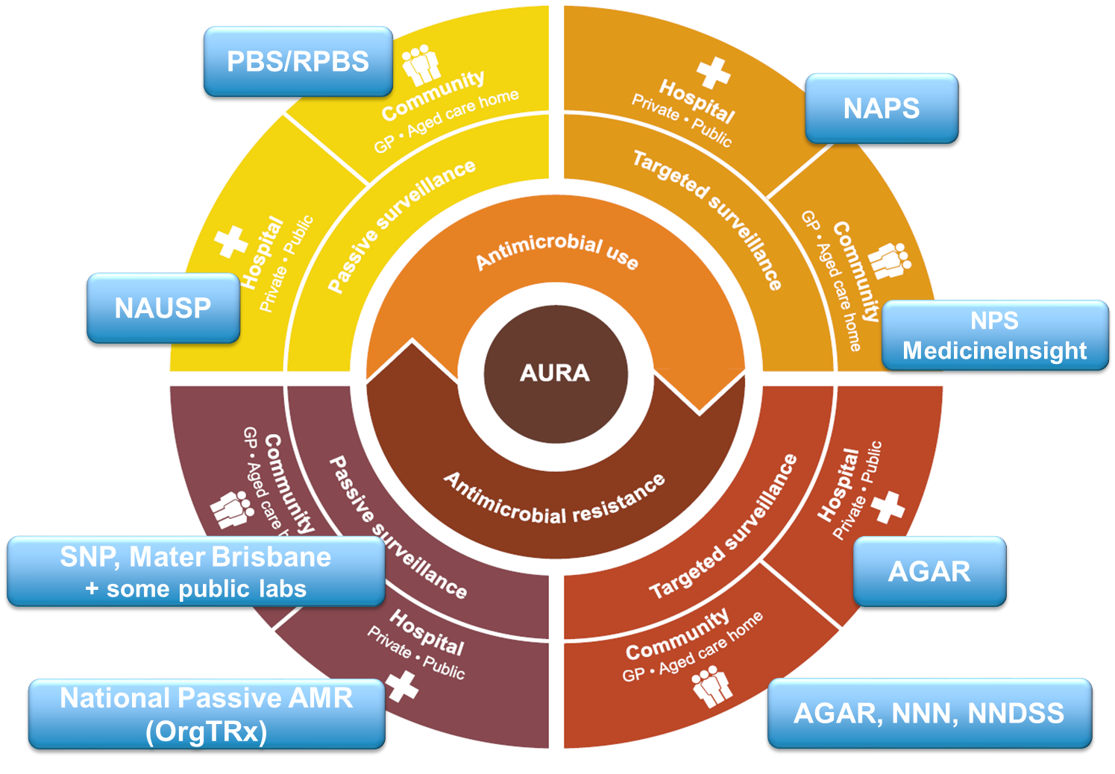

Slide 5
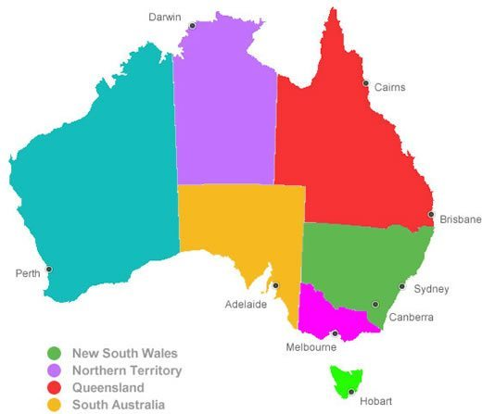
National Passive AMR (OrgTRx)
NT Pathology
Sullivan-Nicolaides
Pathology
Queensland
Mater Brisbane
OrgTRX
Northern NSW, HNE, Mid-North Coast
SE Sydney, Illawarra, Shoalhaven
Sydney, Sydney SW
PathWest
SA Pathology
ACT Pathology
Northern Sydney, Central Coast
Monash Health
Royal Hobart

Slide 6
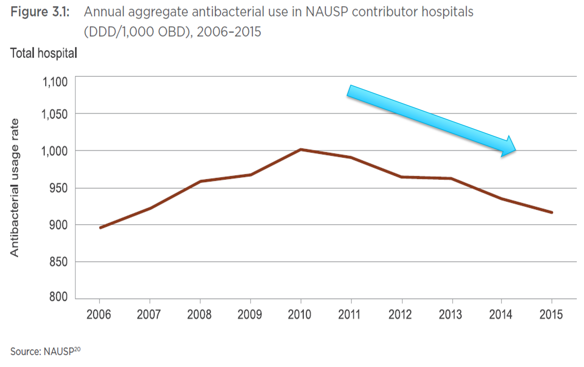
Hospital Use

Slide 7
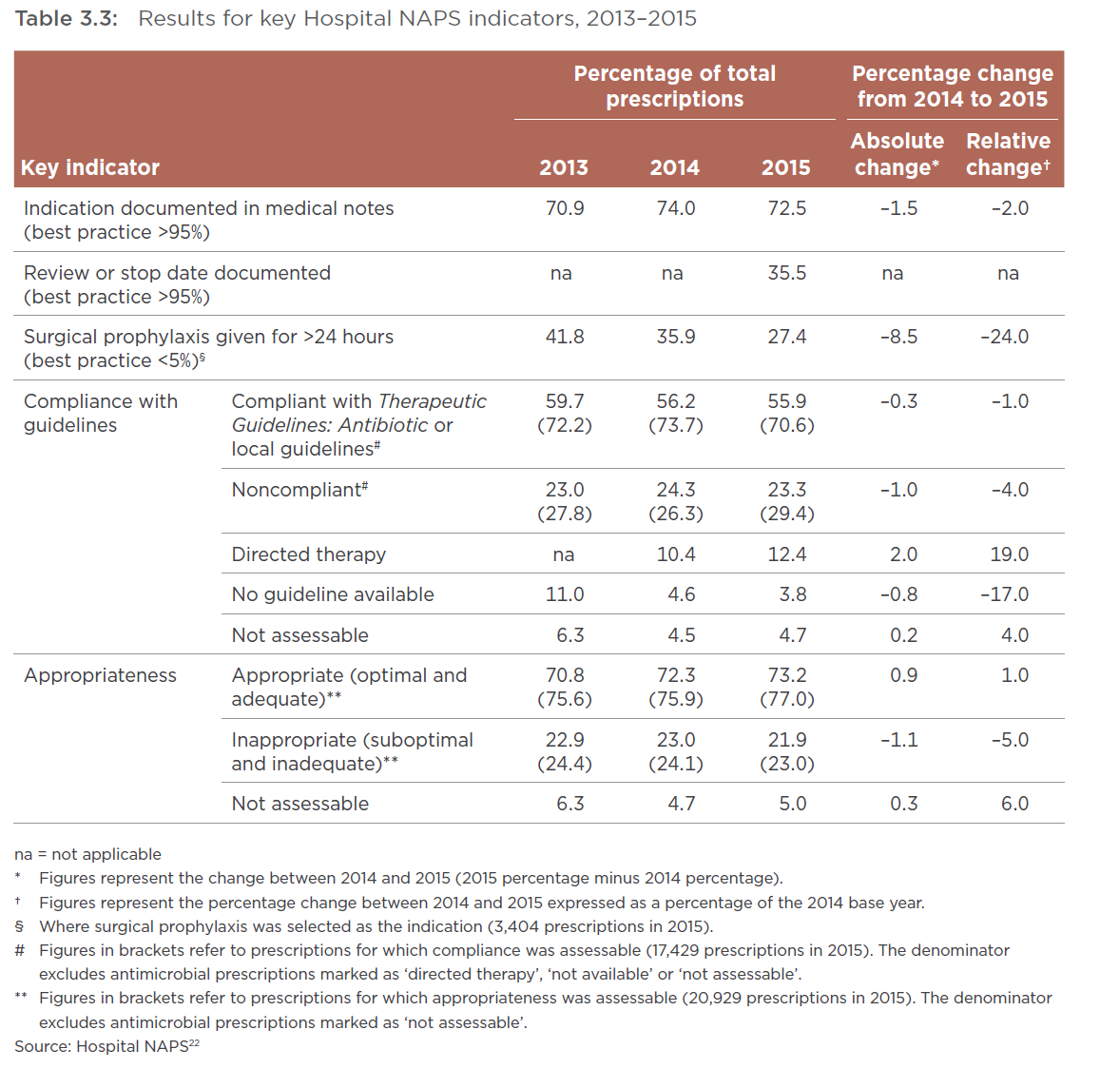
Hospital Use

Slide 8
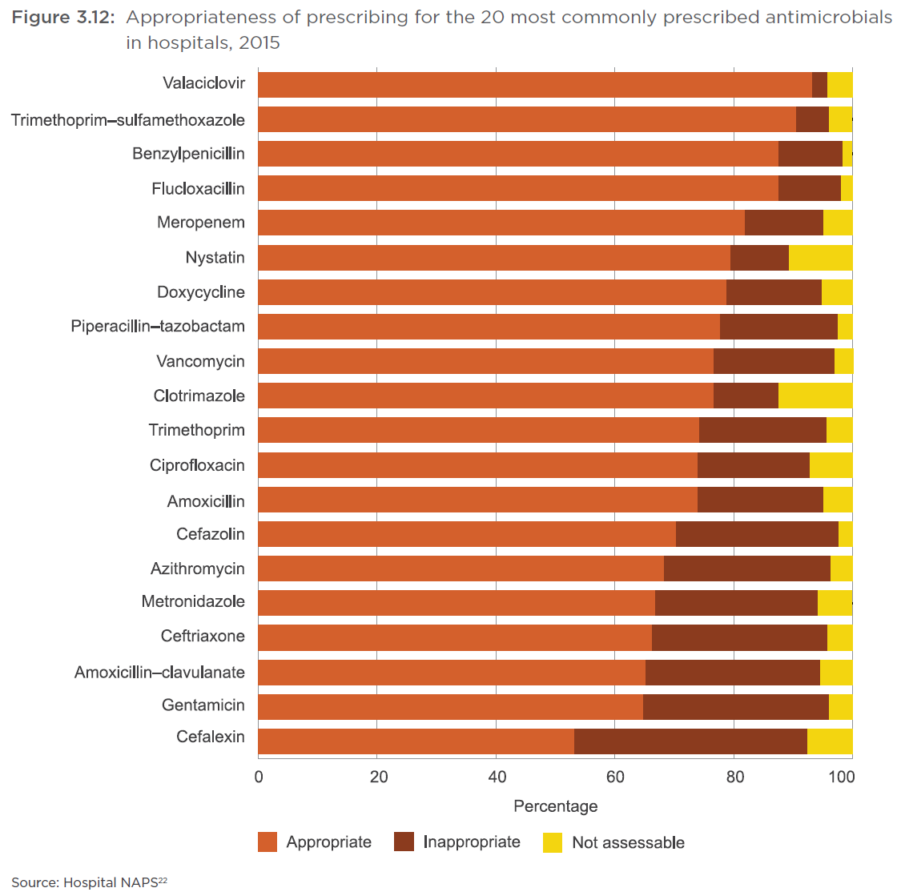
Hospital Use

Slide 9
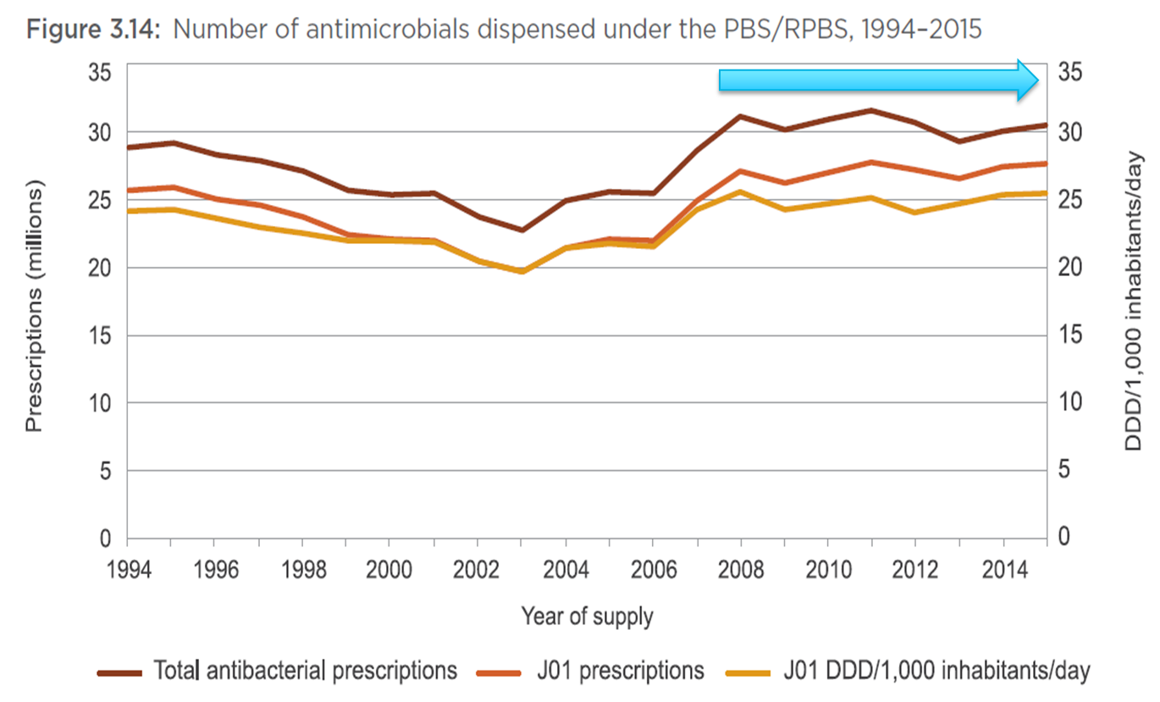
Community Use

Slide 10
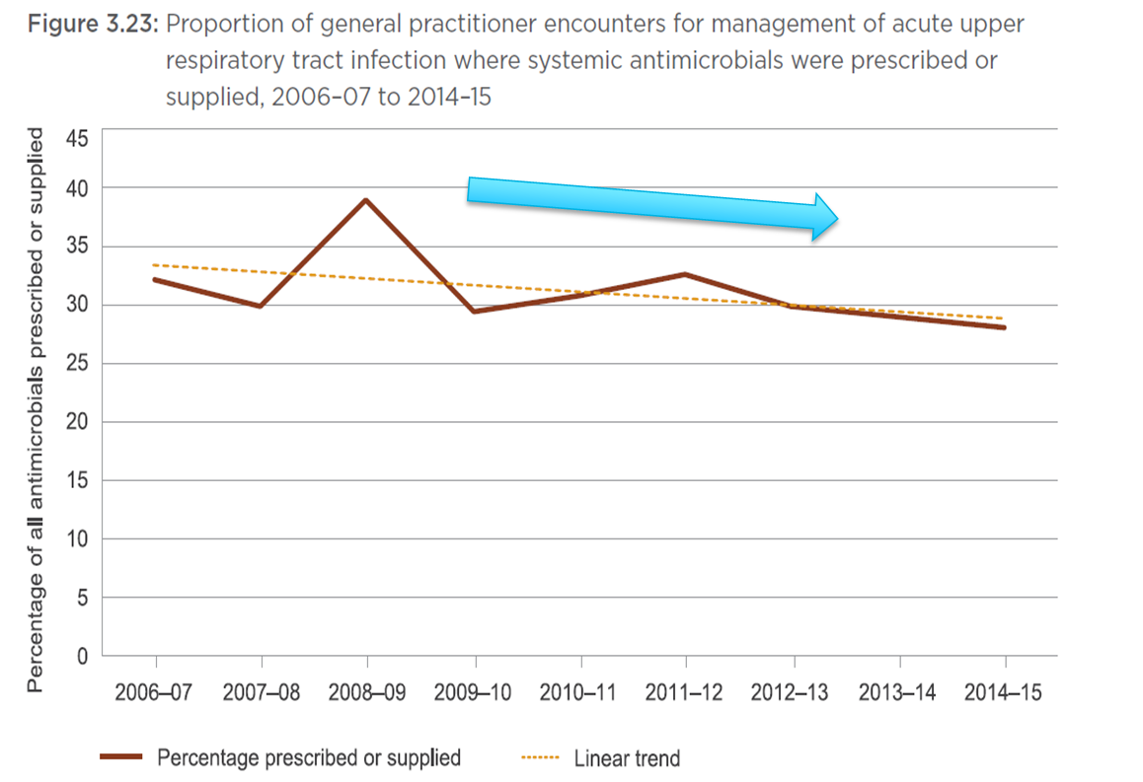
Community Use

Slide 11
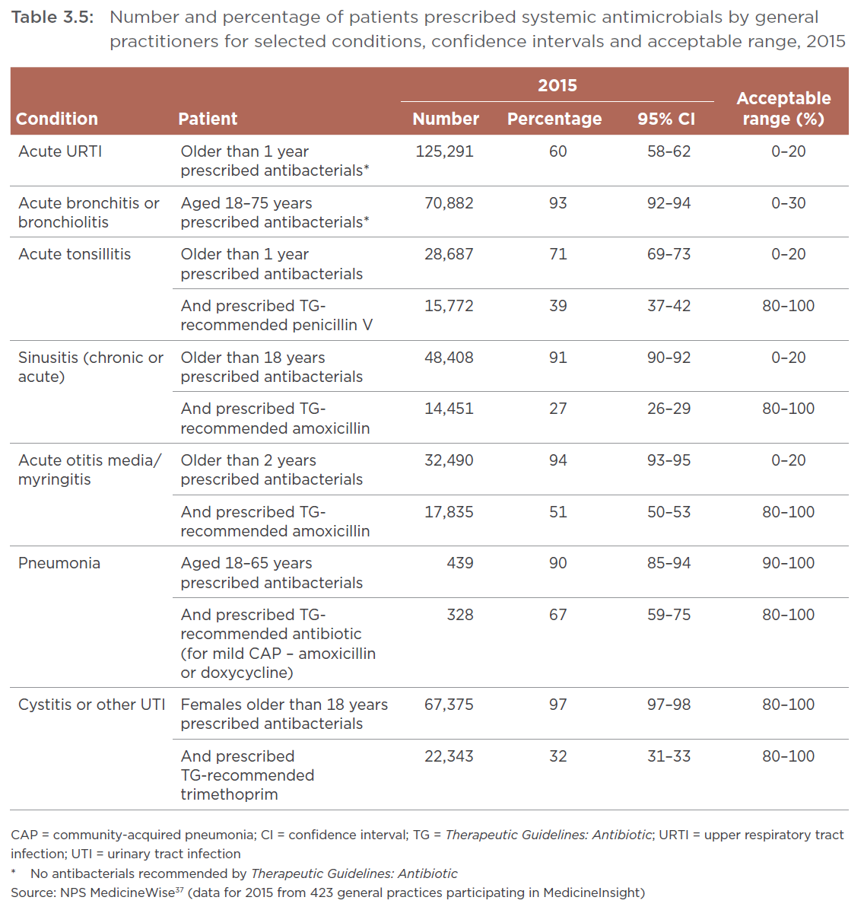
Community Use

Slide 12
Community Use
✓
✓
✓

Slide 13
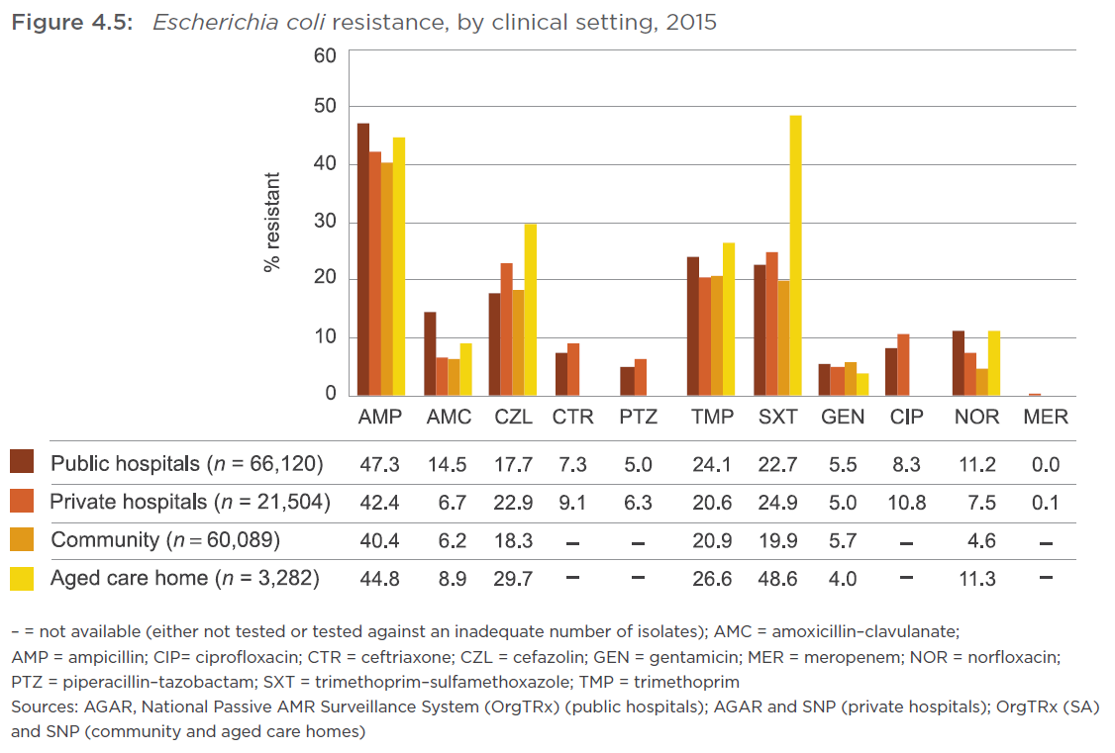
Resistance: Escherichia coli

Slide 14
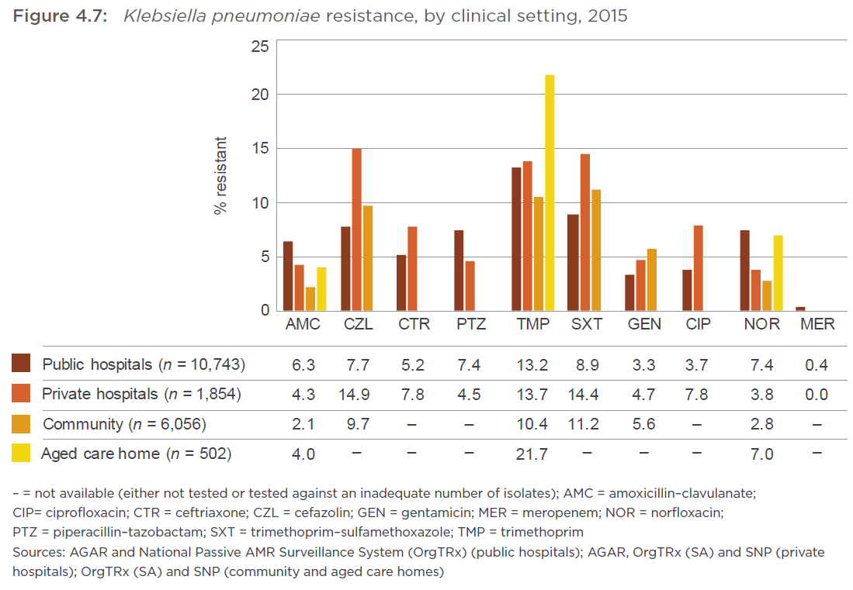
Resistance: Klebsiella pneumoniae

Slide 15
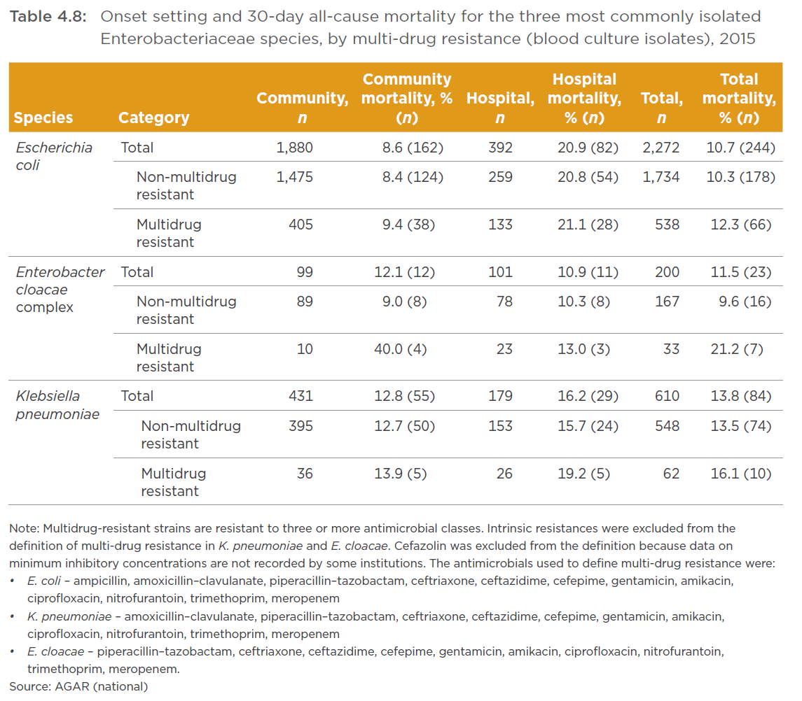
Resistance: Impact of multi-drug resistance

Slide 16
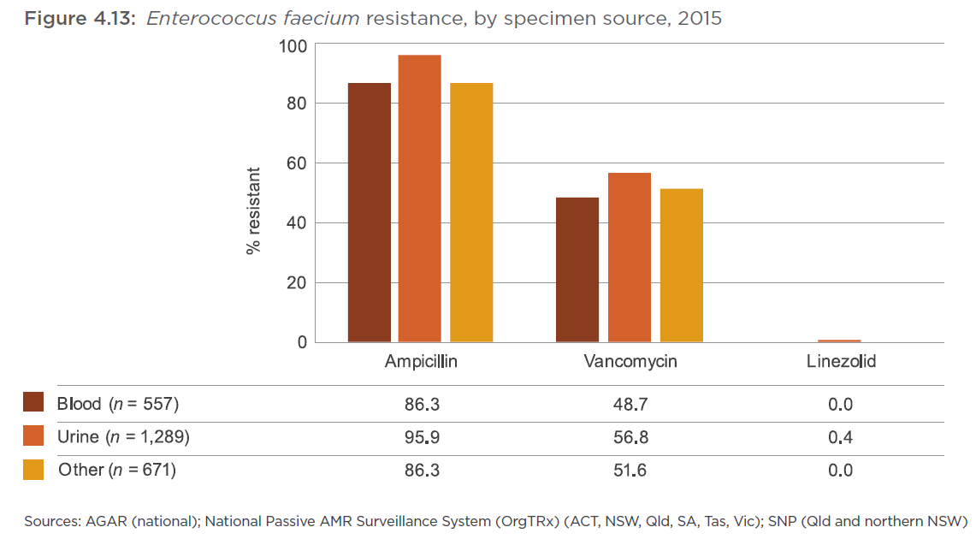
Resistance: Enterococcus faecium

Slide 17
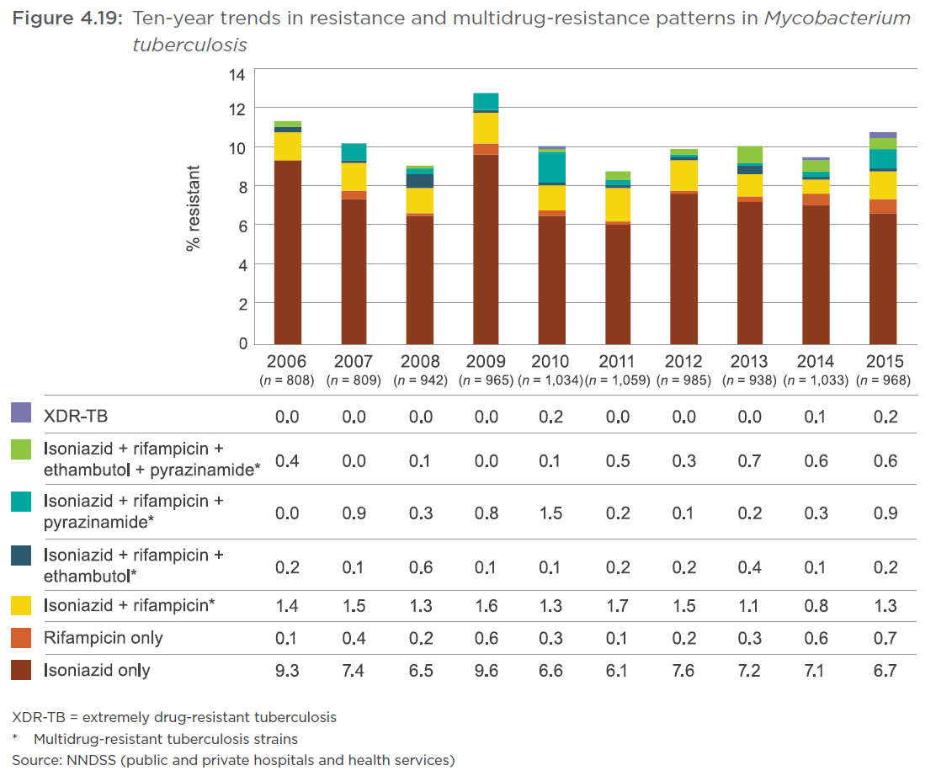
Resistance: Mycobacterium tuberculosis

Slide 18
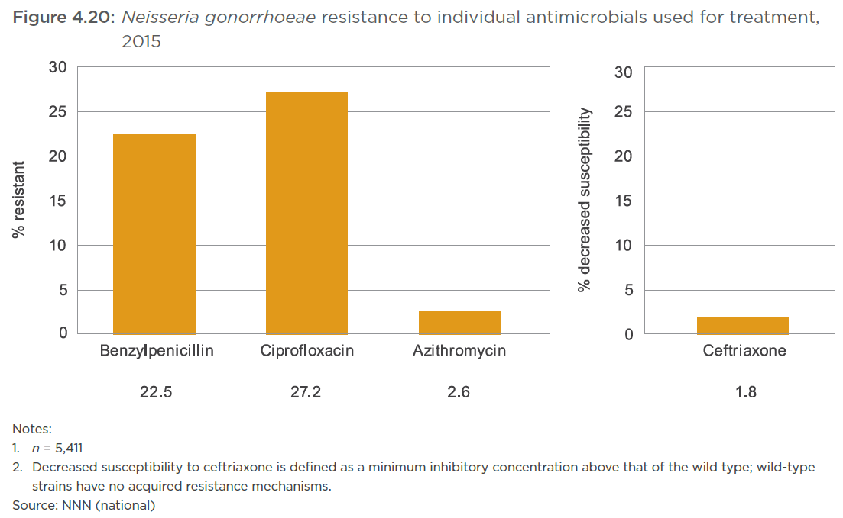
Resistance: Neisseria gonorrhoeae

Slide 19
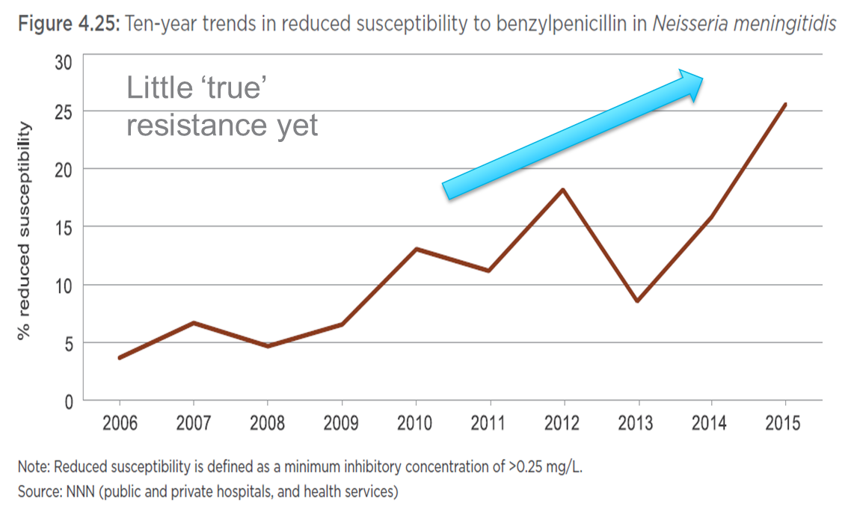
Resistance: Neisseria meningitidis

Slide 20
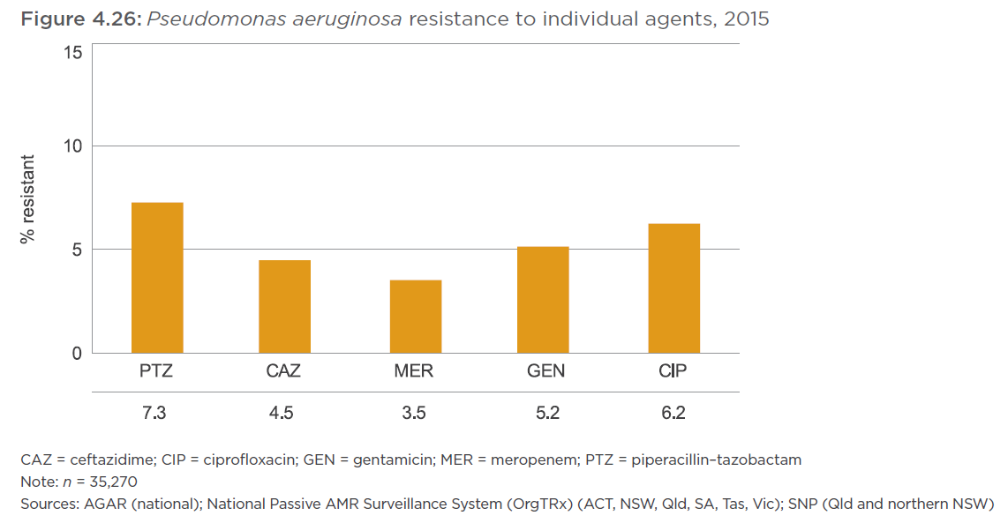
Resistance: Pseudomonas aeruginosa

Slide 21
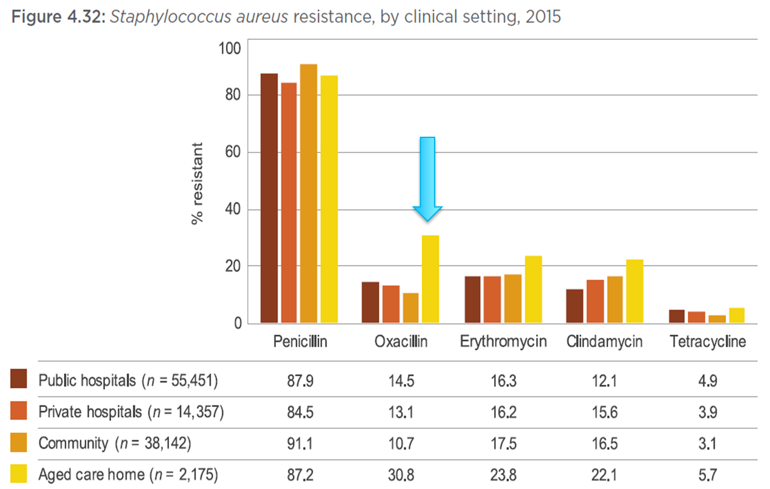
Resistance: Staphylococcus aureus

Slide 22
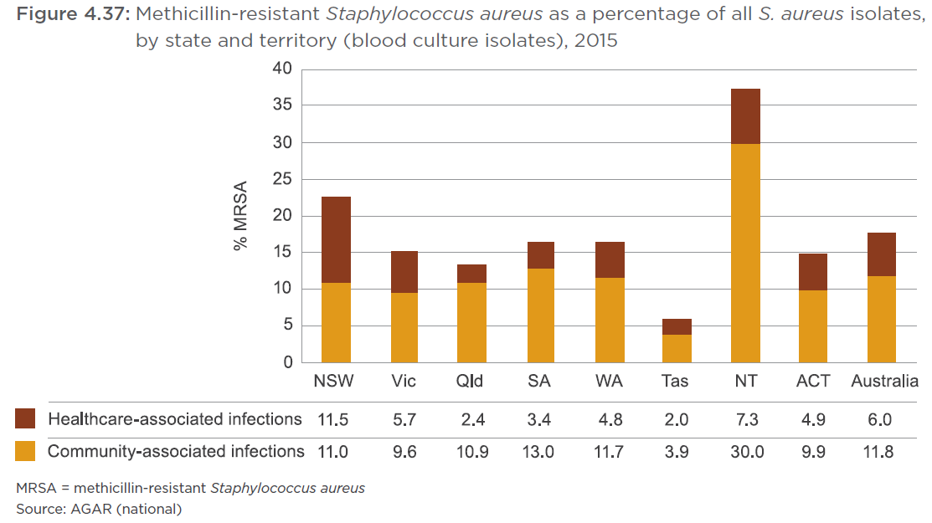
Resistance: Staphylococcus aureus

Slide 23
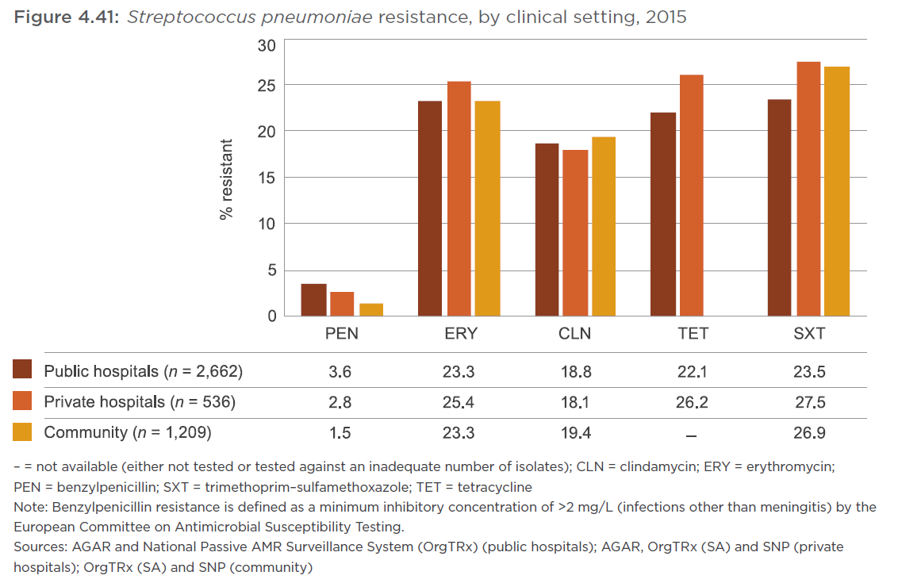
Resistance: Streptococcus pneumoniae

Slide 24
AURA – Identified areas for action
Intensify efforts to reduce unnecessary prescribing in the community
Improve the appropriateness of antimicrobial prescribing in surgical prophylaxis
Strengthen infection-control practices to minimise spread of vancomycin-resistant Enterococci
Implement actions to control carbapenemase-producing Enterobacteriaceae
Monitor resistant gonococcal infections to inform treatment guidelines.
The Commission will be working with a range of stakeholders to progress these areas for action over 2017– 2019.

Slide 25
#AURA_2017

