Slide 1

AURA 2017 IMPLICATIONS FOR CHANGE IN CLINICAL PRACTICE
Dr Kathryn Daveson
@KathrynDaveson
#2017AURA

Slide 2
Person/
Population
Place
Time
Notes:
Antibiotic resistance stops for no man/woman

Slide 3
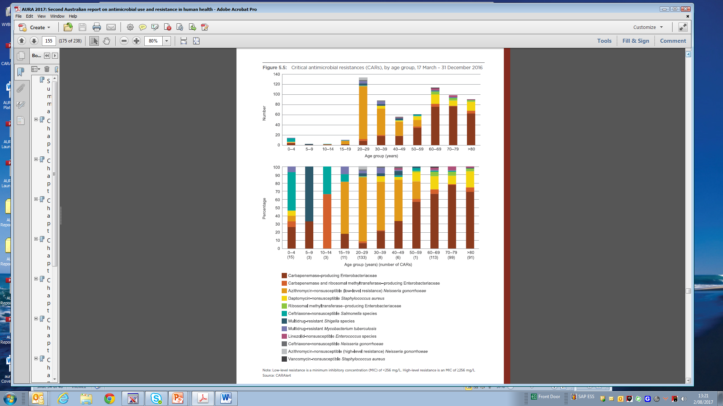
Resistance impacts everyone
Notes:
Talking points –
GBS prophylaxis and sepsis
Gram negative resistance an neonatal sepsis

Slide 4
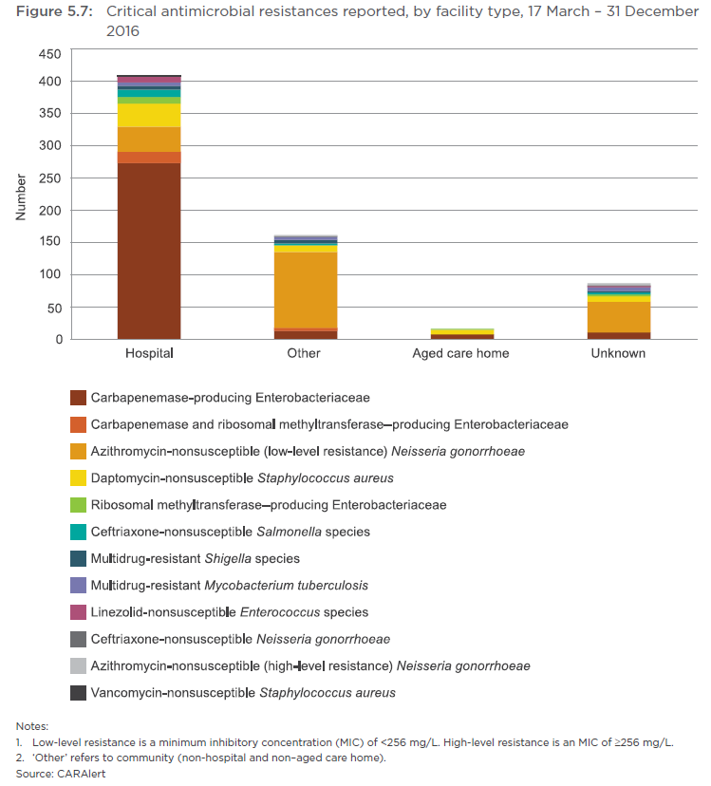
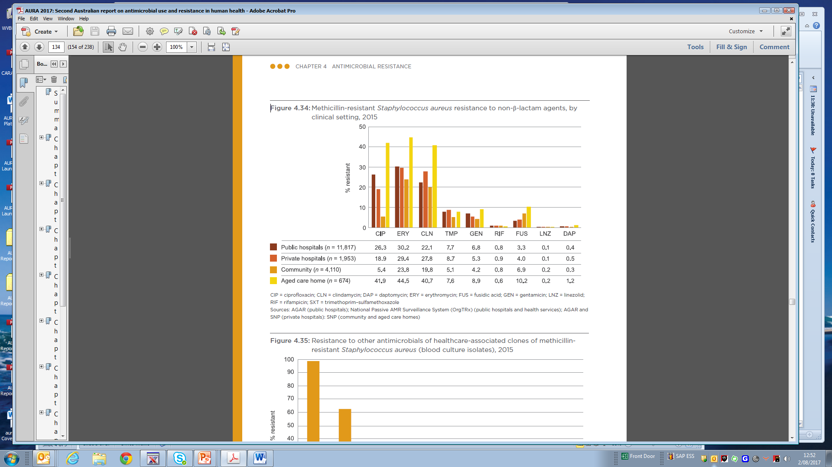
Resistance is not restricted to tertiary care
Notes:
Neisseria and consideration of changing testing and treatment protocols – downfalls of non culture based techniques
Reminder to continue to keep old skills handy

Slide 5
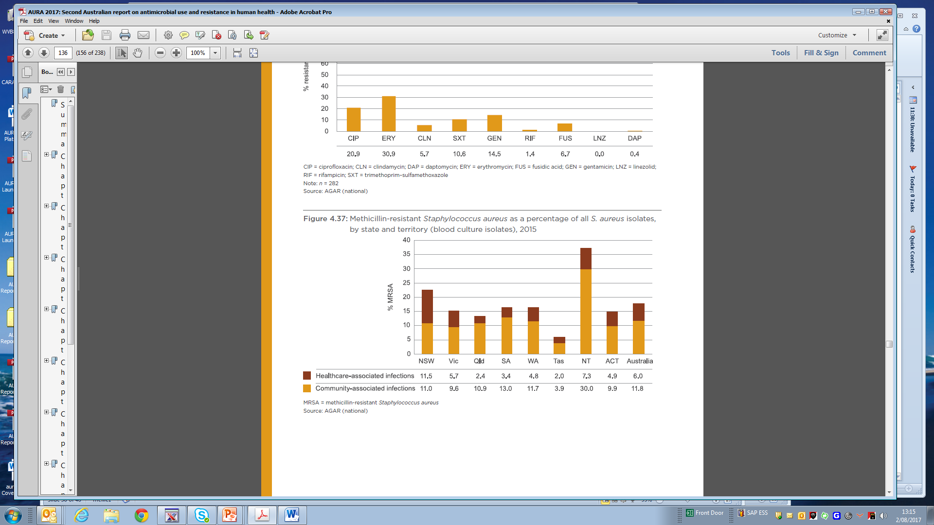
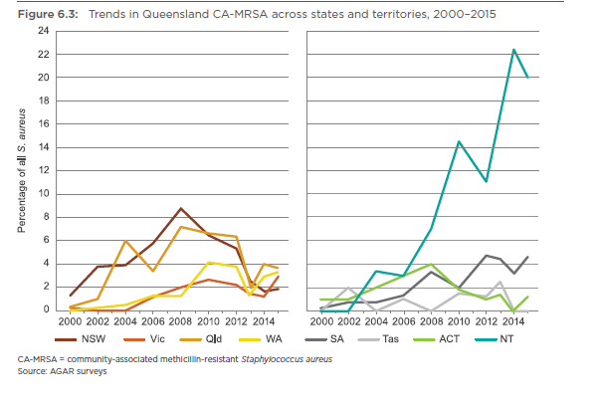
Resistance is important all across Australia
Notes:
Speak to the NT and indigenous peoples
Sociodemographic disparties in health
Vignette about uti and cephalexin

Slide 6
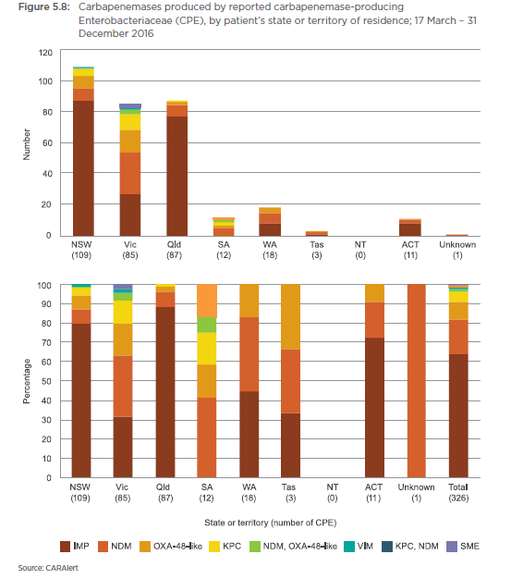
Resistance is different all across Australia
Notes:
CPE burdens.
SA relatively free
Different practices in different states in critical gram negative infections

Slide 7
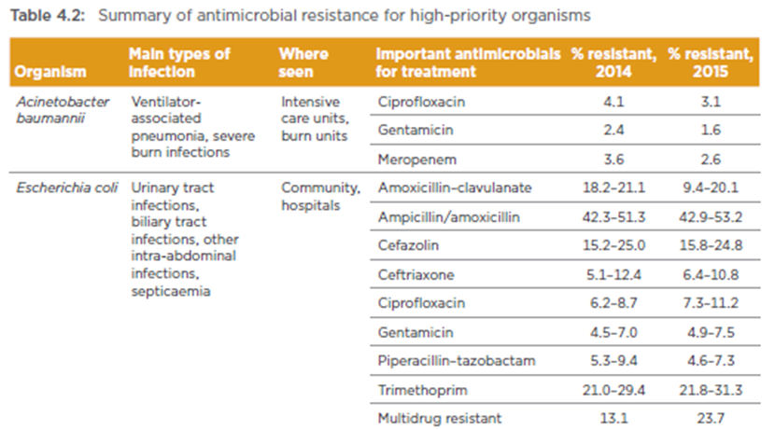
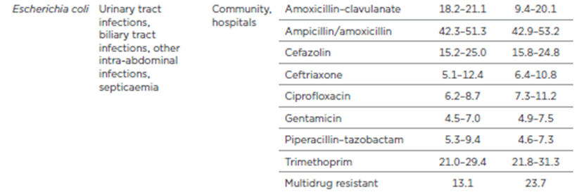
Resistance needs action now

Slide 8
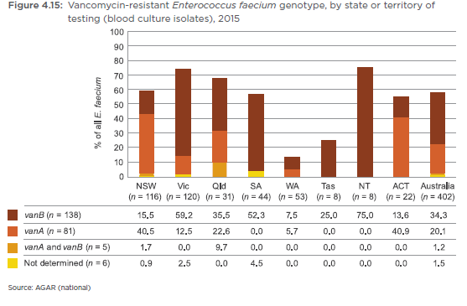
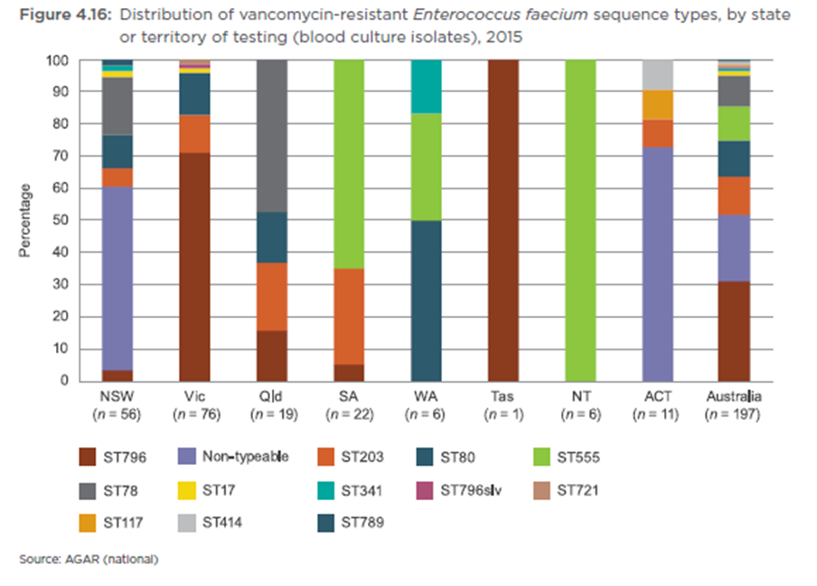
Resistance needs to be tackled by everyone
Notes:
Patterns are different across Australia and to control these things we need to work cross-jurisdictionally on the same platforms with the same agendas
Effects in one jurisdiction affect others and influence therapeutic considerations, costs, LOS and patient outcome

Slide 9

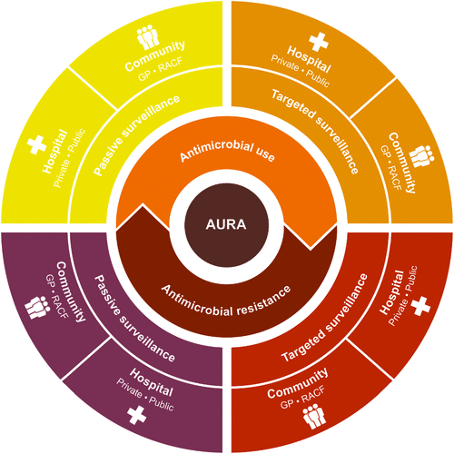
The Future Power of AURA for Clinical Practice
The Little Engine that Could
Notes:
Use it clinically much more: practice patterns, resistance overviews, antibiotic shortages, guidelines changes
It is intended that states and territories will use the data to identify local issues and respond to potential and proven multi-site outbreaks of CARs.
Balancing the issues that require immediate action and those that can have ongoing surveillance.
Getting us all on the same page so we can instill our trust in AURA and all it can deliver for clinical care.

