Slide 1
National Standard for
User-applied Labelling of Injectable Medicines, Fluids and Lines
June 2016

Slide 2
Presentation summary
Labelling for safety
Labelling Standard
  Aims
  Minimum requirements
  Outline and content
Application in clinical practice

Slide 3
Labelling for safety
Labelling of injectable medicines, fluids and delivery devices is a major patient safety issue
Medicines removed from original manufacturer’s packaging must be identifiable
Incomplete/omitted labelling is a source of medication error

Slide 4
Medicine administration errors
Errors relating to absent or inadequate labelling include:
Wrong medicine
Wrong route
Wrong patient
Errors attributable to labelling have been associated with:
Patient transfer
Perioperative sterile field
0.9% sodium chloride flush
Line misconnections

Slide 5
Medicine administration errors: case reports
10 mg morphine was given in error as the clinician thought the syringe contained 0.9% sodium chloride. The unlabelled syringe had a 0.9% sodium chloride ampoule attached (unpublished)
A patient was given intravenous (IV) lignocaine with adrenaline solution intended for local anaesthetic infiltration. This syringe had been drawn up and placed in a kidney dish alongside IV morphine and midazolam for procedural sedation (unpublished)

Slide 6

The Labelling Standard
National Standard for User-applied Labelling of Injectable Medicines, Fluids and Lines, September 2015
Replaces the previous Labelling Recommendations (2012) and Issues Register

Slide 7
The Labelling Standard
A national standard for clinical practice in Australia
Identifies medicines and fluids removed from original manufacturer’s packaging prior to patient administration
Identifies line route

Slide 8
Labelling Standard aims
Provide standardisation for user-applied labelling of injectable medicines
Provide minimum requirements for user-applied labelling of injectable medicines
Promote safer use of injectable medicines

Slide 9
Labelling Standard development
Draft recommendations developed by NSW Therapeutic Advisory Group Safer Medicines Group
National consultation and pilot testing supported by the Australian Commission on Safety and Quality in Health Care commenced in 2009
Labelling Recommendations endorsed by Australian Health Ministers in November 2010
Further evaluation, particularly in perioperative areas and interventional procedure rooms
Labelling Standard published September 2015

Slide 10
Labelling Standard development
Based on:
  International literature/recommendations
  Australian Standard AS4940: 2002 User-applied identification labels for use on fluid bags, syringes and drug administration lines
  Expert opinion and consultation
  Pilot testing
  Reported medicine administration incidents

Slide 11
Labelling Standard consultation
Labelling Standard development since 2009 has involved:
State and territory health departments
State and territory safer medicines groups
Australian Association of Nuclear Medicine Specialists
Australian College of Critical Care Nurses
Australian College of Nursing
Australian College of Operating Room Nurses
Australian and New Zealand College of Anaesthetists
Australian and New Zealand Intensive Care Society
Australian and New Zealand Society for Nuclear Medicine
Australian Nursing and Midwifery Federation
Australian Pharmaceutical Healthcare Systems
Australian Private Hospitals Association
Cancer Council Australia
Cardiac Society of Australia and New Zealand
Catheter Laboratory Nursing Council
Clinical Oncological Society of Australia
College of Emergency Nursing Australia
Consumers Health Forum
Council of Australian Therapeutic Advisory Groups
Intensive Care Coordination and Monitoring Unit, New South Wales
Renal Society of Australasia
Royal Australian and New Zealand College of Radiologists
SESIAHS Sterilising Services, Randwick Hospitals Campus
Society of Hospital Pharmacists of Australia
Women’s & Children’s Hospitals Australasia

Slide 12
Labelling Standard: minimum requirements
Medicines or fluid removed from original packaging must be identifiable
All containers (e.g. bags and syringes) containing medicines must be labelled on leaving the hands of the person preparing the medicine
Prepare and label one medicine at a time
Discard medicines or fluids in unlabelled containers

Slide 13
Labelling Standard: outline
What should be labelled
What should be included on the label
Where the label should be placed

Slide 14
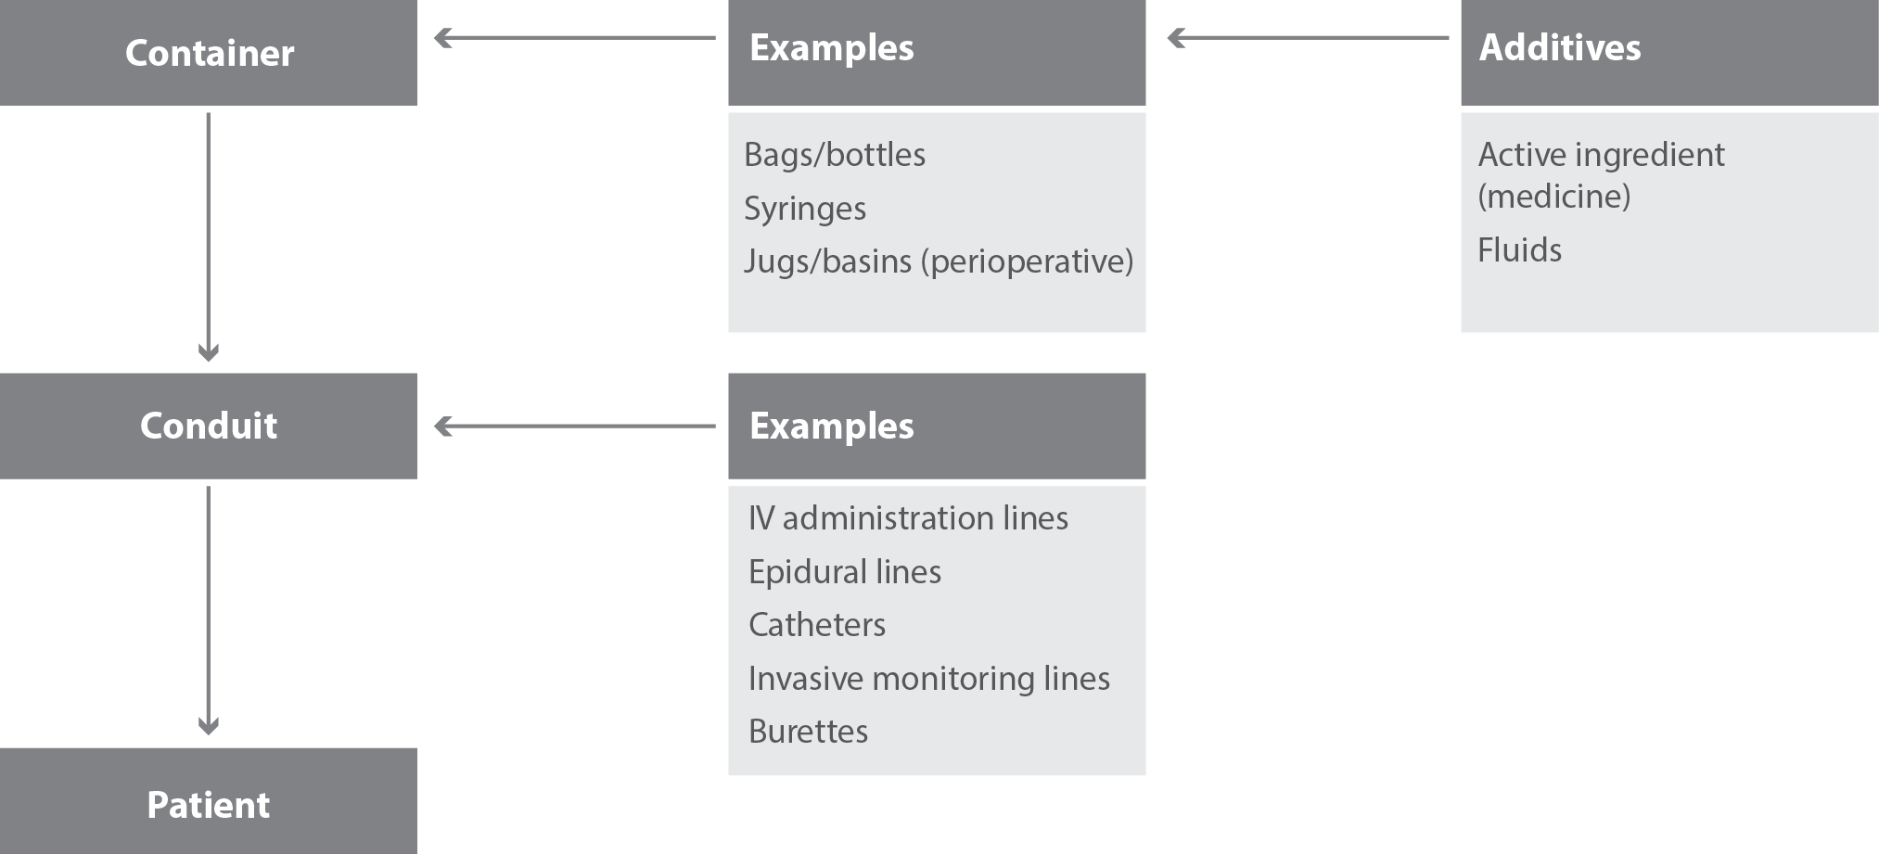
Labelling Standard: scope

Slide 15
Labelling Standard: exclusions
Injectable medicines and fluids:
  prepared by hospital pharmacy departments, external manufacturers or compounding centres
  not directly administered to the patient
  (e.g. ampoules)
Administration portals
Syringe drivers and pumps

Slide 16
Application in clinical practice

Slide 17
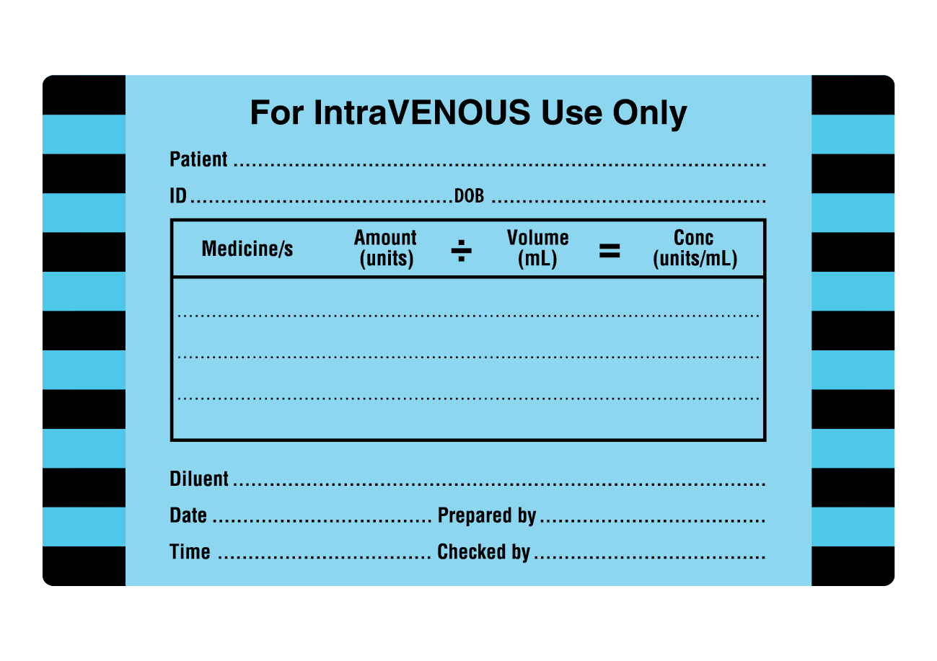
All containers: label content
Patient: Given name and family name
Identifier (ID): This is the URN or MRN or other local unique patient identifier
DOB: Patient’s date of birth
For each medicine added to the container, specify:
  Generic medicine name
  Amount (total added to the container) including units
  Volume (the total volume of fluid in the container) in mL
  Concentration (units/mL)
  Diluent (syringes only)
  Date and time of preparation
  Signed by personnel preparing and checking medicine

Slide 18
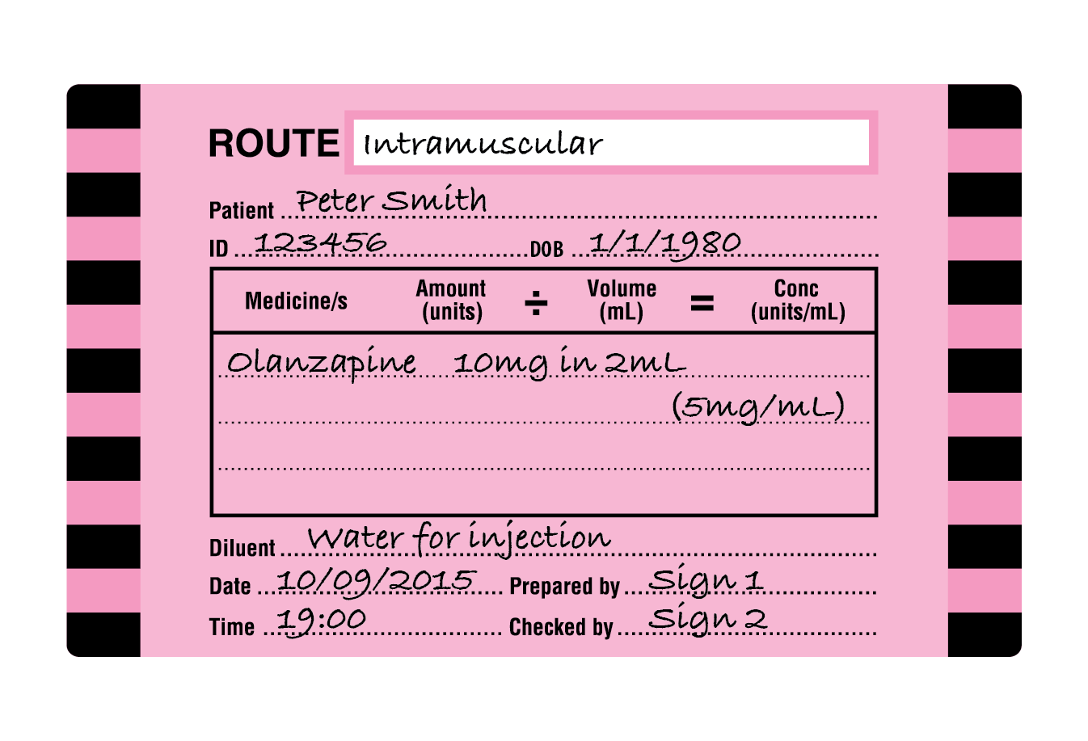
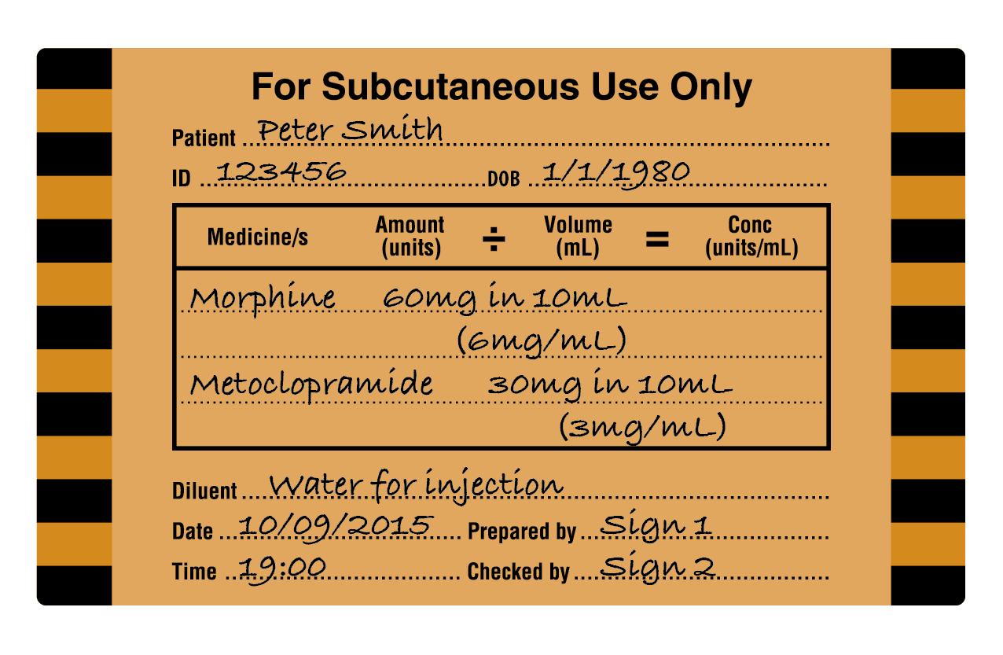
All containers: label content
Example of miscellaneous route syringe label
Example of subcutaneous route syringe label

Slide 19
Identifying target tissue/ route of administration
A standard colour system is used to identify the target tissue/intended route of administration*
Target tissue | Route of administration | Colour
Intra-arterial | Intra-arterial | Red
Intravenous | Intravenous | Blue
Neural | Epidural / Intrathecal / Regional | Yellow
Subcutaneous | Subcutaneous | Beige
Intragastric | Enteral | Green
Respiratory | Inhalational | White
Miscellaneous | Any other route not specified above | Pink
*Modified from Australian Standard AS4940

Slide 20
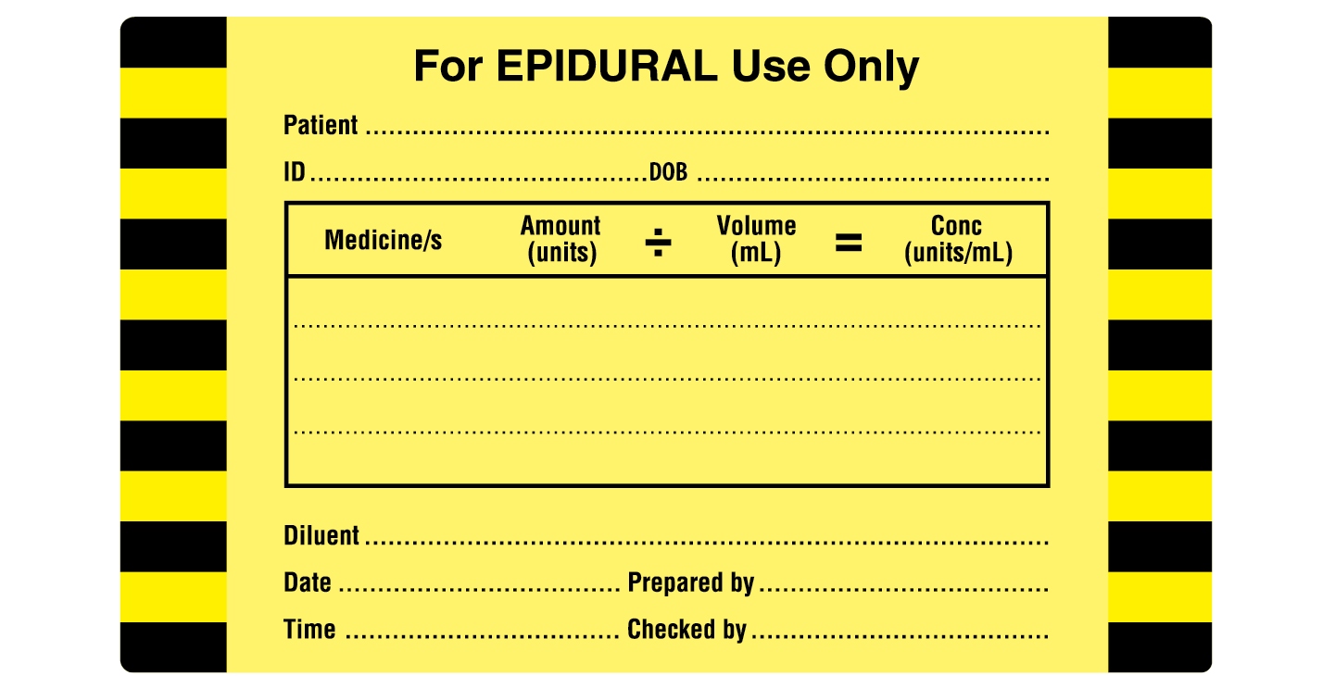
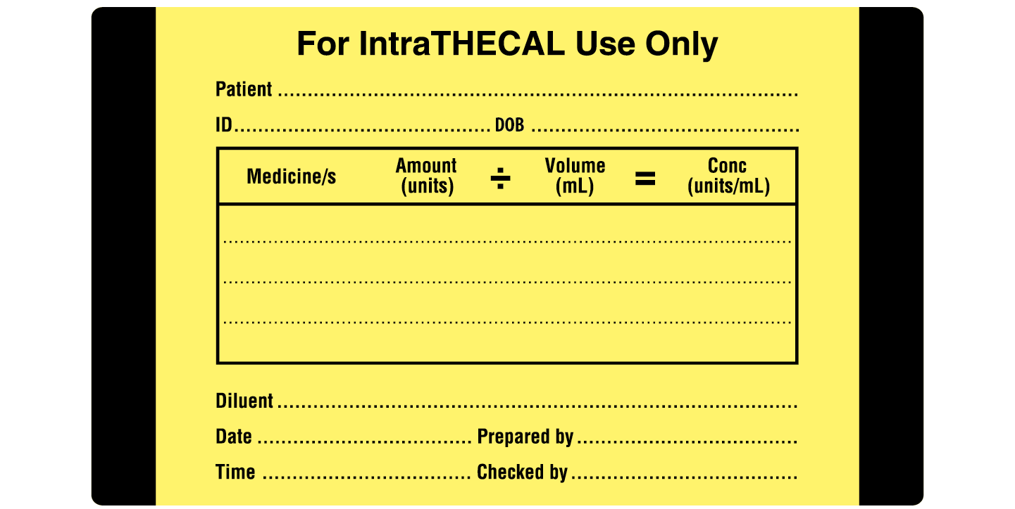
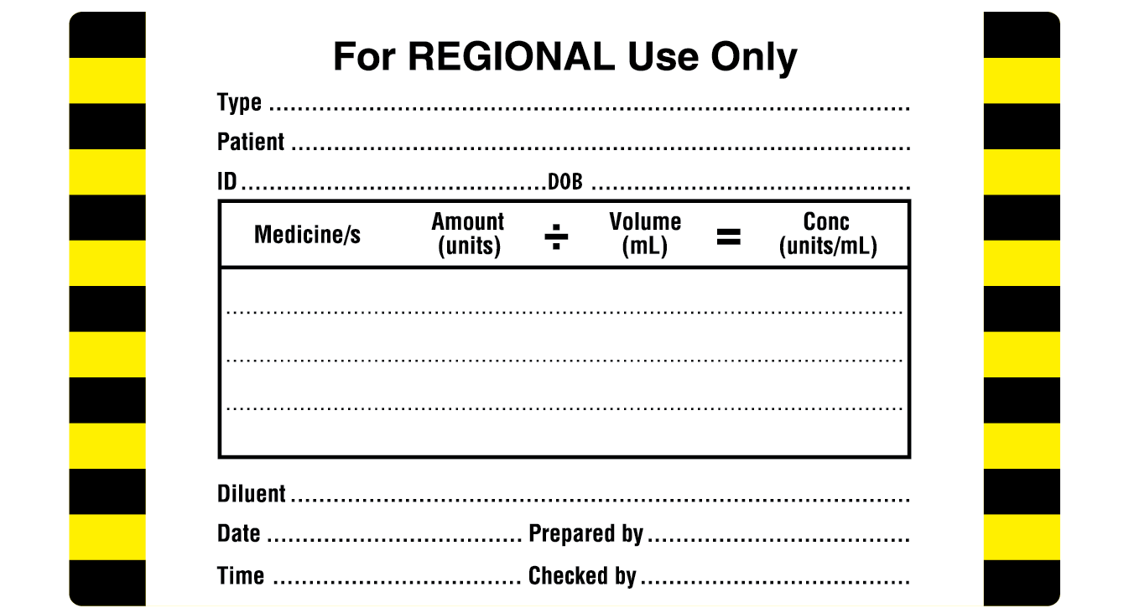
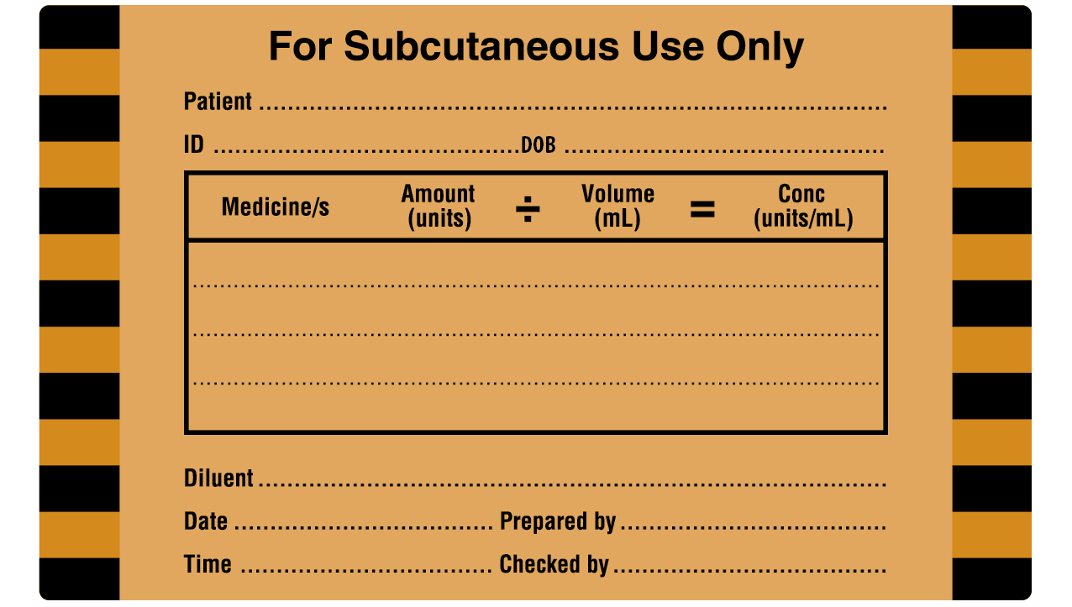
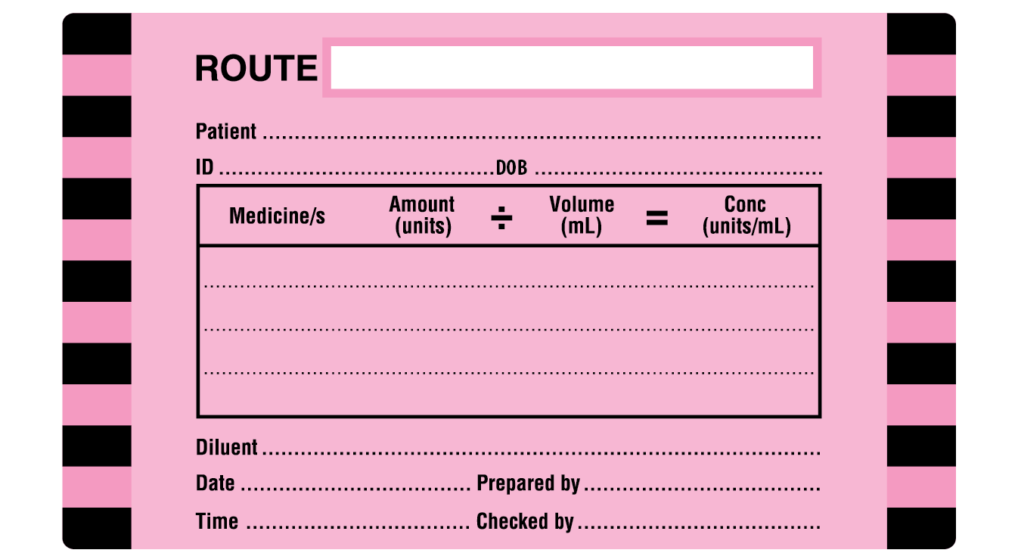
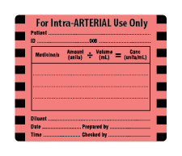
Bag and syringe labels: 2 sizes

Slide 21
Bags with additives
Bags (and bottles) require labelling when a medicine is added in the clinical/ward area
Label IMMEDIATELY when an injectable medicine is added
The ‘diluent’ should be identified on the label if the base fluid is not easily identifiable from the original manufacturer’s label (see label placement)

Slide 22
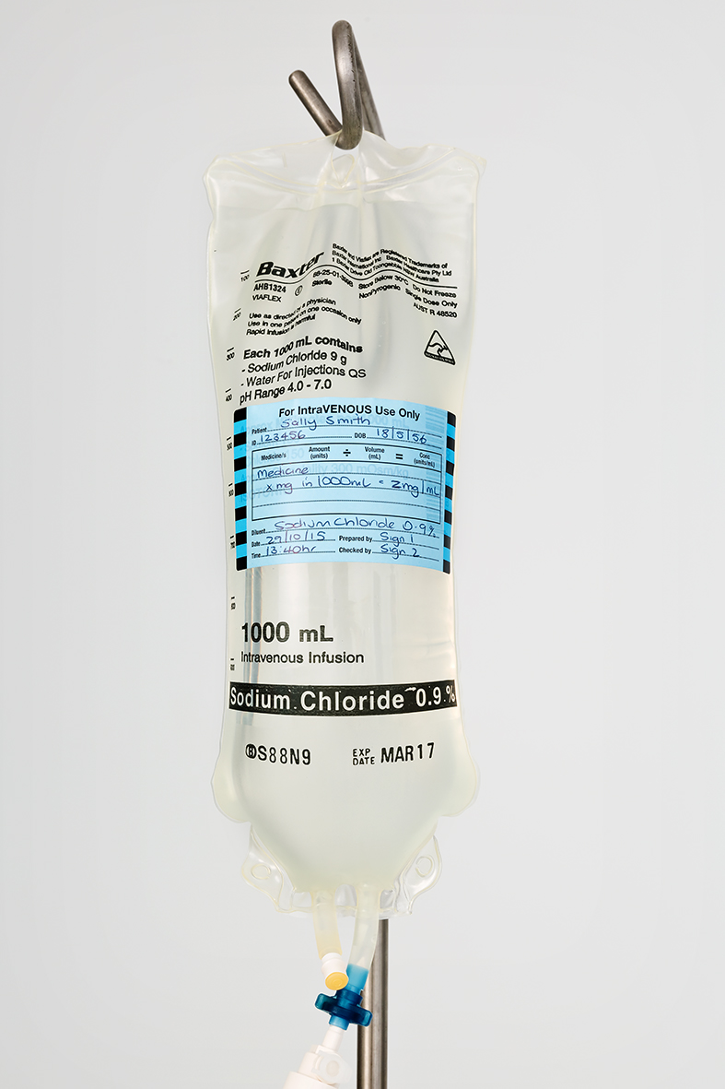
Bags with additives
(continued)
Placement:
Place labels on the FRONT of the bag to ensure the name of base fluid, batch number and expiry date remain visible
Place slightly off centre to ensure graduations on one side of the bag remain visible

Slide 23
Syringes for bolus or infusion
Label IMMEDIATELY all injectable medicines drawn up in syringes that leave the hand of the operator
Prepare and label multiple syringes sequentially in independent operations
Exception: Labelling is not required when
  preparation and bolus administration of a SINGLE medicine from a SINGLE syringe are one uninterrupted process, and
  the syringe DOES NOT leave the hands of the person who prepared it, and
  the same person administers the medicine IMMEDIATELY

Slide 24
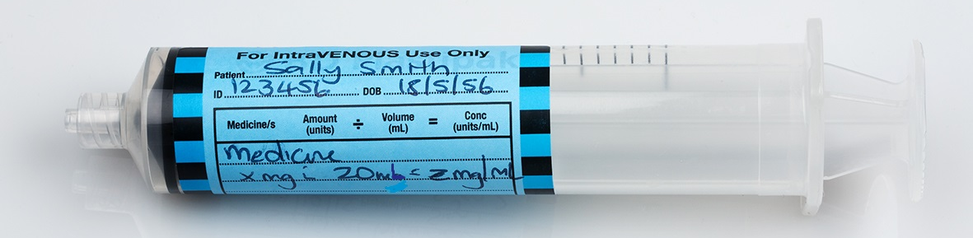
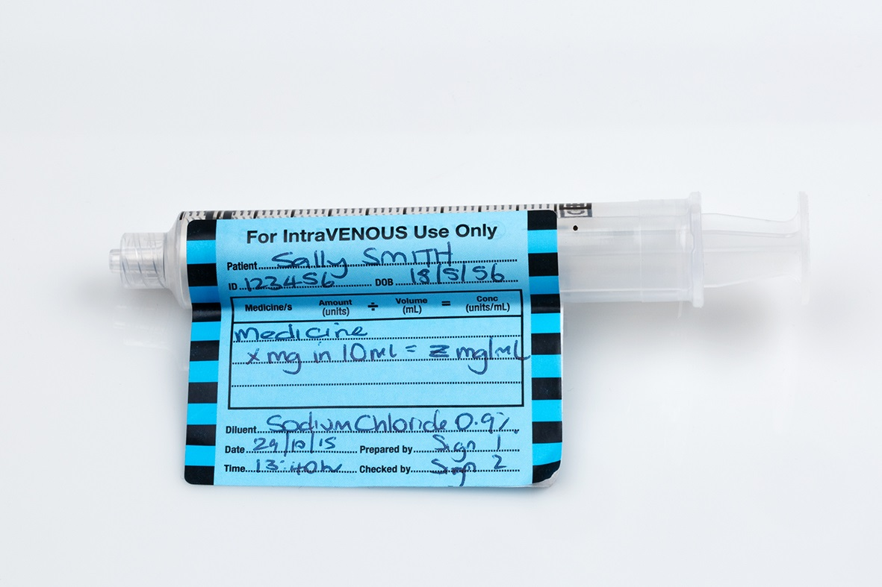
Syringes for bolus or infusion (continued)
Placement
Place label so graduations on the syringe scale remain visible
Apply parallel to the long axis of the syringe barrel, top edge flush with scale
Apply label as a ‘flag’
for small syringes

Slide 25
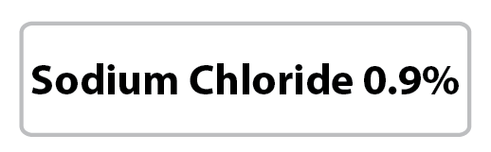
Labelling IV flushes
Label any fluid drawn up in a syringe for use as an IV flush (e.g. 0.9% sodium chloride) unless preparation and bolus administration is one uninterrupted process.

Slide 26
All containers: discarding content
Any unlabelled container holding a solution must be immediately discarded
Any container, where there is doubt over content, must be discarded
Any medicine remaining in the container at the end of a procedure must be discarded

Slide 27

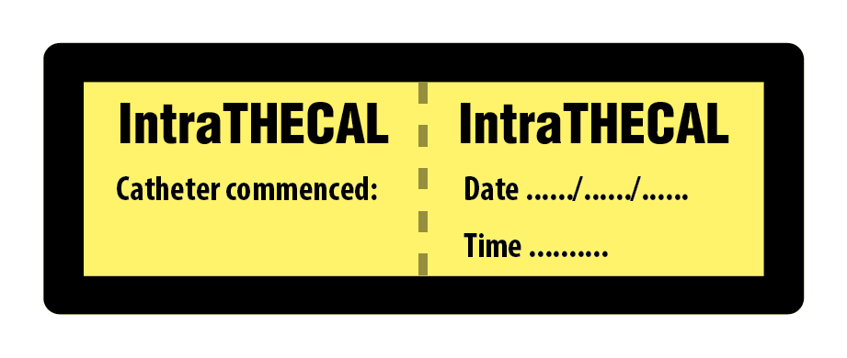


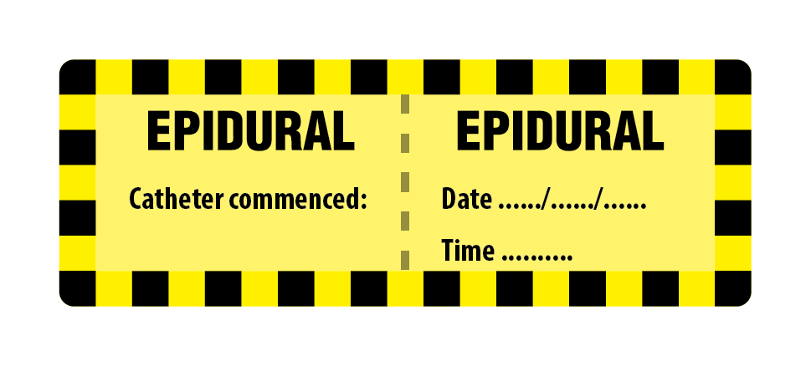


Lines and catheters: route of administration

Slide 28
Lines and catheters: route of administration (continued)
Labelling administration lines and catheters
  Label all lines to identify route
  Add date and time the line was commenced
  Identify catheters where there is a risk of wrong route administration (e.g. where the patient entry portal is distant from the administration site)
Labelling invasive monitoring lines
  Identify all lines, including those not primarily intended for medicine administration

Slide 29
Lines: active ingredient
Identify the active ingredient in administration lines for dedicated continuous infusions.
Labels may be preprinted. Colour should comply with ISO26825:2008. For example
The pre-printed medicine line label guide has more examples
Lines for intermittent infusions may be labelled for medicine content, but ensure label is removed on completion of infusion

Slide 30
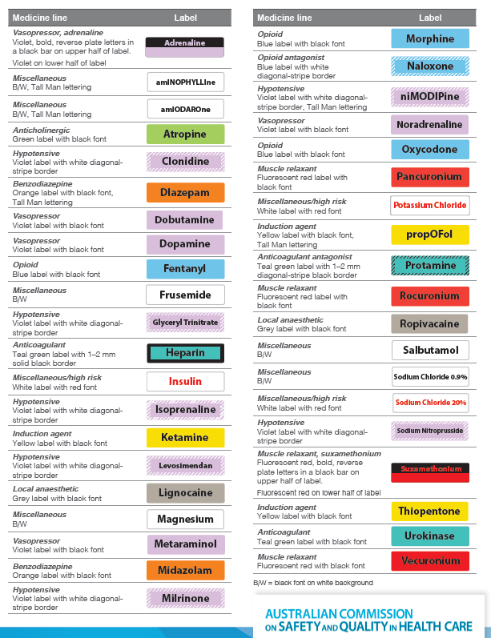
Pre-printed medicine line label guide

Slide 31
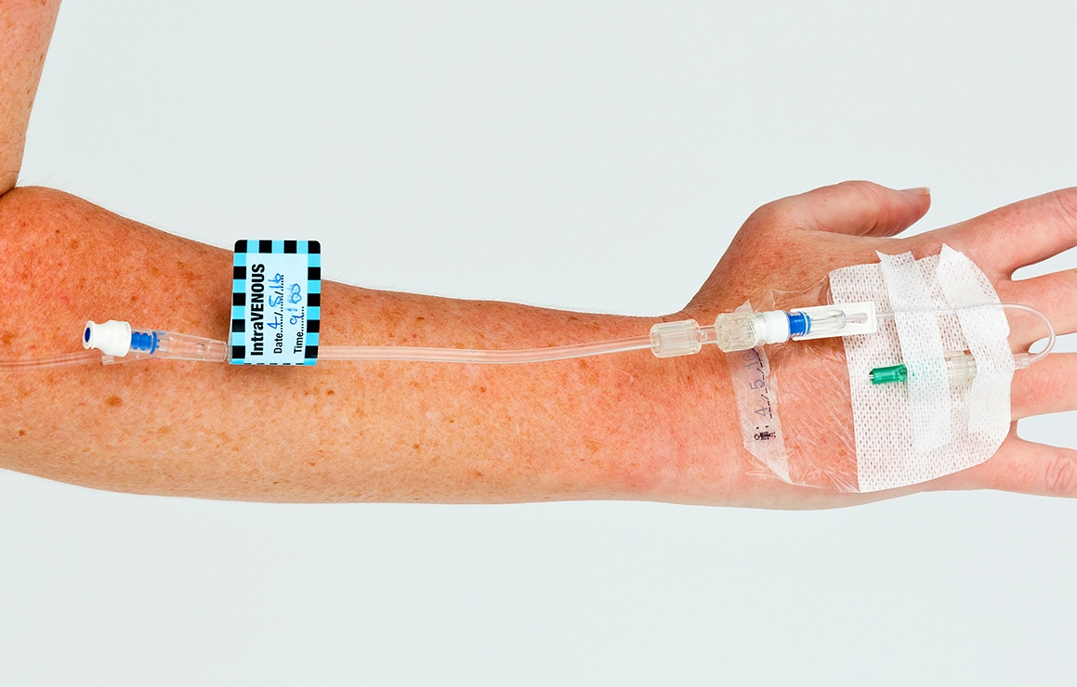
Lines
Label placement
Route:
  Use colour coded route label
  Label near the injection port on the patient side*
  *Exception where there is a possibility of tampering (e.g. paediatric patients)

Slide 32
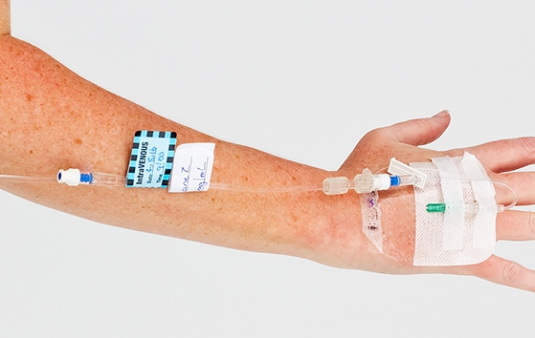
Lines (continued)
Label placement
Active ingredient:
  Use medicine line label (preprinted where possible)
  Label adjacent to route label
  Label close to patient entry portal*
*Exception where there is a possibility of tampering (e.g. paediatric patients)

Slide 33
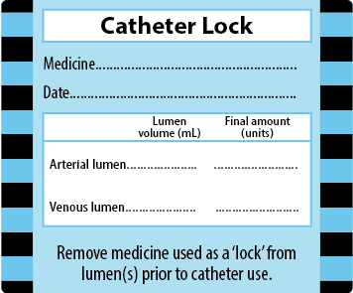
Catheter lock
For central venous access devices that are locked with a medicine (e.g. heparin)
Label to partially cover the catheter dressing
Remove label after removing medicine from the lock
ADD PHOTOGRAPH

Slide 34
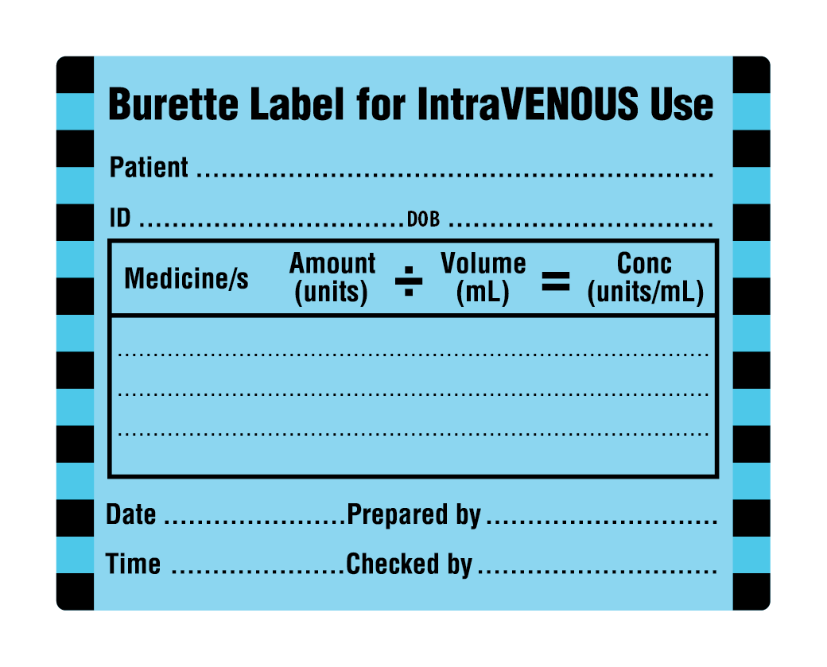
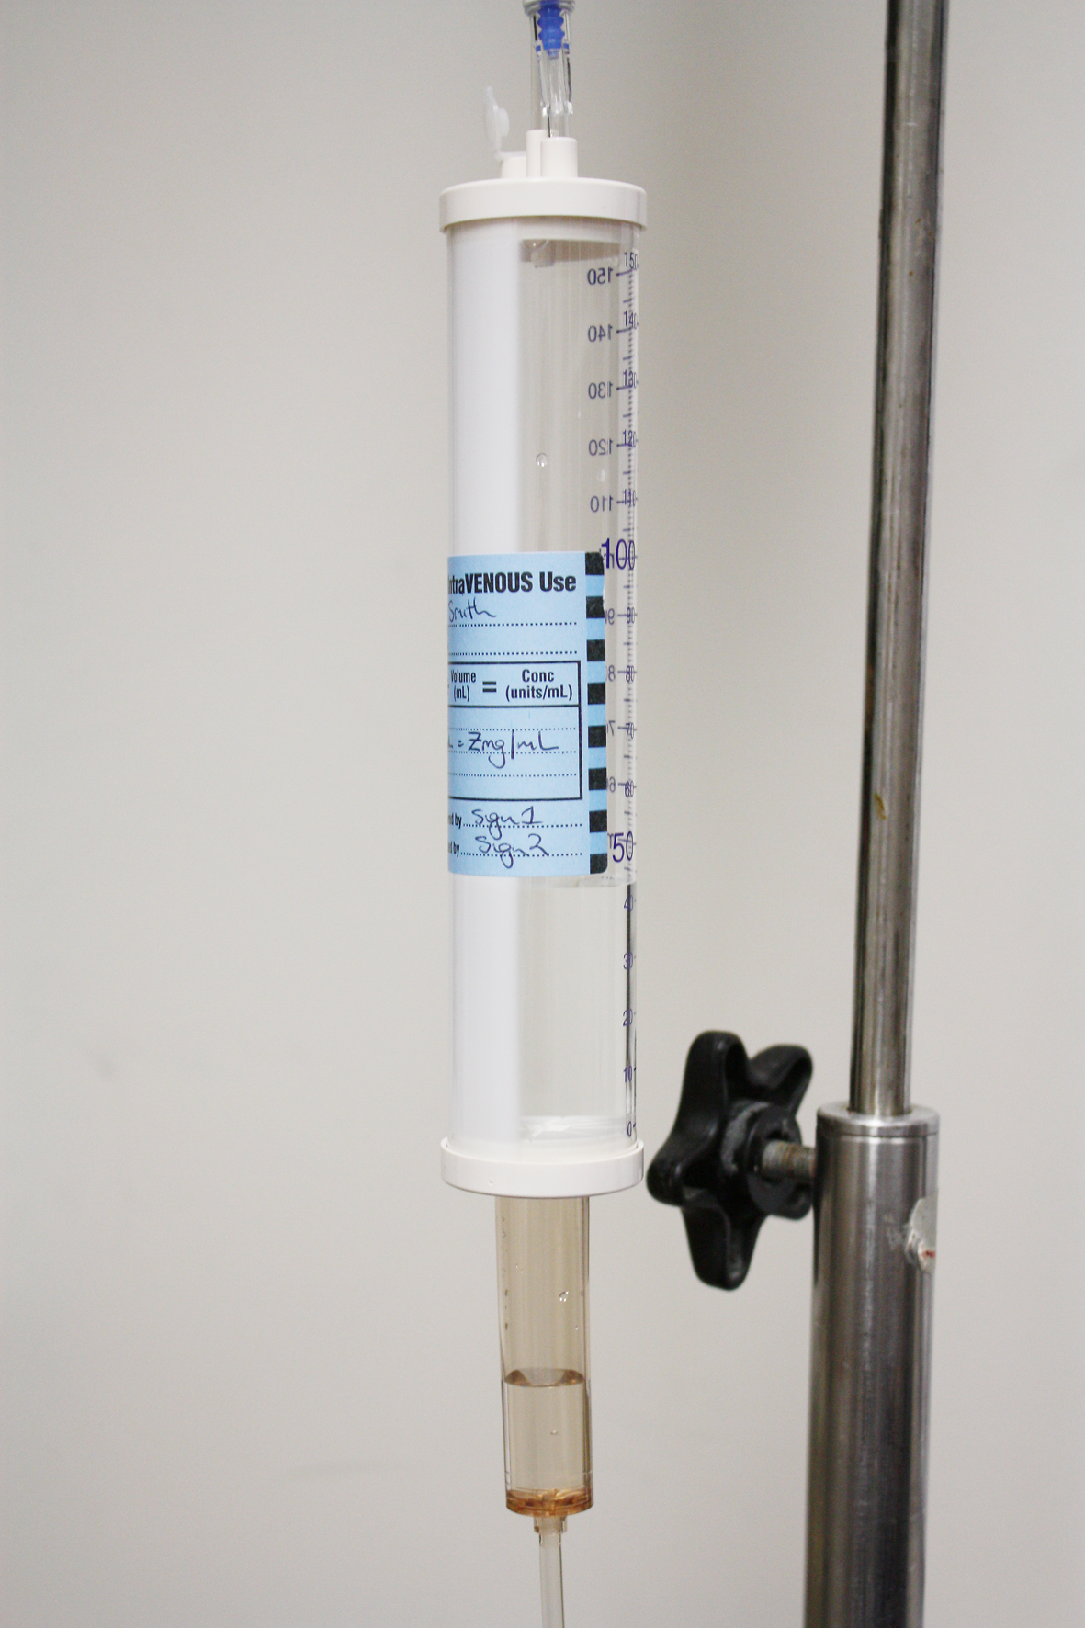
Burettes
Use ‘peel-off’ labels reserved for use on burettes ONLY
Place label so that text is upright and ensure that the burette graduations are not obscured
Burette labels must be removed once the medicine has been administered to the patient

Slide 35
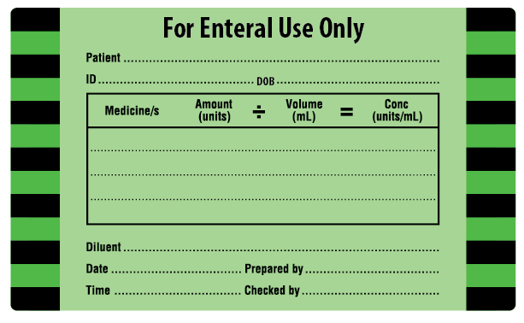
Non-injectable medicines: enteral route
Syringe and line labels
Syringes for non-injectable solutions must not be compatible with parenteral entry points

Slide 36
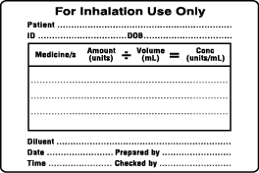
Non-injectable medicines: inhalation route
Label syringes used to measure nebuliser solutions

Slide 37
Closed-practice environments

Slide 38
Sterile field (i.e. aseptic conditions)
Closed-practice environment: where patient identification is established and other means of recording labelling and preparation signatories are available
Examples: perioperative sterile field, interventional cardiology and radiology procedure rooms

Slide 39
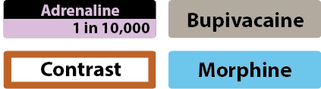
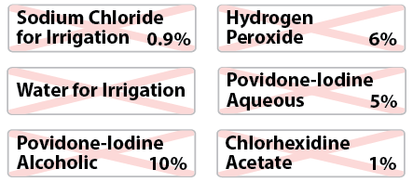
Sterile field (continued)
Any container holding medicines or fluids on the perioperative sterile field must be identifiable
Preprinted abbreviated container labels can be used
Non-injectable medicines and fluids are identified with a red St Andrew’s Cross watermark
Sterile markers must be available to complete generic labels

Slide 40
Perioperative environments

Slide 41
Perioperative environments
Continue to label syringes containing drugs used during anaesthesia to comply with ISO26825:2008
Use preprinted labels or the ‘peel off’ abbreviated container label where patient identity is established and there are other means of recording labelling and preparation signatories

Slide 42
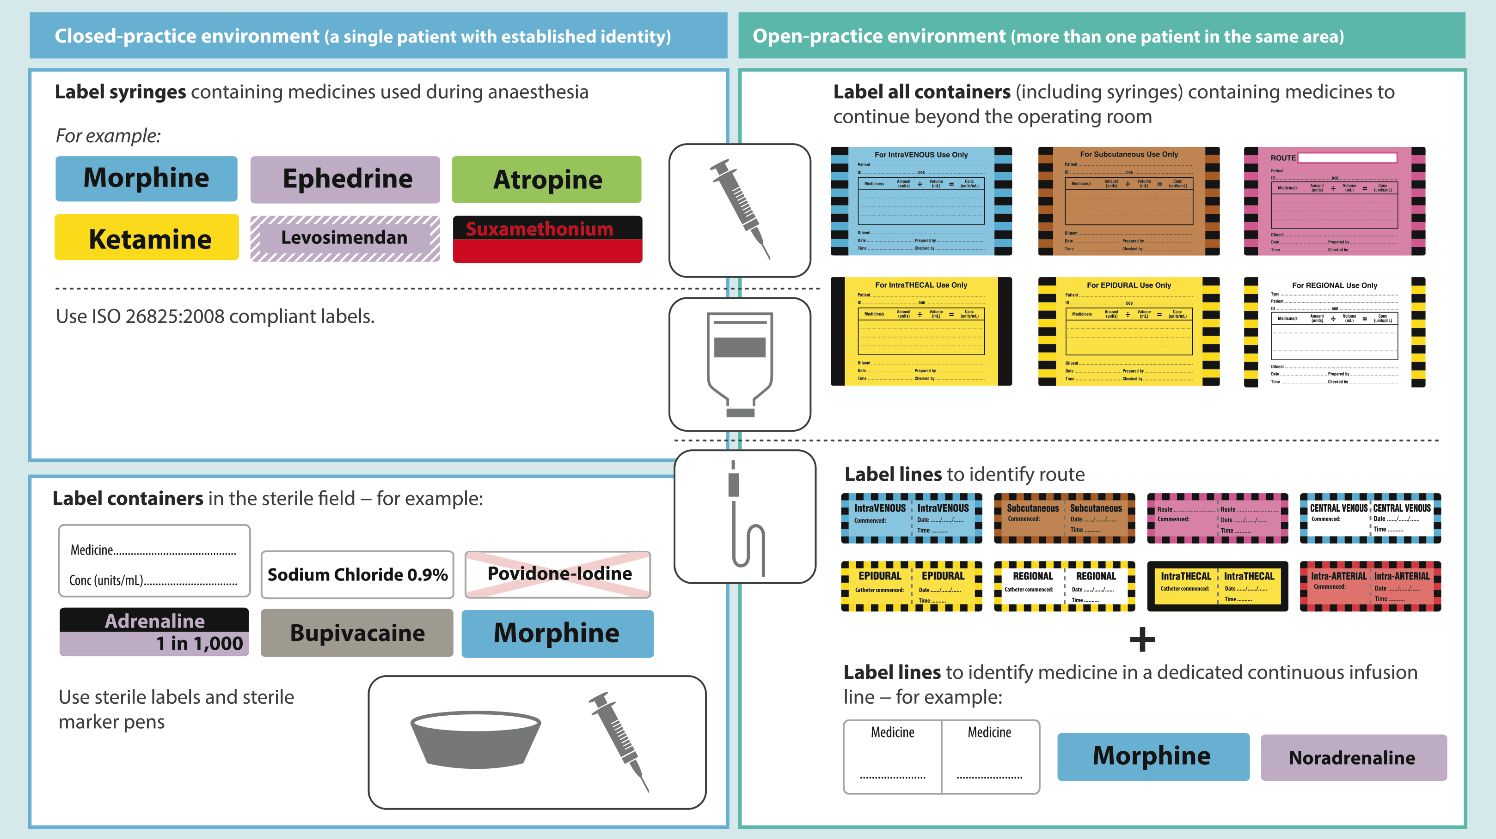
Perioperative environments

Slide 43
Perioperative sterile field
Use preprinted label sheets with medicine name and concentration. Colour coding to follow ISO26825:2008 (Anaesthetic Labelling Standard)
Use abbreviated container label where preprinted labels unavailable
Labels must remain intact for duration of procedure
Labels must adhere for duration of procedure
Labels should be removed at the end of the procedure for reusable hollowware containers

Slide 44
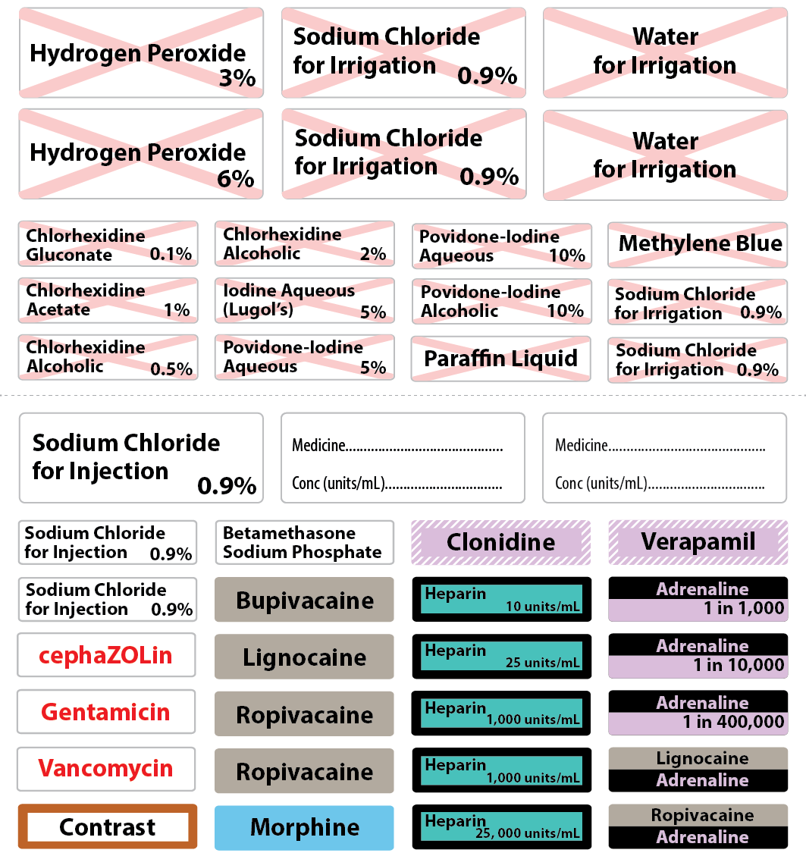
Perioperative sterile field
Example of preprinted label sheet for perioperative sterile field
Note that labels for non-injectable fluids (with the St Andrew’s Cross) are in a separate section on the sheet

Slide 45
Interventional cardiology, radiology and other low-light procedure areas

Slide 46
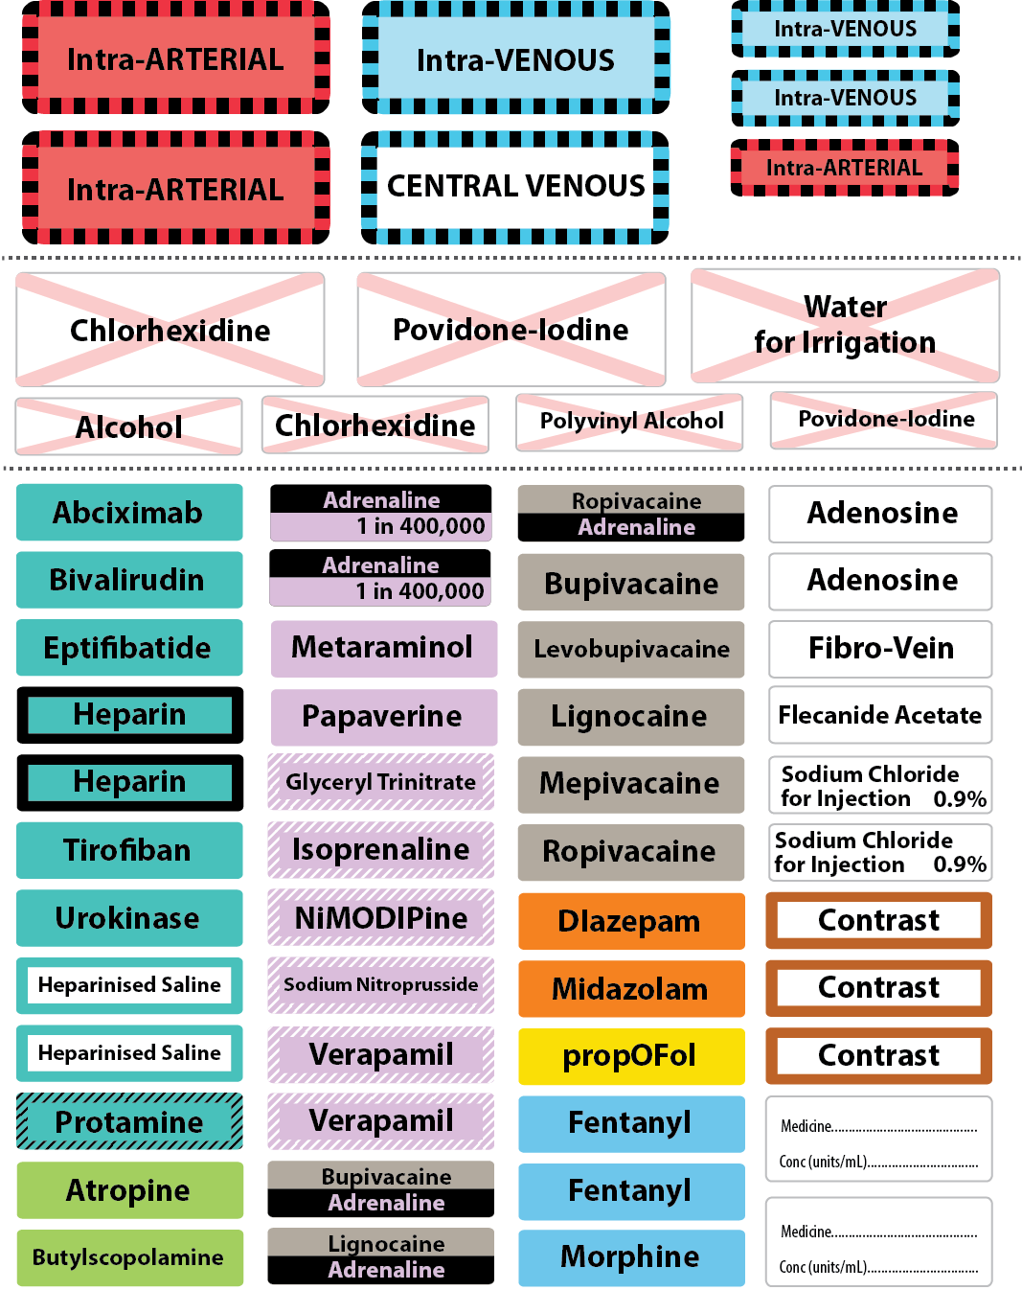
Low-light procedure areas
Use preprinted label sheets with medicine name
Colour coding to follow ISO26825:2008 (Anaesthetic Labelling Standard)
Example preprinted label sheet for cardiac catheter laboratory

Slide 47
Further information:
Australian Commission on Safety and Quality in Health Care www.safetyandquality.gov.au

