Slide 1
A Regional Women's Health Services approach to HMB
Presented by:
Louise Holland
Clinical Nurse Consultant

Slide 2
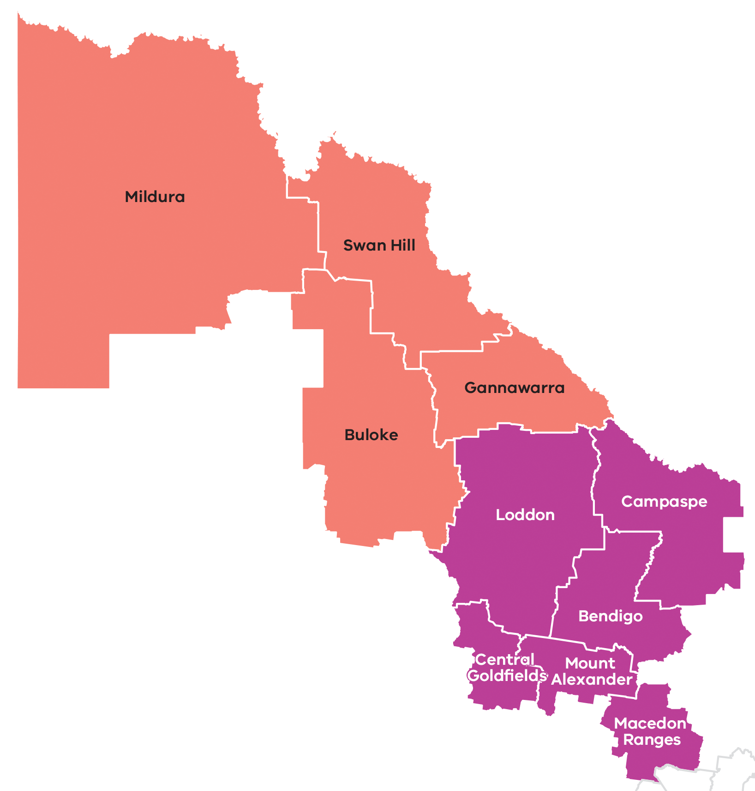
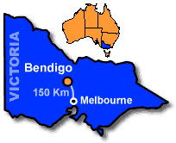
Where are we?

Slide 3
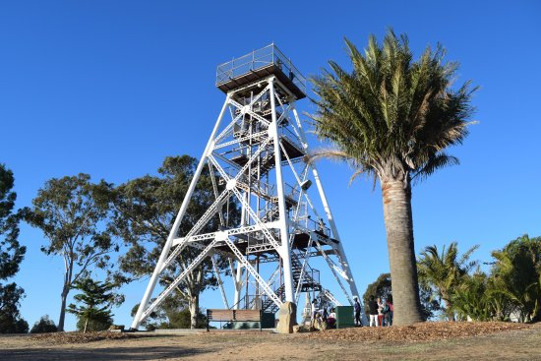
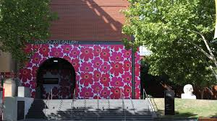
Bendigo – Loddon Mallee region
Notes:
In Greater Bendigo the population aged 25 - 64 years is projected to increase by 13,871 people (25%) in Greater Bendigo and this increase is much higher than the regional Victoria (10%) average and higher than the Victoria (22%) average. In Loddon, the population aged 25 - 64 years is projected to decrease by 675 people (-19%).

Slide 4
Access to female health professionals
Access:
2008 = Number of female GPs in Bendigo specialising in Women’s Health and providing mainstream bulk billing services was limited to less than 5.
2018 = Number of female GPs providing this service as a mainstream bulk billing service has increased.
Women in Greater Bendigo and Loddon have less access to bulk billing compared to Victorian average.
Disadvantage:
Report : “Dropping off the edge 2015: persistent communal disadvantage in Australia”*
Postcodes: 3520 (Korong Vale)
3523 (Heathcote),
3556 (Eaglehawk)
These are among the 20 most disadvantaged postcodes in Victoria , these locations were also in the top 5% of most disadvantaged Victorian postcodes in 2007.
Bendigo Loddon Primary Care Partnership Population Health Profile - 25 May 2017, Bendigo Loddon Primary Care Partnership, Bendigo, Victoria
Notes:
“Dropping off the edge 2015: persistent communal disadvantage in Australia”*
The report found that postcodes: 3520 (Korong Vale); 3523 (Heathcote), and 3556 (Eaglehawk) are among the 20 most disadvantaged postcodes in Victoria and that all locations were also in the top 5% of most disadvantaged Victorian postcodes in 2007.
Access
This data indicates that residents of Greater Bendigo and Loddon, particularly of Loddon, have less access to bulk billing medical services compared to the Victorian average.
In 2014, Greater Bendigo females aged 50 to 74 years were more likely to have had a mammogram in the past two years compared to the Victoria and regional Victoria average; while Loddon females were less likely.
In 2014, compared to Victoria (83.1%), a greater proportion of Greater Bendigo and Loddon females aged 18 years and over reported they had ever had a Pap Test. However, just 48% of Loddon females reported they had a Pap Test within the last 2 years compared to the Victorian average of 72.1%.
Bendigo Loddon Primary Care Partnership Population Health Profile - 25 May 2017, Bendigo Loddon Primary Care Partnership, Bendigo, Victoria
Numbers of female HP in region
PHN data
GP services delivered - by sex (2009-12)
Within the Murray PHN catchment, the lowest rate of GP services delivered per female population was seen in the North East region, followed by the Central Victoria region. In total, 17 put of 22 Murray PHN LGAs had a lower rate than the Victorian average of GP services delivered per female population.
The rate of GP services delivered per male population was lower in 19 out of the 22 Murray PHN LGAs, compared to the Victorian average. Rates were lowest in the North East then Central Victoria regions. Males had a substantially lower rate than females of GP services delivered per population.
https://www.phnexchange.com.au/central-Victoria

Slide 5
The team
Notes:
In response to the Victorian Government's – Women’s sexual and reproductive health strategy
BCHS was one of the first Pilot Sexual and reproductive Hubs.
Our response:
GPs trained in MTOP increased from 2- 4 ( 3 are providing the service at CBD clinic)
GPs trained in IUD LARC increased from 1- 3 ( 2 are providing the service from our CBD clinic)
Sexual health nurses to complete Implanon NXT training and provide Implanon insertion and removals- ( x2 Nurses completed the training and providing the service)
Access to LARC services from 3 to 5 days a week- ( this has been implemented)
Equipment:
Upgraded consult rooms in Central clinic and Eaglehawk
Installation of new Gynae beds / lighting/ in all female GP rooms
Purchased upgraded specula equipment for examinations

Slide 6
Well Women’s Clinic
MODEL OF CARE
Referrals:
Self by women
Internal GPs
External GPs
Extended Women’s Health Services:
Mirena and Copper IUD insertion
Nurse Implanon insertion and removal
Collaborative Nurse/GP Medical Termination
Secondary consult with a nurse:
Women’s Health Nurses within LMR
GPs outside Bendigo
Notes:
Women can self refer to the service
Our Primary care service ; our Opiate Substitution Program all refer women into our clinic
GPs within the Greater City of Bendigo (particularly male GPs)
GP practices that do not provide the specialist women’s health services.
GPs outside Bendigo from the surrounding LGA’s.

Slide 7
Model of care: Nurse consultation
Appointment times: 30 – 45 minutes
Her story: Psychosocial and History Assessment
Investigations:
Cervical screening test, STI testing, vaginal swabs etc.
Depends on outcome of investigations GP assessment:
Referral to female GP in team.
What is happening
How is this affecting her day to day life
What is her idea of being a “woman”?
Notes:
In 2014 Greater Bendigo:
Mammograms: Females aged 50 to 74 years were more likely to have had a mammogram in the past two years compared to the Victoria and regional Victoria average.
Loddon females were less likely.
Cervical Screening:
In 2014,
compared to Victoria (83.1%), a greater proportion of Greater Bendigo and Loddon females aged 18 years and over reported they had ever had a Pap Test. However, just 48% of Loddon females reported they had a Pap Test within the last 2 years compared to the Victorian average of 72.1%.

Slide 8
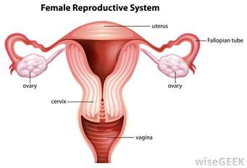
Model of care: Nurse consultation
Education & information
Fact sheets
Recommended websites:
www.Jeanhailes.org.au
www.menopause.org.au
www.thewomens.org.au
IUS Mirena:
Surgery: Ablation
Notes:
Providing relevant

Slide 9
Further considerations
Addressing the Victorian Governments: Women’s sexual and reproductive health; Key priorities 2017-2020
Re-orientate healthcare in primary health setting by utilising the skilled and experienced women’s health nurses who traditionally provided cervical cancer screening under previous National guidelines.
Advocate for innovative models of care to be supported to be financial sustainable for Primary and Community Health Centres.
Support referral systems into Sexual and Reproductive Hubs within Victoria.
Notes:
Women’s health services in Primary care have been impacted by the new Cervical screening guidelines- a thorough women’s health assessment at the tome of the “pap test” often identified issues of HMB.
The skill and experience of such PN can be utilised by PHC centres as part of a nurse /GP led model.
Financial sustainability for PHC and CHC is fundamental- advocating the Commonwealth to revise Medicare items to reflect this work.
Some GPs prefer to refer on “complex” women’s health clients : referrals to Hubs that are comprehensive reduces patient delay/ frustration/ poor outcomes.

Slide 10
THANK YOU
Louise Holland
Clinical Nurse Consultant
Connect with us at
www.bchs.com.au
Working hand in hand with our community to achieve healthier lives.

