Slide 1
ISLHD Health Literacy Framework 2012 - 2015
A Plan for Becoming a Health Literate Organisation
Vicki Biro, Fiorina Mastroianni and Lucy Vellar
Clinical Governance Unit (CGU)

Slide 2
Key Principles of the ISLHD Health Literacy Framework
Embed health literacy into high-level systems and organisational policies and practices.
Integrate health literacy into our planning and evaluation for clinical and quality improvement.
Have plain English health information that is easy to read, understand and use.
Partner with consumers in the evaluation of health information and access and navigation of services.
Have effective and evidence based health literacy strategies in interpersonal communication.

Slide 3
Accreditation and National Standards
The ISLHD Health Literacy Framework provides a model that
Enables our health service to be responsive to patient, carer and consumer needs by specifically meeting Standard 2. 4 Consulting consumers on patient information distributed by the organisation
Meets actions relevant for health service organisations as outlined in the ACSQHC Health Literacy National Statement
Supports accreditation requirements for the organisation in relation to quality and safe health care that is consumer focused

Slide 4
Key Components of ISLHD Health Literacy Framework
Plain language consumer information
Systems and Resources to drive and support change
Organisational resources to drive and support change
Patient Information Portal (PIP)
Becoming a health literate organisation
Health Literacy Ambassador Program
•
Access and way-finding
Effective communication (teach-back)
Notes:
Resources for Change:
Allocated resources to health literacy at a District level (Patient Information Coordinator)
governance around consumer information – ‘a new way of doing business’
Plain English Consumer Information procedure / Plain English Guidelines
Plain Language Consumer Information:
Patient Information Portal (PIP) – intranet site for ISLHD staff to find plain English and translated consumer information that has been developed by the ISLHD. The site also contains tools to help staff develop new plain English consumer resources, information about health literacy and links to useful external consumer information resources.
Health literacy and teach-back information and resources also available on the PIP
Plain English medication labels (in progress)
Multi-lingual grants program
Health Literacy Ambassador Program:
Support staff at their respective site /service to produce patient information that is in plain English and easy to use and understand
Training and on-going support provided by Patient Information Coordinator
Goal = conduct stock-take of all consumer information used by their departments / ward to identify which information is in plain English and tested with consumers.
Access & Way-Finding
ACCESSAbility Hospital Way-Finding Program
Welcome to The Wollongong Hospital Tours for Refugees and newly arrived Migrants
Joint staff / consumer way-finding committee (new TWH development)
Education Programs
Health literacy information provided to all new staff at general orientation
Health literacy information provided to 4th year medicine students, psychiatric registrars, ….
ISLHD Health Literacy training resources available on the PIP
Teach-back training package available on the PIP (in progress)
Patient Information Portal (next slide)

Slide 5
Key Outcomes
Governance system for the plain English consumer information - ISLHD Procedure OPS 61 Development and Publishing of Plain English Consumer Information
ISLHD Patient Information Portal (PIP) went live November 2013
Toolkit - writing guides, testing tools and templates
Over 4,800 visits to the PIP site, and over 221,000 pages viewed since November 2013
We have engaged over 900 consumers in the testing of health information

Slide 6
http://islhnintranet/Patient_Information_Portal/
Notes:
First in state and in Australia
One-stop-shop for consumer information resources
Tools to support and build capacity of staff to develop plain English consumer resources and to engage with patients
Tools and information for our HLAs
Information about health literacy and teach-back

Slide 7
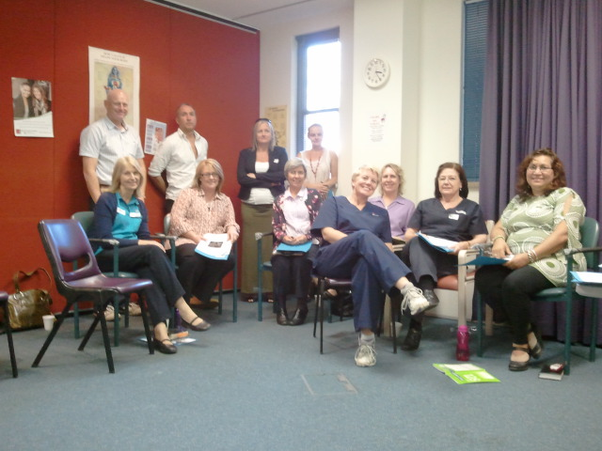
Key Outcomes
Provision of Health Literacy Ambassador training and resources
Over 70 HLAs recruited
Health literacy information is provided to all new staff at general orientation
Health literacy CPI project commenced to reduce cancellation and poor attendance rates

Slide 8
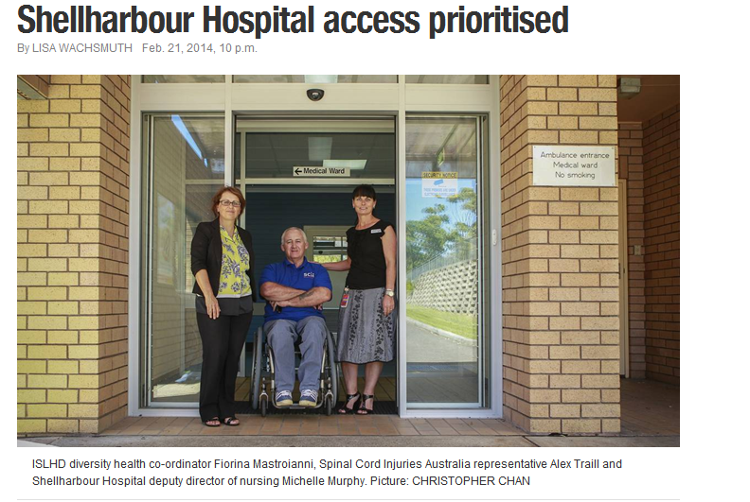
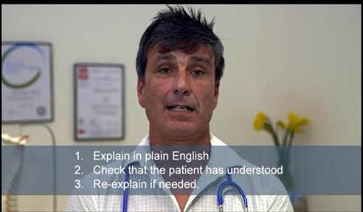
Key Outcomes
Partnership with consumers and consumer advocacy groups to conduct ACCESSAbility Way-Finding Audits at our sites
Audio-visual teach-back training resources developed and available on the Patient Information Portal (PiP)

Slide 9
How will we know we are achieving our goals?
Number of
Staff using PiP
Resources in plain English / language
Consumers consulted
ACCESSAbility Audits & site improvements
HLAs recruited and trained
Consumer information inventories completed

Slide 10
How will we know we are achieving our goals?
Six month reviews of HLA and PiP program
Annual audit of completed consumer resources to measure compliance with Procedure (including consumer feedback)
Health literacy methodology integrated into all District clinical practice improvement projects
Notes:
Last point re: integrating HL into all district CPI projects – this means that we will incorporate additional elements of:
review of consumer information linked to issue / problem being evaluated
Involvement of consumers to improve information (in plain English)
Evaluation of access to services and navigation in our facilities

Slide 11
Collaboration to promote health literacy
CEC and ACSQHC support for the launch of PIP in November 2013 – including key note addresses on health literacy
The NSW Clinical Excellence Commission (CEC) is promoting the ISLHD’s Health Literacy Framework and some of its key components on the CEC website as an exemplar for other LHDs

Slide 13
Collaboration to promote health literacy
The Australian Commission for Safety & Quality in Healthcare (ACSQHC) has included the ISLHD Health Literacy Framework as a example of a coordinated approach to addressing health literacy in ACSQHC Health Literacy Background Paper, 2014.
National Health Round Table Innovation Workshop and Awards, Nov 2014
Innovation Award for Improving Self Care
and
Innovation Award for Partnering with Consumers to improve patient care

Slide 15
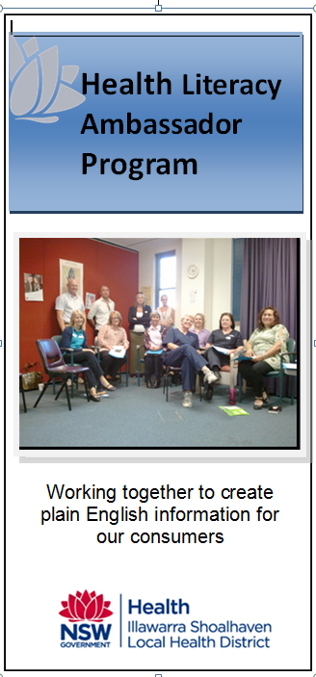
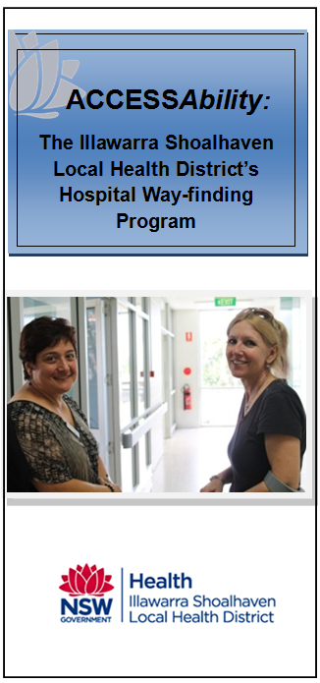
Packaging PIP

Slide 16
For more information email:
ISLHDpatientinfo@sesiahs.health.nsw.gov.au

