Slide 1
Comprehensive Care
Implementing the Standard
Name
Position
Notes:
Speaker notes:
One of the key drivers for safety and quality improvement in Australia are NSQHS Standards. The NSQHS Standards were developed by the Commission in collaboration with the Australian Government, state and territories, the private sector, clinical experts, patients and carers. The primary aims of the NSQHS Standards are to protect the public from harm and to improve the quality of health care provision. They provide a quality assurance mechanism that tests whether relevant systems are in place to ensure expected standards of safety and quality are met.

Slide 2

National Safety and Quality Health
Service Standards (2nd edition)
Notes:
Speaker notes:
The second edition of the NSQHS Standards¹ includes the following eight standards:
Clinical Governance Standard
Partnering with Consumers Standard
Preventing and Controlling Healthcare-Associated Infection Standard
Medication Safety Standard
Comprehensive Care Standard
Communicating for Safety Standard
Blood Management Standard
Recognising and Responding to Acute Deterioration Standard.
The Comprehensive Care Standard, relates to the delivery of comprehensive care for patients within a health service organisation. Safety and quality gaps are frequently reported as failures to provide adequate care for specific conditions, or in specific situations or settings, or to achieve expected outcomes in particular populations.

Slide 3





Comprehensive Care Standard
Addresses cross-cutting issues that underlie many adverse events
Focuses on care that balances patient clinical and personal goals
Recognises the importance of teamwork and collaboration in high quality care
Introduces important safety and quality requirements for people with mental health and cognitive impairment, or people at the end of life
Incorporates requirements from first edition for falls and pressure injuries
Notes:
Speaker notes:
The intent of the Comprehensive Care Standard is to ensure that patients receive comprehensive care – that is, coordinated delivery of the total health care required or requested by a patient. This care is aligned with the patient’s expressed goals of care and healthcare needs, considers the impact of the patient’s health issues on their life and wellbeing, and is clinically appropriate. In addition, the Comprehensive Care Standard aims to ensure that risks of harm for patients during health care are prevented and managed. Clinicians identify patients at risk of specific harm during health care by applying the screening and assessment processes required in this standard.
Although the Comprehensive Care Standard refers to actions needed within a single episode of patient care, it is fundamental that each single episode or period of care is part of the continuum of care for a patient. Meaningful implementation of the Comprehensive Care Standard requires attention to the processes for partnering with patients in their own care, and for safely managing transitions between episodes of care. This requires that the systems and processes necessary to meet the requirements of this standard also meet the requirements of the Partnering with Consumers and Communicating for Safety standards.

Slide 4



Supporting documents
Notes:
Speaker notes:
Resources have been and continue to be developed to support implementation of the Comprehensive Care Standard.
As new resources are developed you will find them on the comprehensive care webpages. The links are on the last slide.
Currently available resources include:
A conceptual model for supporting comprehensive care delivery
Essential elements for delivering comprehensive care
Approaches to person-centred screening
Coming soon are short guides for the remaining essential elements. These elemenst will be described through this presentation

Slide 5
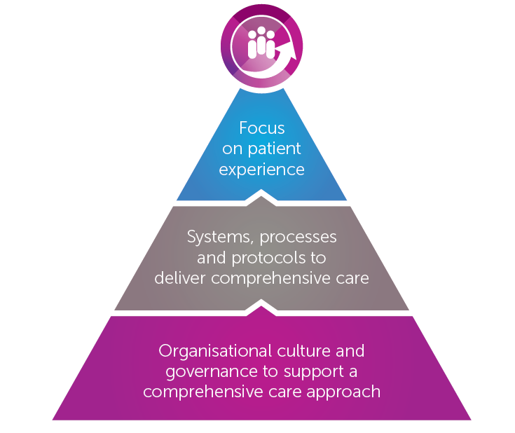
Conceptual model for Comprehensive Care
Notes:
Speaker notes:
To support a shared understanding of the Comprehensive Care Standard, the Commission has developed a conceptual model describing the key organisational requirements for supporting the delivery of comprehensive care in health services. The organisational requirements in this conceptual model are grouped into three domains:
A focus on patient experience:
having an organisation-wide commitment to the delivery of care that is person-centred, and working to improve the patient experience
Systems, processes and protocols to deliver comprehensive care:
having systems, processes and protocols to guide and support healthcare providers to deliver comprehensive care consistently and effectively
Organisational culture and governance to support a comprehensive care approach:
having organisation-wide governance, leadership and systems that embed the delivery of high-quality person-centred comprehensive care as the organisational standard.

Slide 6



Essential elements for Comprehensive Care
Element 1: Clinical assessment and diagnosis
Element 2: Identify goals of care
Element 3: Risk screening and assessment
Element 4: Develop comprehensive care plan
Element 5: Deliver comprehensive care
Element 6: Review and evaluate comprehensive care delivery
Notes:
Speaker notes:
The Commission has identified a set of six essential elements for comprehensive care delivery, which represent different stages or processes that a patient may experience when clinical care is delivered. Whereas the conceptual model provides an organisational perspective of comprehensive care, the essential elements for comprehensive care delivery integrate these organisational pre-requisites with the clinical processes required to care for individual patients.

Slide 7
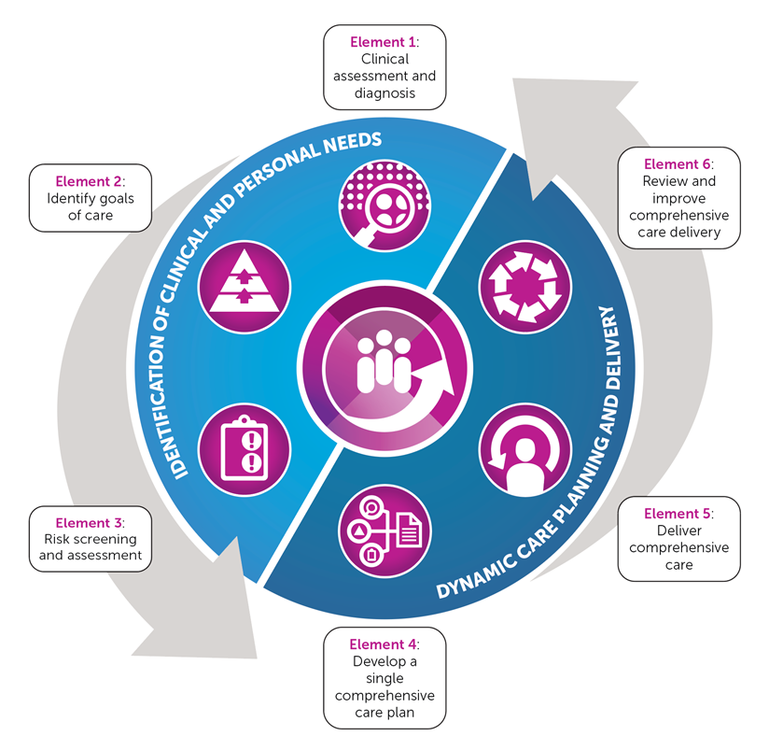
Essential elements for Comprehensive Care
Notes:
Speaker notes:
The figure provides a representation of how these six elements interact and where the patient is likely to come into contact with the elements along their healthcare journey.
Dynamic care planning and delivery requires the identification of clinical and personal needs of every patient. The process is a continuing cycle to support delivery of high-quality care every time a patient attends any facility in Australia.

Slide 8

Element 1: Clinical assessment and diagnosis
To evaluate the clinical information and make a provisional, and possible differential diagnoses
To determine appropriate investigations and actions required by the healthcare team
To prioritise and delegate interventions, timeframes and appropriate escalation processes
To commence the development of an appropriate and effective comprehensive care plan with the patient, families, carers and other support people and the multidisciplinary team
Notes:
Speaker notes:
The first step in delivering comprehensive care is undertaking a clinical assessment. Clinical assessment should be based on the patient’s subjective report of the symptoms and course of the illness or condition, and objective findings from clinical assessment to determine provisional and differential diagnoses.

Slide 9

Element 2: Identify goals of care
Develop a shared understanding of:
The patient’s goals for their health care in the short, medium and long term
The clinical situation, including diagnoses, treatment options and clinical goals
The patient’s values, needs and preferences about their health and care
The patient’s expectations about the care episode and treatment outcomes
Notes:
Speaker notes:
A focus on patient experience is critical to the delivery of comprehensive care. Talking with patients about their needs and preferences helps clarify what is important to them as an individual. Developing a shared understanding of these things can provide a foundation for trust, and a basis for discussion about healthcare options. Understanding a patient’s values and their expectations and aspirations for their health and wellbeing helps to establish their goals for care, and contributes to understanding the actions to be taken.

Slide 10
Element 3: Risk screening and assessment
To gain an understanding of the degree to which a patient might be at risk of harm, or poorer outcomes
To inform decisions about action the healthcare team needs to take immediately to address identified risks such as specific assessment processes, implementation of risk mitigation strategies, and escalation of care where needed
To inform the development of a comprehensive care plan with the patient
Notes:
Speaker notes:
Identifying patients who may be at risk of harm, and mitigating risks for those patients is a core part of comprehensive care planning and treatment.
The Comprehensive Care Standard requires the use of screening and assessment processes with patients, carers and families. In addition to these general screening and assessment processes, the Standard highlights the need to identify specific risks of harm in the areas of falls, pressure injuries, cognitive impairment, malnutrition, self-harm and suicide, violence and aggression, and seclusion and restraint.

Slide 11

Element 4: Develop a comprehensive care plan
To develop a single, clear and holistic plan that includes the goals of care, identified risks, action taken and key treatment information for the episode of care
Provide an accessible resource that can be shared, used and updated by the multidisciplinary team
Notes:
Speaker notes:
A comprehensive care plan is a single document describing the agreed personal and clinical goals of care, and outlining key aspects of planned medical, nursing and allied health activities for a patient to achieve those goals. Patients only need to have one comprehensive care plan; separate plans are not needed for different parts of health care.

Slide 12

Element 5: Deliver comprehensive care
To ensure patients receive coordinated delivery of the total health care required or requested
To ensure the care provided meets the agreed clinical and personal goals of care as described in the care plan
Notes:
Speaker notes:
Patients will require different health care depending on their individual needs, preferences and goals. It is important that care is provided continuously and collaboratively in line with their diagnoses, agreed goals of care and the comprehensive care plan.

Slide 13

Element 6: Review and improve comprehensive care delivery
To confirm the care delivered aligns with the comprehensive care plan
To allow for the revision or modification of the comprehensive care plan and delivery, in response to changes in patient health and circumstances
To review the delivery of comprehensive care and support ongoing quality improvement
Notes:
Speaker notes:
Reviewing the delivery of comprehensive care is important for ensuring patients are receiving care that meets their clinical and personal needs; that risks are efficiently and effectively identified and mitigated; that the agreed comprehensive care plan is achieving what it aimed to; and that patient goals and expectations are being met.

Slide 14
Resources
Web page: https://www.safetyandquality.gov.au/our-work/comprehensive-care/
Conceptual model: https://www.safetyandquality.gov.au/our-work/comprehensive-care/essential-elements-for-comprehensive-care-delivery/
Essential elements: https://www.safetyandquality.gov.au/wp-content/uploads/2018/10/Implementing-Comprehensive-care-Essential-Elements-Accessibility-PDF.pdf
NSQHS Standards second edition: https://www.safetyandquality.gov.au/our-work/assessment-to-the-nsqhs-standards/nsqhs-standards-second-edition/
Guides: Guide for Hospitals (PDF 7MB)
  Guide for Day Procedure Services (PDF 6MB)
  Guide for Multi-Purpose Services and Small Hospitals (PDF 6MB)
Others: User Guide for Aboriginal and Torres Strait Islander Health (PDF 2MB)
  National Model Clinical Governance Framework (PDF 1MB)
  Accreditation Workbook (PDF 3MB)
Fact sheet: Comprehensive Care (PDF 94KB)

