Slide 1
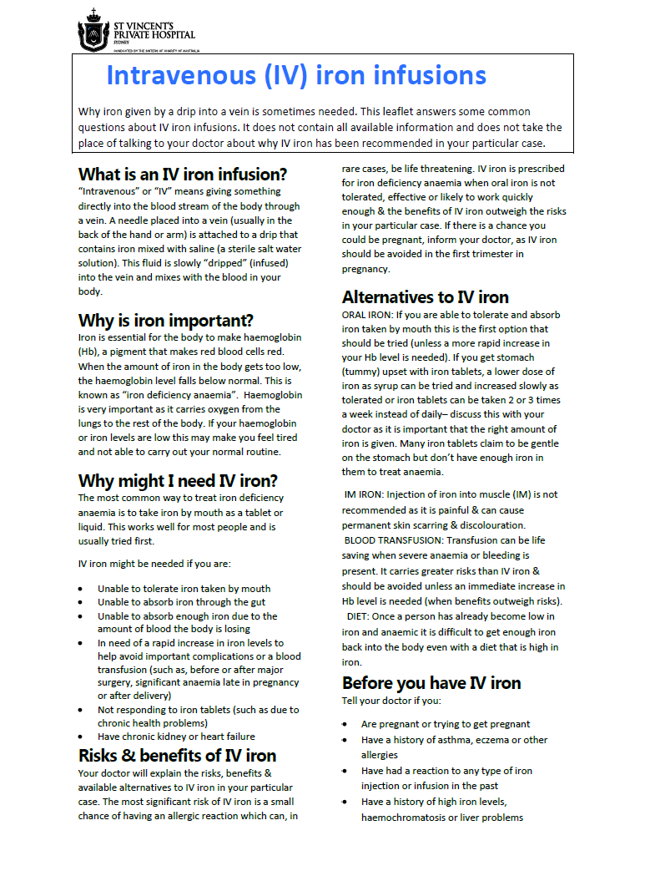
SAMPLE RESOURCE FOR IMPROVED PBM

Slide 2
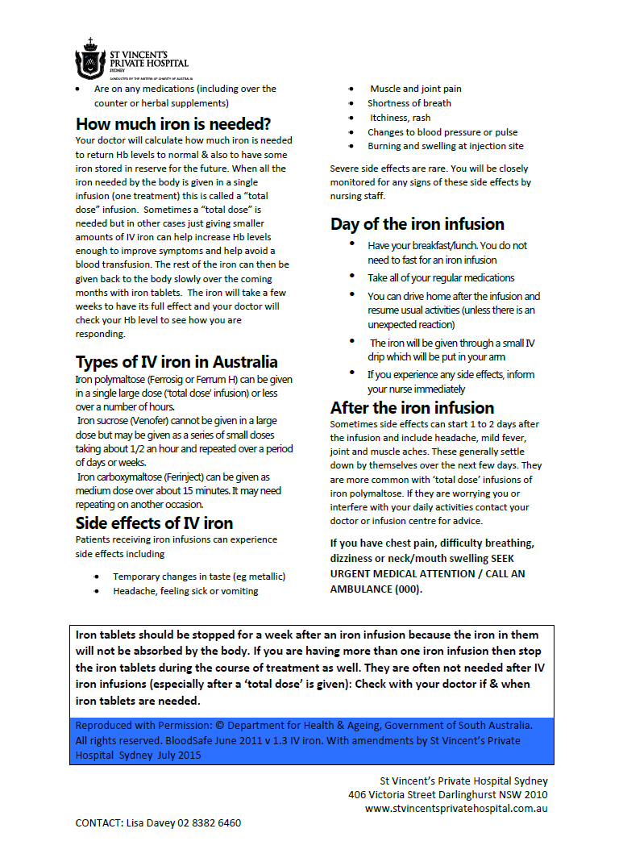
SAMPLE RESOURCE FOR IMPROVED PBM

