Slide 1
Surgical Antimicrobial Prophylaxis
Notes:
These slides have been produced by the Australian Commission on Safety and Quality in Health Care’s Surgical Antimicrobial Prophylaxis Working Group with representatives from the Royal Australasian College of Surgeons; Australian and New Zealand College of Anaesthetists; Australian College of Perioperative Nursing; Australian Private Hospitals Association; National Centre for Antimicrobial Stewardship; Safer Care Victoria and, the NSW Health Clinical Excellence Commission
The content within this presentation can be modified, expanded upon, or points/slides deleted to tailor it to clinical audiences within local hospitals and healthcare facilities where antibiotics are prescribed and used.

Slide 2
Overview
Principles of Antimicrobial Prophylaxis
Surgical Site Infections
Consensus-Based Guidelines
National Safety and Quality Health Service Standards
Auditing Surgical Antimicrobial Prophylaxis
Reasons for Variation
Improving Practice
Resources
Notes:
This is an overview of the content covered in this presentation.

Slide 3
Principles of Antimicrobial Prophylaxis
Objective: Prevent surgical site infections, morbidity and mortality
Optimise the patient’s surgical procedure and overall outcomes
Select the ideal agent and use in an appropriate way
Work against the pathogens most likely to contaminate site, with consideration of their resistance patterns
Shortest effective durations
Correct administration to ensure optimal concentration during the procedure
Minimal adverse effects
Adverse drug reaction from the antibiotic
Selection pressure for resistant organisms
Complications (such as Clostridium difficile infections and cannula site infections)
Notes:
The primary aim of Surgical Antimicrobial Prophylaxis is to reduce surgical site infections whilst minimising costs and adverse effects.
Some risks can be patient level and/or population level.
Adverse effects may include adverse drug reactions from the antibiotic, such as ototoxicity from gentamicin. Selection pressure for resistant organisms can develop within a patient over time when they have prolonged surgical prophylaxis to an antibiotic such as cefazolin. The patient can develop an overgrowth of cefazolin resistant organisms. When cefazolin (or other antibiotics) are administered for prolonged periods without clear benefit, organisms that are already present in the surgical site in low numbers and unlikely to cause infection at the time of surgery, overgrow the organisms that will be killed by the administered antibiotic (antibiotic selective pressure). These can be considered colonisers or contaminants despite sometimes being isolated on swabs after surgery. These organisms are often resistant in the laboratory to cefazolin (eg Enterococcus or Pseudomonas) and can be more difficult to treat if they eventually cause a surgical site infection than the normal skin organisms. Ceasing surgical prophylaxis when it has no clear benefit allows the skin (or surgical site) to return to its normal healthy balance over time and maintain a healthy environment for continued wound healing. Continuing prophylaxis therefore does not mean there will be no growth of organisms in a surgical site.
Complications can include the patient developing Clostridium difficile infection (recent antibiotic use is a risk factor for this) or the patient developing a cannula site infection due to the prolonged administration of IV surgical prophylaxis.

Slide 4
Surgical Site Infection Surveillance
Surveillance Period: Within 30 days or 90 days (if any implantable device is involved) of procedure
Contributing Factors:
Pre-operative | Intra-operative | Post-operative
Underlying medical condition (eg diabetes, obesity, immune compromise) | Surgical and sterile technique
Pre-operative preparation (scrub etc) | Nature and duration of procedure
 | Perioperative management (glycaemic control)
Hospital environment (environmental cleaning)
Suboptimal antimicrobial prophylaxis
Ref: 1 & 2
Notes:
A surgical site infection is defined as an infection that occurs within 30 days after the procedure or 1 year if a prosthesis is inserted. There are many contributing factors to the development of surgical site infections of which antimicrobial prophylaxis is one of them. Further information can be found in the Commission’s Surgical Site Infection Definition document (https://www.safetyandquality.gov.au/former-publications/surgical-site-infection-ssi-definition-pdf-196-kb/) or Approaches to Surgical Site Infection Surveillance document (https://www.safetyandquality.gov.au/publications/approaches-to-surgical-site-infection-surveillance/ )

Slide 5
Antimicrobials – part of the Surgical Site Infection Puzzle
Ref: 3 and 19
Whilst alcohol -based surgical skin preparations have been used in theatres over many years with rare fire and burns complications, it is important to note that appropriate precautions should be undertaken
Notes:
Antimicrobials are a key factor in the prevention of surgical site infections. This is why the development of antimicrobial resistance is of significant concern, because if antibiotics lose the ability to prevent infections, then the risk of surgery may outweigh the benefits of it.

Slide 6
Consensus-Based Guidelines
New version expected to be published in February 2019
Ref: 4
Notes:
The Australian Therapeutic Guidelines are the main reference for evidence based guidelines in Australia and have in depth coverage of surgical prophylaxis.

Slide 7
Consensus-Based Guidelines
The Centres for Disease Control advocate:
Clean/clean-contaminated procedures do not require antimicrobials after surgical incision is closed (even if drain present)
Topical antimicrobials should not be applied to the surgical incision
Time antimicrobials to maximise concentration in serum/tissues at incision time
Ref: 5
Notes:
The Centres for Diseases Control in America advocated that low risk procedures do not need antibiotics once the surgical incision is closed. This is shorter duration than the currently advocated “less than 24 hours”.

Slide 8
Local Guidelines
Organisations can use this slide to highlight their own local surgical prophylaxis guidelines. Many health care settings will not need to develop local guidelines but it may be a useful exercise to engage key stakeholders and create local endorsement.

Slide 9
National Safety and Quality Health Service Standards
Antimicrobial Stewardship
Surgical Antimicrobial Prophylaxis is an important consideration in Antimicrobial Stewardship
Ref: 6
Notes:
The Australian Commission on Safety and Quality In Health Care developed the National Safety and Quality Health Service Standards to drive the implementation of safety and quality systems to improve patient care. Surgical Prophylaxis is a key consideration within the Antimicrobial Stewardship criterion.

Slide 10
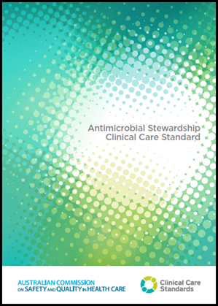
Antimicrobial Stewardship Clinical Care Standard
Consists of quality statements describing the clinical care that a patient should be offered for a specific clinical condition, and suggested indicators for monitoring
Quality statement 9 pertains to surgical antimicrobial prophylaxis:
Suggested indicators for surgical prophylaxis:
9a: Proportion of patients for whom surgical prophylaxis antibiotics were prescribed in accordance with guidelines.
9b: Proportion of patients who are administered indicated prophylactic antibiotics within 2 hours before a surgical procedure.
9c: Proportion of patients whose prophylactic antibiotics were discontinued within 24 hours after surgery, or 48 hours for vascular surgery.
Ref: 7
Notes:
The Antimicrobial Stewardship Clinical Care Standard aims to ensure that a patient with a bacterial infection receives optimal treatment with antibiotics. ‘Optimal treatment’ means the right antibiotic to treat their condition, the right dose, by the right route, at the right time and for the right duration based on accurate assessment and timely review.

Slide 11
Advisory no: A17/01
“Health service organisations should ensure surgical prophylaxis is included and addressed as part of their antimicrobial stewardship program”
Ref: 8
Notes:
In response to successive National Antimicrobial Prescribing Surveys (NAPS) showing sustained levels of inappropriate prescribing of antimicrobials the Australian Commission on Safety and Quality in Health Care circulated an Advisory notice to draw attention to the issue. NAPS is one example of an activity organisations may do to assess their surgical prophylaxis. Organisations may develop their own local audit or adapt one that is already available such the NSW CEC 5x5 audit (http://www.cec.health.nsw.gov.au/patient-safety-programs/medication-safety/antimicrobial-stewardship/quah/5x5-antimicrobial-audit )

Slide 12
Auditing Surgical Antimicrobial Prophylaxis in your health service organisation
HNAPS – Hospital National Antimicrobial Prescribing Survey
SNAPS – Surgical National Antimicrobial Prescribing Survey
Local audit tools e.g. Simplified audits designed by the organisation to measure what they wish to target.
Monitoring antimicrobial use and surgical site infections continuously with Infection Prevention Staff
Notes:
There are many options for auditing surgical antimicrobial prophylaxis depending on the facilities context, casemix and resources available.
Hospital NAPS captures surgical prophylaxis greater than 24 hours as an indicator – but it does not capture timing of administration with respect to incision, or re-dosing in relation to procedure duration
Surgical NAPS is specifically designed for surgical (and non-surgical) procedures - captures more comprehensive data on the quantity and quality of antimicrobial prescribing in this setting.

Slide 13
Hospital NAPS 2017
The Hospital National Antimicrobial Prescribing Survey is a voluntary survey assessing antimicrobial appropriateness in Australia
On average 30.5% of antimicrobial prophylaxis in inpatients extended 24 hours beyond the time of surgery (n = 26,227 prescriptions)
Private hospitals – 26.5% extended beyond 24 hours (n = 4,817 prescriptions)
Public hospitals – 36.4% extended beyond 24 hours (n = 21,410 prescriptions)
Women’s hospitals – 15.8% extended beyond 24 hours (n = 294 prescriptions)
South Australia – lowest rate (18.3%) of surgical prophylaxis beyond 24 hours (n = 1,420 prescriptions)
Ref: 9
Notes:
The Hospital NAPS 2017 report demonstrated that surgical prophylaxis remained an issue of concern.
The Hospital NAPS 2015 report demonstration that the most commonly identified reasons for inappropriateness were incorrect duration, incorrect dose and the procedure not requiring antimicrobials.

Slide 14
Local Hospital NAPS Data on surgical prophylaxis
Organisations can use this slide to present their own Hospital NAPS data or equivalent local data on surgical prophylaxis

Slide 15
Surgical National Antimicrobial Prescribing Survey (SNAPS)
Survey specific for surgery
Results of the 2016 report:
43.4% inappropriate procedural prophylaxis (n = 2,641 surgical episodes)
46.5% inappropriate post-procedural prophylaxis (n = 1,248 surgical episodes)
Ref: 10
Notes:
The SNAPS was developed to collect more detailed information about prescribing practices for surgical antimicrobial prophylaxis.

Slide 16
Local Surgical NAPS Data
Organisations can use this slide to present their own Surgical NAPS data (from either SNAPS or their own local audit tool)

Slide 17
Local Audits
Organisations can use this slide to display local surgical audits or data from speciality registries such as the American College of Surgeons National Surgical Quality Improvement Program (NSQIP)
Notes:
Locally designed audits have the benefit of being appropriate for the local context and resources available to complete them

Slide 18
Reasons for Variation
Many factors can influence variation in practice, some of these are highlighted below.
Ref: 11
Notes:
There are many complex factors for variation amongst surgical prophylaxis practices.

Slide 19
Reasons for Variation
Specific reasons for variation can be:
Ownership of risk for surgical site infections
Gaps in evidence for surgical prophylaxis
Workflow
Antimicrobial prophylaxis treated as low priority with competing demands of theatre
Surgeon’s benevolence for individual patient
Ref: 11 & 12
Notes:
There are many reasons for variation on surgical antimicrobial prophylaxis. Recent literature has considered why this might be. The reasons may vary depending on the context of the organisation.

Slide 20
Risks of prolonged surgical prophylaxis
A meta-analysis of 44 RCTs demonstrated that prolonged postoperative antibiotic prophylaxis had no benefit when compared to a single dose of antibiotic prophylaxis in reducing surgical site infections after surgery
The odds of not receiving guideline concordant antibiotic prophylaxis were 6.7 times higher (95% CI: 2.9, 15.5) among those patients who developed an infection with C. difficile compared to those who did not.
Ref: 13 & 14

Slide 21
Risks of prolonged surgical prophylaxis
Harbarth et al. compared the effect of short (<48 h) versus prolonged (>48 h) perioperative antibiotic prophylaxis on surgical site infections and acquired antimicrobial resistance in an observational 4-year cohort study in 2,641 patients who underwent coronary artery bypass graft surgery.
After adjustment for possible confounding factors, prolonged perioperative antibiotic prophylaxis was not associated with a decreased risk of surgical site infections (adjusted odds ratio (OR): 1.2; confidence interval (CI): 0.8-1.6)
It was correlated with an increased risk of isolation of enterobacteriaceae or enterococci with acquired resistance to the administered prophylactic agent (i.e. cephalosporins or vancomycin) (adjusted OR: 1.6; CI: 1.1-2.6)
Ref: 15

Slide 22
Improving Practice
Ref: 16
Notes:
There are actions surgeons can take to improve antimicrobial stewardship.

Slide 23
Improving Practice
Opportunities for improving practice can be achieved by all clinicians including:
Surgeons/Anaesthetists/Medical Team
Prescribe procedural prophylaxis according to guidelines
Nurses
Facilitate the administration of procedural prophylaxis at the optimum time
Pharmacists
Review the duration of post-procedural prophylaxis and discuss with the medical team if it does not follow guidelines
Antimicrobial Stewardship Teams
Provide timely multidisciplinary advice for patients who may not fit local guidelines eg: resistant organisms

Slide 24
Improving Practice
 | Procedural | Post-Operative
Indication | Is it needed at all? | Is it still needed?
Drug | Considerations: colonisation (eg MRSA); screening; allergies; guidelines; pre-existing infection; recent antibiotic use; prolonged hospitalisation. What is available in theatre (imprest)?
Time | Admin within 60 mins knife to skin | Defined documented duration
Route | Supported by evidence – not topical administration (irrigation, pastes, cement and washes)
Infection Control | Always
Dose | Blood loss/long procedure (consider repeat dosing) Weight (consider larger dose) |  | Patient’s weight (consider larger dose)
Notes:
There are some uniform considerations that can be applied to every surgical antimicrobial prescription.
Optimising surgical antimicrobial prophylaxis can begin before the procedure, this may involve discussions with the AMS team regarding the value of urine screening and the best approach to asymptomatic bacteriuria.

Slide 25
Improving Practice
Surgeon/anaesthetic focused strategies:
Involve representatives from surgery and anaesthetics and operating theatres in your AMS Committee
Joint surgical and AMS team quality improvement projects
Write a local surgical antimicrobial prophylaxis guideline involving key stakeholders in your facility
Many health care settings will not need to develop local guidelines but it may be a useful exercise to engage key stakeholders and create local endorsement.
Surveillance and feedback of progress in surgical antimicrobial prophylaxis quality improvement to key prescribers
Notes:
Any effort to improve surgical antimicrobial prophylaxis should be a multi-faceted approach to increase changes of success and sustainability.

Slide 26
Improving Practice
Other strategies cont.
Surveillance of surgical site infections – via Infection Prevention Committee or combined AMS and infection prevention activities
Develop a targeted action plan for your facility
Circulate correspondence in your facility endorsed by hospital executive
Display posters in theatre or anaesthetic bays
Review what antimicrobials are available in theatre/imprest

Slide 27
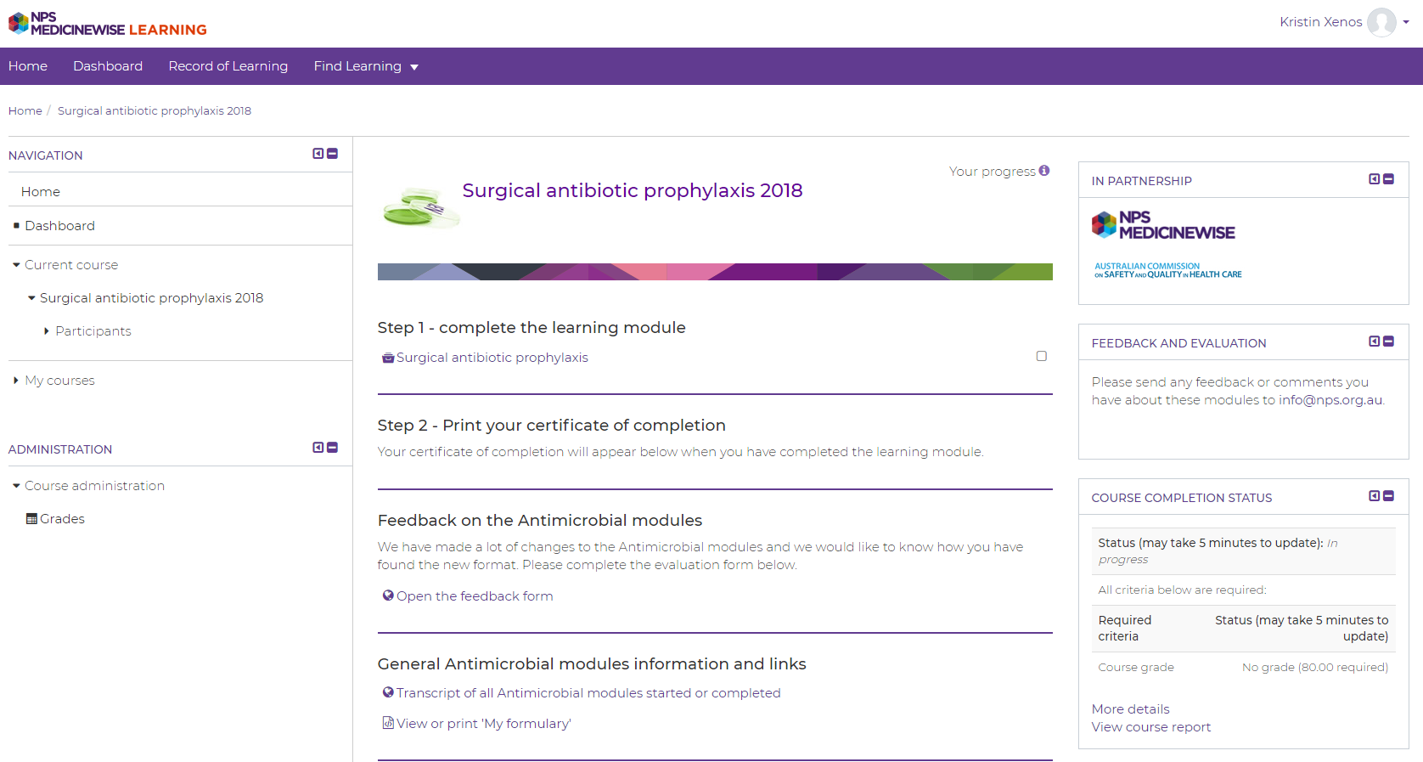
Resources
NPS MedicineWise Antimicrobial Prescribing Courses
Ref: 17
Notes:
The Australian Commission on Safety and Quality in Health Care along with NPS MedicineWise have developed online modules for antimicrobial prescribing. There is a module on Surgical Prophylaxis. An updated version is due for release in early 2019.
https://learn.nps.org.au/mod/page/view.php?id=4282

Slide 28
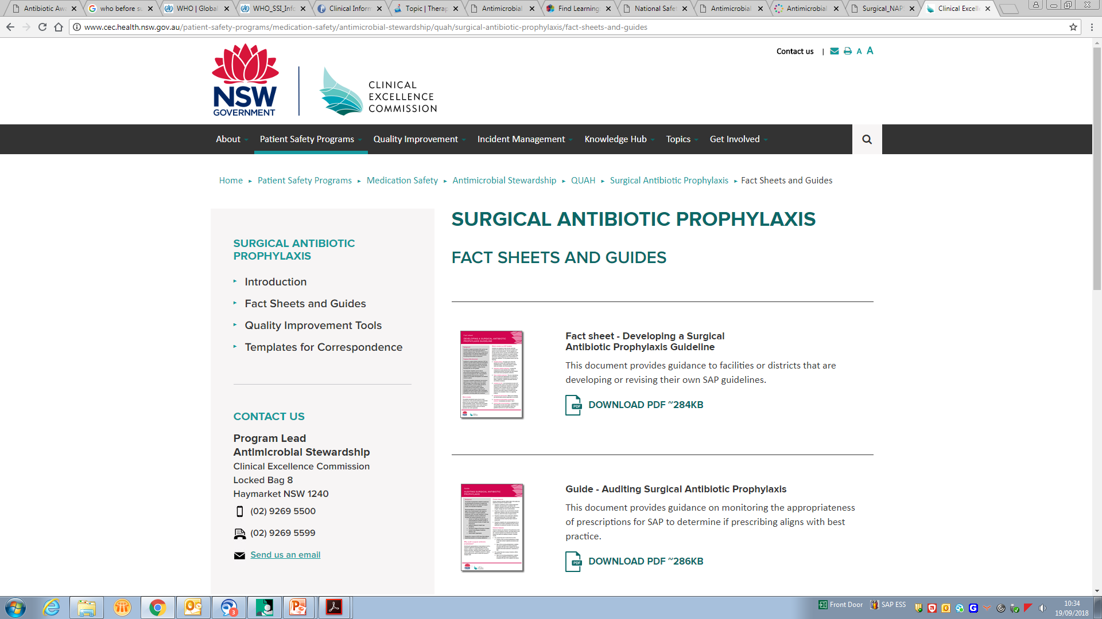
Resources: NSW Health CEC
Fact sheets and guides
Developing a Surgical Antibiotic Prophylaxis Guideline
Auditing Surgical Antibiotic Prophylaxis
Quality improvement tools
Cause & Effect diagram
Process Map/Flow Chart
Driver Diagram
Templates for correspondence
Template memo: Improving antibiotic prescribing for surgical prophylaxis to decrease surgical site infection rates
Template letter – Evidence-based recommendations for preventing surgical site infections
Template position statement – topical use of antibiotics
Ref: 18
Notes:
The NSW CEC has developed a suite of resources to support facilities improve surgical antimicrobial prophylaxis.
http://www.cec.health.nsw.gov.au/patient-safety-programs/medication-safety/antimicrobial-stewardship/quah/surgical-antibiotic-prophylaxis

Slide 29
References
https://www.cdc.gov/nhsn/pdfs/pscmanual/9pscssicurrent.pdf
Australian Commission on Safety and Quality in Health Care. Approaches to Surgical Site Infection Surveillance. Sydney: ACSQHC; 2017
WHO Global guidelines on the prevention of surgical site infection: http://www.who.int/gpsc/ssi-guidelines/en/
Antibiotic Expert Group. Therapeutic guidelines: antibiotic. Version 15. Melbourne: Therapeutic Guidelines Limited; 2010.
Berríos-Torres SI, Umscheid CA, Bratzler DW, et al. Centers for Disease Control and Prevention Guideline for the Prevention of Surgical Site Infection, 2017. JAMA Surg.2017;152(8):784–791. doi:10.1001/jamasurg.2017.0904
Australian Commission on Safety and Quality in Health Care. National Safety and Quality Health Service Standards. 2nd ed. Sydney: ACSQHC; 2017
Australian Commission on Safety and Quality in Health Care. Antimicrobial Stewardship Clinical Care Standard. Sydney: ACSQHC, 2014.
Australian Commission on Safety and Quality in Health Care, Advisory No: A17/01; November 2017
National Centre for Antimicrobial Stewardship and Australian Commission on Safety and Quality in Health Care. Antimicrobial prescribing practice in Australian hospitals: Results of the 2017 National Antimicrobial Prescribing Survey. Sydney: ACSQHC; 2018
National Centre for Antimicrobial Stewardship and Australian Commission on Safety and Quality in Health Care. Surgical National Antimicrobial Prescribing Survey: results of the 2016 pilot. Sydney: ACSQHC; 2017.
Understanding antibiotic decision making in surgery—a qualitative analysis, Clinical Microbiology and Infection , Volume 23 , Issue 10 , 752 – 760, Charani, E. et al.
Improvisation versus guideline concordance in surgical antibiotic prophylaxis: a qualitative study, Broom, J., Broom, A., Kirby, E. et al. Infection (2018) 46: 541.
http://www.who.int/gpsc/appendix25.pdf
Balch A, Wendelboe AM, Vesely SK, Bratzler DW. Antibiotic prophylaxis for surgical site infections as a risk factor for infection with Clostridium difficile. Conly J, ed. PLoS ONE. 2017;12(6):e0179117. doi:10.1371/journal.pone.0179117.
https://www.ncbi.nlm.nih.gov/pubmed/10869263
Leeds IL, Fabrizio A, Cosgrove SE, Wick EC. Treating Wisely: The Surgeon’s Role in Antibiotic Stewardship. Annals of surgery. 2017;265(5):871-873. doi:10.1097/SLA.0000000000002034.
NPS Medicinewise Antimicrobial modules - https://learn.nps.org.au/mod/page/view.php?id=4282
NSW CEC - http://www.cec.health.nsw.gov.au/patient-safety-programs/medication-safety/antimicrobial-stewardship/quah/surgical-antibiotic-prophylaxis
NSW Health Safety Information SI:001/11 – Safe Use of Alcohol Based Skin Preparations for Surgical and Anaesthetic Procedures

