Slide 1
The Third Australian Atlas of Healthcare Variation
2018

Slide 2
The Australian Atlas of Healthcare Variation series
Notes:
Speaker notes:
Mapping variation is an invaluable tool for understanding how our healthcare system is providing care. The Australian Atlas of Healthcare Variation series illuminates variation by mapping use of health care according to where people live. Each Atlas identifies specific achievable actions for exploration and quality improvement.
The Australian Commission on Safety and Quality in Health Care (the Commission) has collaborated with the Australian, state and territory governments, specialist medical colleges, clinicians and consumer representatives to develop the Atlas series.
The Atlas publications can be downloaded from the Atlas website.

Slide 3
Interactive Atlas
Notes:
Speaker notes:
The Atlas data can also be further explored using the online interactive Atlas platform.

Slide 4
Australian Commission on Safety and Quality in Health Care
Australian Government agency
Leads & coordinates national improvements in safety & quality of health care based on best available evidence
Works in partnership with patients, consumers, clinicians, managers, policy makers & health care organisations
Aims to ensure that the health system is sustainable, better informed, supported & organised to deliver safe & high quality care
Notes:
Speaker notes:
The Commission’s role is to lead and coordinate national improvements in the safety and quality of health care. The Commission works in partnership with the Australian Government, state and territory governments and the private sector to achieve a safe and high-quality, sustainable health system. In doing so, the Commission also works closely with patients, carers, clinicians, managers, policymakers and healthcare organisations.
Key functions of the Commission include developing national safety and quality standards, developing clinical care standards to improve the implementation of evidence-based health care, coordinating work in specific areas to improve outcomes for patients, and providing information, publications and resources about safety and quality.
The Commission works in four priority areas:
- Patient safety
- Partnering with patients, consumers and communities
- Quality, cost and value
- Supporting health professionals to provide care that is informed, supported and organised to deliver safe and high-quality health care.
One of the Commission’s key programs is the National Safety and Quality Health Service (NSQHS) Standards. The primary aim of the NSQHS Standards are to protect the public from harm and to improve the quality of health service provision. The NSQHS Standards were developed by the Commission in partnership with the Australian, state and territory governments, the private sector, clinicians, patients and carers.

Slide 5
Third Australian Atlas of Healthcare Variation
Examines variation nationally in 13 clinical items, grouped into 4 themes
Neonatal and paediatric health
Early planned caesarean section without medical or obstetric indication
Antibiotic dispensing in children, 9 years and under
Proton pump inhibitor dispensing in infants, 1 year and under
Gastrointestinal investigations and treatments
Proton pump inhibitor dispensing in adults
Colonoscopy hospitalisations
Gastroscopy hospitalisations
Thyroid investigations and treatments
Thyroid stimulating hormone tests
Thyroid function tests
Neck ultrasound
Thyroidectomy hospitalisations
Cardiac tests
Cardiac stress tests and imaging
Stress echocardiography
Myocardial perfusion scans
Standard echocardiography
Notes:
Speaker notes:
The third Atlas, released in December 2018, examines four clinical themes: neonatal and paediatric health, gastrointestinal investigations and treatments, thyroid investigations and treatments and cardiac tests.

Slide 6
Inside this slide pack
Why does variation matter?
How is variation measured in the Atlas?
How is variation presented in the Atlas?
Notes on data
Key findings
Promoting appropriate care
Further resources
Notes:
Speaker notes:
This slide pack explores why variation matters and what unwarranted variation in healthcare is. This slide pack explores the key findings for the ‘Cardiac tests’ chapter and shows findings, maps and graphs for each of the clinical items in this chapter.

Slide 7
Why does variation matter?
Large variations in health care use have been documented by researchers around the world for many years
A proportion of this variation is termed ‘unwarranted’
Unwarranted variation:
Is unrelated to patient need or preference
May signal inappropriate care
May signal ineffective use of resources
It raises questions about appropriateness of care, health system efficiency, equity and access
Can highlight opportunities for further investigation and for the health system to improve
Notes:
Speaker notes:
Variations documented for many years: One of the first major studies published was by Glover in 1938 who noted a rise in England & Wales in incidence of tonsillectomy and very large differences in rates between school districts which “defies any explanation, save that of variations of medical opinion on the indications for operation.” He also noted “Large and, in some cases, drastic reductions in the numbers of operations performed in elementary school children in certain areas have had no unsatisfactory results” and that “The mortality from the operation is larger than is generally appreciated”.
He noted that that the conspicuous success of the operation in some cases may have led to its adoption in many doubtful cases.
Getting the best outcomes for patients and improving appropriateness of care is the goal of the Atlas. Where we see substantial variation in use of a particular treatment, it is an alarm bell that should make us stop and investigate whether appropriate care is being delivered.
Variation in itself is not necessarily bad, and it can be good if it reflects health services responding to differences in patient preferences or underlying needs. When a difference in the use of health services does not reflect these factors, it is unwarranted variation and represents an opportunity for the health system to improve. Rates of an intervention that are substantially higher or lower in some areas can highlight:
- Inequity of access to evidence-based care, and the need to deliver services more fairly
- Uncertainty about the intervention’s place in therapy, and the need for better data on its benefits and harms
- Gaps in accessible evidence for clinicians, and the need for clinical care standards
- Inadequate system supports for appropriate care, and the need for changes in training or financial incentives.
Looking at how healthcare use varies between people living in different areas, between people with and without socioeconomic disadvantage, and between Aboriginal and Torres Strait Islander Australians and other Australians can show who in our community is missing out. Fundamental changes to address the underlying determinants of ill health, as well as better service delivery for those with existing disease, are needed where these inequities are found.
Reference: Glover JA. The Incidence of Tonsillectomy in School Children: (Section of Epidemiology and State Medicine). Proc R Soc Med. 1938;31(10):1219-36.

Slide 8
How is variation measured in the Atlas?
Healthcare use is mapped by residence of patient (not location of the health provider)
Location of residence mapped at Statistical Area Level 3 (SA3)
Data are age- and sex-standardised, with a few exceptions
Data sources used:
National Hospital Morbidity Database (NHMD)
Medicare Benefits Schedule (MBS)
Pharmaceutical Benefits Scheme (PBS)
National Perinatal Data Collection (NPDC)
Data extraction and analysis performed by the Australian Institute of Health and Welfare (AIHW)
Interactive Atlas
Notes:
Speaker notes:
Healthcare use is mapped by residence of the patient (Not by where the care was provided)
Most items in this Atlas are mapped to the Statistical Area Level 3 (SA3). Some are mapped to the state and territory level because events were too low to map at a smaller geographical level. SA3s are standard geographical regions used by the Australian Bureau of Statistics. SA3s generally have populations of between 30,000 and 130,000.
Rates are age and sex-standardised per 100,000 population to remove the effect of differences in population age structure when comparing crude rates for different geographic areas.
Data specifications for each item are available on the AHIW’s Metadata Online Registry (METeOR). Information on data analysis and methodology available in the technical supplement.

Slide 9
How is variation presented in the Atlas?
Data are presented in maps and graphs
Statistical Area 3 level data is presented for:
State and territory analysis
Remoteness and socioeconomic disadvantage
State and territory level data is presented for:
Aboriginal and Torres Strait Islander Australian status
Public and private patient funding status
Notes:
Speaker notes:
Data are presented in maps and graphs.
For indicators where the annual number of hospitalisations is too low or unreliable to report at a local level, three years of data are combined.
For each item, SA3 level data are grouped by state and territory, remoteness and socioeconomic status to assist comparisons between local areas.
For each item, where possible, state and territory level data is presented by Aboriginal and Torres Strait Islander status and patient funding status
Data specifications for each item are available on the AHIW’s Metadata Online Registry (METeOR).

Slide 10
Data suppression
A confidentiality process has been followed for all data items in the Atlas to protect the identity of patients and providers
The process includes applying standard rules set by The Australian Institute of Health and Welfare and by the Australian Government Department of Health for reporting of MBS and PBS data
The MBS rules for protecting provider identity have had a marked effect on reporting of three items: myocardial perfusion scans, thyroid stimulating hormone and thyroid function tests.
For example, ‘data cannot be reported for an area if 85% of services were done by one provider, or 90% by two providers’
For the items affected the most, the magnitude of variations are likely to be underestimates of the true variation across Australia.
Notes:
Speaker notes:
For all MBS items in the Atlas, some data have been suppressed to manage volatility and confidentiality. This process takes into account the Australian Government Department of Health’s requirements for reporting MBS data.
The process has resulted in particularly marked data suppression for MBS items for thyroid function testing and for myocardial perfusion scans. Most local areas (Statistical Area Level 3 – SA3) were suppressed to prevent identification of the provider (practitioner or business entity).
More detail on data suppression can be found in the technical supplement: https://www.safetyandquality.gov.au/wp-content/uploads/2018/12/Text-Technical-supplement.pdf

Slide 11
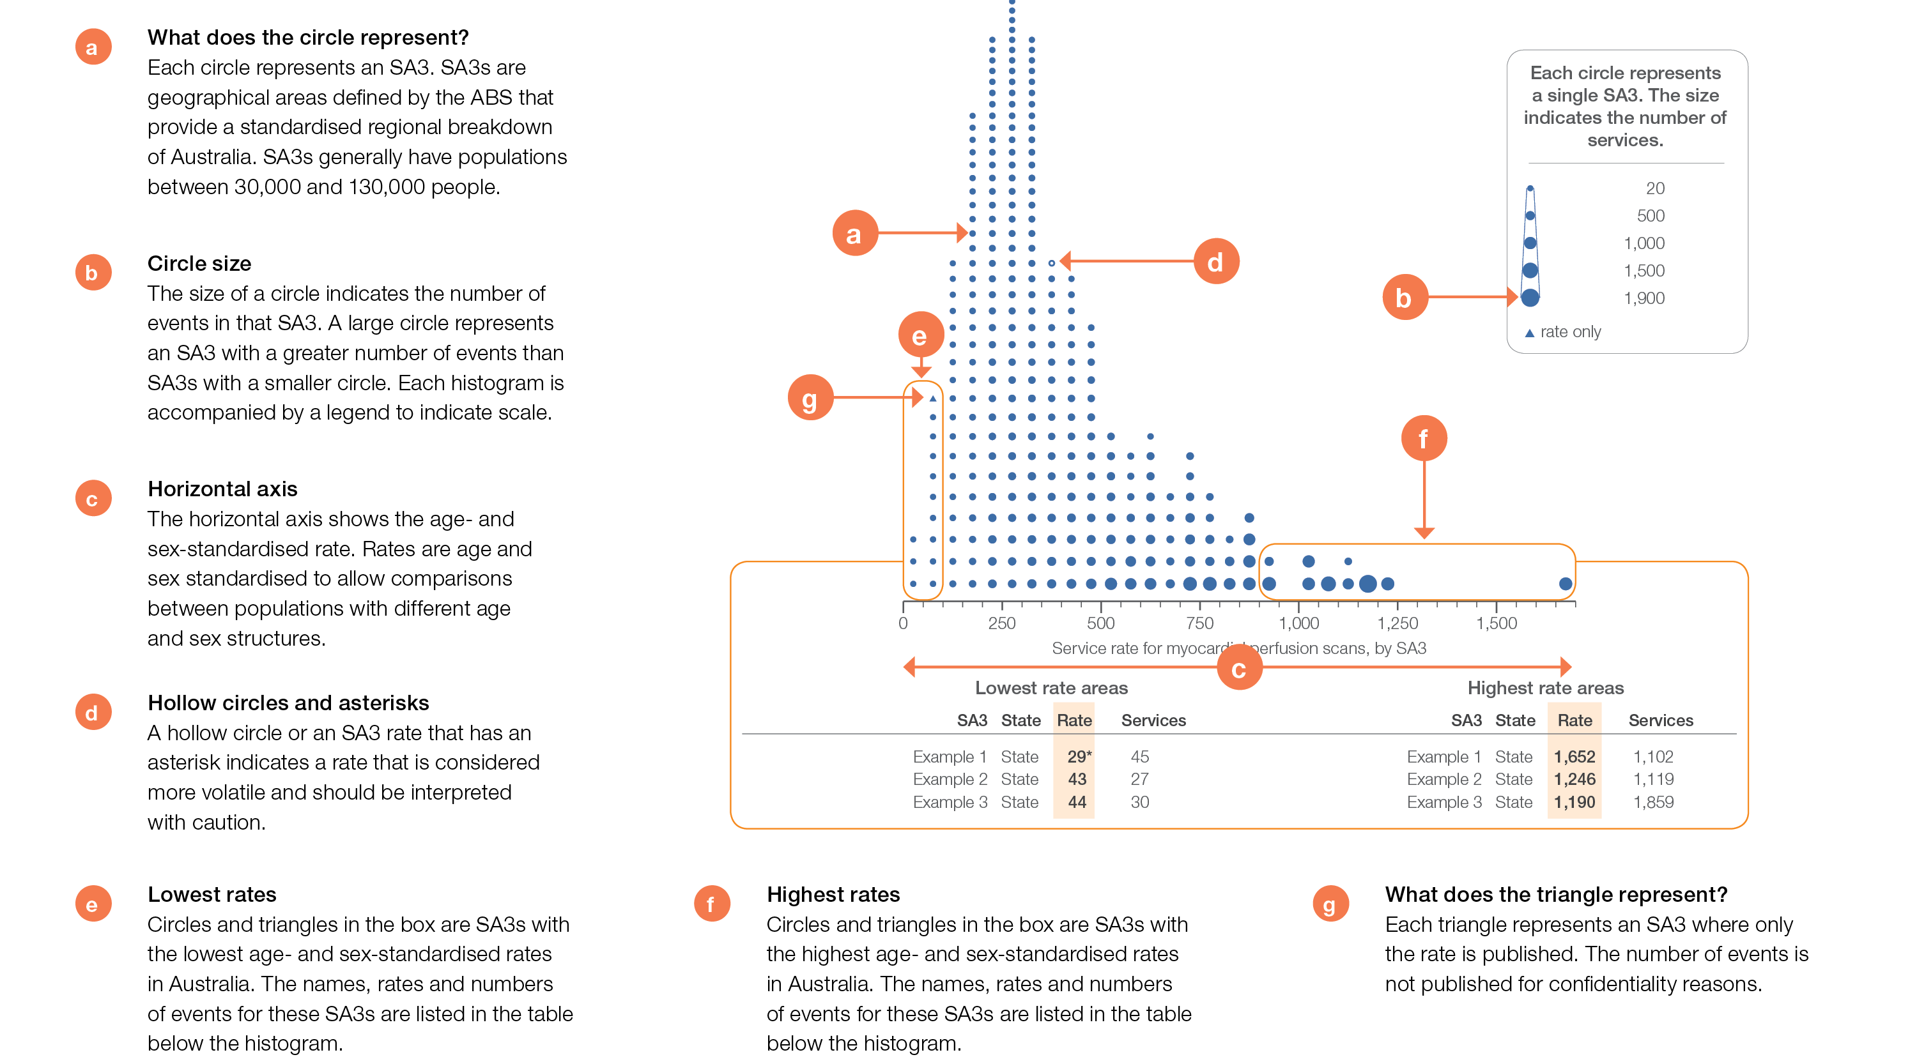
How to interpret our data visualisations
Histogram

Slide 12
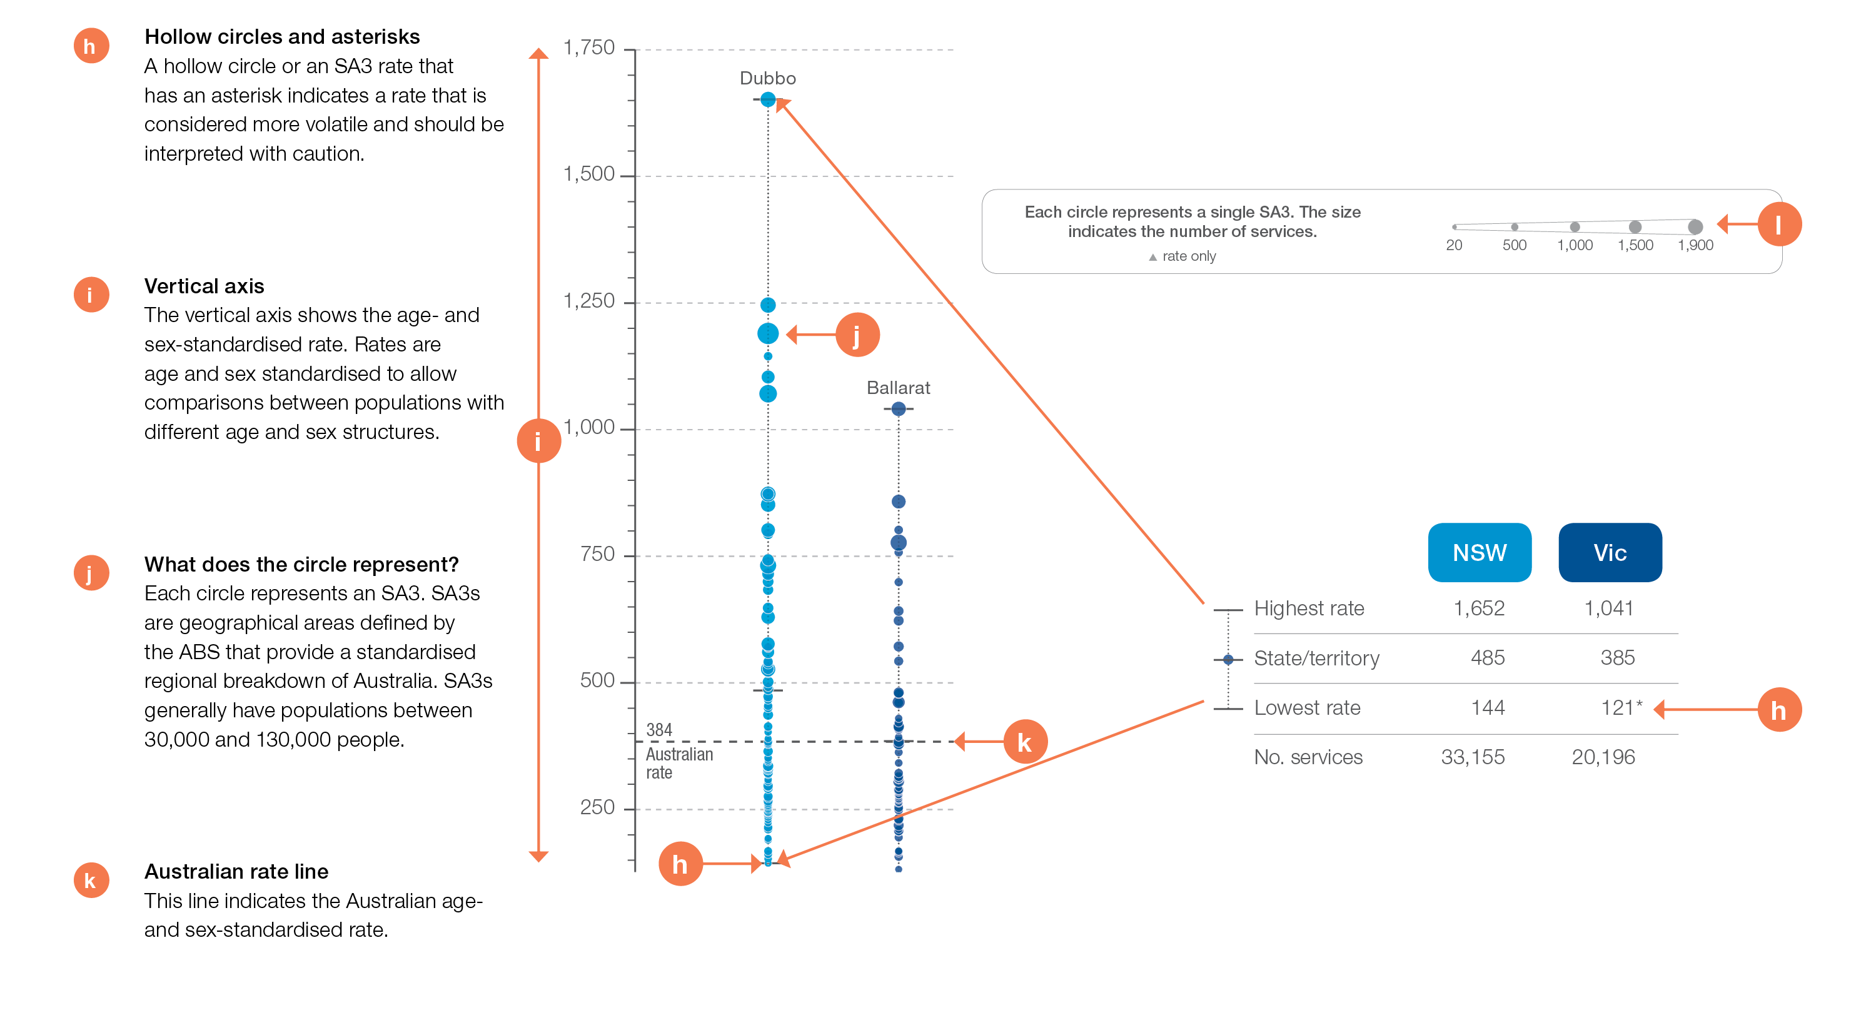
How to interpret our data visualisations
State and territory graph

Slide 13
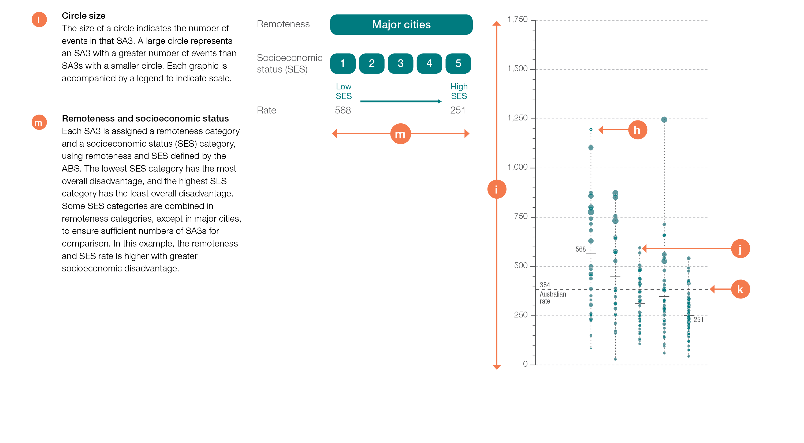
How to interpret our data visualisations
Remoteness and socioeconomic status graph

Slide 14
Cardiac tests
Notes:
Speaker notes:
This chapter examines:
- Cardiac stress tests and imaging, 18 years and over
- Stress echocardiography, 18 years and over
- Myocardial perfusion scans, 18 years and over
- Standard echocardiography, 18 years and over

Slide 15
Cardiac tests
Key findings
Data item | Range across local areas* per 100,000 | Times difference | Times difference excluding top and bottom 10% | Number during 2016–17
4.1 Cardiac stress tests and imaging†§, 18 years and over | 1,184–11,568 | 9.8 | 3.8 | 933,727
4.2 Stress echocardiography§, 18 years and over | 104–4,894 | 47.1 | 5.8 | 303,525
4.3 Myocardial perfusion scans§, 18 years and over | 29–1,652 | 57.0 | 4.9 | 79,905
4.4 Standard echocardiography§, 18 years and over | 2,279–7,957 | 3.5 | 2.1 | 945,056
* Statistical Area Level 3
† Exercise electrocardiograms, stress echocardiography, myocardial perfusion scans and computed tomography of coronary arteries
§ Based on number of MBS-subsidised services
Sources: MBS data 2016-17, and ABS Estimated Resident Population 30 June 2016
Notes:
Speaker notes:
In 2016–17, there were over 900,000 MBS-subsidised services for cardiac stress tests and imaging, representing 4,575 services per 100,000 people aged 18 years and over.
Rates of cardiac stress tests and imaging were highest in the 45–79 years age group.
Substantial variation was observed between Statistical Area Level 3 (SA3) areas in the rates of stress echocardiography. They were 47.1 times as high in the area with the highest rate compared to the area with the lowest rate. For myocardial perfusion scans, the rate was 57.0 times as high in the area with the highest rate compared to the area with the lowest rate.
The marked variation between states is likely to be affected by factors such as rates of underlying disease, access to services, funding models and availability of previous test results.

Slide 16
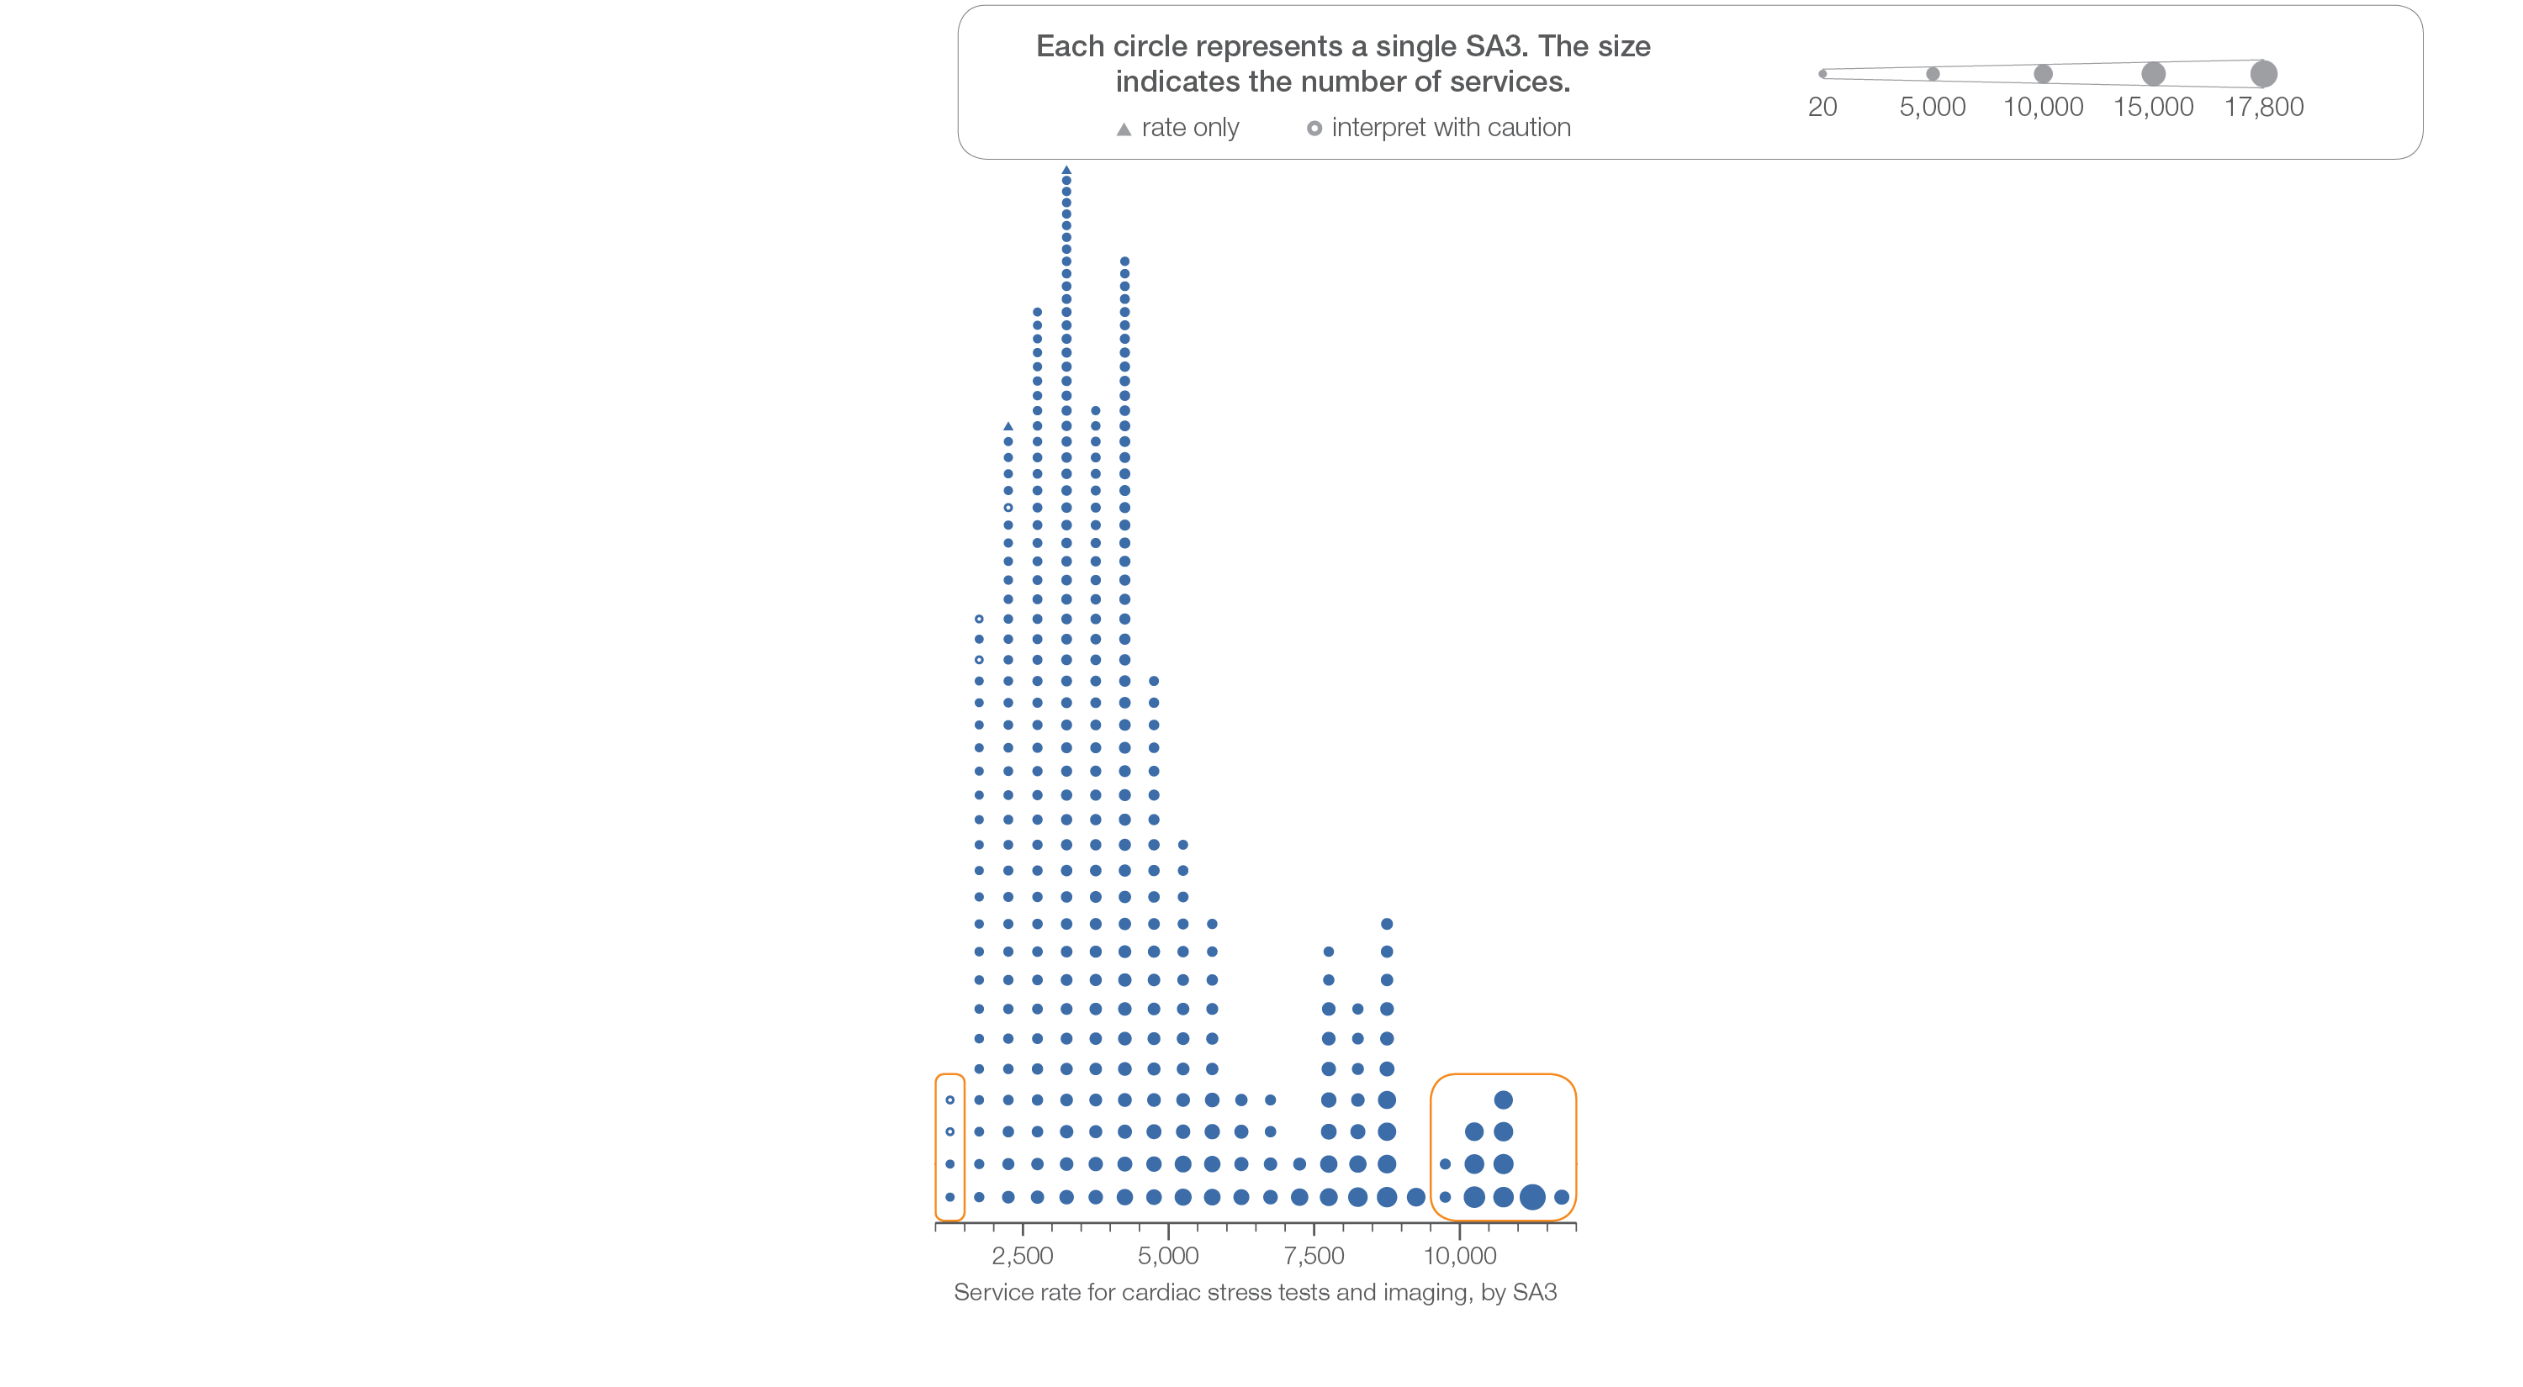
4.1 Cardiac stress tests and imaging, 18 years and over
Sources: MBS data 2016-17, and ABS Estimated Resident Population 30 June 2016
Notes:
Speaker notes:
This slide shows the distribution of rates by Statistical Area Level 3 (SA3) for cardiac stress tests and imaging.
Each circle on the graph represents an SA3. The size of the circle indicates how many services have been recorded for people living in that area. The horizontal axis shows the standardised rates for the clinical item.
Hollow circles and asterisks indicate rates that are considered more volatile than other published rates and should be interpreted with caution. Triangles indicate SA3s where only rates are published. The numbers of services are not published for confidentiality reasons.
For further detail about the methods used, please refer to the Technical Supplement.
For further information on how to interpret the figures, please refer to the ‘How to interpret’ resource available at: www.safetyandquality.gov.au/atlas/the-third-australian-atlas-of-healthcare-variation-2018/how-to-interpret-the-data/

Slide 17
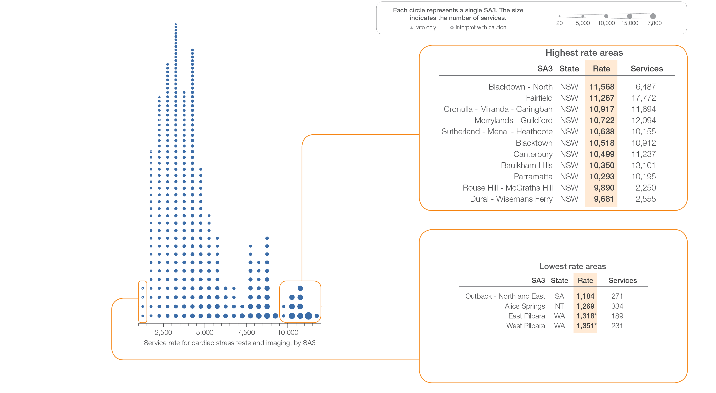
4.1 Cardiac stress tests and imaging, 18 years and over
Sources: MBS data 2016-17, and ABS Estimated Resident Population 30 June 2016
Notes:
Speaker notes:
This slide shows the distribution of rates by Statistical Area Level 3 (SA3) for cardiac stress tests and imaging.
Each circle on the graph represents an SA3. The size of the circle indicates how many services have been recorded for people living in that area. The horizontal axis shows the standardised rates for the clinical item.
Hollow circles and asterisks indicate rates that are considered more volatile than other published rates and should be interpreted with caution. Triangles indicate SA3s where only rates are published. The numbers of services are not published for confidentiality reasons.
For further detail about the methods used, please refer to the Technical Supplement.
For further information on how to interpret the figures, please refer to the ‘How to interpret’ resource available at: www.safetyandquality.gov.au/atlas/the-third-australian-atlas-of-healthcare-variation-2018/how-to-interpret-the-data/

Slide 18
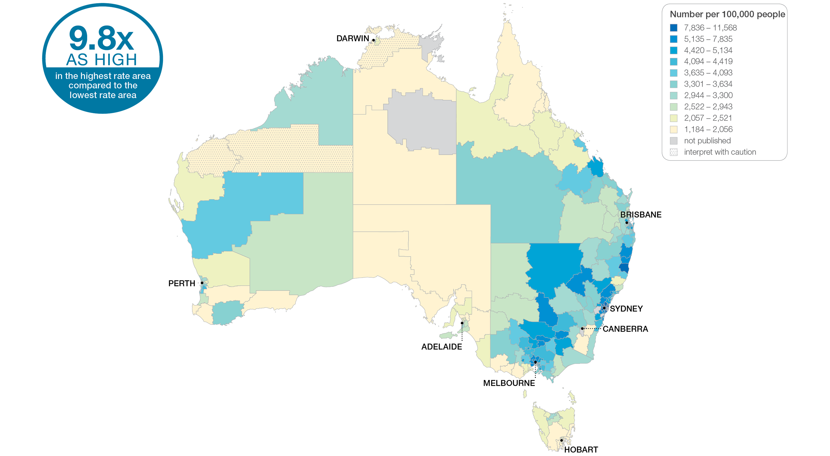
4.1 Cardiac stress tests and imaging, 18 years and over
Sources: MBS data 2016-17, and ABS Estimated Resident Population 30 June 2016
Notes:
Speaker notes:
This slide shows the distribution of rates by Statistical Area Level 3 (SA3) for cardiac stress tests and imaging. Rates are based on the patient’s usual place of residence, not the location of the healthcare provider.
In 2016–17, there were 933,727 MBS-subsidised services for cardiac stress tests and imaging, representing 4,575 services per 100,000 people aged 18 years and over (the Australian rate).
The number of MBS-subsidised services for cardiac stress tests and imaging across 329* local areas (Statistical Area Level 3 – SA3) ranged from 1,184 to 11,568 per 100,000 people aged 18 years and over.
The rate was 9.8 times as high in the area with the highest rate compared to the area with the lowest rate.
The number of services varied across states and territories, from 2,289 per 100,000 people aged 18 years and over in Tasmania to 6,673 in New South Wales.
The range of rates represented by each colour are shown in the legend for the map. The darker blue colour represents SA3s with higher rates. The lighter colours represent SA3s with lower rates.
Dotted areas indicate rates that are considered more volatile than other published rates and should be interpreted with caution. These rates are excluded from the calculation of the difference between the highest and lowest SA3 rates in Australia.
For further detail about the methods used, please refer to the Technical Supplement.
For further information on how to interpret the figures, please refer to the ‘How to interpret’ resource available at: www.safetyandquality.gov.au/atlas/the-third-australian-atlas-of-healthcare-variation-2018/how-to-interpret-the-data/

Slide 19
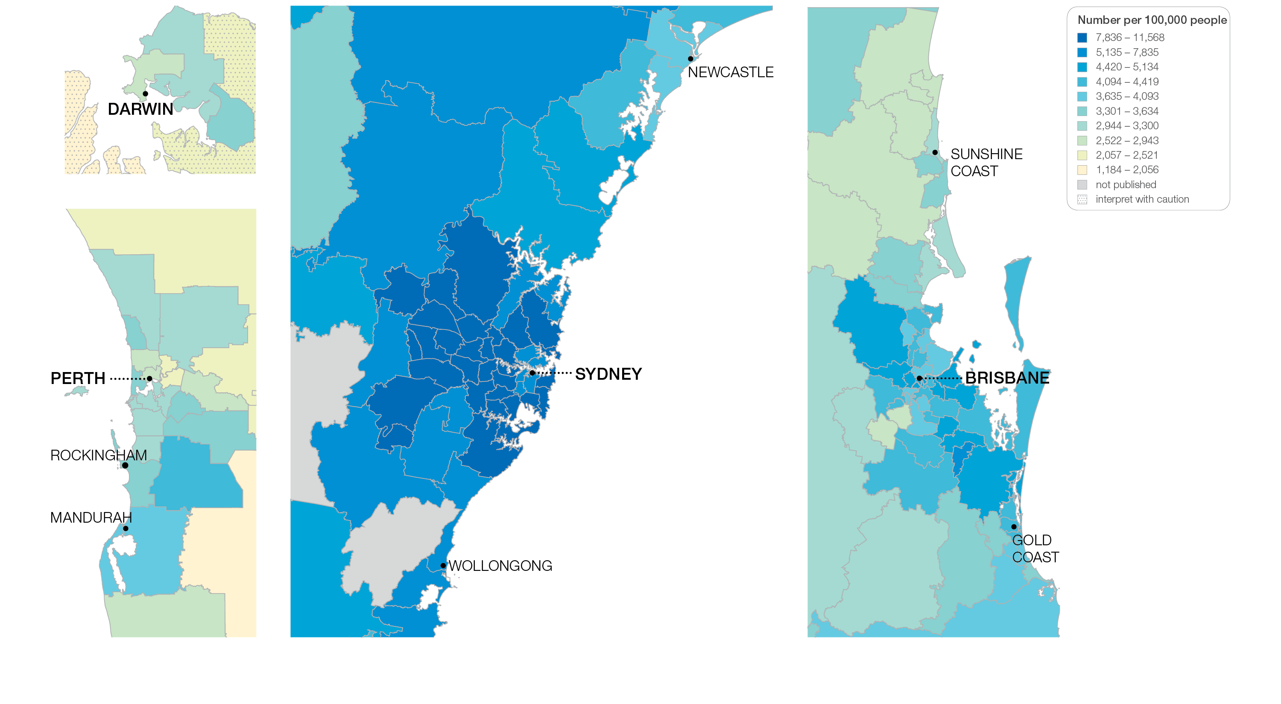
4.1 Cardiac stress tests and imaging, 18 years and over
Sources: MBS data 2016-17, and ABS Estimated Resident Population 30 June 2016
Notes:
Speaker notes:
This slide shows the distribution of rates by Statistical Area Level 3 (SA3) for cardiac stress tests and imaging by capital city area. Rates are based on the patient’s usual place of residence, not the location of the healthcare provider.

Slide 20
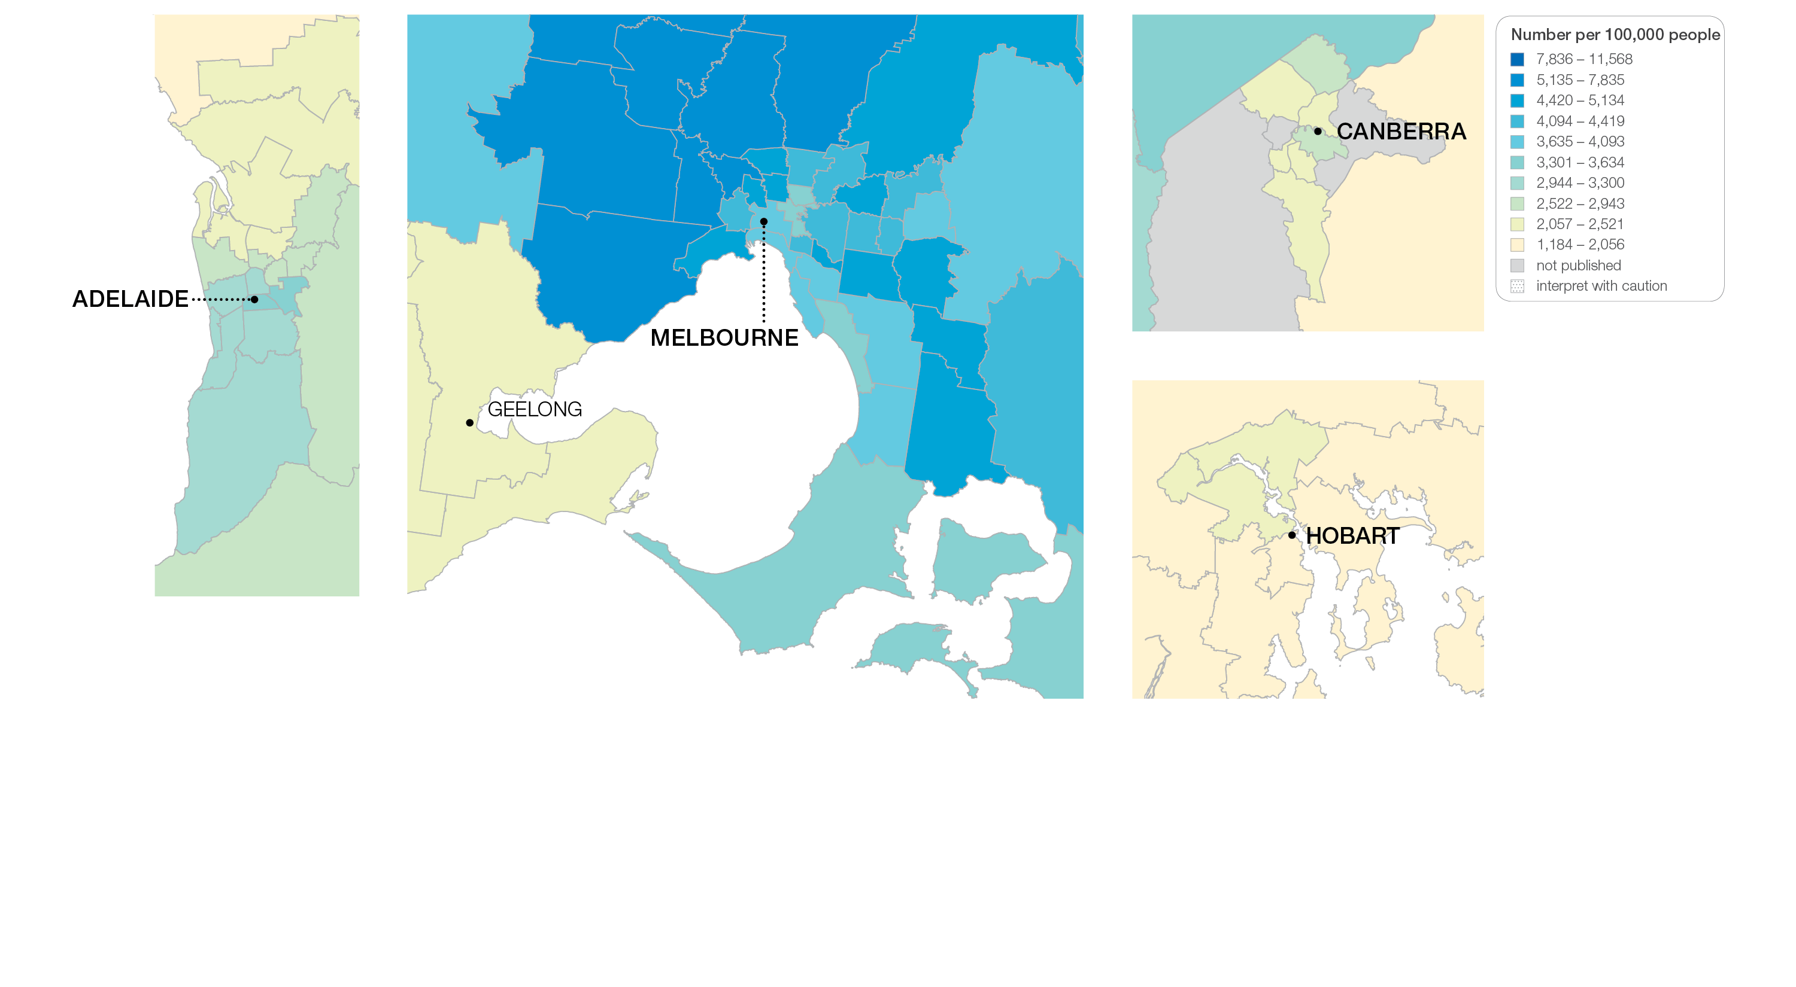
4.1 Cardiac stress tests and imaging, 18 years and over
Sources: MBS data 2016-17, and ABS Estimated Resident Population 30 June 2016
Notes:
Speaker notes:
This slide shows the distribution of rates by Statistical Area Level 3 (SA3) for cardiac stress tests and imaging by capital city area. Rates are based on the patient’s usual place of residence, not the location of the healthcare provider.

Slide 21
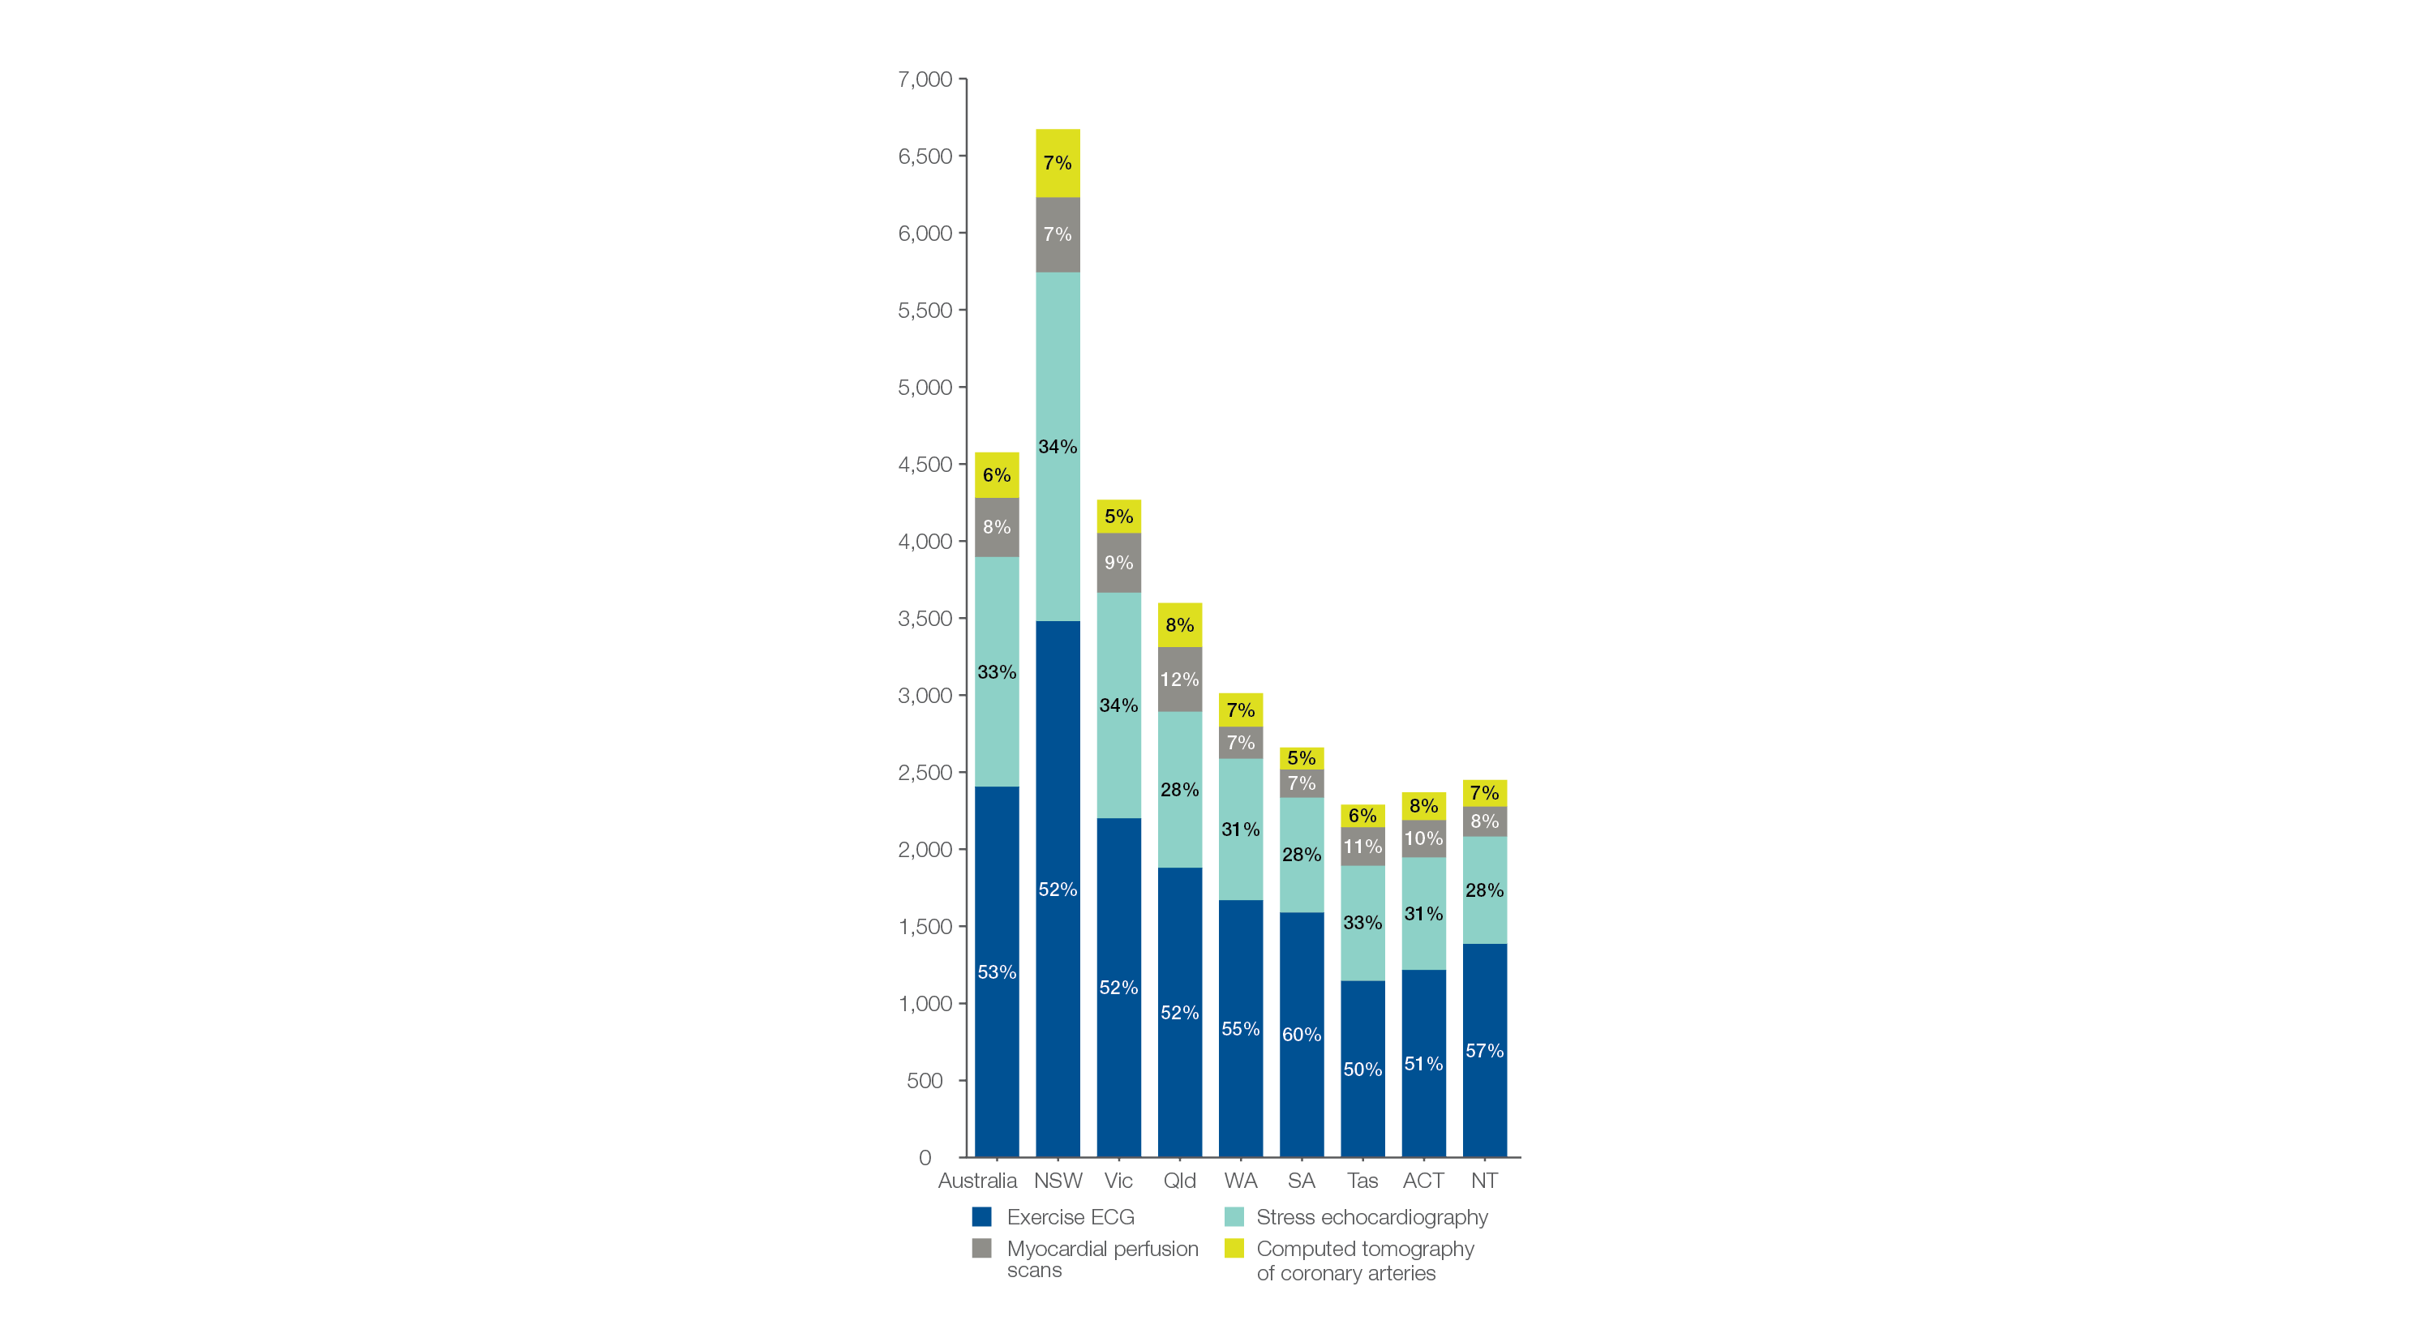
4.1 Cardiac stress tests and imaging, 18 years and over
MBS-subsidised services, by cardiac test type
Number per 100,000 people
Sources: MBS data 2016-17, and ABS Estimated Resident Population 30 June 2016
Notes:
Speaker notes:
Nationally, 53% of cardiac stress tests and imaging were exercise ECGs, 33% were stress echocardiograms, 8% were MPS and 6% were CTCA.
The proportions for each test were similar across all states and territories.

Slide 22
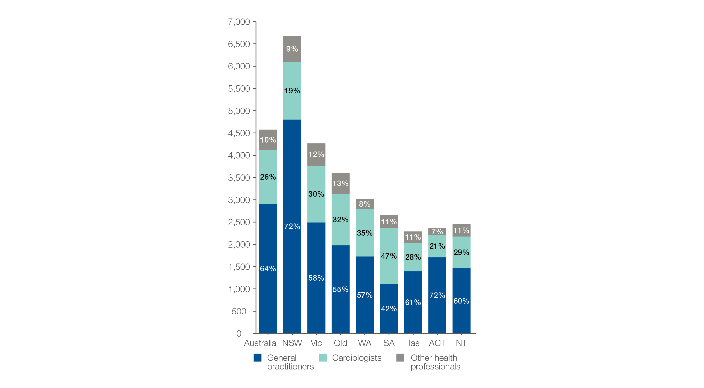
4.1 Cardiac stress tests and imaging, 18 years and over
MBS-subsidised services, by referrer
Number per 100,000 people
Sources: MBS data 2016-17, and ABS Estimated Resident Population 30 June 2016
Notes:
Speaker notes:
Nationally, 64% of cardiac stress tests and imaging were requested by general practitioners (GPs), 26% of tests were requested by cardiologists and 10% were requested by other health professionals.
The proportion of tests requested by GPs varied from 42% in South Australia to 72% in New South Wales and the Australian Capital Territory.
The proportion of tests requested by cardiologists varied from 19% in New South Wales to 47% in South Australia

Slide 23
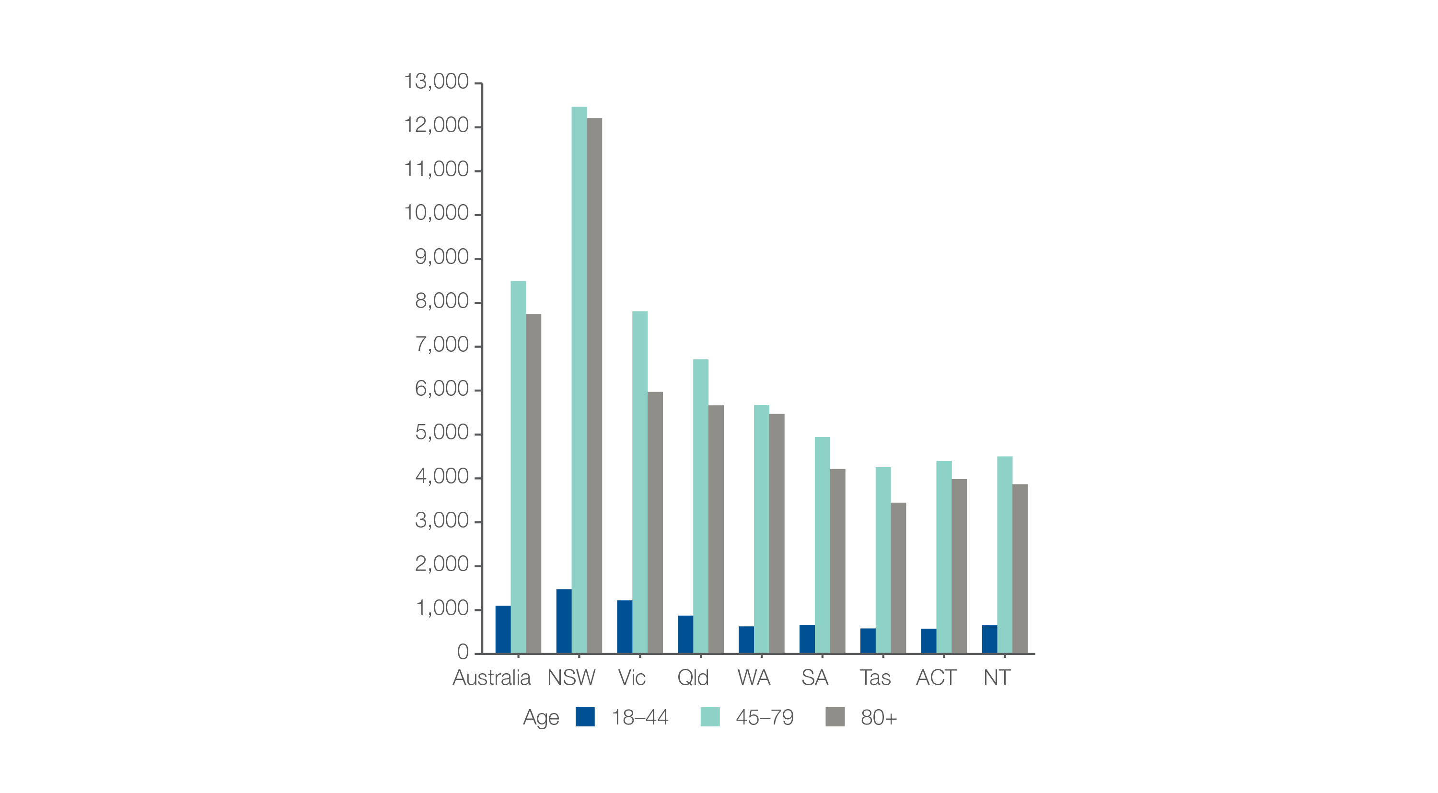
4.1 Cardiac stress tests and imaging, 18 years and over
MBS-subsidised services, by age group
Number per 100,000 people
Sources: MBS data 2016-17, and ABS Estimated Resident Population 30 June 2016
Notes:
Speaker notes:
Rates of cardiac stress tests and imaging were highest in the 45–79 years age group.
The national rate in this age group was 8,497 per 100,000 people and varied from 4,255 per 100,000 people in Tasmania to 12,466 per 100,000 people in New South Wales.
The national rate for tests performed on the 80 years and over age group was slightly lower at 7,744 per 100,000 people. The rate varied from 3,447 per 100,000 people in Tasmania to 12,211 per 100,000 people in New South Wales.

Slide 24
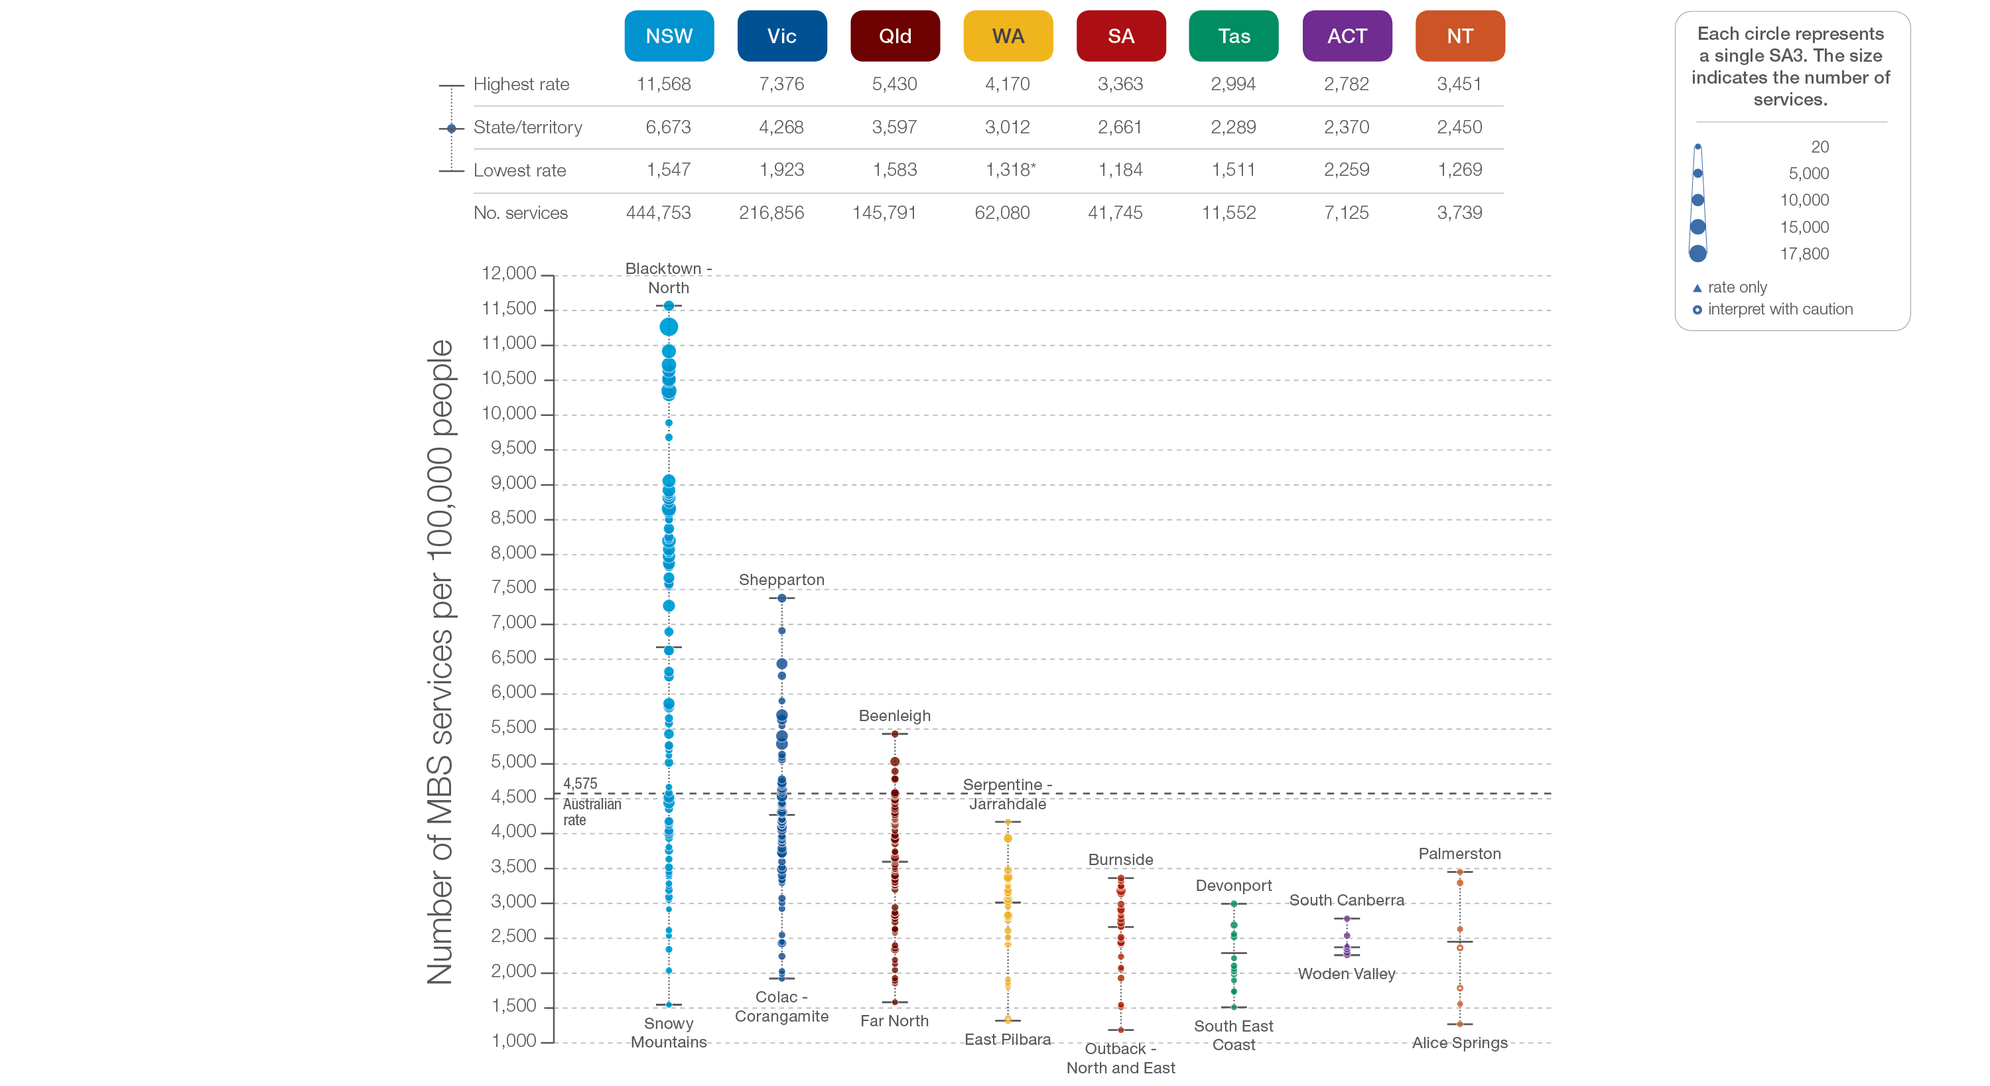
4.1 Cardiac stress tests and imaging, 18 years and over
State and territory
Sources: MBS data 2016-17, and ABS Estimated Resident Population 30 June 2016
Notes:
Speaker notes:
The number of services varied across states and territories, from 2,289 per 100,000 people aged 18 years and over in Tasmania to 6,673 in New South Wales.
Each circle on the graph represents an SA3. The size of the circle indicates how many services have been recorded for people living in that area. The vertical axis shows the standardised rates for the clinical item.
Hollow circles and asterisks indicate rates that are considered more volatile than other published rates and should be interpreted with caution. Triangles indicate SA3s where only rates are published. The numbers of services are not published for confidentiality reasons.
For further detail about the methods used, please refer to the Technical Supplement.
For further information on how to interpret the figures, please refer to the ‘How to interpret’ resource available at: www.safetyandquality.gov.au/atlas/the-third-australian-atlas-of-healthcare-variation-2018/how-to-interpret-the-data/

Slide 25
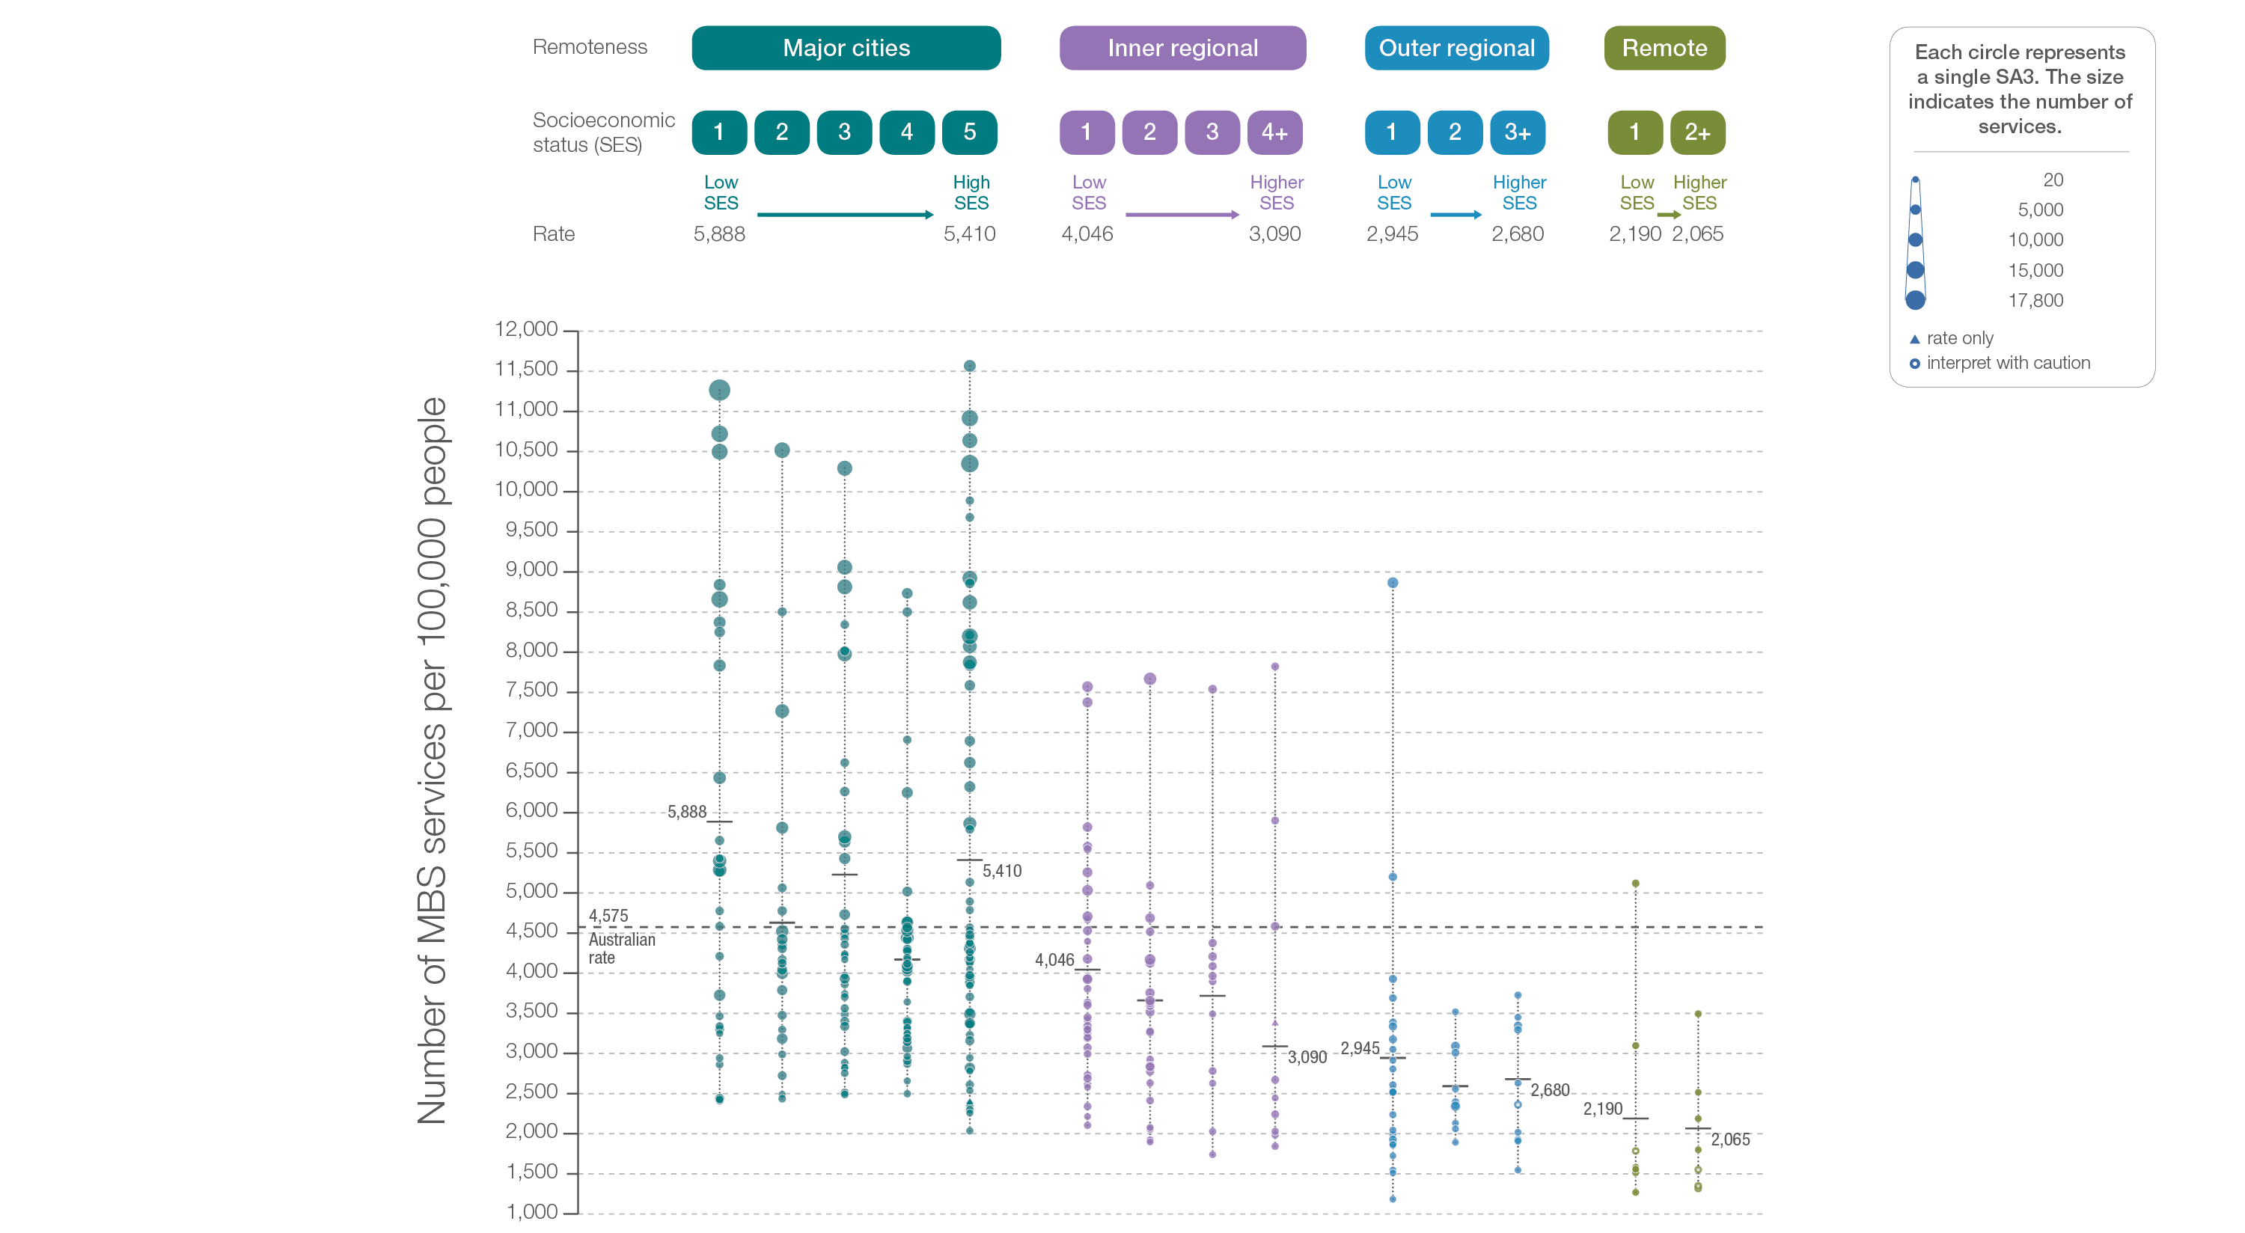
4.1 Cardiac stress tests and imaging, 18 years and over
Remoteness and socioeconomic status
Sources: MBS data 2016-17, and ABS Estimated Resident Population 30 June 2016
Notes:
Speaker notes:
Rates of cardiac stress tests and imaging were higher in major cities than in other areas. There was no clear pattern according to socioeconomic status.
Hollow circles indicate rates that are considered more volatile than other published rates and should be interpreted with caution. Triangles indicate SA3s where only rates are published. The numbers of services are not published for confidentiality reasons.
For further detail about the methods used, please refer to the Technical Supplement.
For further information on how to interpret the figures, please refer to the ‘How to interpret’ resource available at: www.safetyandquality.gov.au/atlas/the-third-australian-atlas-of-healthcare-variation-2018/how-to-interpret-the-data/

Slide 26
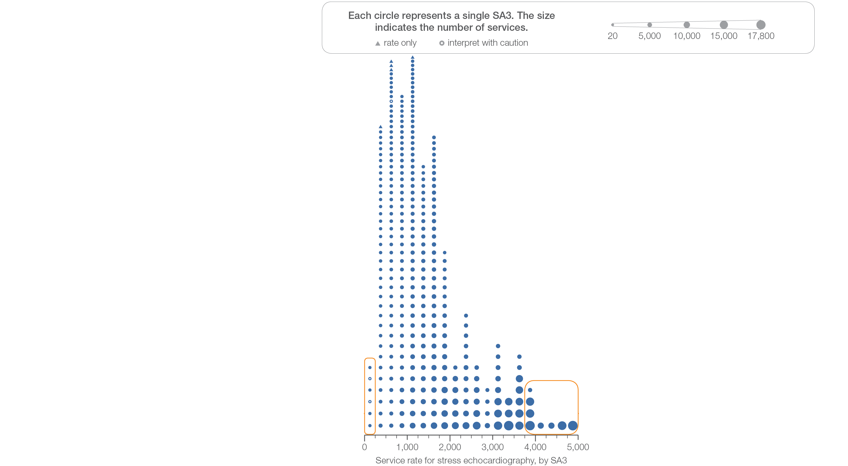
4.2 Stress echocardiography, 18 years and over
Sources: MBS data 2016-17, and ABS Estimated Resident Population 30 June 2016
Notes:
Speaker notes:
This slide shows the distribution of rates by Statistical Area Level 3 (SA3) for stress echocardiography.
Each circle on the graph represents an SA3. The size of the circle indicates how many services have been recorded for people living in that area. The horizontal axis shows the standardised rates for the clinical item.
Hollow circles and asterisks indicate rates that are considered more volatile than other published rates and should be interpreted with caution. Triangles indicate SA3s where only rates are published. The numbers of services are not published for confidentiality reasons.
For further detail about the methods used, please refer to the Technical Supplement.
For further information on how to interpret the figures, please refer to the ‘How to interpret’ resource available at: www.safetyandquality.gov.au/atlas/the-third-australian-atlas-of-healthcare-variation-2018/how-to-interpret-the-data/

Slide 27
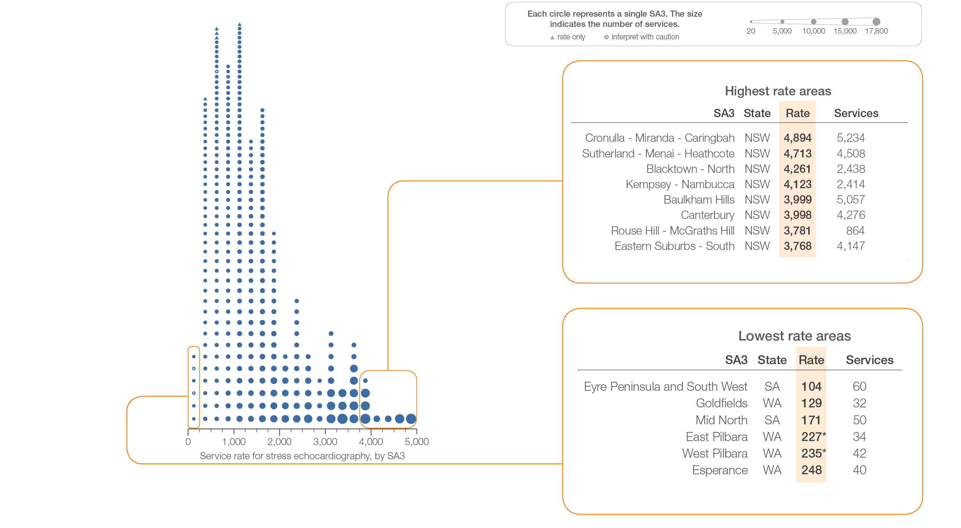
4.2 Stress echocardiography, 18 years and over
Sources: MBS data 2016-17, and ABS Estimated Resident Population 30 June 2016
Notes:
Speaker notes:
This slide shows the distribution of rates by Statistical Area Level 3 (SA3) for stress echocardiography.
Each circle on the graph represents an SA3. The size of the circle indicates how many services have been recorded for people living in that area. The horizontal axis shows the standardised rates for the clinical item.
Hollow circles and asterisks indicate rates that are considered more volatile than other published rates and should be interpreted with caution. Triangles indicate SA3s where only rates are published. The numbers of services are not published for confidentiality reasons.
For further detail about the methods used, please refer to the Technical Supplement.
For further information on how to interpret the figures, please refer to the ‘How to interpret’ resource available at: www.safetyandquality.gov.au/atlas/the-third-australian-atlas-of-healthcare-variation-2018/how-to-interpret-the-data/

Slide 28
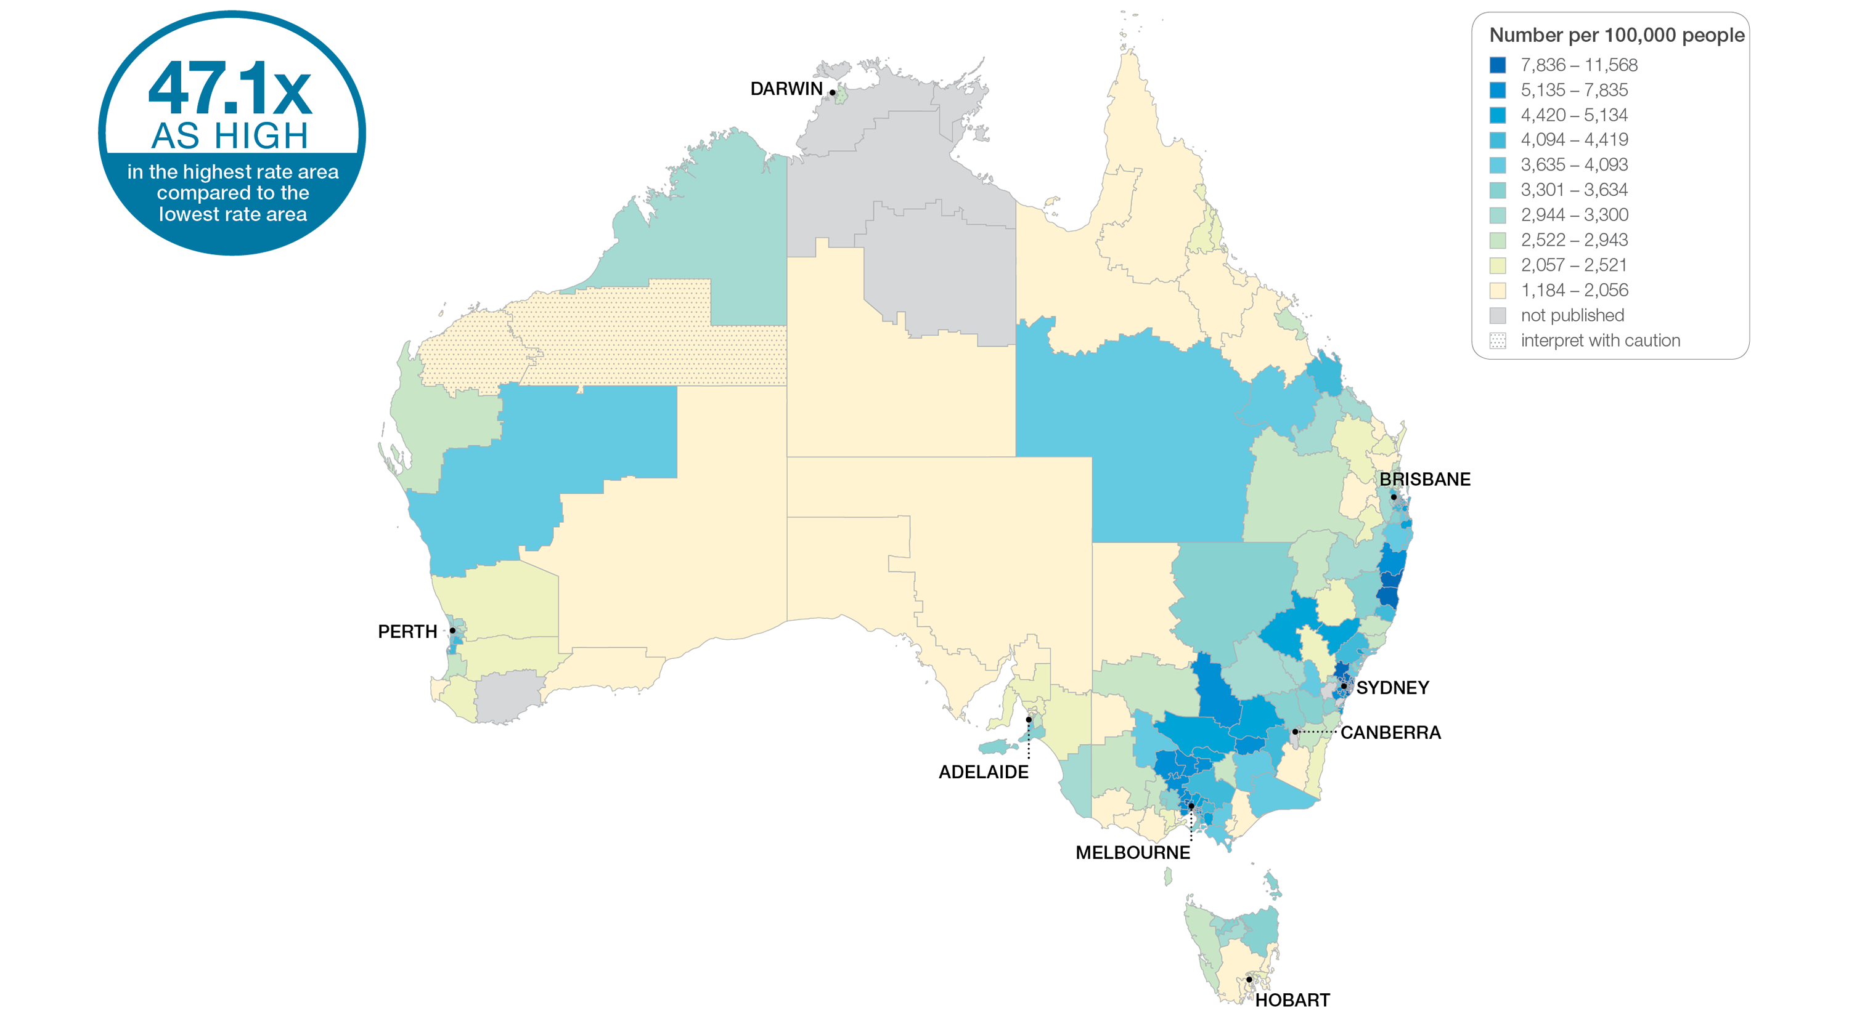
4.2 Stress echocardiography, 18 years and over
Sources: MBS data 2016-17, and ABS Estimated Resident Population 30 June 2016
Notes:
Speaker notes:
This slide shows the distribution of rates by Statistical Area Level 3 (SA3) for stress echocardiography. Rates are based on the patient’s usual place of residence, not the location of the healthcare provider.
In 2016–17, there were 303,525 MBS-subsidised services for stress echocardiography, representing 1,491 services per 100,000 people aged 18 years and over (the Australian rate).
The number of MBS-subsidised services for stress echocardiography across 325* local areas (Statistical Area Level 3 – SA3) ranged from 104 to 4,894 per 100,000 people aged 18 years and over.
The rate was 47.1 times as high in the area with the highest rate compared to the area with the lowest rate.
The number of services varied across states and territories, from 698 per 100,000 people aged 18 years and over in the Northern Territory to 2,265 in New South Wales.
The range of rates represented by each colour are shown in the legend for the map. The darker blue colour represents SA3s with higher rates. The lighter colours represent SA3s with lower rates.
Dotted areas indicate rates that are considered more volatile than other published rates and should be interpreted with caution. These rates are excluded from the calculation of the difference between the highest and lowest SA3 rates in Australia.
For further detail about the methods used, please refer to the Technical Supplement.
For further information on how to interpret the figures, please refer to the ‘How to interpret’ resource available at: www.safetyandquality.gov.au/atlas/the-third-australian-atlas-of-healthcare-variation-2018/how-to-interpret-the-data/

Slide 29
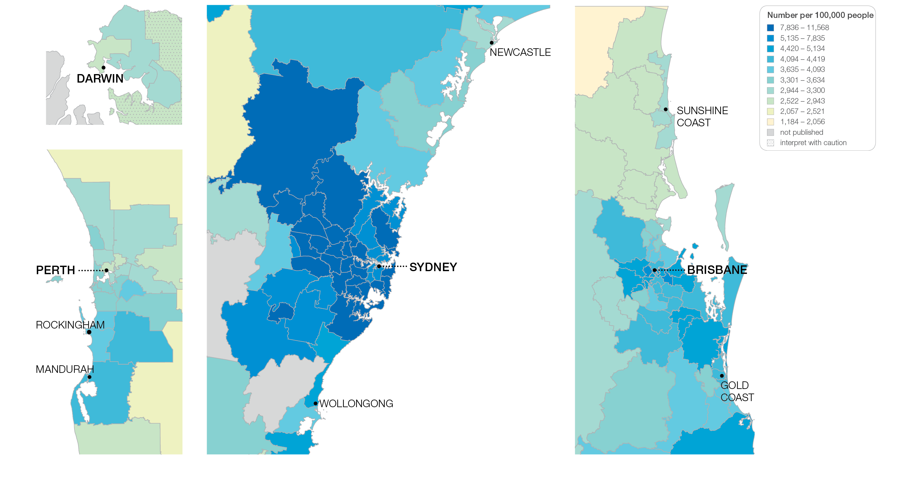
4.2 Stress echocardiography, 18 years and over
Sources: MBS data 2016-17, and ABS Estimated Resident Population 30 June 2016
Notes:
Speaker notes:
This slide shows the distribution of rates by Statistical Area Level 3 (SA3) for stress echocardiography by capital city area. Rates are based on the patient’s usual place of residence, not the location of the healthcare provider.

Slide 30
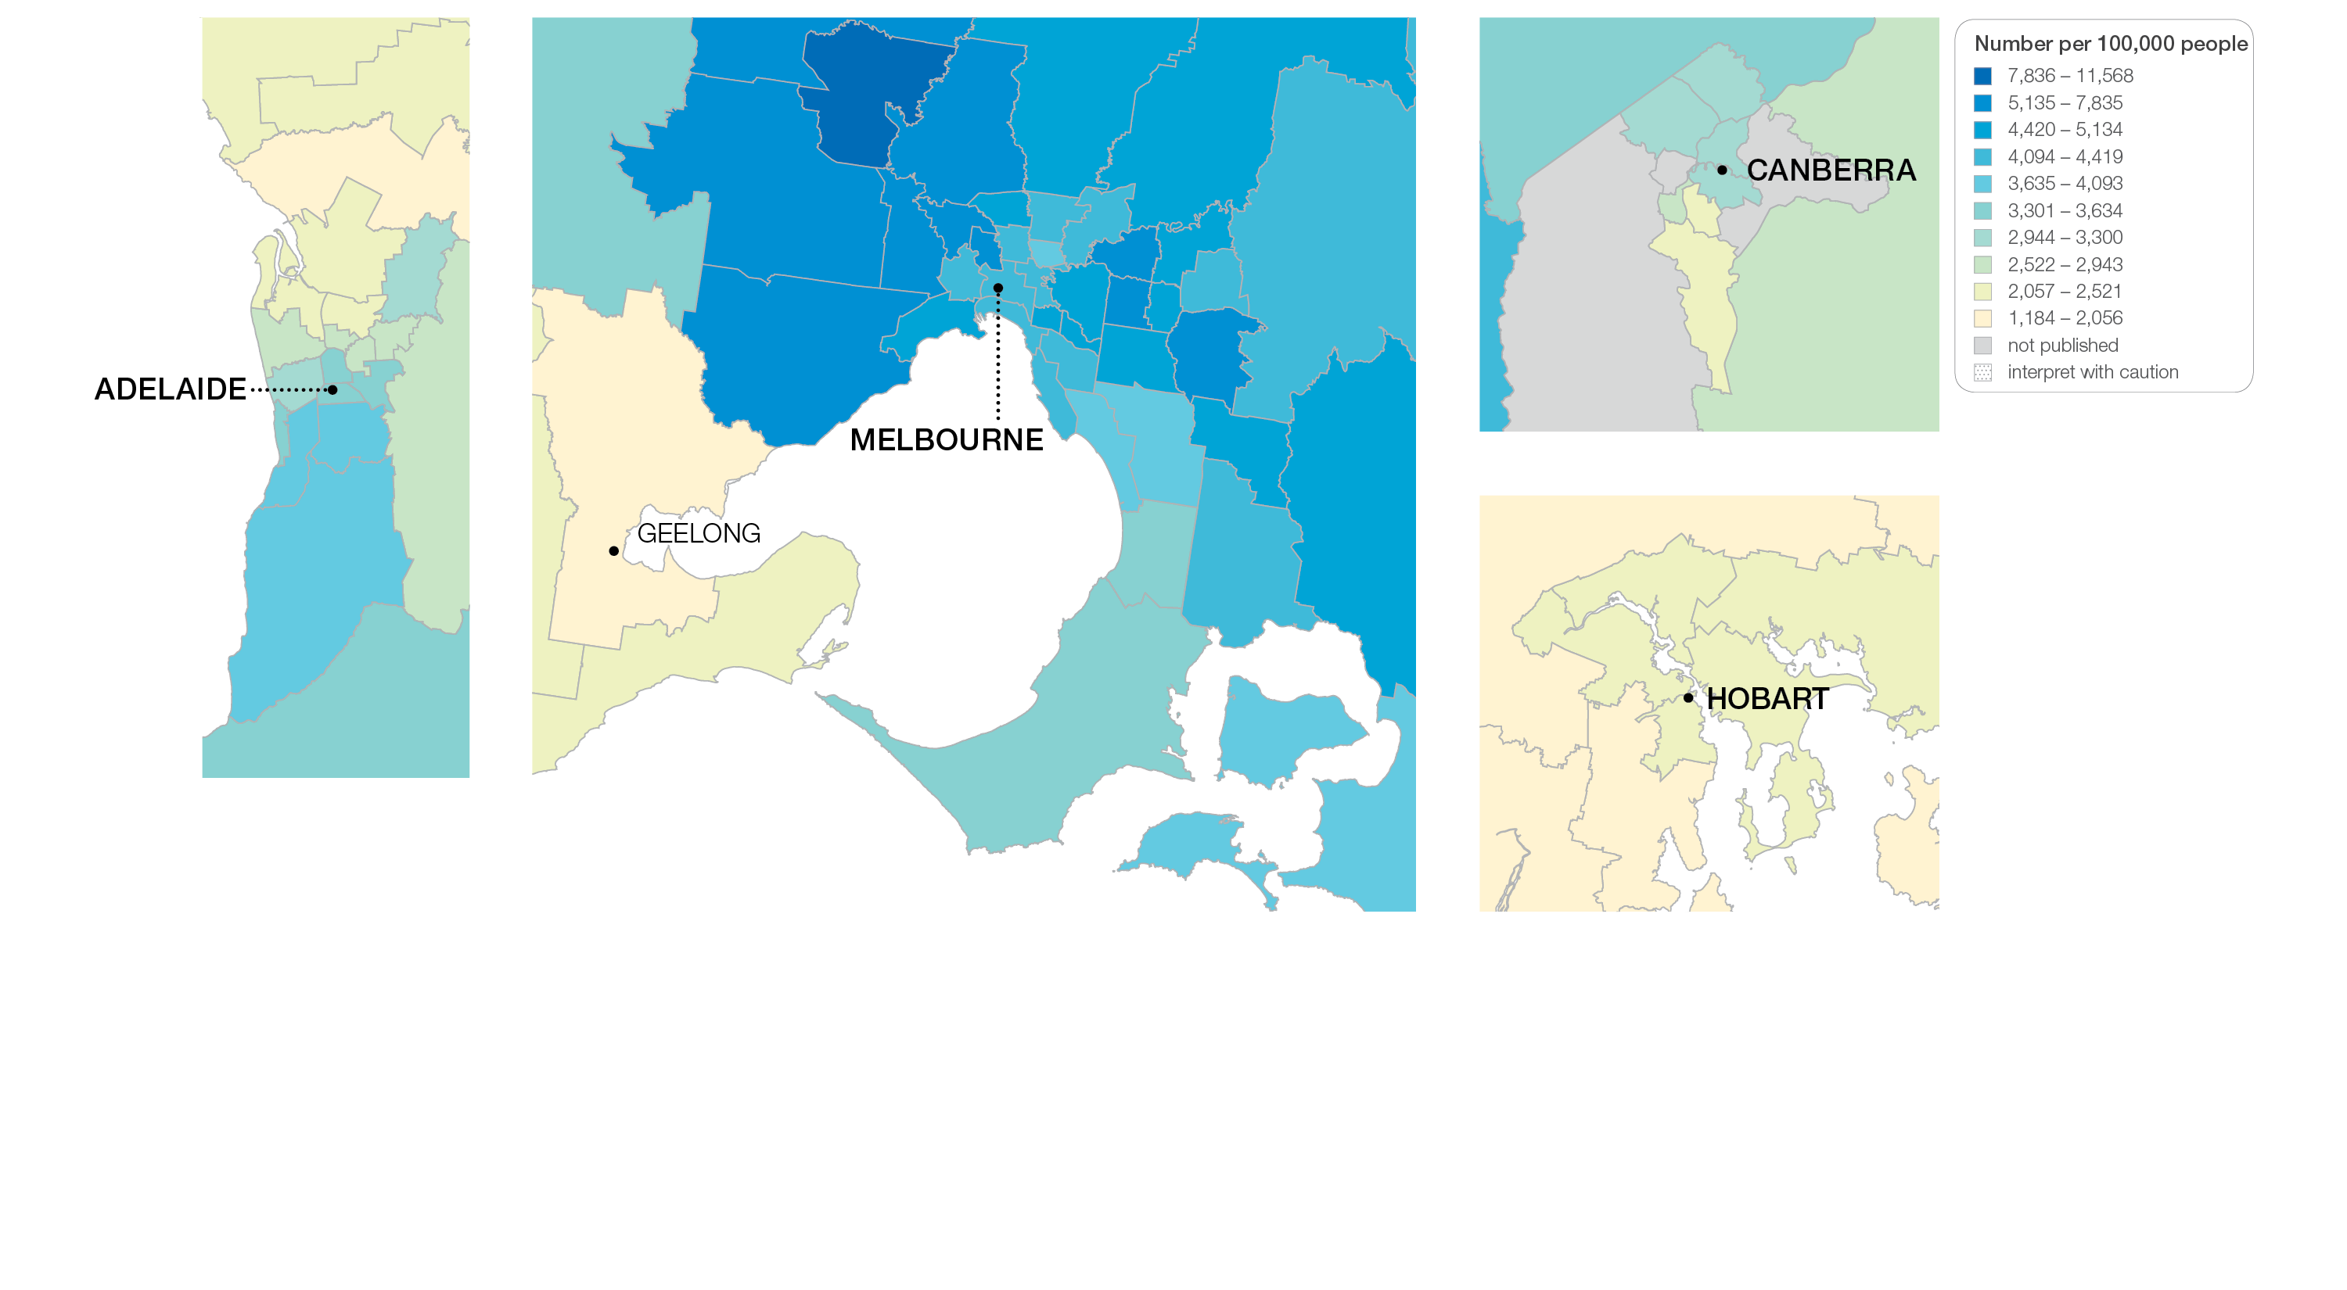
4.2 Stress echocardiography, 18 years and over
Sources: MBS data 2016-17, and ABS Estimated Resident Population 30 June 2016
Notes:
Speaker notes:
This slide shows the distribution of rates by Statistical Area Level 3 (SA3) for stress echocardiography by capital city area. Rates are based on the patient’s usual place of residence, not the location of the healthcare provider.

Slide 31
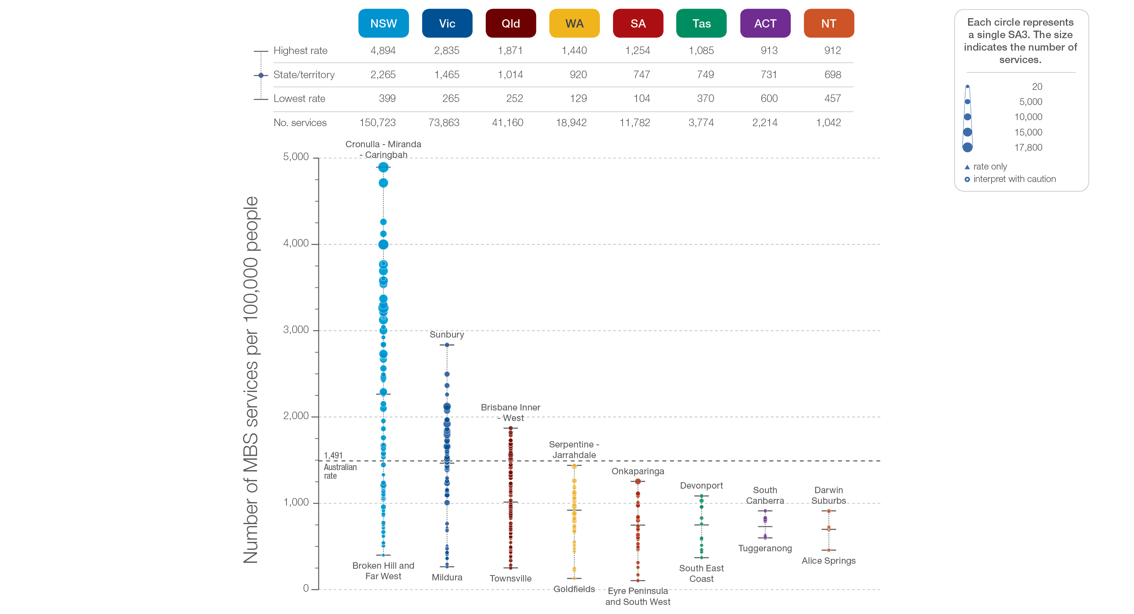
4.2 Stress echocardiography, 18 years and over
State and territory
Sources: MBS data 2016-17, and ABS Estimated Resident Population 30 June 2016
Notes:
Speaker notes:
The number of services varied across states and territories, from 698 per 100,000 people aged 18 years and over in the Northern Territory to 2,265 in New South Wales.
Each circle on the graph represents an SA3. The size of the circle indicates how many services have been recorded for people living in that area. The vertical axis shows the standardised rates for the clinical item.
Hollow circles and asterisks indicate rates that are considered more volatile than other published rates and should be interpreted with caution. Triangles indicate SA3s where only rates are published. The numbers of services are not published for confidentiality reasons.
For further detail about the methods used, please refer to the Technical Supplement.
For further information on how to interpret the figures, please refer to the ‘How to interpret’ resource available at: www.safetyandquality.gov.au/atlas/the-third-australian-atlas-of-healthcare-variation-2018/how-to-interpret-the-data/

Slide 32
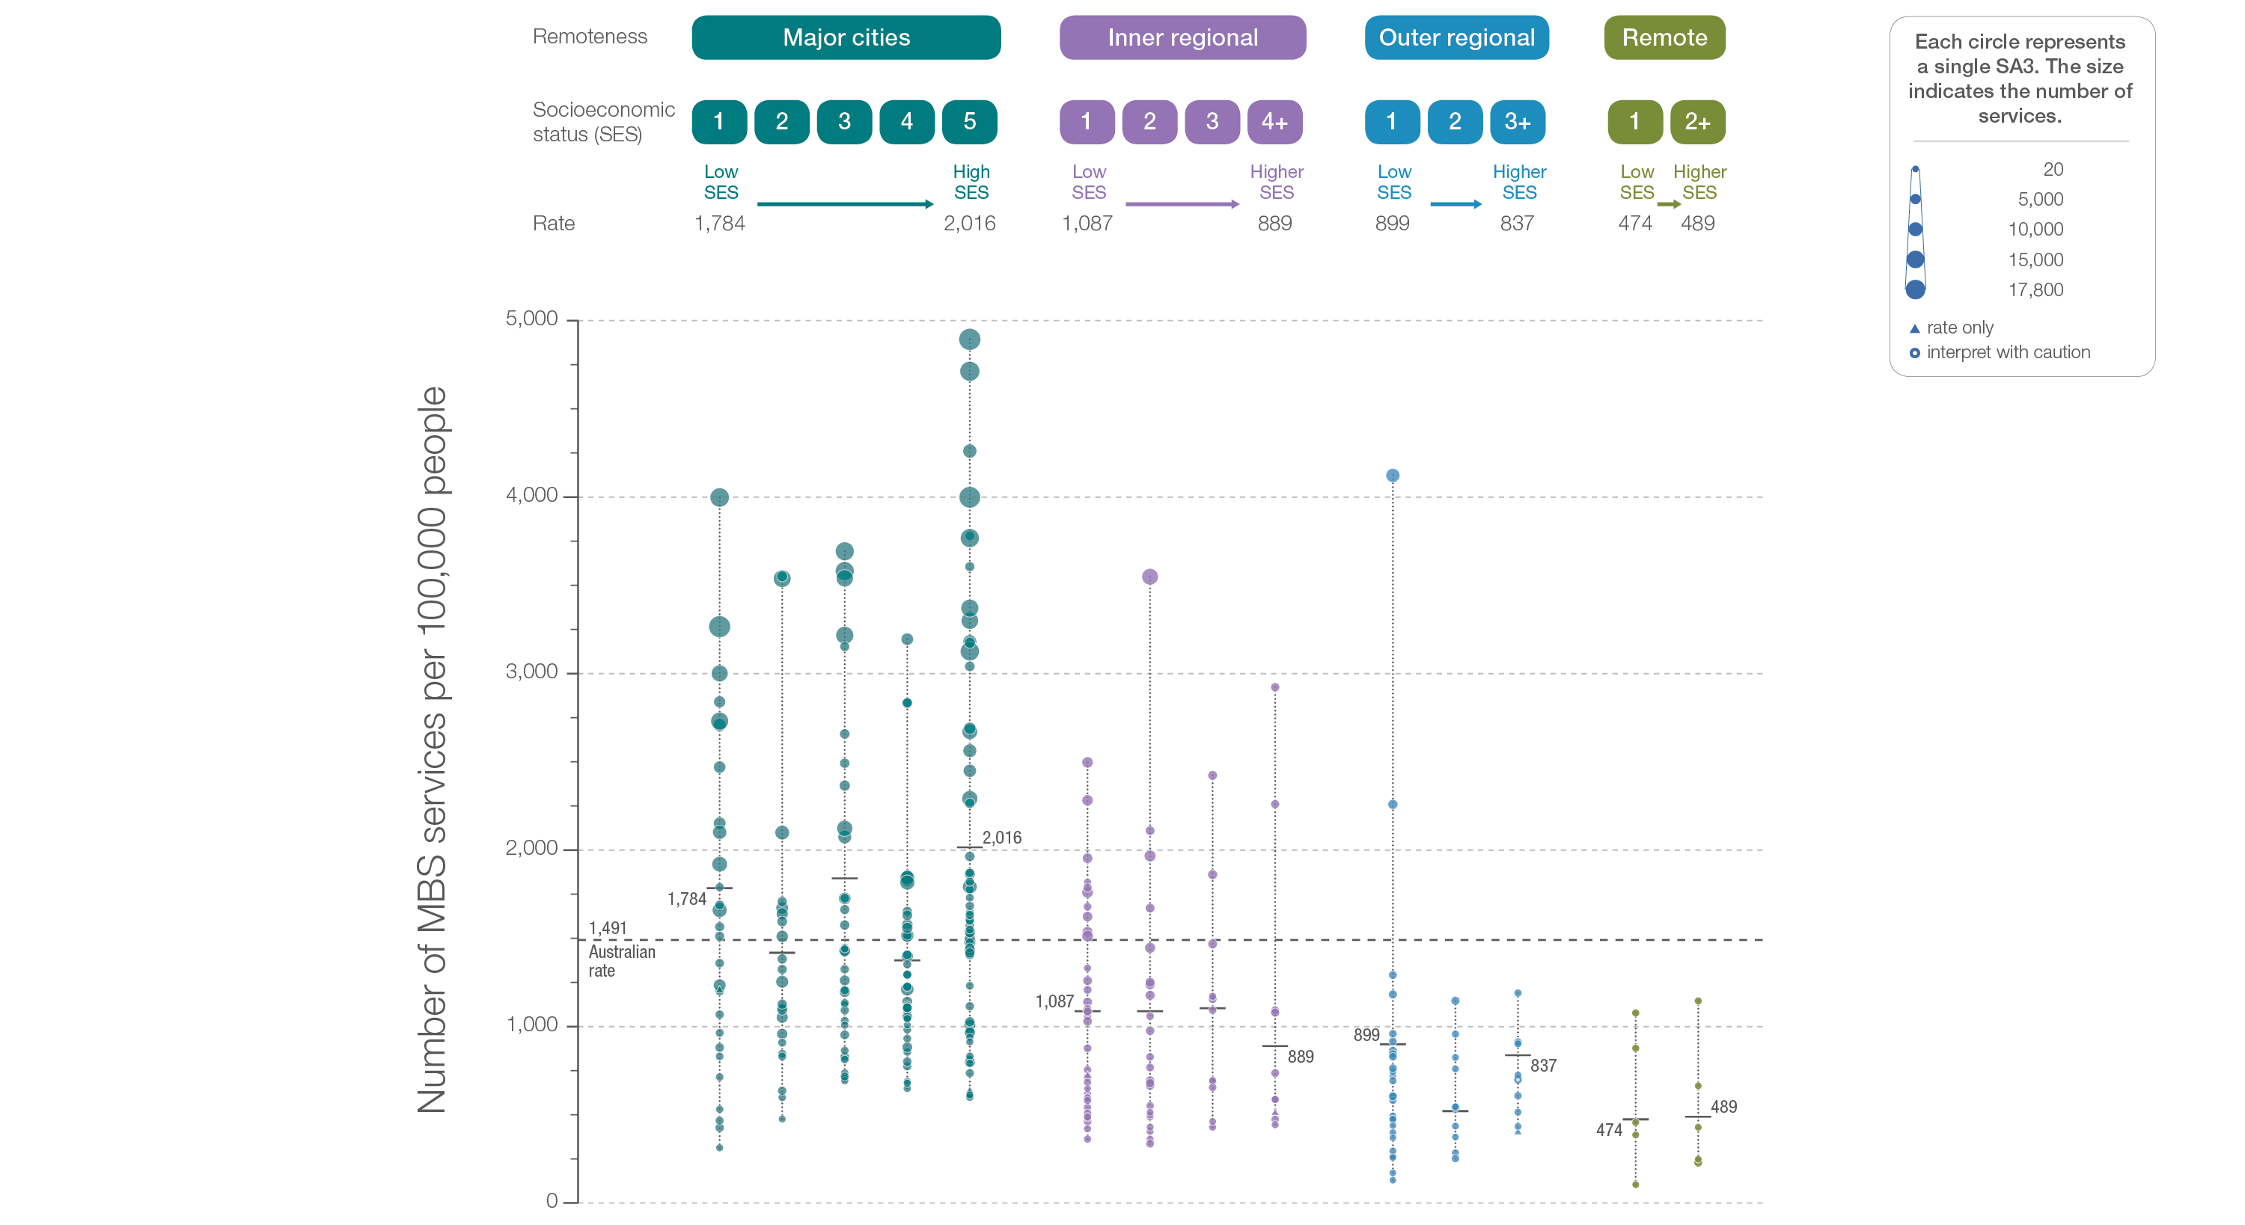
4.2 Stress echocardiography, 18 years and over
Remoteness and socioeconomic status
Sources: MBS data 2016-17, and ABS Estimated Resident Population 30 June 2016
Notes:
Speaker notes:
Rates of stress echocardiography were higher in major cities and inner regional areas than in outer regional and remote areas. There was no clear pattern according to socioeconomic status.
Hollow circles indicate rates that are considered more volatile than other published rates and should be interpreted with caution. Triangles indicate SA3s where only rates are published. The numbers of services are not published for confidentiality reasons.
For further detail about the methods used, please refer to the Technical Supplement.
For further information on how to interpret the figures, please refer to the ‘How to interpret’ resource available at: www.safetyandquality.gov.au/atlas/the-third-australian-atlas-of-healthcare-variation-2018/how-to-interpret-the-data/

Slide 33
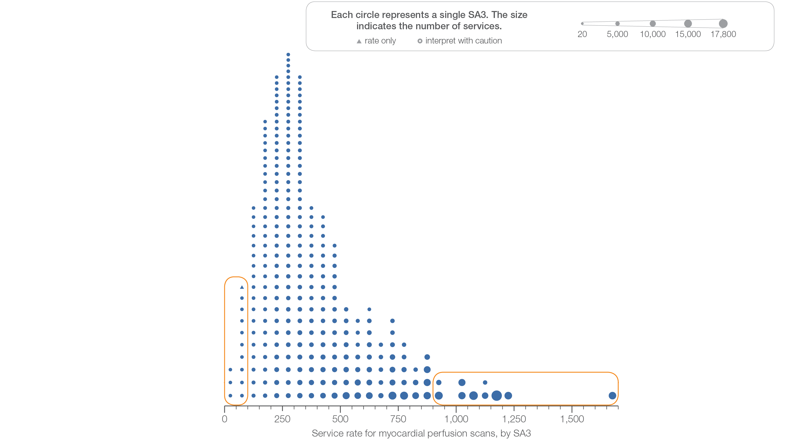
4.3 Myocardial perfusion scans, 18 years and over
Sources: MBS data 2016-17, and ABS Estimated Resident Population 30 June 2016
Notes:
Speaker notes:
This slide shows the distribution of rates by Statistical Area Level 3 (SA3) for myocardial perfusion scans.
Each circle on the graph represents an SA3. The size of the circle indicates how many services have been recorded for people living in that area. The horizontal axis shows the standardised rates for the clinical item.
Triangles indicate SA3s where only rates are published. The numbers of services are not published for confidentiality reasons.
For further detail about the methods used, please refer to the Technical Supplement.
For further information on how to interpret the figures, please refer to the ‘How to interpret’ resource available at: www.safetyandquality.gov.au/atlas/the-third-australian-atlas-of-healthcare-variation-2018/how-to-interpret-the-data/

Slide 34
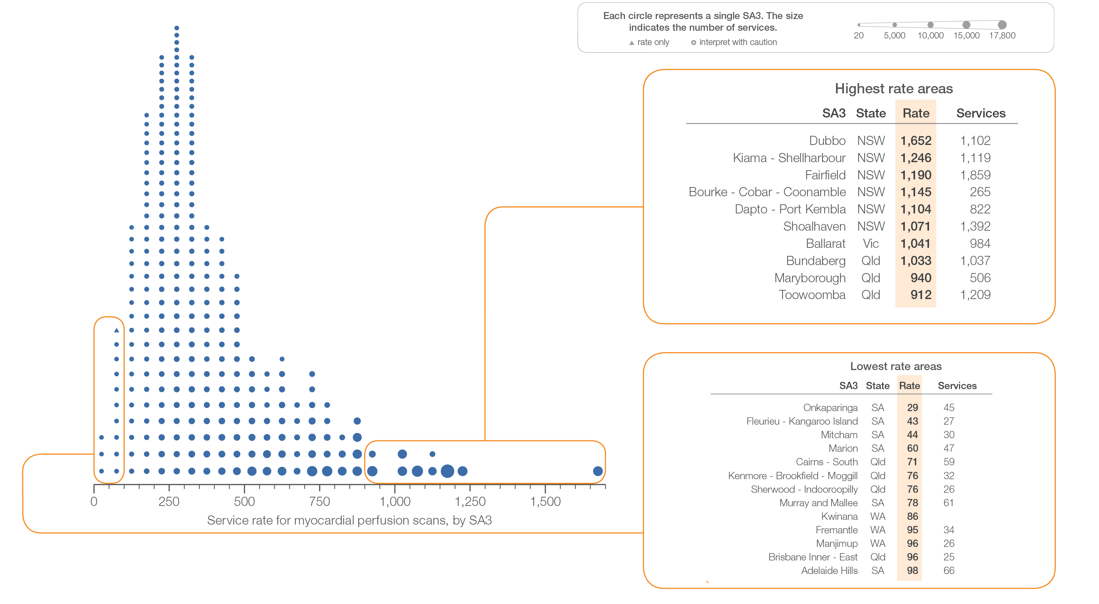
4.3 Myocardial perfusion scans, 18 years and over
Sources: MBS data 2016-17, and ABS Estimated Resident Population 30 June 2016
Notes:
Speaker notes:
This slide shows the distribution of rates by Statistical Area Level 3 (SA3) for myocardial perfusion scans.
Each circle on the graph represents an SA3. The size of the circle indicates how many services have been recorded for people living in that area. The horizontal axis shows the standardised rates for the clinical item.
Triangles indicate SA3s where only rates are published. The numbers of services are not published for confidentiality reasons.
For further detail about the methods used, please refer to the Technical Supplement.
For further information on how to interpret the figures, please refer to the ‘How to interpret’ resource available at: www.safetyandquality.gov.au/atlas/the-third-australian-atlas-of-healthcare-variation-2018/how-to-interpret-the-data/

Slide 35
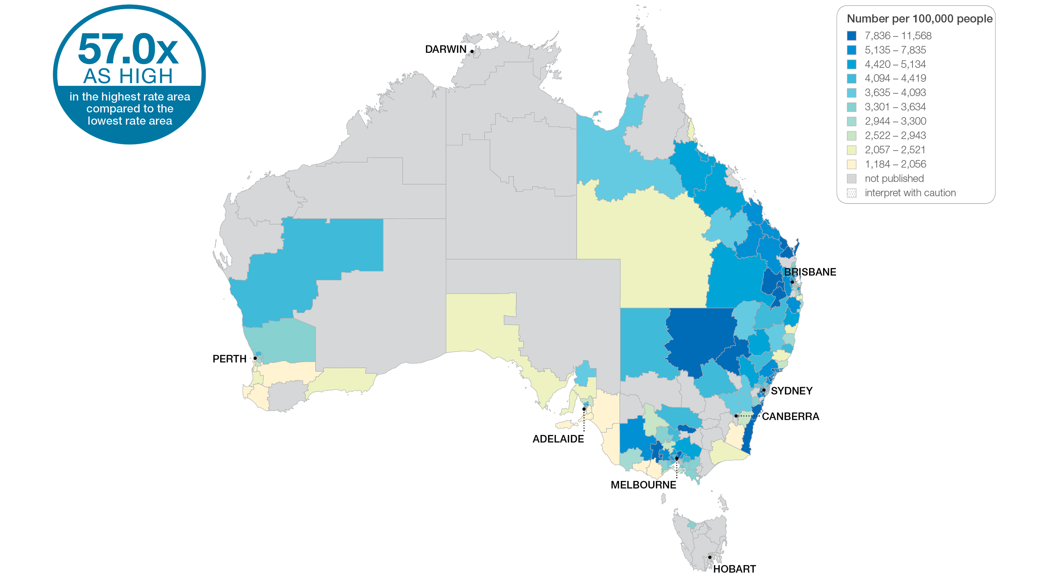
4.3 Myocardial perfusion scans, 18 years and over
Sources: MBS data 2016-17, and ABS Estimated Resident Population 30 June 2016
Notes:
Speaker notes:
This slide shows the distribution of rates by Statistical Area Level 3 (SA3) for myocardial perfusion scans. Rates are based on the patient’s usual place of residence, not the location of the healthcare provider.
In 2016–17, there were 79,905 MBS-subsidised services for MPS, representing 384 services per 100,000 people aged 18 years and over (the Australian rate).
The number of MBS-subsidised services for MPS across 278* local areas (Statistical Area Level 3 – SA3) ranged from 29 to 1,652 per 100,000 people aged 18 years and over.
The rate was 57.0 times as high in the area with the highest rate compared to the area with the lowest rate.
The number of services varied across states and territories, from 182 per 100,000 people aged 18 years and over in South Australia to 485 in New South Wales.
The range of rates represented by each colour are shown in the legend for the map. The darker blue colour represents SA3s with higher rates. The lighter colours represent SA3s with lower rates.
Data for the MPS MBS items have been suppressed, indicated on the maps in grey. Most local areas (Statistical Area Level 3 – SA3) were suppressed to prevent identification of the provider (practitioner or business entity). The effect of data suppression was greatest in inner and outer regional and remote areas:
- Overall, 62 SA3s were suppressed, which represents 18% of all SA3s and 8% of all services
- 37 SA3s were suppressed to prevent identification of the provider
- The proportion of SA3s suppressed in each remoteness category was 3% in major cities, 26% in inner regional areas, 43% in outer regional areas and 74% in remote areas.
For further detail about the methods used, please refer to the Technical Supplement.
For further information on how to interpret the figures, please refer to the ‘How to interpret’ resource available at: www.safetyandquality.gov.au/atlas/the-third-australian-atlas-of-healthcare-variation-2018/how-to-interpret-the-data/

Slide 36
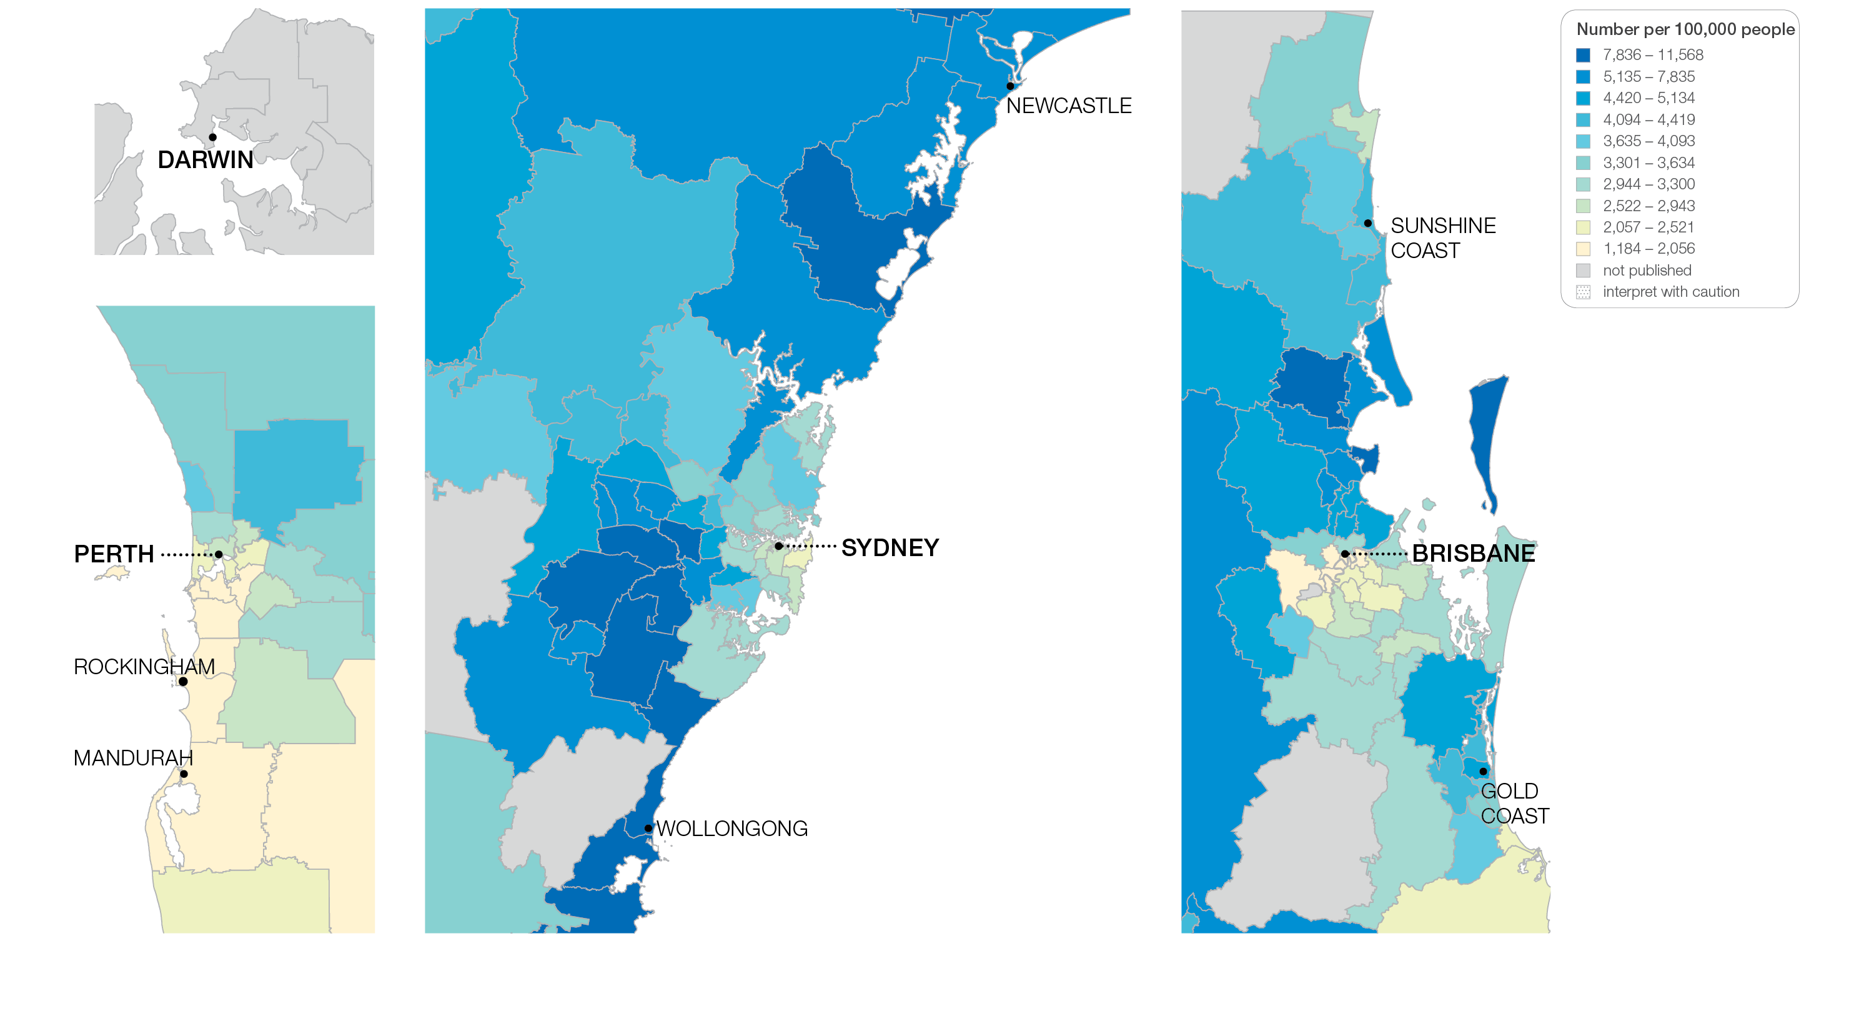
4.3 Myocardial perfusion scans, 18 years and over
Sources: MBS data 2016-17, and ABS Estimated Resident Population 30 June 2016
Notes:
Speaker notes:
This slide shows the distribution of rates by Statistical Area Level 3 (SA3) for myocardial perfusion scans by capital city area. Rates are based on the patient’s usual place of residence, not the location of the healthcare provider.

Slide 37
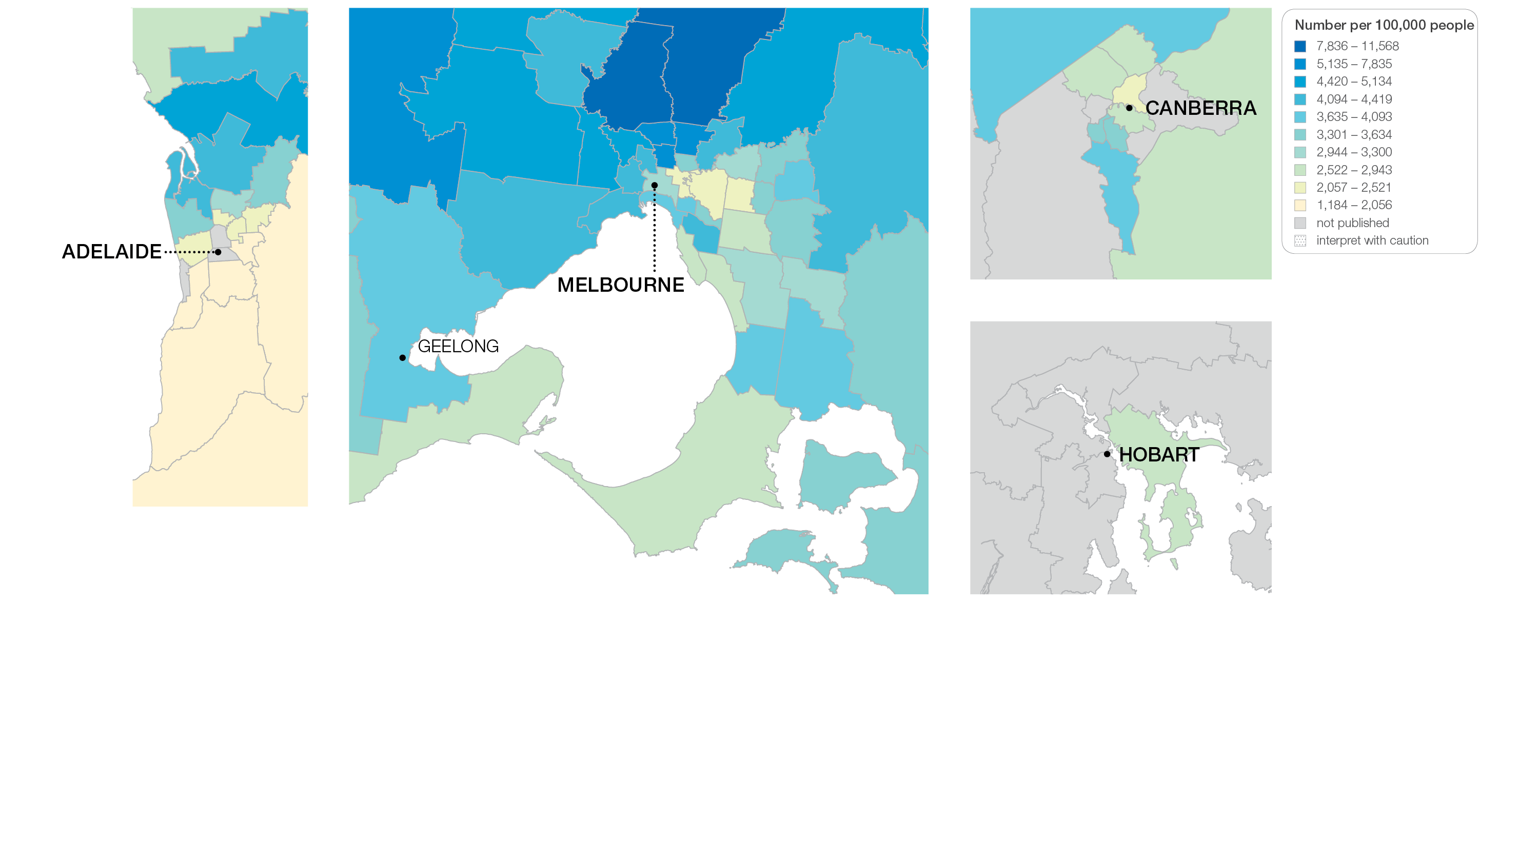
4.3 Myocardial perfusion scans, 18 years and over
Sources: MBS data 2016-17, and ABS Estimated Resident Population 30 June 2016
Notes:
Speaker notes:
This slide shows the distribution of rates by Statistical Area Level 3 (SA3) for myocardial perfusion scans by capital city area. Rates are based on the patient’s usual place of residence, not the location of the healthcare provider.

Slide 38
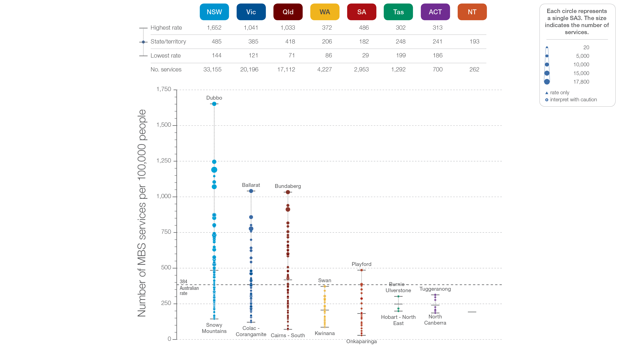
4.3 Myocardial perfusion scans, 18 years and over
State and territory
Sources: MBS data 2016-17, and ABS Estimated Resident Population 30 June 2016
Notes:
Speaker notes:
The number of services varied across states and territories, from 182 per 100,000 people aged 18 years and over in South Australia to 485 in New South Wales.
Each circle on the graph represents an SA3. The size of the circle indicates how many services have been recorded for people living in that area. The vertical axis shows the standardised rates for the clinical item.
Triangles indicate SA3s where only rates are published. The numbers of services are not published for confidentiality reasons.
Rates for NT SA3s are not published for reliability and/or confidentiality reasons.
For further detail about the methods used, please refer to the Technical Supplement.
For further information on how to interpret the figures, please refer to the ‘How to interpret’ resource available at: www.safetyandquality.gov.au/atlas/the-third-australian-atlas-of-healthcare-variation-2018/how-to-interpret-the-data/

Slide 39
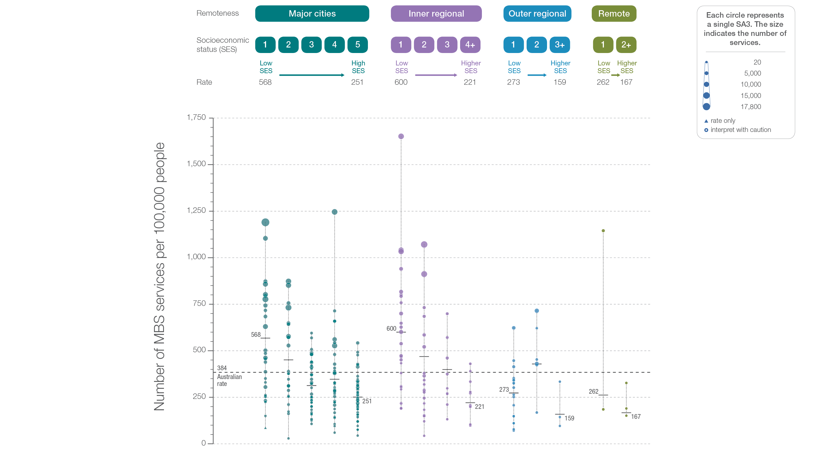
4.3 Myocardial perfusion scans, 18 years and over
Remoteness and socioeconomic status
Sources: MBS data 2016-17, and ABS Estimated Resident Population 30 June 2016
Notes:
Speaker notes:
Rates of MPS were higher in major cities and inner regional areas than in other remote areas. Rates were higher in areas with lower socioeconomic status in major cities, and inner regional and remote areas. There was no clear pattern according to socioeconomic status in outer regional areas.
Triangles indicate SA3s where only rates are published. The numbers of services are not published for confidentiality reasons.
For further detail about the methods used, please refer to the Technical Supplement.
For further information on how to interpret the figures, please refer to the ‘How to interpret’ resource available at: www.safetyandquality.gov.au/atlas/the-third-australian-atlas-of-healthcare-variation-2018/how-to-interpret-the-data/

Slide 40
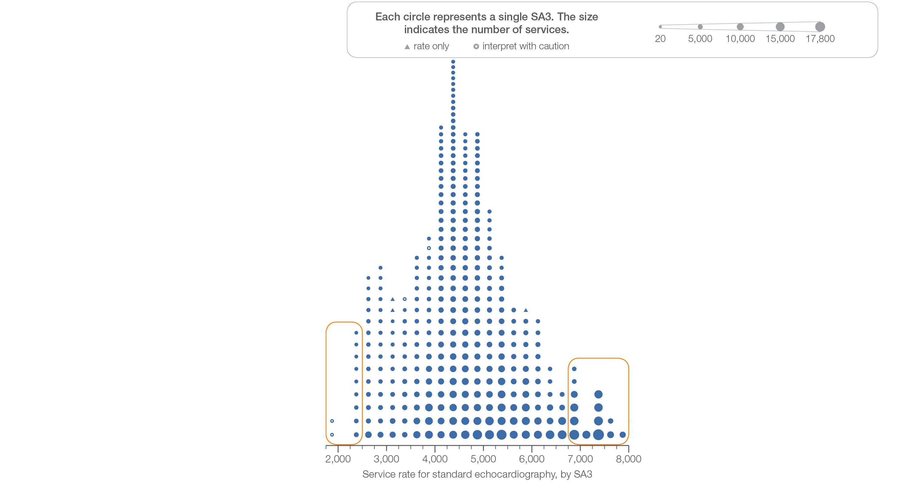
4.4 Standard echocardiography, 18 years and over
Sources: MBS data 2016-17, and ABS Estimated Resident Population 30 June 2016
Notes:
Speaker notes:
This slide shows the distribution of rates by Statistical Area Level 3 (SA3) for standard echocardiography.
Each circle on the graph represents an SA3. The size of the circle indicates how many services have been recorded for people living in that area. The horizontal axis shows the standardised rates for the clinical item.
Hollow circles and asterisks indicate rates that are considered more volatile than other published rates and should be interpreted with caution. Triangles indicate SA3s where only rates are published. The numbers of services are not published for confidentiality reasons.
For further detail about the methods used, please refer to the Technical Supplement.
For further information on how to interpret the figures, please refer to the ‘How to interpret’ resource available at: www.safetyandquality.gov.au/atlas/the-third-australian-atlas-of-healthcare-variation-2018/how-to-interpret-the-data/

Slide 41
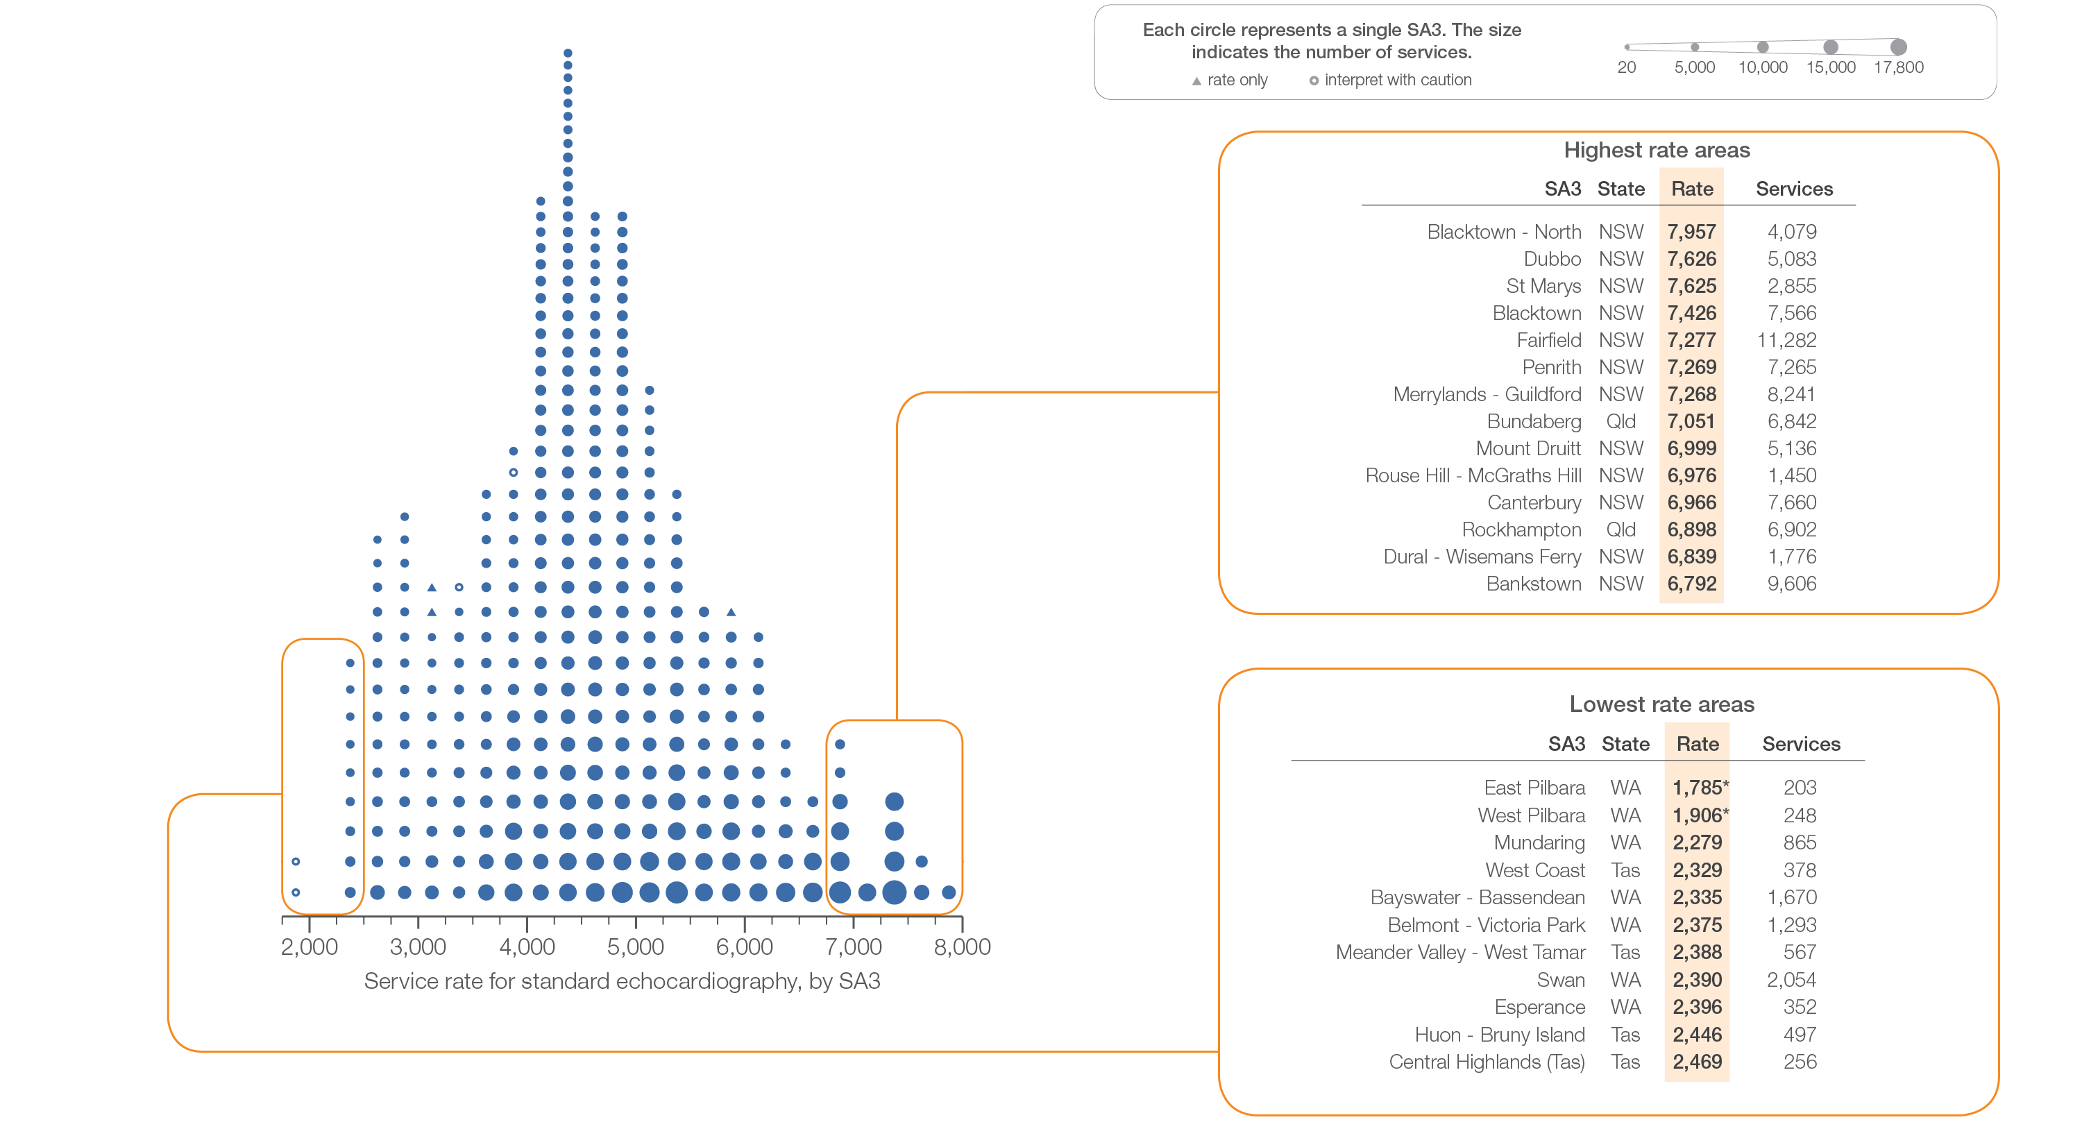
4.4 Standard echocardiography, 18 years and over
Sources: MBS data 2016-17, and ABS Estimated Resident Population 30 June 2016
Notes:
Speaker notes:
This slide shows the distribution of rates by Statistical Area Level 3 (SA3) for standard echocardiography.
Each circle on the graph represents an SA3. The size of the circle indicates how many services have been recorded for people living in that area. The horizontal axis shows the standardised rates for the clinical item.
Hollow circles and asterisks indicate rates that are considered more volatile than other published rates and should be interpreted with caution. Triangles indicate SA3s where only rates are published. The numbers of services are not published for confidentiality reasons.
For further detail about the methods used, please refer to the Technical Supplement.
For further information on how to interpret the figures, please refer to the ‘How to interpret’ resource available at: www.safetyandquality.gov.au/atlas/the-third-australian-atlas-of-healthcare-variation-2018/how-to-interpret-the-data/

Slide 42
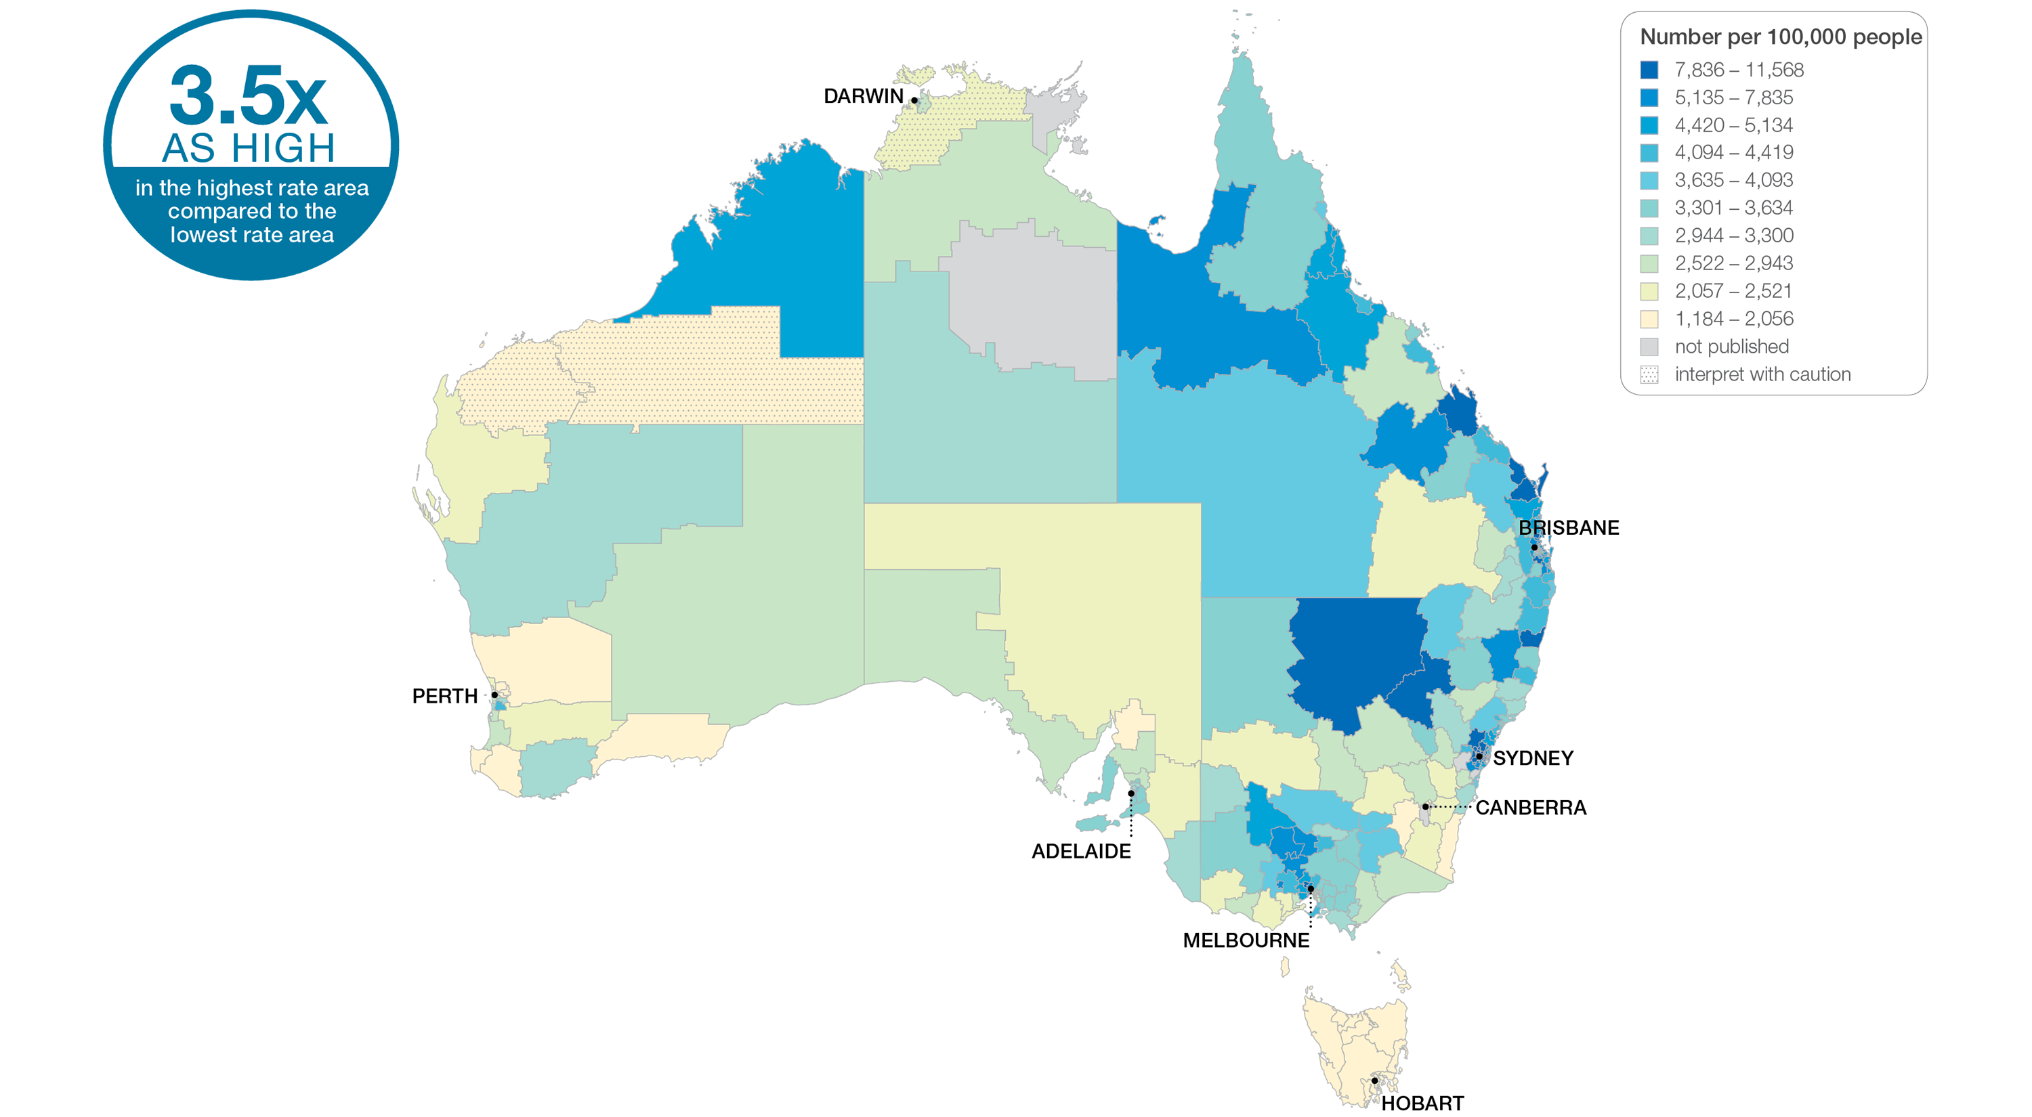
4.4 Standard echocardiography, 18 years and over
Sources: MBS data 2016-17, and ABS Estimated Resident Population 30 June 2016
Notes:
Speaker notes:
This slide shows the distribution of rates by Statistical Area Level 3 (SA3) for standard echocardiography. Rates are based on the patient’s usual place of residence, not the location of the healthcare provider.
In 2016–17, there were 945,056 MBS-subsidised services for standard echocardiography, representing 4,599 services per 100,000 people aged 18 years and over (the Australian rate).
The number of MBS-subsidised services for standard echocardiography across 328* local areas (Statistical Area Level 3 – SA3) ranged from 2,279 to 7,957 per 100,000 people aged 18 years and over.
The rate was 3.5 times as high in the area with the highest rate compared to the area with the lowest rate.
The number of services varied across states and territories, from 2,624 per 100,000 people aged 18 years and over in Tasmania to 5,309 in New South Wales.
The range of rates represented by each colour are shown in the legend for the map. The darker blue colour represents SA3s with higher rates. The lighter colours represent SA3s with lower rates.
Dotted areas indicate rates that are considered more volatile than other published rates and should be interpreted with caution. These rates are excluded from the calculation of the difference between the highest and lowest SA3 rates in Australia.
For further detail about the methods used, please refer to the Technical Supplement.
For further information on how to interpret the figures, please refer to the ‘How to interpret’ resource available at: www.safetyandquality.gov.au/atlas/the-third-australian-atlas-of-healthcare-variation-2018/how-to-interpret-the-data/

Slide 43
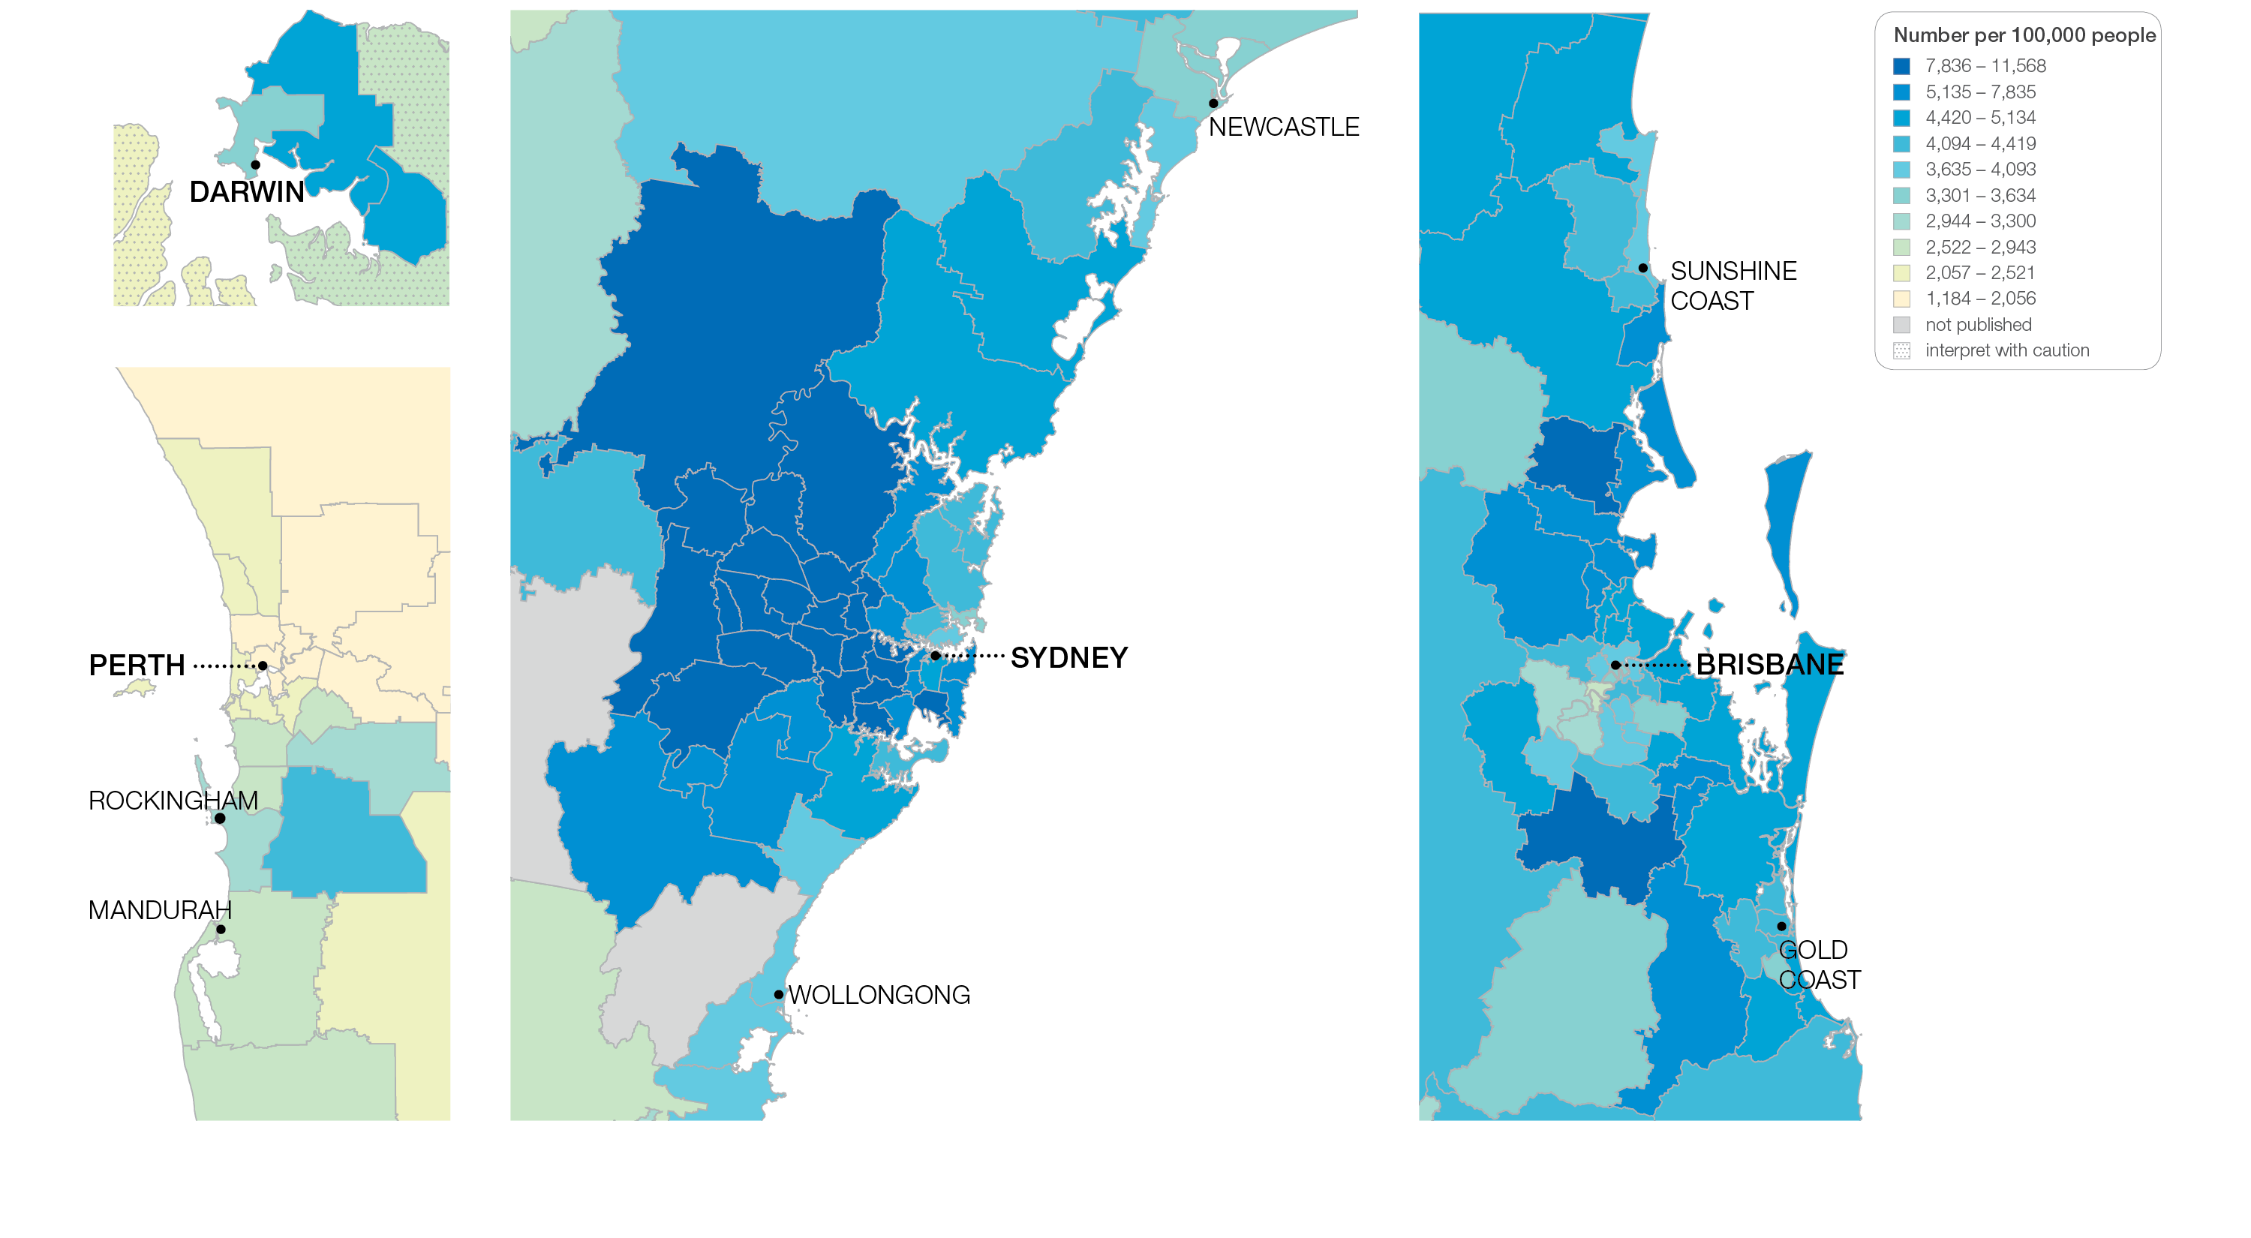
4.4 Standard echocardiography, 18 years and over
Sources: MBS data 2016-17, and ABS Estimated Resident Population 30 June 2016
Notes:
Speaker notes:
This slide shows the distribution of rates by Statistical Area Level 3 (SA3) for standard echocardiography by capital city area. Rates are based on the patient’s usual place of residence, not the location of the healthcare provider.

Slide 44
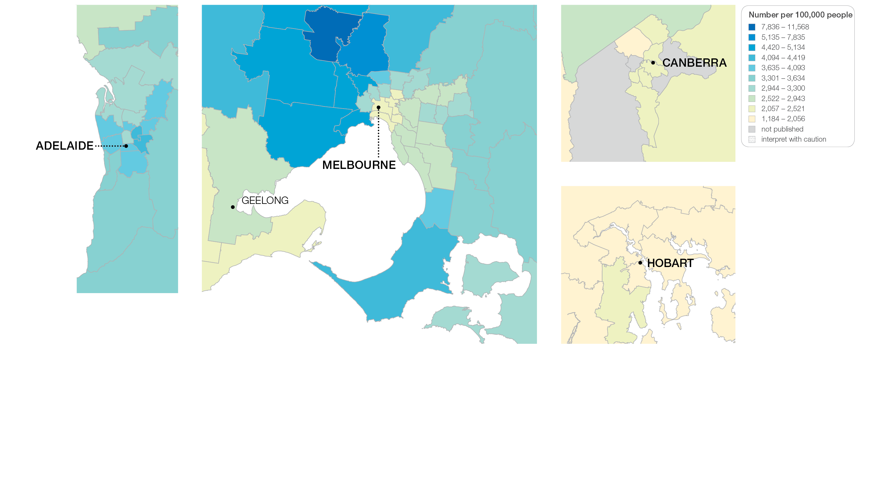
4.4 Standard echocardiography, 18 years and over
Sources: MBS data 2016-17, and ABS Estimated Resident Population 30 June 2016
Notes:
Speaker notes:
This slide shows the distribution of rates by Statistical Area Level 3 (SA3) for standard echocardiography by capital city area. Rates are based on the patient’s usual place of residence, not the location of the healthcare provider.

Slide 45
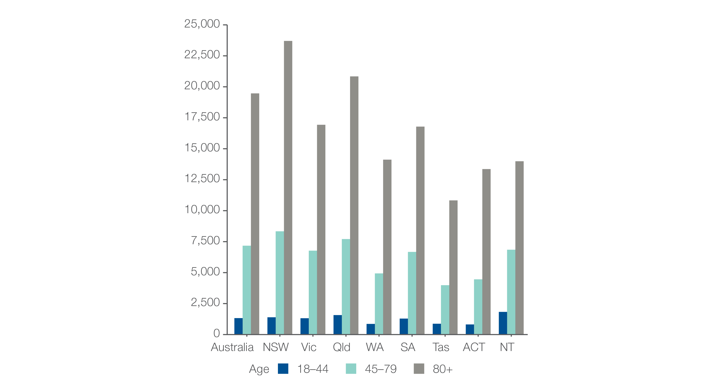
4.4 Standard echocardiography, 18 years and over
MBS-subsidised services, by age group
Number per 100,000 people
Sources: MBS data 2016-17, and ABS Estimated Resident Population 30 June 2016
Notes:
Speaker notes:
Rates of standard echocardiography were highest for the 80 years and over age group.
The national rate for this age group was 19,469 services per 100,000 people and varied from 10,829 services per 100,000 people in Tasmania to 23,703 services per 100,000 people in New South Wales.
The national rate for tests performed on the 80 years and over age group was 2.7 times as high as the rate for the 45–79 years age group (which had the next highest rate). This pattern was consistent across all states and territories.

Slide 46
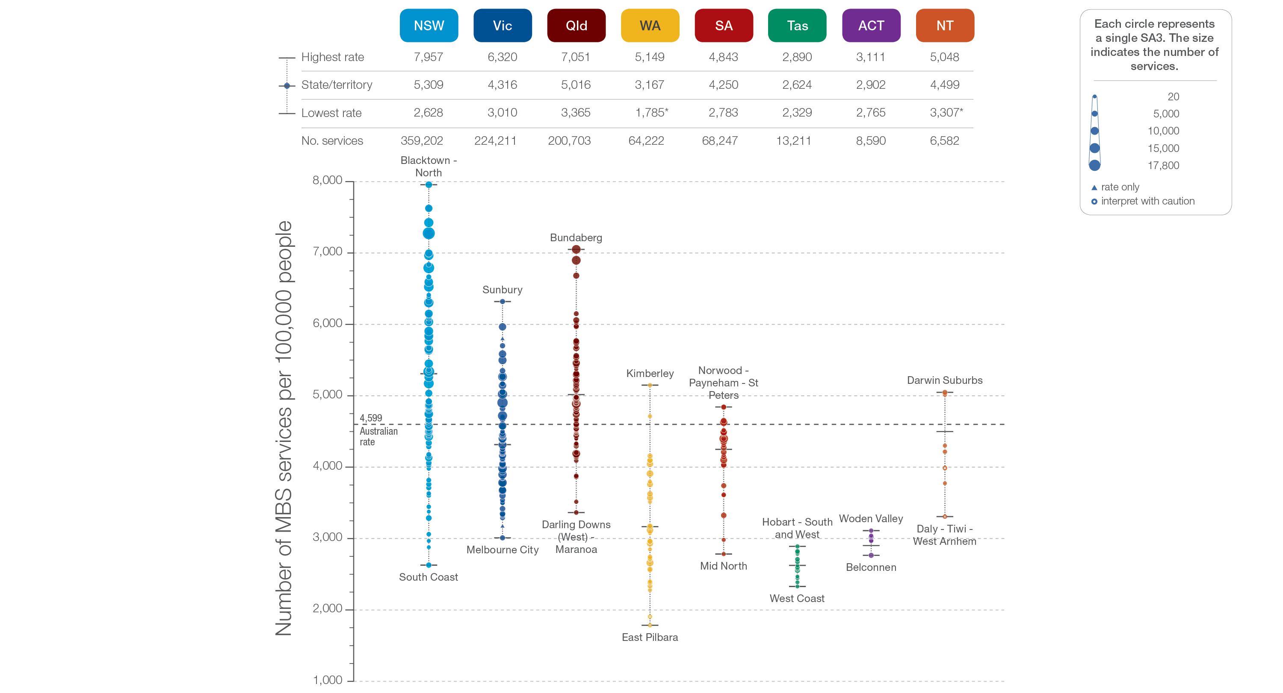
4.4 Standard echocardiography, 18 years and over
State and territory
Sources: MBS data 2016-17, and ABS Estimated Resident Population 30 June 2016
Notes:
Speaker notes:
The number of services varied across states and territories, from 2,624 per 100,000 people aged 18 years and over in Tasmania to 5,309 in New South Wales.
Each circle on the graph represents an SA3. The size of the circle indicates how many services have been recorded for people living in that area. The vertical axis shows the standardised rates for the clinical item.
Hollow circles and asterisks indicate rates that are considered more volatile than other published rates and should be interpreted with caution. Triangles indicate SA3s where only rates are published. The numbers of services are not published for confidentiality reasons.
For further detail about the methods used, please refer to the Technical Supplement.
For further information on how to interpret the figures, please refer to the ‘How to interpret’ resource available at: www.safetyandquality.gov.au/atlas/the-third-australian-atlas-of-healthcare-variation-2018/how-to-interpret-the-data/

Slide 47
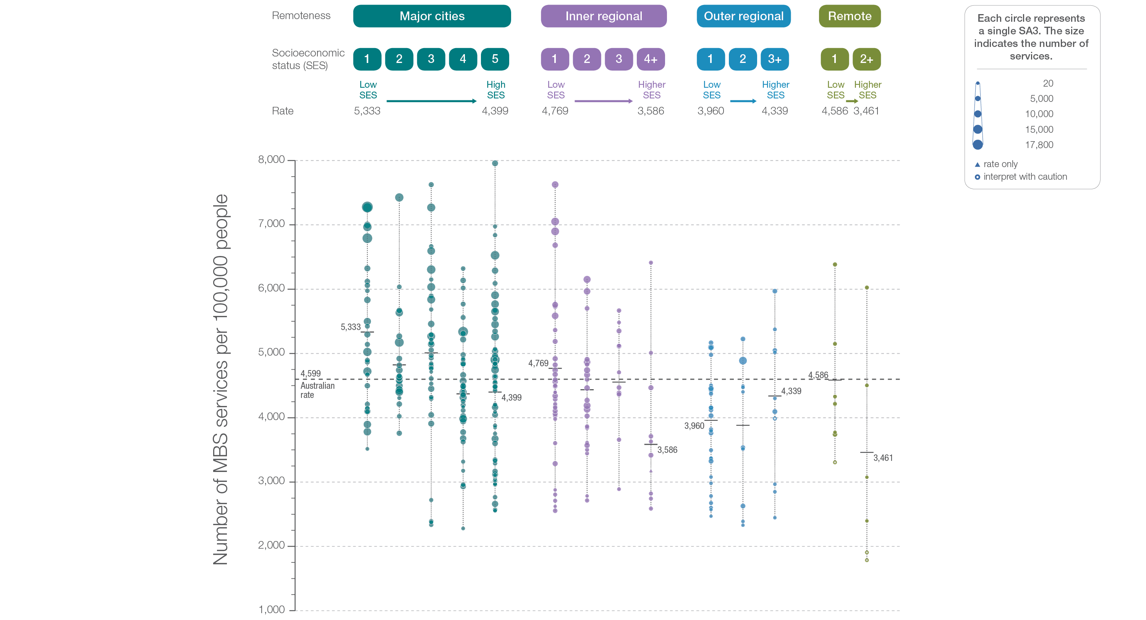
4.4 Standard echocardiography, 18 years and over
Remoteness and socioeconomic status
Sources: MBS data 2016-17, and ABS Estimated Resident Population 30 June 2016
Notes:
Speaker notes:
Rates of standard echocardiography were higher in major cities and inner regional areas than in outer regional and remote areas. There was no clear pattern according to socioeconomic status.
Hollow circles indicate rates that are considered more volatile than other published rates and should be interpreted with caution. Triangles indicate SA3s where only rates are published. The numbers of services are not published for confidentiality reasons.
For further detail about the methods used, please refer to the Technical Supplement.
For further information on how to interpret the figures, please refer to the ‘How to interpret’ resource available at: www.safetyandquality.gov.au/atlas/the-third-australian-atlas-of-healthcare-variation-2018/how-to-interpret-the-data/

Slide 48
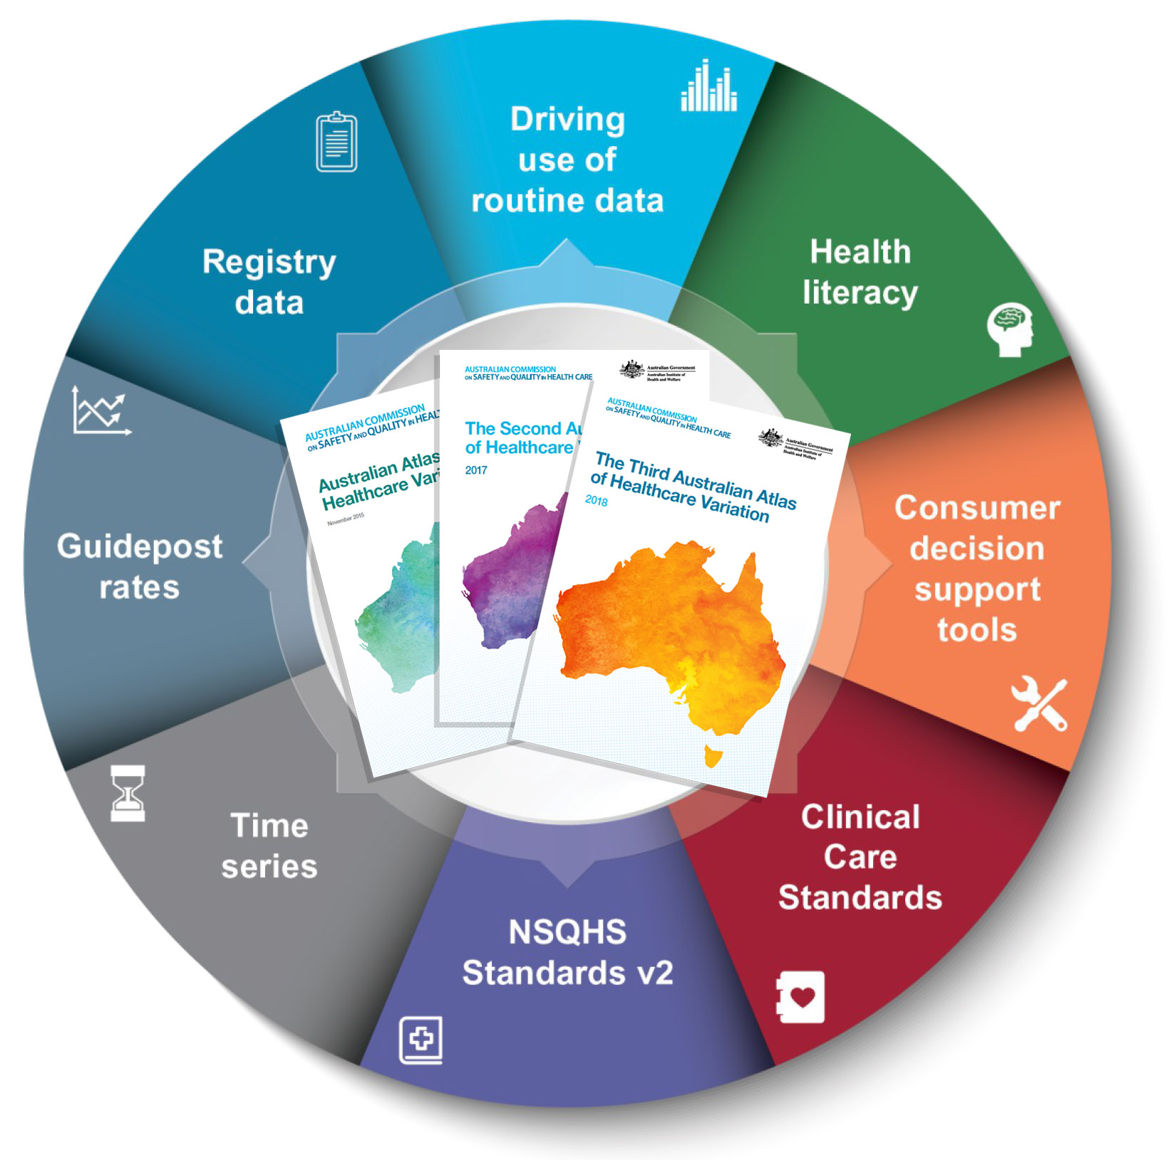
Promoting appropriate care
Explore variation
Identify unwarranted variation
Address unwarranted variation
Notes:
Speaker notes:
Mapping variation is an invaluable tool for understanding how our healthcare system is providing care, but gathering the data is only the first step. Understanding the underlying reasons for marked differences in the use of some health services across Australia, and considering how we can improve, are key for translating this work into better outcomes for patients.
The patterns shown in the maps in this Atlas and the accompanying commentaries show that there are many opportunities for making meaningful changes in Australia’s delivery of health care. The recommendations in the third Atlas highlight that action is needed at all levels – from addressing the social determinants of health through to better data collection, system changes and providing the best supports for individual clinician–patient interactions. These goals are ambitious, but the recommended changes have the potential to result in meaningful progress in defining and delivering appropriate care – and improving patient outcomes.

Slide 49
Further resources
Explore the data further using the interactive Atlas at www.safetyandquality.gov.au/atlas/
Please send any queries to atlas@safetyandquality.gov.au
Notes:
Further resources
Explore the data further using the interactive Atlas at www.safetyandquality.gov.au/atlas/
Please send any queries to atlas@safetyandquality.gov.au

