Slide 1
The Third Australian Atlas of Healthcare Variation
2018

Slide 2
The Australian Atlas of Healthcare Variation series
Notes:
Speaker notes:
Mapping variation is an invaluable tool for understanding how our healthcare system is providing care. The Australian Atlas of Healthcare Variation series illuminates variation by mapping use of health care according to where people live. Each Atlas identifies specific achievable actions for exploration and quality improvement.
The Australian Commission on Safety and Quality in Health Care (the Commission) has collaborated with the Australian, state and territory governments, specialist medical colleges, clinicians and consumer representatives to develop the Atlas series.
The Atlas publications can be downloaded from the Atlas website.

Slide 3
Interactive Atlas
Notes:
Speaker notes:
The Atlas data can also be further explored using the online interactive Atlas platform.

Slide 4
Australian Commission on Safety and Quality in Health Care
Australian Government agency
Leads & coordinates national improvements in safety & quality of health care based on best available evidence
Works in partnership with patients, consumers, clinicians, managers, policy makers & health care organisations
Aims to ensure that the health system is sustainable, better informed, supported & organised to deliver safe & high quality care
Notes:
Speaker notes:
The Commission’s role is to lead and coordinate national improvements in the safety and quality of health care. The Commission works in partnership with the Australian Government, state and territory governments and the private sector to achieve a safe and high-quality, sustainable health system. In doing so, the Commission also works closely with patients, carers, clinicians, managers, policymakers and healthcare organisations.
Key functions of the Commission include developing national safety and quality standards, developing clinical care standards to improve the implementation of evidence-based health care, coordinating work in specific areas to improve outcomes for patients, and providing information, publications and resources about safety and quality.
The Commission works in four priority areas:
- Patient safety
- Partnering with patients, consumers and communities
- Quality, cost and value
- Supporting health professionals to provide care that is informed, supported and organised to deliver safe and high-quality health care.
One of the Commission’s key programs is the National Safety and Quality Health Service (NSQHS) Standards. The primary aim of the NSQHS Standards are to protect the public from harm and to improve the quality of health service provision. The NSQHS Standards were developed by the Commission in partnership with the Australian, state and territory governments, the private sector, clinicians, patients and carers.

Slide 5
Third Australian Atlas of Healthcare Variation
Examines variation nationally in 13 clinical items, grouped into 4 themes
Neonatal and paediatric health
Early planned caesarean section without medical or obstetric indication
Antibiotic dispensing in children, 9 years and under
Proton pump inhibitor dispensing in infants, 1 year and under
Gastrointestinal investigations and treatments
Proton pump inhibitor dispensing in adults
Colonoscopy hospitalisations
Gastroscopy hospitalisations
Thyroid investigations and treatments
Thyroid stimulating hormone tests
Thyroid function tests
Neck ultrasound
Thyroidectomy hospitalisations
Cardiac tests
Cardiac stress tests and imaging
Stress echocardiography
Myocardial perfusion scans
Standard echocardiography
Notes:
Speaker notes:
The third Atlas, released in December 2018, examines four clinical themes: neonatal and paediatric health, gastrointestinal investigations and treatments, thyroid investigations and treatments and cardiac tests.

Slide 6
Inside this slide pack
Why does variation matter?
How is variation measured in the Atlas?
How is variation presented in the Atlas?
Notes on data
Key findings
Promoting appropriate care
Further resources.
Notes:
Speaker notes:
This slide pack explores why variation matters and what unwarranted variation in healthcare is. This slide pack explores the key findings for the ‘Gastrointestinal investigations and treatments’ chapter and shows findings, maps and graphs for each of the clinical items in this chapter.

Slide 7
Why does variation matter?
Large variations in health care use have been documented by researchers around the world for many years
A proportion of this variation is termed ‘unwarranted’
Unwarranted variation:
Is unrelated to patient need or preference
May signal inappropriate care
May signal ineffective use of resources
It raises questions about appropriateness of care, health system efficiency, equity and access
Can highlight opportunities for further investigation and for the health system to improve
Notes:
Speaker notes:
Variations documented for many years: One of the first major studies published was by Glover in 1938 who noted a rise in England & Wales in incidence of tonsillectomy and very large differences in rates between school districts which “defies any explanation, save that of variations of medical opinion on the indications for operation.” He also noted “Large and, in some cases, drastic reductions in the numbers of operations performed in elementary school children in certain areas have had no unsatisfactory results” and that “The mortality from the operation is larger than is generally appreciated”.
He noted that that the conspicuous success of the operation in some cases may have led to its adoption in many doubtful cases.
Getting the best outcomes for patients and improving appropriateness of care is the goal of the Atlas. Where we see substantial variation in use of a particular treatment, it is an alarm bell that should make us stop and investigate whether appropriate care is being delivered.
Variation in itself is not necessarily bad, and it can be good if it reflects health services responding to differences in patient preferences or underlying needs. When a difference in the use of health services does not reflect these factors, it is unwarranted variation and represents an opportunity for the health system to improve. Rates of an intervention that are substantially higher or lower in some areas can highlight:
- Inequity of access to evidence-based care, and the need to deliver services more fairly
- Uncertainty about the intervention’s place in therapy, and the need for better data on its benefits and harms
- Gaps in accessible evidence for clinicians, and the need for clinical care standards
- Inadequate system supports for appropriate care, and the need for changes in training or financial incentives.
Looking at how healthcare use varies between people living in different areas, between people with and without socioeconomic disadvantage, and between Aboriginal and Torres Strait Islander Australians and other Australians can show who in our community is missing out. Fundamental changes to address the underlying determinants of ill health, as well as better service delivery for those with existing disease, are needed where these inequities are found.
Reference: Glover JA. The Incidence of Tonsillectomy in School Children: (Section of Epidemiology and State Medicine). Proc R Soc Med. 1938;31(10):1219-36.

Slide 8
How is variation measured in the Atlas?
Healthcare use is mapped by residence of patient (not location of the health provider)
Location of residence mapped at Statistical Area Level 3 (SA3)
Data are age- and sex-standardised, with a few exceptions
Data sources used:
National Hospital Morbidity Database (NHMD)
Medicare Benefits Schedule (MBS)
Pharmaceutical Benefits Scheme (PBS)
National Perinatal Data Collection (NPDC)
Data extraction and analysis performed by the Australian Institute of Health and Welfare (AIHW)
Interactive Atlas
Notes:
Speaker notes:
Healthcare use is mapped by residence of the patient (Not by where the care was provided)
Most items in this Atlas are mapped to the Statistical Area Level 3 (SA3). Some are mapped to the state and territory level because events were too low to map at a smaller geographical level. SA3s are standard geographical regions used by the Australian Bureau of Statistics. SA3s generally have populations of between 30,000 and 130,000.
Rates are age and sex-standardised per 100,000 population to remove the effect of differences in population age structure when comparing crude rates for different geographic areas.
Data specifications for each item are available on the AHIW’s Metadata Online Registry (METeOR). Information on data analysis and methodology available in the technical supplement.

Slide 9
How is variation presented in the Atlas?
Data are presented in maps and graphs
Statistical Area 3 level data is presented for:
State and territory analysis
Remoteness and socioeconomic disadvantage
State and territory level data is presented for:
Aboriginal and Torres Strait Islander Australian status
Public and private patient funding status
Notes:
Speaker notes:
Data are presented in maps and graphs.
For indicators where the annual number of hospitalisations is too low or unreliable to report at a local level, three years of data are combined.
For each item, SA3 level data are grouped by state and territory, remoteness and socioeconomic status to assist comparisons between local areas.
For each item, where possible, state and territory level data is presented by Aboriginal and Torres Strait Islander status and patient funding status
Data specifications for each item are available on the AHIW’s Metadata Online Registry (METeOR).

Slide 10
Data suppression
A confidentiality process has been followed for all data items in the Atlas to protect the identity of patients and providers
The process includes applying standard rules set by The Australian Institute of Health and Welfare and by the Australian Government Department of Health for reporting of MBS and PBS data
The MBS rules for protecting provider identity have had a marked effect on reporting of three items: myocardial perfusion scans, thyroid stimulating hormone and thyroid function tests.
For example, ‘data cannot be reported for an area if 85% of services were done by one provider, or 90% by two providers’
For the items affected the most, the magnitude of variations are likely to be underestimates of the true variation across Australia.
Notes:
Speaker notes:
For all MBS items in the Atlas, some data have been suppressed to manage volatility and confidentiality. This process takes into account the Australian Government Department of Health’s requirements for reporting MBS data.
The process has resulted in particularly marked data suppression for MBS items for thyroid function testing and for myocardial perfusion scans. Most local areas (Statistical Area Level 3 – SA3) were suppressed to prevent identification of the provider (practitioner or business entity).
More detail on data suppression can be found in the technical supplement: https://www.safetyandquality.gov.au/wp-content/uploads/2018/12/Text-Technical-supplement.pdf

Slide 11
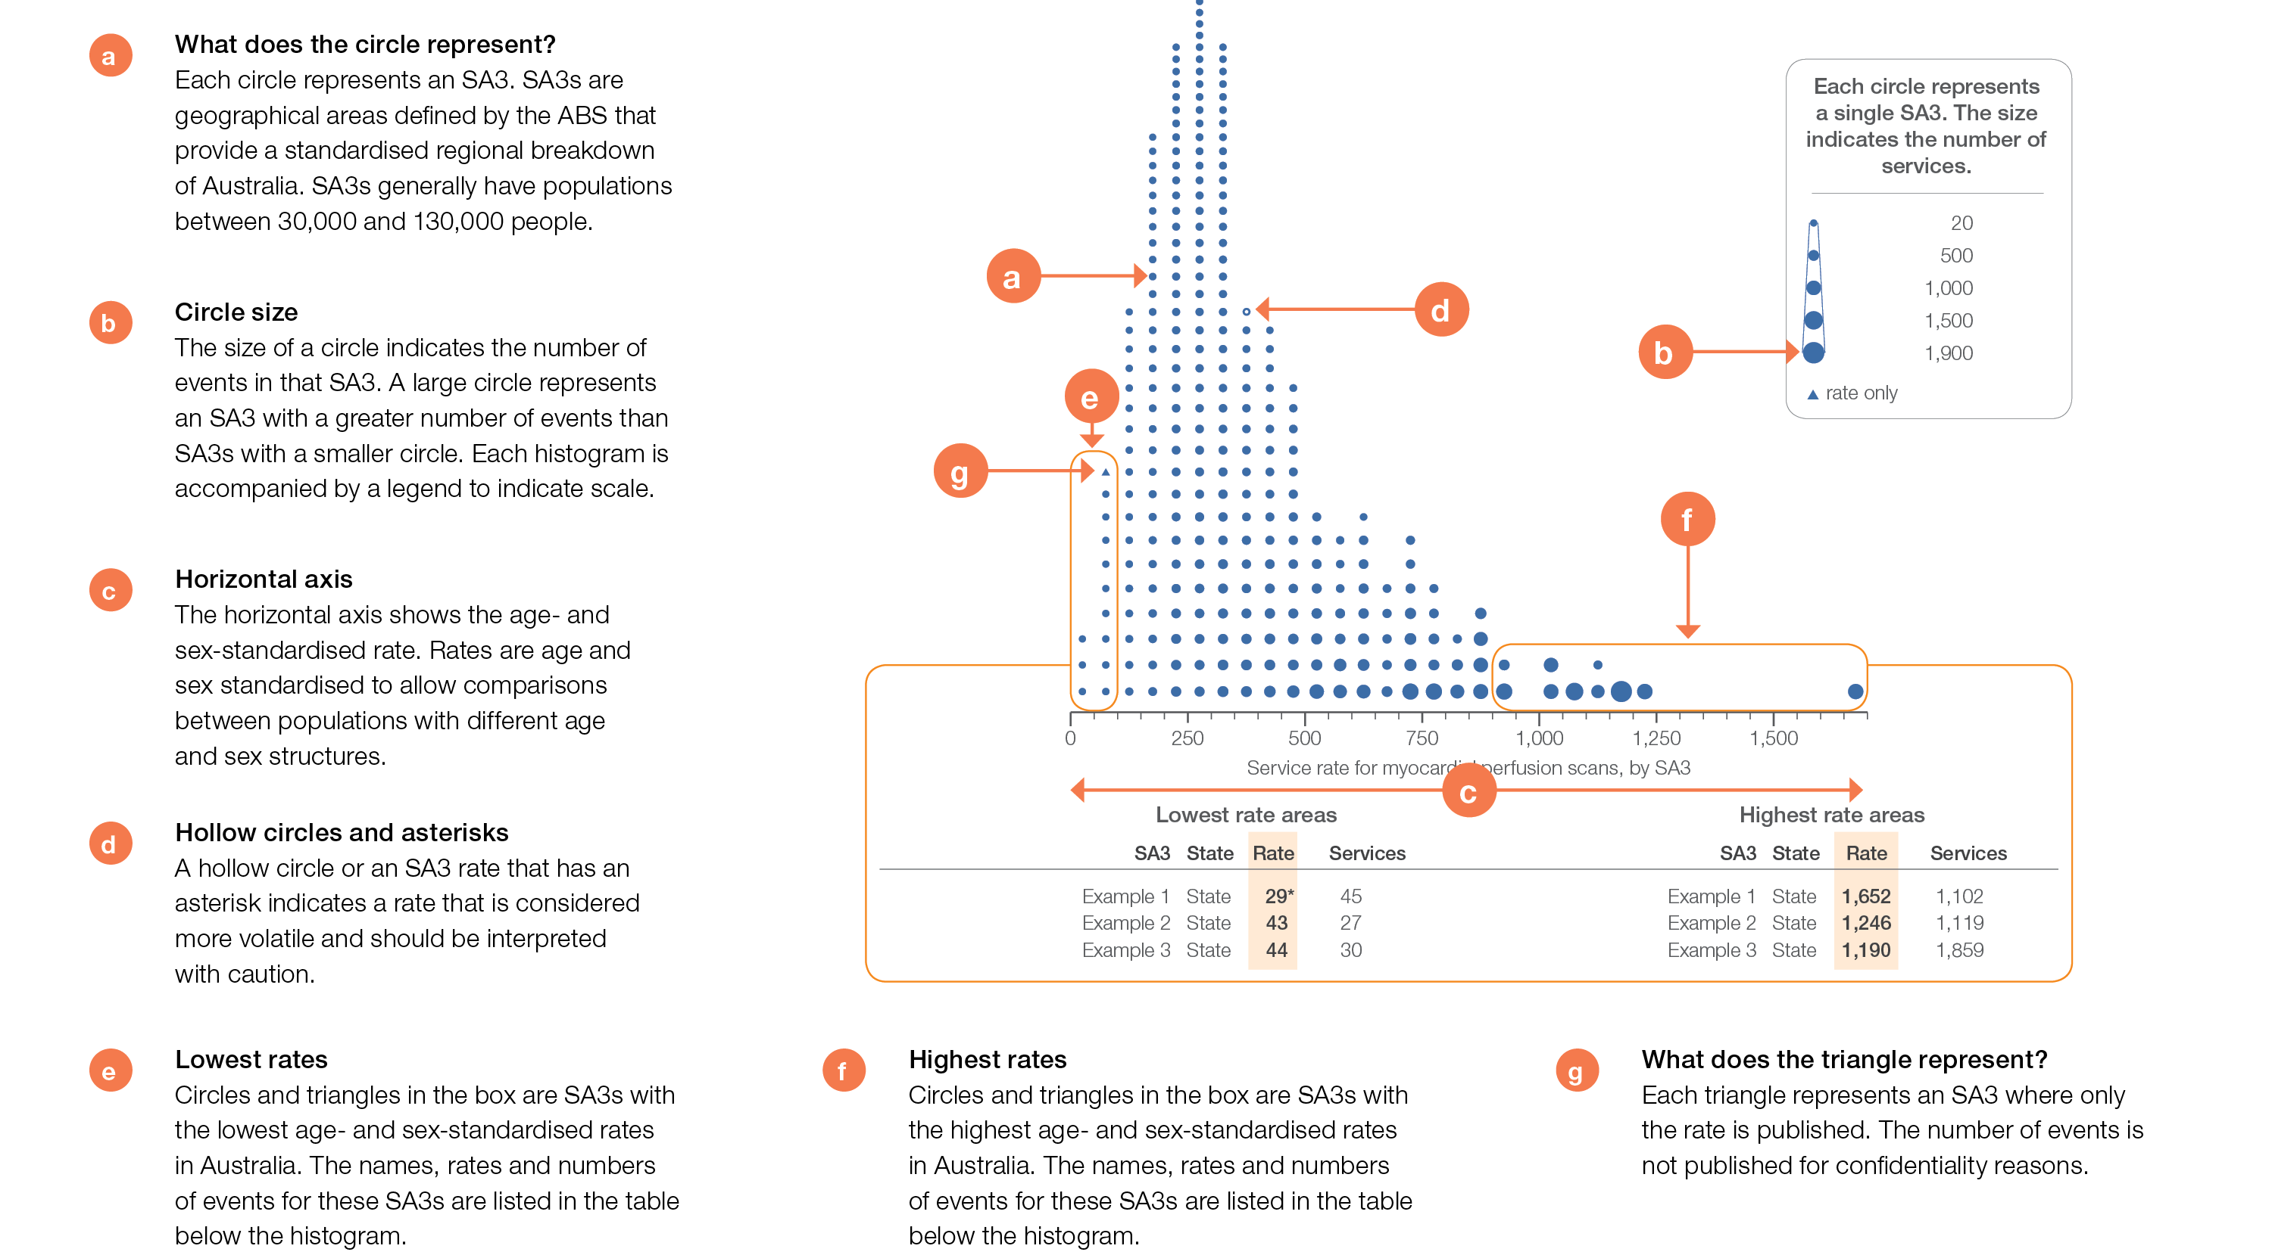
How to interpret our data visualisations
Histogram

Slide 12
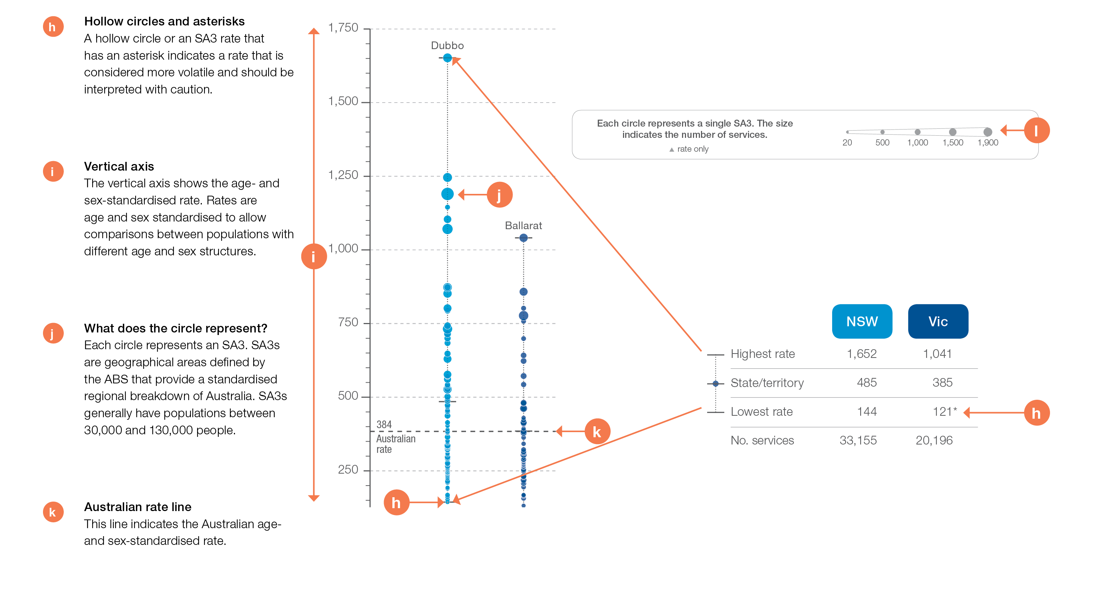
How to interpret our data visualisations
State and territory graph

Slide 13
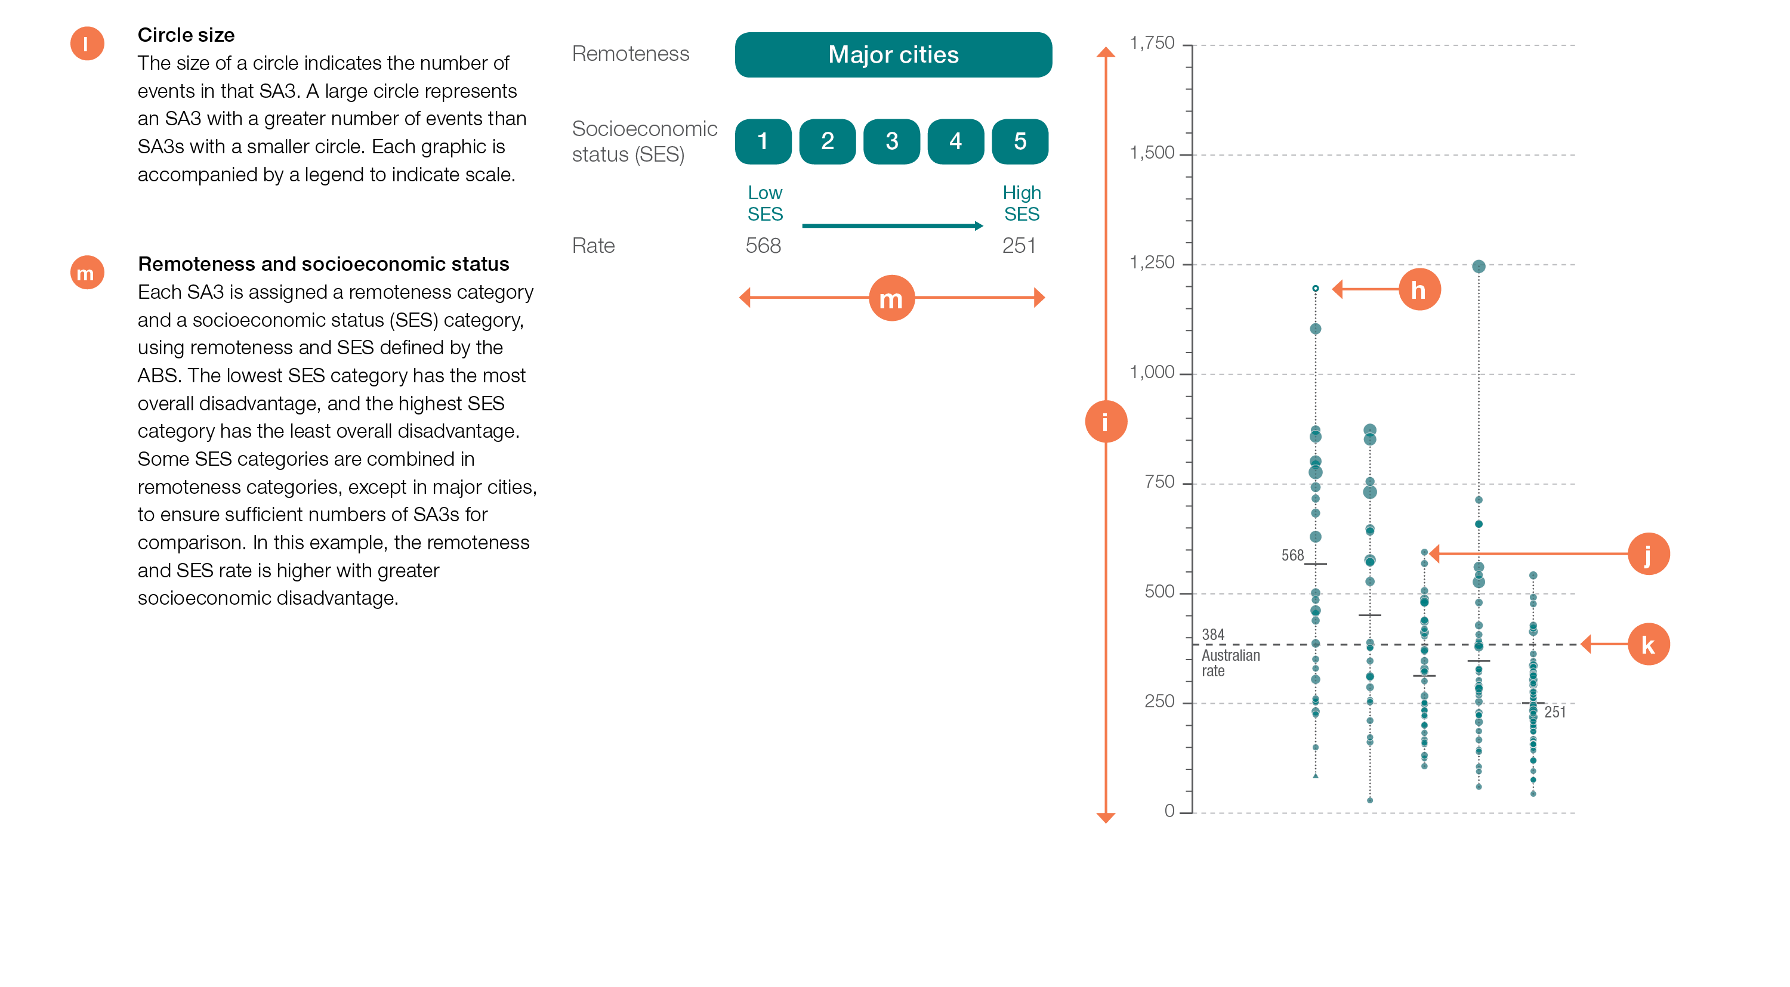
How to interpret our data visualisations
Remoteness and socioeconomic status graph

Slide 14
Gastrointestinal investigations and treatments
Notes:
Speaker notes:
This chapter examines:
- Colonoscopy hospitalisations, all ages
- Gastroscopy hospitalisations, all ages
- Proton pump inhibitor medicines dispensing,18 years and older

Slide 15
Gastrointestinal investigations and treatments
Key findings
Data item | Range across local areas* per 100,000 | Times difference | Times difference excluding top and bottom 10% | Number during 2016–17
2.1 Colonoscopy hospitalisations, all ages | 622–4,607 | 7.4 | 2.2 | 765,411
2.2 Gastroscopy hospitalisations, all ages | 444–3,297 | 7.4 | 2.1 | 505,544
2.3 Proton pump inhibitor medicines dispensing,† 18 years and older | 34,489–172,780 | 5.0 | 1.6 | 21,768,718
* Statistical Area Level 3
† Based on number of PBS prescriptions
Notes:
Speaker notes:
The Atlas found the rate of hospitalisation for inpatient colonoscopy varies up to about seven-fold between local areas across Australia. The rate of hospitalisations for colonoscopy for Aboriginal and Torres Strait Islander Australians was 47% lower than the rate for other Australians.
There were 505,544 hospitalisations for gastroscopy, representing 1,931 hospitalisations per 100,000 people.
The number of prescriptions for PPI medicines dispensed in 2016–17 equates to every person in Australia aged 18 years and over receiving at least one prescription for a PPI medicine annually.

Slide 16
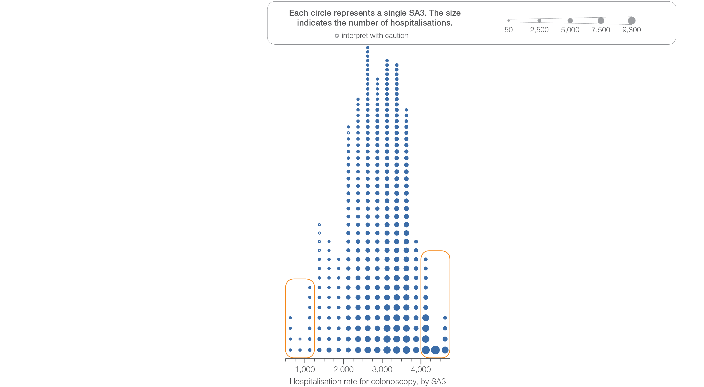
2.1 Colonoscopy hospitalisations, all ages
Sources: NHMD data 2016-17, and ABS Estimated Resident Population 30 June 2016
Notes:
Speaker notes:
This slide shows the distribution of rates by Statistical Area Level 3 (SA3) for colonoscopy hospitalisations, all ages.
Each circle on the graph represents an SA3. The size of the circle indicates how many hospitalisations have been recorded for people living in that area. The horizontal axis shows the standardised rates for the clinical item.
For further information on how to interpret the figures, please refer to the ‘How to interpret’ resource available at: www.safetyandquality.gov.au/atlas/the-third-australian-atlas-of-healthcare-variation-2018/how-to-interpret-the-data/

Slide 17
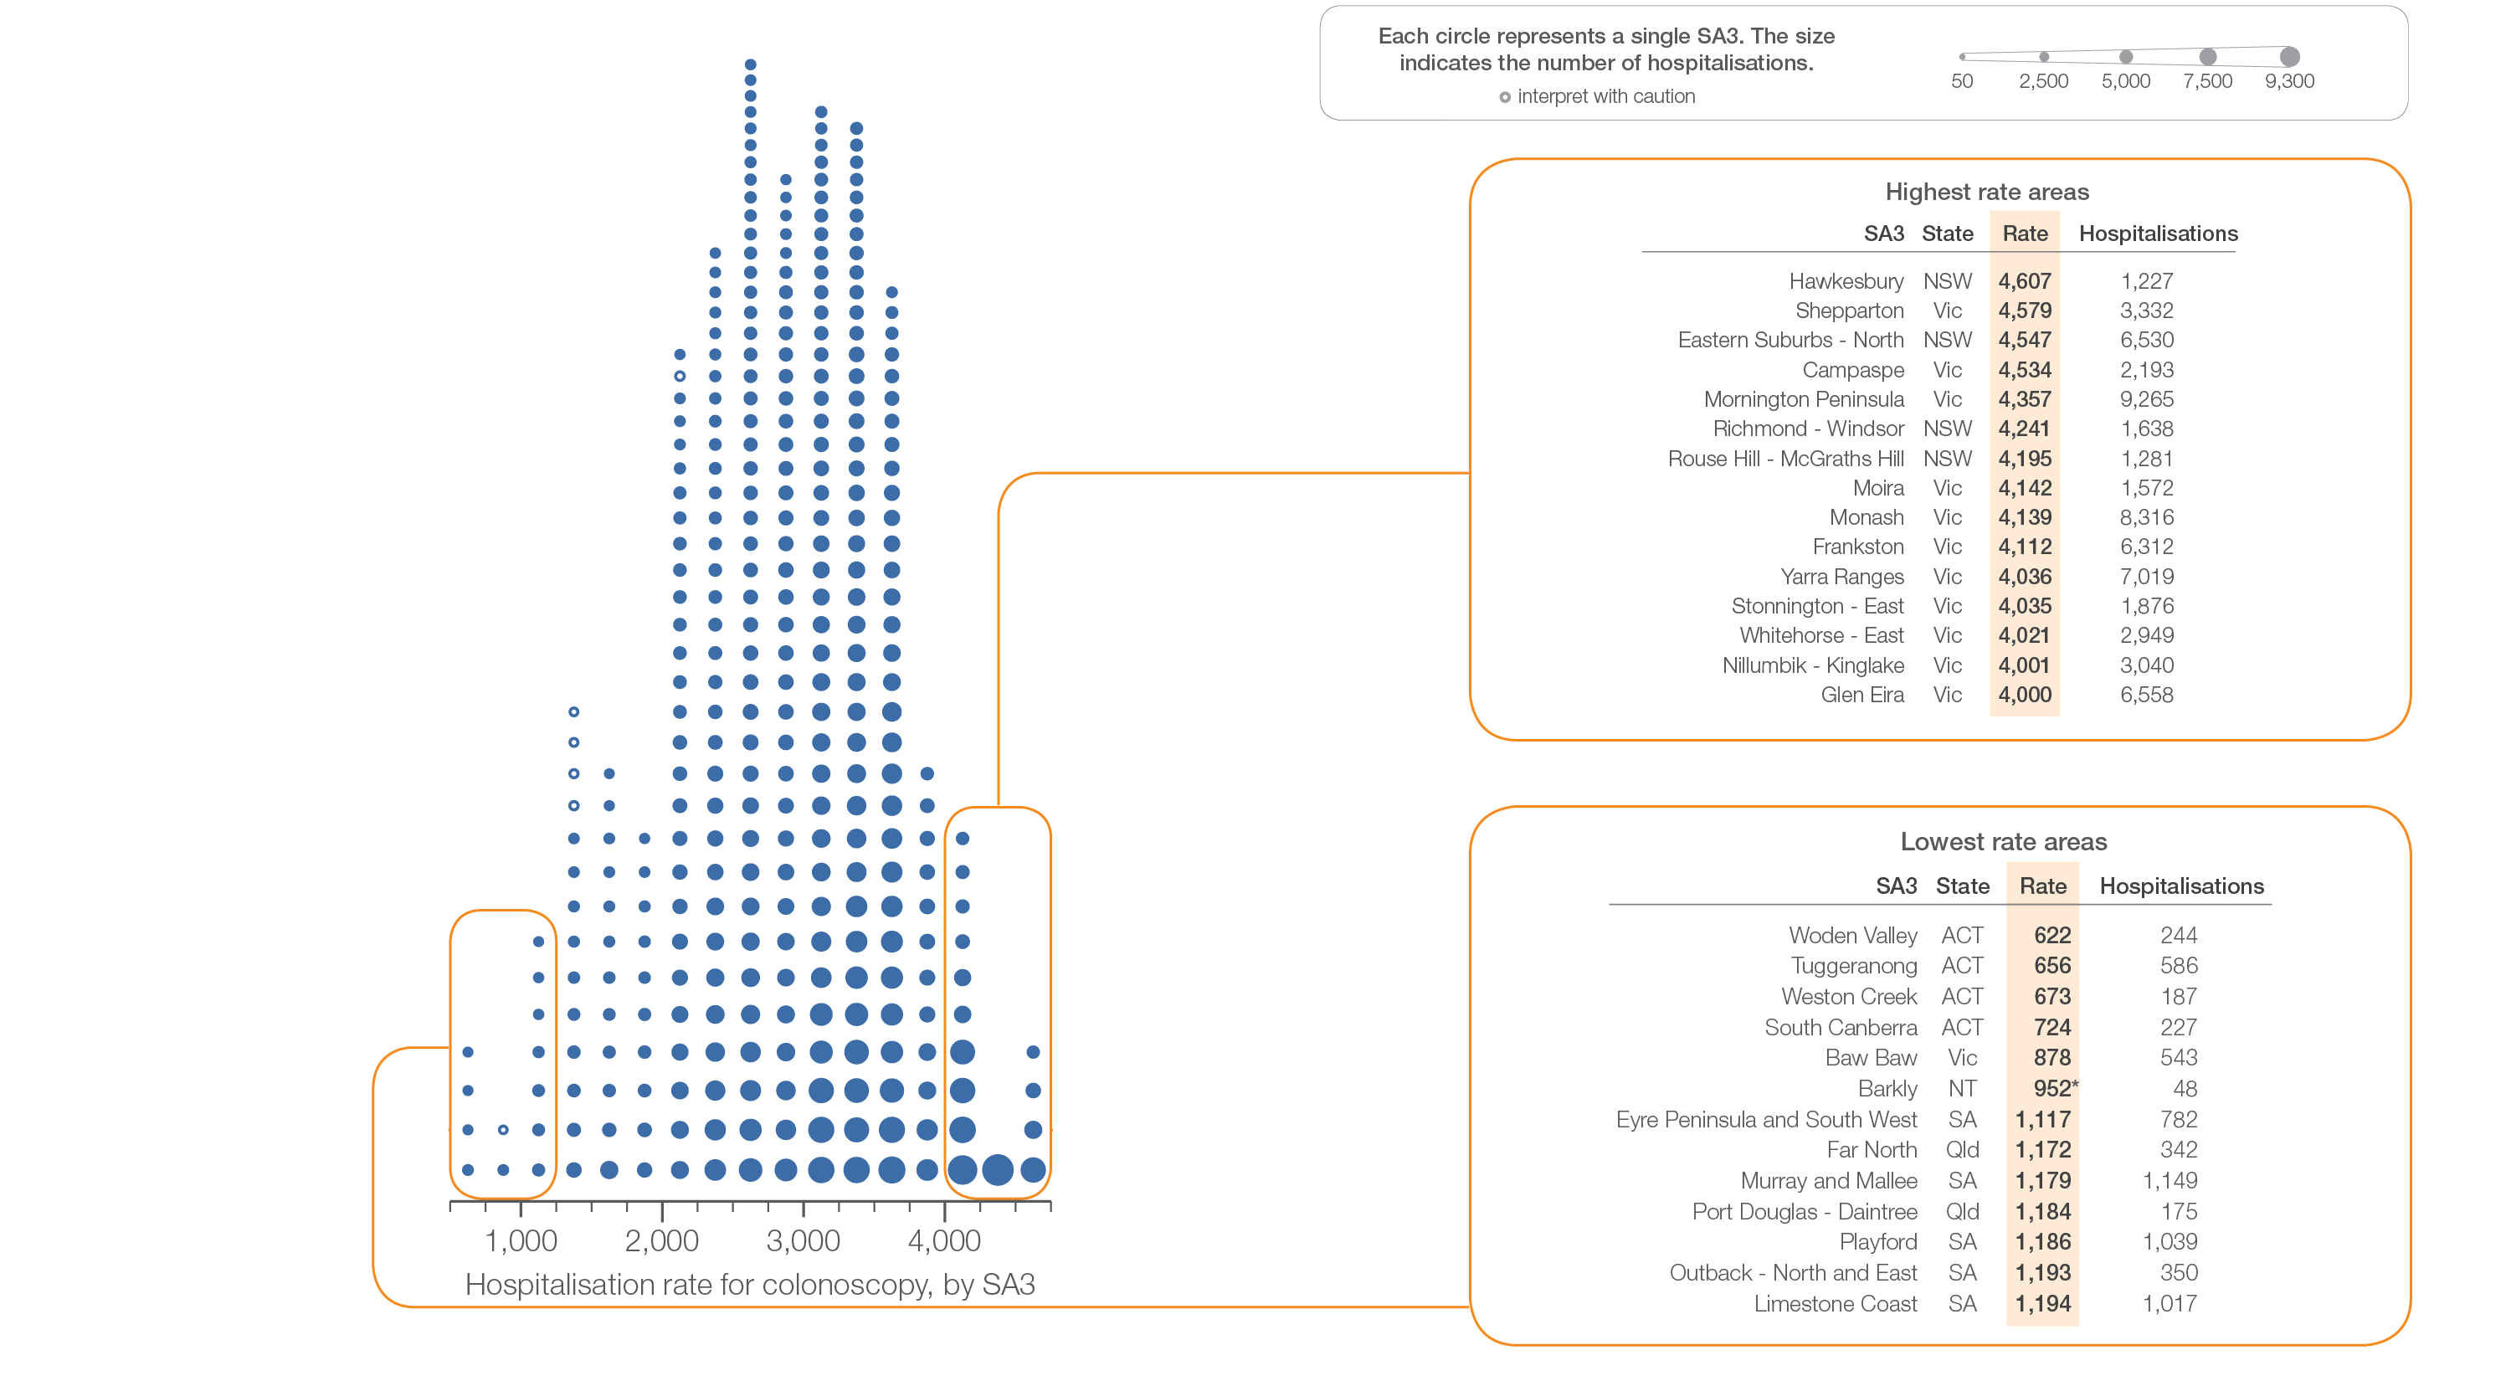
2.1 Colonoscopy hospitalisations, all ages
Sources: NHMD data 2016-17, and ABS Estimated Resident Population 30 June 2016
Notes:
Speaker notes:
This slide shows the distribution of rates by Statistical Area Level 3 (SA3) for colonoscopy hospitalisations, all ages.
Each circle on the graph represents an SA3. The size of the circle indicates how many hospitalisations have been recorded for people living in that area. The horizontal axis shows the standardised rates for the clinical item.
For further information on how to interpret the figures, please refer to the ‘How to interpret’ resource available at: www.safetyandquality.gov.au/atlas/the-third-australian-atlas-of-healthcare-variation-2018/how-to-interpret-the-data/

Slide 18
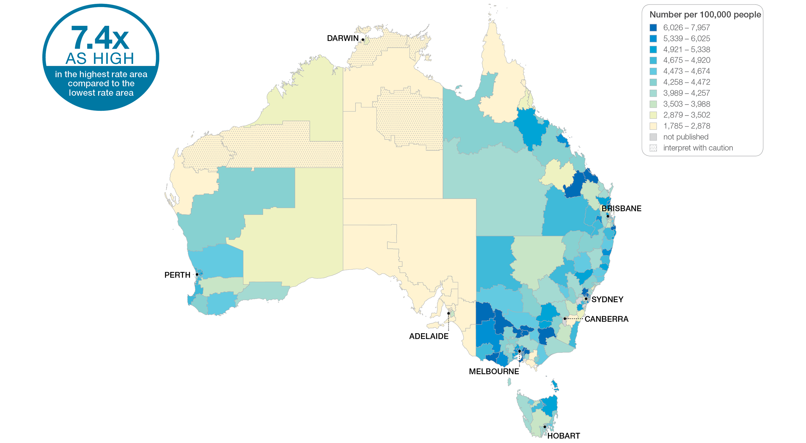
2.1 Colonoscopy hospitalisations, all ages
Sources: NHMD data 2016-17, and ABS Estimated Resident Population 30 June 2016
Notes:
Speaker notes:
This slide shows the distribution of rates by Statistical Area Level 3 (SA3) for colonoscopy hospitalisations. Rates are based on the patient’s usual place of residence, not the location of the healthcare provider.
In 2016–17, there were 765,411 hospitalisations for colonoscopy, representing 2,881 hospitalisations per 100,000 people of all ages (the Australian rate).
The number of hospitalisations for colonoscopy across 330 local areas (Statistical Area Level 3 – SA3) ranged from 622 to 4,607 per 100,000 people of all ages.
The rate was 7.4 times as high in the area with the highest rate compared to the area with the lowest rate.
The number of hospitalisations varied across states and territories, from 1,144 per 100,000 people of all ages in the Australian Capital Territory to 3,371 in Victoria.
The range of rates represented by each colour are shown in the legend for the map. The darker blue colour represents SA3s with higher rates. The lighter colours represent SA3s with lower rates. Dotted areas indicate rates that are considered more volatile than other published rates and should be interpreted with caution. These rates are excluded from the calculation of the difference between the highest and lowest SA3 rates in Australia.
Data from a number of ACT private hospitals, which undertake some colonoscopies, were not provided to the National Hospital Morbidity Database. For this reason, data for the ACT should be interpreted with caution.
For further detail about the methods used, please refer to the Technical Supplement.
For further information on how to interpret the figures, please refer to the ‘How to interpret’ resource available at: www.safetyandquality.gov.au/atlas/the-third-australian-atlas-of-healthcare-variation-2018/how-to-interpret-the-data/

Slide 19
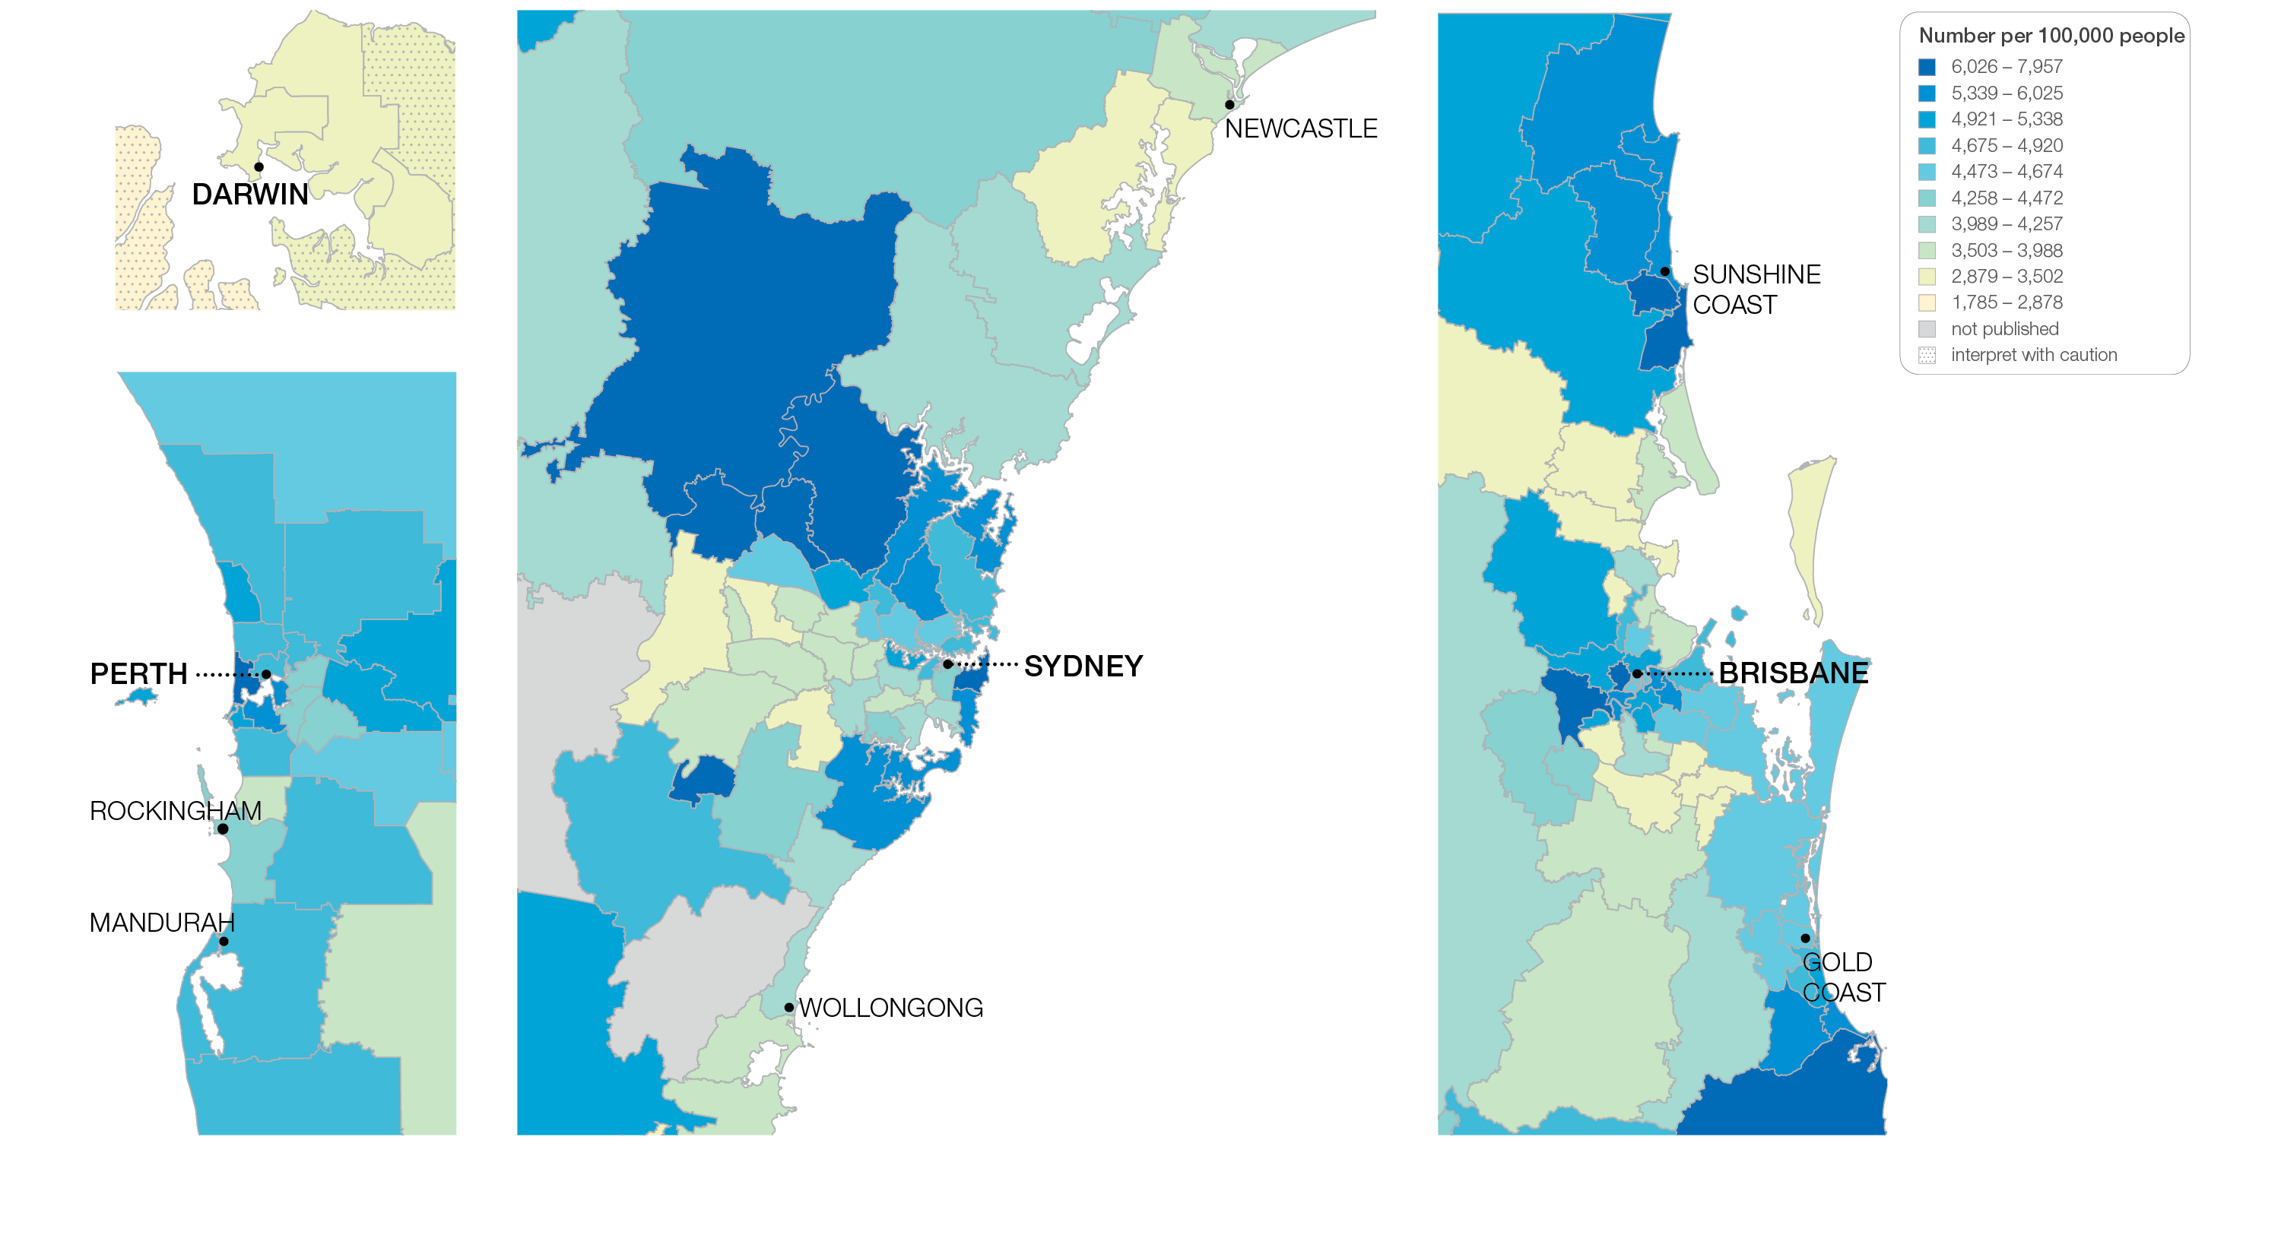
2.1 Colonoscopy hospitalisations, all ages
Sources: NHMD data 2016-17, and ABS Estimated Resident Population 30 June 2016
Notes:
Speaker notes:
This slide shows the distribution of rates by Statistical Area Level 3 (SA3) for colonoscopy hospitalisations by capital city area. Rates are based on the patient’s usual place of residence, not the location of the healthcare provider.

Slide 20
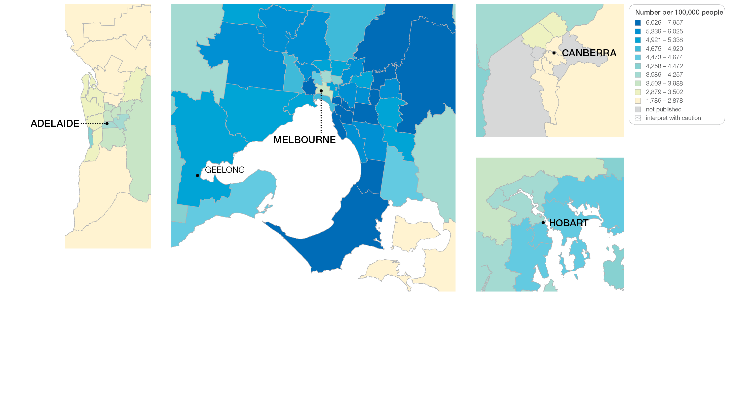
2.1 Colonoscopy hospitalisations, all ages
Sources: NHMD data 2016-17, and ABS Estimated Resident Population 30 June 2016
Notes:
Speaker notes:
This slide shows the distribution of rates by Statistical Area Level 3 (SA3) for colonoscopy hospitalisations by capital city area. Rates are based on the patient’s usual place of residence, not the location of the healthcare provider.

Slide 21
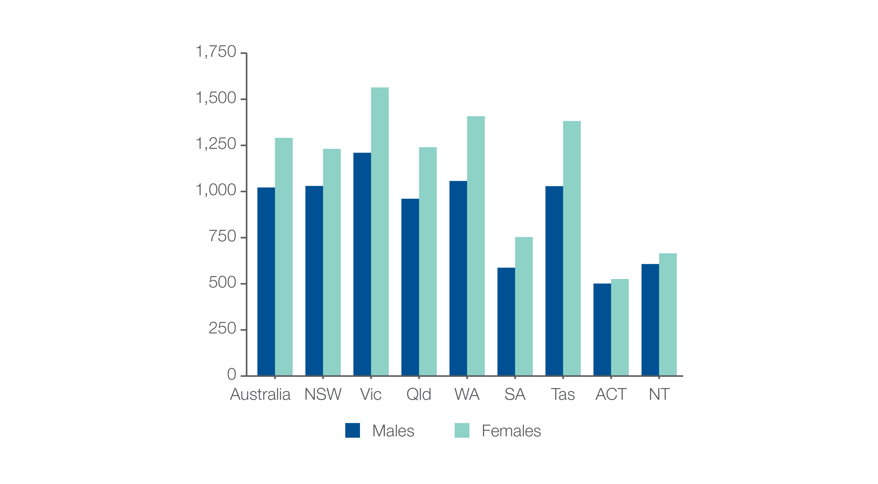
2.1 Colonoscopy hospitalisations, all ages
Analysis by sex, age 49 years and under
Number per 100,000 people
Sources: NHMD data 2016-17, and ABS Estimated Resident Population 30 June 2016
Notes:
Speaker notes:
The age-standardised rate of hospitalisations for colonoscopy among people aged 49 years and under was 1,022 per 100,000 for males and 1,291 per 100,000 for females.

Slide 22
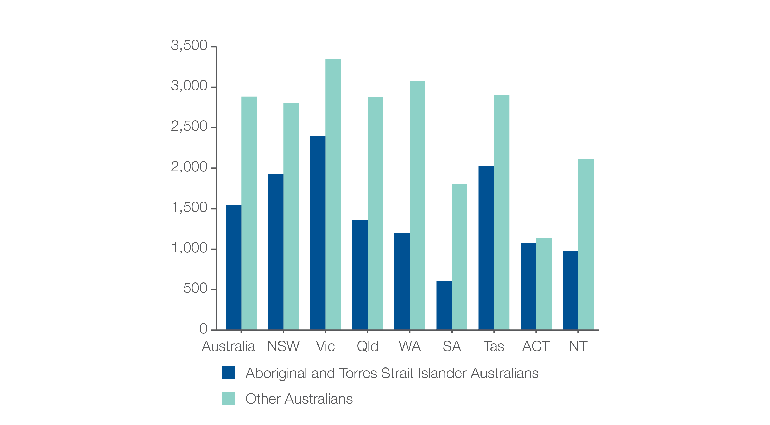
2.1 Colonoscopy hospitalisations, all ages
Aboriginal and Torres Strait Islander status
Number per 100,000 people
Sources: NHMD data 2016-17, and ABS Estimated Resident Population 30 June 2016
Notes:
Speaker notes:
The rate for Aboriginal and Torres Strait Islander Australians (1,542 per 100,000 people) was 47% lower than the rate for other Australians (2,884 per 100,000 people).

Slide 23
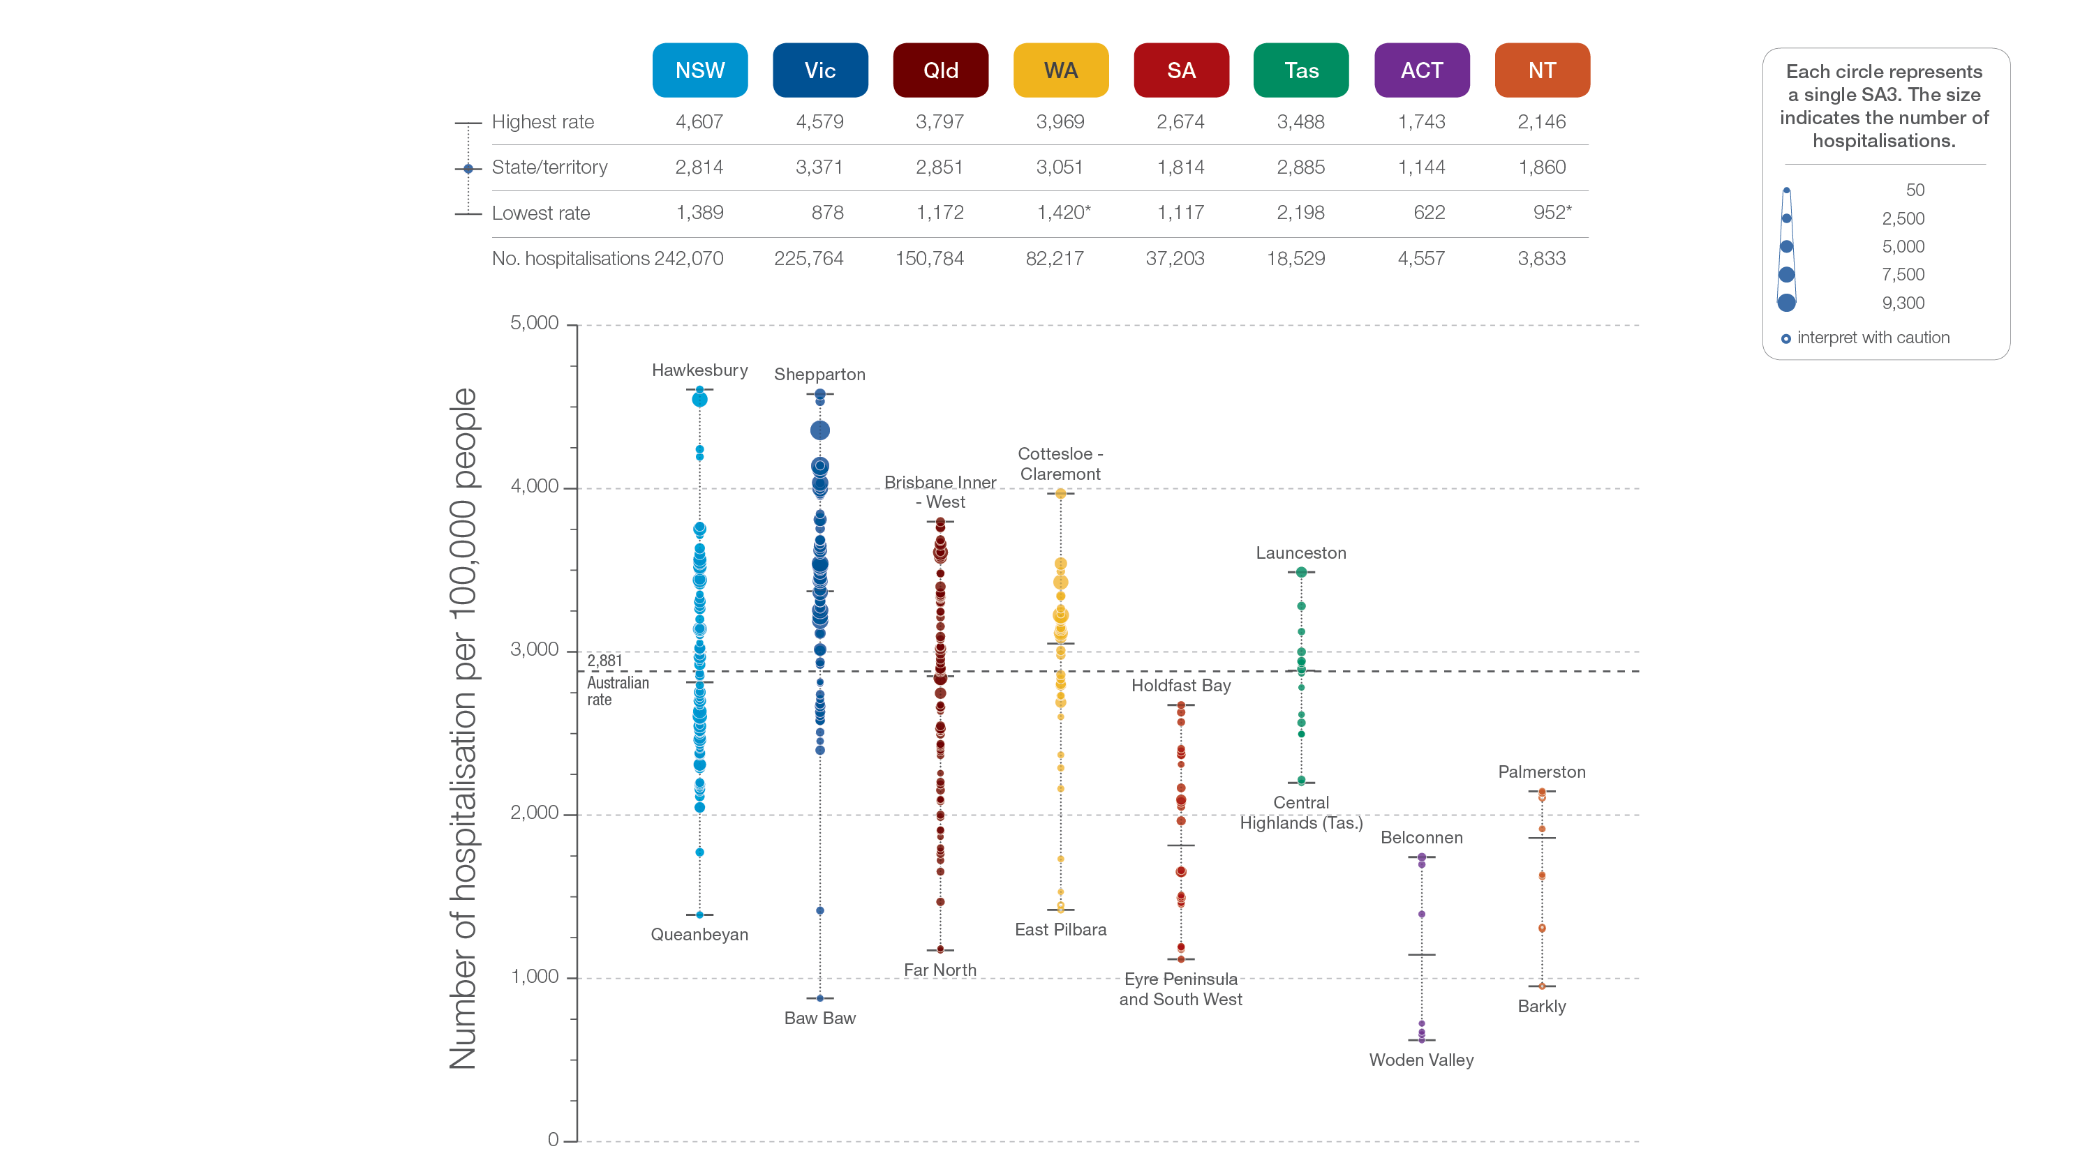
2.1 Colonoscopy hospitalisations, all ages
State and territory
Sources: NHMD data 2016-17, and ABS Estimated Resident Population 30 June 2016
Notes:
Speaker notes:
The number of hospitalisations varied across states and territories, from 1,144 per 100,000 people of all ages in the Australian Capital Territory to 3,371 in Victoria.
Each circle on the graph represents an SA3. The size of the circle indicates how many hospitalisations have been recorded for people living in that area. The vertical axis shows the standardised rates for the clinical item.
Hollow circles and asterisks indicate rates that are considered more volatile than other published rates and should be interpreted with caution. Data from a number of ACT private hospitals, which undertake some colonoscopies, were not provided to the National Hospital Morbidity Database. For this reason, data for the ACT should be interpreted with caution.
For further detail about the methods used, please refer to the Technical Supplement.
For further information on how to interpret the figures, please refer to the ‘How to interpret’ resource available at: www.safetyandquality.gov.au/atlas/the-third-australian-atlas-of-healthcare-variation-2018/how-to-interpret-the-data/

Slide 24
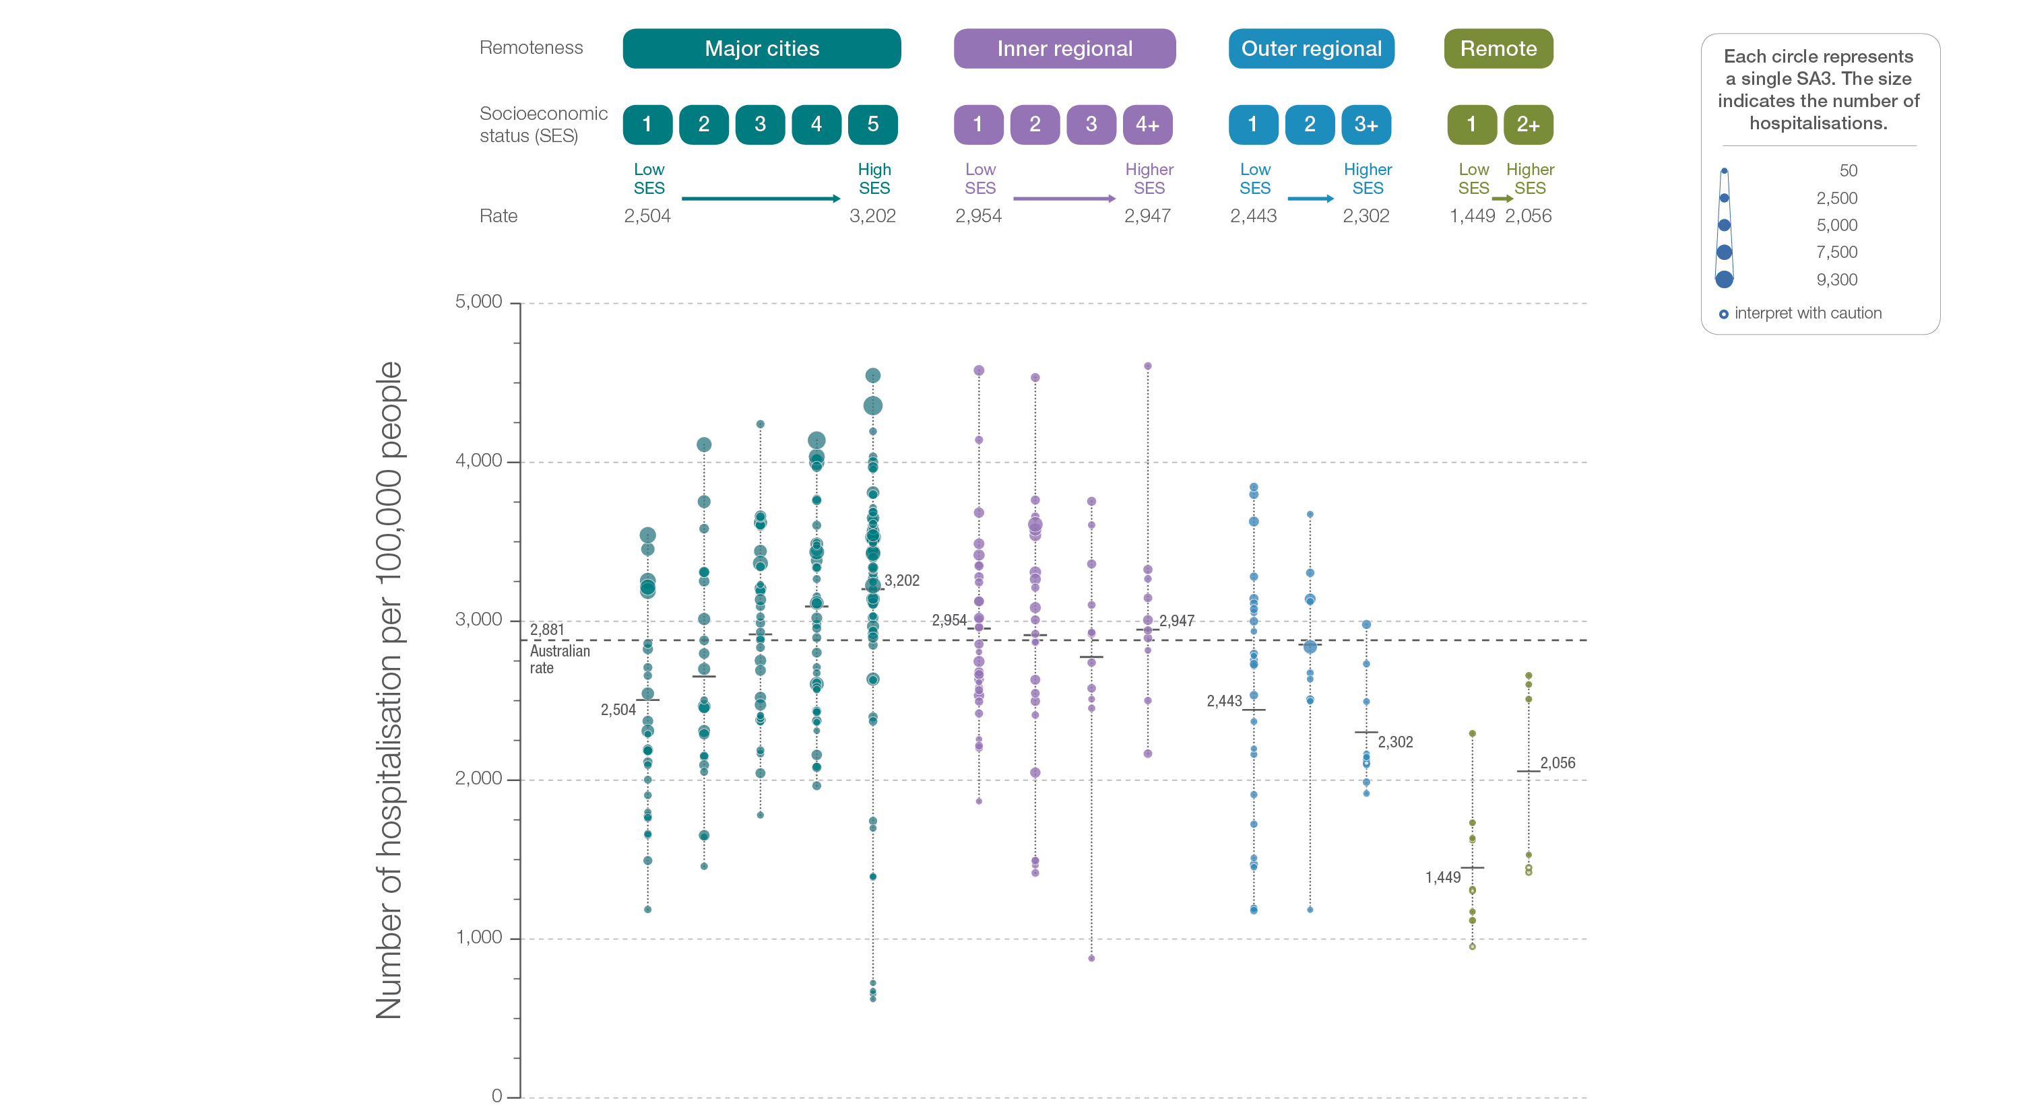
2.1 Colonoscopy hospitalisations, all ages
Remoteness and socioeconomic status
Sources: NHMD data 2016-17, and ABS Estimated Resident Population 30 June 2016
Notes:
Speaker notes:
Rates for hospitalisation for colonoscopy were higher in major cities and inner regional areas than in outer regional and remote areas. Rates were lower in areas with lower socioeconomic status in major cities and remote areas. However, there was no clear pattern according to socioeconomic status in other remoteness categories.
Each circle on the graph represents an SA3. The size of the circle indicates how many clinical events have been recorded for people living in that area. The vertical axis shows the standardised rates for the clinical item.
Hollow circles indicate rates that are considered more volatile than other published rates and should be interpreted with caution. For further detail about the methods used, please refer to the Technical Supplement.
For further information on how to interpret the figures, please refer to the ‘How to interpret’ resource available at: www.safetyandquality.gov.au/atlas/the-third-australian-atlas-of-healthcare-variation-2018/how-to-interpret-the-data/

Slide 25
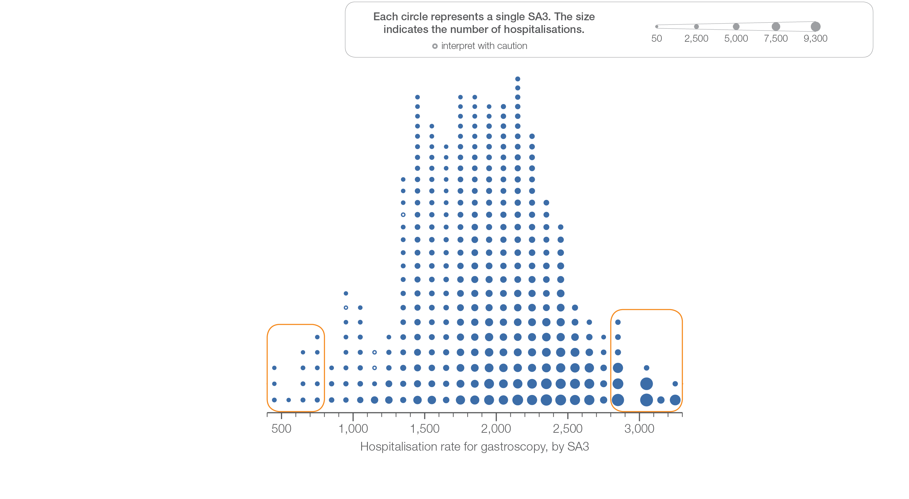
2.2 Gastroscopy hospitalisations, all ages
Sources: NHMD data 2016-17, and ABS Estimated Resident Population 30 June 2016
Notes:
Speaker notes:
This slide shows the distribution of rates by Statistical Area Level 3 (SA3) for antibiotics dispensing in children aged 9 years and under.
Each circle on the graph represents an SA3. The size of the circle indicates how many prescriptions have been dispensed for children living in that area. The horizontal axis shows the standardised rates for the clinical item.
For further information on how to interpret the figures, please refer to the ‘How to interpret’ resource available at: www.safetyandquality.gov.au/atlas/the-third-australian-atlas-of-healthcare-variation-2018/how-to-interpret-the-data/

Slide 26
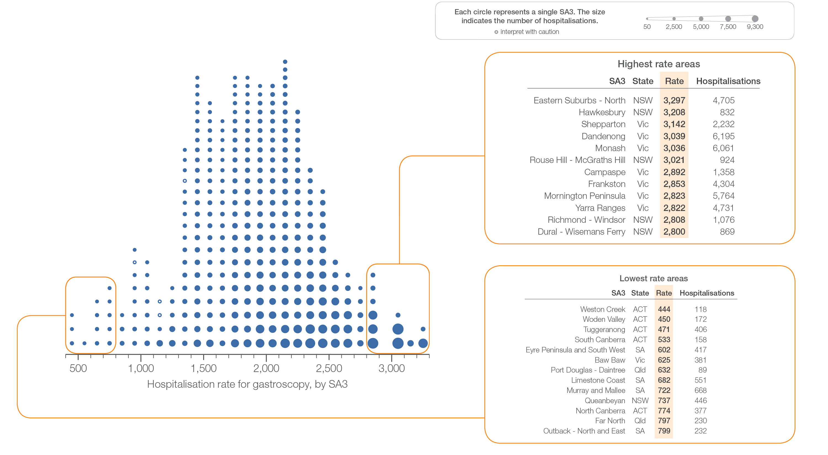
2.2 Gastroscopy hospitalisations, all ages
Sources: NHMD data 2016-17, and ABS Estimated Resident Population 30 June 2016
Notes:
Speaker notes:
This slide shows the distribution of rates by Statistical Area Level 3 (SA3) for antibiotics dispensing in children aged 9 years and under.
Each circle on the graph represents an SA3. The size of the circle indicates how many prescriptions have been dispensed for children living in that area. The horizontal axis shows the standardised rates for the clinical item.
For further information on how to interpret the figures, please refer to the ‘How to interpret’ resource available at: www.safetyandquality.gov.au/atlas/the-third-australian-atlas-of-healthcare-variation-2018/how-to-interpret-the-data/

Slide 27
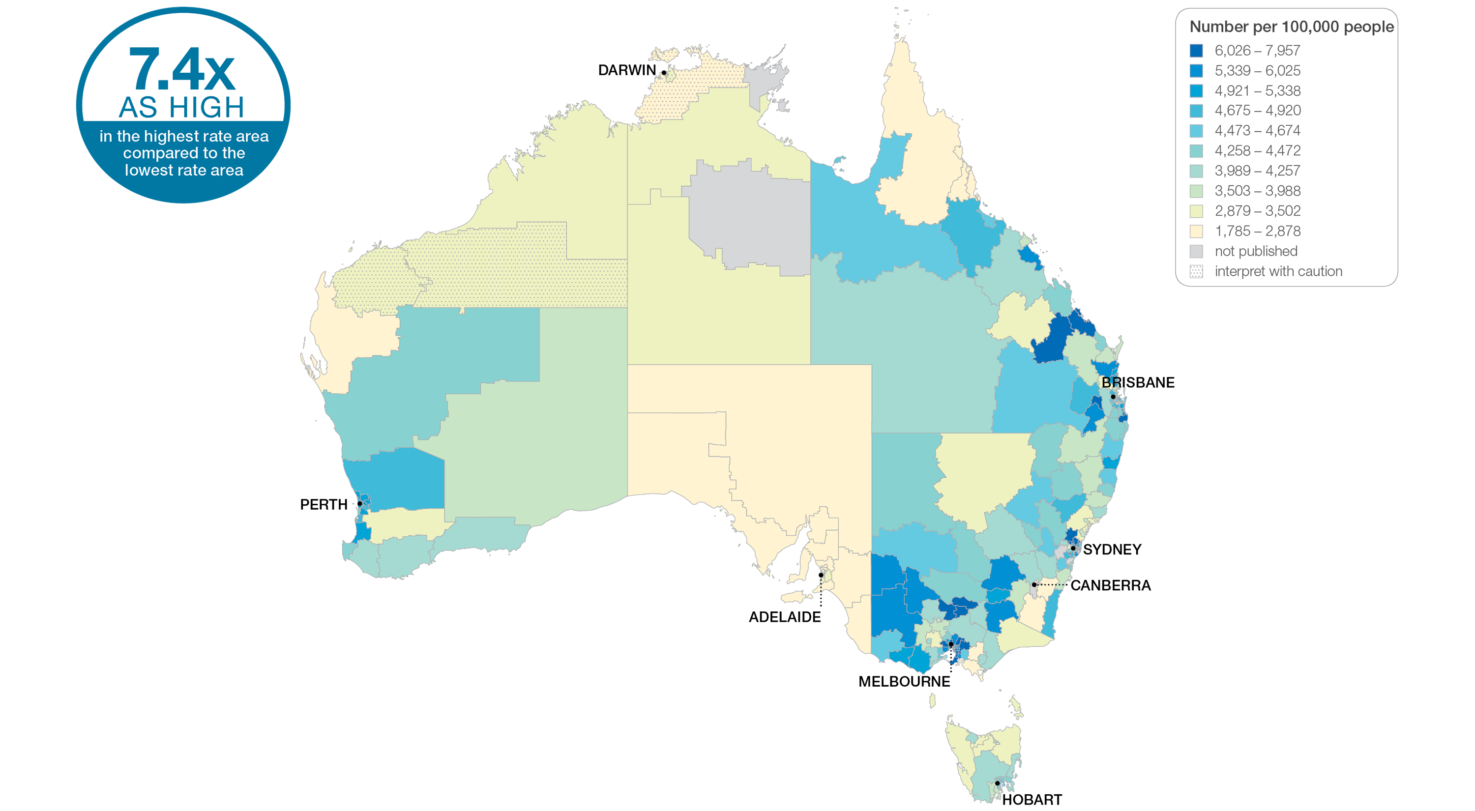
2.2 Gastroscopy hospitalisations, all ages
Sources: NHMD data 2016-17, and ABS Estimated Resident Population 30 June 2016
Notes:
Speaker notes:
This slide shows the distribution of rates by Statistical Area Level 3 (SA3) for gastroscopy hospitalisations. Rates are based on the patient’s usual place of residence, not the location of the healthcare provider.
In 2016–17, there were 505,544 hospitalisations for gastroscopy, representing 1,931 hospitalisations per 100,000 people of all ages (the Australian rate).
The number of hospitalisations for gastroscopy across 328* local areas (Statistical Area Level 3 – SA3) ranged from 444 to 3,297 per 100,000 people of all ages.
The rate was 7.4 times as high in the area with the highest rate compared to the area with the lowest rate.
The number of hospitalisations varied across states and territories, from 701 per 100,000 people of all ages in the Australian Capital Territory to 2,259 in Victoria.
The range of rates represented by each colour are shown in the legend for the map. The darker blue colour represents SA3s with higher rates. The lighter colours represent SA3s with lower rates.
Dotted areas indicate rates that are considered more volatile than other published rates and should be interpreted with caution. These rates are excluded from the calculation of the difference between the highest and lowest SA3 rates in Australia. Data from a number of ACT private hospitals, which undertake some gastroscopies, were not provided to the National Hospital Morbidity Database. For this reason, data for the ACT should be interpreted with caution.
For further detail about the methods used, please refer to the Technical Supplement.
For further information on how to interpret the figures, please refer to the ‘How to interpret’ resource available at: www.safetyandquality.gov.au/atlas/the-third-australian-atlas-of-healthcare-variation-2018/how-to-interpret-the-data/

Slide 28
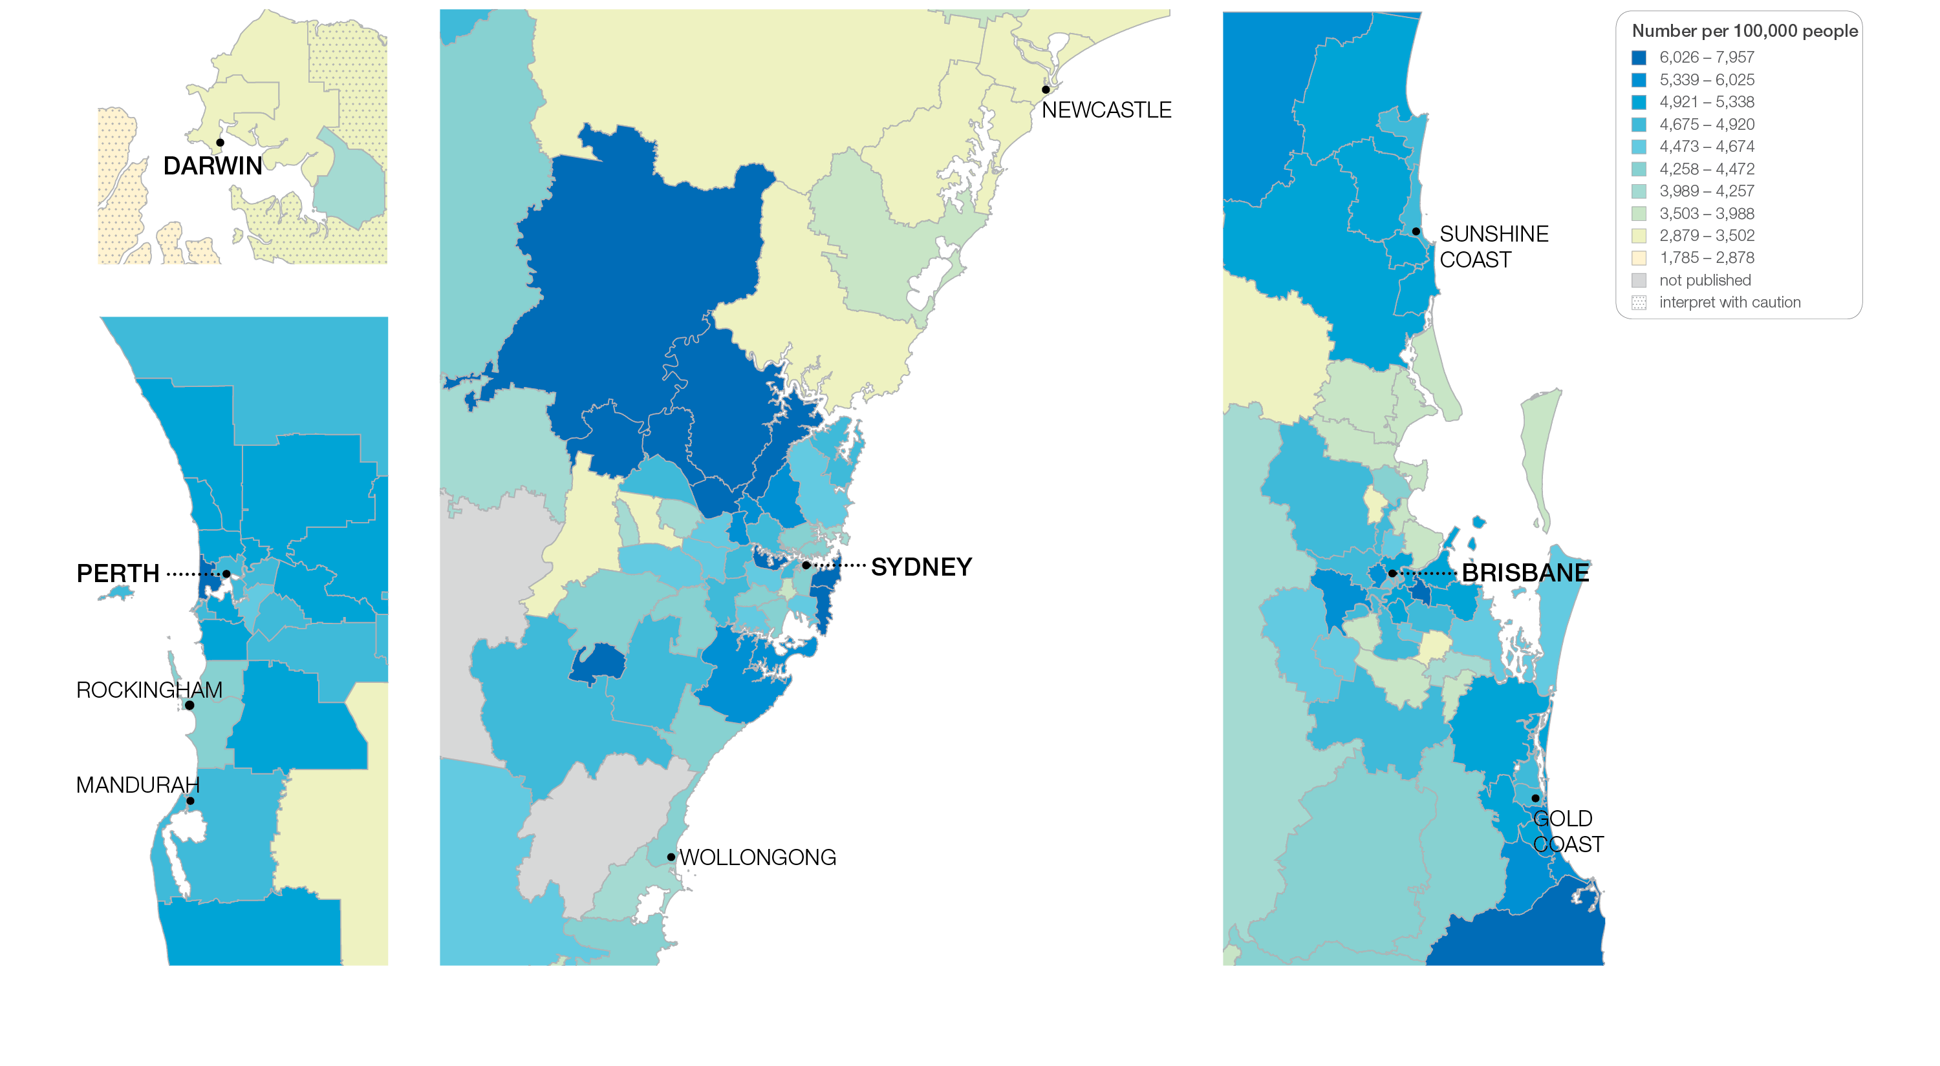
2.2 Gastroscopy hospitalisations, all ages
Sources: NHMD data 2016-17, and ABS Estimated Resident Population 30 June 2016
Notes:
Speaker notes:
This slide shows the distribution of rates by Statistical Area Level 3 (SA3) for gastroscopy hospitalisations by capital city area. Rates are based on the patient’s usual place of residence, not the location of the healthcare provider.

Slide 29
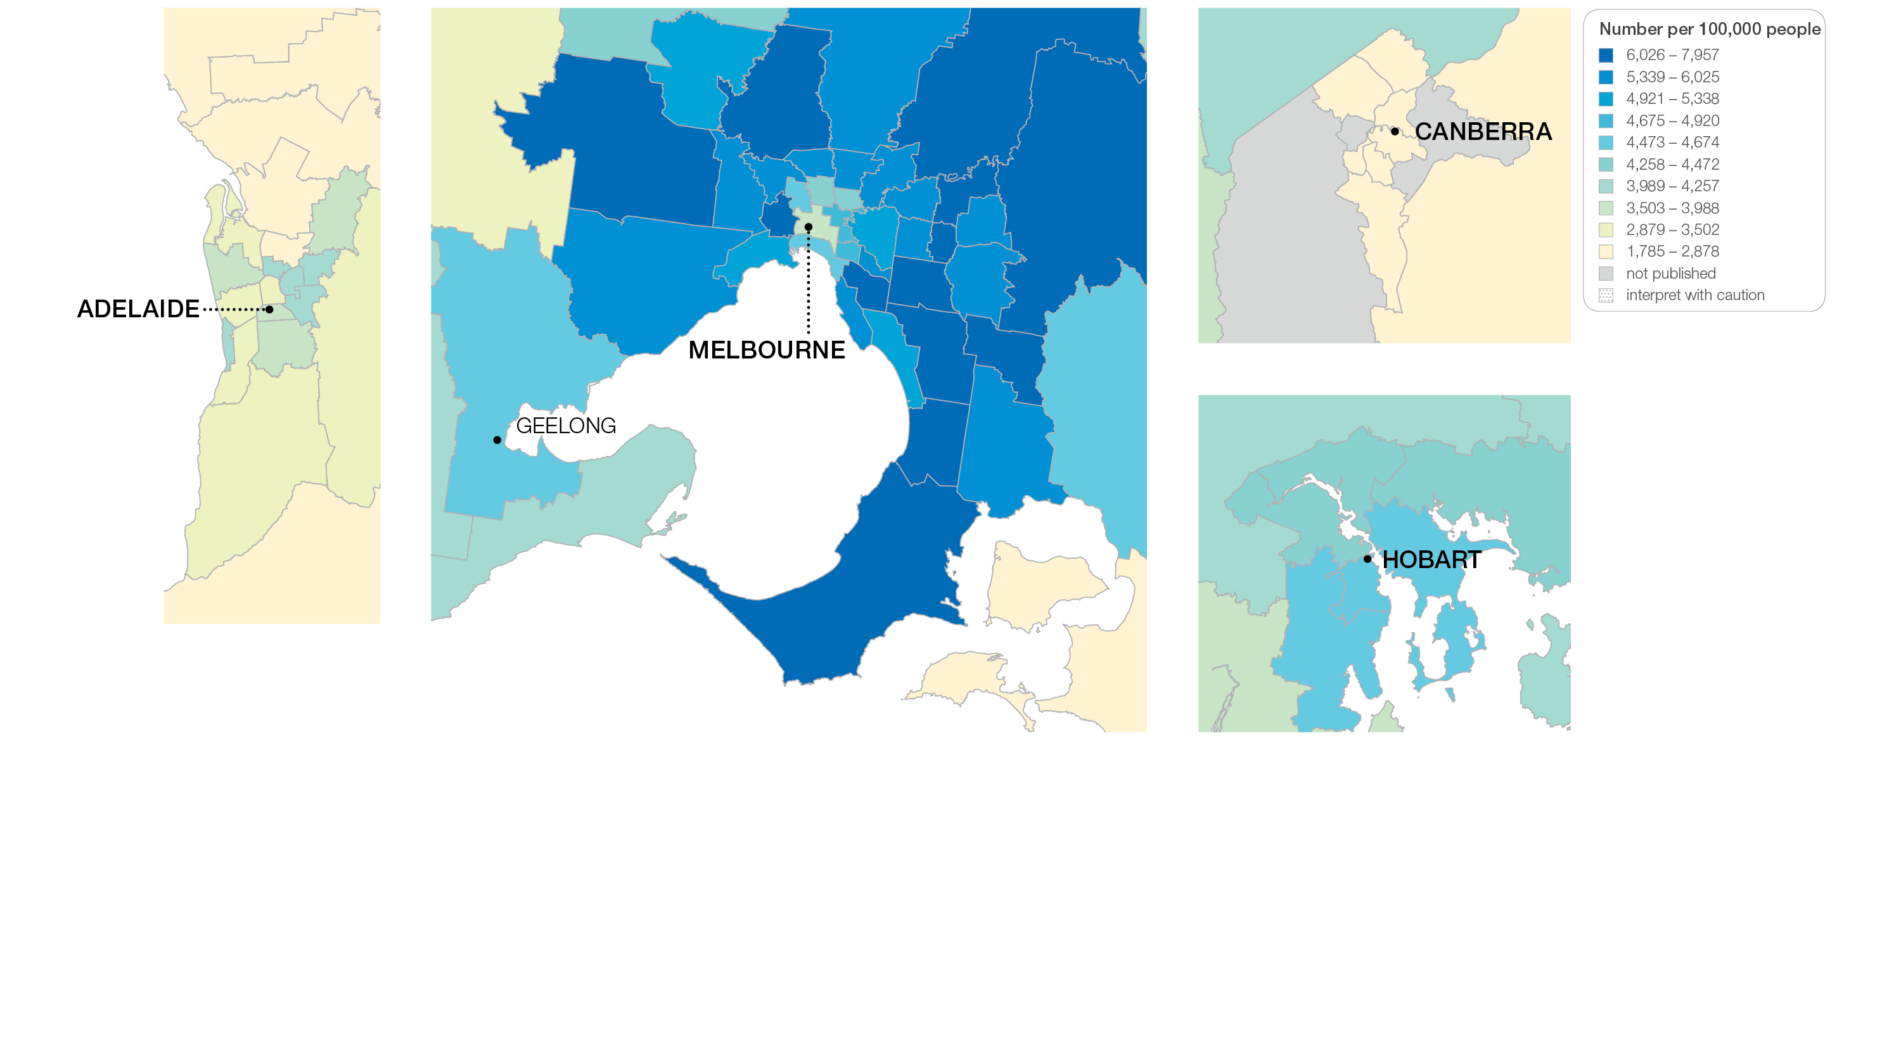
2.2 Gastroscopy hospitalisations, all ages
Sources: NHMD data 2016-17, and ABS Estimated Resident Population 30 June 2016
Notes:
Speaker notes:
This slide shows the distribution of rates by Statistical Area Level 3 (SA3) for gastroscopy hospitalisations by capital city area. Rates are based on the patient’s usual place of residence, not the location of the healthcare provider.

Slide 30
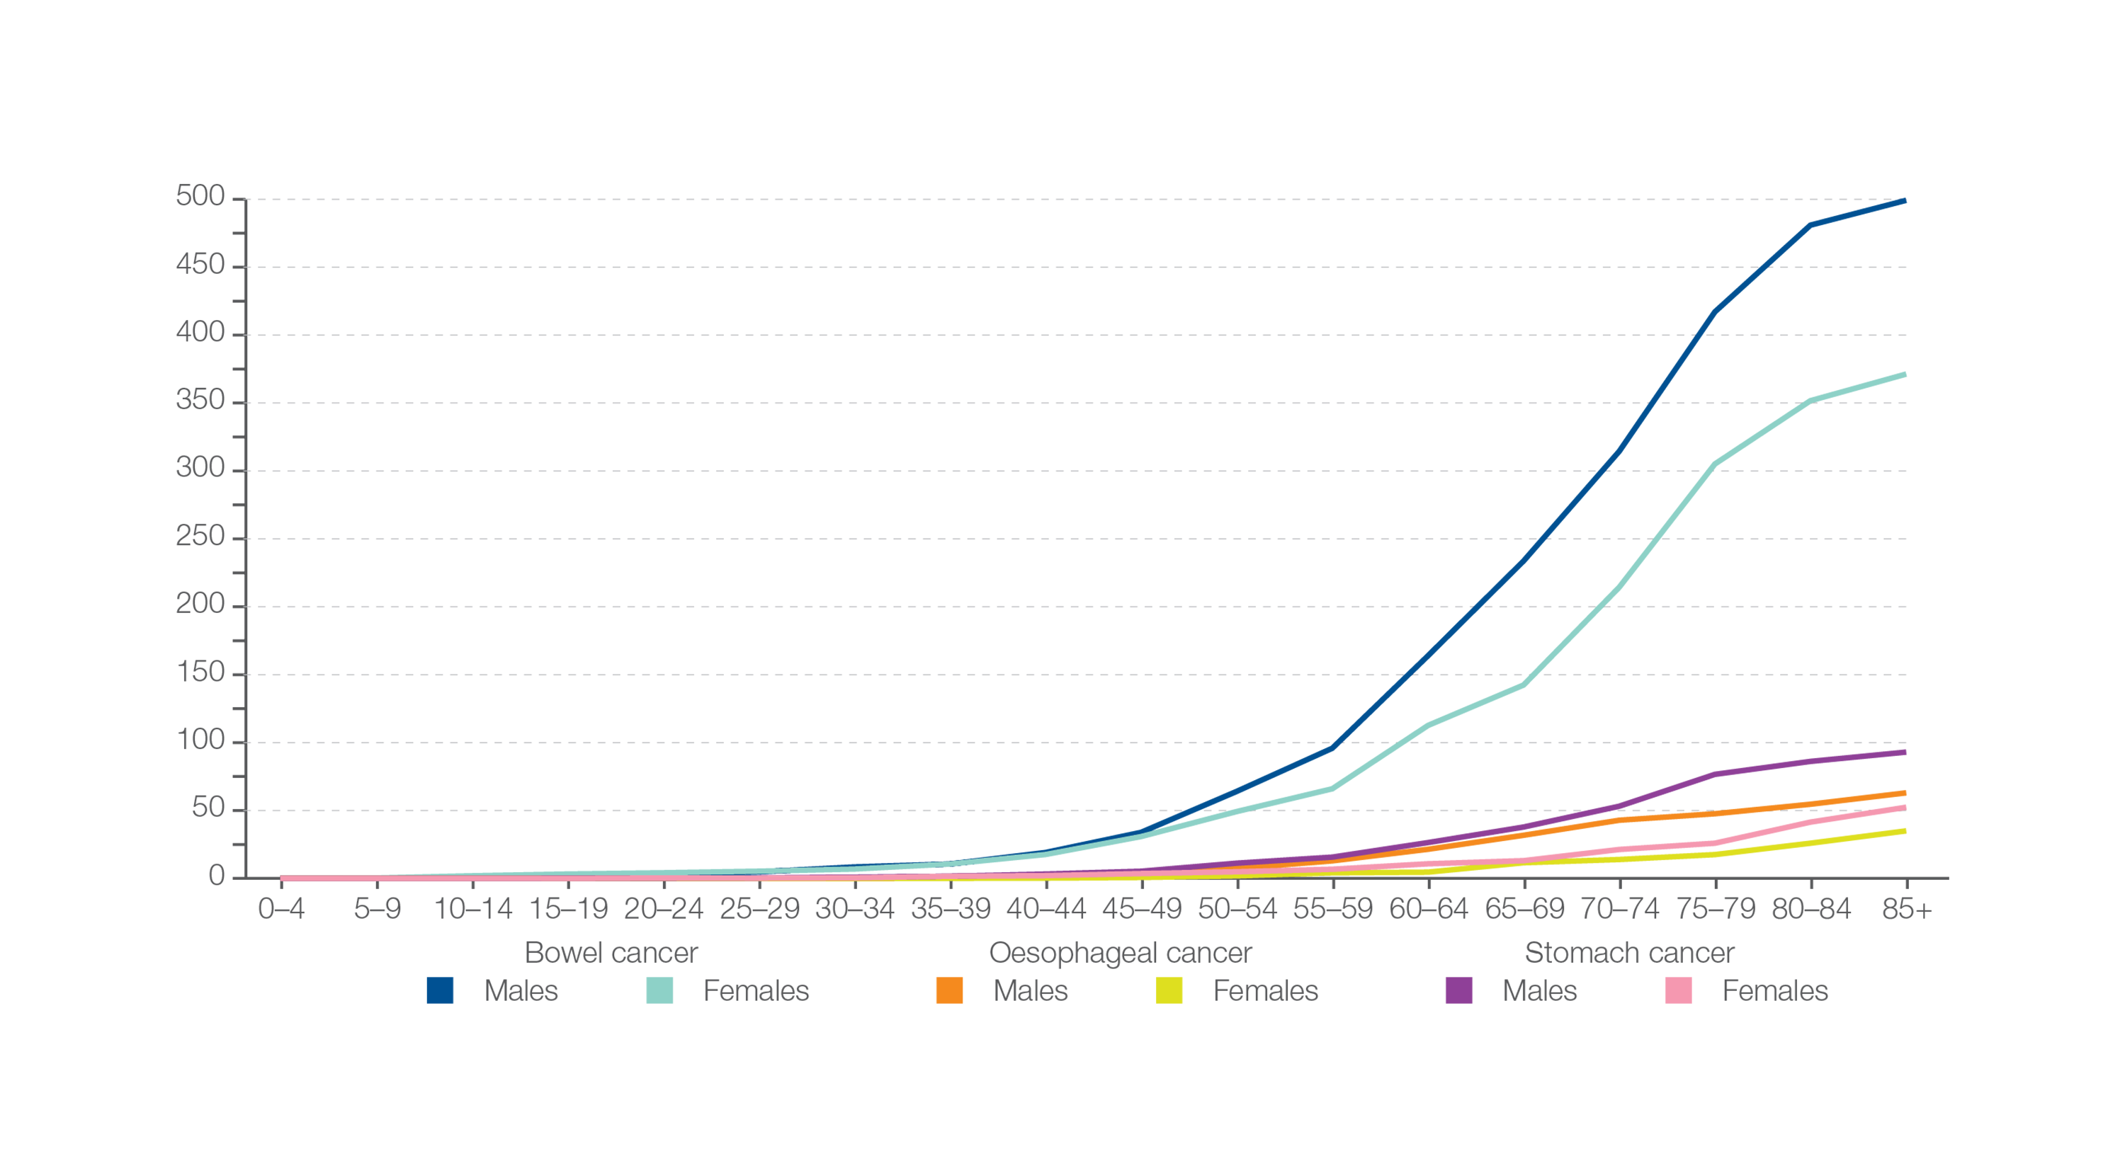
2.2 Gastroscopy hospitalisations, all ages
Incidence of bowel cancer, oesophageal cancer and stomach cancer
Number per 100,000 people, by age group and sex
Sources: Australian Institute of Health and Welfare. Australian Cancer Incidence and Mortality (ACIM) books: colorectal cancer, stomach cancer, oesophageal cancer. Canberra: AIHW; 2017.
Notes:
Speaker notes:
This graph shows the incidence of bowel cancer, oesophageal cancer and stomach cancer per 100,000 people, by age group and sex, in Australia in 2014.
Rates of upper gastrointestinal cancers are rare, particularly before 55 years of age.

Slide 31
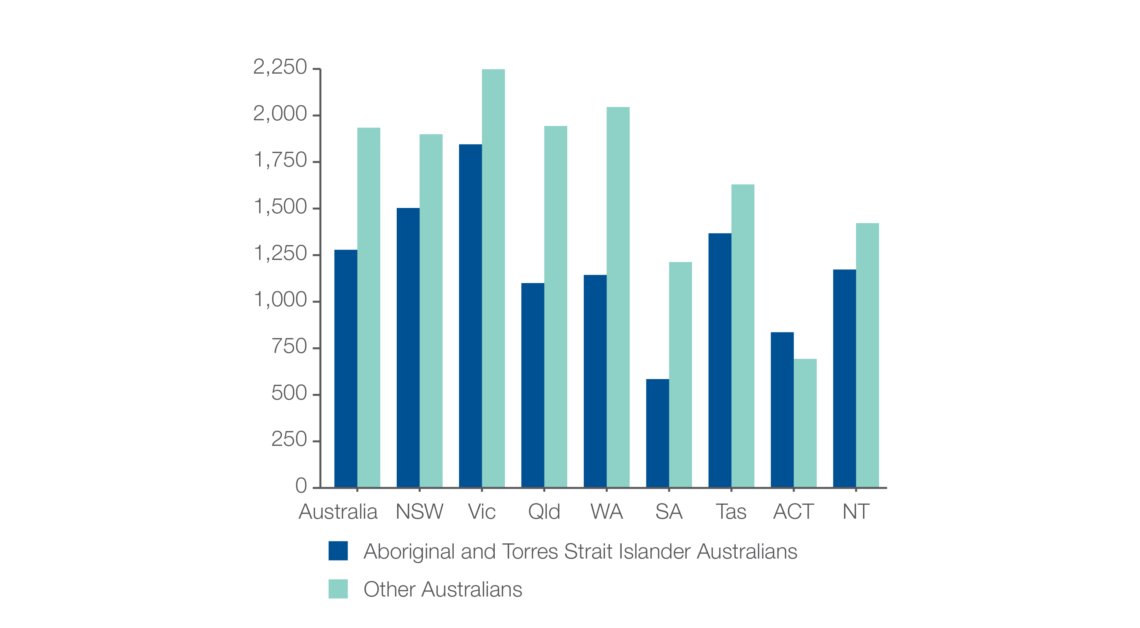
2.2 Gastroscopy hospitalisations, all ages
Aboriginal and Torres Strait Islander status
Number per 100,000 people
Sources: NHMD data 2016-17, and ABS Estimated Resident Population 30 June 2016
Notes:
Speaker notes:
The rate for Aboriginal and Torres Strait Islander Australians (1,279 per 100,000 people) was 34% lower than the rate for other Australians (1,934 per 100,000 people).
The identification of Aboriginal and Torres Strait Islander patients may not be accurate for all admissions, and processes for seeking and recording identification may vary among states and territories. Therefore, the data shown may under-count the number of Aboriginal and Torres Strait Islander Australians hospitalised for gastroscopy.

Slide 32
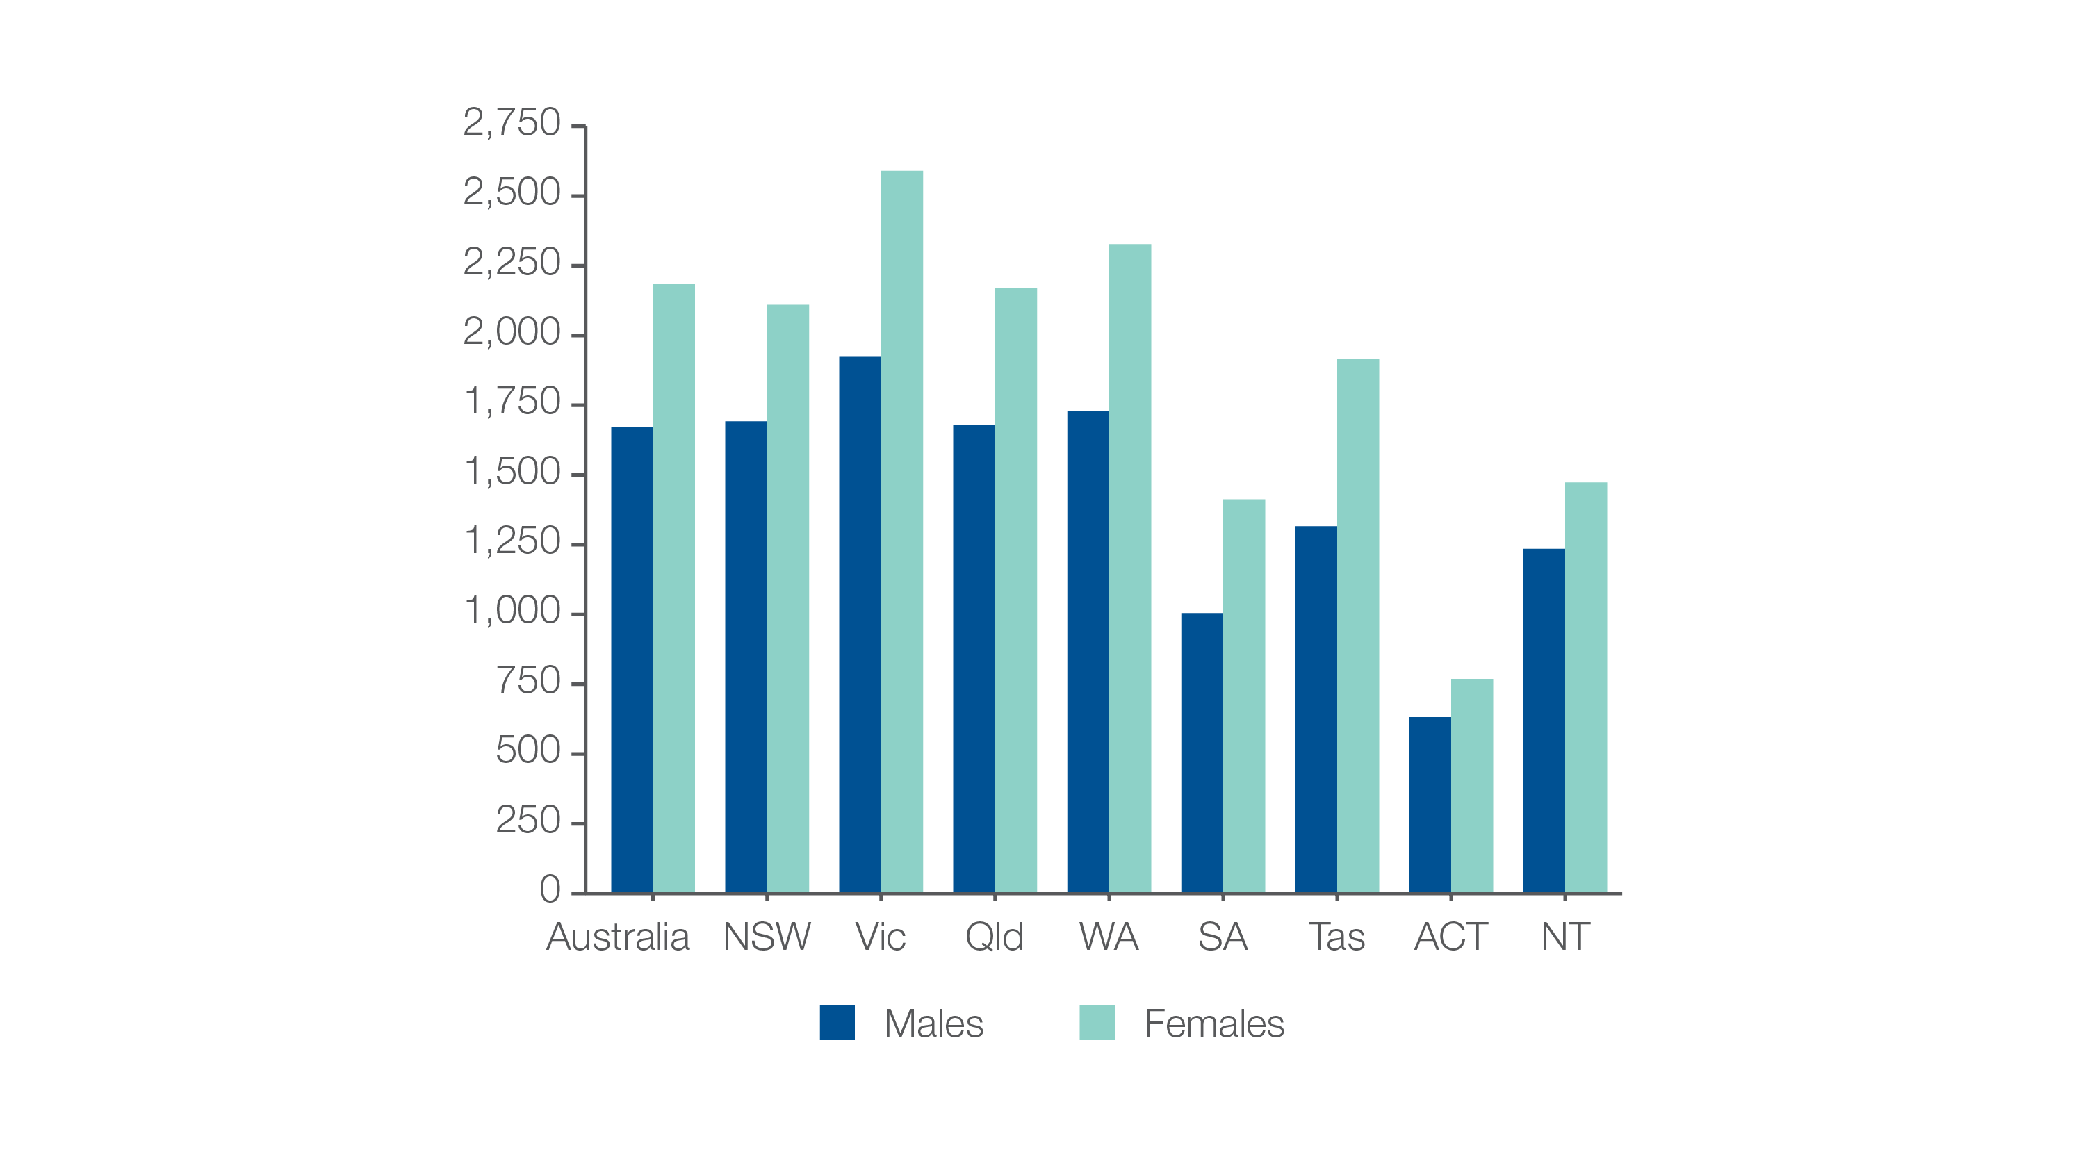
2.2 Gastroscopy hospitalisations, all ages
Analysis by sex
Number per 100,000 people
Sources: NHMD data 2016-17, and ABS Estimated Resident Population 30 June 2016
Notes:
Speaker notes:
The rate of hospitalisations for gastroscopy was 1.3 times as high in females as in males.
In 2016–17, there were 220,687 hospitalisations for gastroscopy for males of all ages, representing 1,673 hospitalisations per 100,000 males (the Australian rate). The number of hospitalisations varied across states and territories, from 632 per 100,000 males in the Australian Capital Territory to 1,923 per 100,000 in Victoria.
In 2016–17, there were 284,857 hospitalisations for gastroscopy in females of all ages, representing 2,185 hospitalisations per 100,000 females (the Australian rate). The number of hospitalisations varied across states and territories, from 769 per 100,000 females in the Australian Capital Territory to 2,590 per 100,000 in Victoria.

Slide 33
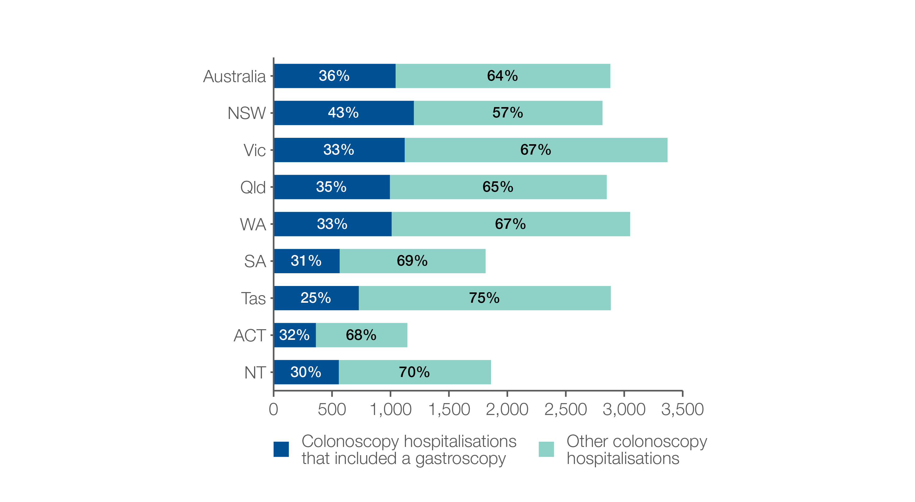
2.2 Gastroscopy hospitalisations, all ages
Colonoscopy hospitalisations that also included gastroscopy
Number per 100,000 people
Sources: NHMD data 2016-17, and ABS Estimated Resident Population 30 June 2016
Notes:
Speaker notes:
In 2016–17, 36% of hospitalisations for colonoscopy included a gastroscopy. There were 274,559 hospitalisations for colonoscopy that also included gastroscopy, representing 1,044 hospitalisations per 100,000 people of all ages (the Australian rate).
The number of hospitalisations varied across states and territories, from 362 per 100,000 people in the Australian Capital Territory to 1,200 per 100,000 people in New South Wales.

Slide 34
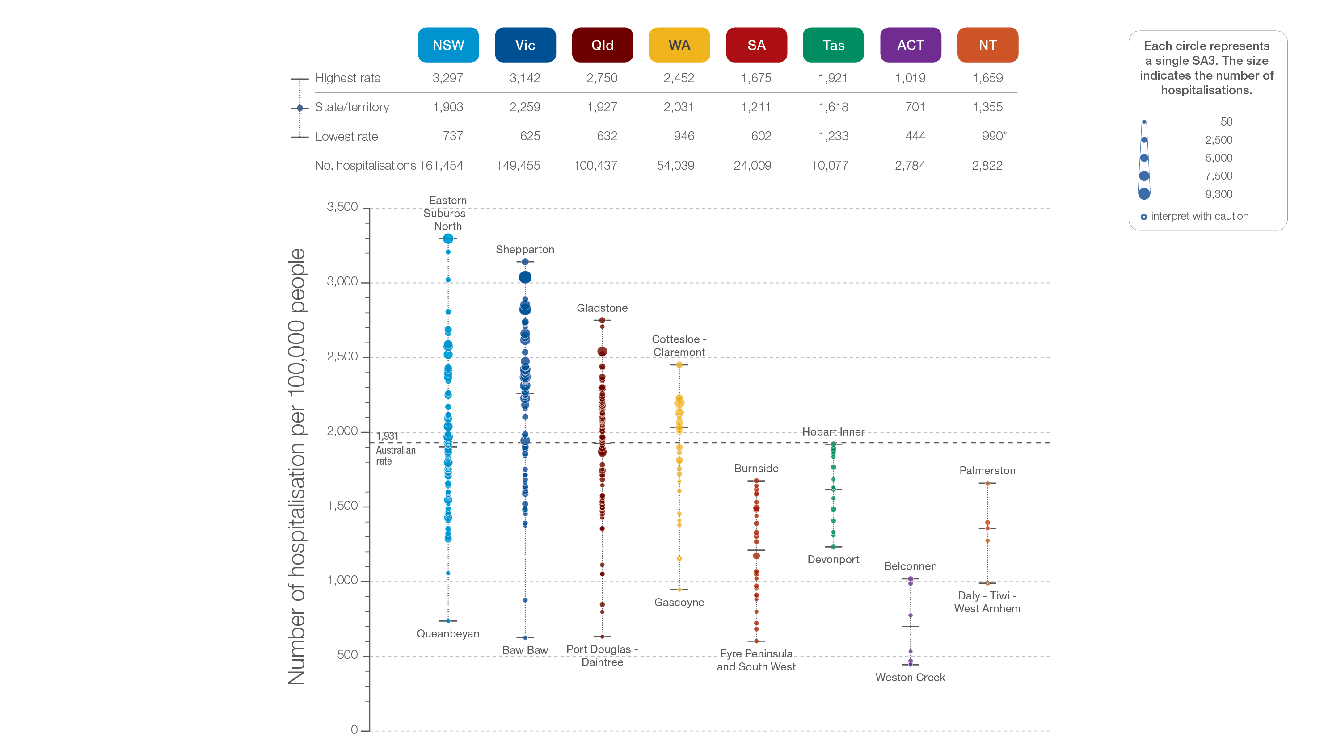
2.2 Gastroscopy hospitalisations, all ages
State and territory
Sources: NHMD data 2016-17, and ABS Estimated Resident Population 30 June 2016
Notes:
Speaker notes:
The number of hospitalisations for gastroscopy varied across states and territories, from 701 per 100,000 people of all ages in the Australian Capital Territory to 2,259 in Victoria .
Each circle on the graph represents an SA3. The size of the circle indicates how many hospitalisations have been recorded for people living in that area. The vertical axis shows the standardised rates for the clinical item.
Hollow circles and asterisks indicate rates that are considered more volatile than other published rates and should be interpreted with caution. Data from a number of ACT private hospitals, which undertake some gastroscopies, were not provided to the National Hospital Morbidity Database. For this reason, data for the ACT should be interpreted with caution.
For further detail about the methods used, please refer to the Technical Supplement.
For further information on how to interpret the figures, please refer to the ‘How to interpret’ resource available at: www.safetyandquality.gov.au/atlas/the-third-australian-atlas-of-healthcare-variation-2018/how-to-interpret-the-data/

Slide 35
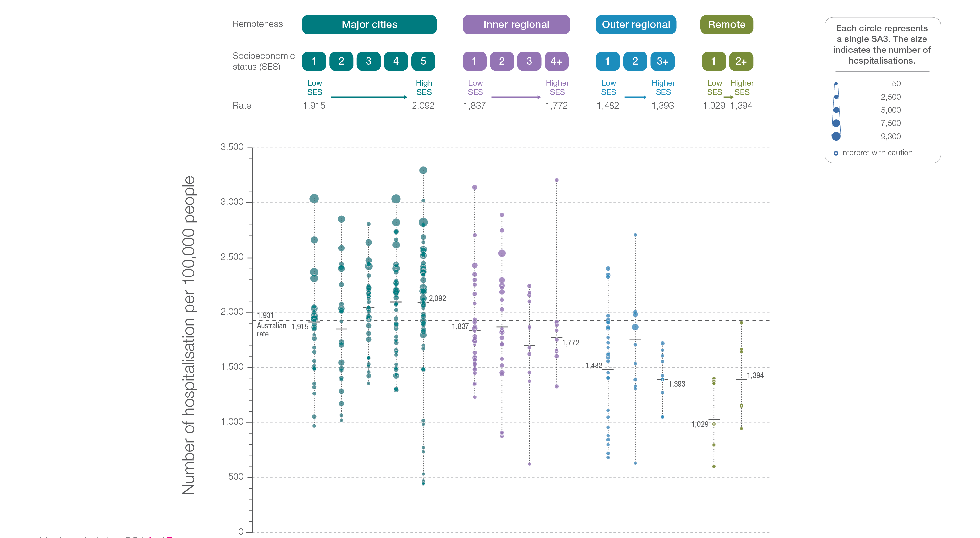
2.2 Gastroscopy hospitalisations, all ages
Remoteness and socioeconomic status
Sources: NHMD data 2016-17, and ABS Estimated Resident Population 30 June 2016
Notes:
Speaker notes:
Rates of hospitalisation for gastroscopy were higher in major cities and inner regional areas than in outer regional and remote areas. Rates were lower in areas with lower socioeconomic status in major cities and remote areas. However, there was no clear pattern according to socioeconomic status in other remoteness categories.
Each circle on the graph represents an SA3. The size of the circle indicates how many clinical events have been recorded for people living in that area. The vertical axis shows the standardised rates for the clinical item.
Hollow circles indicate rates that are considered more volatile than other published rates and should be interpreted with caution. For further detail about the methods used, please refer to the Technical Supplement.
For further information on how to interpret the figures, please refer to the ‘How to interpret’ resource available at: www.safetyandquality.gov.au/atlas/the-third-australian-atlas-of-healthcare-variation-2018/how-to-interpret-the-data/

Slide 36
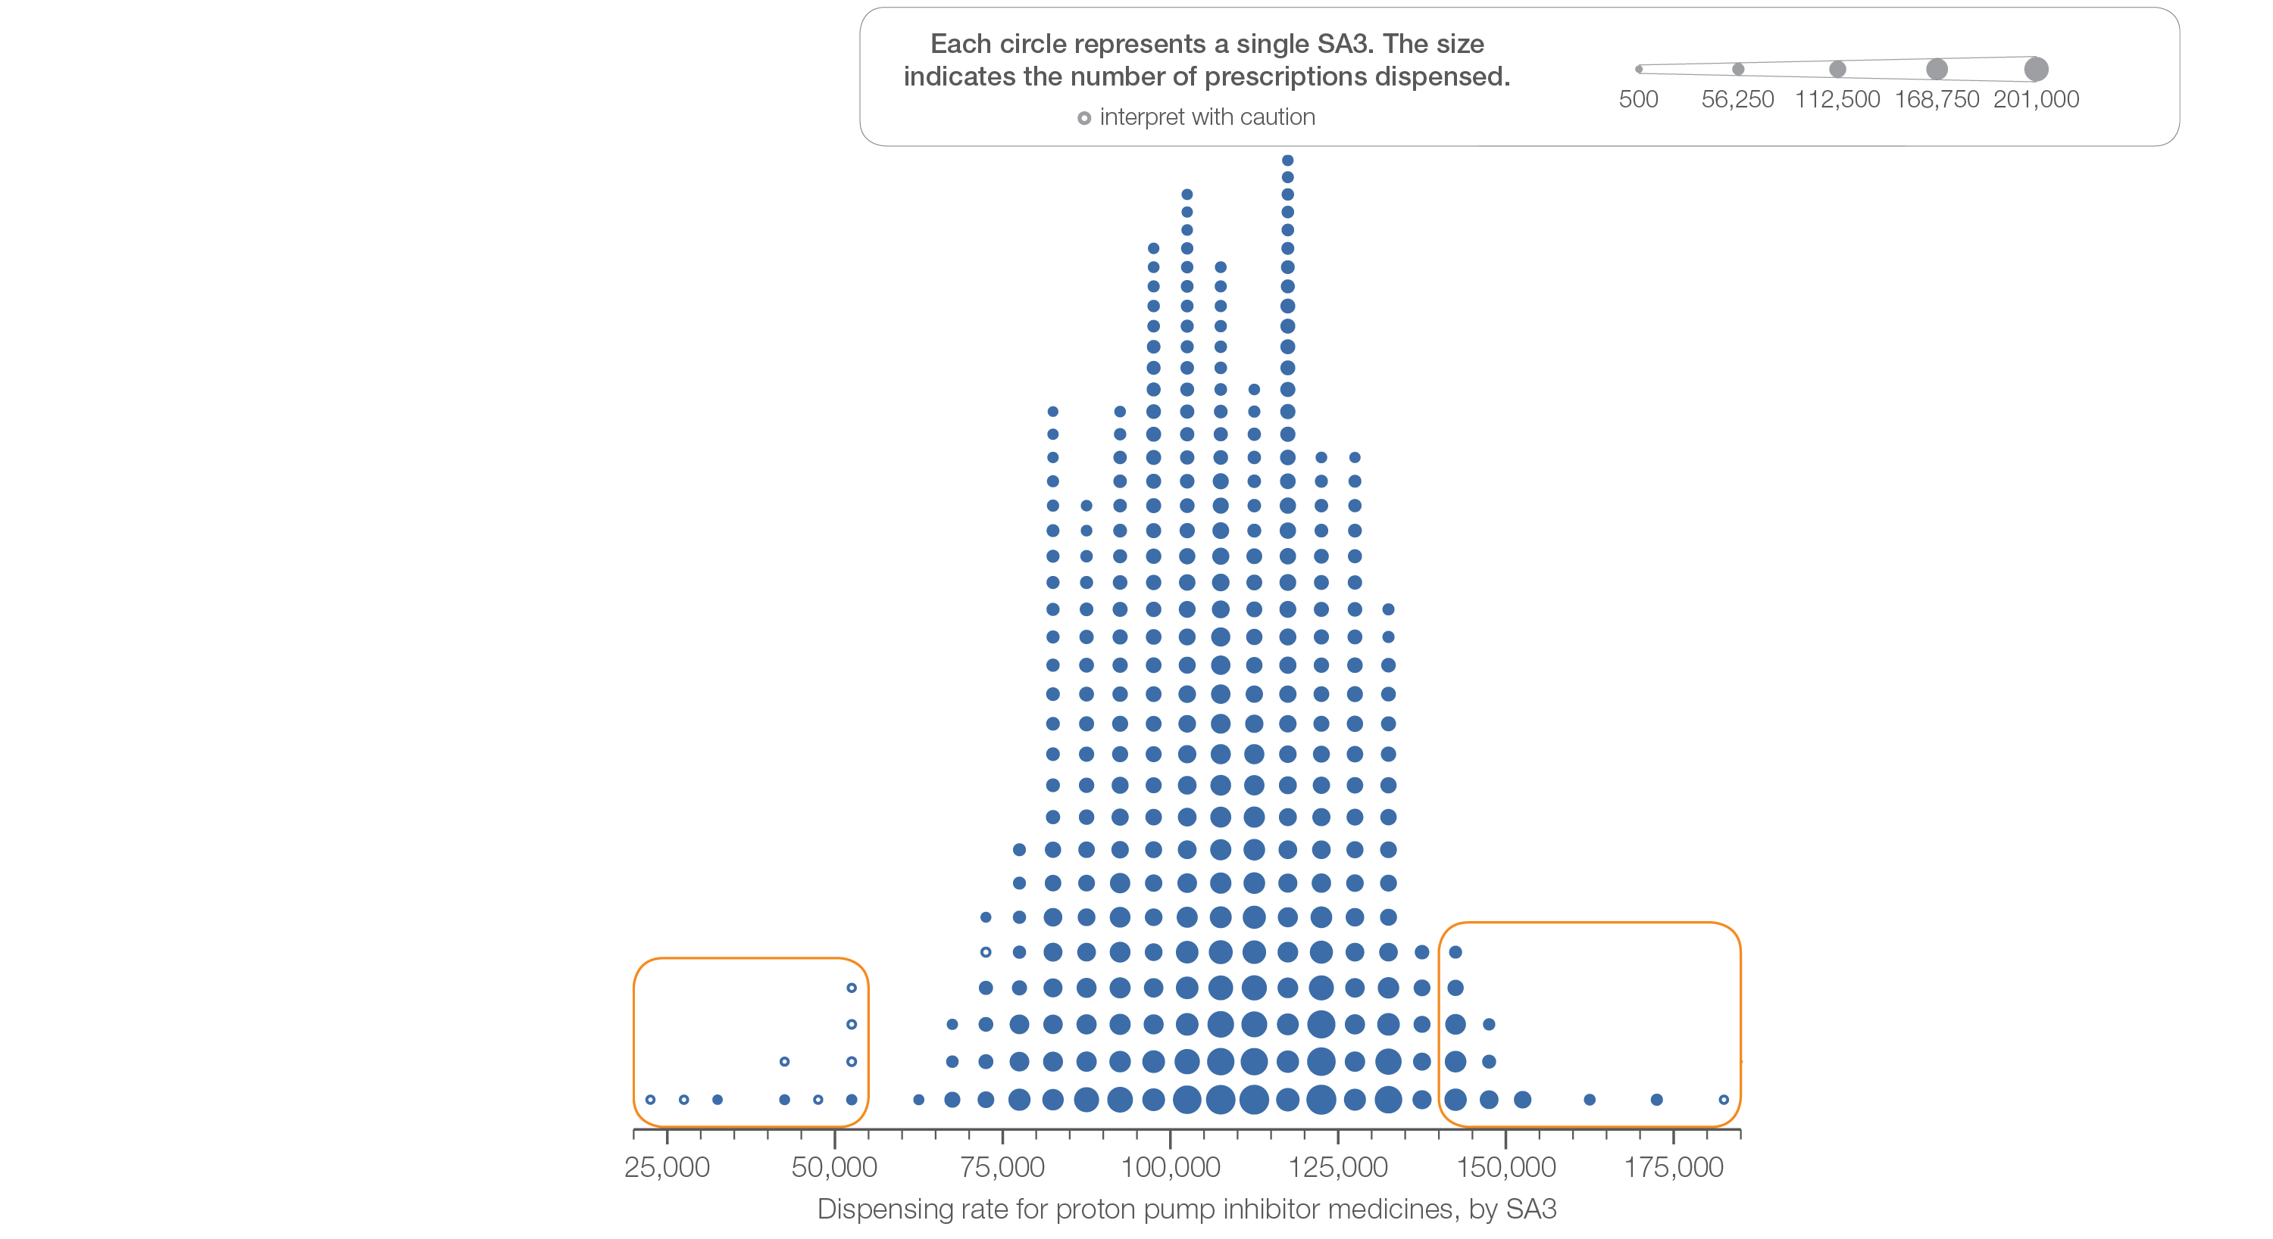
2.3 Proton pump inhibitor medicines dispensing, 18 years and over
Sources: PBS data 2016-17, and ABS Estimated Resident Population 30 June 2016
Notes:
Speaker notes:
This slide shows the distribution of rates by Statistical Area Level 3 (SA3) for proton pump inhibitor medicines dispensing, 18 years and over.
Each circle on the graph represents an SA3. The size of the circle indicates how many prescriptions have been dispensed for people living in that area. The horizontal axis shows the standardised rates for the clinical item.
Hollow circles indicate rates that are considered more volatile than other published rates and should be interpreted with caution. For further detail about the methods used, please refer to the Technical Supplement.
For further information on how to interpret the figures, please refer to the ‘How to interpret’ resource available at: www.safetyandquality.gov.au/atlas/the-third-australian-atlas-of-healthcare-variation-2018/how-to-interpret-the-data/

Slide 37
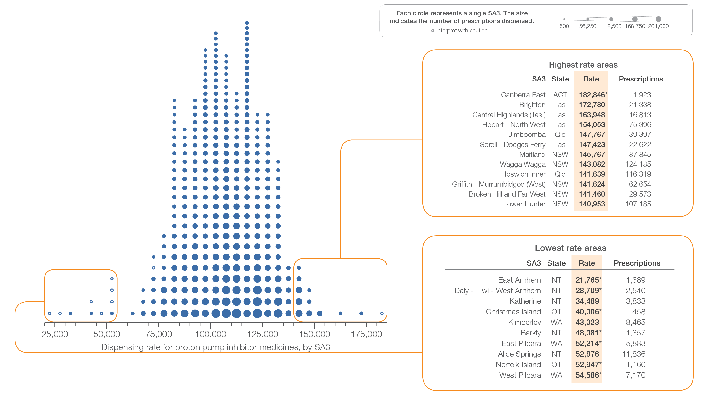
2.3 Proton pump inhibitor medicines dispensing, 18 years and over
Sources: PBS data 2016-17, and ABS Estimated Resident Population 30 June 2016
Notes:
Speaker notes:
This slide shows the distribution of rates by Statistical Area Level 3 (SA3) for proton pump inhibitor medicines dispensing, 18 years and over.
Each circle on the graph represents an SA3. The size of the circle indicates how many prescriptions have been dispensed for people living in that area. The horizontal axis shows the standardised rates for the clinical item.
For further information on how to interpret the figures, please refer to the ‘How to interpret’ resource available at: www.safetyandquality.gov.au/atlas/the-third-australian-atlas-of-healthcare-variation-2018/how-to-interpret-the-data/

Slide 38
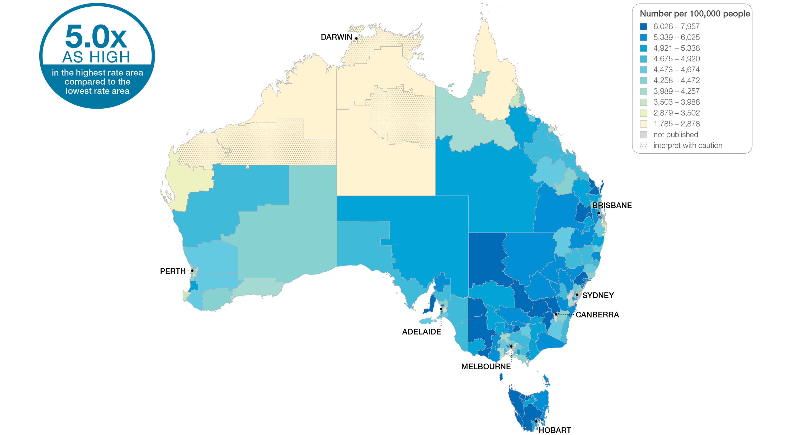
2.3 Proton pump inhibitor medicines dispensing, 18 years and over
Sources: PBS data 2016-17, and ABS Estimated Resident Population 30 June 2016
Notes:
Speaker notes:
This slide shows the distribution of rates by Statistical Area Level 3 (SA3) for proton pump inhibitor medicines dispensing. Rates are based on the patient’s usual place of residence, not the location of the healthcare provider.
In 2016–17, there were 21,768,718 PBS prescriptions dispensed for PPI medicines, representing 105,294 prescriptions per 100,000 people aged 18 years and over (the Australian rate).
The number of PBS prescriptions dispensed for PPI medicines across 333* local areas (Statistical Area Level 3 – SA3) ranged from 34,489 to 172,780 per 100,000 people aged 18 years and over.
The rate was 5.0 times as high in the area with the highest rate compared to the area with the lowest rate.
The number of prescriptions dispensed varied across states and territories, from 63,230 per 100,000 people aged 18 years and over in the Northern Territory to 127,993 in Tasmania.
The range of rates represented by each colour are shown in the legend for the map. The darker blue colour represents SA3s with higher rates. The lighter colours represent SA3s with lower rates.
Dotted areas indicate rates that are considered more volatile than other published rates and should be interpreted with caution. These rates are excluded from the calculation of the difference between the highest and lowest SA3 rates in Australia.
For further detail about the methods used, please refer to the Technical Supplement.
For further information on how to interpret the figures, please refer to the ‘How to interpret’ resource available at: www.safetyandquality.gov.au/atlas/the-third-australian-atlas-of-healthcare-variation-2018/how-to-interpret-the-data/

Slide 39
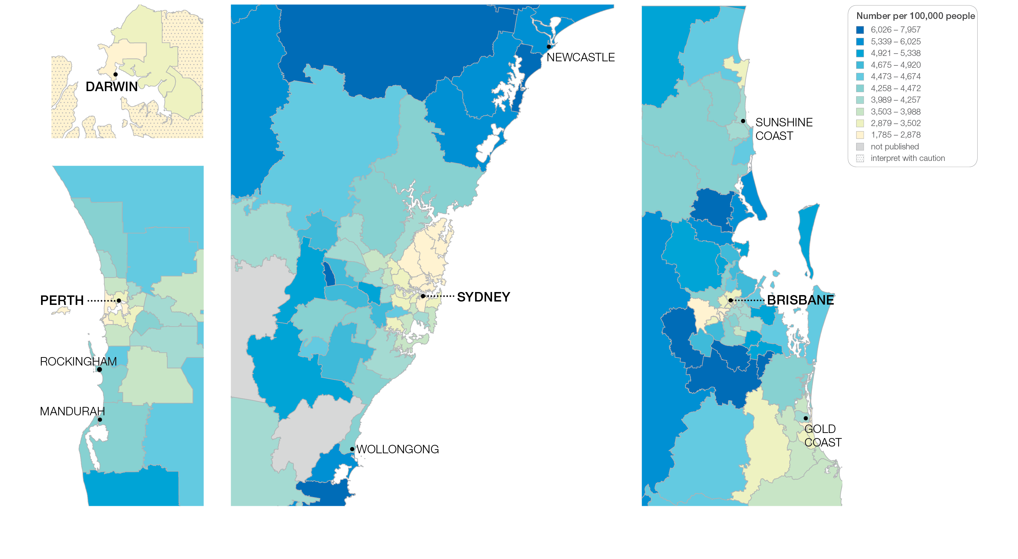
2.3 Proton pump inhibitor medicines dispensing, 18 years and over
Sources: PBS data 2016-17, and ABS Estimated Resident Population 30 June 2016
Notes:
Speaker notes:
This slide shows the distribution of rates by Statistical Area Level 3 (SA3) for proton pump inhibitor medicines dispensing by capital city area. Rates are based on the patient’s usual place of residence, not the location of the healthcare provider.

Slide 40
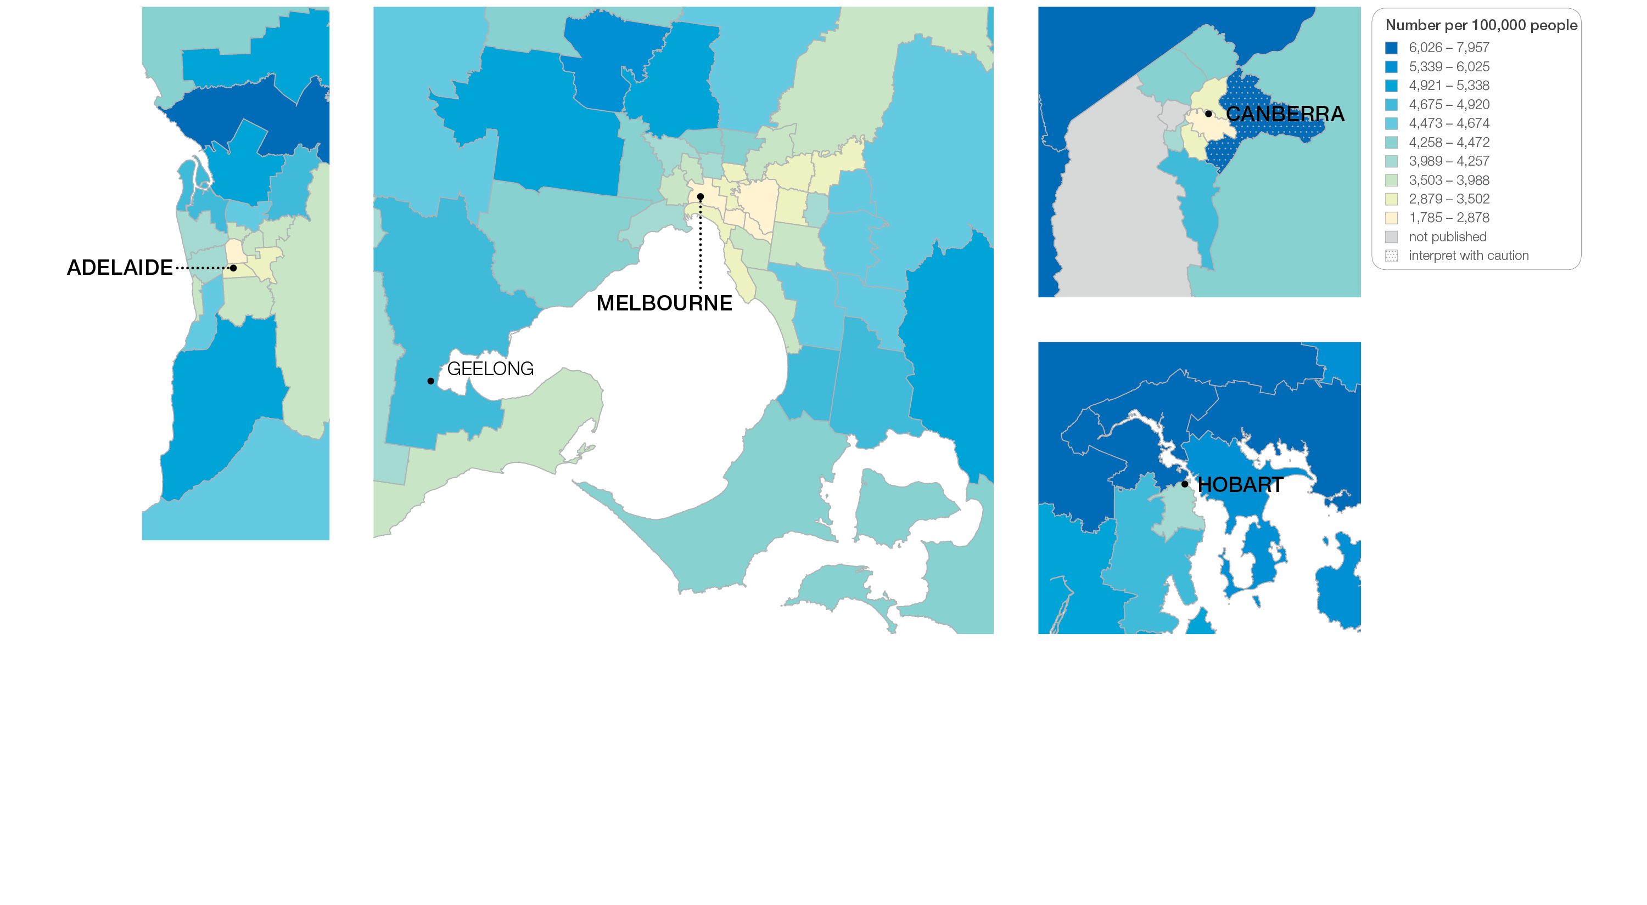
2.3 Proton pump inhibitor medicines dispensing, 18 years and over
Sources: PBS data 2016-17, and ABS Estimated Resident Population 30 June 2016
Notes:
Speaker notes:
This slide shows the distribution of rates by Statistical Area Level 3 (SA3) for proton pump inhibitor medicines dispensing by capital city area. Rates are based on the patient’s usual place of residence, not the location of the healthcare provider.

Slide 41
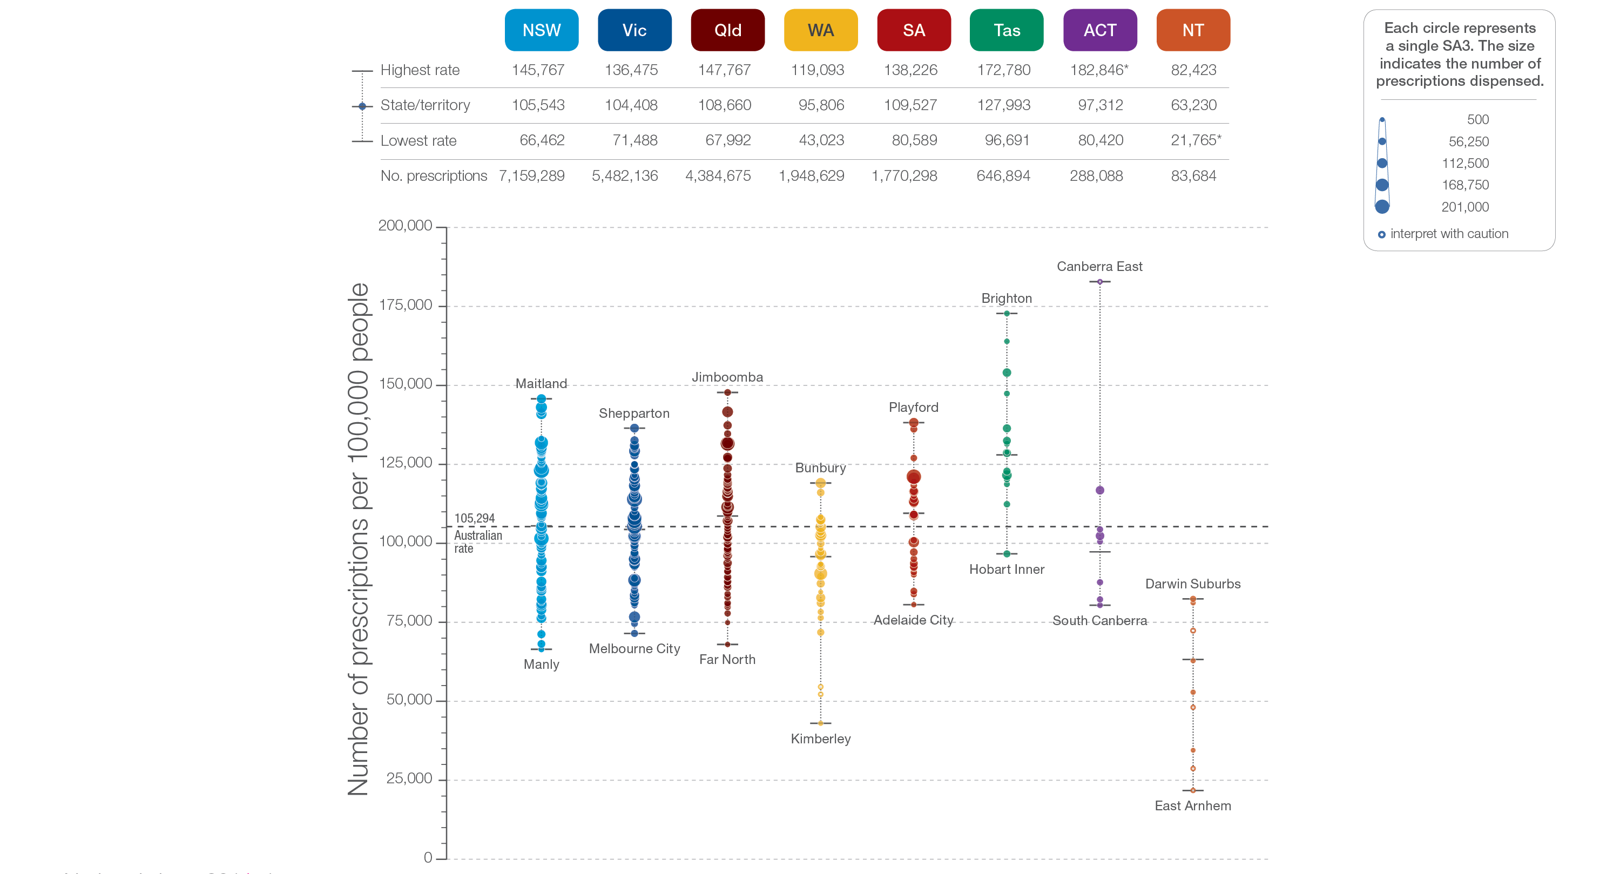
2.3 Proton pump inhibitor medicines dispensing, 18 years and over
State and territory
Sources: PBS data 2016-17, and ABS Estimated Resident Population 30 June 2016
Notes:
Speaker notes:
The number of PBS prescriptions for PPI medicines dispensed varied across states and territories, from 63,230 per 100,000 people aged 18 years and over in the Northern Territory to 127,993 in Tasmania.
Each circle on the graph represents an SA3. The size of the circle indicates how many hospitalisations have been recorded for people living in that area. The vertical axis shows the standardised rates for the clinical item.
Hollow circles and asterisks indicate rates that are considered more volatile than other published rates and should be interpreted with caution.
For further detail about the methods used, please refer to the Technical Supplement.
For further information on how to interpret the figures, please refer to the ‘How to interpret’ resource available at: www.safetyandquality.gov.au/atlas/the-third-australian-atlas-of-healthcare-variation-2018/how-to-interpret-the-data/

Slide 42
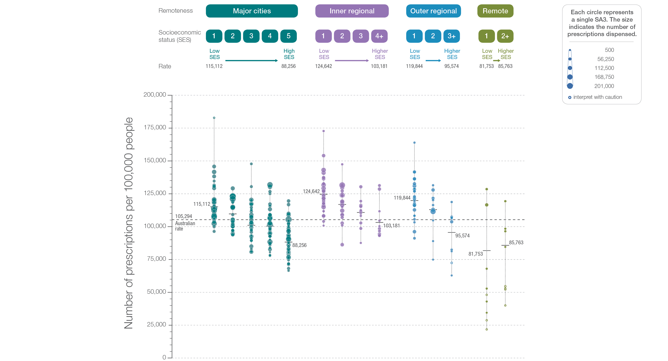
2.3 Proton pump inhibitor medicines dispensing, 18 years and over
Remoteness and socioeconomic status
Sources: PBS data 2016-17, and ABS Estimated Resident Population 30 June 2016
Notes:
Speaker notes:
Rates of PPI medicines dispensing were higher in inner regional and outer regional areas than in other areas. There was a pattern of an increasing rate of PPI medicines dispensing with socioeconomic disadvantage in major cities, and inner regional and outer regional areas.
Hollow circles indicate rates that are considered more volatile than other published rates and should be interpreted with caution.

Slide 43
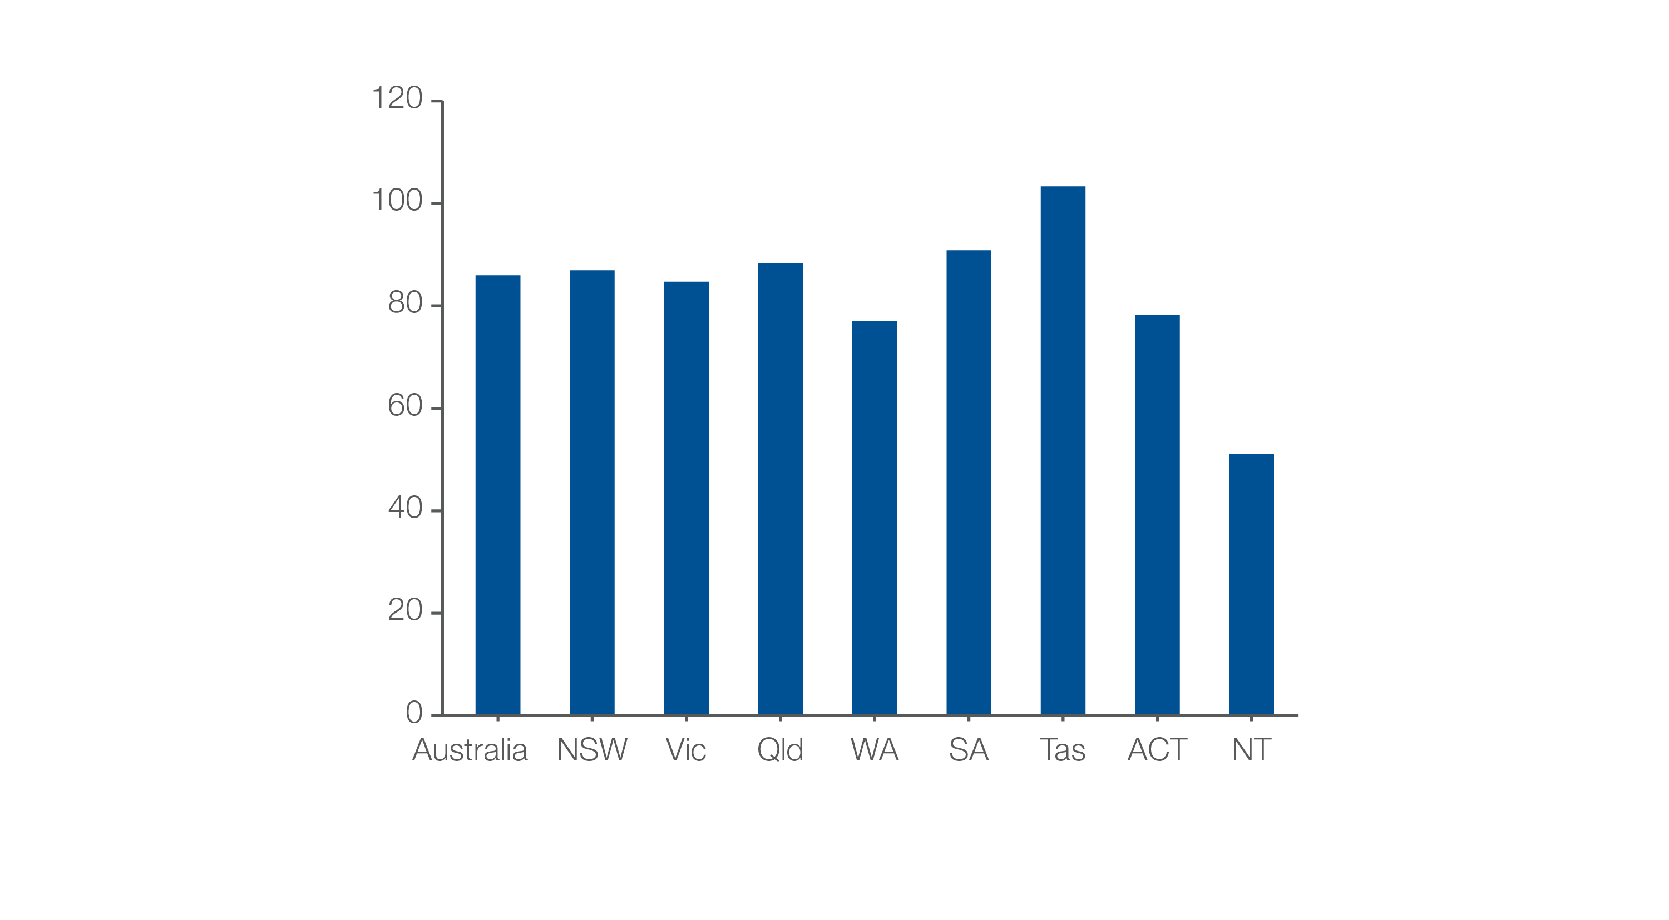
2.3 Proton pump inhibitor medicines dispensing, 18 years and over
Defined daily doses (DDD)
Number of DDDs per 1000 people per day
Sources: PBS data 2016-17, and ABS Estimated Resident Population 30 June 2016
Notes:
Speaker notes:
A defined daily dose (DDD) is a measure of medicines use that allows comparison between different therapeutic groups, and between countries. The DDD is based on the average dose per day of the medicine when used for its main indication by adults.
The number of defined daily doses (DDD) of PPI medicines per 1,000 people aged 18 years and over dispensed on any given day was 85.95, equivalent to 8.6% of the adult population receiving a PPI medicine on any given day of 2016–17.
The DDD rate varied across states and territories from 51.15 per 1,000 people per day in the Northern Territory to 103.32 in Tasmania.

Slide 44
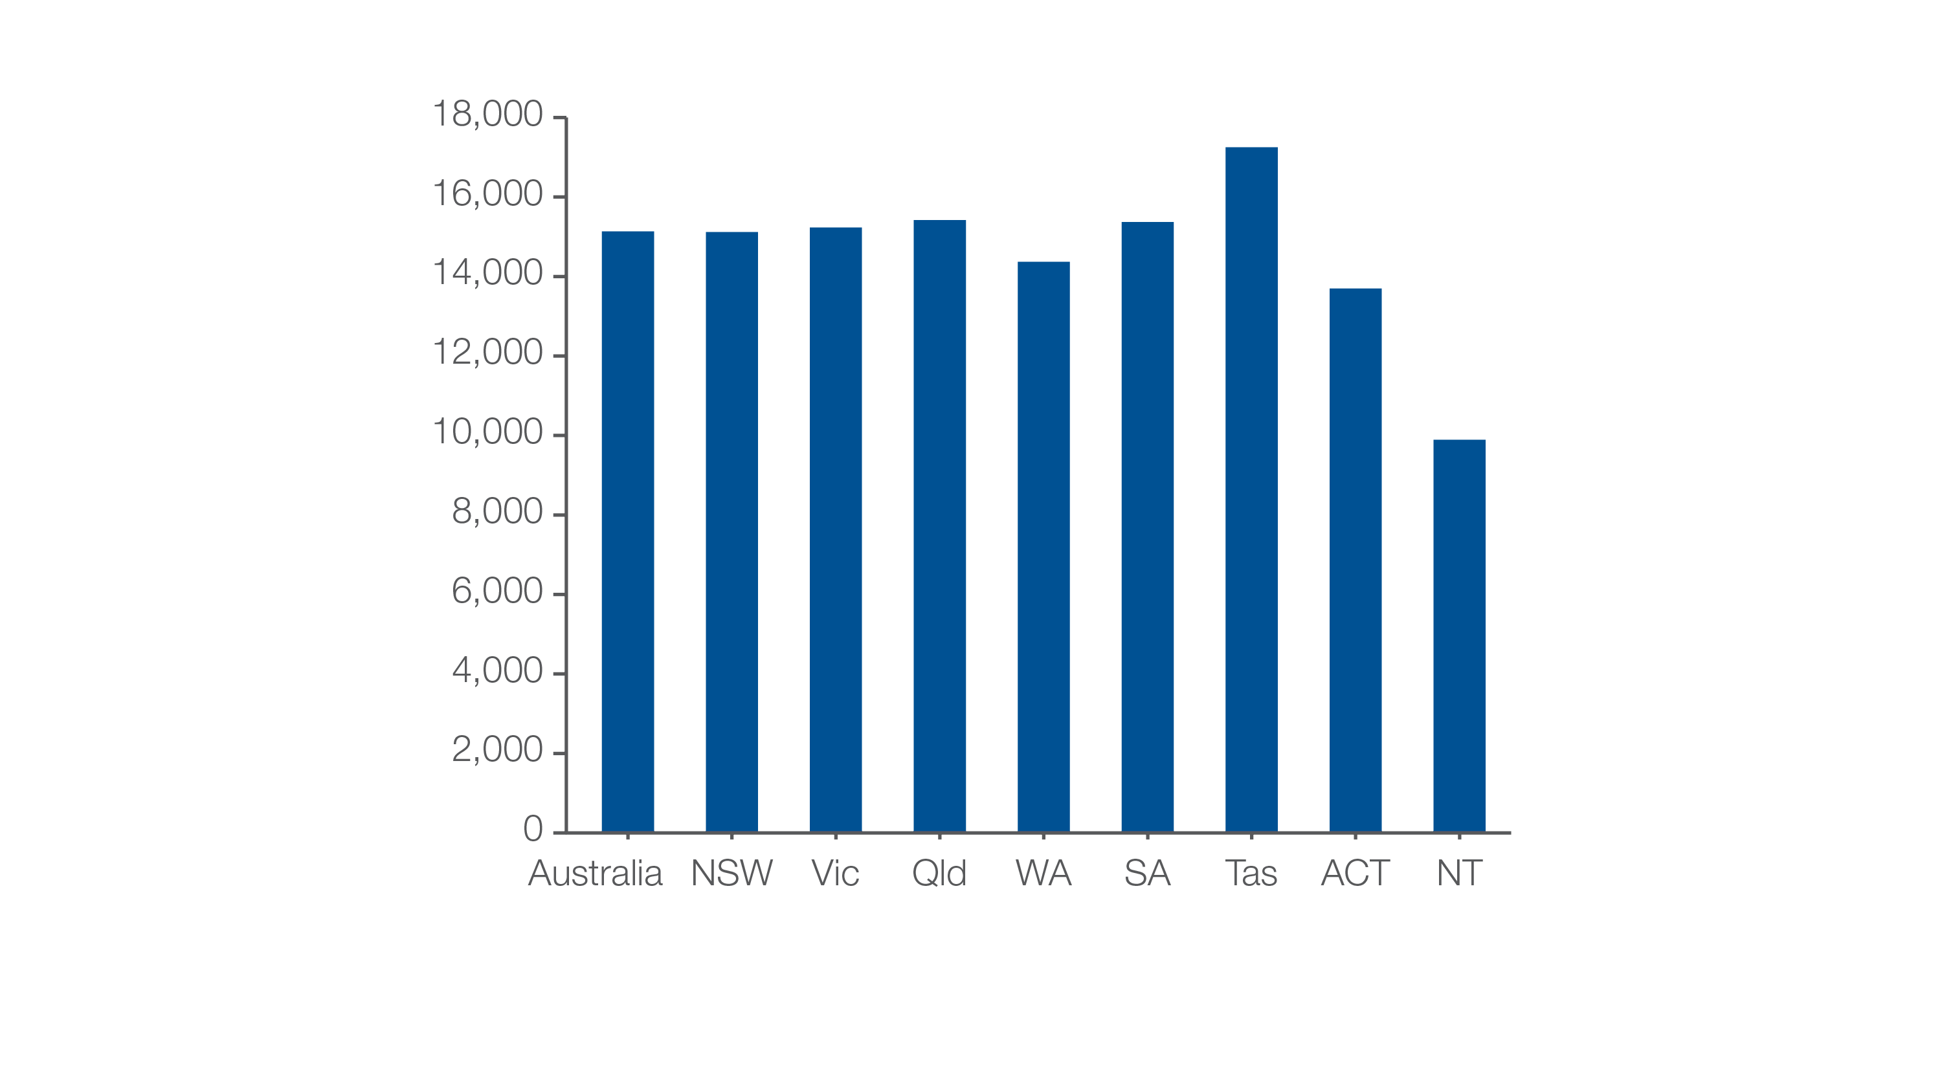
2.3 Proton pump inhibitor medicines dispensing, 18 years and over
Patients dispensed at least one proton pump inhibitor medicine
Number of patients per 100,000 people
Sources: PBS data 2016-17, and ABS Estimated Resident Population 30 June 2016
Notes:
Speaker notes:
The number of people aged 18 years and over who had at least one prescription for a PPI medicine dispensed in 2016–17 was 15,135 per 100,000 people – that is 15% of the adult population.

Slide 45
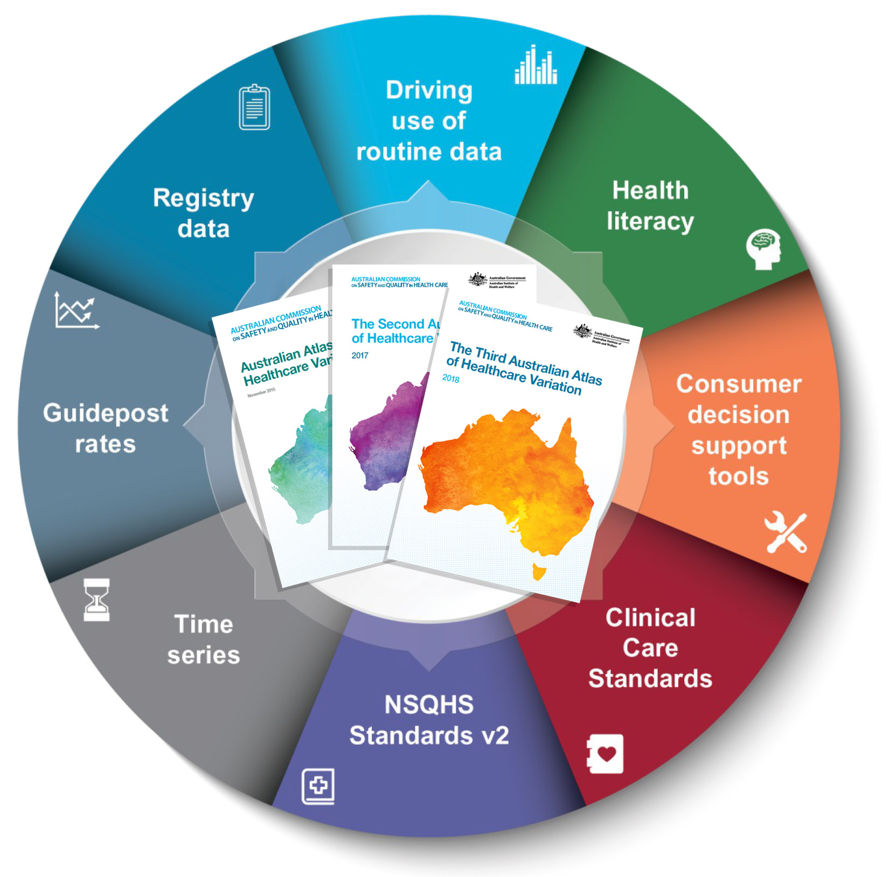
Promoting appropriate care
Explore variation
Identify unwarranted variation
Address unwarranted variation
Notes:
Speaker notes:
Mapping variation is an invaluable tool for understanding how our healthcare system is providing care, but gathering the data is only the first step. Understanding the underlying reasons for marked differences in the use of some health services across Australia, and considering how we can improve, are key for translating this work into better outcomes for patients.
The patterns shown in the maps in this Atlas and the accompanying commentaries show that there are many opportunities for making meaningful changes in Australia’s delivery of health care. The recommendations in the third Atlas highlight that action is needed at all levels – from addressing the social determinants of health through to better data collection, system changes and providing the best supports for individual clinician–patient interactions. These goals are ambitious, but the recommended changes have the potential to result in meaningful progress in defining and delivering appropriate care – and improving patient outcomes.

Slide 46
Further resources
Explore the data further using the interactive Atlas at www.safetyandquality.gov.au/atlas/
Please send any queries to atlas@safetyandquality.gov.au
Notes:
Further resources
Explore the data further using the interactive Atlas at www.safetyandquality.gov.au/atlas/
Please send any queries to atlas@safetyandquality.gov.au

