Slide 1
The Third Australian Atlas of Healthcare Variation
2018

Slide 2
The Australian Atlas of Healthcare Variation series
Notes:
Speaker notes:
Mapping variation is an invaluable tool for understanding how our healthcare system is providing care. The Australian Atlas of Healthcare Variation series illuminates variation by mapping use of health care according to where people live. Each Atlas identifies specific achievable actions for exploration and quality improvement.
The Australian Commission on Safety and Quality in Health Care (the Commission) has collaborated with the Australian, state and territory governments, specialist medical colleges, clinicians and consumer representatives to develop the Atlas series.
The Atlas publications can be downloaded from the Atlas website.

Slide 3
Interactive Atlas
Notes:
Speaker notes:
The Atlas data can also be further explored using the online interactive Atlas platform.

Slide 4
Australian Commission on Safety and Quality in Health Care
Australian Government agency
Leads & coordinates national improvements in safety & quality of health care based on best available evidence
Works in partnership with patients, consumers, clinicians, managers, policy makers & health care organisations
Aims to ensure that the health system is sustainable, better informed, supported & organised to deliver safe & high quality care
Notes:
Speaker notes:
The Commission’s role is to lead and coordinate national improvements in the safety and quality of health care. The Commission works in partnership with the Australian Government, state and territory governments and the private sector to achieve a safe and high-quality, sustainable health system. In doing so, the Commission also works closely with patients, carers, clinicians, managers, policymakers and healthcare organisations.
Key functions of the Commission include developing national safety and quality standards, developing clinical care standards to improve the implementation of evidence-based health care, coordinating work in specific areas to improve outcomes for patients, and providing information, publications and resources about safety and quality.
The Commission works in four priority areas:
- Patient safety
- Partnering with patients, consumers and communities
- Quality, cost and value
- Supporting health professionals to provide care that is informed, supported and organised to deliver safe and high-quality health care.
One of the Commission’s key programs is the National Safety and Quality Health Service (NSQHS) Standards. The primary aim of the NSQHS Standards are to protect the public from harm and to improve the quality of health service provision. The NSQHS Standards were developed by the Commission in partnership with the Australian, state and territory governments, the private sector, clinicians, patients and carers.

Slide 5
Third Australian Atlas of Healthcare Variation
Examines variation nationally in 13 clinical items, grouped into 4 themes
Neonatal and paediatric health
Early planned caesarean section without medical or obstetric indication
Antibiotic dispensing in children, 9 years and under
Proton pump inhibitor dispensing in infants, 1 year and under
Gastrointestinal investigations and treatments
Proton pump inhibitor dispensing in adults
Colonoscopy hospitalisations
Gastroscopy hospitalisations
Thyroid investigations and treatments
Thyroid stimulating hormone tests
Thyroid function tests
Neck ultrasound
Thyroidectomy hospitalisations
Cardiac tests
Cardiac stress tests and imaging
Stress echocardiography
Myocardial perfusion scans
Standard echocardiography
Notes:
Speaker notes:
The third Atlas, released in December 2018, examines four clinical themes: neonatal and paediatric health, gastrointestinal investigations and treatments, thyroid investigations and treatments and cardiac tests.

Slide 6
Third Australian Atlas of Healthcare Variation
Content continued
Repeat analyses
Examines changes over four years in the numbers of Pharmaceutical Benefits Scheme (PBS) prescriptions dispensed for:
Antimicrobial medicines
Antipsychotic and ADHD medicines
Opioid medicines
Response to the Atlas series
The Atlas series aims to provide clinically meaningful information that can be used to investigate and improve the appropriateness, effectiveness and efficiency of health care in Australia.
This section illustrates how the Atlas series can improve the value
of healthcare delivery.
Notes:
Speaker notes:
It also includes a repeat analysis chapter, examining

Slide 7
Inside this slide pack
Why does variation matter?
How is variation measured in the Atlas?
How is variation presented in the Atlas?
Notes on data
Key findings
Promoting appropriate care
Further resources
Notes:
Speaker notes:
This slide pack explores why variation matters and what unwarranted variation in healthcare is. This slide pack explores the key findings for the ‘Neonatal and paediatric health’ chapter and shows findings, maps and graphs for each of the clinical items in this chapter.

Slide 8
Why does variation matter?
Large variations in health care use have been documented by researchers around the world for many years
A proportion of this variation is termed ‘unwarranted’
Unwarranted variation:
Is unrelated to patient need or preference
May signal inappropriate care
May signal ineffective use of resources
It raises questions about appropriateness of care, health system efficiency, equity and access
Can highlight opportunities for further investigation and for the health system to improve
Notes:
Speaker notes:
Variations have been documented for many years: One of the first major studies published was by Glover in 1938 who noted a rise in England & Wales in incidence of tonsillectomy and very large differences in rates between school districts which “defies any explanation, save that of variations of medical opinion on the indications for operation.” He also noted “Large and, in some cases, drastic reductions in the numbers of operations performed in elementary school children in certain areas have had no unsatisfactory results” and that “The mortality from the operation is larger than is generally appreciated”.
He noted that that the conspicuous success of the operation in some cases may have led to its adoption in many doubtful cases.
Getting the best outcomes for patients and improving appropriateness of care is the goal of the Atlas. Where we see substantial variation in use of a particular treatment, it is an alarm bell that should make us stop and investigate whether appropriate care is being delivered.
Variation in itself is not necessarily bad, and it can be good if it reflects health services responding to differences in patient preferences or underlying needs. When a difference in the use of health services does not reflect these factors, it is unwarranted variation and represents an opportunity for the health system to improve. Rates of an intervention that are substantially higher or lower in some areas can highlight:
- Inequity of access to evidence-based care, and the need to deliver services more fairly
- Uncertainty about the intervention’s place in therapy, and the need for better data on its benefits and harms
- Gaps in accessible evidence for clinicians, and the need for clinical care standards
- Inadequate system supports for appropriate care, and the need for changes in training or financial incentives.
Looking at how healthcare use varies between people living in different areas, between people with and without socioeconomic disadvantage, and between Aboriginal and Torres Strait Islander Australians and other Australians can show who in our community is missing out. Fundamental changes to address the underlying determinants of ill health, as well as better service delivery for those with existing disease, are needed where these inequities are found.
Reference: Glover JA. The Incidence of Tonsillectomy in School Children: (Section of Epidemiology and State Medicine). Proc R Soc Med. 1938;31(10):1219-36.

Slide 9
How is variation measured in the Atlas?
Healthcare use is mapped by residence of patient (not location of the health provider)
Location of residence mapped at Statistical Area Level 3 (SA3)
Data are age- and sex-standardised, with a few exceptions
Data sources used:
National Hospital Morbidity Database (NHMD)
Medicare Benefits Schedule (MBS)
Pharmaceutical Benefits Scheme (PBS)
National Perinatal Data Collection (NPDC)
Data extraction and analysis performed by the Australian Institute of Health and Welfare (AIHW)
Interactive Atlas
Notes:
Speaker notes:
Healthcare use is mapped by residence of the patient (not by where the care was provided).
Most items in this Atlas are mapped to the Statistical Area Level 3 (SA3). Some are mapped to the state and territory level because events were too low to map at a smaller geographical level. SA3s are standard geographical regions used by the Australian Bureau of Statistics. SA3s generally have populations of between 30,000 and 130,000.
Rates are age and sex-standardised per 100,000 population to remove the effect of differences in population age structure when comparing crude rates for different geographic areas.
Data specifications for each item are available on the AHIW’s Metadata Online Registry (METeOR). Information on data analysis and methodology available in the technical supplement.

Slide 10
How is variation presented in the Atlas?
Data are presented in maps and graphs
Statistical Area 3 level data is presented for:
State and territory analysis
Remoteness and socioeconomic disadvantage
State and territory level data is presented for:
Aboriginal and Torres Strait Islander Australian status
Public and private patient funding status
Notes:
Speaker notes:
Data are presented in maps and graphs.
For indicators where the annual number of hospitalisations is too low or unreliable to report at a local level, three years of data are combined.
For each item, SA3 level data are grouped by state and territory, remoteness and socioeconomic status to assist comparisons between local areas.
For each item, where possible, state and territory level data is presented by Aboriginal and Torres Strait Islander status and patient funding status
Data specifications for each item are available on the AHIW’s Metadata Online Registry (METeOR).

Slide 11
Data suppression
A confidentiality process has been followed for all data items in the Atlas to protect the identity of patients and providers
The process includes applying standard rules set by The Australian Institute of Health and Welfare and by the Australian Government Department of Health for reporting of MBS and PBS data
The MBS rules for protecting provider identity have had a marked effect on reporting of three items: myocardial perfusion scans, thyroid stimulating hormone and thyroid function tests.
For example, ‘data cannot be reported for an area if 85% of services were done by one provider, or 90% by two providers’
For the items affected the most, the magnitude of variations are likely to be underestimates of the true variation across Australia.
Notes:
Speaker notes:
For all MBS items in the Atlas, some data have been suppressed to manage volatility and confidentiality. This process takes into account the Australian Government Department of Health’s requirements for reporting MBS data.
The process has resulted in particularly marked data suppression for MBS items for thyroid function testing and for myocardial perfusion scans. Most local areas (Statistical Area Level 3 – SA3) were suppressed to prevent identification of the provider (practitioner or business entity).
More detail on data suppression can be found in the technical supplement: https://www.safetyandquality.gov.au/wp-content/uploads/2018/12/Text-Technical-supplement.pdf

Slide 12
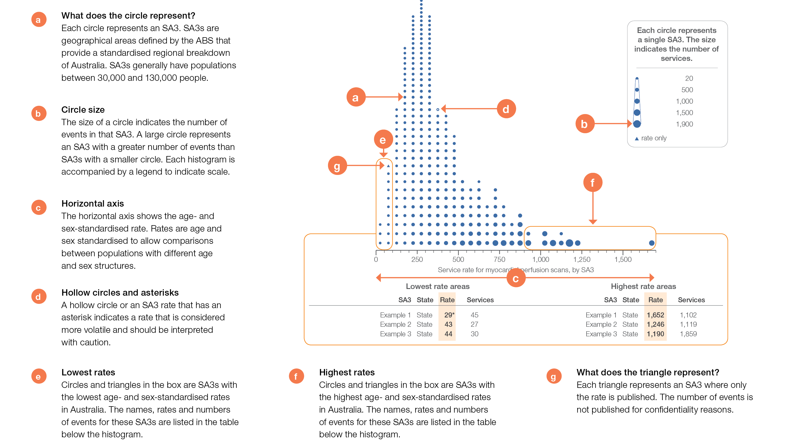
How to interpret our data visualisations
Histogram

Slide 13
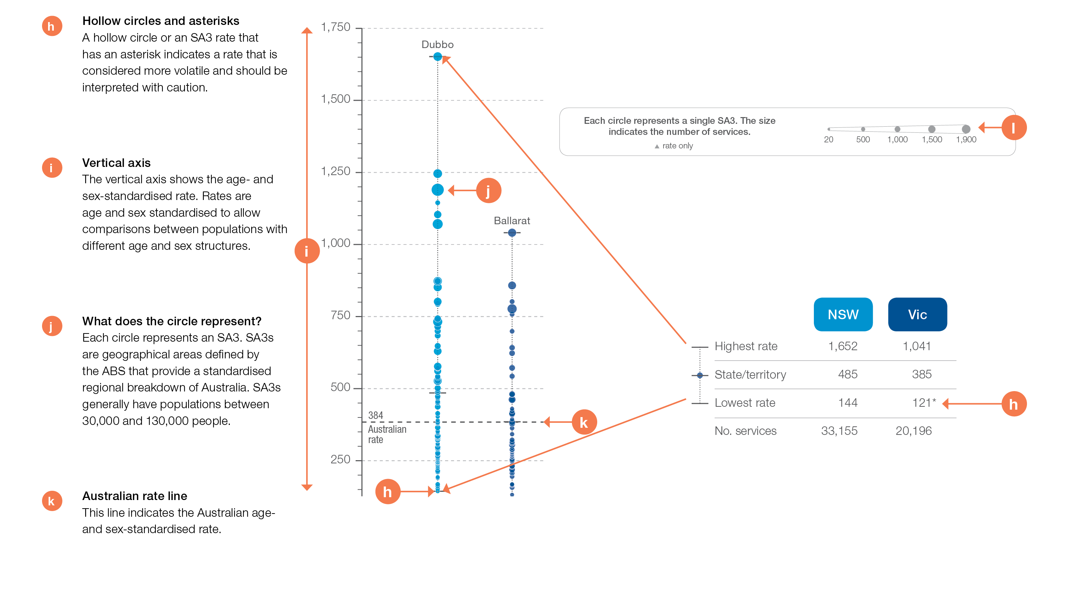
How to interpret our data visualisations
State and territory graph

Slide 14
Neonatal and paediatric health
Notes:
Speaker notes:
This chapter examines:
-Early planned caesarean section without medical or obstetric indication
-Antibiotics dispensing in children, aged 9 years and under
-Proton pump inhibitor medicines dispensing, aged 1 year and under

Slide 15
Neonatal and paediatric health
 | Percentage of planned caesarean sections at specified gestational age, without medical or obstetric indication
Data item | Less than 39 weeks’ gestation* | Less than 37 weeks’ gestation*
1.1 Early planned caesarean section without medical or obstetric indication | 42–60% | 10–22%
* Range across the four published states/territories
Data item | Range across local areas* per 100,000 | Times difference | Times difference excluding top and bottom 10% | Number during 2016–17
1.2 Antibiotics dispensing in children, † 9 years and under | 9,707–150,688 | 16.5 | 1.7 | 3,053,315
* Range across the four published states/territories
† Based on number of PBS prescriptions
Data item | Range across states and territories per 100,000 | Times difference | Number during 2016–17
1.3 Proton pump inhibitor medicines dispensing*, 1 year and under | 2,195–8,066 | 3.7 | 22,810
* Based on number of PBS prescriptions
Notes:
Speaker notes:
Almost half of early planned caesarean sections (42-60%) occurred before 39 weeks of gestation, where there was no medical or obstetric indication (for the four states with reported data).
Substantial variation (16.5) was observed between Statistical Area Level 3 (SA3) areas in the rates of antibiotic dispensing in children aged 9 years and under, with over 3 million prescriptions dispensed - an equivalent rate of almost one per child in the age group.
There were 22,810 PBS prescriptions dispensed for PPI medicines to infants aged 1 year and under, representing 3,628 prescriptions per 100,000.

Slide 16
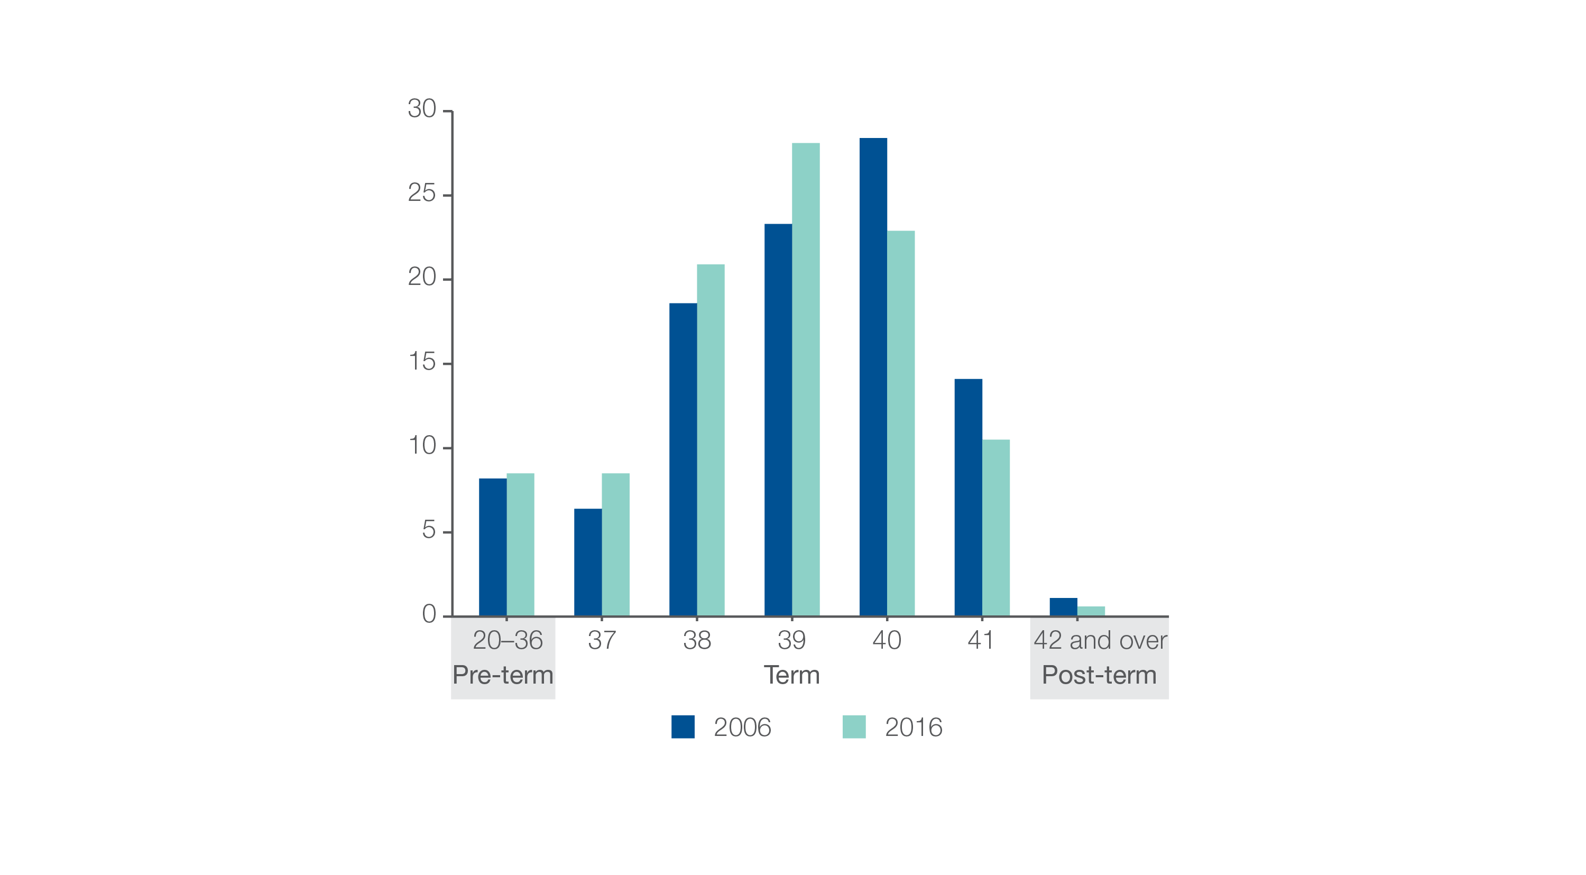
1.1 Early planned caesarean section without medical or obstetric indication
Percentage of babies, by gestational age in weeks, 2006 and 2016,
(AIHW, Australia’s Mothers and Babies, 2016)
Pre-term births include a small number of births of less than 20 weeks’ gestation.
Source: Australia’s Mothers and Babies, 2016
Notes:
Speaker notes:
Rates of caesarean section overall has risen steadily in Australia since the early 1990s. In 2016, 34% of births in Australia were by caesarean section, compared with 31% in 2006 and 18% in 1990.
The proportion of babies born at early term has increased in the past decade. Between 2006 and 2016, the proportion of babies born between 37 and 39 weeks’ gestation increased, while the proportion born from 40 weeks onwards decreased.
Between 2006 and 2016, the average gestational age for all babies born in Australia fell from 38.9 weeks to 38.6 weeks.

Slide 17
1.1 Early planned caesarean section without medical or obstetric indication
Key findings
Among the four states/territories with reportable data on this item:
42%−60% of planned caesarean sections done at <39 weeks’ did not have an obstetric or medical indication
10%− 22% of planned caesarean sections done at < 37 weeks’ did not have an obstetric or medical indication
of planned caesarean sections done at <39 weeks without a medical or obstetric indication, 60% were for privately funded patients vs 52% for publicly funded patients
of planned caesarean sections done at <37 weeks without an obstetric or medical indication, 20% were for privately funded patients vs14% for publicly funded patients
of planned caesarean sections done at <39 weeks without a medical or obstetric indication, percentages were similar for Aboriginal and Torres Strait Islander women and other women in 3 of the 4 states/territories; and lower in one state/territory (53% vs 56%).
Source: NPDC data 2015.
Notes:
Speaker notes:

Slide 18
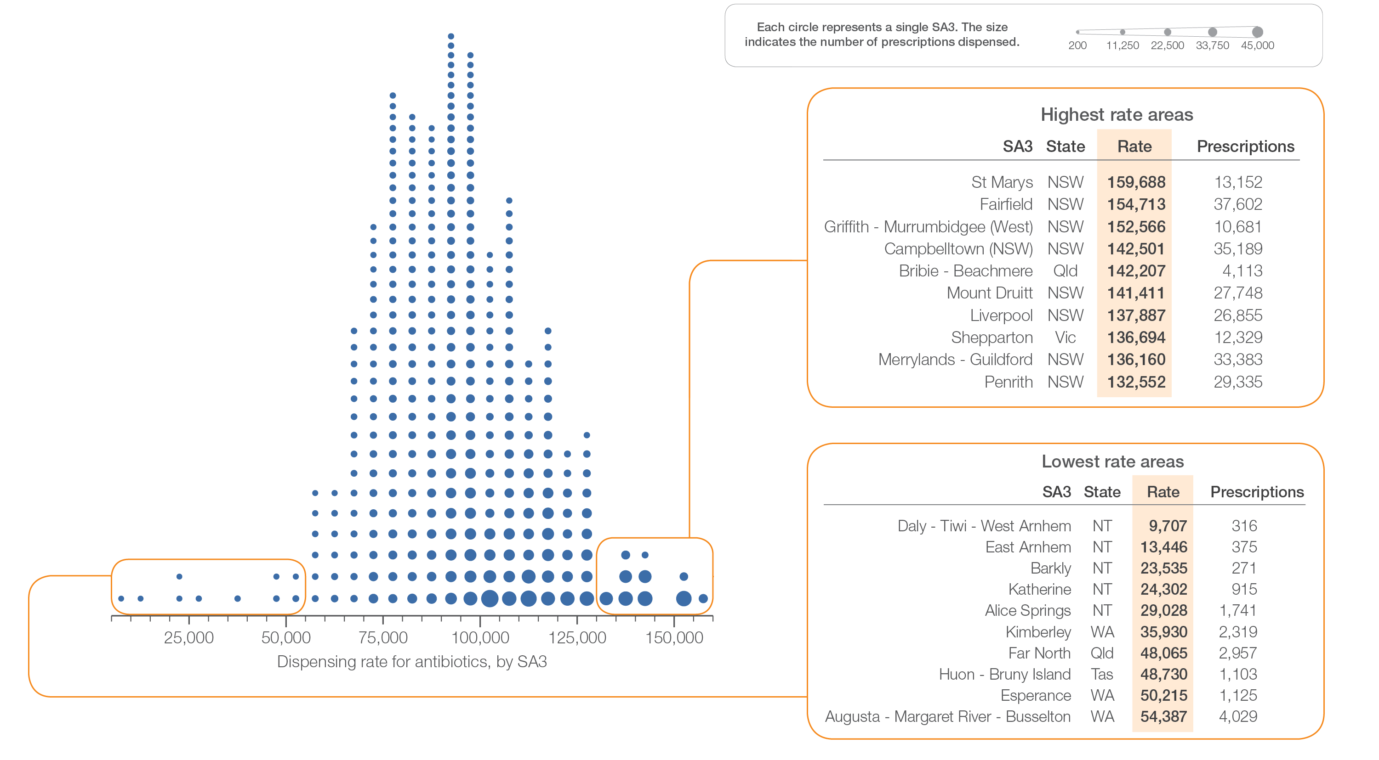
1.2 Antibiotics dispensing in children, 9 years and under
Sources: PBS data 2016-17, and ABS Estimated Resident Population 30 June 2016
Notes:
Speaker notes:
This slide shows the distribution of rates by Statistical Area Level 3 (SA3) for antibiotics dispensing in children aged 9 years and under.
Each circle on the graph represents an SA3. The size of the circle indicates how many prescriptions have been dispensed for children living in that area. The horizontal axis shows the standardised rates for the clinical item.
For further information on how to interpret the figures, please refer to the ‘How to interpret’ resource available at: www.safetyandquality.gov.au/atlas/the-third-australian-atlas-of-healthcare-variation-2018/how-to-interpret-the-data/

Slide 19
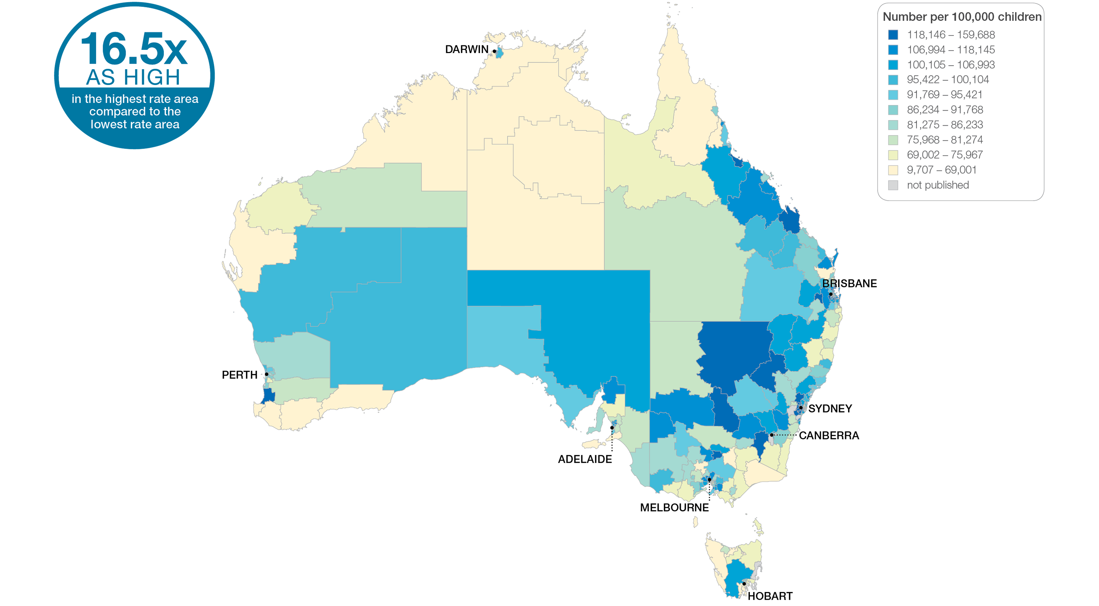
1.2 Antibiotics dispensing in children, 9 years and under
Sources: PBS data 2016-17, and ABS Estimated Resident Population 30 June 2016
Notes:
Speaker notes:
This slide shows the distribution of rates by Statistical Area Level 3 (SA3) for antibiotics dispensing in children aged 9 years and under. Rates are based on the patient’s usual place of residence, not the location of the healthcare provider.
In 2016–17, there were 3,053,315 PBS prescriptions dispensed for antibiotics in children, representing 96,721 prescriptions per 100,000 children aged 9 years and under (the Australian rate).
The number of PBS prescriptions dispensed for antibiotics across 328* local areas (Statistical Area Level 3 – SA3), ranged from 9,707 to 159,688 per 100,000 children aged 9 years and under.
The rate was 16.5 times as high in the area with the highest rate compared to the area with the lowest rate.
The range of rates represented by each colour are shown in the legend for the map. The darker blue colour represents SA3 with higher rates. The lighter colours represent SA3s with lower rates. The grey areas represent areas where the rates have been suppressed. Reasons for rates being suppressed or to be interpreted with caution can include rates based on low numbers of events and/or very small populations are more susceptible to random fluctuations and therefore may not provide a reliable representation of activity in that area. For more information on the suppression protocol, see the Technical Supplement.
The number of prescriptions dispensed varied across states and territories, from 69,015 per 100,000 children aged 9 years and under in the Northern Territory to 102,339 in Queensland.
For further information on how to interpret the figures, please refer to the ‘How to interpret’ resource available at: www.safetyandquality.gov.au/atlas/the-third-australian-atlas-of-healthcare-variation-2018/how-to-interpret-the-data/

Slide 20
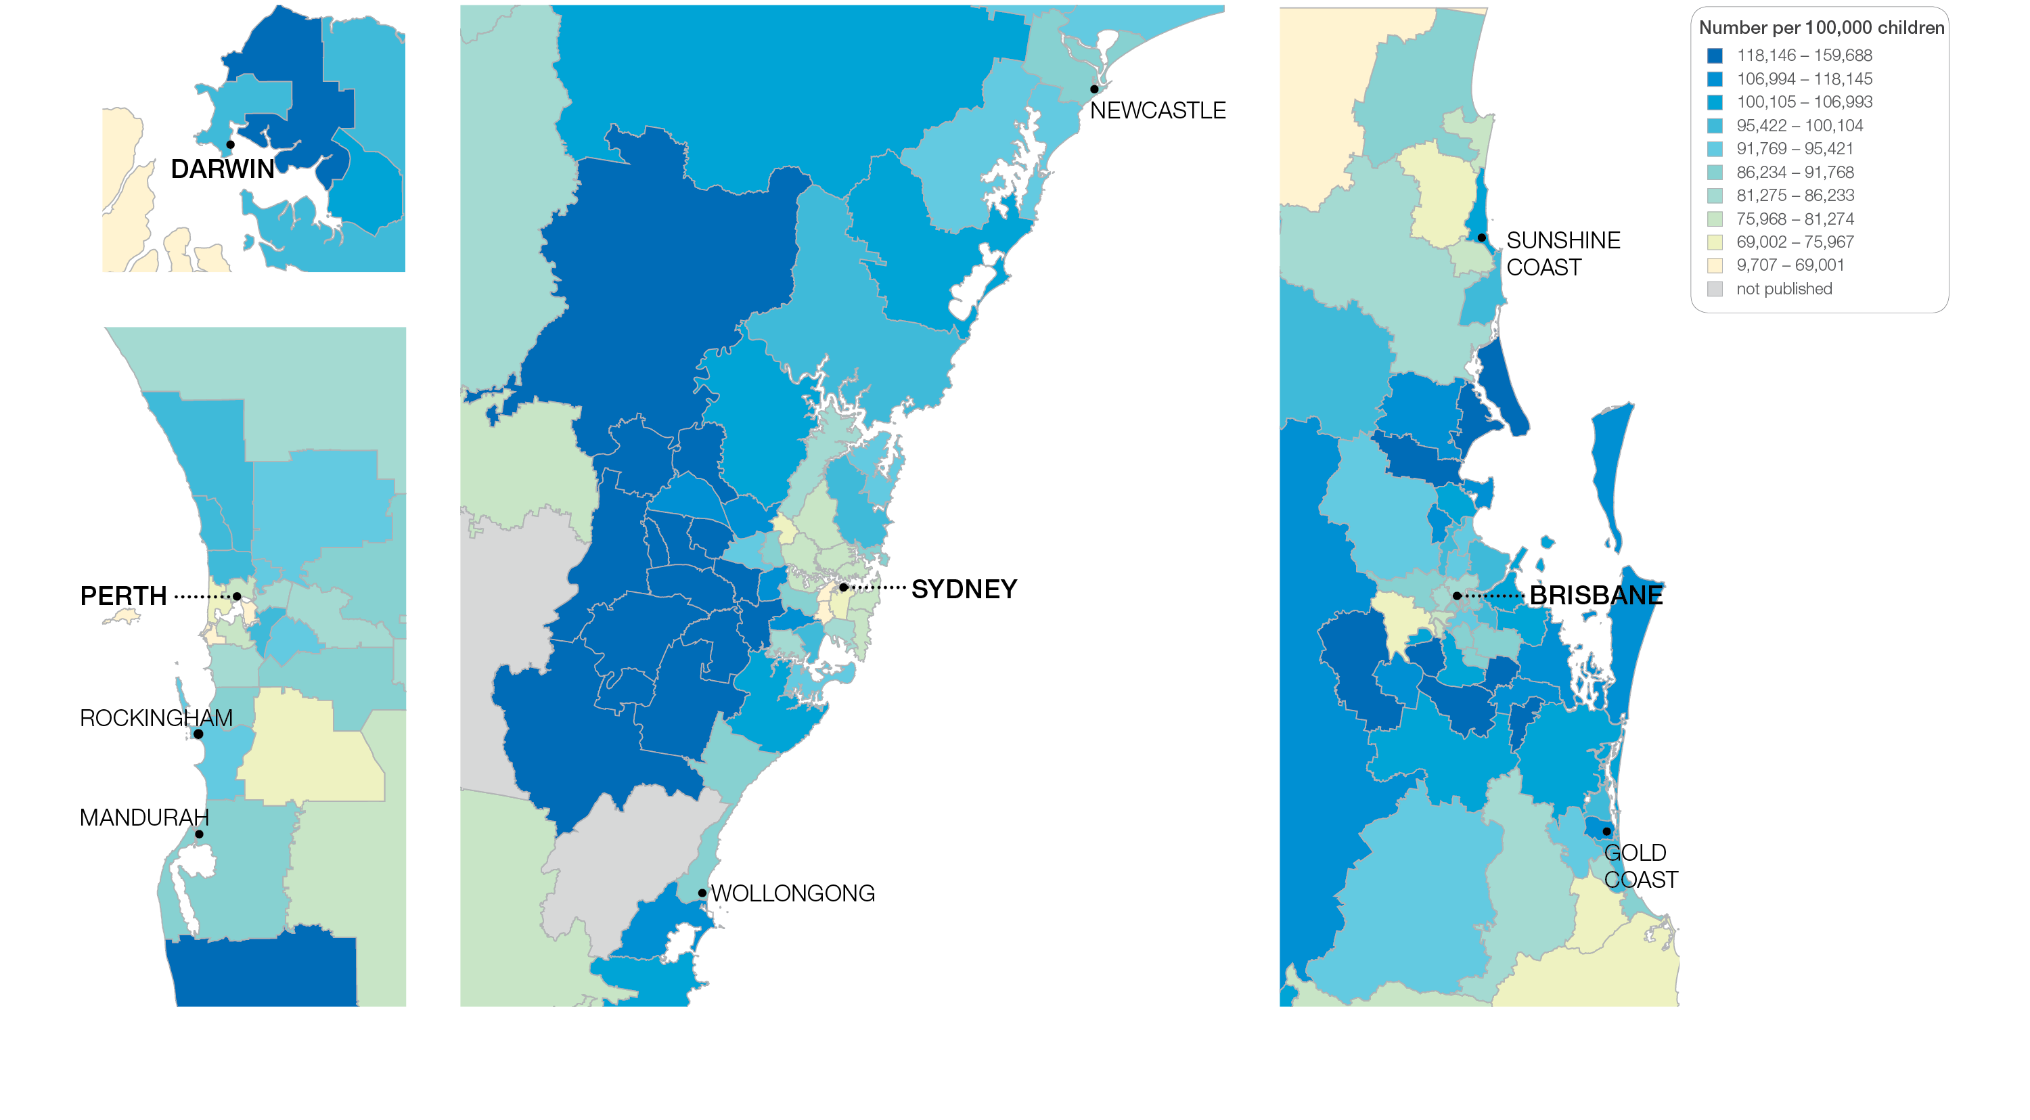
1.2 Antibiotics dispensing in children, 9 years and under
Sources: PBS data 2016-17, and ABS Estimated Resident Population 30 June 2016
Notes:
Speaker notes:
This slide shows the distribution of rates by Statistical Area Level 3 (SA3) for antibiotics dispensing in children aged 9 years and under by capital city area. Rates are based on the patient’s usual place of residence, not the location of the healthcare provider.

Slide 21
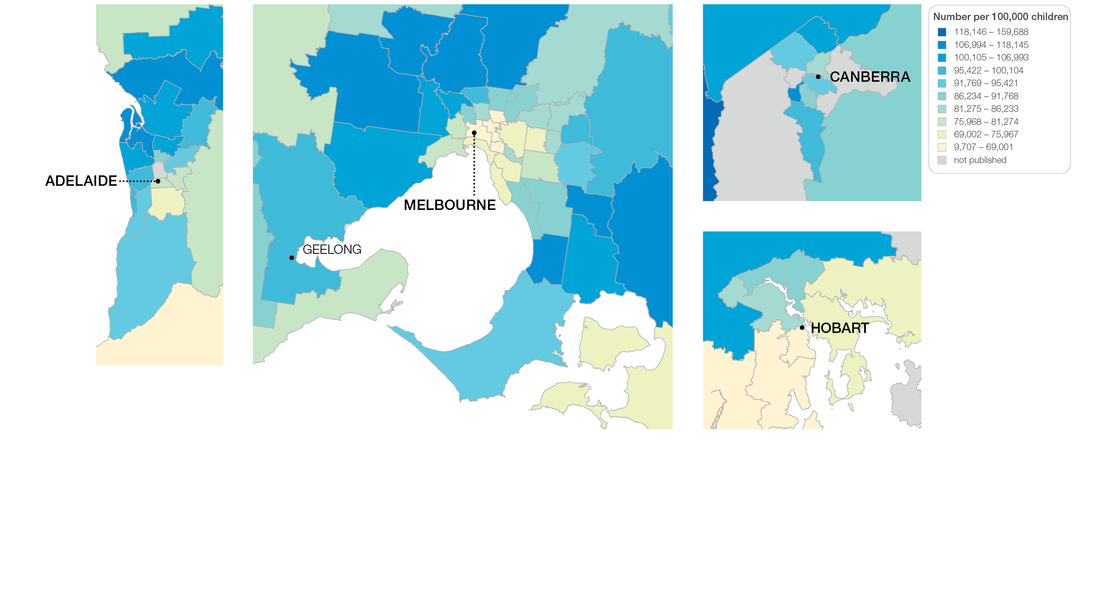
1.2 Antibiotics dispensing in children, 9 years and under
Sources: PBS data 2016-17, and ABS Estimated Resident Population 30 June 2016
Notes:
Speaker notes:
This slide shows the distribution of rates by Statistical Area Level 3 (SA3) for antibiotics dispensing in children aged 9 years and under by capital city area. Rates are based on the patient’s usual place of residence, not the location of the healthcare provider.

Slide 22
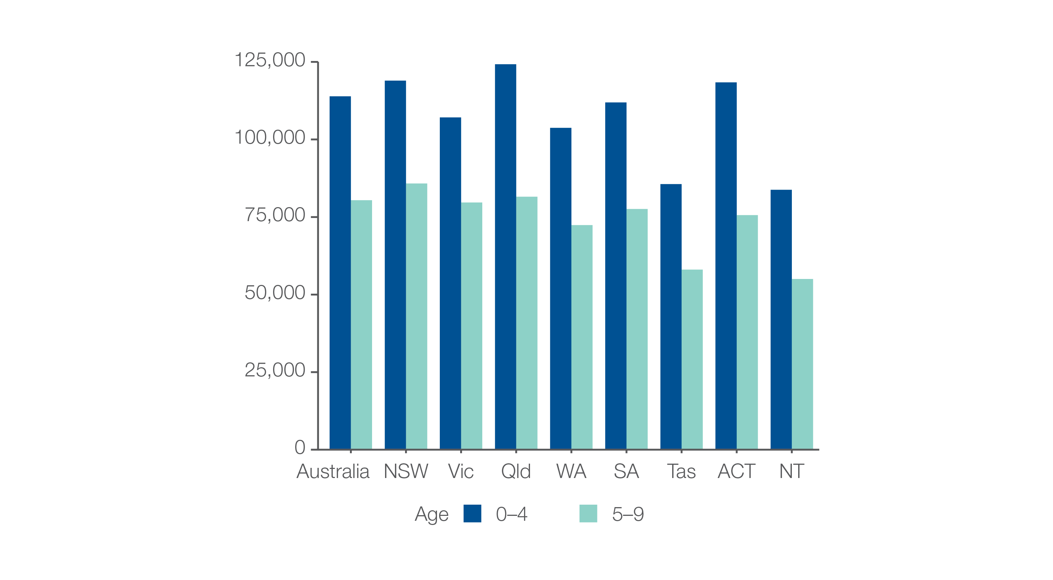
1.2 Antibiotics dispensing in children, 9 years and under
Analysis by age group
Number per 100,000 children
Sources: PBS data 2016-17, and ABS Estimated Resident Population 30 June 2016
Notes:
Speaker notes:
The rate of antibiotic dispensing was higher for children aged 4 years and under (113,906 prescriptions per 100,000 children) than for children aged 5–9 years (80,417 prescriptions per 100,000 children). This pattern was consistent across all states and territories.

Slide 23
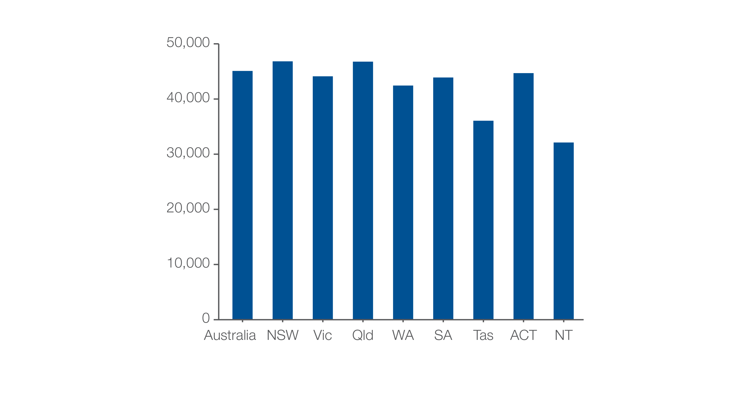
1.2 Antibiotics dispensing in children, 9 years and under
Children dispensed at least one prescription
Number per 100,000 children
Sources: PBS data 2016-17, and ABS Estimated Resident Population 30 June 2016
Notes:
Speaker notes:
The number of children aged 9 years and under who had at least one prescription for an antibiotic dispensed in 2016–17 was 45,085 per 100,000 – that is, 45% of the child population aged 9 years and under.
The rate varied from 32,108 per 100,000 children aged 9 years and under in the Northern Territory to 46,824 per 100,000 in New South Wales

Slide 24
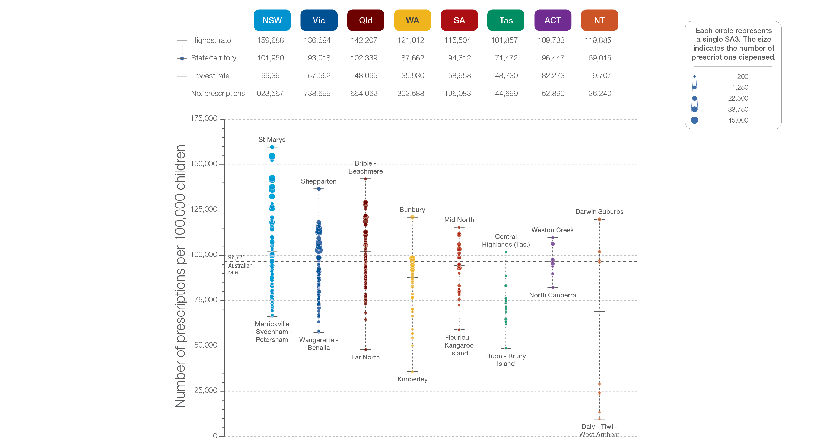
1.2 Antibiotics dispensing in children, 9 years and under
State and territory
Sources: PBS data 2016-17, and ABS Estimated Resident Population 30 June 2016
Notes:
Speaker notes:
The number of prescriptions dispensed varied across states and territories, from 69,015 per 100,000 children aged 9 years and under in the Northern Territory to 102,339 in Queensland.
Each circle on the graph represents an SA3. The size of the circle indicates how many prescriptions have been recorded for children living in that area. The vertical axis shows the standardised rates for the clinical item.
For further information on how to interpret the figures, please refer to the ‘How to interpret’ resource available at: www.safetyandquality.gov.au/atlas/the-third-australian-atlas-of-healthcare-variation-2018/how-to-interpret-the-data/

Slide 25
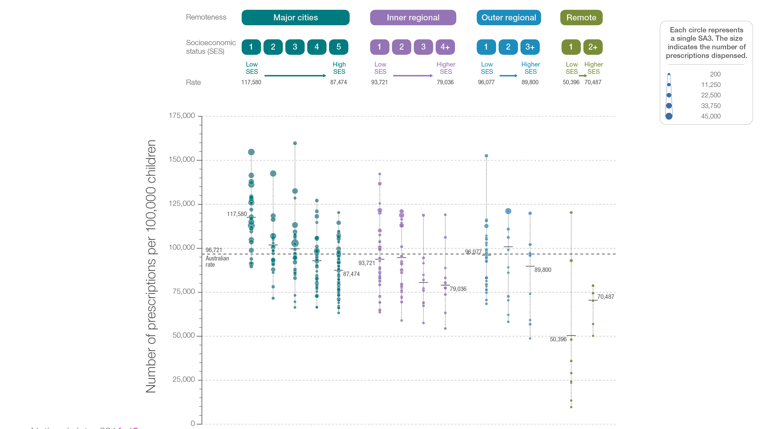
1.2 Antibiotics dispensing in children, 9 years and under
Remoteness and socioeconomic status
Sources: PBS data 2016-17, and ABS Estimated Resident Population 30 June 2016
Notes:
Speaker notes:
Rates of antibiotic dispensing in children aged 9 years and under were higher in major cities than in other areas. Rates were higher in areas with lower socioeconomic status in major cities and inner regional areas. However, there was no clear pattern according to socioeconomic status in other remoteness categories.
Low rates of antibiotic dispensing in some remote, low‑socioeconomic‑status areas may be underestimates because dispensing through Aboriginal health services is not captured in the data.
Each circle on the graph represents an SA3. The size of the circle indicates how many clinical events have been recorded for people living in that area. The vertical axis shows the standardised rates for the clinical item.
For further information on how to interpret the figures, please refer to the ‘How to interpret’ resource available at: www.safetyandquality.gov.au/atlas/the-third-australian-atlas-of-healthcare-variation-2018/how-to-interpret-the-data/

Slide 26
1.3 Proton pump inhibitor medicines dispensing, 1 year and under
Rates by state and territory and prescriber type
Number of prescriptions dispensed per 100,000 infants
Unshaded data (Tas other health professionals) are based on a small number of prescriptions dispensed.
Sources: PBS data 2016-17, and ABS Estimated Resident Population 30 June 2016
Notes:
Speaker notes:
In 2016–17, there were 22,810 PBS prescriptions dispensed for PPI medicines to infants aged 1 year and under, representing 3,628 prescriptions per 100,000 infants aged 1 year and under (the Australian rate).
The number of PBS prescriptions dispensed for PPI medicines varied across states and territories, from 2,195 per 100,000 infants in the Northern Territory to 8,066 per 100,000 in South Australia
GPs prescribed 66% of the PBS prescriptions dispensed for PPI medicines in infants, paediatricians prescribed 27%, and other health professionals prescribed 7%. The proportion prescribed by GPs varied across states and territories from 30% in the Northern Territory to 80% in Western Australia.

Slide 27
Gastrointestinal investigations and treatments
Notes:
Speaker notes:
This chapter examines:
- Colonoscopy hospitalisations, all ages
- Gastroscopy hospitalisations, all ages
- Proton pump inhibitor medicines dispensing,18 years and older

Slide 28
Gastrointestinal investigations and treatments
Key findings
Data item | Range across local areas* per 100,000 | Times difference | Times difference excluding top and bottom 10% | Number during 2016–17
2.1 Colonoscopy hospitalisations, all ages | 622–4,607 | 7.4 | 2.2 | 765,411
2.2 Gastroscopy hospitalisations, all ages | 444–3,297 | 7.4 | 2.1 | 505,544
2.3 Proton pump inhibitor medicines dispensing,† 18 years and older | 34,489–172,780 | 5.0 | 1.6 | 21,768,718
* Statistical Area Level 3
† Based on number of PBS prescriptions
Notes:
Speaker notes:
The Atlas found the rate of hospitalisation for inpatient colonoscopy varies up to about seven-fold between local areas across Australia. The rate of hospitalisations for colonoscopy for Aboriginal and Torres Strait Islander Australians was 47% lower than the rate for other Australians.
There were 505,544 hospitalisations for gastroscopy, representing 1,931 hospitalisations per 100,000 people.
The number of prescriptions for PPI medicines dispensed in 2016–17 equates to every person in Australia aged 18 years and over receiving at least one prescription for a PPI medicine annually.

Slide 29
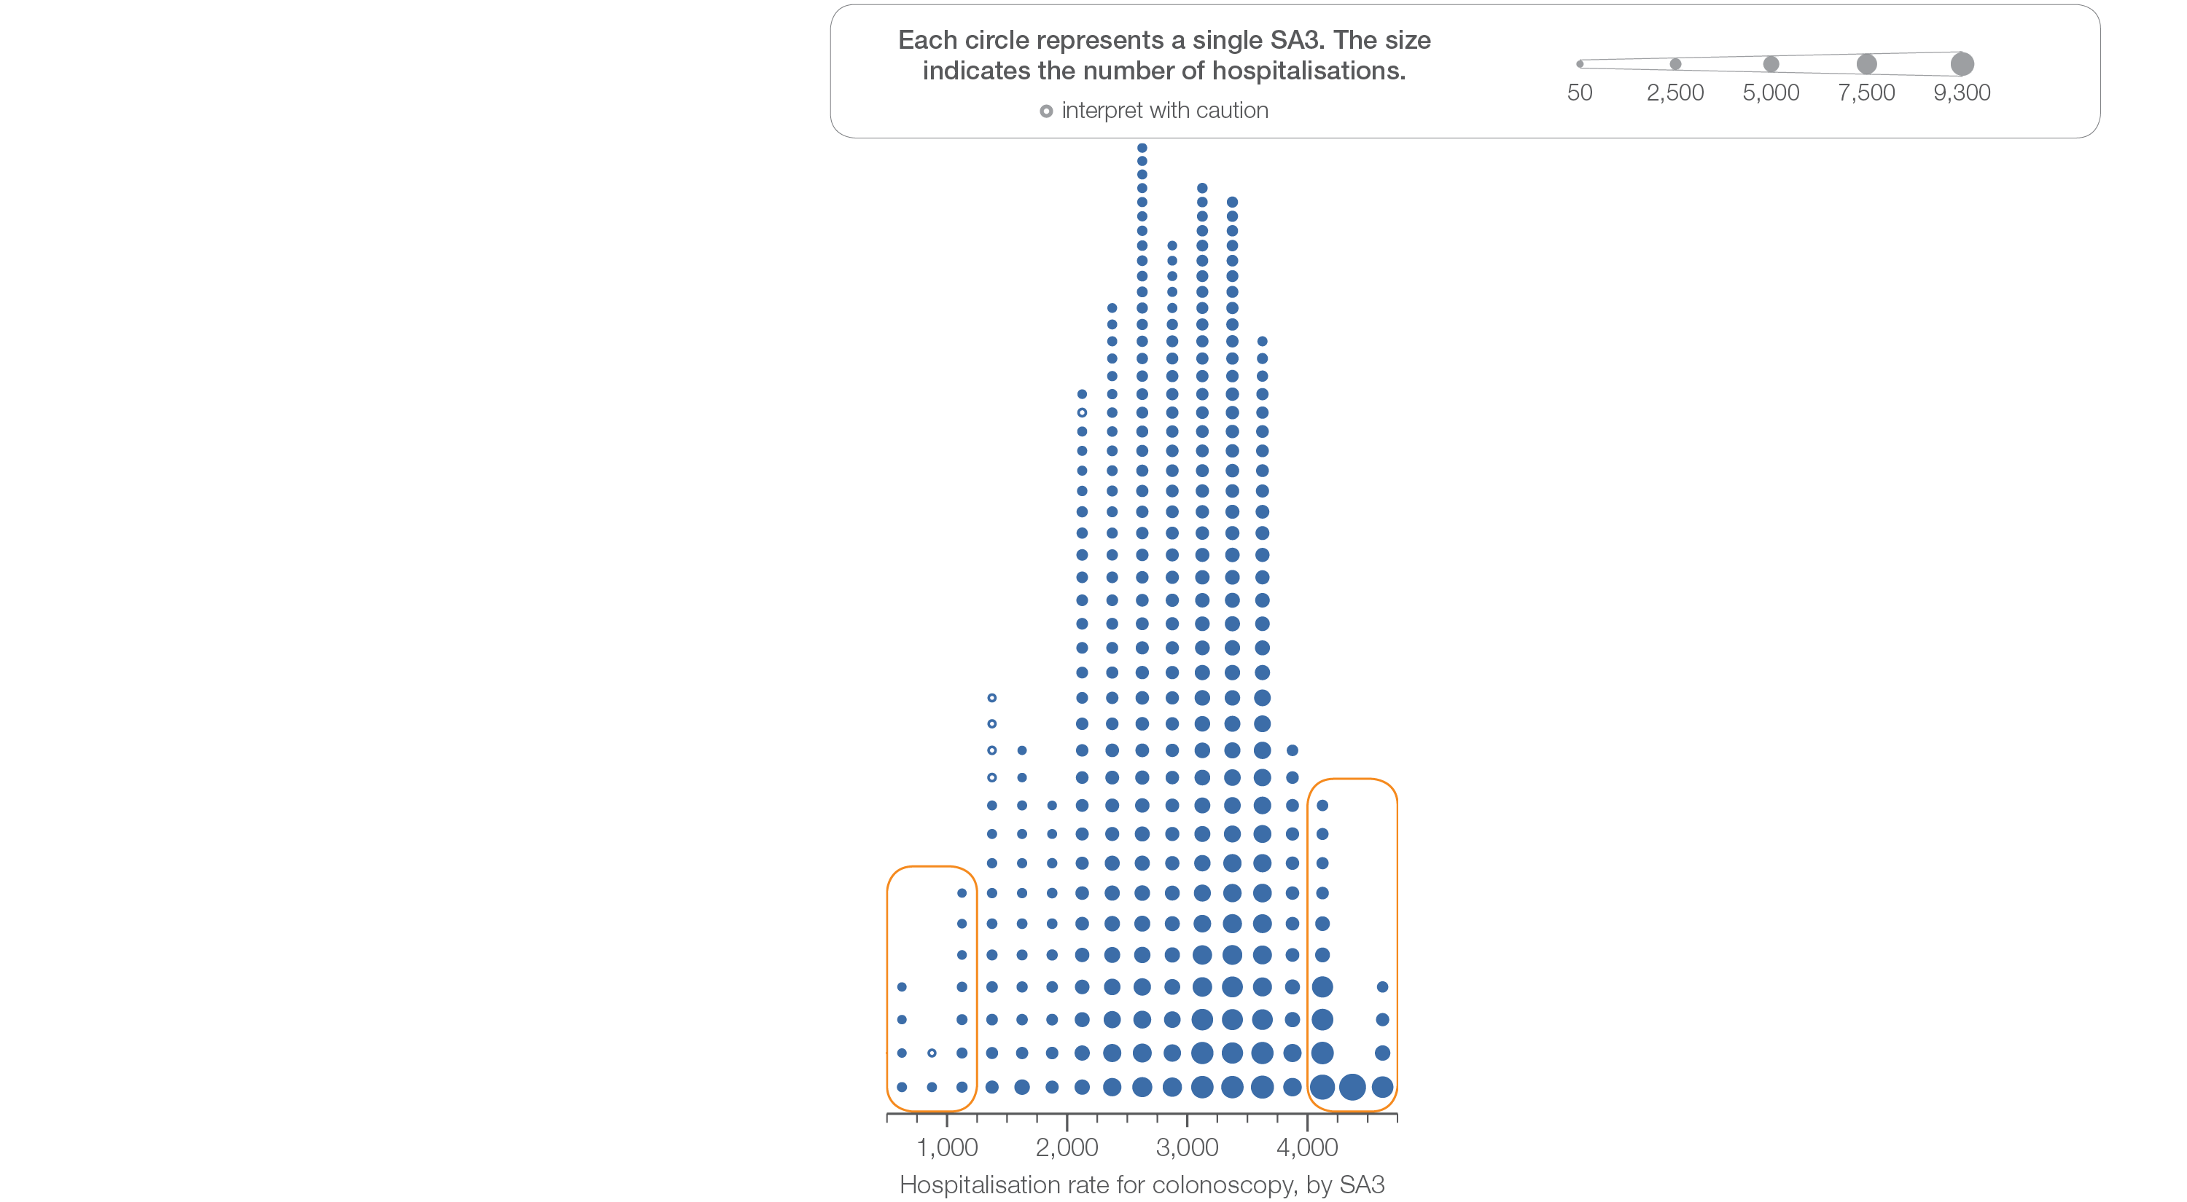
2.1 Colonoscopy hospitalisations, all ages
Sources: NHMD data 2016-17, and ABS Estimated Resident Population 30 June 2016
Notes:
Speaker notes:
This slide shows the distribution of rates by Statistical Area Level 3 (SA3) for colonoscopy hospitalisations, all ages.
Each circle on the graph represents an SA3. The size of the circle indicates how many hospitalisations have been recorded for people living in that area. The horizontal axis shows the standardised rates for the clinical item.
For further information on how to interpret the figures, please refer to the ‘How to interpret’ resource available at: www.safetyandquality.gov.au/atlas/the-third-australian-atlas-of-healthcare-variation-2018/how-to-interpret-the-data/

Slide 30
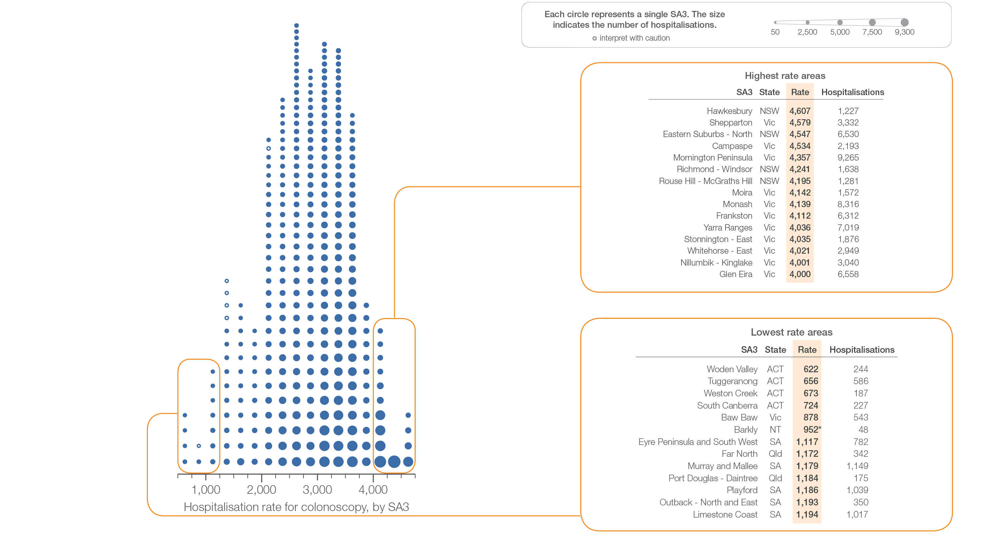
2.1 Colonoscopy hospitalisations, all ages
Sources: NHMD data 2016-17, and ABS Estimated Resident Population 30 June 2016
Notes:
Speaker notes:
This slide shows the distribution of rates by Statistical Area Level 3 (SA3) for colonoscopy hospitalisations, all ages.
Each circle on the graph represents an SA3. The size of the circle indicates how many hospitalisations have been recorded for people living in that area. The horizontal axis shows the standardised rates for the clinical item.
For further information on how to interpret the figures, please refer to the ‘How to interpret’ resource available at: www.safetyandquality.gov.au/atlas/the-third-australian-atlas-of-healthcare-variation-2018/how-to-interpret-the-data/

Slide 31
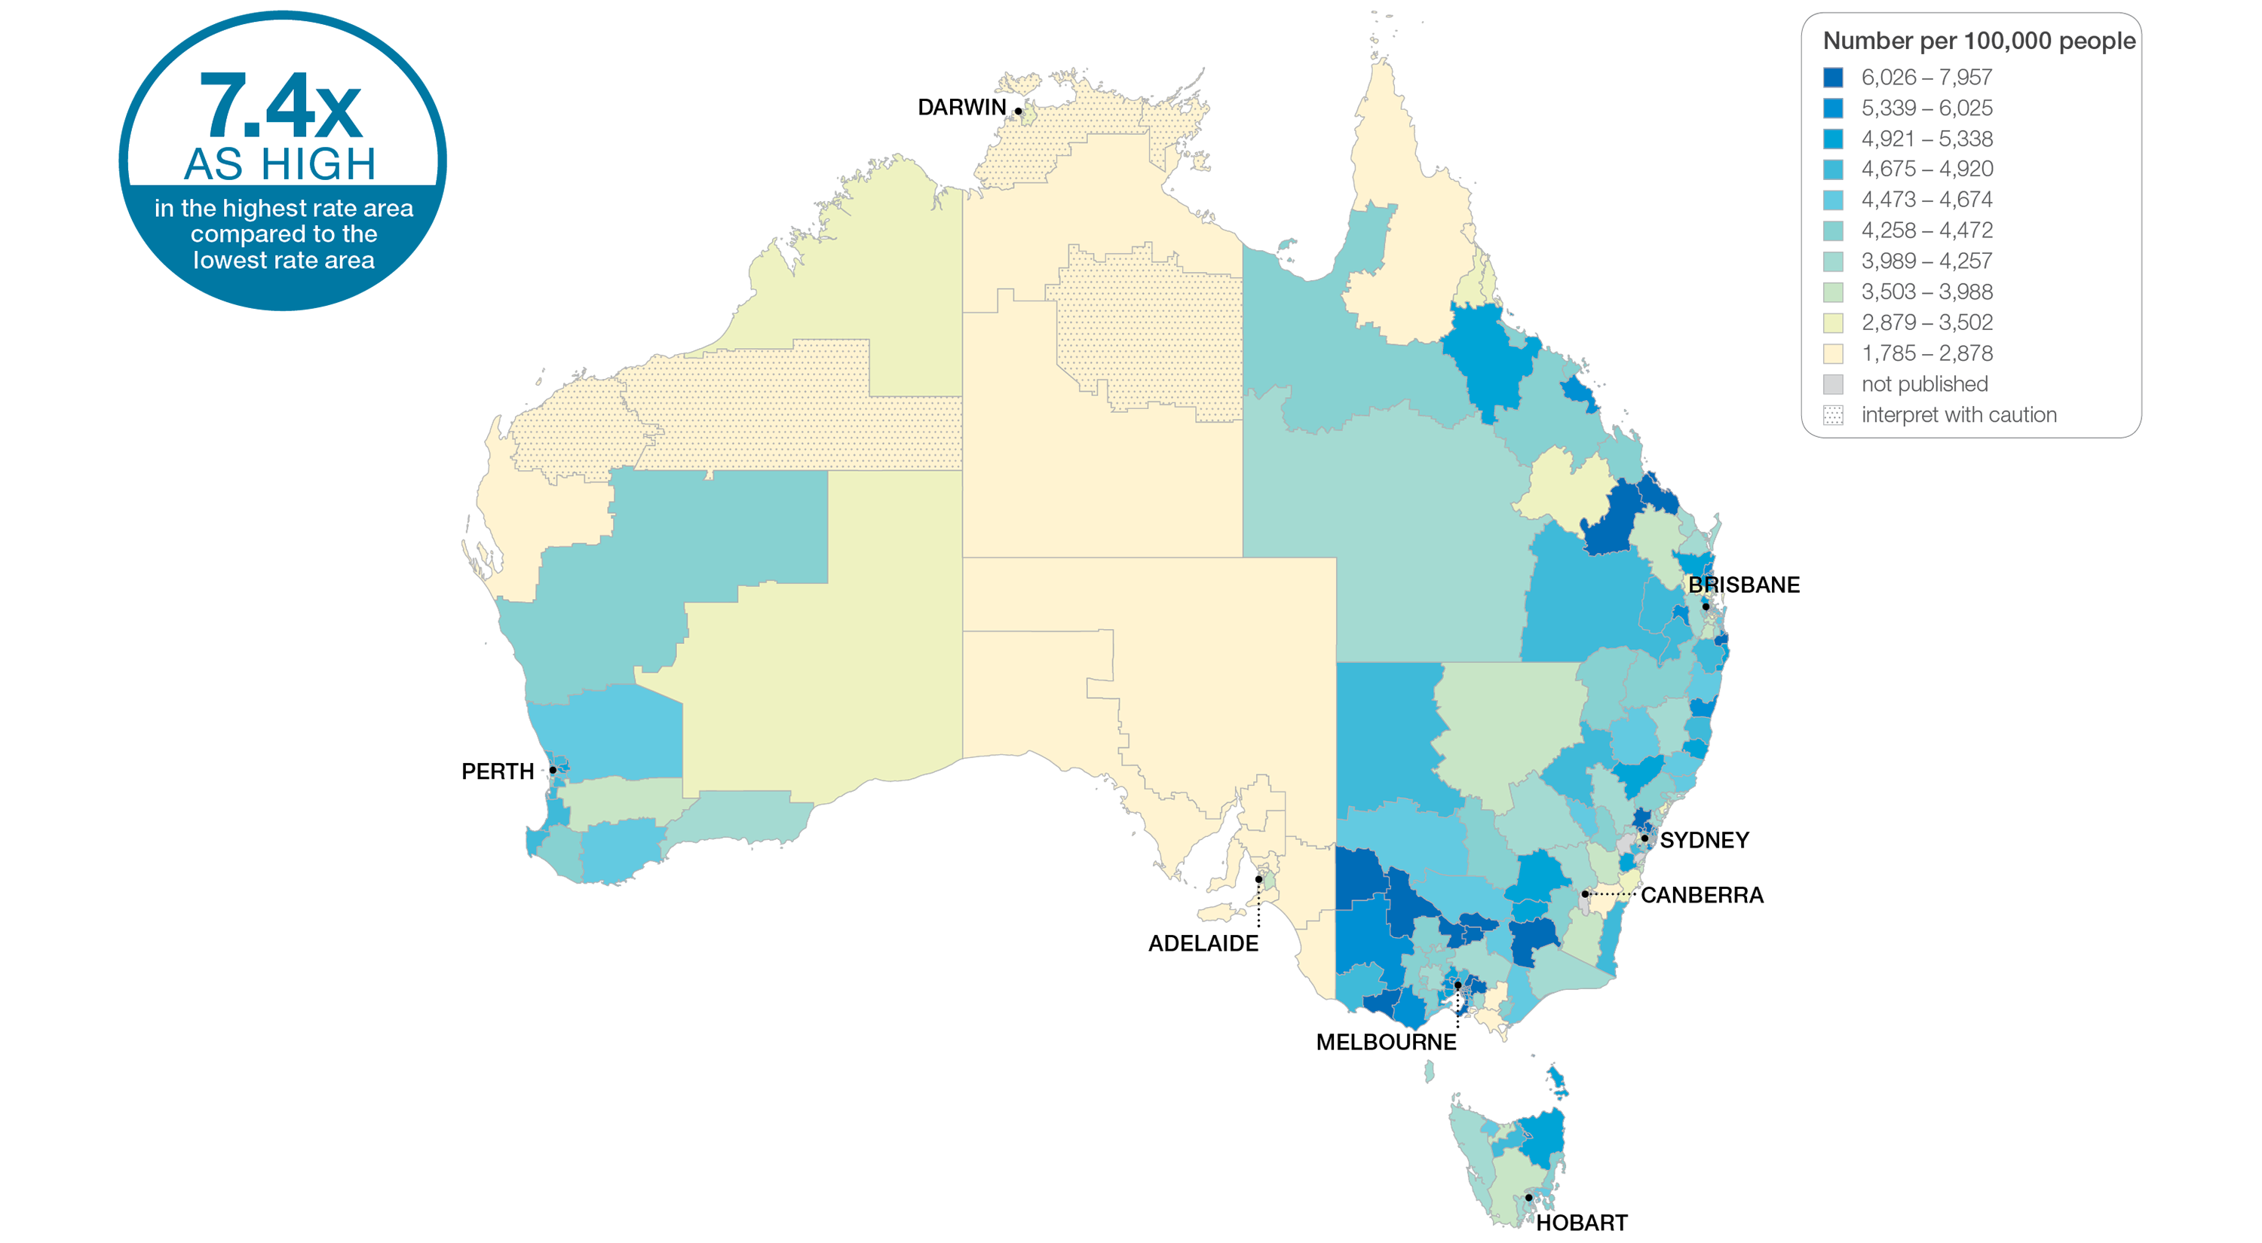
2.1 Colonoscopy hospitalisations, all ages
Sources: NHMD data 2016-17, and ABS Estimated Resident Population 30 June 2016
Notes:
Speaker notes:
This slide shows the distribution of rates by Statistical Area Level 3 (SA3) for colonoscopy hospitalisations. Rates are based on the patient’s usual place of residence, not the location of the healthcare provider.
In 2016–17, there were 765,411 hospitalisations for colonoscopy, representing 2,881 hospitalisations per 100,000 people of all ages (the Australian rate).
The number of hospitalisations for colonoscopy across 330 local areas (Statistical Area Level 3 – SA3) ranged from 622 to 4,607 per 100,000 people of all ages.
The rate was 7.4 times as high in the area with the highest rate compared to the area with the lowest rate.
The number of hospitalisations varied across states and territories, from 1,144 per 100,000 people of all ages in the Australian Capital Territory to 3,371 in Victoria.
The range of rates represented by each colour are shown in the legend for the map. The darker blue colour represents SA3s with higher rates. The lighter colours represent SA3s with lower rates. Dotted areas indicate rates that are considered more volatile than other published rates and should be interpreted with caution. These rates are excluded from the calculation of the difference between the highest and lowest SA3 rates in Australia.
Data from a number of ACT private hospitals, which undertake some colonoscopies, were not provided to the National Hospital Morbidity Database. For this reason, data for the ACT should be interpreted with caution.
For further detail about the methods used, please refer to the Technical Supplement.
For further information on how to interpret the figures, please refer to the ‘How to interpret’ resource available at: www.safetyandquality.gov.au/atlas/the-third-australian-atlas-of-healthcare-variation-2018/how-to-interpret-the-data/

Slide 32
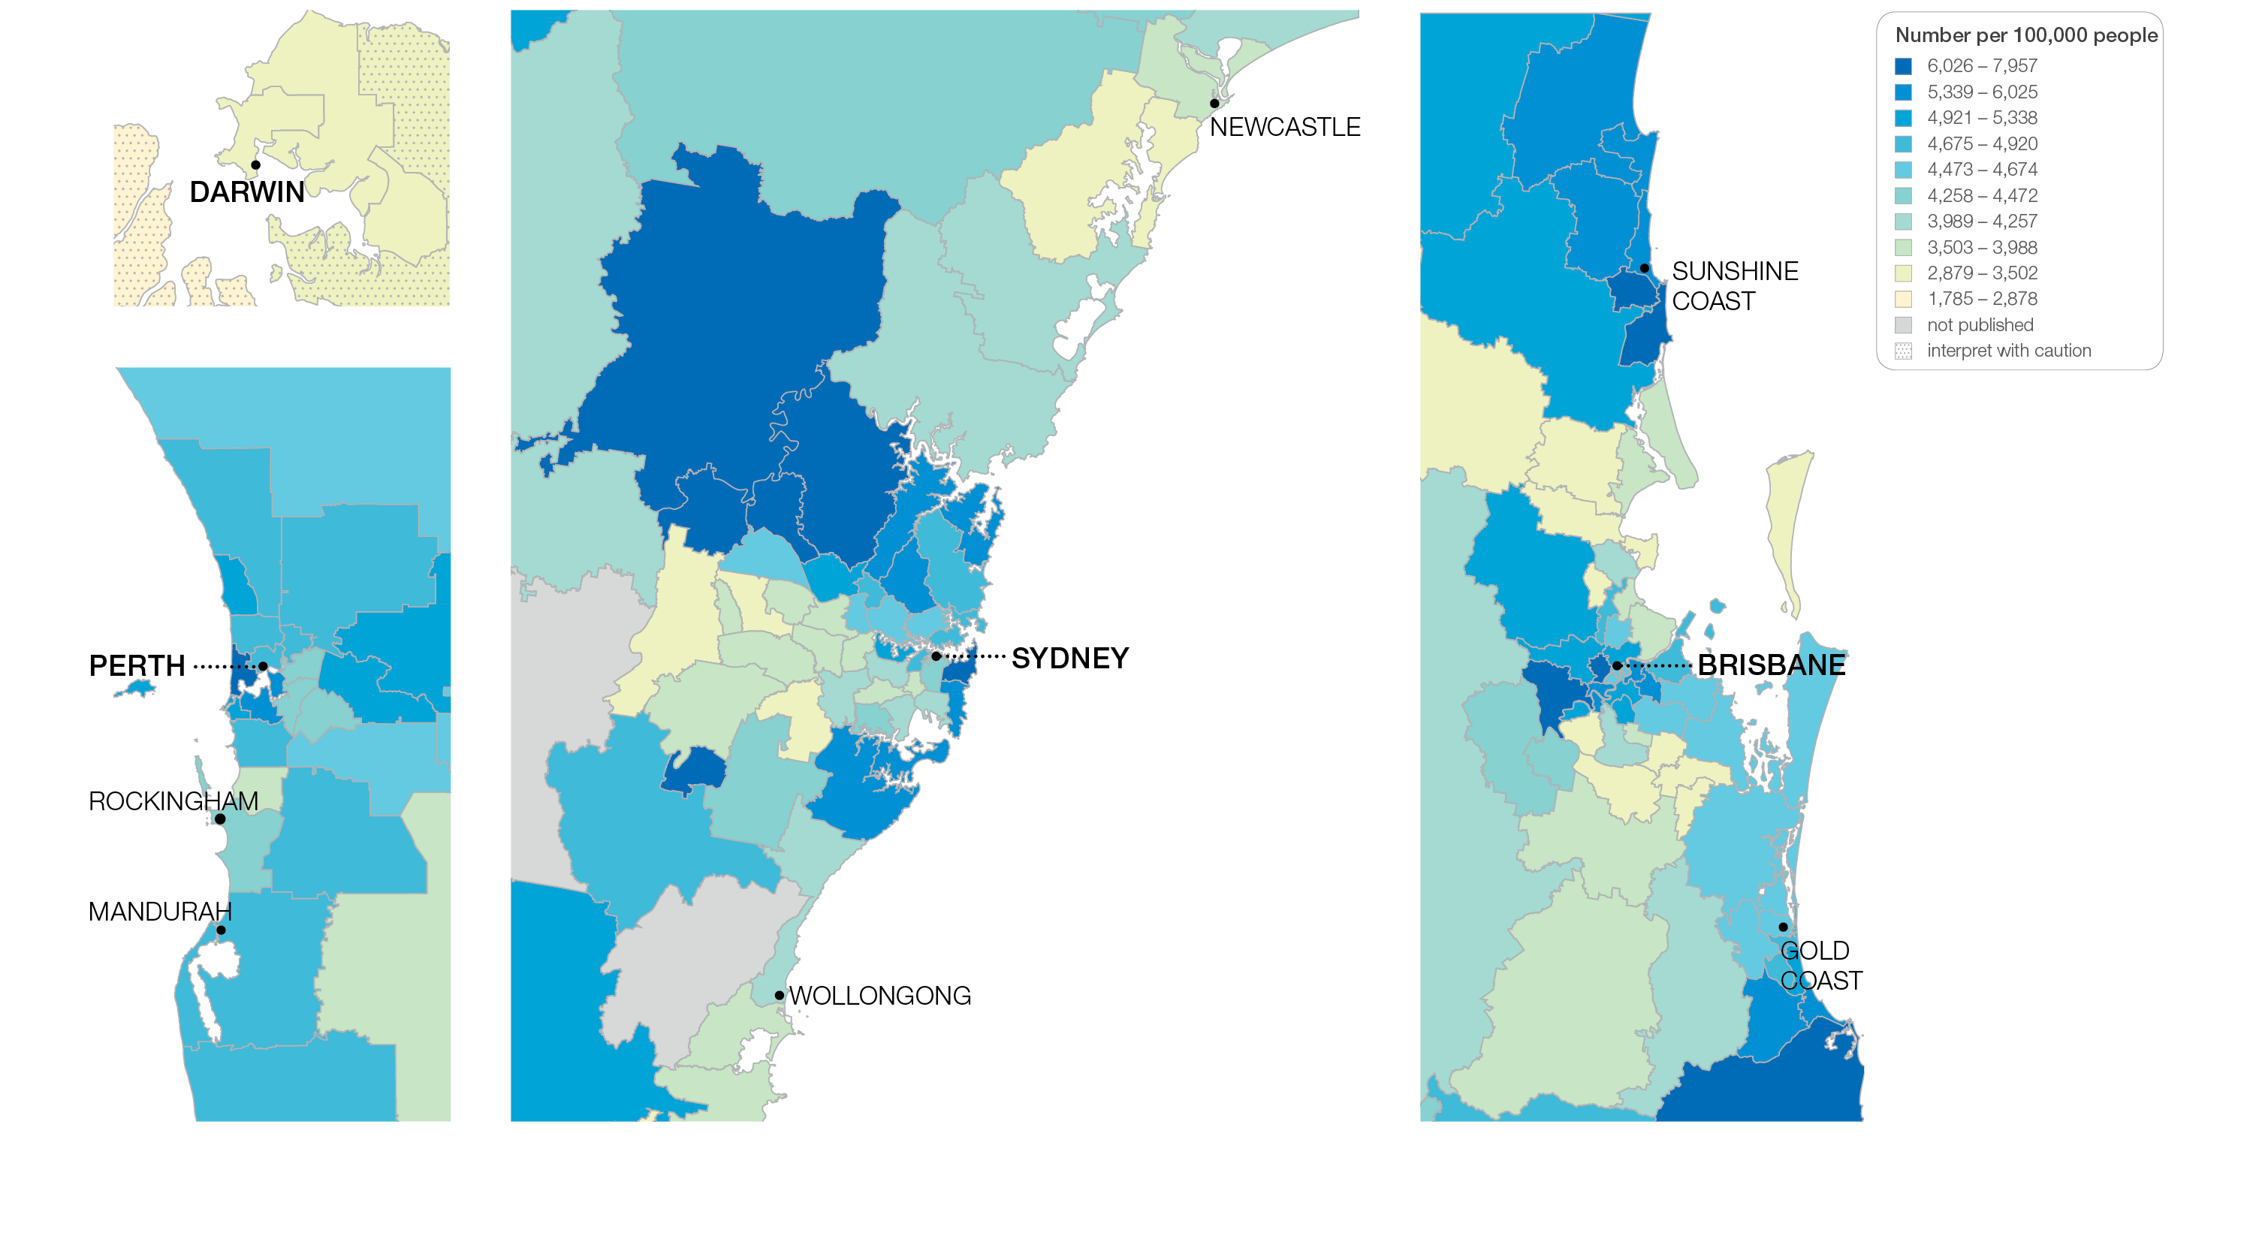
2.1 Colonoscopy hospitalisations, all ages
Sources: NHMD data 2016-17, and ABS Estimated Resident Population 30 June 2016
Notes:
Speaker notes:
This slide shows the distribution of rates by Statistical Area Level 3 (SA3) for colonoscopy hospitalisations by capital city area. Rates are based on the patient’s usual place of residence, not the location of the healthcare provider.

Slide 33
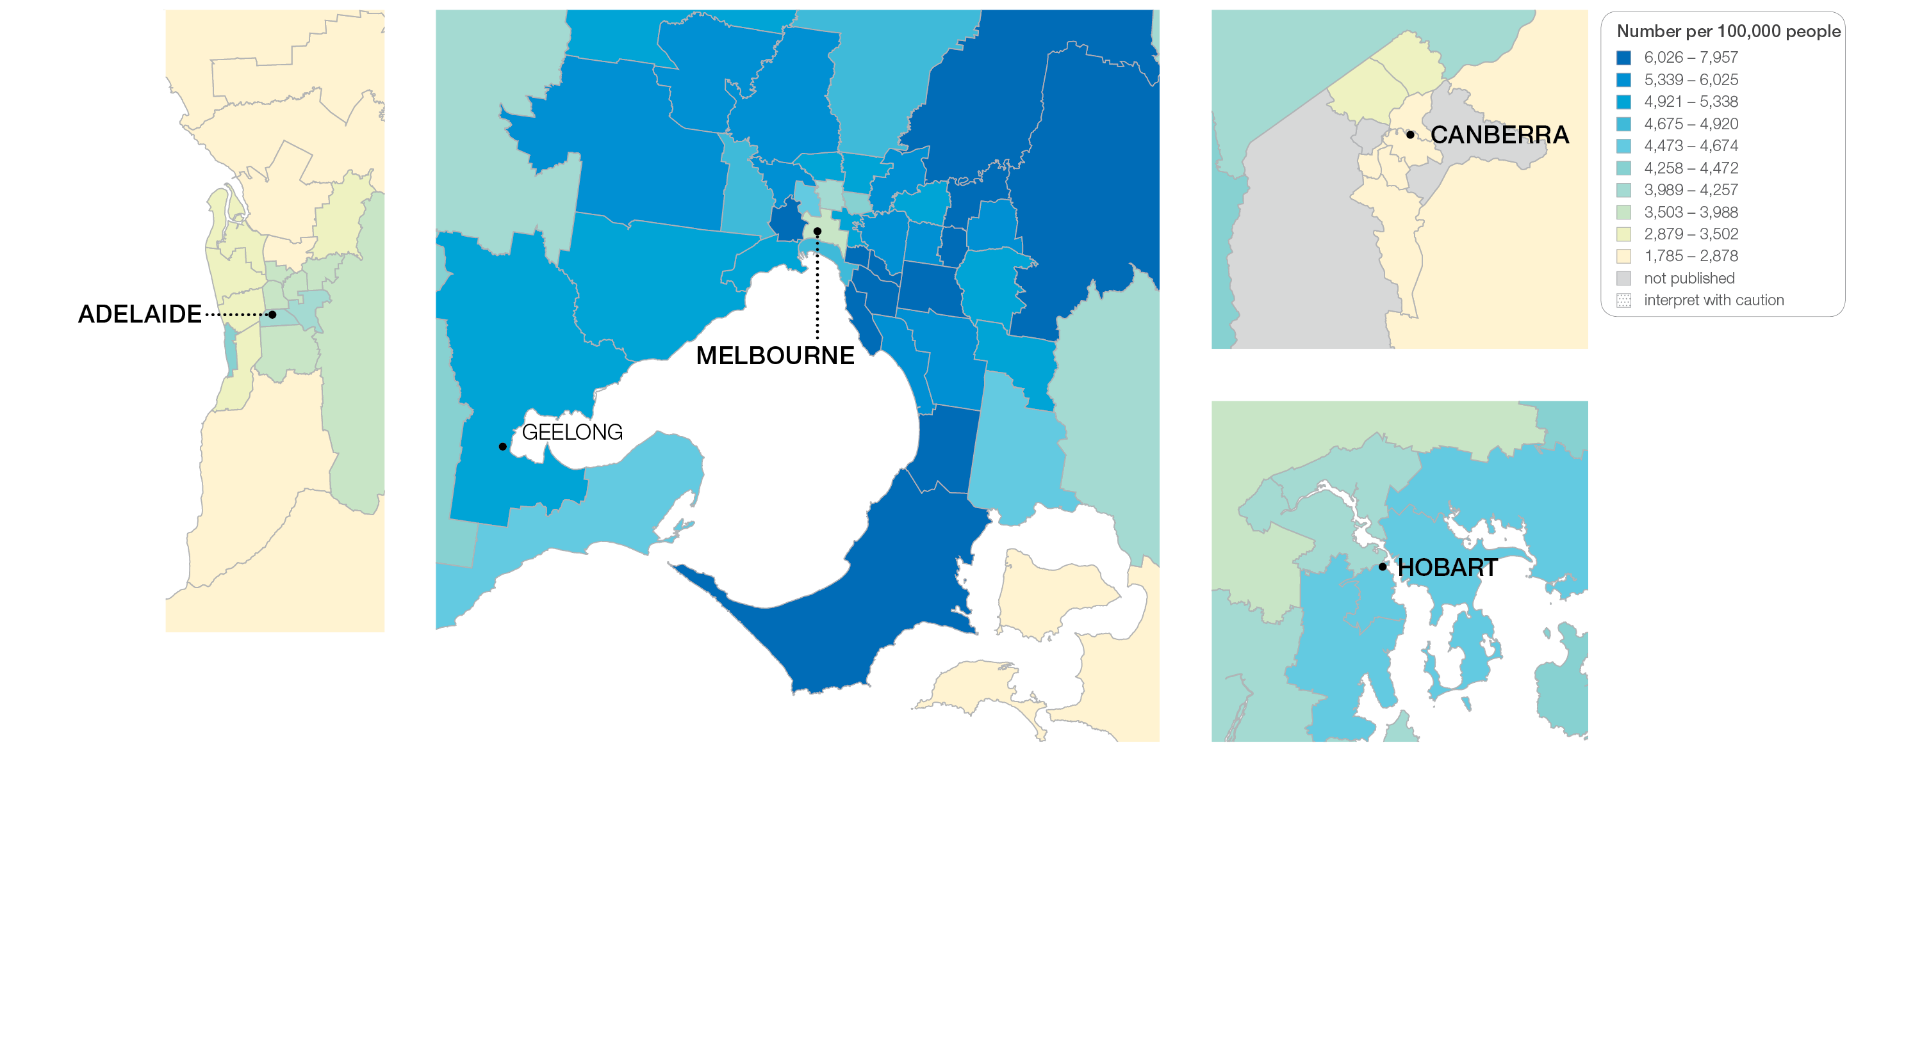
2.1 Colonoscopy hospitalisations, all ages
Sources: NHMD data 2016-17, and ABS Estimated Resident Population 30 June 2016
Notes:
Speaker notes:
This slide shows the distribution of rates by Statistical Area Level 3 (SA3) for colonoscopy hospitalisations by capital city area. Rates are based on the patient’s usual place of residence, not the location of the healthcare provider.

Slide 34
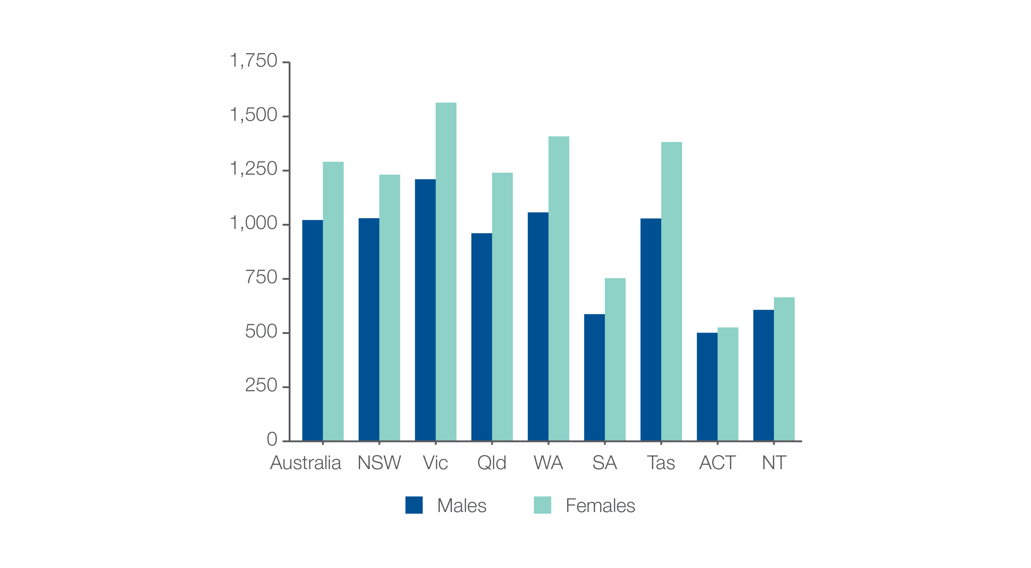
2.1 Colonoscopy hospitalisations, all ages
Analysis by sex, age 49 years and under
Number per 100,000 people
Sources: NHMD data 2016-17, and ABS Estimated Resident Population 30 June 2016
Notes:
Speaker notes:
The age-standardised rate of hospitalisations for colonoscopy among people aged 49 years and under was 1,022 per 100,000 for males and 1,291 per 100,000 for females.

Slide 35
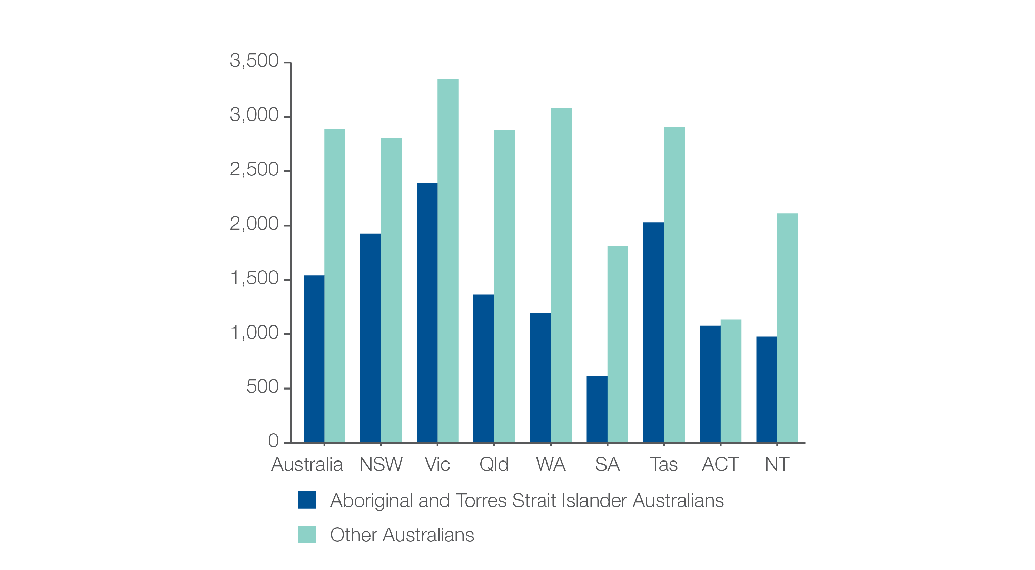
2.1 Colonoscopy hospitalisations, all ages
Aboriginal and Torres Strait Islander status
Number per 100,000 people
Sources: NHMD data 2016-17, and ABS Estimated Resident Population 30 June 2016
Notes:
Speaker notes:
The rate for Aboriginal and Torres Strait Islander Australians (1,542 per 100,000 people) was 47% lower than the rate for other Australians (2,884 per 100,000 people).

Slide 36
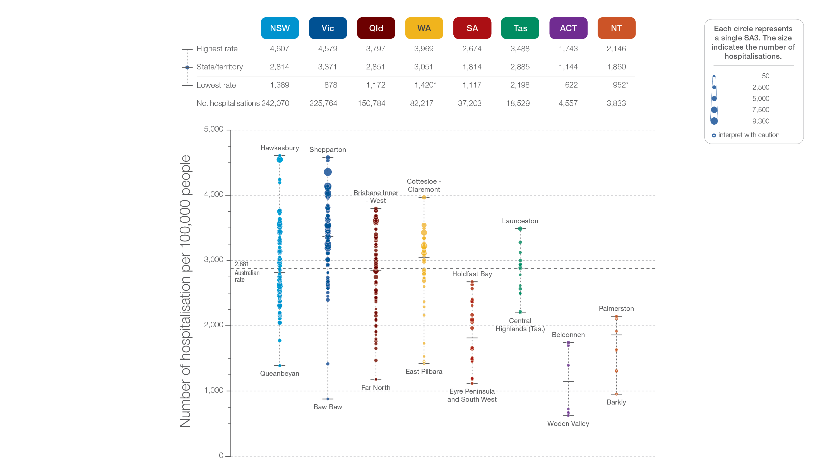
2.1 Colonoscopy hospitalisations, all ages
State and territory
Sources: NHMD data 2016-17, and ABS Estimated Resident Population 30 June 2016
Notes:
Speaker notes:
The number of hospitalisations varied across states and territories, from 1,144 per 100,000 people of all ages in the Australian Capital Territory to 3,371 in Victoria.
Each circle on the graph represents an SA3. The size of the circle indicates how many hospitalisations have been recorded for people living in that area. The vertical axis shows the standardised rates for the clinical item.
Hollow circles and asterisks indicate rates that are considered more volatile than other published rates and should be interpreted with caution. Data from a number of ACT private hospitals, which undertake some colonoscopies, were not provided to the National Hospital Morbidity Database. For this reason, data for the ACT should be interpreted with caution.
For further detail about the methods used, please refer to the Technical Supplement.
For further information on how to interpret the figures, please refer to the ‘How to interpret’ resource available at: www.safetyandquality.gov.au/atlas/the-third-australian-atlas-of-healthcare-variation-2018/how-to-interpret-the-data/

Slide 37
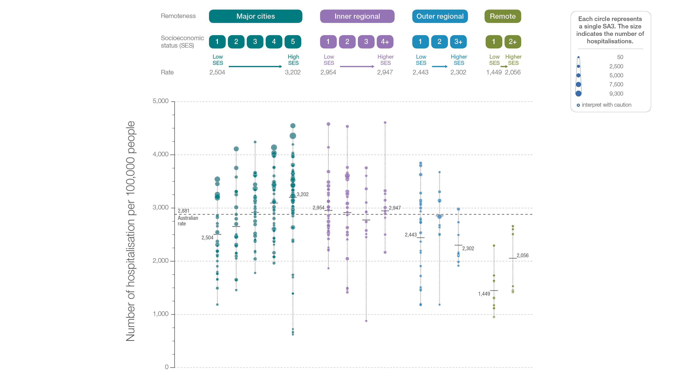
2.1 Colonoscopy hospitalisations, all ages
Remoteness and socioeconomic status
Sources: NHMD data 2016-17, and ABS Estimated Resident Population 30 June 2016
Notes:
Speaker notes:
Rates for hospitalisation for colonoscopy were higher in major cities and inner regional areas than in outer regional and remote areas. Rates were lower in areas with lower socioeconomic status in major cities and remote areas. However, there was no clear pattern according to socioeconomic status in other remoteness categories.
Each circle on the graph represents an SA3. The size of the circle indicates how many clinical events have been recorded for people living in that area. The vertical axis shows the standardised rates for the clinical item.
Hollow circles indicate rates that are considered more volatile than other published rates and should be interpreted with caution. For further detail about the methods used, please refer to the Technical Supplement.
For further information on how to interpret the figures, please refer to the ‘How to interpret’ resource available at: www.safetyandquality.gov.au/atlas/the-third-australian-atlas-of-healthcare-variation-2018/how-to-interpret-the-data/

Slide 38
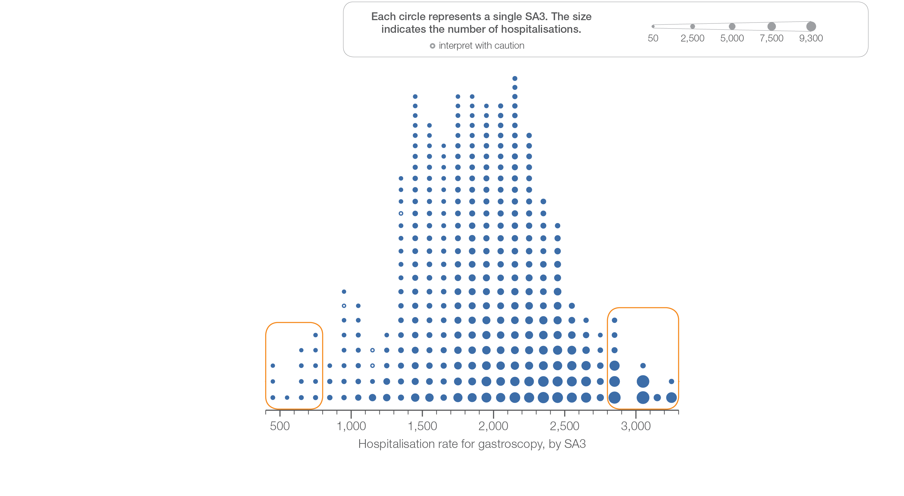
2.2 Gastroscopy hospitalisations, all ages
Sources: NHMD data 2016-17, and ABS Estimated Resident Population 30 June 2016
Notes:
Speaker notes:
This slide shows the distribution of rates by Statistical Area Level 3 (SA3) for antibiotics dispensing in children aged 9 years and under.
Each circle on the graph represents an SA3. The size of the circle indicates how many prescriptions have been dispensed for children living in that area. The horizontal axis shows the standardised rates for the clinical item.
For further information on how to interpret the figures, please refer to the ‘How to interpret’ resource available at: www.safetyandquality.gov.au/atlas/the-third-australian-atlas-of-healthcare-variation-2018/how-to-interpret-the-data/

Slide 39
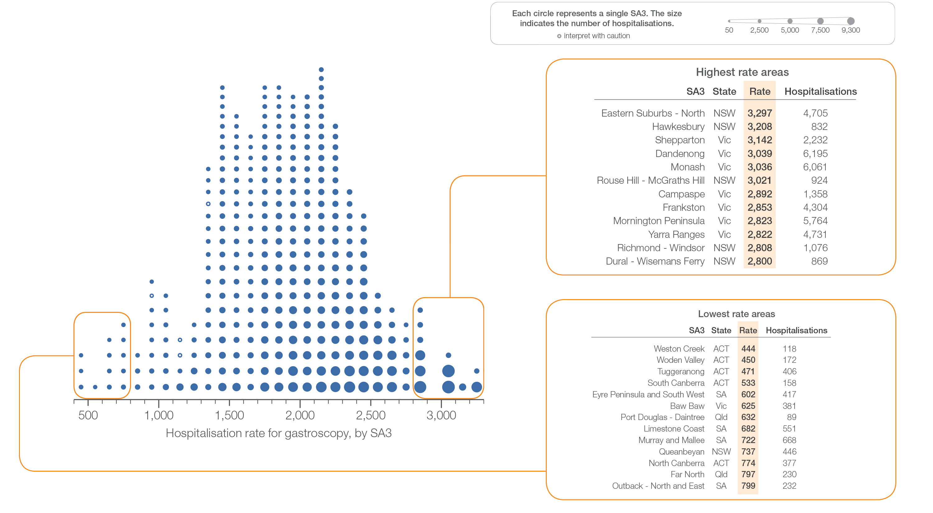
2.2 Gastroscopy hospitalisations, all ages
Sources: NHMD data 2016-17, and ABS Estimated Resident Population 30 June 2016
Notes:
Speaker notes:
This slide shows the distribution of rates by Statistical Area Level 3 (SA3) for antibiotics dispensing in children aged 9 years and under.
Each circle on the graph represents an SA3. The size of the circle indicates how many prescriptions have been dispensed for children living in that area. The horizontal axis shows the standardised rates for the clinical item.
For further information on how to interpret the figures, please refer to the ‘How to interpret’ resource available at: www.safetyandquality.gov.au/atlas/the-third-australian-atlas-of-healthcare-variation-2018/how-to-interpret-the-data/

Slide 40
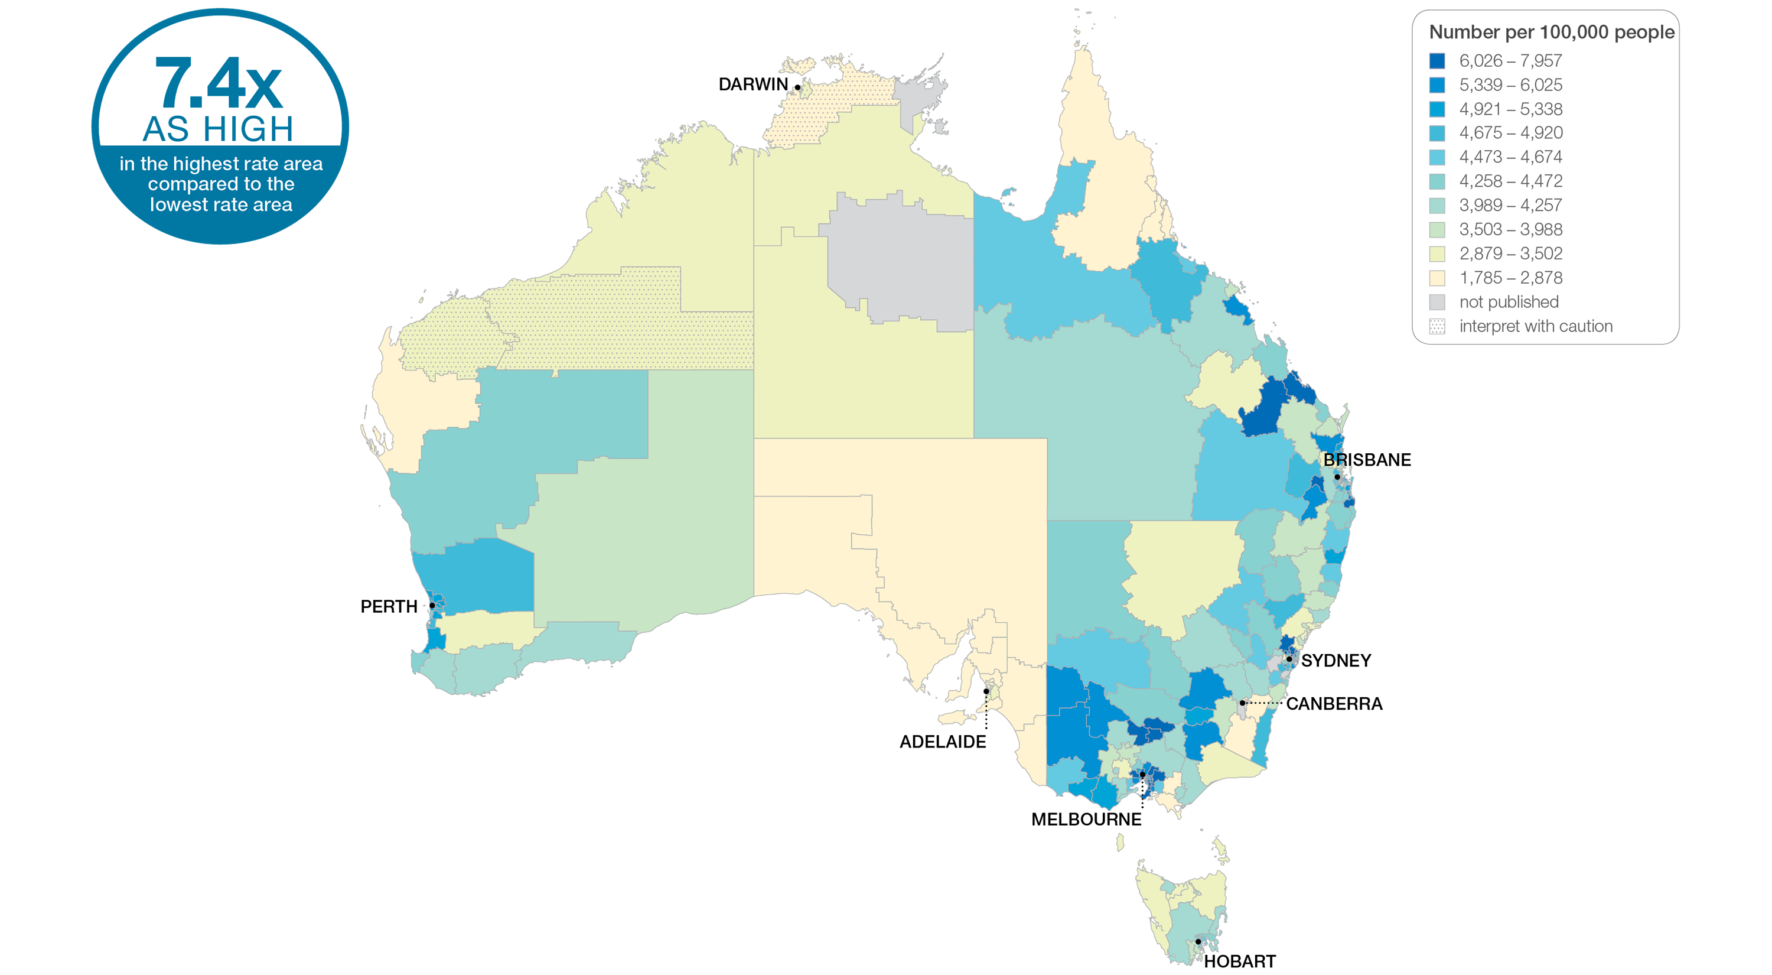
2.2 Gastroscopy hospitalisations, all ages
Sources: NHMD data 2016-17, and ABS Estimated Resident Population 30 June 2016
Notes:
Speaker notes:
This slide shows the distribution of rates by Statistical Area Level 3 (SA3) for gastroscopy hospitalisations. Rates are based on the patient’s usual place of residence, not the location of the healthcare provider.
In 2016–17, there were 505,544 hospitalisations for gastroscopy, representing 1,931 hospitalisations per 100,000 people of all ages (the Australian rate).
The number of hospitalisations for gastroscopy across 328* local areas (Statistical Area Level 3 – SA3) ranged from 444 to 3,297 per 100,000 people of all ages.
The rate was 7.4 times as high in the area with the highest rate compared to the area with the lowest rate.
The number of hospitalisations varied across states and territories, from 701 per 100,000 people of all ages in the Australian Capital Territory to 2,259 in Victoria.
The range of rates represented by each colour are shown in the legend for the map. The darker blue colour represents SA3s with higher rates. The lighter colours represent SA3s with lower rates.
Dotted areas indicate rates that are considered more volatile than other published rates and should be interpreted with caution. These rates are excluded from the calculation of the difference between the highest and lowest SA3 rates in Australia. Data from a number of ACT private hospitals, which undertake some gastroscopies, were not provided to the National Hospital Morbidity Database. For this reason, data for the ACT should be interpreted with caution.
For further detail about the methods used, please refer to the Technical Supplement.
For further information on how to interpret the figures, please refer to the ‘How to interpret’ resource available at: www.safetyandquality.gov.au/atlas/the-third-australian-atlas-of-healthcare-variation-2018/how-to-interpret-the-data/

Slide 41
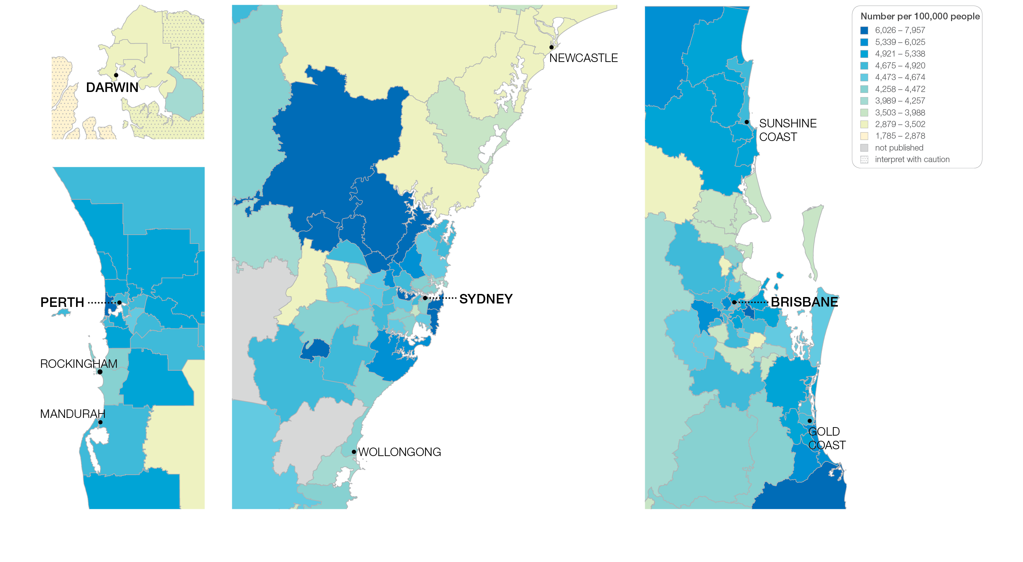
2.2 Gastroscopy hospitalisations, all ages
Sources: NHMD data 2016-17, and ABS Estimated Resident Population 30 June 2016
Notes:
Speaker notes:
This slide shows the distribution of rates by Statistical Area Level 3 (SA3) for gastroscopy hospitalisations by capital city area. Rates are based on the patient’s usual place of residence, not the location of the healthcare provider.

Slide 42
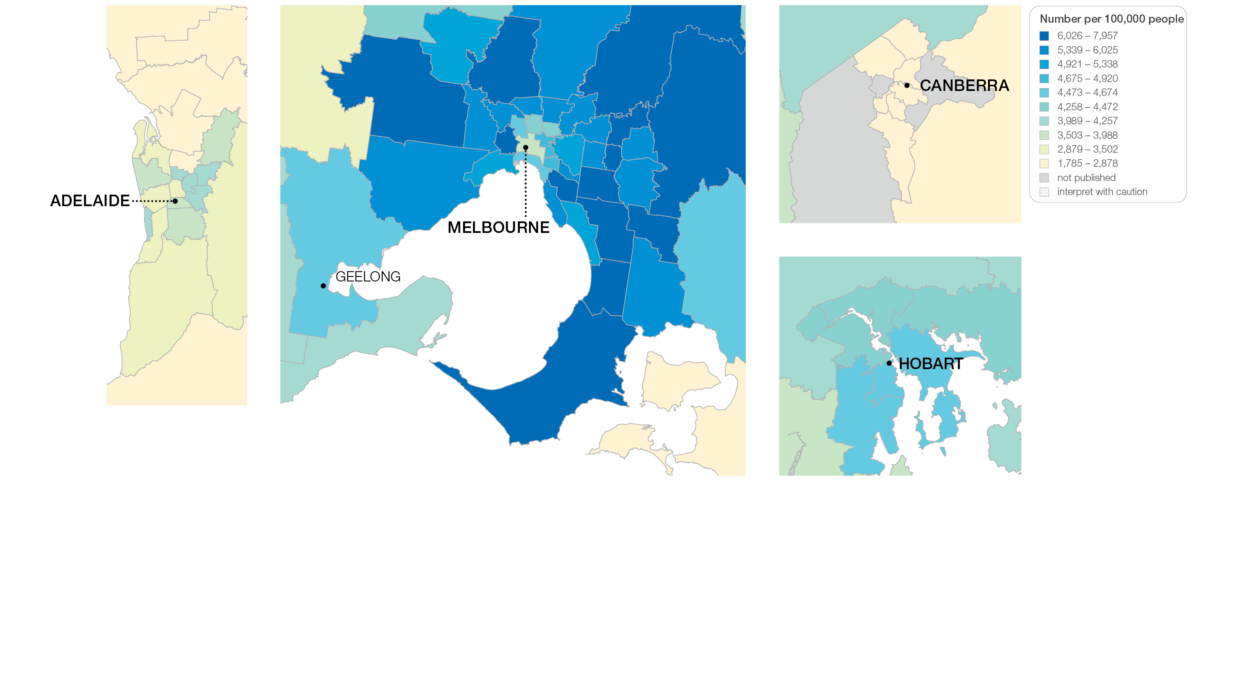
2.2 Gastroscopy hospitalisations, all ages
Sources: NHMD data 2016-17, and ABS Estimated Resident Population 30 June 2016
Notes:
Speaker notes:
This slide shows the distribution of rates by Statistical Area Level 3 (SA3) for gastroscopy hospitalisations by capital city area. Rates are based on the patient’s usual place of residence, not the location of the healthcare provider.

Slide 43
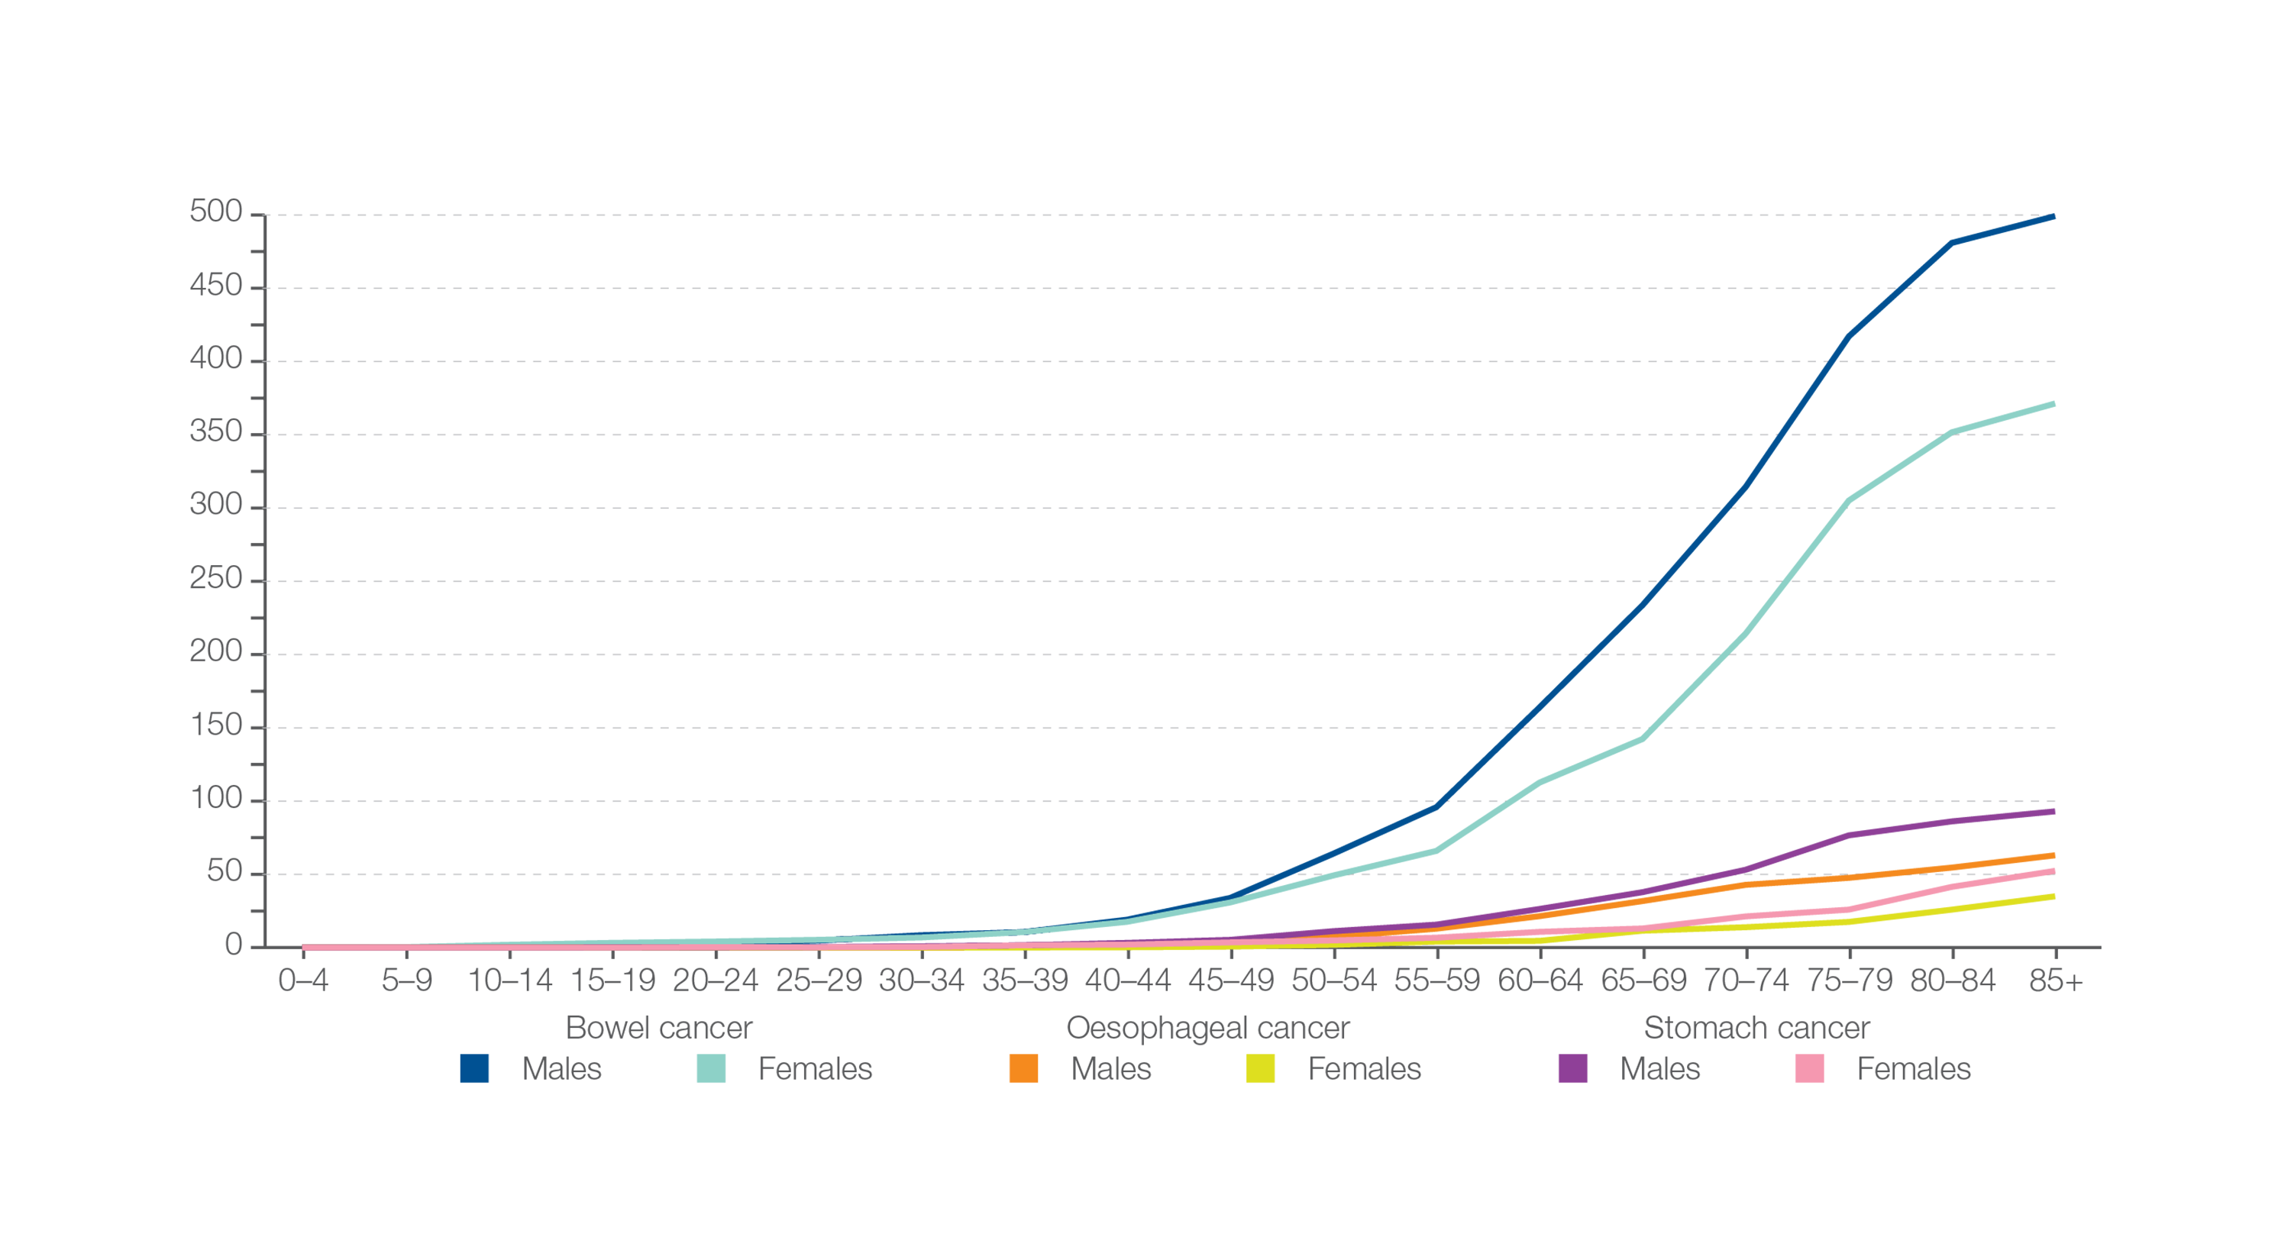
2.2 Gastroscopy hospitalisations, all ages
Incidence of bowel cancer, oesophageal cancer and stomach cancer
Number per 100,000 people, by age group and sex
Sources: Australian Institute of Health and Welfare. Australian Cancer Incidence and Mortality (ACIM) books: colorectal cancer, stomach cancer, oesophageal cancer. Canberra: AIHW; 2017.
Notes:
Speaker notes:
This graph shows the incidence of bowel cancer, oesophageal cancer and stomach cancer per 100,000 people, by age group and sex, in Australia in 2014.
Rates of upper gastrointestinal cancers are rare, particularly before 55 years of age.

Slide 44
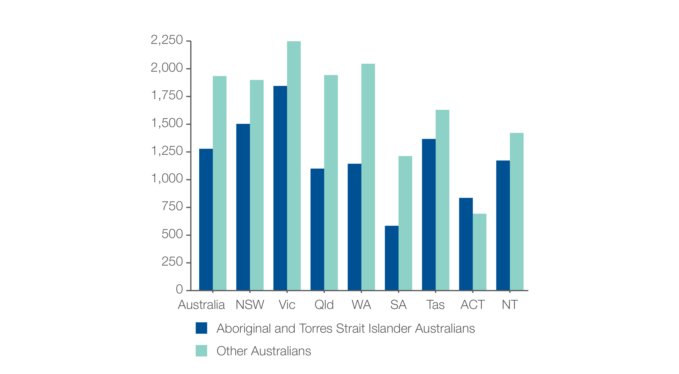
2.2 Gastroscopy hospitalisations, all ages
Aboriginal and Torres Strait Islander status
Number per 100,000 people
Sources: NHMD data 2016-17, and ABS Estimated Resident Population 30 June 2016
Notes:
Speaker notes:
The rate for Aboriginal and Torres Strait Islander Australians (1,279 per 100,000 people) was 34% lower than the rate for other Australians (1,934 per 100,000 people).
The identification of Aboriginal and Torres Strait Islander patients may not be accurate for all admissions, and processes for seeking and recording identification may vary among states and territories. Therefore, the data shown may under-count the number of Aboriginal and Torres Strait Islander Australians hospitalised for gastroscopy.

Slide 45
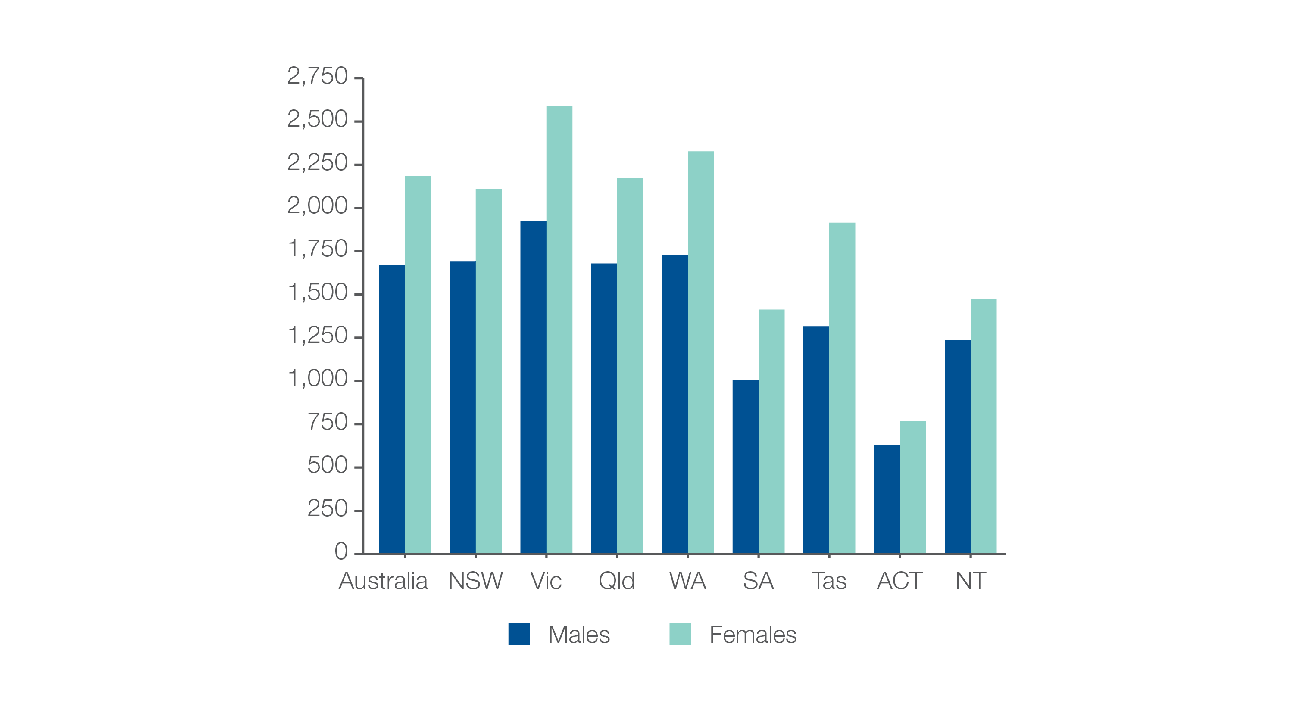
2.2 Gastroscopy hospitalisations, all ages
Analysis by sex
Number per 100,000 people
Sources: NHMD data 2016-17, and ABS Estimated Resident Population 30 June 2016
Notes:
Speaker notes:
The rate of hospitalisations for gastroscopy was 1.3 times as high in females as in males.
In 2016–17, there were 220,687 hospitalisations for gastroscopy for males of all ages, representing 1,673 hospitalisations per 100,000 males (the Australian rate). The number of hospitalisations varied across states and territories, from 632 per 100,000 males in the Australian Capital Territory to 1,923 per 100,000 in Victoria.
In 2016–17, there were 284,857 hospitalisations for gastroscopy in females of all ages, representing 2,185 hospitalisations per 100,000 females (the Australian rate). The number of hospitalisations varied across states and territories, from 769 per 100,000 females in the Australian Capital Territory to 2,590 per 100,000 in Victoria.

Slide 46
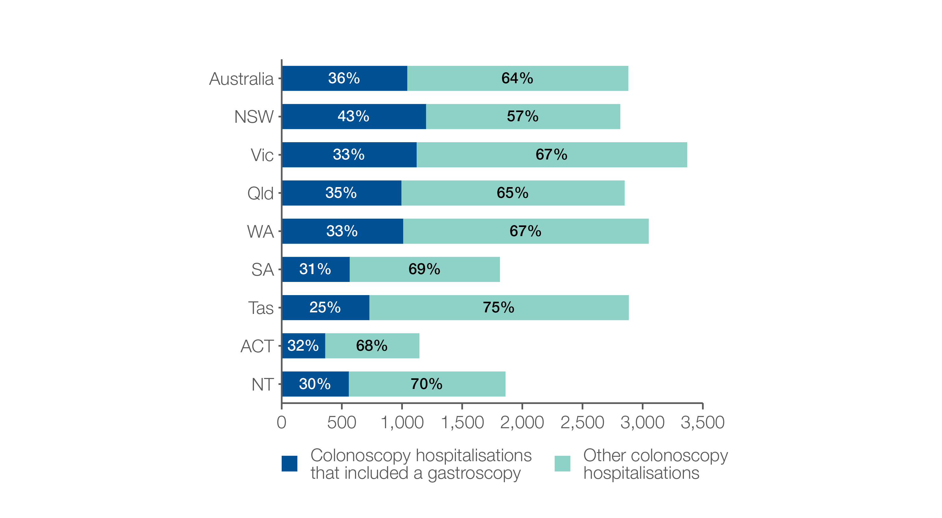
2.2 Gastroscopy hospitalisations, all ages
Colonoscopy hospitalisations that also included gastroscopy
Number per 100,000 people
Sources: NHMD data 2016-17, and ABS Estimated Resident Population 30 June 2016
Notes:
Speaker notes:
In 2016–17, 36% of hospitalisations for colonoscopy included a gastroscopy. There were 274,559 hospitalisations for colonoscopy that also included gastroscopy, representing 1,044 hospitalisations per 100,000 people of all ages (the Australian rate).
The number of hospitalisations varied across states and territories, from 362 per 100,000 people in the Australian Capital Territory to 1,200 per 100,000 people in New South Wales.

Slide 47
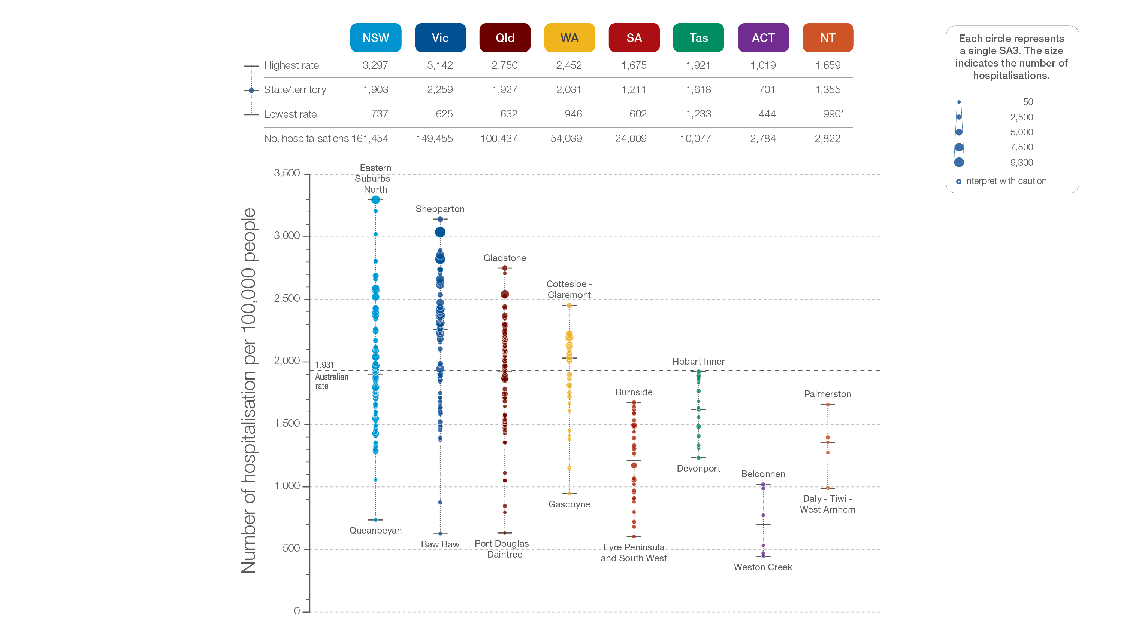
2.2 Gastroscopy hospitalisations, all ages
State and territory
Sources: NHMD data 2016-17, and ABS Estimated Resident Population 30 June 2016
Notes:
Speaker notes:
The number of hospitalisations for gastroscopy varied across states and territories, from 701 per 100,000 people of all ages in the Australian Capital Territory to 2,259 in Victoria .
Each circle on the graph represents an SA3. The size of the circle indicates how many hospitalisations have been recorded for people living in that area. The vertical axis shows the standardised rates for the clinical item.
Hollow circles and asterisks indicate rates that are considered more volatile than other published rates and should be interpreted with caution. Data from a number of ACT private hospitals, which undertake some gastroscopies, were not provided to the National Hospital Morbidity Database. For this reason, data for the ACT should be interpreted with caution.
For further detail about the methods used, please refer to the Technical Supplement.
For further information on how to interpret the figures, please refer to the ‘How to interpret’ resource available at: www.safetyandquality.gov.au/atlas/the-third-australian-atlas-of-healthcare-variation-2018/how-to-interpret-the-data/

Slide 48
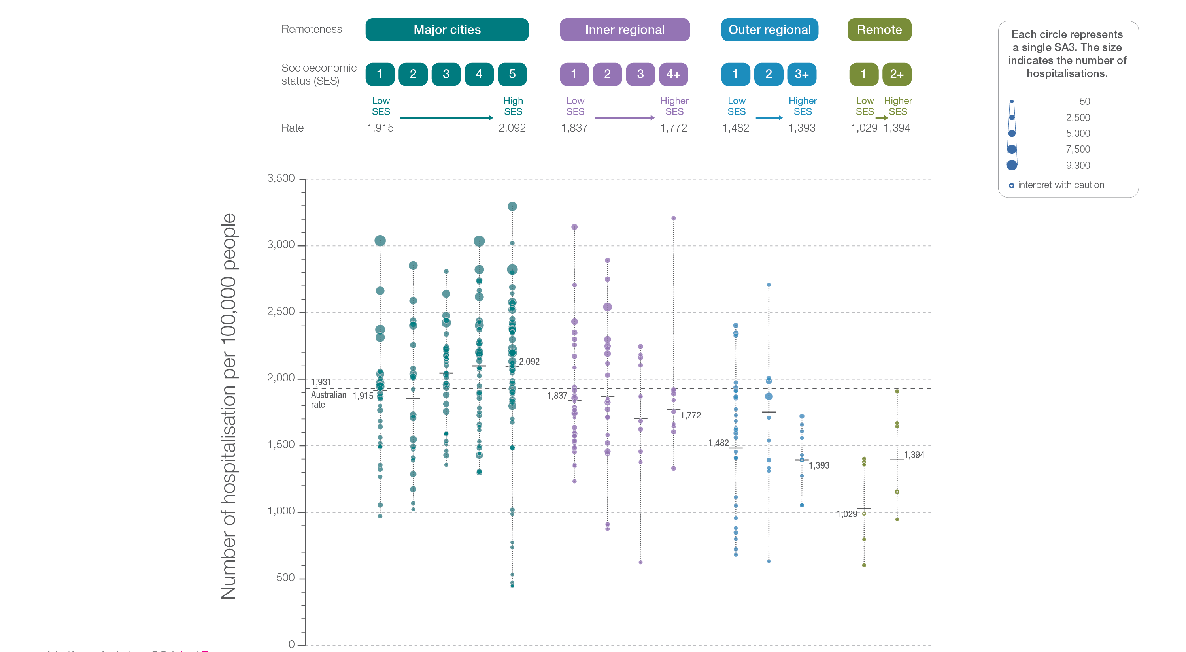
2.2 Gastroscopy hospitalisations, all ages
Remoteness and socioeconomic status
Sources: NHMD data 2016-17, and ABS Estimated Resident Population 30 June 2016
Notes:
Speaker notes:
Rates of hospitalisation for gastroscopy were higher in major cities and inner regional areas than in outer regional and remote areas. Rates were lower in areas with lower socioeconomic status in major cities and remote areas. However, there was no clear pattern according to socioeconomic status in other remoteness categories.
Each circle on the graph represents an SA3. The size of the circle indicates how many clinical events have been recorded for people living in that area. The vertical axis shows the standardised rates for the clinical item.
Hollow circles indicate rates that are considered more volatile than other published rates and should be interpreted with caution. For further detail about the methods used, please refer to the Technical Supplement.
For further information on how to interpret the figures, please refer to the ‘How to interpret’ resource available at: www.safetyandquality.gov.au/atlas/the-third-australian-atlas-of-healthcare-variation-2018/how-to-interpret-the-data/

Slide 49
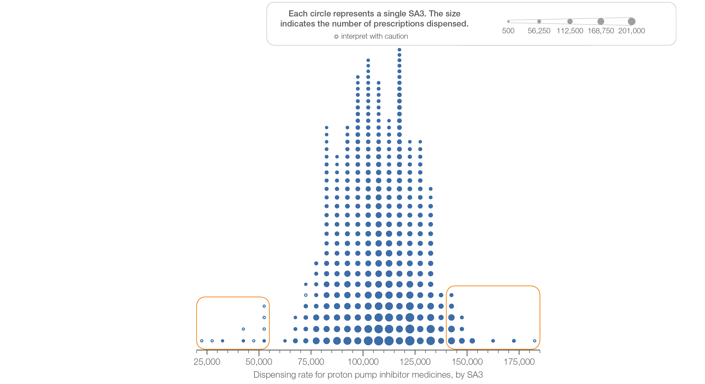
2.3 Proton pump inhibitor medicines dispensing, 18 years and over
Sources: PBS data 2016-17, and ABS Estimated Resident Population 30 June 2016
Notes:
Speaker notes:
This slide shows the distribution of rates by Statistical Area Level 3 (SA3) for proton pump inhibitor medicines dispensing, 18 years and over.
Each circle on the graph represents an SA3. The size of the circle indicates how many prescriptions have been dispensed for people living in that area. The horizontal axis shows the standardised rates for the clinical item.
Hollow circles indicate rates that are considered more volatile than other published rates and should be interpreted with caution. For further detail about the methods used, please refer to the Technical Supplement.
For further information on how to interpret the figures, please refer to the ‘How to interpret’ resource available at: www.safetyandquality.gov.au/atlas/the-third-australian-atlas-of-healthcare-variation-2018/how-to-interpret-the-data/

Slide 50
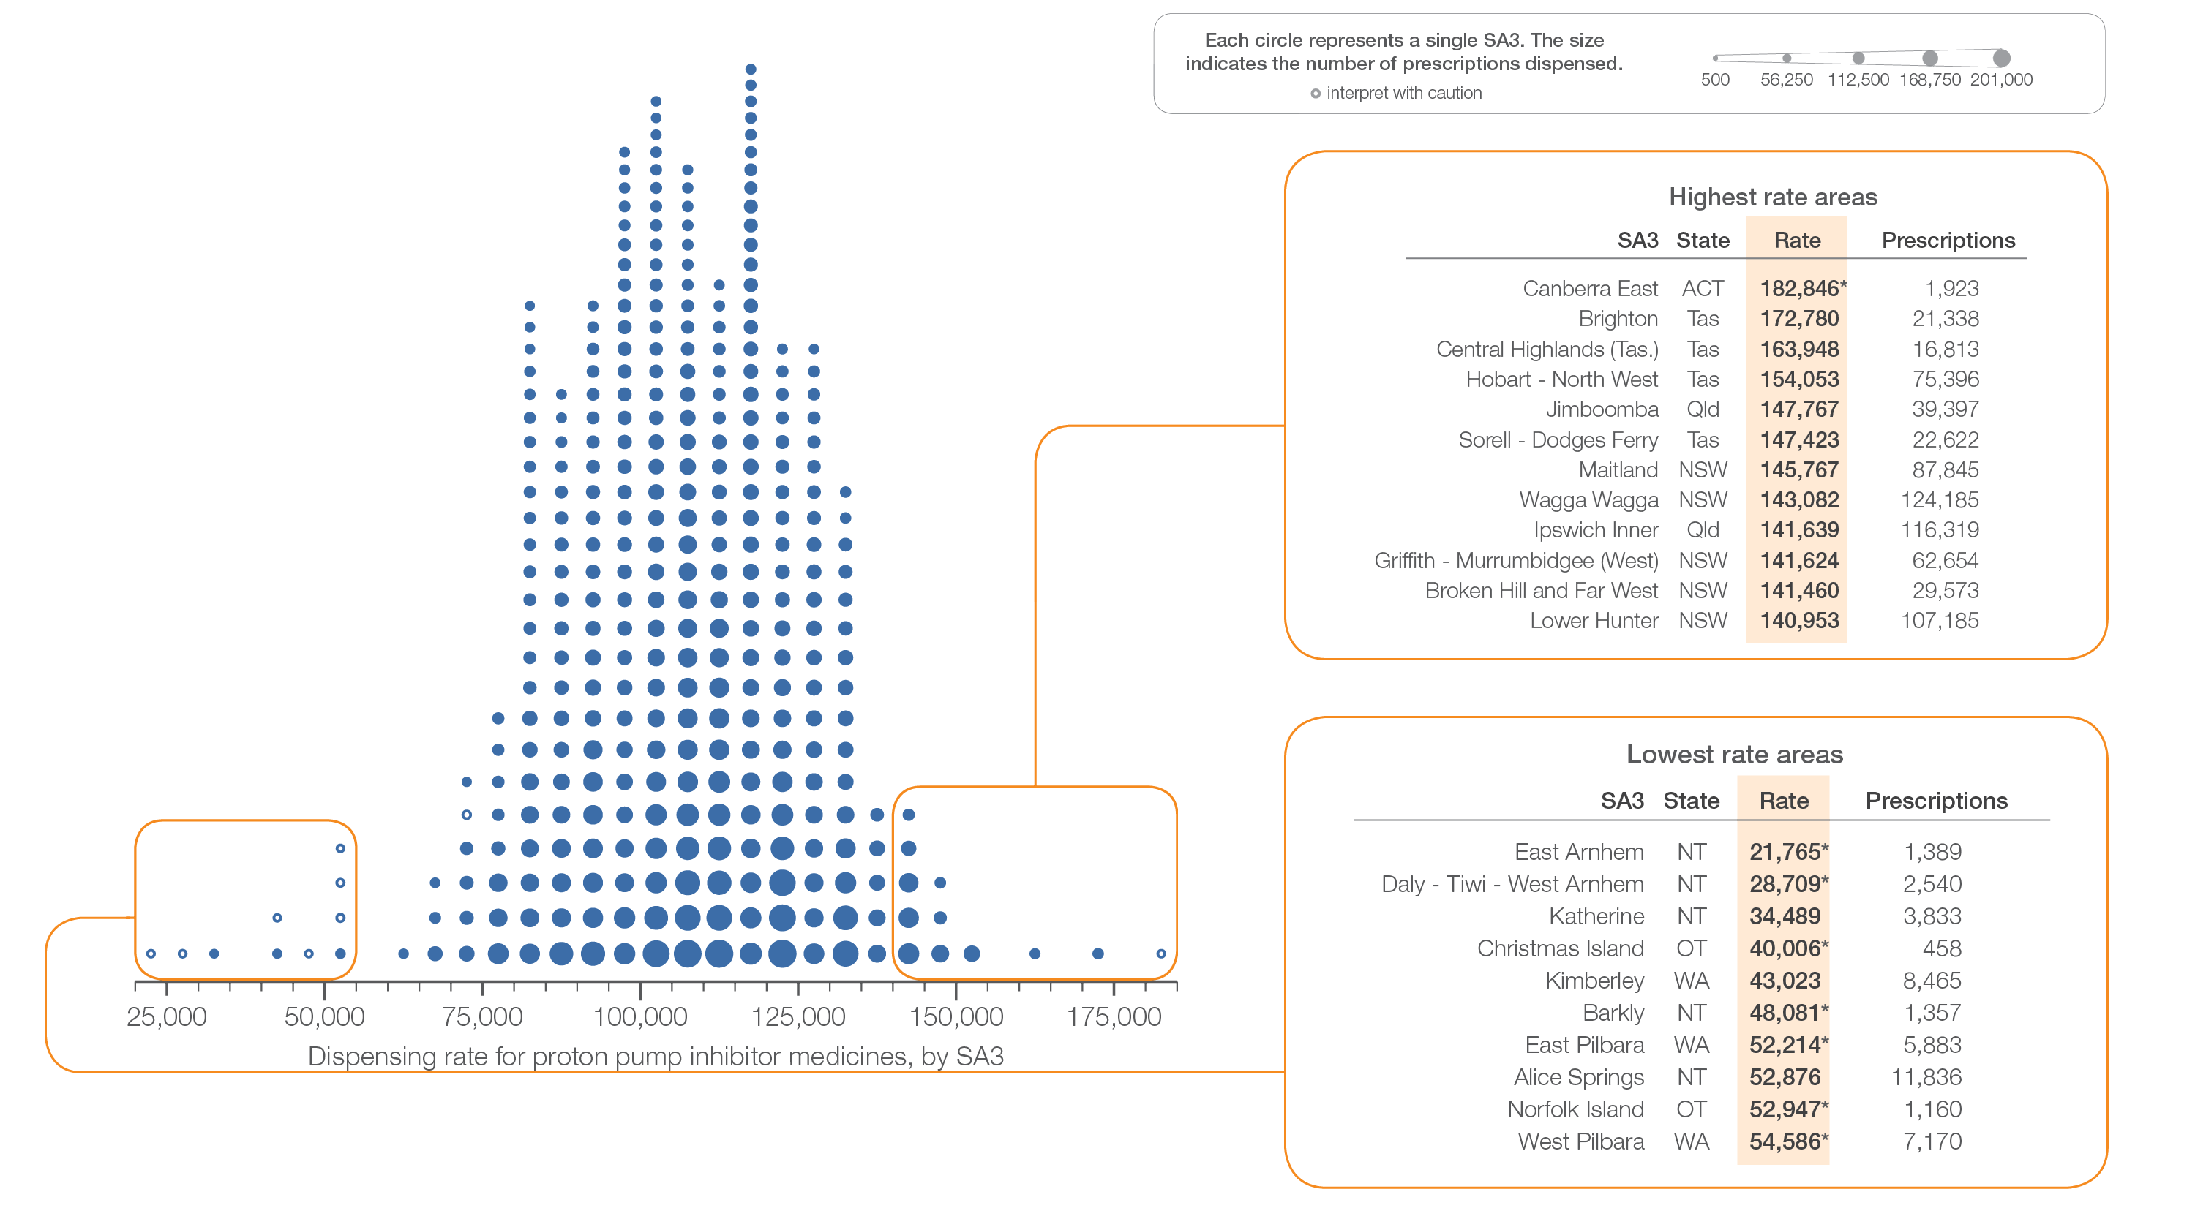
2.3 Proton pump inhibitor medicines dispensing, 18 years and over
Sources: PBS data 2016-17, and ABS Estimated Resident Population 30 June 2016
Notes:
Speaker notes:
This slide shows the distribution of rates by Statistical Area Level 3 (SA3) for proton pump inhibitor medicines dispensing, 18 years and over.
Each circle on the graph represents an SA3. The size of the circle indicates how many prescriptions have been dispensed for people living in that area. The horizontal axis shows the standardised rates for the clinical item.
For further information on how to interpret the figures, please refer to the ‘How to interpret’ resource available at: www.safetyandquality.gov.au/atlas/the-third-australian-atlas-of-healthcare-variation-2018/how-to-interpret-the-data/

Slide 51
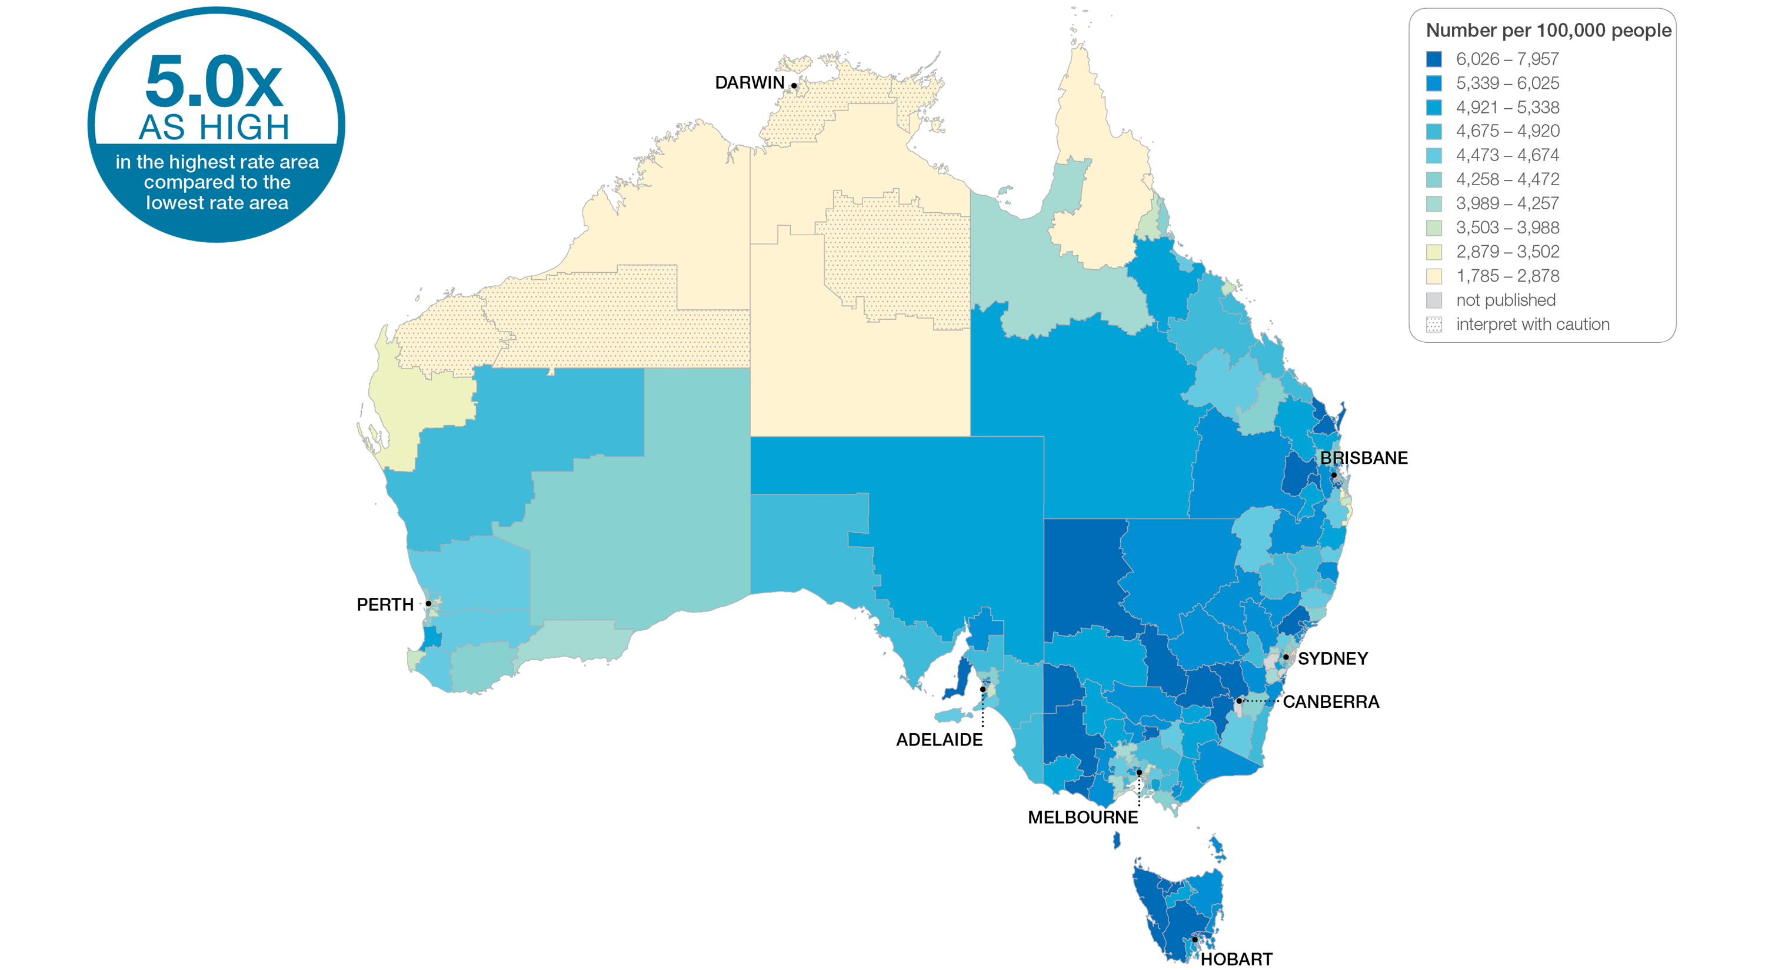
2.3 Proton pump inhibitor medicines dispensing, 18 years and over
Sources: PBS data 2016-17, and ABS Estimated Resident Population 30 June 2016
Notes:
Speaker notes:
This slide shows the distribution of rates by Statistical Area Level 3 (SA3) for proton pump inhibitor medicines dispensing. Rates are based on the patient’s usual place of residence, not the location of the healthcare provider.
In 2016–17, there were 21,768,718 PBS prescriptions dispensed for PPI medicines, representing 105,294 prescriptions per 100,000 people aged 18 years and over (the Australian rate).
The number of PBS prescriptions dispensed for PPI medicines across 333* local areas (Statistical Area Level 3 – SA3) ranged from 34,489 to 172,780 per 100,000 people aged 18 years and over.
The rate was 5.0 times as high in the area with the highest rate compared to the area with the lowest rate.
The number of prescriptions dispensed varied across states and territories, from 63,230 per 100,000 people aged 18 years and over in the Northern Territory to 127,993 in Tasmania.
The range of rates represented by each colour are shown in the legend for the map. The darker blue colour represents SA3s with higher rates. The lighter colours represent SA3s with lower rates.
Dotted areas indicate rates that are considered more volatile than other published rates and should be interpreted with caution. These rates are excluded from the calculation of the difference between the highest and lowest SA3 rates in Australia.
For further detail about the methods used, please refer to the Technical Supplement.
For further information on how to interpret the figures, please refer to the ‘How to interpret’ resource available at: www.safetyandquality.gov.au/atlas/the-third-australian-atlas-of-healthcare-variation-2018/how-to-interpret-the-data/

Slide 52
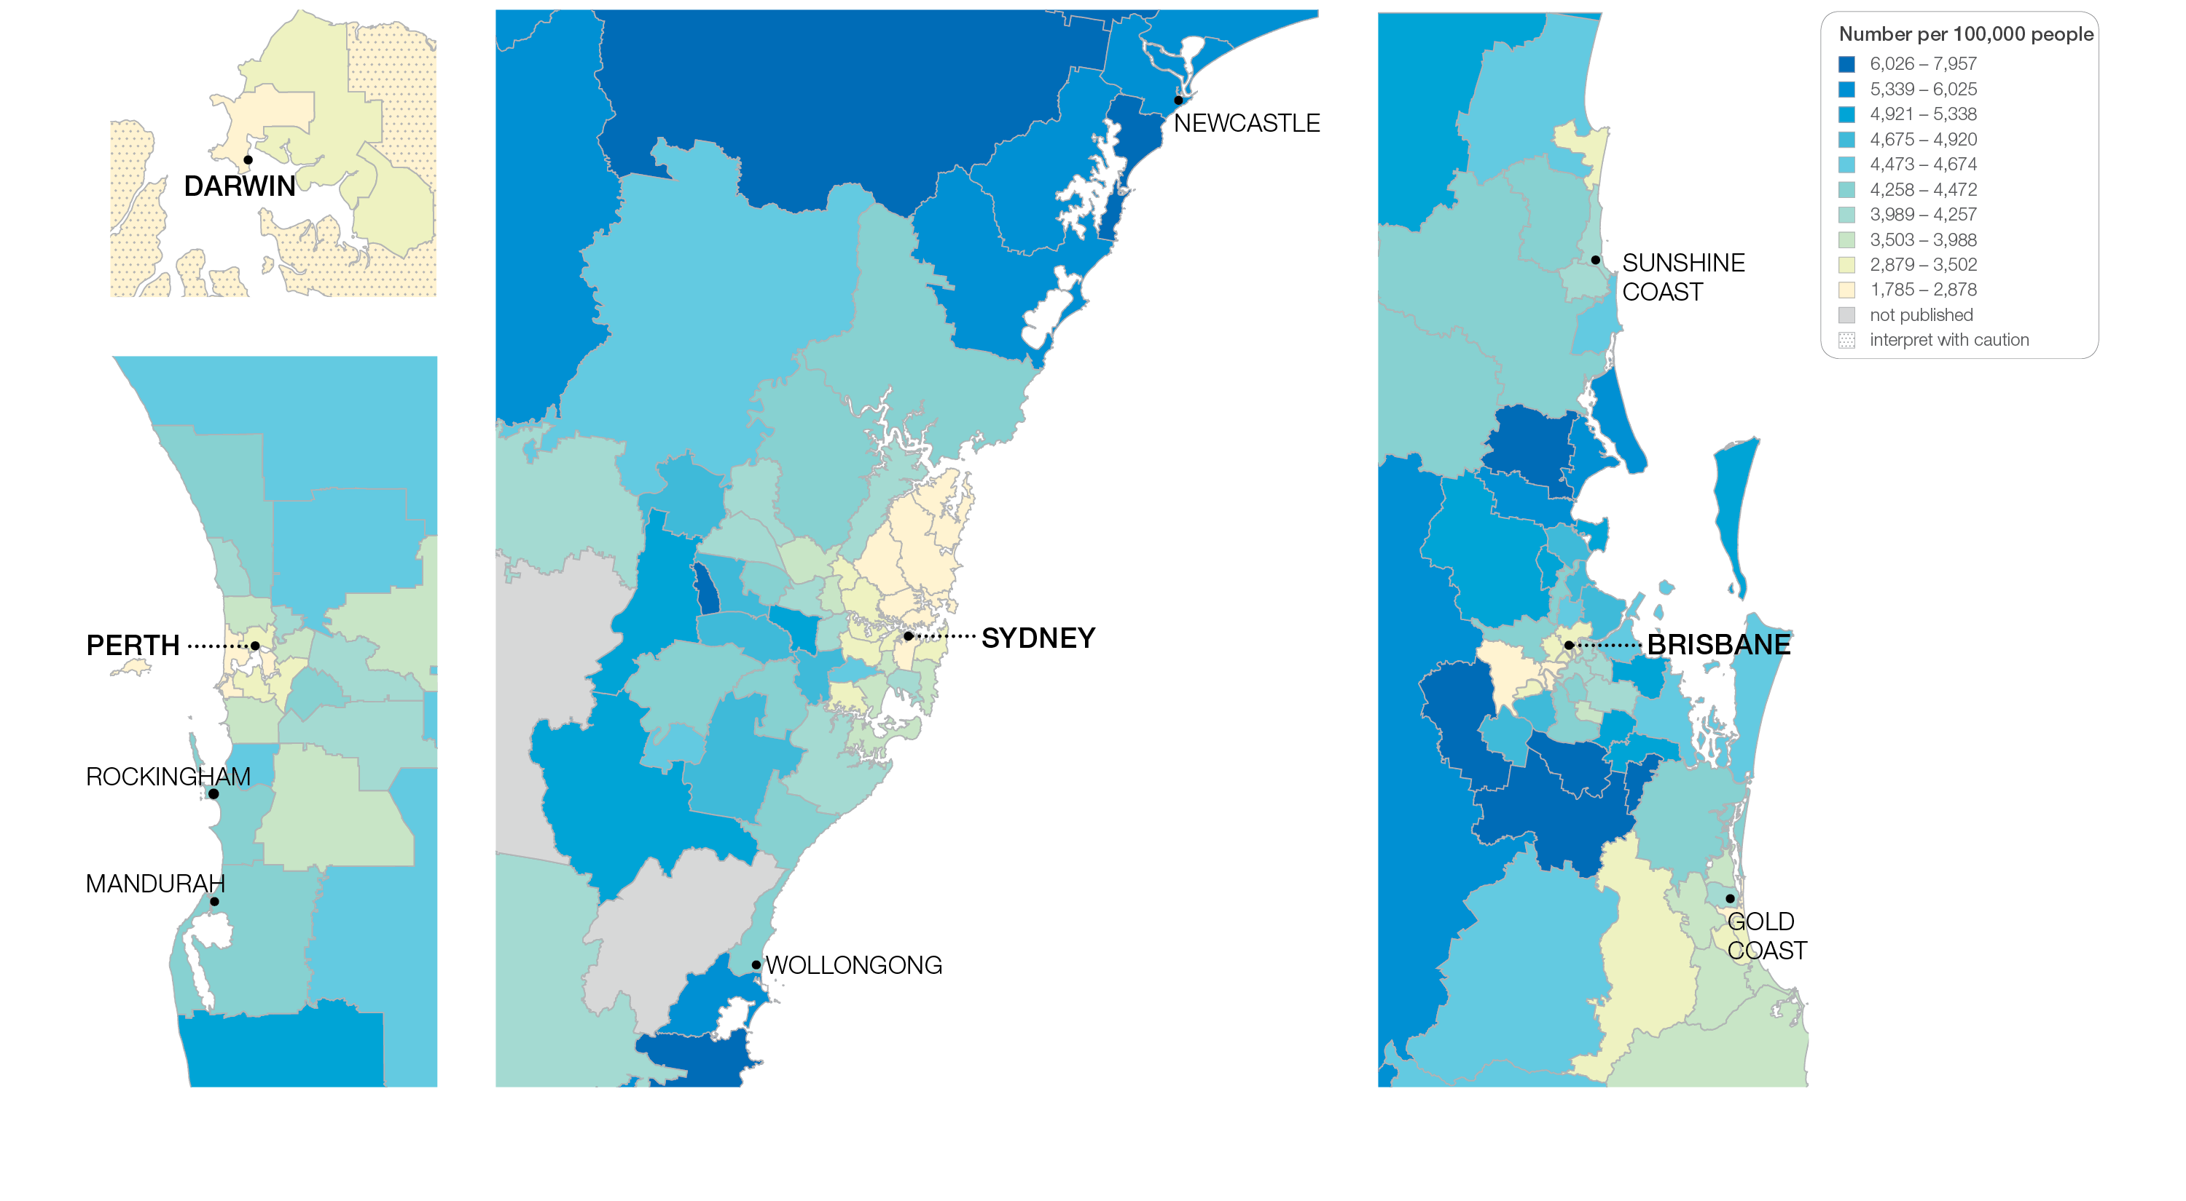
2.3 Proton pump inhibitor medicines dispensing, 18 years and over
Sources: PBS data 2016-17, and ABS Estimated Resident Population 30 June 2016
Notes:
Speaker notes:
This slide shows the distribution of rates by Statistical Area Level 3 (SA3) for proton pump inhibitor medicines dispensing by capital city area. Rates are based on the patient’s usual place of residence, not the location of the healthcare provider.

Slide 53
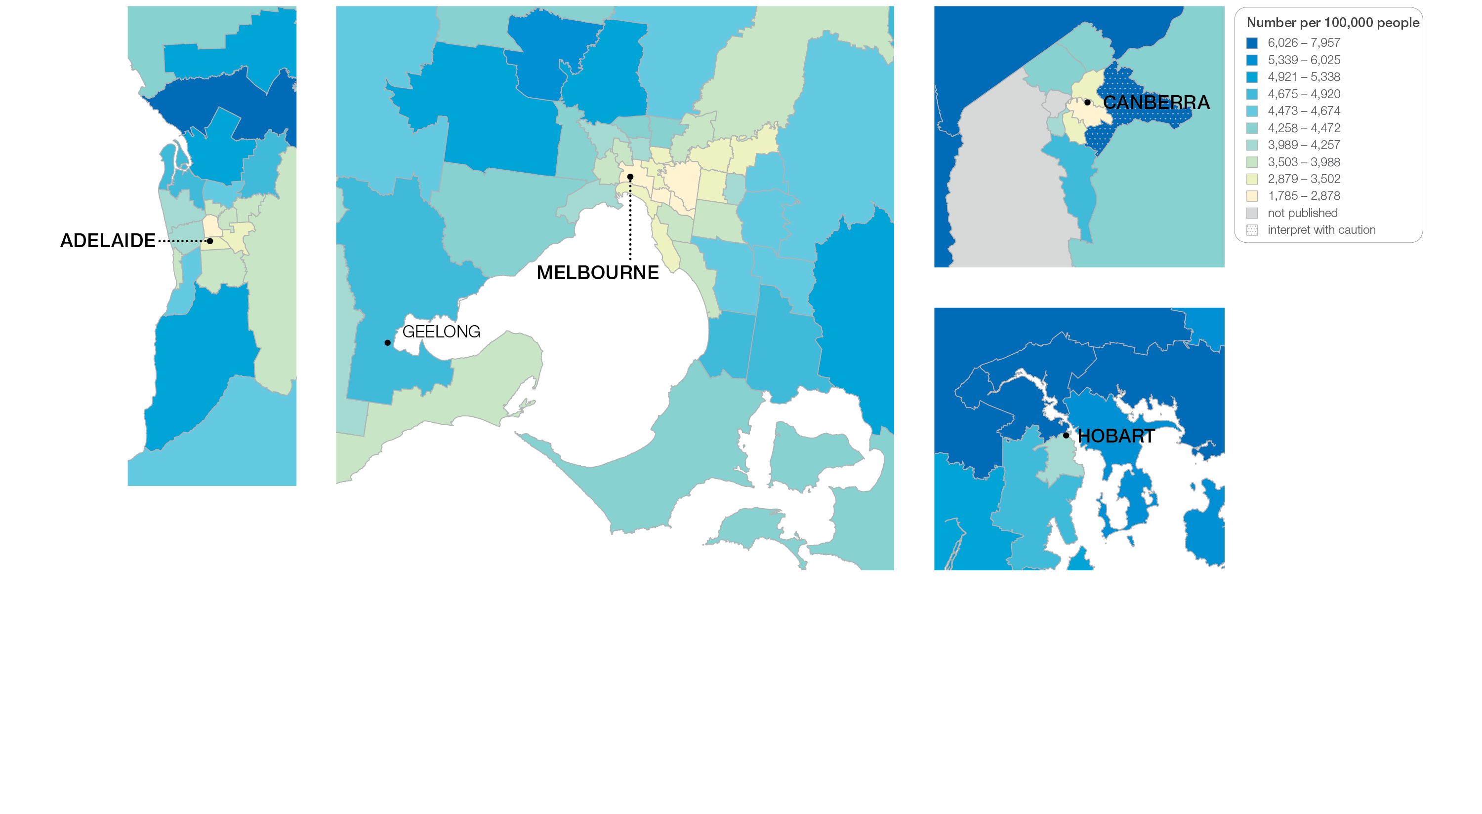
2.3 Proton pump inhibitor medicines dispensing, 18 years and over
Sources: PBS data 2016-17, and ABS Estimated Resident Population 30 June 2016
Notes:
Speaker notes:
This slide shows the distribution of rates by Statistical Area Level 3 (SA3) for proton pump inhibitor medicines dispensing by capital city area. Rates are based on the patient’s usual place of residence, not the location of the healthcare provider.

Slide 54
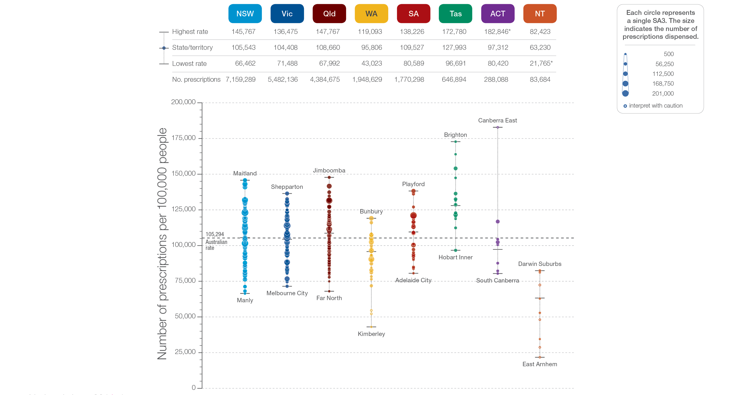
2.3 Proton pump inhibitor medicines dispensing, 18 years and over
State and territory
Sources: PBS data 2016-17, and ABS Estimated Resident Population 30 June 2016
Notes:
Speaker notes:
The number of PBS prescriptions for PPI medicines dispensed varied across states and territories, from 63,230 per 100,000 people aged 18 years and over in the Northern Territory to 127,993 in Tasmania.
Each circle on the graph represents an SA3. The size of the circle indicates how many hospitalisations have been recorded for people living in that area. The vertical axis shows the standardised rates for the clinical item.
Hollow circles and asterisks indicate rates that are considered more volatile than other published rates and should be interpreted with caution.
For further detail about the methods used, please refer to the Technical Supplement.
For further information on how to interpret the figures, please refer to the ‘How to interpret’ resource available at: www.safetyandquality.gov.au/atlas/the-third-australian-atlas-of-healthcare-variation-2018/how-to-interpret-the-data/

Slide 55
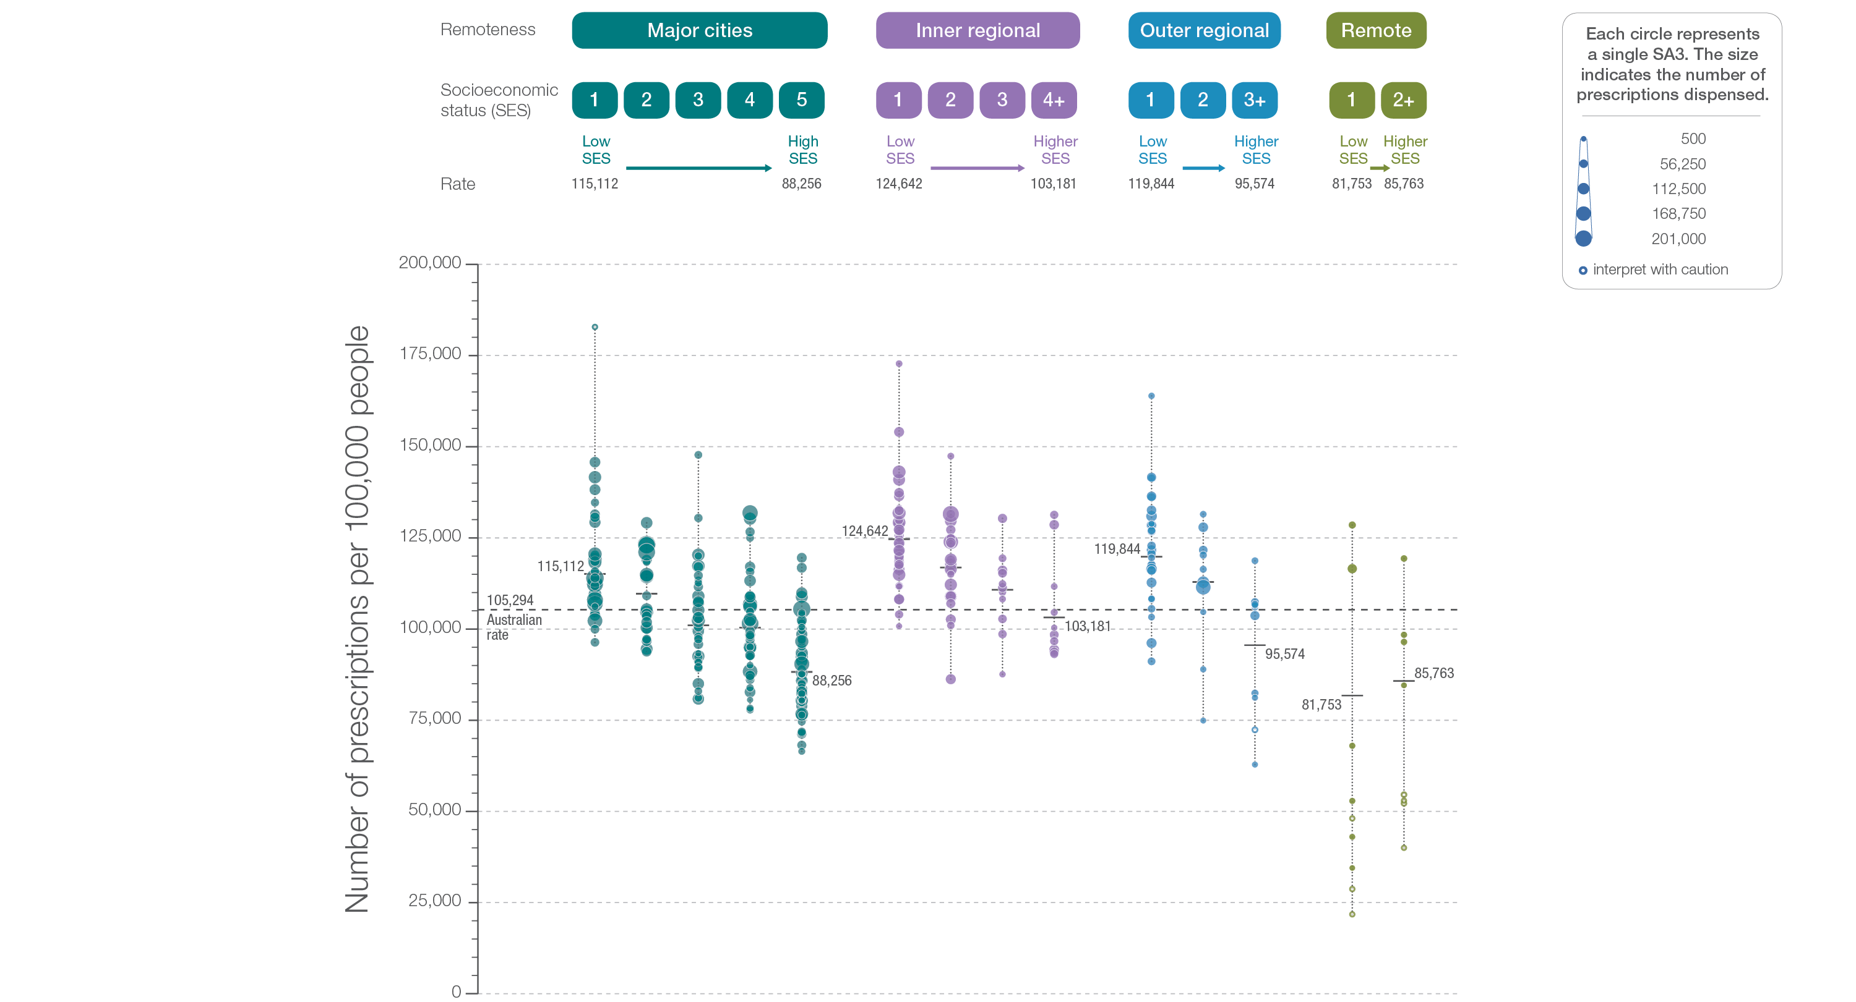
2.3 Proton pump inhibitor medicines dispensing, 18 years and over
Remoteness and socioeconomic status
Sources: PBS data 2016-17, and ABS Estimated Resident Population 30 June 2016
Notes:
Speaker notes:
Rates of PPI medicines dispensing were higher in inner regional and outer regional areas than in other areas. There was a pattern of an increasing rate of PPI medicines dispensing with socioeconomic disadvantage in major cities, and inner regional and outer regional areas.
Hollow circles indicate rates that are considered more volatile than other published rates and should be interpreted with caution.

Slide 56
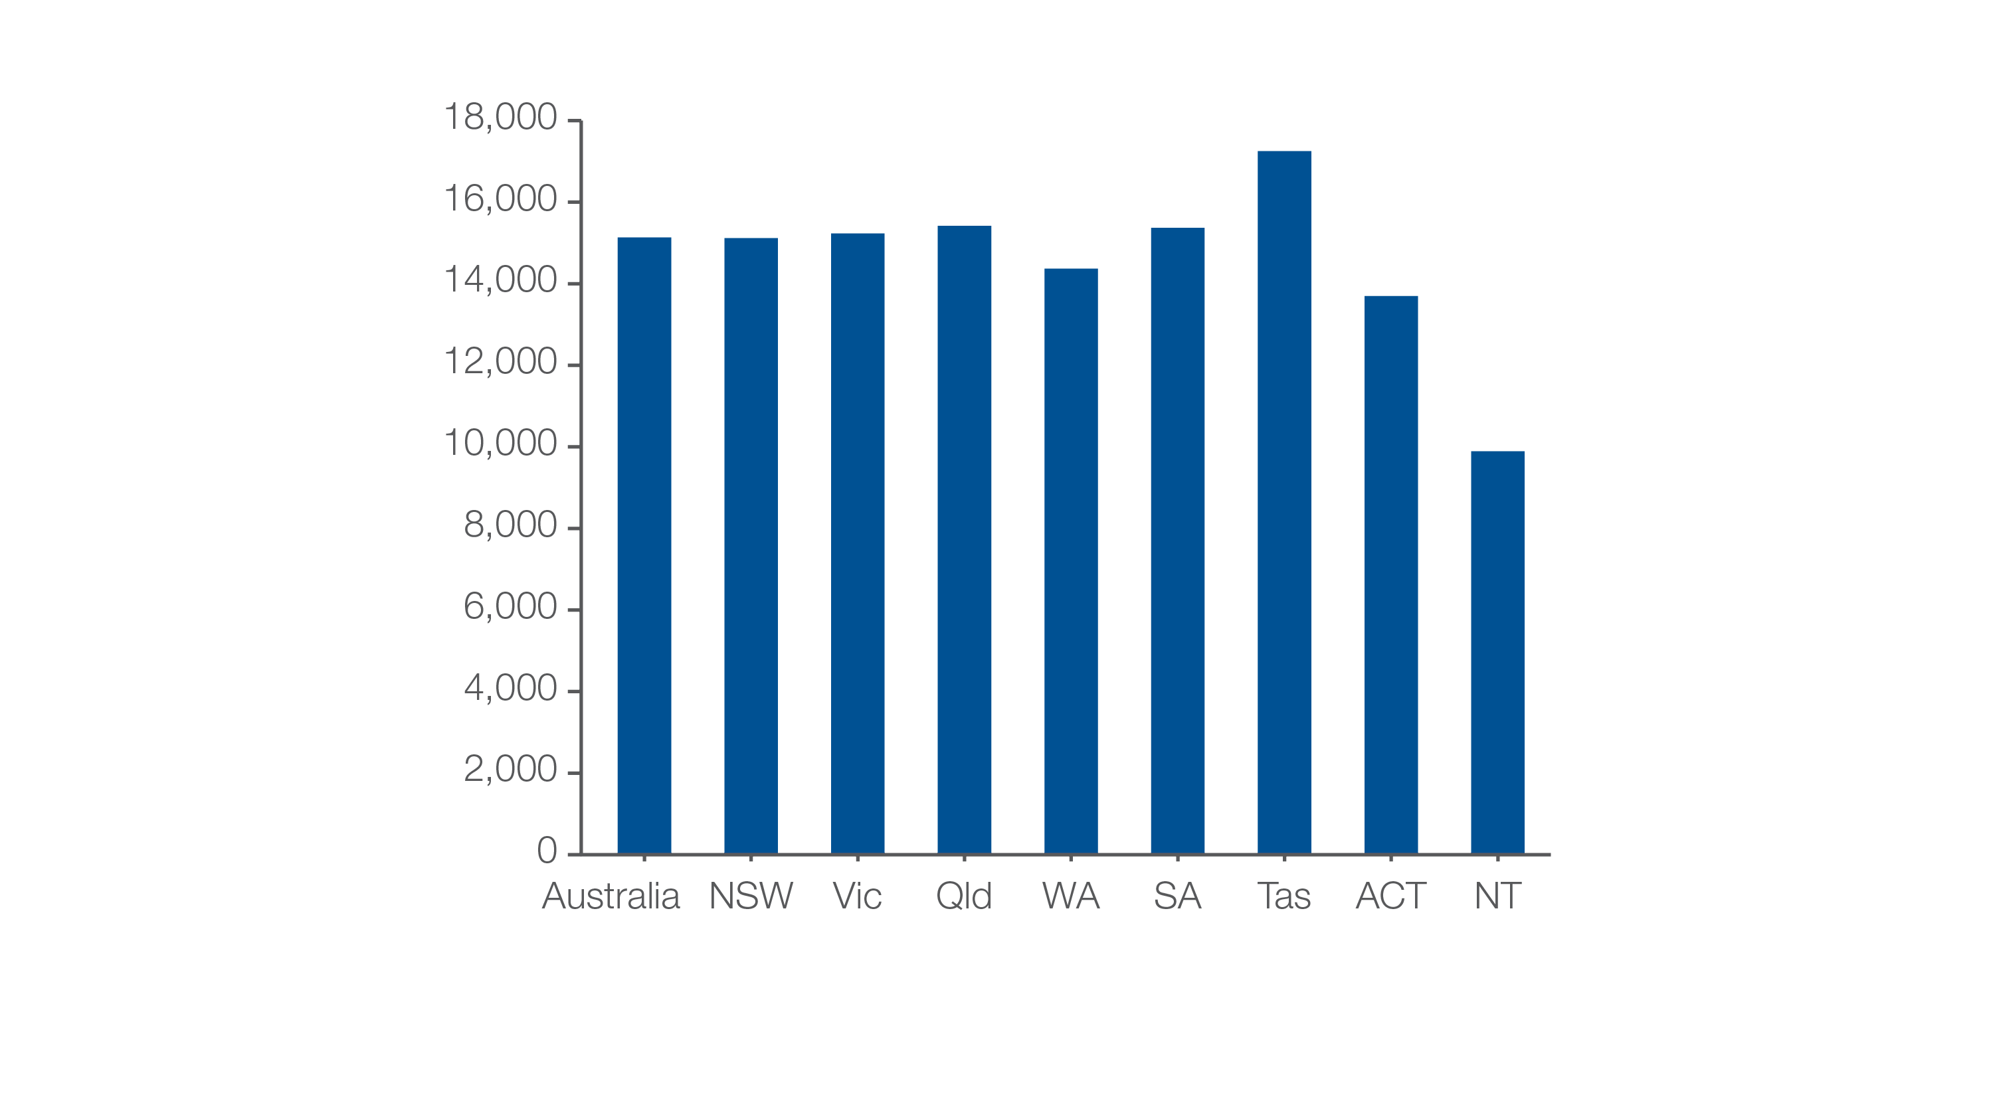
2.3 Proton pump inhibitor medicines dispensing, 18 years and over
Patients dispensed at least one proton pump inhibitor medicine
Number of patients per 100,000 people
Sources: PBS data 2016-17, and ABS Estimated Resident Population 30 June 2016
Notes:
Speaker notes:
The number of people aged 18 years and over who had at least one prescription for a PPI medicine dispensed in 2016–17 was 15,135 per 100,000 people – that is 15% of the adult population.

Slide 57
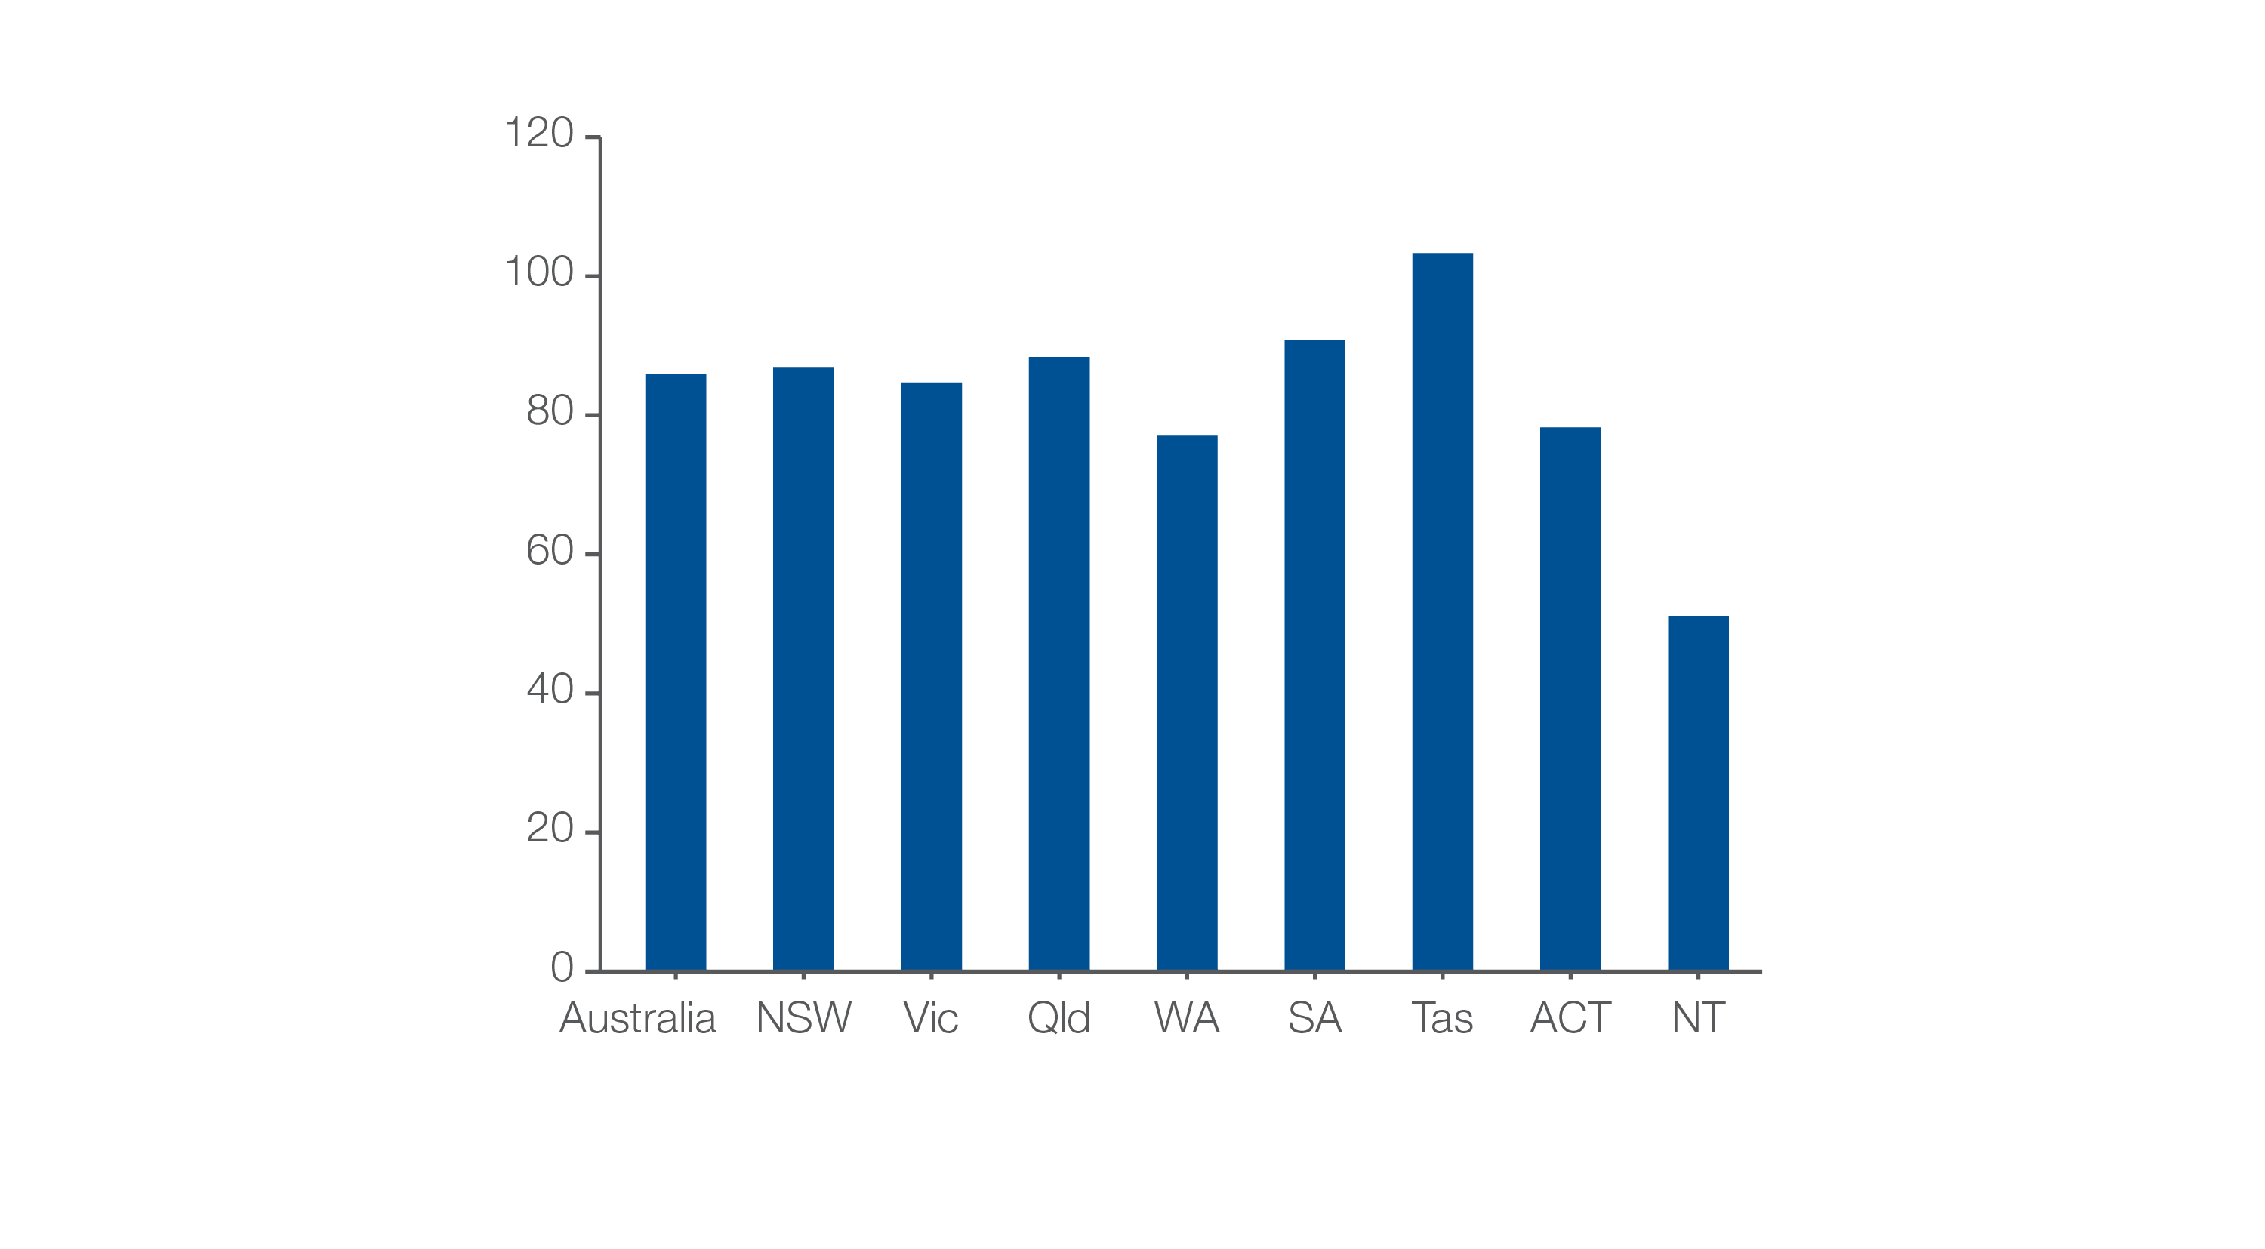
2.3 Proton pump inhibitor medicines dispensing, 18 years and over
Defined daily doses (DDD)
Number of DDDs per 1000 people per day
Sources: PBS data 2016-17, and ABS Estimated Resident Population 30 June 2016
Notes:
Speaker notes:
A defined daily dose (DDD) is a measure of medicines use that allows comparison between different therapeutic groups, and between countries. The DDD is based on the average dose per day of the medicine when used for its main indication by adults.
The number of defined daily doses (DDD) of PPI medicines per 1,000 people aged 18 years and over dispensed on any given day was 85.95, equivalent to 8.6% of the adult population receiving a PPI medicine on any given day of 2016–17.
The DDD rate varied across states and territories from 51.15 per 1,000 people per day in the Northern Territory to 103.32 in Tasmania.

Slide 58
Thyroid investigations and treatments
Notes:
Speaker notes:
This chapter examines:
- Thyroid stimulating hormone tests, 18 years and over
- Thyroid function tests, 18 years and over
- Neck ultrasound tests, 18 years and over
- Thyroidectomy hospitalisations, 18 years and over

Slide 59
Thyroid investigations and treatments
Key findings
Data item | Range across local areas* per 100,000 | Times difference | Times difference excluding top and bottom 10% | Number during 2016–17
3.1a Thyroid stimulating hormone tests†, 18 years and over | 15,735–40,814 | 2.6 | 1.6 | 5,539,805
3.1b Thyroid function tests†, 18 years and over | 6,425–16,077 | 2.5 | 1.6 | 2,344,089
3.1c Neck ultrasound tests†, 18 years and over | 513–2,893 | 5.6 | 2.1 | 308,247
* Statistical Area Level 3
† Based on number of MBS services
Data item | Range across local areas* per 100,000 | Times difference | Times difference excluding top and bottom 10% | Number during 2016–17
3.2b Thyroidectomy hospitalisations, 18 years and over | 28–130 | 4.6 | 2.0 | 35,166
* Statistical Area Level 3
Notes:
Speaker notes:
The number of people having thyroid function testing in Australia has increased faster than the rate of population growth.
In 2016–17, there were 5,539,805 MBS-subsidised services for TSH tests, representing 28,742 services per 100,000 people aged 18 years and over (the Australian rate).
Rates of TFTs were 3.2 times as high in females as in males.
The Atlas found the rate of neck ultrasound varies up to six-fold and the rate of thyroidectomy varies up to five-fold between local areas across Australia.

Slide 60
What’s included in TSH and TFT
Thyroid stimulating hormone (TSH) tests:
TSH tests that do not include T3 or T4
Vast majority of these are TSH alone [ie, MBS item number 66716].
Thyroid function tests (TFTs):
TSH in combination with free tri-iodothyronine (T3) and/or free thyroxine (T4) [ie, MBS item number 66719].

Slide 61
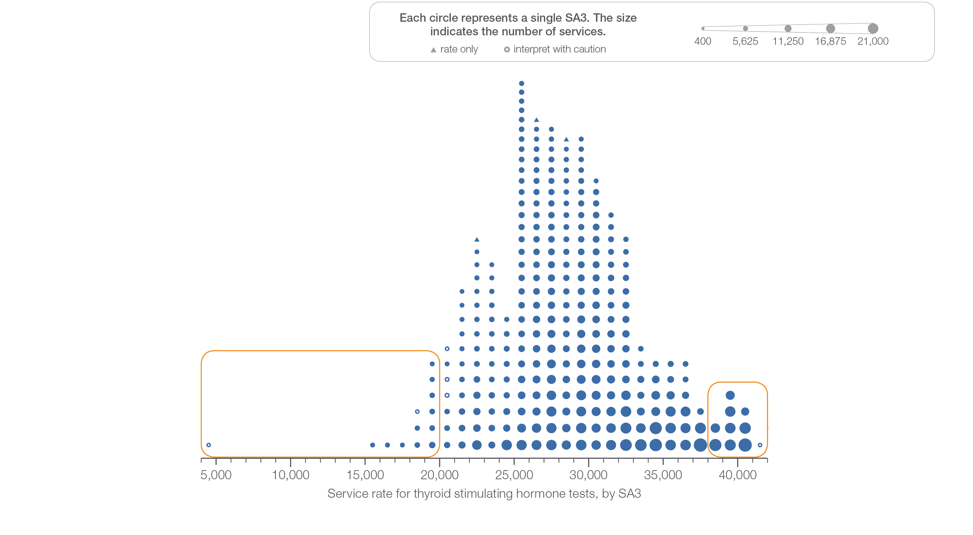
3.1 Thyroid stimulating hormone tests
Sources: MBS data 2016-17, and ABS Estimated Resident Population 30 June 2016
Notes:
Speaker notes:
This slide shows the distribution of rates by Statistical Area Level 3 (SA3) for thyroid stimulating hormone tests.
Each circle on the graph represents an SA3. The size of the circle indicates how many services have been recorded for people living in that area. The horizontal axis shows the standardised rates for the clinical item.
Triangles indicate SA3s where only rates are published. The numbers of services are not published for confidentiality reasons. OT represents other territories.
For further detail about the methods used, please refer to the Technical Supplement.
For further information on how to interpret the figures, please refer to the ‘How to interpret’ resource available at: www.safetyandquality.gov.au/atlas/the-third-australian-atlas-of-healthcare-variation-2018/how-to-interpret-the-data/

Slide 62
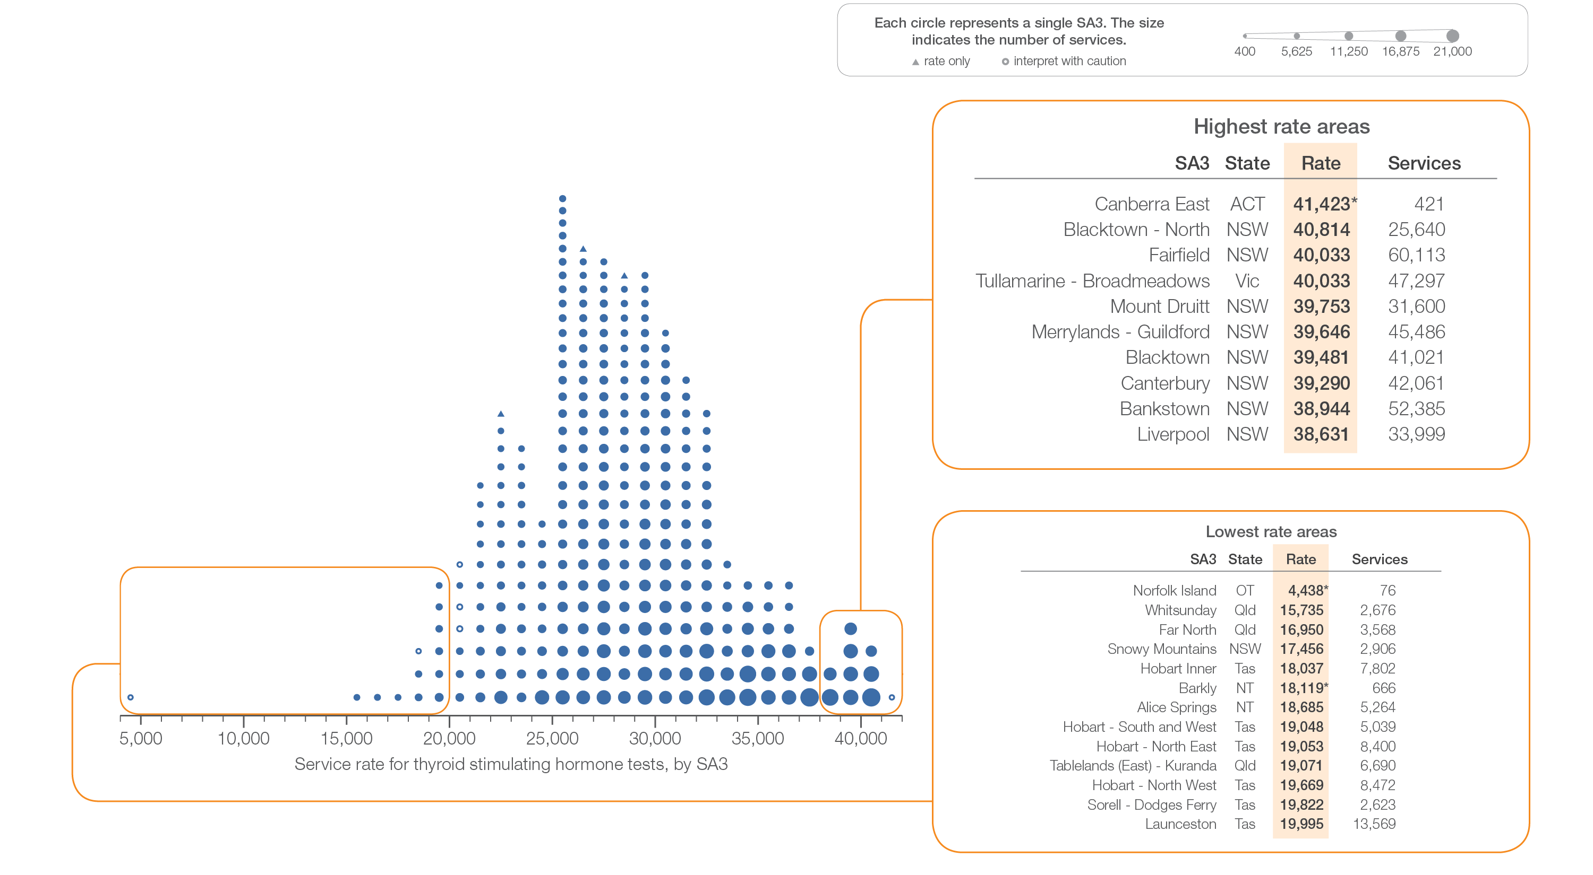
3.1 Thyroid stimulating hormone tests
Sources: MBS data 2016-17, and ABS Estimated Resident Population 30 June 2016
Notes:
Speaker notes:
This slide shows the distribution of rates by Statistical Area Level 3 (SA3) for thyroid stimulating hormone tests.
Each circle on the graph represents an SA3. The size of the circle indicates how many services have been recorded for people living in that area. The horizontal axis shows the standardised rates for the clinical item.
Triangles indicate SA3s where only rates are published. The numbers of services are not published for confidentiality reasons. OT represents other territories.
For further detail about the methods used, please refer to the Technical Supplement.
For further information on how to interpret the figures, please refer to the ‘How to interpret’ resource available at: www.safetyandquality.gov.au/atlas/the-third-australian-atlas-of-healthcare-variation-2018/how-to-interpret-the-data/

Slide 63
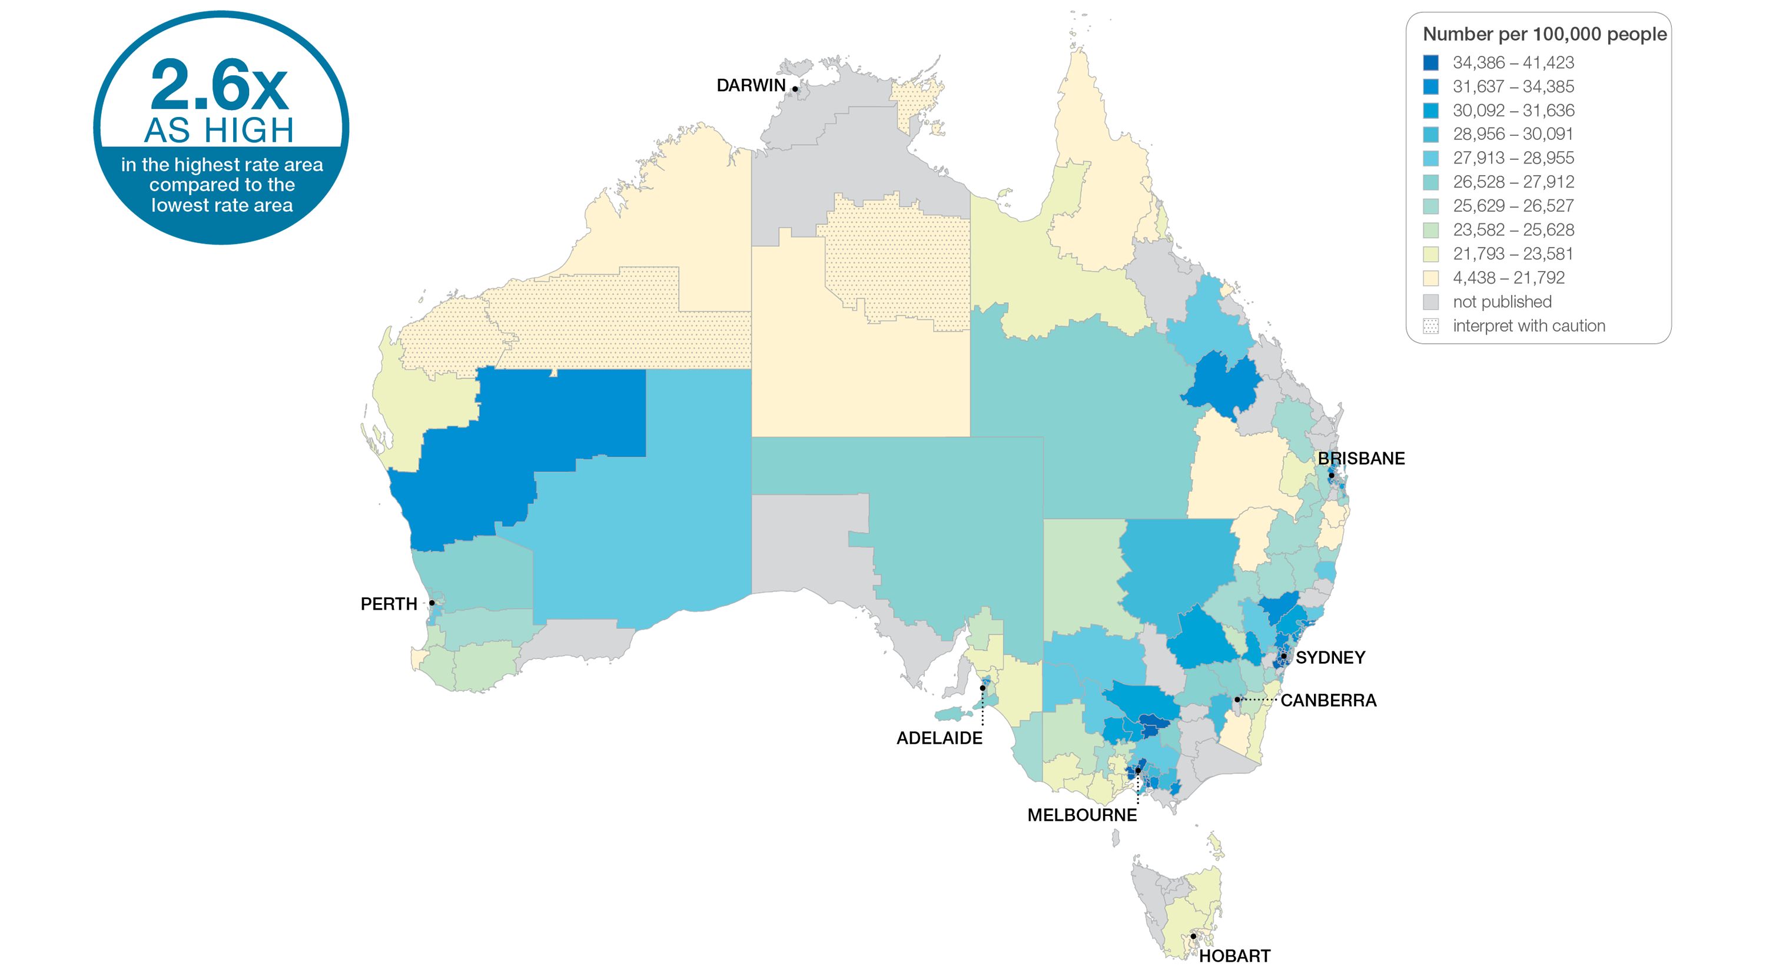
3.1 Thyroid stimulating hormone tests
Sources: MBS data 2016-17, and ABS Estimated Resident Population 30 June 2016
Notes:
Speaker notes:
This slide shows the distribution of rates by Statistical Area Level 3 (SA3) for thyroid stimulating hormone tests. Rates are based on the patient’s usual place of residence, not the location of the healthcare provider.
In 2016–17, there were 5,539,805 MBS-subsidised services for TSH tests, representing 28,742 services per 100,000 people aged 18 years and over (the Australian rate).
The number of MBS-subsidised services for TSH tests across 287§ local areas (Statistical Area Level 3 – SA3) ranged from 15,735 to 40,814 per 100,000 people aged 18 years and over.
The rate was 2.6 times as high in the area with the highest rate compared to the area with the lowest rate.
The number of services varied across states and territories, from 20,106 per 100,000 people aged 18 years and over in Tasmania to 30,640 in New South Wales.
The range of rates represented by each colour are shown in the legend for the map. The darker blue colour represents SA3s with higher rates. The lighter colours represent SA3s with lower rates. Dotted areas indicate rates that are considered more volatile than other published rates and should be interpreted with caution. These rates are excluded from the calculation of the difference between the highest and lowest SA3 rates in Australia.
For further detail about the methods used, please refer to the Technical Supplement.
For further information on how to interpret the figures, please refer to the ‘How to interpret’ resource available at: www.safetyandquality.gov.au/atlas/the-third-australian-atlas-of-healthcare-variation-2018/how-to-interpret-the-data/

Slide 64
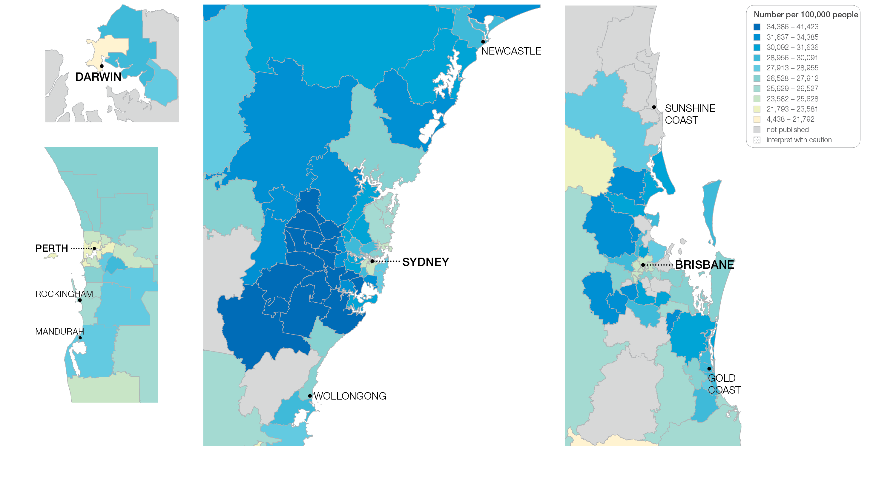
3.1 Thyroid stimulating hormone tests
Sources: MBS data 2016-17, and ABS Estimated Resident Population 30 June 2016
Notes:
Speaker notes:
This slide shows the distribution of rates by Statistical Area Level 3 (SA3) for thyroid stimulating hormone tests by capital city area. Rates are based on the patient’s usual place of residence, not the location of the healthcare provider.

Slide 65
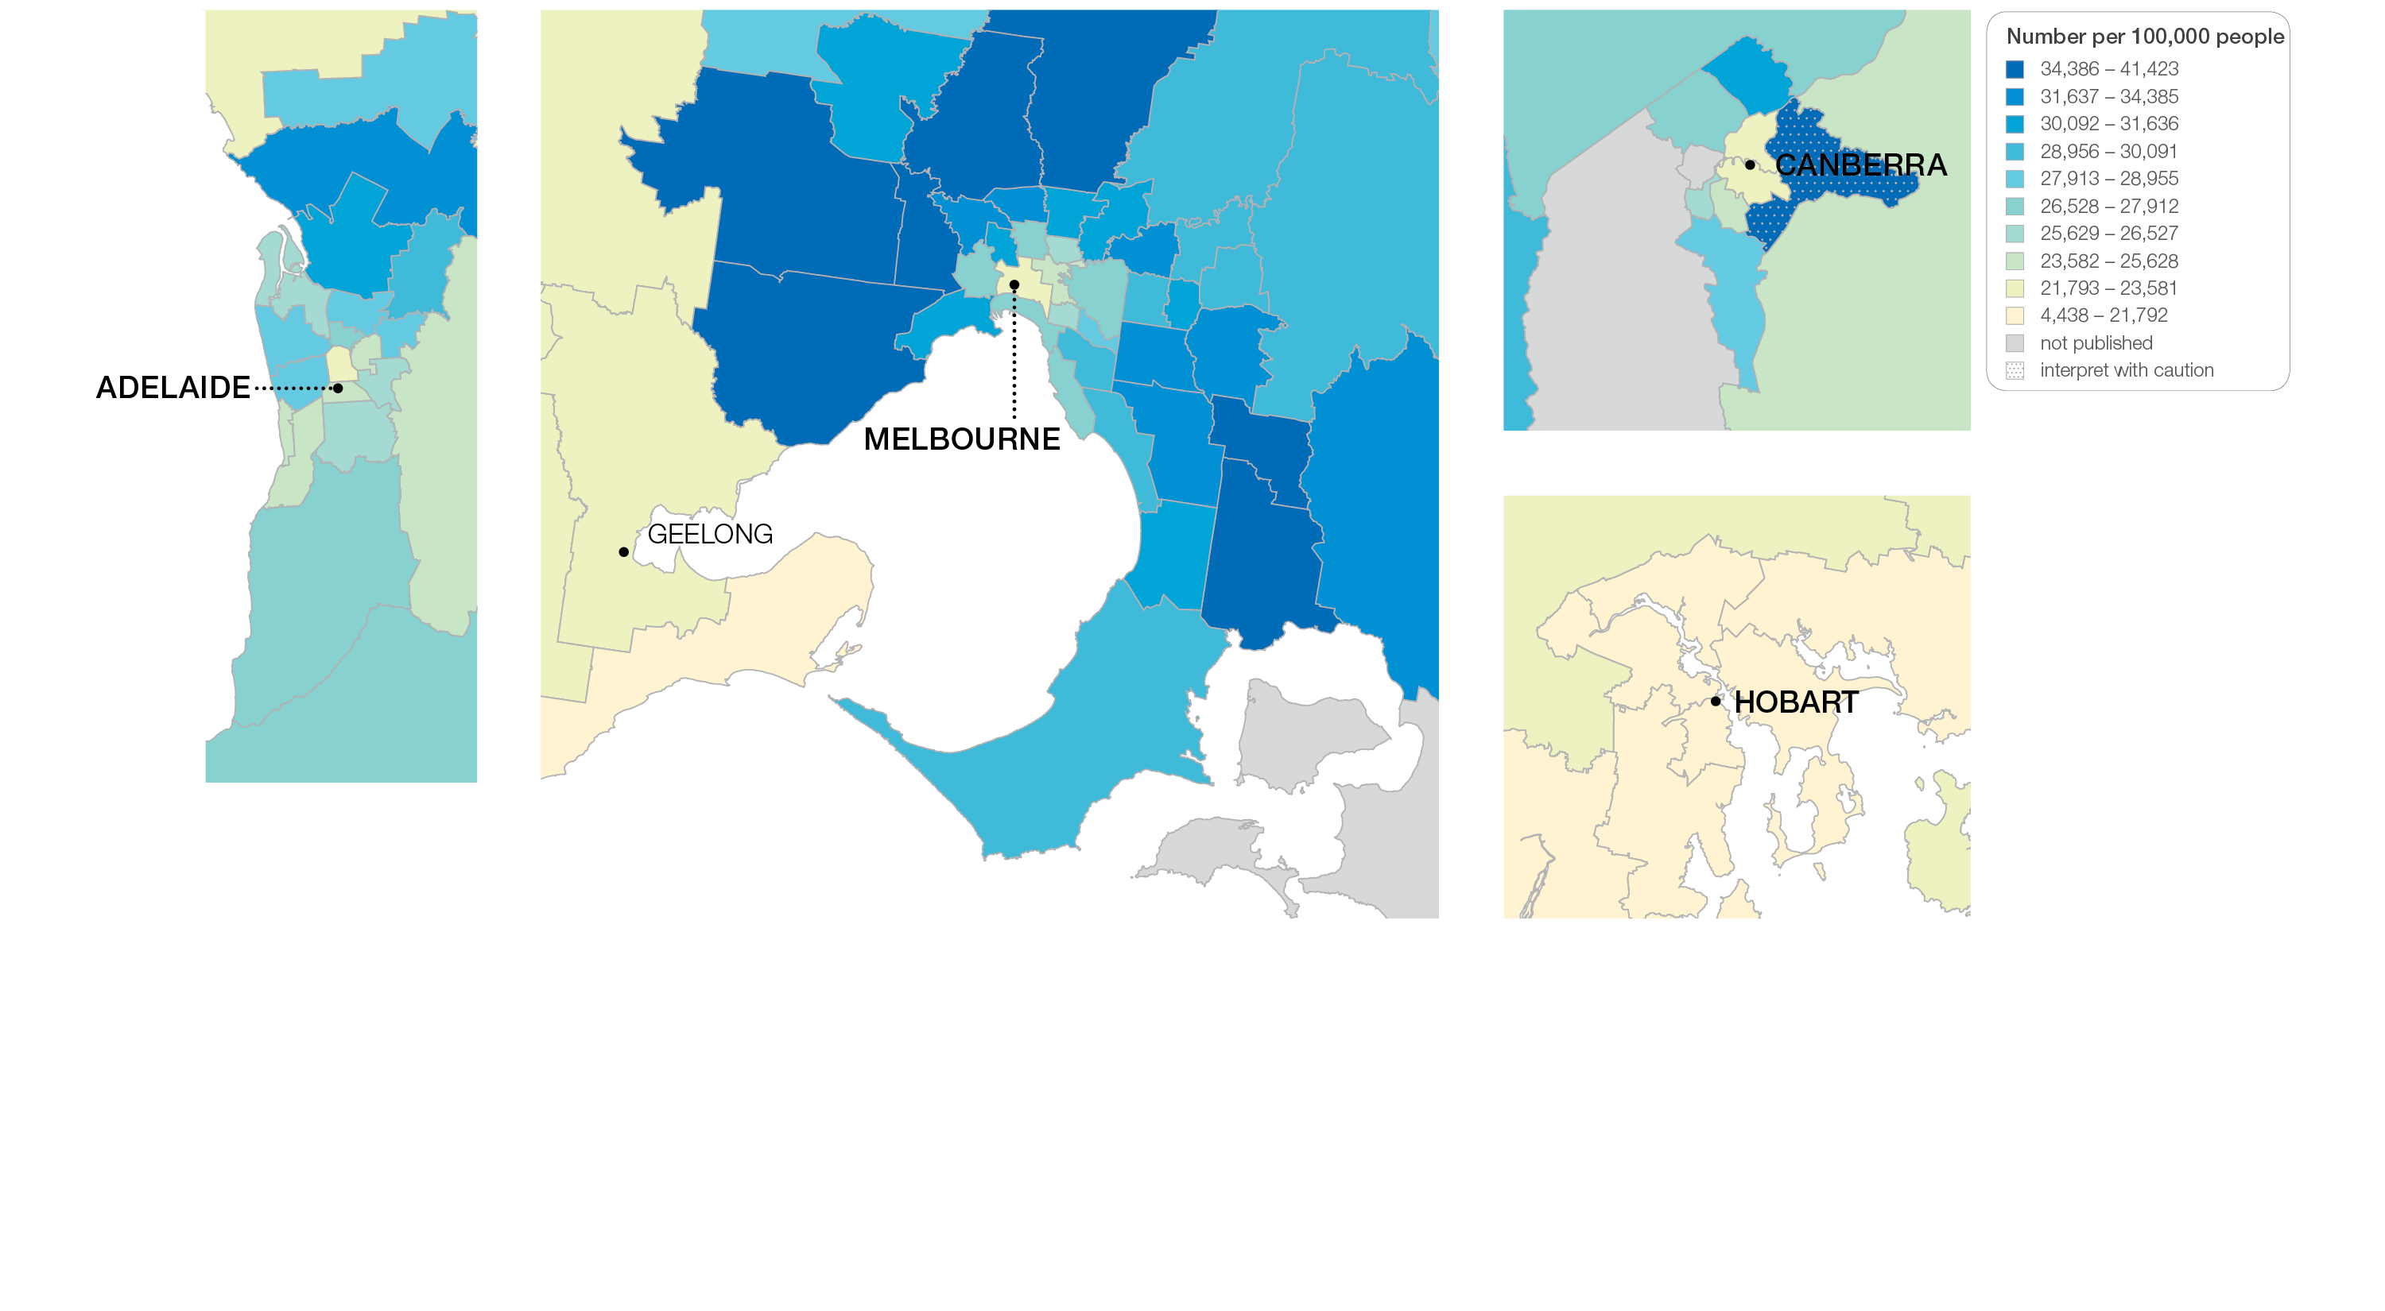
3.1 Thyroid stimulating hormone tests
Sources: MBS data 2016-17, and ABS Estimated Resident Population 30 June 2016
Notes:
Speaker notes:
This slide shows the distribution of rates by Statistical Area Level 3 (SA3) for thyroid stimulating hormone tests by capital city area. Rates are based on the patient’s usual place of residence, not the location of the healthcare provider.

Slide 66
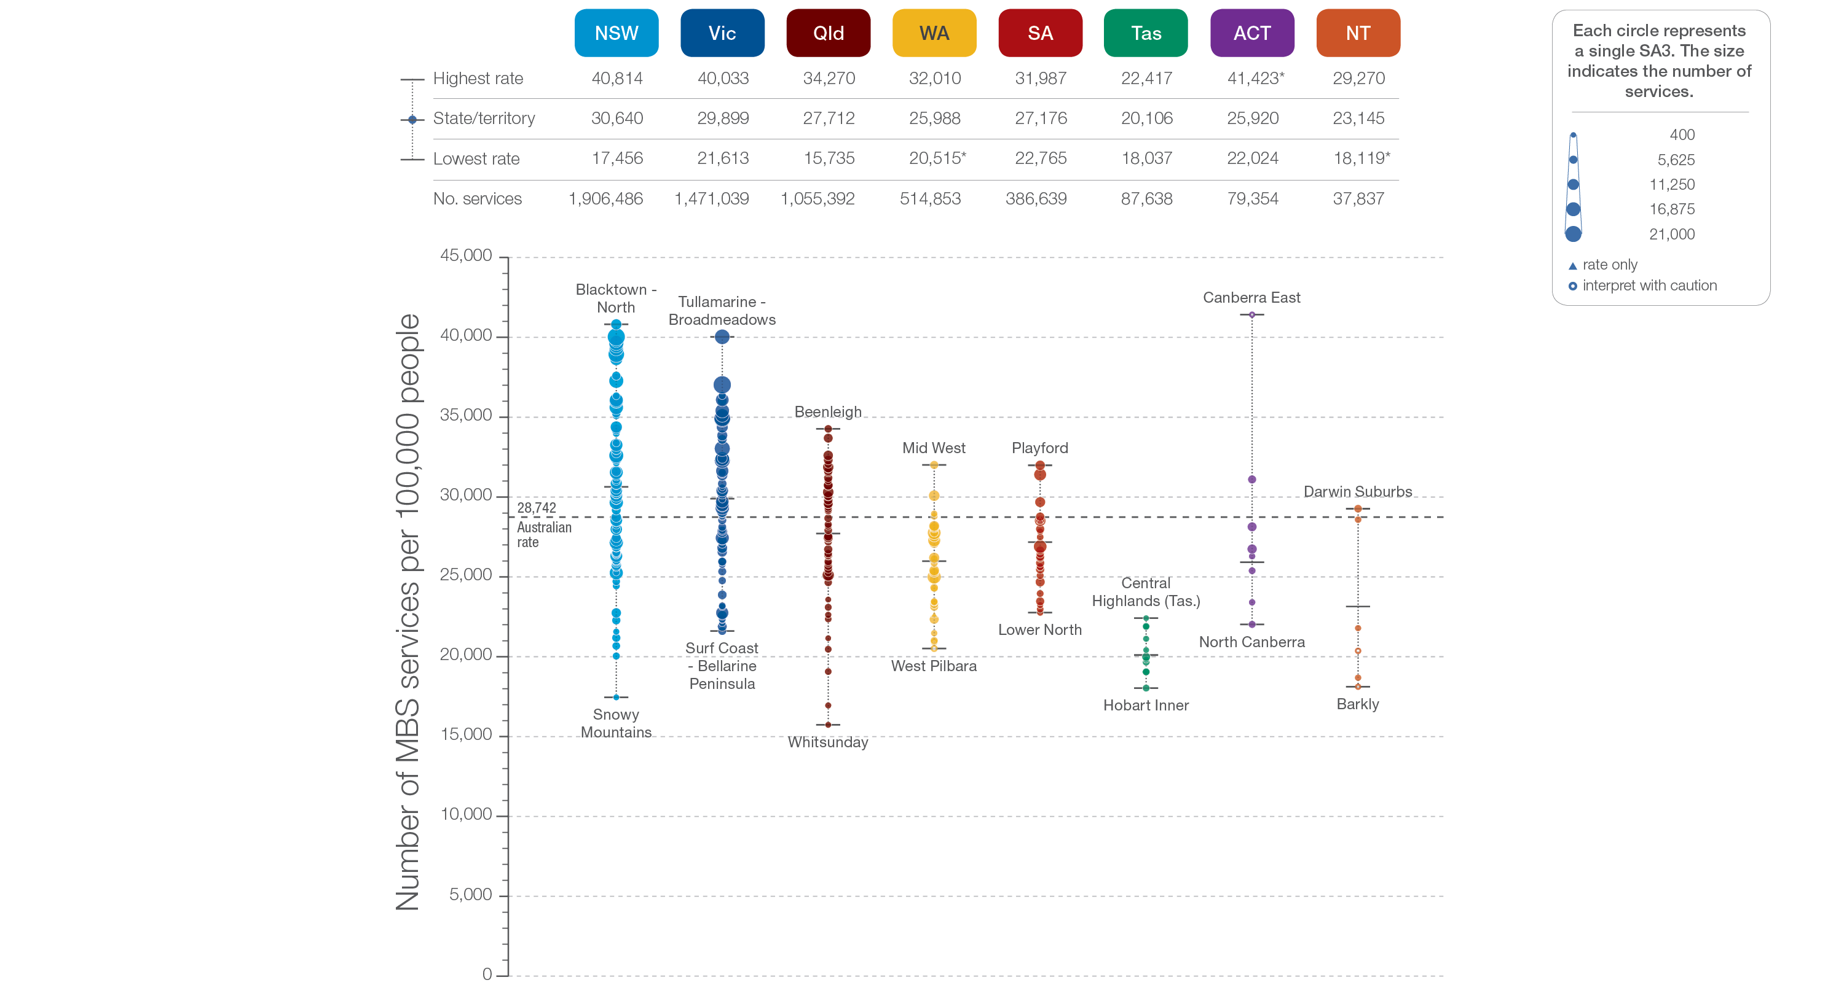
3.1 Thyroid stimulating hormone tests
State and territory
Sources: MBS data 2016-17, and ABS Estimated Resident Population 30 June 2016
Notes:
Speaker notes:
The number of MBS services for TSH tests varied across states and territories, from 20,106 per 100,000 people aged 18 years and over in Tasmania to 30,640 in New South Wales.
Each circle on the graph represents an SA3. The size of the circle indicates how many services have been recorded for people living in that area. The vertical axis shows the standardised rates for the clinical item.
Hollow circles and asterisks indicate rates that are considered more volatile than other published rates and should be interpreted with caution. Triangles indicate SA3s where only rates are published. The numbers of services are not published for confidentiality reasons.
For further detail about the methods used, please refer to the Technical Supplement.
For further information on how to interpret the figures, please refer to the ‘How to interpret’ resource available at: www.safetyandquality.gov.au/atlas/the-third-australian-atlas-of-healthcare-variation-2018/how-to-interpret-the-data/

Slide 67
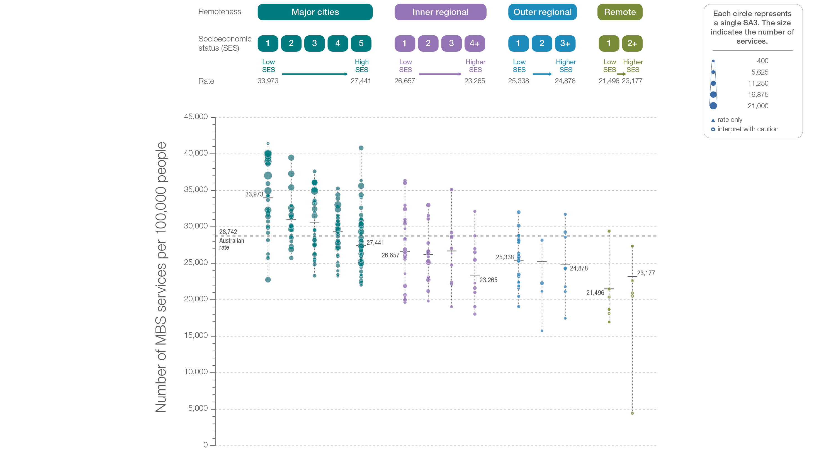
3.1 Thyroid stimulating hormone tests
Remoteness and socioeconomic status
Sources: MBS data 2016-17, and ABS Estimated Resident Population 30 June 2016
Notes:
Speaker notes:
Rates of TSH tests were higher in major cities and in inner regional areas than in outer regional and remote areas. Rates were higher in areas with lower socioeconomic status in major cities, inner regional areas and outer regional areas. The pattern was less clear in remote areas.
Hollow circles indicate rates that are considered more volatile than other published rates and should be interpreted with caution. Triangles indicate SA3s where only rates are published. The numbers of services are not published for confidentiality reasons.
For further detail about the methods used, please refer to the Technical Supplement.
For further information on how to interpret the figures, please refer to the ‘How to interpret’ resource available at: www.safetyandquality.gov.au/atlas/the-third-australian-atlas-of-healthcare-variation-2018/how-to-interpret-the-data/

Slide 68
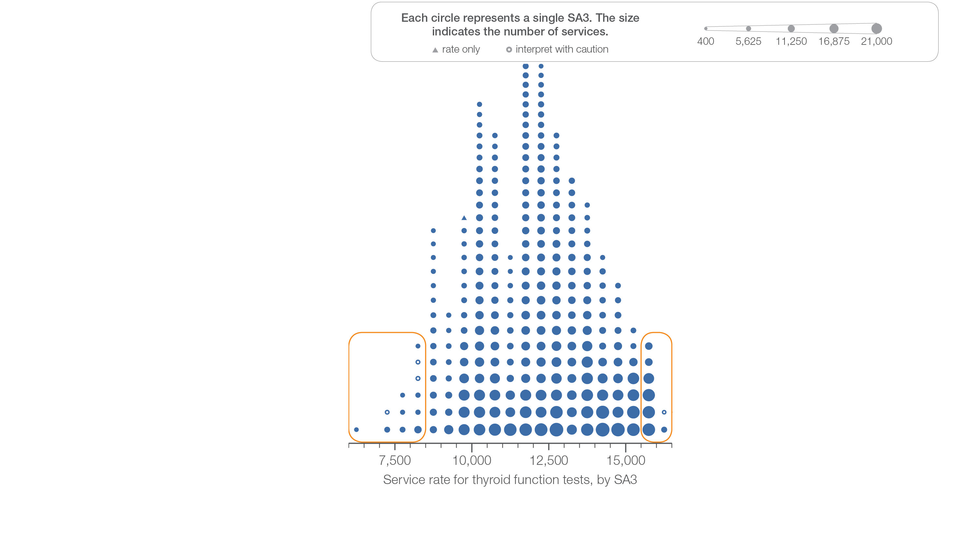
3.1 Thyroid function tests
Sources: MBS data 2016-17, and ABS Estimated Resident Population 30 June 2016
Notes:
Speaker notes:
This slide shows the distribution of rates by Statistical Area Level 3 (SA3) for thyroid function tests.
Each circle on the graph represents an SA3. The size of the circle indicates how many services have been recorded for people living in that area. The horizontal axis shows the standardised rates for the clinical item.
Hollow circles and asterisks indicate rates that are considered more volatile than other published rates and should be interpreted with caution. Triangles indicate SA3s where only rates are published. The numbers of services are not published for confidentiality reasons.
For further detail about the methods used, please refer to the Technical Supplement.
For further information on how to interpret the figures, please refer to the ‘How to interpret’ resource available at: www.safetyandquality.gov.au/atlas/the-third-australian-atlas-of-healthcare-variation-2018/how-to-interpret-the-data/

Slide 69
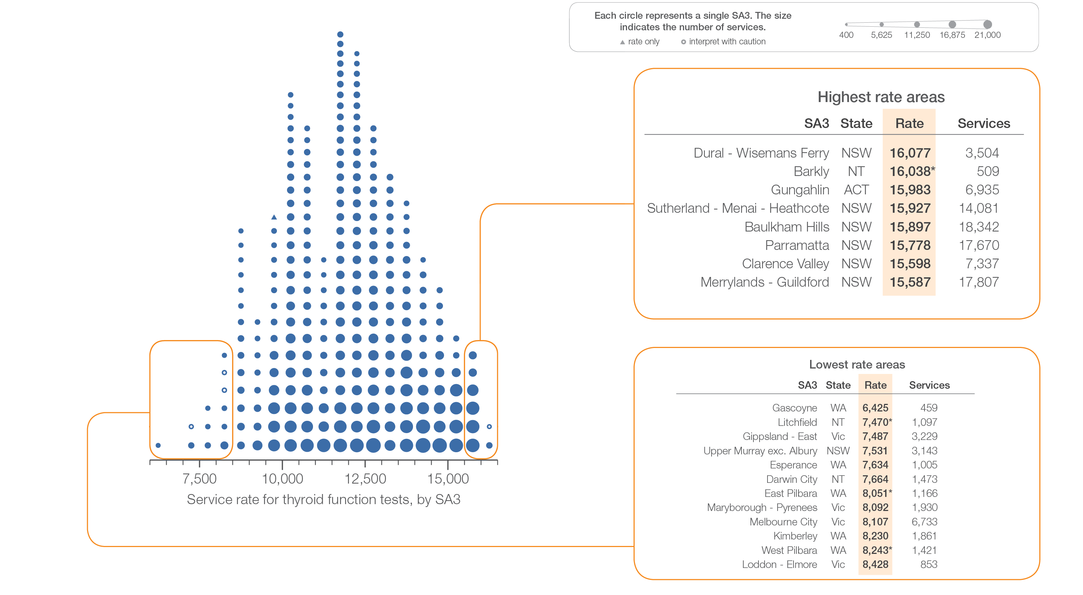
3.1 Thyroid function tests
Sources: MBS data 2016-17, and ABS Estimated Resident Population 30 June 2016
Notes:
Speaker notes:
This slide shows the distribution of rates by Statistical Area Level 3 (SA3) for thyroid function tests.
Each circle on the graph represents an SA3. The size of the circle indicates how many services have been recorded for people living in that area. The horizontal axis shows the standardised rates for the clinical item.
Hollow circles and asterisks indicate rates that are considered more volatile than other published rates and should be interpreted with caution. Triangles indicate SA3s where only rates are published. The numbers of services are not published for confidentiality reasons.
For further detail about the methods used, please refer to the Technical Supplement.
For further information on how to interpret the figures, please refer to the ‘How to interpret’ resource available at: www.safetyandquality.gov.au/atlas/the-third-australian-atlas-of-healthcare-variation-2018/how-to-interpret-the-data/

Slide 70
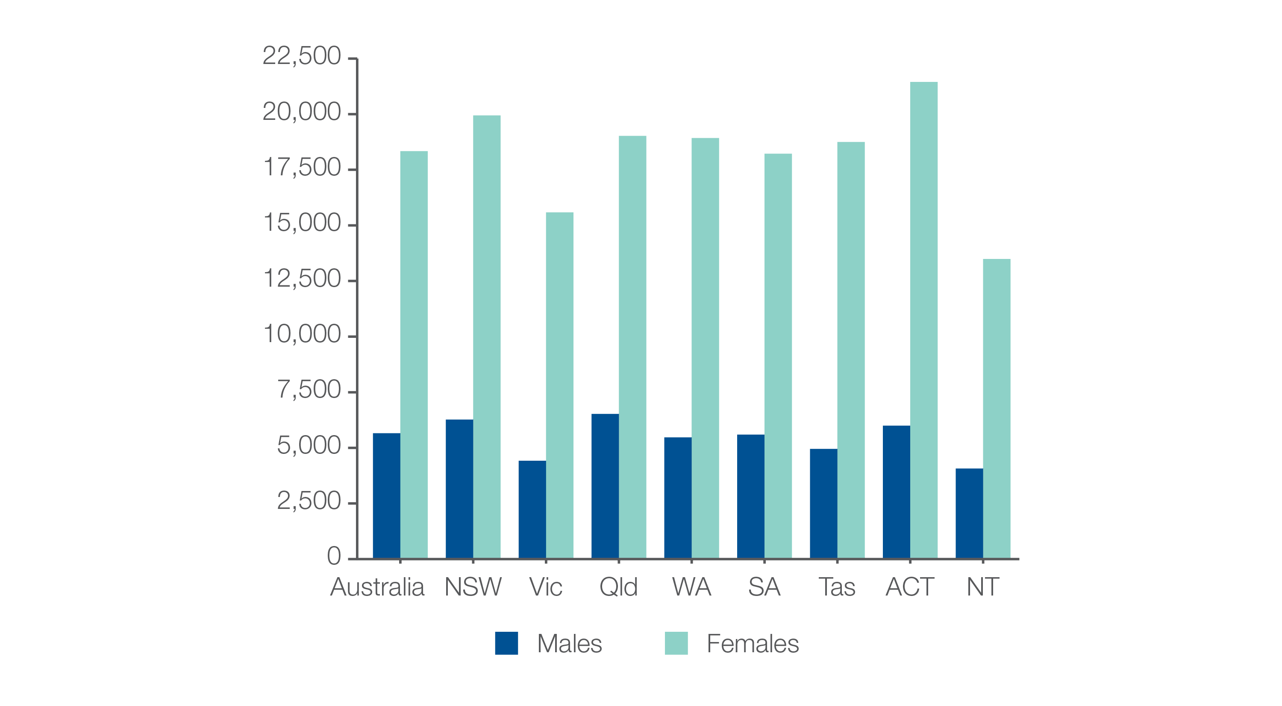
3.1 Thyroid function testing
MBS-subsidised services, by sex
Number per 100,000 people
Sources: MBS data 2016-17, and ABS Estimated Resident Population 30 June 2016
Notes:
Speaker notes:
Rates of TFTs were 3.2 times as high in females as in males.
In 2016–17, there were 558,142 MBS-subsidised services for TFTs for males aged 18 years and over, representing 5,656 services per 100,000 males (the Australian rate). The number of services varied across states and territories, from 4,072 per 100,000 males in the Northern Territory to 6,527 per 100,000 males in Queensland.
In 2016–17, there were 1,785,947 MBS-subsidised TFTs for females aged 18 years and over, representing 18,341 services per 100,000 females. The number of services varied across states and territories, from 13,490 services per 100,000 females in the Northern Territory to 21,449 per 100,000 females in the Australian Capital Territory.

Slide 71
3.1 Thyroid function testing
MBS-subsidised services, by age group
Number per 100,000 people
Sources: MBS data 2016-17, and ABS Estimated Resident Population 30 June 2016
Notes:
Speaker notes:
Rates of TFTs were highest for the 70 years and over age group (23,258 services per 100,000 people).
The number of services for this age group varied across states and territories, from 19,735 per 100,000 people in the Northern Territory to 28,407 per 100,000 people in the Australian Capital Territory.
The rate for the 70 years and over age group was 1.8 times as high as the rate for the 40–69 years age group and 2.9 times as high as the rate for the 18–39 years age group

Slide 72
3.1 Thyroid function testing
MBS-subsidised services, by referrer type
Number per 100,000 people
Sources: MBS data 2016-17, and ABS Estimated Resident Population 30 June 2016
Notes:
Speaker notes:
GPs ordered 73% of TFTs in Australia, endocrinologists ordered 8%, obstetricians and gynaecologists ordered 4%, and other health professionals ordered 15%.
The proportion ordered by GPs varied from 68% in New South Wales to 88% in the Northern Territory

Slide 73
3.1 Thyroid function tests
Sources: MBS data 2016-17, and ABS Estimated Resident Population 30 June 2016
Notes:
Speaker notes:
This slide shows the distribution of rates by Statistical Area Level 3 (SA3) for thyroid function tests. Rates are based on the patient’s usual place of residence, not the location of the healthcare provider.
The number of MBS-subsidised services for TFTs across 261 local areas (Statistical Area Level 3 – SA3) ranged from 6,425 to 16,077 per 100,000 people aged 18 years and over.
The rate was 2.5 times as high in the area with the highest rate compared to the area with the lowest rate.
The number of services varied across states and territories, from 8,868 per 100,000 people aged 18 years and over in the Northern Territory to 13,866 in the Australian Capital Territory.
The range of rates represented by each colour are shown in the legend for the map. The darker blue colour represents SA3s with higher rates. The lighter colours represent SA3s with lower rates.
Dotted areas indicate rates that are considered more volatile than other published rates and should be interpreted with caution. These rates are excluded from the calculation of the difference between the highest and lowest SA3 rates in Australia.
There are 340 SA3s. For this item, data were suppressed for 79 SA3s due to one or more of a small number of services or population in an area, or potential identification of individual patients, practitioners or business entities.
For further detail about the methods used, please refer to the Technical Supplement.
For further information on how to interpret the figures, please refer to the ‘How to interpret’ resource available at: www.safetyandquality.gov.au/atlas/the-third-australian-atlas-of-healthcare-variation-2018/how-to-interpret-the-data/

Slide 74
3.1 Thyroid function tests
Sources: MBS data 2016-17, and ABS Estimated Resident Population 30 June 2016
Notes:
Speaker notes:
This slide shows the distribution of rates by Statistical Area Level 3 (SA3) for thyroid function tests by capital city area. Rates are based on the patient’s usual place of residence, not the location of the healthcare provider.

Slide 75
3.1 Thyroid function tests
Sources: MBS data 2016-17, and ABS Estimated Resident Population 30 June 2016
Notes:
Speaker notes:
This slide shows the distribution of rates by Statistical Area Level 3 (SA3) for thyroid function tests by capital city area. Rates are based on the patient’s usual place of residence, not the location of the healthcare provider.

Slide 76
3.1 Thyroid function tests
State and territory
Sources: MBS data 2016-17, and ABS Estimated Resident Population 30 June 2016
Notes:
Speaker notes:
The number of services varied across states and territories, from 8,868 per 100,000 people aged 18 years and over in the Northern Territory to 13,866 in the Australian Capital Territory.
Each circle on the graph represents an SA3. The size of the circle indicates how many services have been recorded for people living in that area. The vertical axis shows the standardised rates for the clinical item.
Hollow circles and asterisks indicate rates that are considered more volatile than other published rates and should be interpreted with caution. Triangles indicate SA3s where only rates are published. The numbers of services are not published for confidentiality reasons.
For further detail about the methods used, please refer to the Technical Supplement.
For further information on how to interpret the figures, please refer to the ‘How to interpret’ resource available at: www.safetyandquality.gov.au/atlas/the-third-australian-atlas-of-healthcare-variation-2018/how-to-interpret-the-data/

Slide 77
3.1 Thyroid function tests
Remoteness and socioeconomic status
Sources: MBS data 2016-17, and ABS Estimated Resident Population 30 June 2016
Notes:
Speaker notes:
Rates of TFTs were markedly lower in remote areas than in other areas. There was no clear pattern according to socioeconomic status.
Suppressed data are included in the calculation of overall rates by remoteness and socioeconomic status.
Hollow circles and asterisks indicate rates that are considered more volatile than other published rates and should be interpreted with caution. Triangles indicate SA3s where only rates are published. The numbers of services are not published for confidentiality reasons.
For further detail about the methods used, please refer to the Technical Supplement.
For further information on how to interpret the figures, please refer to the ‘How to interpret’ resource available at: www.safetyandquality.gov.au/atlas/the-third-australian-atlas-of-healthcare-variation-2018/how-to-interpret-the-data/

Slide 78
3.2 Neck ultrasound
Sources: MBS data 2016-17, and ABS Estimated Resident Population 30 June 2016
Notes:
Speaker notes:
This slide shows the distribution of rates by Statistical Area Level 3 (SA3) for neck ultrasounds.
Each circle on the graph represents an SA3. The size of the circle indicates how many services have been recorded for people living in that area. The horizontal axis shows the standardised rates for the clinical item.
Hollow circles and asterisks indicate rates that are considered more volatile than other published rates and should be interpreted with caution. Triangles indicate SA3s where only rates are published. The numbers of services are not published for confidentiality reasons.
For further detail about the methods used, please refer to the Technical Supplement.
For further information on how to interpret the figures, please refer to the ‘How to interpret’ resource available at: www.safetyandquality.gov.au/atlas/the-third-australian-atlas-of-healthcare-variation-2018/how-to-interpret-the-data/

Slide 79
3.2 Neck ultrasound
Sources: MBS data 2016-17, and ABS Estimated Resident Population 30 June 2016
Notes:
Speaker notes:
This slide shows the distribution of rates by Statistical Area Level 3 (SA3) for neck ultrasounds.
Each circle on the graph represents an SA3. The size of the circle indicates how many services have been recorded for people living in that area. The horizontal axis shows the standardised rates for the clinical item.
Hollow circles and asterisks indicate rates that are considered more volatile than other published rates and should be interpreted with caution. Triangles indicate SA3s where only rates are published. The numbers of services are not published for confidentiality reasons.
For further detail about the methods used, please refer to the Technical Supplement.
For further information on how to interpret the figures, please refer to the ‘How to interpret’ resource available at: www.safetyandquality.gov.au/atlas/the-third-australian-atlas-of-healthcare-variation-2018/how-to-interpret-the-data/

Slide 80
3.2 Neck ultrasound
Sources: MBS data 2016-17, and ABS Estimated Resident Population 30 June 2016
Notes:
Speaker notes:
This slide shows the distribution of rates by Statistical Area Level 3 (SA3) for neck ultrasound. Rates are based on the patient’s usual place of residence, not the location of the healthcare provider.
In 2016–17, there were 308,247 MBS-subsidised services for neck ultrasound, representing 1,606 services per 100,000 people aged 18 years and over (the Australian rate).
The number of MBS-subsidised services for neck ultrasound across 329 local areas (Statistical Area Level 3 – SA3), ranged from 513 to 2,893 per 100,000 people aged 18 years and over.
The rate was 5.6 times as high in the area with the highest rate compared to the area with the lowest rate.
The number of services varied across states and territories, from 983 per 100,000 people aged 18 years and over in the Northern Territory to 1,946 in New South Wales.
The range of rates represented by each colour are shown in the legend for the map. The darker blue colour represents SA3s with higher rates. The lighter colours represent SA3s with lower rates.
Dotted areas indicate rates that are considered more volatile than other published rates and should be interpreted with caution. These rates are excluded from the calculation of the difference between the highest and lowest SA3 rates in Australia.
For further detail about the methods used, please refer to the Technical Supplement.
For further information on how to interpret the figures, please refer to the ‘How to interpret’ resource available at: www.safetyandquality.gov.au/atlas/the-third-australian-atlas-of-healthcare-variation-2018/how-to-interpret-the-data/

Slide 81
3.2 Neck ultrasound
Sources: MBS data 2016-17, and ABS Estimated Resident Population 30 June 2016
Notes:
Speaker notes:
This slide shows the distribution of rates by Statistical Area Level 3 (SA3) for neck ultrasound by capital city area. Rates are based on the patient’s usual place of residence, not the location of the healthcare provider.

Slide 82
3.2 Neck ultrasound
Sources: MBS data 2016-17, and ABS Estimated Resident Population 30 June 2016
Notes:
Speaker notes:
This slide shows the distribution of rates by Statistical Area Level 3 (SA3) for neck ultrasound by capital city area. Rates are based on the patient’s usual place of residence, not the location of the healthcare provider.

Slide 83
3.2 Neck ultrasound
State and territory
Sources: MBS data 2016-17, and ABS Estimated Resident Population 30 June 2016
Notes:
Speaker notes:
The number of MBS services for neck ultrasound varied across states and territories, from 983 per 100,000 people aged 18 years and over in the Northern Territory to 1,946 in New South Wales.
Each circle on the graph represents an SA3. The size of the circle indicates how many services have been recorded for people living in that area. The vertical axis shows the standardised rates for the clinical item.
Hollow circles and asterisks indicate rates that are considered more volatile than other published rates and should be interpreted with caution. Triangles indicate SA3s where only rates are published. The numbers of services are not published for confidentiality reasons.
For further detail about the methods used, please refer to the Technical Supplement.
For further information on how to interpret the figures, please refer to the ‘How to interpret’ resource available at: www.safetyandquality.gov.au/atlas/the-third-australian-atlas-of-healthcare-variation-2018/how-to-interpret-the-data/

Slide 84
3.2 Neck ultrasound
Remoteness and socioeconomic status
Sources: MBS data 2016-17, and ABS Estimated Resident Population 30 June 2016
Notes:
Speaker notes:
Rates of neck ultrasound were higher in major cities than in other areas. Rates were higher in areas with lower socioeconomic status in major cities and remote areas. However, there was no clear pattern according to socioeconomic status in other remoteness categories.
Hollow circles indicate rates that are considered more volatile than other published rates and should be interpreted with caution. Triangles indicate SA3s where only rates are published. The numbers of services are not published for confidentiality reasons.
For further detail about the methods used, please refer to the Technical Supplement.
For further information on how to interpret the figures, please refer to the ‘How to interpret’ resource available at: www.safetyandquality.gov.au/atlas/the-third-australian-atlas-of-healthcare-variation-2018/how-to-interpret-the-data/

Slide 85
3.2 Thyroidectomy hospitalisations
Sources: NHMD data 2016-17, and ABS Estimated Resident Population 30 June 2016
Notes:
Speaker notes:
This slide shows the distribution of rates by Statistical Area Level 3 (SA3) for thyroidectomy hospitalisations.
Each circle on the graph represents an SA3. The size of the circle indicates how many services have been recorded for people living in that area. The horizontal axis shows the standardised rates for the clinical item.
For further information on how to interpret the figures, please refer to the ‘How to interpret’ resource available at: www.safetyandquality.gov.au/atlas/the-third-australian-atlas-of-healthcare-variation-2018/how-to-interpret-the-data/

Slide 86
3.2 Thyroidectomy hospitalisations
Sources: NHMD data 2016-17, and ABS Estimated Resident Population 30 June 2016
Notes:
Speaker notes:
This slide shows the distribution of rates by Statistical Area Level 3 (SA3) for thyroidectomy hospitalisations.
Each circle on the graph represents an SA3. The size of the circle indicates how many services have been recorded for people living in that area. The horizontal axis shows the standardised rates for the clinical item.
For further information on how to interpret the figures, please refer to the ‘How to interpret’ resource available at: www.safetyandquality.gov.au/atlas/the-third-australian-atlas-of-healthcare-variation-2018/how-to-interpret-the-data/

Slide 87
3.2 Thyroidectomy
Sources: NHMD data 2014-15 to 2016-17, and ABS Estimated Resident Population 30 June 2016
Notes:
Speaker notes:
This slide shows the distribution of rates by Statistical Area Level 3 (SA3) for thyroidectomy hospitalisations. Rates are based on the patient’s usual place of residence, not the location of the healthcare provider.
Over the three-year period 2014–15 to 2016–17, there were 35,166 hospitalisations for thyroidectomy, representing an average rate of 62 hospitalisations per 100,000 people aged 18 years and over (the Australian rate).
The number of hospitalisations for thyroidectomy across 327 local areas (Statistical Area Level 3 – SA3), ranged from 28 to 130 per 100,000 people aged 18 years and over (there are 340 SA3s. For this item, data were suppressed for 13 SA3s due to a small number of hospitalisations and/or population in an area).
The rate was 4.6 times as high in the area with the highest rate compared to the area with the lowest rate.
The number of hospitalisations varied across states and territories, from 42 per 100,000 people aged 18 years and over in the Australian Capital Territory to 68 in New South Wales.
The range of rates represented by each colour are shown in the legend for the map. The darker blue colour represents SA3s with higher rates. The lighter colours represent SA3s with lower rates. Dotted areas indicate rates that are considered more volatile than other published rates and should be interpreted with caution. These rates are excluded from the calculation of the difference between the highest and lowest SA3 rates in Australia.
For further detail about the methods used, please refer to the Technical Supplement.
For further information on how to interpret the figures, please refer to the ‘How to interpret’ resource available at: www.safetyandquality.gov.au/atlas/the-third-australian-atlas-of-healthcare-variation-2018/how-to-interpret-the-data/

Slide 88
3.2 Thyroidectomy
Sources: NHMD data 2014-15 to 2016-17, and ABS Estimated Resident Population 30 June 2016
Notes:
Speaker notes:
This slide shows the distribution of rates by Statistical Area Level 3 (SA3) for thyroidectomy hospitalisation by capital city area. Rates are based on the patient’s usual place of residence, not the location of the healthcare provider.

Slide 89
3.2 Thyroidectomy
Sources: NHMD data 2014-15 to 2016-17, and ABS Estimated Resident Population 30 June 2016
Notes:
Speaker notes:
This slide shows the distribution of rates by Statistical Area Level 3 (SA3) for thyroidectomy hospitalisation by capital city area. Rates are based on the patient’s usual place of residence, not the location of the healthcare provider.

Slide 90
3.2 Thyroidectomy
Hospitalisations by Aboriginal and Torres Strait Islander status
Number per 100,000 people
Sources: NHMD data 2014-15 to 2016-17 , and ABS Estimated Resident Population 30 June 2016
Notes:
Speaker notes:
The rate of hospitalisations for thyroidectomy for Aboriginal and Torres Strait Islander Australians (54 per 100,000 people) was 13% lower than the rate for other Australians (62 per 100,000 people).

Slide 91
3.2 Thyroidectomy
Hospitalisations by patient funding status
Number per 100,000 people
Sources: NHMD data 2014-15 to 2016-17, and ABS Estimated Resident Population 30 June 2016
Notes:
Speaker notes:
Overall, 56% of hospitalisations for thyroidectomy were for privately funded patients.
This proportion varied from 47% in the Northern Territory to 62% in Western Australia.
The median age at operation was 53 years for publicly funded patients and 56 years for privately funded patients.

Slide 92
3.2 Thyroidectomy
Hospitalisations by principal diagnosis
Number per 100,000 people
Sources: NHMD data 2014-15 to 2016-17, and ABS Estimated Resident Population 30 June 2016
Notes:
Speaker notes:
The number of hospitalisations for thyroidectomy for patients with malignant neoplasms varied across states and territories, from 12 per 100,000 people in the Australian Capital Territory, Victoria and Tasmania to 18 in New South Wales.
The number of hospitalisations for thyroidectomy for patients with goitre varied from 15 per 100,000 people in the Northern Territory to 36 in Victoria

Slide 93
3.2 Thyroidectomy
State and territory
Sources: NHMD data 2014-15 to 2016-17, and ABS Estimated Resident Population 30 June 2016
Notes:
Speaker notes:
The number of hospitalisations varied across states and territories, from 42 per 100,000 people aged 18 years and over in the Australian Capital Territory to 68 in New South Wales.
Each circle on the graph represents an SA3. The size of the circle indicates how many services have been recorded for people living in that area. The vertical axis shows the standardised rates for the clinical item.
For further detail about the methods used, please refer to the Technical Supplement.
For further information on how to interpret the figures, please refer to the ‘How to interpret’ resource available at: www.safetyandquality.gov.au/atlas/the-third-australian-atlas-of-healthcare-variation-2018/how-to-interpret-the-data/

Slide 94
3.2 Thyroidectomy
Remoteness and socioeconomic status
Sources: NHMD data 2014-15 to 2016-17, and ABS Estimated Resident Population 30 June 2016
Notes:
Speaker notes:
Rates of hospitalisations for thyroidectomy were higher in major cities and inner regional areas than in outer regional and remote areas. Rates were higher in areas with lower socioeconomic status in major cities and in inner regional areas. However, there was no clear pattern according to socioeconomic status in other remoteness categories.
Each circle on the graph represents an SA3. The size of the circle indicates how many services have been recorded for people living in that area. The vertical axis shows the standardised rates for the clinical item.
For further detail about the methods used, please refer to the Technical Supplement.
For further information on how to interpret the figures, please refer to the ‘How to interpret’ resource available at: www.safetyandquality.gov.au/atlas/the-third-australian-atlas-of-healthcare-variation-2018/how-to-interpret-the-data/

Slide 95
Cardiac tests
Notes:
Speaker notes:
This chapter examines:
- Cardiac stress tests and imaging, 18 years and over
- Stress echocardiography, 18 years and over
- Myocardial perfusion scans, 18 years and over
- Standard echocardiography, 18 years and over

Slide 96
Cardiac tests
Key findings
Data item | Range across local areas* per 100,000 | Times difference | Times difference excluding top and bottom 10% | Number during 2016–17
4.1 Cardiac stress tests and imaging†§, 18 years and over | 1,184–11,568 | 9.8 | 3.8 | 933,727
4.2 Stress echocardiography§, 18 years and over | 104–4,894 | 47.1 | 5.8 | 303,525
4.3 Myocardial perfusion scans§, 18 years and over | 29–1,652 | 57.0 | 4.9 | 79,905
4.4 Standard echocardiography§, 18 years and over | 2,279–7,957 | 3.5 | 2.1 | 945,056
* Statistical Area Level 3
† Exercise electrocardiograms, stress echocardiography, myocardial perfusion scans and computed tomography of coronary arteries
§ Based on number of MBS-subsidised services
Sources: MBS data 2016-17, and ABS Estimated Resident Population 30 June 2016
Notes:
Speaker notes:
In 2016–17, there were over 900,000 MBS-subsidised services for cardiac stress tests and imaging, representing 4,575 services per 100,000 people aged 18 years and over.
Rates of cardiac stress tests and imaging were highest in the 45–79 years age group.
Substantial variation was observed between Statistical Area Level 3 (SA3) areas in the rates of stress echocardiography. They were 47.1 times as high in the area with the highest rate compared to the area with the lowest rate. For myocardial perfusion scans, the rate was 57.0 times as high in the area with the highest rate compared to the area with the lowest rate.
The marked variation between states is likely to be affected by factors such as rates of underlying disease, access to services, funding models and availability of previous test results.

Slide 97
4.1 Cardiac stress tests and imaging, 18 years and over
Sources: MBS data 2016-17, and ABS Estimated Resident Population 30 June 2016
Notes:
Speaker notes:
This slide shows the distribution of rates by Statistical Area Level 3 (SA3) for cardiac stress tests and imaging.
Each circle on the graph represents an SA3. The size of the circle indicates how many services have been recorded for people living in that area. The horizontal axis shows the standardised rates for the clinical item.
Hollow circles and asterisks indicate rates that are considered more volatile than other published rates and should be interpreted with caution. Triangles indicate SA3s where only rates are published. The numbers of services are not published for confidentiality reasons.
For further detail about the methods used, please refer to the Technical Supplement.
For further information on how to interpret the figures, please refer to the ‘How to interpret’ resource available at: www.safetyandquality.gov.au/atlas/the-third-australian-atlas-of-healthcare-variation-2018/how-to-interpret-the-data/

Slide 98
4.1 Cardiac stress tests and imaging, 18 years and over
Sources: MBS data 2016-17, and ABS Estimated Resident Population 30 June 2016
Notes:
Speaker notes:
This slide shows the distribution of rates by Statistical Area Level 3 (SA3) for cardiac stress tests and imaging.
Each circle on the graph represents an SA3. The size of the circle indicates how many services have been recorded for people living in that area. The horizontal axis shows the standardised rates for the clinical item.
Hollow circles and asterisks indicate rates that are considered more volatile than other published rates and should be interpreted with caution. Triangles indicate SA3s where only rates are published. The numbers of services are not published for confidentiality reasons.
For further detail about the methods used, please refer to the Technical Supplement.
For further information on how to interpret the figures, please refer to the ‘How to interpret’ resource available at: www.safetyandquality.gov.au/atlas/the-third-australian-atlas-of-healthcare-variation-2018/how-to-interpret-the-data/

Slide 99
4.1 Cardiac stress tests and imaging, 18 years and over
Sources: MBS data 2016-17, and ABS Estimated Resident Population 30 June 2016
Notes:
Speaker notes:
This slide shows the distribution of rates by Statistical Area Level 3 (SA3) for cardiac stress tests and imaging. Rates are based on the patient’s usual place of residence, not the location of the healthcare provider.
In 2016–17, there were 933,727 MBS-subsidised services for cardiac stress tests and imaging, representing 4,575 services per 100,000 people aged 18 years and over (the Australian rate).
The number of MBS-subsidised services for cardiac stress tests and imaging across 329* local areas (Statistical Area Level 3 – SA3) ranged from 1,184 to 11,568 per 100,000 people aged 18 years and over.
The rate was 9.8 times as high in the area with the highest rate compared to the area with the lowest rate.
The number of services varied across states and territories, from 2,289 per 100,000 people aged 18 years and over in Tasmania to 6,673 in New South Wales.
The range of rates represented by each colour are shown in the legend for the map. The darker blue colour represents SA3s with higher rates. The lighter colours represent SA3s with lower rates.
Dotted areas indicate rates that are considered more volatile than other published rates and should be interpreted with caution. These rates are excluded from the calculation of the difference between the highest and lowest SA3 rates in Australia.
For further detail about the methods used, please refer to the Technical Supplement.
For further information on how to interpret the figures, please refer to the ‘How to interpret’ resource available at: www.safetyandquality.gov.au/atlas/the-third-australian-atlas-of-healthcare-variation-2018/how-to-interpret-the-data/

Slide 100
4.1 Cardiac stress tests and imaging, 18 years and over
Sources: MBS data 2016-17, and ABS Estimated Resident Population 30 June 2016
Notes:
Speaker notes:
This slide shows the distribution of rates by Statistical Area Level 3 (SA3) for cardiac stress tests and imaging by capital city area. Rates are based on the patient’s usual place of residence, not the location of the healthcare provider.

Slide 101
4.1 Cardiac stress tests and imaging, 18 years and over
Sources: MBS data 2016-17, and ABS Estimated Resident Population 30 June 2016
Notes:
Speaker notes:
This slide shows the distribution of rates by Statistical Area Level 3 (SA3) for cardiac stress tests and imaging by capital city area. Rates are based on the patient’s usual place of residence, not the location of the healthcare provider.

Slide 102
4.1 Cardiac stress tests and imaging, 18 years and over
MBS-subsidised services, by cardiac test type
Number per 100,000 people
Sources: MBS data 2016-17, and ABS Estimated Resident Population 30 June 2016
Notes:
Speaker notes:
Nationally, 53% of cardiac stress tests and imaging were exercise ECGs, 33% were stress echocardiograms, 8% were MPS and 6% were CTCA.
The proportions for each test were similar across all states and territories.

Slide 103
4.1 Cardiac stress tests and imaging, 18 years and over
MBS-subsidised services, by referrer
Number per 100,000 people
Sources: MBS data 2016-17, and ABS Estimated Resident Population 30 June 2016
Notes:
Speaker notes:
Nationally, 64% of cardiac stress tests and imaging were requested by general practitioners (GPs), 26% of tests were requested by cardiologists and 10% were requested by other health professionals.
The proportion of tests requested by GPs varied from 42% in South Australia to 72% in New South Wales and the Australian Capital Territory.
The proportion of tests requested by cardiologists varied from 19% in New South Wales to 47% in South Australia

Slide 104
4.1 Cardiac stress tests and imaging, 18 years and over
MBS-subsidised services, by age group
Number per 100,000 people
Sources: MBS data 2016-17, and ABS Estimated Resident Population 30 June 2016
Notes:
Speaker notes:
Rates of cardiac stress tests and imaging were highest in the 45–79 years age group.
The national rate in this age group was 8,497 per 100,000 people and varied from 4,255 per 100,000 people in Tasmania to 12,466 per 100,000 people in New South Wales.
The national rate for tests performed on the 80 years and over age group was slightly lower at 7,744 per 100,000 people. The rate varied from 3,447 per 100,000 people in Tasmania to 12,211 per 100,000 people in New South Wales.

Slide 105
4.1 Cardiac stress tests and imaging, 18 years and over
State and territory
Sources: MBS data 2016-17, and ABS Estimated Resident Population 30 June 2016
Notes:
Speaker notes:
The number of services varied across states and territories, from 2,289 per 100,000 people aged 18 years and over in Tasmania to 6,673 in New South Wales.
Each circle on the graph represents an SA3. The size of the circle indicates how many services have been recorded for people living in that area. The vertical axis shows the standardised rates for the clinical item.
Hollow circles and asterisks indicate rates that are considered more volatile than other published rates and should be interpreted with caution. Triangles indicate SA3s where only rates are published. The numbers of services are not published for confidentiality reasons.
For further detail about the methods used, please refer to the Technical Supplement.
For further information on how to interpret the figures, please refer to the ‘How to interpret’ resource available at: www.safetyandquality.gov.au/atlas/the-third-australian-atlas-of-healthcare-variation-2018/how-to-interpret-the-data/

Slide 106
4.1 Cardiac stress tests and imaging, 18 years and over
Remoteness and socioeconomic status
Sources: MBS data 2016-17, and ABS Estimated Resident Population 30 June 2016
Notes:
Speaker notes:
Rates of cardiac stress tests and imaging were higher in major cities than in other areas. There was no clear pattern according to socioeconomic status.
Hollow circles indicate rates that are considered more volatile than other published rates and should be interpreted with caution. Triangles indicate SA3s where only rates are published. The numbers of services are not published for confidentiality reasons.
For further detail about the methods used, please refer to the Technical Supplement.
For further information on how to interpret the figures, please refer to the ‘How to interpret’ resource available at: www.safetyandquality.gov.au/atlas/the-third-australian-atlas-of-healthcare-variation-2018/how-to-interpret-the-data/

Slide 107
4.2 Stress echocardiography, 18 years and over
Sources: MBS data 2016-17, and ABS Estimated Resident Population 30 June 2016
Notes:
Speaker notes:
This slide shows the distribution of rates by Statistical Area Level 3 (SA3) for stress echocardiography.
Each circle on the graph represents an SA3. The size of the circle indicates how many services have been recorded for people living in that area. The horizontal axis shows the standardised rates for the clinical item.
Hollow circles and asterisks indicate rates that are considered more volatile than other published rates and should be interpreted with caution. Triangles indicate SA3s where only rates are published. The numbers of services are not published for confidentiality reasons.
For further detail about the methods used, please refer to the Technical Supplement.
For further information on how to interpret the figures, please refer to the ‘How to interpret’ resource available at: www.safetyandquality.gov.au/atlas/the-third-australian-atlas-of-healthcare-variation-2018/how-to-interpret-the-data/

Slide 108
4.2 Stress echocardiography, 18 years and over
Sources: MBS data 2016-17, and ABS Estimated Resident Population 30 June 2016
Notes:
Speaker notes:
This slide shows the distribution of rates by Statistical Area Level 3 (SA3) for stress echocardiography.
Each circle on the graph represents an SA3. The size of the circle indicates how many services have been recorded for people living in that area. The horizontal axis shows the standardised rates for the clinical item.
Hollow circles and asterisks indicate rates that are considered more volatile than other published rates and should be interpreted with caution. Triangles indicate SA3s where only rates are published. The numbers of services are not published for confidentiality reasons.
For further detail about the methods used, please refer to the Technical Supplement.
For further information on how to interpret the figures, please refer to the ‘How to interpret’ resource available at: www.safetyandquality.gov.au/atlas/the-third-australian-atlas-of-healthcare-variation-2018/how-to-interpret-the-data/

Slide 109
4.2 Stress echocardiography, 18 years and over
Sources: MBS data 2016-17, and ABS Estimated Resident Population 30 June 2016
Notes:
Speaker notes:
This slide shows the distribution of rates by Statistical Area Level 3 (SA3) for stress echocardiography. Rates are based on the patient’s usual place of residence, not the location of the healthcare provider.
In 2016–17, there were 303,525 MBS-subsidised services for stress echocardiography, representing 1,491 services per 100,000 people aged 18 years and over (the Australian rate).
The number of MBS-subsidised services for stress echocardiography across 325* local areas (Statistical Area Level 3 – SA3) ranged from 104 to 4,894 per 100,000 people aged 18 years and over.
The rate was 47.1 times as high in the area with the highest rate compared to the area with the lowest rate.
The number of services varied across states and territories, from 698 per 100,000 people aged 18 years and over in the Northern Territory to 2,265 in New South Wales.
The range of rates represented by each colour are shown in the legend for the map. The darker blue colour represents SA3s with higher rates. The lighter colours represent SA3s with lower rates.
Dotted areas indicate rates that are considered more volatile than other published rates and should be interpreted with caution. These rates are excluded from the calculation of the difference between the highest and lowest SA3 rates in Australia.
For further detail about the methods used, please refer to the Technical Supplement.
For further information on how to interpret the figures, please refer to the ‘How to interpret’ resource available at: www.safetyandquality.gov.au/atlas/the-third-australian-atlas-of-healthcare-variation-2018/how-to-interpret-the-data/

Slide 110
4.2 Stress echocardiography, 18 years and over
Sources: MBS data 2016-17, and ABS Estimated Resident Population 30 June 2016
Notes:
Speaker notes:
This slide shows the distribution of rates by Statistical Area Level 3 (SA3) for stress echocardiography by capital city area. Rates are based on the patient’s usual place of residence, not the location of the healthcare provider.

Slide 111
4.2 Stress echocardiography, 18 years and over
Sources: MBS data 2016-17, and ABS Estimated Resident Population 30 June 2016
Notes:
Speaker notes:
This slide shows the distribution of rates by Statistical Area Level 3 (SA3) for stress echocardiography by capital city area. Rates are based on the patient’s usual place of residence, not the location of the healthcare provider.

Slide 112
4.2 Stress echocardiography, 18 years and over
State and territory
Sources: MBS data 2016-17, and ABS Estimated Resident Population 30 June 2016
Notes:
Speaker notes:
The number of services varied across states and territories, from 698 per 100,000 people aged 18 years and over in the Northern Territory to 2,265 in New South Wales.
Each circle on the graph represents an SA3. The size of the circle indicates how many services have been recorded for people living in that area. The vertical axis shows the standardised rates for the clinical item.
Hollow circles and asterisks indicate rates that are considered more volatile than other published rates and should be interpreted with caution. Triangles indicate SA3s where only rates are published. The numbers of services are not published for confidentiality reasons.
For further detail about the methods used, please refer to the Technical Supplement.
For further information on how to interpret the figures, please refer to the ‘How to interpret’ resource available at: www.safetyandquality.gov.au/atlas/the-third-australian-atlas-of-healthcare-variation-2018/how-to-interpret-the-data/

Slide 113
4.2 Stress echocardiography, 18 years and over
Remoteness and socioeconomic status
Sources: MBS data 2016-17, and ABS Estimated Resident Population 30 June 2016
Notes:
Speaker notes:
Rates of stress echocardiography were higher in major cities and inner regional areas than in outer regional and remote areas. There was no clear pattern according to socioeconomic status.
Hollow circles indicate rates that are considered more volatile than other published rates and should be interpreted with caution. Triangles indicate SA3s where only rates are published. The numbers of services are not published for confidentiality reasons.
For further detail about the methods used, please refer to the Technical Supplement.
For further information on how to interpret the figures, please refer to the ‘How to interpret’ resource available at: www.safetyandquality.gov.au/atlas/the-third-australian-atlas-of-healthcare-variation-2018/how-to-interpret-the-data/

Slide 114
4.3 Myocardial perfusion scans, 18 years and over
Sources: MBS data 2016-17, and ABS Estimated Resident Population 30 June 2016
Notes:
Speaker notes:
This slide shows the distribution of rates by Statistical Area Level 3 (SA3) for myocardial perfusion scans.
Each circle on the graph represents an SA3. The size of the circle indicates how many services have been recorded for people living in that area. The horizontal axis shows the standardised rates for the clinical item.
Triangles indicate SA3s where only rates are published. The numbers of services are not published for confidentiality reasons.
For further detail about the methods used, please refer to the Technical Supplement.
For further information on how to interpret the figures, please refer to the ‘How to interpret’ resource available at: www.safetyandquality.gov.au/atlas/the-third-australian-atlas-of-healthcare-variation-2018/how-to-interpret-the-data/

Slide 115
4.3 Myocardial perfusion scans, 18 years and over
Sources: MBS data 2016-17, and ABS Estimated Resident Population 30 June 2016
Notes:
Speaker notes:
This slide shows the distribution of rates by Statistical Area Level 3 (SA3) for myocardial perfusion scans.
Each circle on the graph represents an SA3. The size of the circle indicates how many services have been recorded for people living in that area. The horizontal axis shows the standardised rates for the clinical item.
Triangles indicate SA3s where only rates are published. The numbers of services are not published for confidentiality reasons.
For further detail about the methods used, please refer to the Technical Supplement.
For further information on how to interpret the figures, please refer to the ‘How to interpret’ resource available at: www.safetyandquality.gov.au/atlas/the-third-australian-atlas-of-healthcare-variation-2018/how-to-interpret-the-data/

Slide 116
4.3 Myocardial perfusion scans, 18 years and over
Sources: MBS data 2016-17, and ABS Estimated Resident Population 30 June 2016
Notes:
Speaker notes:
This slide shows the distribution of rates by Statistical Area Level 3 (SA3) for myocardial perfusion scans. Rates are based on the patient’s usual place of residence, not the location of the healthcare provider.
In 2016–17, there were 79,905 MBS-subsidised services for MPS, representing 384 services per 100,000 people aged 18 years and over (the Australian rate).
The number of MBS-subsidised services for MPS across 278* local areas (Statistical Area Level 3 – SA3) ranged from 29 to 1,652 per 100,000 people aged 18 years and over.
The rate was 57.0 times as high in the area with the highest rate compared to the area with the lowest rate.
The number of services varied across states and territories, from 182 per 100,000 people aged 18 years and over in South Australia to 485 in New South Wales.
The range of rates represented by each colour are shown in the legend for the map. The darker blue colour represents SA3s with higher rates. The lighter colours represent SA3s with lower rates.
Data for the MPS MBS items have been suppressed, indicated on the maps in grey. Most local areas (Statistical Area Level 3 – SA3) were suppressed to prevent identification of the provider (practitioner or business entity). The effect of data suppression was greatest in inner and outer regional and remote areas:
- Overall, 62 SA3s were suppressed, which represents 18% of all SA3s and 8% of all services
- 37 SA3s were suppressed to prevent identification of the provider
- The proportion of SA3s suppressed in each remoteness category was 3% in major cities, 26% in inner regional areas, 43% in outer regional areas and 74% in remote areas.
For further detail about the methods used, please refer to the Technical Supplement.
For further information on how to interpret the figures, please refer to the ‘How to interpret’ resource available at: www.safetyandquality.gov.au/atlas/the-third-australian-atlas-of-healthcare-variation-2018/how-to-interpret-the-data/

Slide 117
4.3 Myocardial perfusion scans, 18 years and over
Sources: MBS data 2016-17, and ABS Estimated Resident Population 30 June 2016
Notes:
Speaker notes:
This slide shows the distribution of rates by Statistical Area Level 3 (SA3) for myocardial perfusion scans by capital city area. Rates are based on the patient’s usual place of residence, not the location of the healthcare provider.

Slide 118
4.3 Myocardial perfusion scans, 18 years and over
Sources: MBS data 2016-17, and ABS Estimated Resident Population 30 June 2016
Notes:
Speaker notes:
This slide shows the distribution of rates by Statistical Area Level 3 (SA3) for myocardial perfusion scans by capital city area. Rates are based on the patient’s usual place of residence, not the location of the healthcare provider.

Slide 119
4.3 Myocardial perfusion scans, 18 years and over
State and territory
Sources: MBS data 2016-17, and ABS Estimated Resident Population 30 June 2016
Notes:
Speaker notes:
The number of services varied across states and territories, from 182 per 100,000 people aged 18 years and over in South Australia to 485 in New South Wales.
Each circle on the graph represents an SA3. The size of the circle indicates how many services have been recorded for people living in that area. The vertical axis shows the standardised rates for the clinical item.
Triangles indicate SA3s where only rates are published. The numbers of services are not published for confidentiality reasons.
Rates for NT SA3s are not published for reliability and/or confidentiality reasons.
For further detail about the methods used, please refer to the Technical Supplement.
For further information on how to interpret the figures, please refer to the ‘How to interpret’ resource available at: www.safetyandquality.gov.au/atlas/the-third-australian-atlas-of-healthcare-variation-2018/how-to-interpret-the-data/

Slide 120
4.3 Myocardial perfusion scans, 18 years and over
Remoteness and socioeconomic status
Sources: MBS data 2016-17, and ABS Estimated Resident Population 30 June 2016
Notes:
Speaker notes:
Rates of MPS were higher in major cities and inner regional areas than in other remote areas. Rates were higher in areas with lower socioeconomic status in major cities, and inner regional and remote areas. There was no clear pattern according to socioeconomic status in outer regional areas.
Triangles indicate SA3s where only rates are published. The numbers of services are not published for confidentiality reasons.
For further detail about the methods used, please refer to the Technical Supplement.
For further information on how to interpret the figures, please refer to the ‘How to interpret’ resource available at: www.safetyandquality.gov.au/atlas/the-third-australian-atlas-of-healthcare-variation-2018/how-to-interpret-the-data/

Slide 121
4.4 Standard echocardiography, 18 years and over
Sources: MBS data 2016-17, and ABS Estimated Resident Population 30 June 2016
Notes:
Speaker notes:
This slide shows the distribution of rates by Statistical Area Level 3 (SA3) for standard echocardiography.
Each circle on the graph represents an SA3. The size of the circle indicates how many services have been recorded for people living in that area. The horizontal axis shows the standardised rates for the clinical item.
Hollow circles and asterisks indicate rates that are considered more volatile than other published rates and should be interpreted with caution. Triangles indicate SA3s where only rates are published. The numbers of services are not published for confidentiality reasons.
For further detail about the methods used, please refer to the Technical Supplement.
For further information on how to interpret the figures, please refer to the ‘How to interpret’ resource available at: www.safetyandquality.gov.au/atlas/the-third-australian-atlas-of-healthcare-variation-2018/how-to-interpret-the-data/

Slide 122
4.4 Standard echocardiography, 18 years and over
Sources: MBS data 2016-17, and ABS Estimated Resident Population 30 June 2016
Notes:
Speaker notes:
This slide shows the distribution of rates by Statistical Area Level 3 (SA3) for standard echocardiography.
Each circle on the graph represents an SA3. The size of the circle indicates how many services have been recorded for people living in that area. The horizontal axis shows the standardised rates for the clinical item.
Hollow circles and asterisks indicate rates that are considered more volatile than other published rates and should be interpreted with caution. Triangles indicate SA3s where only rates are published. The numbers of services are not published for confidentiality reasons.
For further detail about the methods used, please refer to the Technical Supplement.
For further information on how to interpret the figures, please refer to the ‘How to interpret’ resource available at: www.safetyandquality.gov.au/atlas/the-third-australian-atlas-of-healthcare-variation-2018/how-to-interpret-the-data/

Slide 123
4.4 Standard echocardiography, 18 years and over
Sources: MBS data 2016-17, and ABS Estimated Resident Population 30 June 2016
Notes:
Speaker notes:
This slide shows the distribution of rates by Statistical Area Level 3 (SA3) for standard echocardiography. Rates are based on the patient’s usual place of residence, not the location of the healthcare provider.
In 2016–17, there were 945,056 MBS-subsidised services for standard echocardiography, representing 4,599 services per 100,000 people aged 18 years and over (the Australian rate).
The number of MBS-subsidised services for standard echocardiography across 328* local areas (Statistical Area Level 3 – SA3) ranged from 2,279 to 7,957 per 100,000 people aged 18 years and over.
The rate was 3.5 times as high in the area with the highest rate compared to the area with the lowest rate.
The number of services varied across states and territories, from 2,624 per 100,000 people aged 18 years and over in Tasmania to 5,309 in New South Wales.
The range of rates represented by each colour are shown in the legend for the map. The darker blue colour represents SA3s with higher rates. The lighter colours represent SA3s with lower rates.
Dotted areas indicate rates that are considered more volatile than other published rates and should be interpreted with caution. These rates are excluded from the calculation of the difference between the highest and lowest SA3 rates in Australia.
For further detail about the methods used, please refer to the Technical Supplement.
For further information on how to interpret the figures, please refer to the ‘How to interpret’ resource available at: www.safetyandquality.gov.au/atlas/the-third-australian-atlas-of-healthcare-variation-2018/how-to-interpret-the-data/

Slide 124
4.4 Standard echocardiography, 18 years and over
Sources: MBS data 2016-17, and ABS Estimated Resident Population 30 June 2016
Notes:
Speaker notes:
This slide shows the distribution of rates by Statistical Area Level 3 (SA3) for standard echocardiography by capital city area. Rates are based on the patient’s usual place of residence, not the location of the healthcare provider.

Slide 125
4.4 Standard echocardiography, 18 years and over
Sources: MBS data 2016-17, and ABS Estimated Resident Population 30 June 2016
Notes:
Speaker notes:
This slide shows the distribution of rates by Statistical Area Level 3 (SA3) for standard echocardiography by capital city area. Rates are based on the patient’s usual place of residence, not the location of the healthcare provider.

Slide 126
4.4 Standard echocardiography, 18 years and over
MBS-subsidised services, by age group
Number per 100,000 people
Sources: MBS data 2016-17, and ABS Estimated Resident Population 30 June 2016
Notes:
Speaker notes:
Rates of standard echocardiography were highest for the 80 years and over age group.
The national rate for this age group was 19,469 services per 100,000 people and varied from 10,829 services per 100,000 people in Tasmania to 23,703 services per 100,000 people in New South Wales.
The national rate for tests performed on the 80 years and over age group was 2.7 times as high as the rate for the 45–79 years age group (which had the next highest rate). This pattern was consistent across all states and territories.

Slide 127
4.4 Standard echocardiography, 18 years and over
State and territory
Sources: MBS data 2016-17, and ABS Estimated Resident Population 30 June 2016
Notes:
Speaker notes:
The number of services varied across states and territories, from 2,624 per 100,000 people aged 18 years and over in Tasmania to 5,309 in New South Wales.
Each circle on the graph represents an SA3. The size of the circle indicates how many services have been recorded for people living in that area. The vertical axis shows the standardised rates for the clinical item.
Hollow circles and asterisks indicate rates that are considered more volatile than other published rates and should be interpreted with caution. Triangles indicate SA3s where only rates are published. The numbers of services are not published for confidentiality reasons.
For further detail about the methods used, please refer to the Technical Supplement.
For further information on how to interpret the figures, please refer to the ‘How to interpret’ resource available at: www.safetyandquality.gov.au/atlas/the-third-australian-atlas-of-healthcare-variation-2018/how-to-interpret-the-data/

Slide 128
4.4 Standard echocardiography, 18 years and over
Remoteness and socioeconomic status
Sources: MBS data 2016-17, and ABS Estimated Resident Population 30 June 2016
Notes:
Speaker notes:
Rates of standard echocardiography were higher in major cities and inner regional areas than in outer regional and remote areas. There was no clear pattern according to socioeconomic status.
Hollow circles indicate rates that are considered more volatile than other published rates and should be interpreted with caution. Triangles indicate SA3s where only rates are published. The numbers of services are not published for confidentiality reasons.
For further detail about the methods used, please refer to the Technical Supplement.
For further information on how to interpret the figures, please refer to the ‘How to interpret’ resource available at: www.safetyandquality.gov.au/atlas/the-third-australian-atlas-of-healthcare-variation-2018/how-to-interpret-the-data/

Slide 129
Repeat analyses

Slide 130
How is change over time measured?
Changes in dispensing of these medicines from 2013-14 to 2016-17 were determined using these measurements:
Number of prescriptions dispensed per 100,000 people
Magnitude of variation (difference between highest SA3 rate and lowest SA3 rate)
Number of people dispensed at least one prescription in the year per 100,000 people
Volume of use (Defined Daily Dose per 1,000 people per day)

Slide 131
Repeat analyses
Analyses of dispensing rates by year over 4 years, from 2013/14 to 2016/17
Antimicrobial dispensing
Antimicrobial dispensing, all ages
Amoxycillin and amoxycillin-clavulanate dispensing, all ages
Psychotropic medicines
Antipsychotic medicines dispensing 17 years and under
Antipsychotic medicines dispensing 18 to 64 years
Antipsychotic medicines dispensing 65 years and over
ADHD medicines dispensing 17 years and under
Opioids
Opioid medicines dispensing, all ages

Slide 132
Why explore use of these medicines over time?
Growing concerns about the potential harms to individuals and the community from high and rising use of these medicines demonstrates a clear need to monitor variations in their use across Australia.
Antimicrobials
Monitoring use is a national priority for antimicrobials. Antimicrobial resistance is a global threat to human health.
Antipsychotic and ADHD medicines
The third Atlas findings on antipsychotic medicines and ADHD medicines are of particular importance for better understanding use among key prescribers.
Opioids
Improving opioid medicines use is a national priority as a result of recent increases in misuse, overdose and opioid dependence.

Slide 133
Repeat analysis - key findings
Australian rates over time
Data item | Number of prescriptions dispensed per 100,000 people
 | 2013-14 | 2014-15 | 2015-16 | 2016-17
5.1 Antimicrobial medicines dispensing, all ages | 126,863 | 129,137 | 122,892 | 115,894
5.2.1 Amoxycillin dispensing, all ages | 24,112 | 24,502 | 23,312 | 22,286
5.2.2 Amoxycillin and amoxycillin-clavulanate dispensing, all ages | 19,110 | 20,400 | 19,888 | 19,568
5.3 Antipsychotic medicines dispensing, 17 years and under | 2,082 | 2,138 | 2,231 | 2,256
5.4 Antipsychotic medicines dispensing, 18 to 64 years | 17,873 | 18,544 | 19,032 | 19,420
5.5 Antipsychotic medicines dispensing, 65 years and over | 27,396 | 26,636 | 26,145 | 25,788
5.6 ADHD medicines dispensing, 17 years and under | 10,805 | 11,373 | 12,730 | 14,061
5.7 Opioid dispensing, all ages | 55,899 | 57,833 | 58,600 | 58,595
Source: Pharmaceutical Benefits Scheme
Notes:
Speaker notes:

Slide 134
How to interpret the data visualisations
Repeat analysis graphic
Notes:
Speaker notes:
a - What does the rectangle represent? Each rectangle represents an SA3. SA3s are geographical areas defined by the ABS that provide a standardised regional breakdown of Australia. SA3s generally have populations between 30,000 and 130,000 people.
b - Hollow rectangles and asterisks A hollow rectangle or an SA3 rate that has an asterisk indicates a rate that is considered more volatile and should be interpreted with caution.
c - Vertical axis The vertical axis shows the age- and sex‑standardised rate. Rates are age and sex standardised to allow comparisons between populations with different age and sex structures.
d - Highest rate without top 10% This line indicates the highest age- and sex‑standardised rate after excluding the highest 10% of SA3 rates.
e - Australian rate This line indicates the Australian age-and sex‑standardised rate.
f - Lowest rate without bottom 10% This line indicates the lowest age- and sex‑standardised rate after excluding the lowest 10% of SA3 rates.
i - Magnitude of variation The magnitude of variation is the times difference between the highest and lowest SA3 rates in Australia. Rates published with caution are excluded from the calculation.
j - Magnitude of variation without top and bottom 10% The magnitude of variation is the times difference between the highest and lowest SA3 rates after excluding the highest and lowest 10% of SA3 rates.
Rate of dispensing Darker colours represent SA3s with a higher age- and sex-standardised rate, and lighter colours represent SA3s with a lower rate.

Slide 135
How to interpret the data visualisations
Repeat analysis graphic

Slide 136
5.1 Antimicrobial medicines dispensing, all ages
Number of PBS prescriptions per 100,000 people, by SA3 of patient residence, 2013-14 to 2016-17
Source: Pharmaceutical Benefits Scheme
Notes:
Speaker notes:
In 2016–17, there were 29,147,238 PBS prescriptions dispensed for antimicrobial medicines, representing an Australian rate of 115,894 prescriptions dispensed per 100,000 people of all ages. The Australian rate decreased from 2013–14, when 126,864 prescriptions per 100,000 people were dispensed.
Between 2013–14 and 2016–17, the rate of antimicrobial prescriptions dispensed nationally decreased by 9%, and the rate of people dispensed at least one prescription for an antimicrobial also decreased.

Slide 137
5.2 Amoxicillin dispensing, all ages
Number of PBS prescriptions per 100,000 people of all ages, by SA3 of patient residence, 2013–14 to 2016–17
Source: Pharmaceutical Benefits Scheme
Notes:
Speaker notes:
In 2016–17, there were 5,443,251 PBS prescriptions dispensed for amoxicillin, representing an Australian rate of 22,286 prescriptions dispensed per 100,000 people of all ages. The Australian rate decreased from 2013–14, when 24,112 prescriptions per 100,000 people were dispensed.
Between 2013–14 and 2016–17, the rate of amoxicillin prescriptions dispensed nationally decreased by 7.6%, and the rate of people dispensed at least one prescription for amoxicillin also decreased.

Slide 138
5.2 Amoxicillin and amoxicillin–clavulanate dispensing, all ages
Number of PBS prescriptions per 100,000 people of all ages, by SA3 of patient residence, 2013–14 to 2016-17
Source: Pharmaceutical Benefits Scheme
Notes:
Speaker notes:
In 2016–17, there were 4,936,412 PBS prescriptions dispensed for amoxicillin–clavulanate, representing an Australian rate of 19,567 prescriptions dispensed per 100,000 people of all ages. The Australian rate increased from 2013–14, when 19,110 prescriptions per 100,000 people were dispensed.
Between 2013–14 and 2016–17 the rate of amoxicillin–clavulanate prescriptions dispensed nationally increased by 2.4%.

Slide 139
5.3 Antipsychotic medicines dispensing, 17 years and under
Number of PBS prescriptions per 100,000 people aged 17 years and under, by SA3 of patient residence, 2013–14 to 2016–17
Source: Pharmaceutical Benefits Scheme
Notes:
Speaker notes:
In 2016–17, there were 117,511 PBS prescriptions dispensed for antipsychotic medicines to people aged 17 years and under, representing an Australian rate of 2,256 prescriptions per 100,000 people aged 17 years and under. The Australian rate increased during the four years from 2013–14, when 2,082 prescriptions per 100,000 people aged 17 years and under were dispensed.
Between 2013–14 and 2016–17, the rate of antipsychotic medicines dispensed per 100,000 people aged 17 years and under increased by 8% in Australia during the four‑year period.

Slide 140
5.4 Antipsychotic medicines dispensing, 18–64 years
Number of PBS prescriptions per 100,000 people aged 18–64 years, by SA3 of patient residence, 2013–14 to 2016–17
Source: Pharmaceutical Benefits Scheme
Notes:
Speaker notes:
In 2016–17, there were 2,908,555 PBS prescriptions dispensed for antipsychotic medicines to people aged 18–64 years, representing an Australian rate of 19,420 prescriptions dispensed per 100,000 people aged 18–64 years. The Australian rate increased during the four years from 2013–14, when 17,873 prescriptions per 100,000 people were dispensed.
Between 2013–14 and 2016–17, the rate of antipsychotic medicines dispensed per 100,000 people aged 18–64 years increased by 9% in Australia during the four-year period.

Slide 141
5.5 Antipsychotic medicines dispensing, 65 years and over
Number of PBS prescriptions per 100,000 people aged 65 years and over, by SA3 of patient residence,2013-14 to 2016-17.
Source: Pharmaceutical Benefits Scheme
Notes:
Speaker notes:
In 2016–17, there were 947,941 PBS prescriptions dispensed for antipsychotic medicines to people aged 65 years and over, representing an Australian rate of 25,788 prescriptions dispensed per 100,000 people aged 65 years and over. The Australian rate decreased during the four years from 2013–14, when 27,396 prescriptions per 100,000 people were dispensed.
Between 2013–14 and 2016–17, the rate of antipsychotic medicine prescriptions dispensed per 100,000 people aged 65 years and over decreased by 6% in Australia during the four year period, and the rate of people dispensed at least one prescription also decreased.

Slide 142
5.6 ADHD medicines dispensing, 17 years and under
Number of PBS prescriptions per 100,000 people aged 17 years and under, by SA3 of patient residence, 2013-14 to 2015-16.
Source: Pharmaceutical Benefits Scheme
Notes:
Speaker notes:
In 2016–17, there were 737,037 PBS prescriptions dispensed for ADHD medicines to people aged 17 years and under, representing an Australian rate of 14,061 prescriptions dispensed per 100,000 people aged 17 years and under. The Australian rate increased during the four years from 2013–14, when 10,805 prescriptions per 100,000 people aged 17 years and under were dispensed.
Between 2013–14 and 2016–17, the rate of ADHD medicines dispensed aged 17 years and under increased by 30% in Australia during the four-year period. The rate of people dispensed at least one prescription also increased during the four years from 2013–14.

Slide 143
5.7 Opioid medicines dispensing, all ages
Number of PBS prescriptions dispensed per 100,000 people of all ages, by SA3 of patient residence, 2013–14 to 2016–17
Source: Pharmaceutical Benefits Scheme
Notes:
Speaker notes:
In 2016–17, there were 15,419,793 PBS prescriptions dispensed for opioid medicines, representing an Australian rate of 58,595 prescriptions dispensed per 100,000 people of all ages. The Australian rate increased from 2013–14, when 55,900 prescriptions per 100,000 people were dispensed.

Slide 144
Response to the Atlas series
Responses from the healthcare system to the first and second Atlases
Findings and recommendations from the Atlas series has prompted change across the health system.
Examples:
Victorian Clinical Senate
Queensland Clinical Senate
NT Clinical Senate
Repeat analysis of antimicrobials dispensed
Clinical Care Standard: Osteoarthritis of the Knee
Rates of MBS knee arthroscopies 2012-2018
Notes:
Speaker notes:
The aim of the Atlas series is to provide clinically meaningful information that can be used to investigate and improve the appropriateness, effectiveness and efficiency of health care in Australia.
Changes in the health system are usually the result of the accumulated efforts of many players over many years, rather than a single intervention such as the Atlas series. The third Atlas provides examples of how different groups within the health sector have addressed issues highlighted in the first and second Atlases, in the context of the many other organisations working to improve health care in Australia.
Mapping data is only the first step in using data on clinical variation for quality improvement. Translating the information in the Atlas series into better patient care and outcomes also depends on:
- Raising awareness of how to use data on variation to improve health care
- Building capacity for data collection and audit into clinical practice
- Engaging clinicians, policymakers and system managers to investigate reasons for variation and to address unwarranted variation
- Raising awareness among consumers of risks and benefits of healthcare interventions
- Implementing appropriate change at all relevant levels of the health system.

Slide 145
Repeat analyses: antimicrobial prescriptions dispensed
Number of PBS prescriptions dispensed for antimicrobial medicines per 100,000 people of all ages, age and sex standardised, by Statistical Area Level 3 (SA3) of patient residence, 2013–14 to 2016–17
Source: Pharmaceutical Benefits Scheme
Notes:
Speaker notes:
Rates of antimicrobial medicines dispensing were published in the first Atlas in 2015. Improving the use of antimicrobials is a national priority because of the ongoing concern about antimicrobial resistance (AMR) and because inappropriate use is exposing patients unnecessarily to the adverse effects of these medicines.
This has prompted a number of policy and regulatory responses to reduce inappropriate prescribing of antimicrobials. Australia has taken a One Health approach, coordinating responses from all sectors that use antimicrobials.
In 2016–17, there were 29,147,238 PBS prescriptions dispensed for antimicrobial medicines, representing an Australian rate of 115,894 prescriptions dispensed per 100,000 people of all ages. The Australian rate decreased from 2013–14, when 126,864 prescriptions per 100,000 people were dispensed.

Slide 146
Example: Clinical Care Standard - osteoarthritis of the knee
Source: https://www.safetyandquality.gov.au/our-work/clinical-care-standards/osteoarthritis-clinical-care-standard/
Notes:
Speaker notes:
In 2015, the first Atlas reported that there were more than 33,000 admissions for knee arthroscopy in people aged 55 years and over in Australia in 2012–13.5 The rate of admissions was seven times higher in the area with the highest rate compared with the area with the lowest rate.
In light of the Atlas findings, the Commission released a clinical care standard for osteoarthritis of the knee and commissioned a documentary about appropriate care for knee pain. The Commission also referred the findings to the MBS Review Taskforce, which subsequently recommended removal of funding for knee arthroscopy for degenerative changes.

Slide 147
Example: MBS Knee Arthroscopy Data 2012-2018
Notes:
Speaker notes:
The rate of knee arthroscopy in people aged 55 years and over in Australia fell from 412 per 100,000 in 2015 to 312 per 100,000 in 2017 – a 24% drop. Many drivers are likely to have contributed to this reduction, in addition to the Atlas – for example, research and guidelines highlighting the lack of benefit of knee arthroscopy for osteoarthritis, and the MBS Review Taskforce review.

Slide 148
Promoting appropriate care
Explore variation
Identify unwarranted variation
Address unwarranted variation
Notes:
Speaker notes:
Mapping variation is an invaluable tool for understanding how our healthcare system is providing care, but gathering the data is only the first step. Understanding the underlying reasons for marked differences in the use of some health services across Australia, and considering how we can improve, are key for translating this work into better outcomes for patients.
The patterns shown in the maps in this Atlas and the accompanying commentaries show that there are many opportunities for making meaningful changes in Australia’s delivery of health care. The recommendations in the third Atlas highlight that action is needed at all levels – from addressing the social determinants of health through to better data collection, system changes and providing the best supports for individual clinician–patient interactions. These goals are ambitious, but the recommended changes have the potential to result in meaningful progress in defining and delivering appropriate care – and improving patient outcomes.

Slide 149
Further resources
Explore the data further using the interactive Atlas at www.safetyandquality.gov.au/atlas/
Please send any queries to atlas@safetyandquality.gov.au
Notes:
Further resources
Explore the data further using the interactive Atlas at www.safetyandquality.gov.au/atlas/
Please send any queries to atlas@safetyandquality.gov.au

