Slide 1
The Third Australian Atlas of Healthcare Variation
2018

Slide 2
The Australian Atlas of Healthcare Variation series
Notes:
Speaker notes:
Mapping variation is an invaluable tool for understanding how our healthcare system is providing care. The Australian Atlas of Healthcare Variation series illuminates variation by mapping use of health care according to where people live. Each Atlas identifies specific achievable actions for exploration and quality improvement.
The Australian Commission on Safety and Quality in Health Care (the Commission) has collaborated with the Australian, state and territory governments, specialist medical colleges, clinicians and consumer representatives to develop the Atlas series.
The Atlas publications can be downloaded from the Atlas website.

Slide 3

Interactive Atlas
Notes:
Speaker notes:
The Atlas data can also be further explored using the online interactive Atlas platform.

Slide 4

Australian Commission on Safety and Quality in Health Care
Australian Government agency
Leads & coordinates national improvements in safety & quality of health care based on best available evidence
Works in partnership with patients, consumers, clinicians, managers, policy makers & health care organisations
Aims to ensure that the health system is sustainable, better informed, supported & organised to deliver safe & high quality care
Notes:
Speaker notes:
The Commission’s role is to lead and coordinate national improvements in the safety and quality of health care. The Commission works in partnership with the Australian Government, state and territory governments and the private sector to achieve a safe and high-quality, sustainable health system. In doing so, the Commission also works closely with patients, carers, clinicians, managers, policymakers and healthcare organisations.
Key functions of the Commission include developing national safety and quality standards, developing clinical care standards to improve the implementation of evidence-based health care, coordinating work in specific areas to improve outcomes for patients, and providing information, publications and resources about safety and quality.
The Commission works in four priority areas:
- Patient safety
- Partnering with patients, consumers and communities
- Quality, cost and value
- Supporting health professionals to provide care that is informed, supported and organised to deliver safe and high-quality health care.
One of the Commission’s key programs is the National Safety and Quality Health Service (NSQHS) Standards. The primary aim of the NSQHS Standards are to protect the public from harm and to improve the quality of health service provision. The NSQHS Standards were developed by the Commission in partnership with the Australian, state and territory governments, the private sector, clinicians, patients and carers.

Slide 5





Third Australian Atlas of Healthcare Variation
Examines variation nationally in 13 clinical items, grouped into 4 themes
Neonatal and paediatric health
Early planned caesarean section without medical or obstetric indication
Antibiotic dispensing in children, 9 years and under
Proton pump inhibitor dispensing in infants,
1 year and under
Gastrointestinal investigations and treatments
Proton pump inhibitor dispensing in adults
Colonoscopy hospitalisations
Gastroscopy hospitalisations
Thyroid investigations and treatments
Thyroid stimulating hormone tests
Thyroid function tests
Neck ultrasound
Thyroidectomy hospitalisations
Cardiac tests
Cardiac stress tests and imaging
Stress echocardiography
Myocardial perfusion scans
Standard echocardiography
Notes:
Speaker notes:
The third Atlas, released in December 2018, examines four clinical themes: neonatal and paediatric health, gastrointestinal investigations and treatments, thyroid investigations and treatments and cardiac tests.

Slide 6
Inside this slide pack
Why does variation matter?
How is variation measured in the Atlas?
How is variation presented in the Atlas?
Notes on data
Key findings
Promoting appropriate care
Further resources
Notes:
Speaker notes:
This slide pack explores why variation matters and what unwarranted variation in healthcare is. This slide pack explores the key findings for the ‘Neonatal and paediatric health’ chapter and shows findings, maps and graphs for each of the clinical items in this chapter.

Slide 7
Why does variation matter?
Large variations in health care use have been documented by researchers around the world for many years
A proportion of this variation is termed ‘unwarranted’
Unwarranted variation:
Is unrelated to patient need or preference
May signal inappropriate care
May signal ineffective use of resources
It raises questions about appropriateness of care, health system efficiency, equity and access
Can highlight opportunities for further investigation and for the health system to improve
Notes:
Speaker notes:
Variations have been documented for many years: One of the first major studies published was by Glover in 1938 who noted a rise in England & Wales in incidence of tonsillectomy and very large differences in rates between school districts which “defies any explanation, save that of variations of medical opinion on the indications for operation.” He also noted “Large and, in some cases, drastic reductions in the numbers of operations performed in elementary school children in certain areas have had no unsatisfactory results” and that “The mortality from the operation is larger than is generally appreciated”.
He noted that that the conspicuous success of the operation in some cases may have led to its adoption in many doubtful cases.
Getting the best outcomes for patients and improving appropriateness of care is the goal of the Atlas. Where we see substantial variation in use of a particular treatment, it is an alarm bell that should make us stop and investigate whether appropriate care is being delivered.
Variation in itself is not necessarily bad, and it can be good if it reflects health services responding to differences in patient preferences or underlying needs. When a difference in the use of health services does not reflect these factors, it is unwarranted variation and represents an opportunity for the health system to improve. Rates of an intervention that are substantially higher or lower in some areas can highlight:
- Inequity of access to evidence-based care, and the need to deliver services more fairly
- Uncertainty about the intervention’s place in therapy, and the need for better data on its benefits and harms
- Gaps in accessible evidence for clinicians, and the need for clinical care standards
- Inadequate system supports for appropriate care, and the need for changes in training or financial incentives.
Looking at how healthcare use varies between people living in different areas, between people with and without socioeconomic disadvantage, and between Aboriginal and Torres Strait Islander Australians and other Australians can show who in our community is missing out. Fundamental changes to address the underlying determinants of ill health, as well as better service delivery for those with existing disease, are needed where these inequities are found.
Reference: Glover JA. The Incidence of Tonsillectomy in School Children: (Section of Epidemiology and State Medicine). Proc R Soc Med. 1938;31(10):1219-36.

Slide 8
How is variation measured in the Atlas?
Healthcare use is mapped by residence of patient (not location of the health provider)
Location of residence mapped at Statistical Area Level 3 (SA3)
Data are age- and sex-standardised, with a few exceptions
Data sources used:
  National Hospital Morbidity Database (NHMD)
  Medicare Benefits Schedule (MBS)
  Pharmaceutical Benefits Scheme (PBS)
  National Perinatal Data Collection (NPDC)
Data extraction and analysis performed by the Australian Institute of Health and Welfare (AIHW)
Interactive Atlas
Notes:
Speaker notes:
Healthcare use is mapped by residence of the patient (not by where the care was provided).
Most items in this Atlas are mapped to the Statistical Area Level 3 (SA3). Some are mapped to the state and territory level because events were too low to map at a smaller geographical level. SA3s are standard geographical regions used by the Australian Bureau of Statistics. SA3s generally have populations of between 30,000 and 130,000.
Rates are age and sex-standardised per 100,000 population to remove the effect of differences in population age structure when comparing crude rates for different geographic areas.
Data specifications for each item are available on the AHIW’s Metadata Online Registry (METeOR). Information on data analysis and methodology available in the technical supplement.

Slide 9
How is variation presented in the Atlas?
Data are presented in maps and graphs
Statistical Area 3 level data is presented for:
  State and territory analysis
  Remoteness and socioeconomic disadvantage
State and territory level data is presented for:
  Aboriginal and Torres Strait Islander Australian status
  Public and private patient funding status
Notes:
Speaker notes:
Data are presented in maps and graphs.
For indicators where the annual number of hospitalisations is too low or unreliable to report at a local level, three years of data are combined.
For each item, SA3 level data are grouped by state and territory, remoteness and socioeconomic status to assist comparisons between local areas.
For each item, where possible, state and territory level data is presented by Aboriginal and Torres Strait Islander status and patient funding status
Data specifications for each item are available on the AHIW’s Metadata Online Registry (METeOR).

Slide 10
Data suppression
A confidentiality process has been followed for all data items in the Atlas to protect the identity of patients and providers
The process includes applying standard rules set by The Australian Institute of Health and Welfare and by the Australian Government Department of Health for reporting of MBS and PBS data
  The MBS rules for protecting provider identity have had a marked effect on reporting of three items: myocardial perfusion scans, thyroid stimulating hormone and thyroid function tests.
  For example, ‘data cannot be reported for an area if 85% of services were done by one provider, or 90% by two providers’
For the items affected the most, the magnitude of variations are likely to be underestimates of the true variation across Australia.
Notes:
Speaker notes:
For all MBS items in the Atlas, some data have been suppressed to manage volatility and confidentiality. This process takes into account the Australian Government Department of Health’s requirements for reporting MBS data.
The process has resulted in particularly marked data suppression for MBS items for thyroid function testing and for myocardial perfusion scans. Most local areas (Statistical Area Level 3 – SA3) were suppressed to prevent identification of the provider (practitioner or business entity).
More detail on data suppression can be found in the technical supplement: https://www.safetyandquality.gov.au/wp-content/uploads/2018/12/Text-Technical-supplement.pdf

Slide 11
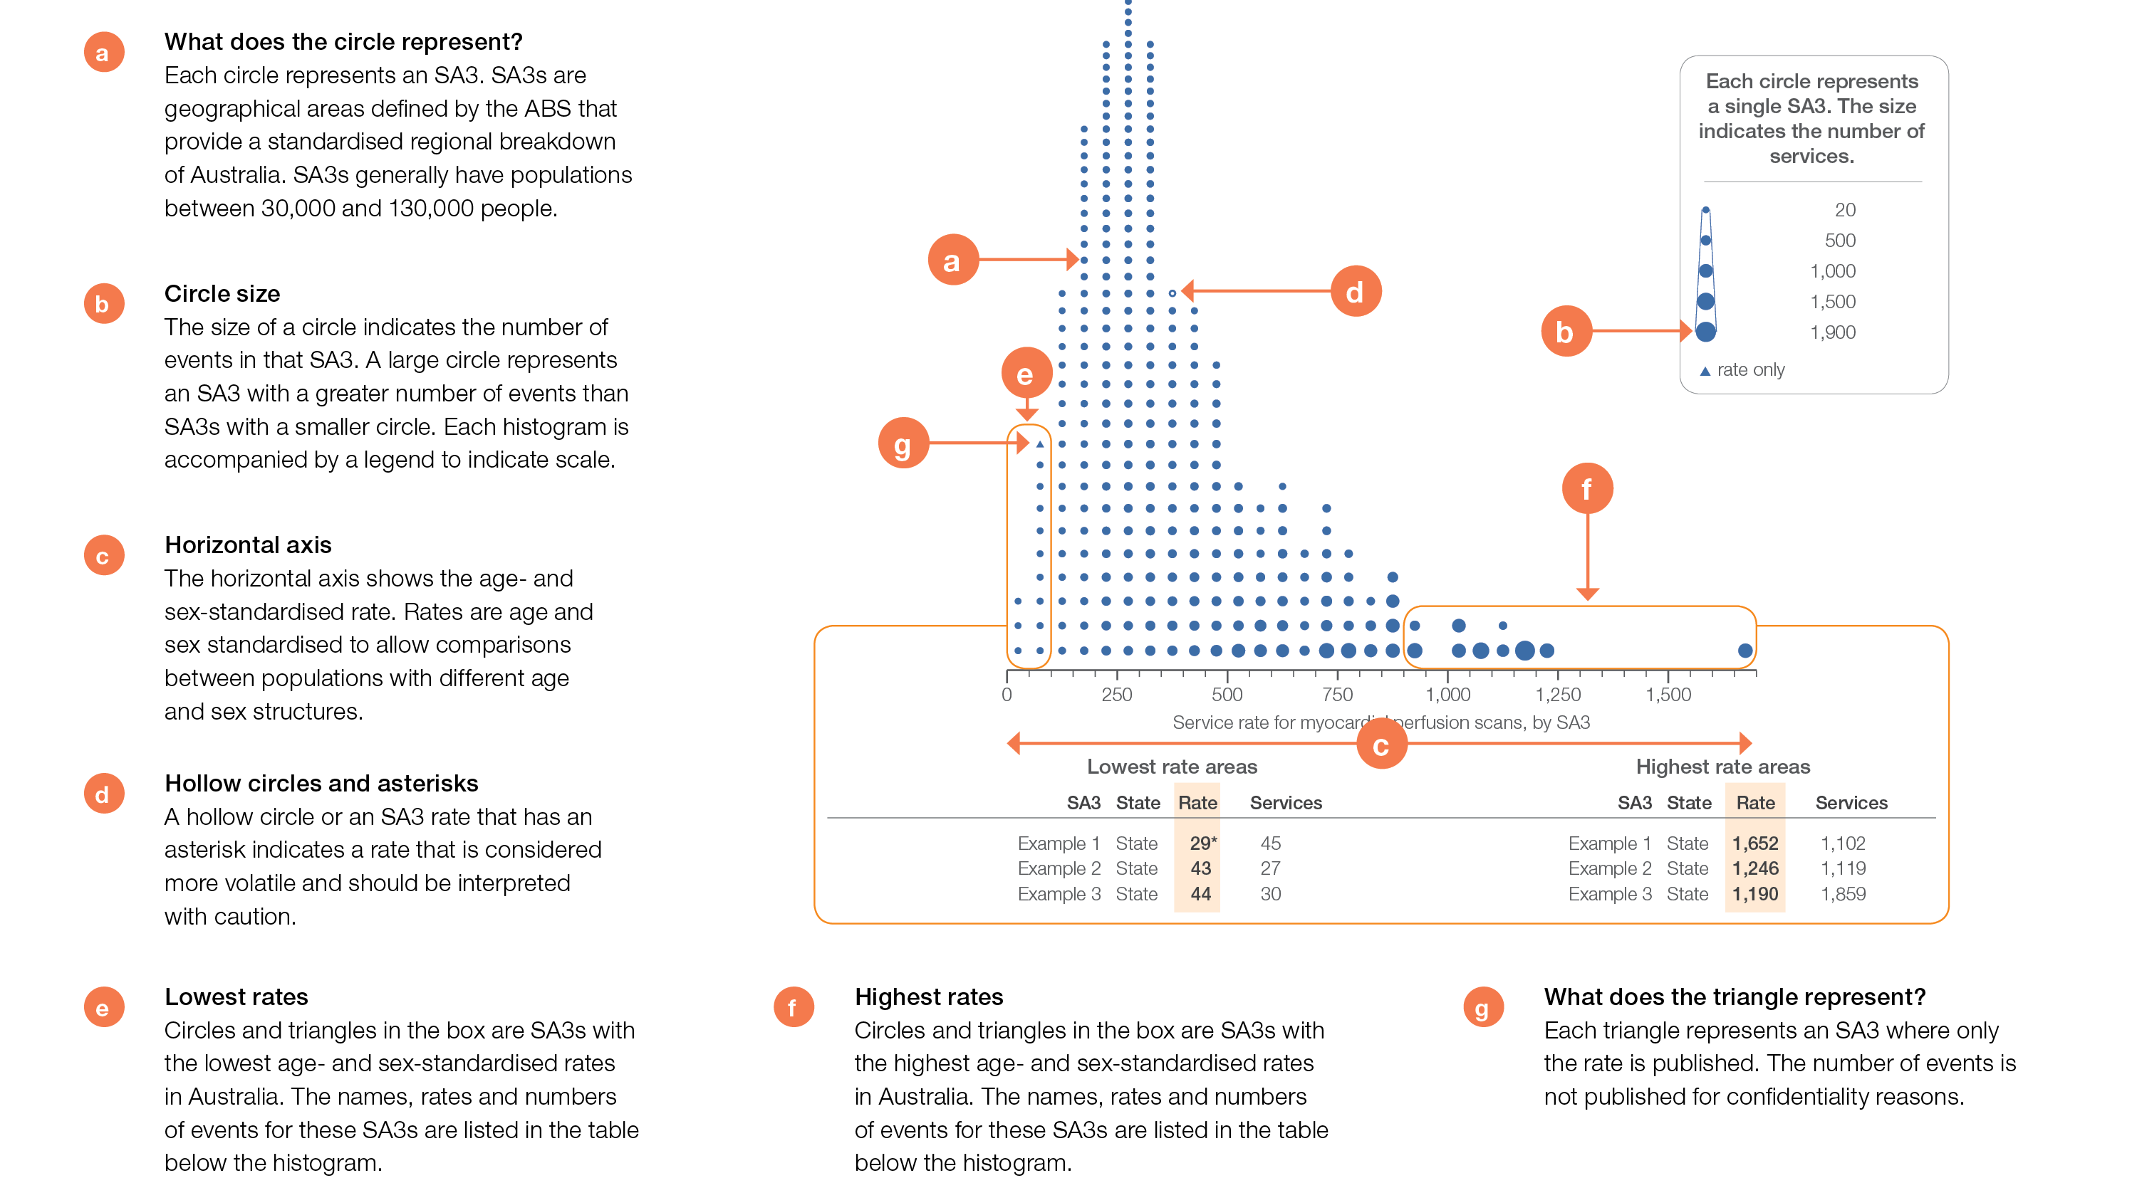
How to interpret our data visualisations
Histogram

Slide 12
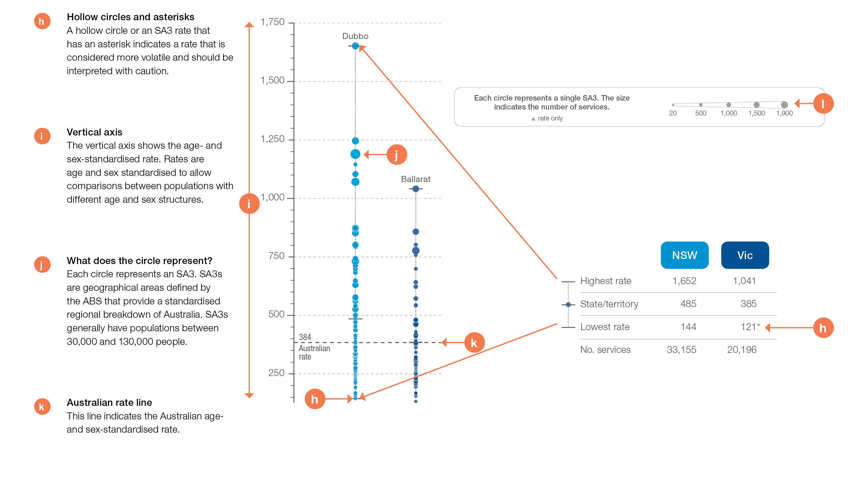
How to interpret our data visualisations
State and territory graph

Slide 13
Neonatal and paediatric health
Notes:
Speaker notes:
This chapter examines:
-Early planned caesarean section without medical or obstetric indication
-Antibiotics dispensing in children, aged 9 years and under
-Proton pump inhibitor medicines dispensing, aged 1 year and under

Slide 14
Neonatal and paediatric health
 | Percentage of planned caesarean sections at specified gestational age, without medical or obstetric indication
Data item | Less than 39 weeks’ gestation* | Less than 37 weeks’ gestation*
1.1 Early planned caesarean section without medical or obstetric indication | 42–60% | 10–22%
* Range across the four published states/territories
Data item | Range across local areas* per 100,000 | Times difference | Times difference excluding top and bottom 10% | Number during 2016–17
1.2 Antibiotics dispensing in children, † 9 years and under | 9,707–150,688 | 16.5 | 1.7 | 3,053,315
* Range across the four published states/territories
† Based on number of PBS prescriptions
Data item | Range across states and territories per 100,000 | Times difference | Number during 2016–17
1.3 Proton pump inhibitor medicines dispensing*, 1 year and under | 2,195–8,066 | 3.7 | 22,810
* Based on number of PBS prescriptions
Notes:
Speaker notes:
Almost half of early planned caesarean sections (42-60%) occurred before 39 weeks of gestation, where there was no medical or obstetric indication (for the four states with reported data).
Substantial variation (16.5) was observed between Statistical Area Level 3 (SA3) areas in the rates of antibiotic dispensing in children aged 9 years and under, with over 3 million prescriptions dispensed - an equivalent rate of almost one per child in the age group.
There were 22,810 PBS prescriptions dispensed for PPI medicines to infants aged 1 year and under, representing 3,628 prescriptions per 100,000.

Slide 15
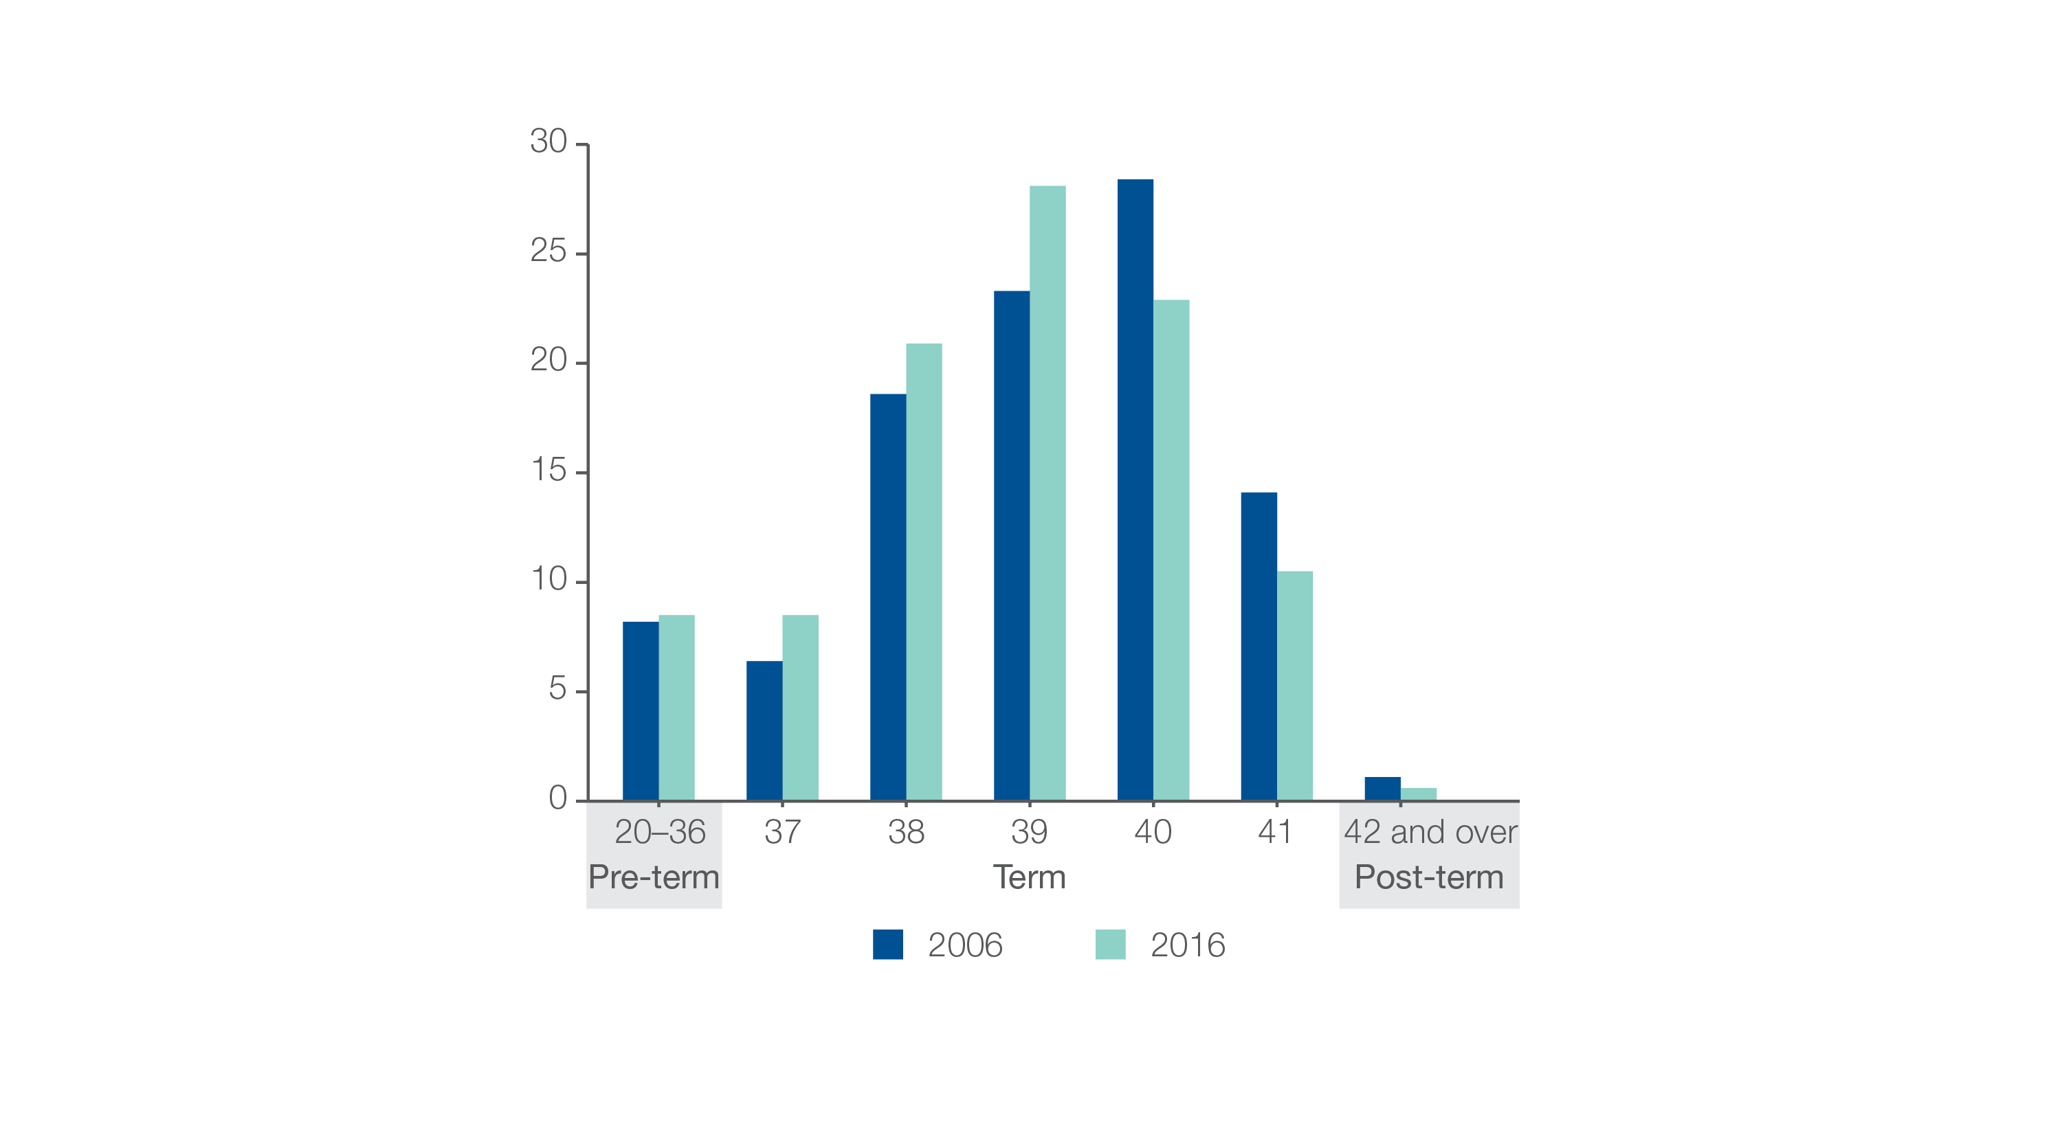
1.1 Early planned caesarean section without medical or obstetric indication
Percentage of babies, by gestational age in weeks, 2006 and 2016,
(AIHW, Australia’s Mothers and Babies, 2016)
Pre-term births include a small number of births of less than 20 weeks’ gestation.
Source: Australia’s Mothers and Babies, 2016
Notes:
Speaker notes:
Rates of caesarean section overall has risen steadily in Australia since the early 1990s. In 2016, 34% of births in Australia were by caesarean section, compared with 31% in 2006 and 18% in 1990.
The proportion of babies born at early term has increased in the past decade. Between 2006 and 2016, the proportion of babies born between 37 and 39 weeks’ gestation increased, while the proportion born from 40 weeks onwards decreased.
Between 2006 and 2016, the average gestational age for all babies born in Australia fell from 38.9 weeks to 38.6 weeks.

Slide 16
1.1 Early planned caesarean section without medical or obstetric indication
Key findings
Among the four states/territories with reportable data on this item:
42%−60% of planned caesarean sections done at <39 weeks’ did not have an obstetric or medical indication
10%− 22% of planned caesarean sections done at < 37 weeks’ did not have an obstetric or medical indication
of planned caesarean sections done at <39 weeks without a medical or obstetric indication, 60% were for privately funded patients vs 52% for publicly funded patients
of planned caesarean sections done at <37 weeks without an obstetric or medical indication, 20% were for privately funded patients vs14% for publicly funded patients
of planned caesarean sections done at <39 weeks without a medical or obstetric indication, percentages were similar for Aboriginal and Torres Strait Islander women and other women in 3 of the 4 states/territories; and lower in one state/territory (53% vs 56%).
Source: NPDC data 2015.
Notes:
Speaker notes:

Slide 17
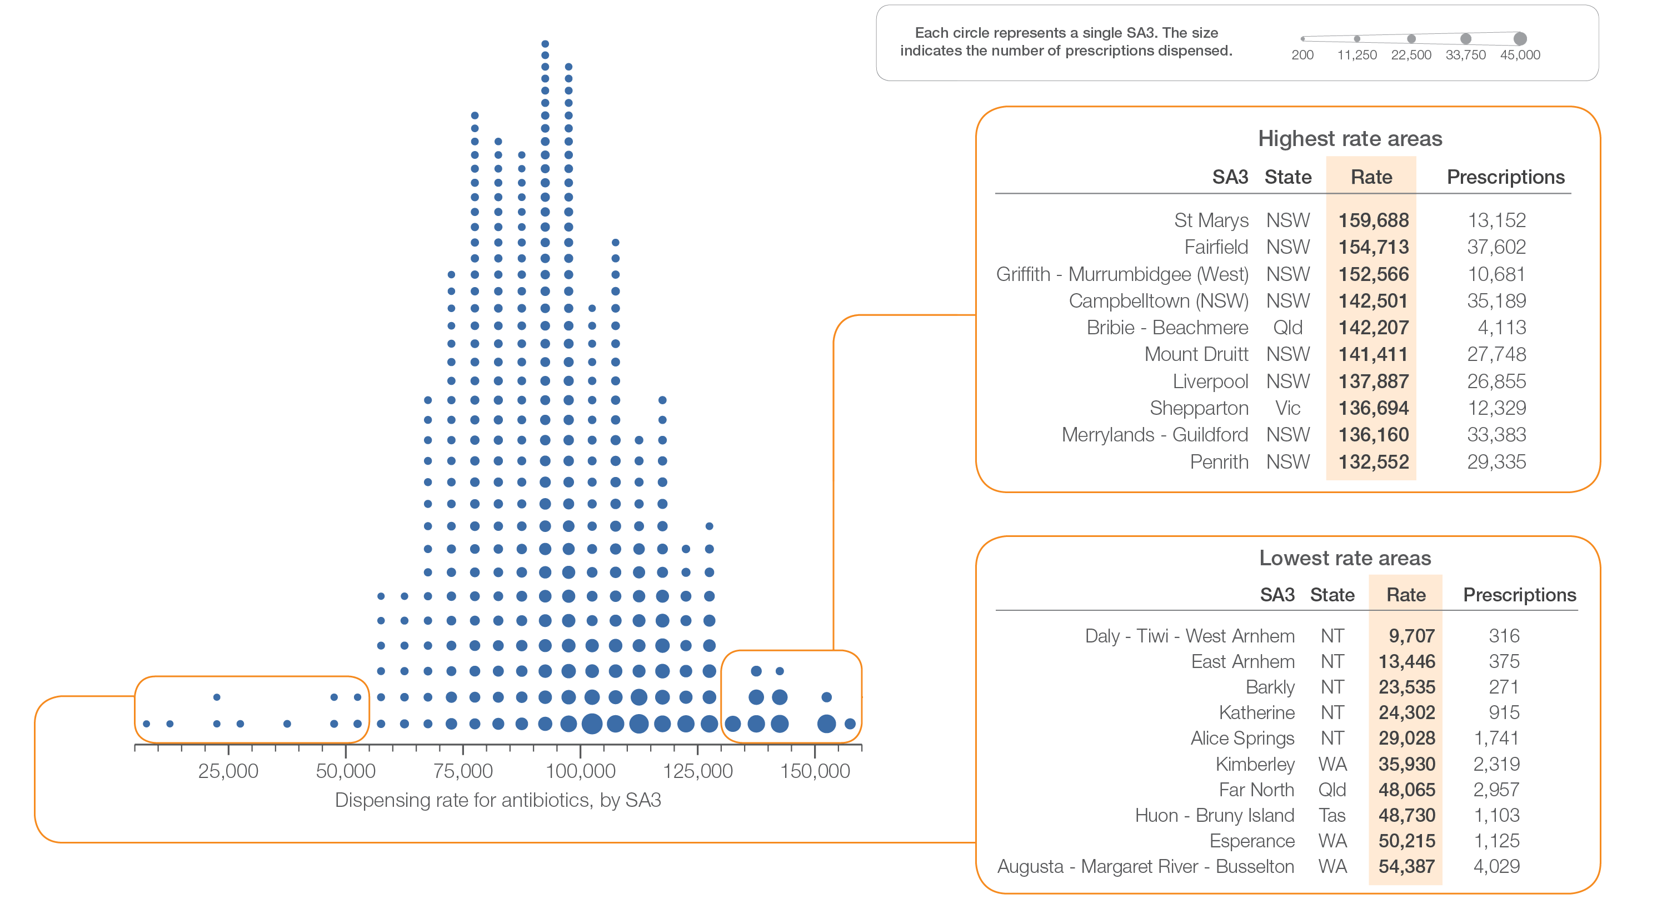
1.2 Antibiotics dispensing in children, 9 years and under
Sources: PBS data 2016-17, and ABS Estimated Resident Population 30 June 2016
Notes:
Speaker notes:
This slide shows the distribution of rates by Statistical Area Level 3 (SA3) for antibiotics dispensing in children aged 9 years and under.
Each circle on the graph represents an SA3. The size of the circle indicates how many prescriptions have been dispensed for children living in that area. The horizontal axis shows the standardised rates for the clinical item.
For further information on how to interpret the figures, please refer to the ‘How to interpret’ resource available at: www.safetyandquality.gov.au/atlas/the-third-australian-atlas-of-healthcare-variation-2018/how-to-interpret-the-data/

Slide 18
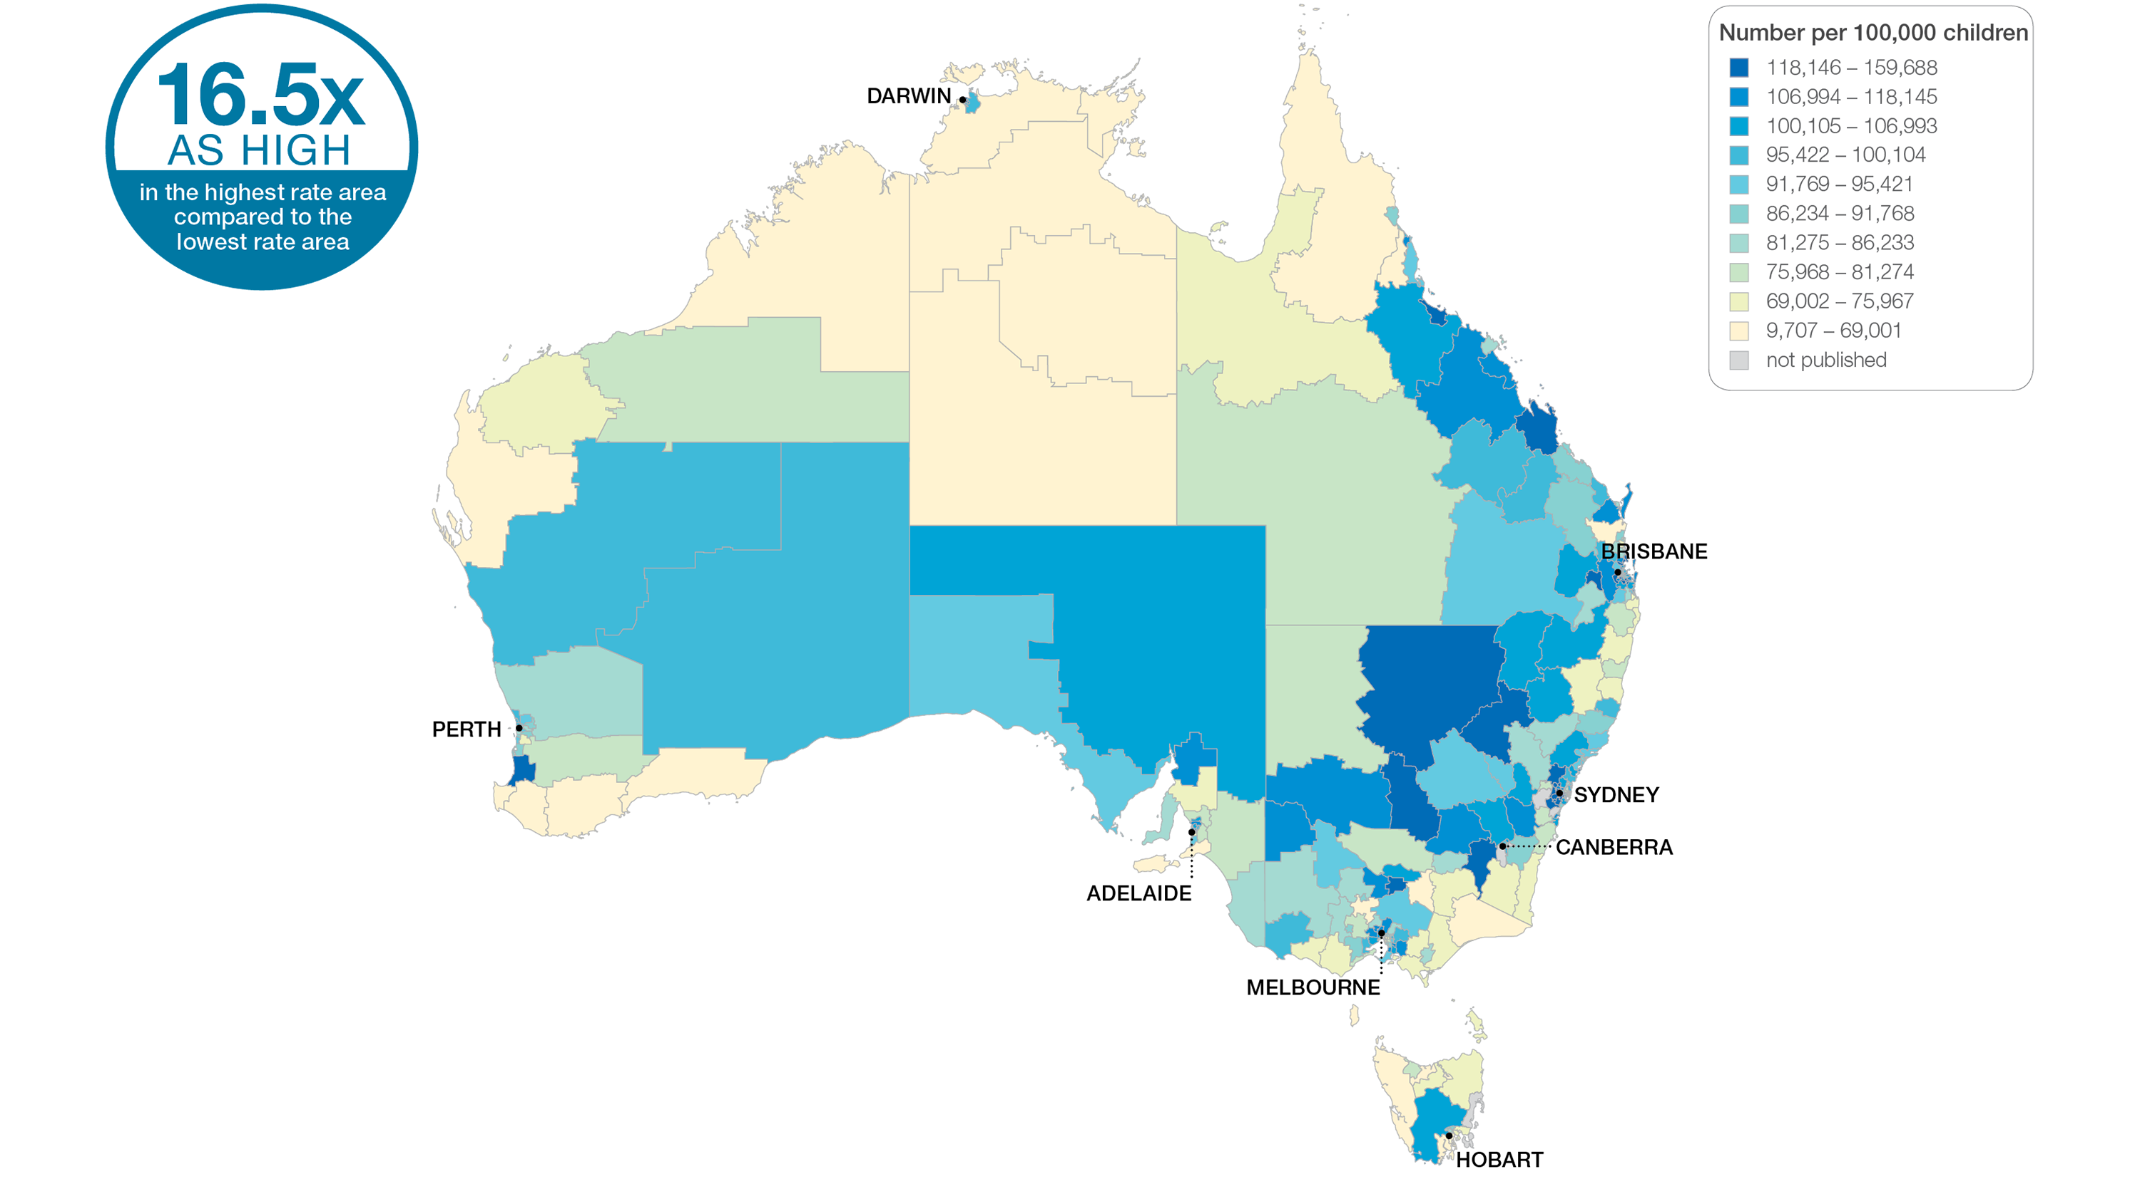
1.2 Antibiotics dispensing in children, 9 years and under
Sources: PBS data 2016-17, and ABS Estimated Resident Population 30 June 2016
Notes:
Speaker notes:
This slide shows the distribution of rates by Statistical Area Level 3 (SA3) for antibiotics dispensing in children aged 9 years and under. Rates are based on the patient’s usual place of residence, not the location of the healthcare provider.
In 2016–17, there were 3,053,315 PBS prescriptions dispensed for antibiotics in children, representing 96,721 prescriptions per 100,000 children aged 9 years and under (the Australian rate).
The number of PBS prescriptions dispensed for antibiotics across 328* local areas (Statistical Area Level 3 – SA3), ranged from 9,707 to 159,688 per 100,000 children aged 9 years and under.
The rate was 16.5 times as high in the area with the highest rate compared to the area with the lowest rate.
The range of rates represented by each colour are shown in the legend for the map. The darker blue colour represents SA3 with higher rates. The lighter colours represent SA3s with lower rates. The grey areas represent areas where the rates have been suppressed. Reasons for rates being suppressed or to be interpreted with caution can include rates based on low numbers of events and/or very small populations are more susceptible to random fluctuations and therefore may not provide a reliable representation of activity in that area. For more information on the suppression protocol, see the Technical Supplement.
The number of prescriptions dispensed varied across states and territories, from 69,015 per 100,000 children aged 9 years and under in the Northern Territory to 102,339 in Queensland.
For further information on how to interpret the figures, please refer to the ‘How to interpret’ resource available at: www.safetyandquality.gov.au/atlas/the-third-australian-atlas-of-healthcare-variation-2018/how-to-interpret-the-data/

Slide 19
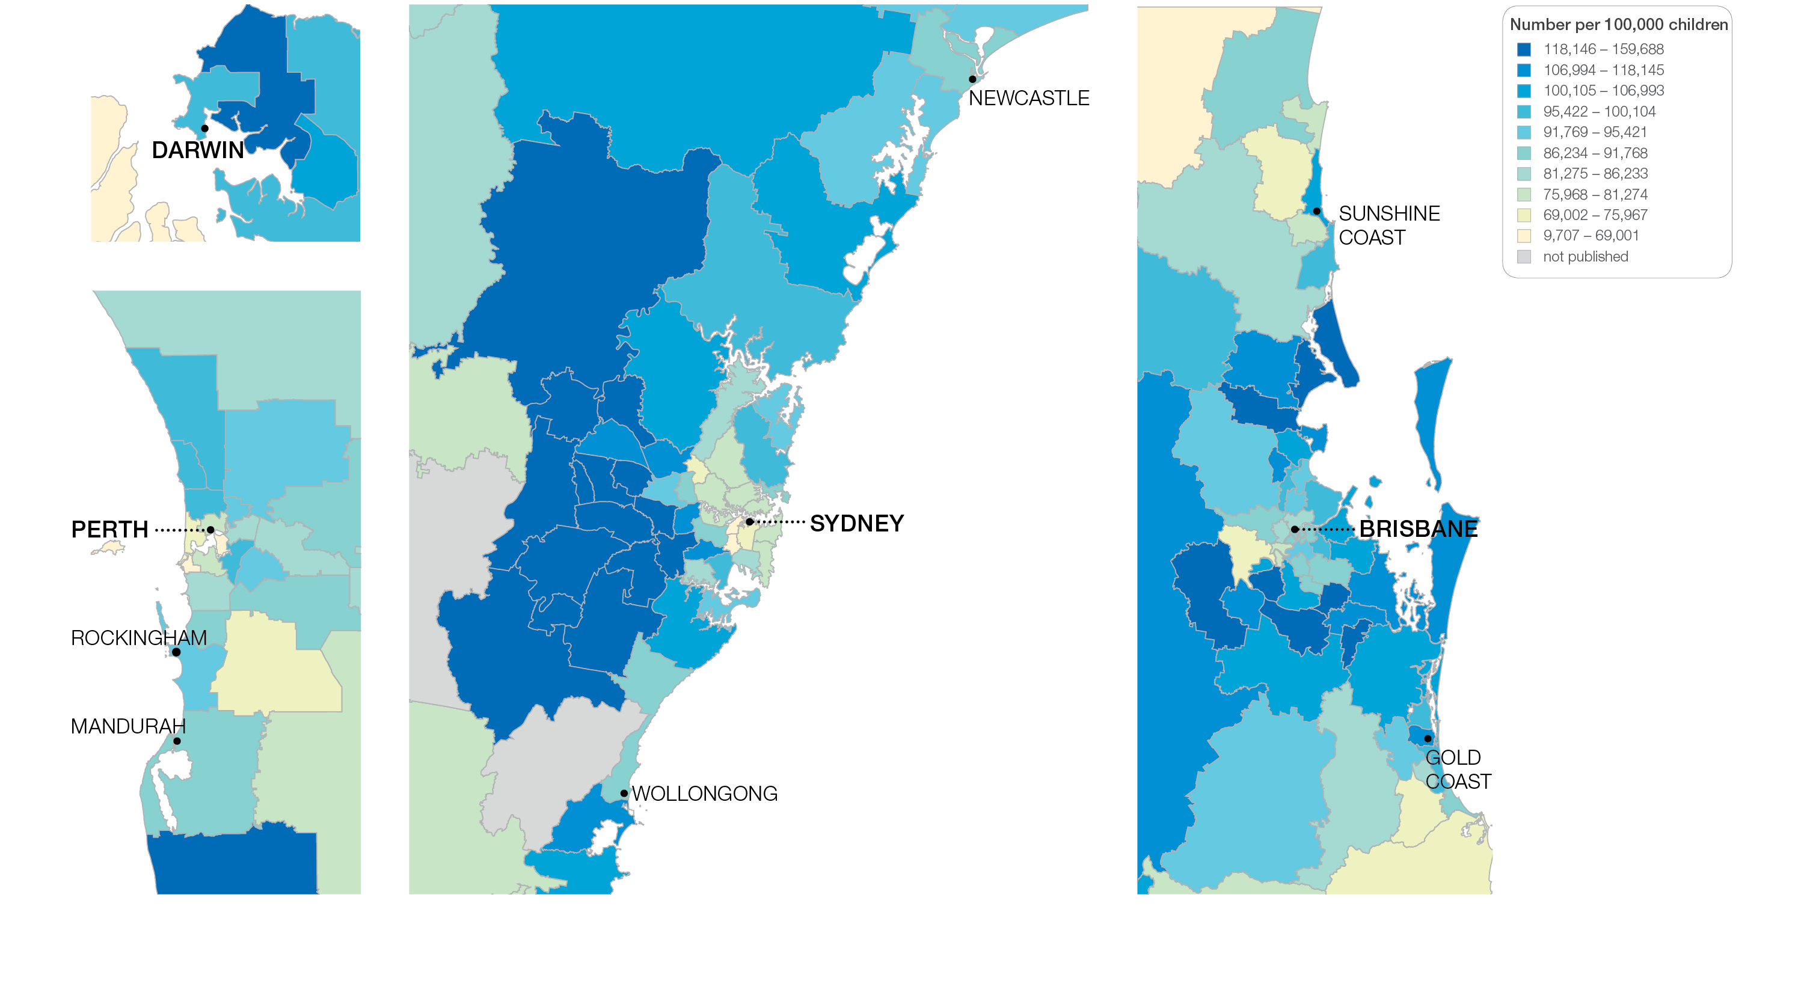
1.2 Antibiotics dispensing in children, 9 years and under
Sources: PBS data 2016-17, and ABS Estimated Resident Population 30 June 2016
Notes:
Speaker notes:
This slide shows the distribution of rates by Statistical Area Level 3 (SA3) for antibiotics dispensing in children aged 9 years and under by capital city area. Rates are based on the patient’s usual place of residence, not the location of the healthcare provider.

Slide 20
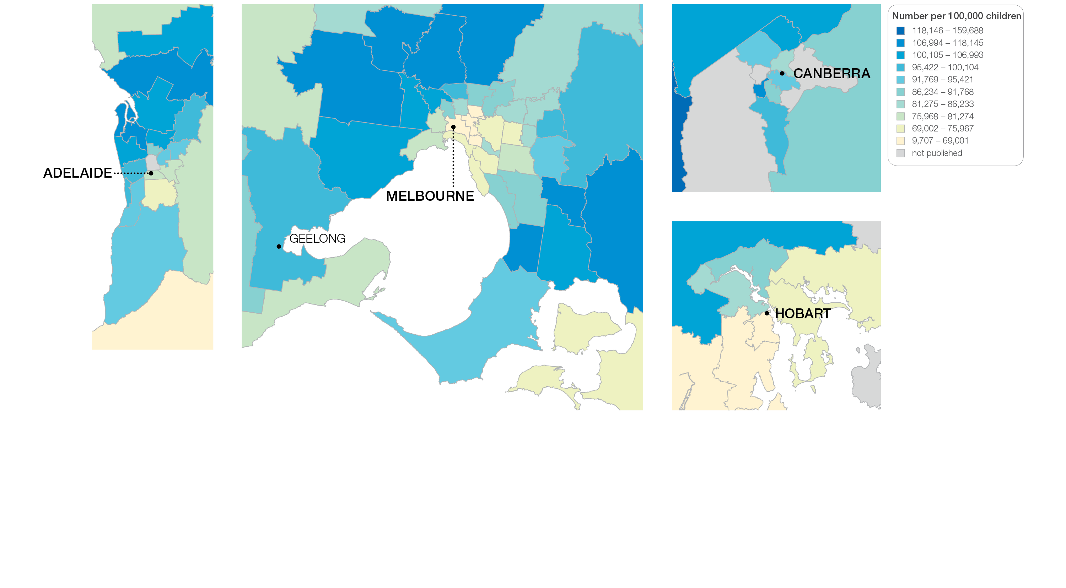
1.2 Antibiotics dispensing in children, 9 years and under
Sources: PBS data 2016-17, and ABS Estimated Resident Population 30 June 2016
Notes:
Speaker notes:
This slide shows the distribution of rates by Statistical Area Level 3 (SA3) for antibiotics dispensing in children aged 9 years and under by capital city area. Rates are based on the patient’s usual place of residence, not the location of the healthcare provider.

Slide 21
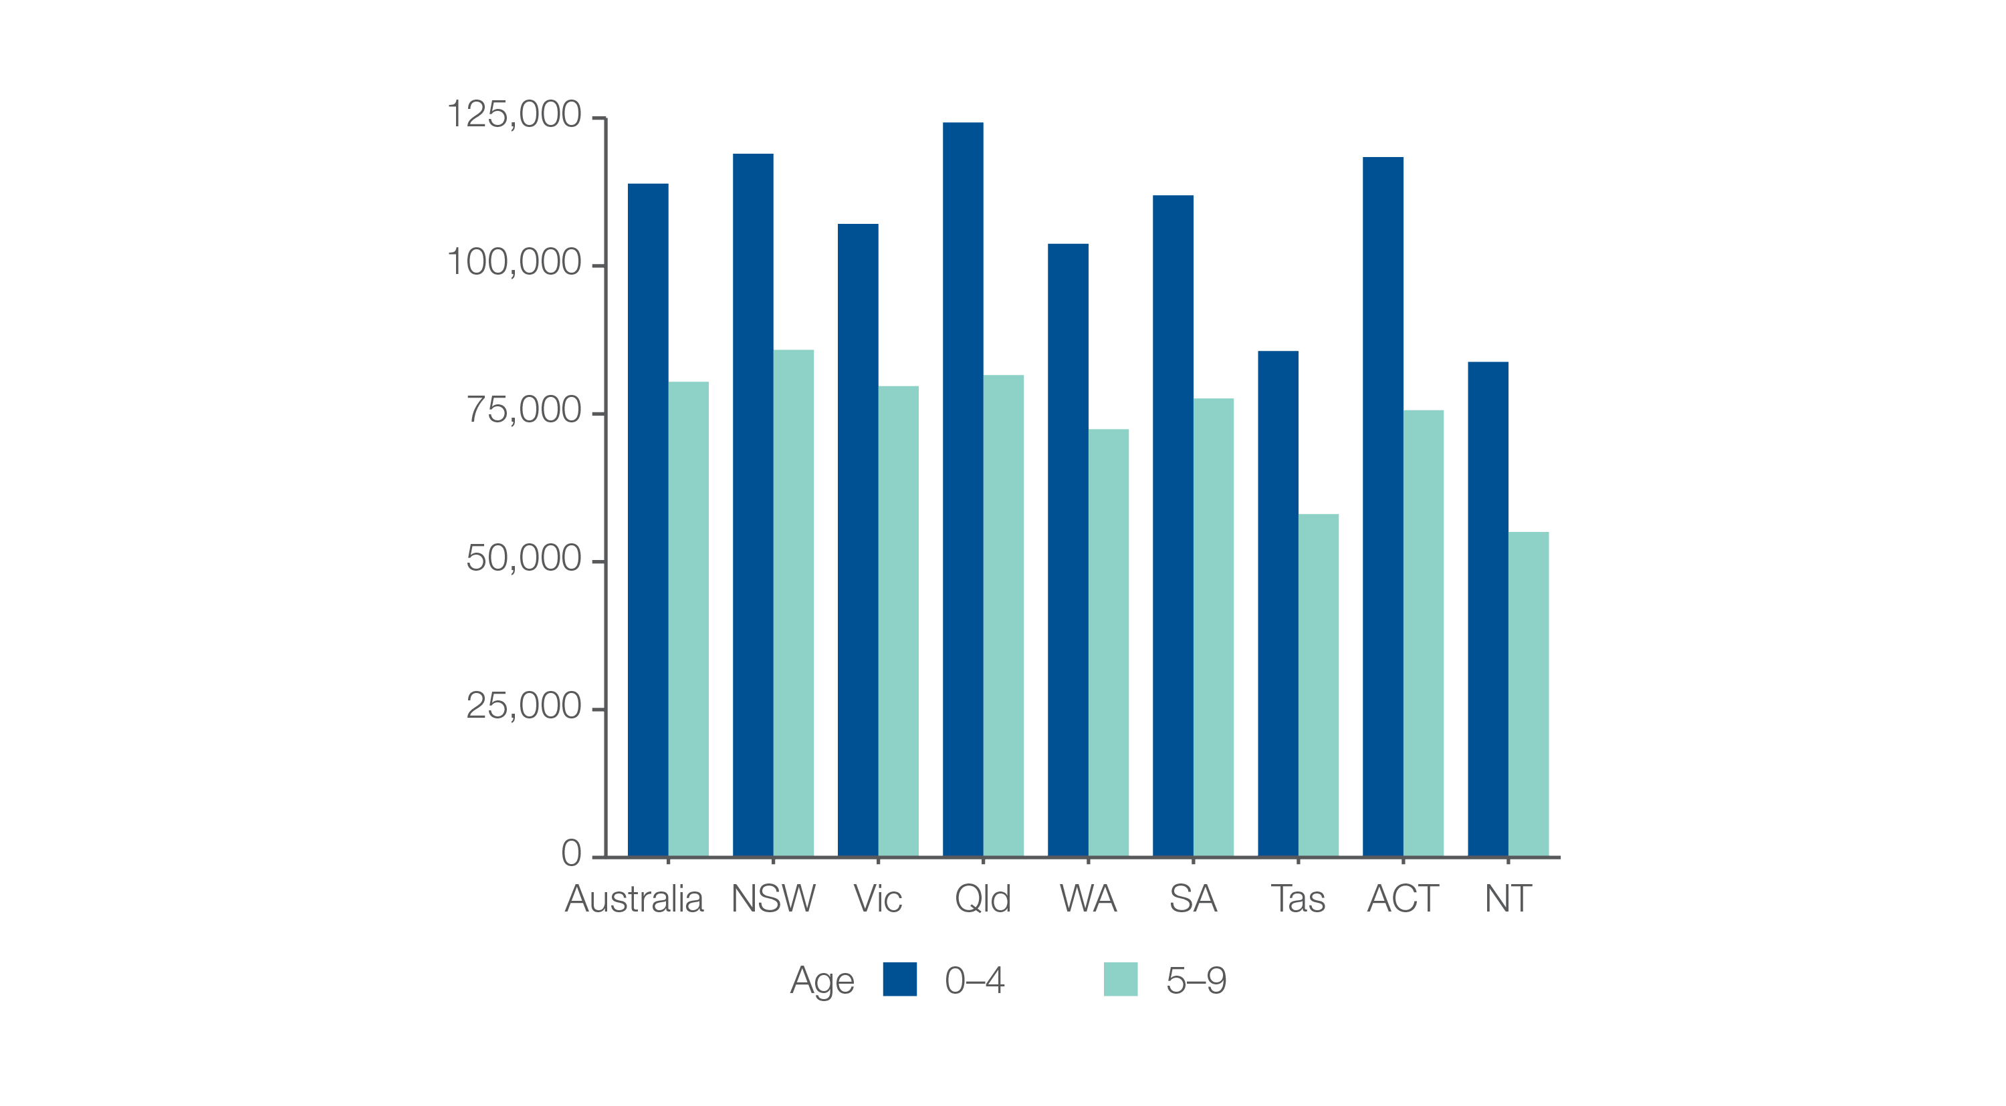
1.2 Antibiotics dispensing in children, 9 years and under
Analysis by age group
Number per 100,000 children
Sources: PBS data 2016-17, and ABS Estimated Resident Population 30 June 2016
Notes:
Speaker notes:
The rate of antibiotic dispensing was higher for children aged 4 years and under (113,906 prescriptions per 100,000 children) than for children aged 5–9 years (80,417 prescriptions per 100,000 children). This pattern was consistent across all states and territories.

Slide 22
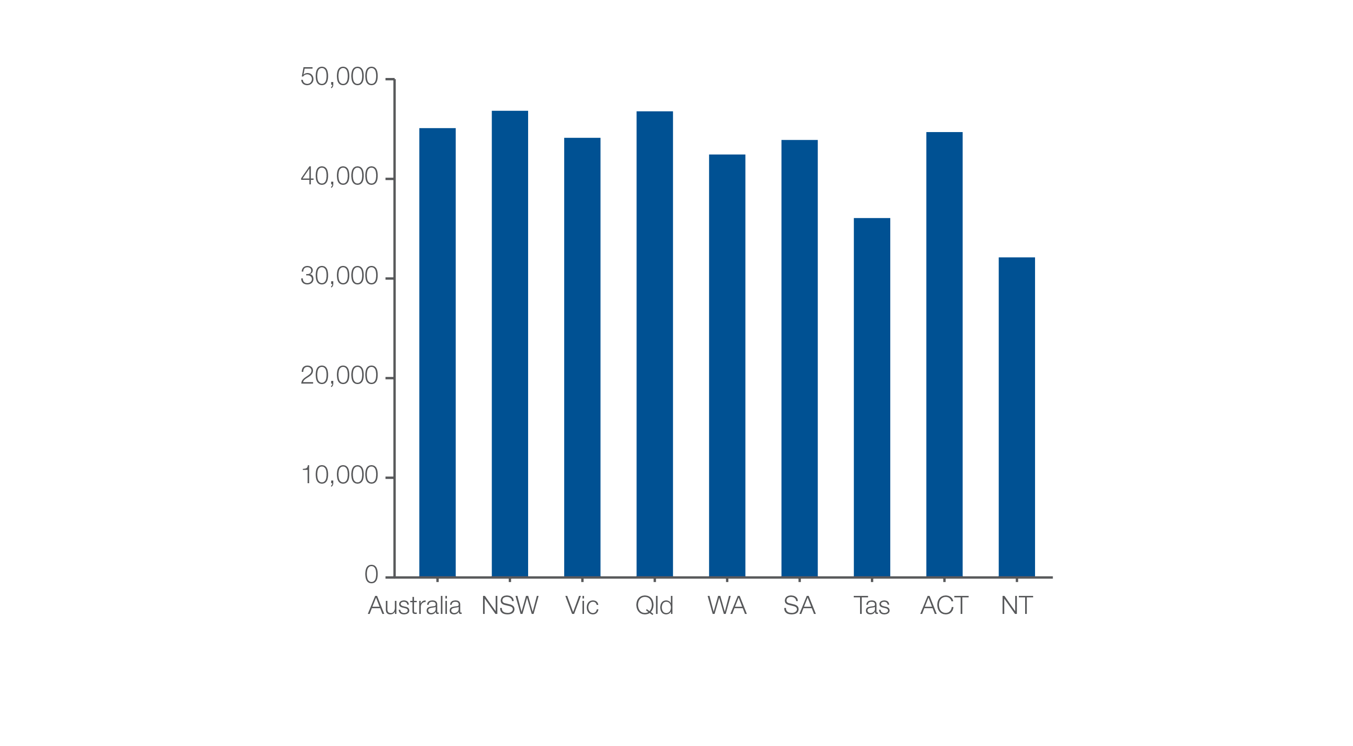
1.2 Antibiotics dispensing in children, 9 years and under
Children dispensed at least one prescription
Number per 100,000 children
Sources: PBS data 2016-17, and ABS Estimated Resident Population 30 June 2016
Notes:
Speaker notes:
The number of children aged 9 years and under who had at least one prescription for an antibiotic dispensed in 2016–17 was 45,085 per 100,000 – that is, 45% of the child population aged 9 years and under.
The rate varied from 32,108 per 100,000 children aged 9 years and under in the Northern Territory to 46,824 per 100,000 in New South Wales

Slide 23
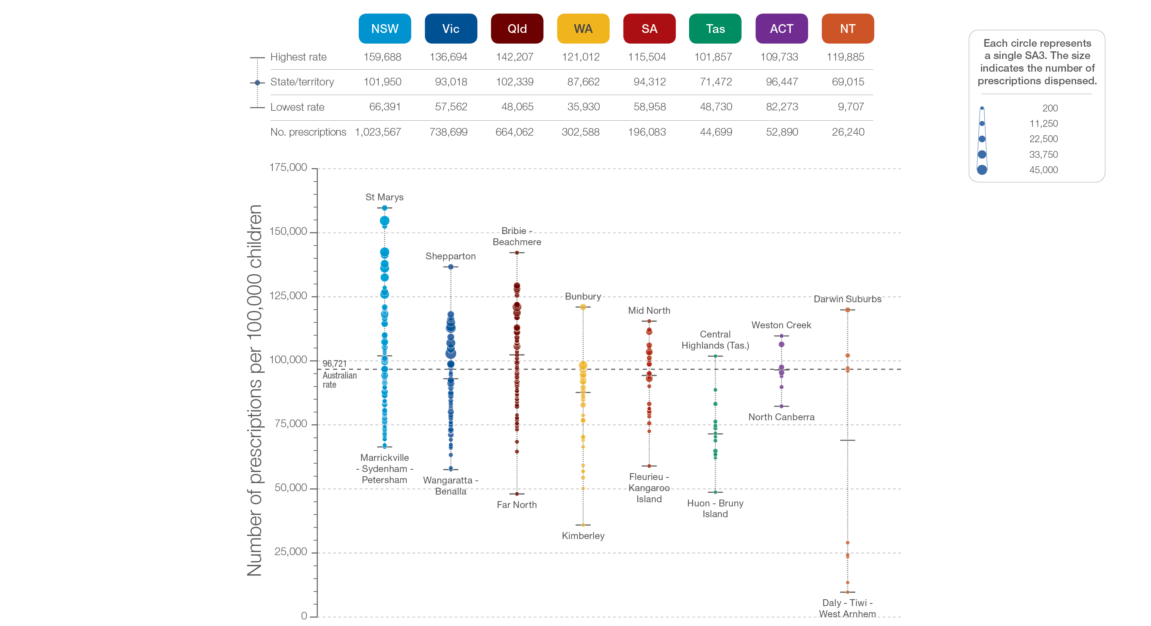
1.2 Antibiotics dispensing in children, 9 years and under
State and territory
Sources: PBS data 2016-17, and ABS Estimated Resident Population 30 June 2016
Notes:
Speaker notes:
The number of prescriptions dispensed varied across states and territories, from 69,015 per 100,000 children aged 9 years and under in the Northern Territory to 102,339 in Queensland.
Each circle on the graph represents an SA3. The size of the circle indicates how many prescriptions have been recorded for children living in that area. The vertical axis shows the standardised rates for the clinical item.
For further information on how to interpret the figures, please refer to the ‘How to interpret’ resource available at: www.safetyandquality.gov.au/atlas/the-third-australian-atlas-of-healthcare-variation-2018/how-to-interpret-the-data/

Slide 24
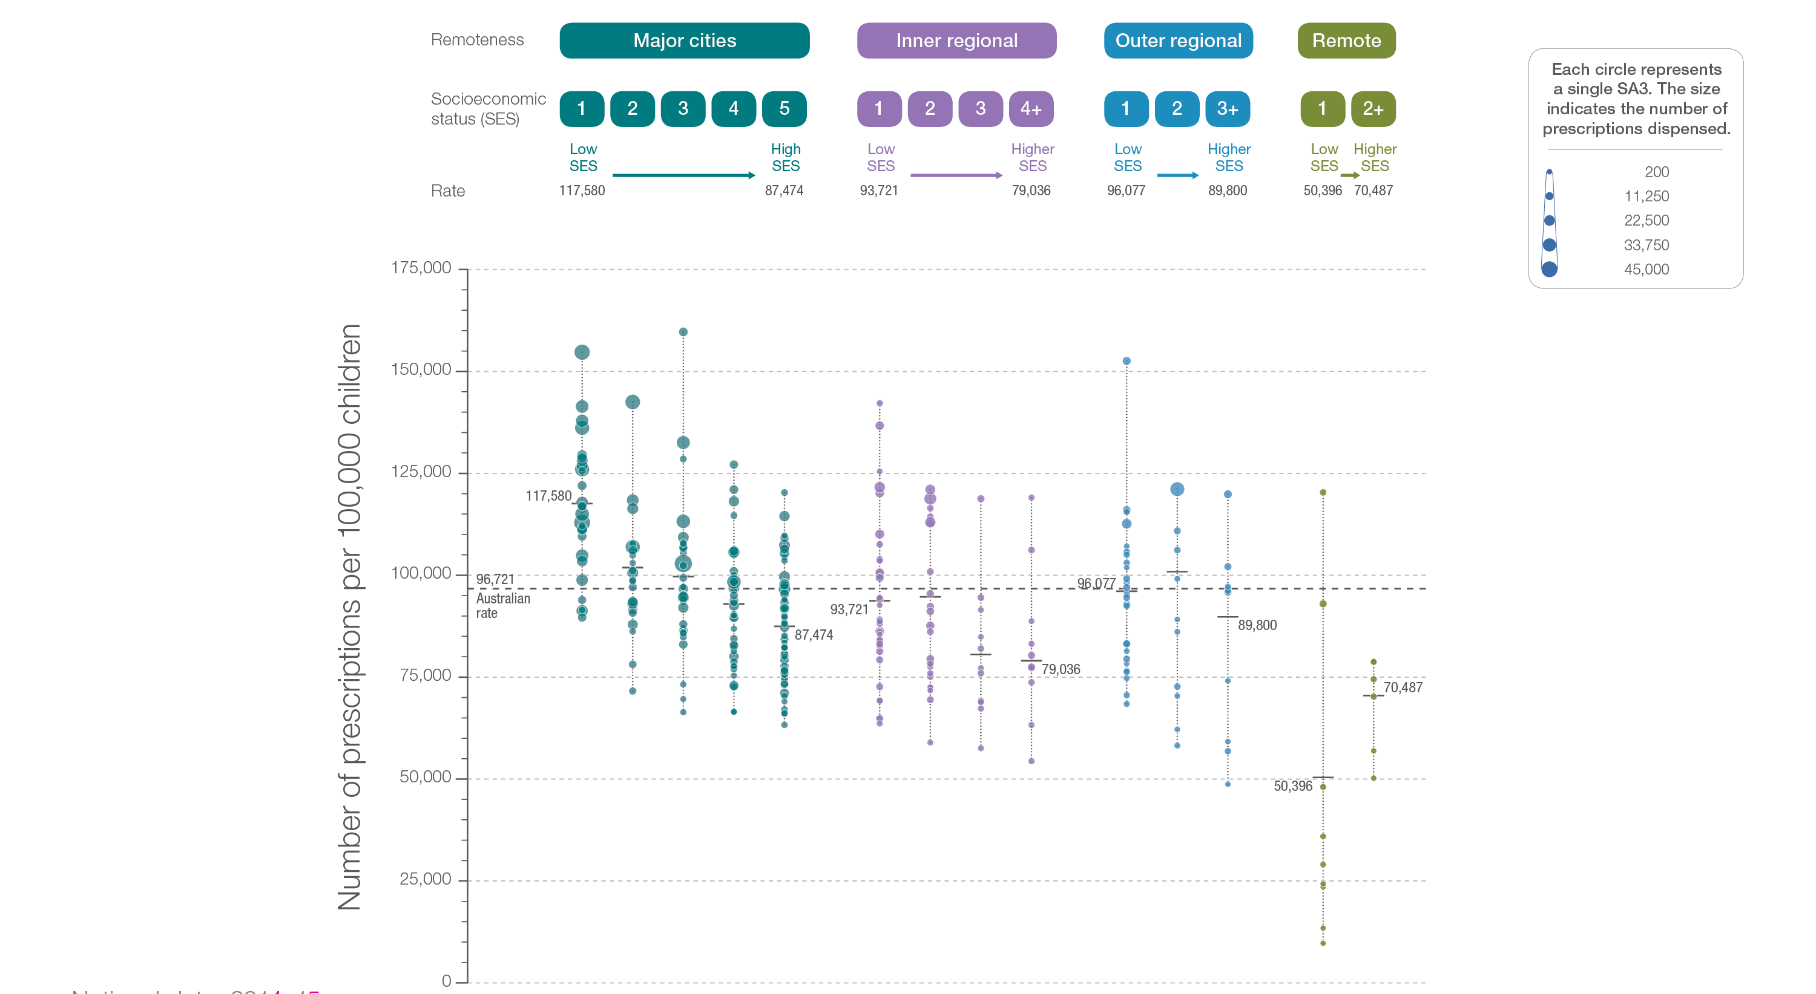
1.2 Antibiotics dispensing in children, 9 years and under
Remoteness and socioeconomic status
Sources: PBS data 2016-17, and ABS Estimated Resident Population 30 June 2016
Notes:
Speaker notes:
Rates of antibiotic dispensing in children aged 9 years and under were higher in major cities than in other areas. Rates were higher in areas with lower socioeconomic status in major cities and inner regional areas. However, there was no clear pattern according to socioeconomic status in other remoteness categories.
Low rates of antibiotic dispensing in some remote, low‑socioeconomic‑status areas may be underestimates because dispensing through Aboriginal health services is not captured in the data.
Each circle on the graph represents an SA3. The size of the circle indicates how many clinical events have been recorded for people living in that area. The vertical axis shows the standardised rates for the clinical item.
For further information on how to interpret the figures, please refer to the ‘How to interpret’ resource available at: www.safetyandquality.gov.au/atlas/the-third-australian-atlas-of-healthcare-variation-2018/how-to-interpret-the-data/

Slide 25
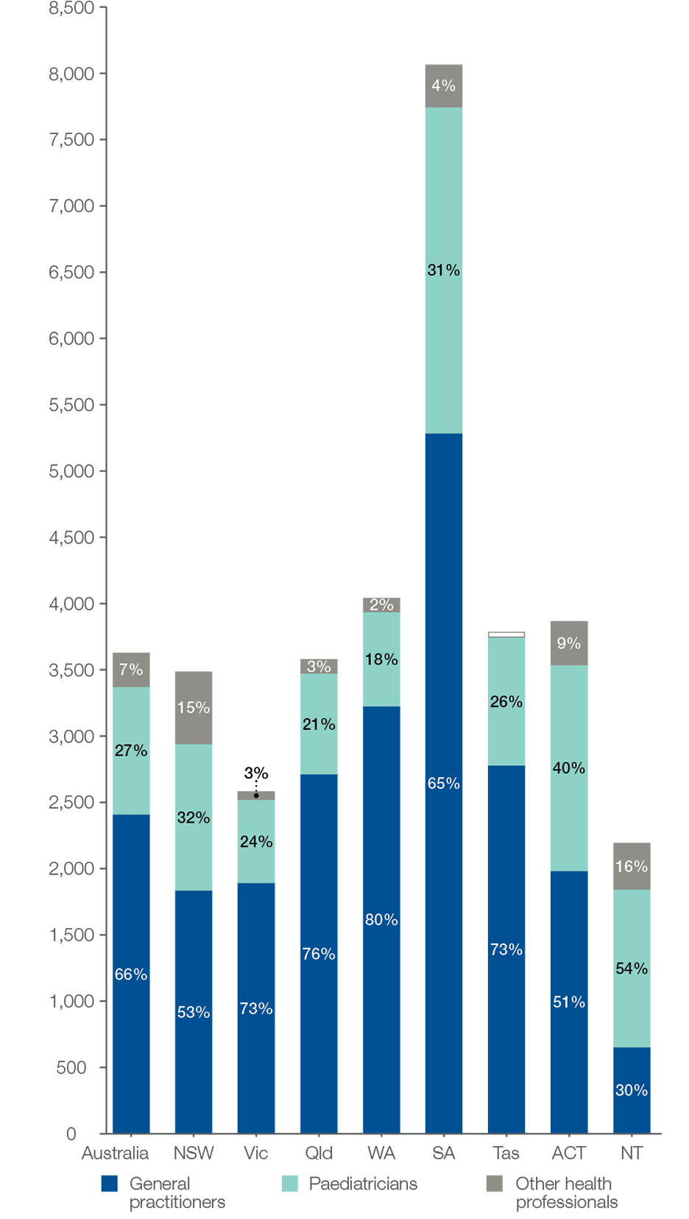
1.3 Proton pump inhibitor medicines dispensing, 1 year and under
Rates by state and territory and prescriber type
Number of prescriptions dispensed per 100,000 infants
Unshaded data (Tas other health professionals) are based on a small number of prescriptions dispensed.
Sources: PBS data 2016-17, and ABS Estimated Resident Population 30 June 2016
Notes:
Speaker notes:
In 2016–17, there were 22,810 PBS prescriptions dispensed for PPI medicines to infants aged 1 year and under, representing 3,628 prescriptions per 100,000 infants aged 1 year and under (the Australian rate).
The number of PBS prescriptions dispensed for PPI medicines varied across states and territories, from 2,195 per 100,000 infants in the Northern Territory to 8,066 per 100,000 in South Australia
GPs prescribed 66% of the PBS prescriptions dispensed for PPI medicines in infants, paediatricians prescribed 27%, and other health professionals prescribed 7%. The proportion prescribed by GPs varied across states and territories from 30% in the Northern Territory to 80% in Western Australia.

Slide 26
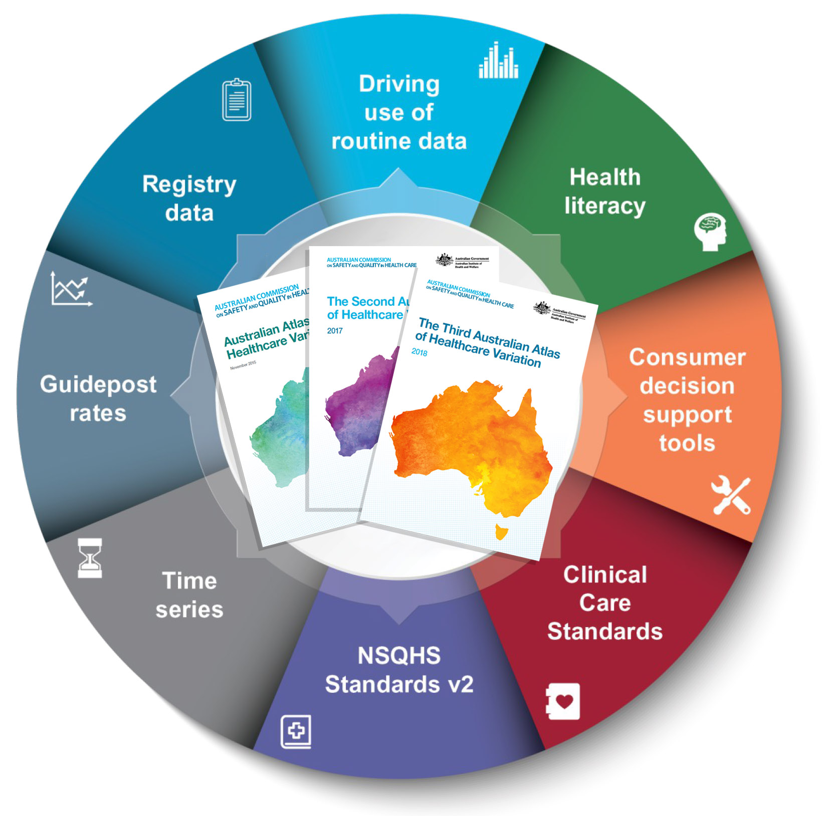
Promoting appropriate care
Explore variation
Identify unwarranted variation
Address unwarranted variation
Notes:
Speaker notes:
Mapping variation is an invaluable tool for understanding how our healthcare system is providing care, but gathering the data is only the first step. Understanding the underlying reasons for marked differences in the use of some health services across Australia, and considering how we can improve, are key for translating this work into better outcomes for patients.
The patterns shown in the maps in this Atlas and the accompanying commentaries show that there are many opportunities for making meaningful changes in Australia’s delivery of health care. The recommendations in the third Atlas highlight that action is needed at all levels – from addressing the social determinants of health through to better data collection, system changes and providing the best supports for individual clinician–patient interactions. These goals are ambitious, but the recommended changes have the potential to result in meaningful progress in defining and delivering appropriate care – and improving patient outcomes.

Slide 27
Further resources
Explore the data further using the interactive Atlas at www.safetyandquality.gov.au/atlas/
Please send any queries to atlas@safetyandquality.gov.au
Notes:
Further resources
Explore the data further using the interactive Atlas at www.safetyandquality.gov.au/atlas/
Please send any queries to atlas@safetyandquality.gov.au

