Slide 1
The Third Australian Atlas of Healthcare Variation
2018

Slide 2
The Australian Atlas of Healthcare Variation series
Notes:
Speaker notes:
Mapping variation is an invaluable tool for understanding how our healthcare system is providing care. The Australian Atlas of Healthcare Variation series illuminates variation by mapping use of health care according to where people live. Each Atlas identifies specific achievable actions for exploration and quality improvement.
The Australian Commission on Safety and Quality in Health Care (the Commission) has collaborated with the Australian, state and territory governments, specialist medical colleges, clinicians and consumer representatives to develop the Atlas series.
The Atlas publications can be downloaded from the Atlas website.

Slide 3

Interactive Atlas
Notes:
Speaker notes:
The Atlas data can also be further explored using the online interactive Atlas platform.

Slide 4

Australian Commission on Safety and Quality in Health Care
Australian Government agency
Leads & coordinates national improvements in safety & quality of health care based on best available evidence
Works in partnership with patients, consumers, clinicians, managers, policy makers & health care organisations
Aims to ensure that the health system is sustainable, better informed, supported & organised to deliver safe & high quality care
Notes:
Speaker notes:
The Commission’s role is to lead and coordinate national improvements in the safety and quality of health care. The Commission works in partnership with the Australian Government, state and territory governments and the private sector to achieve a safe and high-quality, sustainable health system. In doing so, the Commission also works closely with patients, carers, clinicians, managers, policymakers and healthcare organisations.
Key functions of the Commission include developing national safety and quality standards, developing clinical care standards to improve the implementation of evidence-based health care, coordinating work in specific areas to improve outcomes for patients, and providing information, publications and resources about safety and quality.
The Commission works in four priority areas:
- Patient safety
- Partnering with patients, consumers and communities
- Quality, cost and value
- Supporting health professionals to provide care that is informed, supported and organised to deliver safe and high-quality health care.
One of the Commission’s key programs is the National Safety and Quality Health Service (NSQHS) Standards. The primary aim of the NSQHS Standards are to protect the public from harm and to improve the quality of health service provision. The NSQHS Standards were developed by the Commission in partnership with the Australian, state and territory governments, the private sector, clinicians, patients and carers.

Slide 5





Third Australian Atlas of Healthcare Variation
Examines variation nationally in 13 clinical items, grouped into 4 themes
Neonatal and paediatric health
Early planned caesarean section without medical or obstetric indication
Antibiotic dispensing in children, 9 years and under
Proton pump inhibitor dispensing in infants,
1 year and under
Gastrointestinal investigations and treatments
Proton pump inhibitor dispensing in adults
Colonoscopy hospitalisations
Gastroscopy hospitalisations
Thyroid investigations and treatments
Thyroid stimulating hormone tests
Thyroid function tests
Neck ultrasound
Thyroidectomy hospitalisations
Cardiac tests
Cardiac stress tests and imaging
Stress echocardiography
Myocardial perfusion scans
Standard echocardiography
Notes:
Speaker notes:
The third Atlas, released in December 2018, examines four clinical themes: neonatal and paediatric health, gastrointestinal investigations and treatments, thyroid investigations and treatments and cardiac tests.

Slide 6


Third Australian Atlas of Healthcare Variation
Content continued
Repeat analyses
Examines changes over four years in the numbers of Pharmaceutical Benefits Scheme (PBS) prescriptions dispensed for:
Antimicrobial medicines
Antipsychotic and ADHD medicines
Opioid medicines
Response to the Atlas series
The Atlas series aims to provide clinically meaningful information that can be used to investigate and improve the appropriateness, effectiveness and efficiency of health care in Australia.
This section illustrates how the Atlas series can improve the value
of healthcare delivery.
Notes:
Speaker notes:
It also includes a repeat analysis chapter, examining

Slide 7
Inside this slide pack
Why does variation matter?
How is variation measured in the Atlas?
How is variation presented in the Atlas?
Notes on data
Key findings
Promoting appropriate care
Further resources.
Notes:
Speaker notes:
This slide pack explores why variation matters and what unwarranted variation in healthcare is. This slide pack explores the key findings for the ‘Thyroid investigations and treatments’ chapter and shows findings, maps and graphs for each of the clinical items in this chapter.

Slide 8
Why does variation matter?
Large variations in health care use have been documented by researchers around the world for many years
A proportion of this variation is termed ‘unwarranted’
Unwarranted variation:
Is unrelated to patient need or preference
May signal inappropriate care
May signal ineffective use of resources
It raises questions about appropriateness of care, health system efficiency, equity and access
Can highlight opportunities for further investigation and for the health system to improve
Notes:
Speaker notes:
Variations documented for many years: One of the first major studies published was by Glover in 1938 who noted a rise in England & Wales in incidence of tonsillectomy and very large differences in rates between school districts which “defies any explanation, save that of variations of medical opinion on the indications for operation.” He also noted “Large and, in some cases, drastic reductions in the numbers of operations performed in elementary school children in certain areas have had no unsatisfactory results” and that “The mortality from the operation is larger than is generally appreciated”.
He noted that that the conspicuous success of the operation in some cases may have led to its adoption in many doubtful cases.
Getting the best outcomes for patients and improving appropriateness of care is the goal of the Atlas. Where we see substantial variation in use of a particular treatment, it is an alarm bell that should make us stop and investigate whether appropriate care is being delivered.
Variation in itself is not necessarily bad, and it can be good if it reflects health services responding to differences in patient preferences or underlying needs. When a difference in the use of health services does not reflect these factors, it is unwarranted variation and represents an opportunity for the health system to improve. Rates of an intervention that are substantially higher or lower in some areas can highlight:
- Inequity of access to evidence-based care, and the need to deliver services more fairly
- Uncertainty about the intervention’s place in therapy, and the need for better data on its benefits and harms
- Gaps in accessible evidence for clinicians, and the need for clinical care standards
- Inadequate system supports for appropriate care, and the need for changes in training or financial incentives.
Looking at how healthcare use varies between people living in different areas, between people with and without socioeconomic disadvantage, and between Aboriginal and Torres Strait Islander Australians and other Australians can show who in our community is missing out. Fundamental changes to address the underlying determinants of ill health, as well as better service delivery for those with existing disease, are needed where these inequities are found.
Reference: Glover JA. The Incidence of Tonsillectomy in School Children: (Section of Epidemiology and State Medicine). Proc R Soc Med. 1938;31(10):1219-36.

Slide 9
How is variation measured in the Atlas?
Healthcare use is mapped by residence of patient (not location of the health provider)
Location of residence mapped at Statistical Area Level 3 (SA3)
Data are age- and sex-standardised, with a few exceptions
Data sources used:
  National Hospital Morbidity Database (NHMD)
  Medicare Benefits Schedule (MBS)
  Pharmaceutical Benefits Scheme (PBS)
  National Perinatal Data Collection (NPDC)
Data extraction and analysis performed by the Australian Institute of Health and Welfare (AIHW)
Interactive Atlas
Notes:
Speaker notes:
Healthcare use is mapped by residence of the patient (Not by where the care was provided)
Most items in this Atlas are mapped to the Statistical Area Level 3 (SA3). Some are mapped to the state and territory level because events were too low to map at a smaller geographical level. SA3s are standard geographical regions used by the Australian Bureau of Statistics. SA3s generally have populations of between 30,000 and 130,000.
Rates are age and sex-standardised per 100,000 population to remove the effect of differences in population age structure when comparing crude rates for different geographic areas.
Data specifications for each item are available on the AHIW’s Metadata Online Registry (METeOR). Information on data analysis and methodology available in the technical supplement.

Slide 10
How is variation presented in the Atlas?
Data are presented in maps and graphs
Statistical Area 3 level data is presented for:
  State and territory analysis
  Remoteness and socioeconomic disadvantage
State and territory level data is presented for:
  Aboriginal and Torres Strait Islander Australian status
  Public and private patient funding status
Notes:
Speaker notes:
Data are presented in maps and graphs.
For indicators where the annual number of hospitalisations is too low or unreliable to report at a local level, three years of data are combined.
For each item, SA3 level data are grouped by state and territory, remoteness and socioeconomic status to assist comparisons between local areas.
For each item, where possible, state and territory level data is presented by Aboriginal and Torres Strait Islander status and patient funding status
Data specifications for each item are available on the AHIW’s Metadata Online Registry (METeOR).

Slide 11
Repeat analyses

Slide 12
How is change over time measured?
Changes in dispensing of these medicines from 2013-14 to 2016-17 were determined using these measurements:
Number of prescriptions dispensed per 100,000 people
Magnitude of variation (difference between highest SA3 rate and lowest SA3 rate)
Number of people dispensed at least one prescription in the year per 100,000 people
Volume of use (Defined Daily Dose per 1,000 people per day)

Slide 13

Repeat analyses
Analyses of dispensing rates by year over 4 years, from 2013/14 to 2016/17
    Antimicrobial dispensing
        Antimicrobial dispensing, all ages
        Amoxycillin and amoxycillin-clavulanate dispensing, all ages
        Psychotropic medicines
        Antipsychotic medicines dispensing 17 years and under
        Antipsychotic medicines dispensing 18 to 64 years
        Antipsychotic medicines dispensing 65 years and over
        ADHD medicines dispensing 17 years and under
        Opioids
        Opioid medicines dispensing, all ages

Slide 14
Why explore use of these medicines over time?
Growing concerns about the potential harms to individuals and the community from high and rising use of these medicines demonstrates a clear need to monitor variations in their use across Australia.
Antimicrobials
Monitoring use is a national priority for antimicrobials. Antimicrobial resistance is a global threat to human health.
Antipsychotic and ADHD medicines
The third Atlas findings on antipsychotic medicines and ADHD medicines are of particular importance for better understanding use among key prescribers.
Opioids
Improving opioid medicines use is a national priority as a result of recent increases in misuse, overdose and opioid dependence.

Slide 15
Repeat analysis - key findings
Australian rates over time
Data item | Number of prescriptions dispensed per 100,000 people
 | 2013-14 | 2014-15 | 2015-16 | 2016-17
5.1 Antimicrobial medicines dispensing, all ages | 126,863 | 129,137 | 122,892 | 115,894
5.2.1 Amoxycillin dispensing, all ages | 24,112 | 24,502 | 23,312 | 22,286
5.2.2 Amoxycillin and amoxycillin-clavulanate dispensing, all ages | 19,110 | 20,400 | 19,888 | 19,568
5.3 Antipsychotic medicines dispensing, 17 years and under | 2,082 | 2,138 | 2,231 | 2,256
5.4 Antipsychotic medicines dispensing, 18 to 64 years | 17,873 | 18,544 | 19,032 | 19,420
5.5 Antipsychotic medicines dispensing, 65 years and over | 27,396 | 26,636 | 26,145 | 25,788
5.6 ADHD medicines dispensing, 17 years and under | 10,805 | 11,373 | 12,730 | 14,061
5.7 Opioid dispensing, all ages | 55,899 | 57,833 | 58,600 | 58,595
Source: Pharmaceutical Benefits Scheme
Notes:
Speaker notes:

Slide 16
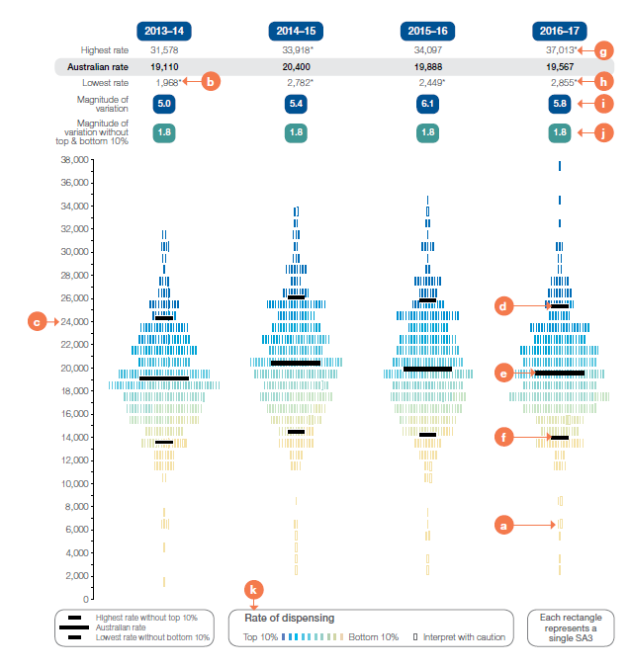
How to interpret the data visualisations
Repeat analysis graphic
Notes:
Speaker notes:
a - What does the rectangle represent? Each rectangle represents an SA3. SA3s are geographical areas defined by the ABS that provide a standardised regional breakdown of Australia. SA3s generally have populations between 30,000 and 130,000 people.
b - Hollow rectangles and asterisks A hollow rectangle or an SA3 rate that has an asterisk indicates a rate that is considered more volatile and should be interpreted with caution.
c - Vertical axis The vertical axis shows the age- and sex‑standardised rate. Rates are age and sex standardised to allow comparisons between populations with different age and sex structures.
d - Highest rate without top 10% This line indicates the highest age- and sex‑standardised rate after excluding the highest 10% of SA3 rates.
e - Australian rate This line indicates the Australian age-and sex‑standardised rate.
f - Lowest rate without bottom 10% This line indicates the lowest age- and sex‑standardised rate after excluding the lowest 10% of SA3 rates.
i - Magnitude of variation The magnitude of variation is the times difference between the highest and lowest SA3 rates in Australia. Rates published with caution are excluded from the calculation.
j - Magnitude of variation without top and bottom 10% The magnitude of variation is the times difference between the highest and lowest SA3 rates after excluding the highest and lowest 10% of SA3 rates.
Rate of dispensing Darker colours represent SA3s with a higher age- and sex-standardised rate, and lighter colours represent SA3s with a lower rate.

Slide 17
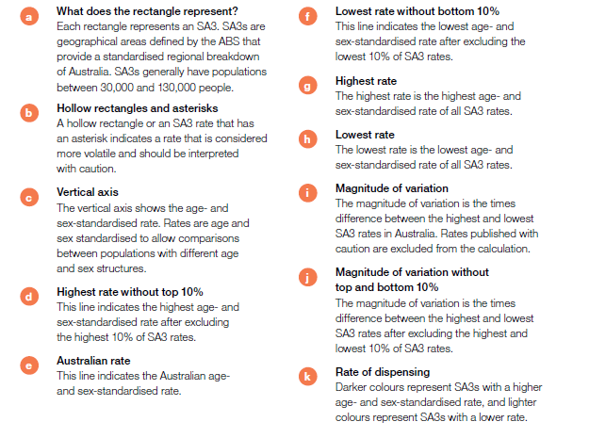
How to interpret the data visualisations
Repeat analysis graphic

Slide 18
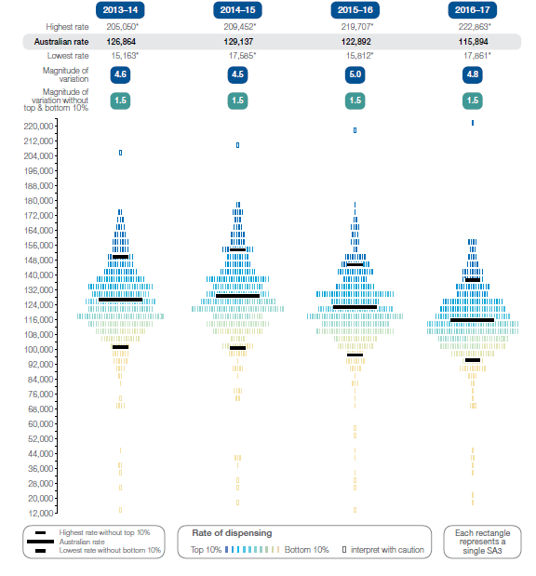
5.1 Antimicrobial medicines dispensing, all ages
Number of PBS prescriptions per 100,000 people, by SA3 of patient residence, 2013-14 to 2016-17
Source: Pharmaceutical Benefits Scheme
Notes:
Speaker notes:
In 2016–17, there were 29,147,238 PBS prescriptions dispensed for antimicrobial medicines, representing an Australian rate of 115,894 prescriptions dispensed per 100,000 people of all ages. The Australian rate decreased from 2013–14, when 126,864 prescriptions per 100,000 people were dispensed.
Between 2013–14 and 2016–17, the rate of antimicrobial prescriptions dispensed nationally decreased by 9%, and the rate of people dispensed at least one prescription for an antimicrobial also decreased.

Slide 19
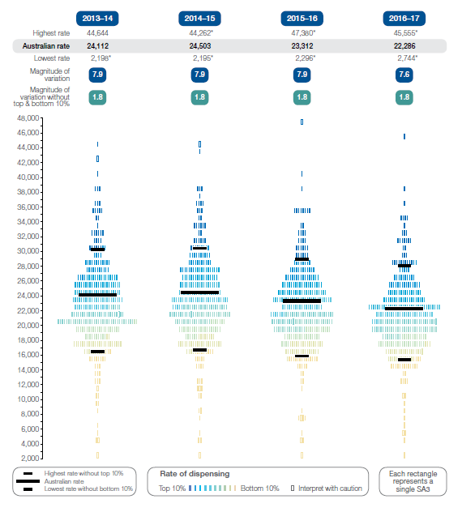
5.2 Amoxicillin dispensing, all ages
Number of PBS prescriptions per 100,000 people of all ages, by SA3 of patient residence, 2013–14 to 2016–17
Source: Pharmaceutical Benefits Scheme
Notes:
Speaker notes:
In 2016–17, there were 5,443,251 PBS prescriptions dispensed for amoxicillin, representing an Australian rate of 22,286 prescriptions dispensed per 100,000 people of all ages. The Australian rate decreased from 2013–14, when 24,112 prescriptions per 100,000 people were dispensed.
Between 2013–14 and 2016–17, the rate of amoxicillin prescriptions dispensed nationally decreased by 7.6%, and the rate of people dispensed at least one prescription for amoxicillin also decreased.

Slide 20
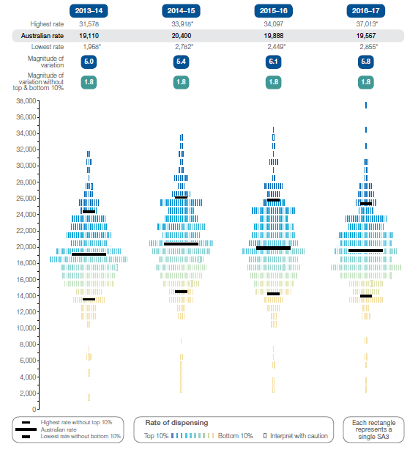
5.2 Amoxicillin and amoxicillin–clavulanate dispensing, all ages
Number of PBS prescriptions per 100,000 people of all ages, by SA3 of patient residence, 2013–14 to 2016-17
Source: Pharmaceutical Benefits Scheme
Notes:
Speaker notes:
In 2016–17, there were 4,936,412 PBS prescriptions dispensed for amoxicillin–clavulanate, representing an Australian rate of 19,567 prescriptions dispensed per 100,000 people of all ages. The Australian rate increased from 2013–14, when 19,110 prescriptions per 100,000 people were dispensed.
Between 2013–14 and 2016–17 the rate of amoxicillin–clavulanate prescriptions dispensed nationally increased by 2.4%.

Slide 21
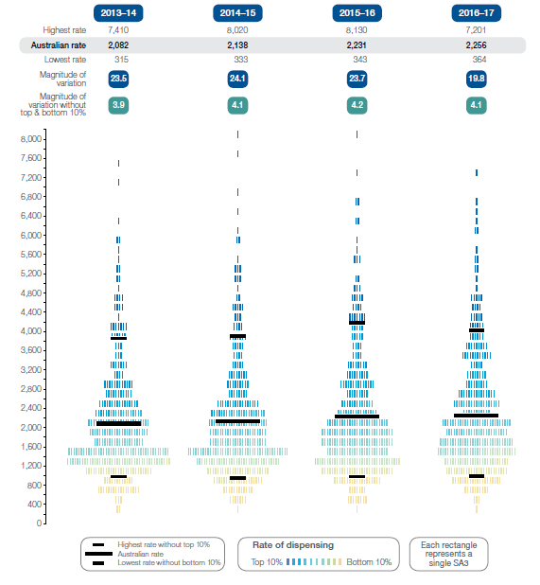
5.3 Antipsychotic medicines dispensing, 17 years and under
Number of PBS prescriptions per 100,000 people aged 17 years and under, by SA3 of patient residence, 2013–14 to 2016–17
Source: Pharmaceutical Benefits Scheme
Notes:
Speaker notes:
In 2016–17, there were 117,511 PBS prescriptions dispensed for antipsychotic medicines to people aged 17 years and under, representing an Australian rate of 2,256 prescriptions per 100,000 people aged 17 years and under. The Australian rate increased during the four years from 2013–14, when 2,082 prescriptions per 100,000 people aged 17 years and under were dispensed.
Between 2013–14 and 2016–17, the rate of antipsychotic medicines dispensed per 100,000 people aged 17 years and under increased by 8% in Australia during the four‑year period.

Slide 22
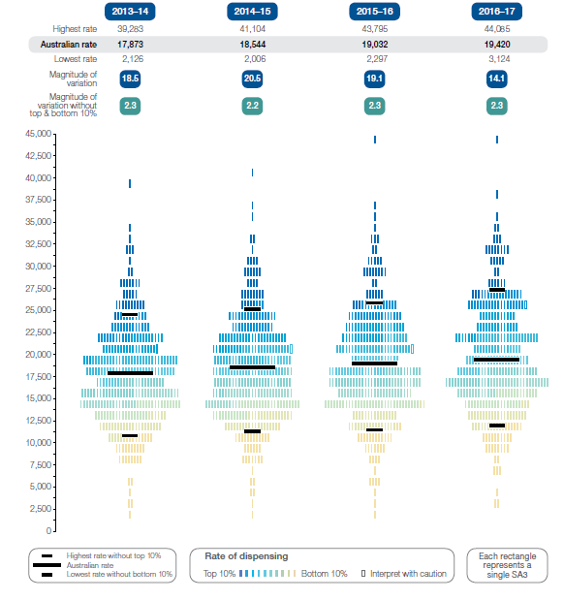
5.4 Antipsychotic medicines dispensing, 18–64 years
Number of PBS prescriptions per 100,000 people aged 18–64 years, by SA3 of patient residence, 2013–14 to 2016–17
Source: Pharmaceutical Benefits Scheme
Notes:
Speaker notes:
In 2016–17, there were 2,908,555 PBS prescriptions dispensed for antipsychotic medicines to people aged 18–64 years, representing an Australian rate of 19,420 prescriptions dispensed per 100,000 people aged 18–64 years. The Australian rate increased during the four years from 2013–14, when 17,873 prescriptions per 100,000 people were dispensed.
Between 2013–14 and 2016–17, the rate of antipsychotic medicines dispensed per 100,000 people aged 18–64 years increased by 9% in Australia during the four-year period.

Slide 23
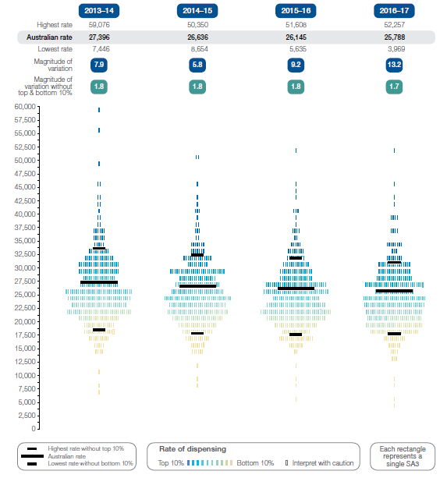
5.5 Antipsychotic medicines dispensing, 65 years and over
Number of PBS prescriptions per 100,000 people aged 65 years and over, by SA3 of patient residence,2013-14 to 2016-17.
Source: Pharmaceutical Benefits Scheme
Notes:
Speaker notes:
In 2016–17, there were 947,941 PBS prescriptions dispensed for antipsychotic medicines to people aged 65 years and over, representing an Australian rate of 25,788 prescriptions dispensed per 100,000 people aged 65 years and over. The Australian rate decreased during the four years from 2013–14, when 27,396 prescriptions per 100,000 people were dispensed.
Between 2013–14 and 2016–17, the rate of antipsychotic medicine prescriptions dispensed per 100,000 people aged 65 years and over decreased by 6% in Australia during the four year period, and the rate of people dispensed at least one prescription also decreased.

Slide 24
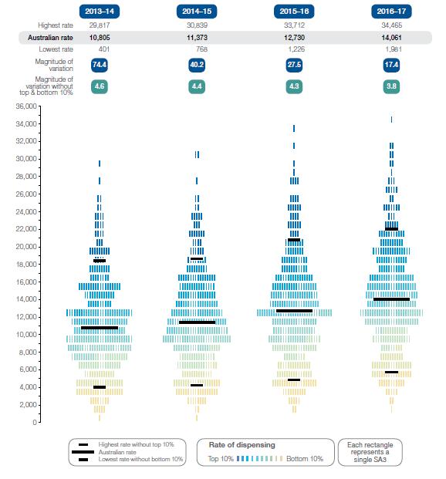
5.6 ADHD medicines dispensing, 17 years and under
Number of PBS prescriptions per 100,000 people aged 17 years and under, by SA3 of patient residence, 2013-14 to 2015-16.
Source: Pharmaceutical Benefits Scheme
Notes:
Speaker notes:
In 2016–17, there were 737,037 PBS prescriptions dispensed for ADHD medicines to people aged 17 years and under, representing an Australian rate of 14,061 prescriptions dispensed per 100,000 people aged 17 years and under. The Australian rate increased during the four years from 2013–14, when 10,805 prescriptions per 100,000 people aged 17 years and under were dispensed.
Between 2013–14 and 2016–17, the rate of ADHD medicines dispensed aged 17 years and under increased by 30% in Australia during the four-year period. The rate of people dispensed at least one prescription also increased during the four years from 2013–14.

Slide 25
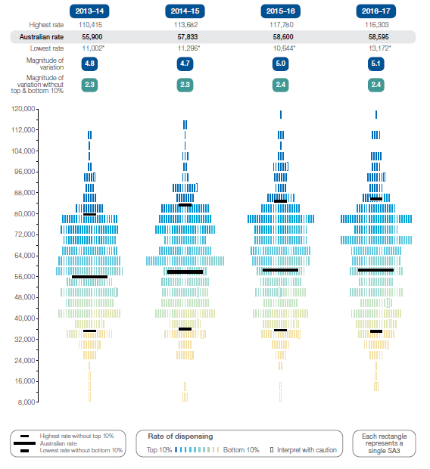
5.7 Opioid medicines dispensing, all ages
Number of PBS prescriptions dispensed per 100,000 people of all ages, by SA3 of patient residence, 2013–14 to 2016–17
Source: Pharmaceutical Benefits Scheme
Notes:
Speaker notes:
In 2016–17, there were 15,419,793 PBS prescriptions dispensed for opioid medicines, representing an Australian rate of 58,595 prescriptions dispensed per 100,000 people of all ages. The Australian rate increased from 2013–14, when 55,900 prescriptions per 100,000 people were dispensed.

Slide 26
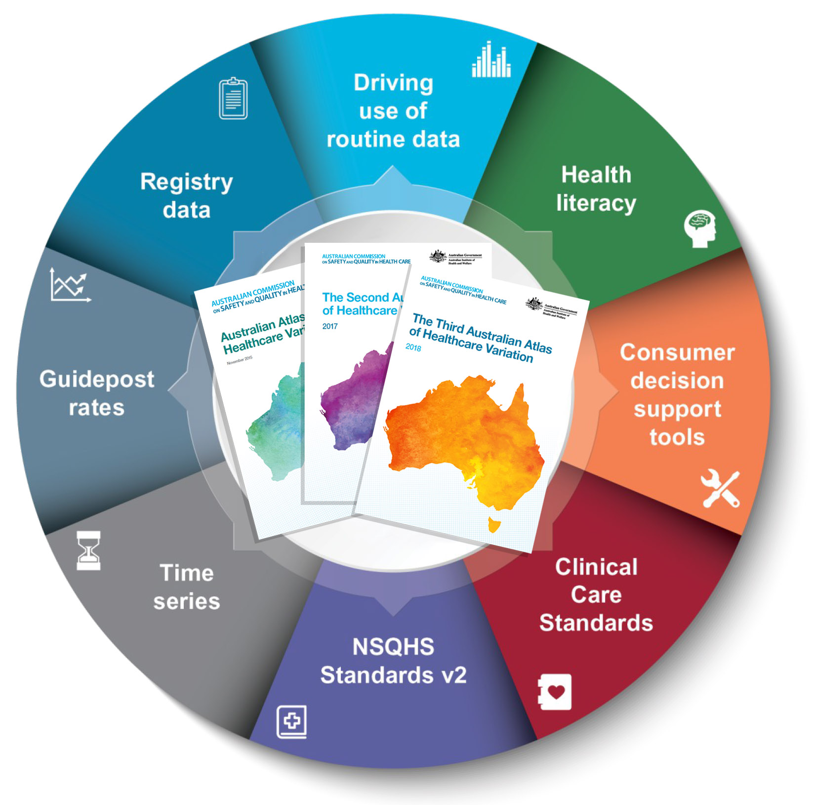
Promoting appropriate care
Explore variation
Identify unwarranted variation
Address unwarranted variation
Notes:
Speaker notes:
Mapping variation is an invaluable tool for understanding how our healthcare system is providing care, but gathering the data is only the first step. Understanding the underlying reasons for marked differences in the use of some health services across Australia, and considering how we can improve, are key for translating this work into better outcomes for patients.
The patterns shown in the maps in this Atlas and the accompanying commentaries show that there are many opportunities for making meaningful changes in Australia’s delivery of health care. The recommendations in the third Atlas highlight that action is needed at all levels – from addressing the social determinants of health through to better data collection, system changes and providing the best supports for individual clinician–patient interactions. These goals are ambitious, but the recommended changes have the potential to result in meaningful progress in defining and delivering appropriate care – and improving patient outcomes.

Slide 27
Further resources
Data for the number of people dispensed at least one prescription, and numbers of Defined Daily Doses per 1,000 people per day are also presented in the third Atlas at www.safetyandquality.gov.au/atlas/
Explore the data further using the interactive Atlas at www.safetyandquality.gov.au/atlas/
Please send any queries to atlas@safetyandquality.gov.au
Notes:
Further resources
Explore the data further using the interactive Atlas at www.safetyandquality.gov.au/atlas/
Please send any queries to atlas@safetyandquality.gov.au

