Slide 1
The Third Australian Atlas of Healthcare Variation
2018

Slide 2
The Australian Atlas of Healthcare Variation series
Notes:
Speaker notes:
Mapping variation is an invaluable tool for understanding how our healthcare system is providing care. The Australian Atlas of Healthcare Variation series illuminates variation by mapping use of health care according to where people live. Each Atlas identifies specific achievable actions for exploration and quality improvement.
The Australian Commission on Safety and Quality in Health Care (the Commission) has collaborated with the Australian, state and territory governments, specialist medical colleges, clinicians and consumer representatives to develop the Atlas series.
The Atlas publications can be downloaded from the Atlas website.

Slide 3
Interactive Atlas
Notes:
Speaker notes:
The Atlas data can also be further explored using the online interactive Atlas platform.

Slide 4
Australian Commission on Safety and Quality in Health Care
Australian Government agency
Leads & coordinates national improvements in safety & quality of health care based on best available evidence
Works in partnership with patients, consumers, clinicians, managers, policy makers & health care organisations
Aims to ensure that the health system is sustainable, better informed, supported & organised to deliver safe & high quality care
Notes:
Speaker notes:
The Commission’s role is to lead and coordinate national improvements in the safety and quality of health care. The Commission works in partnership with the Australian Government, state and territory governments and the private sector to achieve a safe and high-quality, sustainable health system. In doing so, the Commission also works closely with patients, carers, clinicians, managers, policymakers and healthcare organisations.
Key functions of the Commission include developing national safety and quality standards, developing clinical care standards to improve the implementation of evidence-based health care, coordinating work in specific areas to improve outcomes for patients, and providing information, publications and resources about safety and quality.
The Commission works in four priority areas:
- Patient safety
- Partnering with patients, consumers and communities
- Quality, cost and value
- Supporting health professionals to provide care that is informed, supported and organised to deliver safe and high-quality health care.
One of the Commission’s key programs is the National Safety and Quality Health Service (NSQHS) Standards. The primary aim of the NSQHS Standards are to protect the public from harm and to improve the quality of health service provision. The NSQHS Standards were developed by the Commission in partnership with the Australian, state and territory governments, the private sector, clinicians, patients and carers.

Slide 5
Third Australian Atlas of Healthcare Variation
Examines variation nationally in 13 clinical items, grouped into 4 themes
Neonatal and paediatric health
Early planned caesarean section without medical or obstetric indication
Antibiotic dispensing in children, 9 years and under
Proton pump inhibitor dispensing in infants, 1 year and under
Gastrointestinal investigations and treatments
Proton pump inhibitor dispensing in adults
Colonoscopy hospitalisations
Gastroscopy hospitalisations
Thyroid investigations and treatments
Thyroid stimulating hormone tests
Thyroid function tests
Neck ultrasound
Thyroidectomy hospitalisations
Cardiac tests
Cardiac stress tests and imaging
Stress echocardiography
Myocardial perfusion scans
Standard echocardiography
Notes:
Speaker notes:
The third Atlas, released in December 2018, examines four clinical themes: neonatal and paediatric health, gastrointestinal investigations and treatments, thyroid investigations and treatments and cardiac tests.

Slide 6
Inside this slide pack
Why does variation matter?
How is variation measured in the Atlas?
How is variation presented in the Atlas?
Notes on data
Key findings
Promoting appropriate care
Further resources.
Notes:
Speaker notes:
This slide pack explores why variation matters and what unwarranted variation in healthcare is. This slide pack explores the key findings for the ‘Thyroid investigations and treatments’ chapter and shows findings, maps and graphs for each of the clinical items in this chapter.

Slide 7
Why does variation matter?
Large variations in health care use have been documented by researchers around the world for many years
A proportion of this variation is termed ‘unwarranted’
Unwarranted variation:
Is unrelated to patient need or preference
May signal inappropriate care
May signal ineffective use of resources
It raises questions about appropriateness of care, health system efficiency, equity and access
Can highlight opportunities for further investigation and for the health system to improve
Notes:
Speaker notes:
Variations documented for many years: One of the first major studies published was by Glover in 1938 who noted a rise in England & Wales in incidence of tonsillectomy and very large differences in rates between school districts which “defies any explanation, save that of variations of medical opinion on the indications for operation.” He also noted “Large and, in some cases, drastic reductions in the numbers of operations performed in elementary school children in certain areas have had no unsatisfactory results” and that “The mortality from the operation is larger than is generally appreciated”.
He noted that that the conspicuous success of the operation in some cases may have led to its adoption in many doubtful cases.
Getting the best outcomes for patients and improving appropriateness of care is the goal of the Atlas. Where we see substantial variation in use of a particular treatment, it is an alarm bell that should make us stop and investigate whether appropriate care is being delivered.
Variation in itself is not necessarily bad, and it can be good if it reflects health services responding to differences in patient preferences or underlying needs. When a difference in the use of health services does not reflect these factors, it is unwarranted variation and represents an opportunity for the health system to improve. Rates of an intervention that are substantially higher or lower in some areas can highlight:
- Inequity of access to evidence-based care, and the need to deliver services more fairly
- Uncertainty about the intervention’s place in therapy, and the need for better data on its benefits and harms
- Gaps in accessible evidence for clinicians, and the need for clinical care standards
- Inadequate system supports for appropriate care, and the need for changes in training or financial incentives.
Looking at how healthcare use varies between people living in different areas, between people with and without socioeconomic disadvantage, and between Aboriginal and Torres Strait Islander Australians and other Australians can show who in our community is missing out. Fundamental changes to address the underlying determinants of ill health, as well as better service delivery for those with existing disease, are needed where these inequities are found.
Reference: Glover JA. The Incidence of Tonsillectomy in School Children: (Section of Epidemiology and State Medicine). Proc R Soc Med. 1938;31(10):1219-36.

Slide 8
How is variation measured in the Atlas?
Healthcare use is mapped by residence of patient (not location of the health provider)
Location of residence mapped at Statistical Area Level 3 (SA3)
Data are age- and sex-standardised, with a few exceptions
Data sources used:
National Hospital Morbidity Database (NHMD)
Medicare Benefits Schedule (MBS)
Pharmaceutical Benefits Scheme (PBS)
National Perinatal Data Collection (NPDC)
Data extraction and analysis performed by the Australian Institute of Health and Welfare (AIHW)
Interactive Atlas
Notes:
Speaker notes:
Healthcare use is mapped by residence of the patient (Not by where the care was provided)
Most items in this Atlas are mapped to the Statistical Area Level 3 (SA3). Some are mapped to the state and territory level because events were too low to map at a smaller geographical level. SA3s are standard geographical regions used by the Australian Bureau of Statistics. SA3s generally have populations of between 30,000 and 130,000.
Rates are age and sex-standardised per 100,000 population to remove the effect of differences in population age structure when comparing crude rates for different geographic areas.
Data specifications for each item are available on the AHIW’s Metadata Online Registry (METeOR). Information on data analysis and methodology available in the technical supplement.

Slide 9
How is variation presented in the Atlas?
Data are presented in maps and graphs
Statistical Area 3 level data is presented for:
State and territory analysis
Remoteness and socioeconomic disadvantage
State and territory level data is presented for:
Aboriginal and Torres Strait Islander Australian status
Public and private patient funding status
Notes:
Speaker notes:
Data are presented in maps and graphs.
For indicators where the annual number of hospitalisations is too low or unreliable to report at a local level, three years of data are combined.
For each item, SA3 level data are grouped by state and territory, remoteness and socioeconomic status to assist comparisons between local areas.
For each item, where possible, state and territory level data is presented by Aboriginal and Torres Strait Islander status and patient funding status
Data specifications for each item are available on the AHIW’s Metadata Online Registry (METeOR).

Slide 10
Data suppression
A confidentiality process has been followed for all data items in the Atlas to protect the identity of patients and providers
The process includes applying standard rules set by The Australian Institute of Health and Welfare and by the Australian Government Department of Health for reporting of MBS and PBS data
The MBS rules for protecting provider identity have had a marked effect on reporting of three items: myocardial perfusion scans, thyroid stimulating hormone and thyroid function tests.
For example, ‘data cannot be reported for an area if 85% of services were done by one provider, or 90% by two providers’
For the items affected the most, the magnitude of variations are likely to be underestimates of the true variation across Australia.
Notes:
Speaker notes:
Speaker notes:
For all MBS items in the Atlas, some data have been suppressed to manage volatility and confidentiality. This process takes into account the Australian Government Department of Health’s requirements for reporting MBS data.
The process has resulted in particularly marked data suppression for MBS items for thyroid function testing and for myocardial perfusion scans. Most local areas (Statistical Area Level 3 – SA3) were suppressed to prevent identification of the provider (practitioner or business entity).
More detail on data suppression can be found in the technical supplement: https://www.safetyandquality.gov.au/wp-content/uploads/2018/12/Text-Technical-supplement.pdf

Slide 11
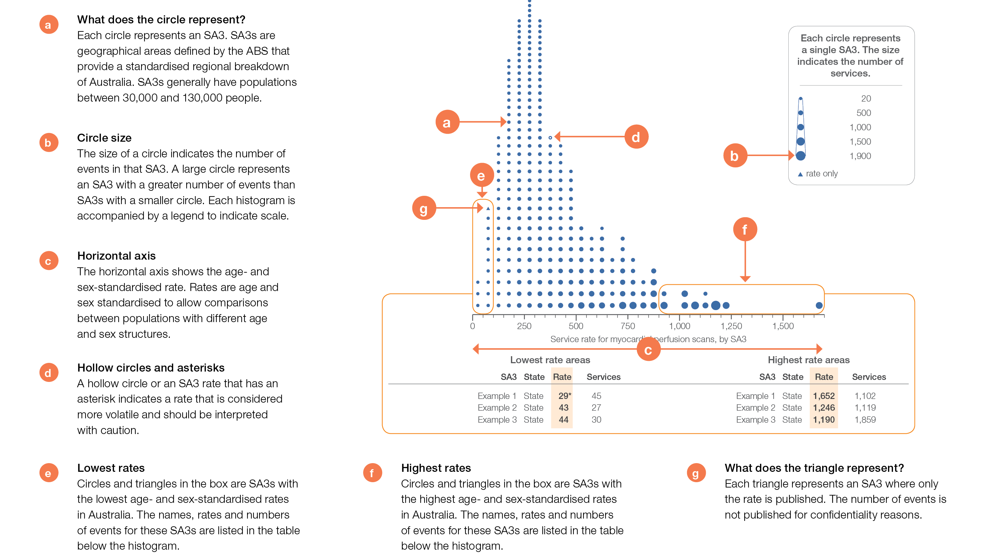
How to interpret our data visualisations
Histogram

Slide 12
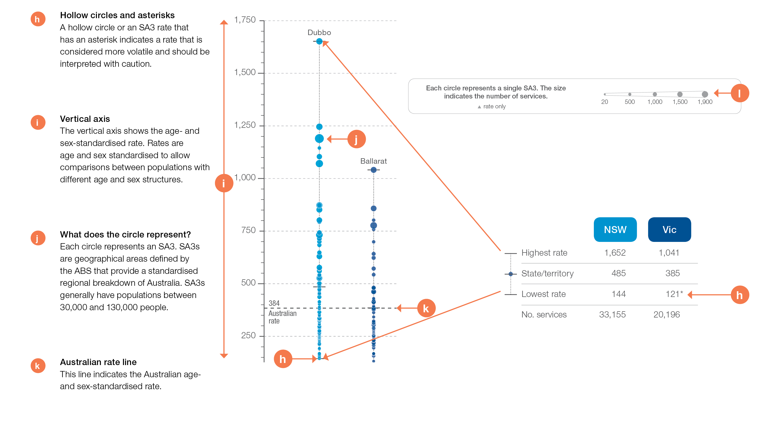
How to interpret our data visualisations
State and territory graph

Slide 13
Thyroid investigations and treatments
Notes:
Speaker notes:
This chapter examines:
- Thyroid stimulating hormone tests, 18 years and over
- Thyroid function tests, 18 years and over
- Neck ultrasound tests, 18 years and over
- Thyroidectomy hospitalisations, 18 years and over

Slide 14
Thyroid investigations and treatments
Key findings
Data item | Range across local areas* per 100,000 | Times difference | Times difference excluding top and bottom 10% | Number during 2016–17
3.1a Thyroid stimulating hormone tests†, 18 years and over | 15,735–40,814 | 2.6 | 1.6 | 5,539,805
3.1b Thyroid function tests†, 18 years and over | 6,425–16,077 | 2.5 | 1.6 | 2,344,089
3.1c Neck ultrasound tests†, 18 years and over | 513–2,893 | 5.6 | 2.1 | 308,247
* Statistical Area Level 3
† Based on number of MBS services
Data item | Range across local areas* per 100,000 | Times difference | Times difference excluding top and bottom 10% | Number during 2016–17
3.2b Thyroidectomy hospitalisations, 18 years and over | 28–130 | 4.6 | 2.0 | 35,166
* Statistical Area Level 3
Notes:
Speaker notes:
The number of people having thyroid function testing in Australia has increased faster than the rate of population growth.
In 2016–17, there were 5,539,805 MBS-subsidised services for TSH tests, representing 28,742 services per 100,000 people aged 18 years and over (the Australian rate).
Rates of TFTs were 3.2 times as high in females as in males.
The Atlas found the rate of neck ultrasound varies up to six-fold and the rate of thyroidectomy varies up to five-fold between local areas across Australia.

Slide 15
What’s included in TSH and TFT
Thyroid stimulating hormone (TSH) tests:
TSH tests that do not include T3 or T4
Vast majority of these are TSH alone [ie, MBS item number 66716].
Thyroid function tests (TFTs):
TSH in combination with free tri-iodothyronine (T3) and/or free thyroxine (T4) [ie, MBS item number 66719].

Slide 16
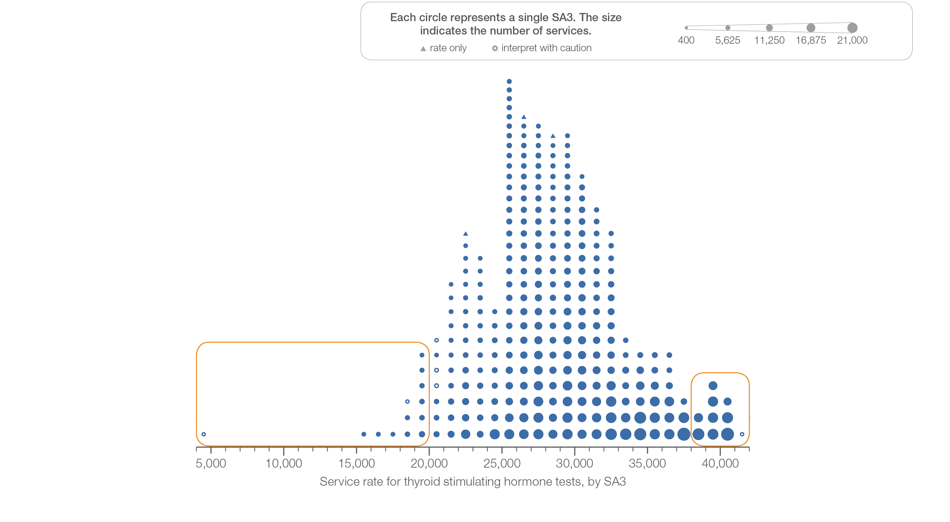
3.1 Thyroid stimulating hormone tests
Sources: MBS data 2016-17, and ABS Estimated Resident Population 30 June 2016
Notes:
Speaker notes:
This slide shows the distribution of rates by Statistical Area Level 3 (SA3) for thyroid stimulating hormone tests.
Each circle on the graph represents an SA3. The size of the circle indicates how many services have been recorded for people living in that area. The horizontal axis shows the standardised rates for the clinical item.
Triangles indicate SA3s where only rates are published. The numbers of services are not published for confidentiality reasons. OT represents other territories.
For further detail about the methods used, please refer to the Technical Supplement.
For further information on how to interpret the figures, please refer to the ‘How to interpret’ resource available at: www.safetyandquality.gov.au/atlas/the-third-australian-atlas-of-healthcare-variation-2018/how-to-interpret-the-data/

Slide 17
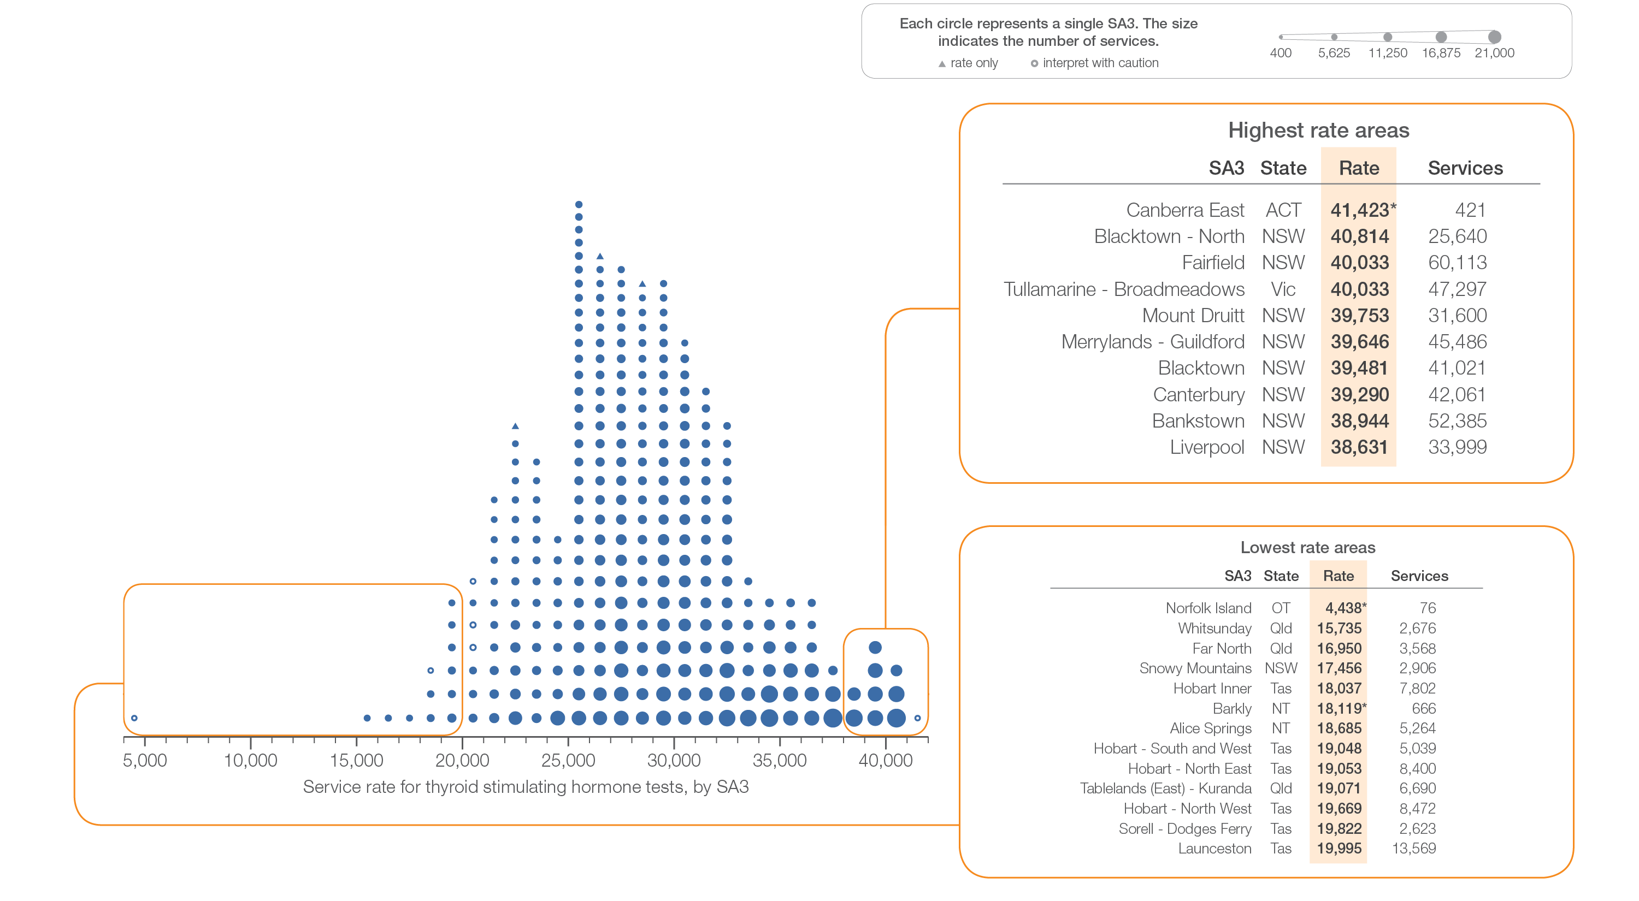
3.1 Thyroid stimulating hormone tests
Sources: MBS data 2016-17, and ABS Estimated Resident Population 30 June 2016
Notes:
Speaker notes:
This slide shows the distribution of rates by Statistical Area Level 3 (SA3) for thyroid stimulating hormone tests.
Each circle on the graph represents an SA3. The size of the circle indicates how many services have been recorded for people living in that area. The horizontal axis shows the standardised rates for the clinical item.
Triangles indicate SA3s where only rates are published. The numbers of services are not published for confidentiality reasons. OT represents other territories.
For further detail about the methods used, please refer to the Technical Supplement.
For further information on how to interpret the figures, please refer to the ‘How to interpret’ resource available at: www.safetyandquality.gov.au/atlas/the-third-australian-atlas-of-healthcare-variation-2018/how-to-interpret-the-data/

Slide 18
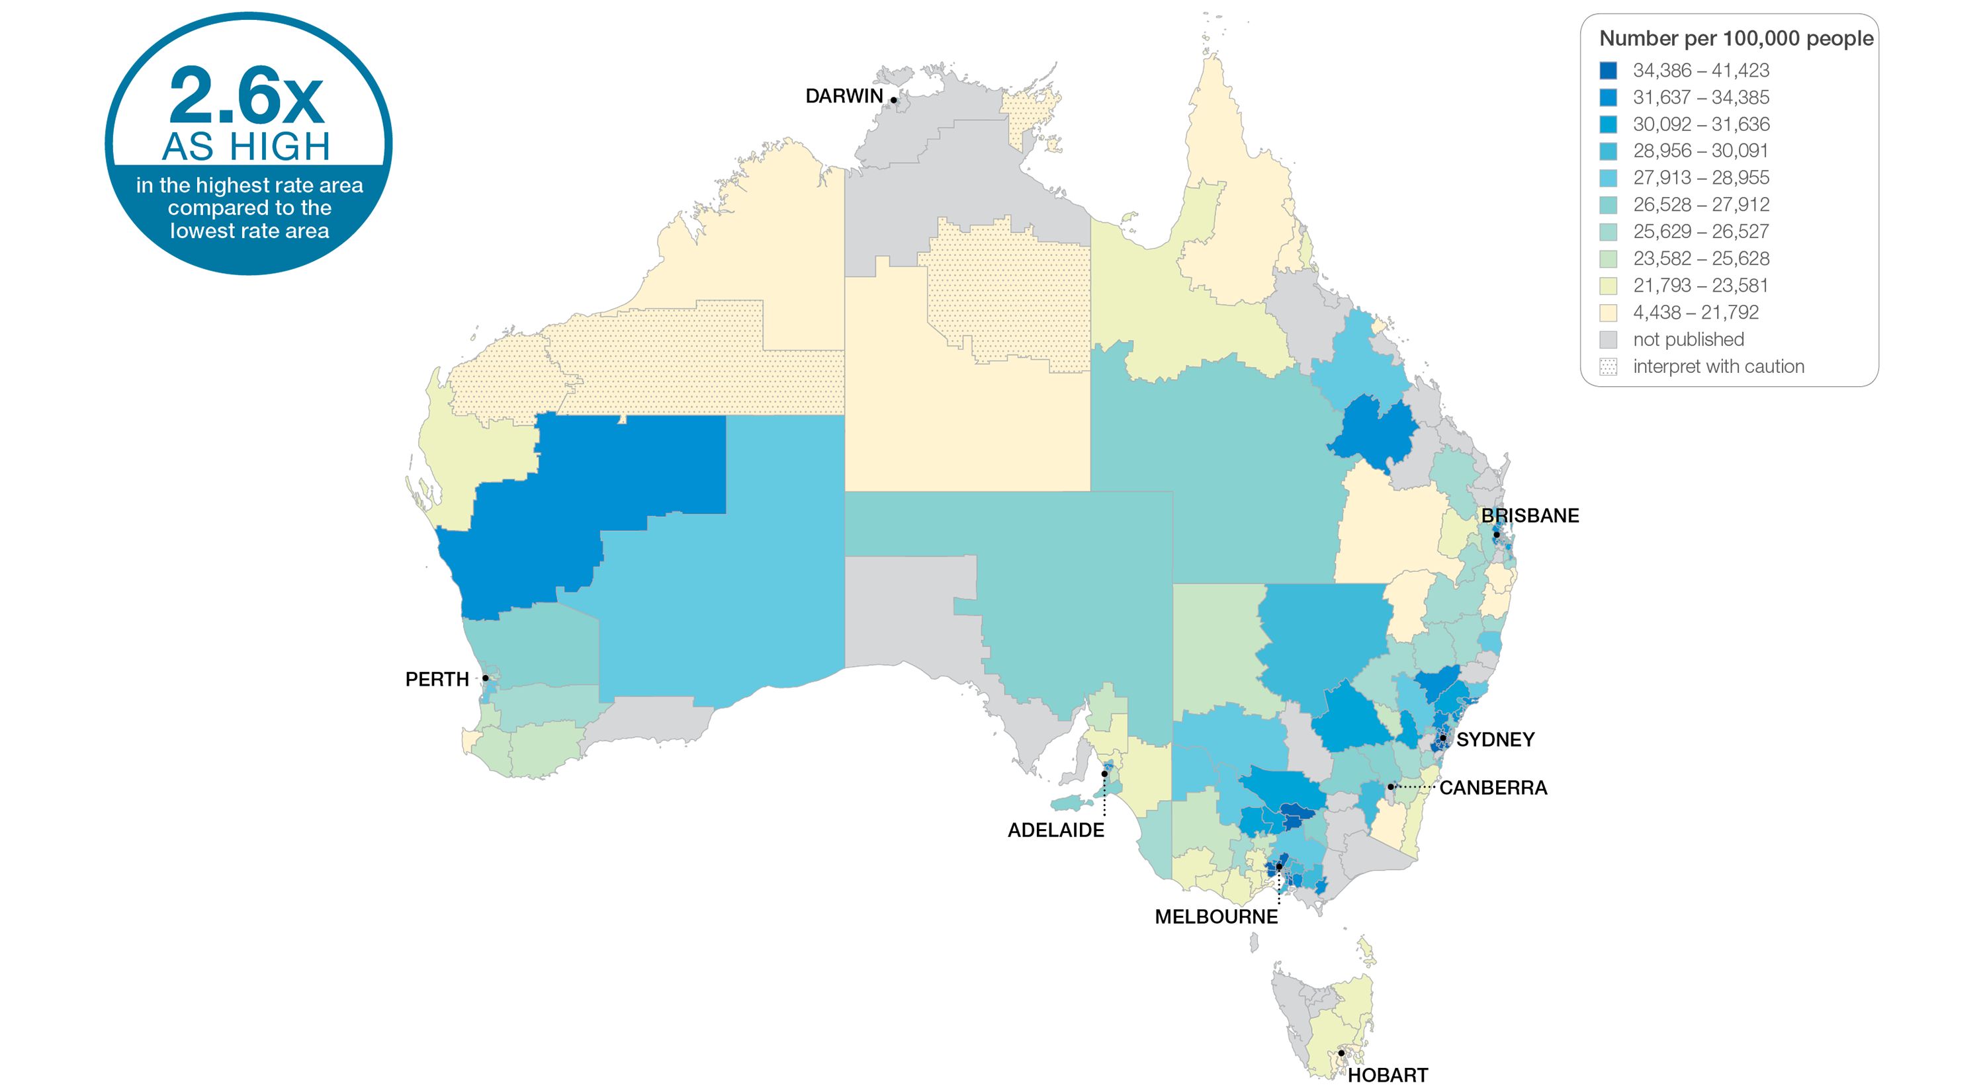
3.1 Thyroid stimulating hormone tests
Sources: MBS data 2016-17, and ABS Estimated Resident Population 30 June 2016
Notes:
Speaker notes:
This slide shows the distribution of rates by Statistical Area Level 3 (SA3) for thyroid stimulating hormone tests. Rates are based on the patient’s usual place of residence, not the location of the healthcare provider.
In 2016–17, there were 5,539,805 MBS-subsidised services for TSH tests, representing 28,742 services per 100,000 people aged 18 years and over (the Australian rate).
The number of MBS-subsidised services for TSH tests across 287§ local areas (Statistical Area Level 3 – SA3) ranged from 15,735 to 40,814 per 100,000 people aged 18 years and over.
The rate was 2.6 times as high in the area with the highest rate compared to the area with the lowest rate.
The number of services varied across states and territories, from 20,106 per 100,000 people aged 18 years and over in Tasmania to 30,640 in New South Wales.
The range of rates represented by each colour are shown in the legend for the map. The darker blue colour represents SA3s with higher rates. The lighter colours represent SA3s with lower rates. Dotted areas indicate rates that are considered more volatile than other published rates and should be interpreted with caution. These rates are excluded from the calculation of the difference between the highest and lowest SA3 rates in Australia.
For further detail about the methods used, please refer to the Technical Supplement.
For further information on how to interpret the figures, please refer to the ‘How to interpret’ resource available at: www.safetyandquality.gov.au/atlas/the-third-australian-atlas-of-healthcare-variation-2018/how-to-interpret-the-data/

Slide 19
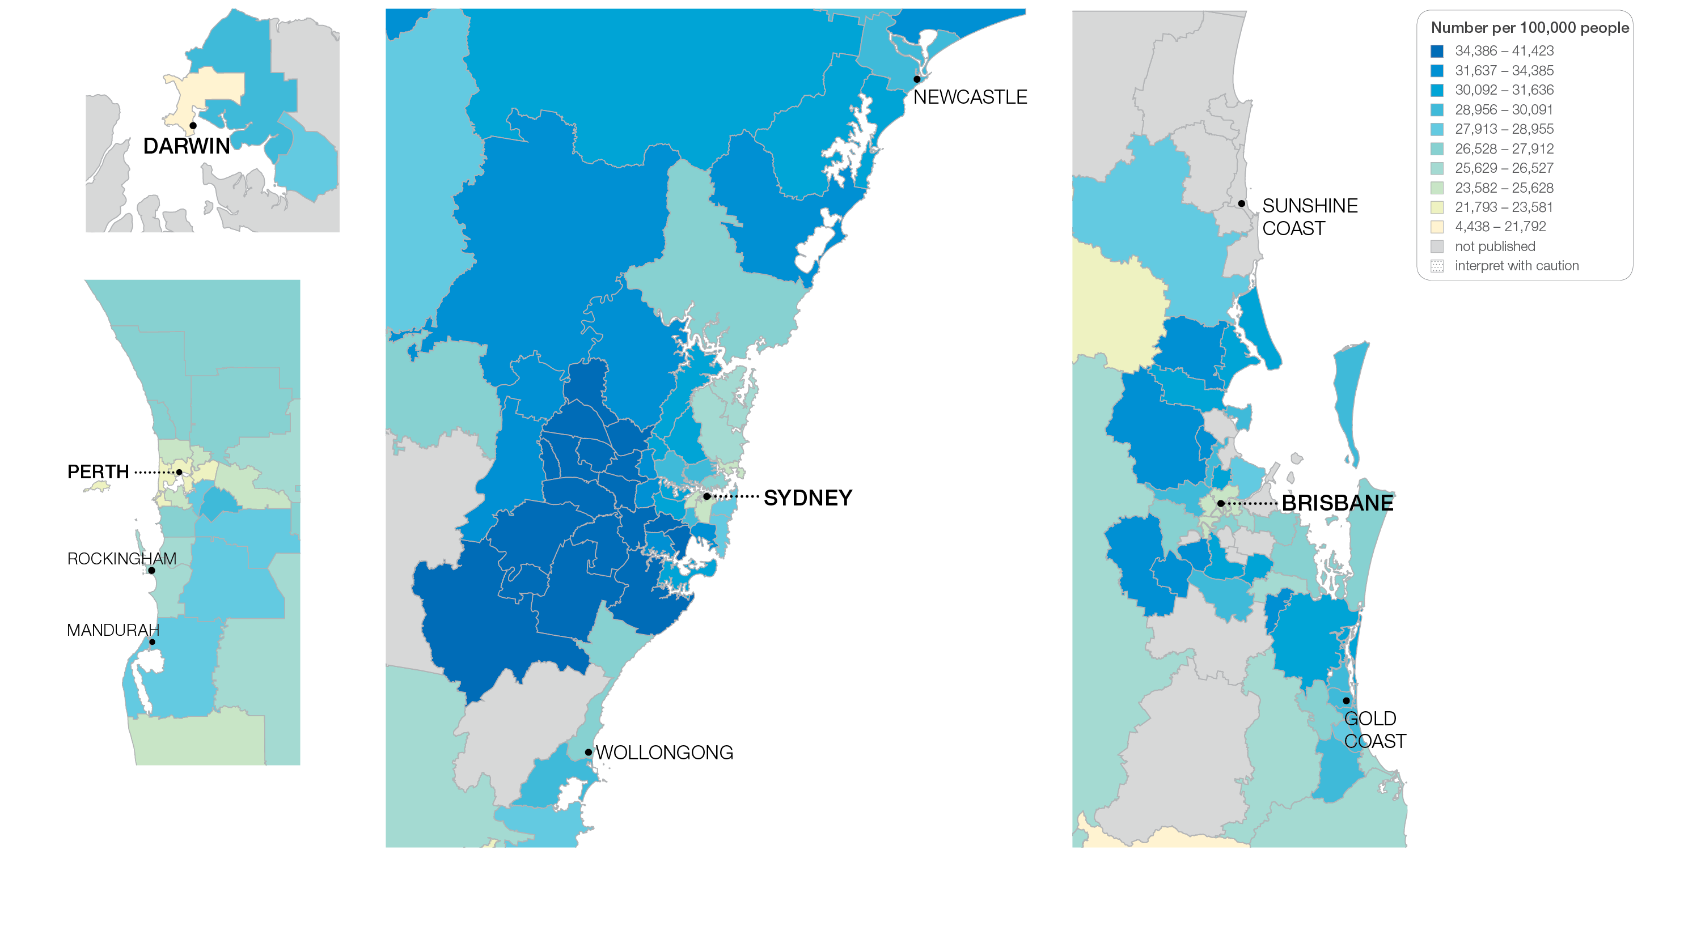
3.1 Thyroid stimulating hormone tests
Sources: MBS data 2016-17, and ABS Estimated Resident Population 30 June 2016
Notes:
Speaker notes:
This slide shows the distribution of rates by Statistical Area Level 3 (SA3) for thyroid stimulating hormone tests by capital city area. Rates are based on the patient’s usual place of residence, not the location of the healthcare provider.

Slide 20
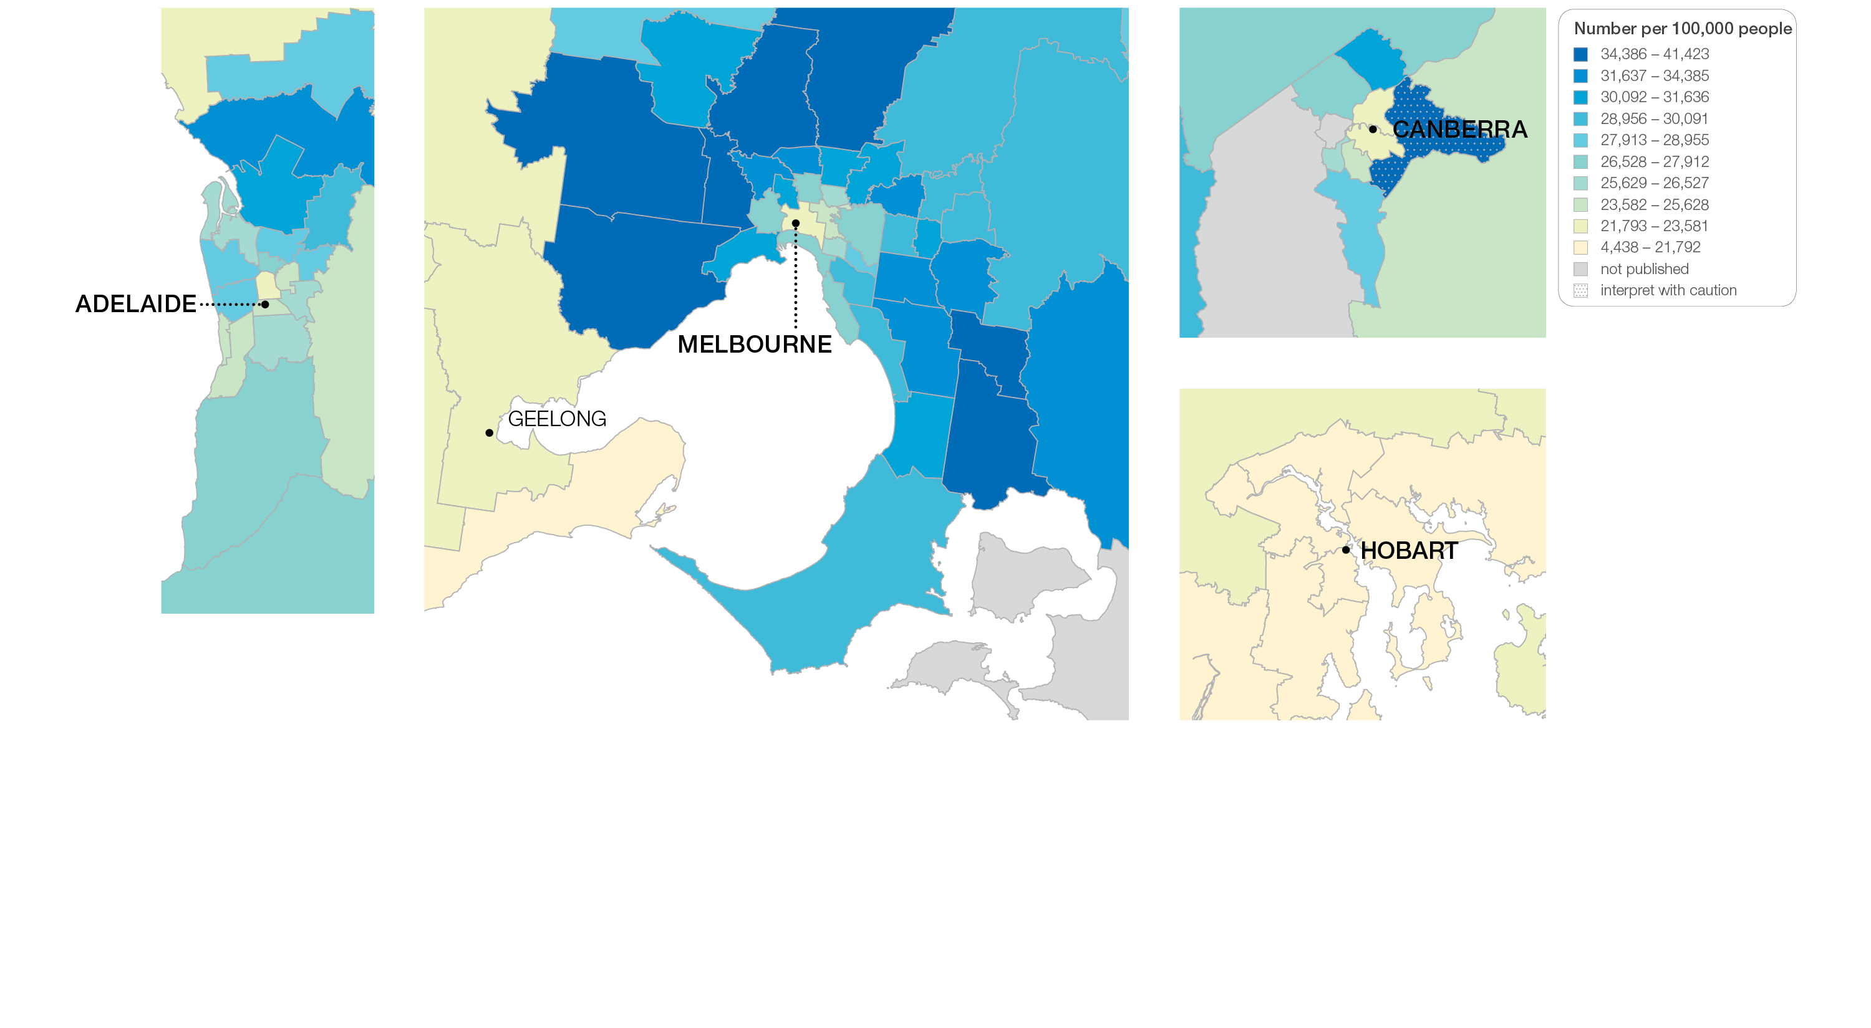
3.1 Thyroid stimulating hormone tests
Sources: MBS data 2016-17, and ABS Estimated Resident Population 30 June 2016
Notes:
Speaker notes:
This slide shows the distribution of rates by Statistical Area Level 3 (SA3) for thyroid stimulating hormone tests by capital city area. Rates are based on the patient’s usual place of residence, not the location of the healthcare provider.

Slide 21
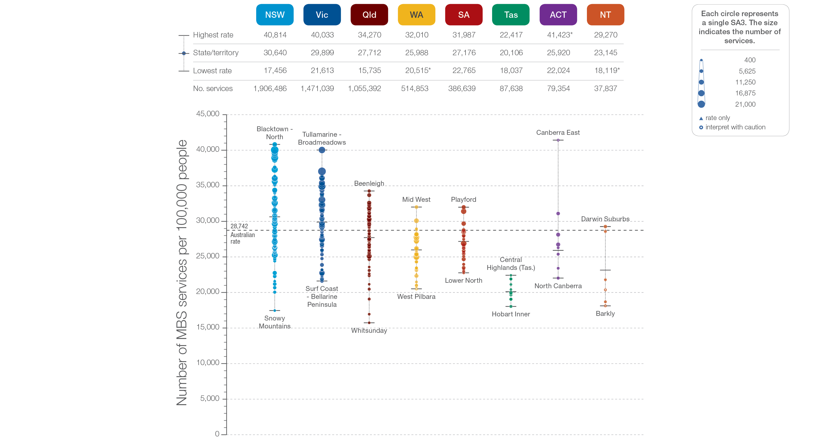
3.1 Thyroid stimulating hormone tests
State and territory
Sources: MBS data 2016-17, and ABS Estimated Resident Population 30 June 2016
Notes:
Speaker notes:
The number of MBS services for TSH tests varied across states and territories, from 20,106 per 100,000 people aged 18 years and over in Tasmania to 30,640 in New South Wales.
Each circle on the graph represents an SA3. The size of the circle indicates how many services have been recorded for people living in that area. The vertical axis shows the standardised rates for the clinical item.
Hollow circles and asterisks indicate rates that are considered more volatile than other published rates and should be interpreted with caution. Triangles indicate SA3s where only rates are published. The numbers of services are not published for confidentiality reasons.
For further detail about the methods used, please refer to the Technical Supplement.
For further information on how to interpret the figures, please refer to the ‘How to interpret’ resource available at: www.safetyandquality.gov.au/atlas/the-third-australian-atlas-of-healthcare-variation-2018/how-to-interpret-the-data/

Slide 22
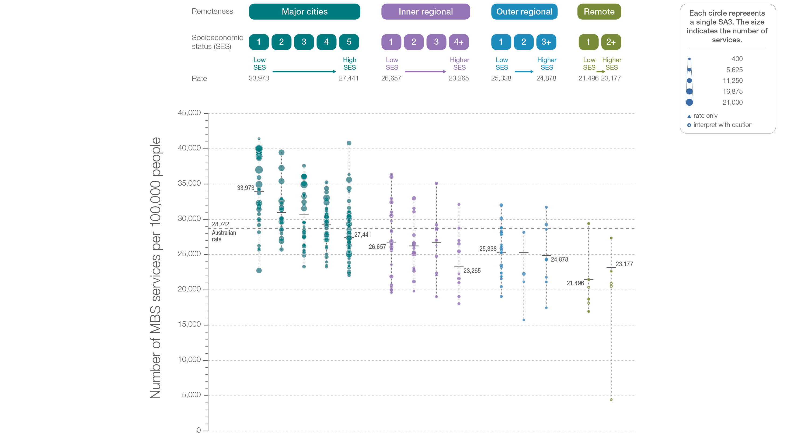
3.1 Thyroid stimulating hormone tests
Remoteness and socioeconomic status
Sources: MBS data 2016-17, and ABS Estimated Resident Population 30 June 2016
Notes:
Speaker notes:
Rates of TSH tests were higher in major cities and in inner regional areas than in outer regional and remote areas. Rates were higher in areas with lower socioeconomic status in major cities, inner regional areas and outer regional areas. The pattern was less clear in remote areas.
Hollow circles indicate rates that are considered more volatile than other published rates and should be interpreted with caution. Triangles indicate SA3s where only rates are published. The numbers of services are not published for confidentiality reasons.
For further detail about the methods used, please refer to the Technical Supplement.
For further information on how to interpret the figures, please refer to the ‘How to interpret’ resource available at: www.safetyandquality.gov.au/atlas/the-third-australian-atlas-of-healthcare-variation-2018/how-to-interpret-the-data/

Slide 23
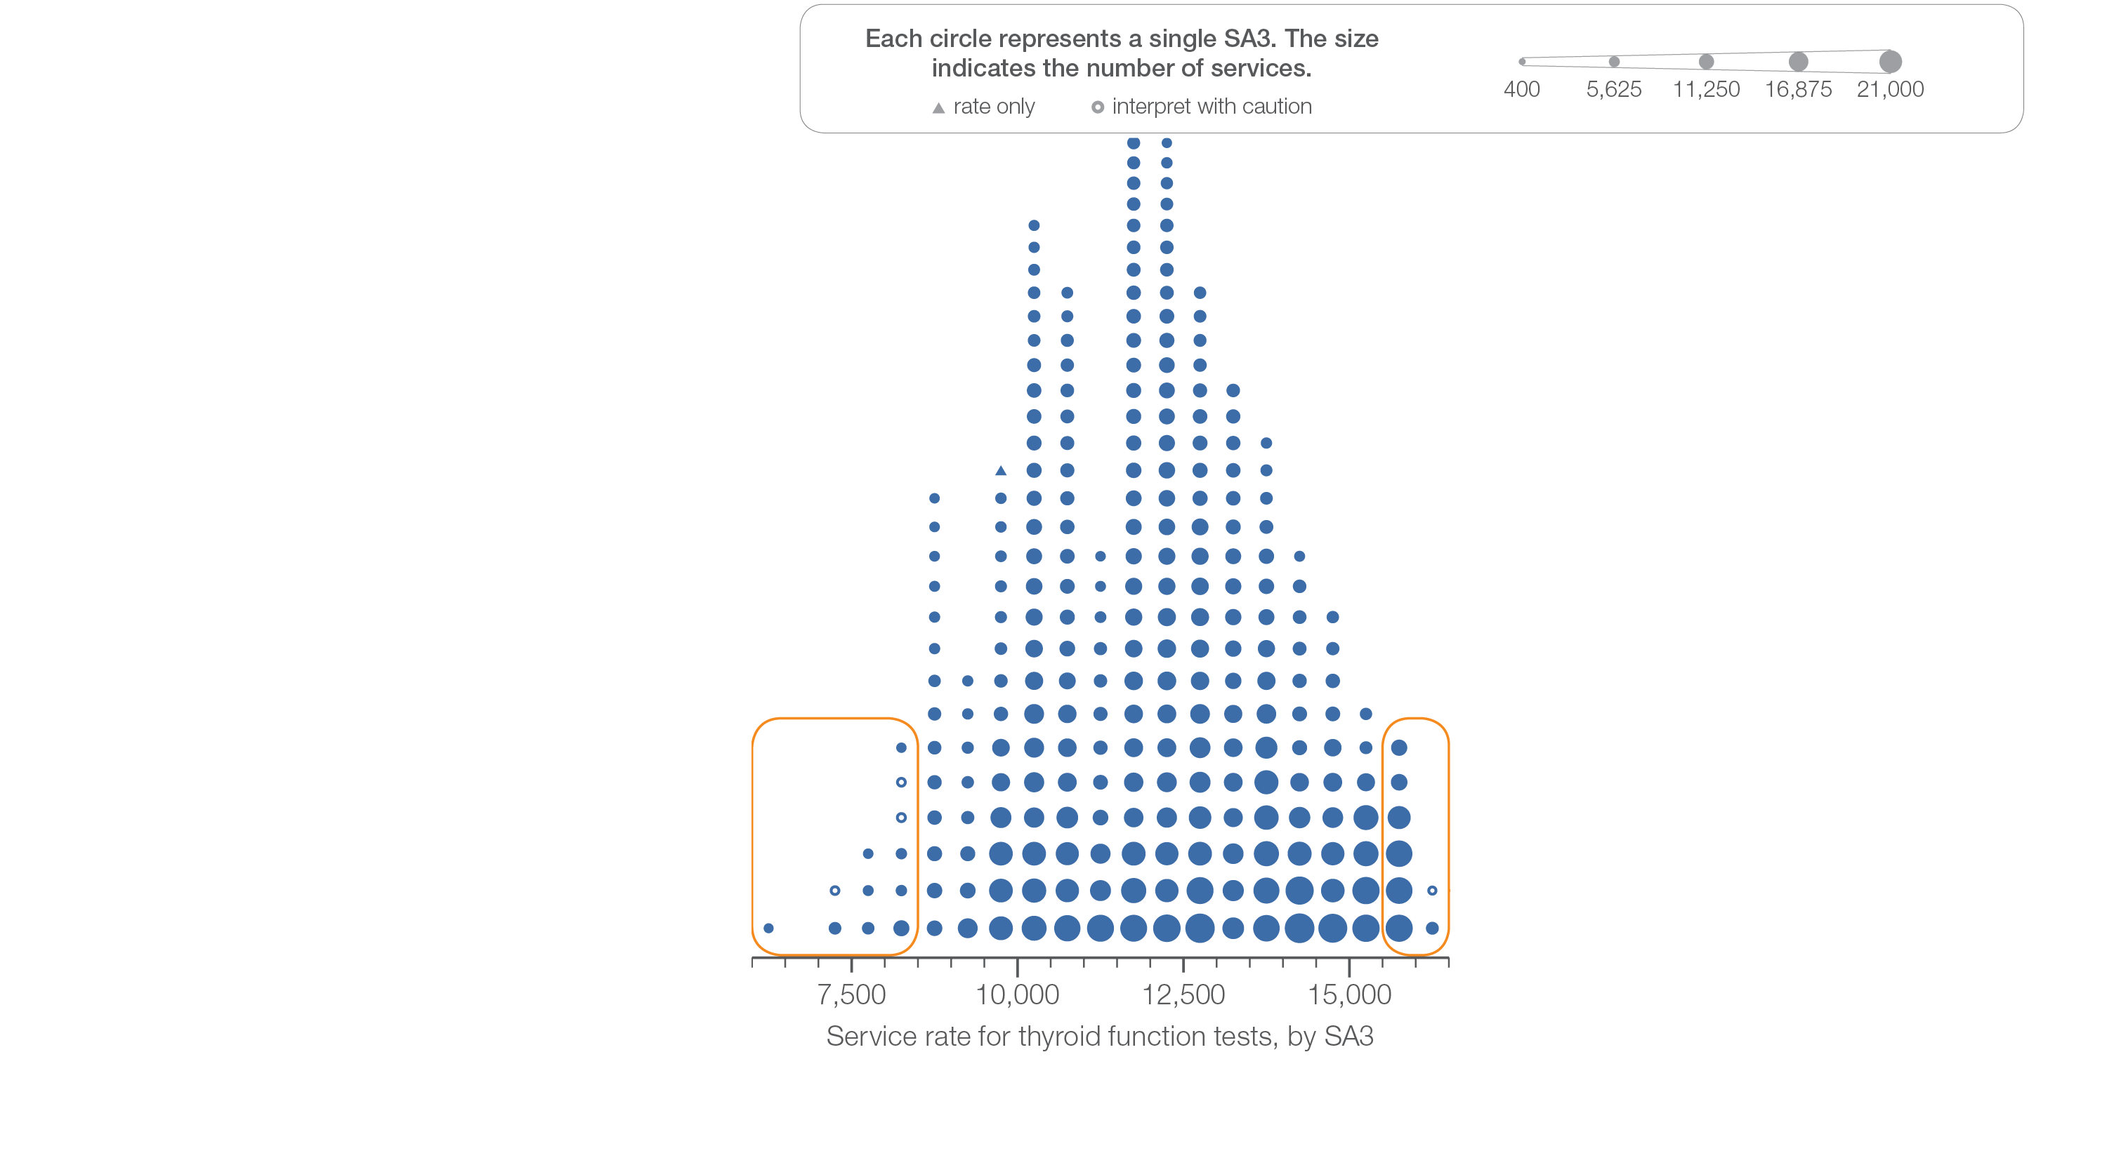
3.1 Thyroid function tests
Sources: MBS data 2016-17, and ABS Estimated Resident Population 30 June 2016
Notes:
Speaker notes:
This slide shows the distribution of rates by Statistical Area Level 3 (SA3) for thyroid function tests.
Each circle on the graph represents an SA3. The size of the circle indicates how many services have been recorded for people living in that area. The horizontal axis shows the standardised rates for the clinical item.
Hollow circles and asterisks indicate rates that are considered more volatile than other published rates and should be interpreted with caution. Triangles indicate SA3s where only rates are published. The numbers of services are not published for confidentiality reasons.
For further detail about the methods used, please refer to the Technical Supplement.
For further information on how to interpret the figures, please refer to the ‘How to interpret’ resource available at: www.safetyandquality.gov.au/atlas/the-third-australian-atlas-of-healthcare-variation-2018/how-to-interpret-the-data/

Slide 24
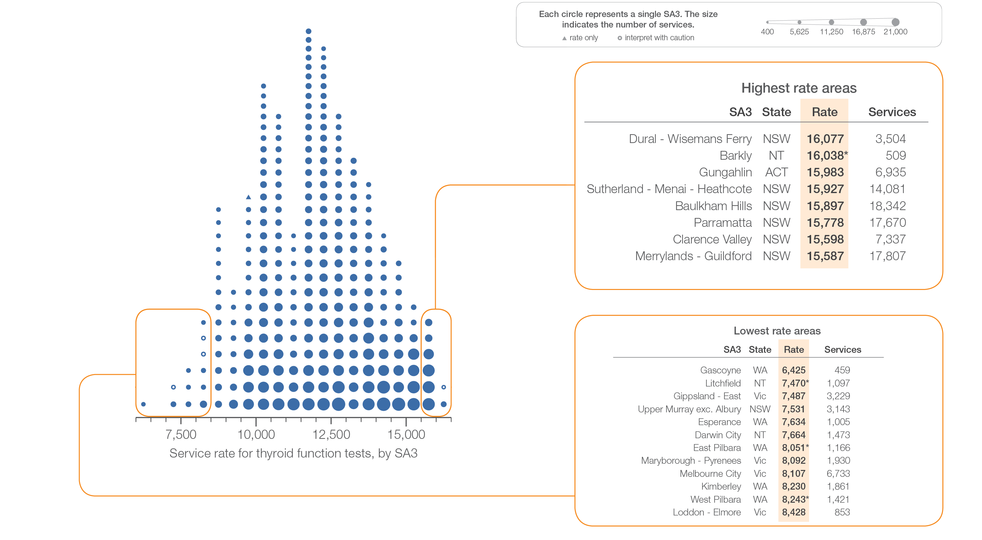
3.1 Thyroid function tests
Sources: MBS data 2016-17, and ABS Estimated Resident Population 30 June 2016
Notes:
Speaker notes:
This slide shows the distribution of rates by Statistical Area Level 3 (SA3) for thyroid function tests.
Each circle on the graph represents an SA3. The size of the circle indicates how many services have been recorded for people living in that area. The horizontal axis shows the standardised rates for the clinical item.
Hollow circles and asterisks indicate rates that are considered more volatile than other published rates and should be interpreted with caution. Triangles indicate SA3s where only rates are published. The numbers of services are not published for confidentiality reasons.
For further detail about the methods used, please refer to the Technical Supplement.
For further information on how to interpret the figures, please refer to the ‘How to interpret’ resource available at: www.safetyandquality.gov.au/atlas/the-third-australian-atlas-of-healthcare-variation-2018/how-to-interpret-the-data/

Slide 25
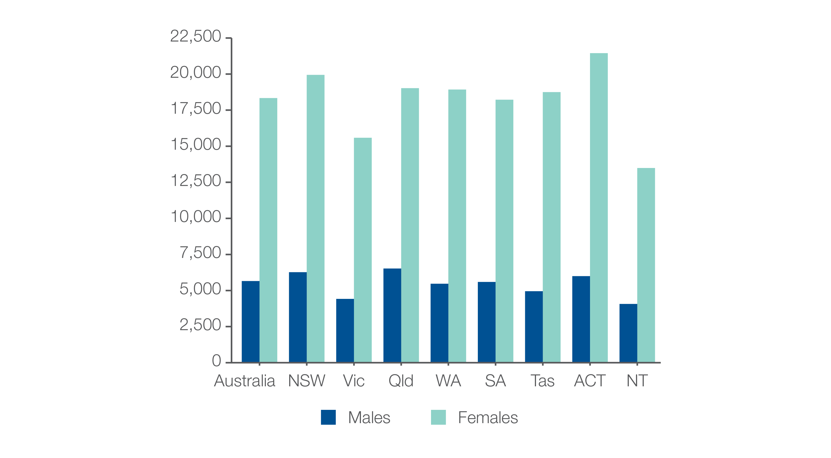
3.1 Thyroid function testing
MBS-subsidised services, by sex
Number per 100,000 people
Sources: MBS data 2016-17, and ABS Estimated Resident Population 30 June 2016
Notes:
Speaker notes:
Rates of TFTs were 3.2 times as high in females as in males.
In 2016–17, there were 558,142 MBS-subsidised services for TFTs for males aged 18 years and over, representing 5,656 services per 100,000 males (the Australian rate). The number of services varied across states and territories, from 4,072 per 100,000 males in the Northern Territory to 6,527 per 100,000 males in Queensland.
In 2016–17, there were 1,785,947 MBS-subsidised TFTs for females aged 18 years and over, representing 18,341 services per 100,000 females. The number of services varied across states and territories, from 13,490 services per 100,000 females in the Northern Territory to 21,449 per 100,000 females in the Australian Capital Territory.

Slide 26
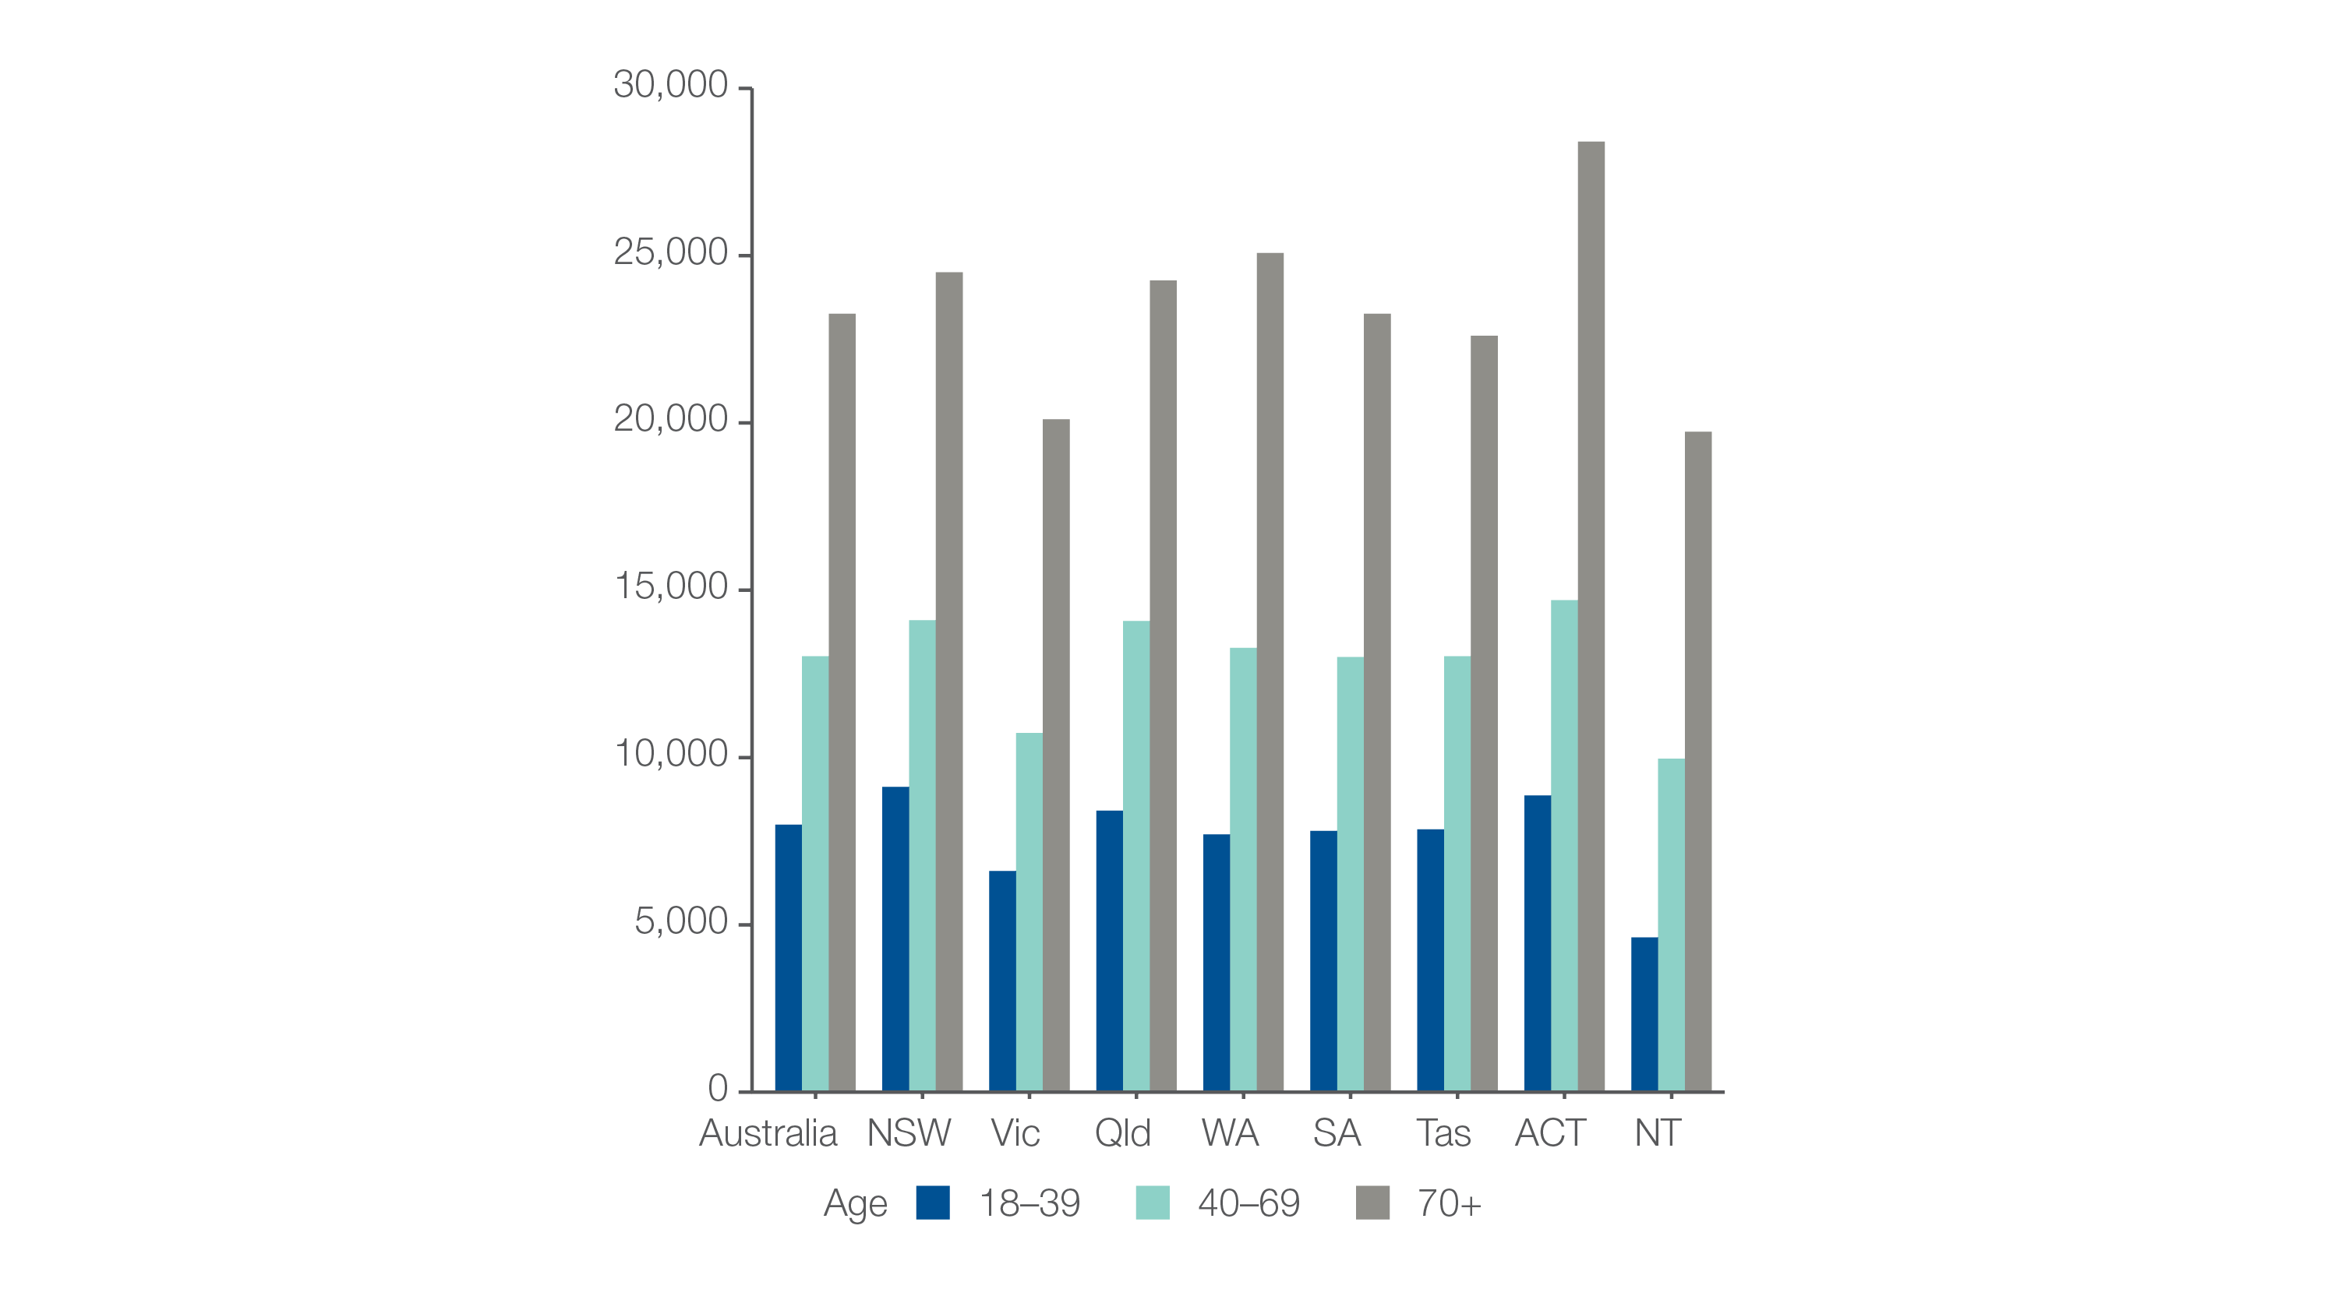
3.1 Thyroid function testing
MBS-subsidised services, by age group
Number per 100,000 people
Sources: MBS data 2016-17, and ABS Estimated Resident Population 30 June 2016
Notes:
Speaker notes:
Rates of TFTs were highest for the 70 years and over age group (23,258 services per 100,000 people).
The number of services for this age group varied across states and territories, from 19,735 per 100,000 people in the Northern Territory to 28,407 per 100,000 people in the Australian Capital Territory.
The rate for the 70 years and over age group was 1.8 times as high as the rate for the 40–69 years age group and 2.9 times as high as the rate for the 18–39 years age group

Slide 27
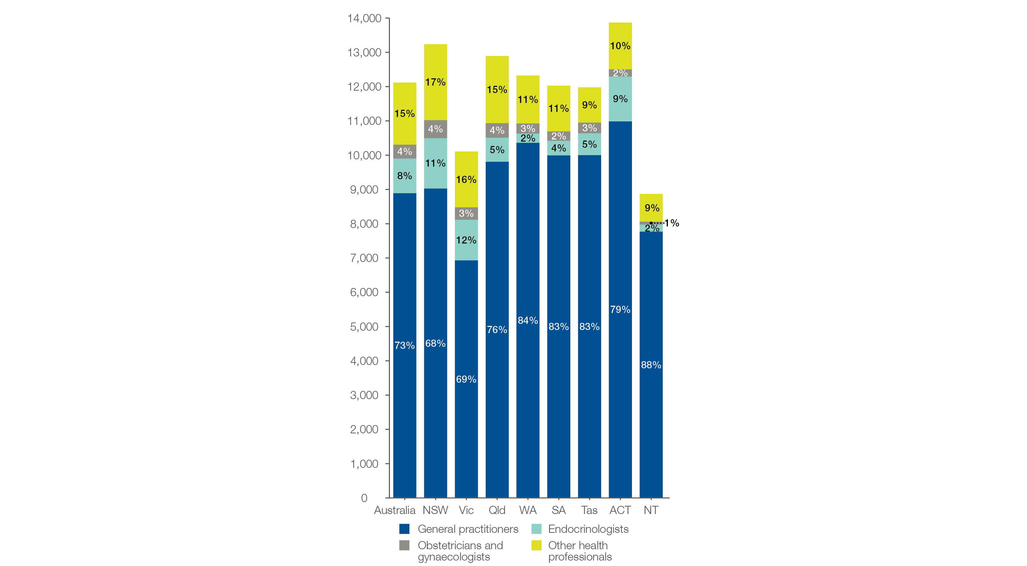
3.1 Thyroid function testing
MBS-subsidised services, by referrer type
Number per 100,000 people
Sources: MBS data 2016-17, and ABS Estimated Resident Population 30 June 2016
Notes:
Speaker notes:
GPs ordered 73% of TFTs in Australia, endocrinologists ordered 8%, obstetricians and gynaecologists ordered 4%, and other health professionals ordered 15%.
The proportion ordered by GPs varied from 68% in New South Wales to 88% in the Northern Territory

Slide 28
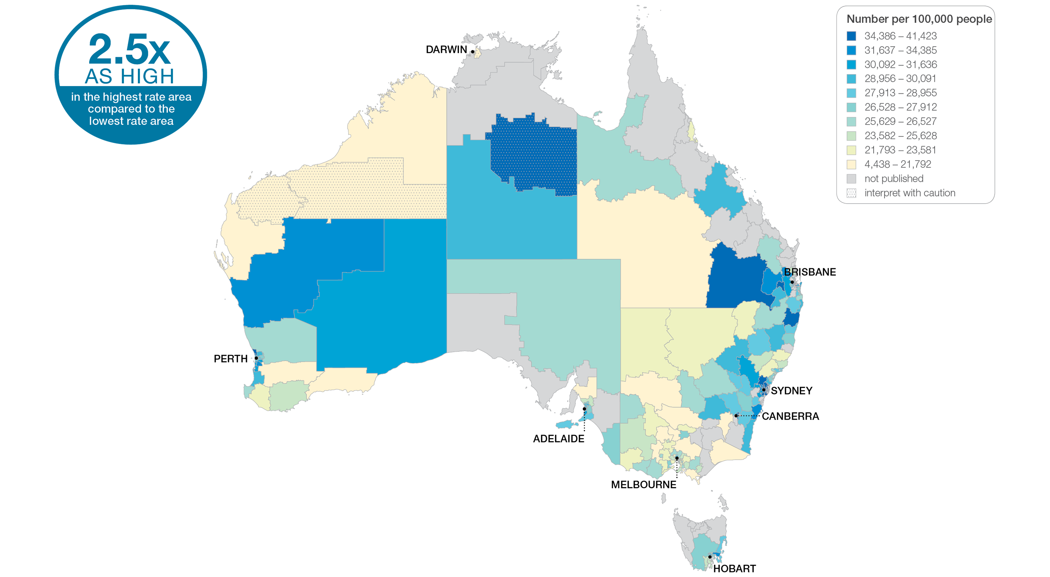
3.1 Thyroid function tests
Sources: MBS data 2016-17, and ABS Estimated Resident Population 30 June 2016
Notes:
Speaker notes:
This slide shows the distribution of rates by Statistical Area Level 3 (SA3) for thyroid function tests. Rates are based on the patient’s usual place of residence, not the location of the healthcare provider.
The number of MBS-subsidised services for TFTs across 261 local areas (Statistical Area Level 3 – SA3) ranged from 6,425 to 16,077 per 100,000 people aged 18 years and over.
The rate was 2.5 times as high in the area with the highest rate compared to the area with the lowest rate.
The number of services varied across states and territories, from 8,868 per 100,000 people aged 18 years and over in the Northern Territory to 13,866 in the Australian Capital Territory.
The range of rates represented by each colour are shown in the legend for the map. The darker blue colour represents SA3s with higher rates. The lighter colours represent SA3s with lower rates.
Dotted areas indicate rates that are considered more volatile than other published rates and should be interpreted with caution. These rates are excluded from the calculation of the difference between the highest and lowest SA3 rates in Australia.
There are 340 SA3s. For this item, data were suppressed for 79 SA3s due to one or more of a small number of services or population in an area, or potential identification of individual patients, practitioners or business entities.
For further detail about the methods used, please refer to the Technical Supplement.
For further information on how to interpret the figures, please refer to the ‘How to interpret’ resource available at: www.safetyandquality.gov.au/atlas/the-third-australian-atlas-of-healthcare-variation-2018/how-to-interpret-the-data/

Slide 29
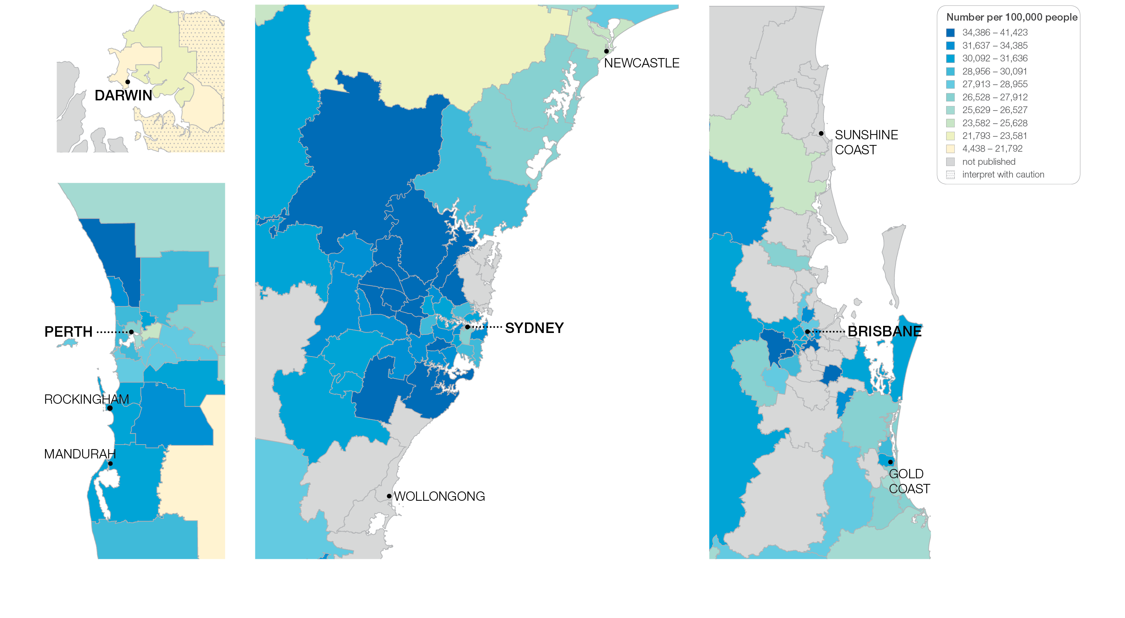
3.1 Thyroid function tests
Sources: MBS data 2016-17, and ABS Estimated Resident Population 30 June 2016
Notes:
Speaker notes:
This slide shows the distribution of rates by Statistical Area Level 3 (SA3) for thyroid function tests by capital city area. Rates are based on the patient’s usual place of residence, not the location of the healthcare provider.

Slide 30
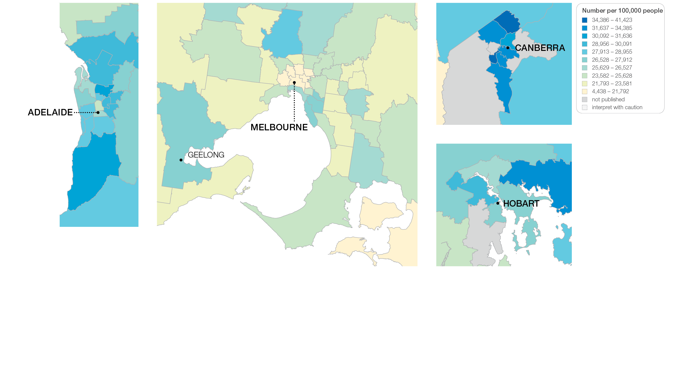
3.1 Thyroid function tests
Sources: MBS data 2016-17, and ABS Estimated Resident Population 30 June 2016
Notes:
Speaker notes:
This slide shows the distribution of rates by Statistical Area Level 3 (SA3) for thyroid function tests by capital city area. Rates are based on the patient’s usual place of residence, not the location of the healthcare provider.

Slide 31
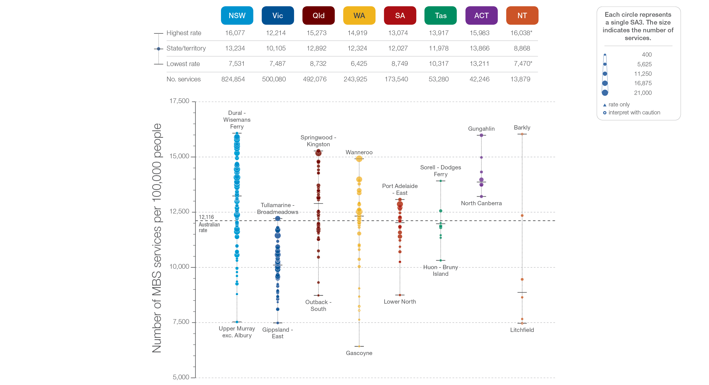
3.1 Thyroid function tests
State and territory
Sources: MBS data 2016-17, and ABS Estimated Resident Population 30 June 2016
Notes:
Speaker notes:
The number of services varied across states and territories, from 8,868 per 100,000 people aged 18 years and over in the Northern Territory to 13,866 in the Australian Capital Territory.
Each circle on the graph represents an SA3. The size of the circle indicates how many services have been recorded for people living in that area. The vertical axis shows the standardised rates for the clinical item.
Hollow circles and asterisks indicate rates that are considered more volatile than other published rates and should be interpreted with caution. Triangles indicate SA3s where only rates are published. The numbers of services are not published for confidentiality reasons.
For further detail about the methods used, please refer to the Technical Supplement.
For further information on how to interpret the figures, please refer to the ‘How to interpret’ resource available at: www.safetyandquality.gov.au/atlas/the-third-australian-atlas-of-healthcare-variation-2018/how-to-interpret-the-data/

Slide 32
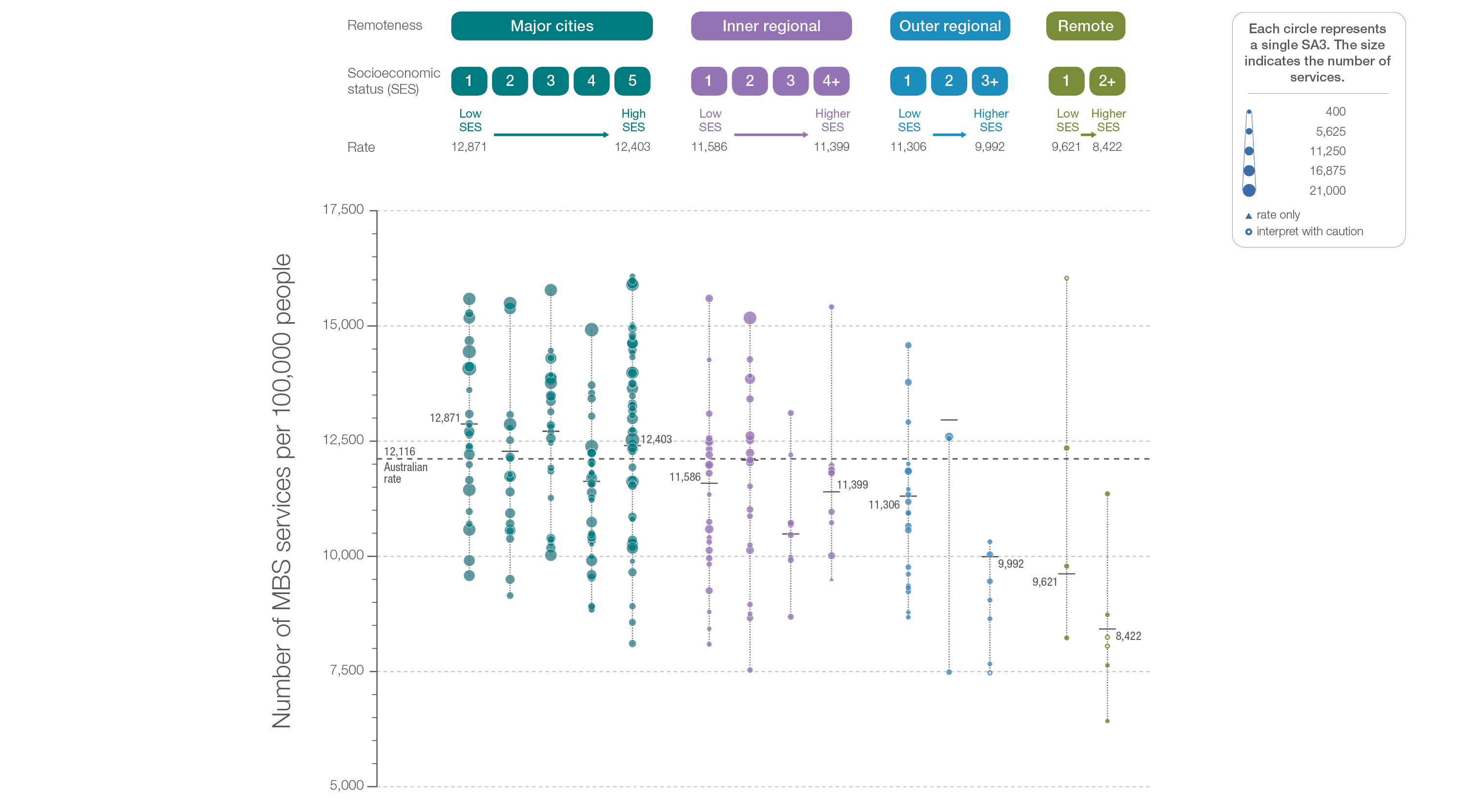
3.1 Thyroid function tests
Remoteness and socioeconomic status
Sources: MBS data 2016-17, and ABS Estimated Resident Population 30 June 2016
Notes:
Speaker notes:
Rates of TFTs were markedly lower in remote areas than in other areas. There was no clear pattern according to socioeconomic status.
Suppressed data are included in the calculation of overall rates by remoteness and socioeconomic status.
Hollow circles and asterisks indicate rates that are considered more volatile than other published rates and should be interpreted with caution. Triangles indicate SA3s where only rates are published. The numbers of services are not published for confidentiality reasons.
For further detail about the methods used, please refer to the Technical Supplement.
For further information on how to interpret the figures, please refer to the ‘How to interpret’ resource available at: www.safetyandquality.gov.au/atlas/the-third-australian-atlas-of-healthcare-variation-2018/how-to-interpret-the-data/

Slide 33
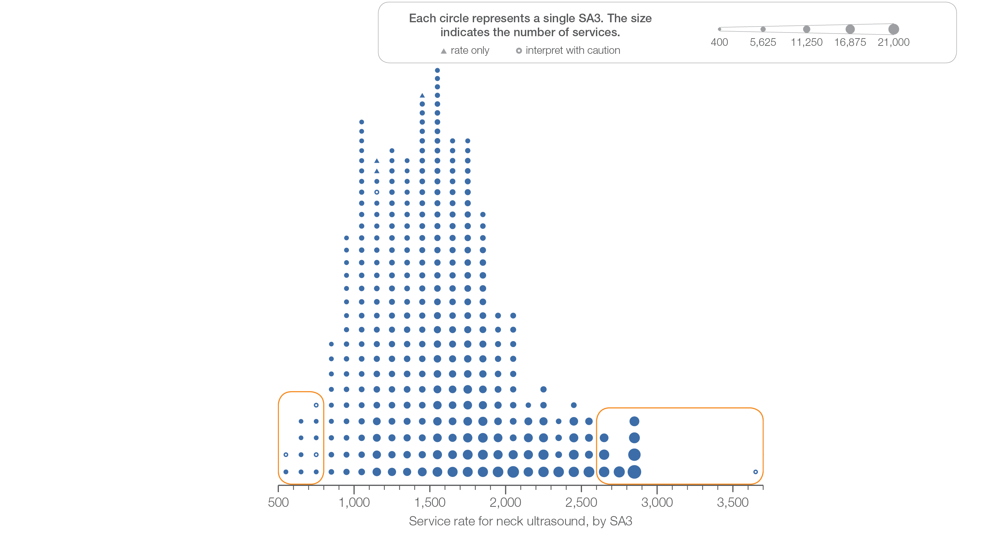
3.2 Neck ultrasound
Sources: MBS data 2016-17, and ABS Estimated Resident Population 30 June 2016
Notes:
Speaker notes:
This slide shows the distribution of rates by Statistical Area Level 3 (SA3) for neck ultrasounds.
Each circle on the graph represents an SA3. The size of the circle indicates how many services have been recorded for people living in that area. The horizontal axis shows the standardised rates for the clinical item.
Hollow circles and asterisks indicate rates that are considered more volatile than other published rates and should be interpreted with caution. Triangles indicate SA3s where only rates are published. The numbers of services are not published for confidentiality reasons.
For further detail about the methods used, please refer to the Technical Supplement.
For further information on how to interpret the figures, please refer to the ‘How to interpret’ resource available at: www.safetyandquality.gov.au/atlas/the-third-australian-atlas-of-healthcare-variation-2018/how-to-interpret-the-data/

Slide 34
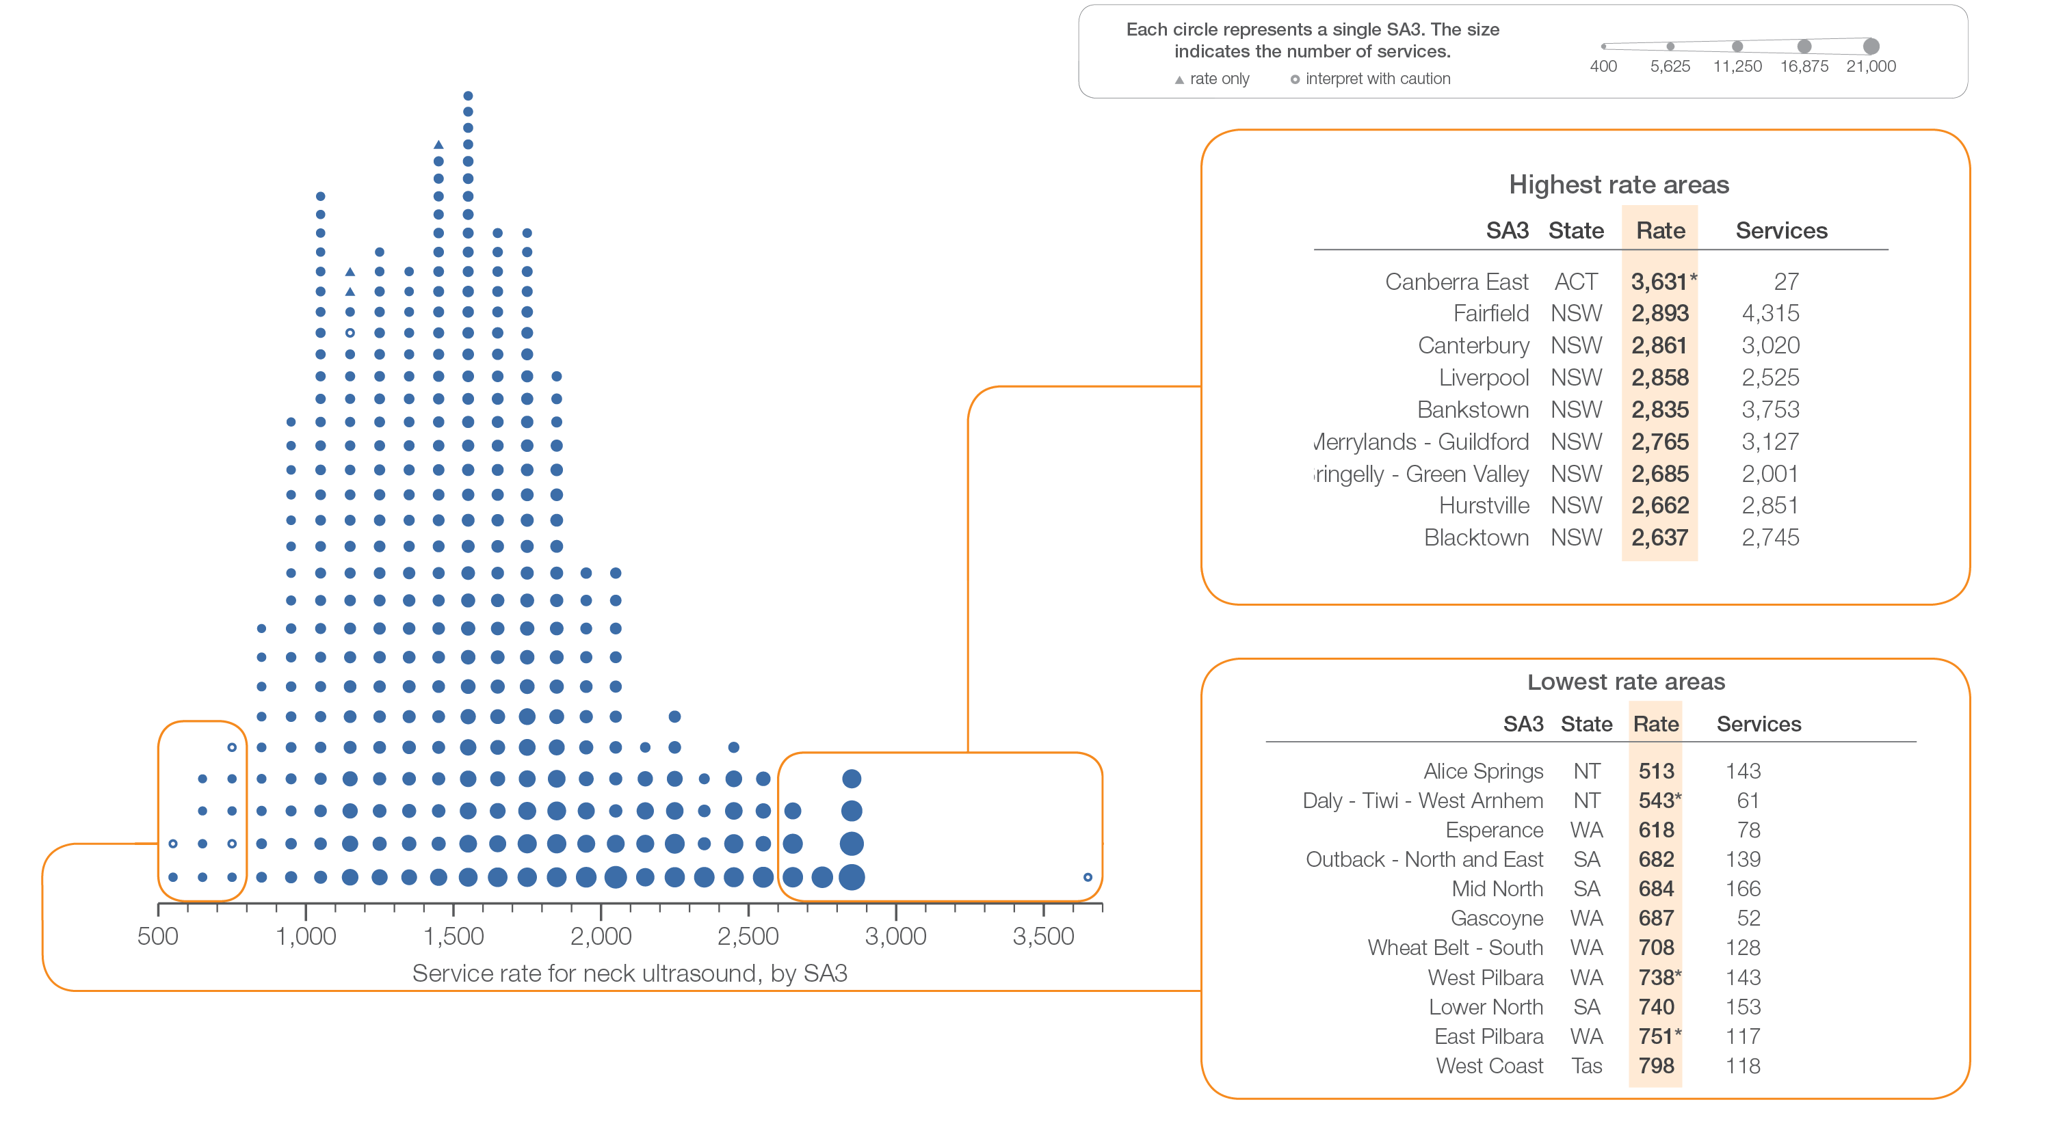
3.2 Neck ultrasound
Sources: MBS data 2016-17, and ABS Estimated Resident Population 30 June 2016
Notes:
Speaker notes:
This slide shows the distribution of rates by Statistical Area Level 3 (SA3) for neck ultrasounds.
Each circle on the graph represents an SA3. The size of the circle indicates how many services have been recorded for people living in that area. The horizontal axis shows the standardised rates for the clinical item.
Hollow circles and asterisks indicate rates that are considered more volatile than other published rates and should be interpreted with caution. Triangles indicate SA3s where only rates are published. The numbers of services are not published for confidentiality reasons.
For further detail about the methods used, please refer to the Technical Supplement.
For further information on how to interpret the figures, please refer to the ‘How to interpret’ resource available at: www.safetyandquality.gov.au/atlas/the-third-australian-atlas-of-healthcare-variation-2018/how-to-interpret-the-data/

Slide 35
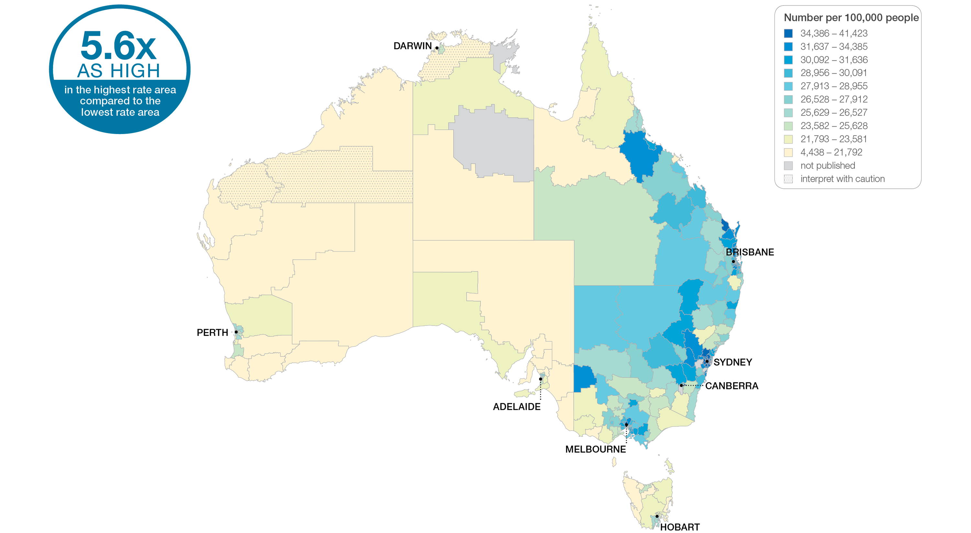
3.2 Neck ultrasound
Sources: MBS data 2016-17, and ABS Estimated Resident Population 30 June 2016
Notes:
Speaker notes:
This slide shows the distribution of rates by Statistical Area Level 3 (SA3) for neck ultrasound. Rates are based on the patient’s usual place of residence, not the location of the healthcare provider.
In 2016–17, there were 308,247 MBS-subsidised services for neck ultrasound, representing 1,606 services per 100,000 people aged 18 years and over (the Australian rate).
The number of MBS-subsidised services for neck ultrasound across 329 local areas (Statistical Area Level 3 – SA3), ranged from 513 to 2,893 per 100,000 people aged 18 years and over.
The rate was 5.6 times as high in the area with the highest rate compared to the area with the lowest rate.
The number of services varied across states and territories, from 983 per 100,000 people aged 18 years and over in the Northern Territory to 1,946 in New South Wales.
The range of rates represented by each colour are shown in the legend for the map. The darker blue colour represents SA3s with higher rates. The lighter colours represent SA3s with lower rates.
Dotted areas indicate rates that are considered more volatile than other published rates and should be interpreted with caution. These rates are excluded from the calculation of the difference between the highest and lowest SA3 rates in Australia.
For further detail about the methods used, please refer to the Technical Supplement.
For further information on how to interpret the figures, please refer to the ‘How to interpret’ resource available at: www.safetyandquality.gov.au/atlas/the-third-australian-atlas-of-healthcare-variation-2018/how-to-interpret-the-data/

Slide 36
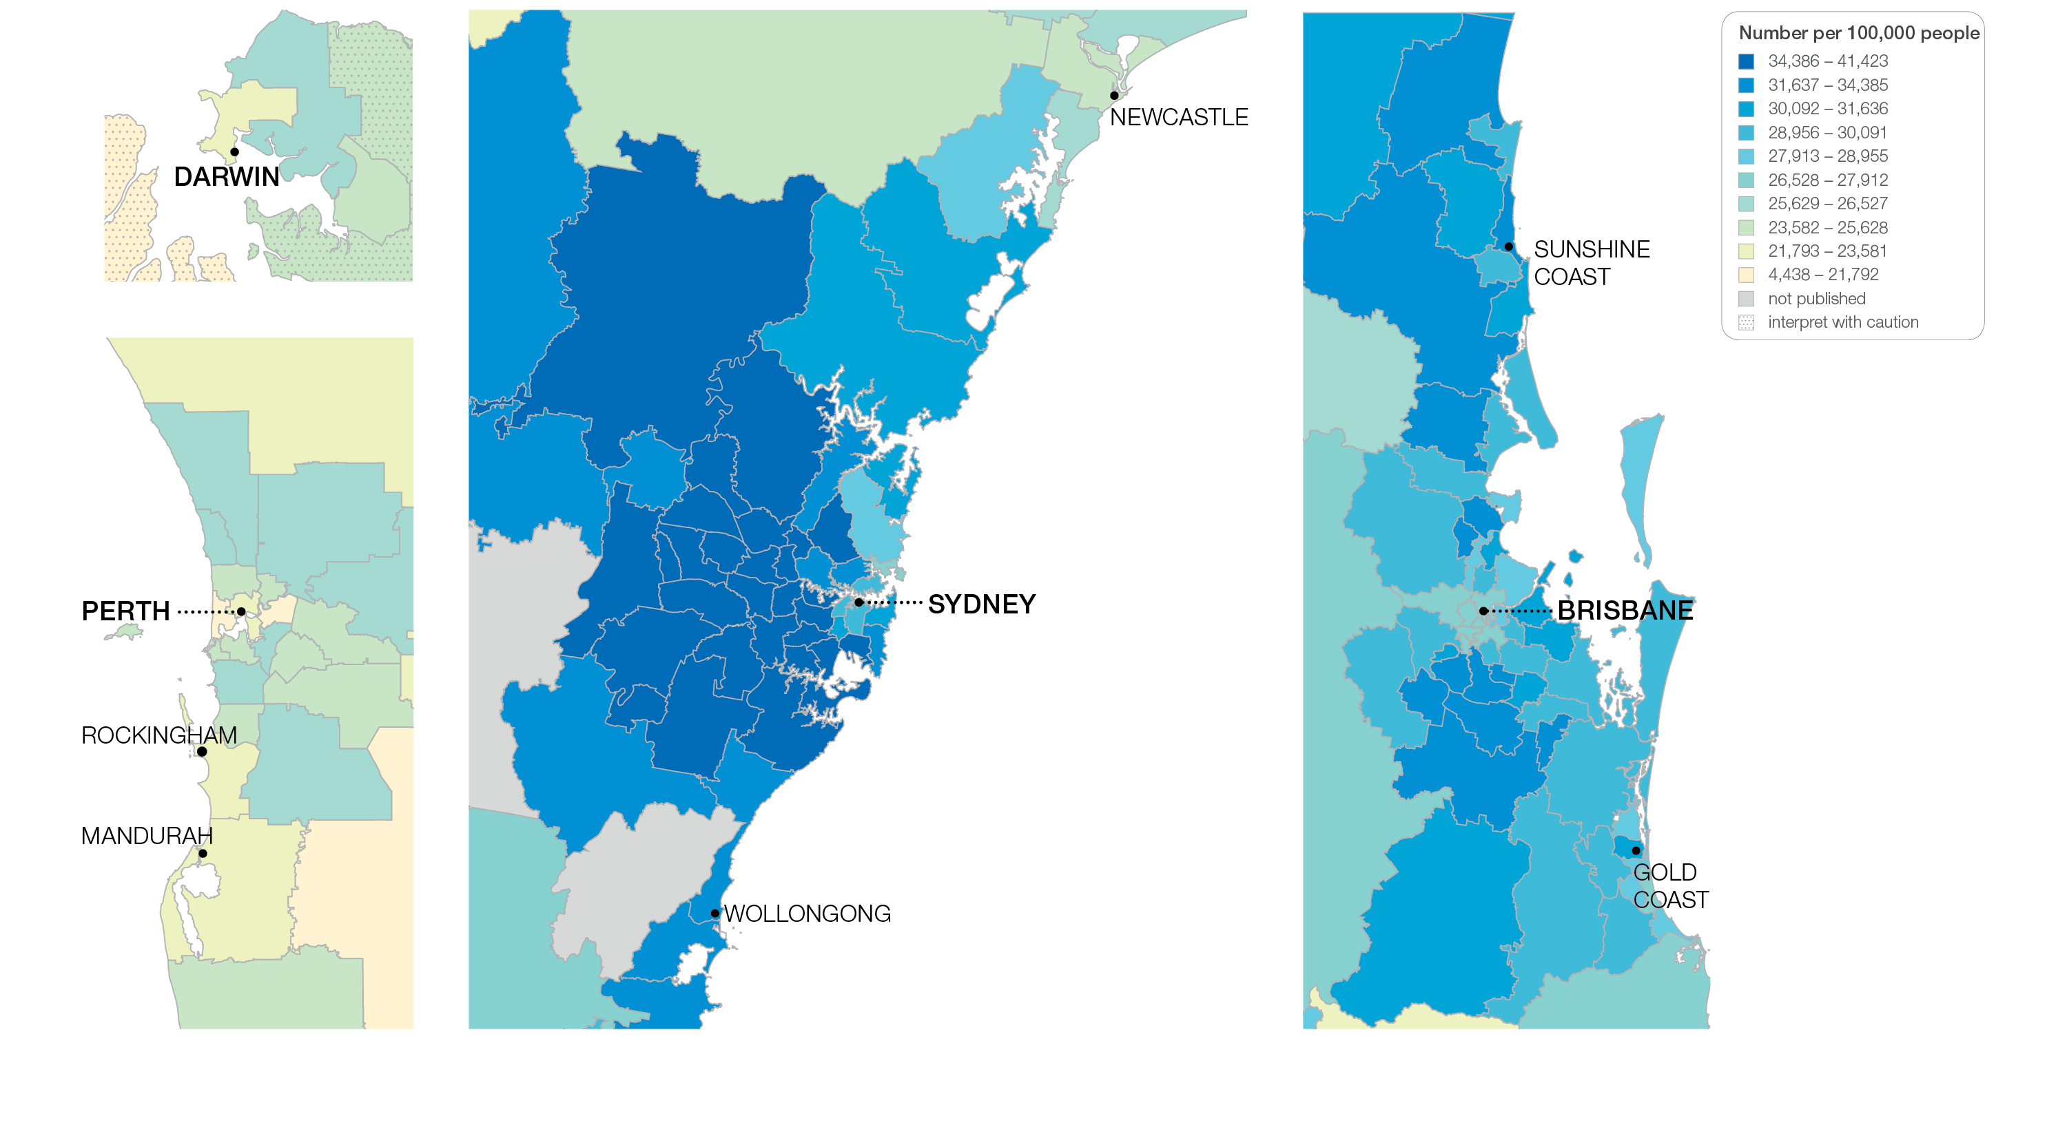
3.2 Neck ultrasound
Sources: MBS data 2016-17, and ABS Estimated Resident Population 30 June 2016
Notes:
Speaker notes:
This slide shows the distribution of rates by Statistical Area Level 3 (SA3) for neck ultrasound by capital city area. Rates are based on the patient’s usual place of residence, not the location of the healthcare provider.

Slide 37
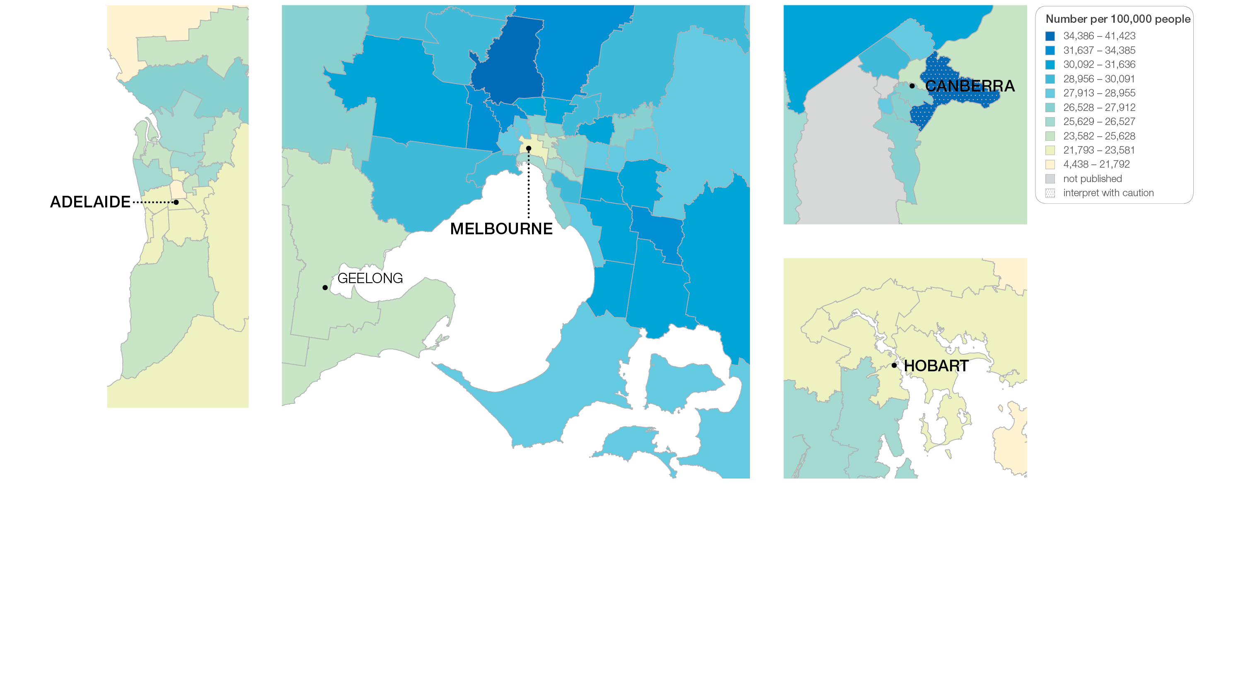
3.2 Neck ultrasound
Sources: MBS data 2016-17, and ABS Estimated Resident Population 30 June 2016
Notes:
Speaker notes:
This slide shows the distribution of rates by Statistical Area Level 3 (SA3) for neck ultrasound by capital city area. Rates are based on the patient’s usual place of residence, not the location of the healthcare provider.

Slide 38
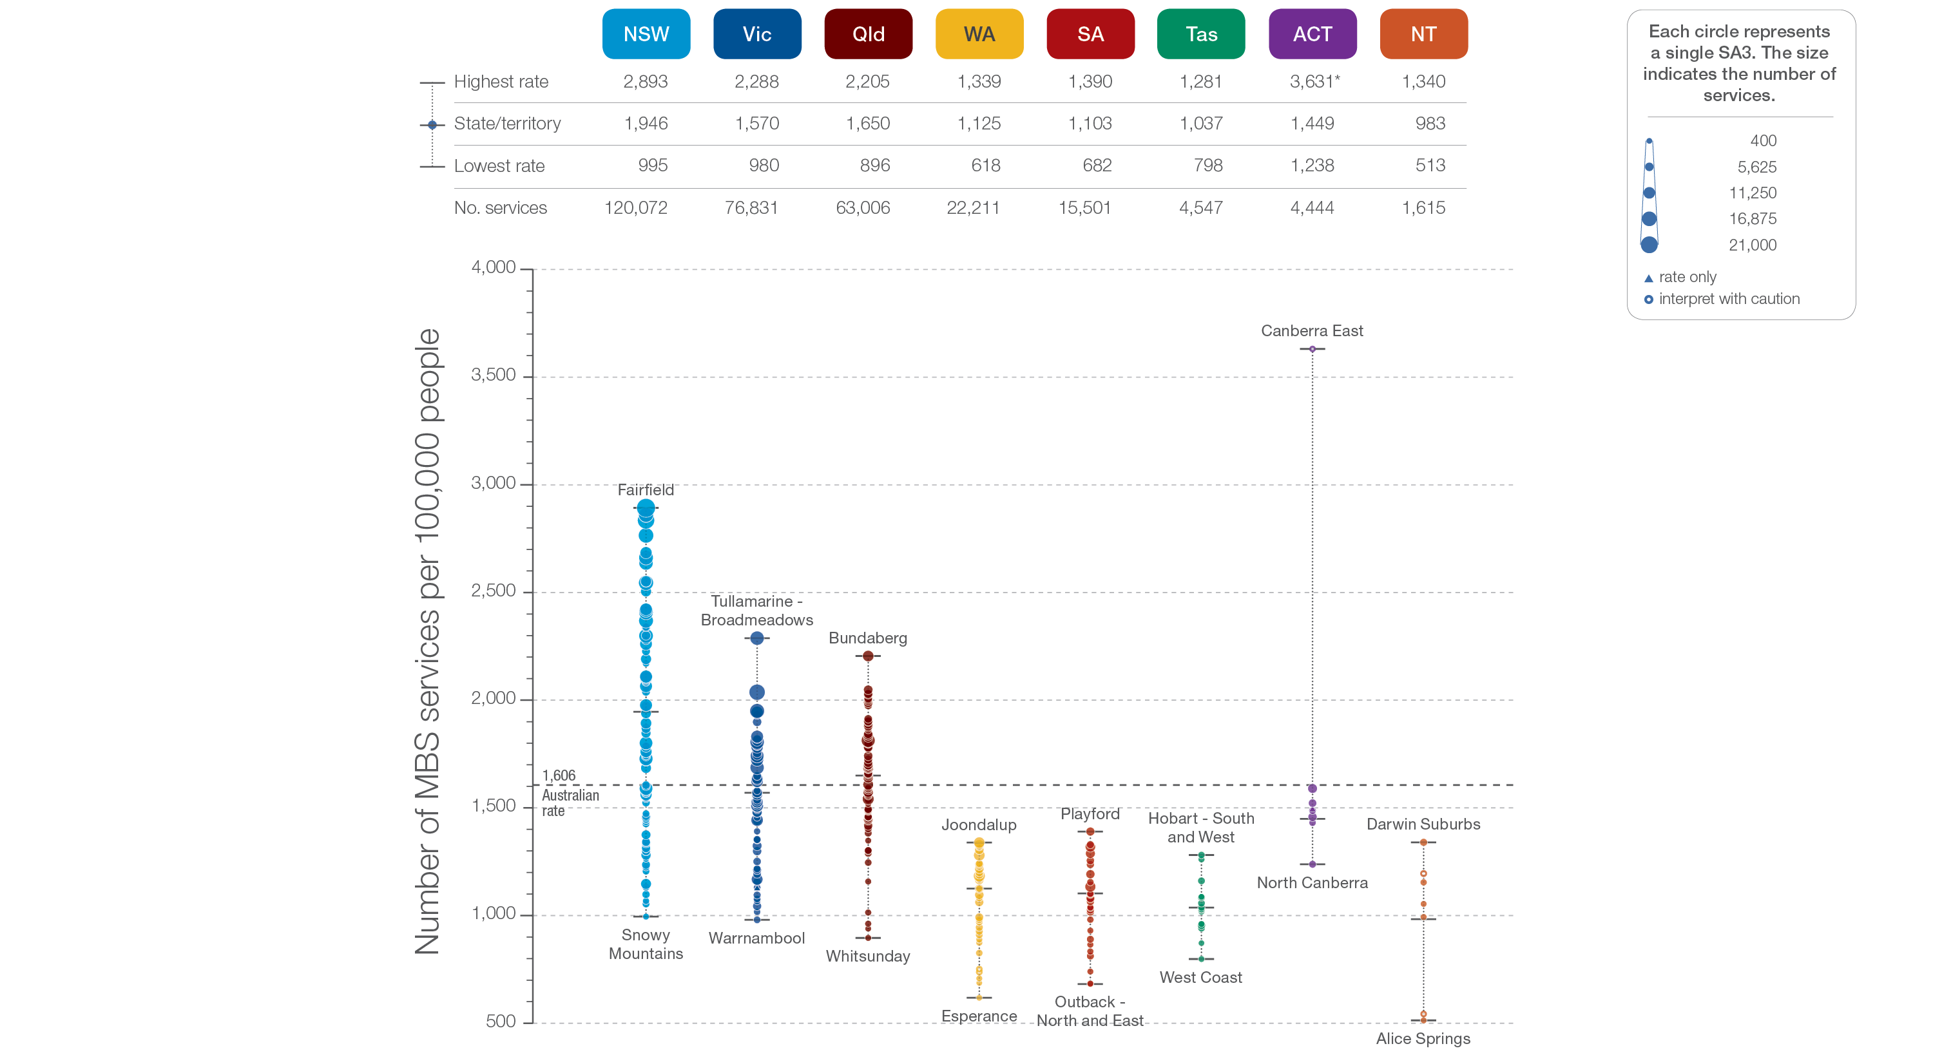
3.2 Neck ultrasound
State and territory
Sources: MBS data 2016-17, and ABS Estimated Resident Population 30 June 2016
Notes:
Speaker notes:
The number of MBS services for neck ultrasound varied across states and territories, from 983 per 100,000 people aged 18 years and over in the Northern Territory to 1,946 in New South Wales.
Each circle on the graph represents an SA3. The size of the circle indicates how many services have been recorded for people living in that area. The vertical axis shows the standardised rates for the clinical item.
Hollow circles and asterisks indicate rates that are considered more volatile than other published rates and should be interpreted with caution. Triangles indicate SA3s where only rates are published. The numbers of services are not published for confidentiality reasons.
For further detail about the methods used, please refer to the Technical Supplement.
For further information on how to interpret the figures, please refer to the ‘How to interpret’ resource available at: www.safetyandquality.gov.au/atlas/the-third-australian-atlas-of-healthcare-variation-2018/how-to-interpret-the-data/

Slide 39
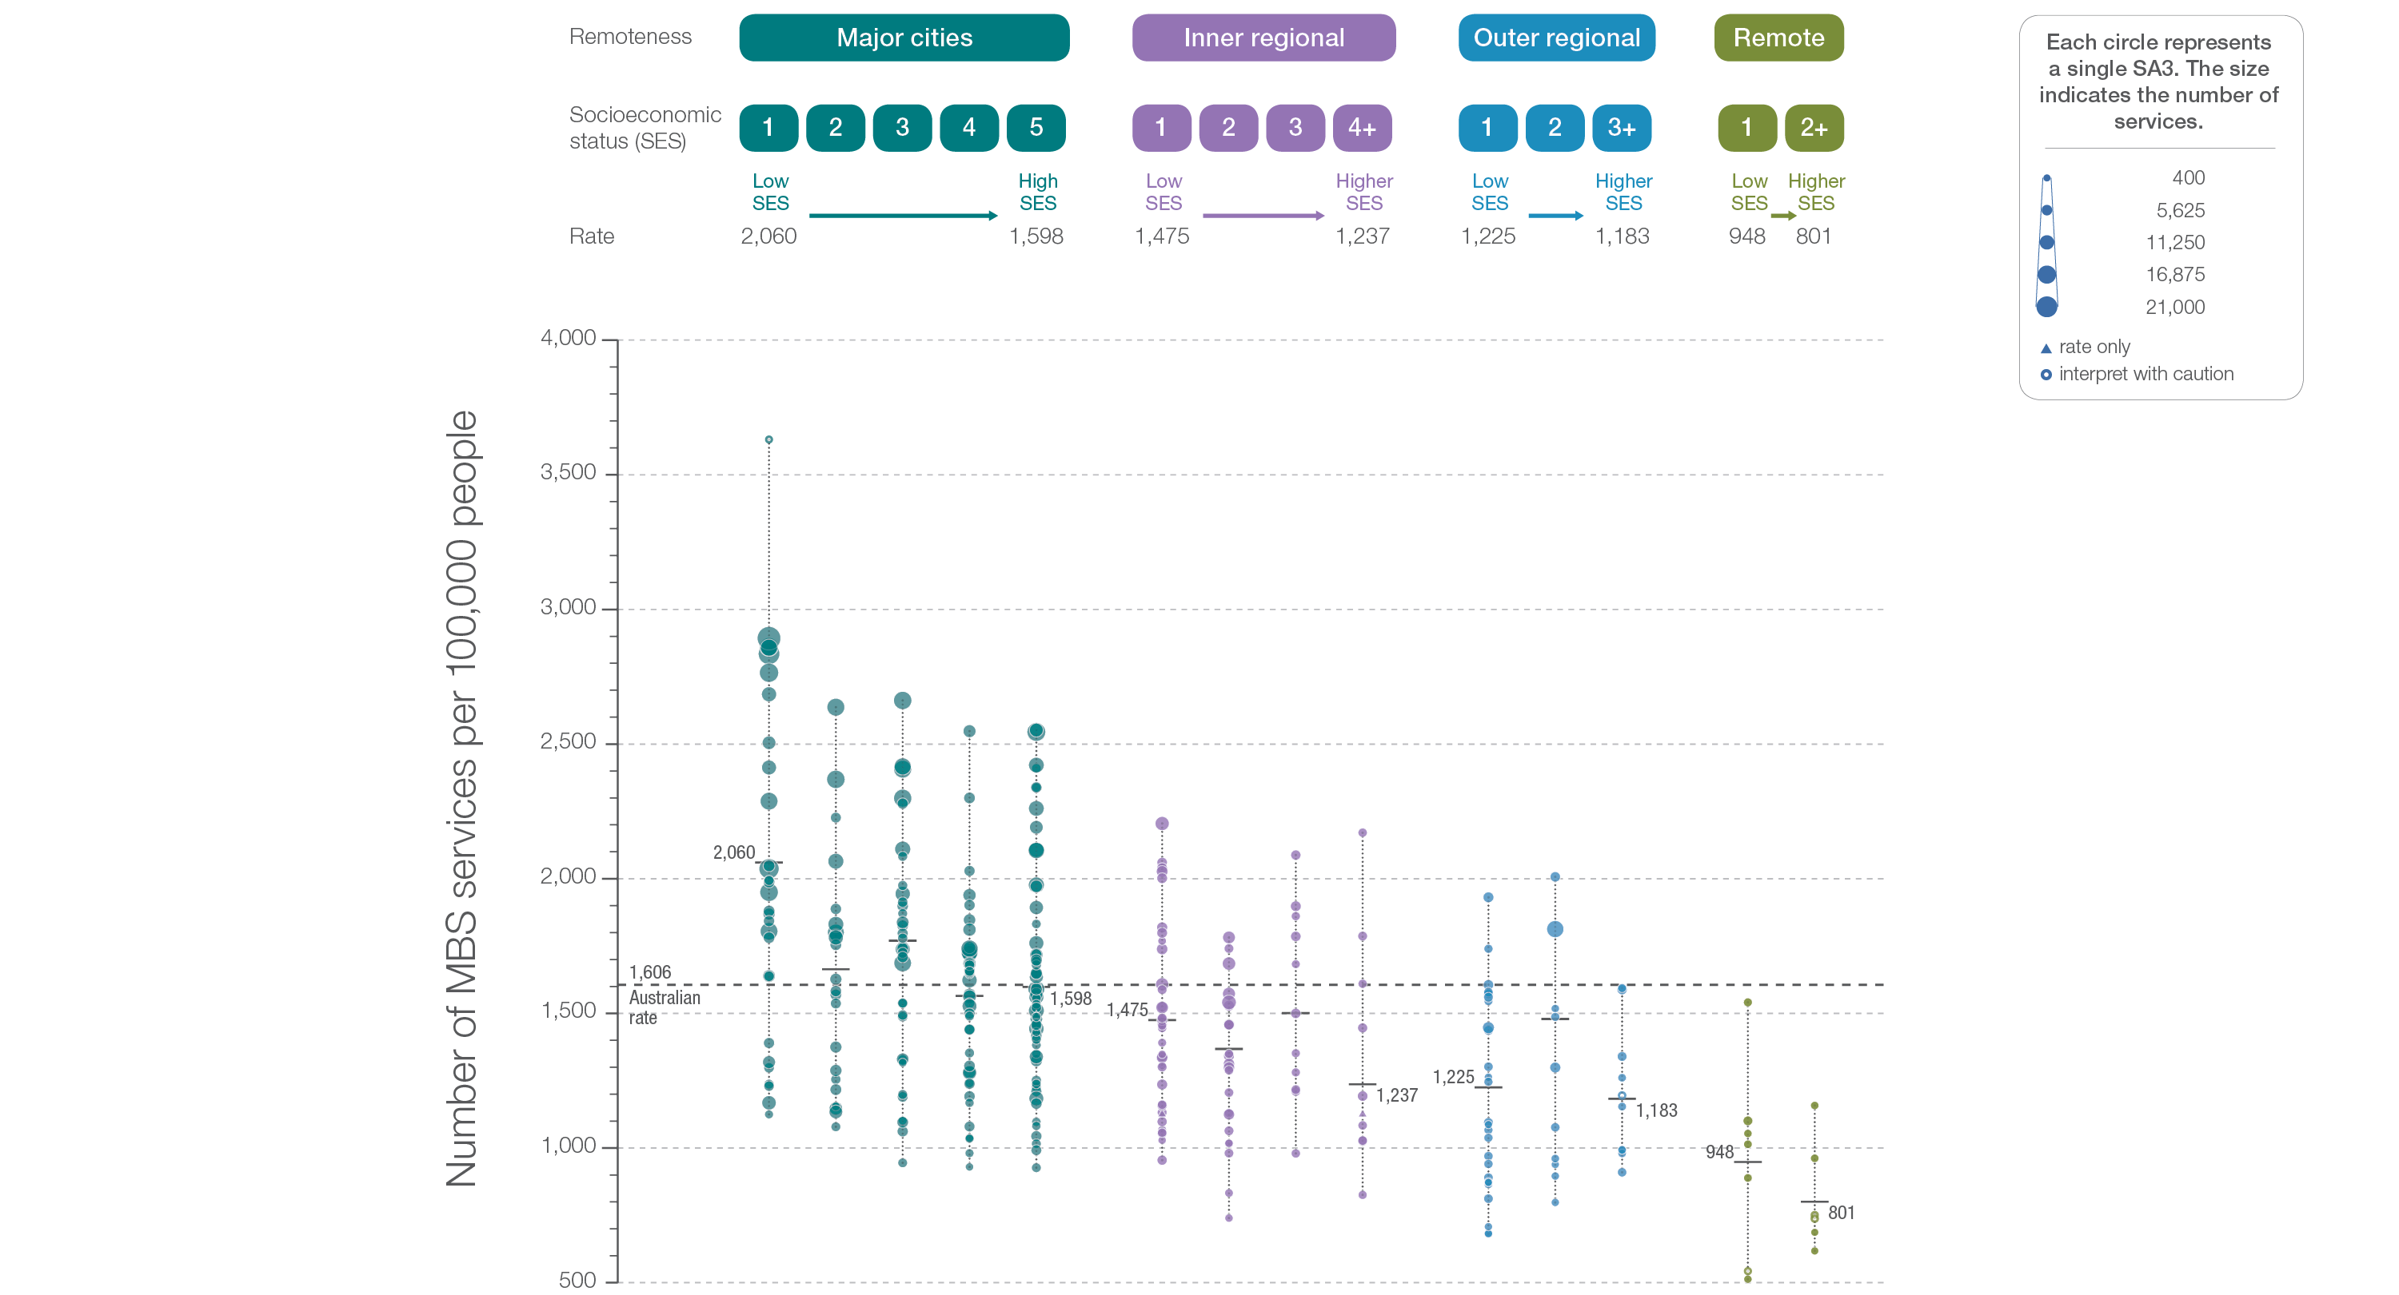
3.2 Neck ultrasound
Remoteness and socioeconomic status
Sources: MBS data 2016-17, and ABS Estimated Resident Population 30 June 2016
Notes:
Speaker notes:
Rates of neck ultrasound were higher in major cities than in other areas. Rates were higher in areas with lower socioeconomic status in major cities and remote areas. However, there was no clear pattern according to socioeconomic status in other remoteness categories.
Hollow circles indicate rates that are considered more volatile than other published rates and should be interpreted with caution. Triangles indicate SA3s where only rates are published. The numbers of services are not published for confidentiality reasons.
For further detail about the methods used, please refer to the Technical Supplement.
For further information on how to interpret the figures, please refer to the ‘How to interpret’ resource available at: www.safetyandquality.gov.au/atlas/the-third-australian-atlas-of-healthcare-variation-2018/how-to-interpret-the-data/

Slide 40
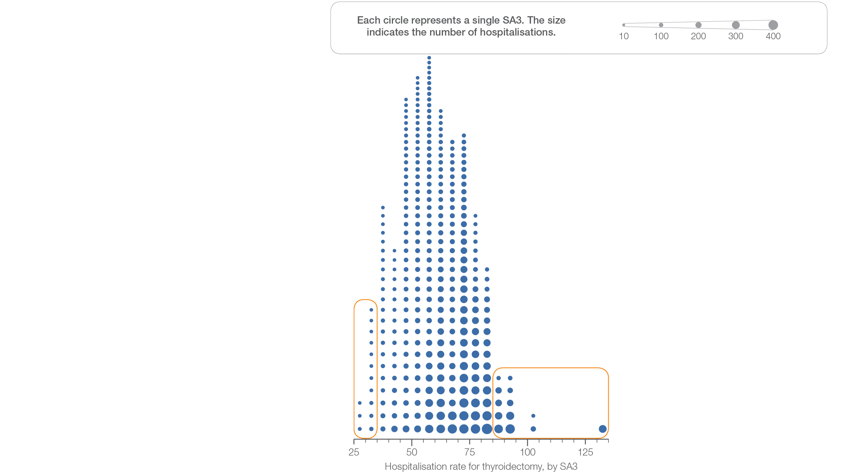
3.2 Thyroidectomy hospitalisations
Sources: NHMD data 2016-17, and ABS Estimated Resident Population 30 June 2016
Notes:
Speaker notes:
This slide shows the distribution of rates by Statistical Area Level 3 (SA3) for thyroidectomy hospitalisations.
Each circle on the graph represents an SA3. The size of the circle indicates how many services have been recorded for people living in that area. The horizontal axis shows the standardised rates for the clinical item.
For further information on how to interpret the figures, please refer to the ‘How to interpret’ resource available at: www.safetyandquality.gov.au/atlas/the-third-australian-atlas-of-healthcare-variation-2018/how-to-interpret-the-data/

Slide 41
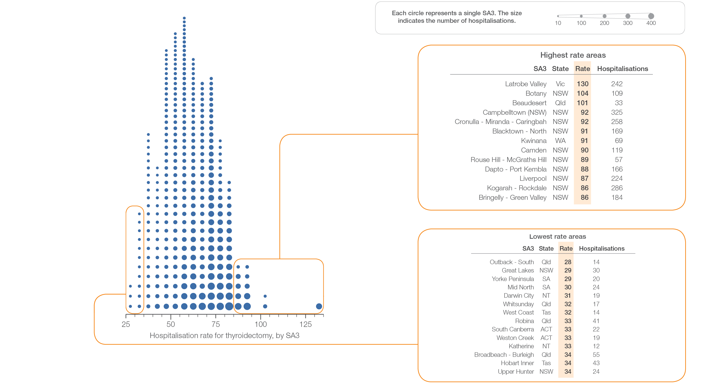
3.2 Thyroidectomy hospitalisations
Sources: NHMD data 2016-17, and ABS Estimated Resident Population 30 June 2016
Notes:
Speaker notes:
This slide shows the distribution of rates by Statistical Area Level 3 (SA3) for thyroidectomy hospitalisations.
Each circle on the graph represents an SA3. The size of the circle indicates how many services have been recorded for people living in that area. The horizontal axis shows the standardised rates for the clinical item.
For further information on how to interpret the figures, please refer to the ‘How to interpret’ resource available at: www.safetyandquality.gov.au/atlas/the-third-australian-atlas-of-healthcare-variation-2018/how-to-interpret-the-data/

Slide 42
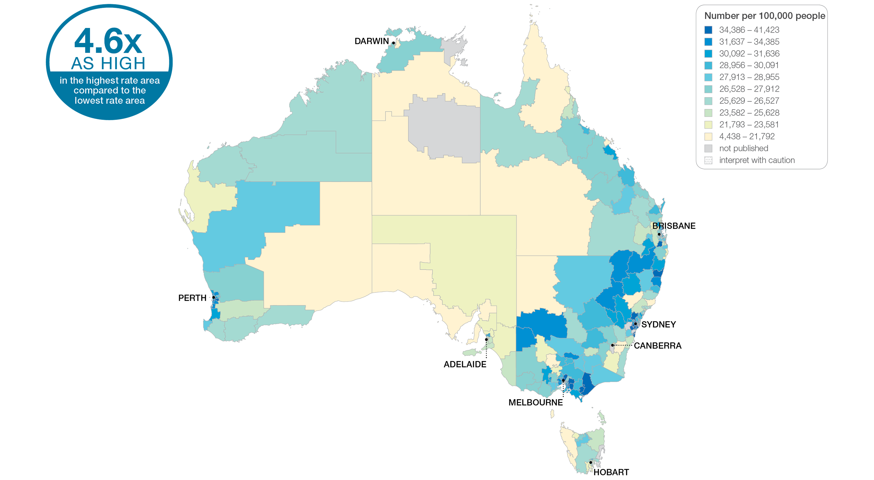
3.2 Thyroidectomy
Sources: NHMD data 2014-15 to 2016-17, and ABS Estimated Resident Population 30 June 2016
Notes:
Speaker notes:
This slide shows the distribution of rates by Statistical Area Level 3 (SA3) for thyroidectomy hospitalisations. Rates are based on the patient’s usual place of residence, not the location of the healthcare provider.
Over the three-year period 2014–15 to 2016–17, there were 35,166 hospitalisations for thyroidectomy, representing an average rate of 62 hospitalisations per 100,000 people aged 18 years and over (the Australian rate).
The number of hospitalisations for thyroidectomy across 327 local areas (Statistical Area Level 3 – SA3), ranged from 28 to 130 per 100,000 people aged 18 years and over (there are 340 SA3s. For this item, data were suppressed for 13 SA3s due to a small number of hospitalisations and/or population in an area).
The rate was 4.6 times as high in the area with the highest rate compared to the area with the lowest rate.
The number of hospitalisations varied across states and territories, from 42 per 100,000 people aged 18 years and over in the Australian Capital Territory to 68 in New South Wales.
The range of rates represented by each colour are shown in the legend for the map. The darker blue colour represents SA3s with higher rates. The lighter colours represent SA3s with lower rates. Dotted areas indicate rates that are considered more volatile than other published rates and should be interpreted with caution. These rates are excluded from the calculation of the difference between the highest and lowest SA3 rates in Australia.
For further detail about the methods used, please refer to the Technical Supplement.
For further information on how to interpret the figures, please refer to the ‘How to interpret’ resource available at: www.safetyandquality.gov.au/atlas/the-third-australian-atlas-of-healthcare-variation-2018/how-to-interpret-the-data/

Slide 43
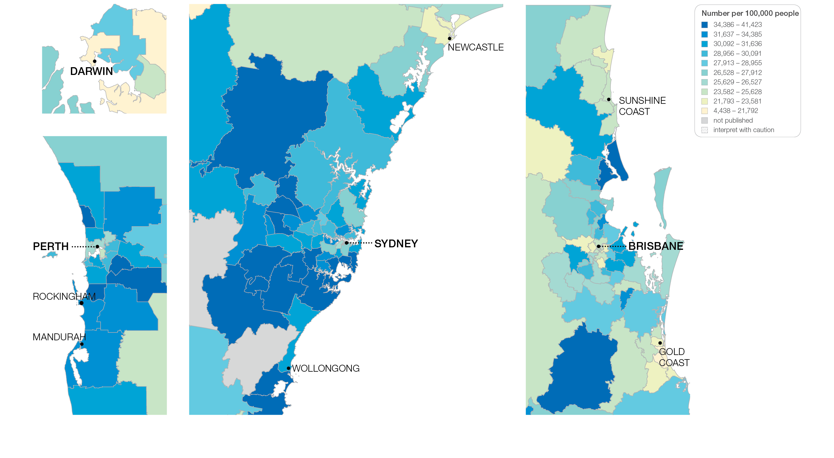
3.2 Thyroidectomy
Sources: NHMD data 2014-15 to 2016-17, and ABS Estimated Resident Population 30 June 2016
Notes:
Speaker notes:
This slide shows the distribution of rates by Statistical Area Level 3 (SA3) for thyroidectomy hospitalisation by capital city area. Rates are based on the patient’s usual place of residence, not the location of the healthcare provider.

Slide 44
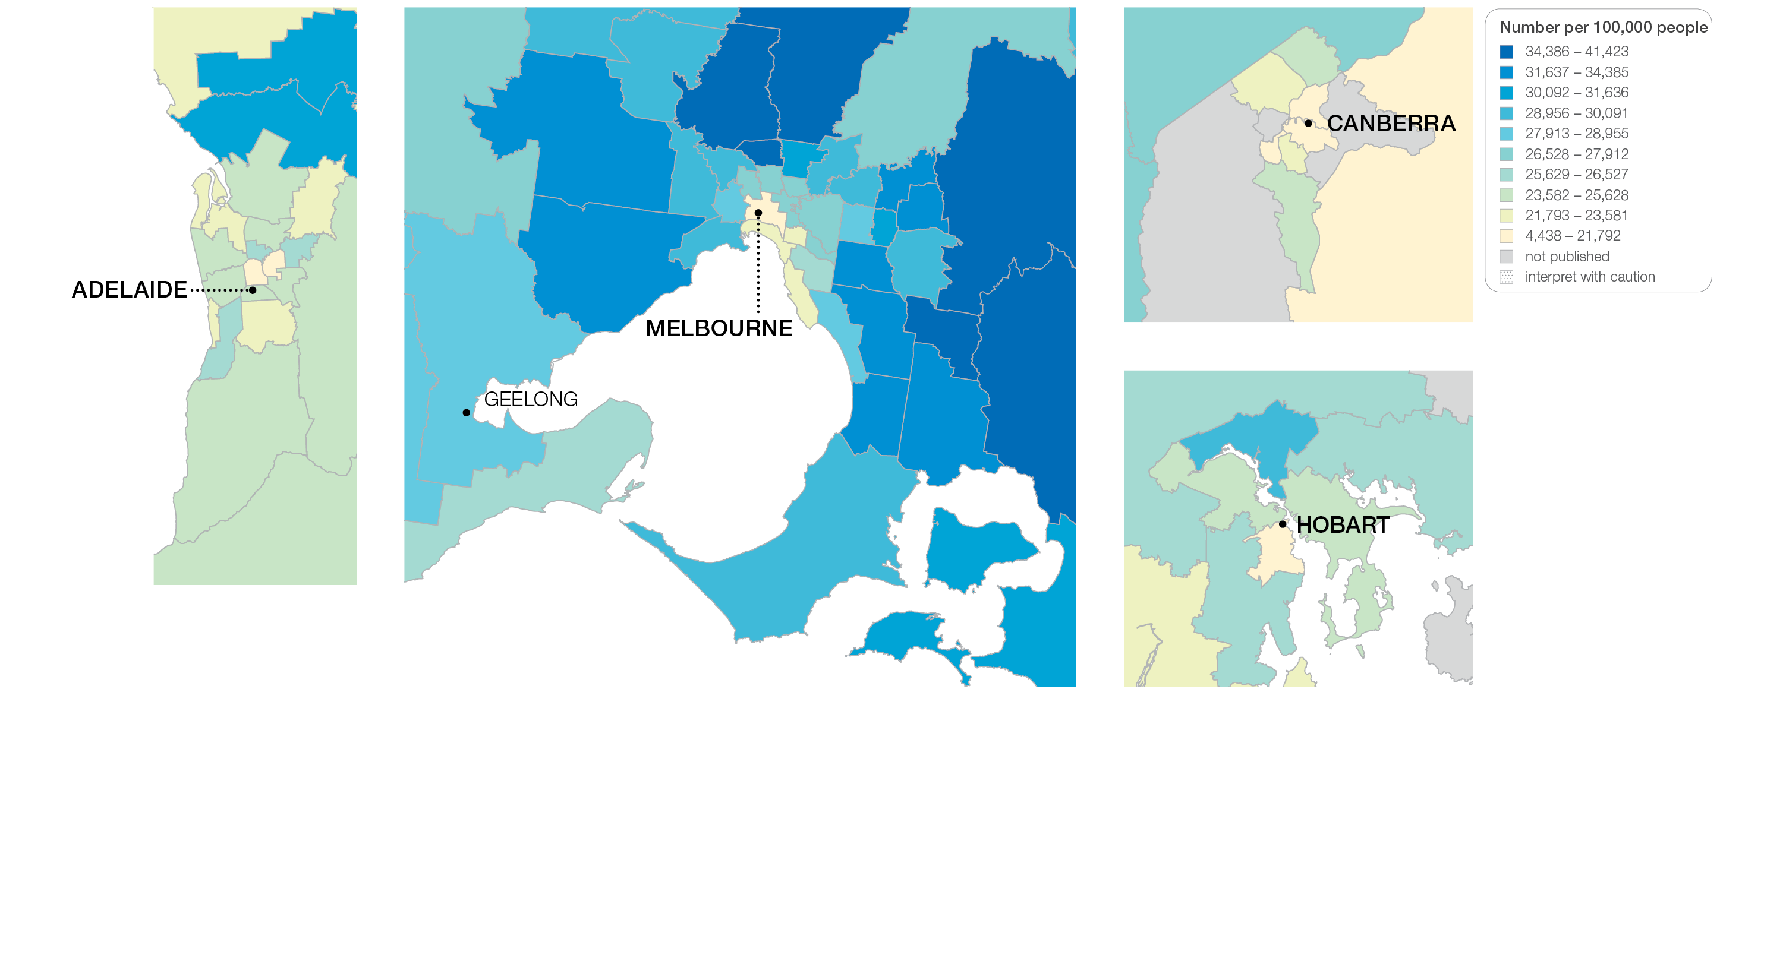
3.2 Thyroidectomy
Sources: NHMD data 2014-15 to 2016-17, and ABS Estimated Resident Population 30 June 2016
Notes:
Speaker notes:
This slide shows the distribution of rates by Statistical Area Level 3 (SA3) for thyroidectomy hospitalisation by capital city area. Rates are based on the patient’s usual place of residence, not the location of the healthcare provider.

Slide 45
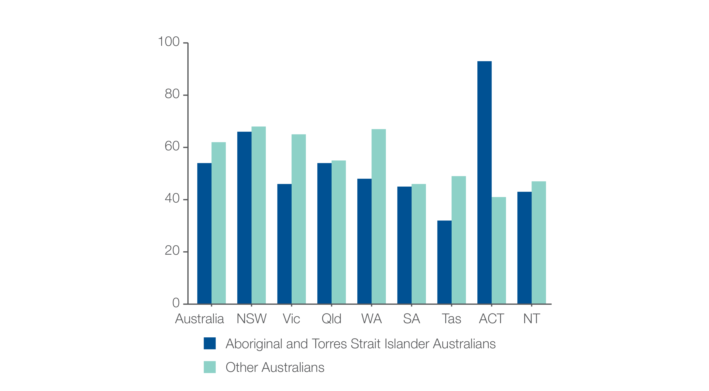
3.2 Thyroidectomy
Hospitalisations by Aboriginal and Torres Strait Islander status
Number per 100,000 people
Sources: NHMD data 2014-15 to 2016-17 , and ABS Estimated Resident Population 30 June 2016
Notes:
Speaker notes:
The rate of hospitalisations for thyroidectomy for Aboriginal and Torres Strait Islander Australians (54 per 100,000 people) was 13% lower than the rate for other Australians (62 per 100,000 people).

Slide 46
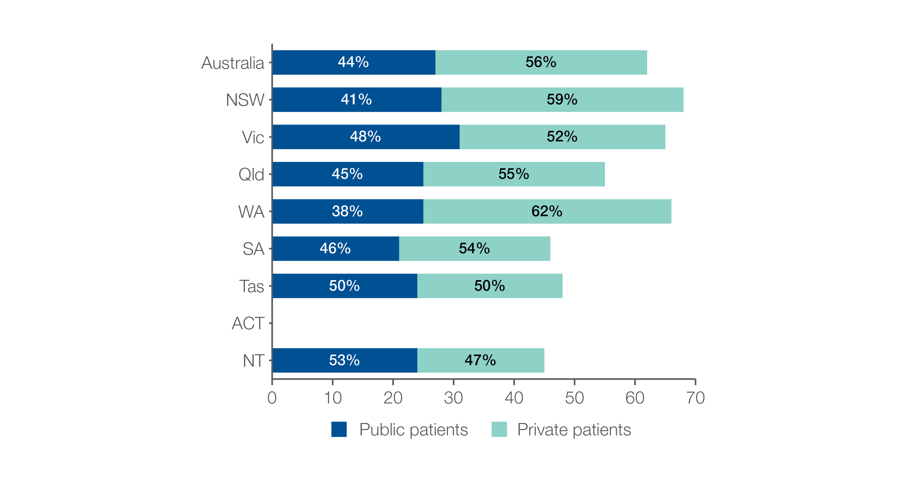
3.2 Thyroidectomy
Hospitalisations by patient funding status
Number per 100,000 people
Sources: NHMD data 2014-15 to 2016-17, and ABS Estimated Resident Population 30 June 2016
Notes:
Speaker notes:
Overall, 56% of hospitalisations for thyroidectomy were for privately funded patients.
This proportion varied from 47% in the Northern Territory to 62% in Western Australia.
The median age at operation was 53 years for publicly funded patients and 56 years for privately funded patients.

Slide 47
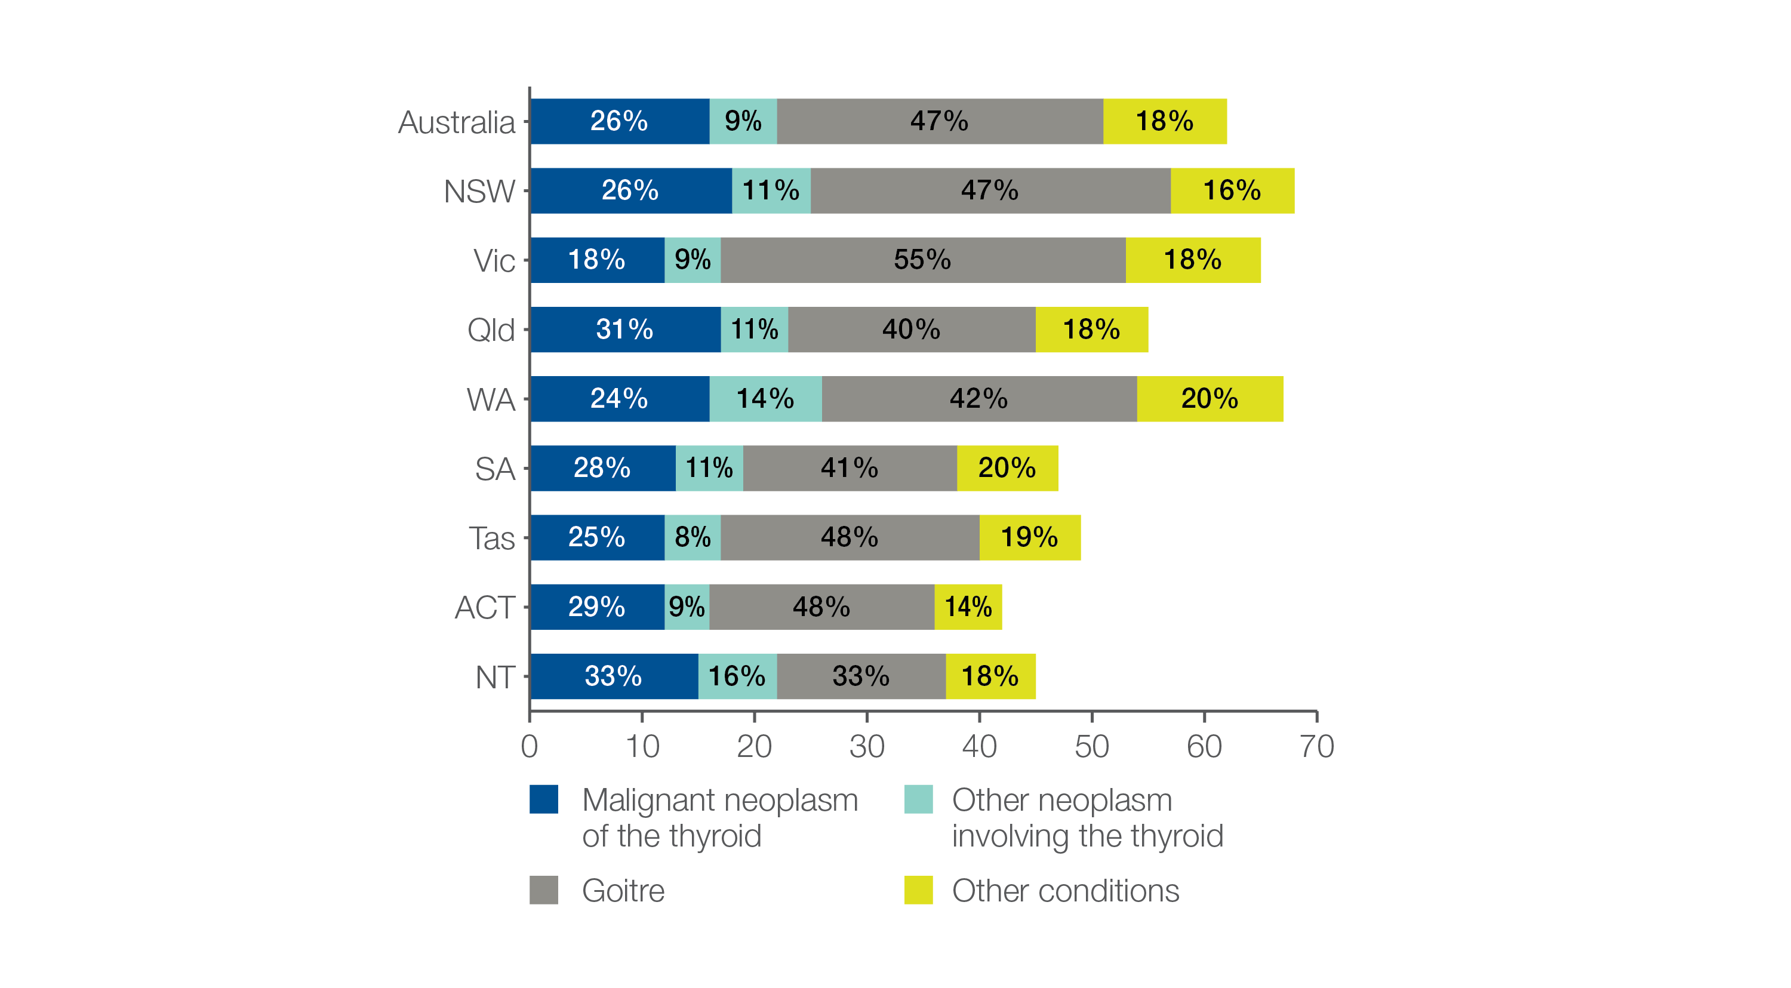
3.2 Thyroidectomy
Hospitalisations by principal diagnosis
Number per 100,000 people
Sources: NHMD data 2014-15 to 2016-17, and ABS Estimated Resident Population 30 June 2016
Notes:
Speaker notes:
The number of hospitalisations for thyroidectomy for patients with malignant neoplasms varied across states and territories, from 12 per 100,000 people in the Australian Capital Territory, Victoria and Tasmania to 18 in New South Wales.
The number of hospitalisations for thyroidectomy for patients with goitre varied from 15 per 100,000 people in the Northern Territory to 36 in Victoria

Slide 48
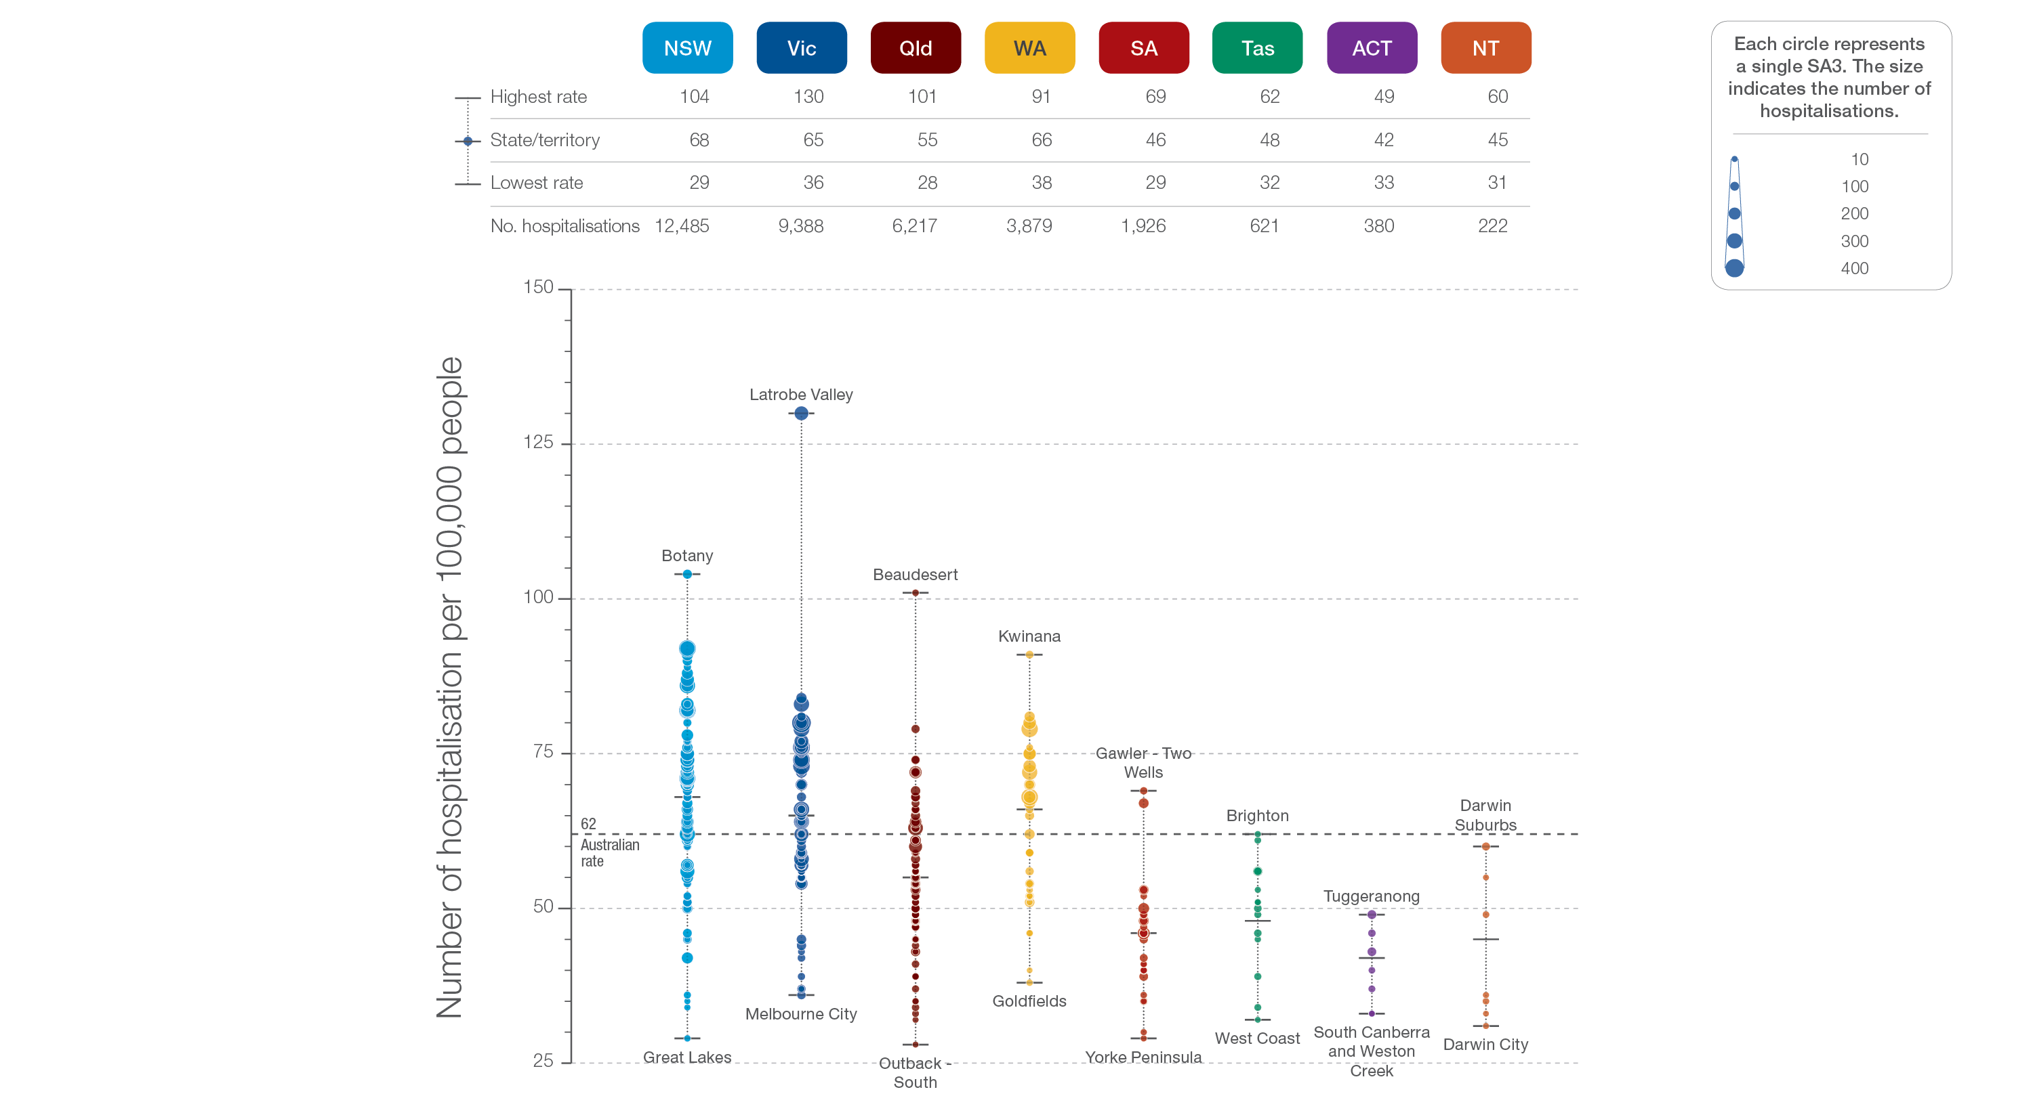
3.2 Thyroidectomy
State and territory
Sources: NHMD data 2014-15 to 2016-17, and ABS Estimated Resident Population 30 June 2016
Notes:
Speaker notes:
The number of hospitalisations varied across states and territories, from 42 per 100,000 people aged 18 years and over in the Australian Capital Territory to 68 in New South Wales.
Each circle on the graph represents an SA3. The size of the circle indicates how many services have been recorded for people living in that area. The vertical axis shows the standardised rates for the clinical item.
For further detail about the methods used, please refer to the Technical Supplement.
For further information on how to interpret the figures, please refer to the ‘How to interpret’ resource available at: www.safetyandquality.gov.au/atlas/the-third-australian-atlas-of-healthcare-variation-2018/how-to-interpret-the-data/

Slide 49
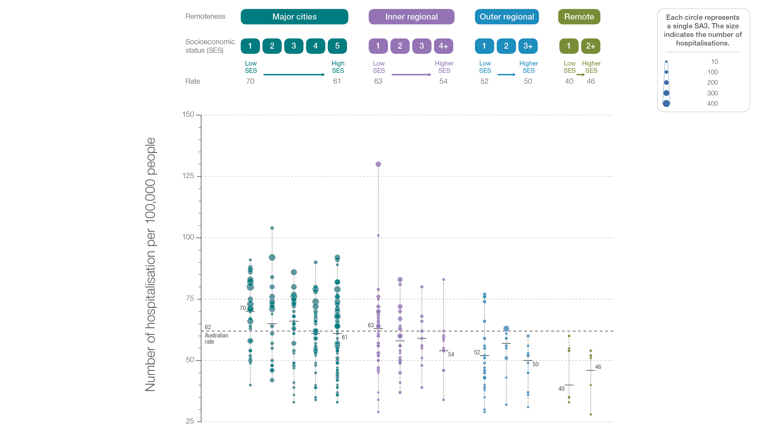
3.2 Thyroidectomy
Remoteness and socioeconomic status
Sources: NHMD data 2014-15 to 2016-17, and ABS Estimated Resident Population 30 June 2016
Notes:
Speaker notes:
Rates of hospitalisations for thyroidectomy were higher in major cities and inner regional areas than in outer regional and remote areas. Rates were higher in areas with lower socioeconomic status in major cities and in inner regional areas. However, there was no clear pattern according to socioeconomic status in other remoteness categories.
Each circle on the graph represents an SA3. The size of the circle indicates how many services have been recorded for people living in that area. The vertical axis shows the standardised rates for the clinical item.
For further detail about the methods used, please refer to the Technical Supplement.
For further information on how to interpret the figures, please refer to the ‘How to interpret’ resource available at: www.safetyandquality.gov.au/atlas/the-third-australian-atlas-of-healthcare-variation-2018/how-to-interpret-the-data/

Slide 50
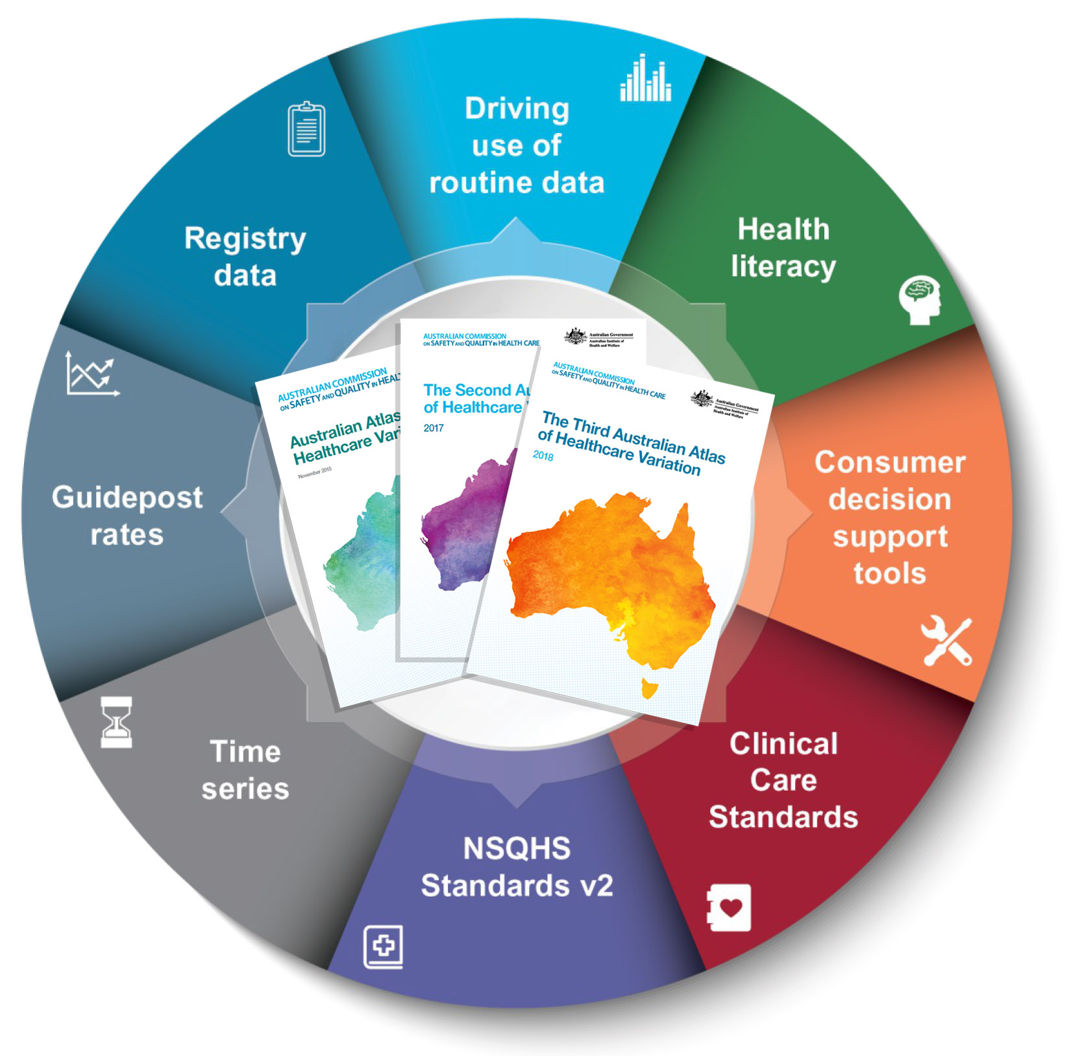
Promoting appropriate care
Explore variation
Identify unwarranted variation
Address unwarranted variation
Notes:
Speaker notes:
Mapping variation is an invaluable tool for understanding how our healthcare system is providing care, but gathering the data is only the first step. Understanding the underlying reasons for marked differences in the use of some health services across Australia, and considering how we can improve, are key for translating this work into better outcomes for patients.
The patterns shown in the maps in this Atlas and the accompanying commentaries show that there are many opportunities for making meaningful changes in Australia’s delivery of health care. The recommendations in the third Atlas highlight that action is needed at all levels – from addressing the social determinants of health through to better data collection, system changes and providing the best supports for individual clinician–patient interactions. These goals are ambitious, but the recommended changes have the potential to result in meaningful progress in defining and delivering appropriate care – and improving patient outcomes.

Slide 51
Further resources
Explore the data further using the interactive Atlas at www.safetyandquality.gov.au/atlas/
Please send any queries to atlas@safetyandquality.gov.au
Notes:
Further resources
Explore the data further using the interactive Atlas at www.safetyandquality.gov.au/atlas/
Please send any queries to atlas@safetyandquality.gov.au

