Slide 1
The Third Australian Atlas of Healthcare Variation
2018

Slide 2
The Australian Atlas of Healthcare Variation series
Notes:
Speaker notes:
Mapping variation is an invaluable tool for understanding how our healthcare system is providing care. The Australian Atlas of Healthcare Variation series illuminates variation by mapping use of health care according to where people live. Each Atlas identifies specific achievable actions for exploration and quality improvement.
The Australian Commission on Safety and Quality in Health Care (the Commission) has collaborated with the Australian, state and territory governments, specialist medical colleges, clinicians and consumer representatives to develop the Atlas series.
The Atlas publications can be downloaded from the Atlas website.

Slide 3

Interactive Atlas
Notes:
Speaker notes:
The Atlas data can also be further explored using the online interactive Atlas platform.

Slide 4

Australian Commission on Safety and Quality in Health Care
Australian Government agency
Leads & coordinates national improvements in safety & quality of health care based on best available evidence
Works in partnership with patients, consumers, clinicians, managers, policy makers & health care organisations
Aims to ensure that the health system is sustainable, better informed, supported & organised to deliver safe & high quality care
Notes:
Speaker notes:
The Commission’s role is to lead and coordinate national improvements in the safety and quality of health care. The Commission works in partnership with the Australian Government, state and territory governments and the private sector to achieve a safe and high-quality, sustainable health system. In doing so, the Commission also works closely with patients, carers, clinicians, managers, policymakers and healthcare organisations.
Key functions of the Commission include developing national safety and quality standards, developing clinical care standards to improve the implementation of evidence-based health care, coordinating work in specific areas to improve outcomes for patients, and providing information, publications and resources about safety and quality.
The Commission works in four priority areas:
- Patient safety
- Partnering with patients, consumers and communities
- Quality, cost and value
- Supporting health professionals to provide care that is informed, supported and organised to deliver safe and high-quality health care.
One of the Commission’s key programs is the National Safety and Quality Health Service (NSQHS) Standards. The primary aim of the NSQHS Standards are to protect the public from harm and to improve the quality of health service provision. The NSQHS Standards were developed by the Commission in partnership with the Australian, state and territory governments, the private sector, clinicians, patients and carers.

Slide 5





Third Australian Atlas of Healthcare Variation
Examines variation nationally in 13 clinical items, grouped into 4 themes
Neonatal and paediatric health
Early planned caesarean section without medical or obstetric indication
Antibiotic dispensing in children, 9 years and under
Proton pump inhibitor dispensing in infants, 1 year and under
Gastrointestinal investigations and treatments
Proton pump inhibitor dispensing in adults
Colonoscopy hospitalisations
Gastroscopy hospitalisations
Thyroid investigations and treatments
Thyroid stimulating hormone tests
Thyroid function tests
Neck ultrasound
Thyroidectomy hospitalisations
Cardiac tests
Cardiac stress tests and imaging
Stress echocardiography
Myocardial perfusion scans
Standard echocardiography
Notes:
Speaker notes:
The third Atlas, released in December 2018, examines four clinical themes: neonatal and paediatric health, gastrointestinal investigations and treatments, thyroid investigations and treatments and cardiac tests.

Slide 6


Third Australian Atlas of Healthcare Variation
Content continued
Repeat analysis
Examines changes over four years in the numbers of Pharmaceutical Benefits Scheme (PBS) prescriptions dispensed for:
Antimicrobial medicines
Antipsychotic and ADHD medicines
Opioid medicines
Response to the Atlas series
The Atlas series aims to provide clinically meaningful information that can be used to investigate and improve the appropriateness, effectiveness and efficiency of health care in Australia.
This section illustrates how the Atlas series can improve the value
of healthcare delivery.
Notes:
Speaker notes:
It also includes a repeat analysis chapter, examining

Slide 7
Inside this slide pack
Why does variation matter
Responses across the health system - examples
Promoting appropriate care
Further resources
Notes:
Speaker notes:
This slide pack explores why variation matters and what unwarranted variation in healthcare is. This slide pack explores the key findings for the ‘Thyroid investigations and treatments’ chapter and shows findings, maps and graphs for each of the clinical items in this chapter.

Slide 8
Why does variation matter?
Large variations in health care use have been documented by researchers around the world for many years
A proportion of this variation is termed ‘unwarranted’
Unwarranted variation:
Is unrelated to patient need or preference
May signal inappropriate care
May signal ineffective use of resources
It raises questions about appropriateness of care, health system efficiency, equity and access
Can highlight opportunities for further investigation and for the health system to improve
Notes:
Speaker notes:
Variations documented for many years: One of the first major studies published was by Glover in 1938 who noted a rise in England & Wales in incidence of tonsillectomy and very large differences in rates between school districts which “defies any explanation, save that of variations of medical opinion on the indications for operation.” He also noted “Large and, in some cases, drastic reductions in the numbers of operations performed in elementary school children in certain areas have had no unsatisfactory results” and that “The mortality from the operation is larger than is generally appreciated”.
He noted that that the conspicuous success of the operation in some cases may have led to its adoption in many doubtful cases.
Getting the best outcomes for patients and improving appropriateness of care is the goal of the Atlas. Where we see substantial variation in use of a particular treatment, it is an alarm bell that should make us stop and investigate whether appropriate care is being delivered.
Variation in itself is not necessarily bad, and it can be good if it reflects health services responding to differences in patient preferences or underlying needs. When a difference in the use of health services does not reflect these factors, it is unwarranted variation and represents an opportunity for the health system to improve. Rates of an intervention that are substantially higher or lower in some areas can highlight:
- Inequity of access to evidence-based care, and the need to deliver services more fairly
- Uncertainty about the intervention’s place in therapy, and the need for better data on its benefits and harms
- Gaps in accessible evidence for clinicians, and the need for clinical care standards
- Inadequate system supports for appropriate care, and the need for changes in training or financial incentives.
Looking at how healthcare use varies between people living in different areas, between people with and without socioeconomic disadvantage, and between Aboriginal and Torres Strait Islander Australians and other Australians can show who in our community is missing out. Fundamental changes to address the underlying determinants of ill health, as well as better service delivery for those with existing disease, are needed where these inequities are found.
Reference: Glover JA. The Incidence of Tonsillectomy in School Children: (Section of Epidemiology and State Medicine). Proc R Soc Med. 1938;31(10):1219-36.

Slide 9

Response to the Atlas series
Responses from the healthcare system to the first and second Atlases
Findings and recommendations from the Atlas series has prompted change across the health system.
Examples:
Victorian Clinical Senate
Queensland Clinical Senate
NT Clinical Senate
Repeat analysis of antimicrobials dispensed
Clinical Care Standard: Osteoarthritis of the Knee
Rates of MBS knee arthroscopies 2012-2018
Notes:
Speaker notes:
The aim of the Atlas series is to provide clinically meaningful information that can be used to investigate and improve the appropriateness, effectiveness and efficiency of health care in Australia.
Changes in the health system are usually the result of the accumulated efforts of many players over many years, rather than a single intervention such as the Atlas series. The third Atlas provides examples of how different groups within the health sector have addressed issues highlighted in the first and second Atlases, in the context of the many other organisations working to improve health care in Australia.
Mapping data is only the first step in using data on clinical variation for quality improvement. Translating the information in the Atlas series into better patient care and outcomes also depends on:
- Raising awareness of how to use data on variation to improve health care
- Building capacity for data collection and audit into clinical practice
- Engaging clinicians, policymakers and system managers to investigate reasons for variation and to address unwarranted variation
- Raising awareness among consumers of risks and benefits of healthcare interventions
- Implementing appropriate change at all relevant levels of the health system.

Slide 10
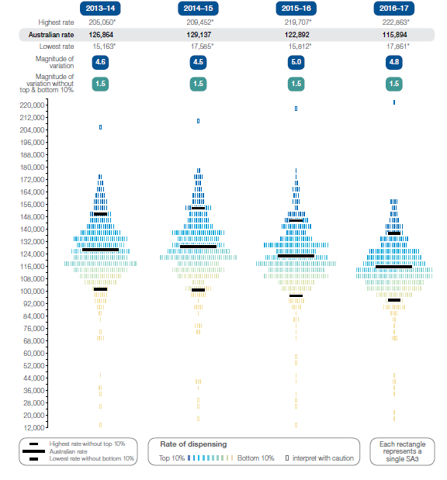
Repeat analyses: antimicrobial prescriptions dispensed
Number of PBS prescriptions dispensed for antimicrobial medicines per 100,000 people of all ages, age and sex standardised, by Statistical Area Level 3 (SA3) of patient residence, 2013–14 to 2016–17
Source: Pharmaceutical Benefits Scheme
Notes:
Speaker notes:
Rates of antimicrobial medicines dispensing were published in the first Atlas in 2015. Improving the use of antimicrobials is a national priority because of the ongoing concern about antimicrobial resistance (AMR) and because inappropriate use is exposing patients unnecessarily to the adverse effects of these medicines.
This has prompted a number of policy and regulatory responses to reduce inappropriate prescribing of antimicrobials. Australia has taken a One Health approach, coordinating responses from all sectors that use antimicrobials.
In 2016–17, there were 29,147,238 PBS prescriptions dispensed for antimicrobial medicines, representing an Australian rate of 115,894 prescriptions dispensed per 100,000 people of all ages. The Australian rate decreased from 2013–14, when 126,864 prescriptions per 100,000 people were dispensed.

Slide 11
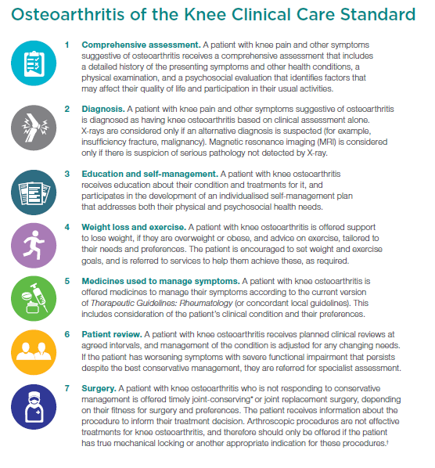

Example: Clinical Care Standard - osteoarthritis of the knee
Source: https://www.safetyandquality.gov.au/our-work/clinical-care-standards/osteoarthritis-clinical-care-standard/
Notes:
Speaker notes:
In 2015, the first Atlas reported that there were more than 33,000 admissions for knee arthroscopy in people aged 55 years and over in Australia in 2012–13.5 The rate of admissions was seven times higher in the area with the highest rate compared with the area with the lowest rate.
In light of the Atlas findings, the Commission released a clinical care standard for osteoarthritis of the knee and commissioned a documentary about appropriate care for knee pain. The Commission also referred the findings to the MBS Review Taskforce, which subsequently recommended removal of funding for knee arthroscopy for degenerative changes.

Slide 12
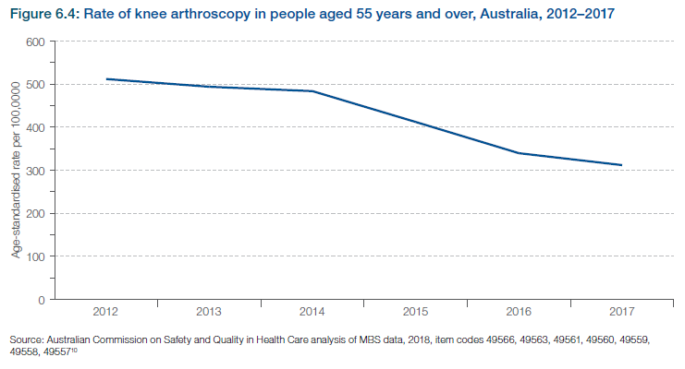
Example: MBS Knee Arthroscopy Data 2012-2018
Notes:
Speaker notes:
The rate of knee arthroscopy in people aged 55 years and over in Australia fell from 412 per 100,000 in 2015 to 312 per 100,000 in 2017 – a 24% drop. Many drivers are likely to have contributed to this reduction, in addition to the Atlas – for example, research and guidelines highlighting the lack of benefit of knee arthroscopy for osteoarthritis, and the MBS Review Taskforce review.

Slide 13

Promoting appropriate care
Explore variation
Identify unwarranted variation
Address unwarranted variation
Notes:
Speaker notes:
Mapping variation is an invaluable tool for understanding how our healthcare system is providing care, but gathering the data is only the first step. Understanding the underlying reasons for marked differences in the use of some health services across Australia, and considering how we can improve, are key for translating this work into better outcomes for patients.
The patterns shown in the maps in this Atlas and the accompanying commentaries show that there are many opportunities for making meaningful changes in Australia’s delivery of health care. The recommendations in the third Atlas highlight that action is needed at all levels – from addressing the social determinants of health through to better data collection, system changes and providing the best supports for individual clinician–patient interactions. These goals are ambitious, but the recommended changes have the potential to result in meaningful progress in defining and delivering appropriate care – and improving patient outcomes.

Slide 14
Further resources
Explore the data further using the interactive Atlas at www.safetyandquality.gov.au/atlas/
Please send any queries to atlas@safetyandquality.gov.au
Notes:
Further resources
Explore the data further using the interactive Atlas at www.safetyandquality.gov.au/atlas/
Please send any queries to atlas@safetyandquality.gov.au

