Slide 1
Risk assessment and management for infection prevention and control (IPC)
safetyandquality.gov.au
IPC Week 2025 – A proactive approach to IPC: Identify, Protect and Control
Insert presenter’s name

Slide 2

Acknowledgement of Country
I would like to pay respect to the Traditional Owners and Custodians of Country where we meet today. We extend that respect to all Aboriginal and Torres Strait Islander peoples, and their deep time connections to land, water and sky.
We recognise that knowledge about healthy Country, community and culture has been developed by Aboriginal and Torres Strait Islander peoples over tens of thousands of years and has been shared for generations. We are committed to partnering with and learning from Aboriginal and Torres Strait Islander peoples through the work that we do.

Slide 3
Instructions for use
This presentation is a framework for building a local infection prevention and control (IPC) presentation about risk assessment and management in IPC.
This presentation includes information on key topic areas, such as:
Meeting the Actions of the National Safety and Quality Health Services Standards
Basic principles of risk assessment and management
Using the hierarchy of controls for IPC.
You can adapt the information in this presentation to make it relevant to your staff and health service organisation.
The notes section in this presentation includes talking points and examples of other information you could include in your own presentation.

Slide 4
Introduction
Each year, many infections are associated with the delivery of health care and affect a large number of patients, and, in some cases, members of the workforce. These infections can:
Cause considerable patient harm and increase the risk of morbidity, and death
Increase the use of health services, e.g. extended length of stay, additional treatment and investigations
Place greater demands on the clinical workforce.
Risk assessment and management is the basis for preventing and reducing harm arising from healthcare-associated infection.
Risk assessment and management occurs on many different levels within a health service organisation and will differ between different clinical settings.
Notes:
NOTES:
Risk assessment and risk management is the core work of infection prevention and control (IPC).
As health service organisations differ greatly in their day-to-day function, it is not possible to provide a one size fits all approach to risk management.
IPC teams regularly identify infection risks across are variety of clinical contexts and select the appropriate course of action for each situation.

Slide 5
The National Safety and Quality Health Service (NSQHS) Standards
The aim of the National Safety and Quality Health Service (NSQHS) Standards is to protect the public from harm and improve the quality of health service provision.
The National Safety and Quality Primary and Community Healthcare Standards aim to protect the public from harm and improve the quality of health care delivered in the primary and community health setting.
The aim of the Preventing and Controlling Infections Standard is to reduce infection risks to patients, consumers and members of the health workforce.
Action 3.01 Integrating clinical governance requires health service organisations to identify and manage risks associated with infections.
Notes:
NOTES:
National Safety and Quality Health Service (NSQHS) Standards are a framework developed to support health service organisations deliver healthcare in a way that protects the public from harm and improves the quality of health service provision.
The IPC actions of NSQHS Standards require health service organisations to have processes to identify and manage infection risks.
The IPC actions of the Primary and Community Healthcare Standards require primary and community health services to use evidence-based processes to identify patients presenting with risk factors for infection and manage these risk factors appropriately.
IDEAS TO ADAPT FOR LOCAL USE:
Briefly describe how your IPC program and organisation is working to meet the actions of the NSQHS Standards or Primary and Community Health Standards.
Why is it important for your organisation to met the actions of the Standards?
Consider including practical examples of how healthcare workers already meet the IPC actions of these Standards in their day-to-day activities.
For more information, hyperlinks are provided in the slide to the NSQHS Standards, Primary and Community Health Standards and the Preventing and controlling Infections Standard.

Slide 6
Risk assessment and management: key concepts
Hazard
A situation or thing that has the potential to harm a person.
Risk
The possibility that harm (death, injury, illness) might occur when exposed to a hazard.
Risk control
Taking action to eliminate or control the risks, so far as is reasonably practical.
Notes:
NOTES:
There are some common terms used in risk assessment and management.
In the context of IPC:
- A hazard is the infectious agent.
A risk is defined as the possibility of microorganism colonisation or infection in a patient or healthcare worker arising from activities associated with healthcare delivery.
Risk control are the IPC interventions used to prevent or reduce the spread of infection.
IDEAS TO ADAPT FOR LOCAL USE:
Depending on your audience , you may want to expand on these terms here or in later slides. It is important that your audience understand the terms in this slide as they are referred to throughout the rest of the presentation.
Consider including examples of risk management in the context of IPC for your organisation.
Examples of hazards might include specific microorganisms that could colonise or infect patients, healthcare workers or visitors or the healthcare environment and equipment.
Examples of risk could include healthcare-associated infections, occupational exposure and sharps or other injuries (e.g thrombophlebitis).
Examples of risk control may include the elements of standard and transmission-based precautions.

Slide 7
Proactive and reactive risk assessment and management for IPC
Risk assessment and management for IPC uses proactive and reactive methods to identify and respond to infection risks.
PROACTIVE examples:
Preoperative screening
Prophylaxis
Protective isolation
REACTIVE examples:
Post exposure prophylaxis
Outbreak management
Contact tracing
Notes:
NOTES:
There are two approaches to risk assessment and management used in IPC- a proactive approach and a reactive approach.
A proactive approach means you are acting to prevent the risk before it occurs, such as preoperative screening and decolonisation programs.
A reactive approach means that you are responding after the risk has occurred – for example, outbreak management.
IPC requires both approaches for risk assessment and management.
IDEAS TO ADAPT FOR LOCAL USE:
Consider adding local examples of proactive approaches and reactive approaches.
For example, a proactive approach to risk assessment and management could include preoperative screening for MRSA for high-risk surgeries (e.g. cardiac, orthopaedic). Knowing if someone is colonised with MRSA means that it may be appropriate for the patient to undergo decolonisation preoperatively or be prescribed appropriate prophylactic antimicrobial treatment for the specific strain of MRSA to reduce the risk of surgical site infection. Another example could be allocating a single room with a dedicated ensuite to patients admitted to hospital with diarrhoea when the cause of the diarrhoea is unknown.
An example of a reactive approach to IPC is responding to an outbreak of gastroenteritis when patients admitted with gastro symptoms are not placed in a single room and the infection has now spread to other patients and staff.

Slide 8
Approaches to risk assessment and management
A successful approach to risk assessment and management occurs on many levels within a health service organisation. Support for effective risk management can be provided through:
Organisation level
Department level
Individual level
An organisational risk management policy
Embedding IPC risk management into all local policies or procedures
Assessing the necessity of a procedure as part of clinical decision-making
The organisation’s risk register
Monitoring environmental conditions (temperature, humidity), water quality and other environmental sampling
Considering and mitigating specific risks associated with specific procedures
Incident monitoring and reporting systems
Workforce IPC training and education programs staff
Preadmission screening
Attending education sessions (for example, hand hygiene or respirator fit checking).
Notes:
NOTES:
Risk assessment and management happens on many different levels within a health service organisation.
A successful IPC risk assessment and management program aims to have an impact at the organisational level such as ensure IPC is embedded in an organisation’s governance structure; at a department level such as ensuring infections risk are considered as part of clinical procedures and on an individual or healthcare worker level as part of the delivery of direct patient care.
IDEAS TO ADAPT FOR LOCAL USE
Consider providing examples of risk management on an organisation-wide level, department-based level and on an individual level.
For example: organisation-wide risk management could include policies/ procedure, mandatory education, standard precautions for all patients;
Consider providing other department level strategies such as tailored cleaning schedules, or specific vaccination requirements for laboratory staff compared to engineering staff

Slide 9

Managing the infection risk
Risk assessment and management helps to prevent and minimise harm from infection risks.
A successful risk assessment and management program:
has executive and healthcare worker support
reflects the specific infection risks in the context of the healthcare environment
selects the most appropriate course of action
uses multiple infection control strategies
includes the elements of standard and transmission-based precautions.
Notes:
NOTES:
For any IPC risk assessment and management program to be successful, support is needed at all levels within a health service organisation.
Management and clinical governance can have a positive impact on the effectiveness of IPC by promoting a continuous quality improvement approach and promoting IPC at all levels within an organisation.
When developing interventions to manage infection risks, it is important to ensure the interventions are specific to the local setting, the type of infection risk and are achievable for the health workforce.
Where possible, interventions should be developed in consultation with those that they are meant to protect (healthcare workers, patients, consumers).
IDEAS TO ADAPT FOR LOCAL USE
Who should be or is involved in risk assessment and management planning in your organisation ?
What areas should a local risk assessment and management plan focus on of your organisation?

Slide 10
Risk assessment and management for infection prevention and control
Identify
Protect
Control
Identify the hazard
Assess the level of risk
Introduce interventions to protect vulnerable patients and members of the health workforce from the risk
Manage the risk by controlling the transmission of infection
Evaluate the interventions to check if they work
Notes:
NOTES:
Risk assessment and management involves the following key steps:
Identifying the hazard or risk and assessing the level of risk, including who is at risk
Protecting those at risk from the risk or hazard (healthcare workers/patients/consumers)
Acting to control the risk
All healthcare workers have a role in infection risk assessment and management.
IDEAS TO ADAPT FOR LOCAL USE:
Consider asking your audience how well they think they can identify hazards, assess for risks, control the risks and whether they think it is their role to review control measures.
This will help you determine what concepts to focus on during the presentation.
You also might want to highlight how different members of the health workforce have different roles in IPC risk assessment and management.

Slide 11
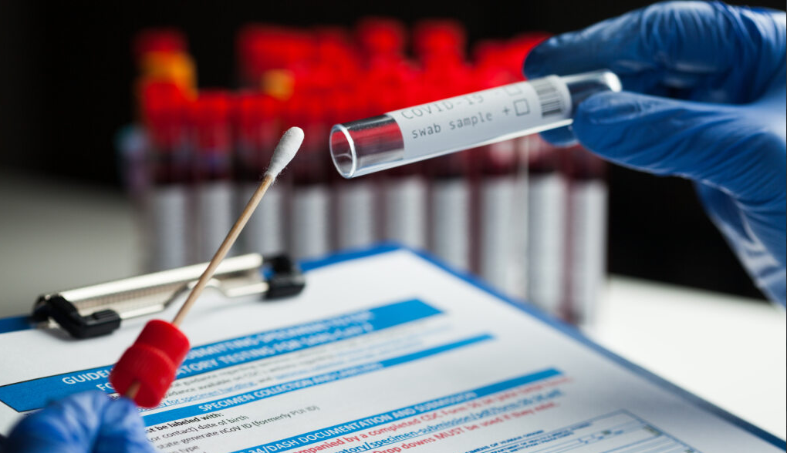
Identify the infection hazard: early detection
Consider factors such as:
Known or suspected infectious agents
Patient symptoms (fever, cough, rash)
Medical history (immune suppression)
Other risk factors (overseas travel or a contact of someone with a confirmed or suspected infection)
Potential or real exposure to blood or other body fluids
Complexity of procedures/types of devices in use.
Notes:
NOTES:
Identifying infection hazards or risks early is a proactive approach to risk management and can reduce the risk for potential or real harm to vulnerable patients and members of the workforce.
All healthcare workers need know how to identify infection hazards and risks.
IDEAS TO ADAPT FOR LOCAL USE:
Provide examples of infection hazards that are specific to your organisation. For example, if your organisation is a day surgery, some infection hazards may include (but not limited to) exposure to sharps (scalpels, needles), blood and body fluid exposure, types of surgery (invasive procedures) and exposure to clinical waste.
Ask whether members of the workforce, patients or visitors could be exposed to different hazards and why?

Slide 12
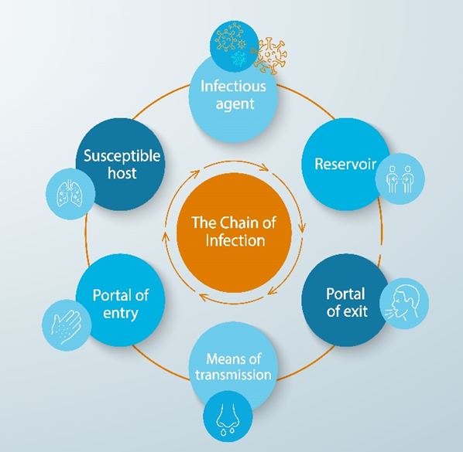
Identify the infection hazard: early detection
Once the infection hazard has been identified, you need to respond to the risk of infection transmission.
The chain of infection:
What type of infection risk is it?
What is the source of the infectious agent?
How is the infection is spread?
Who is at risk and why?
How can you protect those at risk? Or interrupt the chain of infection?
Notes:
NOTES:
Once you know what the infection risk is and how serious the risk is, you will need to understand who is at risk and how the infection will spread.
This information will help to develop actions to protect others and control onward transmission of the infection.
IDEAS TO ADAPT FOR LOCAL USE :
Add more slides with:
further explanations about each element of the chain of infection or examples of each element
scenarios which demonstrates the spread of an infectious agent ( e.g. measles, or norovirus).
Explain how interruption to the chain of infection stops the spread of infection (e.g. Patient placement, immunisations, environmental cleaning)

Slide 13

Identifying the infection hazard: Assessing the level of risk
Consider what could happen if someone is exposed to an infection hazard, and the likelihood of this outcome occurring.
Using a risk assessment process can help determine:
The severity of the risk
The effectiveness of current control measures
What action is required to control the risk
How urgently action should be taken.
Notes:
NOTES:
Assessing the level of risk helps to inform the types of interventions required to protect and control the spread of infection.
Assessing the risk also help to identify how large or serious the risk is and how quickly you need to act.
IDEAS TO ADAPT FOR LOCAL USE:
Broadly relate the risk assessment process to examples of IPC risks that are specific to your organisation. How does your organisation collect information about the risk?
For example, do you have risks for healthcare-associated infections (HAIs)? E.g. surgical site infections (SSI), Staphylococcus aureus bloodstream infection (SABSI), Catheter associated urinary tract infection (CAUTI).
How do you know what the incidence of HAIs are in your organisation? If you do have HAIs, what type of infections do patients get? How severe are these infection?

Slide 14
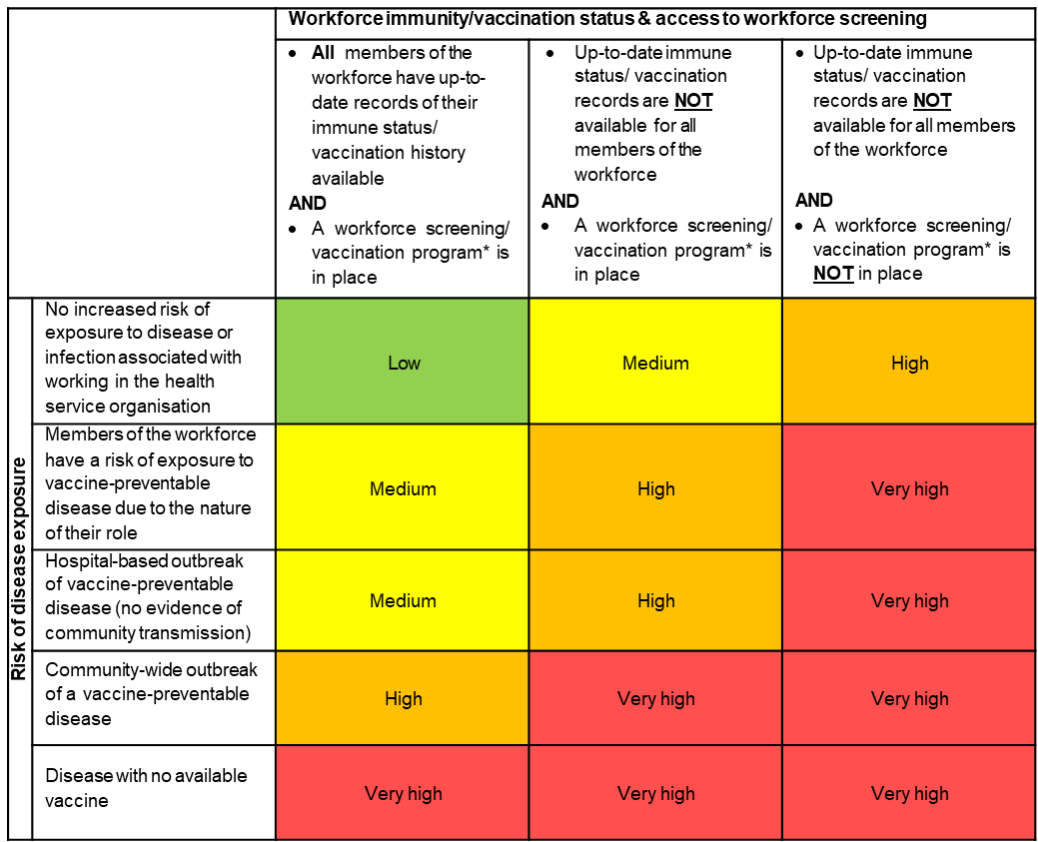
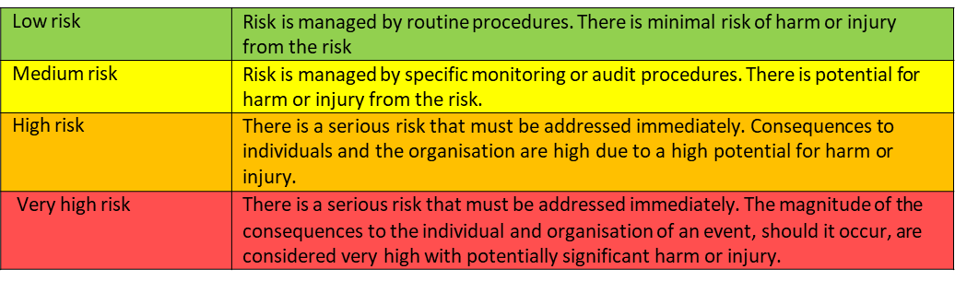
Identifying the infection hazard: Assessing the level of risk
A risk matrix is a tool that can be used to determined the severity of risk associated with a specific hazard.
Once you have determined the level of risk, you are able to implement the timely and appropriate interventions specific to the hazard.
Source: NSQHS Standards Workforce Immunisation Risk Matrix
Notes:
NOTES:
A risk matrix is useful tool that can be used to help quantify the level of risk associated with a specific hazard.
This slide is an example of a simple risk matrix that can be used to measure a risk and help to inform what action you need to take.
IDEAS TO ADAPT FOR LOCAL USE:
The example of the risk matrix is from the NSQHS Standards Workforce Immunisation Risk Matrix resource. A hyperlink to this resource is provided in the slide.
Consider the risk of exposure to a vaccine preventable disease, whether staff are vaccinated or not and the possible consequences of an outbreak related to this disease. What actions can be taken to reduce this type of risk in your organisation?

Slide 15
Protecting patients
A patient centred approach to IPC:
Encourage patients to participate in IPC
Support patients to participate in IPC
Consider the patient’s perspective when developing policies or procedures
Discuss infection risks with patients and their carers
Encourage patients to disclose health or risk status
Provide education about IPC, infectious conditions, care of invasive devices.
Protecting patients includes protecting those who are at risk of infection as well as protecting those who may transmit infection to others.
There are two types of precautions used for controlling infection risks:
Standard precautions
Transmission-based precautions (contact, droplet, airborne or a combination of precautions)
Notes:
NOTES:
Standard precautions are the primary strategy for minimising the transmission of healthcare-associated infections. Standard precautions work to protect individuals at risk of infection and well as those who may be an infection risk to others.
Standard precautions must be used when providing care to all patients, regardless of whether they have an infection or not.
Transmission-based precautions are used in addition to standard precautions, where the suspected or confirmed presence of infectious agents represents an increased risk of transmission.
Involving patients in their care is important to help reduce the risk of infection for patients. Patients and their carers should be provided with information about what they can do the prevent the spread of infection and keep themselves infections free.
To support patients participate in IPC, health service organisations need to provide patients with access to hand hygiene products, PPE as appropriate, access to sharps containers and other waste bins. Services such as Telehealth can also support physical distancing and the ongoing provision of healthcare.
IDEAS TO ADAPT FOR LOCAL USE- standard and transmission-based precautions:
Depending on your audience, you many want to add extra slides to explain standard and transmission-based precautions in more detail.
In relation to an infection risk that is specific to your own organisation, what control measures are currently in use? Think about the different elements of standard precautions:
hand hygiene, as consistent with the 5 moments for hand hygiene - is hand hygiene compliance monitored? Do staff know when and how to do hand hygiene ?
the use of appropriate personal protective equipment (PPE)- can you audit PPE use? Do staff know what PPE to for different infectious conditions?
the safe use and disposal of sharps – what is the incidence of sharps injuries, are sharps containers used correctly?
routine environmental cleaning – how effective is the cleaning program? Is environmental cleaning audited?
reprocessing of reusable medical equipment and instruments – what equipment or instruments require reprocessing in your organisation? Are processes consistent with current Standards?
respiratory hygiene and cough etiquette – do patients have access to tissues, bins, face masks, hand rub
aseptic technique – can staff perform aseptic technique? are there processes to monitor competency and training?
waste management – how is waste managed? Is waste segregated and stored correctly?
appropriate handling of linen – is linen stored (clean and dirty)?
Do all staff use standard precautions well? Are Standard precautions enough? To you need to add transmission-based precautions?
IDEAS TO ADAPT FOR LOCAL USE- Patient-centred care
What resources are available to patients and their carers that explain IPC? (e.g.: hand hygiene, use of PPE, care for invasive devices or wounds)
Are patients included in decisions regarding their care and how it is delivered?
Are there opportunities for patients and their carers to provide feedback or ask questions about IPC?

Slide 16

Protecting members of the workforce
The health workforce are also at risk of exposure to infection.
Health service organisations should have:
Policies and procedures in place to minimise the risk of infection to the workforce
Access to screening and immunisation programs for vaccine-preventable diseases
Support exclusion periods when staff are unwell
Access to services to access and support staff when exposed to infection risks
Provide safe equipment such as appropriate PPE, safety engineered devices, access to hand hygiene facilities.
Notes:
NOTES:
Standard and transmission-based precaution also work to protect the healthcare workers for infection risks.
In addition to standard and transmission-based precautions, health service organisations should have processes in place that protect healthcare worker from infection risks. These may include, but are not limited to, policies and procedures that are consistent with the Australian Guidelines for the Prevention and Control of Infection in Health Care, and relevant work health and safety regulations.
IDEAS TO ADAPT FOR LOCAL USE
What other local processes are in pace to protect healthcare workers?

Slide 17
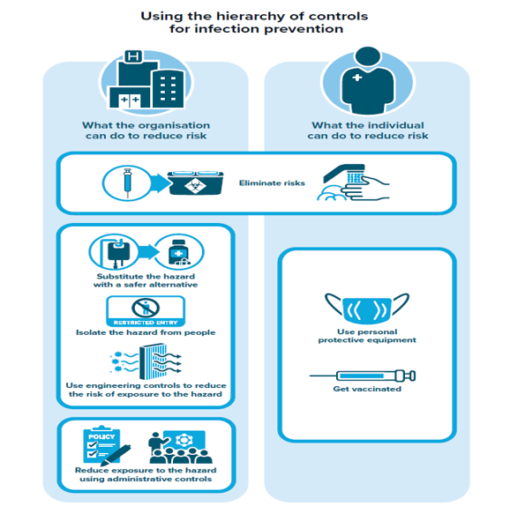
Controlling the infection risk: The hierarchy of controls
The hierarchy of controls is a model used in work health and safety to reduce the risk of exposure to a specific hazard.
The model ranks the different types of interventions from the highest to the lowest level of protection.
System level controls work in a complementary way with individual level controls to provide protection.
If it is not reasonably practical to eliminate risks, then risks must be minimised, as far as is reasonably practicable, by using one or a combination of:
Substitute
Isolation
Engineering controls
Administrative controls
Personal protective equipment (PPE).
Notes:
NOTES:
The hierarchy of controls (HoCs) is a method used in IPC to control exposure to infection hazards.
The HoCs ranks the interventions from highest to the lowest level of protection. Using a combination of interventions can ensure the highest, practical level of protection.
Eliminating the hazard provides the highest level of protection. Substitution, isolation and engineering controls act to reduce the level of exposure to the hazard. These types of interventions work at a system level to force behaviour change and therefore are usually very effective.
Administrative controls act to reduce the risk of exposure to the hazard by informing how procedures or work is performed. The use of personal protective equipment provided the individual with health and safety equipment to reduce their risk of exposure to a hazard. These intervention rely on the individual to flow procedures or use PPE correctly to be effective.
IDEAS TO ADAPT FOR LOCAL USE
Hyperlink is included in this slide for further information on the Hierarchy of controls and how these are used in IPC
Think about how these concepts apply in you own organisation and how you apply these concepts in routine IPC work.
Examples are provided on the next slide or add examples that relate to you own organisation .

Slide 18
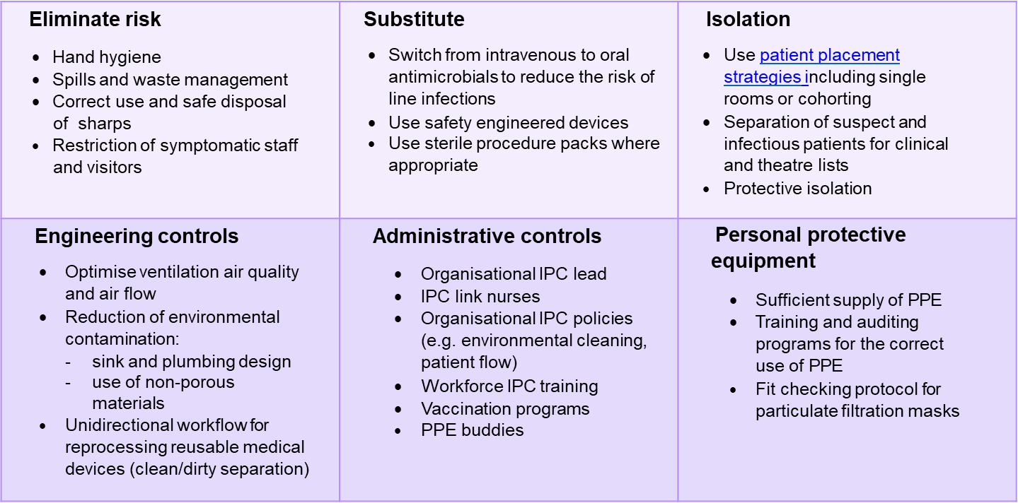
Managing the risk by controlling the transmission of infection: applying the hierarchy of controls
Notes:
NOTES:
This slide provides examples of each element of the hierarchy of controls as IPC interventions to manage infection risks.
IDEAS TO ADAPT FOR LOCAL USE
Other examples of applying the hierarchy of controls that you could add:
Element risk - Telehealth and remote working, early detection, testing and treatment
Isolation – distance between beds. Hyperlink to patient placement factsheet to provide further guidance on patient placement
PPE- supply PPE to visitors/ patients as a means of source control
Substitution- use spacers instead of nebulisers
Engineering controls – workflow, clean up areas, storage spaces
Administrative controls- application of signage, posters, IPC communication strategies

Slide 19
Controlling the infection risk: Evaluating interventions
Process indicators: measure how well an intervention or activity is done.
Outcome indicators: measure the result of an intervention of activity.
For example:
Competency assessments
Hand hygiene compliance
For example:
Environmental cleaning audits
HAI surveillance
Interventions should be routinely monitored and reviewed to see if they are effective in reducing the risk of infection.
Evaluating IPC risk assessment and management programs should be a continuous process.
Notes:
NOTES:
Once a risk management program has been in place for a while, it is important to review these programs to ensure that the interventions are still appropriate and are achieving the desired outcomes. This should be an ongoing process.
One way to review and monitor the effectiveness of IPC risk assessment and management programs is by reviewing the different data or indicators collected as part of an organisation’s IPC program. For example, IPC programs collect both process indicators and outcome indicators.
Hand hygiene compliance data is an example of a process indicator (how well somebody performs a task or activity).
Environmental cleaning audits is an outcome indicator, as it is used to measure the end result of a specific intervention or activity (how hygiene and safe the environment is).
Health service organisations can use these data collections to minimise the risk of infection and improve patient safety.
IDEAS TO ADAPT FOR LOCAL USE: what data can be used to assess infection risks in your organisations?
What information can you get from this data? How is this information used to improve patient and healthcare worker safety?
For example, IPC data provides information on:
• whether there is an infection problem
• the magnitude of the problem
• the factors that contribute to the onset of infection
• the impact of existing IPC strategies
• where to target interventions to improve and minimise the risk of infection.

Slide 20

Controlling the infection risk: Reporting and feedback
Providing timely and relevant feedback has a positive effect on reducing risks and improving infection rates.
Feedback increases:
Awareness of IPC strategies
Recognition of risk factors for infection
Understanding of policy and organisational expectations to improve patient safety outcomes.
Feedback and reporting should facilitate opportunities to discuss the effectiveness of existing practices and quality improvement initiatives.
Notes:
NOTES:
Timely feedback and reporting about IPC risk assessment and management programs to stakeholders is critical to support effective change. It is also important to seek feedback from those individuals whom the program is designed to protect.
Infection outcomes and the processes used to manage infection risks should be reported to the health service organisation’s executives, healthcare workers and consumers as this helps to increase the awareness of IPC and supports inclusion of IPC in the overall organisation‘s governance structure.
Encouraging two-way communication between management and healthcare workers, and among healthcare workers about IPC risk assessment and management programs is an important factor in increasing the level of support for and compliance IPC.
IDEAS TO ADAPT FOR LOCAL USE
At a local level, how does your organisation get feedback on risk assessment and management?
What type of information should be included? Reports, verbal , formal, informal/ program outcomes, HAI rates, audit results
How often should your IPC services provide feedback on infection control risk assessment and management
What is done with this feedback ? Update the risk assessment and management plan, support quality improvement

Slide 21
Key IPC resources
Australian Guidelines for the Prevention and Control of Infection in Healthcare
National Safety and Quality Health Service NSQHS Standards
National Safety and Quality Primary and Community Healthcare Standards
Preventing and Controlling Infections Standard
Antimicrobial stewardship (AMS)
Antimicrobial stewardship clinical care standard
Infection prevention and control
National Hand Hygiene Initiative (NHHI)
Management of peripheral intravenous catheters clinical care standard
Hierarchy of controls
National Alert System for Critical Antimicrobial Resistance (CARAlert)
Australian Passive AMR surveillance (APAS)
Australasian Health Facility Guidelines: Part D
Notes:
NOTES:
The Commission has many resources available to support health service organisations to identify infection hazards, protect patients and members of the workforce from infection hazards, and control the transmission of infections.
IDEAS TO ADAPT FOR LOCAL USE:
Add other local resources that are important to your local organisation

Slide 22
T. +61 2 9126 3600
Level 5, 255 Elizabeth St
Sydney NSW 2000 Australia
safetyandquality.gov.au
© Australian Commission on Safety and Quality in Health Care 2025

