Slide 1
Achieving great person-centred care
PowerPoint template for healthcare organisations
Key attributes of high-performing healthcare organisations

Slide 2
Overview
What is person-centred care?
Why is it important?
Key attributes of person-centred organisations
The National Safety and Quality Health Service (NSQHS) Standards
Getting started in our organisation
Resources

Slide 3
What is person-centred care?
Person-centred care is respectful of, and responsive to, the preferences, needs and values of patients, their families and the community.
Key dimensions include respect, emotional support, physical comfort, information and communication, continuity and transition, care coordination, access to care, and partnerships with patients, carers and family in the design and delivery of care.
Notes:
Person-centred care (or patient-centred care) is defined in the National Safety and Quality Health Service Standards as “being respectful of, and responsive to, the preferences, needs and values of patients, their families and the community”

Slide 4
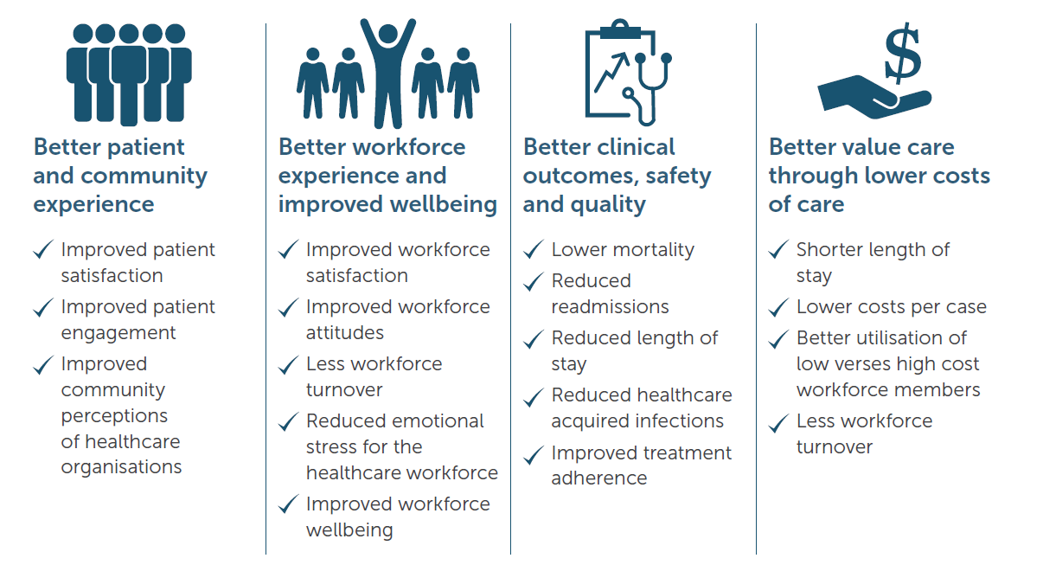
Why is it important?
Person-centred care is the foundation for achieving safe, high-quality health care. Studies have shown that person-centred care can contribute to:

Slide 5
Key attributes of person-centred organisations
A review was conducted to determine what key attributes were shared by healthcare organisations that are high-performing in person-centred care.
The review consisted of:
Literature review (over 90 peer-reviewed publications and grey literature)
Site visits in eight services (four in Australia and four internationally)
Notes:
The Australian Commission on Safety and Quality in Health Care engaged a consulting group, Nous Group, to conduct a review to determine the key common attributes of healthcare organisation who are high-performing in person-centred care.
The review was conducted in 2017 and consisted of:
over 90 peer-reviewed publications and grey literature were reviewed, including journal articles, systematic reviews, guidelines, reports, frameworks and policy documents from Australia and overseas
Eight site visits - four conducted in Australian services, two in the United States, one in Canada and one in Sweden.
Site visits included a range of large, small, public, private, metropolitan and regional hospitals and health services. Interviews were conducted with managers, clinicians, patient representatives and others who are involved in the delivery of person-centred care.

Slide 6
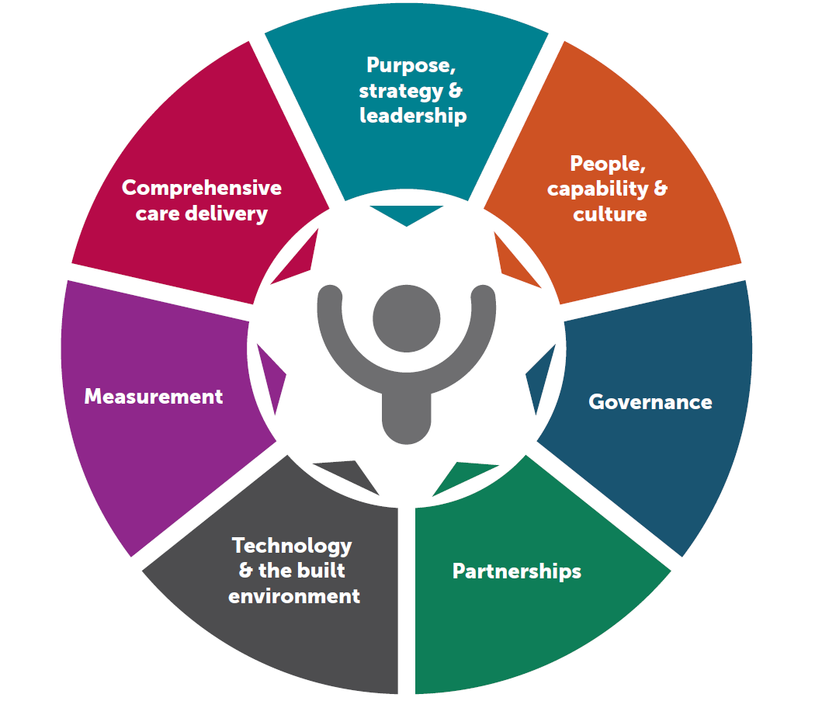
Key attributes
Notes:
The review identified seven key attributes, each of which had a number of elements (see next slide)
These attributes are interrelated and mutually reinforcing. How these will look will differ depending on the service context –to be successful organisations need to consider their particular context: what service they deliver; the community they serve, and take a whole of organisational approach.

Slide 7
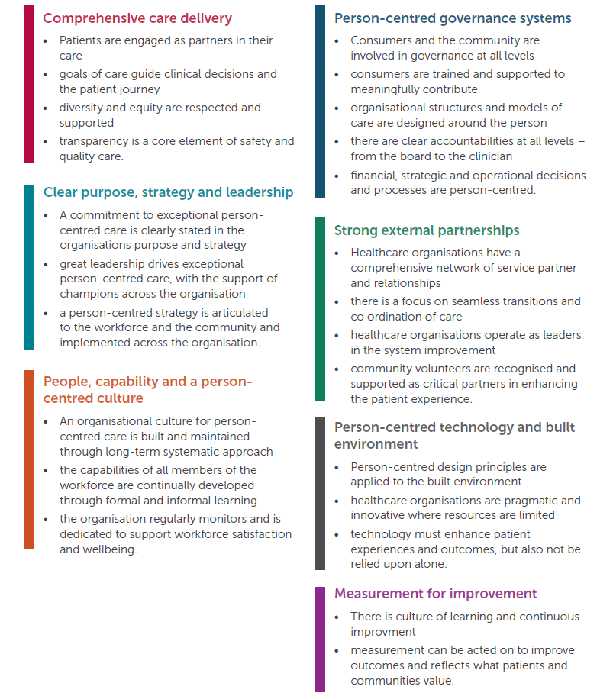
Key attributes (cont.)
Notes:
The attributes are:
Comprehensive care delivery is based on person-centred values applied in every interaction with the patient, their carers and family. Where effective communication drives care and compassion, patients are actively involved in their care, decision making is shared and care is comprehensively coordinated across the team and guided by the patient’s goals and choices.
A clear purpose, strategy and strong leadership that drives the organisation to achieve exceptional person-centred care. Organisational commitment toward this goal is clearly stated in the organisation’s purpose and articulated to the workforce and the community. Leaders at every level champion the importance of person-centred care across the organisation.
People, capability and a person-centred culture are focused on supporting the needs and choices of the individual. A long-term, systematic commitment to developing a person-centred culture is complemented by comprehensive training and capability development. Workforce wellbeing is prioritised and supported as a key enabler of great care.
Person-centred governance systems involve consumers at all levels of the organisation. There are clear accountabilities for individuals and teams at every level of the organisation and management decisions, including resource allocation, explicitly consider and prioritise the delivery of person-centred care.
Strong external partnerships are recognised as integral to coordinating services around the needs and preferences of individuals. Seamless transitions between care settings are enabled, with the organisation taking a leadership role in effecting system change and improvement.
Person-centred technology and built environments have a significant practical impact on experiences of care. While resources for both are often limited, good physical design principles and innovative digital technology are able to be applied in any organisational setting. Technology is used as an enabler for person-centred care and not a replacement for people, culture and capability.
Measurement for improvement. Achieving person-centred care requires an organisation-wide culture of continuous improvement, focused on measuring patient outcomes and experiences. High performers ‘measure what matters’ to get the outcomes that patients expect.

Slide 8
The National Safety and Quality Health Service (NSQHS) Standards
Excelling in the attributes will help you meet some of the actions in the NSQHS Standards (second edition)
Person-centred care is embedded throughout the NSQHS Standards reflecting its importance to the safety and quality of health care
The second edition of the NSQHS Standards was endorsed by Health Ministers in June 2017, and will be mandatory for all Australian hospitals. Assessment to the second edition of the NSQHS Standards will be from 1 January 2019
Doing well, or excelling, against the attributes will enable health service organisations to meet some of the NSQHS Standard actions that support the delivery of person-centred care.

Slide 9
Getting started in our organisation
Identify areas to learn and improve: What is working well? What is not working well?
Prioritise and make a commitment to implement quality improvement strategies
Share responsibility for quality improvement; support members of the workforce; and build capacity
Self assessment against each of the attributes
Monitor, measure and evaluate
Continuously improve
Notes:
The following steps may be helpful when considering how to get started:
Determine how well your organisation is performing against each attribute by reviewing your current practices and environment. It is important to involve as many of your staff (clinical and administrative) as possible and consumer representatives.
2. Identify areas where your organisation could learn or improve – What is working well? What is not working well?
3. Prioritise and make a commitment to implement quality improvement strategies in the areas that are not working well. Where things are working well, share strategies and learnings across your organisation.
4. Share the responsibility of quality improvement with leaders at all levels of the organisation, and support clinicians and your workforce to build their knowledge and skills in quality improvement methods.
5. Ensure you are on the right track - monitor, measure and evaluate.
6. Continuously improve by responding proactively, incorporating what you have learnt, and sharing your learnings with members of your workforce across the organisation.

Slide 10
Activity
Suggested activities:
Use one of the case studies to discuss how the attributes may look in practice, and what they may look like in your organisation?
Go through reflective questions in the self-assessment tool – discuss as a group to identify areas for improvement or learnings that can be shared
Make plans to take action – what will be your first steps?
Notes:
Case studies and the self-assessment tool are available at: https://www.safetyandquality.gov.au/our-work/patient-and-consumer-centred-care

Slide 11
Key points
Person-centred care is the foundation for achieving safe, high-quality health care.
Focusing on person-centred care, and on doing it well, will enable healthcare organisations to be successful in achieving better outcomes for their patients; better experience for their patients and workforce; and better value care
The seven key attributes provide an organisational framework in which healthcare organisations can focus quality improvement work

Slide 12
Key points (cont.)
Delivery of person-centred care is not just a one-off event, or the responsibility of one person. It is a whole of organisation approach, where everyone is working towards a shared goal of achieving high-quality care
You, as a leader of your organisation, have an essential role in ensuring your organisation delivers safe, person-centred care

Slide 13
Resources
Factsheets on each of the key attributes
Report of Review of key attributes of high-performing person-centred healthcare organisations (including case studies)
Person-centred care resources
NSQHS Standards (second edition)
Available at: www.safetyandquality.gov.au

