Slide 1


Heavy Menstrual Bleeding
Clinical Care Standard
June 2024

Slide 2

Notes:
Hayley’s story (5 mins 24 secs) – also available on the Commission’s youtube channel (https://youtu.be/0pQb0xG77Nc)
0:00-0:28 (28 secs) Introduction
0:29-1:52 (1 min 23 secs) Experience of heavy menstrual bleeding
1:53-2:52 (59 secs) Realising bleeding not normal
2:53-4:00 (1 min 7 secs) Treatment options
4:01-4:30 (29 secs) How could my experience have been different?
4:31-5:18 (47 secs) Advice for other women

Slide 3
Objectives
Understand the case for improving the quality of care for women with heavy menstrual bleeding
Ensure timely recognition of heavy menstrual bleeding and conduct a thorough assessment
Offer relevant investigations including high quality pelvic ultrasound
Provide treatment options for HMB, and support informed choice and shared decision making

Slide 4
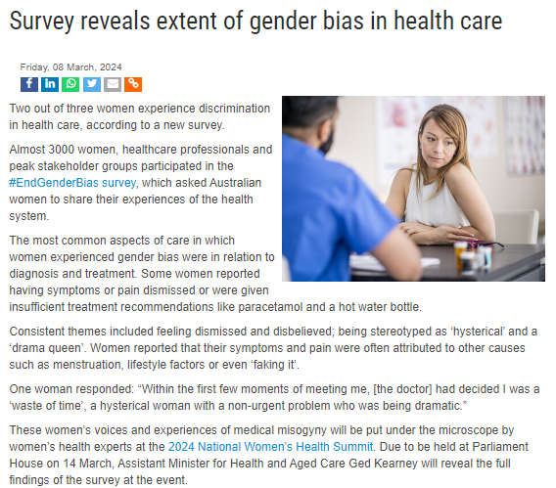
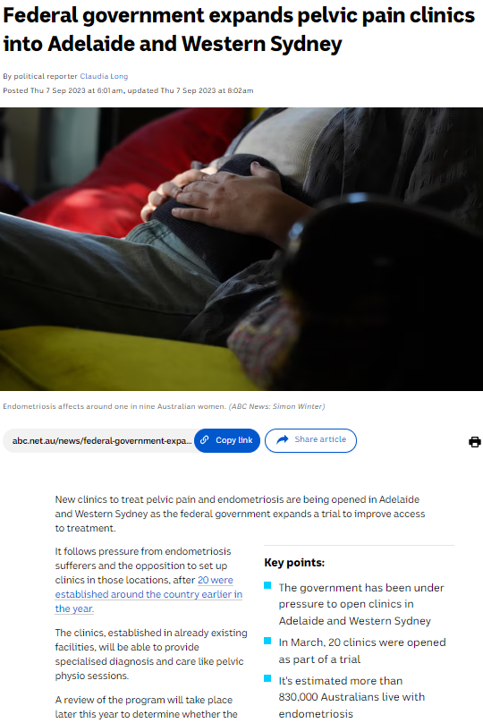

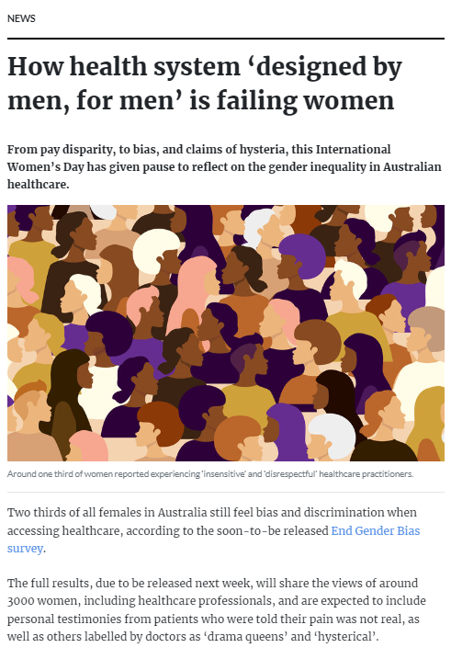
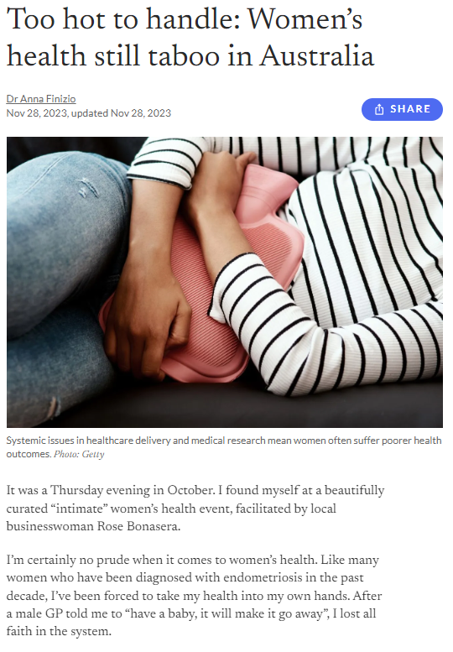

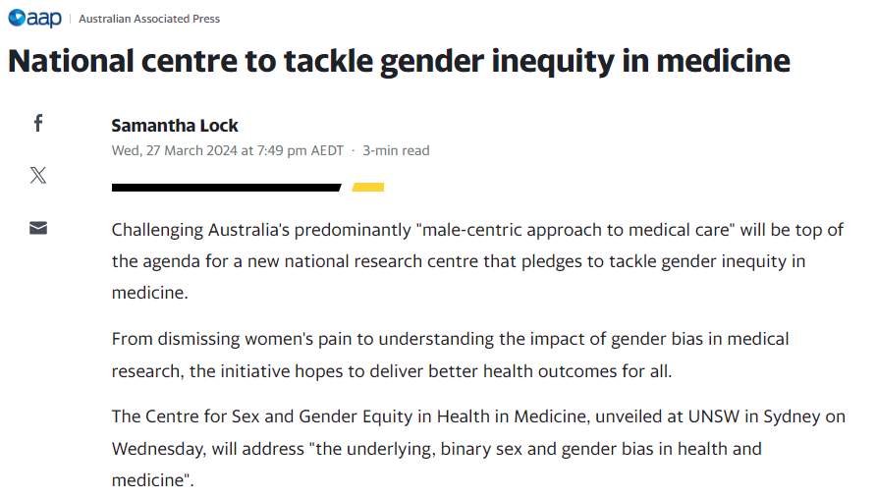
Notes:
Background notes
These are some of the many stories published recently in the health and mainstream media relating to women’s health issues and are here to prompt reflection on how timely it is to be revisiting the topic of heavy menstrual bleeding when there is real momentum around women’s health, and acknowledgement of how stigma and entrenched systems and practices can affect women’s access to, and experience of care, and their health outcomes.

Slide 5

Why do we need a clinical care standard?
Experienced by at least 25% of women
Significant impact on quality of life
Iron deficiency and iron deficiency anaemia
Substantial variation in care
Notes:
Background notes
Heavy menstrual bleeding affects at least 25% of reproductive age women and it can have a debilitating impact on women’s social, emotional and physical quality of life.
At least 60% of women with HMB are iron deficient or have iron deficiency anaemia.
There is substantial variation in the care that women are receiving for heavy menstrual bleeding.
The Australian Commission on Safety and Quality in Health Care has been following rates of hysterectomy and endometrial ablation in Australian women since 2016 and it was in response to findings in the Australian Atlas of Healthcare Variation Series that the first Heavy Menstrual Bleeding Clinical Care Standard was developed in 2017.
The Commission has recently released an updated Women’s Health Focus Report and the following slides provide some insights into the most recent data as well as how Australia compares internationally.

Slide 6
Australia and comparable OECD countries
Hysterectomy procedures per 100,000 women 2014-2019
Ref: OECD Data Explorer, Healthcare Utilisation; accessed 28 April 2024
Notes:
Background notes
This OECD data shows that Australia has very high rates of hysterectomy by international standards.
While there are some limitations when it comes to comparing OECD data across countries, it is striking that Australia’s rate of hysterectomy in 2019 was more than 60% higher than the UK’s and 70% higher than New Zealand’s.
Hysterectomy rates in Australia – and in comparable countries – fell in the five years to 2019. However, in 2019, rates in Australia remained high, especially in comparison to New Zealand and the UK.
Just a note that these OECD data are for both cancer and non-cancer conditions – but we know that approximately 90% of hysterectomies are performed for benign conditions[1]
NB
- data is not age-standardised
- chart considers data up to 2019 (2020 has not been included, noting inconsistency in 2020 data and impact of COVID – Australia was the highest of all OECD countries in 2020)
[1] Aarts JW, Nieboer TE, Johnson N, Tavender E, Garry R, Mol BW, Kluivers KB. Surgical approach to hysterectomy for benign gynaecological disease. Cochrane Database Syst Rev. 2015 Aug 12

Slide 7
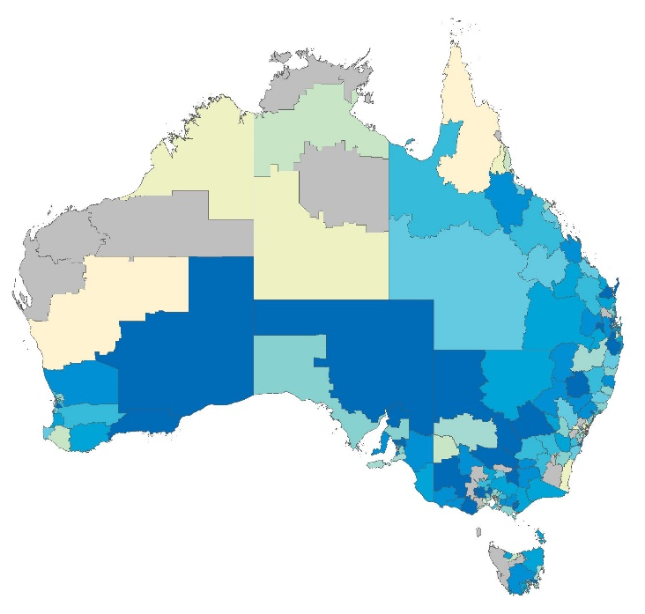
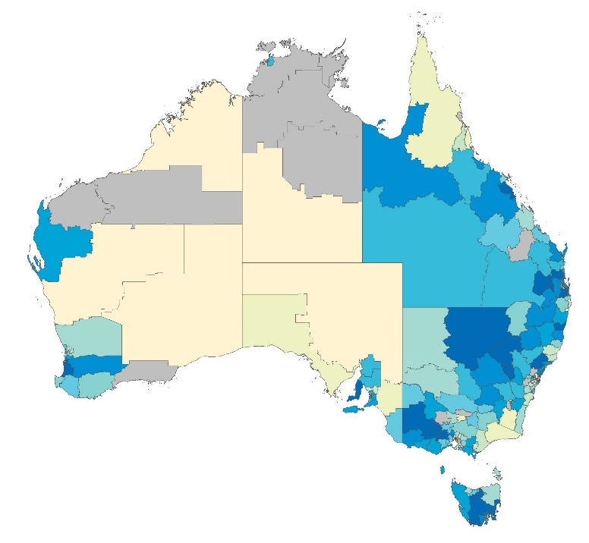

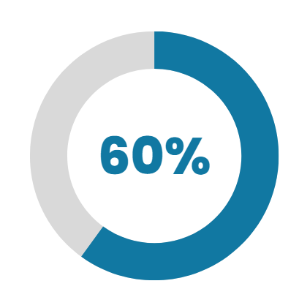
Hysterectomy hospitalisations
Non-cancer indications for women 15 years and over, 2014-15 to 2021-22
Geographical variation over time
National rates
20%
Decrease between 2014–15 and 2021–22
2014–15
2021−22
Consistently over time:
Higher rates in regional areas
60% of hospitalisations were for privately-funded patients
7-fold difference between the local area with the highest rate and the local area with the lowest rate
5-fold difference between the local area with the highest rate and the local area with the lowest rate
In 2021/22
9%
9% higher for Aboriginal and Torres Strait Islander women than other Australian women
Notes:
Background notes
The Women’s Health Focus Report, which the Commission released alongside the updated clinical care standard, examines trends in hysterectomy and endometrial ablation hospitalisations, and follows on from previous analysis of this data in the Second Atlas of Healthcare Variation.
The maps on this slide show how hysterectomy rates were distributed across Australia in 2014-15 and 2021-22. Mapping here is by Statistical Area 3, or SA3. (Rates are based on the patient’s usual place of residence, rather than the location of the healthcare provider.)
SA3s with higher rates of hysterectomy are shown in the darker blue colours and those with lower rates are in the lighter colours. (Areas in grey have not been published.)
The recent analysis shows there was a 20% decrease nationally in the hysterectomy rate between 2014-15 and 2021-22.
Rates were consistently higher in regional areas than in major cities and remote areas. And 60% of hospitalisations were for privately funded patients.
In 21-22 there was a five-fold difference in hysterectomy rates between the local area with the highest rate and the local area with the lowest rate, down from a seven-fold difference in 2014-15.
Hysterectomy rates for Aboriginal and Torres Strait Islander women were 9% higher than for other Australian women

Slide 8
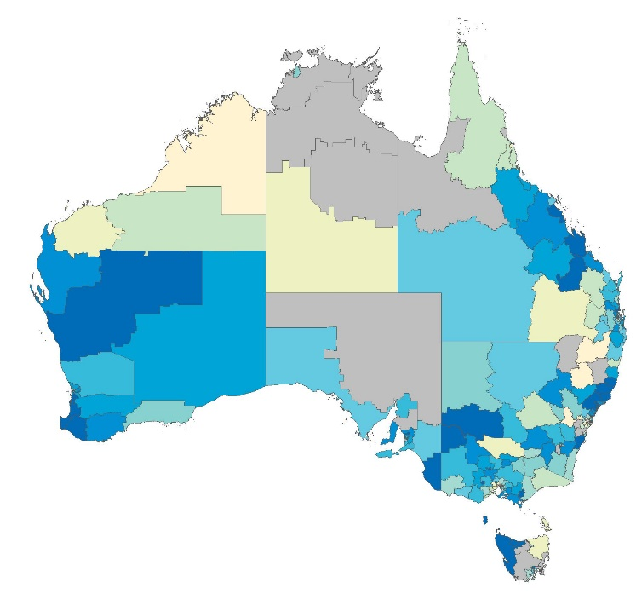
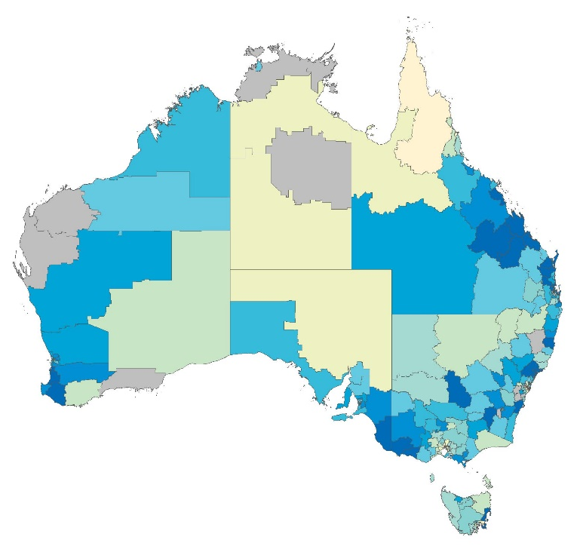
Endometrial ablation hospitalisations
Non-cancer indications for women 15 years and over, 2013-16 to 2019-22
Geographical variation over time
National rates
10%
Increase between 2013–16 and 2019–22
2013–16
2019−22
Consistently over time:
Higher rates in regional areas
60% of hospitalisations were for privately-funded patients
18-fold difference between the local area with the highest rate and the local area with the lowest rate
20-fold difference between the local area with the highest rate and the local area with the lowest rate
In 2021/22
2%
2% lower for Aboriginal and Torres Strait Islander women than other Australian women
Notes:
Background notes
While hysterectomy rates fell, there was a 10% increase in endometrial ablation nationally between 2013-16 and 2019-22
Again, as for hysterectomy, rates were consistently higher in regional areas than in major cities and remote areas, and 60% of hospitalisations were for privately-funded patients.
In the most recent period, there was a substantial, 20-fold difference between the local area with the lowest rate, and the local area with the highest rate of endometrial ablation.
Endometrial ablation rates for Aboriginal and Torres Strait Islander women were 2% lower than for other Australian women in 2019-22.
This has been a very quick look at this data. To learn more, go to the Women’s Health Focus Report on the Commission’s website where you can read about the findings in more detail and see how your local region compares. You will also be able to see the impact on variation of factors such as socioeconomic disadvantage, remoteness, and Indigenous status.

Slide 9

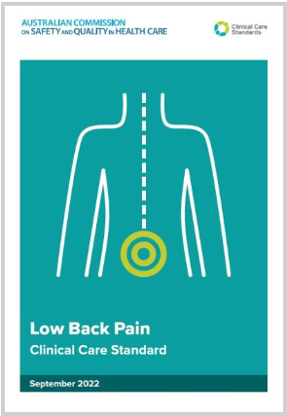




Clinical Care Standards
Support the delivery of evidence-based clinical care for a health condition or procedure
Reduce variation in clinical care
Promote shared decision-making between health professionals and consumers.
Unlike clinical guidelines, they do not describe all components of care. Instead, they comprise a limited set of ‘quality statements’ describing the expected care for a health condition or procedure.
Notes:
Background notes
It was in the context of this variation in care that the Heavy Menstrual Bleeding Clinical Care Standard was originally developed.
The purpose of clinical care standards is to support evidence-based care and reduce variation in care, while promoting shared decision-making between health professionals and consumers.
It is important to note that clinical care standards are not clinical guidelines. They do not describe all the components of care.
Instead, they encompass a limited set of ‘quality statements’ that address quality improvement priorities and describe the expected care for a health condition or procedure.

Slide 10

Heavy Menstrual Bleeding Clinical Care Standard
1. Assessment and diagnosis
2. Informed choice and shared decision making
3. Initiating medical management
4. Quality ultrasound
5. Intrauterine hormonal devices
6. Specialist referral
7. Uterine-preserving alternatives to hysterectomy
8. Hysterectomy
Notes:
Background notes
The HMB Clinical Care Standard is made up of these eight quality statements that describe the expected care for women with HMB.
The Standard aims to ensure that women with heavy menstrual bleeding are offered the least invasive and most effective treatment appropriate to their clinical needs and preferences, and are able to make an informed choice from the range of treatments suitable to their individual situation

Slide 11

1 Assessment and diagnosis
‘Normal’ and ‘heavy’ menstrual bleeding
Comprehensive assessment
Iron deficiency and anaemia
Underlying causes and contributors
Notes:
Background notes
Quality statement 1 – Assessment and diagnosis: The initial assessment of a woman presenting with heavy menstrual bleeding includes a thorough history, assessment of impact on quality of life, a physical examination (where clinically appropriate), and exclusion of pregnancy, iron deficiency and anaemia. Further investigations are based on the initial assessment.
While historically definitions have focused on menstrual blood loss - e.g. 80 ml or more per cycle – HMB now defined as excessive menstrual bleeding that interferes with physical, emotional, social and material quality of life.
The emphasis is on the patient’s report of:
Nature of the bleeding – its heaviness, frequency, regularity and duration (Post-coital, intermenstrual and postmenopausal bleeding require separate investigation)
Its impact on quality of life and general functioning
It is important to take a thorough menstrual history that involves asking a series of simple questions about things such as:
frequency of changing pads and tampons, the use of “double” protection, having to change pads or tampons regularly at night, bleeding through clothing or onto bedding, embarrassment at being unable to contain heavy flow, preparations and rituals needed to prevent embarrassing episodes
Other things to cover during assessment include:
related symptoms such as pelvic pain or pressure; symptoms or history that would suggest systemic causes of bleeding
symptoms suggestive of iron deficiency; assessment should include routine evaluation for iron deficiency and anaemia with serum ferritin and a full blood count.
sexual and reproductive health including parity, desire for future fertility, contraception use, likelihood of pregnancy or miscarriage
current medications and use of over-the-counter supplements that may affect ovulation or bleeding
Heavy menstrual bleeding is one particular pattern of abnormal uterine bleeding. The PALM-COIEN classification system for abnormal uterine bleeding can help the systematic consideration of the diverse possible causes of, and contributors to, HMB. HMB is the most common form of AUB. [NEXT SLIDE]

Slide 12


PALM-COIEN classification system
Structural causes (PALM) |  |  | Non-structural causes (COEIN)
P | Polyps |  | C | Coagulopathy
A | Adenomyosis |  | O | Ovulatory dysfunction
L | Leiomyoma (fibroids) |  | E | Endometrial
M | Malignancy or hyperplasia |  | I | Iatrogenic
 |  |  | N | Not otherwise classified
Munro, Critchley and Fraser 2018 The two FIGO systems for normal and abnormal uterine bleeding symptoms and classification of causes of abnormal uterine bleeding in the reproductive years: 2018 revisions
Notes:
Background notes
This PALM-COIEN system of classification identifies the structural and non-structural causes of, and contributors to, HMB:
The structural causes – the PALM group – are generally those that can be visualised using imaging techniques or diagnosed with histopathology and including polyps, adenomyosis, leiomyomas (or fibroids or myomas), and malignancy or endometrial hyperplasia
The “non-structural” causes - those that are not defined by imaging or histopathology - include coagulopathy, ovulatory disorders, endometrial causes, and iatrogenic causes.
‘N’ refers to causes not otherwise classified.

Slide 13

1 Assessment and diagnosis (cont’d)
Physical examination, and other investigations guided by assessment and history
Pelvic ultrasound
Notes:
Background notes
Assessment should usually include
A physical examination that includes a bimanual pelvic examination, noting this may not be appropriate in some women, such as in younger women who have not been sexually active
Exclusion of pregnancy
Other investigations are guided by assessment – and might include
testing for bleeding disorders or thyroid dysfunction
cervical screening test
STI
Pelvic ultrasound

Slide 14

2 Informed choice and shared decision making
“A woman with heavy menstrual bleeding is informed about her treatment options and their potential benefits and risks. She is supported to participate in shared decision making based on her preferences, priorities and clinical situation.”
Notes:
Background notes
Quality statement 2 – Informed choice and shared decision-making: A woman with heavy menstrual bleeding is informed about her treatment options and their potential benefits and risks. She is supported to participate in shared decision making based on her preferences, priorities and clinical situation.
The principles of informed choice and shared decision-making apply throughout the clinical care standard.
Women often report that they haven’t understood all of the treatment options available to them, and their respective risks and complications.

Slide 15
3 Initiating medical management
Medical therapies for HMB
  Tranexamic acid, NSAIDs
  52 mg levonorgestrel-releasing IUD (LNG-IUD)
  - the most effective medical therapy
  Combined oral contraceptive pill or oral progestogens
Treatment for symptom relief from first presentation
Notes:
Background notes
Quality statement 3 - Initiating medical management: A woman presenting with heavy menstrual bleeding is offered medical management, taking into account evidence‑based guidelines, her individual needs and preferences and any associated symptoms. Oral treatment is offered at first presentation when clinically appropriate, including when a woman is undergoing further investigation or waiting for other treatment.
Quality statement 3 emphasises the need to consider medical management of heavy menstrual bleeding before more invasive treatment options
Medical options include:
Tranexamic acid, an antifibrinolytic, and NSAIDs
A 52 mg levonorgestrel‑releasing intrauterine device (LNG‑IUD), which is the most effective medical therapy (and is the subject of Quality statement 5 – Intrauterine hormonal devices).
Other hormonal options such as combined oral contraceptives or oral progestogens
2022 Overview of Cochrane reviews and network meta-analysis - concluded that, in relation to first-line treatments:
‘LNG-IUS is the best first-line treatment for reducing menstrual blood loss
antifibrinolytics are probably the second best
long-cycle progestogens are likely the third best.
“We cannot make conclusions about the effect of first-line treatments on perception of improvement and satisfaction, as evidence was rated as very low certainty” [Ref]
When clinically appropriate, offer initial oral treatment such as tranexamic acid and/or NSAIDs at first presentation to relieve symptoms and limit complications (for example, from iron deficiency). This is the case, even if the patient’s preferred treatment option is not immediately apparent or available, when further investigations are recommended, or the patient needs to wait for further appointments (for example, for insertion of the LNG‑IUD).
Ref
Bofill Rodriguez M, Dias S, Jordan V, Lethaby A, Lensen SF, Wise MR, Wilkinson J, Brown J, Farquhar C. Interventions for heavy menstrual bleeding; overview of Cochrane reviews and network meta-analysis. Cochrane Database Syst Rev. 2022

Slide 16

4 Quality ultrasound
First-line imaging:
transvaginal ultrasound (TVUS)
Request pelvic ultrasound be performed on days
5-10 of menstrual cycle
where possible
Notes:
Background notes
Quality statement 4 – Quality ultrasound: When a woman requires an ultrasound to investigate the cause of her heavy menstrual bleeding, she is offered a pelvic (preferably transvaginal) ultrasound, which assesses all pelvic structures, including the uterus and endometrium, and is ideally performed in days 5–10 of her menstrual cycle.
Ultrasound is not always required. But based on history and examination you may decide to request a pelvic ultrasound. If that’s the case:
Transvaginal ultrasound should be offered as first‑line imaging as it allows a more detailed assessment of the pelvic structures
noting transvaginal may not always be appropriate, e.g. in non-sexually active adolescents
Request that the ultrasound is performed on days 5–10 of the menstrual cycle to allow the most accurate measurement of endometrial thickness, which is used in risk assessment for endometrial hyperplasia and malignancy.
Ask the woman to arrange her appointment on these days, and include this on the request form as appropriate
(Acknowledging that this can be challenging, particularly in rural areas with limited access to imaging services, and for individuals whose cycles are not predictable.)

Slide 17

5 Intrauterine hormonal devices
More effective and greater improvements in quality of life than other medical therapies
Access challenges
Training and pathways
Notes:
Background notes
As previously mentioned, the 52 mg LNG-IUD is the most effective medical therapy for heavy menstrual bleeding. This is the subject of quality statement 5:
When medical management options are being considered, a woman is offered a 52 mg levonorgestrel‑releasing intrauterine device if clinically appropriate, as it is currently the most effective medical option for managing heavy menstrual bleeding.
It is worth acknowledging some challenges with accessing the IUD, however. For example:
Many women will find it challenging to find a suitably qualified clinician to insert the IUD, and cost will also prove a barrier. This is particularly the case in regional or remote areas.
Women shouldn’t need a specialist referral for an IUD insertion, and ideally within a general practice there will be at least one clinician who can insert IUDs. However, we know there are challenges with delivering the service, even for trained inserters
For clinicians interested in developing skills in this area, training is available, for example through your state-based family planning service
It is important that when there is no clinician to provide this service within the practice, that there are referral pathways in place so that women can access this service
Interesting note? UK’s Medicines Health Regulatory Authority recently approved extended use of the 52 mg LNG-IUD for contraception from 5 to 8 years [Ref 1]. For HMB, approved duration remains 5 years in UK, US and Australia [Ref 2,3,4]
Refs
1. www.fsrh.org/documents/fsrh-ceu-statement-mirena-8-years-contraception-jan-2024/
2. www.gov.uk/drug-safety-update/levonorgestrel-releasing-intrauterine-systems-prescribe-by-brand-name
3. www.accessdata.fda.gov/drugsatfda_docs/label/2022/021225s043lbl.pdf
4. https://amhonline.amh.net.au/chapters/obstetric-gynaecological-drugs/drugs-contraception/progestogens/levonorgestrel-iud

Slide 18
6 Specialist referral
Early referral for patients with any suspicious clinical findings on assessment or ultrasound
Referral for further investigation and treatment for patients who have not responded to medical management
Notes:
Background notes
Quality statement 6 – Specialist review: A woman with heavy menstrual bleeding is referred for early specialist review when there is a suspicion of malignancy or other significant pathology based on clinical assessment or ultrasound. Referral is also offered to a woman who has not responded to medical management.
Most women with heavy menstrual bleeding can be managed in primary care but patients should be referred for early specialist review:
Where there is suspicion of malignancy based on assessment or ultrasound, and having considered the risk factors for endometrial cancer.
And for significant pathology such as large fibroids or endometrial polyps.
Patients are also referred for specialist review if they have not responded to medical management.

Slide 19
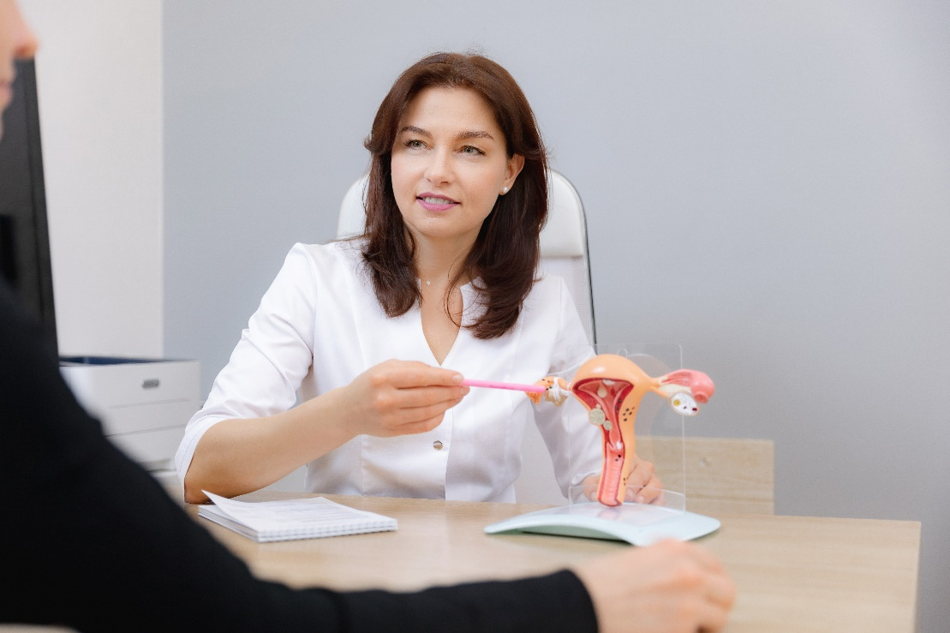
7 Uterine-preserving alternatives
to hysterectomy
Endometrial ablation
Myomectomy
Hysteroscopic resection
Uterine artery embolisation
Notes:
Background notes
Quality statement 7 – Uterine preserving alternatives to hysterectomy: A woman who has heavy menstrual bleeding of benign causes and who is considering non‑medical management is offered uterine‑preserving procedures that may be suitable (such as endometrial ablation, uterine artery embolisation or surgical removal of local pathology). She is supported to make an informed decision and is referred appropriately.
Endometrial ablation is a minimally invasive surgical procedure for women without substantive structural uterine pathology, and who have no desire for future pregnancy. It involves the removal or destruction of the endometrium including the basal layer using one of a variety of techniques including resection and/or ablation, laser, bipolar radiofrequency or thermal balloon ablation. Effective contraception is essential following endometrial ablation.
Myomectomy – the surgical removal of uterine fibroids using laparotomy, laparoscopy, or hysteroscopy. Myomectomy preserves the uterus and is an option for women who wish to retain their fertility.
Hysteroscopic resection of intracavitary pathology (such as polyps or myomas) where these are considered to be causing or contributing to heavy menstrual bleeding. The hysteroscope is passed into the uterine cavity through the vagina and pathology can be removed using electrosurgical or mechanical cutting devices.
Uterine artery embolisation (UAE) which is a minimally invasive radiological procedure treatment option for women with fibroids. The procedure is performed by an interventional radiologist. It involves a small incision in the groin or wrist through which a catheter is taken to the uterine arteries. Embolisation is performed by injecting particles to the arteries supplying the fibroids.
One thing to be aware of is the woman’s desire for fertility, and the evidence is still emerging here. At the moment we know that pregnancy may be possible after UAE. However, in women who desire future pregnancy, where clinically indicated, myomectomy may be preferred.
Women considering UAE should be referred to an interventional radiologist to discuss this option in more detail. If they are desiring fertility they will be counselled based on the available evidence regarding future pregnancy and potential risks.

Slide 20
8 Hysterectomy
Consider less invasive options first where appropriate
Ensure understanding of benefits, risks and consequences
Notes:
Background notes
Quality statement 8 – Hysterectomy: Hysterectomy for management of heavy menstrual bleeding is considered when other treatment options are ineffective or are unsuitable, or at the woman’s request. A woman considering a hysterectomy is fully informed about the potential benefits and risks of the procedure before making a decision.
Quality statement 8 reinforces the importance of:
Ensuring that whenever appropriate, women have been offered less invasive alternatives prior to considering hysterectomy.
Ensuring that women understand the risks, benefits and outcomes of hysterectomy.

Slide 21

Case Study: Sarah
38 years old lives in rural NSW
Seen another GP twice for HMB last 12 months
Advised her menstrual bleeding is ‘normal’
Feels tired
Impacting on relationship and work
What else do we need to know?

Slide 22
Case Study: Sarah
History
Nil other medical problems; nil medications
New relationship last 2 years
LMP 2 weeks ago; using condoms
One child, considering possibility of further pregnancies
Regular cycle with no IMB or PCB
Periods last 8 days with clots ++ and flooding
Associated pain days 1-2 of period
Non smoker
Examination
BMI 31 Kg/m²
Clinical anaemia
Speculum: normal cervix
Bimanual: anteverted uterus
What investigations and initial management would you recommend?

Slide 23

Case Study: Sarah
Investigations and initial management
FBC and Ferritin
TVUS day 5-10 of the cycle
Initiated on tranexamic acid

Slide 24

Case Study: Sarah
FBC and Ferritin – Hb 124 (115-165), Ferritin 12 (>30)
  Initiated on oral iron supplementation
TVUS – no abnormalities found
Used tranexamic acid with some improvement
Interested in exploring other options
What management options would
you discuss with Sarah?

Slide 25

Case Study: Sarah
Information provided on range of pharmaceutical options
  Tranexamic acid and/or NSAIDs and/or COCs
  Cyclic norethisterone or injected long acting progestogens
  52 mg LNG-IUD
Tried pill in the past but felt moody on it
Decides on 52mg LNG-IUD
Referred to experienced inserter in practice
Advised to return for review in 6 weeks

Slide 26

Case study: Sabha
History
42 years old
G3P3 children aged 13, 10, 8, no further planned
Married; uses withdrawal method for contraception
Worsening HMB for 2 years with clots and flooding
Unable to go outside house on first few days
30 day cycle; periods lasting 6-7 days
No IMB or PCB
Examination
Unremarkable
Investigations and initial management
FBC and Ferritin
TVUS
Initiated on NSAID

Slide 27
Case study: Sabha
Investigations
FBC and Ferritin – Hb 115, Ferritin 11
TVUS - three small intramural fibroids (range 10-20mm)
Sabha is requesting a hysterectomy as she does not like the idea of being on hormones.
Should we do anything whilst Sabha waits to see the specialist?

Slide 28
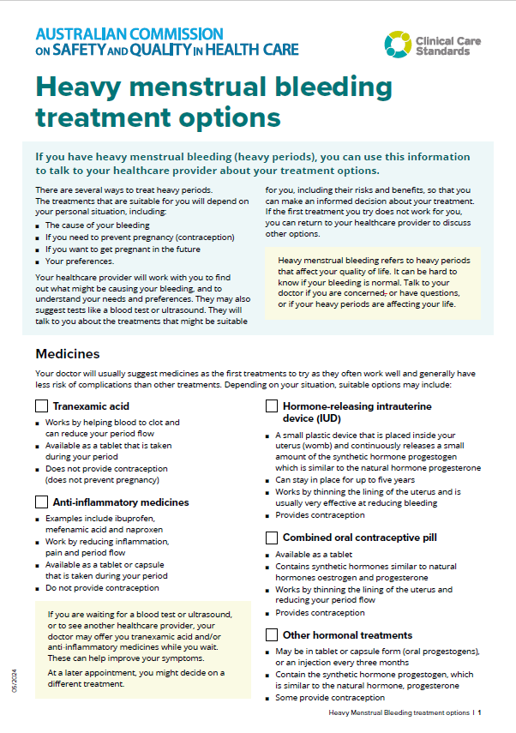
Case study: Sabha
Sabha is referred to a gynaecologist
Support for informed choice and shared decision making
GP provides information about HMB and management options
Specialist consultation
Specialist discusses uterine-preserving alternatives to hysterectomy
Sabha is interested in endometrial ablation

Slide 29

Case study: Suzanne
History
Age 46 years
G1P0 Tubal ligation aged 35 (no children desired)
No current partner
26 day cycle with up to
10 days of heavy bleeding
Symptoms of pelvic ‘pressure’ including urinary frequency
Examination
BMI 25kg/m²
Clinically mildly anaemic
Bulky uterus (12 week size) with mild tenderness
Investigations and initial management
FBC and Ferritin
TVUS days 5-10
Tranexamic acid initiated while waiting for US

Slide 30
Case study: Suzanne
Investigations
Hb 108, Ferritin 7 (18-160 ng/mL)
TVUS shows multiple fibroids
  Very large submucous fibroid (11cm)
  Fundal subserous fibroids ++
Suzanne is referred to a gynaecologist
What options will the specialist discuss with Suzanne?

Slide 31
Case study: Suzanne
Specialist discussion
Uterine artery embolisation
Myomectomy
Hysterectomy

Slide 32
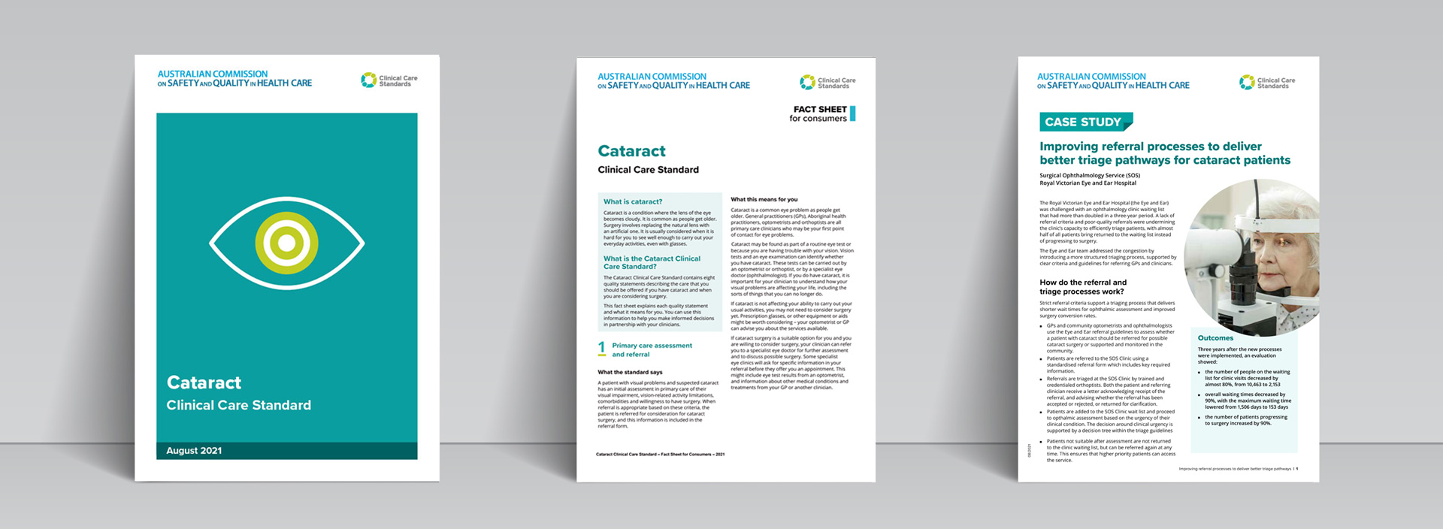
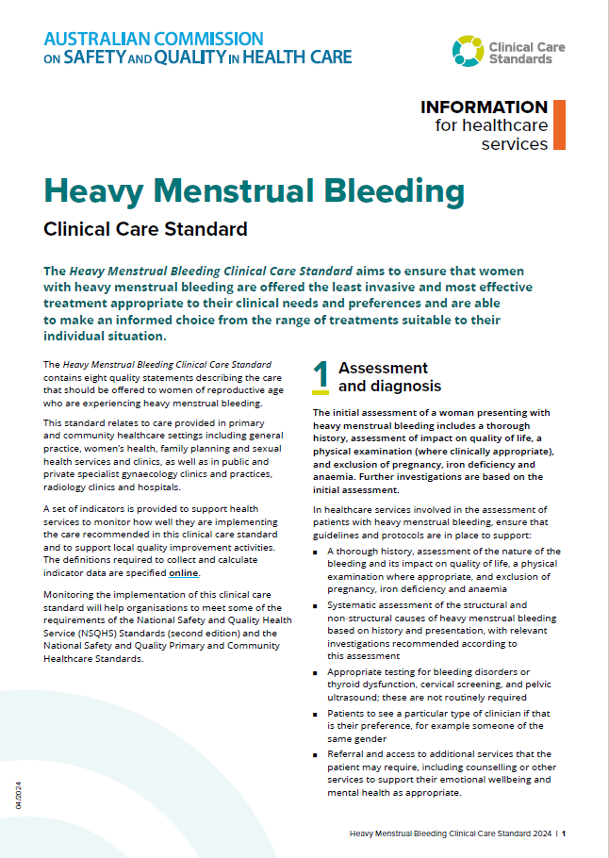
CLINICAL CARE STANDARD
FACTSHEETS
CONSUMER INFORMATION
Notes:
On the Commission’s website you will find more information on the Heavy Menstrual Bleeding Clinical Care Standard, indicators to support local implementation and monitoring, and resources for consumers, clinicians and healthcare services.

Slide 33
Key messages
HMB is significantly impacting many women’s quality of life, and many are not receiving timely, appropriate treatment
Quality care involves thorough assessment, physical examination and appropriate investigations
Offer tranexamic acid and/or NSAIDs, as appropriate, from first presentation to manage symptoms and limit further impact
Consider less invasive treatment options before hysterectomy when clinically appropriate
See the Heavy Menstrual Bleeding Clinical Care Standard and related resources for more information

Slide 34

safetyandquality.gov.au/hmb-ccs

