Slide 1
Replace with site logo
End-of-life Care Audit and Clinician Surveys
Presenter’s name
Presenter’s title

Slide 2

National Consensus Statement
Purpose: to describe essential elements for delivering safe and high-quality end-of-life care
Based on principles of patient-centred, goal directed care
Process:
- expert roundtable- clinicians, consumers, managers, policymakers
- broad consultation- written submissions, online survey, face-to-face workshops nationally
- review of literature and international, national and jurisdictional approaches

Slide 3
National Consensus Statement
Scope:
- adults who are likely to die within the next 12 months
- settings where acute care is provided
- aligns with Palliative Care Australia standards, but may not apply in specialist palliative care
Audience:
- clinicians
- managers and executives
- education and training providers
- registration, regulation and accreditation agencies
- planners, program managers and policy- makers
Emphasis on death and dying being human experiences:
- compassion
- relief and prevention of suffering
- choice

Slide 4
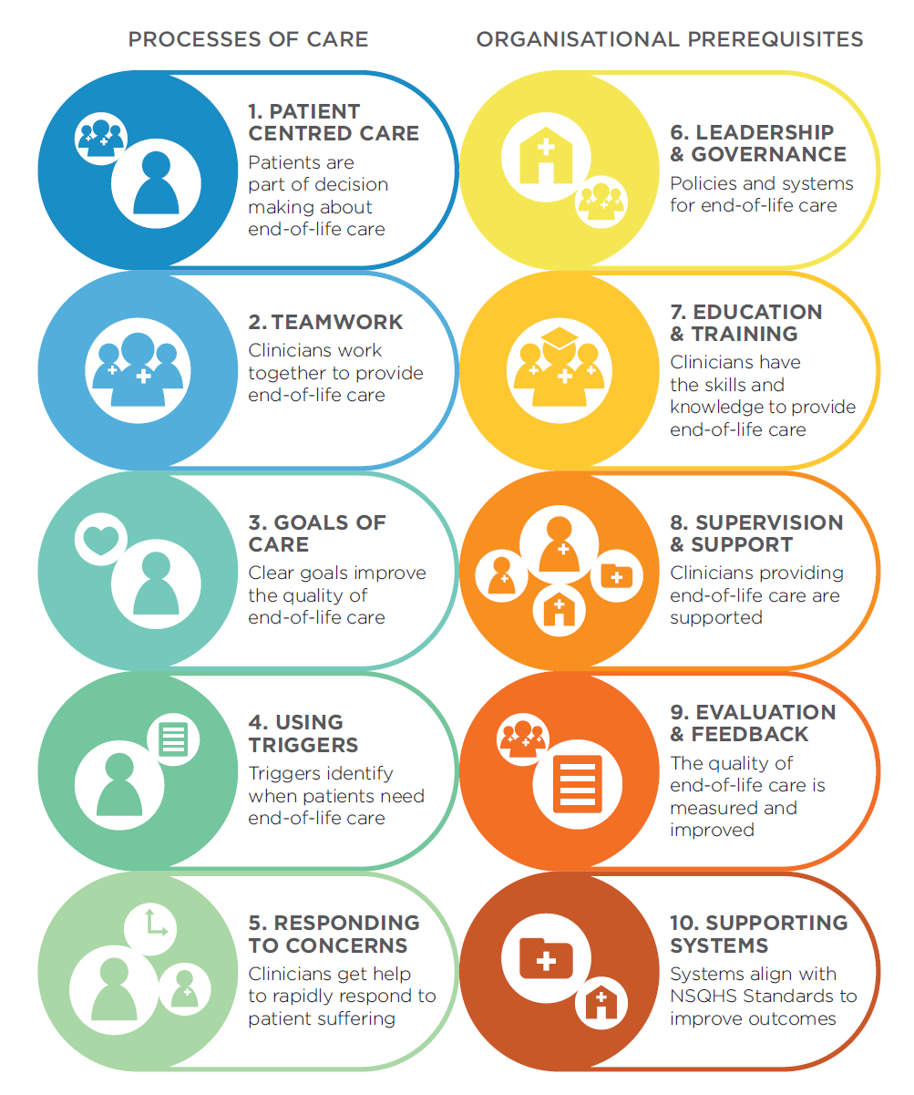
Notes:
There are ten essential elements.
The first five relate to the way in which end-of-life care should be approached and delivered.
The second five elements relate to the structural and organisational prerequisites that are essential to the effective delivery of safe and high-quality end-of-life care.
The elements describe the essential features of systems for recognising and responding to patients who are approaching the end of life but they do not prescribe how care should be delivered.
Health services need to have systems in place to address all elements in the Consensus Statement; however the application of the elements will vary according to the local circumstances, the available resources, and the individual needs of the patient receiving care.
Within each element there is a brief introductory statement followed by a list of actions that describe the necessary processes and systems to effectively address that element.

Slide 5
The Audit Tool
Data collected:
- demographics, admission date, admission source, medical/surgical unit
- diagnosis, co-morbidities, date and place of death, evidence of advance care and resuscitation plans
- documented recognition of dying
- implementation of palliative and comfort care

Slide 6
The Clinician Survey
The clinician survey allows sites to gain insight into clinicians perceptions of the end-of-life care provided. Perceptions can be compared across the four staff groups surveyed; Consultants, Junior doctors, Nurses and Allied health, and with the data obtained from the audit tool.
‘End-of-life care is done well on my ward’
‘I am confident in my ability to recognise when a patient is dying’
‘Dying patients on my ward receive timely withdrawal of acute treatment’

Slide 7
Timelines
Sites should outline the timelines for the audits and clinician survey to be completed and any obligations for staff.

Slide 8
How will the results be reported?
Sites should outline analysis methods and how staff can find out the outcomes of the audit and clinician surveys.

Slide 9
Name
Phone
Email
Insert site logo

