Slide 1
Sustainability and Infection Prevention and Control
Infection Prevention and Control week 2023

Slide 2

Acknowledgement of Country
I would like to acknowledge the Traditional Owners and Custodians of the lands on which we meet today and pay my respects to Elders past, present and emerging.
I would like to extend that acknowledgement and respect to any Aboriginal and Torres Strait Islander peoples here today.
The artwork was designed for the Commission ‘s Reconciliation Action Plan by Kylie Hill, a proud Kalkadoon and Waanyi woman from Mount Isa in far North Queensland.

Slide 3
Introduction
What is climate change?
Climate change is caused by greenhouse gases released from fossil fuels becoming trapped in the Earth’s atmosphere. This is causing Earth’s average temperate to rise
The effects of climate change are already harming human health, both globally and in Australia and making us less resilient to diseases
These effects can be seen by extreme weather events, an increase in vector-borne diseases and changes to natural eco-systems that threatens the quality of food and fresh water

Slide 4
Sustainability and healthcare
What do health service organisation’s (HSO) have to do with climate change?
The healthcare industry has a significant impact on the environment, with worldwide healthcare being responsible for an estimated 4.4% of global net emissions
Australia’s healthcare carbon footprint is attributed to approximately 7% of the nation’s total emissions, with hospitals and the pharmaceutical industry being the major contributors

Slide 5
Sustainability and healthcare
HSO’s use immense amounts of resources, particularly in the use of electricity and generate vast amounts of physical waste in delivering care to their patients
A significant proportion of hospital waste is generated from the need for strict infection control including the use of single-use clinical equipment, energy intensive reprocessing methods, disposable linen, excessive packaging for medical items and materials contaminated by patient fluids or contact

Slide 6
Improving sustainable practices
Improving the environmental sustainability of HSO’s is an opportunity to improve the safety and quality of care, reduce low-value care, eliminate unwarranted variation in care, and reduce healthcare waste
Action 3.03g (Applying quality improvement systems) of the NSQHS Preventing and Controlling Infections Standard requires HSO’s to apply quality improvement systems that support and monitor the safe and sustainable use of IPC resources

Slide 7
Using the 5 Rs to guide to good practice
The fundamental principles of decreasing waste in health services are the same as those used at home; reduce, reuse, and recycle
The addition of 2 extra Rs — rethink and research can improve the applicability of this approach to clinical practice
Reduce
Reuse
Recycle
Rethink
Research
‘The 5 Rs’ approach reflects five sustainable themes which encapsulate a variety of practices aimed to help lower the carbon footprint of HSO’s
The 5 R’s can be demonstrated through reducing the volume of waste, improving waste segregation, reusing certain items, recycling, rethinking outdated practices and low value care and dedicating time to research

Slide 8
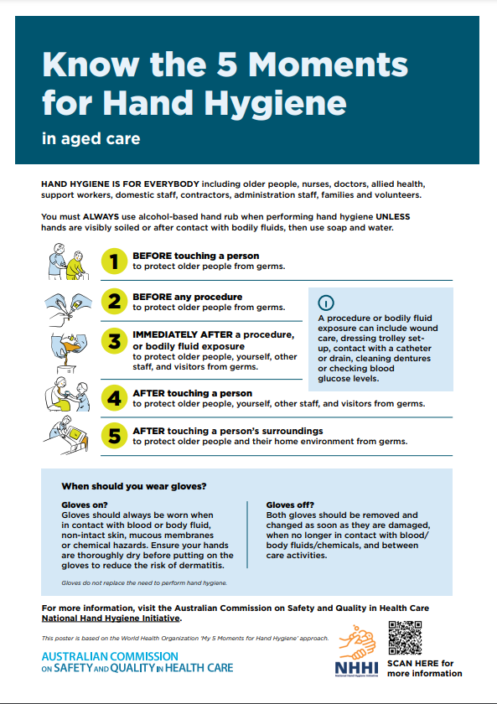
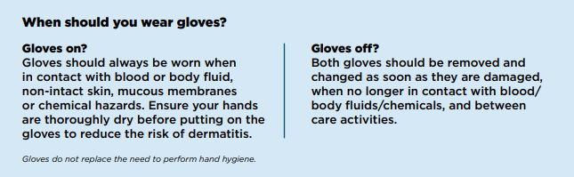
Back to the fundamentals
To effectively mitigate and adapt to delivering sustainable healthcare, HSO’s need to plan for foreseeable climatic events and focus on correctly implementing and educating staff on the fundamental principles of IPC
Educating staff about the basics of hand hygiene and appropriate glove use are simple, practical ways that a fundamental principle of IPC can be used to support sustainable healthcare

Slide 9
More resources to come
The Commission is in the process of developing a suite of infection prevention and control resources to support HSO’s become more sustainable.
These resources will focus on operating theatres, sustainable procurement, use and disposal of personal protective equipment, indwelling devices, sustainable water use and chemical management in reprocessing
In meantime, you can also review ‘A review on sustainable healthcare’ to better understand the potential safety and quality implications and solutions facing HSO’s related to climate change

Slide 10
References
Slide | Reference
3 | Talley NJ, Stanley FJ, Lucas T, & Horton RC. Health and climate change MJA–Lancet Countdown report: Australia gets another failing grade in 2020 but shows signs of progress’, The Lancet, 2020. Climate change and health. World Health Organization.2021. Available at: https://www.who.int/health-topics/climate-change#tab=tab_ The causes of climate change. NASA. 2023. Available at: https://climate.nasa.gov/causes/
4 | Wyssusek KH, Keys MT and van Zundert AA. Operating room greening initiatives – the old, the new, and the way forward: A narrative review, Waste Management Research, 2018 Malik A, Lenzen M, McAlister S & McGain F. The carbon footprint of Australian Health Care, The Lancet Planetary Health, 2018. Pencheon D & Wight J. Making Healthcare and Health Systems Net zero. BMJ. 2020.
5 | Malik A, Lenzen M, McAlister S & McGain F. The carbon footprint of Australian Health Care, The Lancet Planetary Health, 2018. Australian Medical Association. Environmental Sustainability in Health Care – 2019. 2019. Hu H, Cohen G, Sharma B, Yin, H, & McConnell, R. Sustainability in Health Care. Annual Review of Environment and Resources. 2022.
6 | National Safety and Quality Health Service Standards, Action 3.03: Applying quality improvement systems, Australian Commission on Safety and Quality in Healthcare, 2021.
7 | Kagoma Y, Stall N, Rubinstein E, & Naudie D. People, planet and profits: the case for greening operating rooms, Canadian Medical Association Journal, 2012. Lattanzio S, Stefanizzi P, D’ambrosio M, Cuscianna E, Riformato G, Migliore G, Tafuri S, & Bianchi FP. Waste management and the perspective of a Green Hospital—a systematic narrative review. International Journal of Environmental Research and Public Health. 2022.
8 | The 5 Moments for Hand Hygiene in aged care - fact sheet, Australian Commission on Safety and Quality in Healthcare, 2023.
9 | Wyns A*, Bragge P*, Armstrong F, Carino, S, Dolker D, Lennox A, Tsering D. A review of sustainable healthcare policy, practice, and research with a focus on safety and quality. Sydney: ACSQHC; 2022

