Slide 1
World AMR Awareness Week
Insert your organisation’s name here
safetyandquality.gov.au
Notes:
This presentation has been prepared by the Australian Commission on Safety and Quality in Health Care for use during World AMR Awareness Week.
The content within this presentation can be modified, expanded on, points or slides deleted to tailor it to clinical audiences where antimicrobials are prescribed and used. This presentation can also be modified for use in aged care, primary care or any other health care setting where antimicrobials are also prescribed and used.
Disclaimer
safetyandquality.gov.au
© Australian Commission on
Safety and­­ ­Quality in Health Care 2025

Slide 2

Acknowledgement of Country
I would like to pay respect to the Traditional Owners and Custodians of Country where we meet today. We extend that respect to all Aboriginal and Torres Strait Islander peoples, and their deep time connections to land, water and sky.
We recognise that knowledge about healthy Country, community and culture has been developed by Aboriginal and Torres Strait Islander peoples over tens of thousands of years and has been shared for generations. We are committed to partnering with and learning from Aboriginal and Torres Strait Islander peoples through the work that we do.

Slide 3
Overview
Antimicrobial resistance (AMR) and its significance
Addressing antimicrobial resistance in Australia
Antimicrobial use and resistance data
Local data
Antimicrobial stewardship (AMS)
World AMR Awareness Week (WAAW)

Slide 4
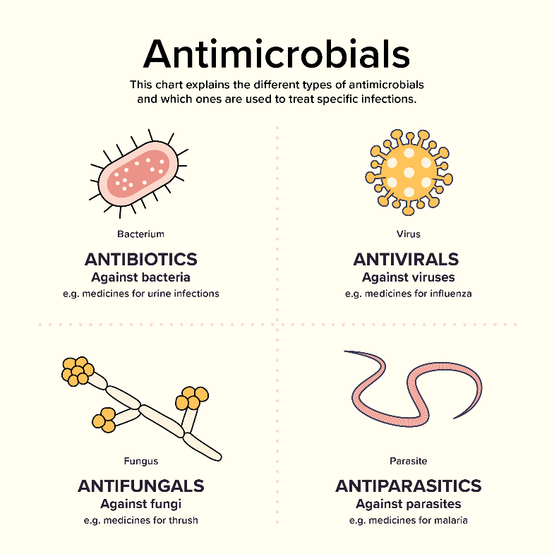
What are antimicrobials?
Antimicrobials are medicines which treat infections
Includes antibiotics, antivirals, antifungals, antiparasitics
Different types of antimicrobials are active against different types of microorganism
Life-saving medicines
Notes:
Antimicrobials are drugs that inhibit or destroy bacterial, viruses, parasites or fungi
Antimicrobials can be classed into four categories
Antibacterials (antibiotics)
Antifungals
Antivirals
Antiparasitics.
Antibiotics are medicines which treat infections caused by bacteria. It is important to know that antibiotics do not work on infections caused by viruses
References:
https://www.safetyandquality.gov.au/publications-and-resources/resource-library/what-are-antimicrobials-graphic

Slide 5
What is antimicrobial resistance (AMR)
Antimicrobial resistance occurs when bacteria, viruses, fungi or parasites change to protect themselves from the effects of antimicrobial drugs designed to destroy them
This means previously effective antimicrobial medicines (e.g. antibiotics) used to treat or prevent infections may no longer work
The World Health Organization (WHO) has identified AMR as ‘one of the biggest threats to global health’
Notes:
Antimicrobial resistance is one of the most significant challenges for the provision of safe, high-quality health services across the world and threatens our ability to treat common infections and perform life-saving procedures including cancer chemotherapy and surgeries
The World Health Organization has declared it as one of the top global public health and development threats

Slide 6
How has AMR developed?
AMR is a natural phenomenon accelerated by overuse and inappropriate use of antibiotics
Through the delivery of increasingly complex health care, often accompanied by extended durations of antibiotics
The potential impact of surgery undertaken overseas where AMR may be more prevalent
Resistant pathogens are spreading:
  during hospitalisation, impacted by infection, prevention, and control practices and antimicrobial use
  with increased overseas travel
Notes:
Antimicrobial resistance occurs when bacteria, viruses, fungi and parasites develop resistance to an antimicrobial that was previously an effective treatment
They develop natural defences against antibiotics and the antibiotic’s effectiveness to treat an infection decreases, reaching to a point where the antibiotic has no benefit at all
Antimicrobial resistance occurs naturally through genetic changes in pathogens, but is accelerated by misuse and overuse of antimicrobials
New challenges in infection control resulting from more complex health care (for example, outpatient chemotherapy) and increasing domestic and international travel have increased the spread of resistant bacteria both between individuals and between countries.
When patients have longer hospital stays, this may increase the chance of patients acquiring resistant organisms from other patients.

Slide 7
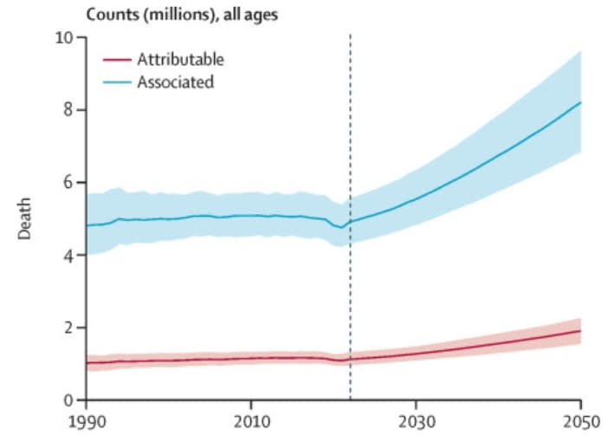
Significance of AMR
Global impact of AMR in 2021:
1.14 million deaths attributed to bacterial AMR infections
4.71 million deaths associated with bacterial AMR infections
Global forecast for 2050:
1.91 million deaths attributable to AMR
8.22 million deaths associated with AMR
Figure 1. Count of global attributable and associated AMR burden
Source: Global burden of bacterial antimicrobial resistance 1990–2021: a systematic analysis with forecasts to 2050
Notes:
The Lancet recently published the ‘Global burden of bacterial antimicrobial resistance 1990-2021: a systematic analysis with forecasts to 2050’
The study estimated, that in 2021, there were 1.14 million deaths attributable to bacterial AMR and 4.71 million associated with bacterial AMR
It is predicted that by 2050, there will be 1.91 million deaths attributable to AMR and 8.22 million deaths associated with AMR could occur globally each year
Regions with the highest all-age AMR mortality forecasted in 2050 are south Asia, Latin America and the Caribbean
The figure shows the number of deaths attributable and associated with AMR. The shading around the lines represents the 95% uncertainty interval and the vertical line is placed at 2021 to distinguish estimates from forecasts
References:
https://www.thelancet.com/journals/lancet/article/PIIS0140-6736(24)01867-1/fulltext

Slide 8
Impact of AMR
Longer hospital stays
Longer recovery times
Recurring infections
Treatment failures
Higher risk of mortality or long-term complications
Higher cost to the health care system
Increase risk of other medical procedures and treatments
Notes:
Antimicrobial resistance has direct effects on patient care and creates a set of critical ongoing challenges to health service delivery
AMR infections are difficult to treat; this can mean longer hospital stays and longer recovery times
Sometimes, they are even impossible to treat, severe infections caused by bacteria that do not respond to available ‘last-line’ antimicrobials (including antibiotics) can result in septicaemia and death
Antimicrobial resistance places a significant burden on patients, health service organisations and the health system. This burden can lead to productivity losses, increased health care costs and a rise in poverty

Slide 9
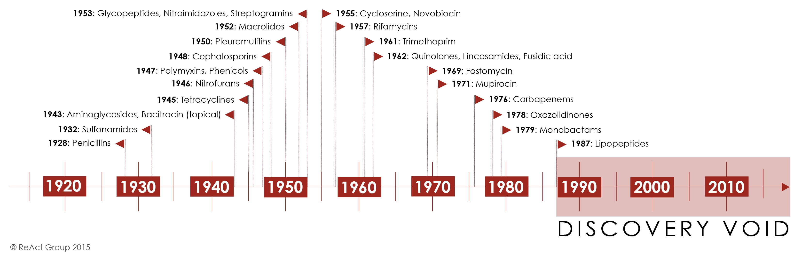
The antibiotic pipeline is drying up
Notes:
So why can’t new antibiotics be developed to tackle resistance? Well, they can but there are reasons why this is a very slow and complex process
Many pharmaceutical companies have stopped developing antibiotics over the last 20 years, resulting in very few new antibiotics being developed and released onto the market
Antibiotics are extremely expensive and resource-intensive to develop
The World Health Organization reviewed the publicly available information on the current clinical development pipeline of antimicrobial agents. Their review showed the current clinical pipeline is still insufficient to mitigate the threat of antimicrobial resistance (particularly Gram-negative bacteria and TB). And most agents in the pipeline are modifications of existing antibiotic classes – therefore they are only short-term solutions as they usually cannot overcome multiple existing resistance mechanisms.
In 2011, there were only 27 new antibiotics in clinical development against priority pathogens, down from 31 products in 2017. Although the number of antibacterial agents in the clinical pipeline increased from 80 in 2021 to 97 in 2023, there is a pressing need for new, innovative agents for serious infections and to replace those becoming ineffective due to widespread use
References:
https://www.who.int/news/item/22-06-2022-22-06-2022-lack-of-innovation-set-to-undermine-antibiotic-performance-and-health-gains
https://www.reactgroup.org/toolbox/understand/how-did-we-end-up-here/few-antibiotics-under-development/
https://www.who.int/news/item/14-06-2024-who-releases-report-on-state-of-development-of-antibacterials#:~:text=Although%20the%20number%20of%20antibacterial,ineffective%20due%20to%20widespread%20use.

Slide 10
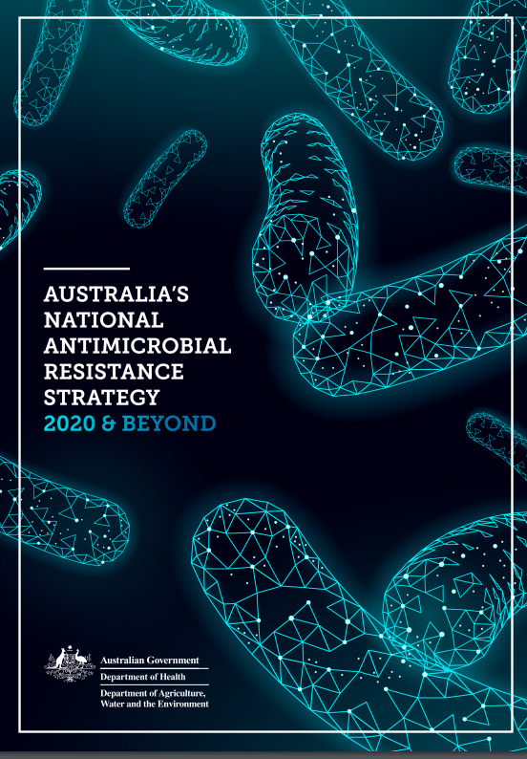
Australia’s response to AMR
Australia’s National Antimicrobial Resistance Strategy was released in 2020
It sets a 20-year vision to protect the health of humans, animals and environment by minimising the spread of AMR
The four pillar objectives include:
  Prevention and control of infection and the spread of resistance
  Greater engagement in the combat against resistance
  Appropriate usage and stewardship practices
  Integrated surveillance and response to resistance and usage
Notes:
The Australian Government released the National Antimicrobial Resistance Strategy in 2020 which sets a 20-year vision to reduce the emergence and spread of AMR. The strategy sets out key objectives and priority areas for action.
References:
https://www.amr.gov.au/resources/australias-national-antimicrobial-resistance-strategy-2020-and-beyond

Slide 11
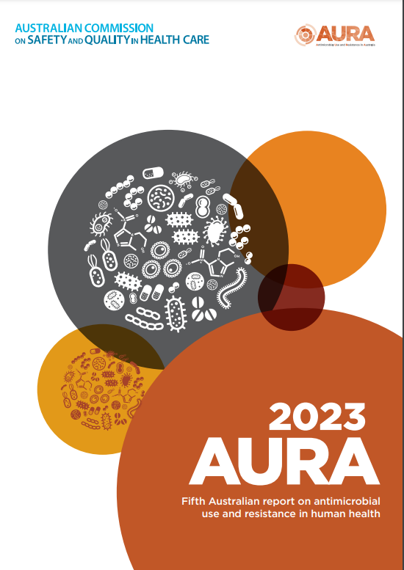
Antimicrobial Use and Resistance in Australia (AURA)
Established by the Commission in 2013–14 with funding provided by the Department of Health, Disability and Ageing
Supports Australia’s efforts to prevent and contain AMR in human health and informs strategies and priorities for antimicrobial stewardship
Coordinates and reports on:
    Australian Passive AMR Surveillance (APAS)
    National Alert System for Critical Antimicrobial Resistances (CARAlert)
  Also reports on community antimicrobial use
  Developed the first five reports in the series of national AURA reports
    Most recently AURA 2023
Notes:
The Antimicrobial Use and Resistance in Australia surveillance program was established by the Commission in 2013-14, with funding provided by the Department of Health, Disability and Ageing. The AURA surveillance program supports the implementation of Australia’s National AMR Strategy – 2020 and Beyond
The AURA project coordinates and reports on elements of the AURA surveillance program. They reports provide comprehensive data and analyses on patterns and trends in antimicrobial use and appropriateness and AMR in Australian acute and community healthcare settings. The reports can be used by policy makers, health service organisations and clinicians to review trends and identify priorities for patient safety and quality improvement
The components which make up AURA include:
APAS: Australian Passive AMR Surveillance collects data on routine antimicrobial susceptibility testing results which are contributed by public and private pathology services Australia. APAS data provides information on trends in antimicrobial resistances across Australia.
CARAlert: The National Alert System for Critical Antimicrobial Resistances monitors organisms with critical resistance to last-line antimicrobials (CARs) in Australia. Participating laboratories voluntarily submit data when they confirm CARs in isolates that are either specimens taken to guide clinical diagnosis or as a screen for infection prevention and control purposes.
Community antimicrobial use analyses data from the Pharmaceutical Benefits Scheme and Repatriation Pharmaceutical Benefits Scheme and MedicineInsight program and shows volume and patterns of antimicrobial prescribing in the community.
The following slides present a summary of key findings and trends for the latest AURA reports

Slide 12
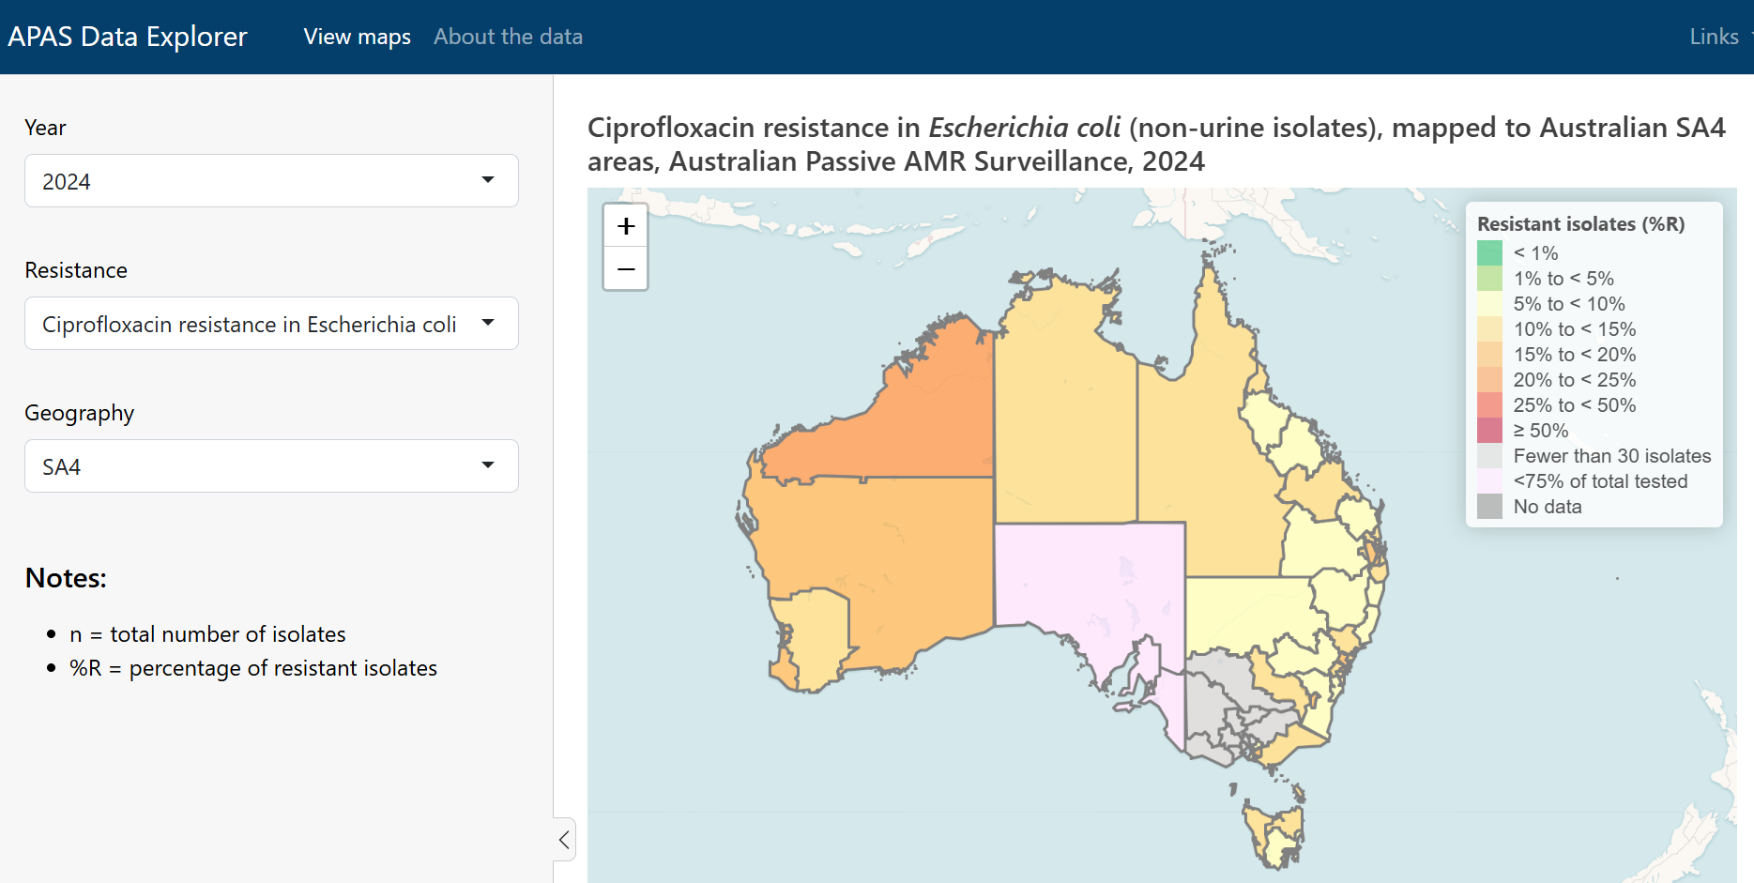
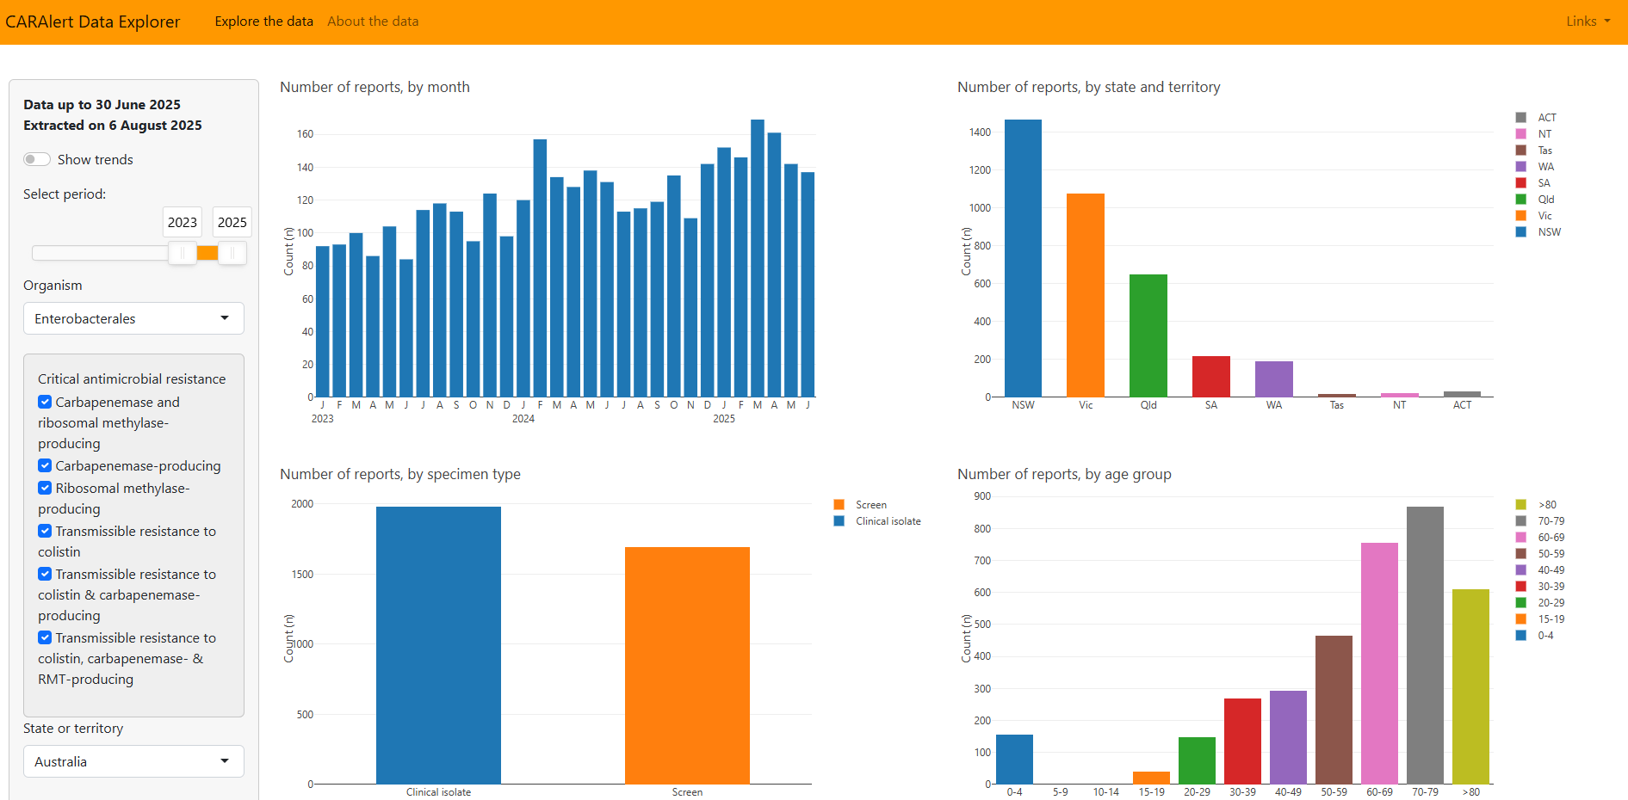
AURA Data Explorers
APAS Data Explorer
shiny.safetyandquality.gov.au
/APASDataExplorer/
CARAlert Data Explorer
shiny.safetyandquality.gov.au
/CARAlertDataExplorer/
Notes:
In 2025, the Commission published two publicly-accessible and interactive dashboards for AURA data.
The APAS Data Explorer provides an interactive way to view the distribution of antimicrobial resistance (AMR) across Australia. The dashboard offers dynamic map-based visualisations data on:
Methicillin resistance in Staphylococcus aureus
Ciprofloxacin resistance in Escherichia coli
Vancomycin resistance in Enterococcus faecium.
The CARAlert Data Explorer is an interactive dashboard that delivers insights into critical antimicrobial resistances (CARs) across Australia. It offers customised analytics and trend tracking and complements CARAlert data updates and annual reports.

Slide 13
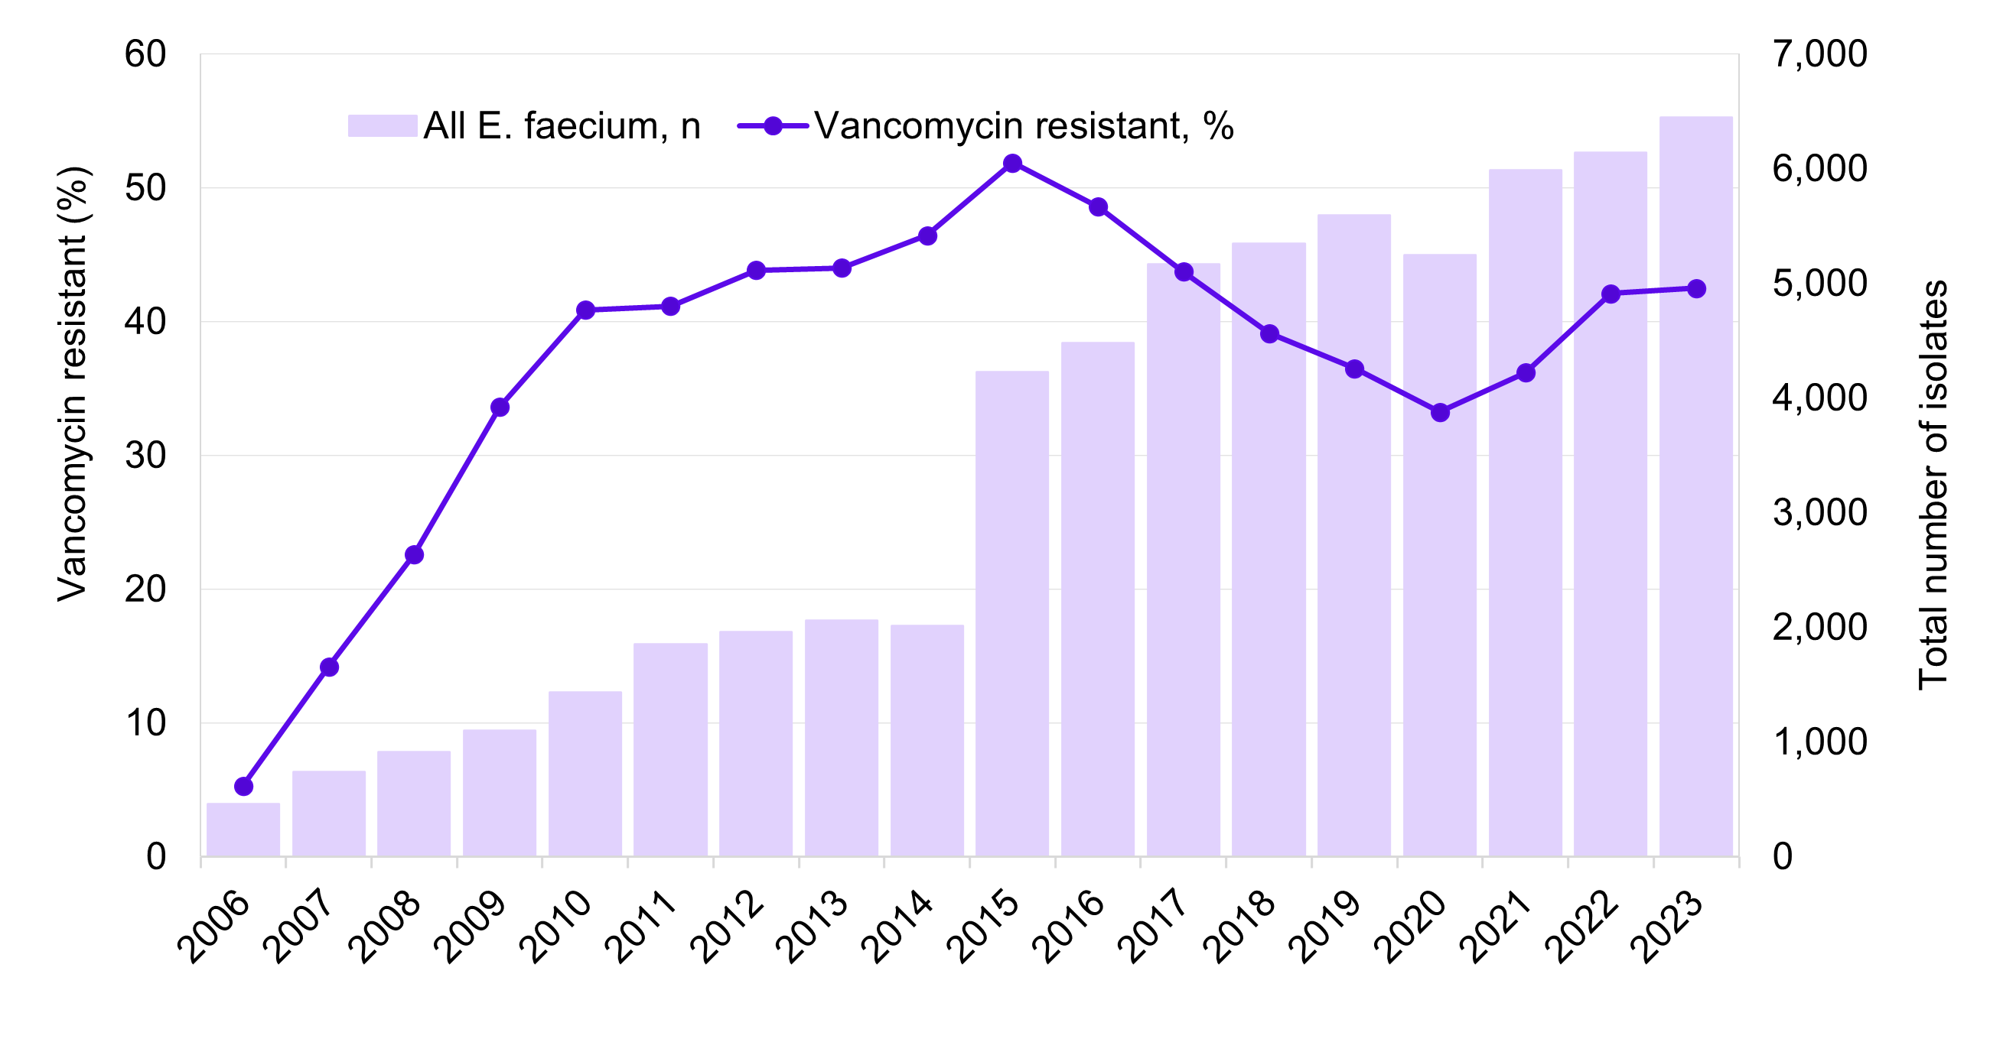
APAS
Figure 2. Percentage of Enterococcus faecium with vancomycin resistance, APAS contributors, 2006–2023
Source: APAS: An update of resistance trends in multidrug-resistant organisms – 2006 to 2023
Notes:
The latest APAS report was published in July 2024 and reports on resistant trends in multidrug-resistant organisms (MROs) from 2006 to 2023
The MROs included in this report include vancomycin resistant Enterococcus faecium (VRE), fluroquinolone resistance in Escherichia coli and methicillin resistance in Staphylococcus aureus (MRSA)
There are high levels of VRE in Australia, particularly in acute healthcare settings
In 2023, 42.5% of E.faecium isolates were vancomycin resistant
As you can see in the graph, the highest level of resistance was reported in 2015, then trended downward until 2020 and rose steeply again in 2022
Resistance has dramatically increased from 5.3% reported in 2006.

Slide 14
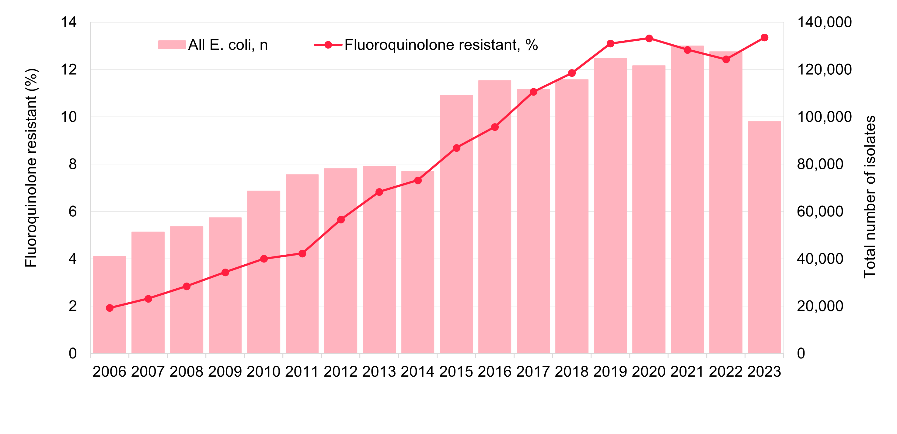
APAS
Figure 3. Percentage of Escherichia coli with fluoroquinolone resistance, APAS contributors, 2006–2023
Source: APAS: An update of resistance trends in multidrug-resistant organisms – 2006 to 2023
Notes:
Fluroquinolone resistance in E.coli has trended up from 1.9% in 2006 up to 13.4% in 2023
In 2023, percentage of resistance was similar in hospitals and in the community (13.4%)
It is concerning that fluroquinolone resistance is trending upward despite restrictions to fluroquinolones in AMS programs in acute care settings and in the community under the Pharmaceutical Benefits Scheme and Repatriation Pharmaceutical Benefits Scheme

Slide 15
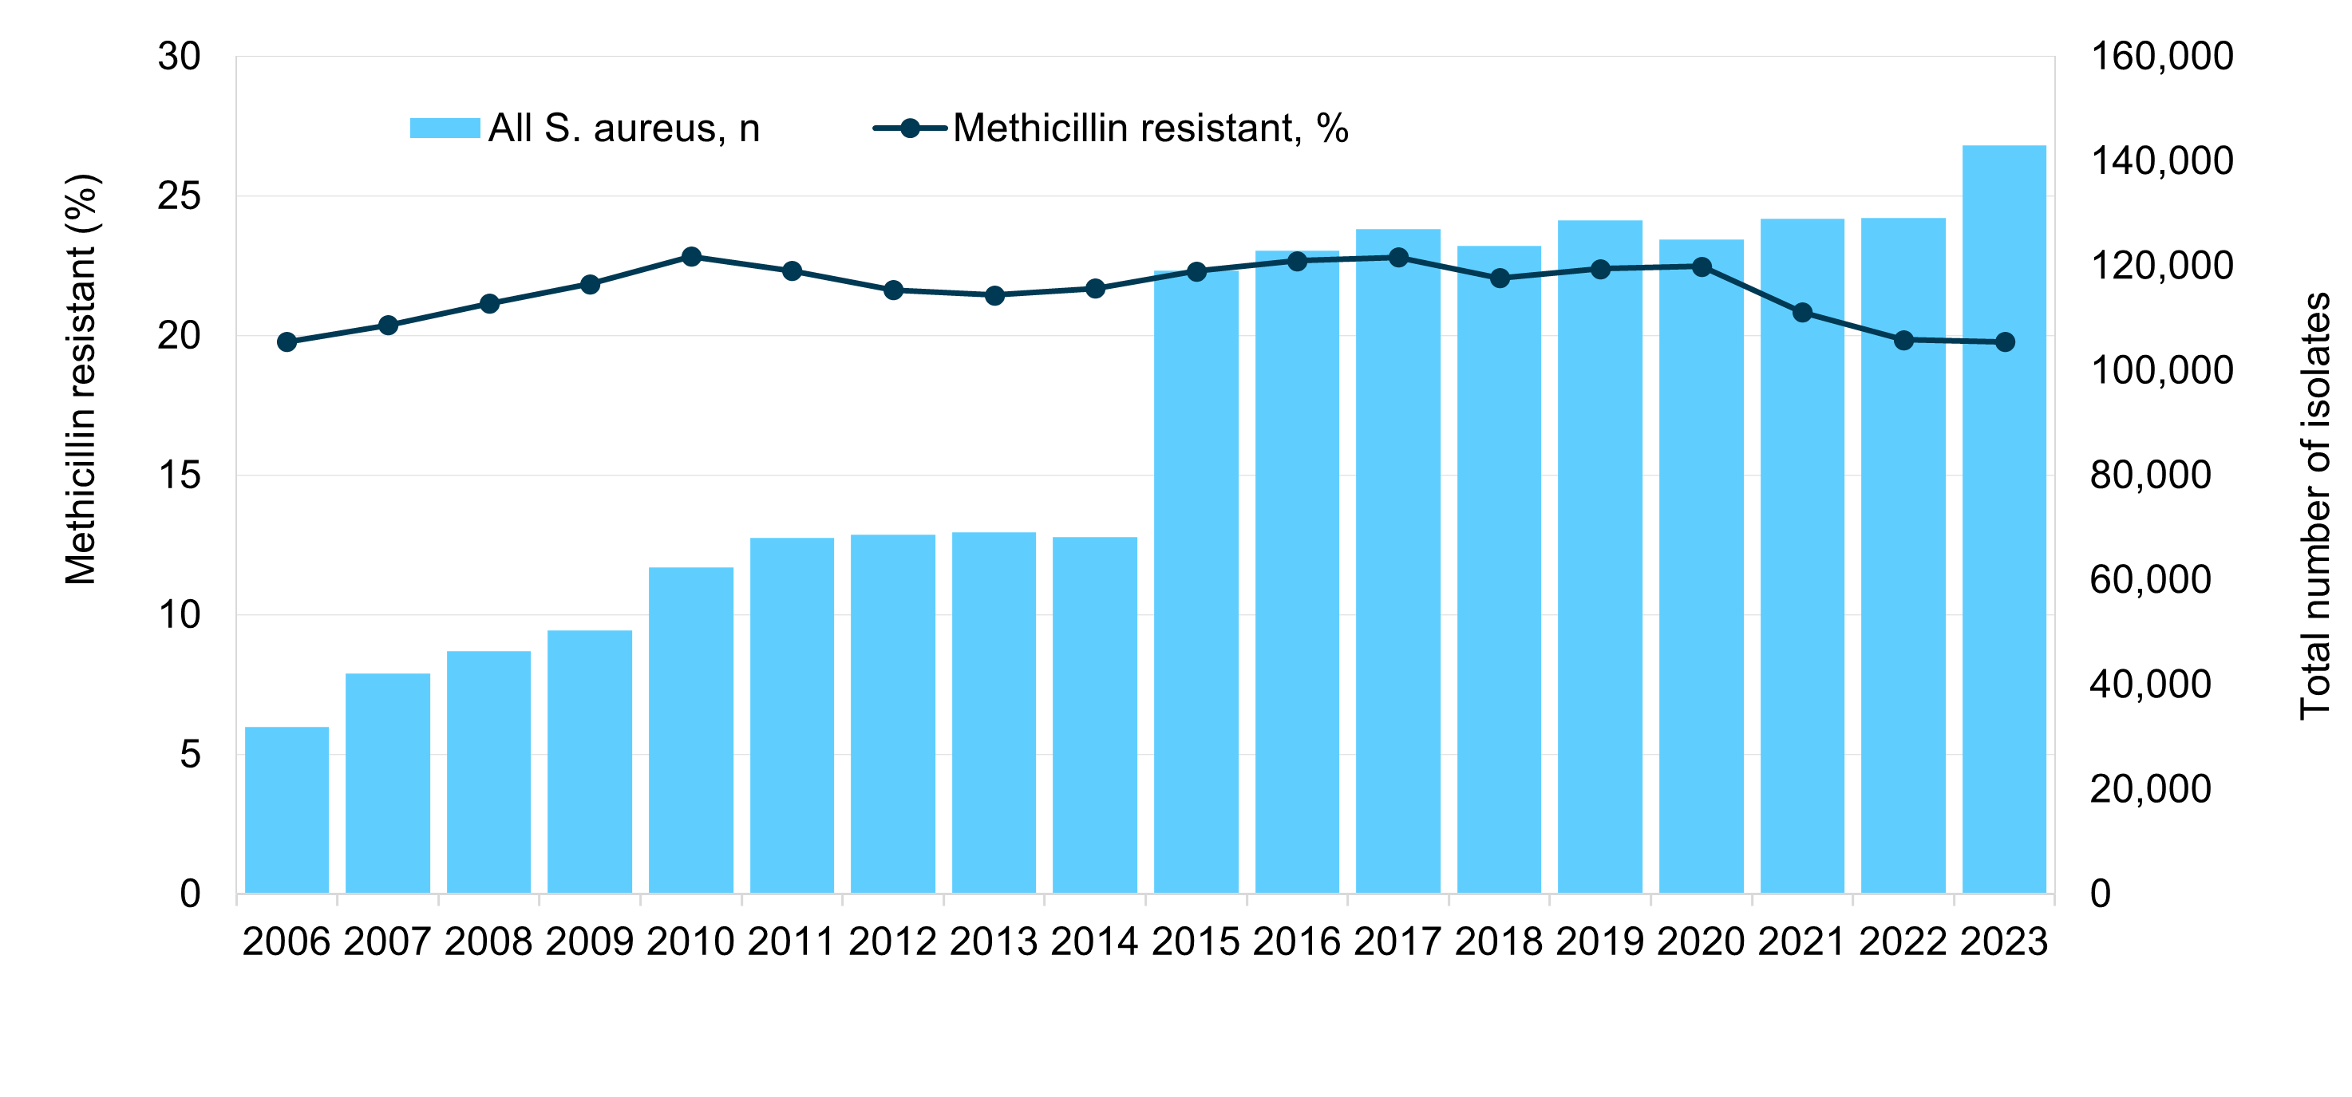
APAS
Figure 4. Percentage of Staphylococcus aureus with methicillin resistance, APAS contributors, 2006–2023
Source: APAS: An update of resistance trends in multidrug-resistant organisms – 2006 to 2023
Notes:
MRSA remains common across Australia in community and in hospitals
As this graph shows, the rate of methicillin resistance in Staphylococcus aureus remained relatively steady from 2006 to 2023
MRSA rates have down trended in aged care homes from 2016 (35.0%) to 2023 (21.9%), but still are more prevalent in aged care homes than in hospitals and the community, despite a comparatively small number of isolates

Slide 16
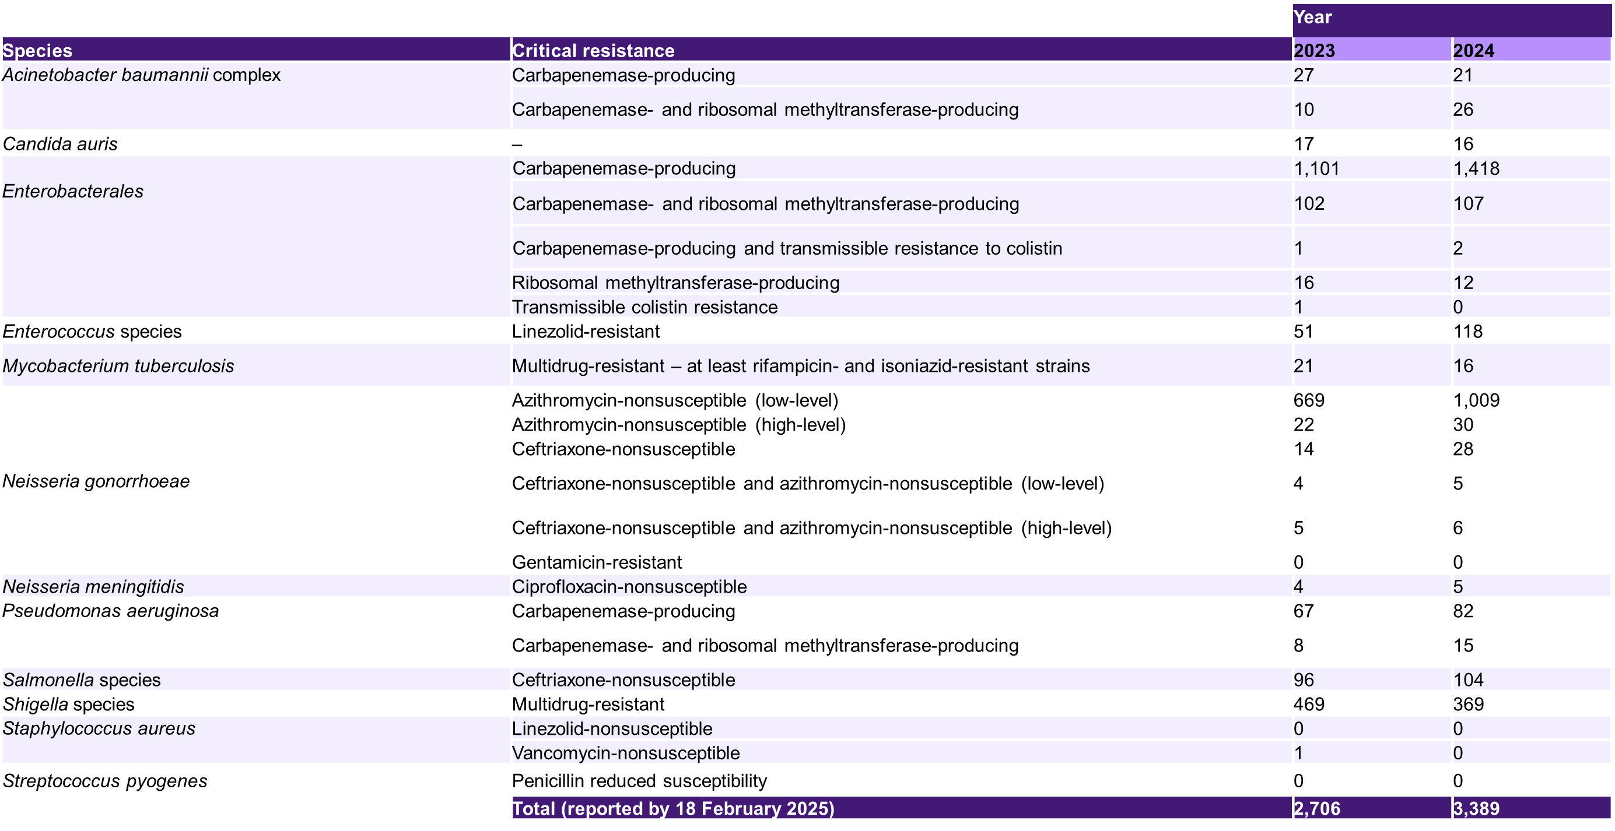
CARAlert
Table 1. Number of critical antimicrobial resistances reported to CARAlert, 2023–24
Source: CARAlert annual report, 2024
Notes:
The latest report on CARAlert was published in April 2025
The report provides analyses of data on confirmed critical antimicrobial resistances (CAR) for 2024, and trend data between 2017 and 2024
The table shows the species with critical resistances and the number of those reported
There was a 25.1% increase in critical antimicrobial resistances reported in 2024 compared to 2023
Where the setting was known, just over one-half of CARs were detected in either hospitalised patients or hospital outpatients. Smaller proportions were isolated in the community and aged care homes
As you can see Enterobacterales, specifically Carbapenemase-producing Enterobacterales (CPE) was the most frequently reported CAR in 2024; with just over two-thirds of all reports from hospitals
the next two slides will show trends in CPE resistance
High-level = azithromycin MIC≥ 256 mg/L; Low-level = azithromycin MIC < 256mg/L; MIC = minimum inhibitory concentration

Slide 17
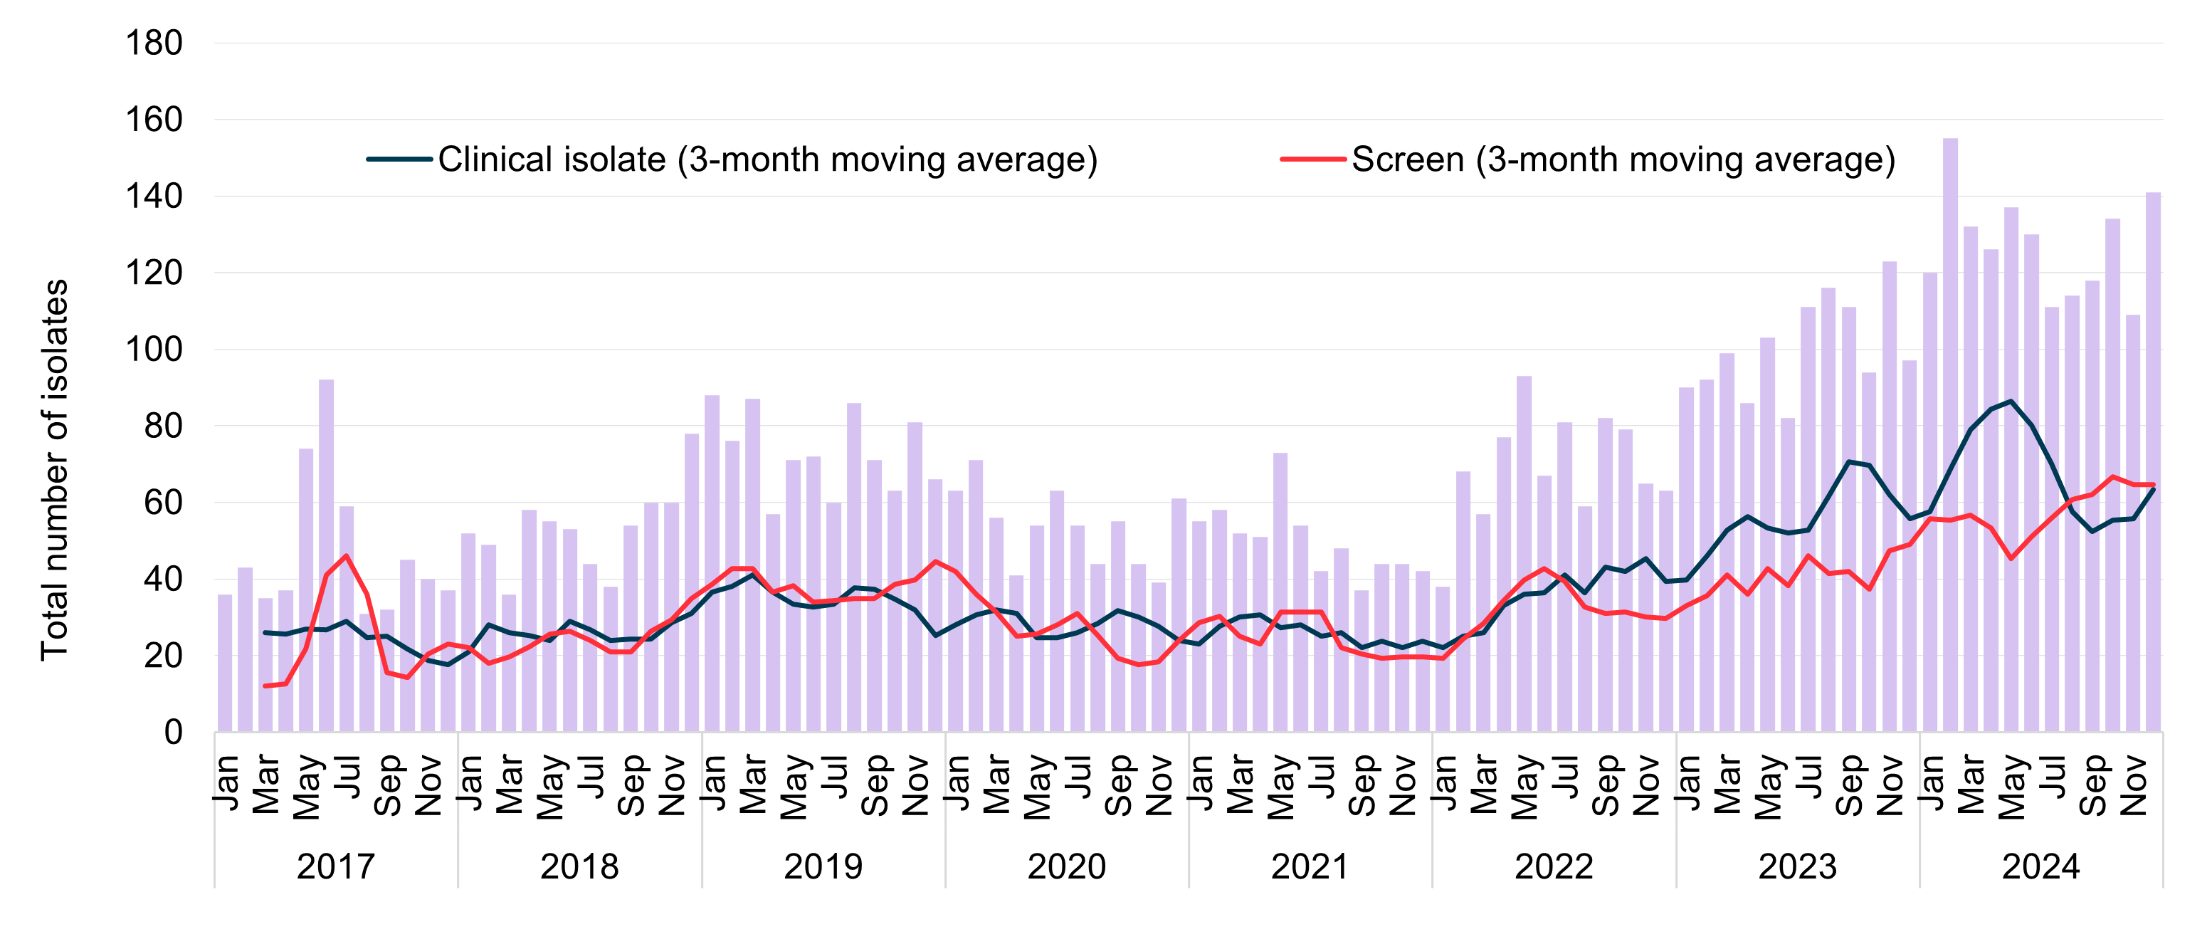
CARAlert
Figure 5. Carbapenemase-producing Enterobacterales, number reported to CARAlert by month and specimen type, national, 2017–2024
Source: CARAlert Annual Report: 2024
Notes:
Enterobacterales is an order of gram-negative, rod-shaped bacteria which is commonly associated with infections of the urinary tract, biliary tract, intra-abdomen and bloodstream
CPEs are resistant to carbapenem antibiotics as well as other beta lactam antibiotics including penicillins and cephalosporins. The remaining treatment options for CPE infections are often more costly, less efficacious and adverse effects
The spread of CPE is a major treat to health care systems worldwide
In 2024, there were 1,527 reports of CPE which is a 26.8% compared to 2023

Slide 18
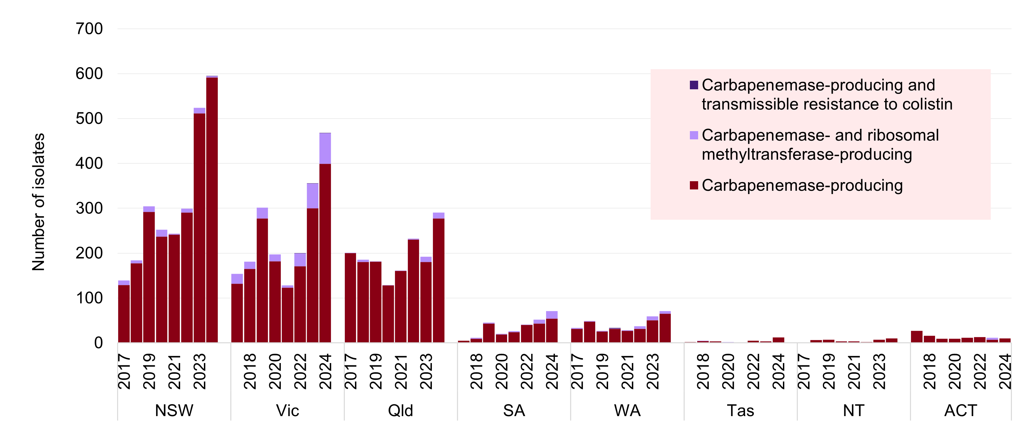
CARAlert
Figure 6. Carbapenemase-producing Enterobacterales, number reported to CARAlert by state and territory, 2017–2024
Source: CARAlert Annual Report: 2024
Notes:
The greatest increase observed in reported CARs from 2023 to 2024 include Queensland (up 51%), South Australia (up 36.5%) and Victoria (31.5%)

Slide 19
Antimicrobial use in the community: 2024
23,190,360 antimicrobial prescriptions supplied in 2024
    4.8% increase from 2023
    13.0% lower than 2019
    20.8% lower than 2015
Over one third of Australians had at least one antimicrobial dispensed
Average 2.29 prescriptions among those who received an antimicrobial
Amoxicillin (22%), cefalexin and amoxicillin‒clavulanic acid remain the most frequently dispensed antimicrobials
Use across states and territories, local areas and age groups remained comparable with trends since 2015
Notes:
It is encouraging that since 2015, there has been an overall decline in antimicrobial use in the community. There has been various events which have influenced this positive downward trend over time including:
The global COVID-19 pandemic which led to various policy changes, expansion of the Medicare Benefits Schedule for telehealth consultations, increased emphasis on infection prevention control (which influenced prevalence of other respiratory tract infections)
In 2020, where there was a change in the maximum prescribed quantity and access to repeats were restricted for the 5 most commonly prescribed antibiotics at the time
Antibiotic shortages in the last few years.
However, since 2022 there has been a gradual upward trend, which is increasing at a sharper rate in aged care.
Reference:
https://safetyandquality.gov.au/community-antimicrobial-use-2024

Slide 20
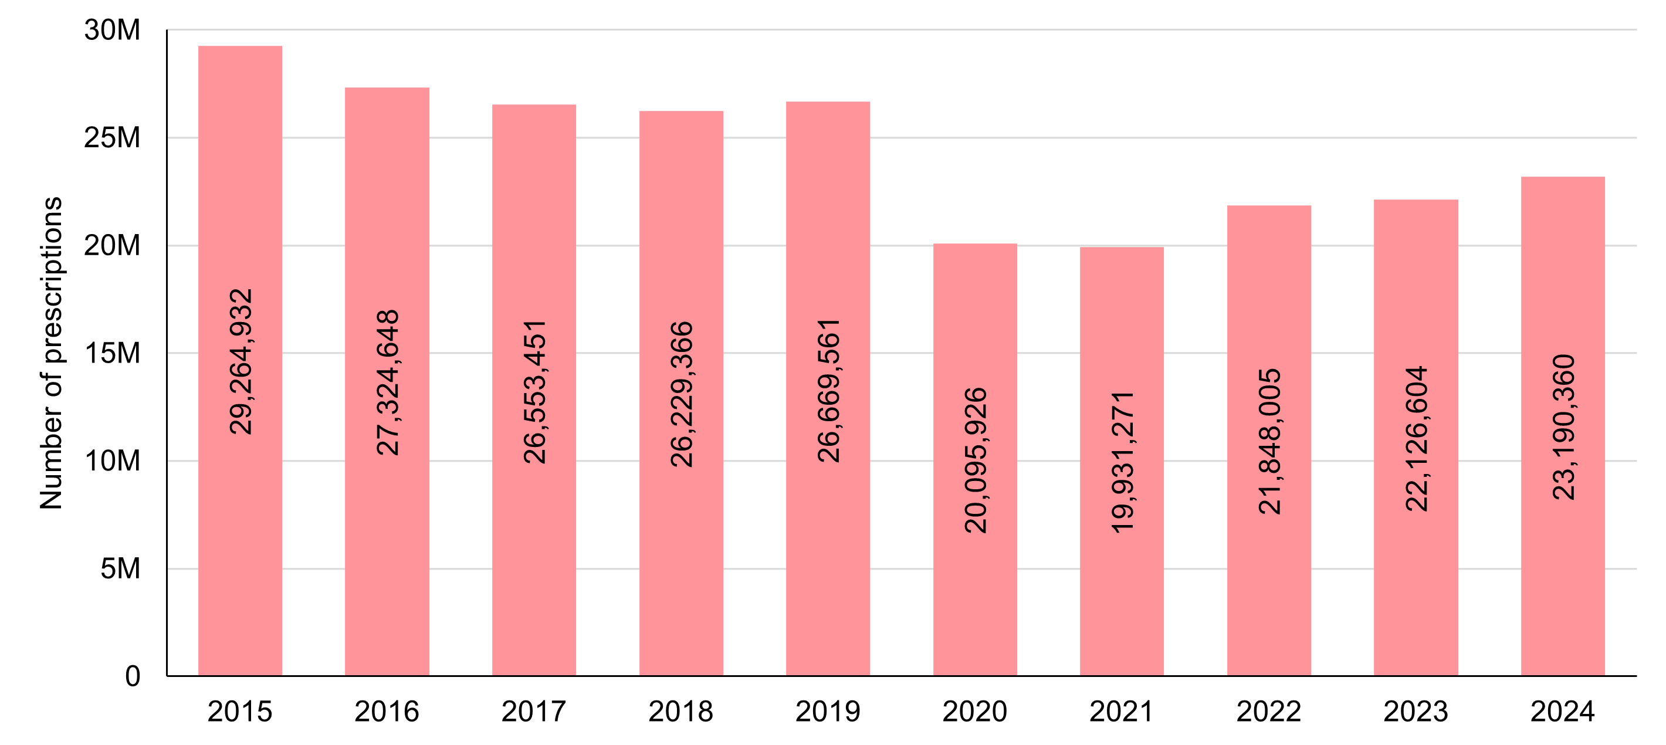
Antimicrobial use in the community: 2024
Figure 7. Number of PBS and RPBS antimicrobial prescriptions dispensed, 2015–2024
Source: Antimicrobial use in the community: 2024
Notes:
The figure shows the number of antimicrobial prescriptions supplied in 2024 and trends from 2015
There were just over 23 million antimicrobial prescriptions supplied in 2024, which is a 4.8% increase from 2023
From the figure, we can see that there was a substantial decrease in antimicrobial use from 2019 to 2020, which coincided with the COVID-19 pandemic
The overall decrease was sustained in 2021; however, use has been slowly increasing since 2022 but still remains lower than the levels of use in 2015

Slide 21
Community antimicrobial use in Australia, European countries, England and Scotland, 2023
DDD/1,000 people/day
Source: Antimicrobial use in the community: 2024
Notes:
Despite the overall downward trend since 2015, Australia has been estimated to have consistently high antimicrobial prescribing rates when compared to other countries in the Organisations for Economic Co-operation and Development (OECD)
Antimicrobial usage in Australia was nearly double that of Netherlands
The trends in antimicrobial use in Australia during the COVID-19 pandemic, followed that of other countries globally
The most pronounced reductions in use were observed in high-income countries

Slide 22
Local data – AMR
Which infections are we seeing? [Insert surveillance data, i.e. what is the most common cause of bacteraemia in your facility]
What are our susceptibility and resistance patterns?
  [Insert hospital data]
  [Numbers of cases]
  [Examples of cases]
Are there local antimicrobial resistance issues?
What are local rates of MRSA, Clostridioides difficile (C diff)?
Do you have access to a local antibiogram?
Notes:
Note to presenters:
Users should insert local hospital data into this slide. If a hospital antibiogram is available, it would be useful to include it here for explanation and discussion. If not, give examples of infections from resistant bacteria that have occurred in your healthcare facility.
Examples might include:
Central-line-associated bacteraemia
Catheter-associated urinary tract infections
Surgical site infections.
Consider the audience and the information that will be most relevant.
Consider also including information about the negative outcomes for patients from resistant infections, such as increased length of stay and personal impact.
Consider asking the audience before revealing the answers:
What are the common infections seen in our hospital?
What are our local susceptibility and resistance patterns?

Slide 23
Local data – Volume and appropriateness
Insert local audit data on appropriateness, usage etc.
Does your healthcare facility audit appropriateness of prescribing?
What tools are used (e.g.. National Antimicrobial Prescribing Survey [NAPS], National Antimicrobial Utilisation Surveillance Program [NAUSP], jurisdictional audit tools)
If your facility uses NAPS or NAUSP, consider
  Comparison to national results
  Time series data
  How local results have contributed to your AMS program
Notes:
Include data on antimicrobial use and appropriateness at your facility

Slide 24
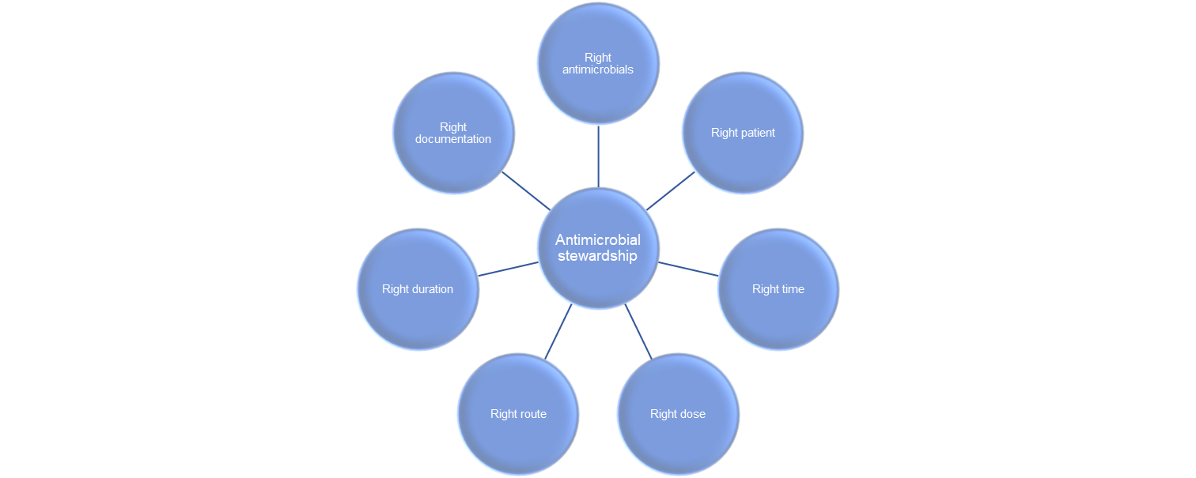
Antimicrobial stewardship
A range of activities that promote and support optimal antimicrobial prescribing and use
Works hand in hand with infection prevention and control, hand hygiene and surveillance
Goals of AMS:
  Improve patient outcomes and patient safety
  Reduce the spread and emergence of AMR
  Reduce costs for a more sustainable health care system
  Reduce unnecessary prescribing and diagnostic tests
Notes:
Antimicrobial Stewardship isn’t about “not using antimicrobials” but rather “identify that small group of patients who really need antibiotic treatment and then explain, reassure and educate the large group of patients who don’t”
Stewardship means to protect something
AMS is a systematic approach to optimising the use of antimicrobials

Slide 25
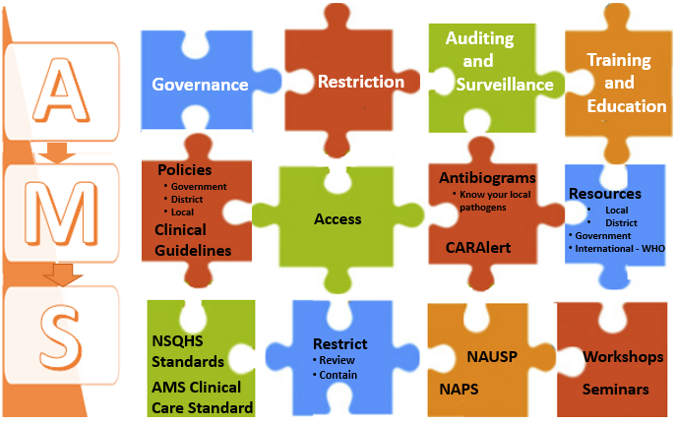
Putting the pieces together
Notes:
AMS is a set of co-ordinated initiatives or activities that together prevent poor prescribing and emergence of resistance.
The four pillars of AMS are good governance, restricting antimicrobials to appropriate indications and first line therapies, auditing and surveillance and using these to undertake quality improvement initiatives and training and educating the workforce using international, government or in-house educational resources, and providing regular workshops and seminars on using antimicrobials wisely

Slide 26
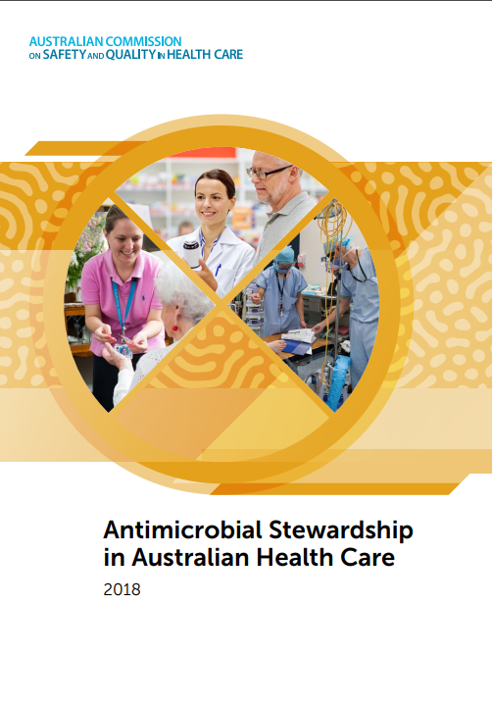
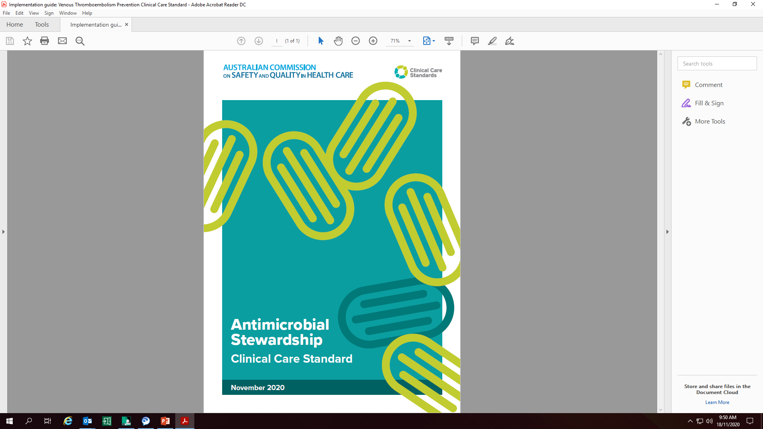
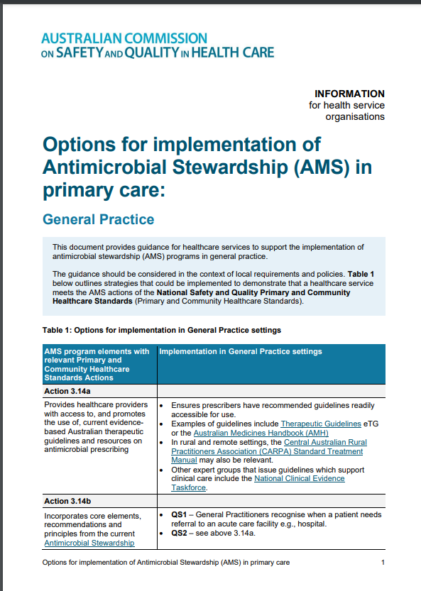
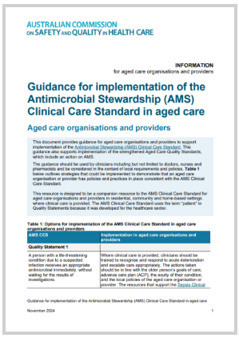
Antimicrobial stewardship resources
Notes:
The Australian Commission on Safety and Quality in Health Care have developed a range of resources to support the implementation of antimicrobial stewardship in health care facilities

Slide 27
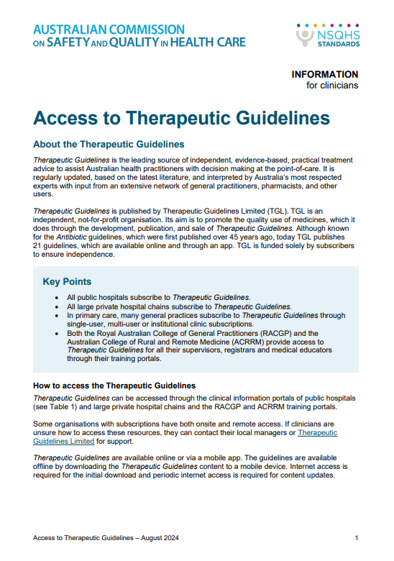
Therapeutic Guidelines
Always use the most current version
Check your hospital’s intranet page
A ‘go to’ reference especially when there are limited local guidelines
Learn more: www.tg.org.au
Notes:
The Therapeutic Guidelines is the leading source of accurate, independent and practical treatment advice for a wide range of clinical conditions
The Antibiotic guidelines were extensively updated in March 2025 including guideline-wide changes with new content and updates to revised topics

Slide 28
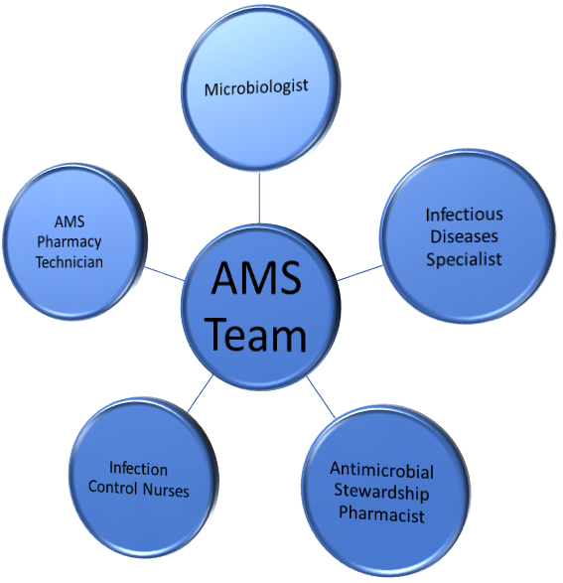
Antimicrobial stewardship in our facility
Insert information on your AMS service:
  Structure, governance – who is responsible?
  Who leads AMS activities?
  Who is on your local AMS team?
  What AMS activities are undertaken?
  What AMS activities are you / your department involved in?
Notes:
Antimicrobial Stewardship requires teamwork at all levels. It is ‘everybody's business’ and requires good partnership with the executive and clinical leadership, the clinical team (doctors, nurses, pharmacists, allied health) and consumers.
Include information about the AMS team at your health service organisation

Slide 29
Sustainability and the environment
Limited antimicrobial pipeline to conserve
Patients with AMR often consume more health resources → larger carbon footprint
Waste management of antimicrobials
  Waterways, landfill, industrial
Procurement decisions
  Consider the environmental impact of the product and the company practices
One Health
Climate change
Following guidance for when diagnostic tests such as throat swabs are appropriate
Notes:
The health system has a responsibility to play in minimising its contributions to carbon emissions and play its part in achieving Australia’s Long-Term Emissions Reduction Plan
Antimicrobial Stewardship promotes the responsible use of antibiotics to preserve their effectiveness while supporting sustainability by reducing the environmental impact of antimicrobial resistance

Slide 30
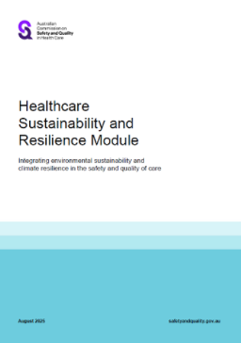
Healthcare Sustainability and Resilience Module
Developed to address health care impacts on the environment and the climate risks affecting outcomes and access to care
A framework of actions for health services
Designed to work with the NSQHS Standards
Aligns with the National Health and Climate Strategy
Notes:
The Commission has developed the Healthcare Sustainability and Resilience Module to address healthcare impacts on the environment and the climate risks affecting health outcomes and access to care.
The Module provides a framework of actions for health service organisations to integrate environmental sustainability and climate resilience strategies to deliver high-quality care.
The Module aims to help health service organisations to improve their:
Sustainability by considering and reducing the environmental impact of harm on its patients, community and environment.
Resilience by identifying and addressing how climate risks affect patients, consumers, community and the delivery of services.
Integration of sustainability and resilience into their governance, leadership and quality improvement systems to deliver person-centred and high-quality care.
It is designed to be implemented with other safety and quality standards developed by the Commission, such as the NSQHS Standards.
It underwent public consultation in 2023 with around 800 pieces of feedback received and a pilot process was designed to understand the maturity and types of strategies currently being used by the sector to ensure the Module was fit-for-purpose.
It aligns with the National Health and Climate Strategy, specifically supporting Action 4.5: New sustainability and climate resilience standards for health service organisations.

Slide 31





The Module
Action 1
  Recognition of role of governing body to set
  priorities, targets and monitor performance
Includes five actions which leverage existing quality improvement frameworks for improving environmental sustainability and climate resilience
Action 2
  Identify processes, practices and services
  that have high environmental impact
Action 3
  Measure, monitor and report on environmental sustainability and climate risk
Action 4
  Train the workforce to identify and implement
  strategies to reduce environmental impacts
Action 5
  Support the workforce and consumers
  to implement change
Notes:
The Module includes five actions which leverage existing quality improvement frameworks for improving environmental sustainability and climate resilience.
Actions include:
Governance, leadership and culture (Action 1)
Evidence-based care and health outcomes (Action 2)
Measurement and quality improvement (Action 3)
Safety and quality training (Action 4)
Communication that supports effective partnerships (Action 5)
The Module supports health service organisations when setting their priorities, targets and strategies for their existing and new services.
It also supports partnering with consumers to design, monitor and evaluate services.

Slide 32

World AMR Awareness Week
18 – 24 November “Act Now: Protect Our Present, Secure Our Future”
World Health Organization (WHO) global campaign celebrated annually
Improve awareness and understanding of AMR
Encourages best practices among the public, One Health stakeholders and policy makers
Notes:
World AMR Awareness Week is a global campaign held annually to raise awareness and improve understanding on antimicrobial resistance

Slide 33
World AMR Awareness Week
List activities occurring at your health facility here + include pictures + contact people
Notes:
Insert information about how your health service organisation is celebrating WAAW. See https://www.safetyandquality.gov.au/publications-and-resources/resource-library/world-amr-awareness-week-ideas-activities-and-events for ideas.

Slide 34
Key messages
Antimicrobial resistance:
  occurs when an organism evolves and develops resistance to an antimicrobial that should inhibit or destroy it
  is reducing the effectiveness of antimicrobials to treat infections
  is happening now
Few new antimicrobials are being developed
All antimicrobial use can contribute to resistance, but the overuse and inappropriate use of antimicrobials can drive further antimicrobial resistance
Antimicrobial stewardship works hand in hand with prevention and control strategies to help address antimicrobial resistance.

Slide 35
Thank you
T. +61 2 9126 3600
Level 5, 255 Elizabeth St
Sydney NSW 2000 Australia
safetyandquality.gov.au
© Australian Commission on Safety and Quality in Health Care

