Slide 1
World AMR Awareness Week
Understanding the importance of antimicrobial resistance - information for consumers
Insert presenter’s name
safetyandquality.gov.au
Notes:
This presentation has been prepared by the Australian Commission on Safety and Quality in Health Care for use during World AMR Awareness Week.
The content within this presentation can be modified, expanded on, points or slides deleted to tailor it to consumer audiences to explain the importance of using antimicrobials appropriately and improve understanding about antimicrobial resistance.
Disclaimer
safetyandquality.gov.au
© Australian Commission on
Safety and­­ ­Quality in Health Care 2025

Slide 2

Acknowledgement of Country
I would like to pay respect to the Traditional Owners and Custodians of Country where we meet today. We extend that respect to all Aboriginal and Torres Strait Islander peoples, and their deep time connections to land, water and sky.
We recognise that knowledge about healthy Country, community and culture has been developed by Aboriginal and Torres Strait Islander peoples over tens of thousands of years and has been shared for generations. We are committed to partnering with and learning from Aboriginal and Torres Strait Islander peoples through the work that we do.

Slide 3
Learn about
What are microbes?
What are antimicrobials?
What are the differences between broad and narrow spectrum antibiotics?
What is antimicrobial resistance?
    How does antimicrobial resistance occur?
    Why is antimicrobial resistance a problem?
  What are the findings from antimicrobial use in the community in 2024?
  How can antimicrobial resistance be addressed?

Slide 4
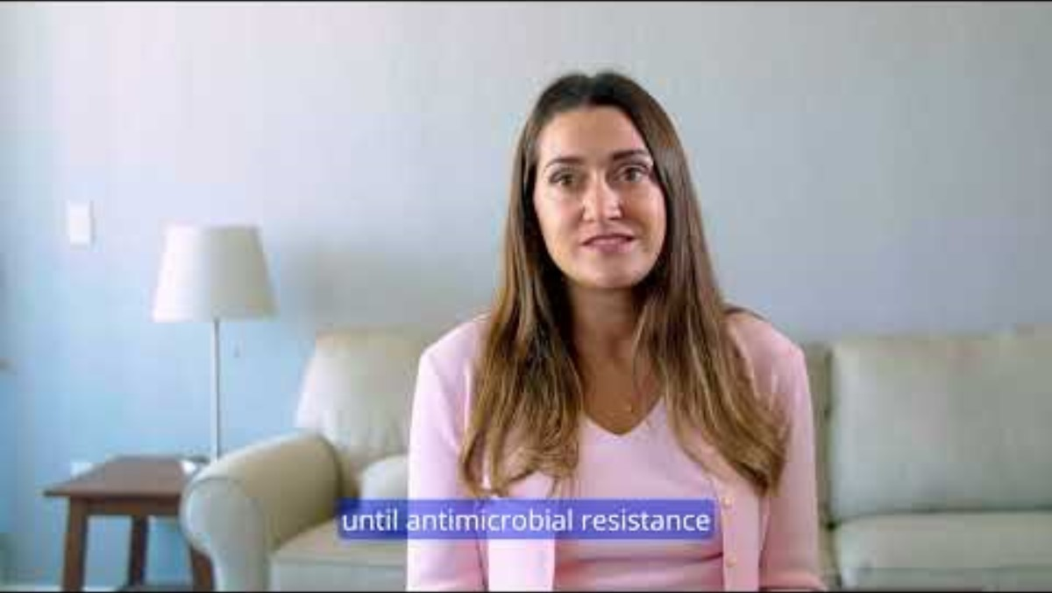
Notes:
Video link - https://www.youtube.com/watch?v=w2bAvyS0UX0
Other consumer stories can be found here:
https://www.idsociety.org/public-health/patient-stories/patient-stories/
https://antibioticguardian.com/stories/stories/

Slide 5
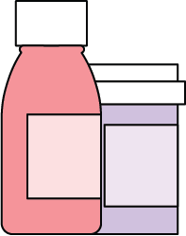
What are microbes?

Slide 6
Microbes or germs
So small a microscope is needed to see them
Are found everywhere
Can be both helpful and harmful to human health
Can cause disease upon entering the body
Notes:
Microbes or germs are also known as microorganisms; they are so small that you will need a microscope to see them
Germs are found everywhere; your body is naturally full of microbes
They can be both helpful and harmful to human health, microbes can become harmful when they enter the body. The spread of microorganisms can occur through skin contact, bodily fluids, airborne particles and contact with feces
There are many types of germs, and these include bacteria, viruses, fungi and parasites.
Reference
https://www.mayoclinic.org/diseases-conditions/infectious-diseases/in-depth/germs/art-20045289

Slide 7
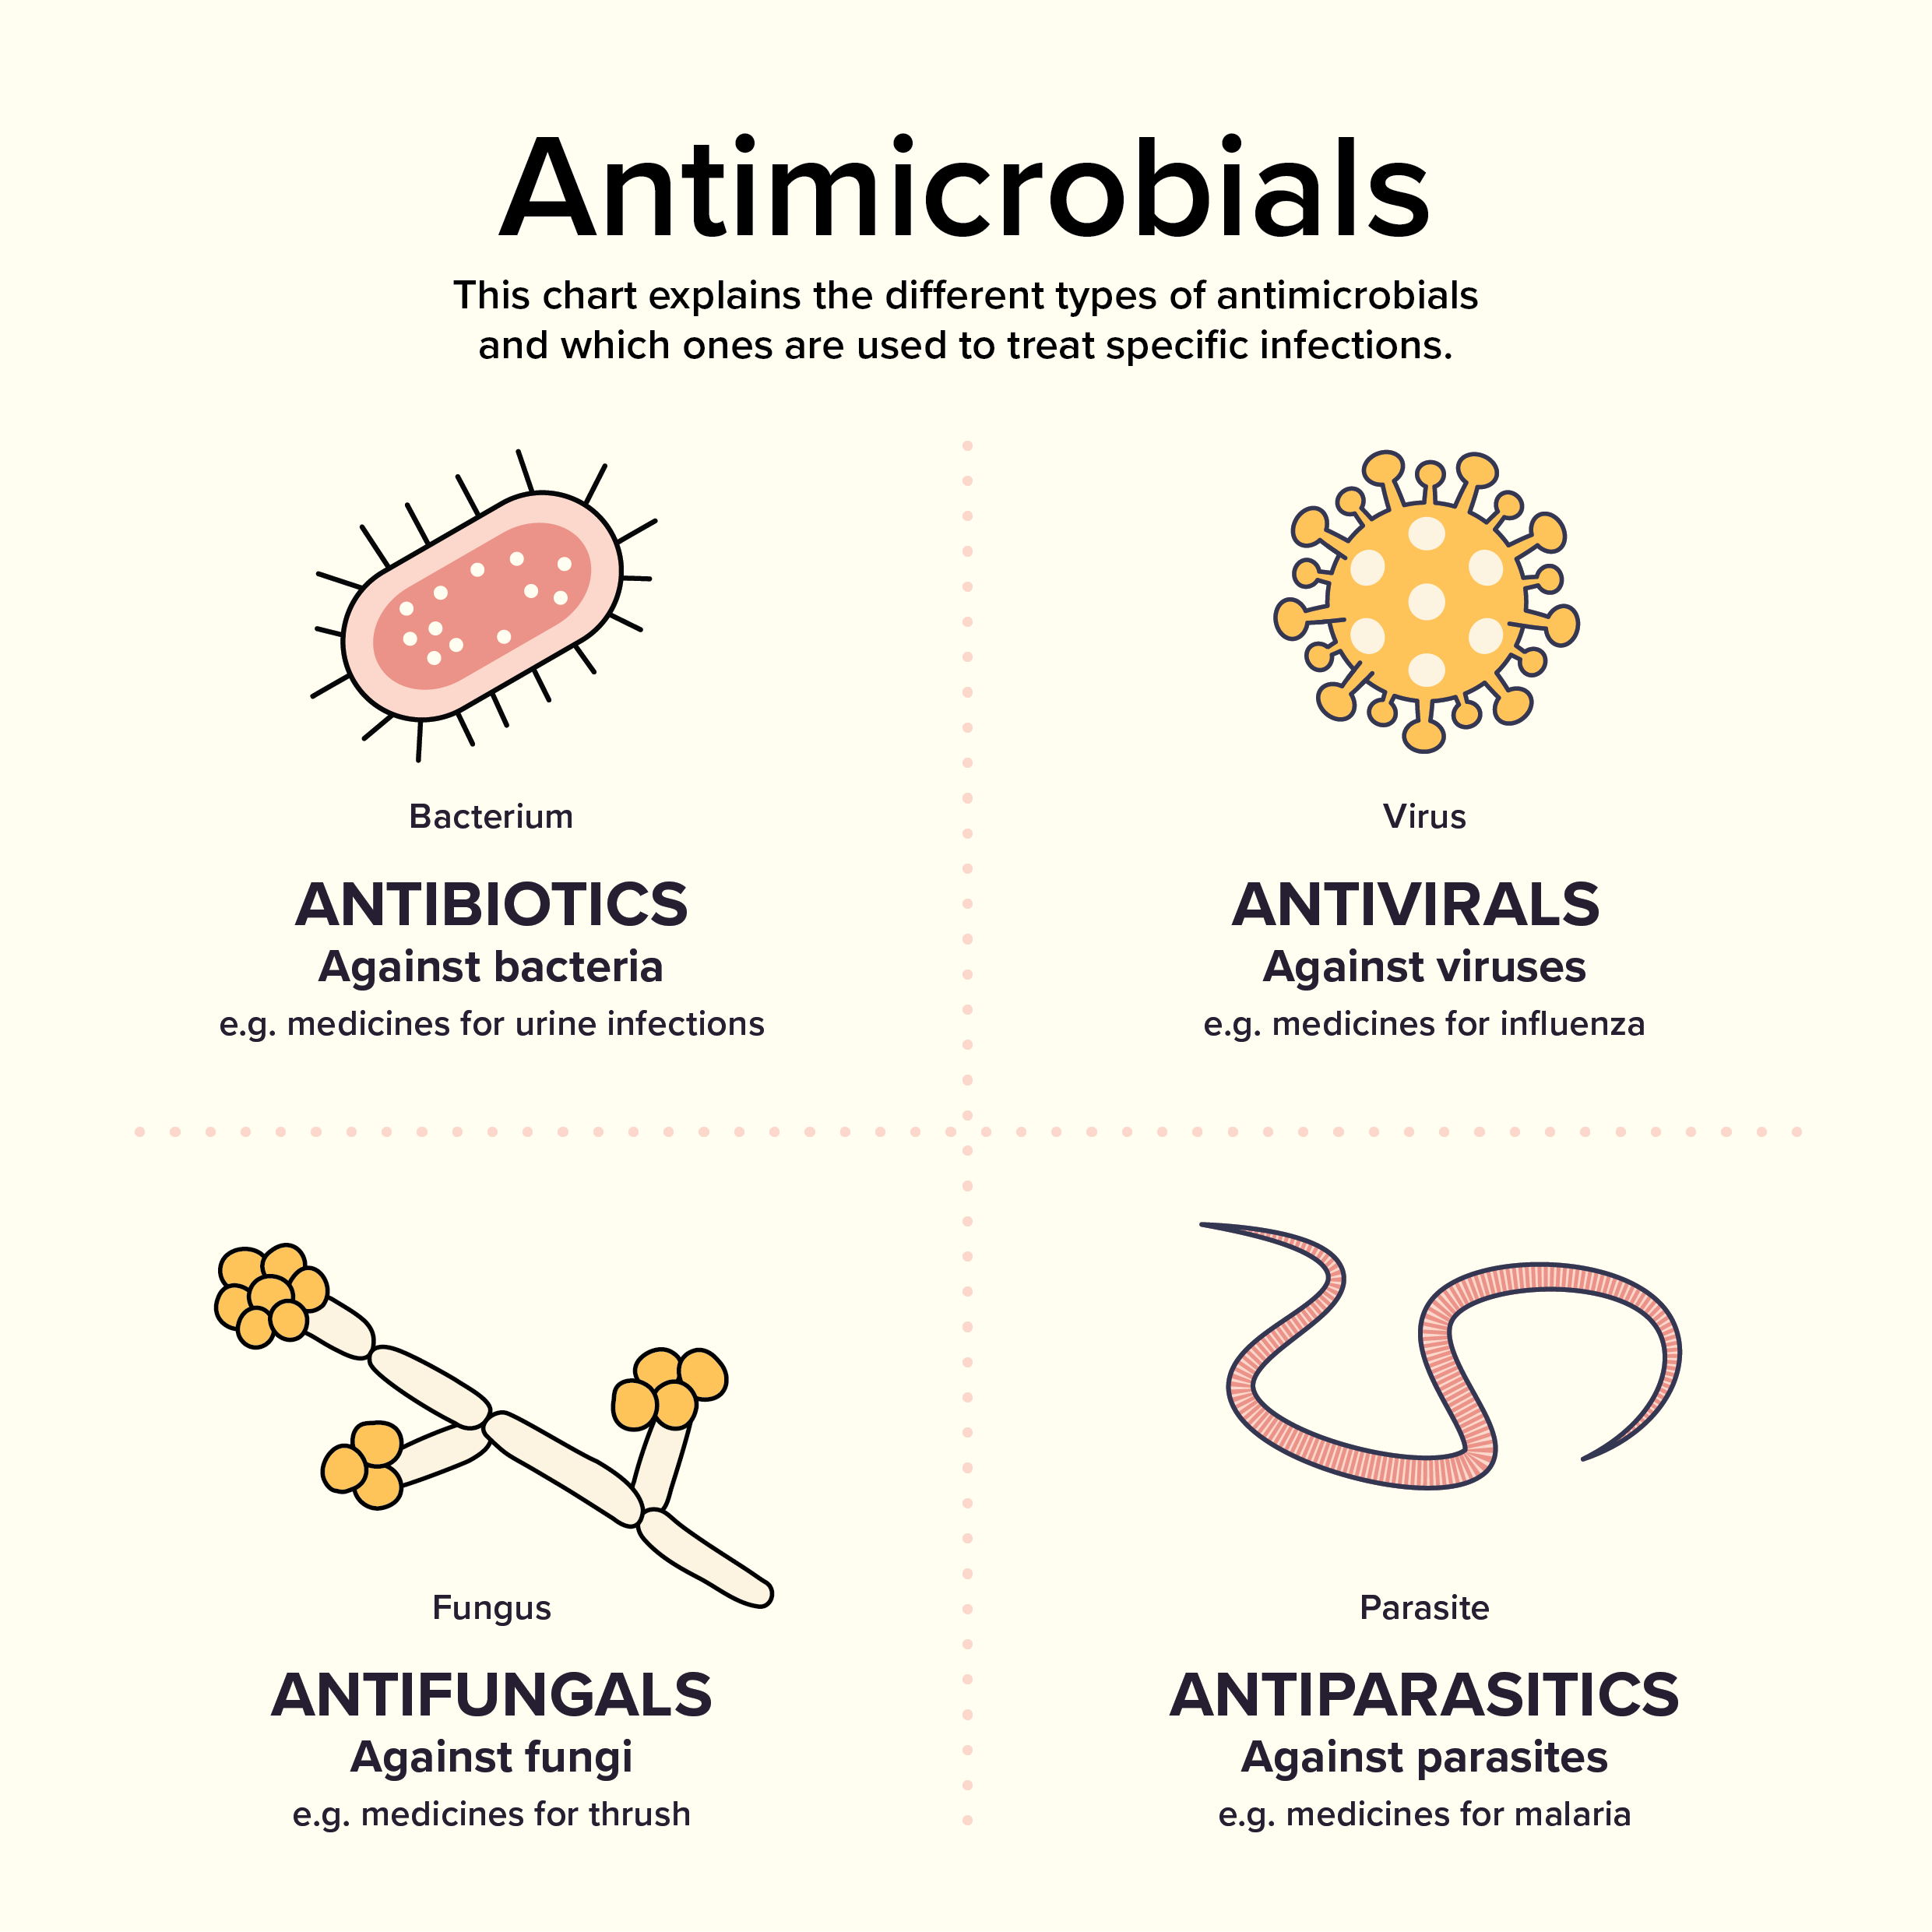
Types of microbes
Bacteria
Virus
Fungi
Parasite
Different types of antimicrobials treat different types of infections
Notes:
There are many different types of microorganisms
The most common ones are bacteria, virus, fungi and parasites
These groups all cause different types of infections

Slide 8
What are antimicrobials?

Slide 9
Antimicrobials
Figure 1. Different types of antimicrobials and the types of infections they treat
Microorganism | Antimicrobial | Example of infection
Bacteria | Antibiotic | Urine infection
Virus | Antiviral | Influenza (flu)
Fungi | Antifungal | Thrush
Parasite | Antiparasitic | Malaria
Notes:
It is important to understand the four different groups as it helps with the understand of why we can’t use antibiotics for viruses
Antibiotics are a type of antimicrobial which fight only against bacteria
They don’t cause harm to human cells or work on viruses or other types of microorganisms
Reference
https://www.reactgroup.org/toolbox/understand/antibiotics/
https://www.safetyandquality.gov.au/publications-and-resources/resource-library/what-are-antimicrobials-graphic

Slide 10
Antibiotics
Antibiotics are a type of antimicrobial that treat infections caused by bacteria
They are lifesaving medications
Should only be used when necessary
The antibiotic prescribed should match the type of bacteria causing the infection
Notes:
For this presentation, we will focus on antibiotics
Antibiotics are used to treat bacterial infections
Examples of bacterial infections include urinary tract infections, meningococcal disease ,strep throat and whooping cough
Antibiotics work by either killing the bacteria or stopping them from multiplying
When antibiotics are overused, they can lose their effectiveness and may no longer work

Slide 11
Antibiotics don’t treat viruses
Antibiotics don’t treat viruses
Antibiotics only work for infections caused by bacteria.
They don’t treat infections caused by viruses, such as:
  Coughs and colds
  Flu and COVID-19
  Most sore throats and ear infections
You may feel better when you take antibiotics, even when they’re not needed. This is because your immune system is working to fight the infection for you.
Notes:
It is important to remind you that antibiotics do not treat infections caused by other microorganism
They do not work for infections that are caused by viruses
Common viral infections include coughs and colds, influenza and COVID-19 and most sore throats and ear infections

Slide 12
Benefits versus risks
Figure 2. Benefits versus risks of taking antibiotics
Benefit | Risk
Kills harmful bacteria that make you sick | Kills good bacteria that keep you healthy e.g gut microbiome
Treat infections that could not be treated before | Can cause side effects e.g. nausea and diarrhoea
Minimises the risk of infection e.g. during some types of surgery, cancer treatments | Increase the risk of antibiotic resistance
Notes:
Like all medicines, there are benefits and risks for taking antibiotics
Antibiotics can kill the bacteria that make you sick, but they can also kill the good bacteria that is naturally found on your body,
Like all medicines, antibiotics can have side effects
For example, the imbalance of good and bad bacterial can cause side effects such as diarrhoea
Antibiotics are life saving medicines, infections which could not be treated before can now be treated
Successful cancer treatments and surgeries rely on antibiotics to prevent the risk of infection
However, these life saving medicines are at risk of becoming ineffective due to antibiotic resistance

Slide 13
What are the differences between broad and narrow spectrum antibiotics?

Slide 14
Broad and narrow antibiotics
Bacteria A | Bacteria B | Bacteria C
Antibiotic 1
 | Antibiotic 2
Antibiotic 3
Antibiotic 1 and 2 are narrow spectrum antibiotics
Antibiotic 3 is a broad spectrum antibiotic
Notes:
There are many types of antibiotics that treat different infections that are caused by different bacteria
Antibiotics that treat only one kind or very few kinds of bacteria are called narrow spectrum antibiotics; they usually have fewer side effects and contribute less to antimicrobial resistance
Antibiotics that can treat many types of bacteria are called broad spectrum antibiotics; they usually have more side effects and contribute more to antimicrobial resistance

Slide 15


Narrow and broad spectrum antibiotics
More targeted
Can only kill a few types of bacteria
Contribute less to resistance
Can kill many types of bacteria
Contribute more to resistance
More side effects
Notes:
Consider narrow spectrum antibiotics like a fishing line, it can only catch one fish as a time. Whereas broad spectrum antibiotics is like a fishing net, where you can catch many fish at a time.

Slide 16
What is antimicrobial resistance?

Slide 17
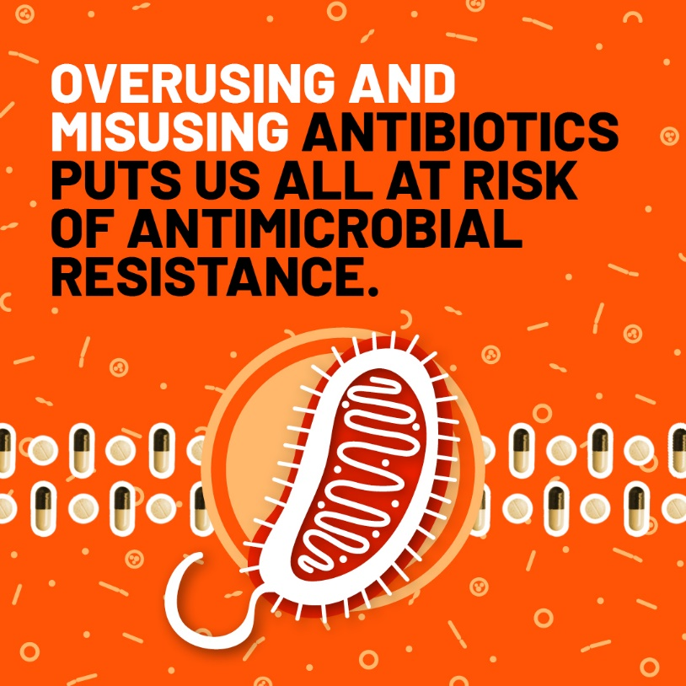
Antimicrobial resistance
Bacteria change over time in response to the environment
These changes allow them to resist antibiotics. This is called antibiotic resistance
When antibiotics are overused or used inappropriately, resistance develops more quickly
Notes:
Antibiotic resistance happens when bacteria change to protect themselves from the antibiotic
This can happen naturally, but the main cause is from:
Using antibiotics when they are not needed
Not taking them properly (such as missing the doses or not finishing the course)

Slide 18

Why antimicrobial resistance is a problem
Rates of antibiotic resistance are rising
Hundreds of people in Australia die from antibiotic-resistant infections each year
Australia uses more antibiotics than many other comparable countries
Much of that use is inappropriate
  Using antibiotics when not needed
  Using antibiotics for too long
Few new antibiotics becoming available
Notes:
Antibiotic resistance rates in Australia are rising, in come cases resistance is becoming so significant that there are only few antibiotics left
Australia uses more antibiotics than comparable countries, it is unclear why. However, Australia is very good at recording the antibiotics we use, so may just be better at capturing the data than some other countries
Resistance is a problem because new antibiotics are not being developed for those microorganisms that become resistant to existing ones. Reasons include:
Research and development is difficult and expensive
Antimicrobials don’t make pharmaceutical companies as much money as medicines for chronic illness
Chronic illness medications are taken ongoing, antimicrobials are only for short durations
Chronic illness medication don’t develop resistance
Chronic illness medications are usually indicated for a larger population

Slide 19
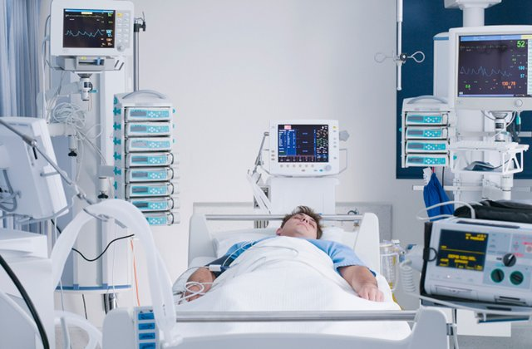
Antibiotic resistant infections
More difficult to treat
Other antibiotics need to be used which may not work as well or can be more toxic
Usually require longer hospital stays
Can become resistant to all antibiotics → untreatable
More likely to spread to others
Notes:
These types of infections are more difficult to treat because there are not as many options
It may require a hospital stay rather than being treated in the community, as often antimicrobial resistant infections require intravenous antibiotics and can be more serious than infections not caused by antimicrobial resistant microorganisms

Slide 20

Antibiotic resistant infections and the environment
Notes:
Antibiotic resistant infections tend to use more health care resources than other types of infections
Because they are harder to treat, this can mean that they require more antibiotics, more diagnostic tests, more admissions to hospital and longer hospital stays
Antibiotic resistance can affect the sustainability of health care
It is important to prevent and control antibiotic resistance so that we prevent over-using resources

Slide 21
  What are the findings from antimicrobial use in the community in 2024?

Slide 22
Key findings from antimicrobial use in the community in 2024
The volume of antimicrobials supplied in the community in 2024 has reduced since 2015, but has been gradually trending up from 2022 (see graph)
There were over 23 million antimicrobial prescriptions supplied in Australia in 2024; one third of Australians had at least one antimicrobial dispensed
Even though there is a smaller population of Australians living in aged care, there are high volumes of antimicrobial use which is trending up faster compared to the overall community
It is important to know prescribing information, so that antimicrobial use among the community can be monitored and reviewed.
Source: Antimicrobial use in the community: 2024
Notes:
As we already spoke about, overuse of antimicrobial medicines can cause antimicrobial resistance to develop more quickly
The Commission released a report in August 2025 which provides an overview of antimicrobial use in the community in 2024
This is important to monitor because it helps us identify where we are overusing antimicrobials and to see if we are using more or less antimicrobials over time
Reference
https://www.safetyandquality.gov.au/publications-and-resources/resource-library/antimicrobial-use-community-2024

Slide 23
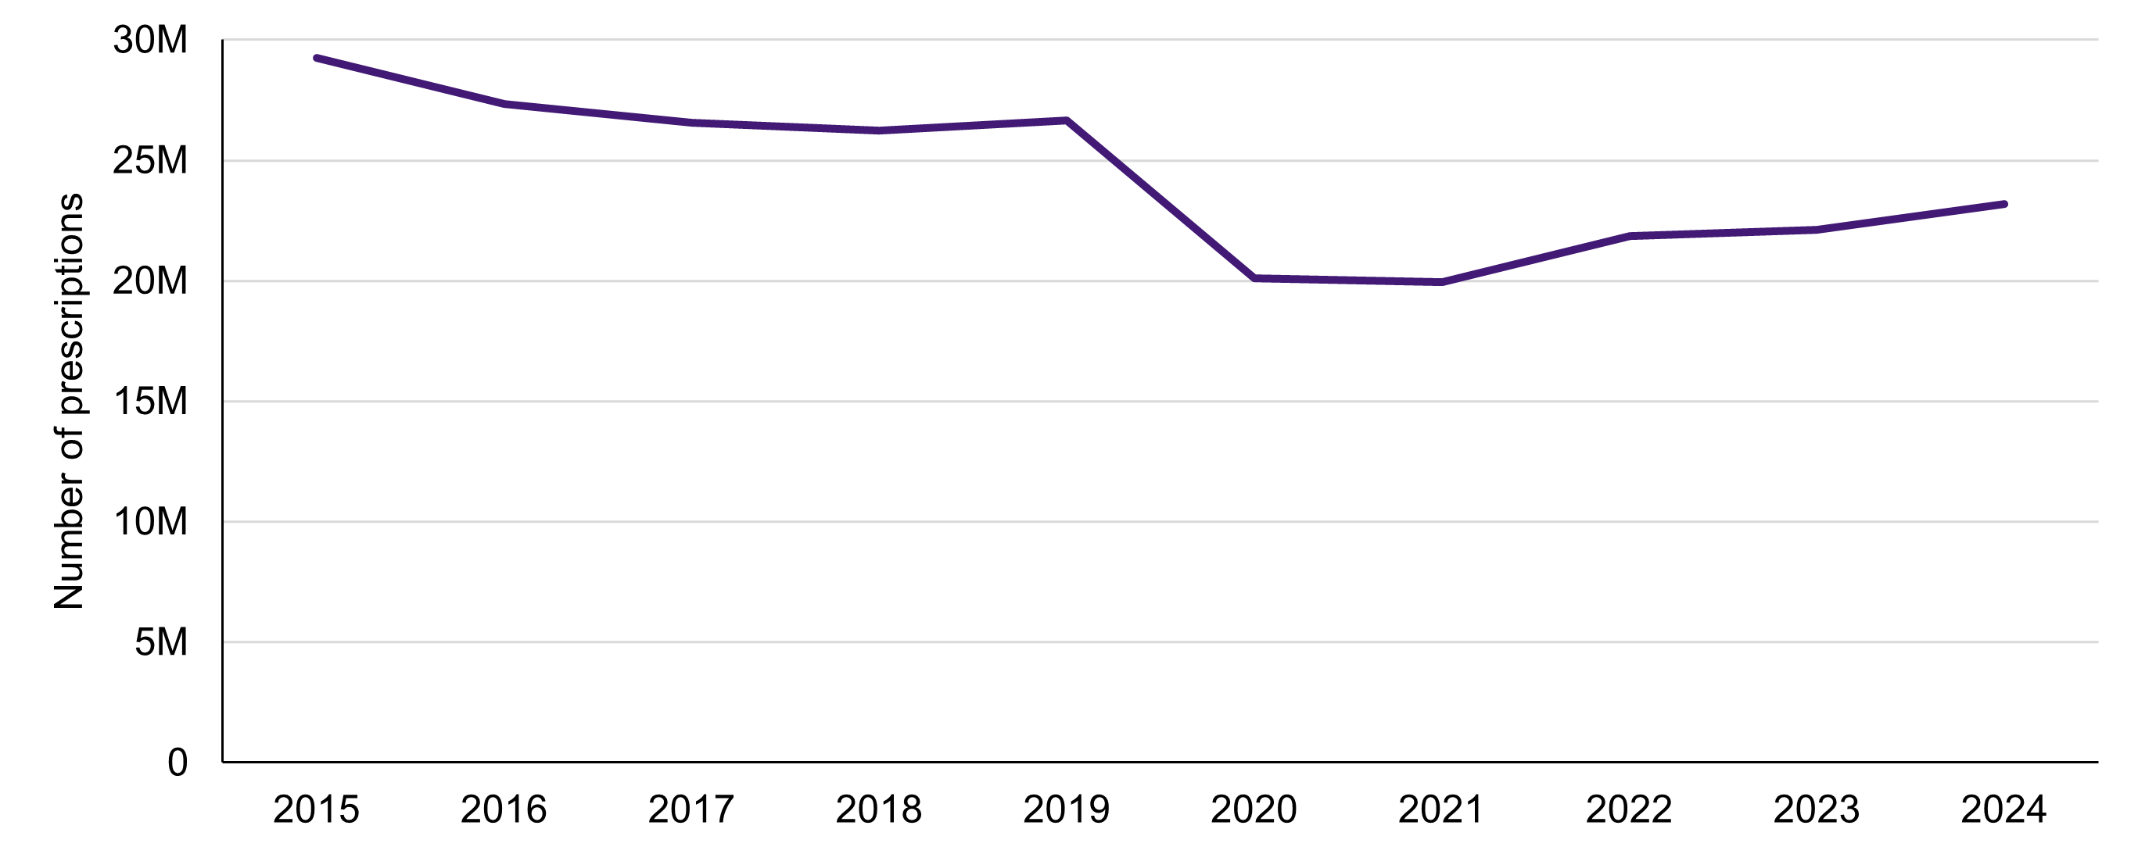
Trends in antimicrobial use in the community, 2015–2024
Figure 1. Number of antimicrobial prescriptions, 2015–2024
Source: Antimicrobial use in the community: 2024
Notes:
In 2015, there was over 29 million antimicrobial prescriptions supplied in the community
From 2019 to 2020, there was a big drop in antimicrobials supplied, this happened at the same time as COVID-19
However, from 2022, there has been a gradual increase in antimicrobials supplied. Despite this, antimicrobials are still 20.8% less in 2024 than what was supplied in 2015
Reference
https://www.safetyandquality.gov.au/publications-and-resources/resource-library/antimicrobial-use-community-2024

Slide 24
  How can antimicrobial resistance be addressed?

Slide 25
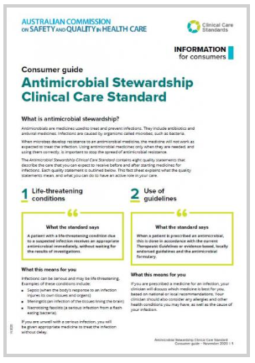
Antimicrobial stewardship
A program or approach aimed at using antibiotics in the right way
Goals:
  Preserve the current antibiotics we have
  Encourage doctors to prescribe the right antibiotic
  Protect patients
Involves collaboration between doctors, pharmacists, nurses and patients
Notes:
Using antimicrobial medicines only when they are needed, and using them correctly, is important to stop the spread of antimicrobial resistance
In health service, such as hospitals, there are programs that ensure antibiotics are being used correctly
Different healthcare professionals collaborate and to make sure antibiotics are used only when they are needed and used correctly

Slide 26
It isn’t about “not using antimicrobials”
but rather
“identify that small group of patients who really need antibiotic treatment and then explain, reassure and educate the large group of patients who don’t.”
Notes:
Reference: https://www.pulsus.com/scholarly-articles/antimicrobial-resistance-amr-the-silent-pandemic-11407.html#:~:text=Antimicrobial%20stewardship%20isn't%20about,patients%20who%20don't%E2%80%9D.

Slide 27
What can individuals and the community do?
Prevent infections
Wash hands
Keep vaccinations up to date
Use antibiotics appropriately
Take antibiotics as prescribed
Return unused antibiotics to a pharmacy for disposal
Use antibiotics only when they are necessary
Do not request antibiotics for coughs, cold and flu
Some infections do not require antibiotics and can get better on their own
Avoid contact with people who are ill
Do not share antibiotics or take previously prescribed antibiotics
Notes:
Like antimicrobial stewardship programs, you can do your part to prevent the spread of antimicrobial resistance

Slide 28
If you are prescribed an antibiotic, ask your doctor…
Do I need the antibiotic, or will my infection get better without it?
What are the risks and benefits of me taking antibiotics?
Do we need to test the cause of my infection?
How often and how long do I take the antibiotic?
Will the antibiotic affect my regular medicines?
How long should my recovery take?

Slide 29
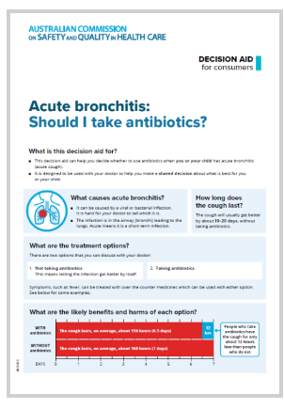
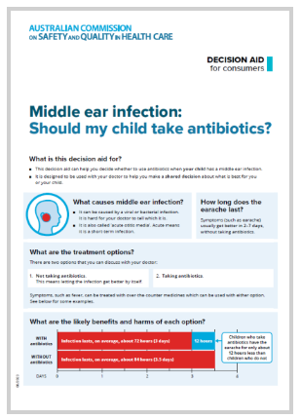
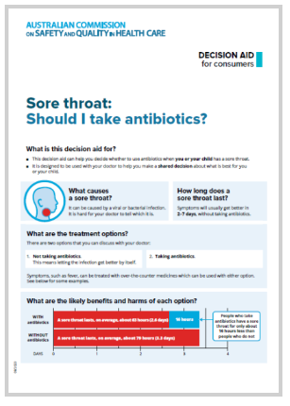
Where to find more information
Australian Commission on Safety and Quality in Health Care
  Antimicrobial Stewardship (AMS) resources and links
Department of Health, Disability and Ageing
  Antimicrobial resistance

Slide 30
Thank you
T. +61 2 9126 3600
Level 5, 255 Elizabeth St
Sydney NSW 2000 Australia
safetyandquality.gov.au
© Australian Commission on Safety and Quality in Health Care 2025

