Slide 1
Understanding the importance of antimicrobial resistance
D24-54142
Information for consumers
Notes:
Disclaimer
safetyandquality.gov.au
© Australian Commission on Safety and­­ ­Quality in Health Care 2024

Slide 2
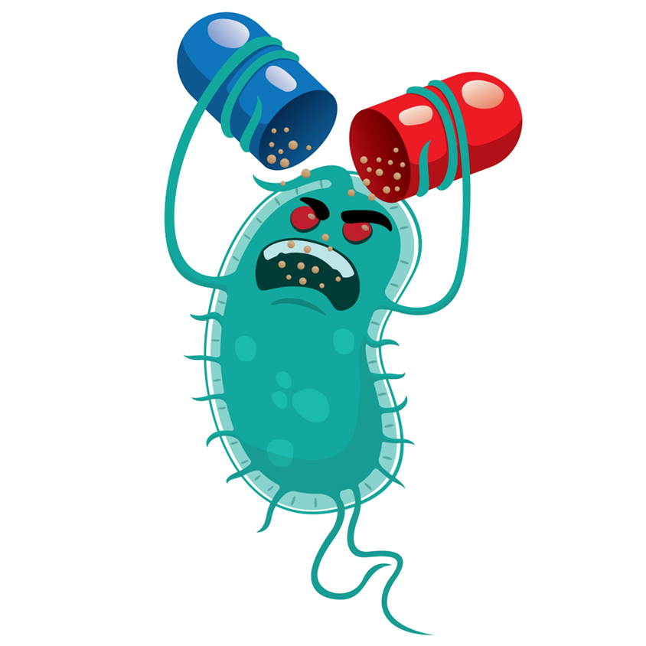
Learn about
What is antimicrobial resistance (AMR)?
Why is antimicrobial resistance a problem?
How does antimicrobial resistance occur?
What is the difference between broad and narrow spectrum antibiotics?
How can antimicrobial resistance be addressed?

Slide 3

A consumer story
Notes:
Play this video - https://www.youtube.com/watch?v=BFYuguuImW8&feature=youtu.be
Other consumer stories can be found here:
https://www.idsociety.org/public-health/patient-stories/patient-stories/
https://antibioticguardian.com/stories/stories/

Slide 4
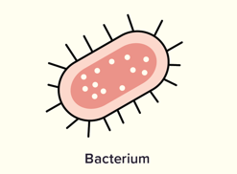

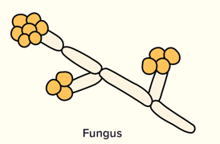
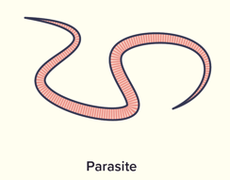
Microbes/Germs
Also known as microorganisms
So small a microscope is needed to see them
Are found everywhere
Can be both helpful and harmful to human health
Most are helpful
Types
Bacteria
Viruses
Fungi
Parasites
Notes:
Germs are also known as micro-organisms, they are so small that you will need a microscope to see them. Germs are found everywhere and can be both helpful and harmful to human health.
There are many types of germs, and these include bacteria, viruses, fungi and parasites.
Reference
https://www.mayoclinic.org/diseases-conditions/infectious-diseases/in-depth/germs/art-20045289

Slide 5
Antimicrobials
Different types of antimicrobials treat different infections
Antimicrobial | Microbe/germ | Example of infection
Antibiotic | Bacterium | Urine infection
Antiviral | Virus | Influenza (flu)
Antifungal | Fungi | Thrush
Antiparasitic | Parasite | Malaria
Notes:
Very important to understand the four different group as it helps with the understand of why we can’t use antibiotics for viruses etc
Antibiotics are a type of antimicrobial that fight against bacteria
Treat bacterial infections by targeting bacteria
They don’t cause harm to human cells or work on viruses
Can cause side effects, drug interactions, allergies and damage the good bacteria that we carry and need (microbiome)
Reference
https://www.reactgroup.org/toolbox/understand/antibiotics/
https://www.safetyandquality.gov.au/publications-and-resources/resource-library/what-are-antimicrobials-graphic

Slide 6
Antibiotics
Antibiotics are a type of antimicrobial that treat infections caused by bacteria
They are lifesaving medications
Should only be used when necessary
The right antibiotic should be chosen to treat the type of bacteria causing the infection
Notes:
We will focus on antibiotics for this presentation. They are lifesaving medications which should only be used when necessary.

Slide 7
Antibiotics – benefits
Kill harmful bacteria that make you sick
Many infections that could not be treated before can now be treated
Minimise the infection risk of modern medicine
During some types of surgery
When cancer treatments weaken immune system

Slide 8

“Antibiotics are like fire extinguishers.
We don’t want to use them all the time, but we are happy we have them on the wall.”
John Rex
Notes:
Reference
Image - https://www.australiansafetysigns.net.au/products/fire-fire-extinguisher

Slide 9
Antibiotics - risks
They kill good bacteria that keep you healthy
Side effects such as nausea or diarrhoea
Giving antibiotics to infants and children can create a higher risk of chronic disease as an adult
Antibiotics have an impact not just for the person taking them, but also the broader community because of antibiotic resistance
Notes:
Antibiotics can kill good bacteria that you keep you healthy. Many of the good bacteria live in the gut and they help our bodies digest food and absorb nutrients.
Like all medicines, antibiotics have side effects. Some patients may experience nausea or diarrhoea when they take them.

Slide 10
Antibiotics don’t treat viruses
Antibiotics only work for infections caused by bacteria.
They don’t treat infections caused by viruses, such as:
Coughs and colds
Flu and COVID-19
Most sore throats and ear infections
You may feel better when you take antibiotics, even when they’re not needed. This is because your immune system is working to fight the infection for you.

Slide 11
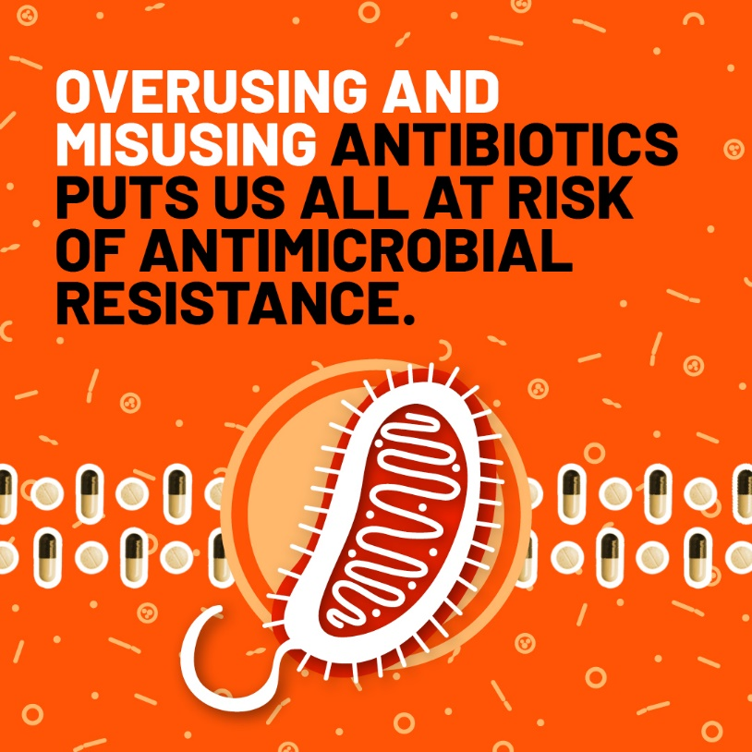
Antimicrobial resistance
Bacteria change over time in response to the environment
These changes allow them to resist antibiotics. This is called antibiotic resistance
When antibiotics are overused or used when they are not needed, resistance develops more quickly
Notes:
Whilst bacteria naturally evolve over time, overuse and/or misuse of antibiotics accelerates this. This acceleration costs us precious time whilst we wait for new therapies to be developed.
Reference
https://www.who.int/campaigns/world-amr-awareness-week/2024

Slide 12
Antimicrobial resistance
Bacteria, not humans, become antibiotic resistant
Resistant bacteria can spread like other germs or microbes
For example, by shaking hands
Resistant bacteria can be carried by anyone – healthy or ill
The use of antibiotics in animals and agriculture contributes to the problem but to a lesser extent than human consumption
The more often or the longer a person takes antibiotics, the more likely they are to carry antibiotic resistant bacteria in their body
Notes:
All exposure to antibiotics can lead to resistant microbes which can be carried by anyone and passed on in simple ways to anyone who may then become ill.
A person can be either ‘colonised’ or ‘infected’ with resistant bacteria.
‘Colonised’ means that a person has the bacteria present on the skin, in body openings or in the gut, but has no signs of infection.
'Infected’ means that a person has signs of an infection, such as fever or pus from a wound.
So, a “healthy” person may be colonised with resistant bacteria and pass this on to anyone who could develop an infection. Also, if that “healthy” person were to develop an infection themselves, the infection would be more serious as they have resistant bacteria.
References:
https://www.gosh.nhs.uk/conditions-and-treatments/general-medical-conditions/resistant-bugs-antibiotic-resistance-and-multidrug-resistant-organisms
https://www.cedars-sinai.org/health-library/diseases-and-conditions/a/antibiotic-resistance.html
Images: https://lovepik.com/image-400225679/bacteria.html ; http://clipart-library.com/free/shaking-hands-clipart-black-and-white.html ; https://www.creativefabrica.com/product/icon-set-time-5-oclock/ ; http://learnonlinedevelopments.blogspot.com/2013/04/free-people-graphic-image.html

Slide 13
How antibiotics work
Bacteria A | Bacteria B | Bacteria C
Antibiotic 1
 | Antibiotic 2
Antibiotic 3
Narrow spectrum
Broad spectrum
Notes:
We need many different kinds of antibiotics to treat the infections they cause.
Antibiotics that treat only one kind of bacteria are called narrow spectrum – these usually have fewer side effects and contribute less to antimicrobial resistance.
Antibiotics that can treat many kinds of bacteria are called broad spectrum – these usually have more side effects and contribute more to antimicrobial resistance.
The diagram shows the range of bacteria that the two types of antibiotics cover, as you can see narrow spectrum antibiotics cover one or two bacteria whilst broad spectrum antibiotics cover a large range of bacteria.

Slide 14

Narrow-spectrum antibiotics
More targeted
Can only kill a few types of bacteria (Antibiotic 1 and 2)
Narrow-spectrum antibiotics contribute less to resistance
Notes:
Narrow-spectrum and broad-spectrum antibiotics can be compared to fishing. Think of narrow-spectrum antibiotics like casting a line to catch a fish. Narrow-spectrum antibiotics can only catch one type of fish.

Slide 15

Broad-spectrum antibiotics
Can kill many different types of bacteria (Antibiotic 3)
BUT – Broad-spectrum antibiotics contribute more to resistance
Notes:
Whereas broad-spectrum antibiotics can be compared to a fishing net where it will capture a lot of fish.
Image - https://ajp.com.au/columns/opinion/wielding-the-sledgehammer/

Slide 16
Where do we use antibiotics?
Humans
Community
Hospital
Animals
Pets
Livestock
Agriculture
Crops
Aquaculture
Notes:
Antibiotics are used in many different situations including human health, veterinary medicine and in agriculture.
In human health, antibiotics are used to treat and prevent bacterial infections. An example of antibiotic use for infection prevention is when a patient receives antibiotics before surgery to prevent any bacterial infections that could possibly occur during the procedure.
Antibiotics are used in animal health to treat bacterial infections. Some farms use antibiotics to prevent disease outbreaks especially in settings where there is crowding of animals. In certain countries, antibiotics are used to promote faster growth in livestock.
In agriculture, antibiotics are used to prevent and treat bacterial infections in crops. In fish farming, antibiotics may be given to prevent or treat bacterial infections to ensure the health of fish livestock.
The widespread use of antibiotics in these sectors is a significant factor in the development of antimicrobial resistance.

Slide 17

Why is resistance a problem?
Rates of antibiotic resistance are rising
Hundreds of people in Australia die from antibiotic-resistant infections each year
Australia uses more antibiotics than many other comparable countries
Much of that use is inappropriate
Using antibiotics when not needed
Using antibiotics for too long
Few new antibiotics becoming available
Notes:
There are rising rates of resistance in Australia to various bacteria, in some cases resistance is becoming so significant that very few antibiotics are left.
It is difficult to know why Australia uses more antibiotics than other countries. Australia does use less antibiotics than other countries where antibiotics are available over the counter without a prescription (and the rates of resistance are worse in those countries). Australia is also very good a recording our antibiotic so we may just be better at capturing the data than some other countries.
The Commission compares healthcare variation for many different things including antimicrobial use.
Few new antibiotics becoming available for many reasons
Research and development is difficult and expensive
Antimicrobials don’t make pharmaceutical companies as much money as medicines for chronic illness
Chronic illness medications are taken ongoing, antimicrobials are only for short durations
Chronic illness medication don’t develop resistance
Chronic illness medications are usually indicated for a larger population
Reference:
safetyandquality.gov.au/antimicrobials-report-2020

Slide 18
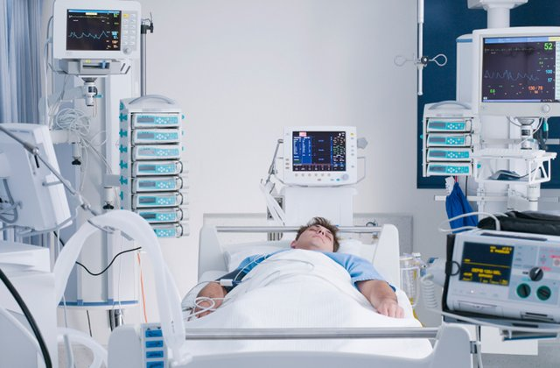
Antibiotic-resistant infections
More difficult to treat
Other antibiotics need to be used which may not work as well or can be more toxic
Usually require longer hospital stays
Can become resistant to all antibiotics → untreatable
More likely to spread to others
Notes:
More difficult to treat because there are not as many options for these types of infections. It may also require a hospital stay rather than being treated in the community because the infection may require intravenous antibiotics and/or be more serious.
Because these infections are resistant to the antibiotics that were previously used to treat that infection, there are less choices. The choices that are available might not work as well. They also may be broad spectrum which means that they may have more side effects and can further worsen resistance.
Reference:
Image - https://health.usnews.com/wellness/articles/2016-11-30/what-to-expect-when-your-loved-one-is-in-the-icu

Slide 19
What can individuals and the community do?
Prevent infections
Hand washing and using alcohol-based hand sanitiser
Keeping vaccinations up-to-date
Preventive medicine e.g., malaria medication when in high-risk areas
Don’t request antibiotics for coughs, cold and flu
These are caused by viruses, antibiotics will not work
Antibiotics are not without personal risk and side effects
Take antibiotics exactly as prescribed
Do not share antibiotics
Do not take previously prescribed antibiotics (for example, an old repeat) for a different illness
Return unused antibiotics to the pharmacy for disposal
Return Unwanted Medicines (or the RUM Project)
Do not put them in regular waste or down the sink
Notes:
Sometimes prescribers will give a prescription for antibiotics with a repeat as the prescribing software often defaults with this option. Consumers may then use this unfilled repeat many months later without seeing the doctor again even though this is probably inappropriate.
What do we mean by “personal risk”? Antimicrobials can have adverse effects. Some mild ie nausea and diarrhoea. Others have more significant adverse effects.
Return Unwanted Medicines (or the RUM Project) is one of the first initiatives that provides consumers with a free and convenient way to dispose of expired and unwanted medicines
References:
https://www.safetyandquality.gov.au/sites/default/files/2019-06/AURA-2019-Consumer-resource-Trifold-Brochure-Do-I-really-need-Content-from-Literally-Inspired.pdf
https://www.mayoclinic.org/diseases-conditions/infectious-diseases/in-depth/germs/art-20045289#dialogId65139475
https://returnmed.com.au/about-us/#:~:text=Return%20Unwanted%20Medicines%20(or%20the,for%20safe%20collection%20and%20disposal.

Slide 20
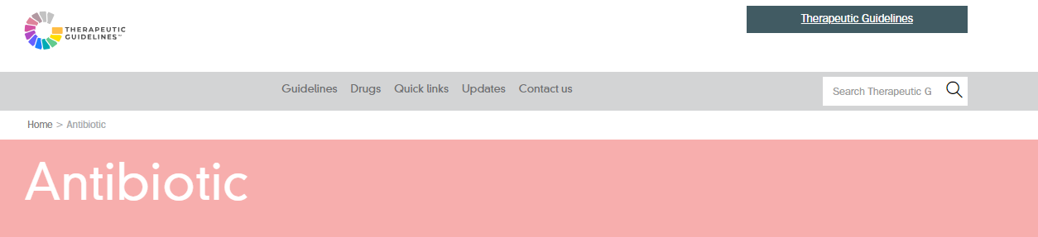
What can your health professional do?
Take measures to prevent and control infections:
Clean shared patient equipment between each use
Practice hand hygiene
Promote and educate patients on vaccination
Use personal protective equipment (PPE) effectively
Follow Australian guidelines when prescribing antibiotics ensures
Antibiotics have the best chance of working effectively and safely
Reduces the chance of creating resistance
Notes:
Reference:
https://www.tg.org.au/

Slide 21
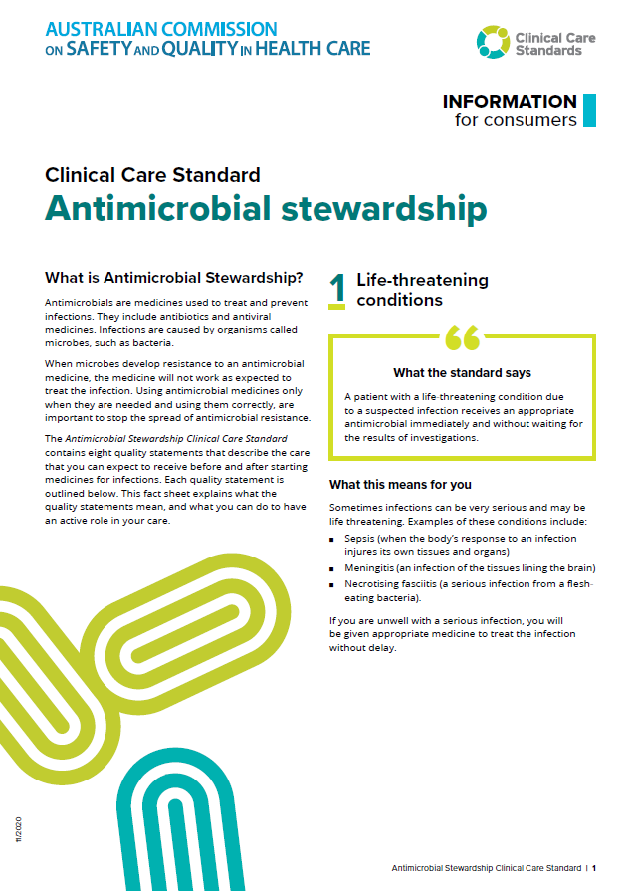
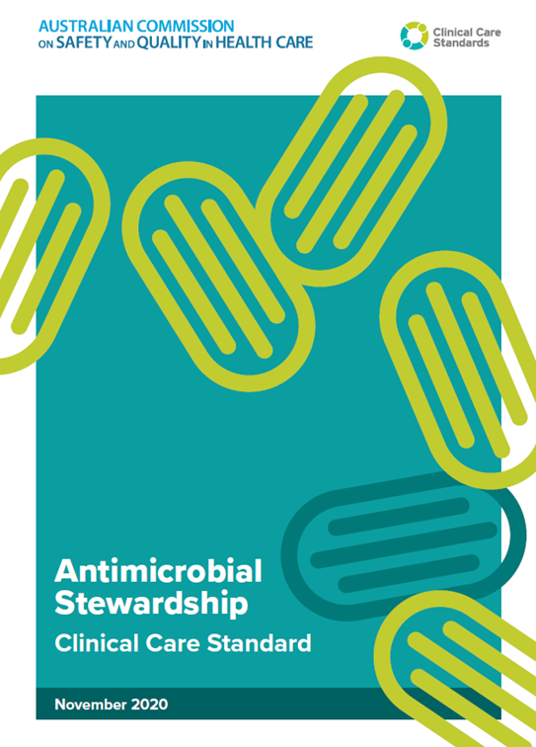
What is antimicrobial stewardship
A program or approach aimed at using antibiotics in the right way
Using antimicrobial medicines only when they are needed, and using them correctly, is important to stop the spread of antimicrobial resistance
Goals:
Preserve the current antibiotics we have
Encourage doctors to prescribe the right antibiotic
Protect patients
Involves collaboration between doctors, pharmacists, nurses and patients
It isn’t about “not using antimicrobials”
but rather
“identify that small group of patients who really need antibiotic treatment and then explain, reassure and educate the large group of patients who don’t.”
Notes:
Reference:
https://www.safetyandquality.gov.au/publications-and-resources/resource-library/antimicrobial-stewardship-clinical-care-standard-consumer-guide

Slide 22
If you are prescribed an antibiotic – ask your doctor…
Do I need the antibiotic, or will my infection get better without it?
What are the risks and benefits of me taking antibiotics?
Do we need to test the cause of my infection?
How often and how long do I take the antibiotic?
Will the antibiotic affect my regular medicines?
How long should my recovery take?
Notes:
References:
Image - https://pngfre.com/question-mark-png/
How long should my recovery take?
Do we need to test the cause of my infection?
What are the risks and benefits of me taking antibiotics?
Will the antibiotic affect my regular medicines?
How often and how long do I take the antibiotic?
Do I need the antibiotic or will my infection get better without it?

Slide 23
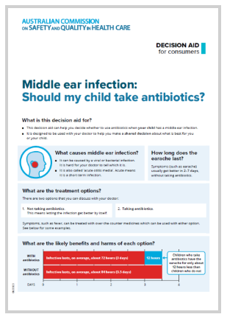
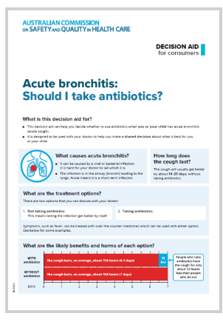
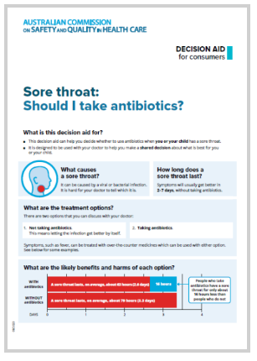
Where to find more information
Commission resources for consumers -https://www.safetyandquality.gov.au/our-work/antimicrobial-stewardship/antimicrobial-stewardship-ams-resources-and-links
Department of Health and Aged Care - https://www.amr.gov.au/

